Slide 1

Automating Linear Optics Measurements
Thanks to:
Tobias H. B. Persson, Michi Hostettler, Andrea Calia,
Delphine Jacquet, Joschua W. Dilly, Ewen H. Maclean,...
And Update for ADT AC Dipole in Multiturn
Ujani Kar
Automating Optics Measurements
Automating Multiturn Operations

Slide 2
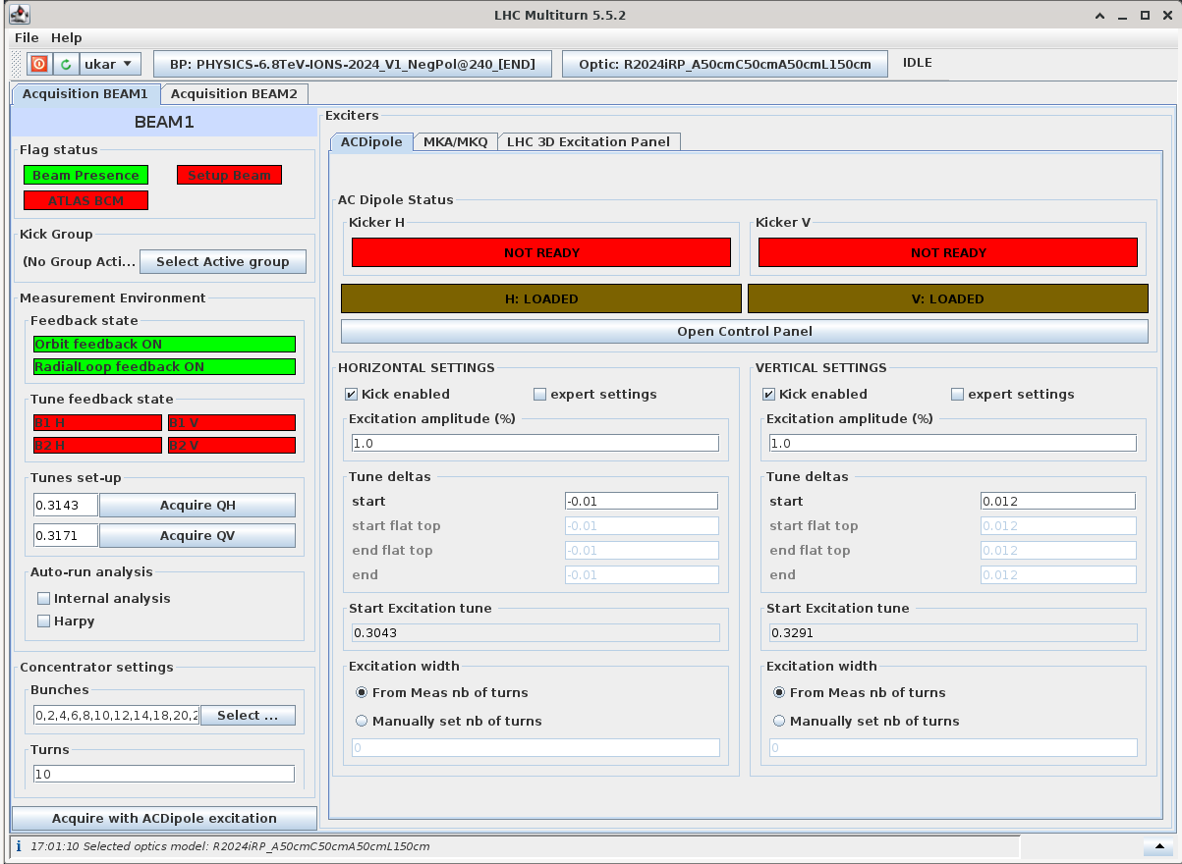
Outline
Part 1:
  Updates in Multiturn – ADT AC Dipole
Part 2:
  Automate Optics Measurements - Multiturn
Automating Optics Measurements
Automating Multiturn Operations

Slide 3
I. ADT AC Dipole in Multiturn
Automating Optics Measurements
Automating Multiturn Operations

Slide 4
Purpose
  Current measurements of ADT AC Dipole using the AccPit goes to Coupling Server, and overloads it.
  Putting the tab in the Multiturn directly writes the kick data to the OMC logbook. Easier to keep track of the data generated.
Automating Optics Measurements
Automating Multiturn Operations

Slide 5
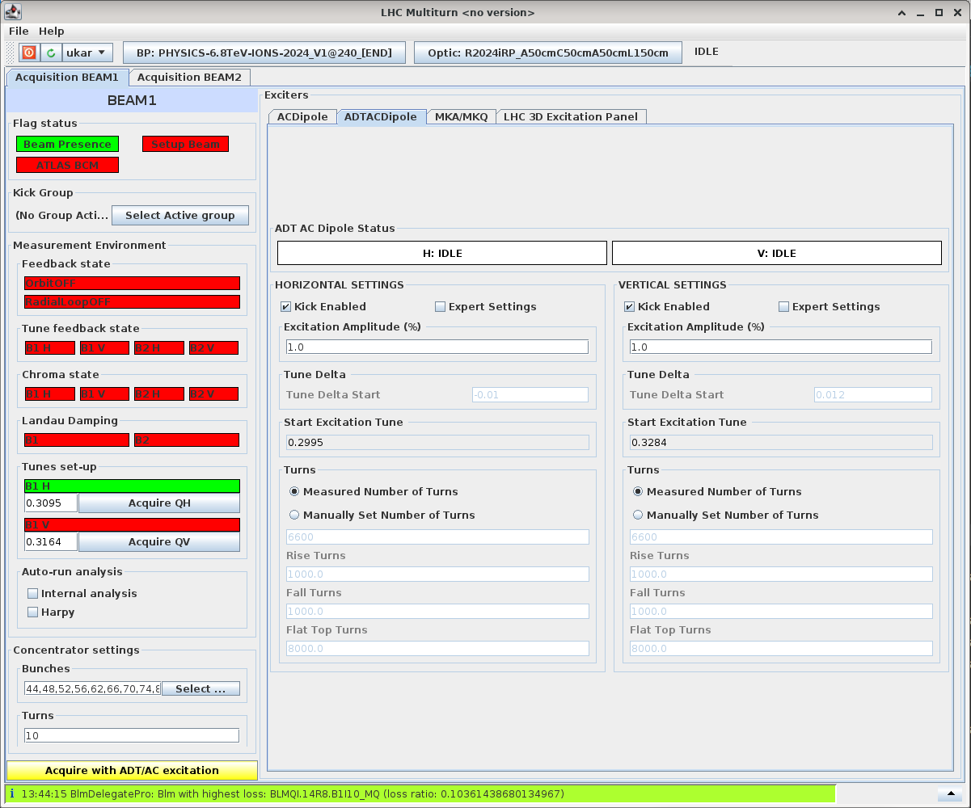
Adding the ADT AC Dipole Tab in Multiturn
ADT AC Dipole controls on the Multiturn, showing status and allowing controls
Required expert controls here:
(Similar to AccPit)
Excitation Amplitude
Controlled number of turns for Rising, Falling and Flat top in the ADT AC Dipole instead of default settings.
Automating Optics Measurements
Automating Multiturn Operations

Slide 6
II. Automating Linear Optics Measurements
Automating Optics Measurements
Automating Multiturn Operations

Slide 7
Objective:
To Automate Linear Optics Measurements in LHC
Make Linear Optics Measurements easier for non-experts, reducing the workload of experts.
Motivation:
Automating Optics Measurements
Automating Multiturn Operations

Slide 8
How Optics Measurements are done
Machine and Beam in Correct State
Excite with AC Dipole until we have sufficient amount of high amplitude kicks
Analyse Data from kicks
Automating Optics Measurements
Automating Multiturn Operations

Slide 9
Plan to Automate Optics Measurements –
A Flow Chart
Tunes
Chroma
Landau Damping
BCM Masked
Collimators open
Beam Intensity
Call for Help
Stop
Huge Losses/
Large Drop in Intensity
Bringing Machine to Correct State
All Good
Excite
Losses?
Intensity?
Enough Amplitude?
Store kicks
Not Enough Amplitude
Increase Amplitude
Send to Analysis
Automating Optics Measurements
Automating Multiturn Operations

Slide 10
Plan to Automate Optics Measurements
Undergoing
Tunes
Chroma
Landau Damping
BCM Masked
Collimators open
Beam Intensity
Call for Help
Stop
Huge Losses/
Large Drop in Intensity
Bringing Machine to Correct State
Bringing Machine to Correct State
All Good
Excite
Losses?
Intensity?
Enough Amplitude?
Store kicks
Not Enough Amplitude
Increase Amplitude
Send to Analysis
Done
Automating Optics Measurements
Automating Multiturn Operations

Slide 11
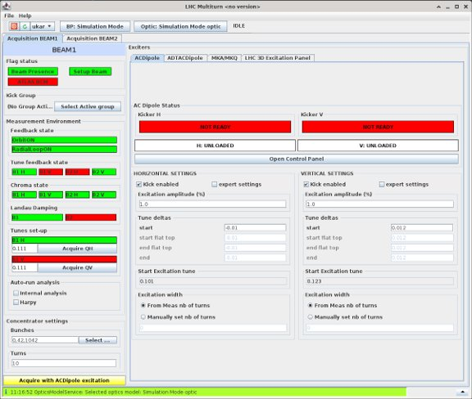
Step 1: Before Kicking/Exciting :
Tunes
Chroma
Landau Damping
BCM Masking
Collimators Check
Beam Intensity
At correct values(as required)
≤3
ATLAS BCM Masked
~0
In course settings
<3x10¹⁰
Make all the manual checks semi-automatised.
Check every time before kicking- individual steps
Bringing Machine to Correct State
Work still ongoing
Status indicators for visual checks
Automating Optics Measurements
Automating Multiturn Operations

Slide 12
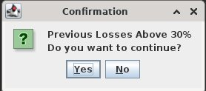
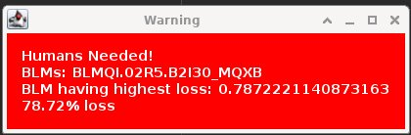
Step 2 : Condition Checks after each Kick
Call for Help
Stop
Huge Losses/
Large Drop in Intensity
All Good
Requests for human help when out of set limits in BLMs or Intensity
Excite
Losses?
Intensity?
Enough Amplitude?
Store kicks
Not Enough Amplitude
Message boxes providing immediate updates on acquisition and control parameters.
Increase Amplitude
Send to Analysis
Automating Optics Measurements
Automating Multiturn Operations

Slide 13
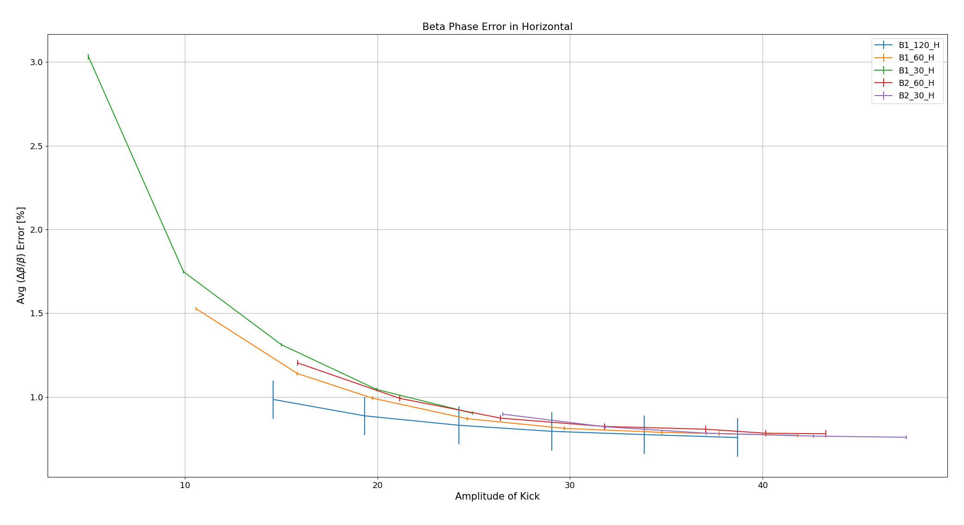
Step 3 : Excite based on Amplitude
Call for Help
Analysis of Error in Beta Beat for Every Kick
Stop
Huge Losses/
Large Drop in Intensity
All Good
Excite
Losses?
Intensity?
Enough Amplitude?
Store kicks
Not Enough Amplitude
Increase Amplitude
Send to Analysis
[%]
Fill nos: 9403, 8521
Betabeat analysed for different kick to find an acceptable level of errorbars in beta amplitude to get a good kick.
Higher amplitude kicks -> Signal-to-noise ratio gets better
[Only works if there are no major changes in the optics/beam set up, such as in 60 degrees]
Automating Optics Measurements
Automating Multiturn Operations

Slide 14
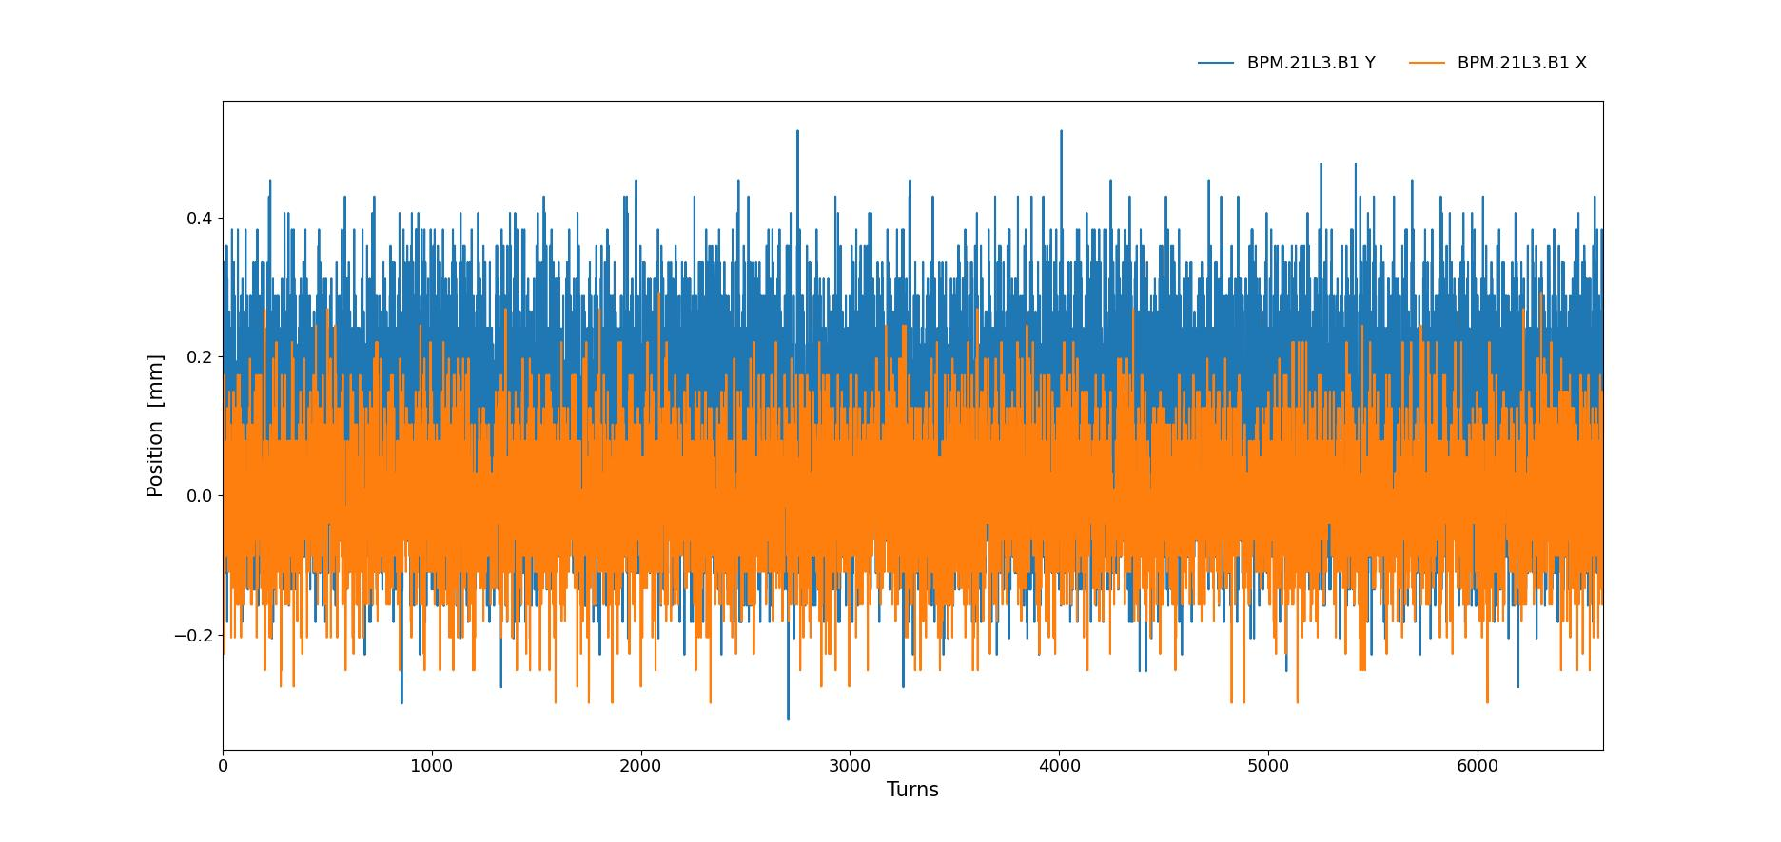
2. Conditional Kicking Based on Peak-to-Peak Amplitude
Turn-by-turn Plot of BPMs
Peak-to-peak amplitude is computed for individual BPM in Non-ATS arc and checked.
[Non-ATS arcs as they stay constant]
If the BPMs peak-to-peak is above ~2mm --> acceptable for the errorbars of betabeat --> Programmed exit.
Automating Optics Measurements
Automating Multiturn Operations

Slide 15
Step 4 : Store kicks, Send for Analysis
Call for Help
Stop
Every good kick has to be stored and sent for analysis automatically.
Analysis can be done in a very similar way as in a coupling server--> reusable.
Next step in the direction of automating the Optics Measurements.
Huge Losses/
Large Drop in Intensity
All Good
Excite
Losses?
Intensity?
Enough Amplitude?
Store kicks
Not Enough Amplitude
Increase Amplitude
Send to Analysis
Automating Optics Measurements
Automating Multiturn Operations

Slide 16
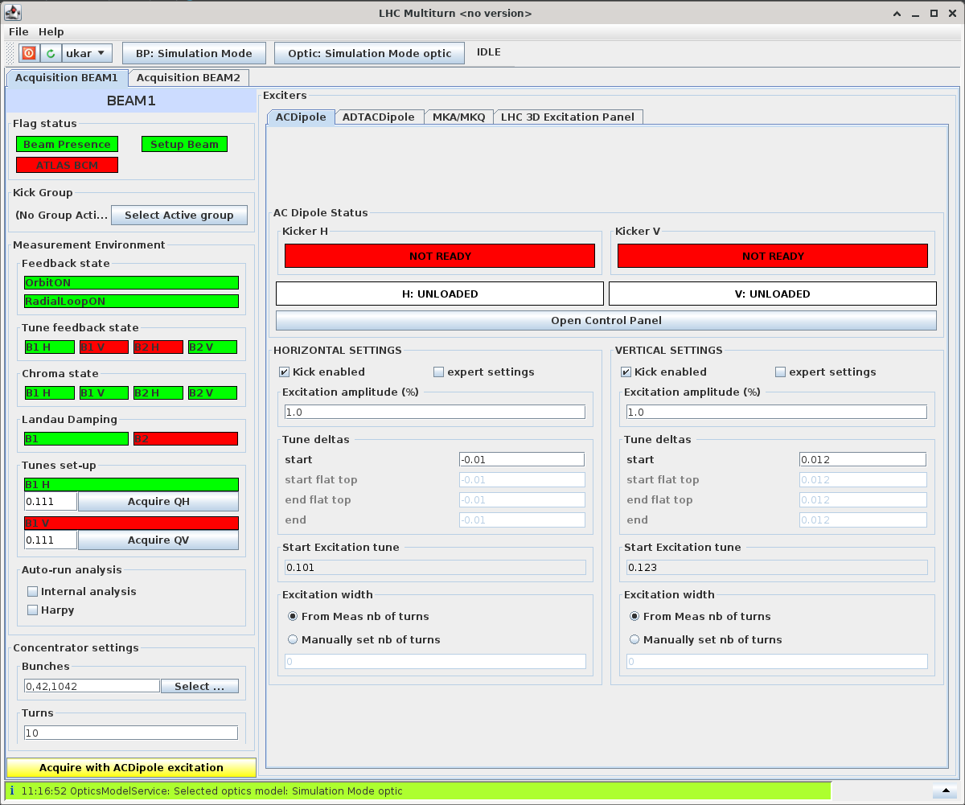
Conclusions
Done: The precondition checks and ongoing checks during kicks
Undergoing: The Analysis for the excitation amplitude and programming a higher kick or exit based on this analysis.
Future Prospect : Integrating with Optics Measurement tools for a complete automated Optics Measurement in LHC.
Automating Optics Measurements
Automating Multiturn Operations

Slide 17
Thank You
Automating Optics Measurements
Automating Multiturn Operations
Automating Optics Measurements
Automating Multiturn Operations

Slide 18
Extra Slides
Automating Optics Measurements
Automating Multiturn Operations

Slide 19
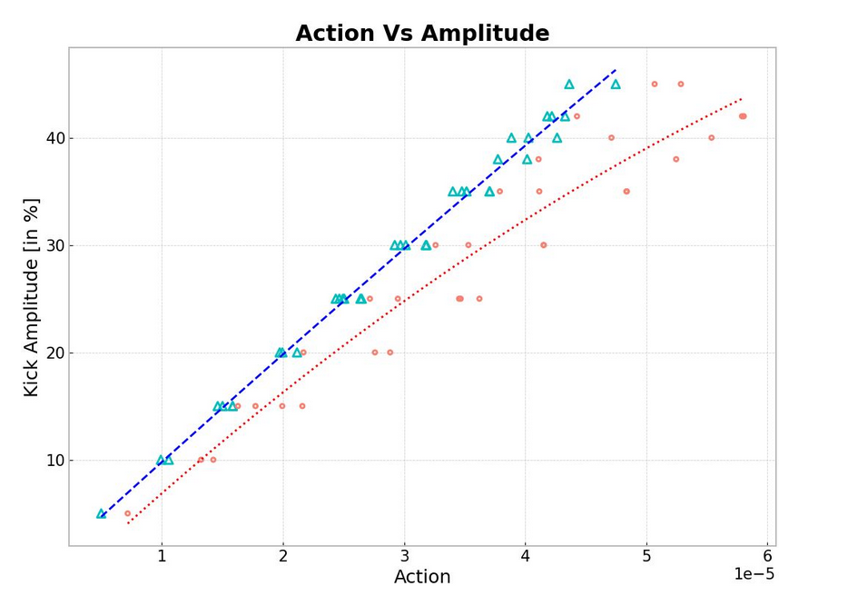
Action Vs Amplitude(kick)
With Amplitude --> Model invariant (except for 60degs) --> Else we have to normalise and make a model of AC Dipole
Automating Optics Measurements
Automating Multiturn Operations

