Slide 1
Sustainable Procurement Workshop
SCE environmental initiatives
28.11.2024 Fred Magnin

Slide 2
Energy – New-Built – Consolidation

Slide 3
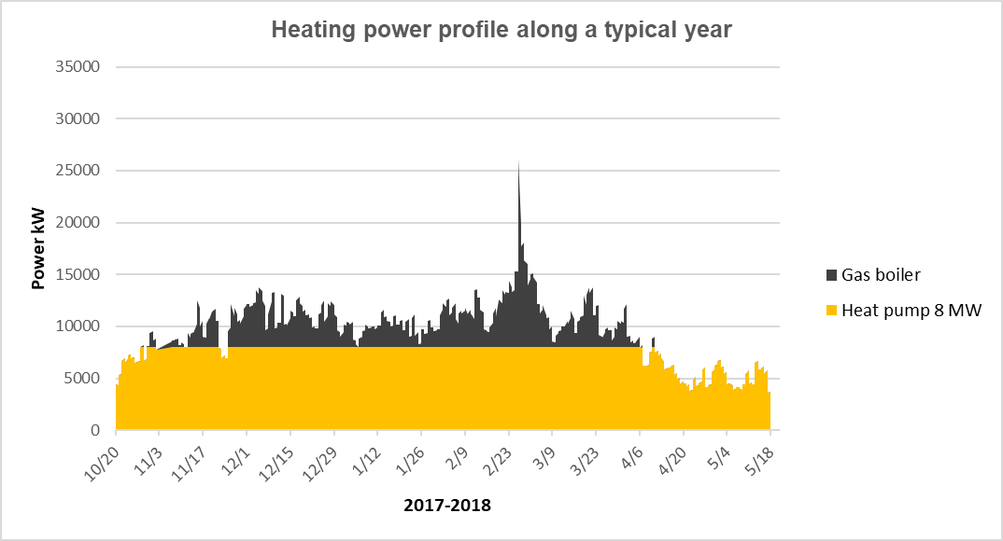
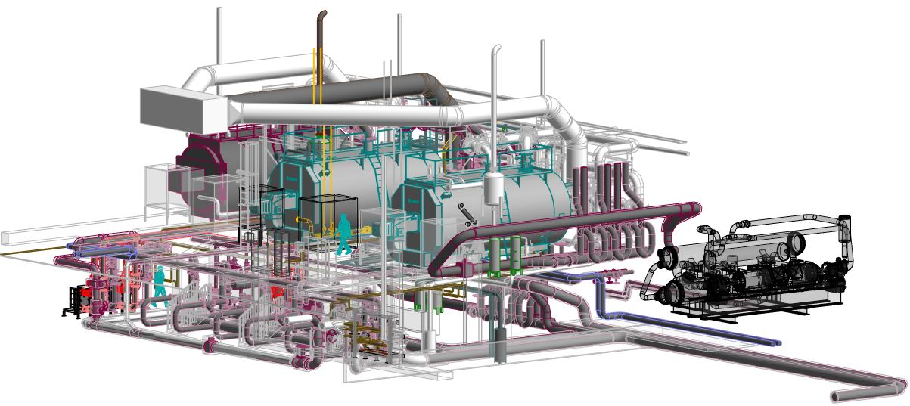
NEW HEATING PLANT MEYRIN B200
Heating plant configuration:
  3 boilers, 15 MW each (existing).
  1 heat pump 6 MW.
  Space for future heat pump.
Objectives:
  Basis: winter 2021-2022.
  Flexibility with gas boilers.
  1 heat pump 8 MW heating capacity (6 MW evaporator = PA1 load).
  Space for future heat pump. No phase 2.
  Total gas consumption 2021-2022: 46,8 GWh gas (9600 tonsCO2).
  Total consumption 2027: 17.6 GWh gas + 15.4 GWh elec.
  Total consumption 2027: 3600 tonsCO2 gas + 340 tonsCO2 elec.
  * The ratio for the gas 0.205kgCO2/kWh could increase due to important part of the GNL gas in the European gas mix
Basic data*

Slide 4
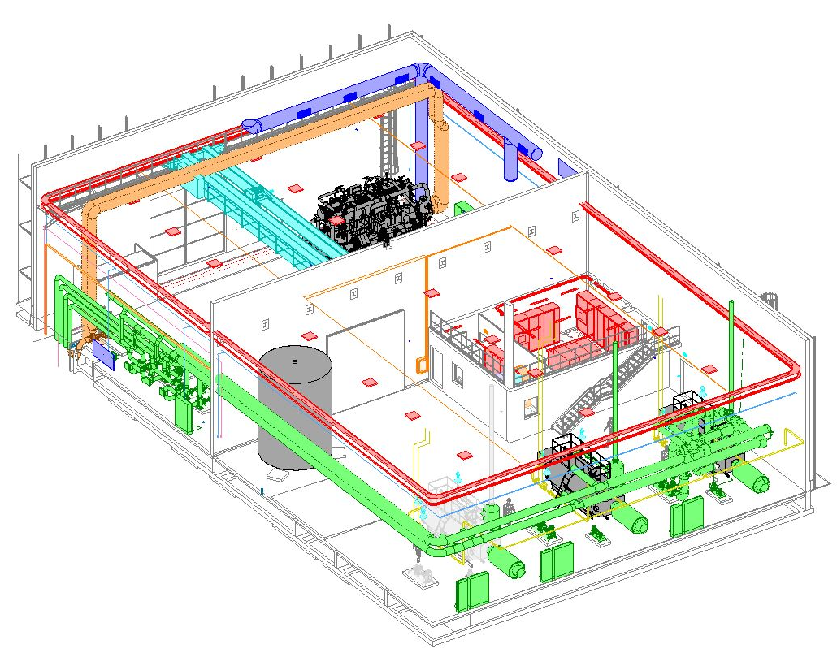
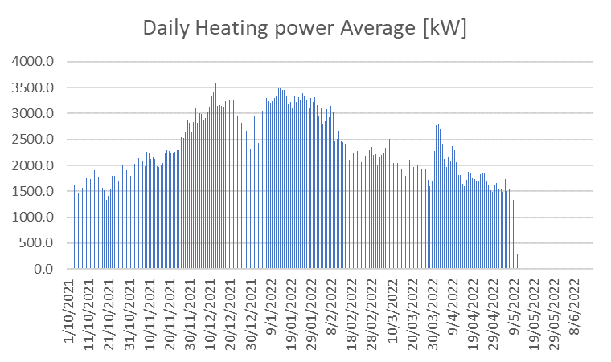
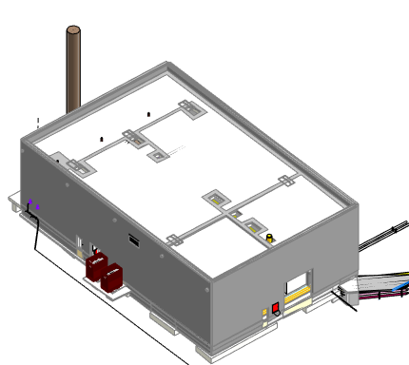
NEW HEATING PLANT PREVESSIN B776
Heating plant configuration:
  2 boilers, 2MW and 4MW boiler Gas&Fuel
  1 heat pump 2 MW.
  Space for future heat pump.
Objectives:
  Basis: winter 2021-2022
  Flexibility with gas boilers.
  1 heat pump 2 MW heating capacity (1.6 MW evaporator = IT load).
  Total gas consumption 2021-2022: 12.337 GWh gas (2529 tonsCO2).
  Total consumption 2027: 1.46 GWh gas + 3.66 GWh elec.
  Total consumption 2027: 299.3 tonsCO2 gas + 80.9 tonsCO2 elec.
* The ratio for the gas 0.205kgCO2/kWh could increase due to important part of the GNL gas in the European gas mix.
Heat pump = 80%
Data from SVD17 web site- Daily gas consumption
Basic data*

Slide 5

ELED campaign
The ELED campaign, launched in January 2023, aims to replace all fluorescent tubes with energy-efficient LED tubes in tertiary buildings.
The campaign is expected to take five years.
To date, 44,424 tubes have been replaced, reducing installed power by 977,4 kW.
A dedicated monitoring system has been established to plan and track the campaign’s progress.

Slide 6

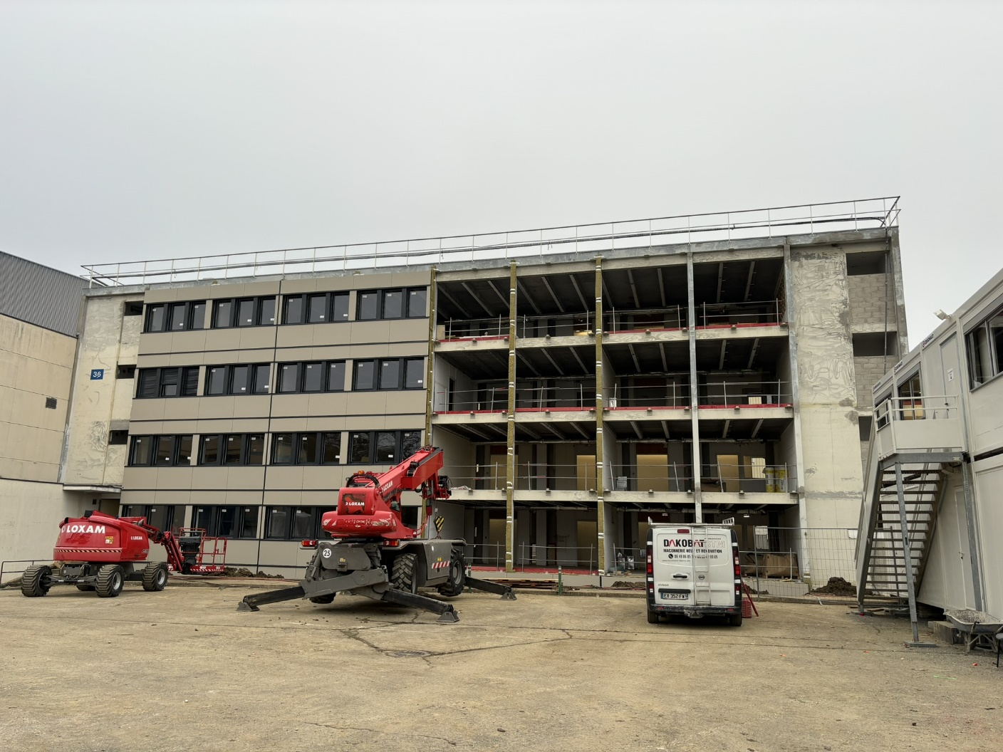
B.36 – Energy performance Renovation

Slide 7
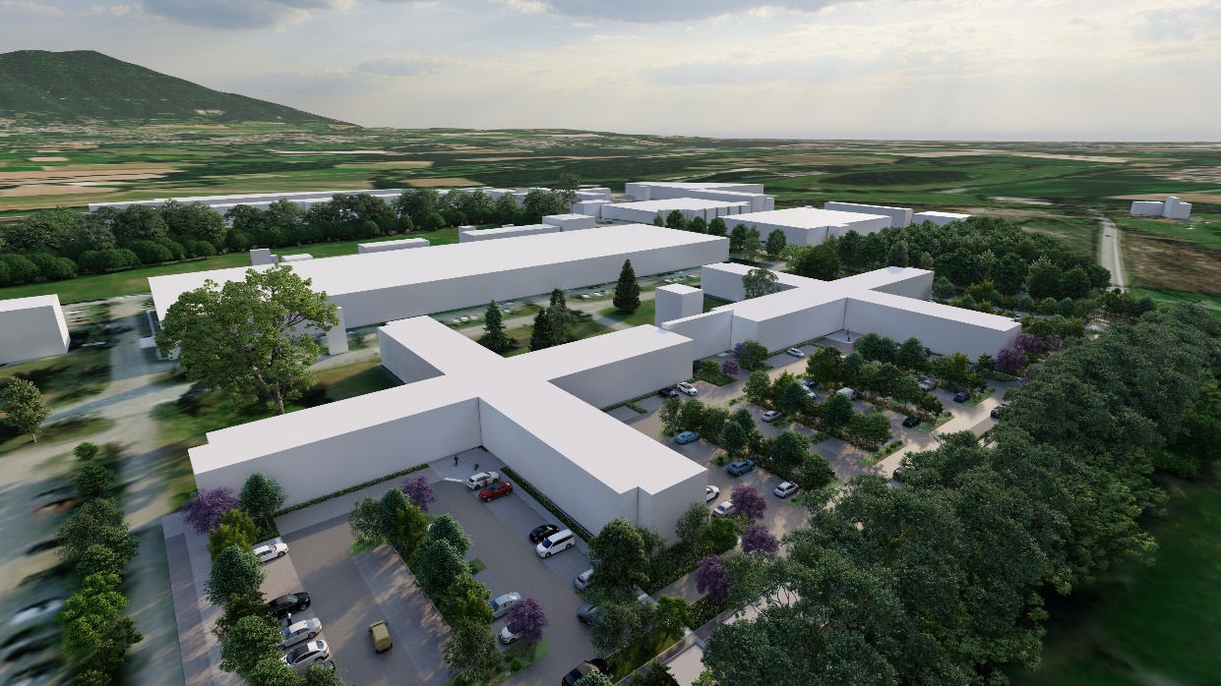
B.864/865 Landscape parking
Planting of 210 trees
Rainwater infiltration and retention system improvements
Installation of 3,300 m² of cellular paving for parking spaces.
Creation of 3,000 m² of flower meadow, including 1,300 m² of vegetated ditches for:
  Rainwater infiltration.
  Natural water retention before infiltration, during heavy rainfall.
Installation of electric vehicle charging stations for CERN’s cars.
New cycle path and installation of bike and motorcycle shelters.

Slide 8
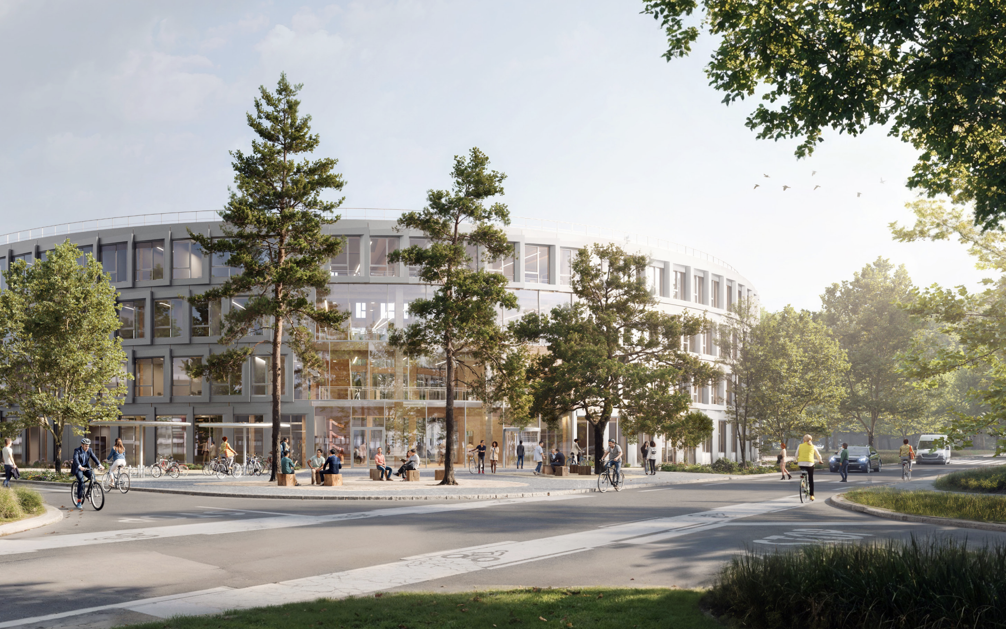
New built project
Increase renewable material
Integrate renewable energy installation
Consider nature and biodiversity
Account for wellbeing
Embrace circularity
Formal certification

Slide 9
Life Cycle Assesment

Slide 10
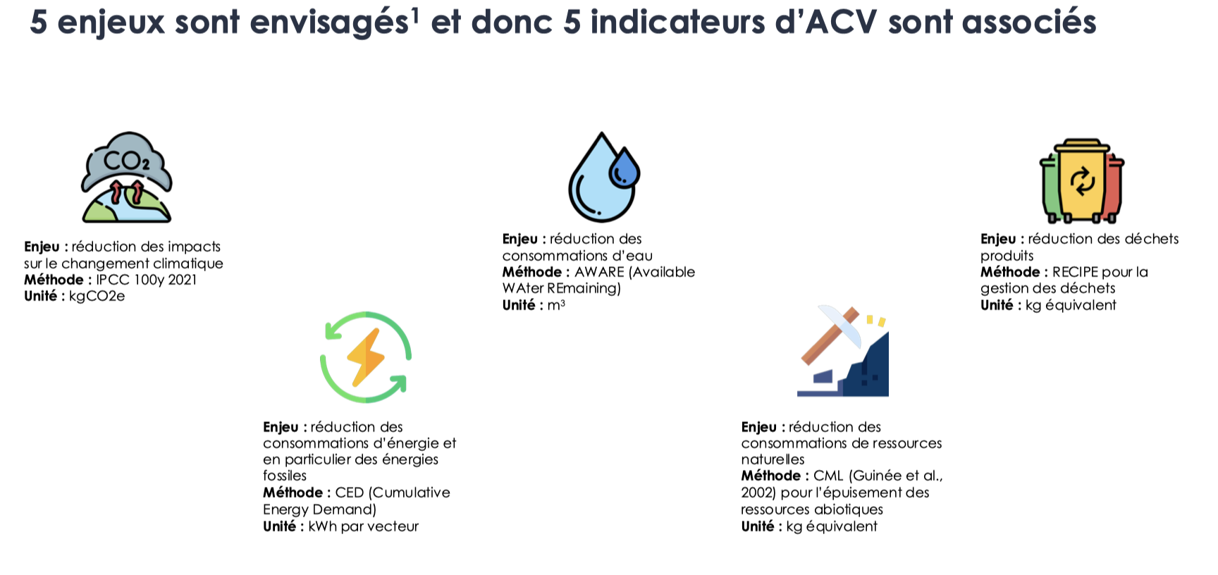
Life cycle analysis

Slide 11
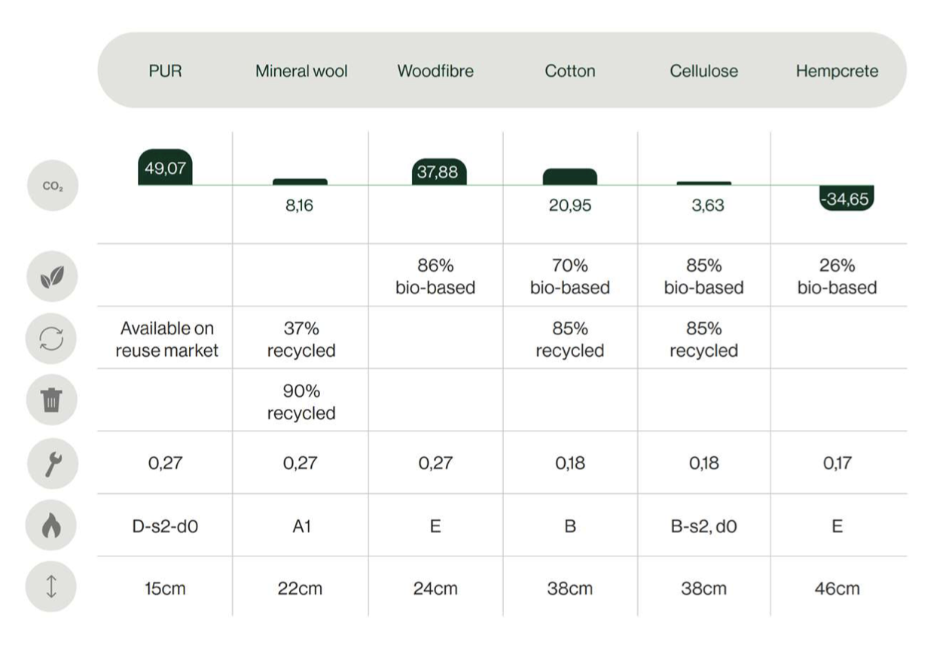
Life cycle analysis

Slide 12
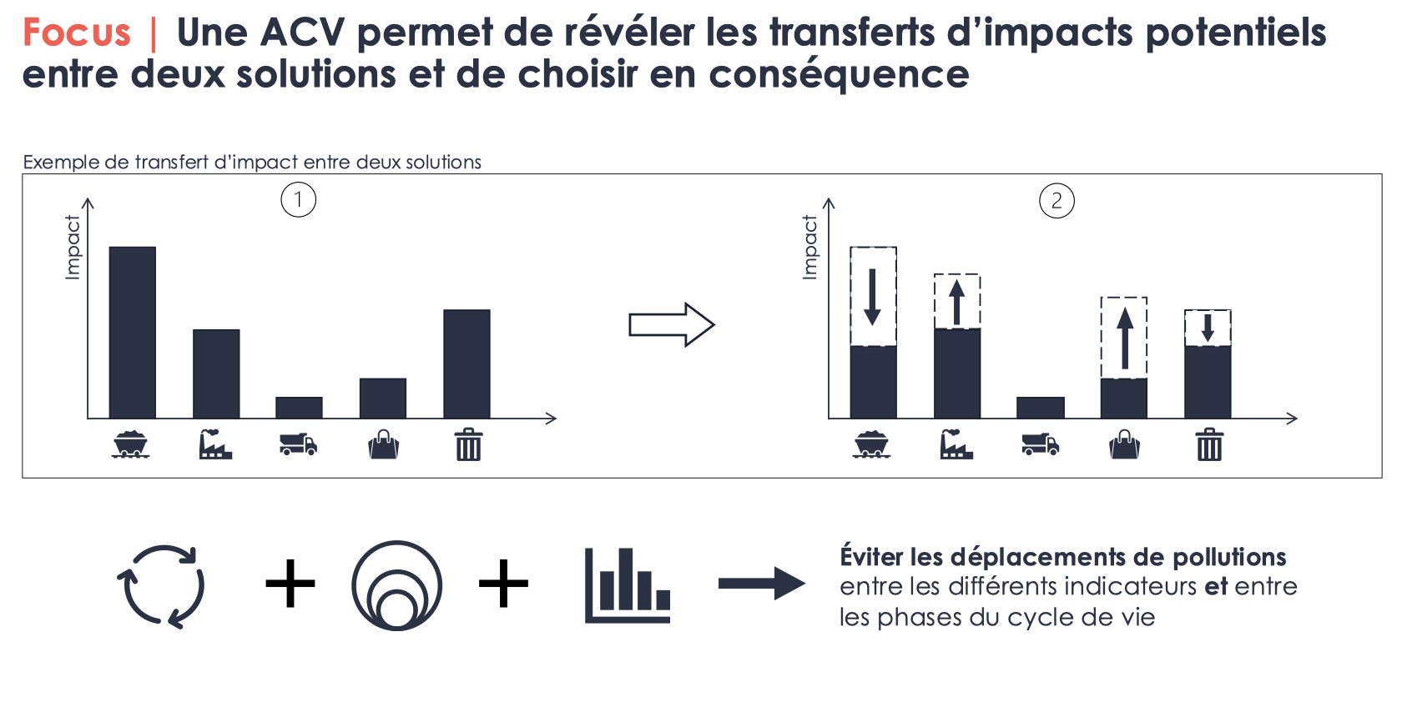
Life cycle analysis

Slide 13
CERN RESP

Slide 14
Regenerative Environment and Social Programme
Our Vision
The CERN Campus is the Gateway to CERN’s Science and discovery. Our vision is to enable science excellence where our community and natural environment thrive in harmony, for future generations. Our approach is one of regenerative environmental stewardship and positive social purpose, with nature being an integral part of an efficient, low carbon campus, protecting it and being protected by it.
Implementing the Vision
This vision shall be delivered through CERN Campus Regenerative Environment and Social Programme (RESP). Through this programme CERN builds on its significant achievements of the Site Consolidation Programme and starts to build on these renewed ambitions. A holistic impact framework (HIF) has been created as a decision making support to enable accountability and transparency of decisions to progress towards these ambitions. The HIF considers carbon emissions and integrates areas of the Campus’ environmental and social context. It will be visible through a digital dashboard showcasing the decisions and rationale.
RESP contributes to CERN taking the lead and rise to the pressing planetary challenges of our time.

Slide 15
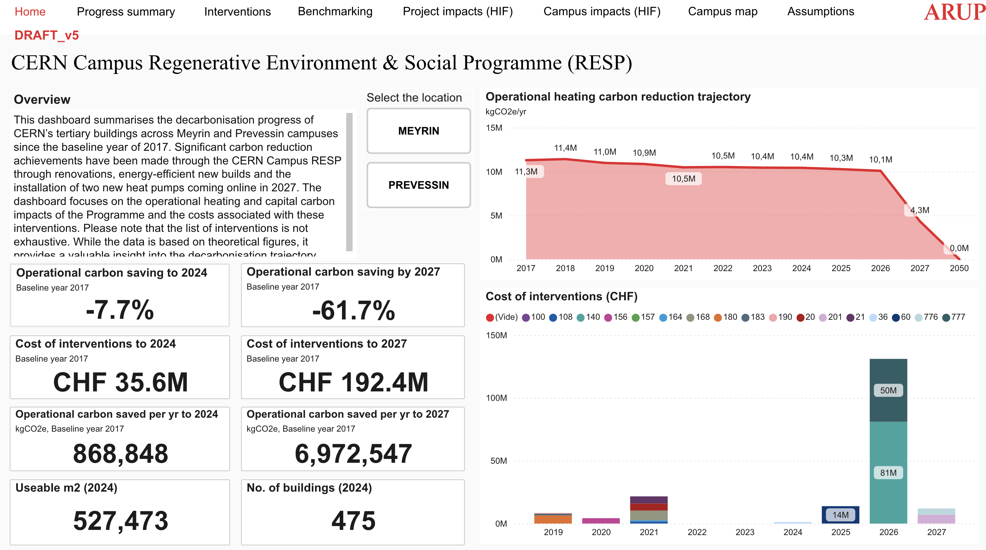
Regenerative Environment and Social Programme

Slide 16
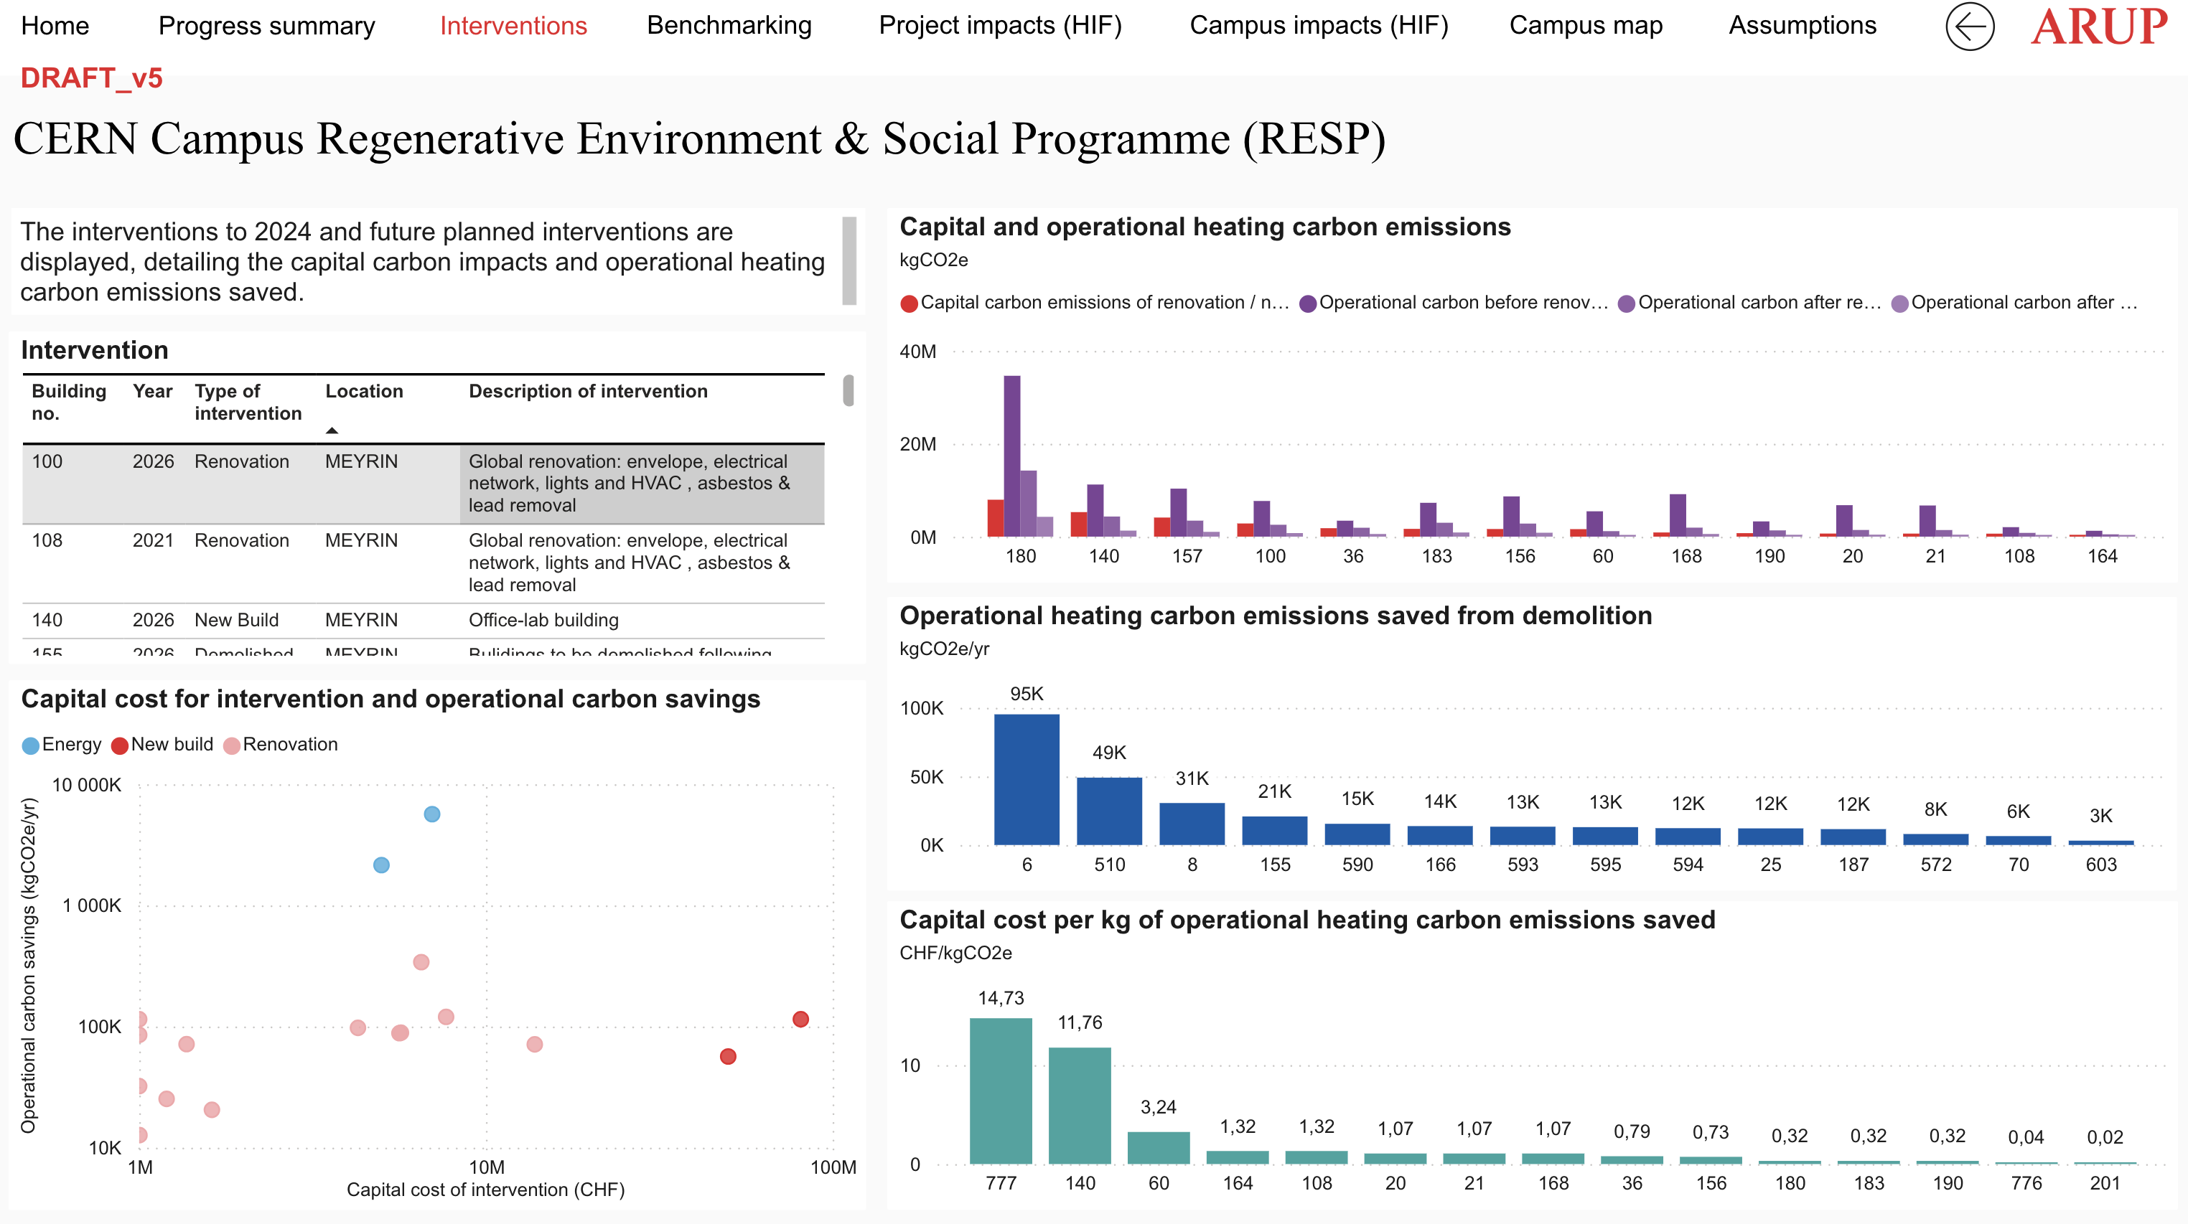
Regenerative Environment and Social Programme

Slide 17
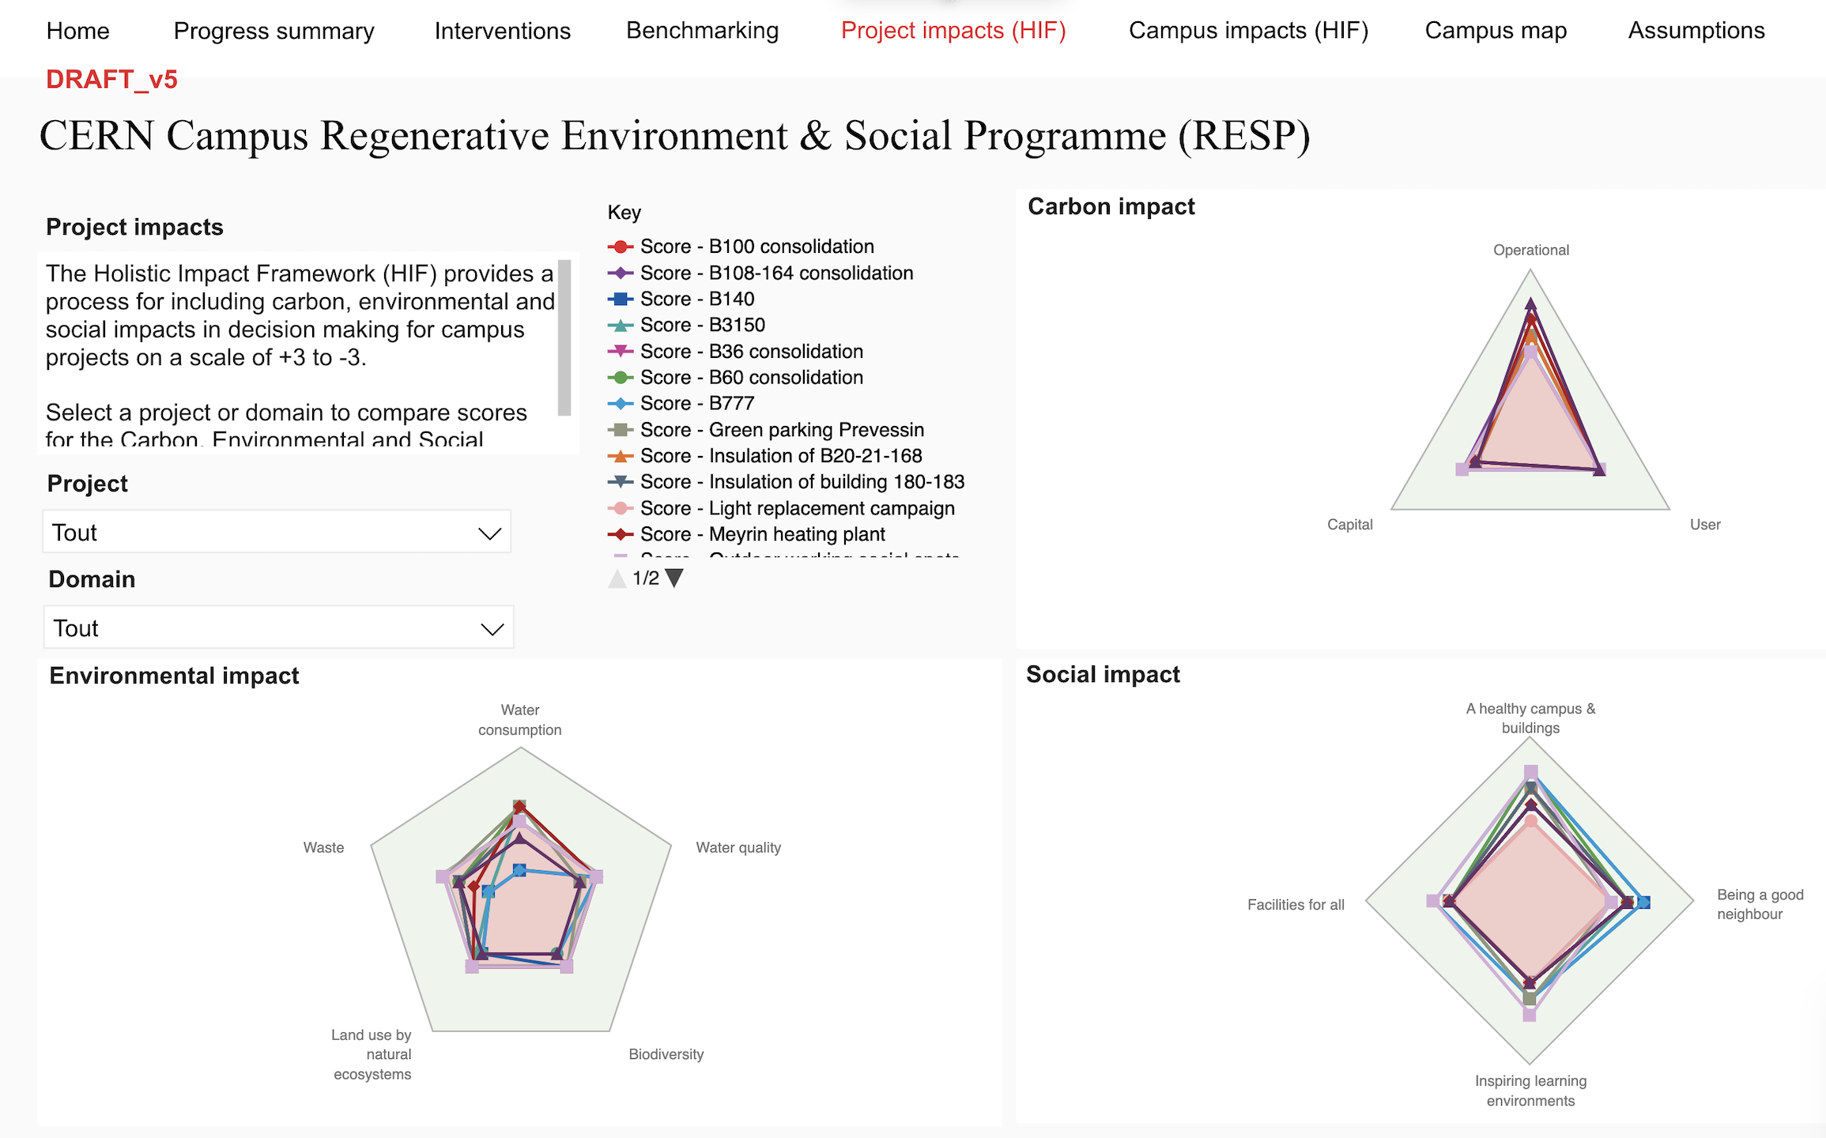
Regenerative Environment and Social Programme

Slide 18
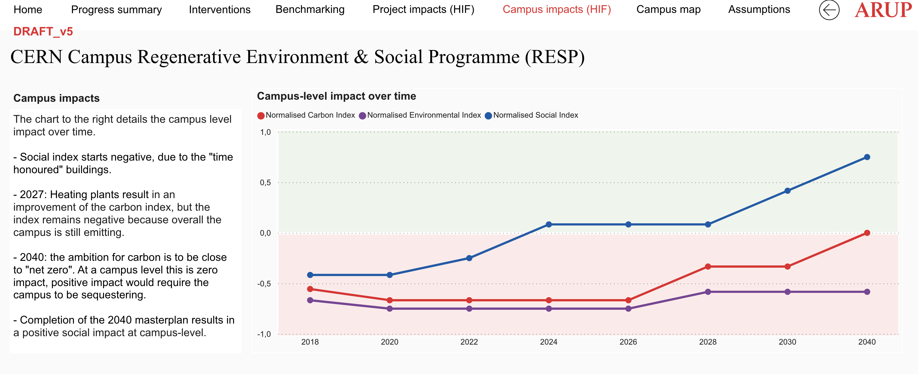
Regenerative Environment and Social Programme

