Slide 1
Sustainable Procurement Workshop
Environment@SSC
Cédric Garino (SCE-SSC), Lisa Bellini Devictor (SCE-SSC-SC), Gilles Bollinger (SCE-SSC-CS)
28.11.2024

Slide 2
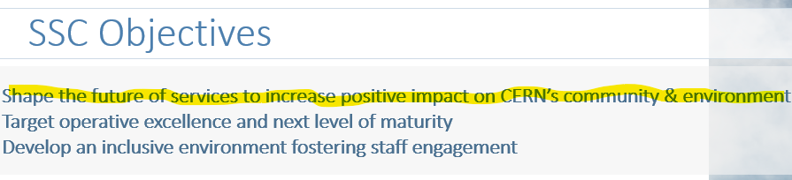
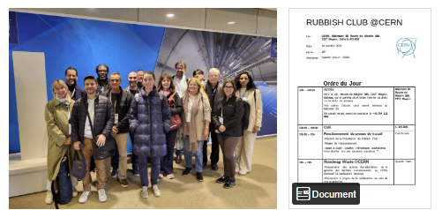
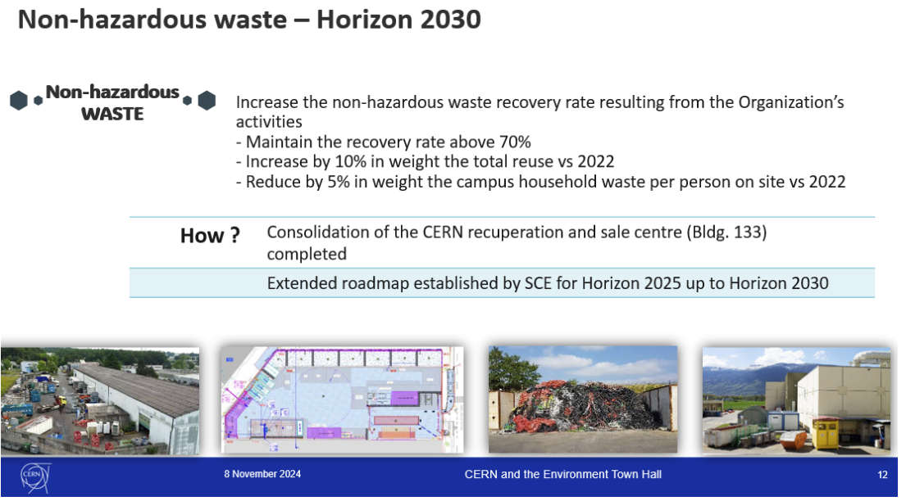
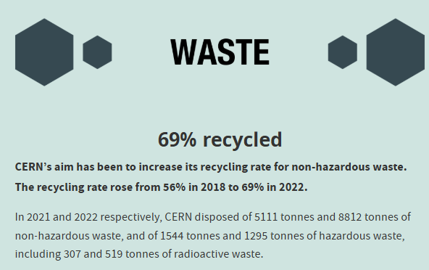

Group - SSC
Collaborations
2050Today – Food + Waste
Rubbish Club
HSE-ENV
Green village : Biodiversity project + collaboration agreement + project agreement
“Responsabilité Sociétale des Entreprises” policies of contractors:
  Helvetia, Novae, Serco, …

Slide 3
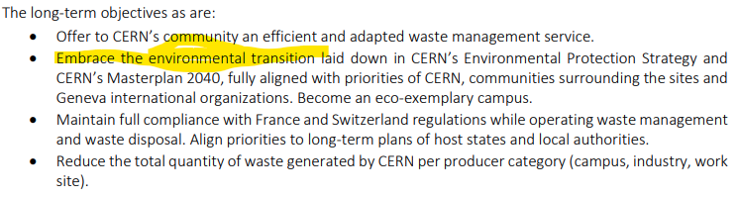
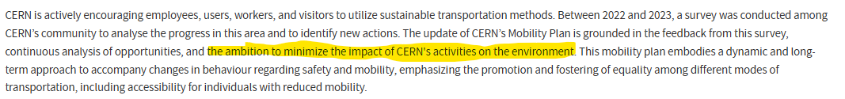
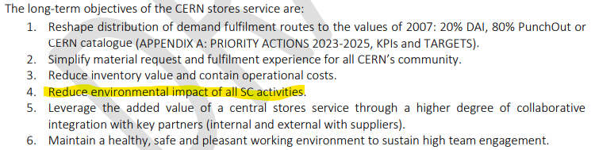
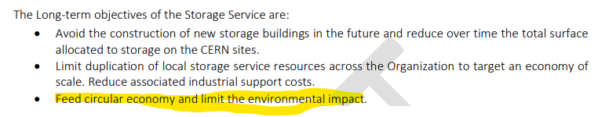
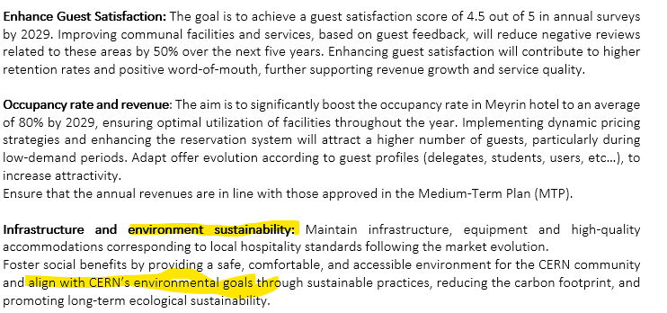
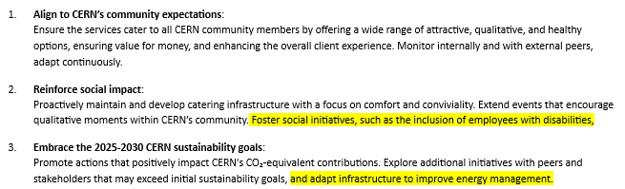
Group - SSC
Waste Management
Integration in roadmaps
CERN Mobility Plan
Stores
Storage Management
Housing
Catering

Slide 4
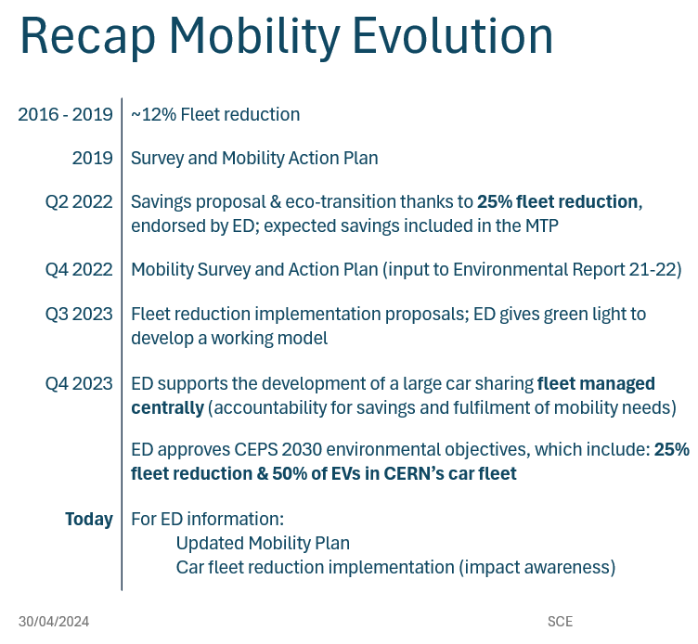






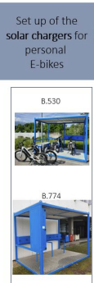
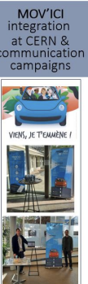


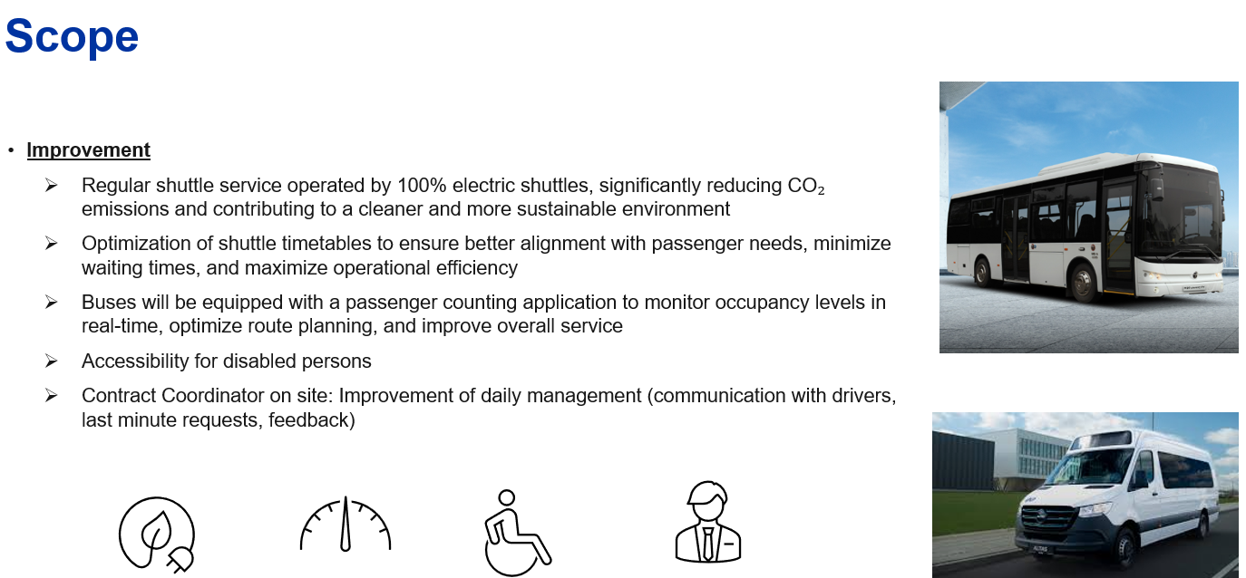


Group – SSC-CS
Mobility

Slide 5
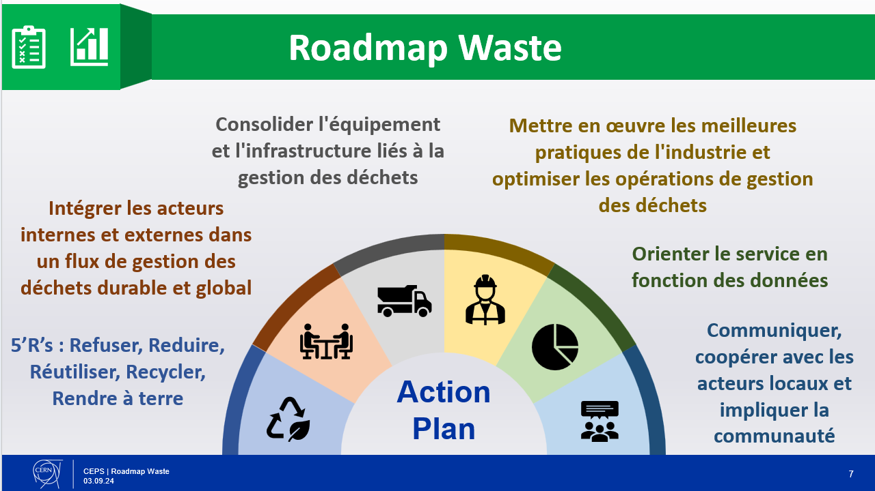
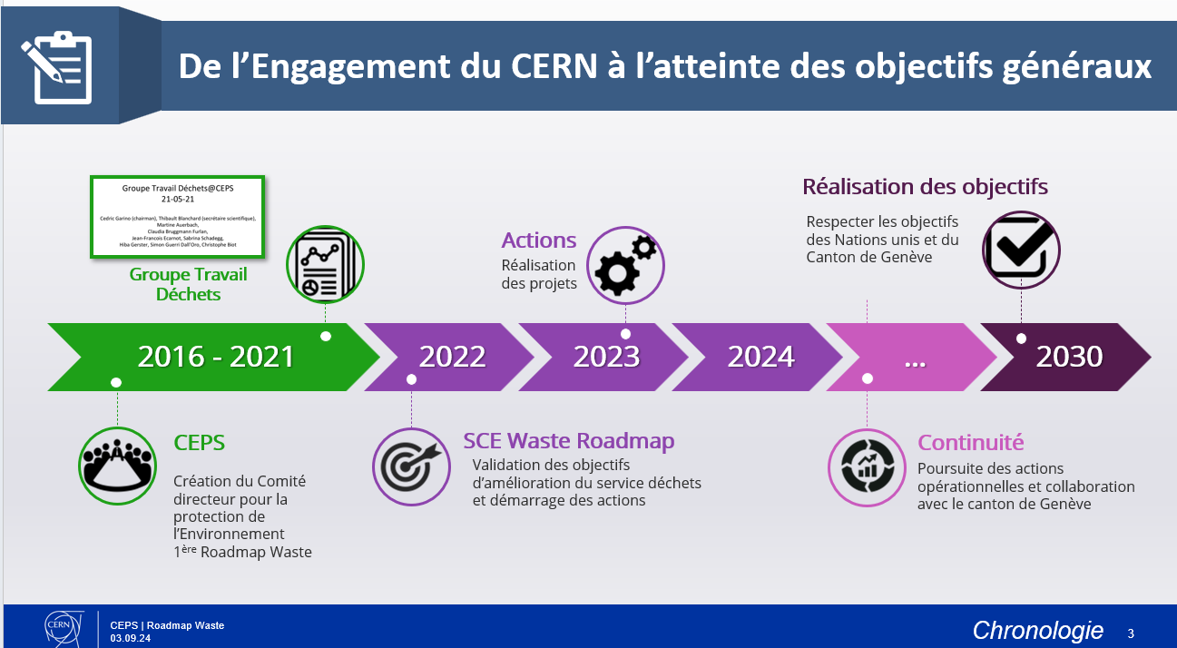
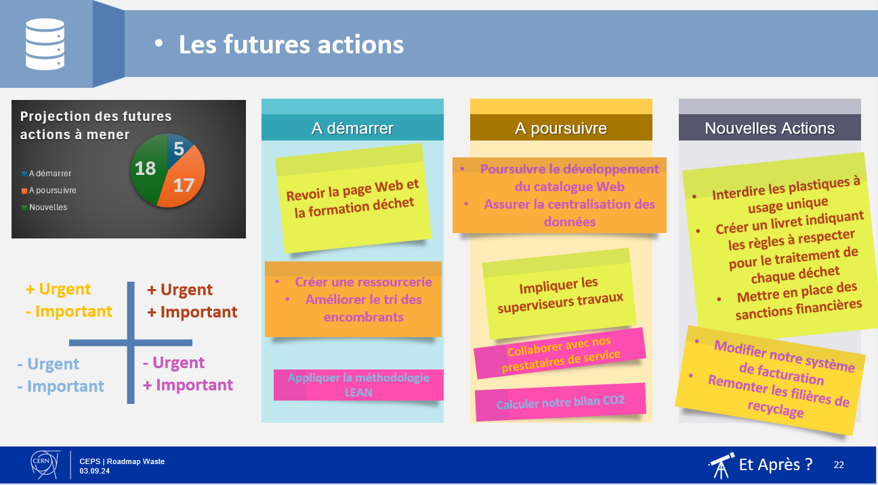
Group – SSC-CS
Cleanliness: Waste roadmap (CEPS Nov. 24)

Slide 6
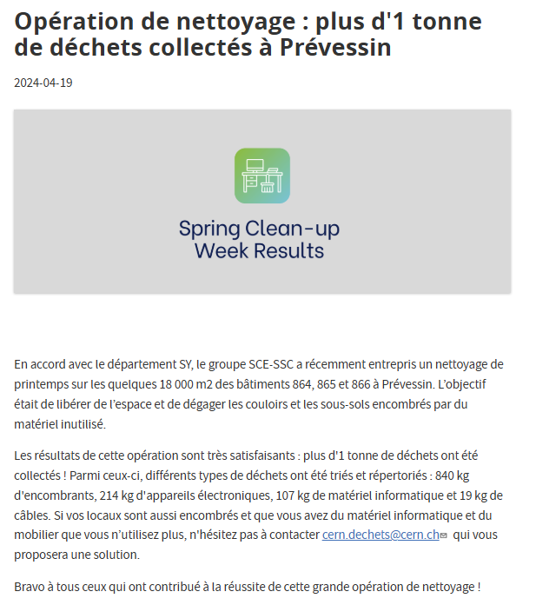
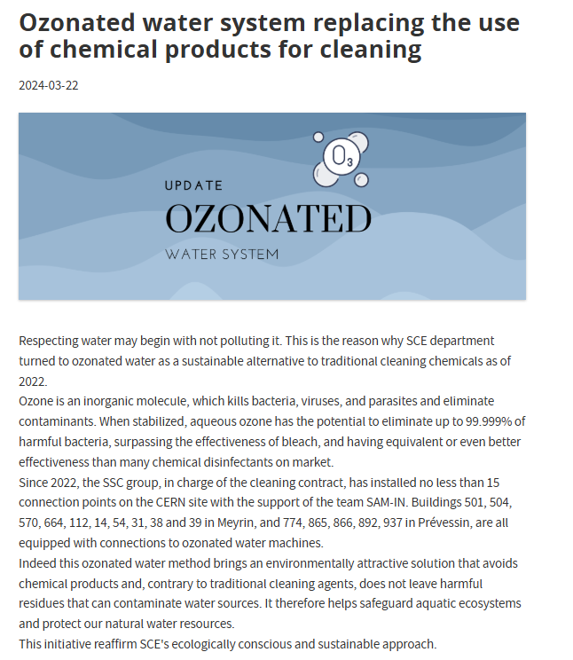
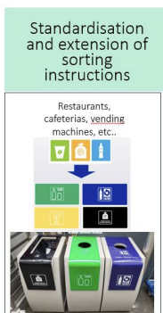
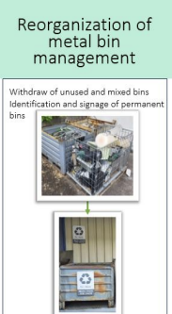
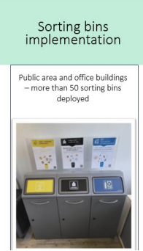
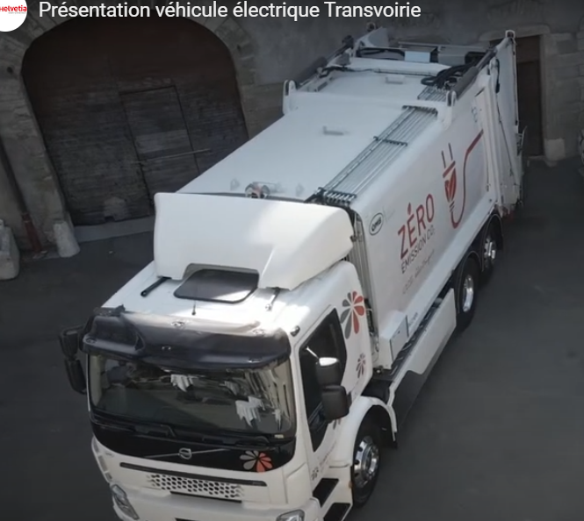


Group – SSC-CS
Cleanliness

Slide 7
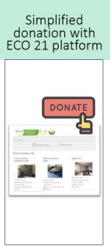

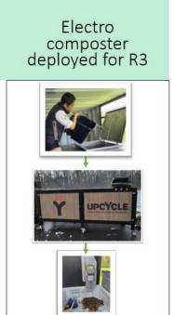
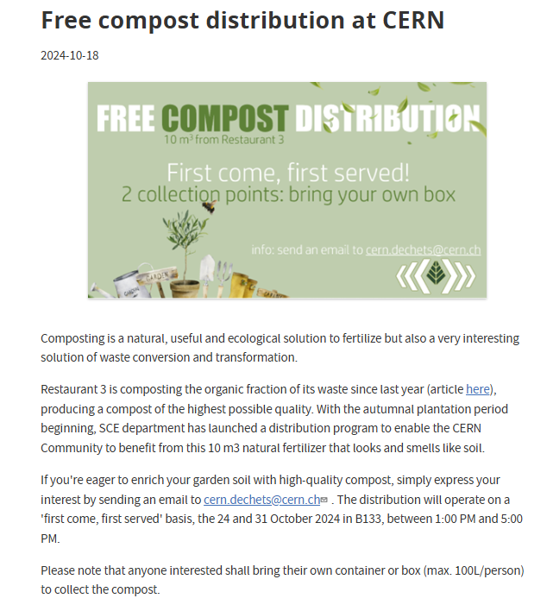
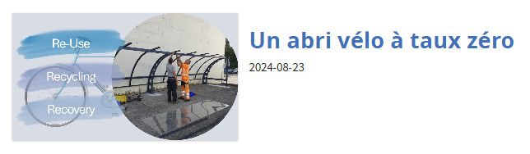


Group – SSC-CS
Cleanliness

Slide 8

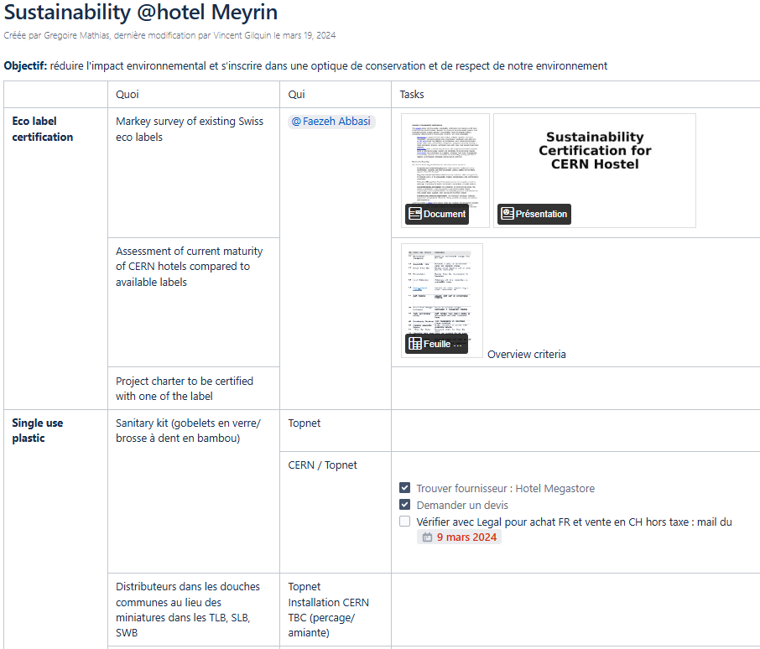
Group – SSC-CS
Housing & Catering
Hotel eco-label: https://confluence.cern.ch/display/ISINT/Sustainability+@hotel+Meyrin

Slide 9

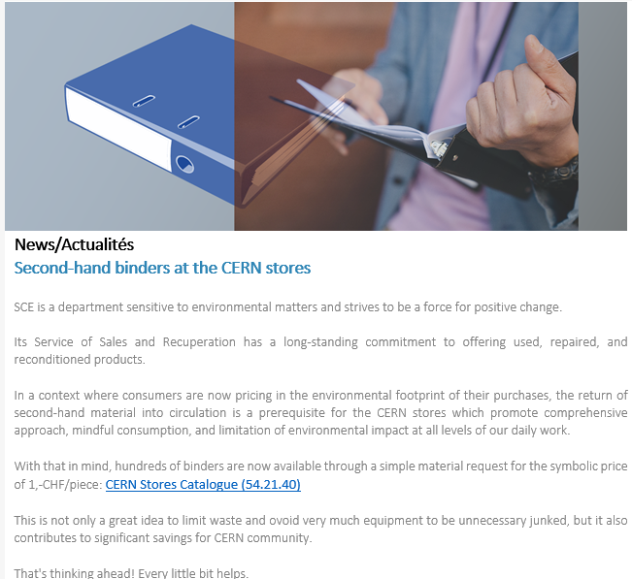
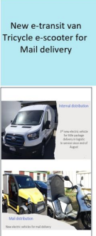

Group – SSC-SC
Supply Chain

Slide 10
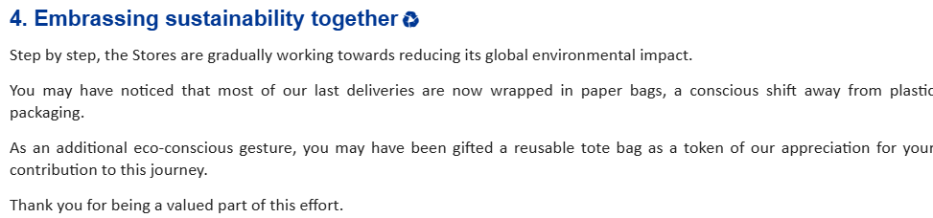
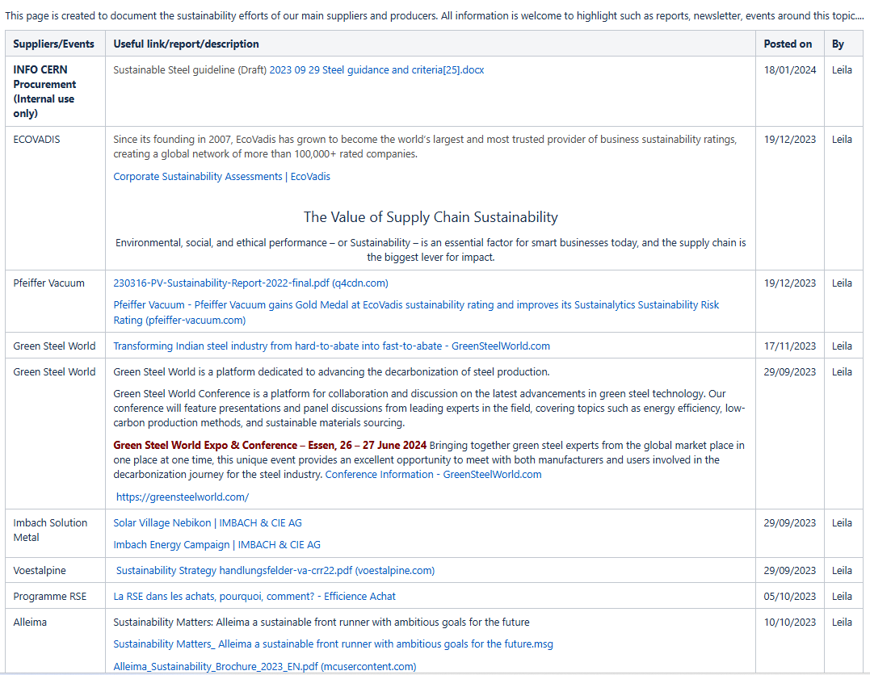
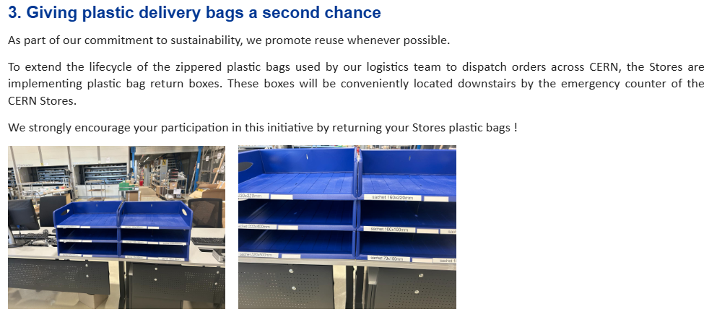
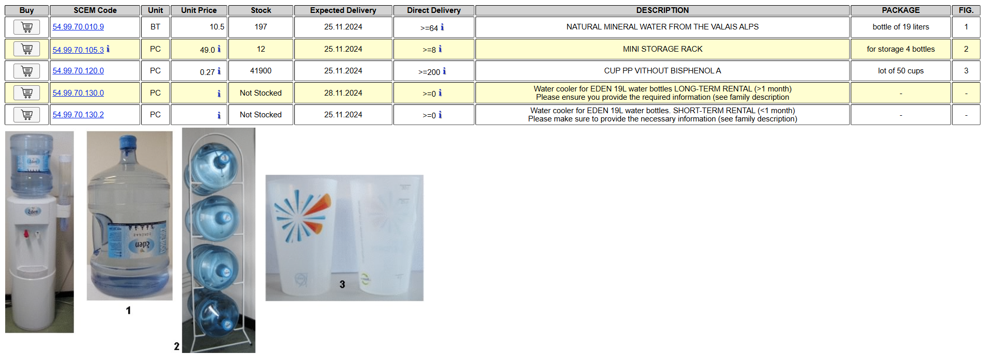
Group - SSC
Supply Chain
This workshop !

Slide 11
Group - SSC
Coming challenges
Service roadmaps release and execution
Objective alignment with key service contracts (workshop to come next year)
CO2eq accounting, standards and metrics
Toward a net-zero Campus (in collaboration with SCE-SAM & SCE-PPM)

