Slide 1
News and Updates – 1
Week of Nov. 11
ISMa tested the quality and are ready to ship 20 1x1x12cm³ crystals
Documentation completed
We have sent a DHL shipping label yesterday ➔ they have received and will ship this week
Wah from UC plan on testing some
They produced 30 more crystals and will ship them to Paul Rubinov mid Dec. ➔ Working on getting the shipping label for the remaining 30 crystals to them ahead of time
New FOA for DOE IF comparative program for FY25 release ➔ we will submit a DAMSA proposal to the open call

Slide 2
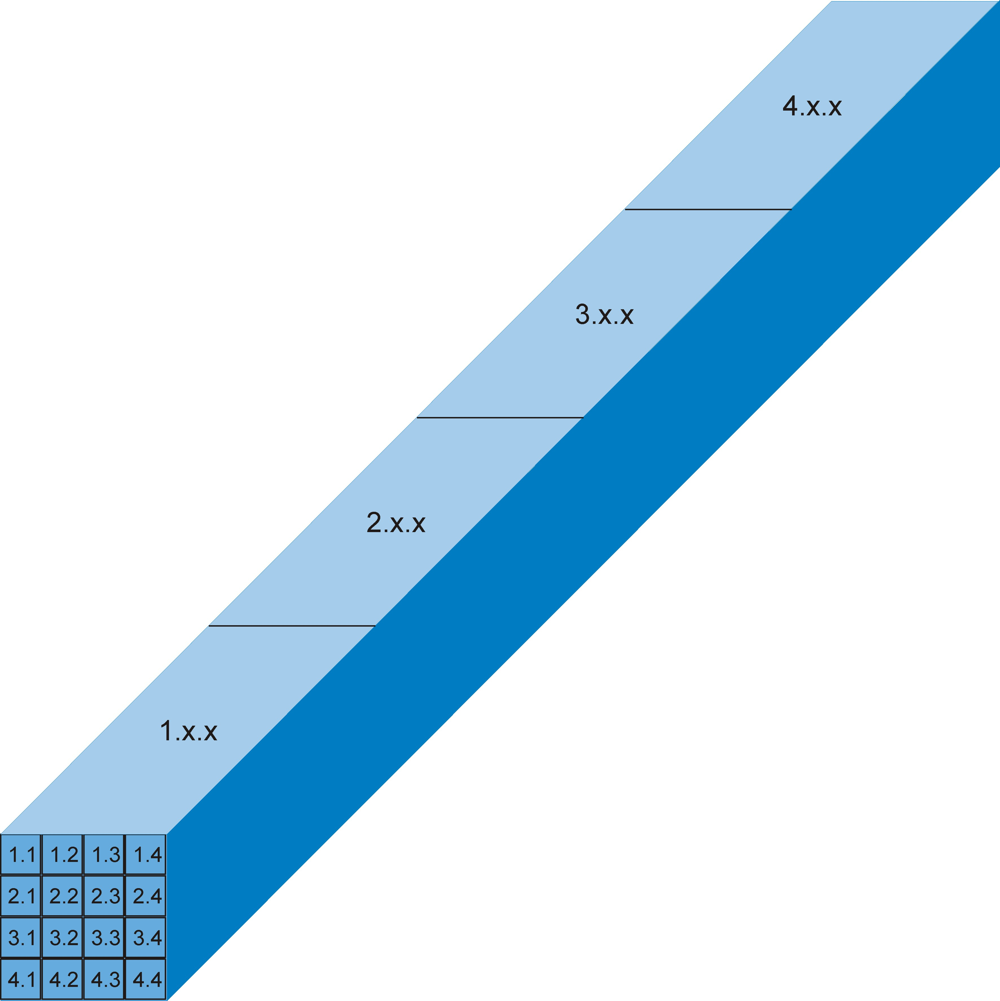
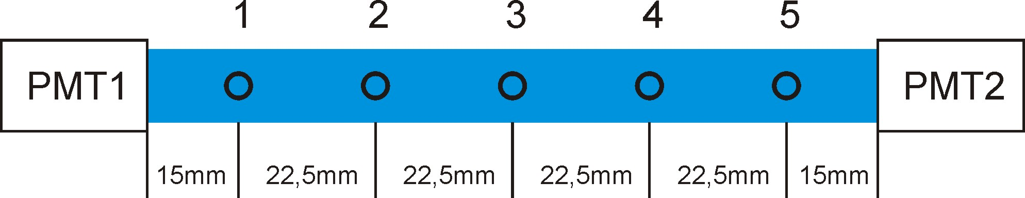
ISMa Crystal Quality Testing Report
10±0.1x10±0.1x120±0.2 mm
Reflector: PTFE film
PMT:R2059 HV=1500V
Collimator d=4mm.
Source: Cs137(γ 662keV)

Slide 3
ISMa Crystal Quality Testing Setup
Sample | position | F/T PMT1 | F/T PMT2 | Sample | position | F/T PMT1 | F/T PMT2
1.1.1 | 1 | 0,44 | 0,45 | 1.2.1 | 1 | 0,46 | 0,48
 | 3 | 0,58 | 0,57 |  | 3 | 0,62 | 0,61
 | 5 | 0,65 | 0,67 |  | 5 | 0,74 | 0,73
Sample | position | F/T PMT1 | Sample | position | F/T PMT1
1.1.2 | 1 | 0,45 | 1.2.2 | 1 | 0,47
 | 3 | 0,60 |  | 3 | 0,60
 | 5 | 0,66 |  | 5 | 0,74
Sample | position | F/T PMT1 | Sample | position | F/T PMT1
1.1.3 | 1 | 0,48 | 1.2.3 | 1 | 0,48
 | 3 | 0,61 |  | 3 | 0,61
 | 5 | 0,69 |  | 5 | 0,72
Sample | position | F/T PMT1 | Sample | position | F/T PMT1
1.3.1 | 1 | 0,50 | 1.3.2 | 1 | 0,51
 | 3 | 0,64 |  | 3 | 0,63
 | 5 | 0,71 |  | 5 | 0,72
Sample | position | F/T PMT1 | F/T PMT2 | Sample | position | F/T PMT1 | F/T PMT2
2.1.1 | 1 | 0,75 | 0,76 | 2.1.2 | 1 | 0,76 | 0,77
 | 3 | 0,79 | 0,79 |  | 3 | 0,80 | 0,82
 | 5 | 0,79 | 0,78 |  | 5 | 0,80 | 0,80

Slide 4
ISMa Crystal Quality Testing Setup
Sample | position | F/T PMT1 | F/T PMT2 | Sample | position | F/T PMT1 | F/T PMT2
3.3.1 | 1 | 0,82 | 0,81 | 3.4.1 | 1 | 0,81 | 0,80
 | 3 | 0,84 | 0,83 |  | 3 | 0,82 | 0,83
 | 5 | 0,85 | 0,85 |  | 5 | 0,85 | 0,85
Sample | position | F/T PMT1 | Sample | position | F/T PMT1
3.2.1 | 1 | 0,80 | 3.2.2 | 1 | 0,82
 | 3 | 0,82 |  | 3 | 0,83
 | 5 | 0,83 |  | 5 | 0,85
Sample | position | F/T PMT1 | Sample | position | F/T PMT1
3.2.3 | 1 | 0,79 | 3.2.4 | 1 | 0,78
 | 3 | 0,83 |  | 3 | 0,82
 | 5 | 0,84 |  | 5 | 0,84
Crystals QE improves from ~0.45 and flattens at ~0.85
Most of them over ~80%
ISMa explanation is the process which the crystals are grown makes the quality at the start of the crystal be different than latter ones
Sample | position | F/T PMT1 | F/T PMT2 | Sample | position | F/T PMT1 | F/T PMT2
4.1.1 | 1 | 0,87 | 0,87 | 4.4.1 | 1 | 0,85 | 0,85
 | 3 | 0,87 | 0,88 |  | 3 | 0,85 | 0,85
 | 5 | 0,87 | 0,87 |  | 5 | 0,87 | 0,87
Sample | position | F/T PMT1 | Sample | position | F/T PMT1
4.4.3 | 1 | 0,85 | 4.2.3 | 1 | 0,85
 | 3 | 0,85 |  | 3 | 0,85
 | 5 | 0,87 |  | 5 | 0,88
Sample | position | F/T PMT1 | Sample | position | F/T PMT1
4.3.1 | 1 | 0,86 | 4.3.2 | 1 | 0,85
 | 3 | 0,86 |  | 3 | 0,85
 | 5 | 0,87 |  | 5 | 0,87

Slide 5
DAMSA Collaboration Meeting
Date : Wed. Jan. 15 – half day Sat. Jan. 18, 2025
Wed. Jan. 15 designated analysis workshop led by Wooyoung Jang
Secured some funding to support junior member travel at ~$300 each
Location : University of Texas at Arlington
An indico page will be produced and will be shared with you next week
Goals of the meeting
Organize the collaboration with responsibility assignments
Current status of various aspects of the experiment, including the world-wide competition and the Fermilab beam status
Strategic plan for the experiment with the goal of data taking at FAST as soon as possible
Funding possibilities and strategy

