Slide 1


Slide 2
Update of ISAAC mechanical design
J. García Matos, C. Martins, F. Toral (CIEMAT)
J.C. Pérez (CERN)

Slide 3
Outline
ISAAC goals & constraints (reminder)
2D Design baselines and configurations (reminder)
2D Design Update
3D Design
      Magnetic – Maxwell
      Mechanical – Ansys
      Conclusions

Slide 4
Outline
ISAAC goals & constraints (reminder)
2D Design baselines and configurations (reminder)
2D Design Update
3D Design
      Magnetic – Maxwell
      Mechanical – Ansys
      Conclusions

Slide 5
ISAAC goals & constraints (reminder)
ISAAC: Investigating Superconducting Assembly to Address Common coil mechanics
Main goal: learn for the 14 T model with existing coils, mostly on mechanics
  Existing RMC coils made at CERN with MQXF strand are selected
  Mechanics & assembly as simple as possible
  Provide ≈14 T in the aperture (100% load)
  Decrease vertical Lorentz force F_{y} to achieve low vertical preload: free horizontal movement when coils are energized, without friction
Assembly with bladder and keys, slight preload just to keep contact between parts
Aluminium shell also contributes to hold the forces
Goal: To have a horizontal coil displacement due to the EMF below 0.5 mm to:
  Reduce the impact on field quality (0.5 mm -> 1% less field in the aperture)
  Reduce the possibility of sudden coil movements (to avoid quenches)

Slide 6
Outline
ISAAC goals & constraints (reminder)
2D Design baselines and configurations (reminder)
2D Design Update
3D Design
      Magnetic – Maxwell
      Mechanical – Ansys
      Conclusions

Slide 7
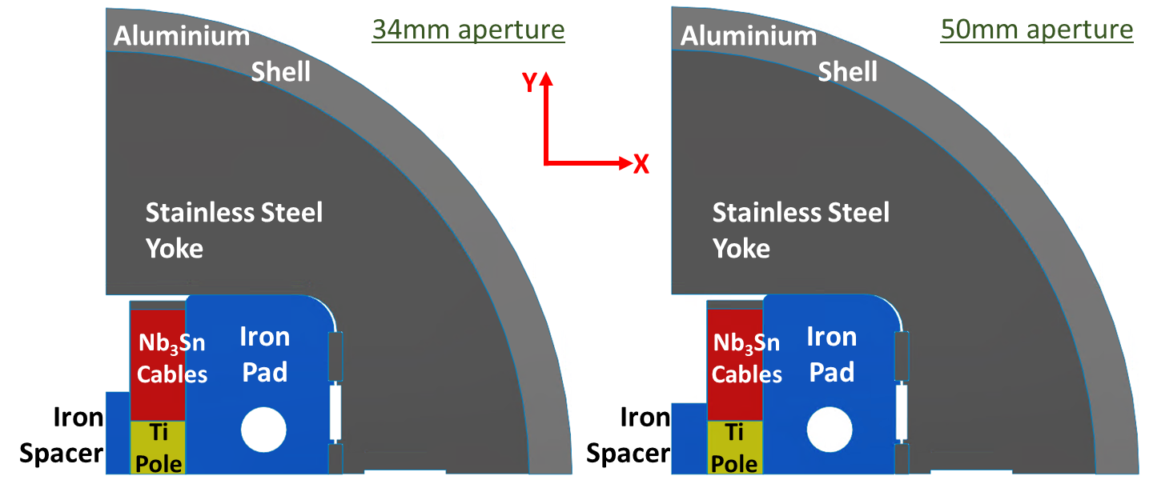
2D Design baselines and configurations (reminder)
One Ø30 mm Rod per quadrant
Pad width: 30 mm @ both sides of the rod with 50 mm aperture
Fixed Yoke and Shell for different apertures (34 mm & 50 mm): Only Pad and Spacer change
Shell dimensions: Ø Outer: 650 mm. Thickness: 30 mm (Ø Inner: 590 mm)
Iron components EMF taken into consideration (Spacer & Pad)

Slide 8
Outline
ISAAC goals & constraints (reminder)
2D Design baselines and configurations (reminder)
2D Design Update
3D Design
      Magnetic – Maxwell
      Mechanical – Ansys
      Conclusions

Slide 9
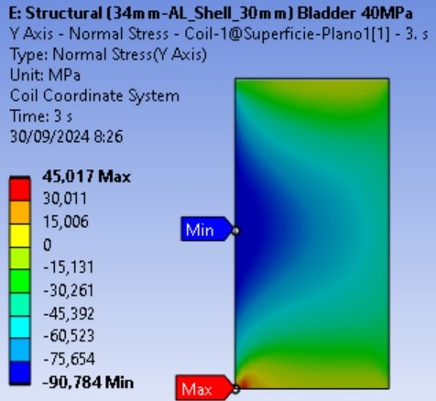
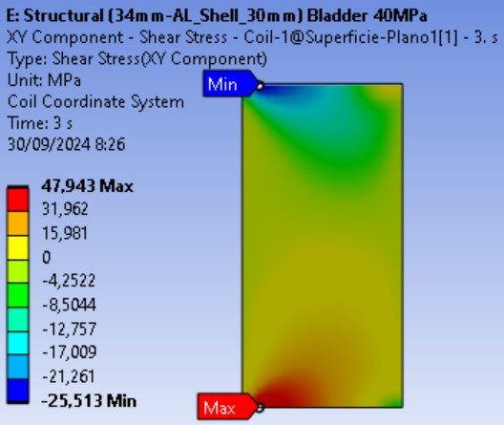
2D Design without preload (34mm aperture)
All components in contact without preload at room temperature
Main concern: Cable detaching from pole due to Vertical (Y) and Shear Stress

Slide 10
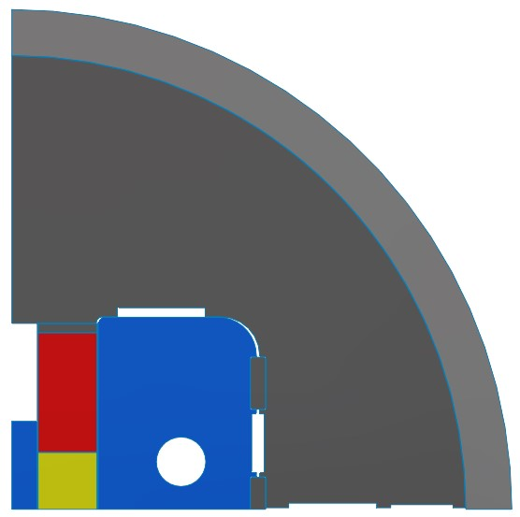
2D Design with (vertical) preload (34mm aperture)
Slot between Yoke parts for a vertical bladder to allow the assembly at room temperature (RT)
Yoke slots for additional bladder and/or keys:
  Between Pad and Yoke: it can allow a bladder or a key
  Between Yoke parts: the one on the right for a key
Gap between Pad and Yoke @RT: 0.15mm
Initial assembly interference @RT: 0.2mm (96.2MPa preload)
Only compression vertical stress (no tension)
Maximum shear stress reduced (below 45MPa)
Horizontal tension stress reduced from 98MPa to 56MPa
The VM equivalent stress is 133MPa (below the limit of 150MPa)
Detailed information about Maxwell and Ansys results in two next slides

Slide 11
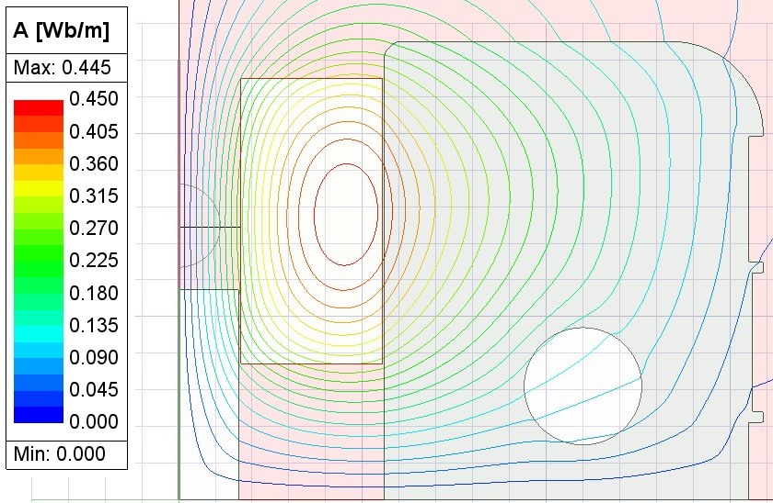
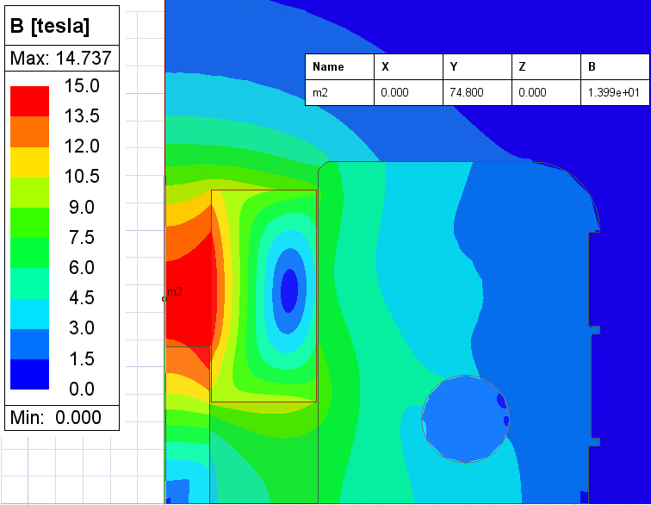
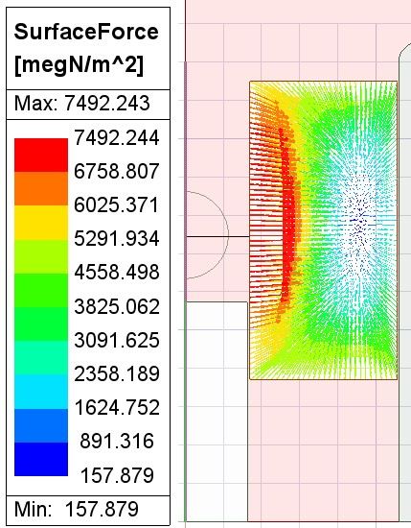
Maxwell 2D - 34mm aperture
Intrabeam: 149.6 mm
Nominal Current: 19340 A
Peak Field: 14.74 T
Aperture Field: 13.99 T
Middle Yoke height (Q1): 57.3 mm (0.5mm to aperture)

Slide 12
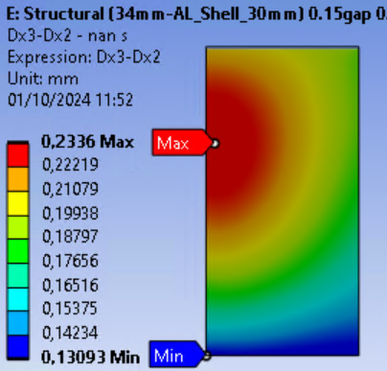
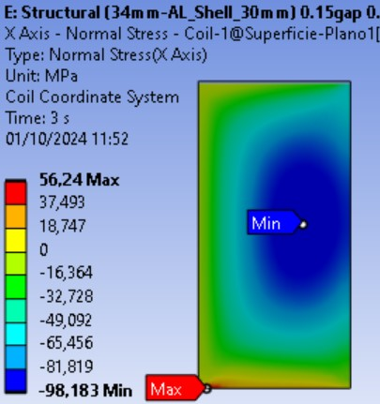
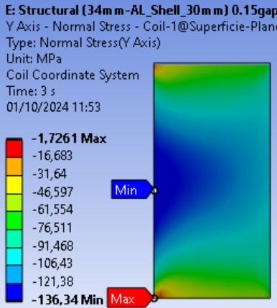
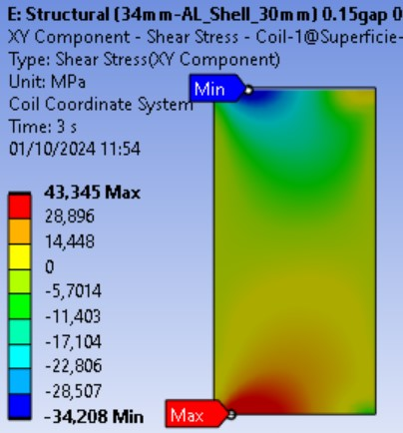
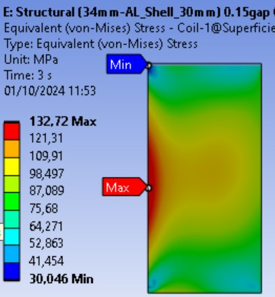
Coil Stress (with vertical preload)
Max. Horizontal Coil Displacement (X) due to EMF: 0.23 mm
Max Stress @ Coil (Cooling + EMF):
  Max X Stress @ Coil: 56.2 MPa (-98.2 MPa)
  Max Y Stress @ Coil: -1.7 MPa (-136.3 MPa)
  Max Shear Stress @ Coil: 43.3 MPa (located @ Pole – Coil transition)
  Max VM Stress @ Coil: 132.7 MPa
Coil Displacement due to EMF

Slide 13
Outline
ISAAC goals & constraints (reminder)
2D Design baselines and configurations (reminder)
2D Design Update
3D Design
      Magnetic – Maxwell
      Mechanical – Ansys
      Conclusions

Slide 14
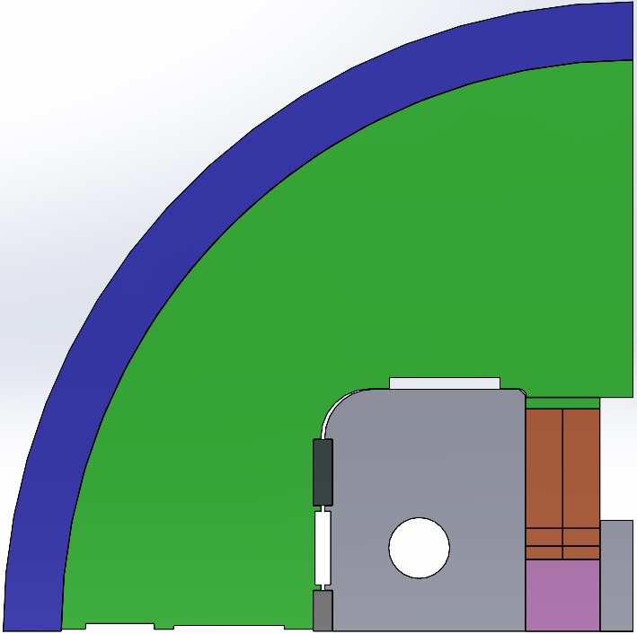
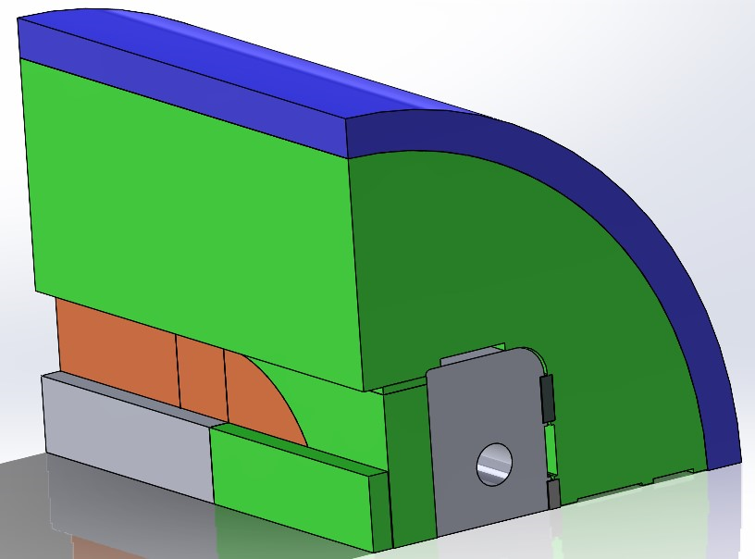
3D Design – 34mm aperture
Geometry and thermal/magnetic conditions as in 2D design
Pad entirely made of Iron
Spacer made of Iron in 3rd cable block straight section (SS+S1), ASC2024-1LPo1G-08
Shell
Yoke
Pad
Spacer

Slide 15
Iron length
The spacer and the pad can be made in iron.
If the spacer is made in iron, it should not be longer than the pad. When the peak field is at the straight section, the margin on load line increases.
The stored magnetic energy decreases with more iron volumen.
A pad made completely in iron provides better support to the large outwards horizontal electromagnetic forces.
The best balanced design option is Case #6.

Slide 16
Outline
ISAAC goals & constraints (reminder)
2D Design baselines and configurations (reminder)
2D Design Update
3D Design
      Magnetic – Maxwell
      Mechanical – Ansys
      Conclusions

Slide 17
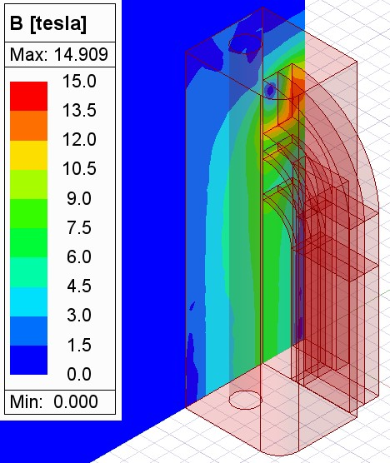
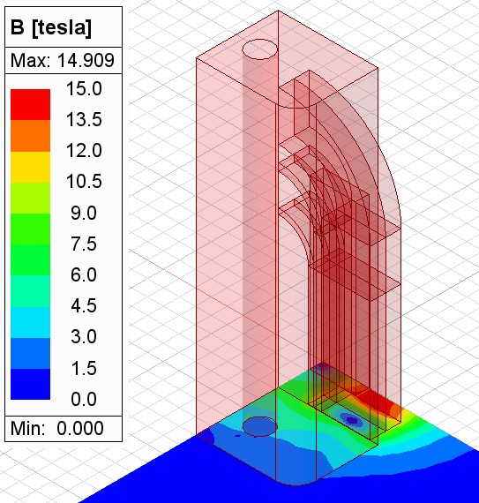
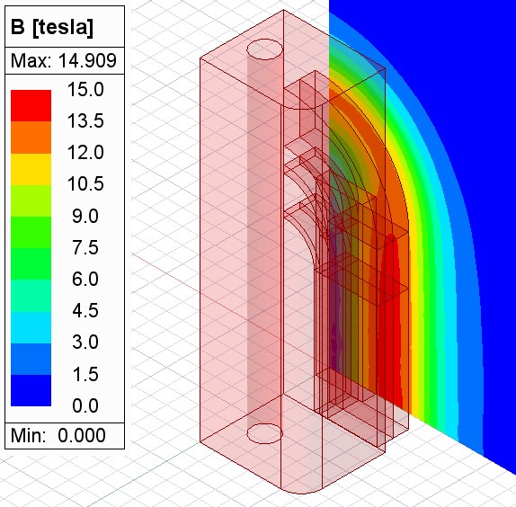
3D Magnetic Design
Nominal current: 19340 A
Aperture Field: 14.069 T
XZ
XY
YZ

Slide 18
Outline
ISAAC goals & constraints (reminder)
2D Design baselines and configurations (reminder)
2D Design Update
3D Design
      Magnetic – Maxwell
      Mechanical – Ansys
      Conclusions

Slide 19
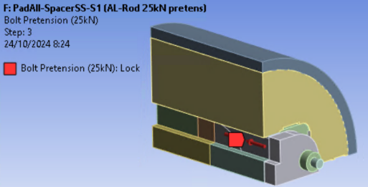
3D Mechanical Design
Vertical preload over Coil: 0.2 mm interference with Yoke @RT
Aluminium Rods
25kN pretension over Rod
EMF(z): 29.64 kN
End Shoe Area: 114.84 x 38.5 mm²
Total EMF(z) pressure: 67 MPa
Rod Area: 754.77 mm²
25 kN pretension over Rod applied at RT (half EMF(z) approx)
Limits @ RT: -120 MPa <-> 20 MPa
Limits @ Cold: -150 MPa <-> 20 MPa

Slide 20
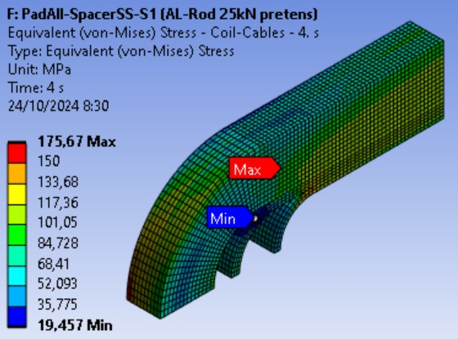
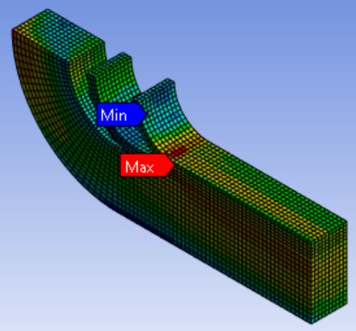
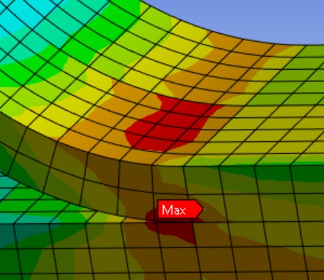
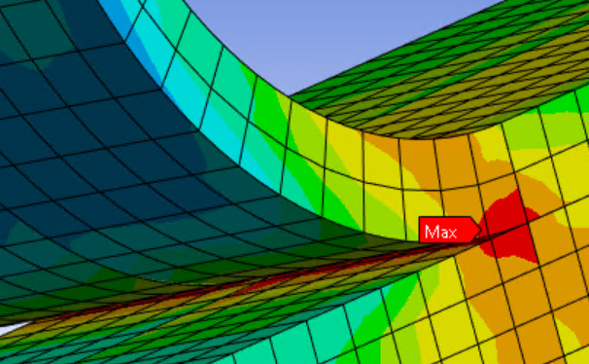
3D. Coil VM equivalent Stress
Limits @ Cold: -150 MPa <-> 20 MPa

Slide 21
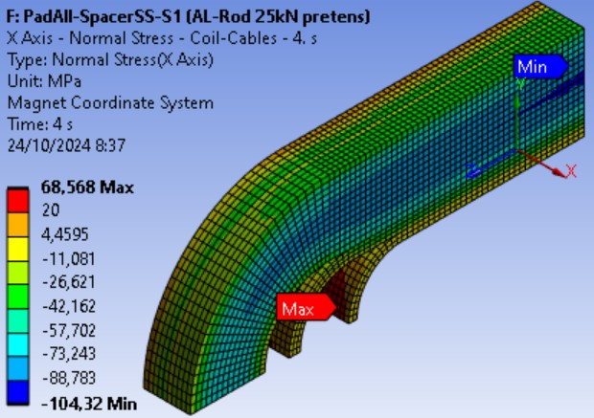
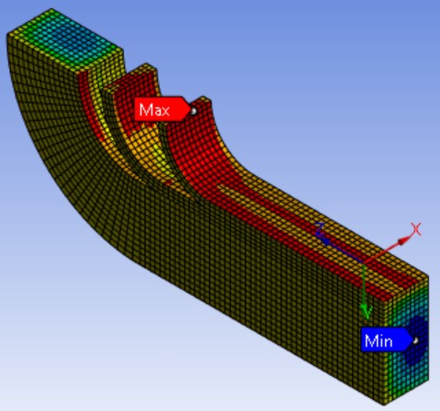
3D. Coil X Stress
Limits @ Cold: -150 MPa <-> 20 MPa

Slide 22
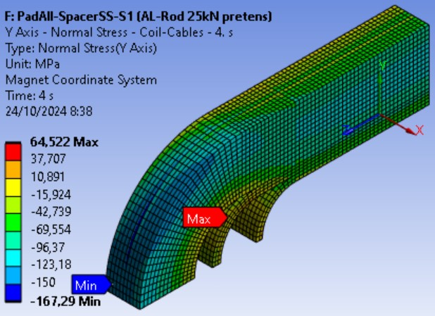
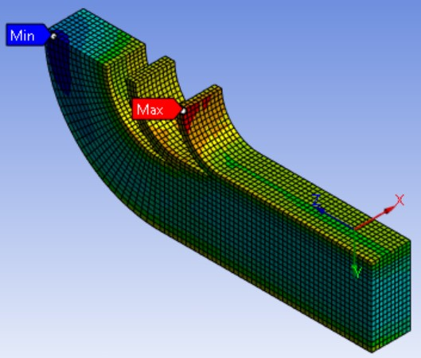
3D. Coil Y Stress
Limits @ Cold: -150 MPa <-> 20 MPa

Slide 23
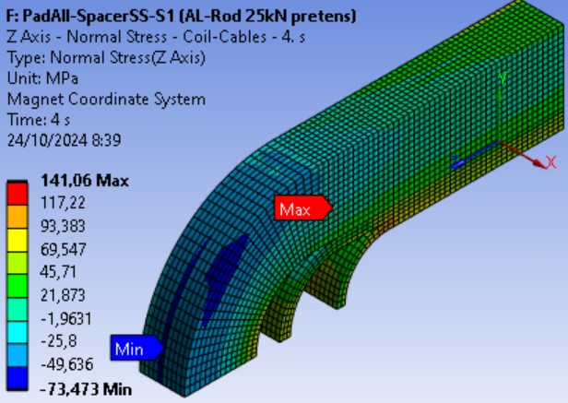
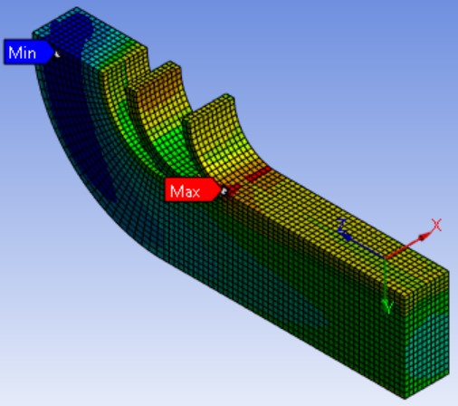
3D. Coil Z Stress
Limits @ Cold: -150 MPa <-> 20 MPa

Slide 24
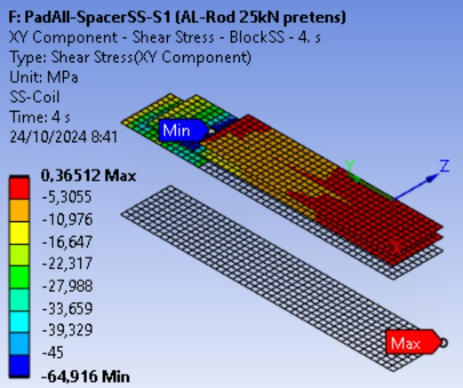
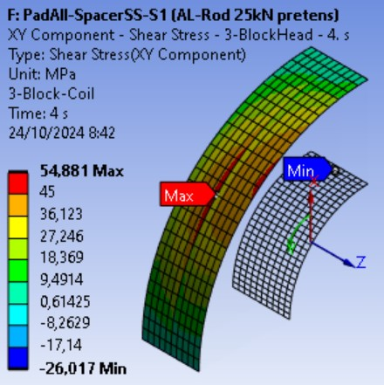
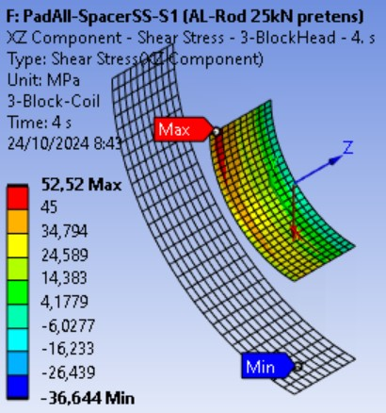
3D. Coil Shear Stress
Limits @ Cold: -45 MPa <-> 45 MPa

Slide 25
Outline
ISAAC goals & constraints (reminder)
2D Design baselines and configurations (reminder)
2D Design Update
3D Design
      Magnetic – Maxwell
      Mechanical – Ansys
      Conclusions

Slide 26
Conclusions
New cross-section design: Coil vertical preload (0.2mm interference with yoke) to reduce vertical and shear stress (avoid cable detaching from pole).
Axial support with aluminium rods preloaded at 25kN.
2D and 3D magnetic and mechanical analysis done, coherent results. Cable stress over limits in some located areas (bonding with coil components)
Detailed manufacturing design ongoing.

