Slide 1
Coronagraph at the LHC
Jan Pucek
Presentation made for the Students and R&D meeting
22.11.2024

Slide 2
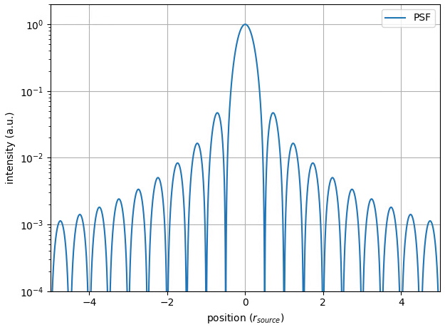

Introduction – what is a coronagraph?
Simple imaging system
Source
Image
$$θ$$
Point source imaged as a distribution
+ potential diffraction on the aperture (dependent on 𝜃)
Aperture
Measured intensity
Position at detector
Figures from D. Butti

Slide 3
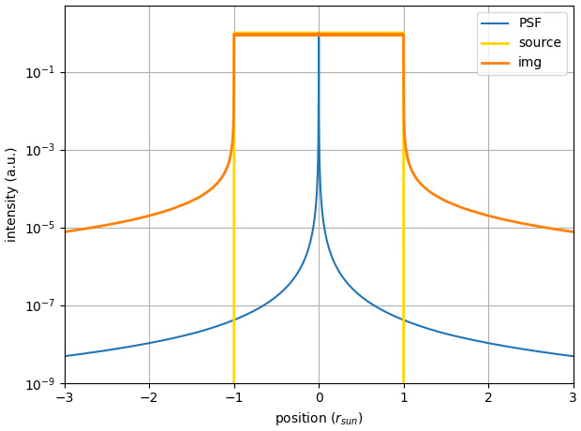


Introduction – what is a coronagraph?
$$r_{sun}$$
photosphere
The PSF is small compared to the Sun’s radius,
only the diffraction tails visible
diff. tails
$${10}^{−6}$$
corona
Figures from D. Butti

Slide 4
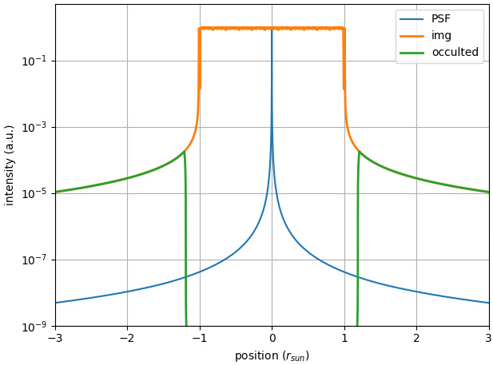
Introduction – what is a coronagraph?
Occulter – blocks ”core” component
photosphere
diff. tails
$${10}^{−6}$$
corona
occulter
Figures from D. Butti

Slide 5
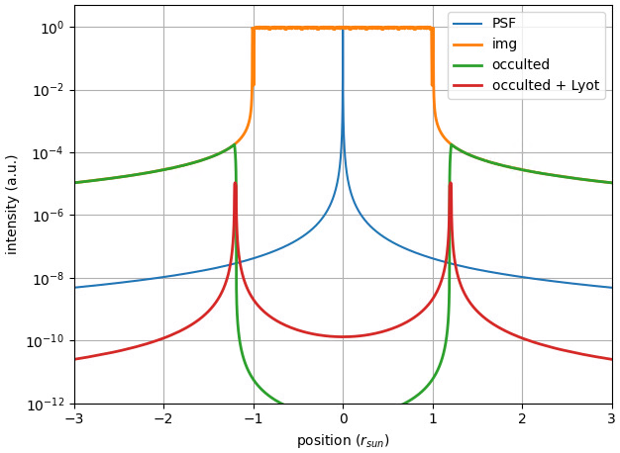

Introduction – what is a coronagraph?
Field lens
photosphere
Lyot’s stop
Field lens images the entrance aperture onto the Lyot’s stop that stops the diffracted portion of the light.
A telescope using a field lens + Lyot’s stop = Coronagraph
$${10}^{−6}$$
corona
occulter
Figures from D. Butti

Slide 6
Introduction – the source
*not to scale
Extraction mirror
RF cavities
SR radiation
Distance between D3 and BSRTM (extraction mirror) ≈ 21m
Synchrotron radiation emitted in a narrow cone (due to Lorenz transformation) ≈ 140 µrad
D3
D3
Beam 2
D4
D4
Beam 1
D3
D3

Slide 7
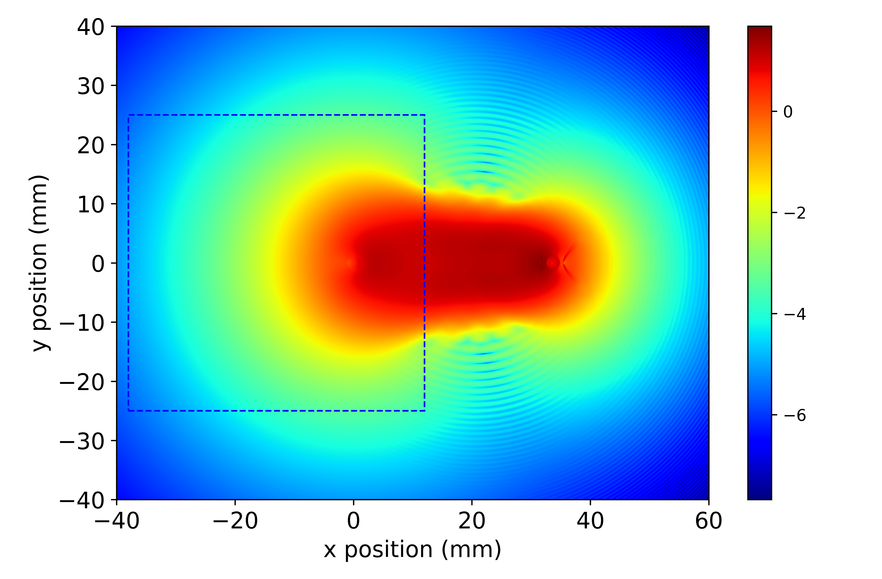
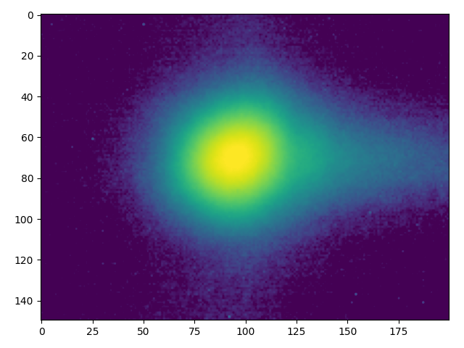
Introduction – the source
Sharp edge of the extraction mirror within the light spot -> source of diffraction in horizontal plane
Diffraction tail
When imaged
Simulation and figure produced by D. Butti

Slide 8
Introduction – the functional specifications
In the era of the HL-LHC the “beam halo” might contain 35MJ – danger to the collimation system
  online monitoring needed
The BSRH should provide reliable measurement of the beam halo population (beam halo = particles outside of 4.7𝜎_{ref} from closed orbit)

Slide 9
Instrument calibration
Charge scaling
= camera counts to p+ population
From image to p⁺ population
Physical units on the axis
(alias magnification)

Slide 10
Instrument calibration
Two independent calibration procedures:
  Calibration of the BSRH magnification (M) and point spread function (PSF)
    Only assumption – the PSF is Gaussian (not valid in H-plane)
    For the calibration used 6 different bunches (3 different emittances)
    Two parameters optimized – M(BSRH) and σ_{PSF(BSRH)}
  Calibration of the charge scaling on the BSRH (meaning protons/counts on camera)
    No assumptions at the moment

Slide 11
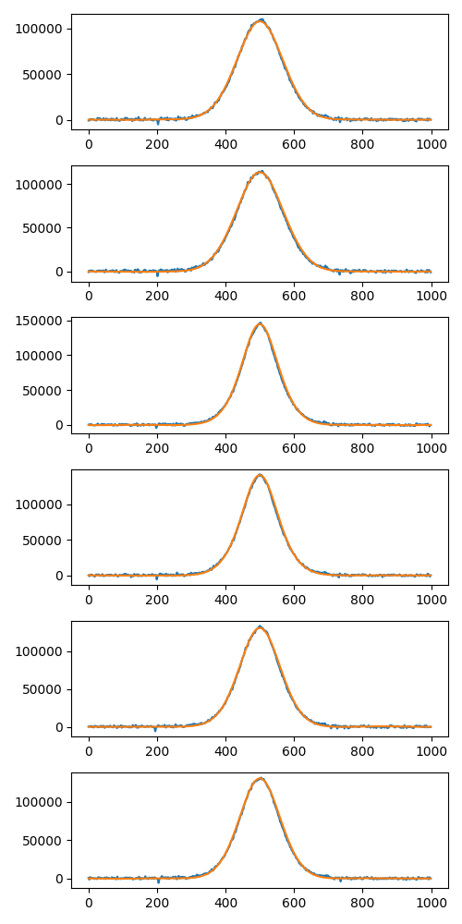
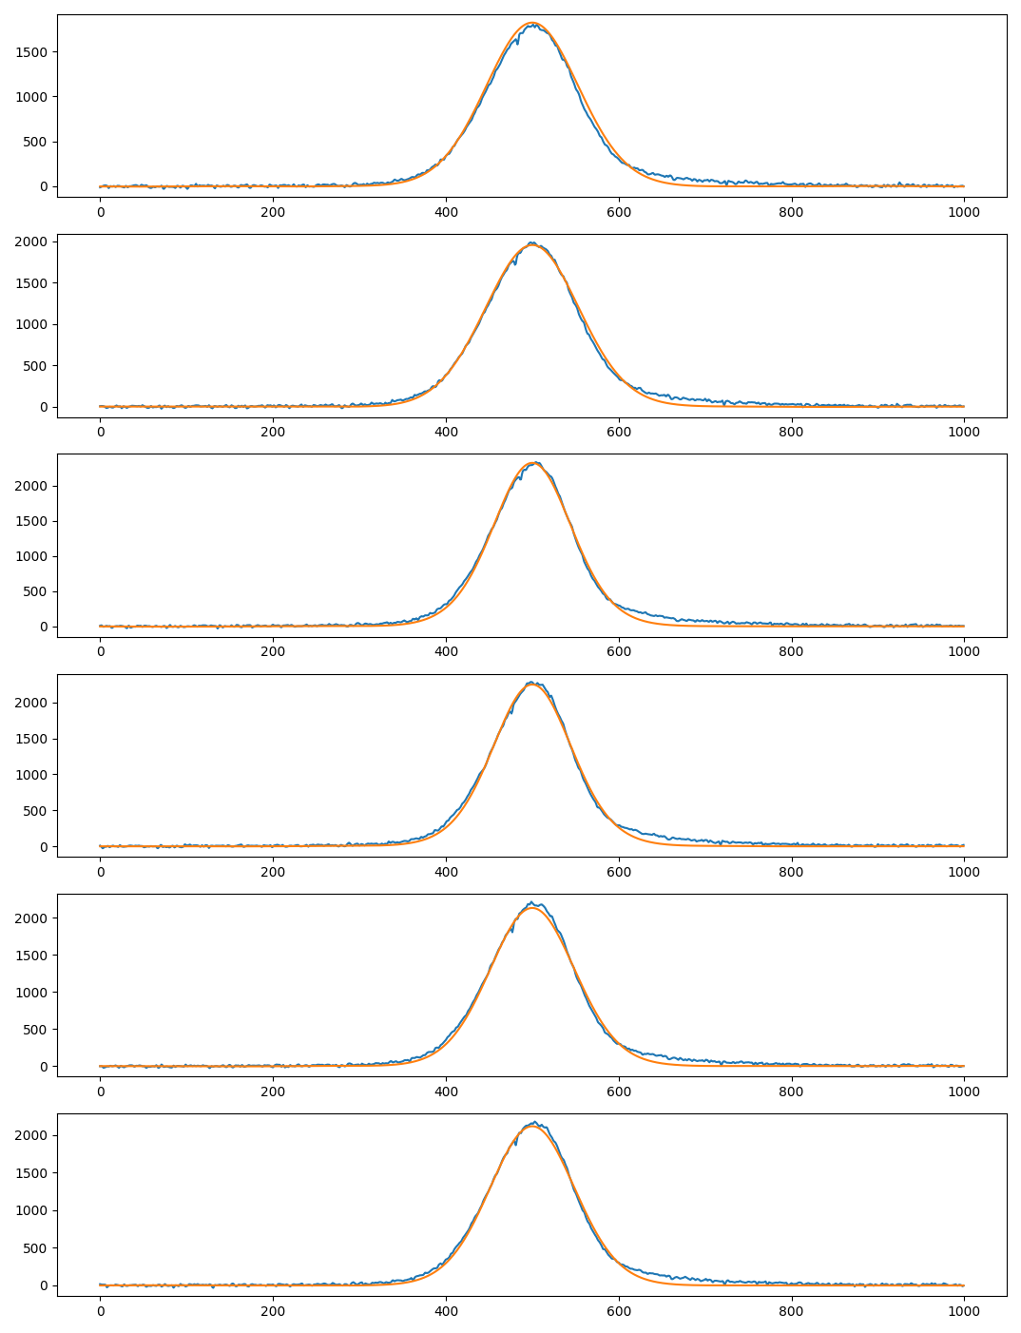
Magnification and point-spread function
Preliminary
Comparison between “true” bunch profile and BSRH profile
Problematic tail
Vertical profiles
Orange = BWS ⊗PSF
Blue = BSRH profile
Horizontal profiles
Orange = BWS ⊗PSF
Blue = BSRH profile
Used a subset of the profile – left of the blue line
Results V: σ = (277 ± 8)μm
m = (0.64 ± 0.006)
ps = (18.3 ± 0.2) μm/px
Results H (L-BFGS-B): σ = (320 ± 30)μm
m = (0.68 ± 0.03)
ps = (17.0 ± 0.8) μm/px

Slide 12
Charge scaling calibration
Simple:
total sum of camera counts * calibration factor = FBCT population
Take into account the exposure time!
cam_counts * c_factor*max_exposure/exposure = population
= 44.5

Slide 13
Machine development session - overview
How to asses the performance of the instrument?
Scrape the beam to known size → beam halo = 0
Blow up a bunch (ADT) to populate the halo region
Measure charge in halo by two instruments (BWS, BSRH)

Slide 14
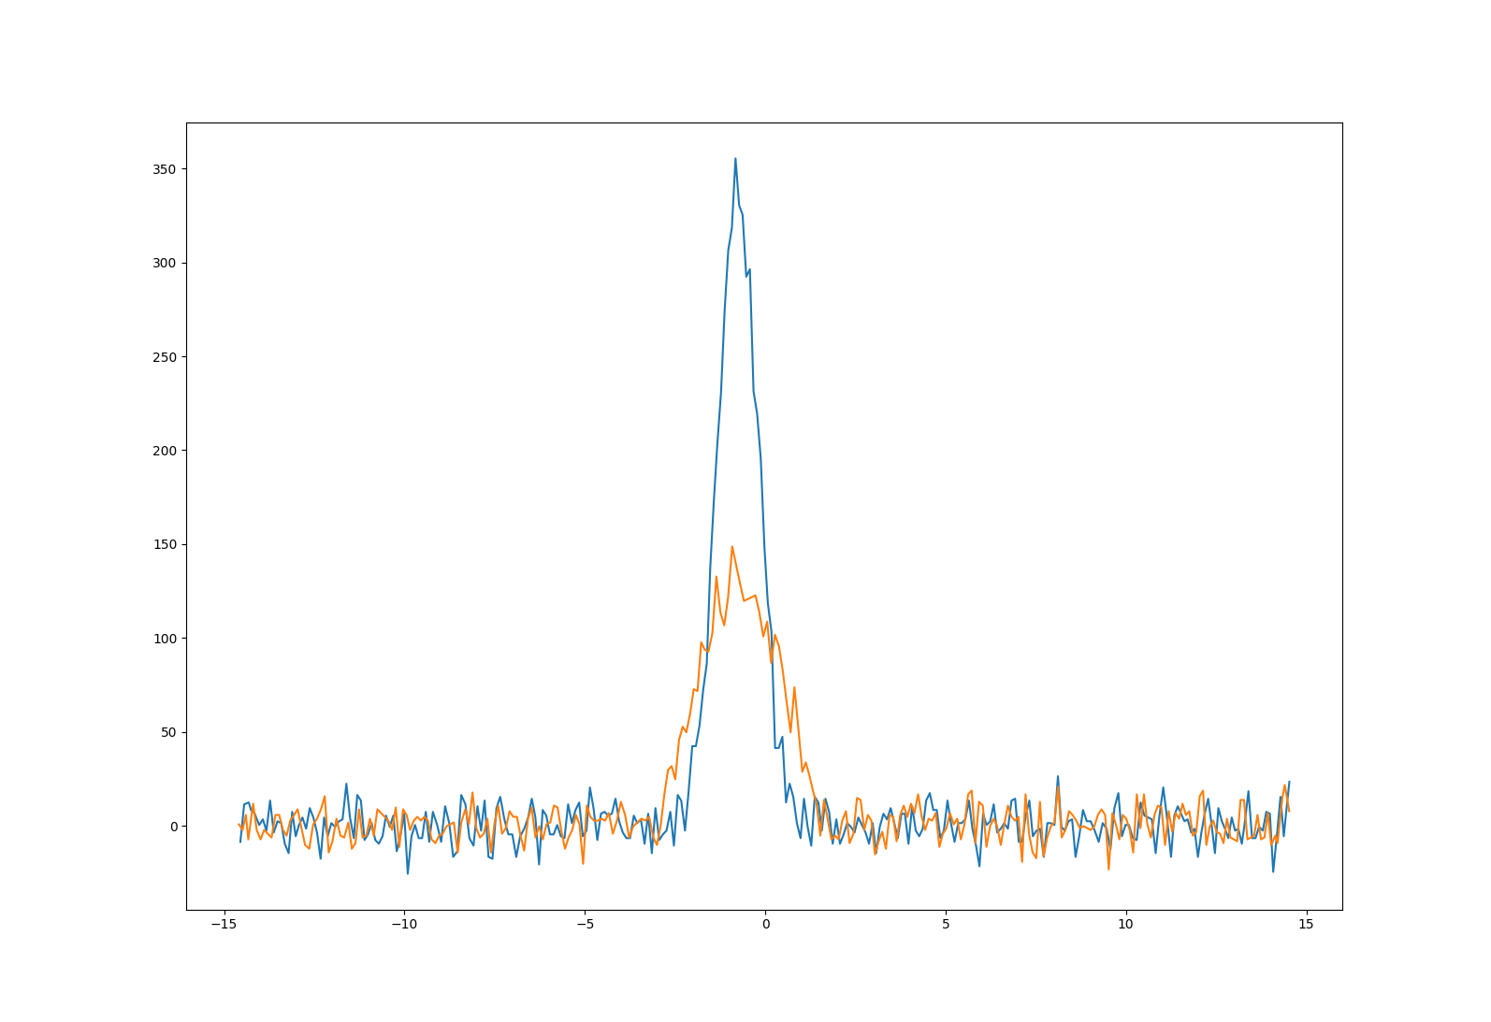
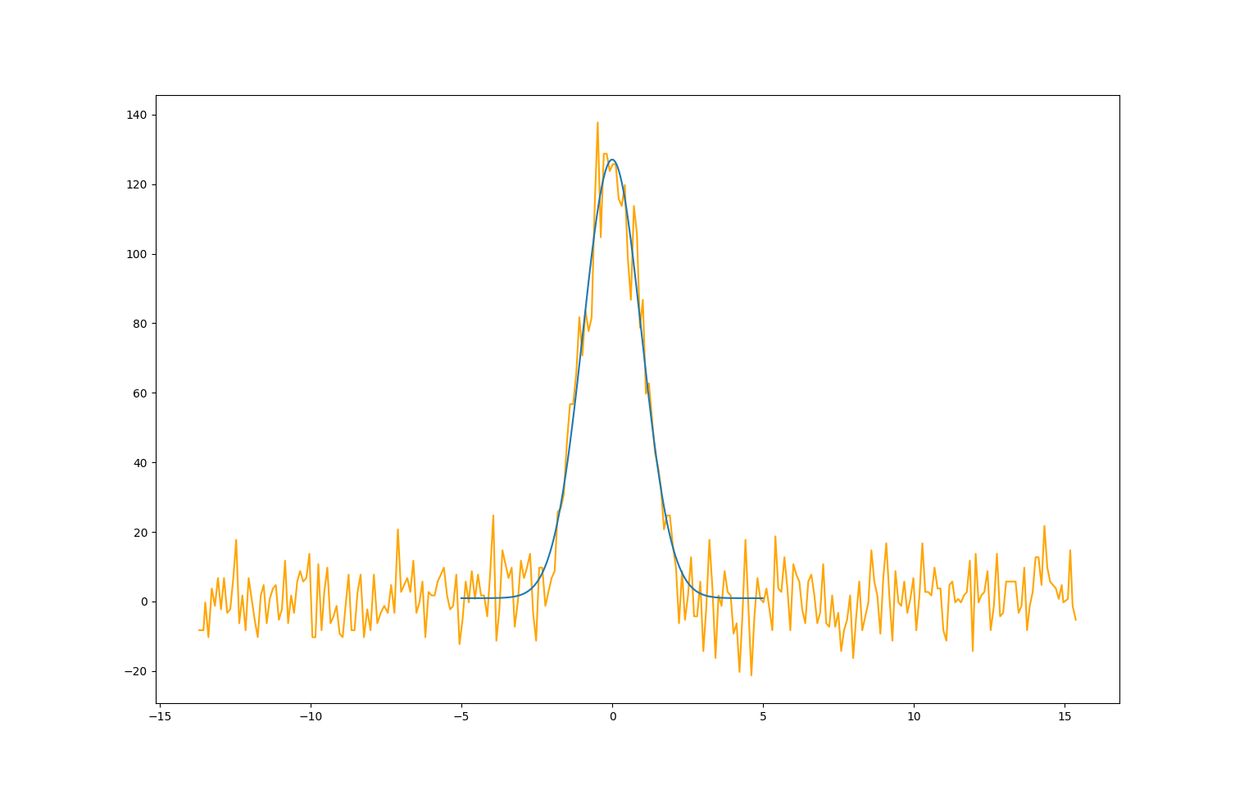
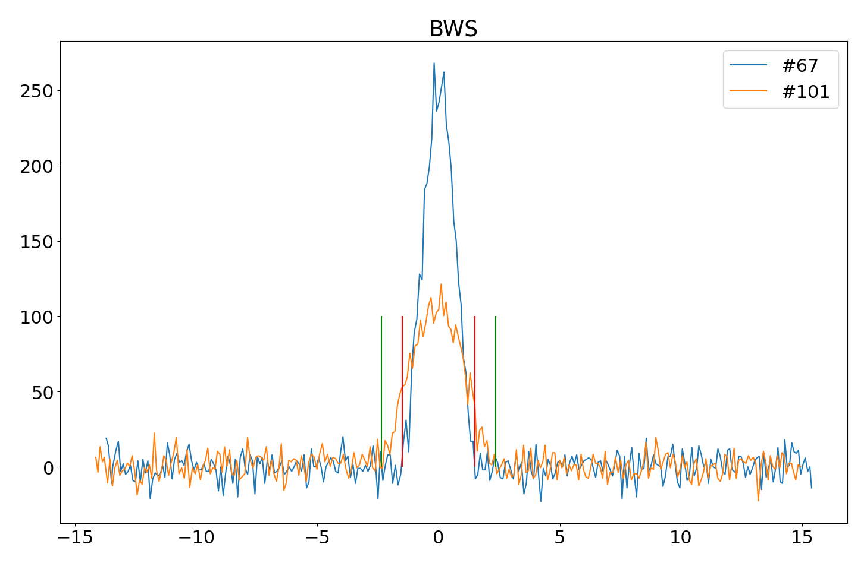
MD results - analysis
Analysis of the BWS – straight forward
Raw data
Getting the center
Calculate integration region
Counts*c_factor = population in halo

Slide 15
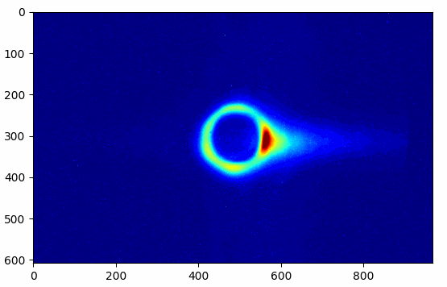
MD results - BSRH
20 times faster than real-life acq.

Slide 16
MD results– BSRH analysis
Raw image
Projection + fit to get center
Calculate integration region,
Calculate the population in halo

Slide 17
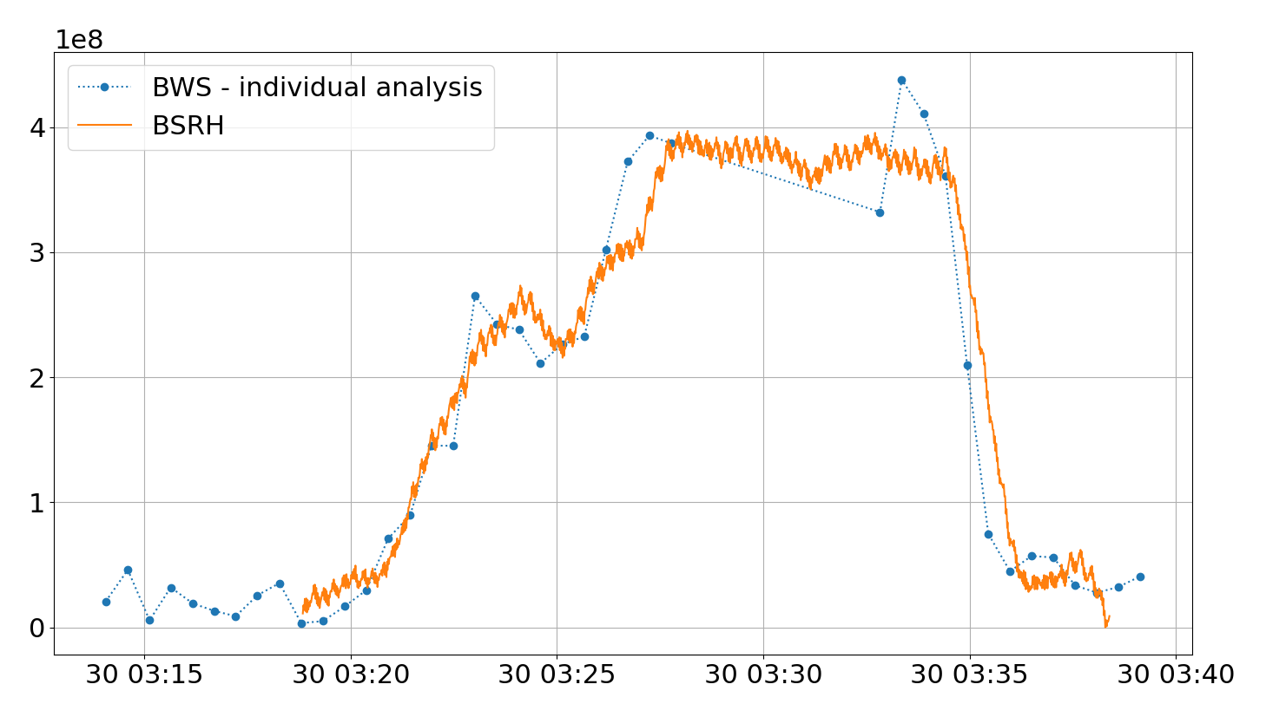
MD results - figures
Preliminary
V-plane results (3.5𝜎 to ∞):
BSRH data – moving average over 40 seconds (loss of exact timing information)
(gating on 10 pilot bunches while blowing up only one → contrast of 0.1%)

Slide 18
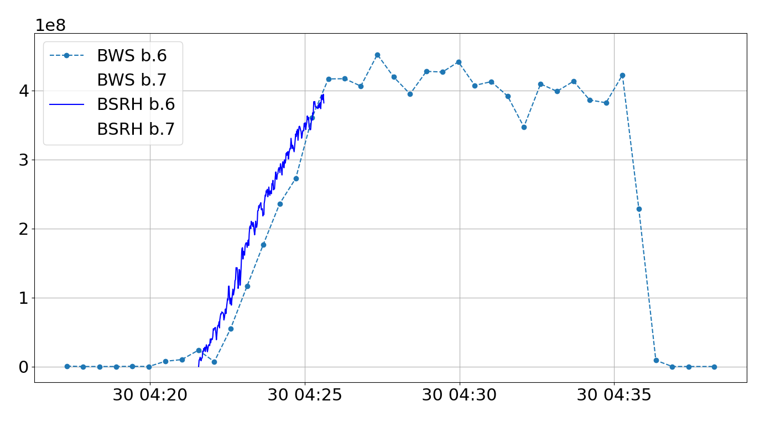
MD results - figures
Preliminary
H-plane results (3.5𝜎 to ∞):
BSRH data – moving average over 2 seconds
(gating on 1 pilot bunch)

Slide 19
MD results - remarks
Pretty good agreement, no?
Problems with the camera intensifier (minimized by moving average)
Additional data to be analysed
These results will be presented in December during a BHM review

Slide 20
Outlook + improvements
Hardware during YETS:
  Exchange the image intensifier (+ maybe trigger cable)
  Make the BSRH parasitic to the BSRT (currently it is possible to send light to only one of the two instruments)
Software:
  Compare profiles from BWS and BSRH (using the “known” PSF)

