Slide 1
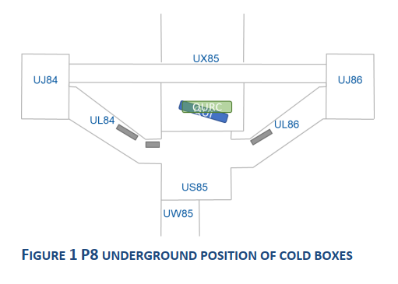
P8 SEU mitigation measures on cryo system for 2025 and 2026 LHC physics Run (and LS3).
M. Pezzetti with the material of B. Ivent, B. Bradu, F. Morant & L. Delprat
AMB

Slide 2
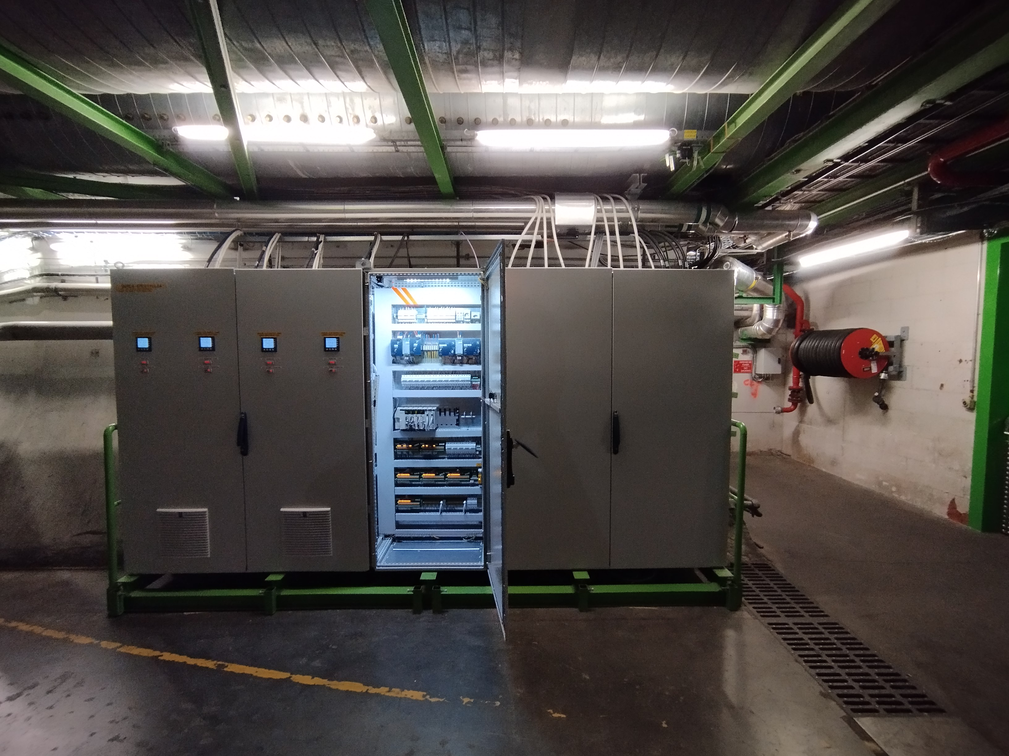
QURCA P8 US85 / UL84 (elevator exit)
QURCA
AMB-Mecos

Slide 3
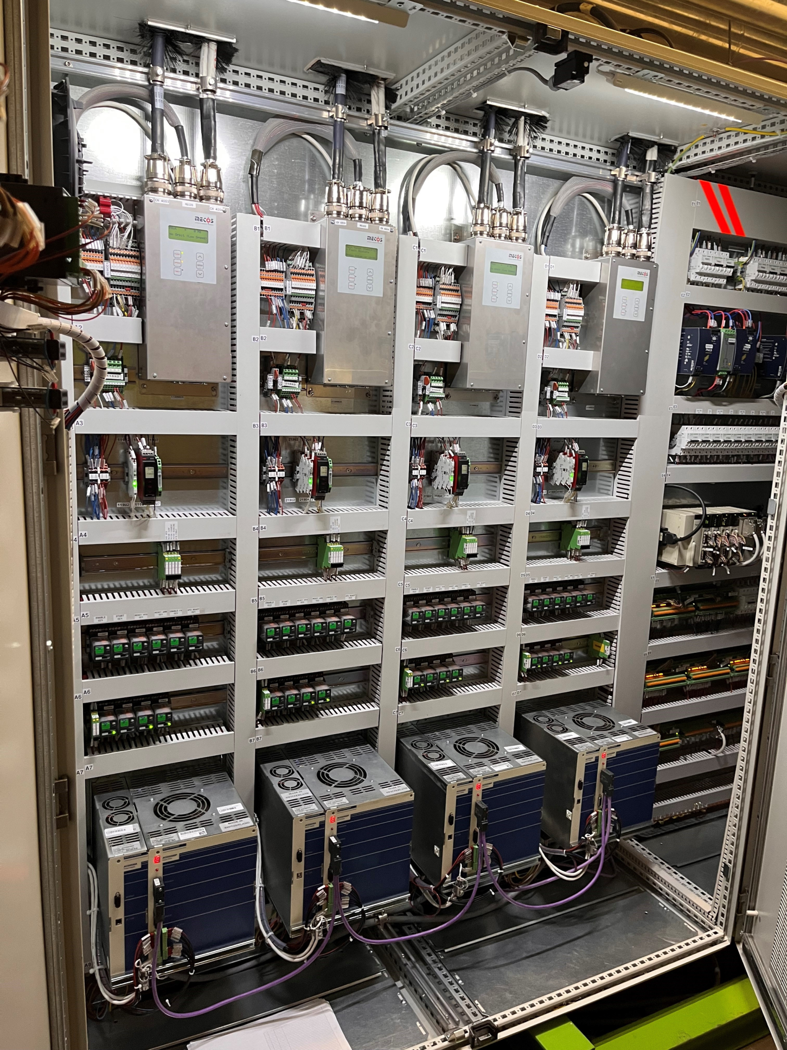
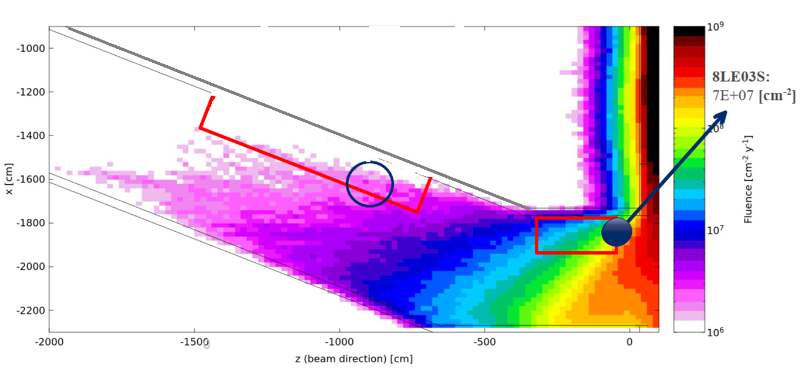
AMB location today and HEH fluence (2024)
AMB MECOS (Active Magnetic Bearings of cold compressors) are located today at the UL84 right extremity (US85 side)
MECOS AMB radiation sensitivity = one failure each 10⁸ HEH/cm² (data obtained after radiation tests in HiRadMat)
Fluka simulations in 2020 were indicating a fluence of ~5.10⁷ HEH/cm² at this location for an integrated lumi in LHCb of 10 fm⁻¹
AMB4 is the most exposed electronic device (but AMB 1,2,3 are also at risk !)
High Energy Hadron (HEH) fluence for 10 fm⁻¹ accumulated in LHCb with Run3 config
CC1
CC2
CC3
CC4
AMB
Courtesy of A. Ciccotelli,
F. Cerutti - EN/STI/BMI (2020)

Slide 4
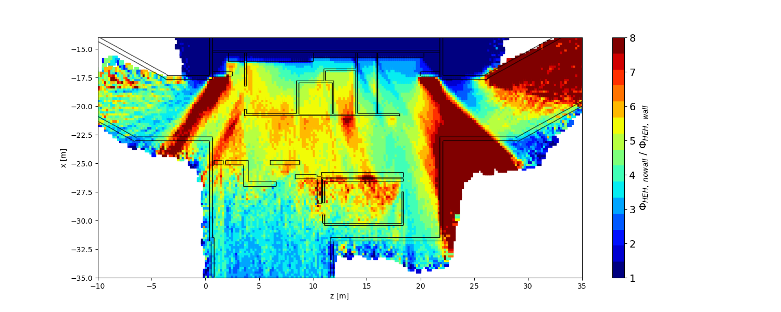
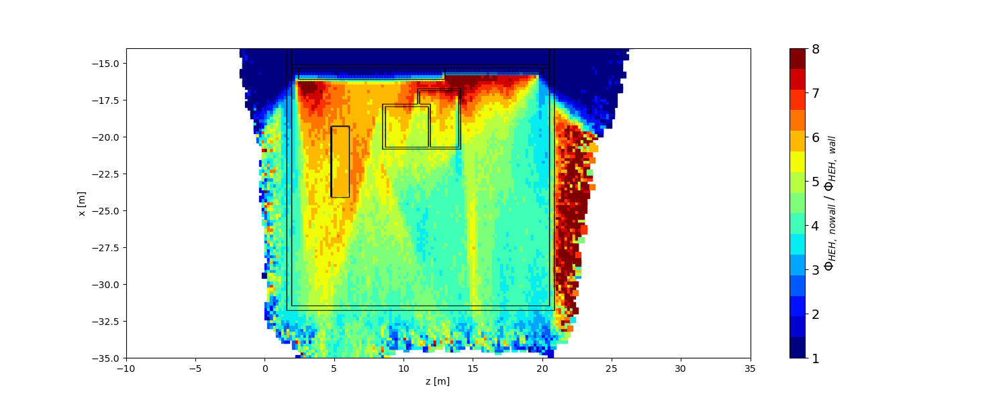
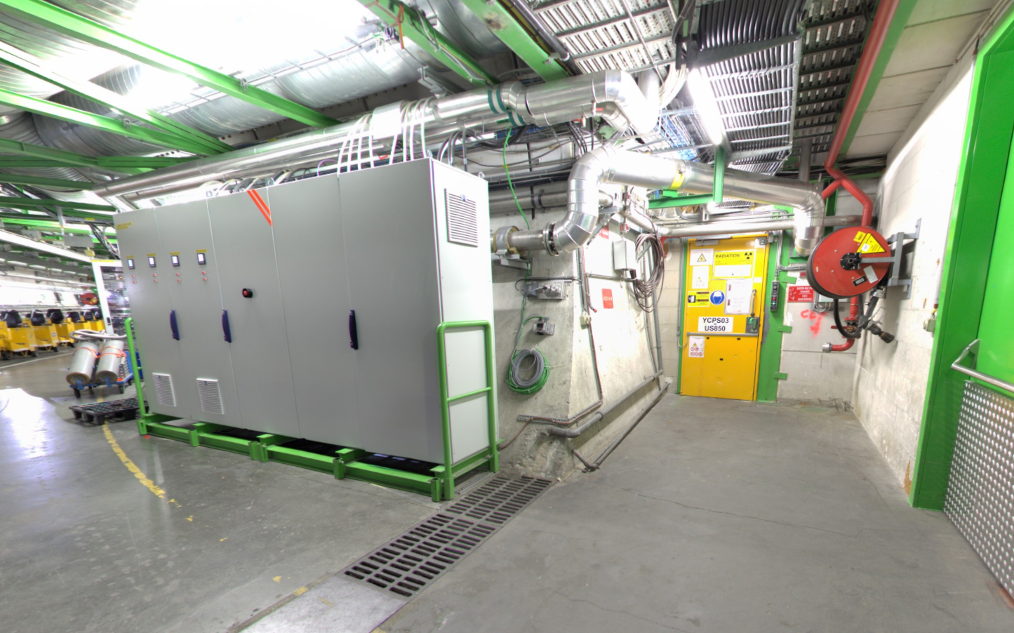
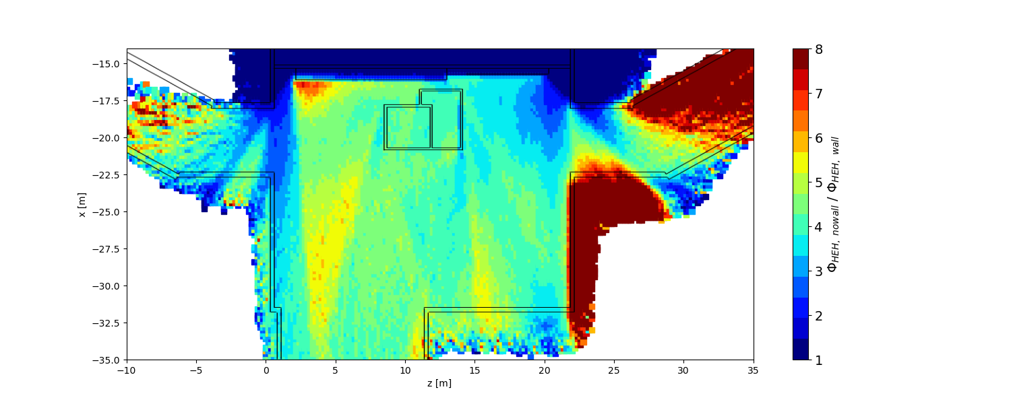
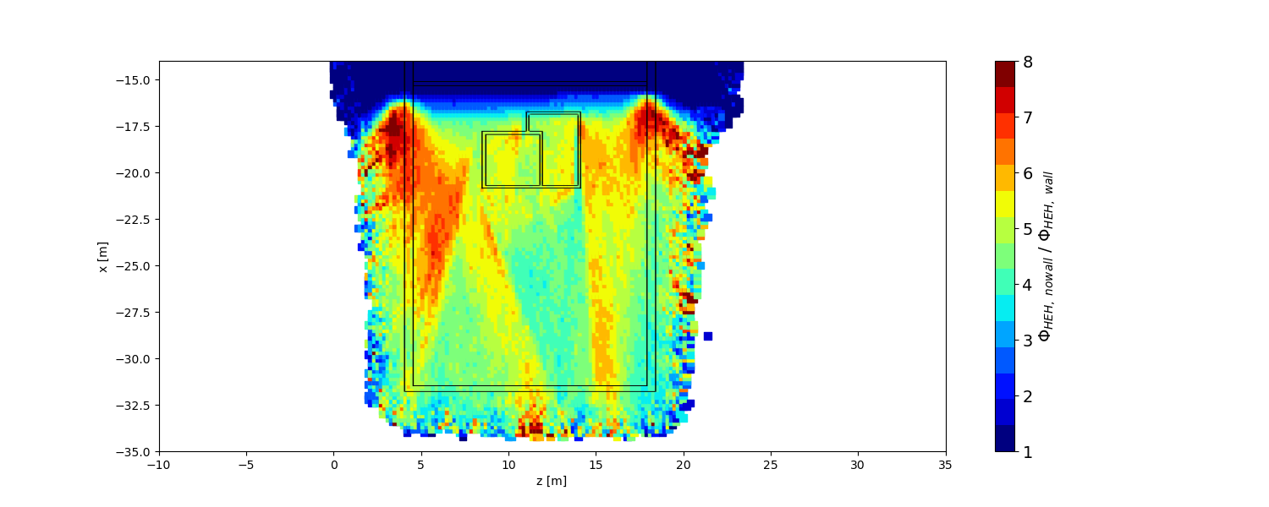
Φ_{HEH, no wall} / Φ_{HEH, wall} at Different Heights
y = 0 m ± 1.1 m
y = 7 m ± 1.1 m
y = 3 m ± 1.1 m
y = 10 m ± 1.1 m
Poor shielding effect exactly where one
of the most radiation exposed rack is located!

Slide 5
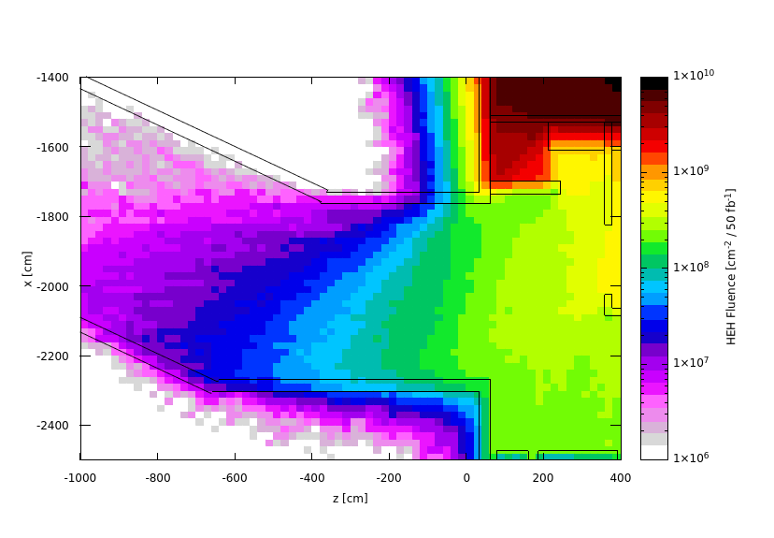
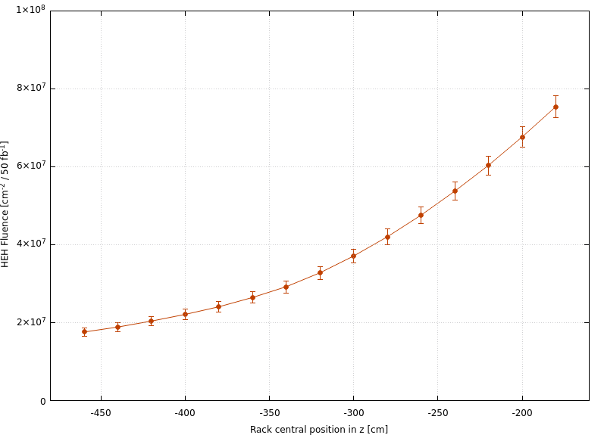
Electronic Rack at UL84 Entrance - HEH Fluence
y = 0 m ± 1.1 m
HEH fluence z-profile averaged within the electronic rack
Rack position
The region where the rack is located showcases a steep gradient in HEH fluence
Moving the rack by a few meters could lead to a significant decrease in its radiation exposure!
2 meters shift towards the UL84
Current rack center position
HEH fluence averaged within the rack drastically decreases from 7.5 ∙ 10⁷ to 2.4 ∙ 10⁷ cm⁻² / 50 fb⁻¹ shifting it towards the UL84 by 2 meters
Such a shift leads to a factor ∼ 3 drop of the mean HEH fluence within the rack!

Slide 6
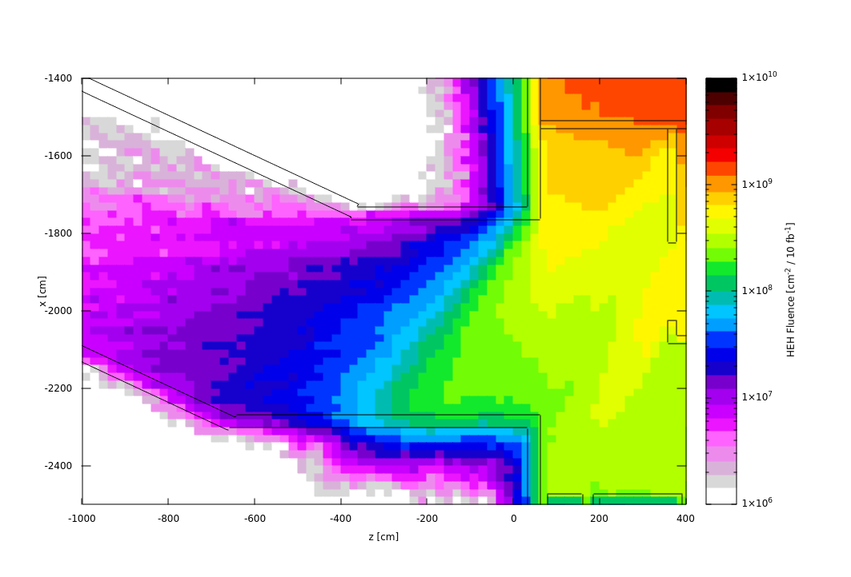
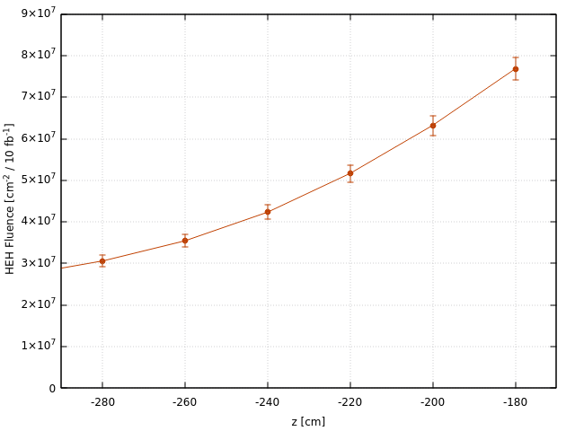
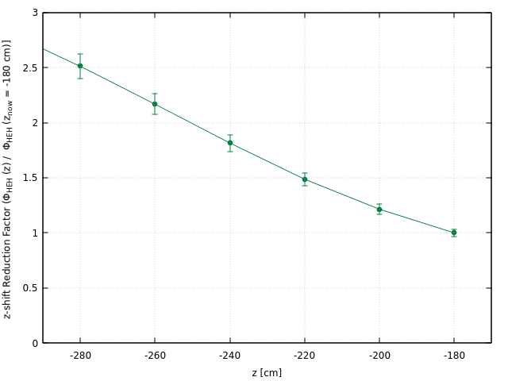

Electronic Rack at UL84 Entrance - HEH Fluence - Current Layout
2024 layout -
No Shielding Walls
HEH fluence z-profile averaged within the rack
Reduction factor z-profile averaged within the rack
y = 0 m ± 1.1 m
Current rack center position
Current rack center position
Rack position
50 cm shift
towards the UL84
50 cm shift
towards the UL84
The region where the rack is exhibits an even steeper gradient in HEH fluence under the current configuration compared to conditions with a potential shielding wall in place:
An even greater impact is expected by shifting the rack towards the UL84
50 cm shift towards the UL84 ⟶ Factor ~ 1.6 drop in the mean HEH fluence within the rack
60 cm shift towards the UL84 ⟶ Factor ~ 1.8 drop in the mean HEH fluence within the rack

Slide 7
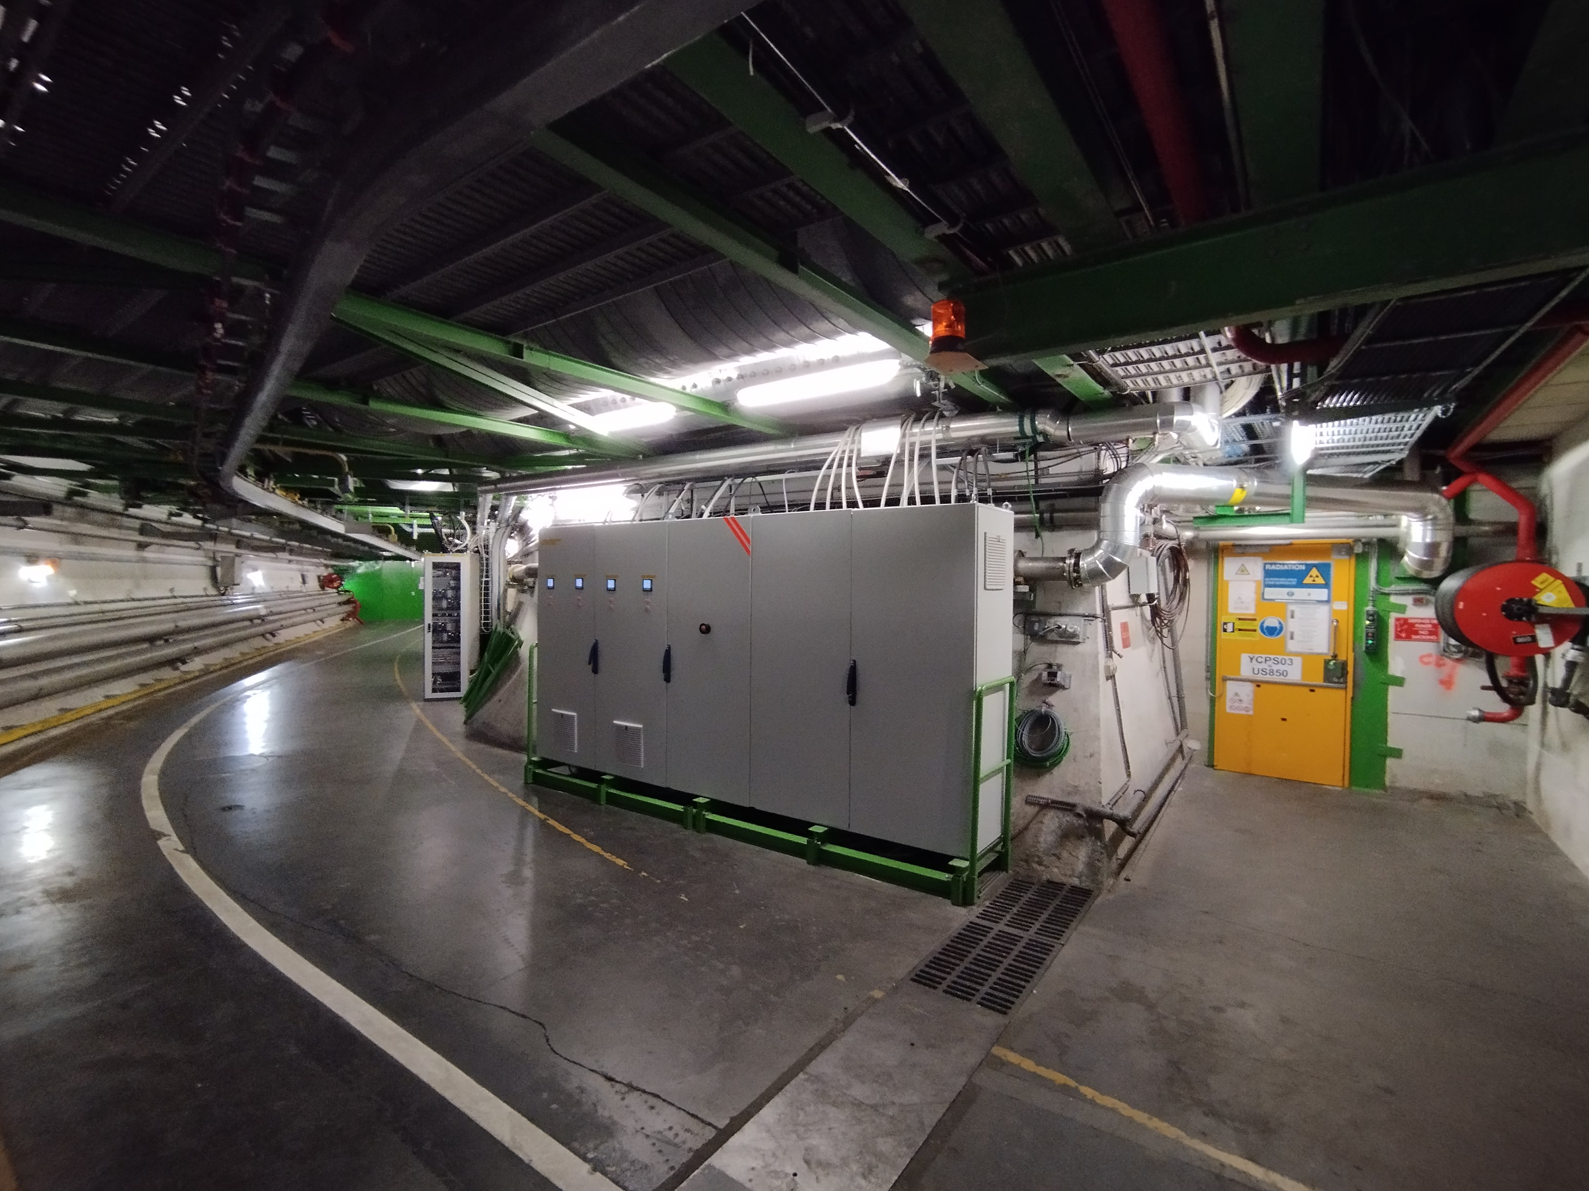
UL84 moving “Step by step”
1. ECR – TE-CRG
2. IMPACT – TE-CRG
3. Coordination/Integration – EN-ACE
4. Electrical Lock out – TE-CRG
5. Structure adaptation (Cutting) – EN-ACE
6. Blocking factors : assess cables length – TE-CRG
7. Moving – Transport
8. Recommissioning – TE-CRG
AMB
~ 50- 60 cm moving !
https://panoramas.cern.ch/viewer?fov=16.00&id=55665551&lat=-32.92&lon=176.50

Slide 8
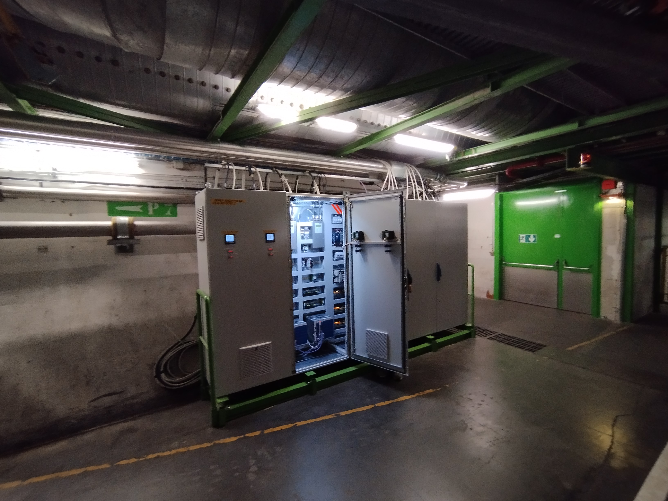
UL84 (elevator exit)
AMB
AMB

Slide 9
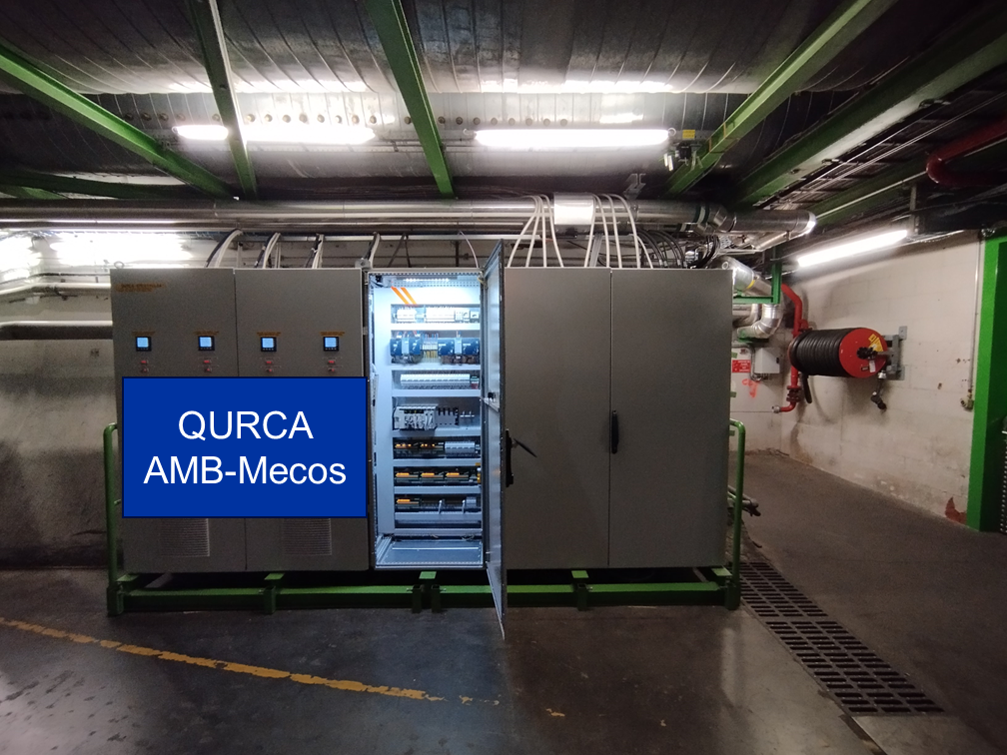
And……

Slide 10

LS3 “QURCA-8-EMC01” cabinet relocation
Wall (of iron block) installation & relocation of QURCA-8-EMC01
EN/EL cabling necessary (minor but essential)
AMB
QURCA-8-EMC01
Wall (of iron block)

