Slide 1
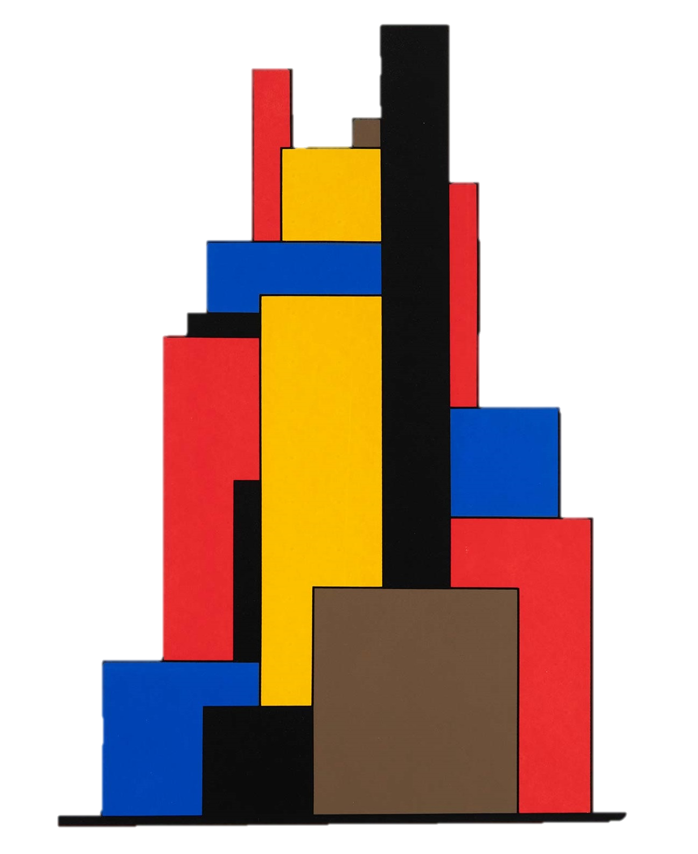


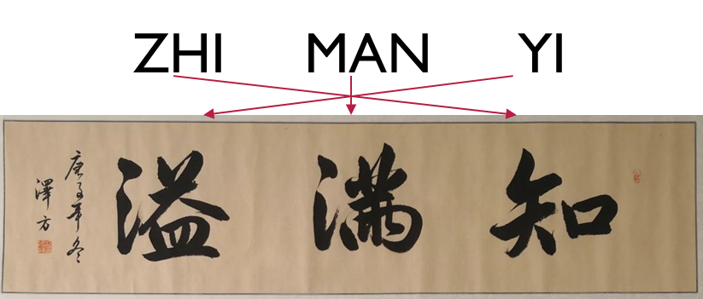

Pion Femtoscopy with Lévy sources: recent developments
máté Csanád (For the Eötvös U femtoscopy group)
2024 Zimányi School Winter Workshop

Slide 2
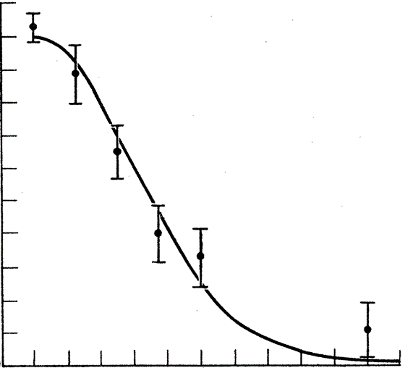
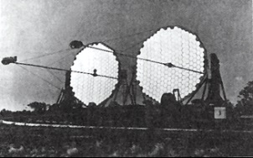
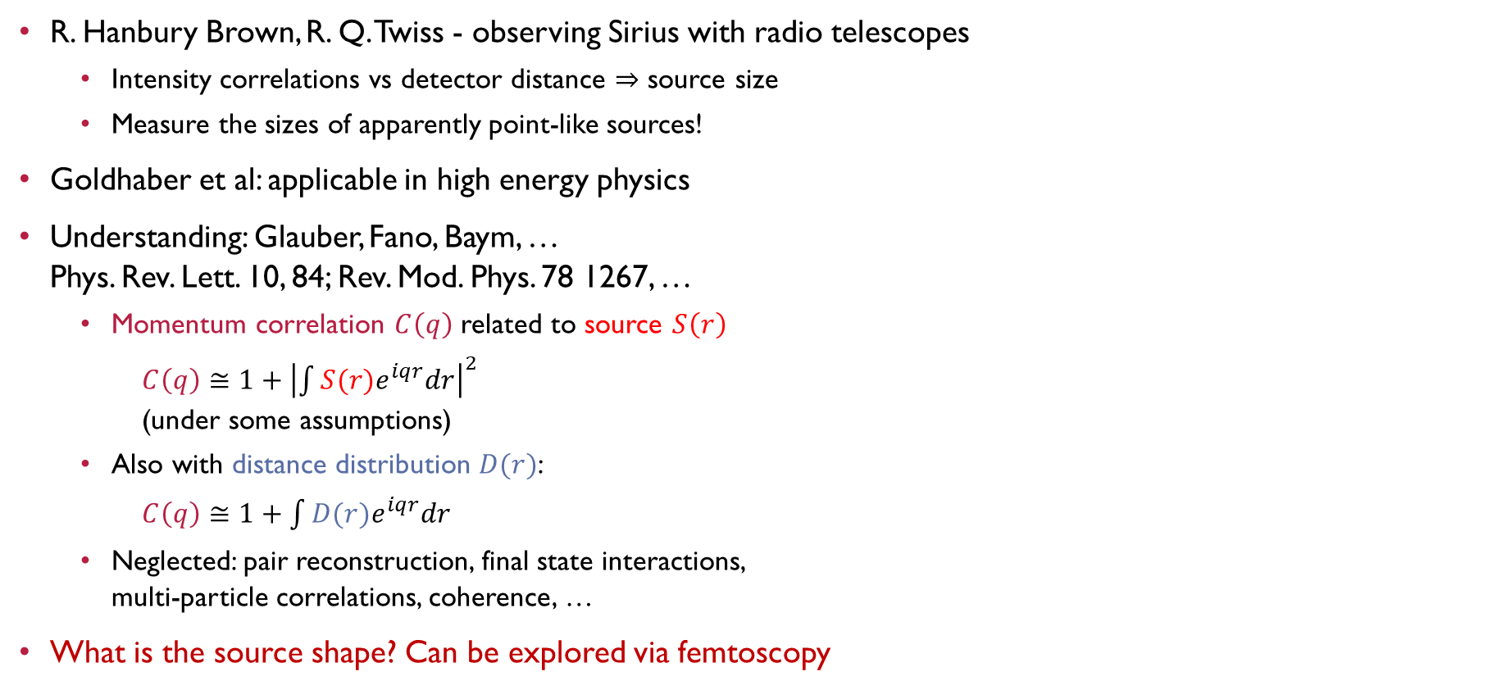
HBT or Femtoscopy in high energy physics
R. Hanbury Brown, R. Q. Twiss - observing Sirius with radio telescopes
  Intensity correlations vs detector distance $⇒$ source size
  Measure the sizes of apparently point-like sources!
Goldhaber et al: applicable in high energy physics
Understanding: Glauber, Fano, Baym, …
Phys. Rev. Lett. 10, 84; Rev. Mod. Phys. 78 1267, …
  Momentum correlation $C\left(q\right)$ related to source $S\left(r\right)$
  $C\left(q\right)≅1+{\left|\int{S(r)e^{iqr}dr}\right|}^{2}$
  (under some assumptions)
  Also with distance distribution $D(r)$:
  $C\left(q\right)≅1+\int{D(r)e^{iqr}dr}$
  Neglected: pair reconstruction, final state interactions,
  multi-particle correlations, coherence, …
What is the source shape? Can be explored via femtoscopy
Correlation strength
~1/R
Detector distance
R
1/R
source function S(r)
correlation funct. C(q)
INTRO PHENO PIONS KAONS

Slide 3
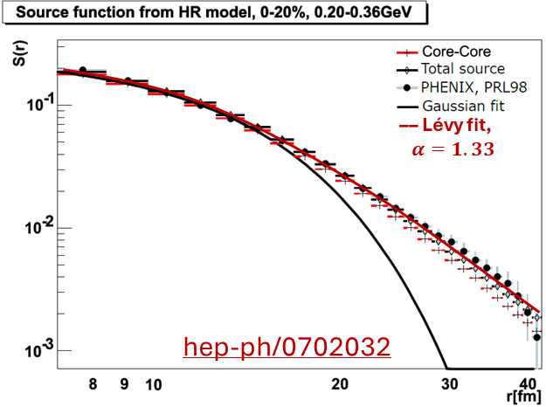
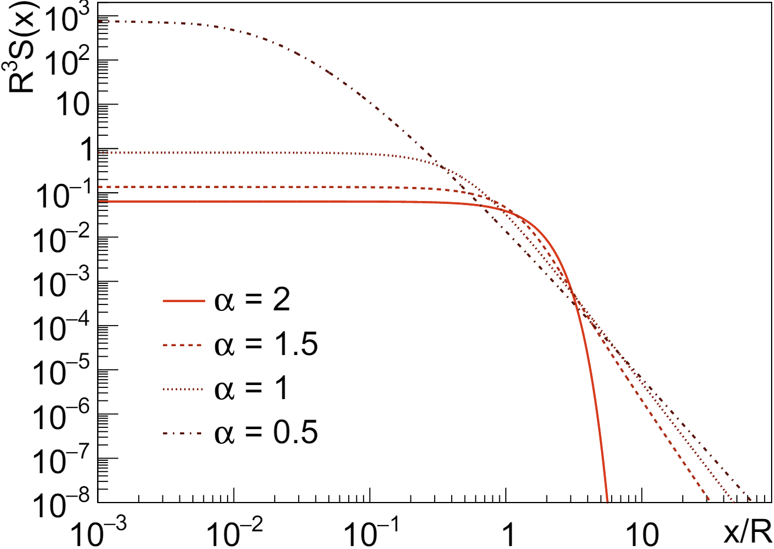
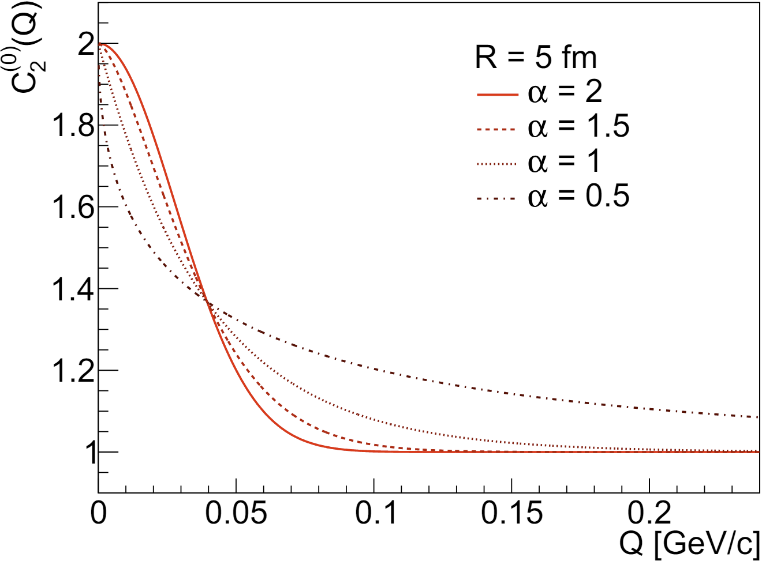
LÉvy distributions in heavy ion physics
Central limit theorem, diffusion, and
thermodynamics lead to Gaussians
Measurements suggest phenomena
beyond Gaussian distribution
Lévy-stable distribution:
  From generalized central limit theorem
  Power-law tail $\sim r^{−1−α}$
  Special cases: α = 2 Gaussian, α = 1 Cauchy
Shape of the correlation functions with Lévy source:
  $C_{2}\left(q\right)=1+λ⋅e^{−{\left|qR\right|}^{α}}$; $α=2:\text{Gaussian};α=1:\text{exponential}$
  Csörgő, Hegyi, Zajc, Eur.Phys.J. C36 (2004) 67-78
Lévy source seen & exponent measured from SPS through RHIC to LHC
NA61 [EPJC83(2023)919], PHENIX [PRC97(2018)064911,PRC(2024)], CMS [PRC109(2024)024914]
$$S\left(r\right)$$
$$λ$$
$$R$$
$$ℒ\left(α,R;r\right)=\frac{1}{2π}\int{d^{3}qe^{iqr}e^{−\frac{1}{2}{\left|qR\right|}^{α}}}$$
$$α$$
$$C\left(q\right)$$
$$λ$$
$$α$$
$$R$$
INTRO PHENO PIONS KAONS

Slide 4
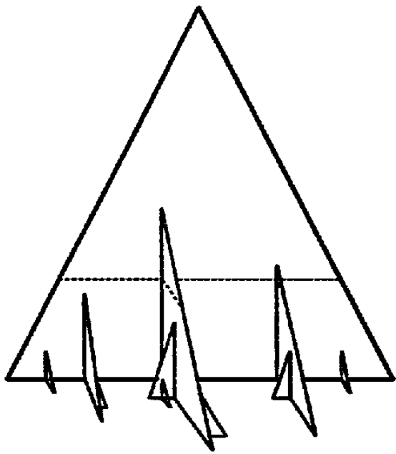
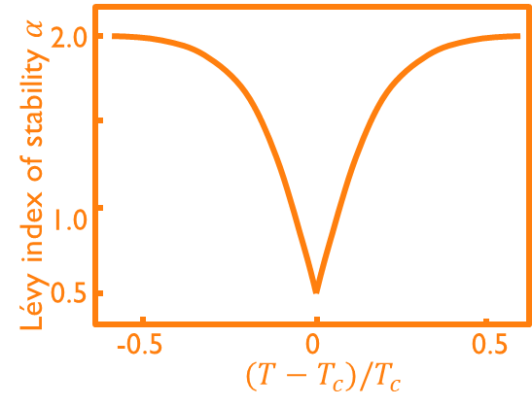
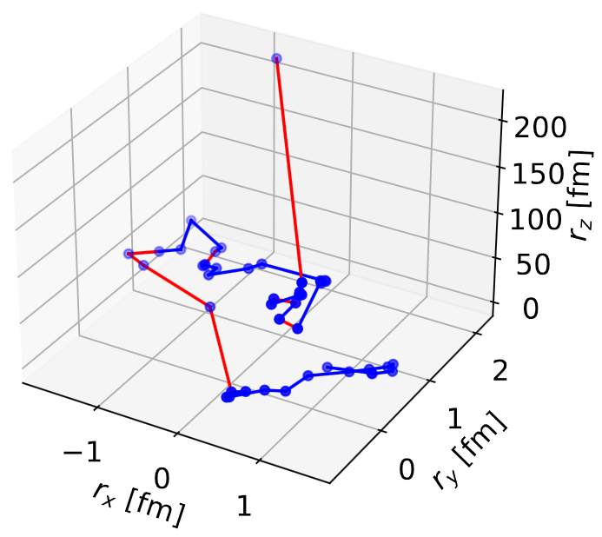
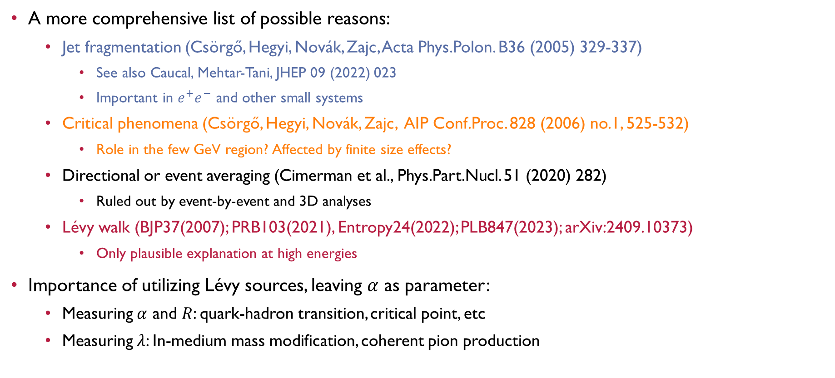

Why Do Lévy shapes appear, why is it important?
A more comprehensive list of possible reasons:
  Jet fragmentation (Csörgő, Hegyi, Novák, Zajc, Acta Phys.Polon. B36 (2005) 329-337)
    See also Caucal, Mehtar-Tani, JHEP 09 (2022) 023
    Important in $e^{+}e^{−}$ and other small systems
  Critical phenomena (Csörgő, Hegyi, Novák, Zajc, AIP Conf.Proc. 828 (2006) no.1, 525-532)
    Role in the few GeV region? Affected by finite size effects?
  Directional or event averaging (Cimerman et al., Phys.Part.Nucl. 51 (2020) 282)
    Ruled out by event-by-event and 3D analyses
  Lévy walk (BJP37(2007); PRB103(2021), Entropy24(2022); PLB847(2023); arXiv:2409.10373)
    Only plausible explanation at high energies
Importance of utilizing Lévy sources, leaving $α$ as parameter:
  Measuring $α$ and $R$: quark-hadron transition, critical point, etc
  Measuring $λ$: In-medium mass modification, coherent pion production
$$α(T)$$
INTRO PHENO PIONS KAONS

Slide 5
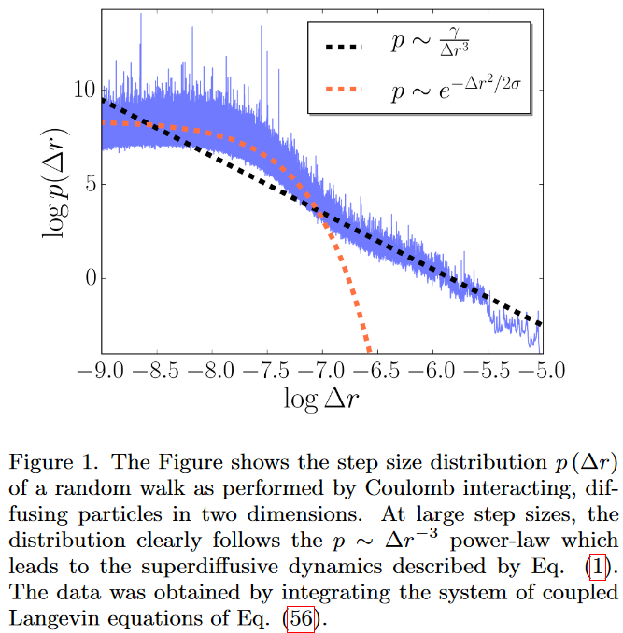
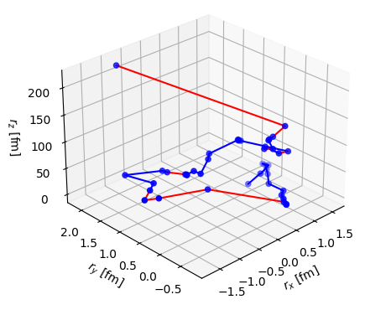
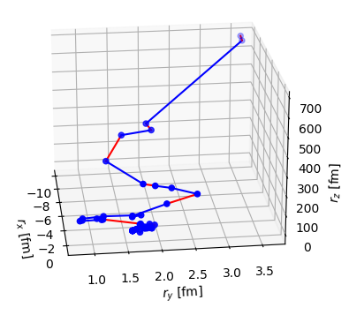
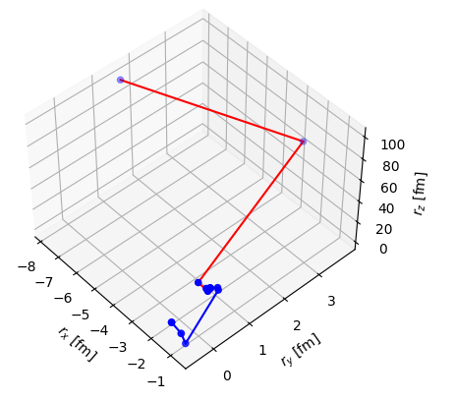
Lévy processes in Nature and in scattering
Lévy walk and Lévy flight: known in ecology, climatology, etc.
  If step size distribution has no finite width:
  generalized central limit theorem, Lévy-stable limiting distributions
In HIC: increasing mean free path, step size increases
  Seen in expansion under Coulomb potential in solid-state physics
Observed in UrQMD [arXiv:2409.10373]
  Scatterings, decays, coalescence (no Coulomb scattering)
E. I. Kiselev, Phys. Rev. B 103, 235116 (2021)
INTRO PHENO PIONS KAONS

Slide 6
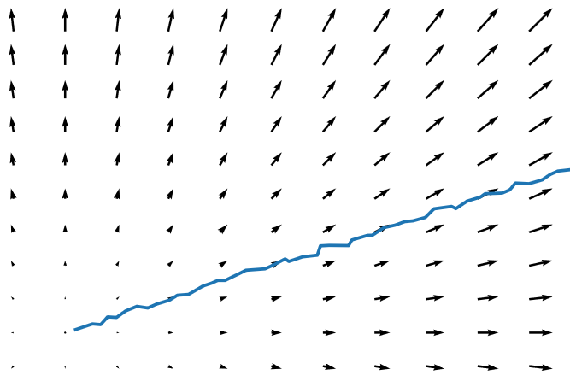
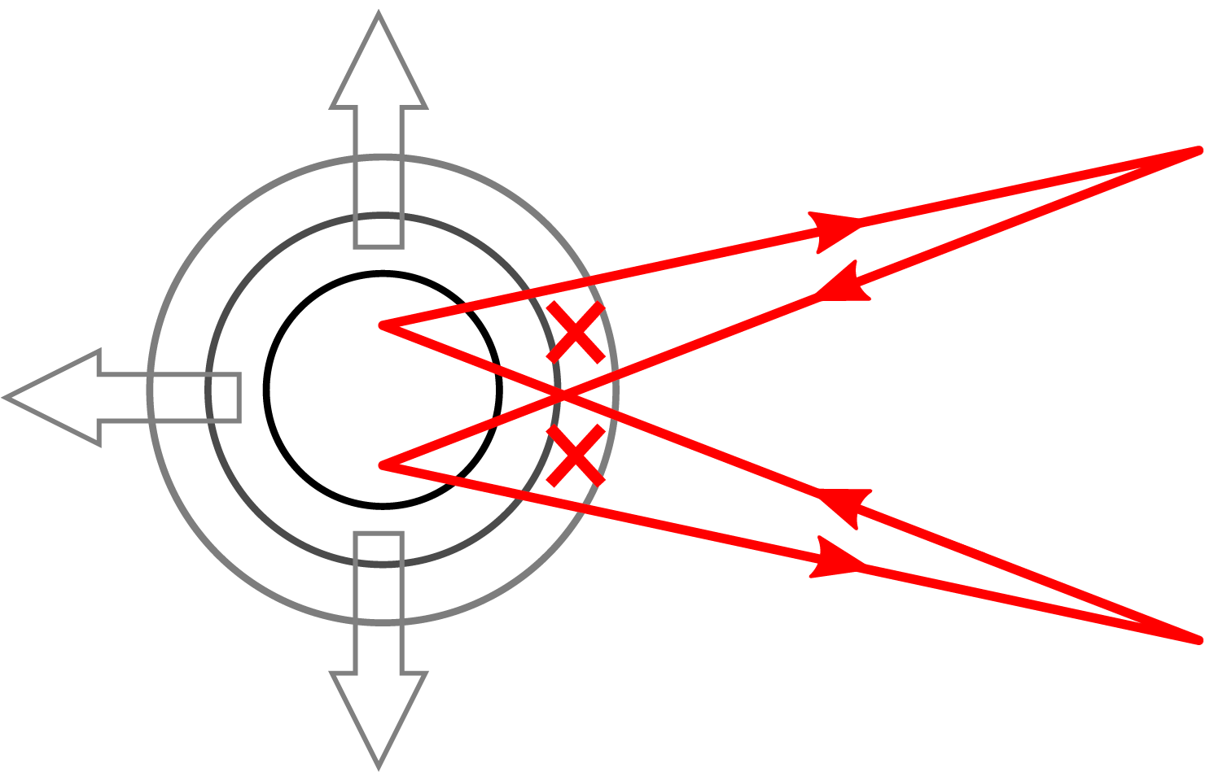
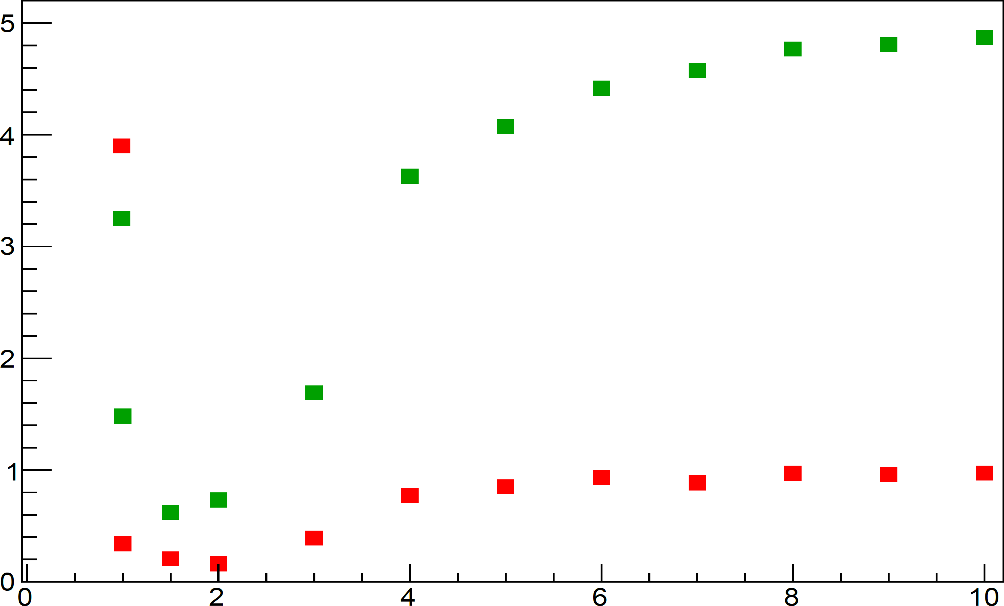
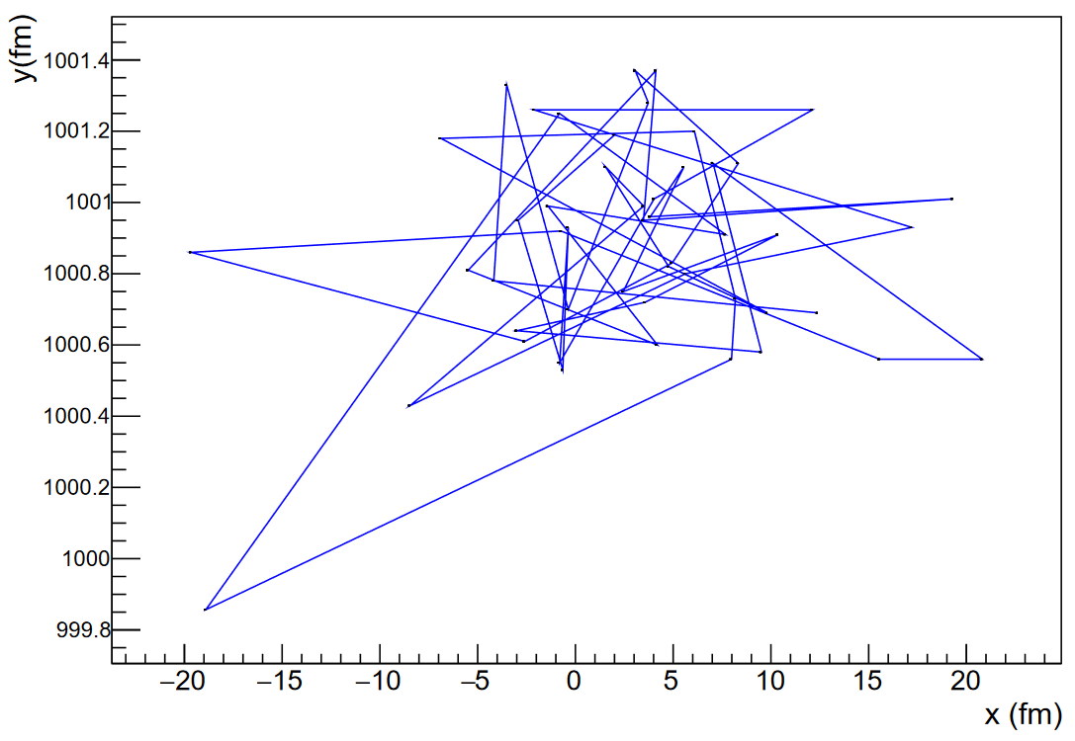





Charged Cloud: Another interesting effect
Coulomb potential: infinite range, affecting evolution for a long time
Solid-state physics (as mentioned on previous slide): may cause Lévy flight and power-law tails
Another interesting effect: distortion of flight paths after kinetic freeze-out
  Phase shift, similarly to an Aharonov-Bohm effect
  (arXiv:2007.07167 and arXiv:2410.15525)
Phase shift decreases correlation strengths
exaggerated illustration
$$λ_{2,3}$$
$$λ_{3}=5$$
$$λ_{2}$$
$$λ_{3}$$
simulated transverse path
No A-B effect, pure core,
fully chaotic source
$$λ_{2}=1$$
$R_{fireball}$ [fm]
INTRO PHENO PIONS KAONS

Slide 7
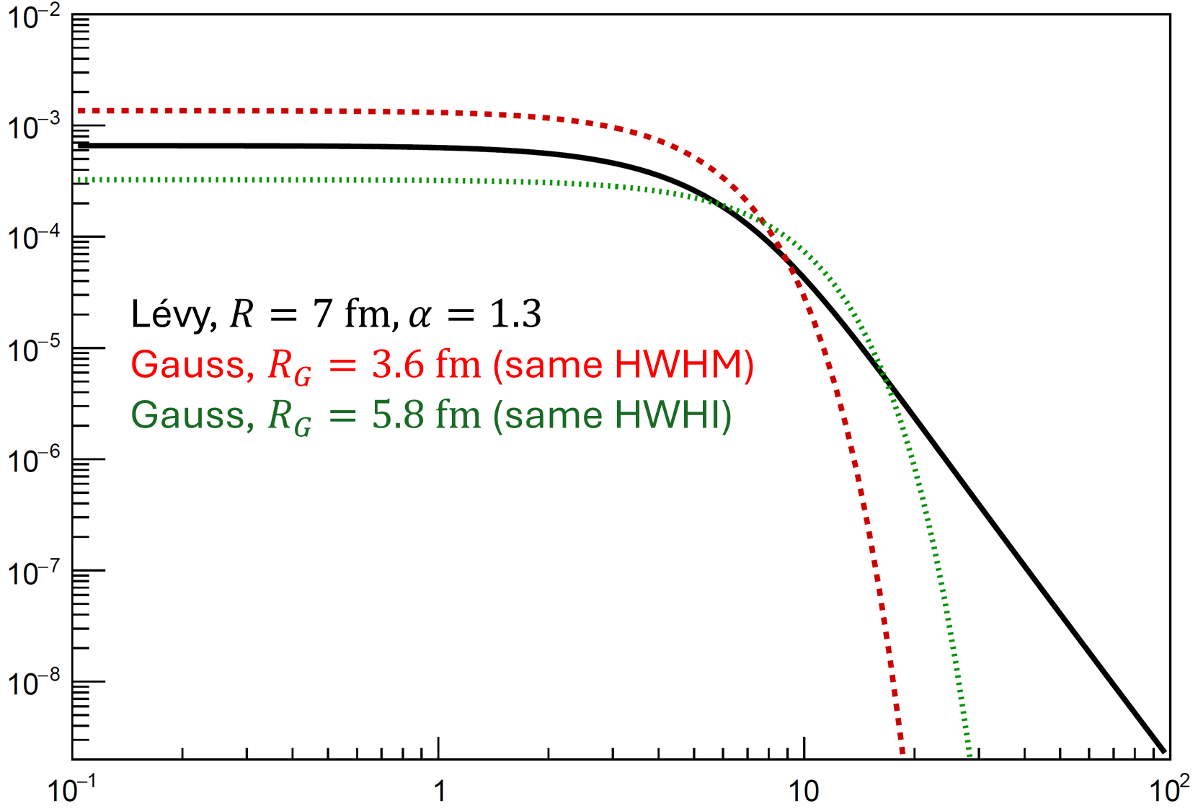
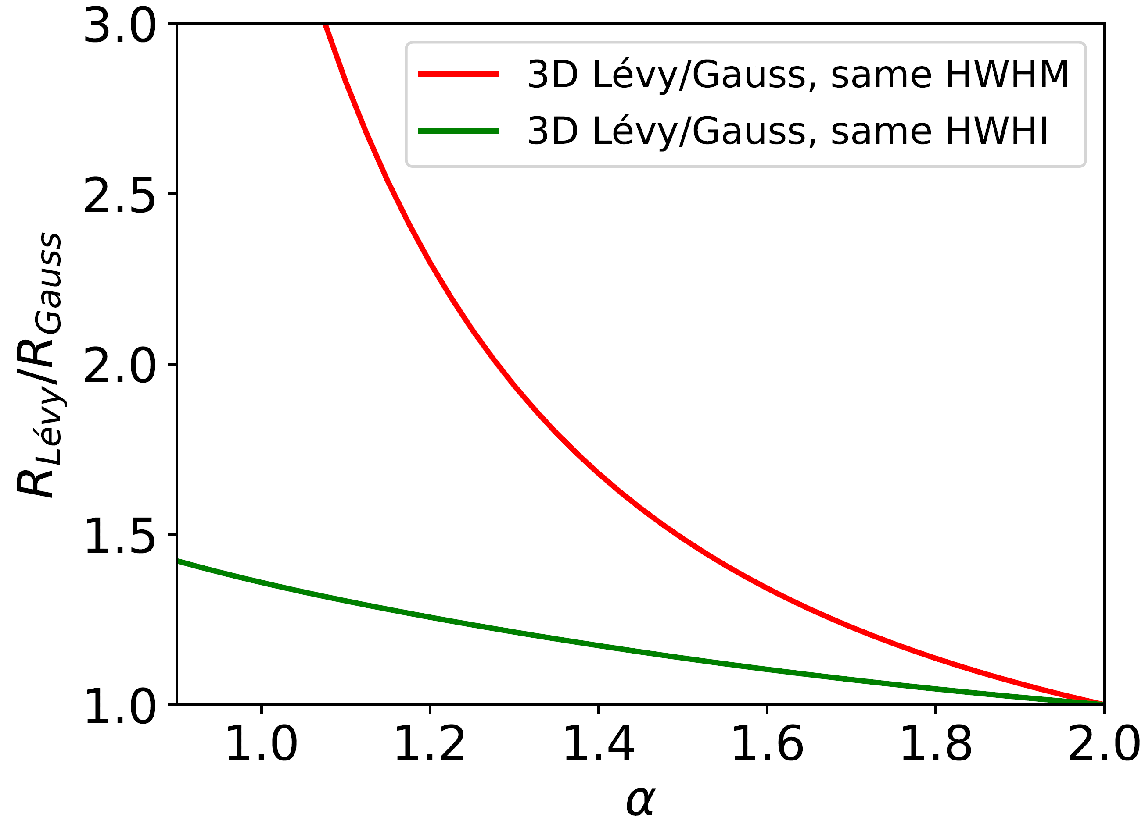



Source size measure change with $α$
Various spatial distributions
No tail if $α=2$, power law and RMS = ∞ if $α<2$: depends on cutoff
What do Gaussian HBT radii mean? Important also w.r.t. CEP search
Alternative measures (see arXiv:2401.01249 for details)
  HWHM: (half) width at half maximum
  HWHI: (half) width at half integral
  Width (normalized by $R$) nontrivially depends on $α$
Relations for 3D Gauss: HWHM $≈1.17⋅R_{G}$, HWHI $≈1.54⋅R_{G}$
For (e.g.) Lévy $α=1.3$: HWHM $≈0.61⋅R_{L}$, HWHI $≈1.27⋅R_{L}$
Thus (e.g.) $α=1.3$ and $R_{L}=7$fm “means”:
  Same HWHM Gaussian: $R_{G}≈3.61$ fm
  Same HWHI Gaussian: $R_{G}≈5.77$ fm
$$R_{Gauss}≈R_{Lévy}/1.94$$
$$R_{Gauss}≈R_{Lévy}/1.21$$
INTRO PHENO PIONS KAONS

Slide 8
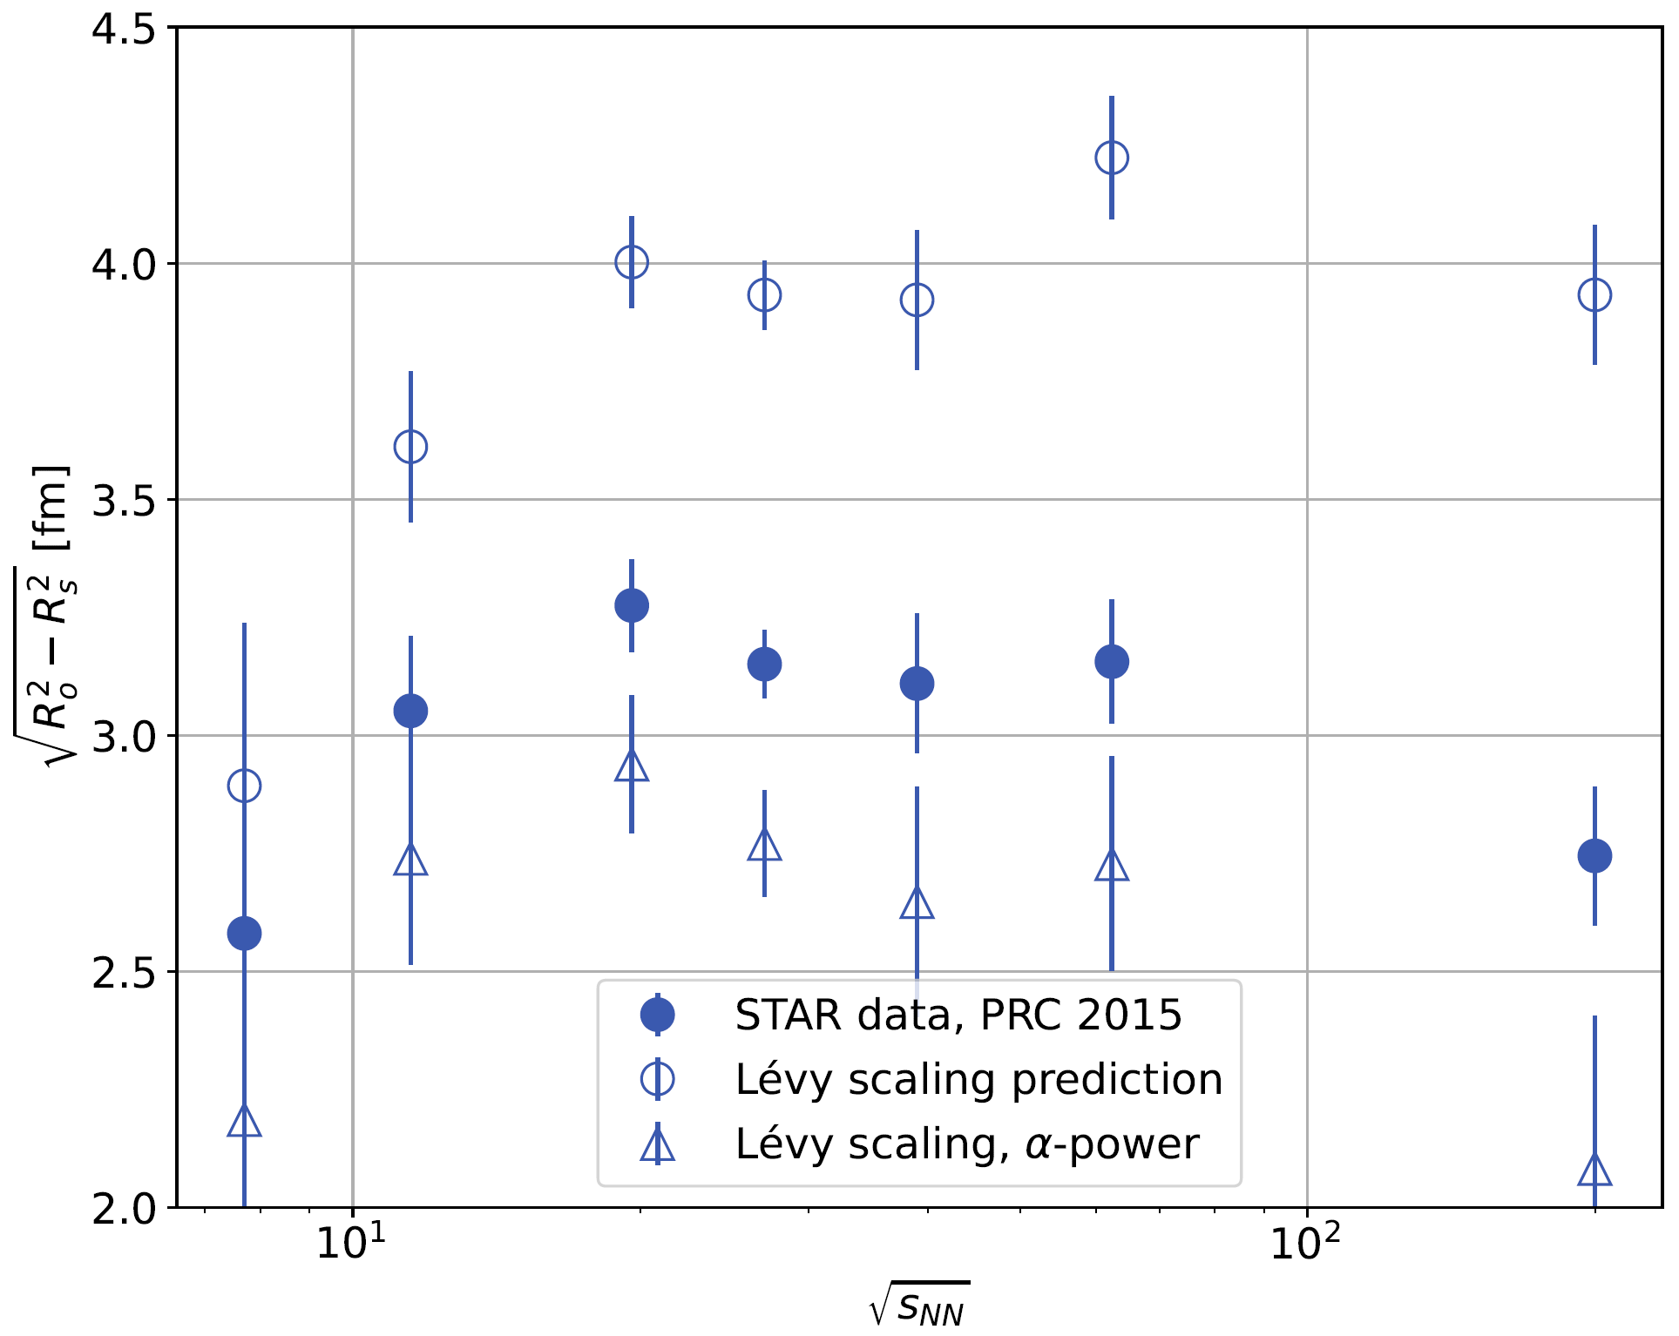


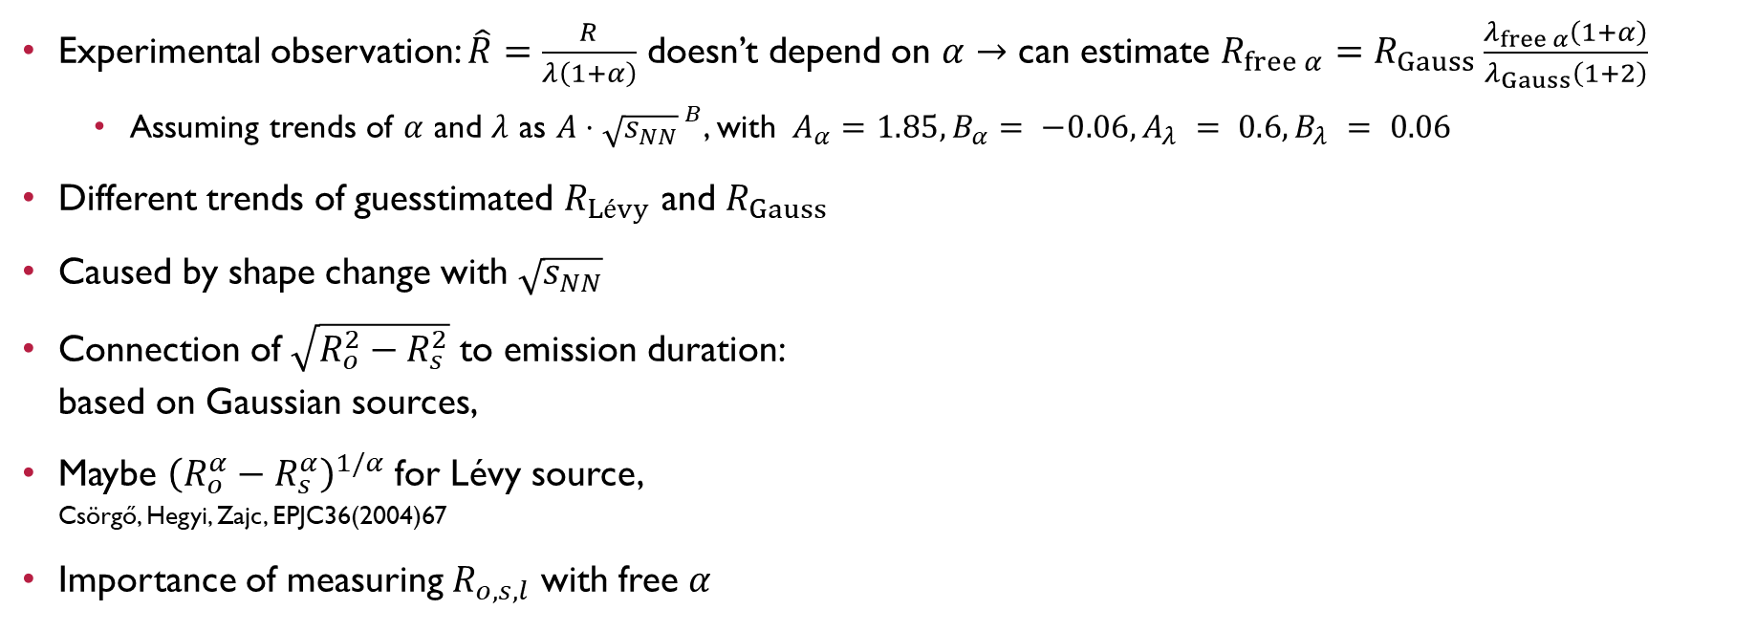


Energy dependence of Lévy source size?
Experimental observation: $\hat{R}=\frac{R}{λ\left(1+α\right)}$ doesn’t depend on $α$ $→$ can estimate $R_{free α}=R_{Gauss}\frac{λ_{free α}\left(1+α\right)}{λ_{Gauss}\left(1+2\right)}$
  Assuming trends of $α$ and $λ$ as $A⋅{\sqrt{s_{NN}}}^{ B}$, with$A_{α}=1.85,B_{α}= −0.06, A_{λ} = 0.6,B_{λ} = 0.06$
Different trends of guesstimated $R_{Lévy}$ and $R_{Gauss}$
Caused by shape change with $\sqrt{s_{NN}}$
Connection of $\sqrt{R_{o}^{2}−R_{s}^{2}}$ to emission duration:
based on Gaussian sources,
Maybe ${\left(R_{o}^{α}−R_{s}^{α}\right)}^{1/α}$ for Lévy source,
Csörgő, Hegyi, Zajc, EPJC36(2004)67
Importance of measuring $R_{o,s,l}$ with free $α$
arXiv:2406.11435
$\sqrt{R_{o}^{2}−R_{s}^{2}}$ [fm]
$\hat{R}$ scaling guesstimate for Lévy radii
original Gaussian radii
$α$-powered version
$\sqrt{s_{NN}}$ [GeV]
INTRO PHENO PIONS KAONS

Slide 9
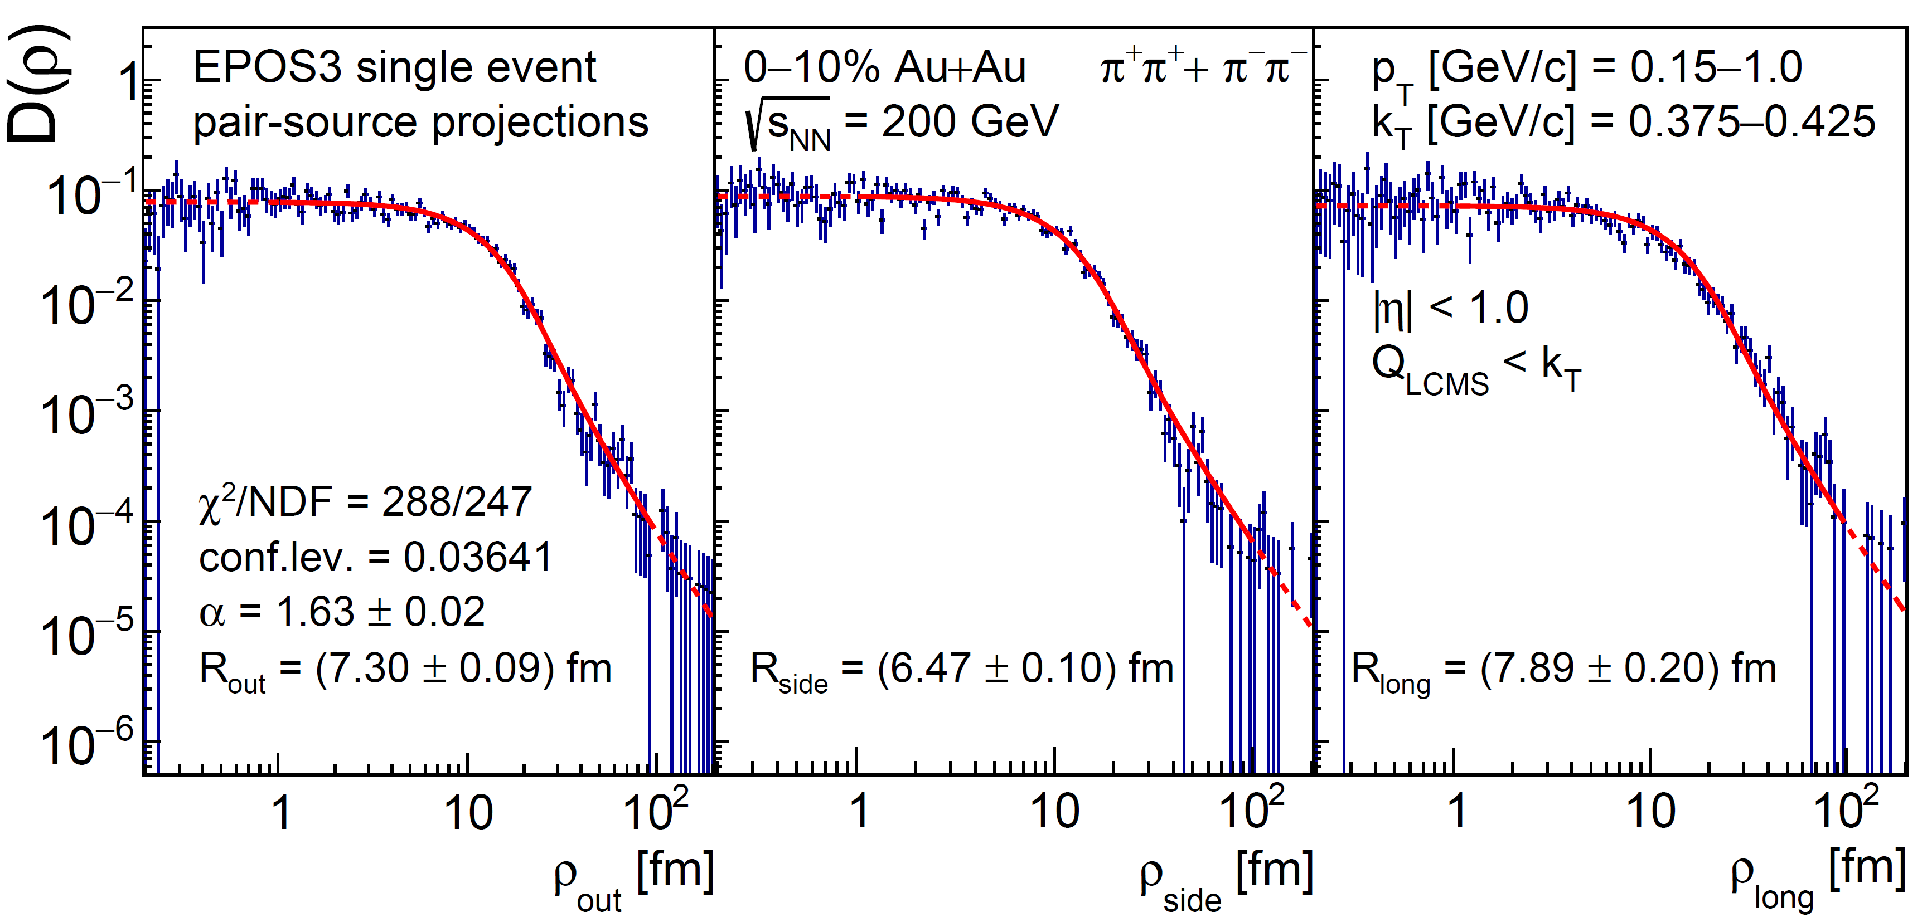
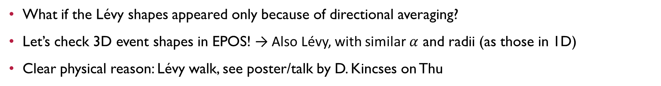
Lévy Shapes in Single 3D ePOS events, 3D
What if the Lévy shapes appeared only because of directional averaging?
Let’s check 3D event shapes in EPOS! → Also Lévy, with similar $α$ and radii (as those in 1D)
Clear physical reason: Lévy walk, see poster/talk by D. Kincses on Thu
arXiv:2409.10373
Lévy-walk
In UrQMD
arXiv:2409.10373
INTRO PHENO PIONS KAONS

Slide 10
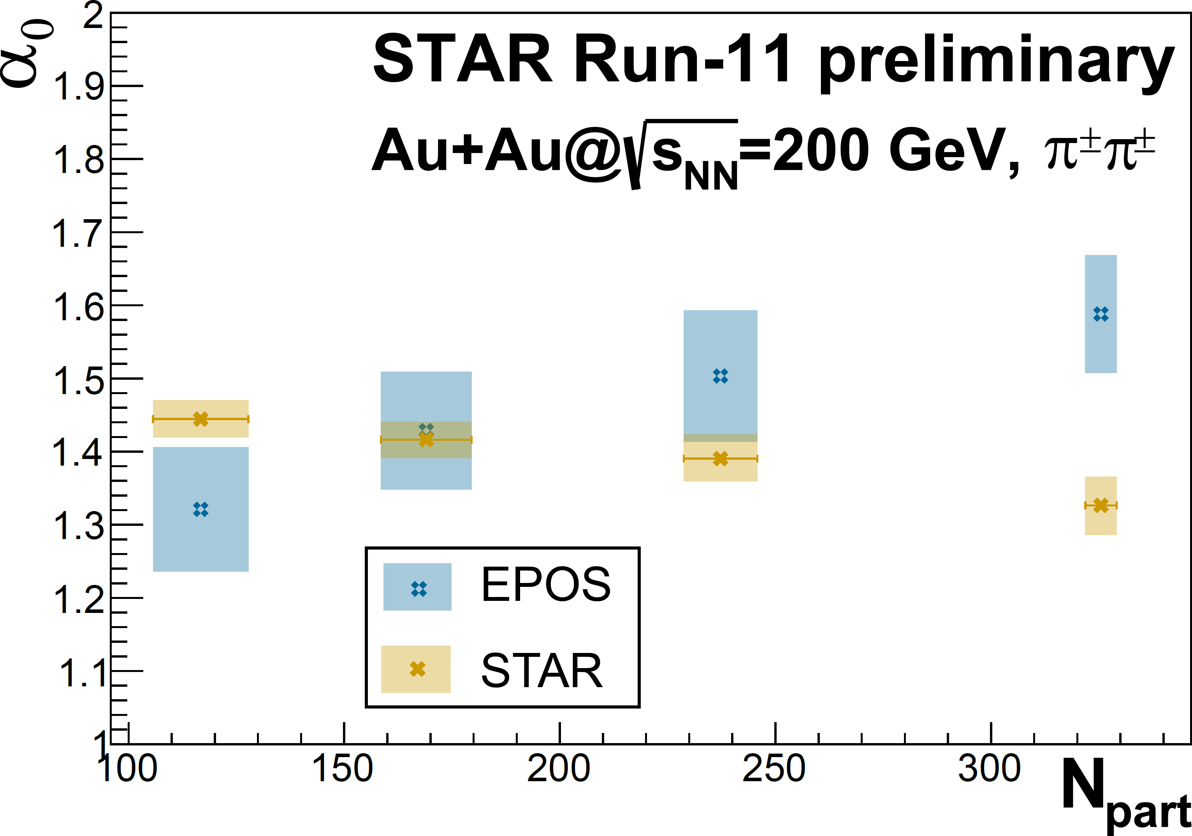
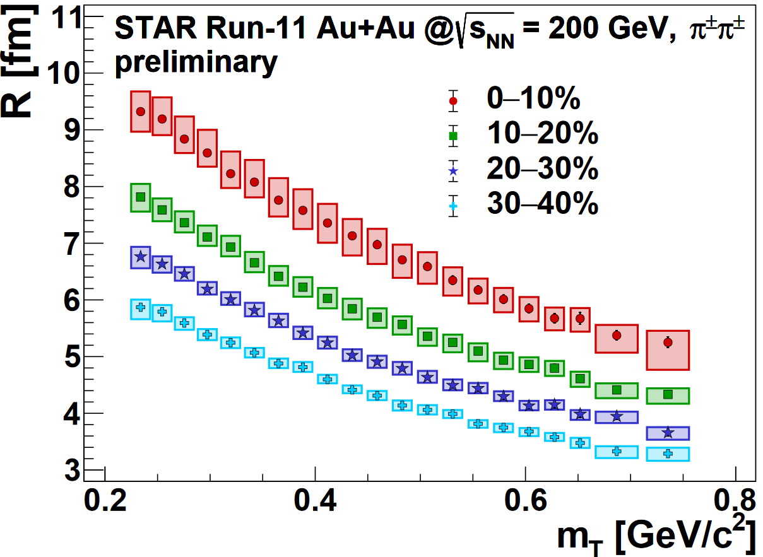
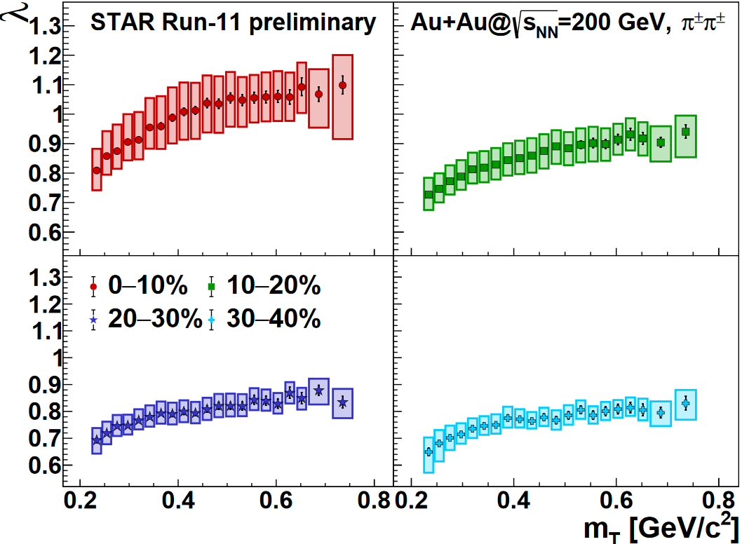
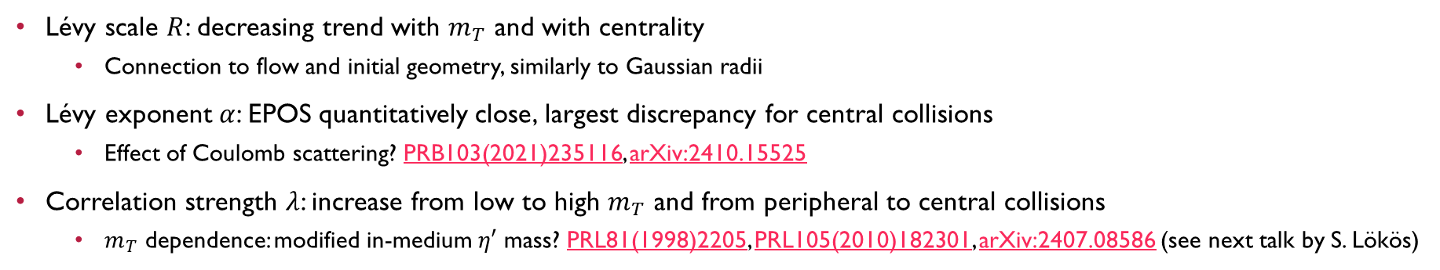
Centrality dependence at 200 GeV
Lévy scale $R$: decreasing trend with $m_{T}$ and with centrality
  Connection to flow and initial geometry, similarly to Gaussian radii
Lévy exponent $α$: EPOS quantitatively close, largest discrepancy for central collisions
  Effect of Coulomb scattering? PRB103(2021)235116, arXiv:2410.15525
Correlation strength $λ$: increase from low to high $m_{T}$ and from peripheral to central collisions
  $m_{T}$ dependence: modified in-medium $η′$ mass? PRL81(1998)2205, PRL105(2010)182301, arXiv:2407.08586 (see next talk by S. Lökös)
INTRO PHENO PIONS KAONS

Slide 11
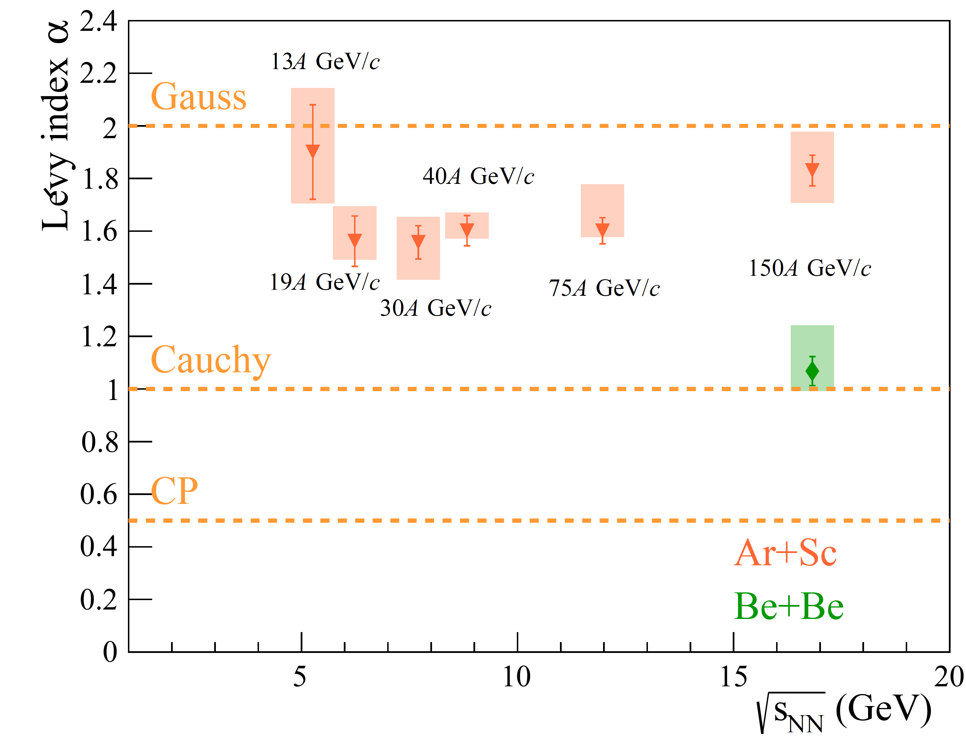
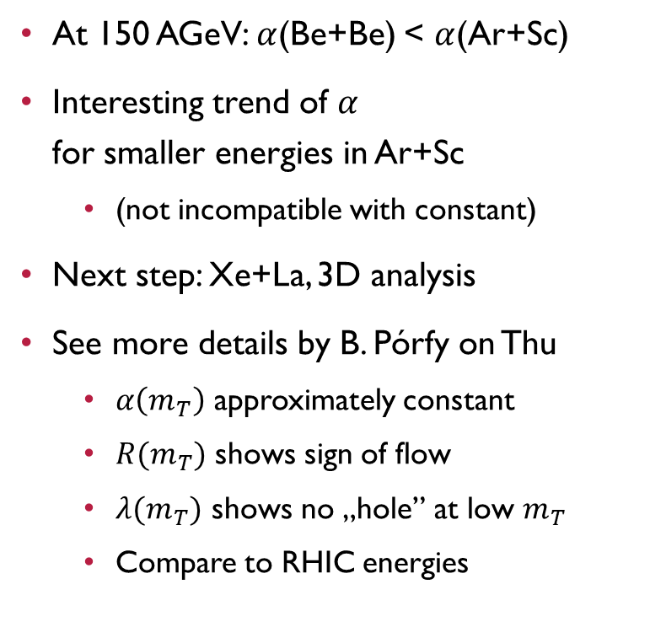
NA61/SHINE results
At 150 AGeV: $α$(Be+Be) < $α$(Ar+Sc)
Interesting trend of $α$
for smaller energies in Ar+Sc
  (not incompatible with constant)
Next step: Xe+La, 3D analysis
See more details by B. Pórfy on Thu
  $α\left(m_{T}\right)$ approximately constant
  $R(m_{T})$ shows sign of flow
  $λ(m_{T})$ shows no „hole” at low $m_{T}$
  Compare to RHIC energies
B. Pórfy [NA61], WPCF 2024
INTRO PHENO PIONS KAONS

Slide 12
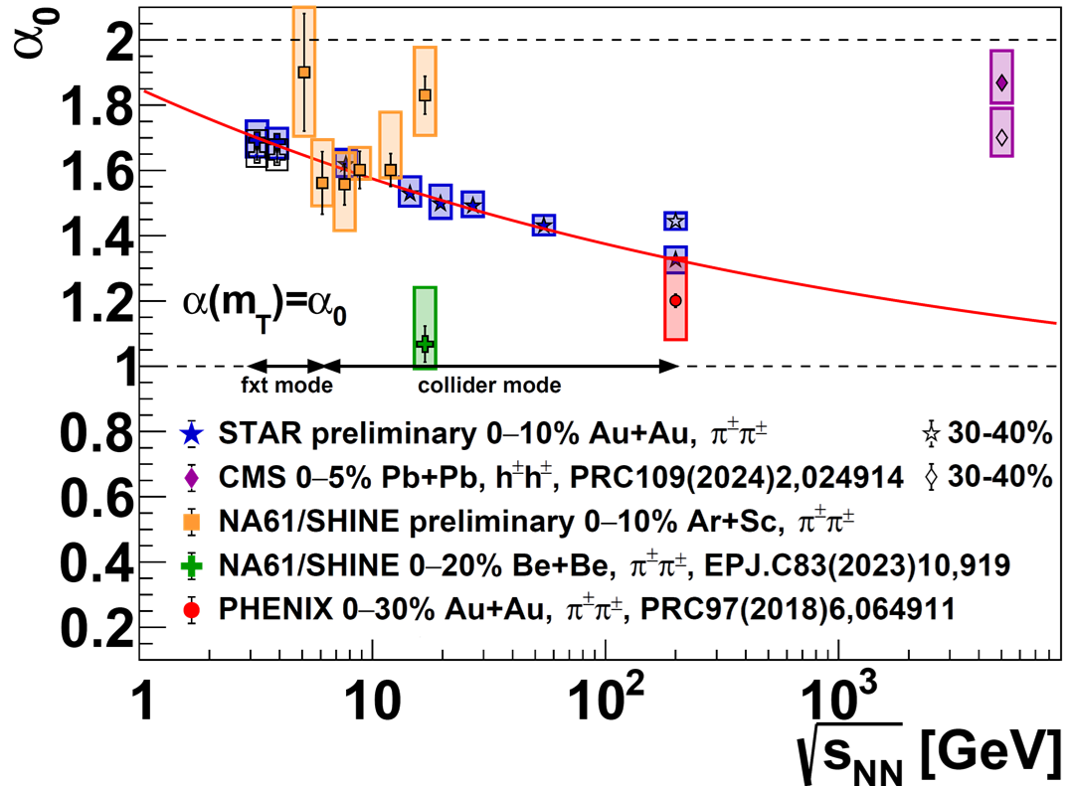
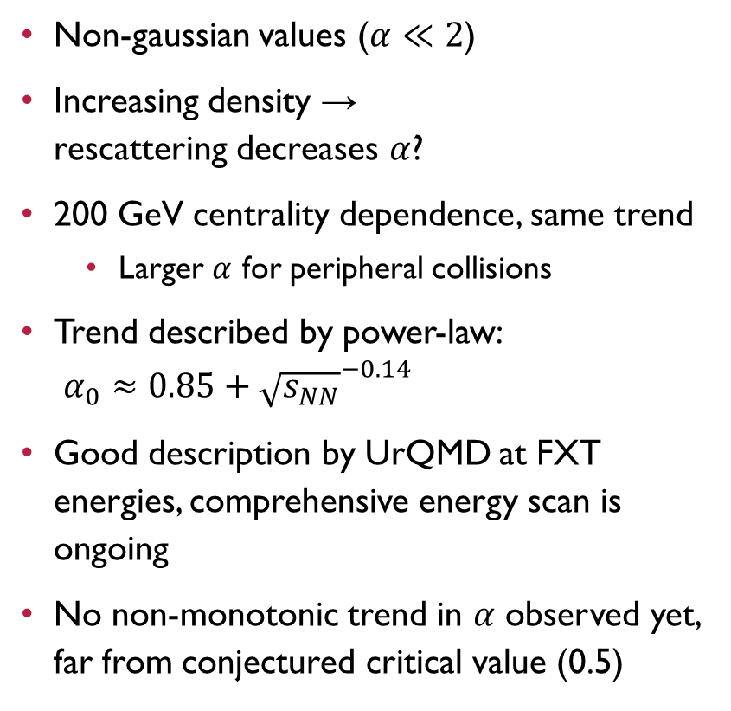
Lévy exponent from 3.2 to 200 GeV
Non-gaussian values ($α≪2$)
Increasing density →
rescattering decreases $α$?
200 GeV centrality dependence, same trend
  Larger $α$ for peripheral collisions
Trend described by power-law:
$α_{0}≈0.85+{\sqrt{s_{NN}}}^{−0.14}$
Good description by UrQMD at FXT energies, comprehensive energy scan is ongoing
No non-monotonic trend in $α$ observed yet, far from conjectured critical value (0.5)
INTRO PHENO PIONS KAONS

Slide 13
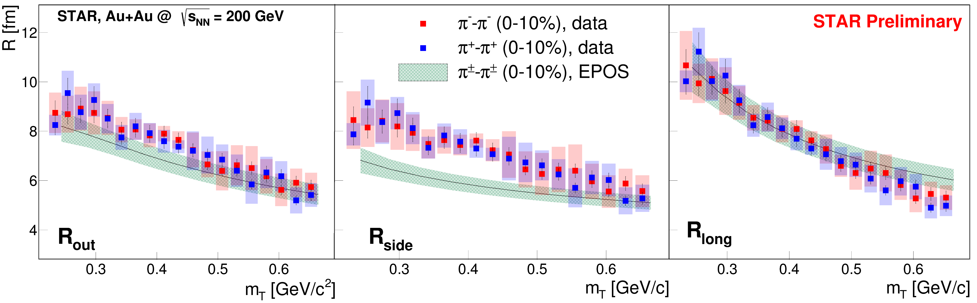
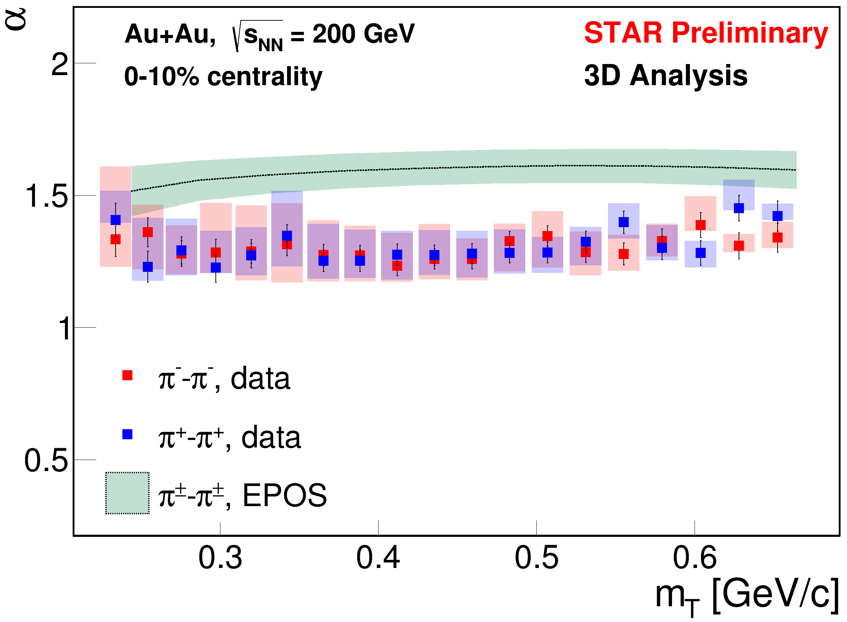



STAR 3D preliminary data at 200 GeV vs EPOS
See STAR analysis in talk by S. Bhosale
EPOS and data (both from 3D analysis) comparison shows good agreement for radii
  EPOS from arXiv:2409.10373
Moderate discrepancy for $R_{side}$ and $α$: maybe due to long-range Coulomb scattering (not in EPOS)
$$R_{o,s,l} vs m_{T}$$
S. Bhosale, WPCF 2024
$$α vs m_{T}$$
INTRO PHENO PIONS KAONS

Slide 14
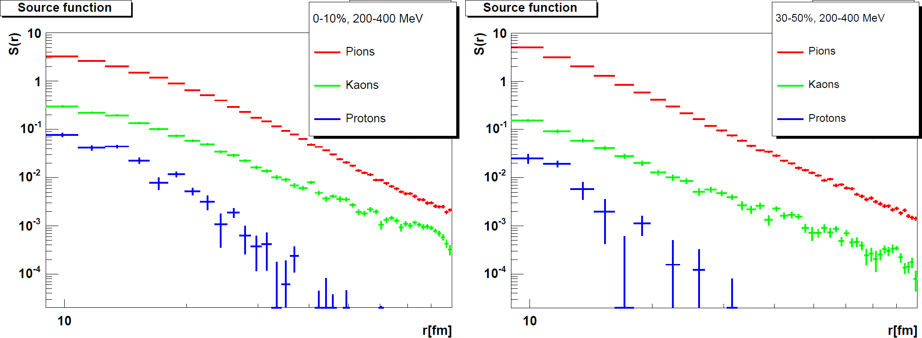
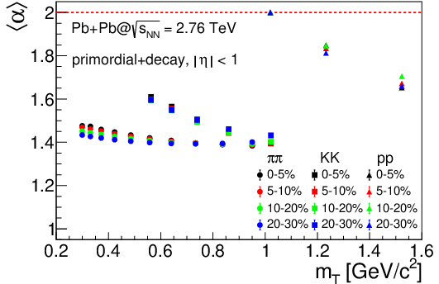
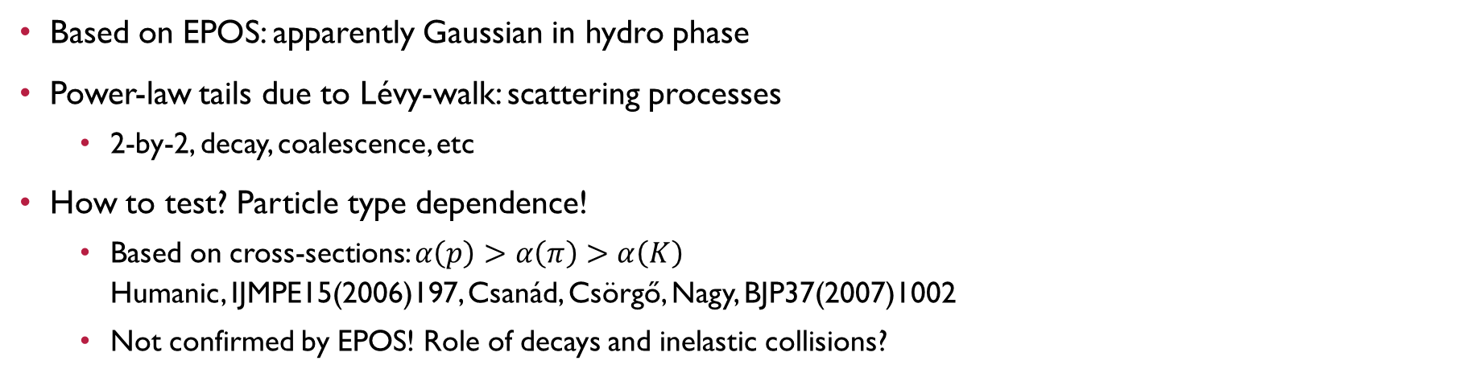
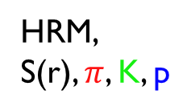
So when do the power-law tails form?
Based on EPOS: apparently Gaussian in hydro phase
Power-law tails due to Lévy-walk: scattering processes
  2-by-2, decay, coalescence, etc
How to test? Particle type dependence!
  Based on cross-sections: $α\left(p\right)>α\left(π\right)>α\left(K\right)$
  Humanic, IJMPE15(2006)197, Csanád, Csörgő, Nagy, BJP37(2007)1002
  Not confirmed by EPOS! Role of decays and inelastic collisions?
arXiv:2409.10373
Lévy-walk
In UrQMD
HRM,
S(r), $π$, K, p
Pb+Pb @ 2.76 TeV
PLB847(2023)138295
INTRO PHENO PIONS KAONS

Slide 15
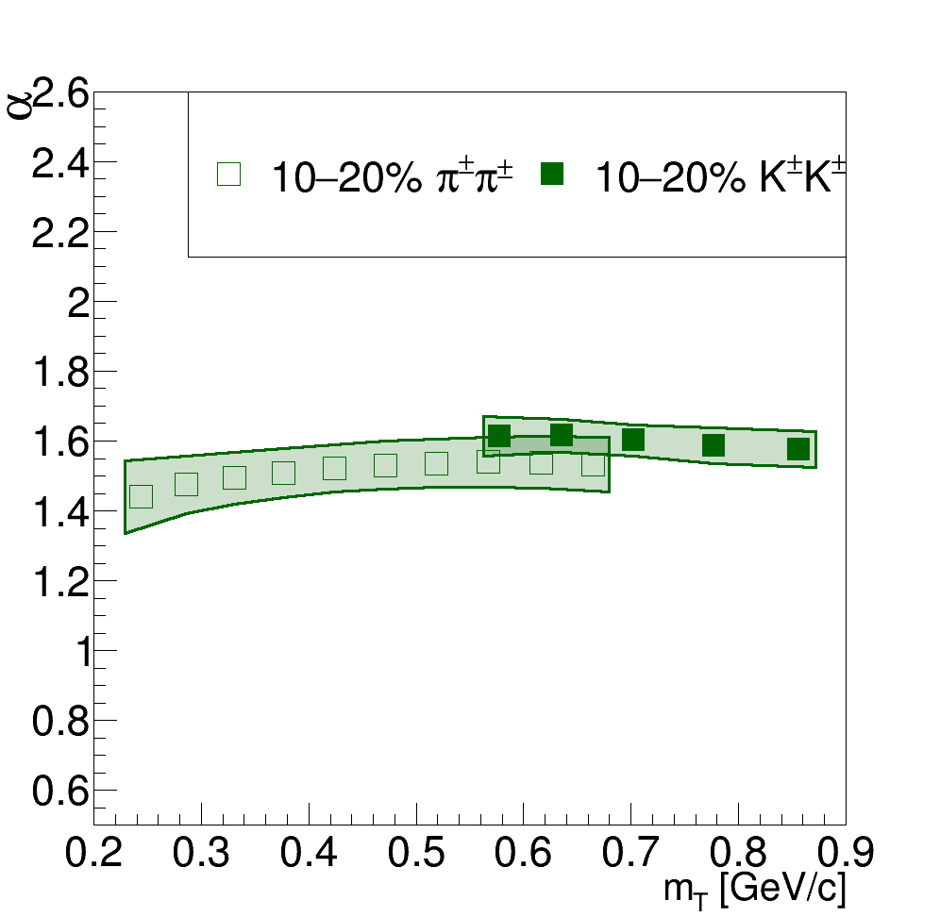
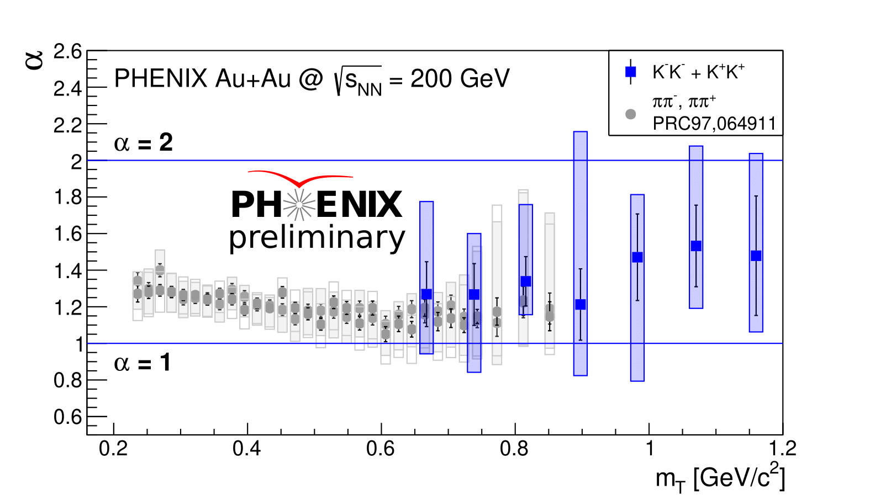
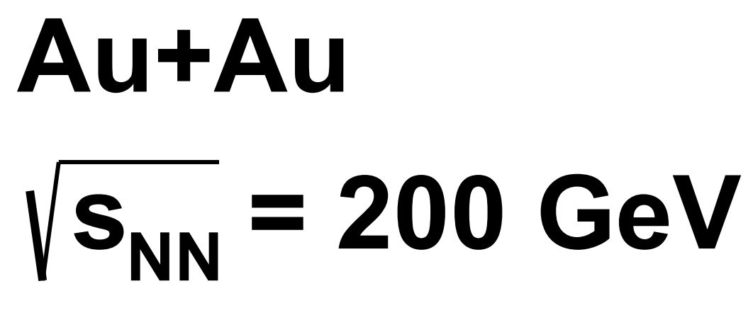
Particle species comparision, Data vs EPOS, Lévy $α$
Good agreement between kaons and pions, experiment and EPOS
  Slightly surprising: same source for kaons and pions, despite role of scattering?
  See talk/poster by L. Kovács on Thursday
EPOS
INTRO PHENO PIONS KAONS

Slide 16
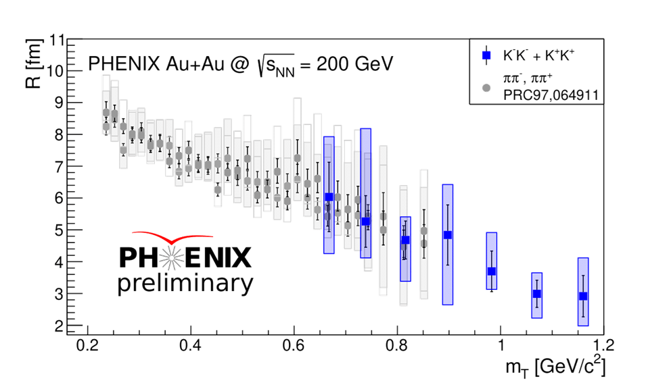
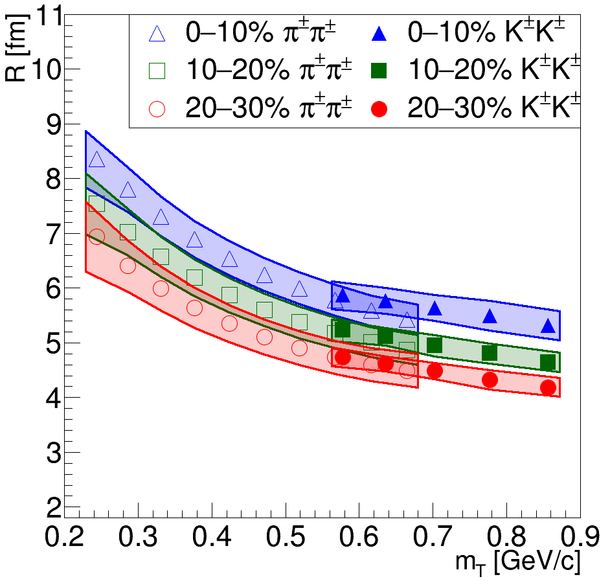
Particle species comparision, Data vs EPOS, Lévy $R$
Good agreement between kaons and pions, experiment and EPOS
  Slightly surprising: same source for kaons and pions, despite role of scattering?
  See talk/poster by L. Kovács on Thursday
INTRO PHENO PIONS KAONS

Slide 17
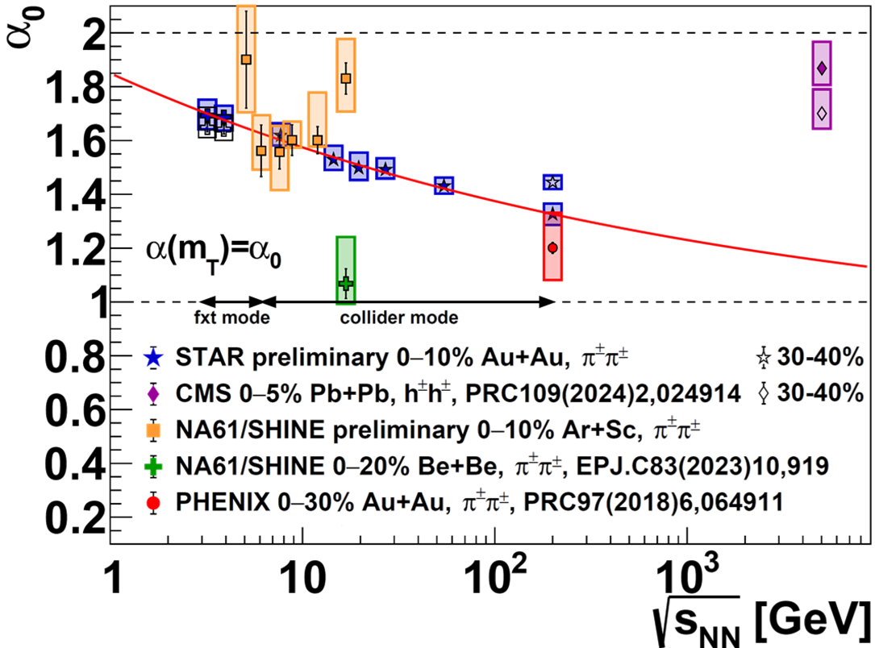
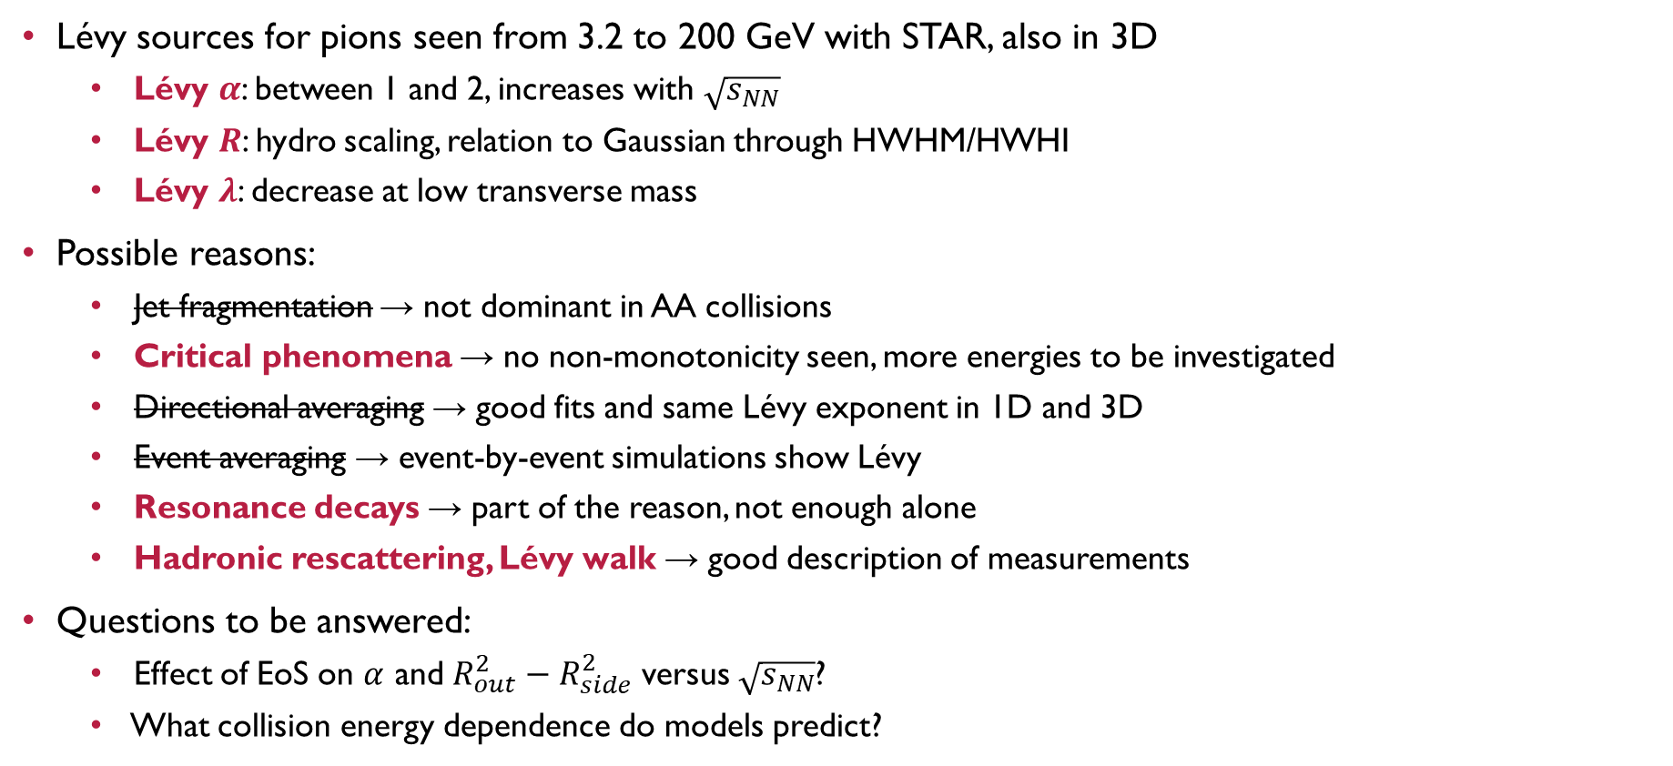
Conclusions and outlook
Lévy sources for pions seen from 3.2 to 200 GeV with STAR, also in 3D
  Lévy $α$: between 1 and 2, increases with $\sqrt{s_{NN}}$
  Lévy $R$: hydro scaling, relation to Gaussian through HWHM/HWHI
  Lévy $λ$: decrease at low transverse mass
Possible reasons:
  Jet fragmentation → not dominant in AA collisions
  Critical phenomena → no non-monotonicity seen, more energies to be investigated
  Directional averaging → good fits and same Lévy exponent in 1D and 3D
  Event averaging → event-by-event simulations show Lévy
  Resonance decays → part of the reason, not enough alone
  Hadronic rescattering, Lévy walk → good description of measurements
Questions to be answered:
  Effect of EoS on $α$ and $R_{out}^{2}−R_{side}^{2}$ versus $\sqrt{s_{NN}}$?
  What collision energy dependence do models predict?
INTRO PHENO PIONS KAONS

Slide 18
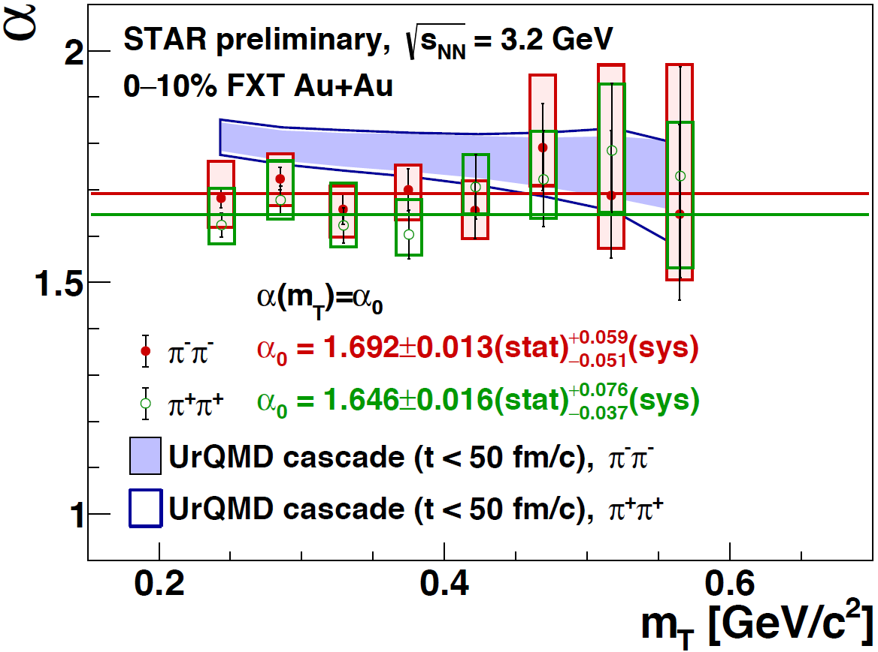

Thank you for your attention

Slide 19
BACKUP

Slide 20



Interactions
Plane-wave result, based on ${\left|Ψ_{2,q}^{\left(0\right)}\left(r\right)\right|}^{2}=1+e^{iqr}$, for pair source $D(r)$
$$C_{2}\left(q,K\right)≅∫D\left(r,K\right){\left|Ψ_{2,q}^{\left(0\right)}\left(r\right)\right|}^{2}dr=1+∫D\left(r,K\right)e^{iqr}dr$$
If there are interactions, solve Schrödinger eq: $Ψ_{2,q}^{\left(0\right)}\left(r\right)→Ψ_{2,q}^{\left(int\right)}\left(r_{1},r_{2}\right)$
For Coulomb, solution is known: ${\left|Ψ_{2,q}^{\left(C\right)}\left(r\right)\right|}^{2}=\frac{πη}{e^{2πη}−1}⋅$ (hypergeometric expression)
Direct fit with this, or the usual iterative Coulomb-correction:
$C_{Bose−Einstein}\left(q\right)K\left(q\right)$, where $K\left(q\right)=∫D\left(r,K\right){\left|Ψ_{2,q}^{\left(C\right)}\left(r\right)\right|}^{2}dr/∫D\left(r,K\right){\left|Ψ_{2,q}^{\left(0\right)}\left(r\right)\right|}^{2}dr$
Complication: need for integrating power-law tails
  Precalculated in a tabular form, iterative fitting, e.g., PHENIX, PRC97(2018)064911
  Interpolating functional form, see Csanád, Lökös, Nagy, Phys.Part.Nucl. 51(2020)238
  Role of the strong interaction, see Kincses, Nagy, Csanád, PRC102(2020)064912
  Recent method: EPJC83(2023)1015, code at github.com/csanadm/CoulCorrLevyIntegral
Many new results, also for the strong interaction: see talk by M. Nagy on Tuesday
INTRO PHENO PIONS KAONS

Slide 21


How to calculate the Coulomb effect
Calculating correlation functions with the Coulomb effect included: time consuming in the past
Method used in early analyses: Coulomb correction calculated for fixed radius and shape
  For example, fixing $R=5$ fm and $α=2$
More consistent method: correlation function
with Coulomb FSI precalculated in a tabular form
  Iterative fitting, see e.g., PHENIX, PRC97 (2018) 6, 064911
Convenient, but somewhat restricted method:
interpolating functional form, in a limited R, $α$ range
  See Csanád, Lökös, Nagy, Phys.Part.Nucl. 51 (2020) 238,
  used in arXiv:2306.11574 [CMS], arXiv:2302.04593 [NA61]
Recent method: see talk by Márton Nagy
  Nagy, Purzsa, Csanád, Kincses Eur. Phys. J. C 83, 1015 (2023), code at github.com/csanadm/CoulCorrLevyIntegral
  Recent developments: 3D calculation, protons, see talk by M. Nagy on Wednesday
INTRO PHENO PIONS KAONS

Slide 22




Lévy index as a critical exponent?
Critical spatial correlation: $\sim r^{−\left(d−2+η\right)}$; Lévy source: $\sim r^{−\left(1+α\right)}$; $α⇔η$?
  Csörgő, Hegyi, Zajc, Eur.Phys.J. C36 (2004) 67
QCD universality class $↔$ 3D Ising
  Halasz et al., Phys.Rev.D58 (1998) 096007
  Stephanov et al., Phys.Rev.Lett.81 (1998) 4816
At the critical point:
  Random field 3D Ising: η = 0.50±0.05
  Rieger, Phys.Rev.B52 (1995) 6659
  3D Ising: η = 0.03631(3)
  El-Showk et al., J.Stat.Phys.157 (4-5): 869
Motivation for precise Lévy HBT!
Change in α_{Levy} proximity of CEP?
Finite-size/time & non-equilibrium effects $→$ what does power-law tail mean?
  Finite-size effects not important? See e.g. Fytas et al, PRE93, 063308 (2016), Ballesteros et al., PLB387 (1996) 125
2.0
1.0
0.5
Lévy index of stability $α$
-0.5 0 0.5
$$(T−T_{c})/T_{c}$$

Slide 23



reScaling HBT Radii from Gauss to Lévy
Source shape and size entangled in Gaussian radii
Fits possible with many $α$ values
  Some statistically acceptable, some not
  Fits to PHENIX HBT paper PRC 2018, Fig 3a
$\hat{R}=R/\left[λ\left(1+α\right)\right]$ scaling observed generally
arXiv:2406.11435
INTRO PHENO PIONS KAONS

Slide 24


Lévy shapes in single EPOS events, 1D
EPOS model: parton-based Gribov-Regge theory (PBGRT)
  Werner et al., PRC82 (2010) 044904, PRC89 (2014) 064903, …
Source observed in four stages:
  CORE, primordial pions: close to Gaussian
  CORE, with decay products: power-law structures
  CORE+CORONA+UrQMD, primordial pions: Lévy shape
  CORE+CORONA+UrQMD, with decay products: Lévy shape
  Radii in the four stages (one example event)
  $3.59$fm $→4.89$ fm $→7.36$fm $→7.45$ fm
  Shape ($α$) change: $2.00→1.77→1.55→1.46$
Can one relate the observed HBT radii
to the hydro phase homogeneity lengths?
More investigations needed…
See talks by D. Kincses, E. Árpási, L. Kovács, M. Molnár on Thu
arXiv:2201.07962
INTRO PHENO PIONS KAONS

Slide 25


Fixed target energies: 3.2 and 3.9 GeV
Non-Gaussian values ($α<2$); small systematic difference between $π^{−}π^{−}$ and $π^{+}π^{+}$ pairs
3.9 and 3.2 GeV compatible, no $m_{T}$ dependence observed
UrQMD within uncertainties – no other effect but rescattering and decays, good agreement (t<50 fm/c!)
D. Kincses, CPOD 24
INTRO PHENO PIONS KAONS

Slide 26


Correlation strength λ: Core/halo
Two-component core+halo source
  Core: hydrodynamically expanding, thermal medium
  Halo: long lived resonances ($≳$ 10 fm/c, ω,η,η’,K₀^{S},…)
  Unresolvable experimentally
  Define $f_{C}=N_{core}/N_{total}$
True $q→0$ limit: $C\left(0\right)=2$
Apparently $C\left(q→0\right)→1+λ$
$λ\left(m_{T}\right)=f_{C}^{2}\left(m_{T}\right)$
Bolz et al, Phys.Rev. D47 (1993) 3860-3870;
Csörgő, Lörstad, Zimányi, Z.Phys. C71 (1996) 491-497
halo
core

Slide 27


Role of event averaging?
Event-averaged source also analyzed
Not perfectly Lévy shape, very large $χ^{2}$
Nevertheless: similar parameters achieved
  Event averaged:
  $α≈1.62, R≈9.15$ fm
  Event-by-event:
  $α≈1.66, R≈8.96$ fm
More reasonable approach for kaons
  No event-by-event analysis possible for kaons

Slide 28

Source or pair distribution?
Under some circumstances (thermal emission, no interactions, …):
$$C_{2}\left(q,K\right)=∫S\left(r_{1},K+\frac{q}{2}\right)S\left(r_{2},K−\frac{q}{2}\right){\left|Ψ_{2}\left(r_{1},r_{2}\right)\right|}^{2}dr_{1}dr_{2} \\ ≅1+{\left|∫S\left(r,K \right)e^{iqr}dr\right|}^{2}$$
Let us introduce the spatial pair distribution:
$D(r,K)=∫S\left(ρ+\frac{r}{2},K\right)S\left(ρ−\frac{r}{2},K\right)dρ$
Then the Bose-Einstein correlation function becomes:
$C_{2}\left(q,K\right)≅∫D\left(r,K\right){\left|Ψ_{2}\left(r\right)\right|}^{2}dr=1+∫D\left(r,K\right)e^{iqr}dr$
Bose-Einstein correlations measure spatial pair distributions!
Coulomb and strong Final State Interactions? Under control for Lévy sources
  Csanad, Lökös, Nagy, Phys. Part. Nuclei 51 (2020) 238 [arXiv:1910.02231]
  Kincses, Nagy, Csanad Phys. Rev. C102, 064912 (2020) [arXiv:1912.01381]

Slide 29



Role of The strong interaction
In case of other interactions or not identical bosons, the formula still works:
$$C_{2}\left(q,K\right)≅∫D\left(r,K\right){\left|Ψ_{2}\left(r\right)\right|}^{2}dr$$
Pair wave function determines $D↔C_{2}$ connection
Mesons, baryons: strong interaction; fermions: anticorrelation
Non-identical pairs: interaction modifies wave function
Kaon-kaon, THERMINATOR2
Proton-proton, UrQMD
Proton-antiproton, UrQMD
From e.g. H. Zbroszczyk’s talk at Zimányi School 2019

Slide 30



strong interaction for pion pairs
Additional potential appearing
Possible handling: strong phase shift,
Modify s-wave component in wave func.
  R. Lednicky, Phys. Part. Nucl.40, 307 (2009)
Small difference in case of pions
Few percent modification in $λ,α$
  Kincses, Nagy, Csanád, Phys.Rev.C 102 (2020) 064912

Slide 31

Two-particle spatial correlations
Object to be investigated: two-particle source
$$D\left(r,K\right)=∫d^{4}ρS\left(ρ+\frac{r}{2},K\right)S\left(ρ−\frac{r}{2},K\right)$$
Experimental results measure power-law tails, Lévy shapes
  Measure momentum-space correlations, reconstruct $D\left(r\right)$ or fit its parameters
Why do these Lévy shapes appear?
  What physics does contribute to it? Rescattering, decays?
  What role does event averaging have in it?
  Cimerman, Plumberg, Tomasik, Phys.Part.Nucl. 51 (2020) 282, PoS ICHEP2020 538
  What do specific $α$ values mean?
Event generator models (like EPOS) – direct access to pair-source!
  Phenomenological investigations of 𝐷(𝑟) possible
  Effects can be turned off or on, investigated separately

Slide 32




EPOS SUMMARY
D(r) calculated in EPOS evt-by-evt
Lévy fits done evt-by-evt
Non-Gaussianity in single events
Extracting mean, & std.dev. of $R$, $α$
$m_{T}$ & centrality dependence

Slide 33



Results at Collider energies: 7.7 to 200 GeV
Slow decrease with $\sqrt{s_{NN}}$
from 200 to 7.7 GeV
  Same trend as Gaussian $R$
Decrease in R with $m_{T}$
  Connection to flow
200 GeV: EPOS close to data
EPOS

Slide 34


Results at Collider energies: 7.7 to 200 GeV
Small, smooth increase
in $α$ with $\sqrt{s_{NN}}$
from 200 to 7.7 GeV
  Connection to decreased density?
No strong dependence
on $m_{T}$
Average $α$
  $≈$1.33 at 200 GeV
  $≈$1.62 at 7.7 GeV
Significantly below 2.0
and above 1.0

Slide 35


Results at Collider energies: 7.7 to 200 GeV
Clear decrease
in $λ$ with $\sqrt{s_{NN}}$
from 200 to 7.7 GeV
  Decrease in multiplicity
  Larger role of halo
Decrease towards small $m_{T}$ values
  Increase in halo
  for small $m_{T}$
  Attributed to modified in-medium $η′$ mass in literature

Slide 36



Lévy scale R at FXT energies
Decreases towards higher $m_{T}$ and lower energies
Small systematic difference between $π^{−}π^{−}$ and $π^{+}π^{+}$ pairs
Two FXT energies compatible
UrQMD describes the trends qualitatively well, moderate quantitative mismatch, but ran only until 50 fm/c
D. Kincses, CPOD 24

