Slide 1
Two topics on high density matter and heavy-ion physics at J-PARC
24th ZIMÁNYI SCHOOL WINTER WORKSHOP ON HEAVY ION PHYSICS, 2024/12/5, Budapest, Hungary
Masakiyo Kitazawa
(YITP, Kyoto)
Taya, Jinno, MK, Nara, 2409.07685.
Nishimura, MK, Kunihiro, Ann. Phys. 469, 169768 (2024); PTEP 2023, 053D01; PTEP 2022, 093D02.
ATHIC2023, Apr. 27, 2023, Hiroshima
Photo: J-PARC Main Ring

Slide 2

QCD Phase Diagram
T
Possible first-order transition and QCD critical point in dense region
Multiple QCD-CP? MK+ (‘02)
Color superconducting phases in dense and cold quark matter
Quark-Gluon Plasma
150MeV
ＱＣＤ Critical Point
Hadron Phase
(confined)
Color SC
~10¹⁵g/cm³
μ

Slide 3
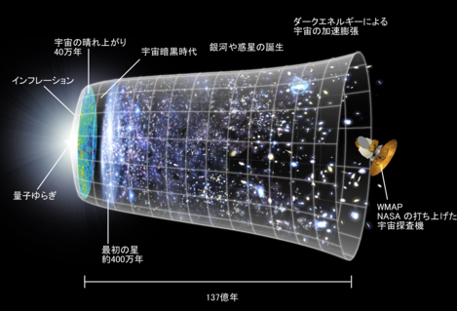
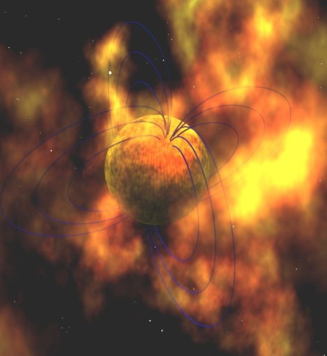
QCD Phase Diagram
Early Universe
T
Possible first-order transition and QCD critical point in dense region
Multiple QCD-CP? MK+ (‘02)
Color superconducting phases in dense and cold quark matter
Quark-Gluon Plasma
150MeV
ＱＣＤ Critical Point
Hadron Phase
(confined)
Color SC
Compact
Stars
~10¹⁵g/cm³
μ

Slide 4
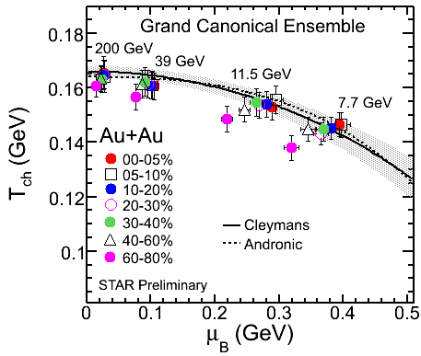
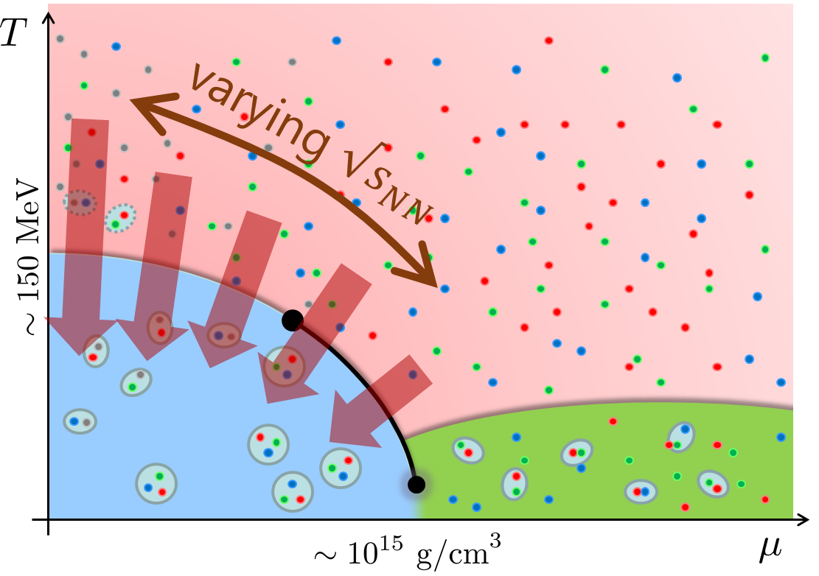
Beam-Energy Scan
STAR, 2012
High E
Low E
Baryon stopping

Slide 5
Beam-Energy Scan
Figure by Gyalatyuk
STAR, 2012
J-PARC-HI
FAIR-CBM
github.com/tgalatyuk/interaction_rate_facilities
NICA
HADES
NA61/SHINE
High E
Low E
RHIC-BES-FXT
RHIC-BES
Baryon stopping

Slide 6
Contents
Optimal collision energy for investigating dense matter
      Taya, Jinno, MK, Nara, 2409.07685
Dilepton production for the signal of phase transitions
      Nishimura, MK, Kunihiro, Ann. Phys. 469, 169768; PTEP 2023, 053D01; PTEP 2022, 093D02

Slide 7
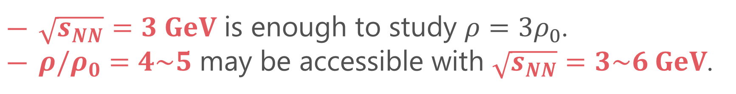
Key Questions
What is the optimal collision energy to explore the baryon-rich matter?
How high density is accessible?
Our Answer
$\sqrt{s_{NN}}=3 GeV$ is enough to study $ρ=3ρ_{0}$.
$ρ/ρ_{0}=4\sim 5$ may be accessible with $\sqrt{s_{NN}}=3\sim 6 GeV$.

Slide 8


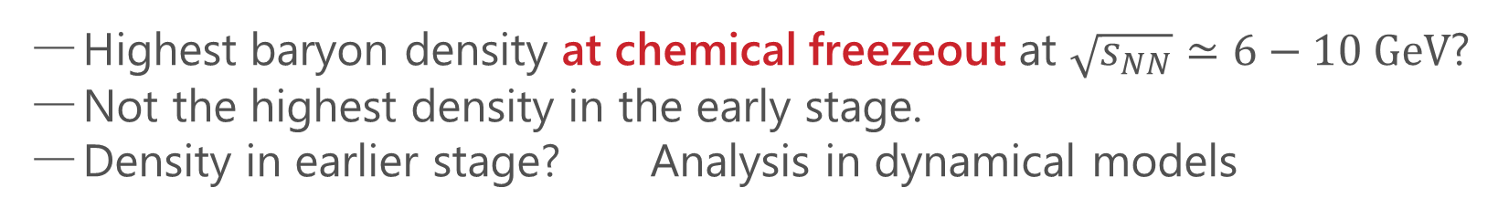

Chemical Freezeout
Randrup, Cleymans, ’06
$$\sqrt{s_{NN}}=10 GeV$$
$$\sqrt{s_{NN}}=6 GeV$$
STAR,2012
$ρ_{0}$
Highest baryon density at chemical freezeout at $\sqrt{s_{NN}}≃6−10 GeV$?
Not the highest density in the early stage.
Density in earlier stage? Analysis in dynamical models

Slide 9
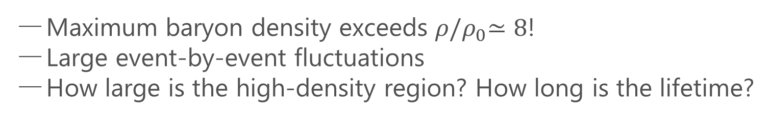


Baryon Density at Collision Point
Simulation by JAM
$$t$$
Ohnishi, 2002
$ρ(x)$ at this point
Maximum baryon density exceeds $ρ{/ρ}_{0}≃8$!
Large event-by-event fluctuations
How large is the high-density region? How long is the lifetime?

Slide 10
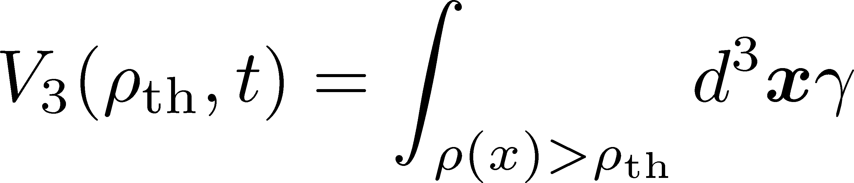
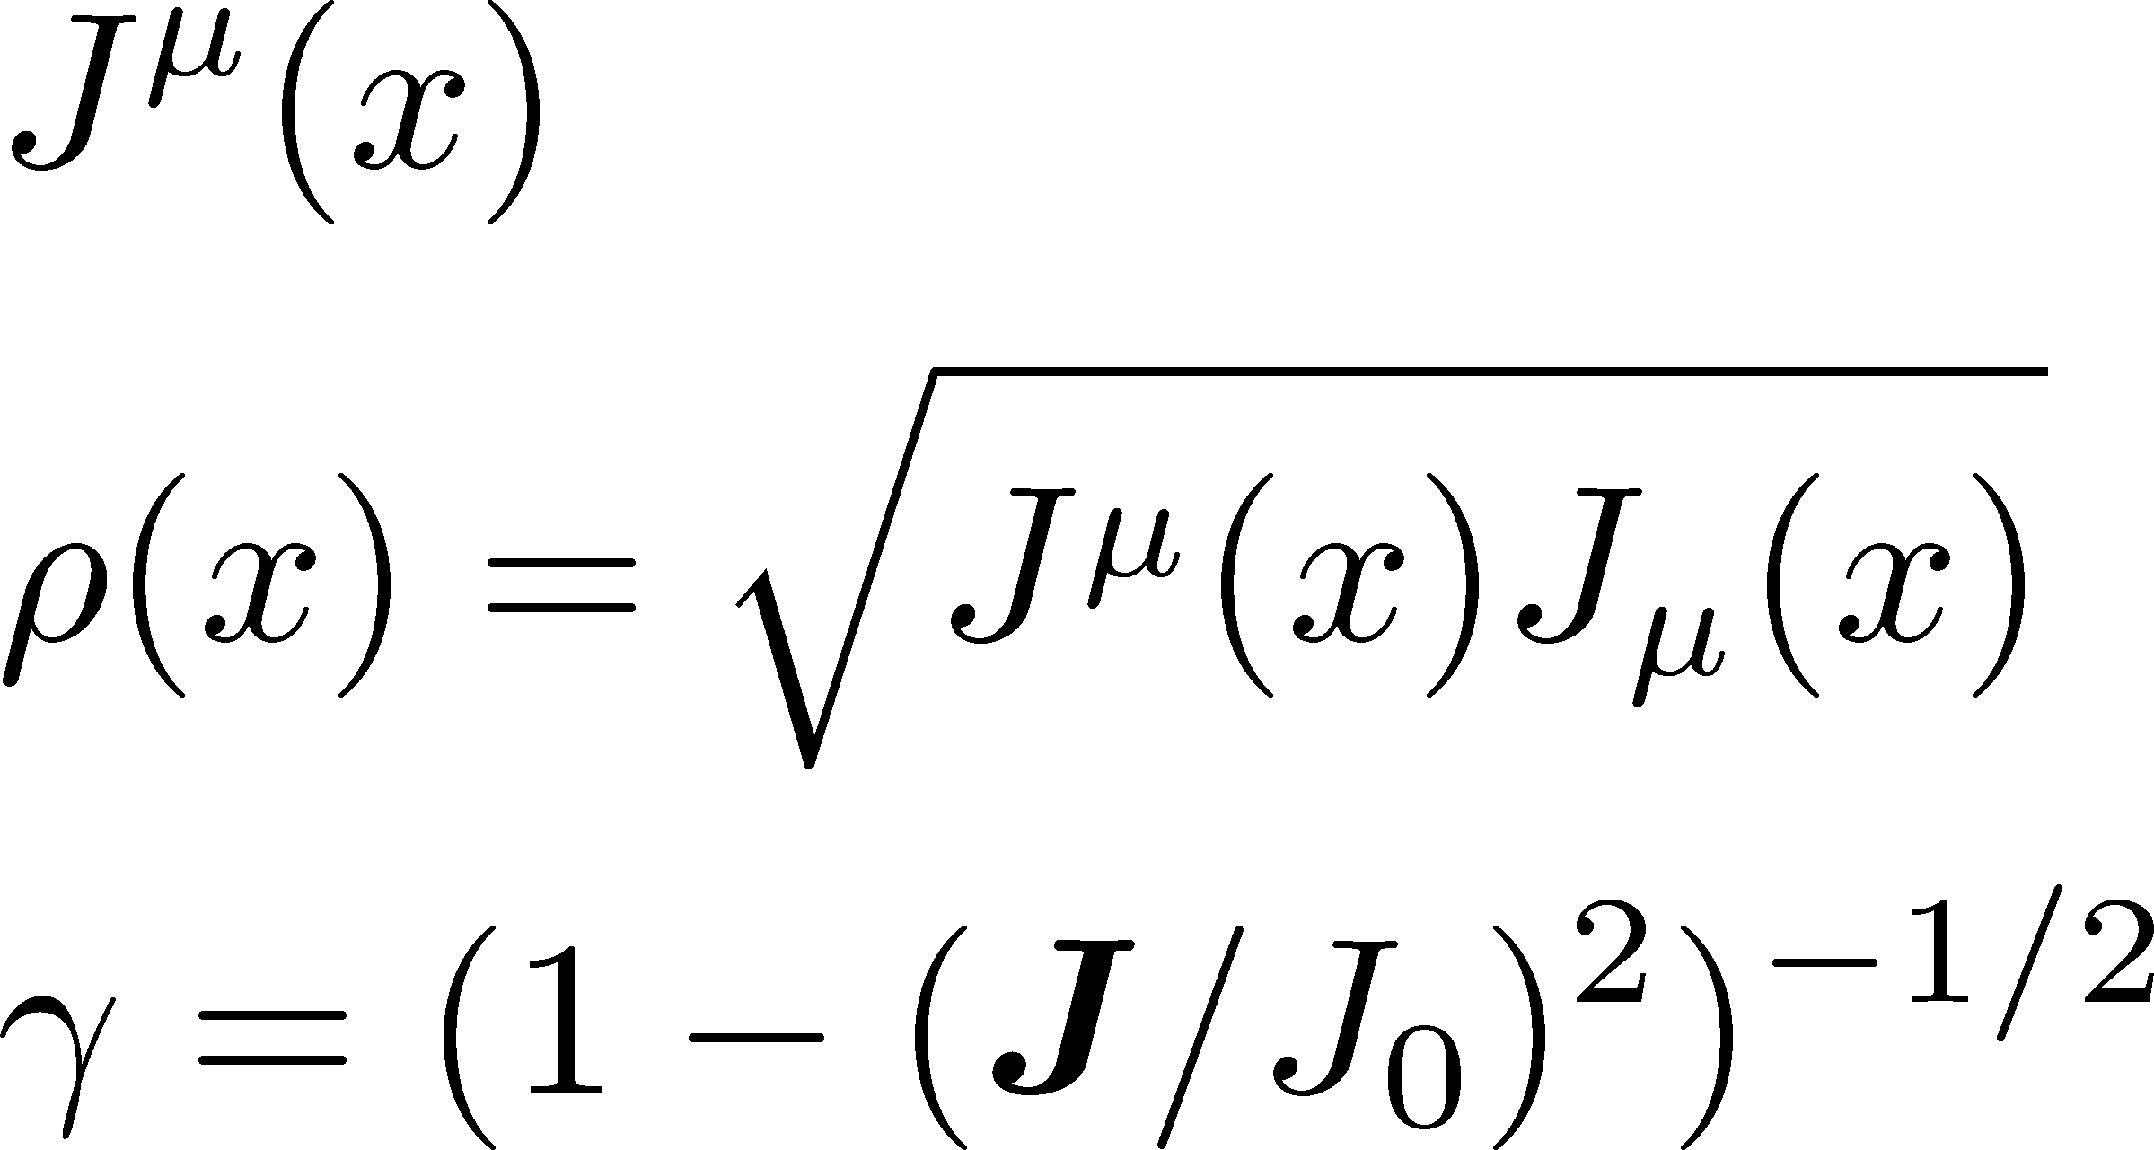
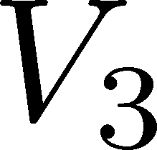
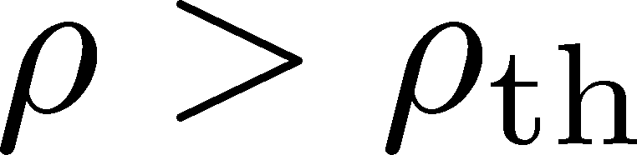
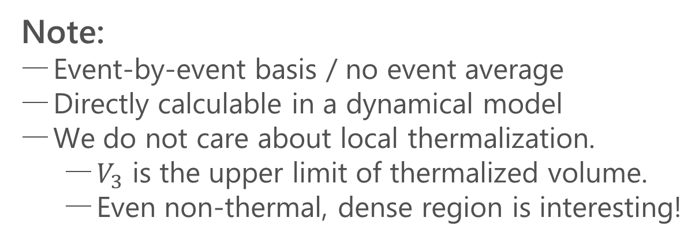
Volume of Dense Region
Taya, Jinno, MK, Nara, 2409.07685
Volume where the local baryon density is larger than a threshold value $ρ_{th}$
Baryon current
Baryon density
Lorentz factor
Note:
Event-by-event basis / no event average
Directly calculable in a dynamical model
We do not care about local thermalization.
  $V_{3}$ is the upper limit of thermalized volume.
  Even non-thermal, dense region is interesting!

Slide 11
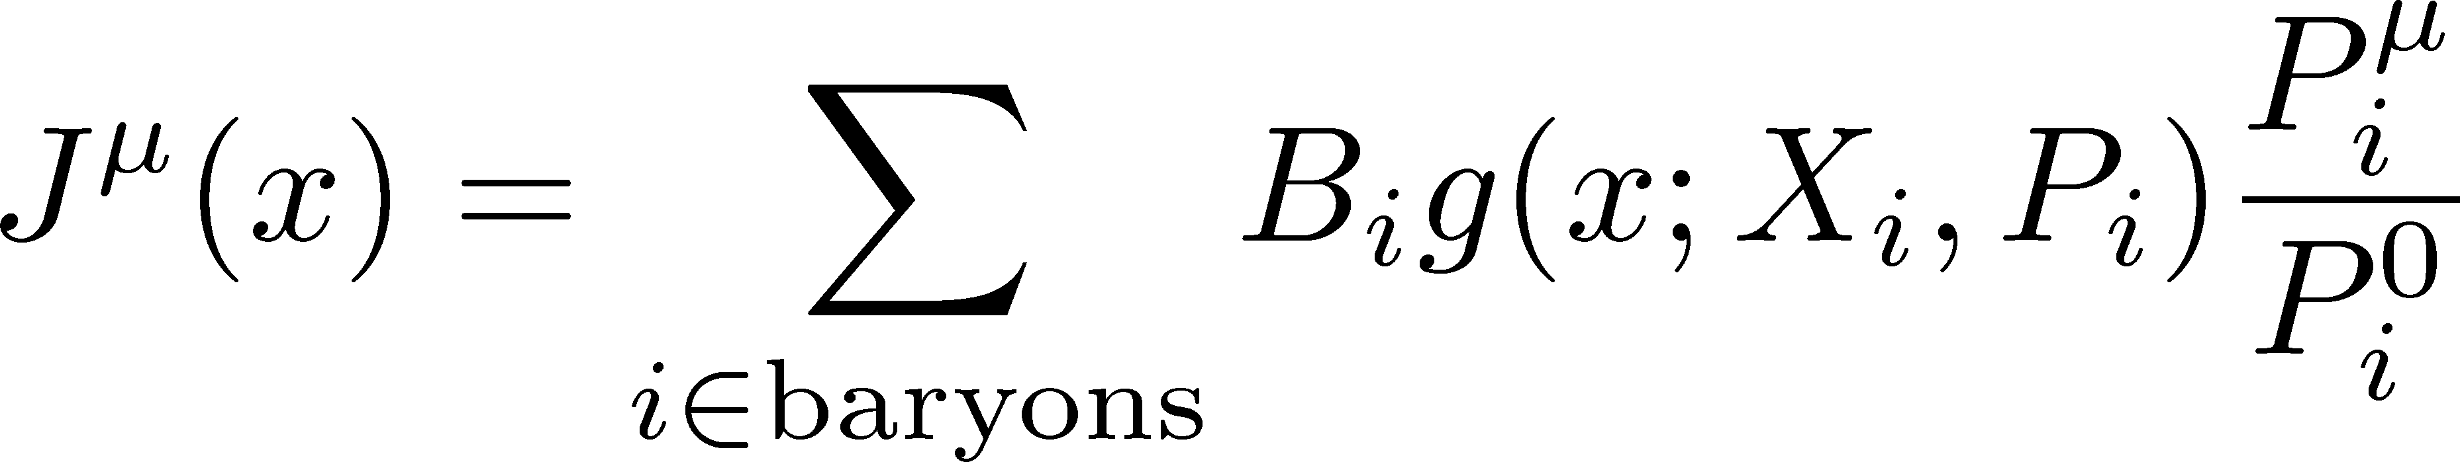
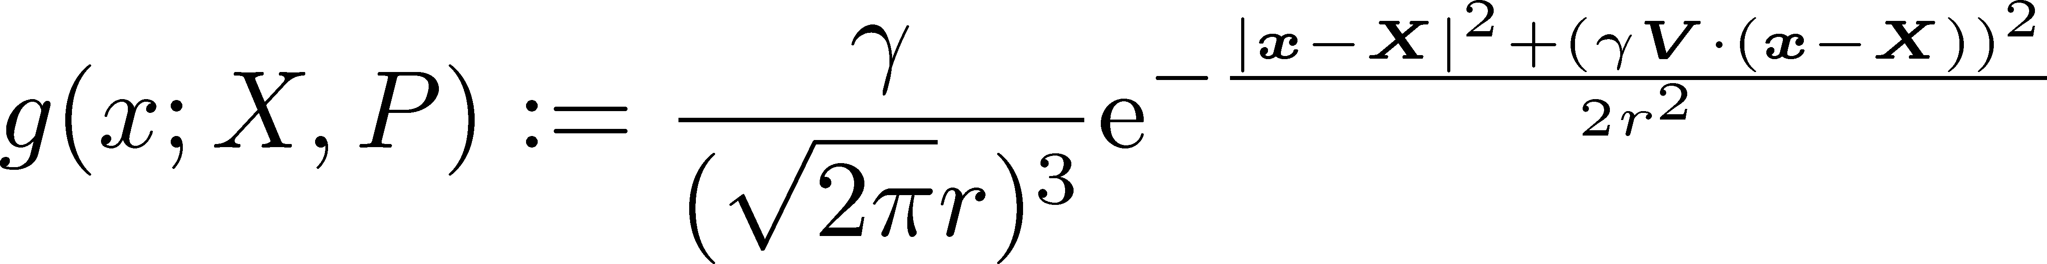
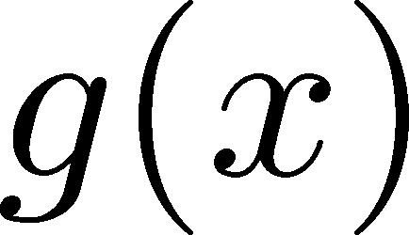

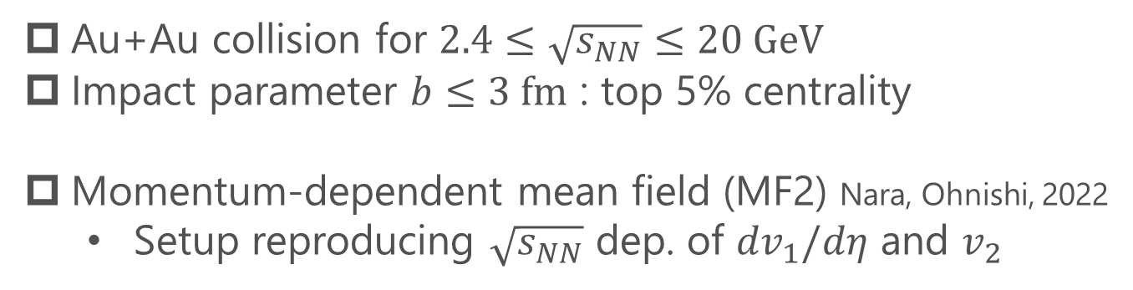
Simulation Setup in JAM
Au+Au collision for $2.4≤\sqrt{s_{NN}}≤20 GeV$
Impact parameter $b≤3 fm$ : top 5% centrality
Momentum-dependent mean field (MF2) Nara, Ohnishi, 2022
  Setup reproducing $\sqrt{s_{NN}}$ dep. of ${dv}_{1}/dη$ and $v_{2}$
Smeared baryon current
discrete particle distribution ➔ continuous current by smearing

Slide 12
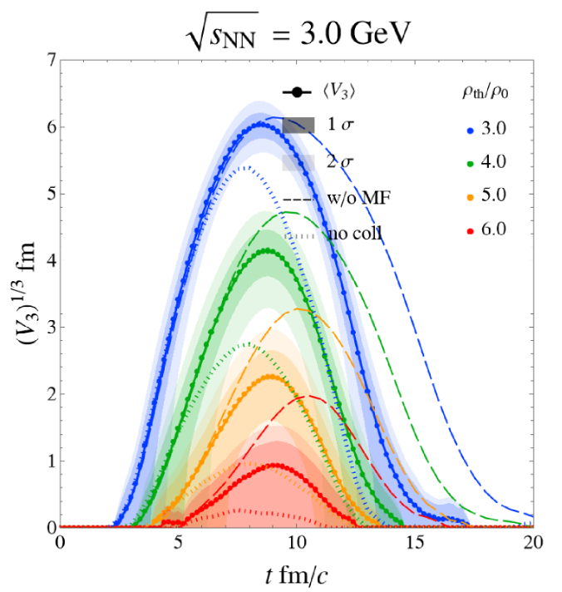


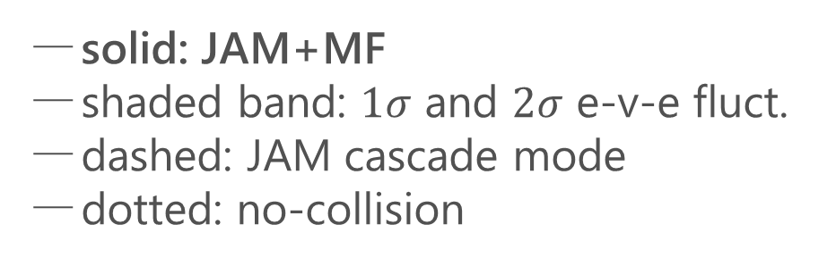
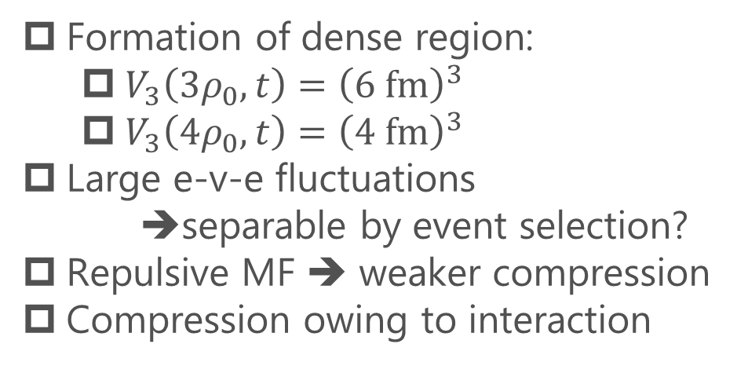
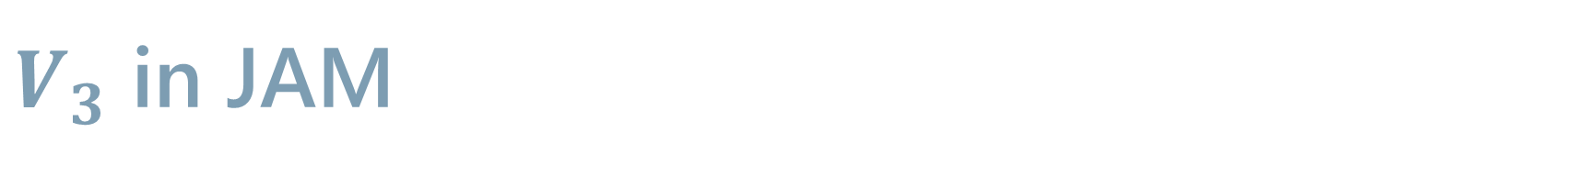
$V_{3}$ in JAM
solid: JAM+MF
shaded band: $1σ$ and $2σ$ e-v-e fluct.
dashed: JAM cascade mode
dotted: no-collision
Nara, Ohnishi, 2022
Formation of dense region:
  $V_{3}\left(3ρ_{0},t\right)={\left(6 fm\right)}^{3}$
  $V_{3}\left(4ρ_{0},t\right)={\left(4 fm\right)}^{3}$
Large e-v-e fluctuations
    ➔separable by event selection?
Repulsive MF ➔ weaker compression
Compression owing to interaction

Slide 13
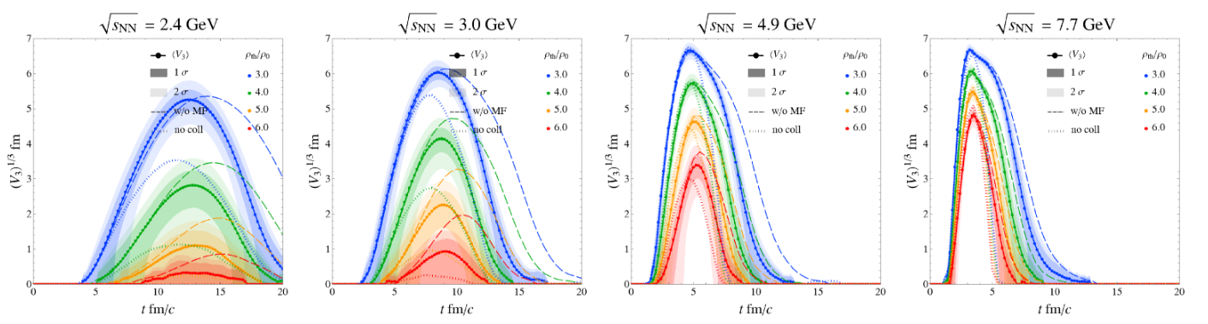
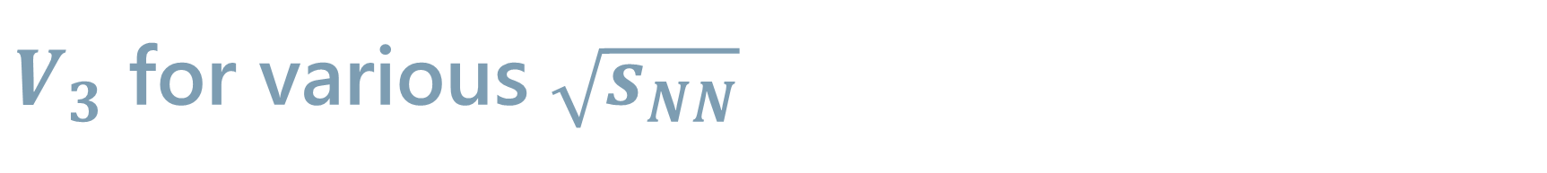
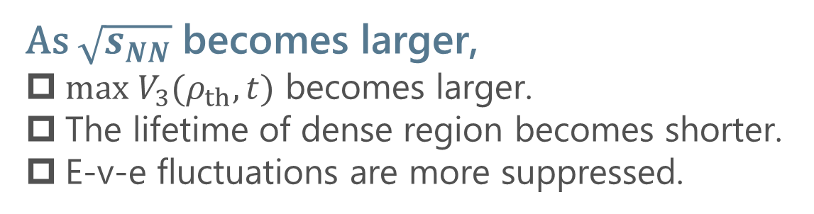
$V_{3}$ for various $\sqrt{s_{NN}}$
As $\sqrt{s_{NN}}$ becomes larger,
$max V_{3}(ρ_{th},t)$ becomes larger.
The lifetime of dense region becomes shorter.
E-v-e fluctuations are more suppressed.

Slide 14
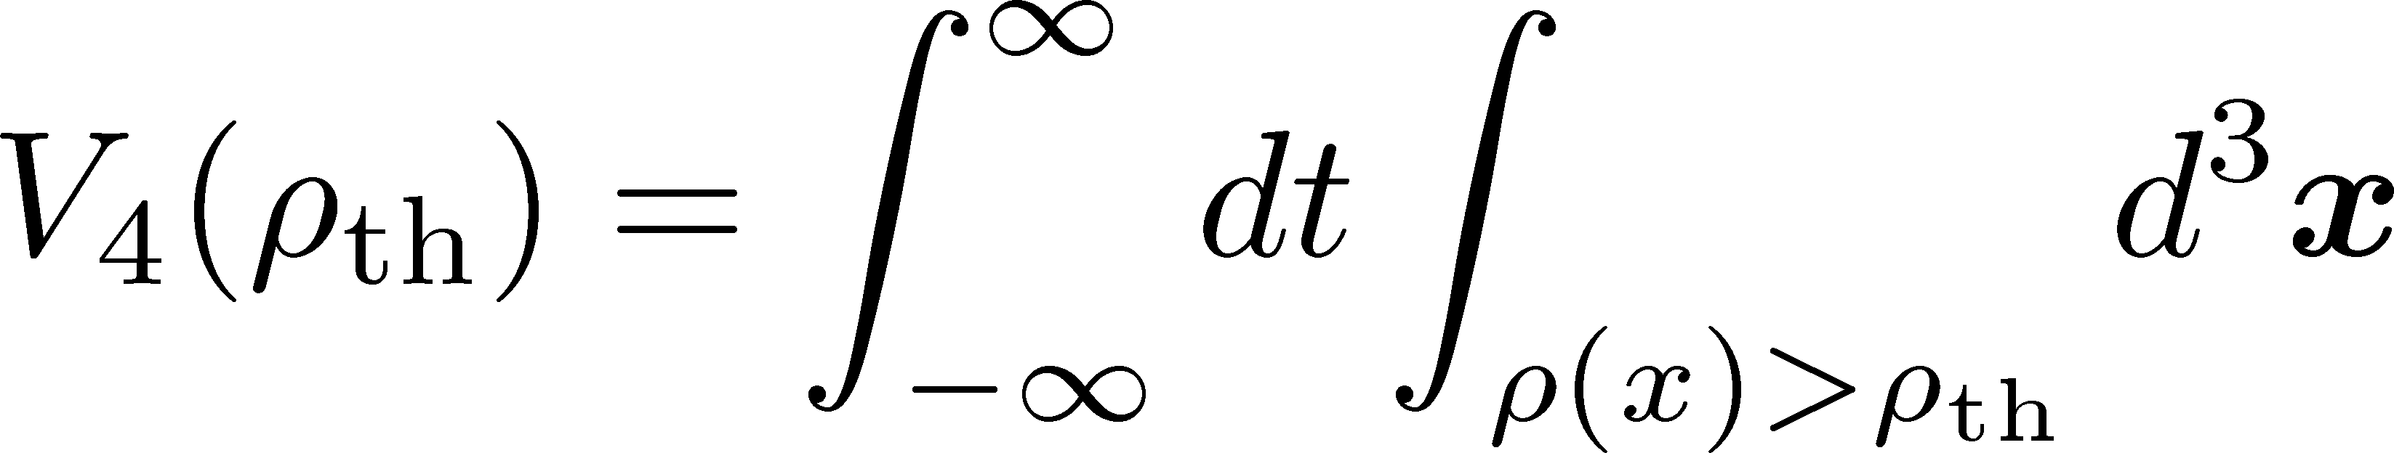
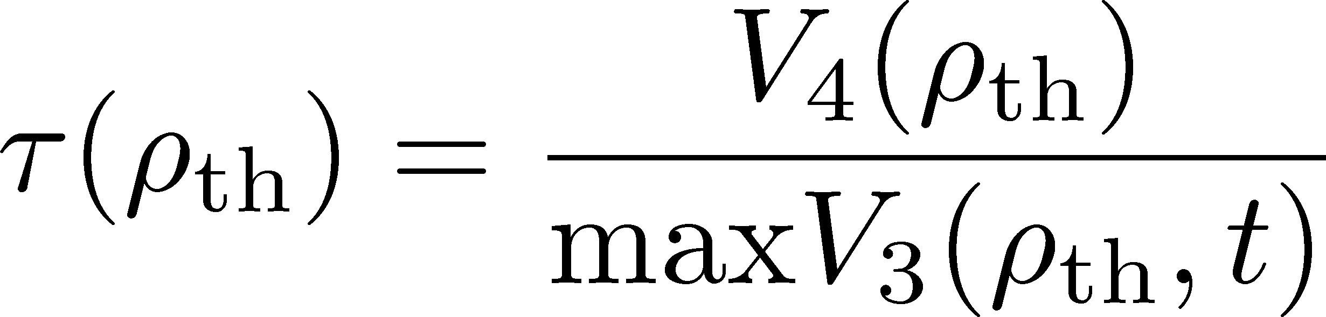
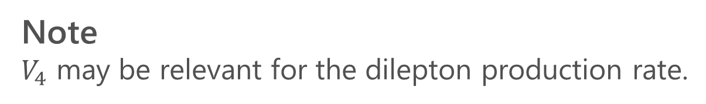
Four-Volume / Lifetime
Four Volume
Lifetime
Note
$V_{4}$ may be relevant for the dilepton production rate.

Slide 15
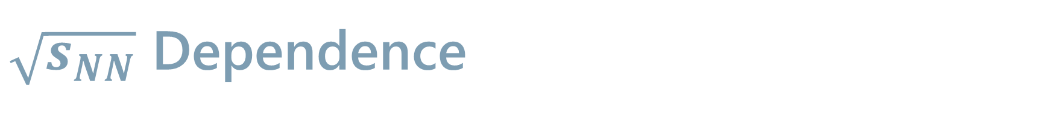
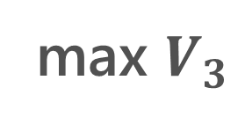
$\sqrt{s_{NN}}$ Dependence
max $V_{3}$
Lifetime

Slide 16
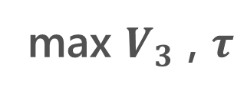

$\sqrt{s_{NN}}$ Dependence
max $V_{3}$ , $τ$
$$V_{4}$$
$\sqrt{s_{NN}}≃3 GeV$ would be the best energy to create $ρ=3\sim 4ρ_{0}$ with large $V_{3}$ and $τ$.
Lower $\sqrt{s_{NN}}$ is suitable to create colder matter.

Slide 17


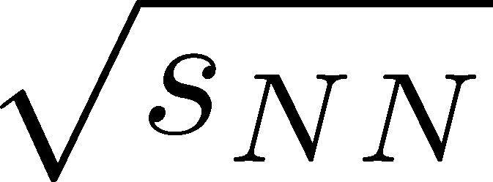
Event Selection
Density Scan?
Taya, Jinno, MK, Nara, 2409.07685
Baryon-rich events
large
e-v-e fluc
transverse energy
Event selections via highest baryon/energy density will allow us a detailed study of QCD phase diagram.
Baryon-rich
events

Slide 18
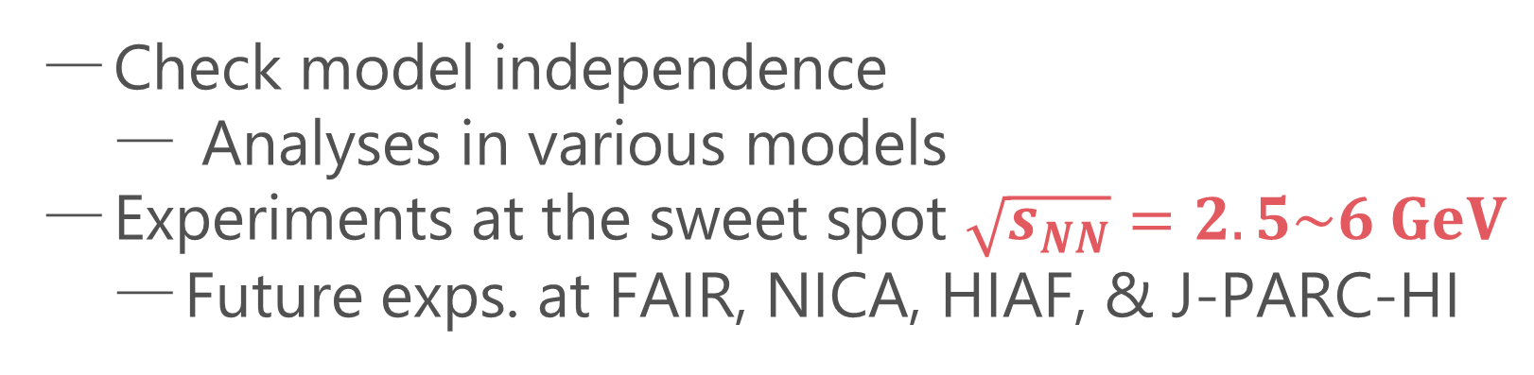
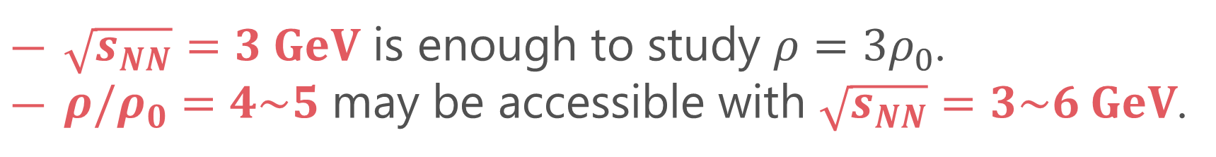
Short Summary
$\sqrt{s_{NN}}=3 GeV$ is enough to study $ρ=3ρ_{0}$.
$ρ/ρ_{0}=4\sim 5$ may be accessible with $\sqrt{s_{NN}}=3\sim 6 GeV$.
Future
Check model independence
  Analyses in various models
Experiments at the sweet spot $\sqrt{s_{NN}}=2.5\sim 6 GeV$
  Future exps. at FAIR, NICA, HIAF, & J-PARC-HI

Slide 19
Contents
Optimal collision energy for investigating dense matter
      Taya, Jinno, MK, Nara, 2409.07685
Dilepton production for the signal of phase transitions
      Nishimura, MK, Kunihiro, Ann. Phys. 469, 169768; PTEP 2023, 053D01; PTEP 2022, 093D02

Slide 20
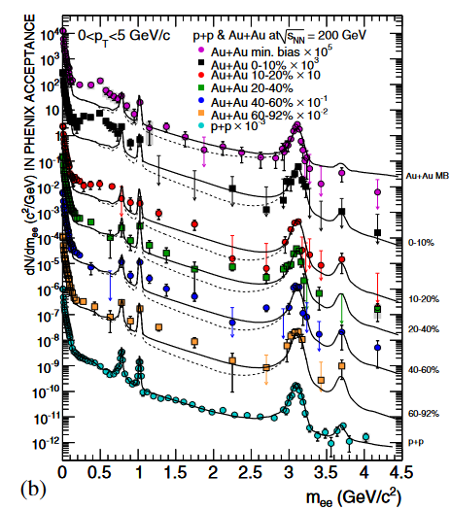
Dilepton Production Rate
Generated by the decay of virtual photons
Carry information of primordial medium
γ
e⁺
e⁻
Physics accessible with DPR
Medium temperature
Dispersion relations
Chiral mixing by chiral restoration
Signal of phase transitions
PHENIX, ‘10
Kim, Gubler, 2020
Sakai+, 2024

Slide 21




Soft Modes of Second-order Phase Transitions
Soft modes
Divergence of the order-parameter fluctuations at a 2nd-order transition.
Collective fluctuations become massless there.
QCD-CP : density-density fluctuations
CSC : diquark-pair field
QCD-CP:
CSC:
$$+$$
$$+ ∙∙∙$$
$$+$$
$$+ ∙∙∙$$
Coupling of soft modes with dynamical observables
Ex.: dilepton production rate

Slide 22
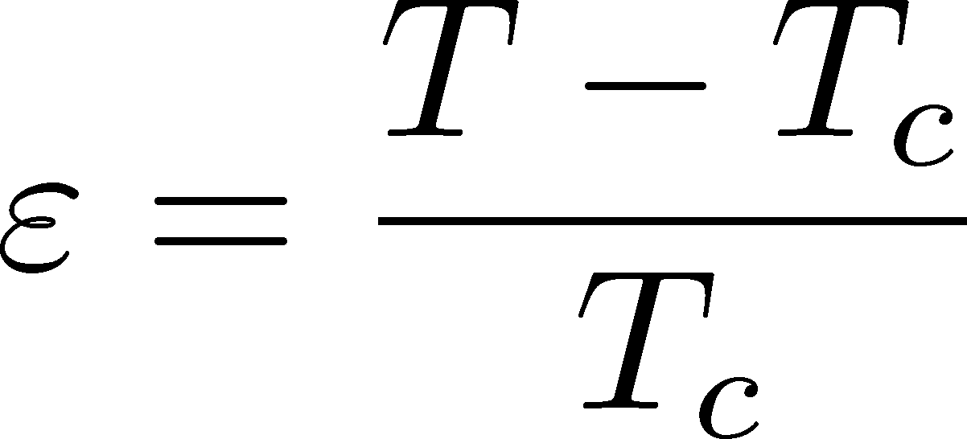


Precursor in Metallic Superconductors
Anomalous behavior of observables near but above Tc of SC
electric conductivity
magnetic susceptibility
pseudogap
Electric conductivity
Skopal, Tinkham(‘75)
Enhanced pair fluctuations is one of the origins of precursory phenomena.
More significant phenomena in strongly-coupled systems.
T>Tc
Landau’s free energy
T<Tc

Slide 23

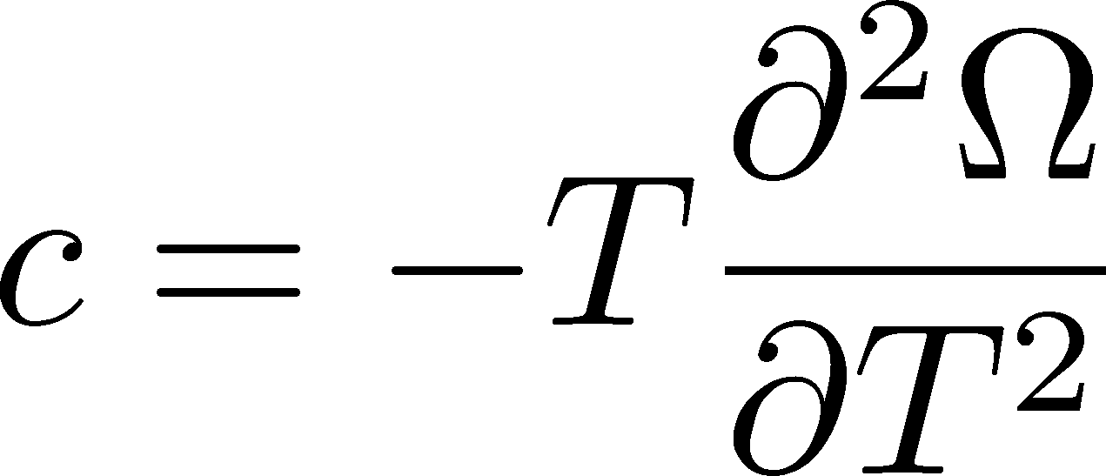
Precursor of Color Superconductivity
MK, Koide, Kunihiro, Nemoto, ’03, ‘05
Thermodynamic Potential
Pseudogap
Specific heat
density of states
Depression
in DoS above Tc

Slide 24
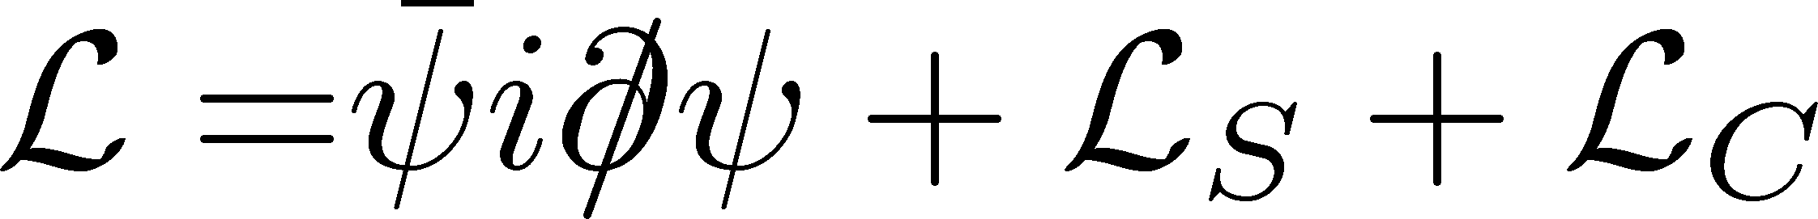
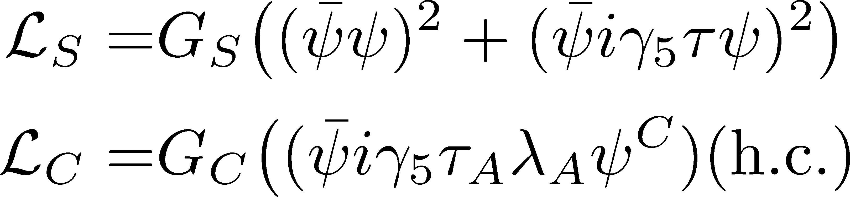
Model
NJL model (2-flavor)
Phase Diagram in MFA
diquark interaction
Parameters
Order of phase transition
  2nd in the MFA
  can be 1st due to gauge fluctuation
Matsuura+(’04), Giannakis+(’04)
Noronha+(’06), Fejos, Yamamoto(’19)

Slide 25
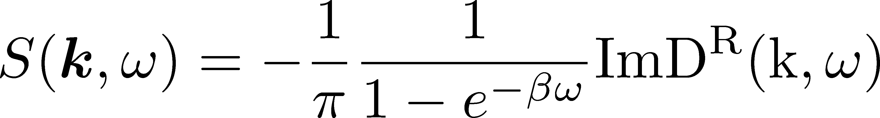
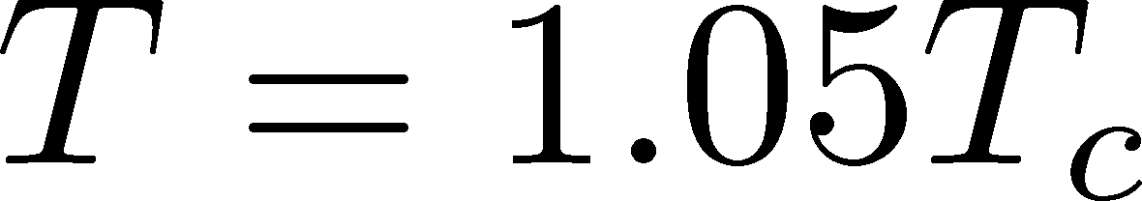
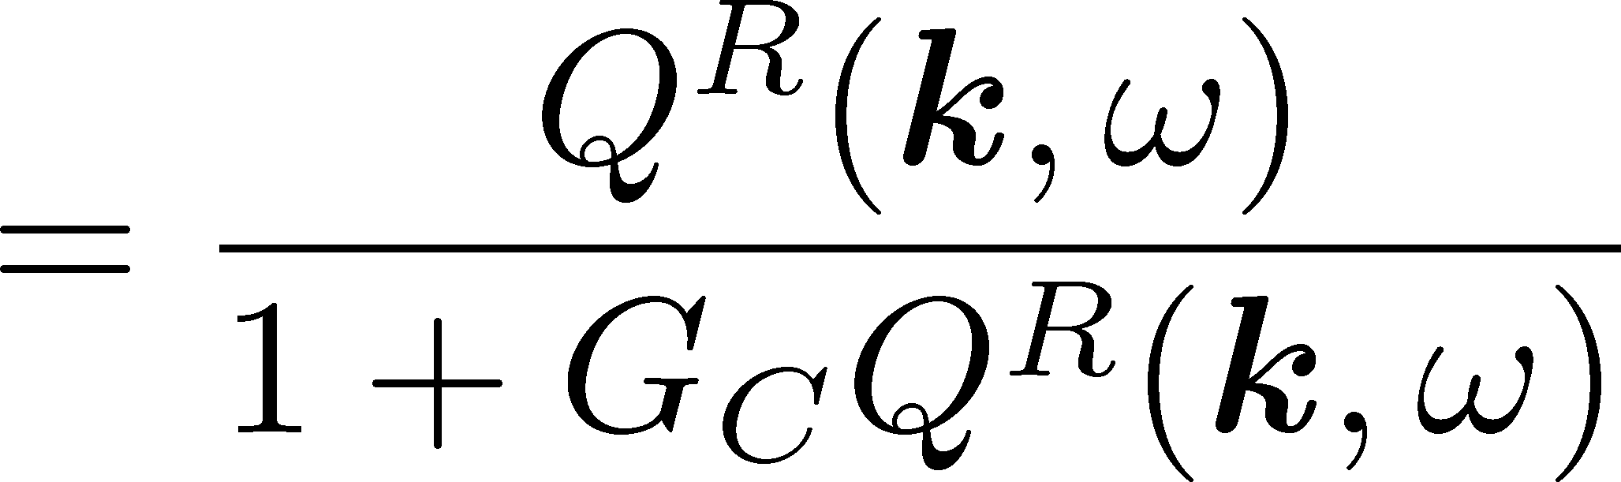
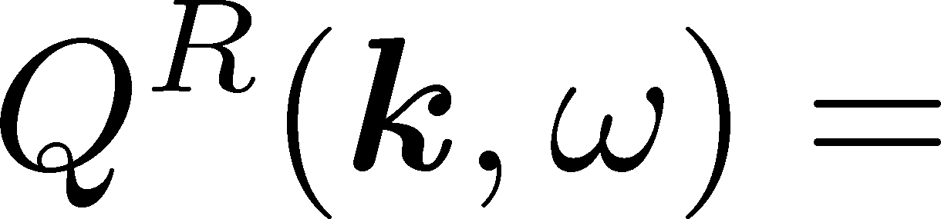



Di-quark Fluctuations
Diquark Propagator
Dynamical Structure Factor
Random Phase Approximaion
$$=$$
$$+$$
$$+ ∙∙∙$$
Diquark field becomes massless at T=Tc
Soft mode of CSC transition
Strength in the space-like region
MK, Koide, Kunihiro, Nemoto, ’01,’05

Slide 26

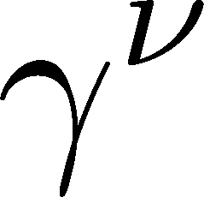
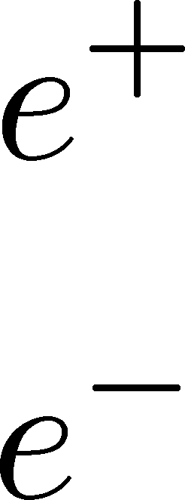
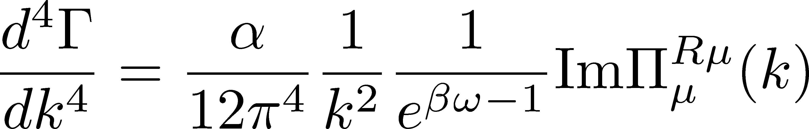
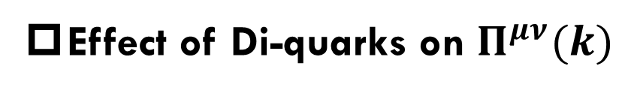
Photon Self-Energy: Precursor of CSC
Dilepton Production Rate
Effect of Di-quarks on $Π^{μν}(k)$
Aslamasov-Larkin term
Maki-Thompson term
DPR from CFL phase
Jaikumar, Rapp, Zahed (’02)
Well-known diagrams in metallic SC
for describing paraconductivity

Slide 27
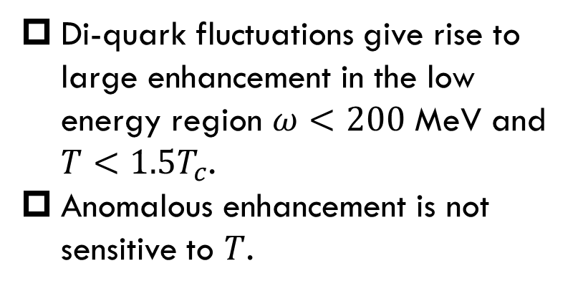
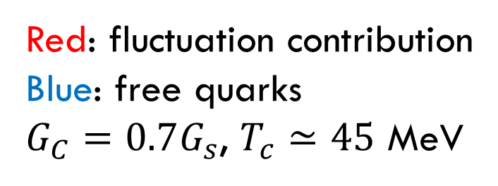
Production Rate at $k=0$
Nishimura, MK, Kunihiro (’22)
Red: fluctuation contribution
Blue: free quarks
$G_{C}=0.7G_{s}$, $T_{c}≃45$ MeV
enhancement
Di-quark fluctuations give rise to large enhancement in the low energy region $ω<200$ MeV and $T<1.5T_{c}$.
Anomalous enhancement is not sensitive to $T$.

Slide 28
Invariant-Mass Spectrum
Nishimura, MK, Kunihiro (’22)
Strong enhancement at low invariant mass.
Observable in the HIC?

Slide 29




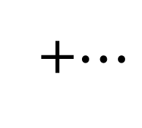
Dileptons from QCD Critical Point
NJL model (2-flavor)
Parameters
Soft Mode of QCD-CP
= fluctuation of scalar ($\overline{q}q$) channel
Modification of dilepton production through
Random Phase Approximaion
$$=$$
$$+$$
$$+ ∙∙∙$$
+$⋯$
MT, DoS

Slide 30
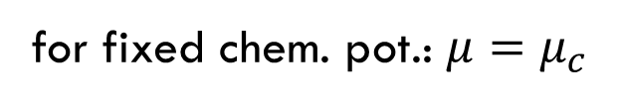

Dilepton production rate near QCD-CP
Invariant mass spectrum
Nishimura, MK, Kunihiro (’23)
for fixed chem. pot.: $μ=μ_{c}$
Enhancement at low $M_{ll}$ region near QCD-CP
Distinguishment from diquark soft mode may be difficult.

Slide 31
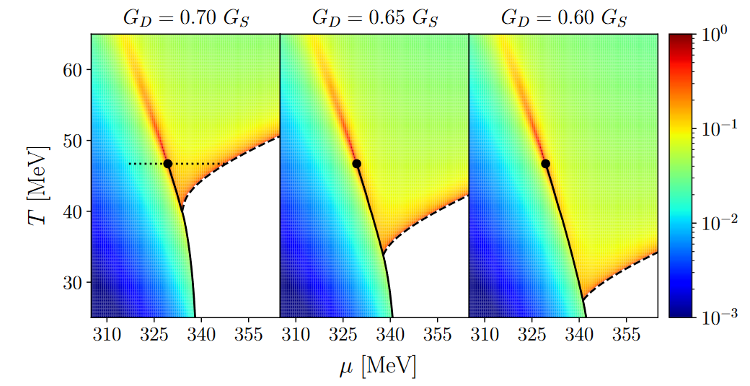

Electric Conductivity on QCD Phase Diagram
Nishimura, MK, Kunihiro (’24)
DPR in the low-energy limit = electric conductivity
Two “hot spots” on the $T$-$μ$ plane

Slide 32




Dilepton Yields: Beam-Energy Scan
Nishimura, Nara, Steinheimer, Eur.Phys.J.A 60, 2024
Dilepton yields
$≃$ integrated rate along isentropic lines
Dilepton Yields $50<M<100$ MeV
from 2SC
Isentropic lines in NJL model
peak from
QCD-CP
~$1/μ$
Effect of 1st-tr on evolution: Savchuk+ 2209.05267

Slide 33

Summary
The beam-energy scan will reveal rich structures on QCD phase diagram, such as the QCD critical point and color superconductivity.
Quantitative analysis of the size and lifetime of the dense region:
  $\sqrt{s_{NN}}≃3 GeV$may be an optimal energy to study $ρ=3\sim 4ρ_{0}$.
Phase transitions in dense quark matter may be detectable through the enhancement of the dilepton production rate at ultra-low-mass-region.

