Slide 1
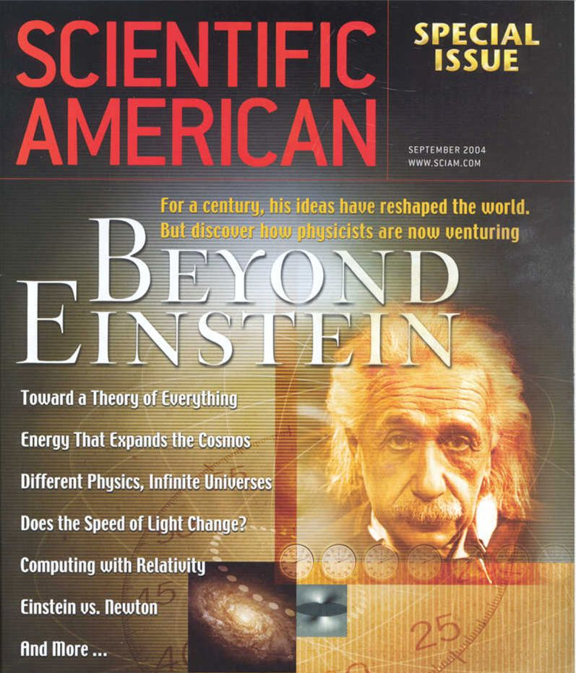

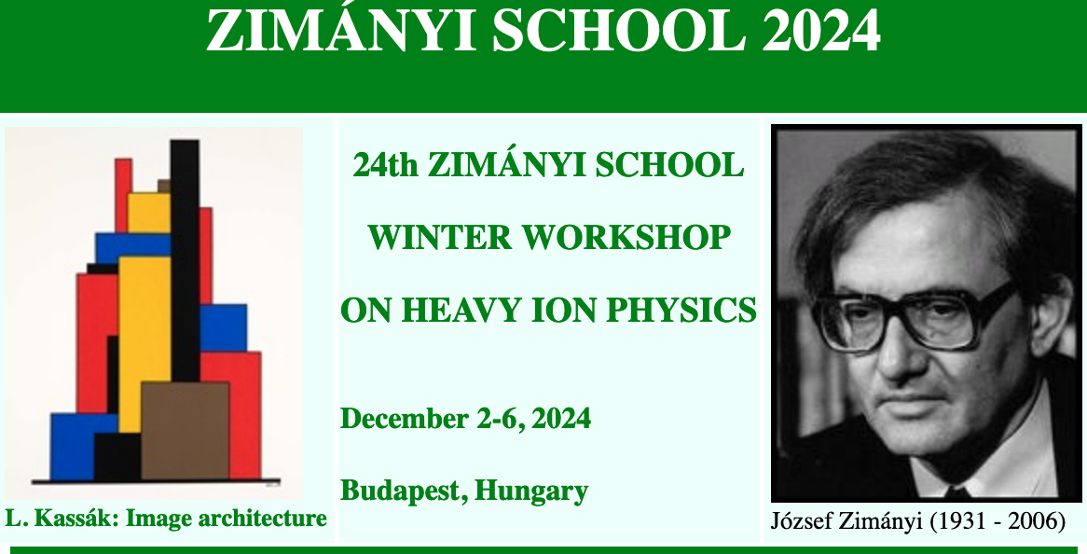
Modern Tests of Spacetime Symmetry
outline
1. Introduction
2. Test of Lorentz violation
3. Lorentz violation in astrophysics
Teppei Katori @teppeikatori
King’s College London
Ortvay colloquium, Eötvös Loránd University
Budapest, Hungary, Dec 5, 2024

Slide 2
Introduction

Slide 3
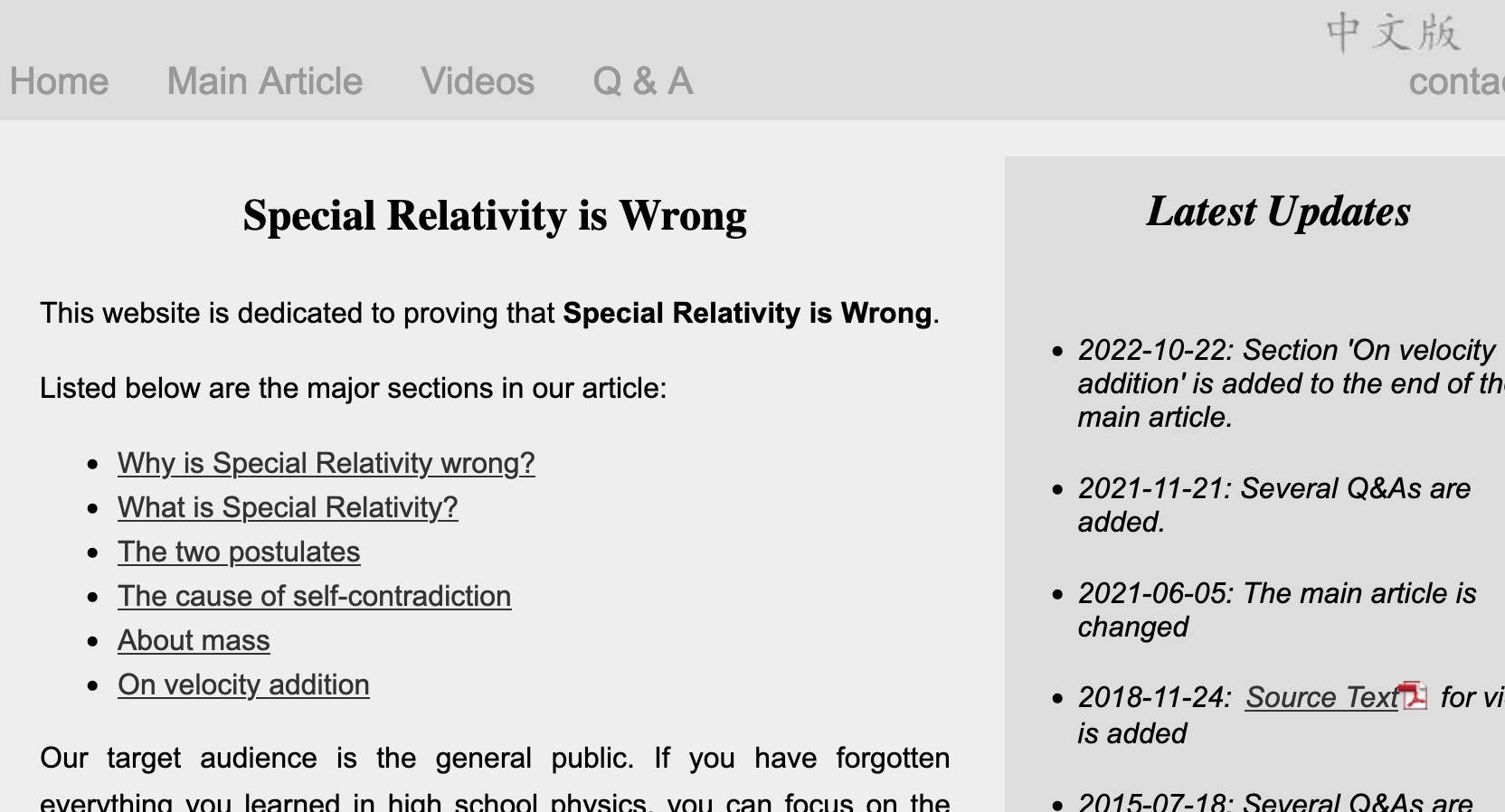
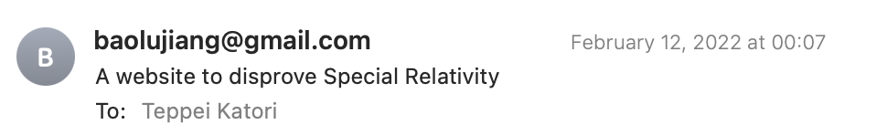
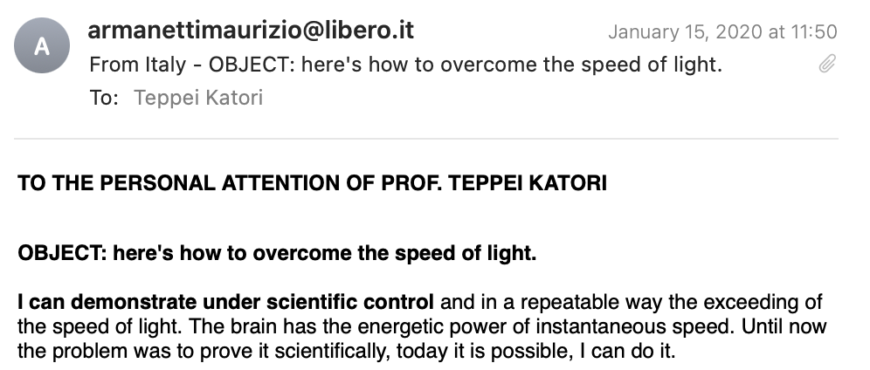
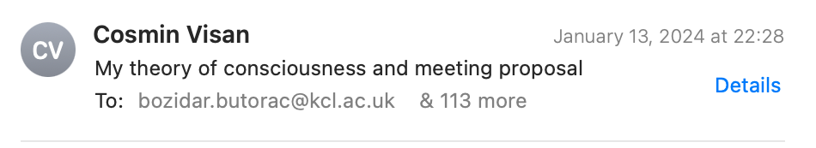
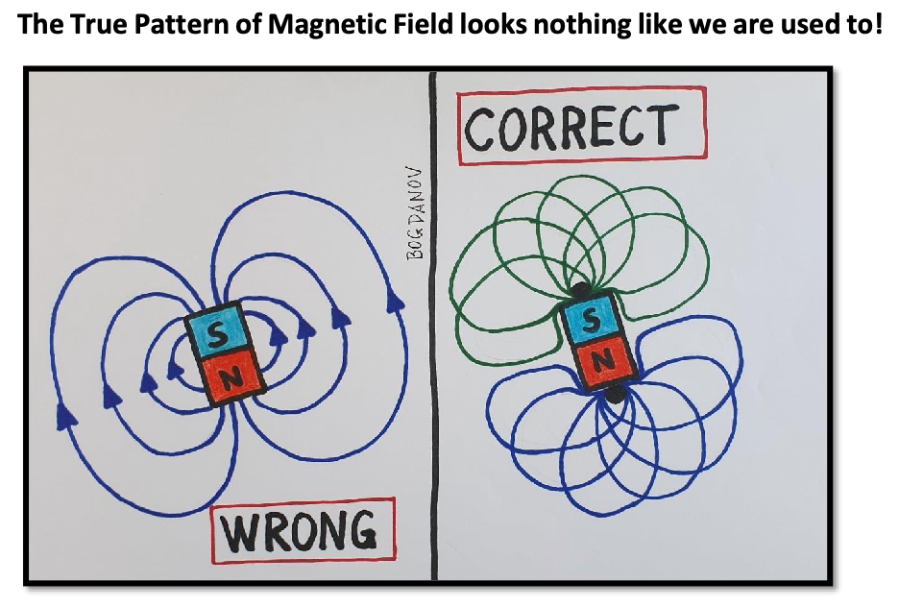
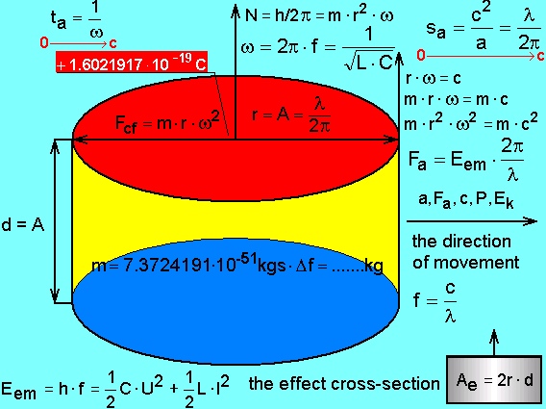
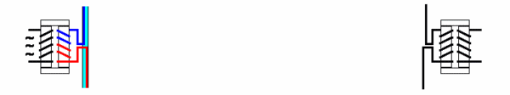
(I want to say) Einstein is wrong!
How to disprove Einstein’s theory scientifically???

Slide 4
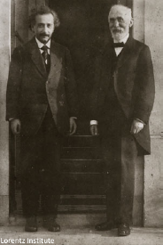
Theory of Special Relativity
Einstein and Lorentz
Special relativity is a basis of both quantum field theory and general relativity
Special relativity is based on Lorentz symmetry
Lorentz symmetry is isotropy of the spacetime
If the universe has a special direction, space doesn’t have Lorentz symmetry and Lorentz transformation is violated
→ Lorentz violation
All fundamental physics phenomena must be experimentally tested including Lorentz symmetry

Slide 5
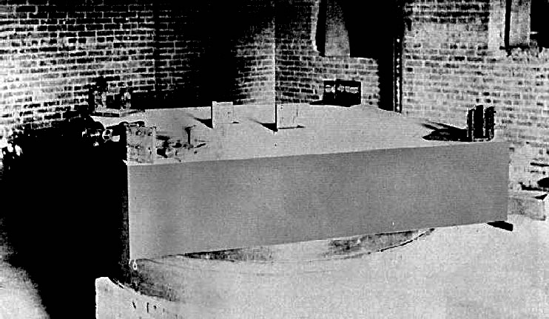
Michelson-Morley experiment
The experiment tried to measure the motion of the Earth relative to æther.
The experiment shows the speed of light is constant regardless the motion of the Earth.
This result suggests the isotropy of the space, and Lorentz symmetry.
Lorentz symmetry is valid down to Δc/c~10⁻⁹
mirror 1
beam splitter
lamp
mirror 2
telescope

Slide 6
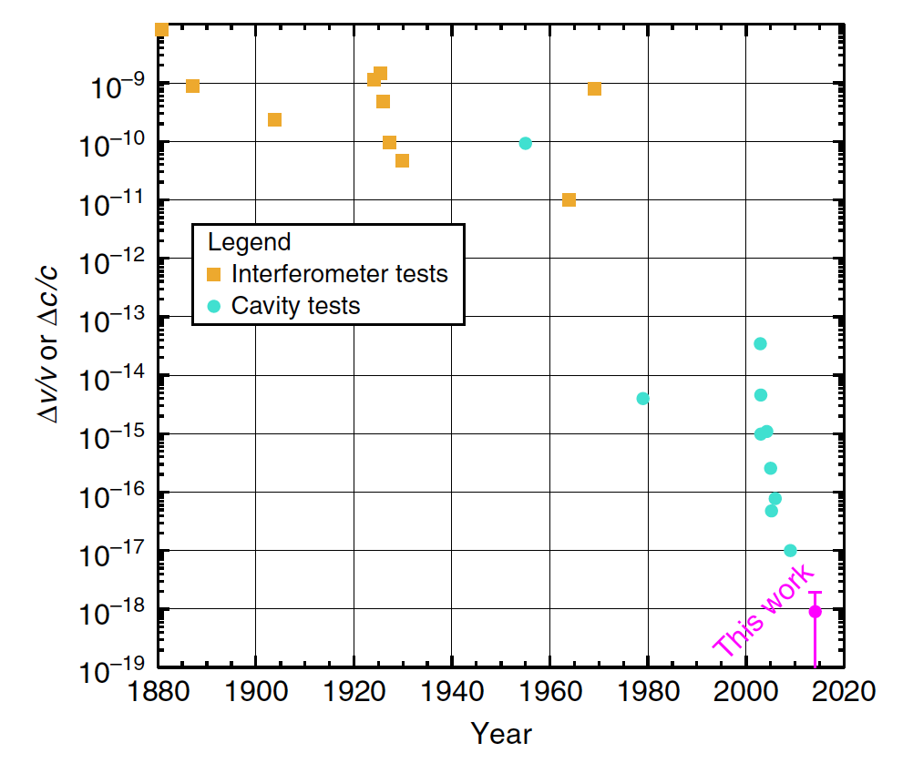
Michelson-Morley experiment
Nagel et al, Nature Comm., 6(2015)8174
The experiment has been improved over 100 years.

Slide 7
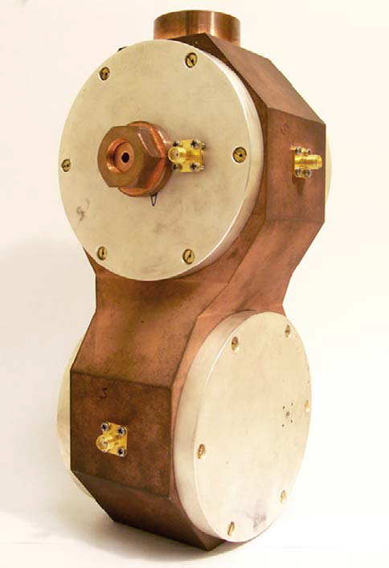
Michelson-Morley experiment
Nagel et al, Nature Comm., 6(2015)8174
The experiment has been improved over 100 years.
Technology shift (interferometer → optical cavity) around 2000s

Slide 8
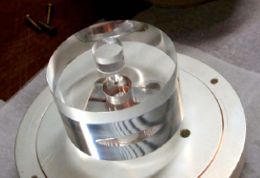
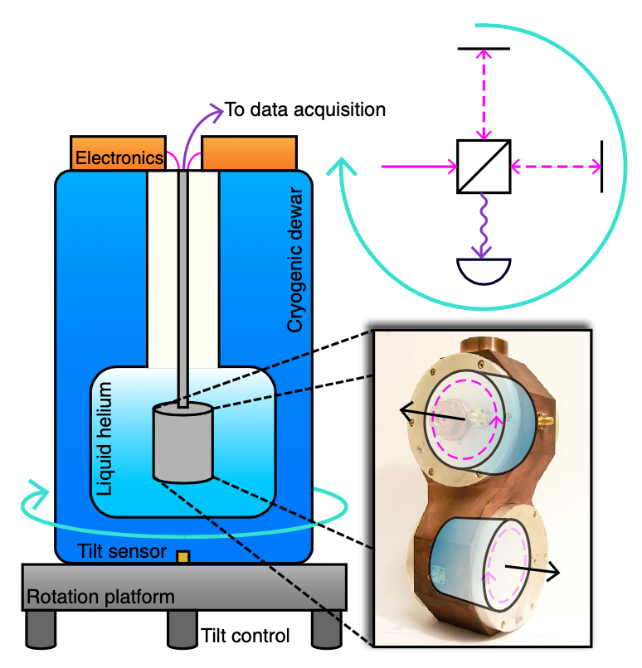
Optical cavity experiment
Nagel et al, Nature Comm., 6(2015)8174,
Modern Michelson-Morley experiment
- Saphire crystal resonator
- Whispering gallery mode
- Vacuum insulation, liquid helium cooling to 4K
- Turntable to actively rotate
This experiment is sensitive to the anisotropy of speed of light down to Δc/c~10⁻¹⁸
Why we keep testing this?
Why do we expect Lorentz violation?

Slide 9

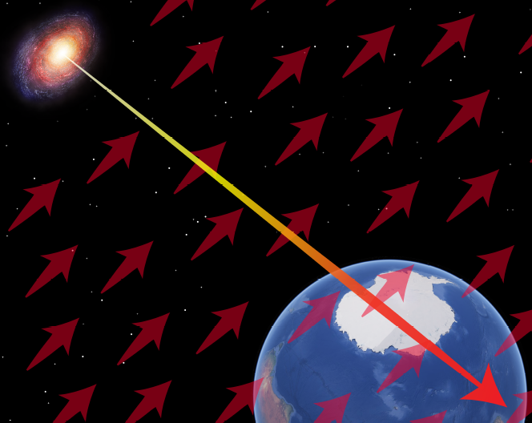
Quantum gravity
Progress in Particle and Nuclear Physics 125 (2022) 103948
Searching Lorentz violation is well motivated
Lorentz violation in Planck scale theories
- string theory
- noncommutative field theory
- quantum loop gravity
- extra dimensions
etc
Lorentz violation is seen as
- spacetime fluctuation
- background field in vacuum
etc
quantum foam
- quantum fluctuation of space-time
Lorentz violating field
- background field of the universe (æther)

Slide 10
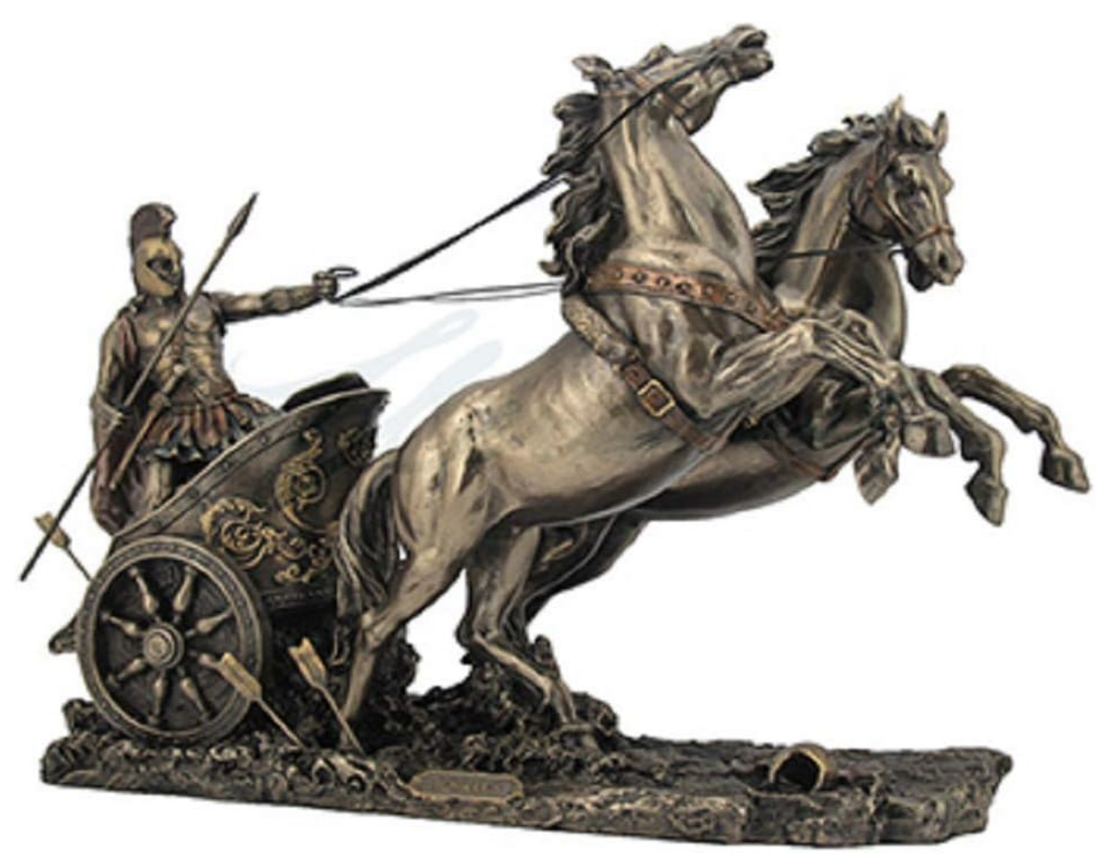
Quantum gravity
Searching Lorentz violation is well motivated
Quantum field theory and general relativity are the foundation of modern physics.
Lorentz symmetry is a basis for both quantum field theory and general relativity
How to formulate Lorentz violation in our theories?
Lorentz symmetry could be spontaneously broken, if so, this doesn’t violate existing framework of modern physics
General Relativity
Quantum Field Theory
Modern Physics
Lorentz symmetry

Slide 11
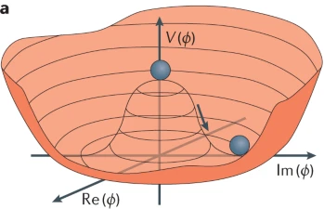
Spontaneous symmetry breaking
Nature has many examples of spontaneous symmetry breaking
- Condensed matter (magnetization, crystallization, etc)
- Phase transition in vacuum (Higgs mechanism, spontaneous Lorentz symmetry breaking)
Magnetization
Higgs mechanism
N
N
N
N
N
S
N
S
S
S
S
N
S
N
N
N
S
N
N
S
N
S
S
S
S
S
N
N
N
N
S
N
S
S
S
S

Slide 12
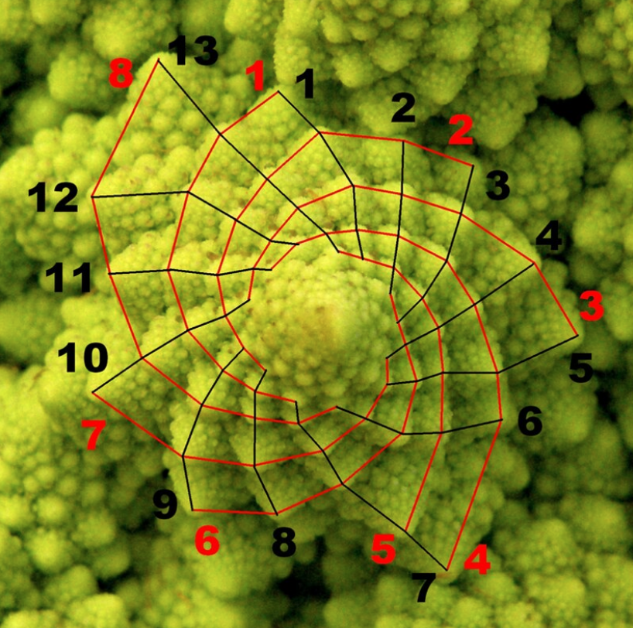
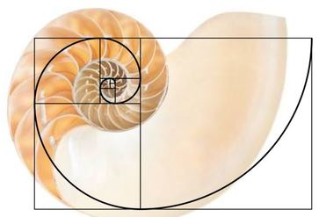
Spontaneous symmetry breaking
Searching Lorentz violation is well motivated
Math is a good approximation of nature
There is no perfect symmetry in nature, all somewhat broken
So why space-time symmetry is so perfect?!
Fibonacci number and broccoli
Golden ratio and seashell

Slide 13
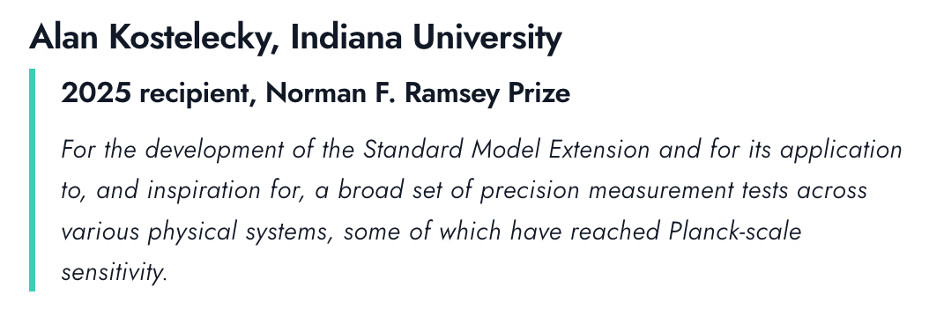
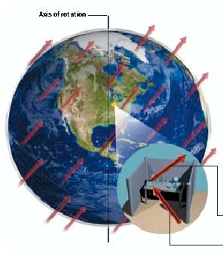
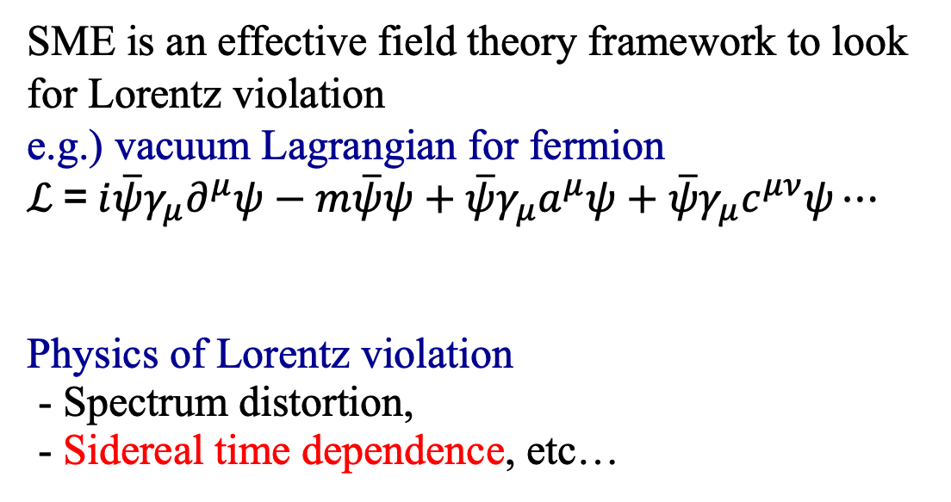
Standard-Model Extension (SME)
Search of Lorentz violation is to find anomalous effects due to the couplings of background fields and ordinary fields (electrons, muons, neutrinos, etc)
Scientific American (Sept. 2004)
SME is an effective field theory framework to look for Lorentz violation
e.g.) vacuum Lagrangian for fermion
$ℒ$ = $i\overline{ψ}γ_{μ}∂^{μ}ψ−m\overline{ψ}ψ+\overline{ψ}γ_{μ}a^{μ}ψ+\overline{ψ}γ_{μ}c^{μν}ψ⋯$
Physics of Lorentz violation
- Spectrum distortion,
- Sidereal time dependence, etc…
Standard Model
couplings with background fields
PM 5:58
AM 6:00
24h 00min 00sec: Solar day
23h 56min 4.1sec: Sidereal day
noon
noon

Slide 14
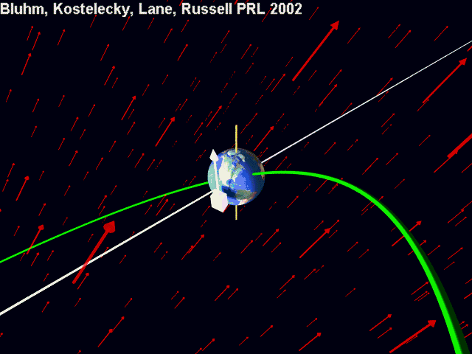

Slide 15
Tests of Lorentz violation

Slide 16
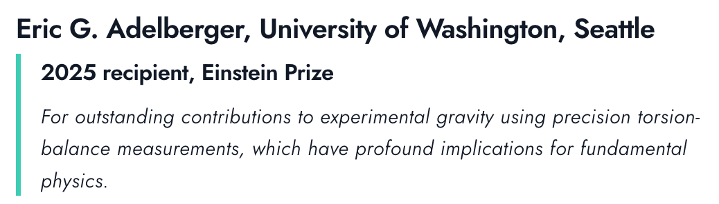
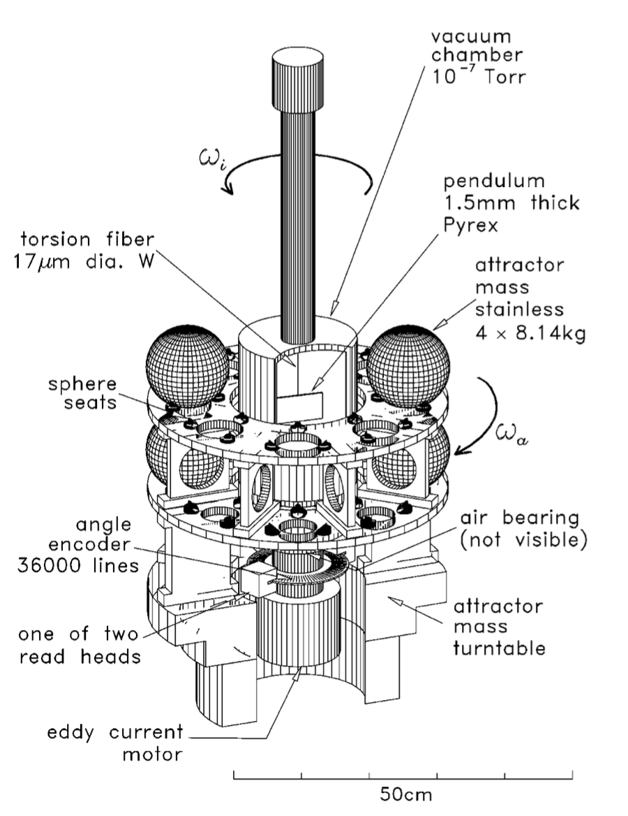
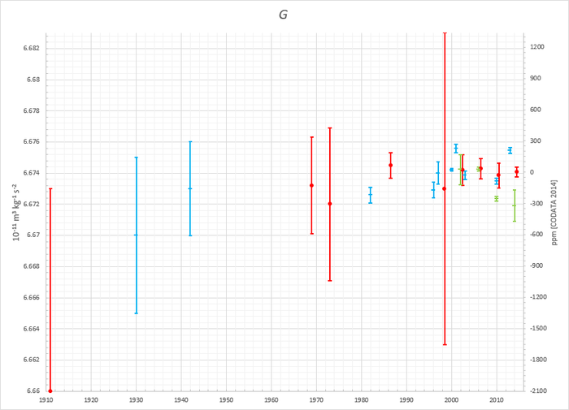
EötWash, PRL85(2000)2869, PRL100,(2008)041101
Torsion pendulum
Eötvös experiment → EötWash experiment
- Modern torsion balance
- Newton constant
- Equivalent of Principle
etc
EötWash
History of Newton constant measurement

Slide 17
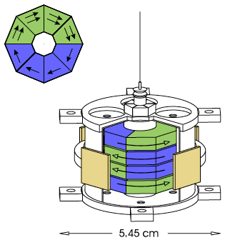
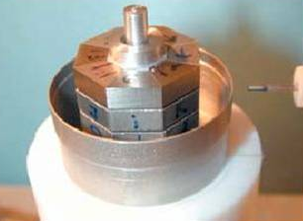
EötWash, PRL97(2006)021603 , PRL122(2019)231301
Torsion pendulum (electron)
Electron spin – background field coupling
- AlNiCo: all magnetic field is from electron spin
- SmCo₅: electron orbital motion creates magnetic field
- Magnetize them to cancel magnetic field, so that the pendulum has net electron spin
- Look for coupling between electron spin and background field

Slide 18
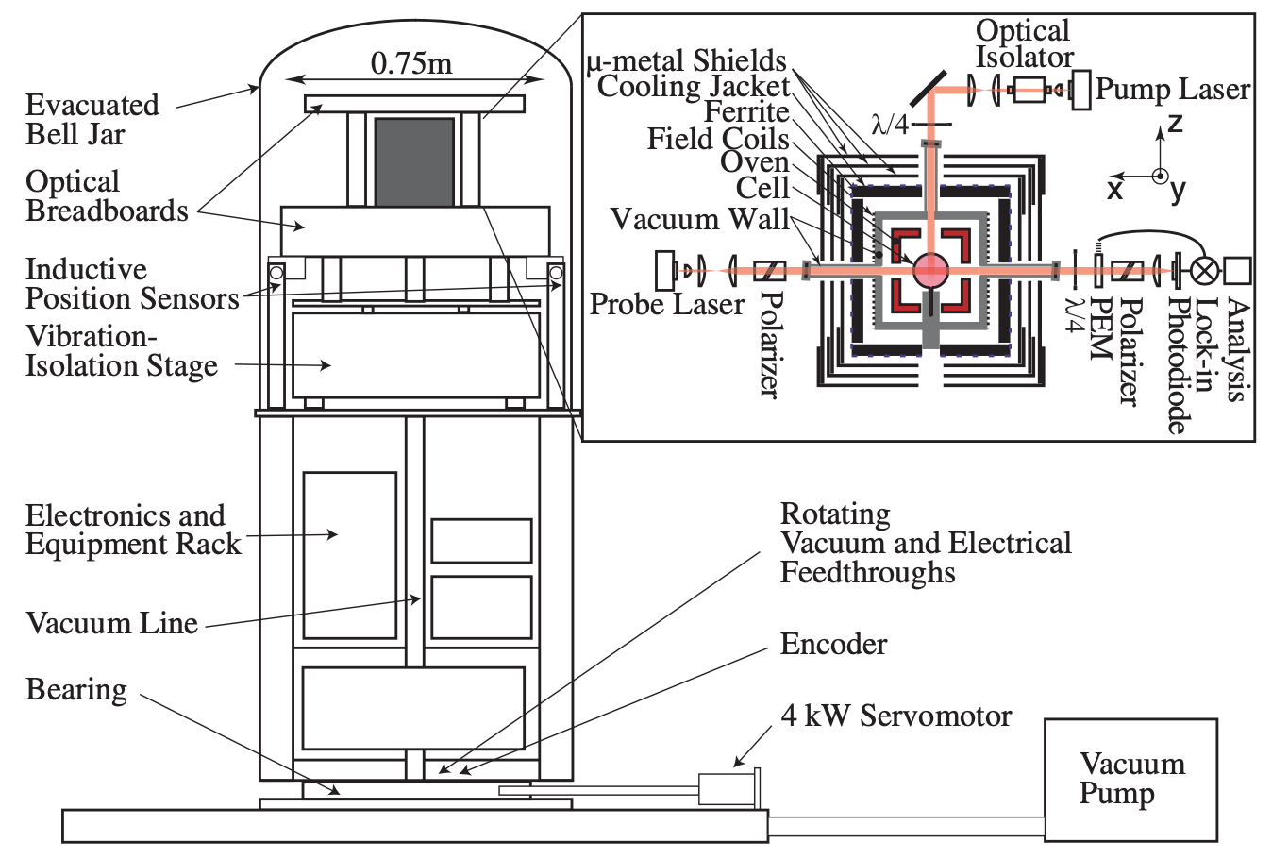
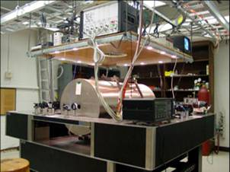
Double gas maser (neutron)
PRL105(2010)151604 and many others
The most sensitive magnetometer
- Optical pump for Rb, K
- Spin transfer to noble gas (Xe, ³He), monitor ³He precession
- Look for coupling between neutron spin and background field

Slide 19
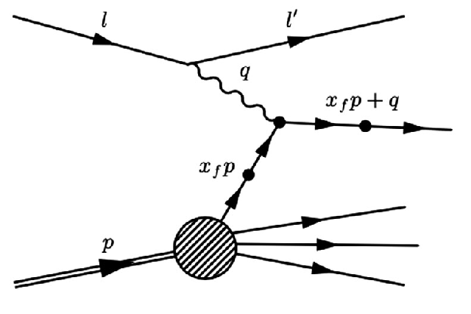
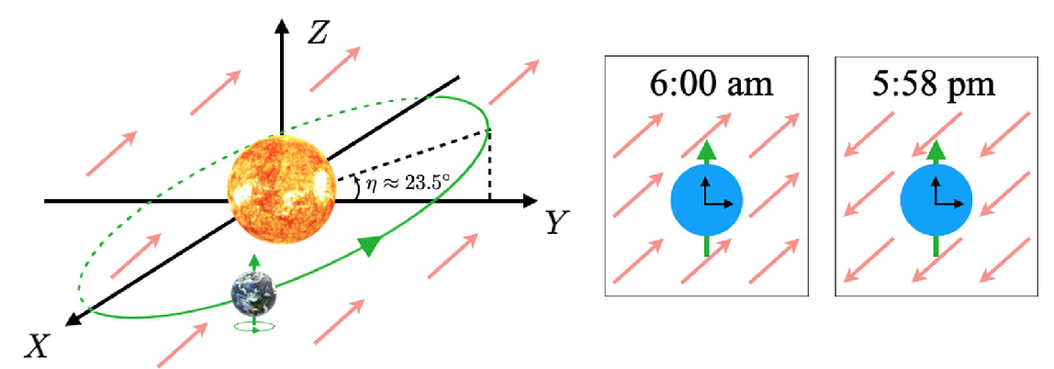

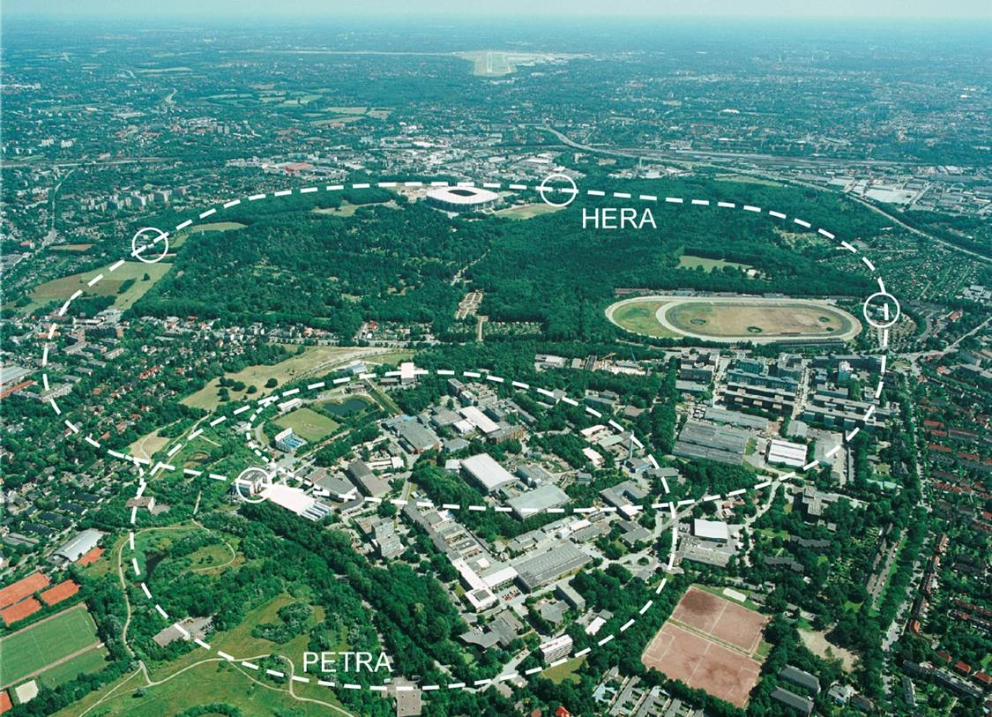
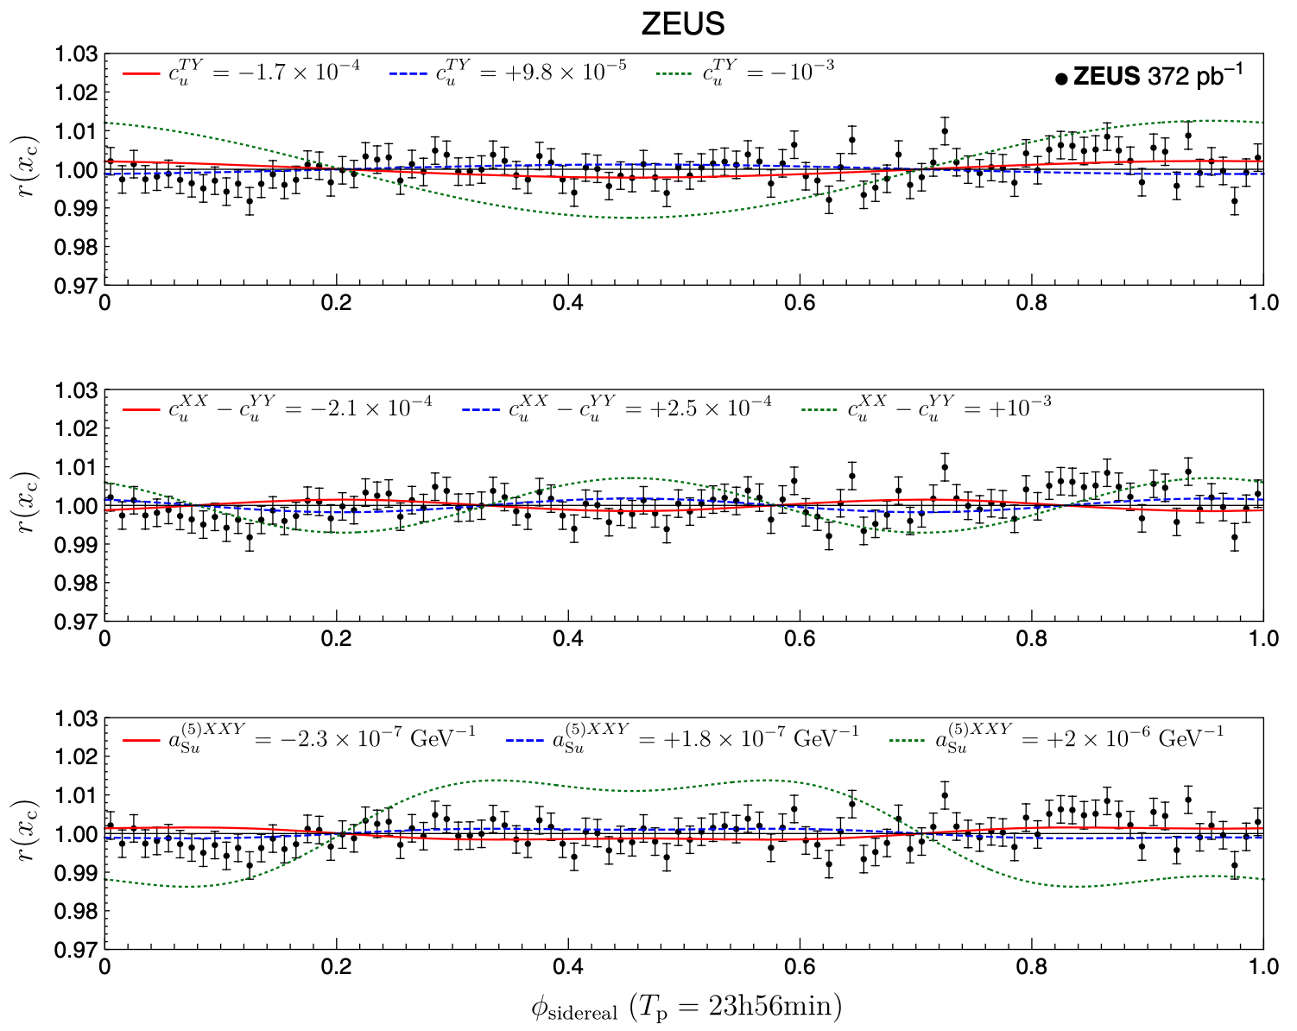
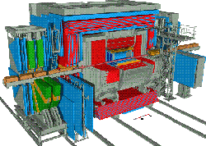
Collider physics (quarks)
ZEUS, PRD107(2023)092008 and many others
HERA p-e⁻ collider
- ZEUS deep-inelastic scattering data
- Monitor sidereal time dependence
- Similar tests are possible for other data

Slide 20

Neutrino physics
Neutrinos in the standard model
The standard model describes 6 quarks and 6 leptons and 3 types of force carriers.
Neutrinos are special because,
1. they only interact with weak nuclear force.
2. interaction eigenstate is not Hamiltonian eigenstate, and propagation of neutrinos changes their species (flavours), called neutrino oscillation.
ν_{μ}
μ
ν_{μ}
ν_{μ}
W
Z
d
u
u
u
Charged Current
(CC) interaction
“W-boson exchange”
Neutral Current
(NC) interaction
“Z-boson exchange”

Slide 21
Neutrino oscillation experiments
Neutrino oscillation is an interference experiment (cf. double slit experiment)
light source
slits
screen
ν₁
ν₂
interference pattern
For double slit experiment, if path ν₁ and path ν₂ have different length, they have different phases and it causes interference.

Slide 22
Neutrino oscillation experiments
Neutrino oscillation is an interference experiment (cf. double slit experiment)
ν_{μ}
ν_{μ}
Neutrino flavour eigenstates are super-position of Hamiltonian eigenstates ν₁ and ν₂

Slide 23
Neutrino oscillation experiments
Neutrino oscillation is an interference experiment (cf. double slit experiment)
ν_{μ}
U_{μ1}
ν₁
U_{e1}∗
ν₂
ν_{μ}
ν₂
ν₁
Neutrino flavour eigenstates are super-position of Hamiltonian eigenstates ν₁ and ν₂
Difference in velocities cause quantum interference

Slide 24
Neutrino oscillation experiments
Neutrino oscillation is an interference experiment (cf. double slit experiment)
ν_{e}
ν_{e}
ν_{e}
ν_{μ}
U_{μ1}
ν₁
U_{e1}∗
ν₂
ν_{μ}
ν_{e}
Neutrino flavour eigenstates are super-position of Hamiltonian eigenstates ν₁ and ν₂
Difference in velocities cause quantum interference
The detection may be different flavour (neutrino oscillations)

Slide 25
Neutrino oscillation experiments
Neutrino oscillation is an interference experiment (cf. double slit experiment)
ν_{e}
ν_{e}
ν_{e}
ν_{μ}
U_{μ1}
ν₁
U_{e1}∗
Background fields of universe
ν₂
ν_{μ}
ν_{e}
Neutrino flavour eigenstates are super-position of Hamiltonian eigenstates ν₁ and ν₂
Difference in velocities cause quantum interference
The detection may be different flavour (neutrino oscillations)
Neutrino propagation may be affected by background fields
→ anomalous neutrino oscillation results

Slide 26
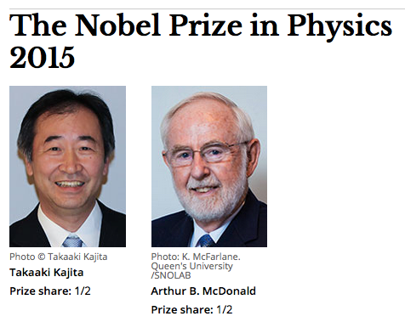
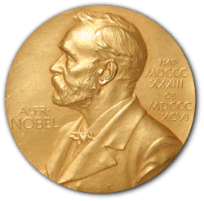
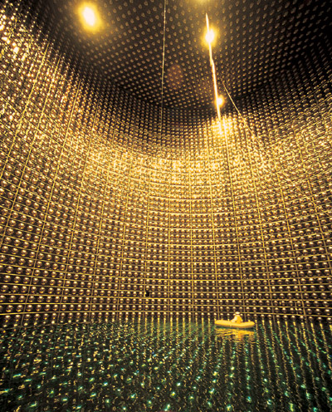
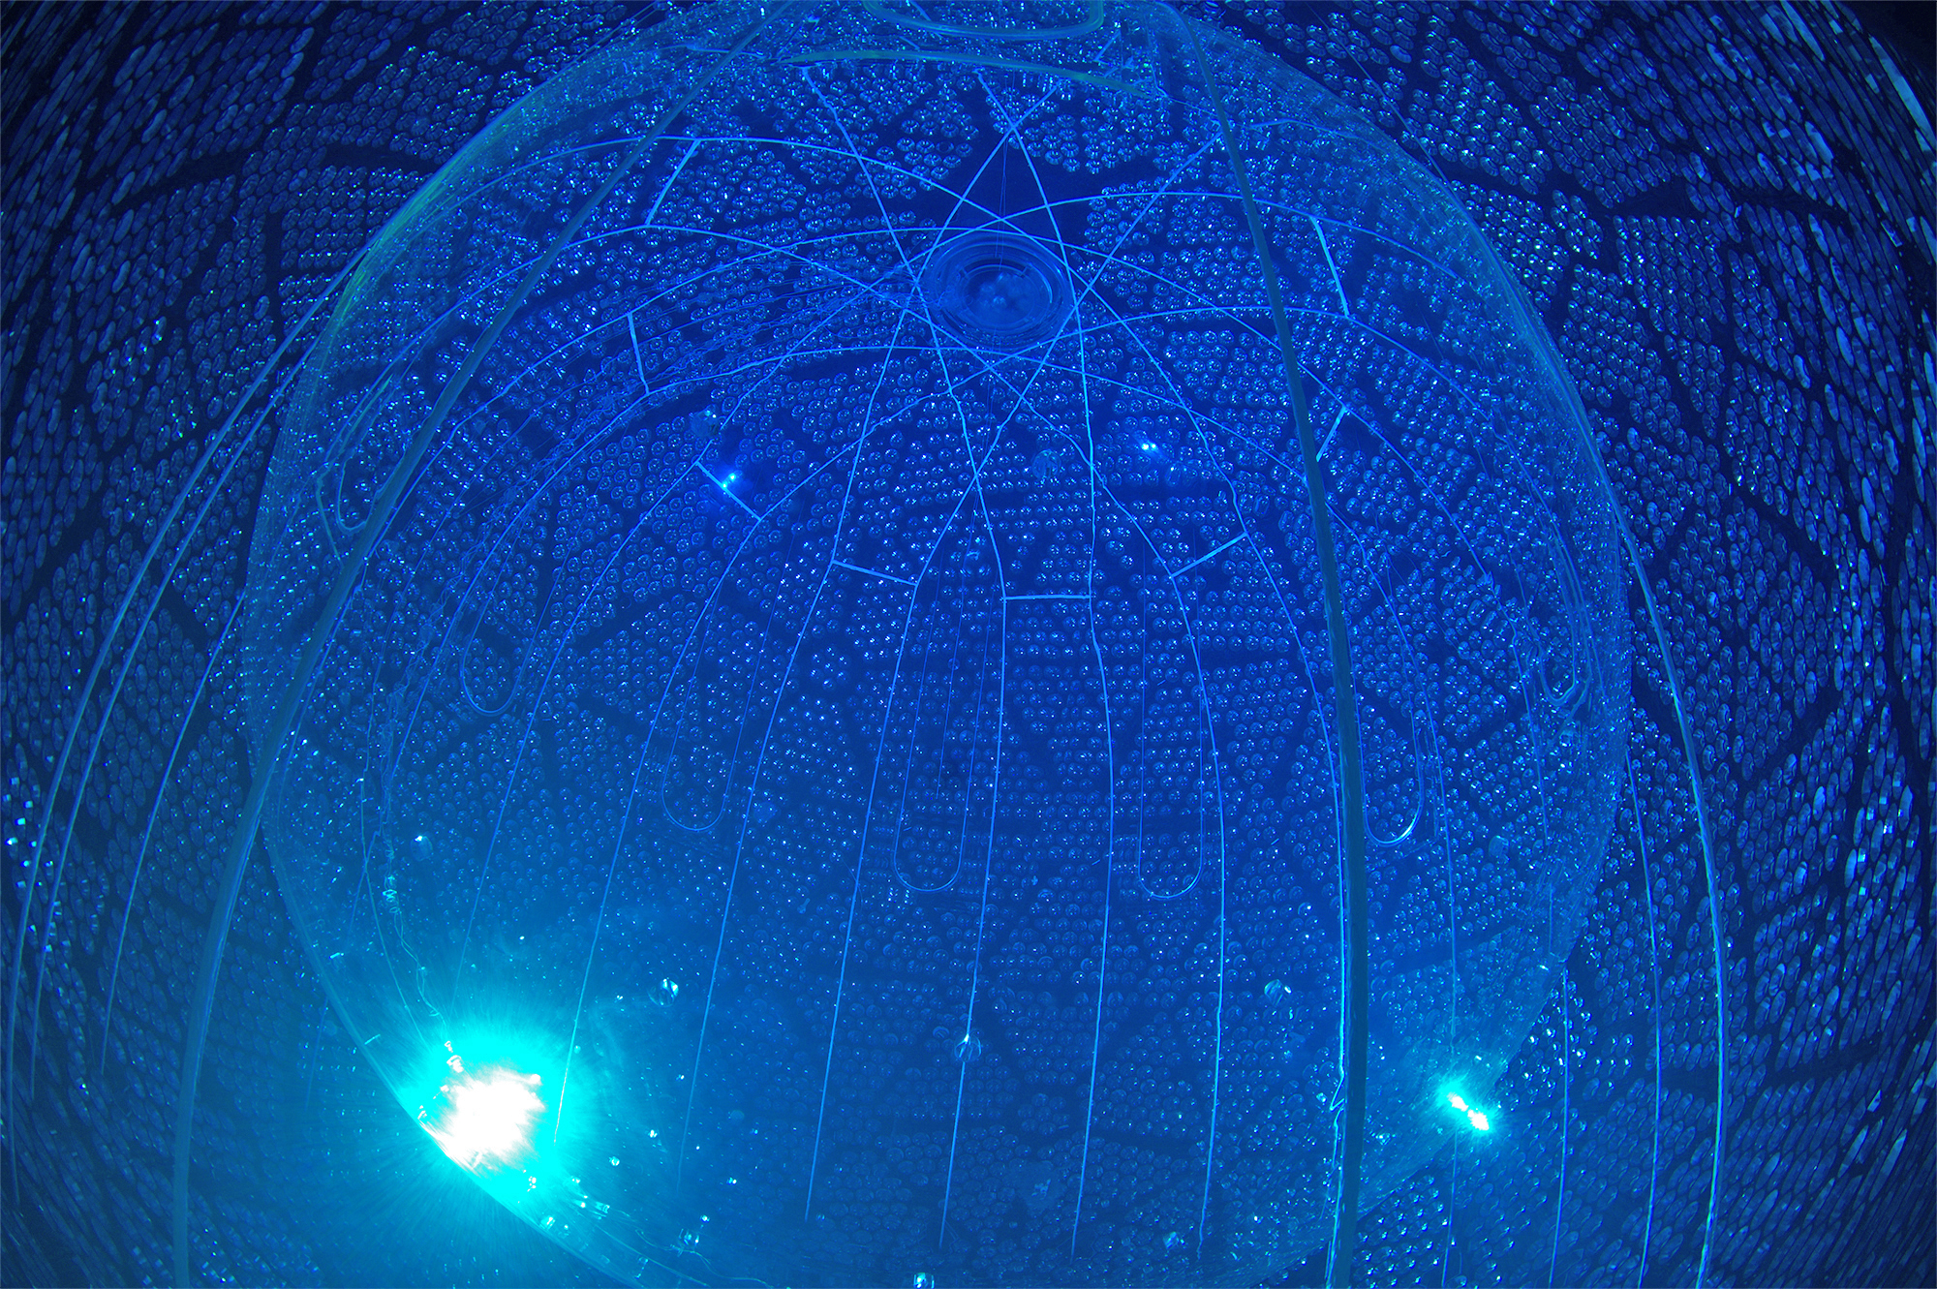
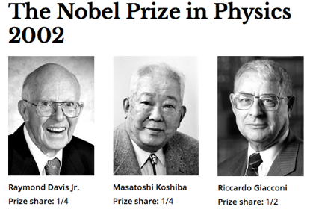
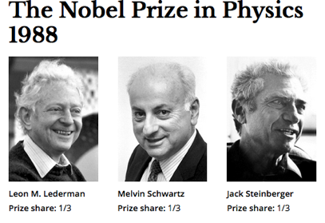
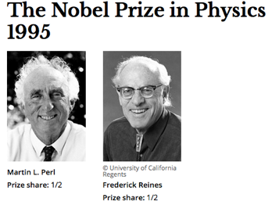
Neutrino oscillation experiments
LSND, PRD64(2001)112007, MiniBooNE, PRL121(2018)22180
Neutrino physics → Home of anomalies
- Solar and atmospheric neutrino anomalies (Nobel prizes, 2002, 2015)
Super-Kamiokande detector
SNO detector
40m

Slide 27
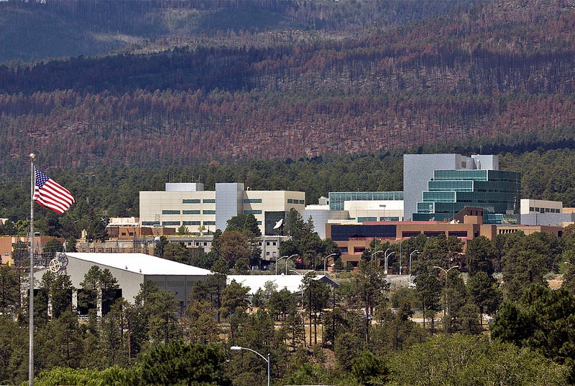
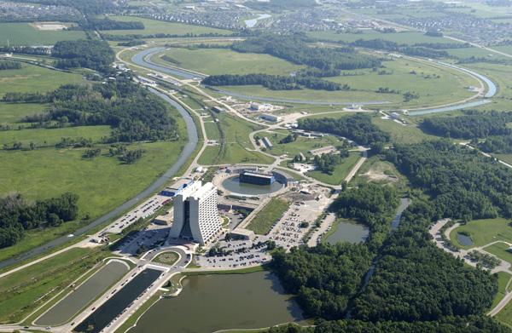


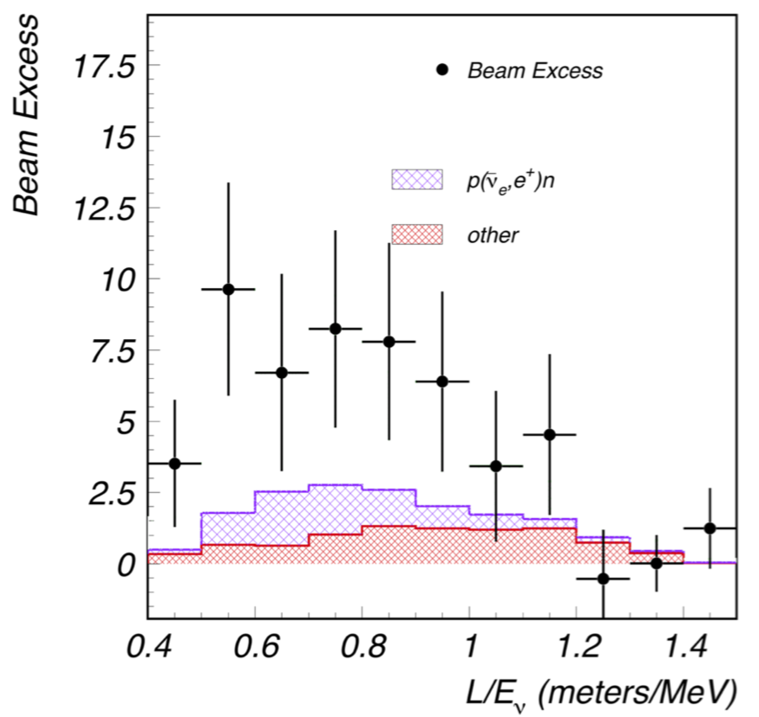
Neutrino oscillation experiments
LSND, PRD64(2001)112007, MiniBooNE, PRL121(2018)22180
Neutrino physics → Home of anomalies
- Solar and atmospheric neutrino anomalies (Nobel prizes, 2001, 2015)
- OPERA Neutrino-faster-than-Speed-of-Light (detector problem)
- LSND excess
- MiniBooNE excess
LSND excess
3.8σ
4.7σ
If these anomalous neutrino oscillation data are due to Lorentz violation, data may show sidereal time dependence
MiniBooNE excess

Slide 28
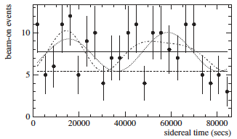
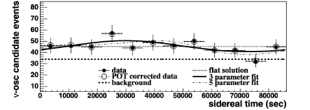
LSND, PRD72(2005)076004, MiniBooNE, PLB718(2013)1303, TK, MPLA27(2012)1230024
Neutrino oscillation experiments
Neutrino physics → Home of anomalies
- Solar and atmospheric neutrino anomalies (Nobel prizes, 2001, 2015)
- OPERA Neutrino-faster-than-Speed-of-Light (detector problem)
- LSND excess
- MiniBooNE excess
LSND excess
3.8σ
4.7σ
MiniBooNE excess
Lorentz violation cannot explain these excesses simultaneously

Slide 29
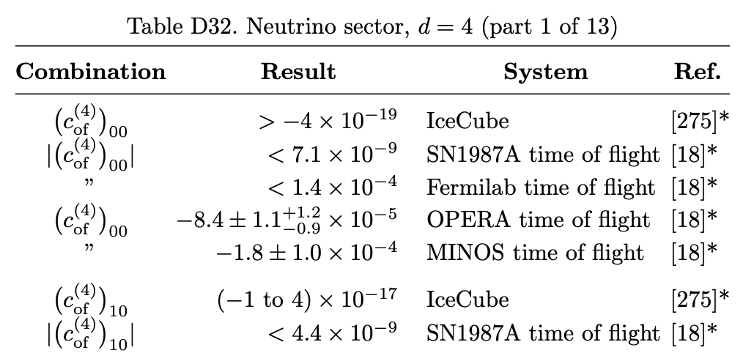
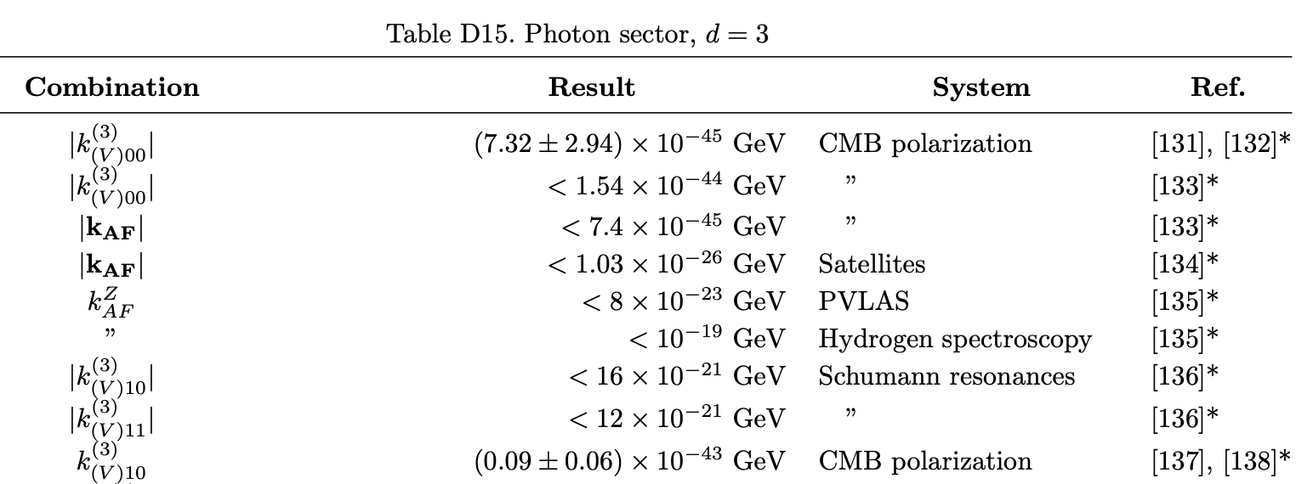


Tests of Lorentz violation – Summary
Limits of SME parameters are summarized in tables
https://arxiv.org/abs/0801.0287v17
So far, there is no compelling evidence of Lorentz violation

Slide 30

When do we find Lorentz violation???
Lorentz violation is motivated by Planck scale theories, so it is suppressed with the power of Planck mass ($\sim {10}^{19} GeV$)
$$\sim \frac{M}{M_{Pl}}, {\left(\frac{M}{M_{Pl}}\right)}^{2}, etc$$
In effective field theory, non-renormalizable operators are the signature of new physics, dimension analysis guides target sensitivity to look for Lorentz violation.
dimension-5 LV operator $<{10}^{−19} {GeV}^{−1}$
dimension-6 LV operator $<{10}^{−38} {GeV}^{−2}$
etc
These numbers can be used as a
guidance to design new experiments
Steven Weinberg
(CERN Courier Nov. 2017)
“We don’t know anything about non-renormalizable interaction terms, but I’ll swear they are there!’

Slide 31
Tests of Lorentz violation – Astrophysics
Terrestrial experiments
- controlled, high-precision
- various systems (optics, pendulum, gas, particle physics, etc)
So far, no compelling evidence of Lorentz violation
Astrophysical and cosmological experiments
- not controlled, low-precision
- extreme systems (highest energy, longest distance, etc)
- more sensitive to nonrenormalizable operators

Slide 32
Tests of Lorentz violation in Astrophysics

Slide 33







Lorentz violation in Astrophysics
Progress in Particle and Nuclear Physics 125 (2022) 103948
Highest energy particles – Ultra-high-energy cosmic rays
Longest propagating particles – Gravitational waves, cosmic microwave background
High-energy and long propagation – Gamma-ray, High-energy astrophysical neutrinos

Slide 34

Amelino-Camelia et al, Nature 393(1998)763, Stecker, et al, PRD91(2015)045009, and many others
Cut-off in high-energy cosmic ray spectrum
Lorentz violation = media in vacuum
- Attenuate high-energy cosmic rays?
High-energy astrophysical neutrino spectrum

Slide 35

Amelino-Camelia et al, Nature 393(1998)763, Auger, JCAP01(2022)023, and many others
Cut-off in high-energy cosmic ray spectrum
Lorentz violation = media in vacuum
- Attenuate high-energy cosmic rays?
Without LV
With LV
A=1
2≤A≤4
5≤A≤22
23≤A≤38
39≤ A≤ 56
Ultra-high-energy cosmic ray spectrum

Slide 36




Huang and Ma, Communications Physics1(2018)62, Amelino-Camelia et al, Nature Astronomy 7(2023)996 and many others
Time delay of high-energy cosmic rays
Lorentz violation = media in vacuum
- Time difference between photons and neutrinos?
Gamma Ray Bursts
- Not identified as point neutrino sources
- Time delay or advance proportion to neutrino energy and sign may fit with data
Lorentz violation
neutrino
photon

Slide 37


IceCube, Nature Physics 18(2022)1287
Anomalous neutrino mixings in vacuum
Lorentz violation = media in vacuum
- Neutrino oscillations are affected by media
- If the universe is saturated with background field, they would affect flavours of astrophysical neutrinos
Sensitive to the target signal region of Lorentz violation ($<{10}^{−38} {GeV}^{−2}$ for dimension-6 operators), no anomalous neutrino oscillation is discovered yet

Slide 38
Neutrino astronomy – Summary
Neutrino astronomy has a high potential to look for Lorentz violation. But there are many unknowns;
- Energy spectrum
- Sources (5 known sources, Sun, SN1987, TXS0506+056, NGC1068, Galactic plane)
- Flavour structure
So far, astrophysical neutrino data are low statistics and further data are needed to search Lorentz violation

Slide 39





Hyper-Kamiokande, ArXiv:1805.04163
Hyper-Kamiokande and IceCube-Gen2
New international neutrino astronomy projects around the world
Hyper-K construction is ongoing
71 m
Super-Kamiokande
68 m
40m

Slide 40




IceCube-Gen2, J.Phys.G48(2021)060501
Hyper-Kamiokande and IceCube-Gen2
New international neutrino astronomy projects around the world
IceCube (~1Gton)
Gen2-Optical (~8 Gton)
DeepCore (>7 GeV)
IceCube-Upgrade (>3GeV)
IceCube
DeepCore
The first stage of Gen2 (IceCube upgrade) is ongoing

Slide 41
Conclusion
Lorentz violation is motivated from Planck-scale theories
There is a worldwide effort to look for Lorentz violation, using various state-of-the-art techniques, but so far no compelling evidence of Lorentz violation
Neutrino oscillation and neutrino astronomy are powerful tools to look for Lorentz violation
Merry Christmas!

Slide 42
Backup

Slide 43


Müller et al., PRL100(2008)031101 and others
Gravity test
Matter wave interferometer

Slide 44
IceCube detector
digital optical module (DOM)

Slide 45

High-energy astrophysical neutrinos
Kowalski, TeVPA 2017
Above ~100 TeV, neutrinos are only particles pointing to their high-energy sources

Slide 46





High-energy astrophysical neutrinos
IceCube, PRD104(2021)022002
60TeV- 2PeV astrophysical neutrinos are observed by IceCube Neutrino Observatory
high-energy starting event (HESE) sample
Northern Sky (up-going)
2. High-energy astrophysical neutrinos
Southern Sky (down-going)
“Bert”
1.1 PeV
“Big Bird”
2.0 PeV
“Ernie”
1.0 PeV

Slide 47




IceCube event morphology
IceCube-Gen2, J.Phys.G48(2021)060501
Track
ν_{μ}CC
$$ν_{μ}+N→μ+X$$
Cascade
ν_{e}CC, ν_{τ}CC, NC
$$ν_{e}+N→e+X$$
$$ν_{τ}+N→τ+X$$
$$ν_{x}+N→ν_{x}+X$$
Double cascade
ν_{τ}CC (L~50m•E/PeV)
$$ν_{τ}+N→τ+X$$
$τ→X′$

Slide 48



Spontaneous symmetry breaking (SSB)
vacuum Lagrangian for fermion
$$L=i\overline{ψ}γ_{μ}∂^{μ}ψ$$
SSB
In the Standard Model, a phase transition of a scalar field gives nonzero field value in vacuum
φ
$$L=\frac{1}{2}{\left(∂_{μ}φ\right)}^{2}−\frac{1}{2}μ^{2}φ^{2}−\frac{1}{4}λφ^{4}$$

Slide 49

Spontaneous symmetry breaking (SSB)
vacuum Lagrangian for fermion
$$L=i\overline{ψ}γ_{μ}∂^{μ}ψ$$
$$−m\overline{ψ}ψ$$
φ
SSB
In the Standard Model, a phase transition of a scalar field gives nonzero field value in vacuum
φ
Particle acquires mass term!
$$L=\frac{1}{2}{\left(∂_{μ}φ\right)}^{2}−\frac{1}{2}μ^{2}φ^{2}−\frac{1}{4}λφ^{4}$$

Slide 50
Spontaneous Lorentz symmetry breaking (SLSB)
vacuum Lagrangian for fermion
$$L=i\overline{ψ}γ_{μ}∂^{μ}ψ$$
$$−m\overline{ψ}ψ$$
φ
SSB
In the Standard Model, a phase transition of a scalar field gives nonzero field value in vacuum
In String Theory, a vector field can be frozen in vacuum by spontaneous symmetry broken
φ
φ
SLSB
a^{μ}
$$L=\frac{1}{2}{\left(∂_{μ}φ\right)}^{2}−\frac{1}{2}μ^{2}φ^{2}−\frac{1}{4}λφ^{4}$$

Slide 51

Spontaneous Lorentz symmetry breaking (SLSB)
vacuum Lagrangian for fermion
$$L=i\overline{ψ}γ_{μ}∂^{μ}ψ$$
$$−m\overline{ψ}ψ$$
$$+\overline{ψ}γ_{μ}a^{μ}ψ$$
φ
SSB
In the Standard Model, a phase transition of a scalar field gives nonzero field value in vacuum
In String Theory, a vector field can be frozen in vacuum by spontaneous symmetry broken
φ
φ
a^{μ}
SLSB
Lorentz symmetry is spontaneously broken!
a^{μ}
$$L=\frac{1}{2}{\left(∂_{μ}φ\right)}^{2}−\frac{1}{2}μ^{2}φ^{2}−\frac{1}{4}λφ^{4}$$

Slide 52
Particle and Observer Lorentz transformation
y
x

Slide 53
Particle and Observer Lorentz transformation
hypothetical background vector field
moving particle
Einstein
(observer)
y
x

Slide 54
Particle and Observer Lorentz transformation
Under the particle Lorentz transformation:
y
x

Slide 55
Particle and Observer Lorentz transformation
Under the particle Lorentz transformation:
Lorentz violation is observable when a particle is moving in the fixed coordinate space
y
Lorentz violation!
x
Notes:
particle motion depends on direction

Slide 56
Particle and Observer Lorentz transformation
Under the particle Lorentz transformation:
Under the observer Lorentz transformation:
Lorentz violation is observable when a particle is moving in the fixed coordinate space
y
y
x
x

Slide 57
Particle and Observer Lorentz transformation
Under the particle Lorentz transformation:
Under the observer Lorentz transformation:
Lorentz violation is observable when a particle is moving in the fixed coordinate space
y
y
x
x

Slide 58
Particle and Observer Lorentz transformation
Under the particle Lorentz transformation:
Under the observer Lorentz transformation:
Lorentz violation cannot be generated by observers motion (coordinate transformation is unbroken)
all observers agree for all observations
Lorentz violation is observable when a particle is moving in the fixed coordinate space
y
y
x
x
Notes:
Lorentz violating effect in one frame is conserved in other frame

