Slide 1
Status of ZDC air-core cables and activities in LHC
06-December-2024
Marco Ciapetti

Slide 2
Introduction
For phase 2, ZDC will require 10 air-core cables on each side (total 20 cables).
4+4 cables have been installed during LS2 and will be kept in LS3.
For the remaining 6 cables per side, there are currently two options:
Install 6+6 new air-core cables from TAXN arm 1 and TAXN arm 2 to USA15 rack Y.30-11.A1
Re-use the currently installed air-core cables of ALFA (4+4) and AFP (2+2)
Due to the difficulty of the installation and the economic aspects, option 2 would be preferable, but the actual conditions of the cables must be tested to proof that they will fulfil ZDC requirements
In case option 1 will be chosen, ALFA and AFP cables must be removed, before the installation of the new cables for ZDC
As a reminder, in any case in LS3 all cables will be removed from the LHC tunnel up to the door of survey galleries (to allow the civil engineering works). This activity is under the responsibility of BE-EA

Slide 3
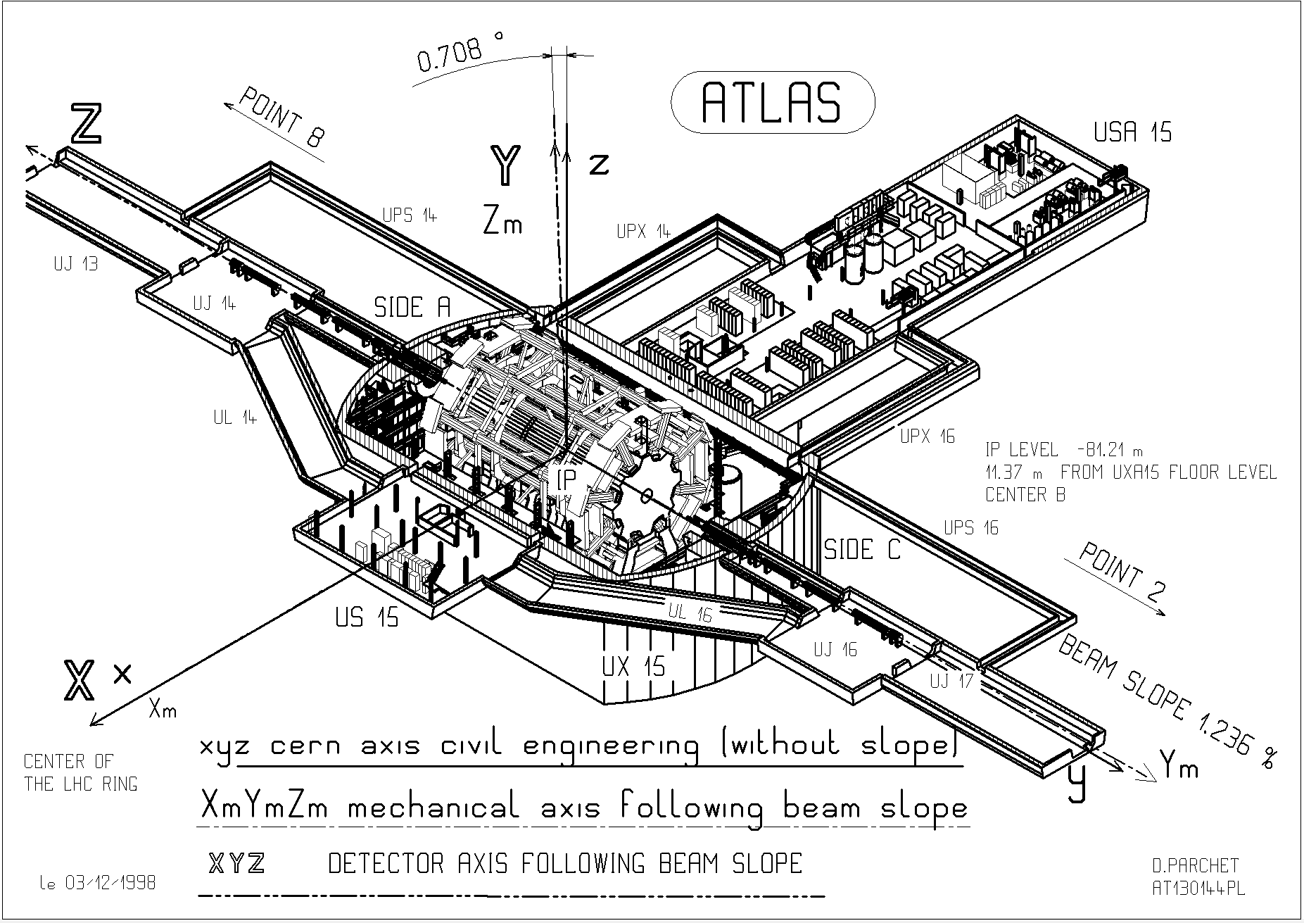
Routing scheme
TAN
Survey gallery
Y.30-11.A1
ALFA + AFP cables
Survey gallery
ZDC cables
TAN

Slide 4
Status in USA15
As shown in the previous picture, the ALFA and AFP air-core cables enter in UX15 from the UPS galleries, and they arrive in Z0 at level 4, where they enter the holes in the concrete wall to reach USA15.
ALFA and AFP air-core end very close to the entrance hole. From there, CC50 cables connect them to rack Y.15-02.A1
ZDC cables, instead, have a similar path up to Z0, but then they go down to enter the TE16 technical gallery and reach the proximity of rack Y.30-11.A1. From there, short CC50 cables connect them to rack
If the test result on ALFA and AFP cables is positive, before choosing which option is preferred, ZDC will have to confirm the maximum length of the CC50 cables: indeed, the distance from the ending point of ALFA and AFP air-core cables in USA15 and rack Y.30-11.A1 is much longer than the distance from the ending point of ZDC and rack Y.30-11.A1.
Length estimation to be done in case of need

Slide 5
Status in LHC
On Monday December 9th, BE-EA-EC (Gianluca and Mohamed) have organized a meeting with Surveyors team (Vincent) in the situ to clarify the open points for cabling in UPS14 and UPS16.
The test on ALFA and AFP air-core cables is foreseen to take place on Tuesday December 10th (IMPACT 242452)
Due to a transport of a heavy load in the arm 1-2 that will take place around 09:00, the test will be performed at first in arm 8-1 and then in arm 1-2.
All cables ALFA and AFP are already disconnected on LHC side.
Each day of next week BE-EA-EC (Gianluca and Mohamed) have organized a meeting with each responsible of the Forward Detectors in both arms (1-2 and 8-1) to clarify the cables to be removed in LS3 (IMPACT 236002): ZDC on Monday, ALFA+AFP on Tuesday, BRAN on Wednesday, LHCf on Thursday

