Slide 1

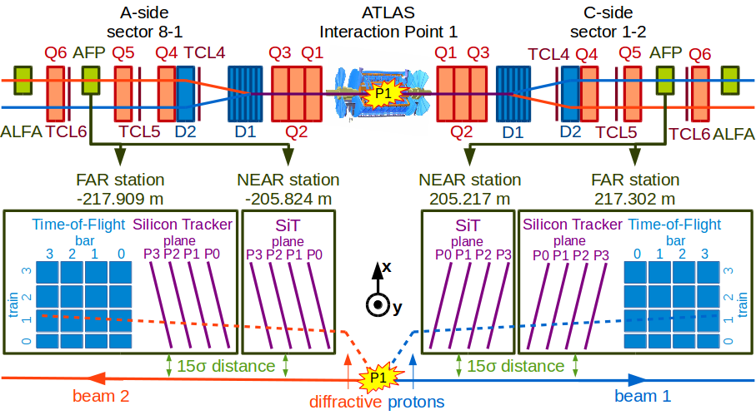
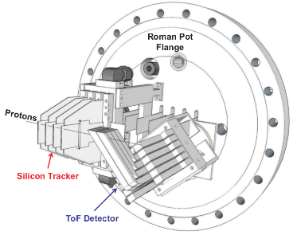
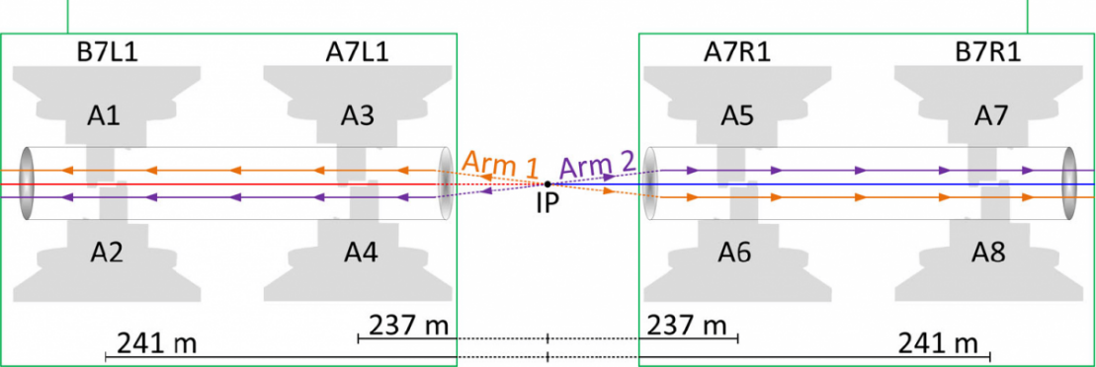
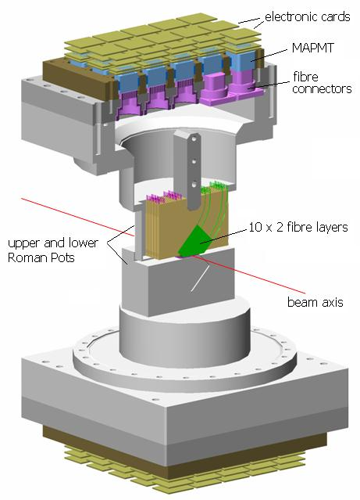
ARP YETS 2024 activities
LHC Tunnel Region Experiments Working Group (TREX)
Marko Milovanovic
06.12.2024.

Slide 2
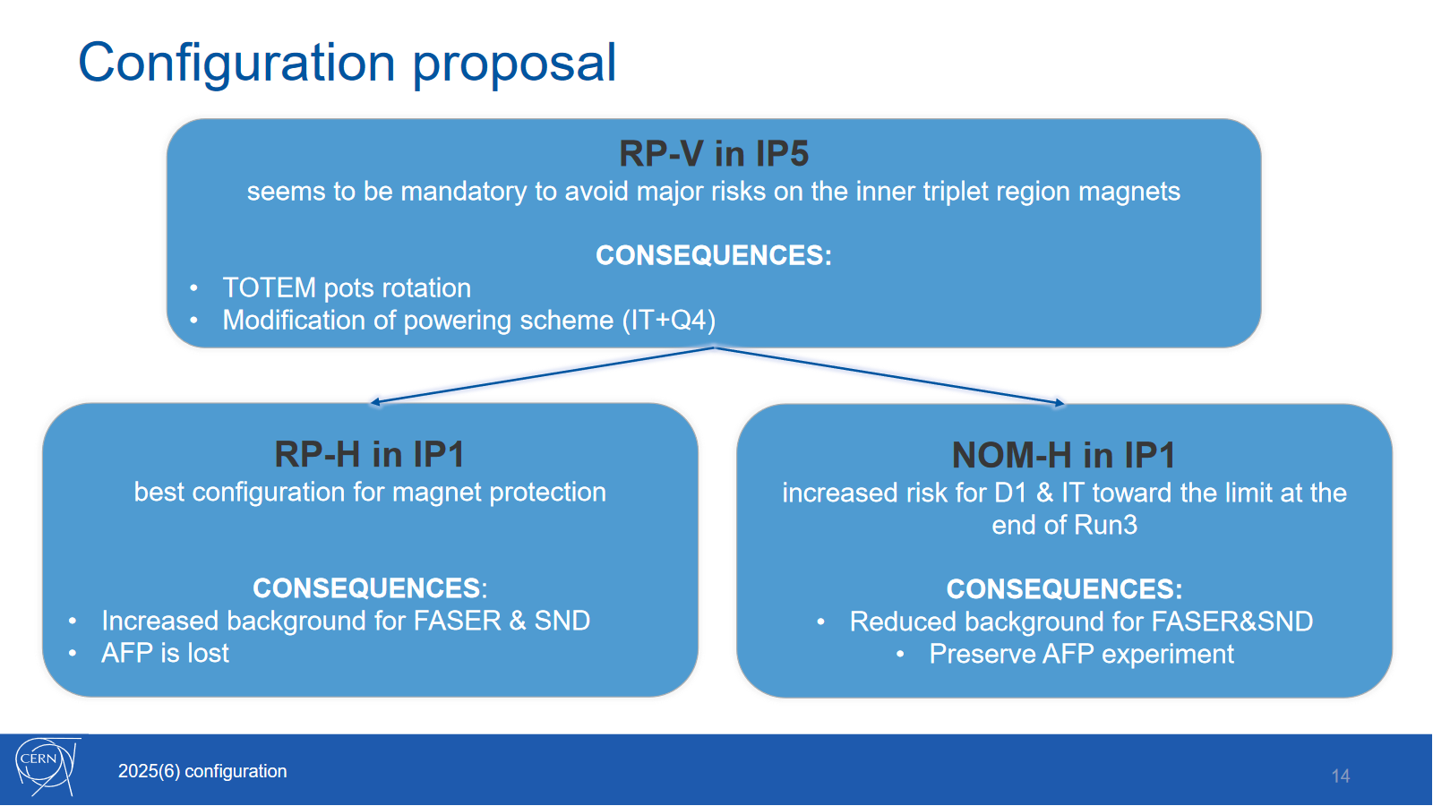
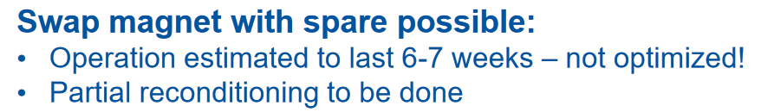
LHC Optics configuration for 2025/26
LHC-BOC final decision:

Slide 3
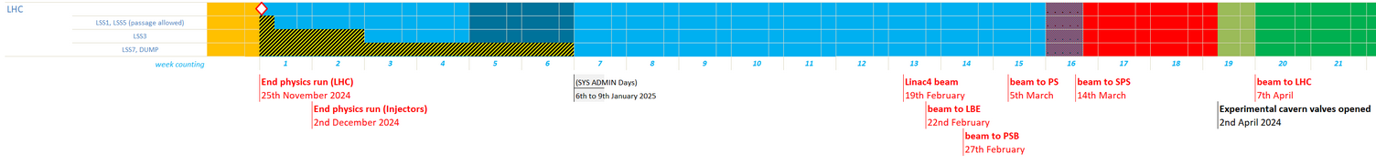
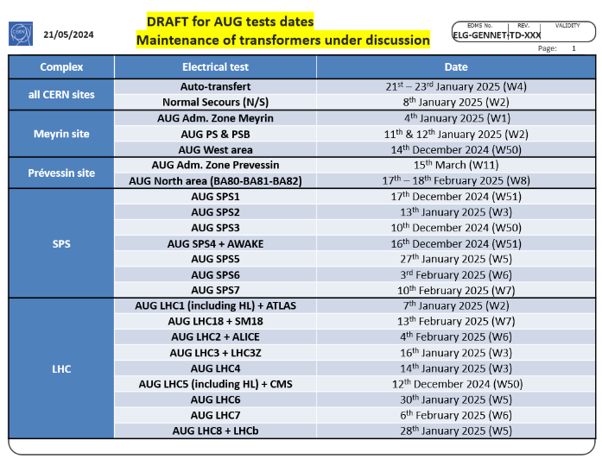
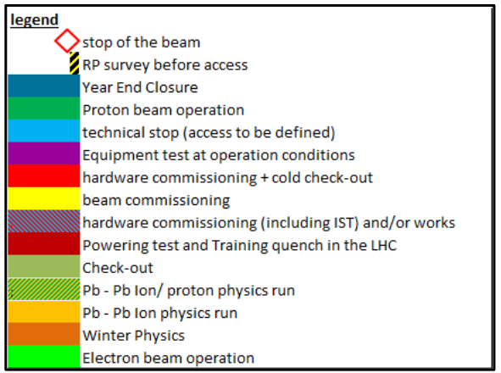
EYETS 2024/25 - Constraints
Closure of LHC Experiments and start of LHC machine check-out on 02/04/2025; LHC beam operation starting on 07/04/2025.
LHC EYETS beam to beam: 19 weeks.
Controls maintenance “SYS ADMIN DAYS” from 6th to 9th January 2025.

Slide 4
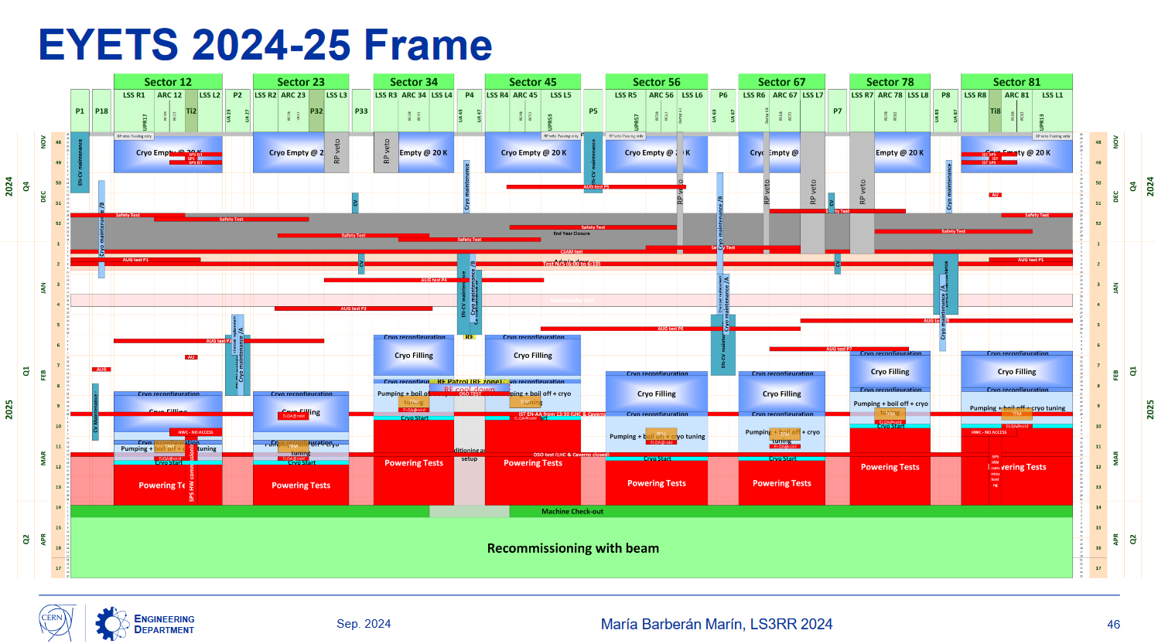
EYETS 2024/25 - Constraints

Slide 5
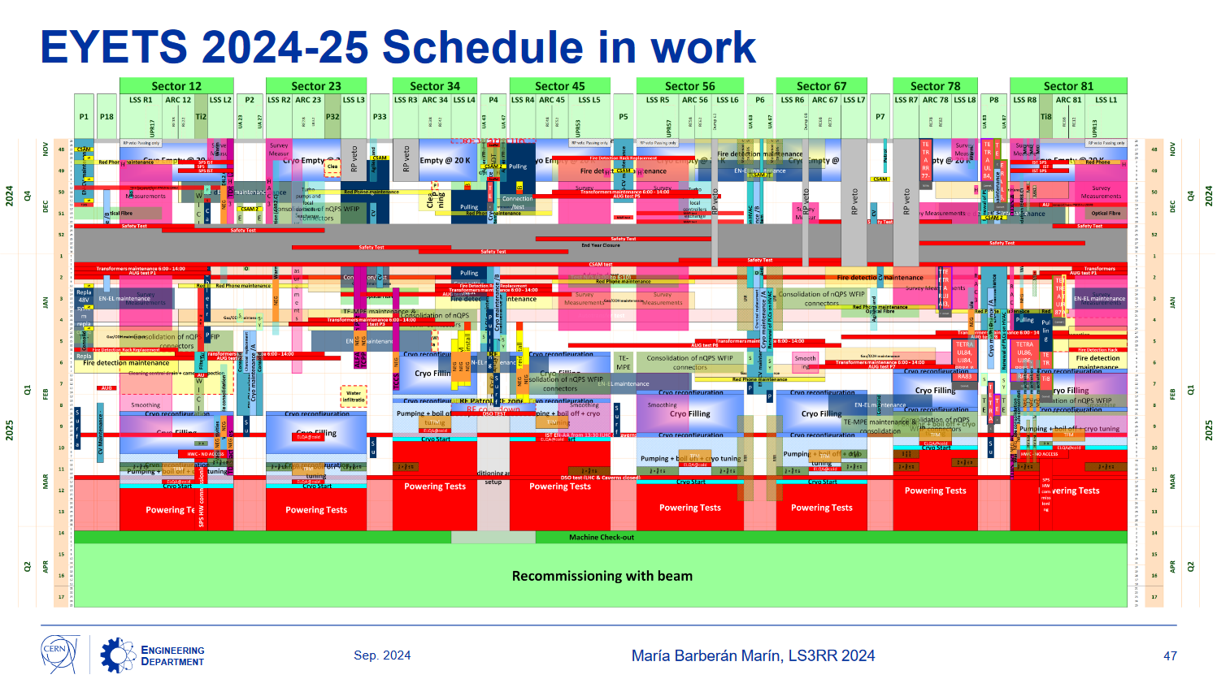
EYETS 2024/25 – Schedule in work

Slide 6
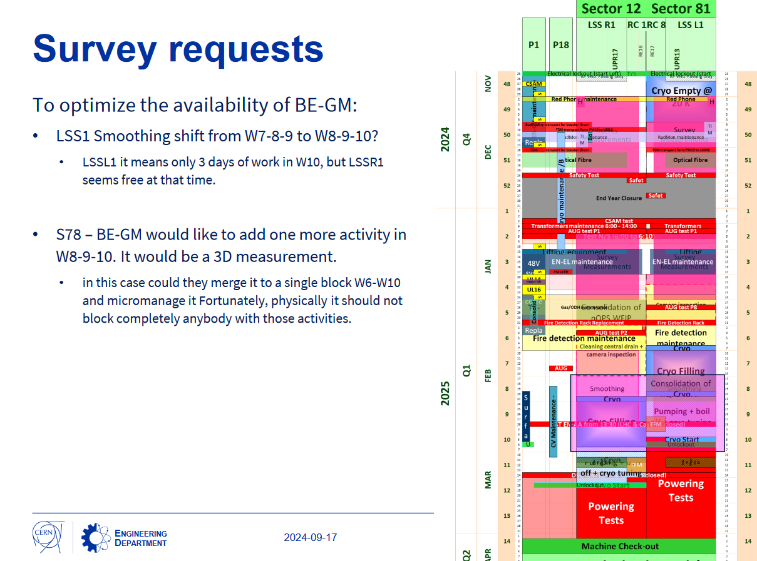
EYETS 2024/25 – focus on LSS1

Slide 7
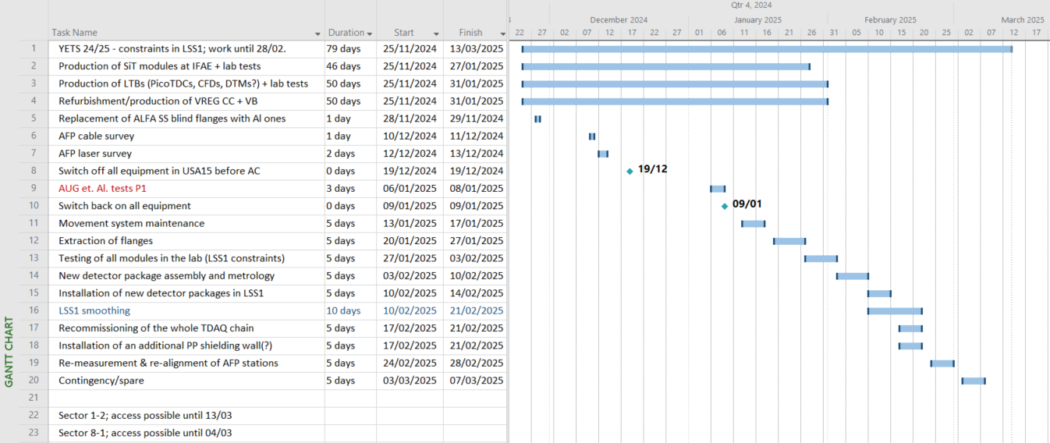
YETS 2024/25 plan
YETS impact approved: https://impact.cern.ch/impact/secure/?place=editActivity:240327
Support needed from BE-GM-ASG for survey (2x) and already arranged (W50+W9).
Will probably also need support from HSE-RP-AS to expedite radioactive transport.
Will ask EP-DT support (as every year) for metrology (CMM).
Ongoing discussion with SY-STI-BMI/R2E about improving/upgrading shielding to cope with increased radiation damage.

Slide 8
Backup
Backup slides.

Slide 9
Reminders, updates & constraints
Replacing Stainless Steel ALFA blind flanges in S81 with Al ones:
  Scheduled for 28-29/11. Sune will use his own impact.
ARP cable survey
  Scheduled for 10/12 – Giulio, Elzbieta, Luis, Maciej, Marko.
1st AFP laser survey
  Scheduled for W50 (ca.12-13/12).
2nd AFP laser survey
  New fiducialisation (if necessary) and new LVDT calibration (~2 days): for these. Precise slot tbd; aiming for W9. A short slot can be locked in order to optimize our presence
  Smoothing alignment: the regular LSS1 smoothing will be done between 2025-02-10 and 2025-02-21 (no help required).
New SiT modules production at IFAE:
  Bump-bonding machine broken at IFAE & wire-bonding technician over-committed. Might send the modules to CERN for wire-bonding.
  Ideally to be ready for pick up by 12/01 (W2) or deliver by 27/01 (W5) to CERN for wire-bonding and testing.
Extraction and re-insertion of flanges w/refurbished detector packages:
  Aiming for removal of flanges in W4 (+-1 week)
  Assembly and metrology of detector packages in W6-7
  Re-installation of flanges w/refurbished packages: W7-8.
  Recommissioning, 2nd survey & smoothing alignment: W9
Sector 8-1 access possible only until 04/03!
  Sector 1-2: access possible until 13/03.

Slide 10
LSS1 focus

Slide 11
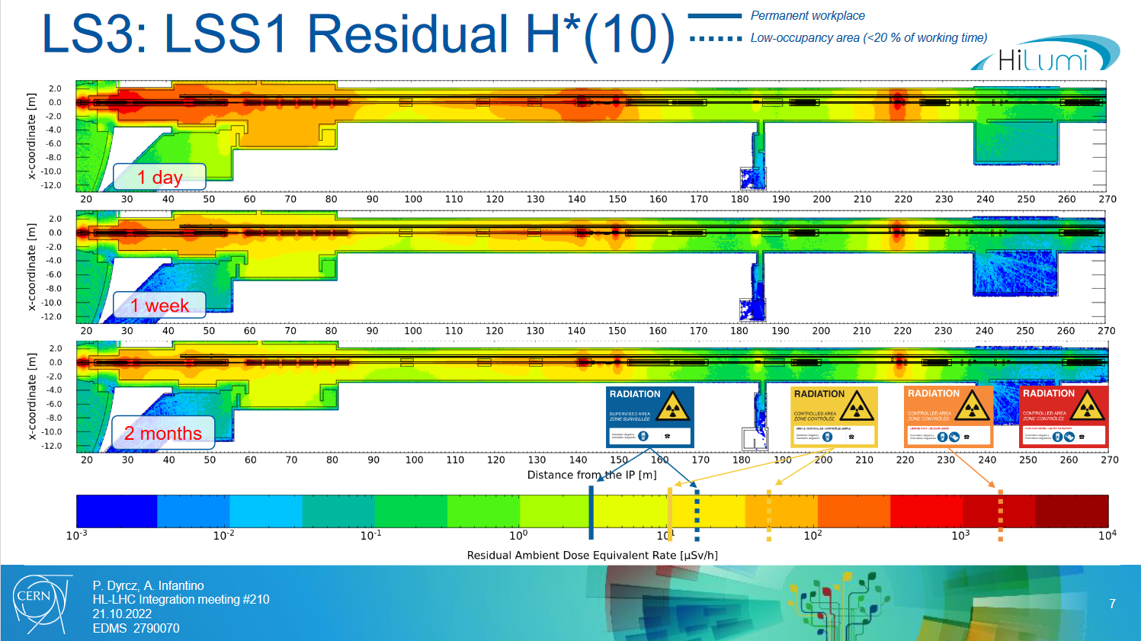
Projected radiation levels in LSS1

Slide 12
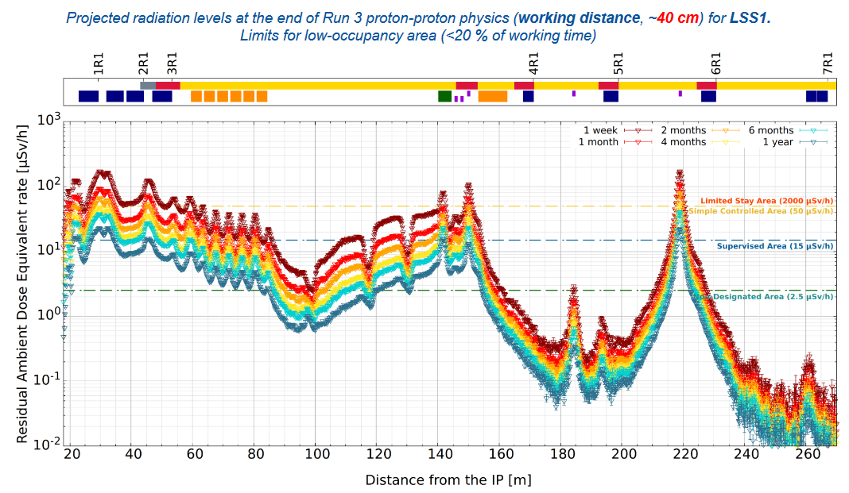
Projected radiation levels in LSS1

