Slide 1




Differentiable Modeling for Calorimeter Simulation using Diffusion Models
Xuan Tung Nguyen*, Long Chen, Tommaso Dorigo, Nicolas R. Gauger, Federico Nardi, Julien Donini
Fifth MODE Workshop on Differentiable Programming for Experiment Design
Kolymbari, Crete, Greece
June 12th, 2025

Slide 2
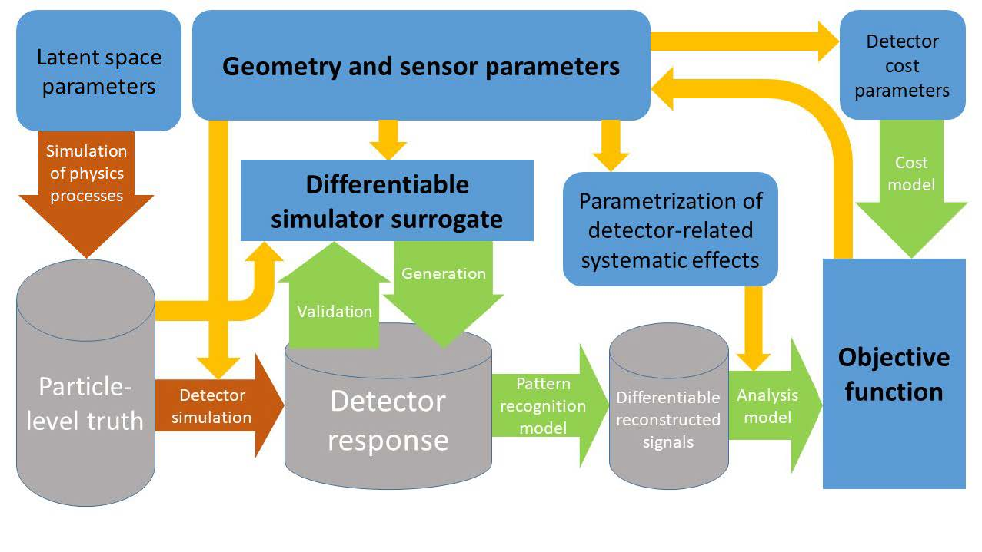
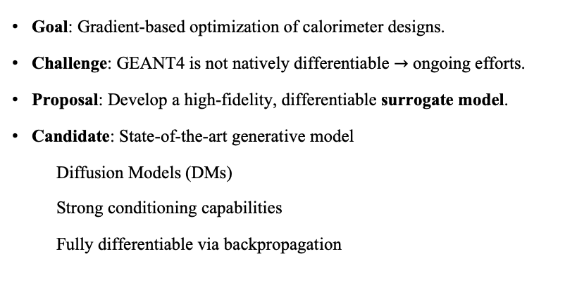
Objectives
Surrogates for Calorimeter Optimization?
Goal: Gradient-based optimization of calorimeter designs.
Challenge: GEANT4 is not natively differentiable $→$ ongoing efforts.
Proposal: Develop a high-fidelity, differentiable surrogate model.
Candidate: State-of-the-art generative model
Diffusion Models (DMs)
Strong conditioning capabilities
    Fully differentiable via backpropagation
T.Dorigo et al., “Toward the End-to-End Optimization of Particle Physics Instruments with Differentiable Programming”, arXiv:2203.13818.
Differentiable Modeling for Calorimeter Simulation using Diffusion Models

Slide 3
Diffusion model for the surrogate
Prompt: “a physicist developing machine learning application for future detector collider”
Text Encoder
Diffusion model
Decoder
Encoded text
RNG
loop
Differentiable Modeling for Calorimeter Simulation using Diffusion Models

Slide 4

Diffusion model for the surrogate
Text Encoder
Diffusion model
Decoder
Encoded text
RNG
loop
Differentiable Modeling for Calorimeter Simulation using Diffusion Models

Slide 5
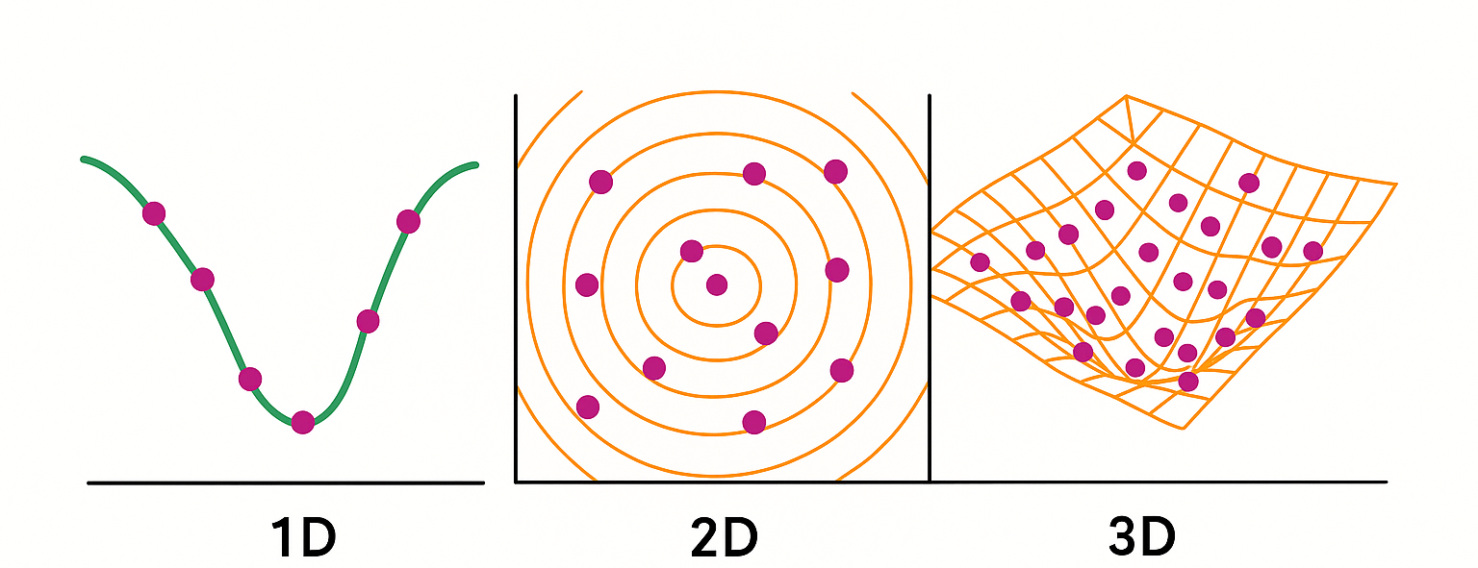
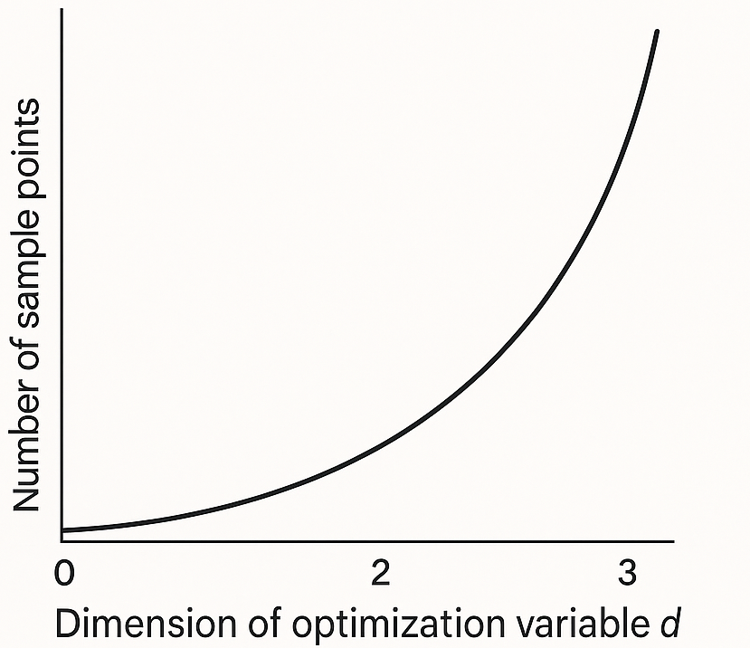
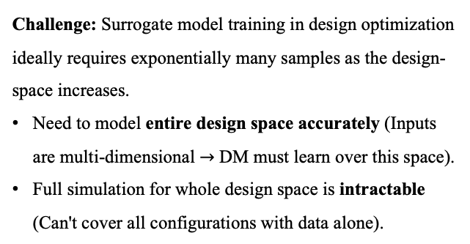
Challenge with Surrogate for Design Optimization
Challenge: Surrogate model training in design optimization ideally requires exponentially many samples as the design-space increases.
Need to model entire design space accurately (Inputs are multi-dimensional $→$ DM must learn over this space).
Full simulation for whole design space is intractable (Can't cover all configurations with data alone).
Differentiable Modeling for Calorimeter Simulation using Diffusion Models

Slide 6
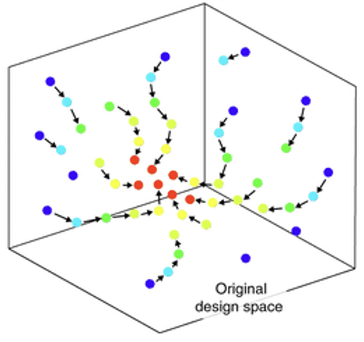
Pre-training + Post-training
Pre-train a foundation model → learns global landscape approximately.
Pre-train model
Differentiable Modeling for Calorimeter Simulation using Diffusion Models

Slide 7
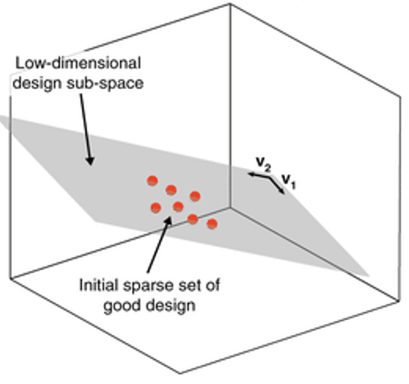
Pre-training + Post-training
Pre-train a foundation model → learns global landscape approximately.
Post-train on current design point → learns local landscape accurately.
Pre-train model
Post-train model
Differentiable Modeling for Calorimeter Simulation using Diffusion Models

Slide 8
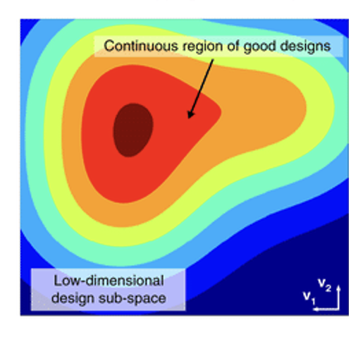
Pre-training + Post-training
Pre-train a foundation model → learns global landscape approximately.
Post-train on current design point → learns local landscape accurately.
Backpropagation of diffusion model to its conditioning gives us gradient surrogate.
Enables gradient-based optimization.
Pre-train model
Post-train model
Optimization
Pezzulla, A., et al. “Inverse Design of Mechanical Metamaterials.” Nature Communications,
Differentiable Modeling for Calorimeter Simulation using Diffusion Models

Slide 9
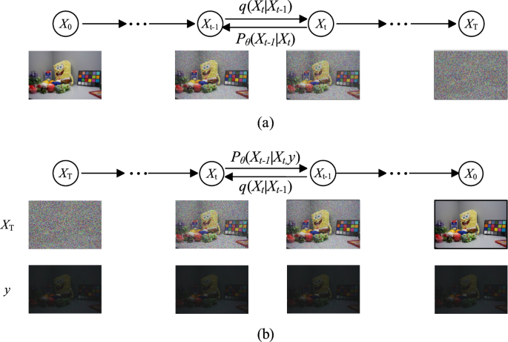



Diffusion Model
Denoising Diffusion Probabilistic Models
Forward process: gradually add noise.
Reverse process: gradually remove noise.
Differentiable Diffusion Models as Surrogate for Homogenous Calorimeter Design Optimization
Differentiable Modeling for Calorimeter Simulation using Diffusion Models

Slide 10
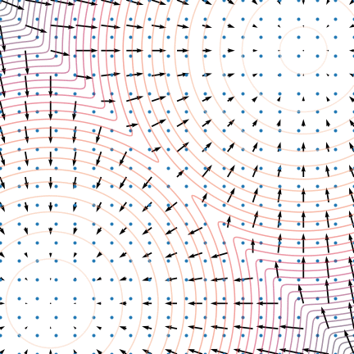
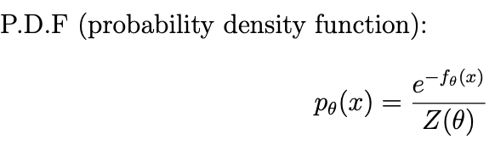
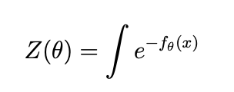
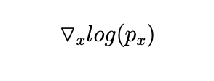
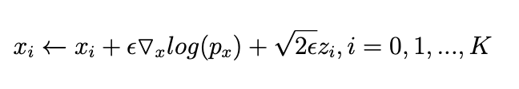
Diffusion Model
Denoising Diffusion Probabilistic Models
General generative model is built based on probability density function:
DDPMs use score function instead $→$ score-based model:
The sampling process of DM is iterative:
Song, Yang. “Generative Modeling by Estimating Gradients of the Data Distribution.” yang‑song.net, 5 May 2021, https://yang-song.net/blog/2021/score/.
We can add an extra parameter y to the score-function to guide the model based on our design $→$ toward conditional denoising diffusion probabilistic models.
Differentiable Modeling for Calorimeter Simulation using Diffusion Models
Notes:
Most generative models start by modeling the probability distribution of the data. One common way is to define a probability density function pθ(x)pθ​(x), which is built from an energy function fθ(x)fθ​(x). This is shown here as:

Slide 11
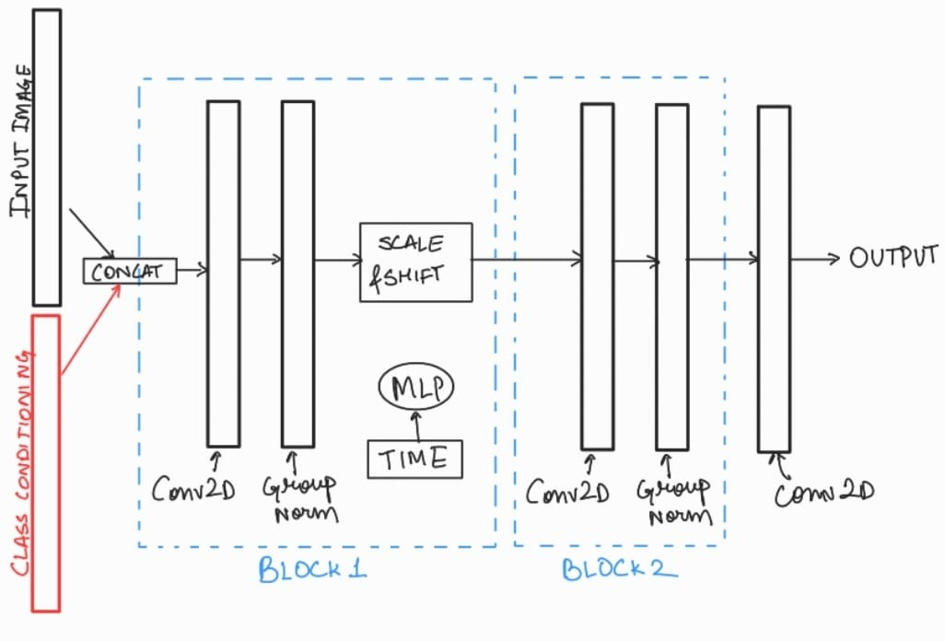
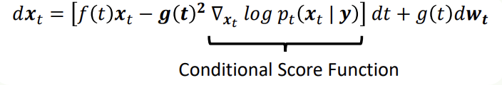
Methods
Diffusion Model
Conditional Denoising Diffusion Probabilistic Models
Conditioning = guide the generation process.
Learn the conditioned data distribution.
Differentiable Modeling for Calorimeter Simulation using Diffusion Models
Differentiable Diffusion Models as Surrogate for Homogenous Calorimeter Design Optimization
Differentiable Modeling for Calorimeter Simulation using Diffusion Models

Slide 12


Methods
Sampling
Efficient Sampling
$$p_{Θ}$$
X₃
X₂
X₁
X₀
$${q( x}_{2}|x_{1})$$
Differentiable Modeling for Calorimeter Simulation using Diffusion Models
Differentiable Diffusion Models as Surrogate for Homogenous Calorimeter Design Optimization
Differentiable Modeling for Calorimeter Simulation using Diffusion Models
Notes:
In standard DDPMs, generating a single takes hundreds or even 1,000 denoising steps.
This is slow and inefficient, especially when you want to optimize over design parameters or deploy the model in practical scenarios.
Denoising Diffusion Implicit Models, or DDIMs, solve this.
The key idea is to redefine the reverse process to be deterministic and non-Markovian, allowing us to skip steps in the denoising process.
Think of DDPMs as a strict chain: each step depends on the previous one, like dominoes falling. DDIMs break that chain and allow us to jump ahead — generating samples in, say, 25 or 50 steps instead of 1000.

Slide 13
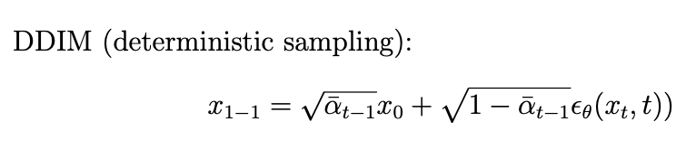
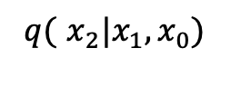
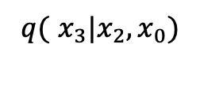
Methods
Sampling
Efficient Sampling
$$p_{Θ}$$
X₃
X₂
X₁
X₀
$${q( x}_{3}|x_{2},x_{0})$$
$${q( x}_{2}|x_{1},x_{0})$$
Efficient sampling.
Requires fewer steps.
Deterministic: can be differentiated.
Differentiable Modeling for Calorimeter Simulation using Diffusion Models
Differentiable Diffusion Models as Surrogate for Homogenous Calorimeter Design Optimization
Differentiable Modeling for Calorimeter Simulation using Diffusion Models

Slide 14

Methods
Sampling
Efficient Sampling
$$p_{Θ}$$
X₃
X₂
X₁
X₀
$${q( x}_{3}|x_{2},x_{0})$$
$${q( x}_{2}|x_{1},x_{0})$$
Efficient sampling.
Requires fewer steps.
Deterministic: can be differentiated.
Differentiable Modeling for Calorimeter Simulation using Diffusion Models
Differentiable Diffusion Models as Surrogate for Homogenous Calorimeter Design Optimization
Differentiable Modeling for Calorimeter Simulation using Diffusion Models

Slide 15
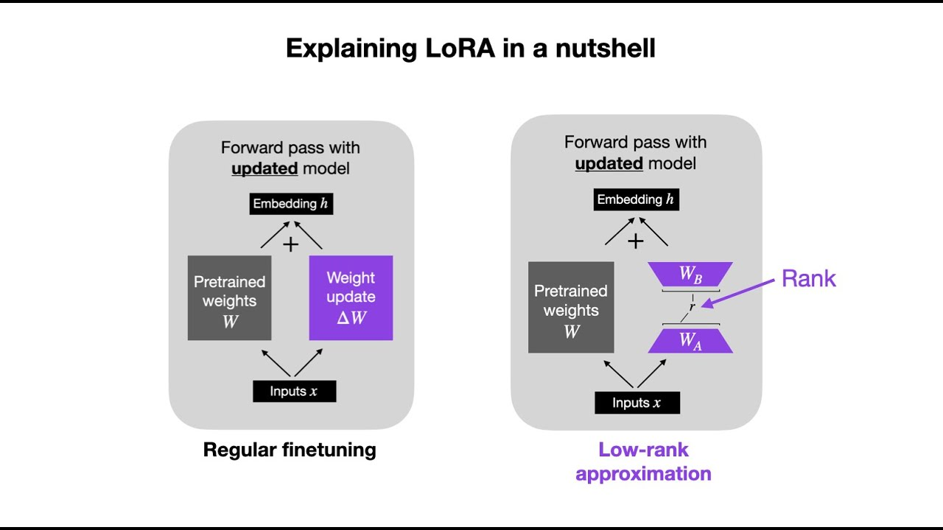
Methods
Post-training: Adapter
Post-train model: Adapter
Differentiable Modeling for Calorimeter Simulation using Diffusion Models
Differentiable Diffusion Models as Surrogate for Homogenous Calorimeter Design Optimization
Differentiable Modeling for Calorimeter Simulation using Diffusion Models
Notes:
So far, we've trained a powerful, conditioned generative model — and we've made it efficient and differentiable using DDIM.
But now comes a practical question: what if the detector design changes?
For example, what if a new experiment proposes a slightly different cell size or material?
Do we retrain the whole model from scratch?
No — that’s expensive and unnecessary.
Instead, we use post-training techniques to quickly adapt our model to a new design configuration using only a small amount of data and compute.

Slide 16
Methods
Post-training: Adapter
Post-train model: Low-rank Adaptation (LoRA)
Differentiable Modeling for Calorimeter Simulation using Diffusion Models
Differentiable Diffusion Models as Surrogate for Homogenous Calorimeter Design Optimization
Differentiable Modeling for Calorimeter Simulation using Diffusion Models

Slide 17
Methods
Post-training: Adapter
Post-train model: Low-rank Adaptation (LoRA)
Output_{pretrain} = W * X
W_{LoRA} = W + r
Where r is low-rank update
r = W_{A} * W_{B}
Differentiable Modeling for Calorimeter Simulation using Diffusion Models
Differentiable Diffusion Models as Surrogate for Homogenous Calorimeter Design Optimization
Differentiable Modeling for Calorimeter Simulation using Diffusion Models

Slide 18
Methods
Post-training: Adapter
Post-train model: Low-rank update (LoRA)
Output_{pretrain} = W * X
W_{LoRA} = W + r
Where r is low-rank update
r = W_{A} * W_{B}
We can adapt our model with different configuration (eg. CRILIN, PANDA, etc.) using LoRA post-training, require only small amount of data and training time
Differentiable Modeling for Calorimeter Simulation using Diffusion Models
Differentiable Diffusion Models as Surrogate for Homogenous Calorimeter Design Optimization
Differentiable Modeling for Calorimeter Simulation using Diffusion Models

Slide 19
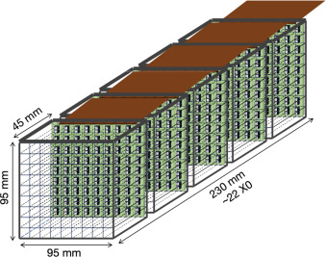
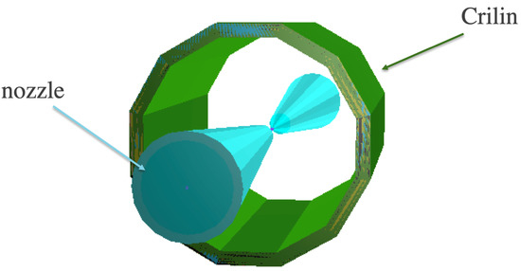
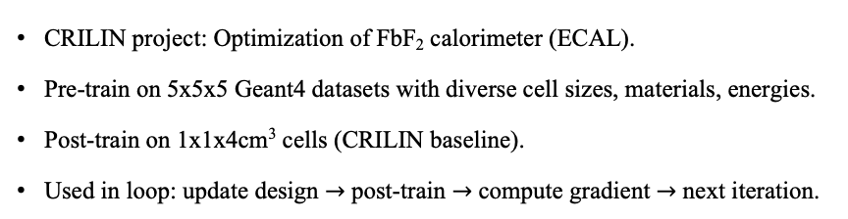
A Case Study
Muon Collider
CRILIN project: Optimization of FbF₂ calorimeter (ECAL).
Pre-train on 5x5x5 Geant4 datasets with diverse cell sizes, materials, energies.
Post-train on 1x1x4cm³ cells (CRILIN baseline).
Used in loop: update design $→$ post-train $→$ compute gradient $→$ next iteration.
Differentiable Modeling for Calorimeter Simulation using Diffusion Models
Differentiable Diffusion Models as Surrogate for Homogenous Calorimeter Design Optimization
Differentiable Modeling for Calorimeter Simulation using Diffusion Models

Slide 20
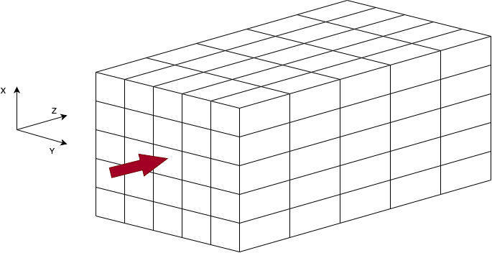
Training Setup
Training Data:
Simulation: Generated using GEANT4.
Dataset Size: 100,000 calorimeter shower images.
Energy levels: 1, 10, 50, 100, 200 GeV.
Granularity: 5 x 5 x 5 cells.
Material: Lead fluoride (PbF₂ ), Lead Tungstate (PbWO₄ ).
Addition labels: 5 different cell size configurations:
                2 x 2 x 6 cm³
                3 x 3 x 8 cm³
                4 x 4 x 10 cm³
                5 x 5 x 15 cm³
                6 x 6 x 20 cm³
Differentiable Modeling for Calorimeter Simulation using Diffusion Models
Differentiable Diffusion Models as Surrogate for Homogenous Calorimeter Design Optimization
Differentiable Modeling for Calorimeter Simulation using Diffusion Models

Slide 21
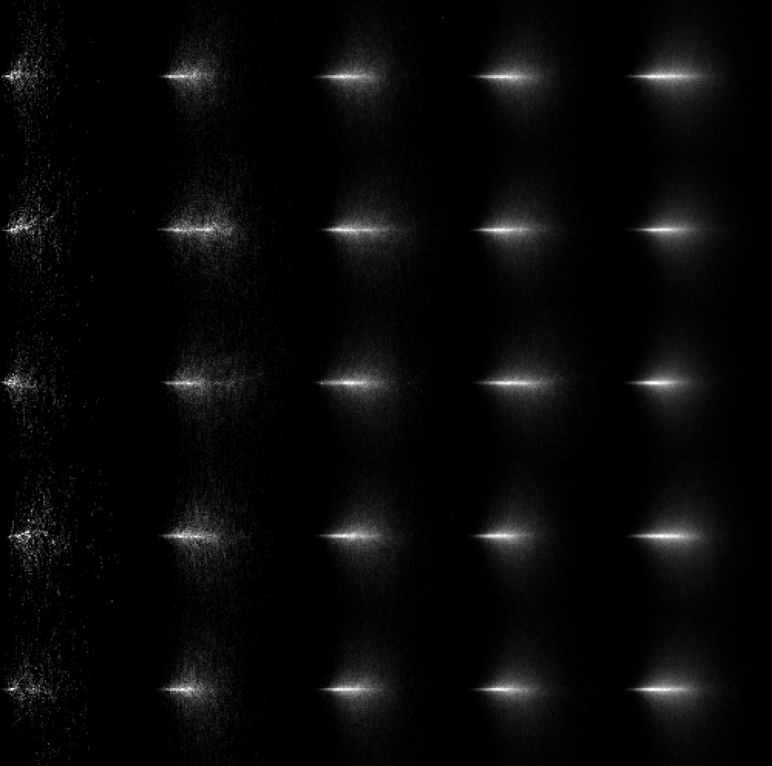
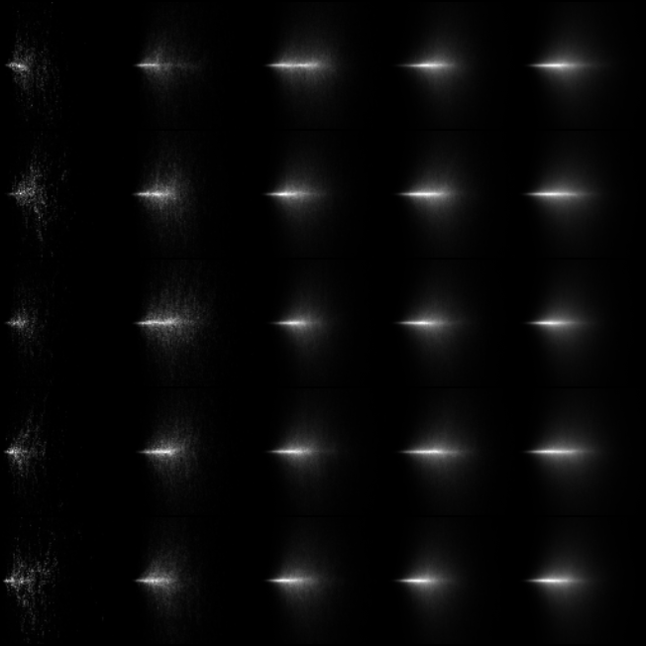
Results
Pre-training Results
GEANT4 Ground-truth
CDDPMs Generated (at 300 epochs)
Comparison of GEANT4 and DDPM-generated showers:
DDPMs accurately reproduces GEANT4-generated showers.
No significant visual differences across energy levels.
Shows that our diffusion model effectively learns that shower distributions.
Differentiable Modeling for Calorimeter Simulation using Diffusion Models
Differentiable Diffusion Models as Surrogate for Homogenous Calorimeter Design Optimization
Differentiable Modeling for Calorimeter Simulation using Diffusion Models

Slide 22
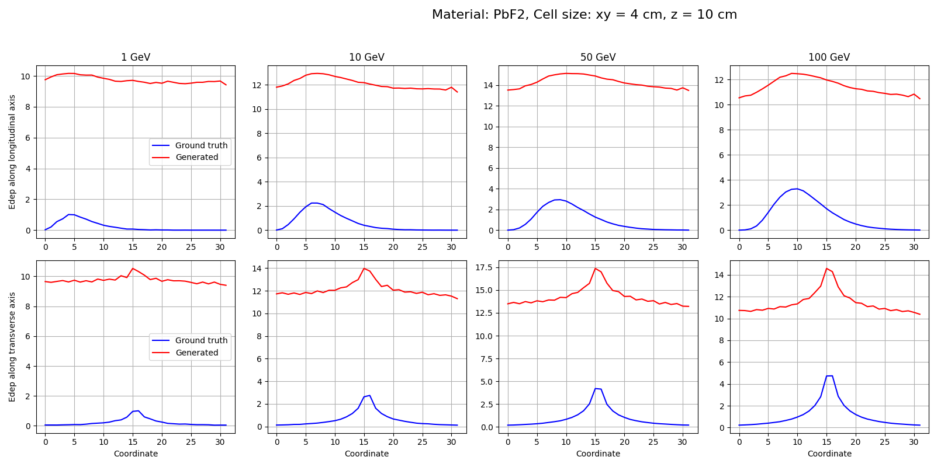
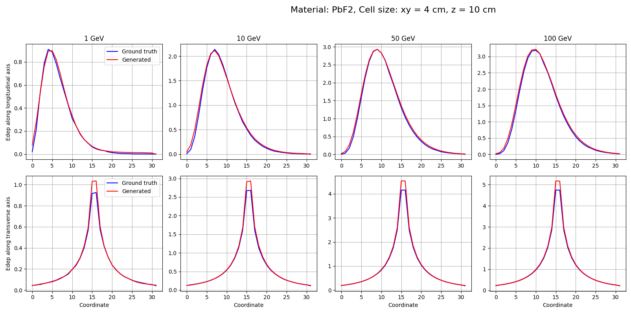
Results
Results
Pre-training Results
Energy profile at early epoch
Energy profile at later epoch
Huge mismatch between generated and ground-truth profiles.
Energy depositions are underestimated, and peak positions are deviate.
Two distributions closely matched across all energy levels.
Improved peak alignment and energy deposition spread.
Our model significantly enhances fidelity and successfully learns the shower calorimeter showers characteristics over time.
Differentiable Modeling for Calorimeter Simulation using Diffusion Models
Differentiable Diffusion Models as Surrogate for Homogenous Calorimeter Design Optimization
Differentiable Modeling for Calorimeter Simulation using Diffusion Models

Slide 23
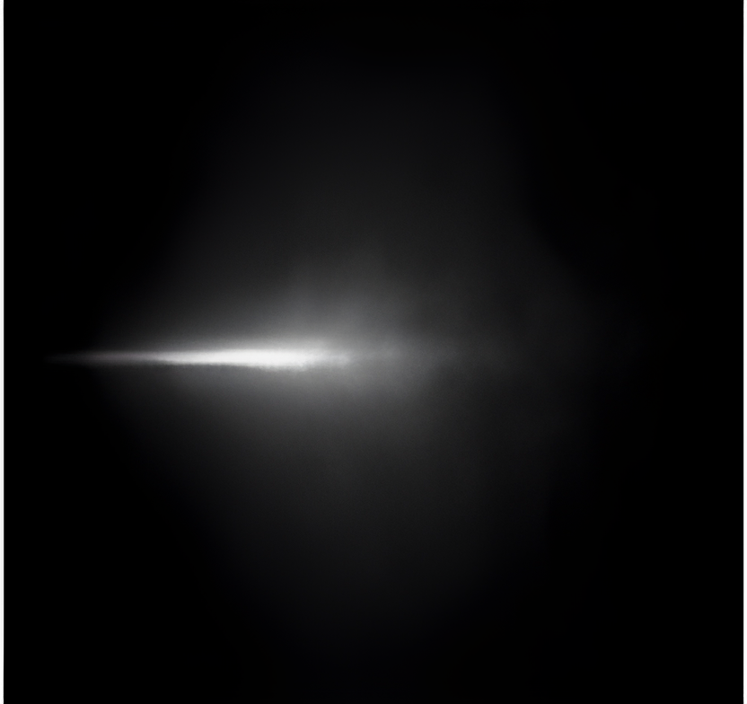
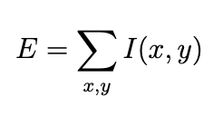
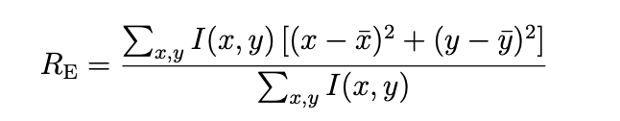
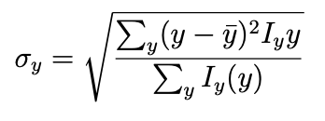
Pre-training Results
Quantify the physical fidelity of the generated shower,
we use physics-motivated metrics.
y
Total Energy (E):
Sum of intensities (energy deposits) over the full grid.
Energy-Weighted Radius (Rₑ):
Describes spread of the shower around its center.
Shower Dispersion (σᵧ):
x
Measures vertical spread using energy profile I_{y} (y).
Differentiable Modeling for Calorimeter Simulation using Diffusion Models

Slide 24
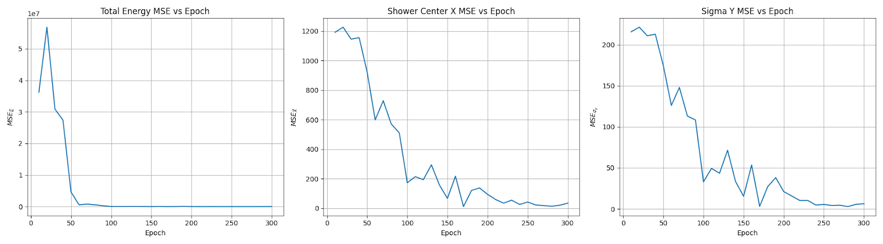
Pre-training Results
Mean Squared Error of each metric across training epochs
These results demonstrate that the model not only learns to generate visually plausible showers, but it generate highly accurate HEP simulation data $→$ it can serve as high fidelity surrogate.
Differentiable Modeling for Calorimeter Simulation using Diffusion Models

Slide 25
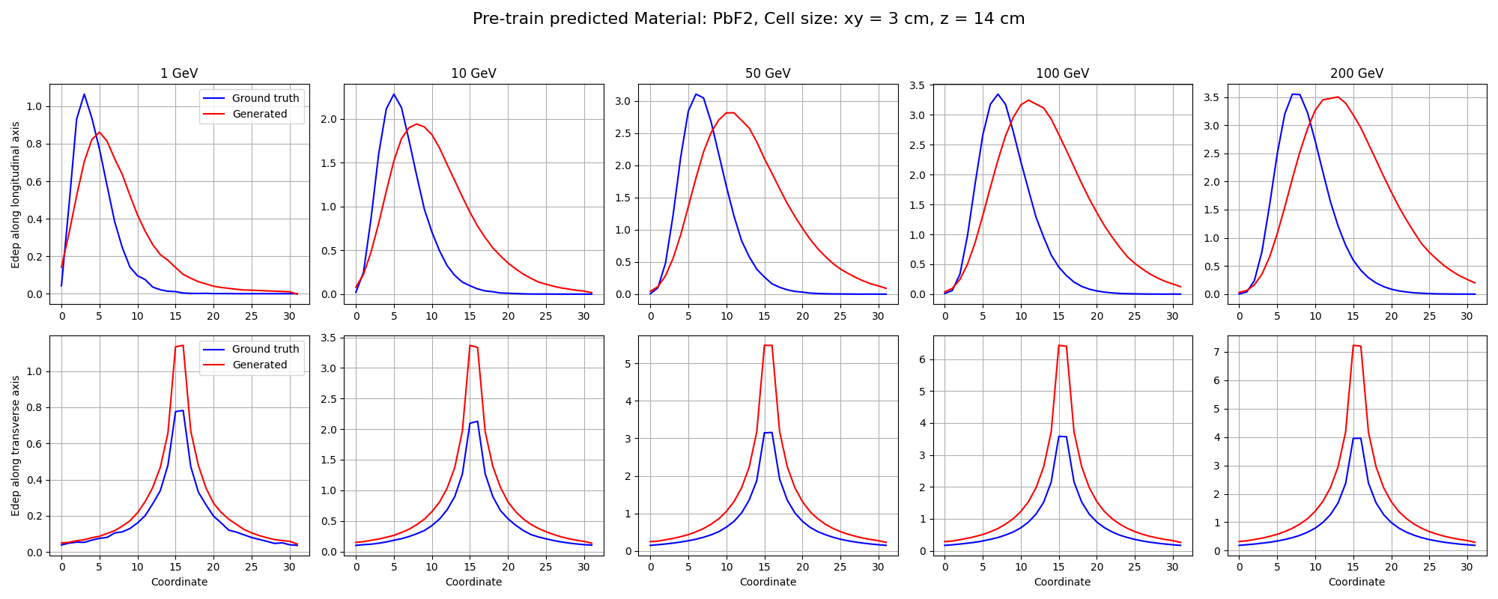
Results
Results
Pre-training Results
Model performance on unseen cell size configurations
The conditional DDPMs was tested on cell size configuration that were not included in the training set to evaluate its ability to generalize.
Model captures the overall distribution but exhibits some deviate in shape.
The transverse profiles are well-aligned with the ground-truth.
Differentiable Modeling for Calorimeter Simulation using Diffusion Models
Differentiable Diffusion Models as Surrogate for Homogenous Calorimeter Design Optimization
Differentiable Modeling for Calorimeter Simulation using Diffusion Models

Slide 26
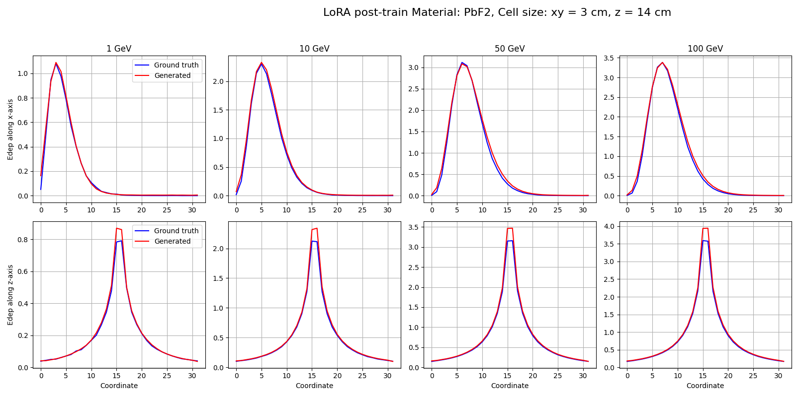
Results
Results on Unseen Data post-train
Posttraining Results
Pre-trained Energy profile
LoRA post-trained Energy profile
LoRA fine-tuning align closely with the ground truth across all energy levels.
Post-training reduces discrepancies with little training time.
Generated energy deposition tends to overshoot the ground truth.
Differentiable Modeling for Calorimeter Simulation using Diffusion Models
Differentiable Diffusion Models as Surrogate for Homogenous Calorimeter Design Optimization
Differentiable Modeling for Calorimeter Simulation using Diffusion Models

Slide 27
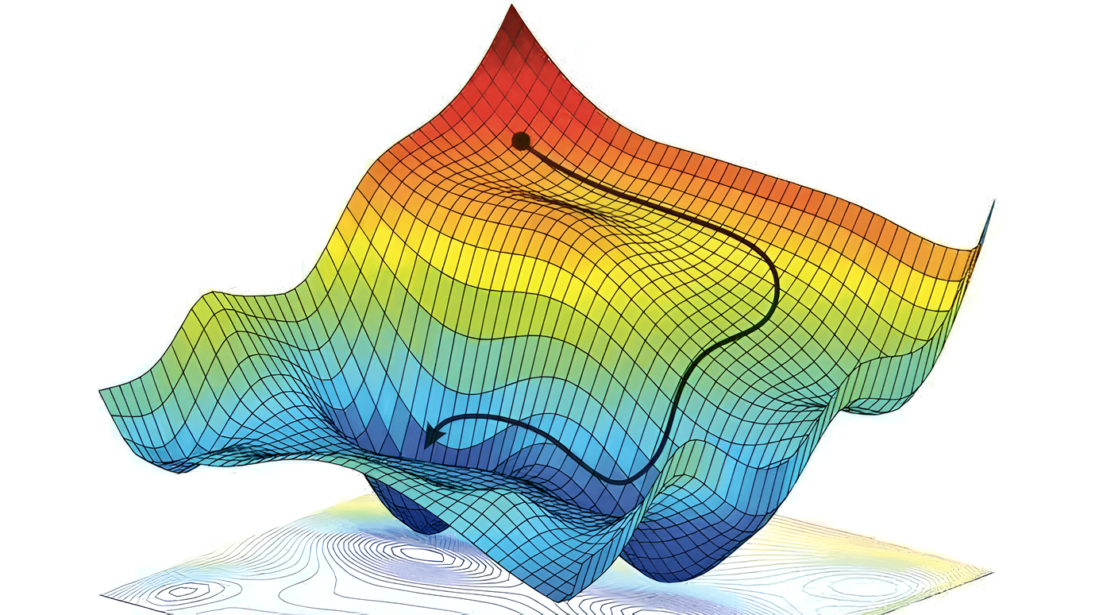
Conclusion of working progress
Advantages of the Pre-train + Post-train Approach
Achieves high fidelity across a wide design space.
Requires only limited data for local adaptation.
Speed Benefit
For simple designs (e.g., homogeneous calorimeters), the speed gain is modest.
For complex or hybrid geometries, surrogate-based sampling will be significantly faster.
Next Steps
Evaluate the quality of gradients from the surrogate.
Apply gradient-based optimization to real design tasks.
Differentiable Modeling for Calorimeter Simulation using Diffusion Models

Slide 28
Summary
Summary
A diffusion model surrogate can generate high-fidelity calorimeter showers, conditioned on design.
Pre-train + post-train to account for the large design space.
DDIM sampling makes inference fast and differentiable.
Gradients can be obtained through backpropagated through diffusion model to the conditioning parameters.
Optimization with surrogate gradients is ongoing.
Differentiable Modeling for Calorimeter Simulation using Diffusion Models
Differentiable Diffusion Models as Surrogate for Homogenous Calorimeter Design Optimization
Differentiable Modeling for Calorimeter Simulation using Diffusion Models

Slide 29
Thank you for your attention!

