Slide 1
Towards differentiable GEANT with EM physics: addressing challenges with Multiple Scattering
Jeff Krupa¹, Max Aehle², Yiyang Zhao³, Mihaly Novak⁴, Max Sagebaum²,
Long Chen², Nicolas Gauger², Mia Liu⁵, Lukas Heinrich⁶, Michael Kagan¹
5th MODE Workshop
June 9, 2025
¹
⁵
³
⁴
²
⁶

Slide 2
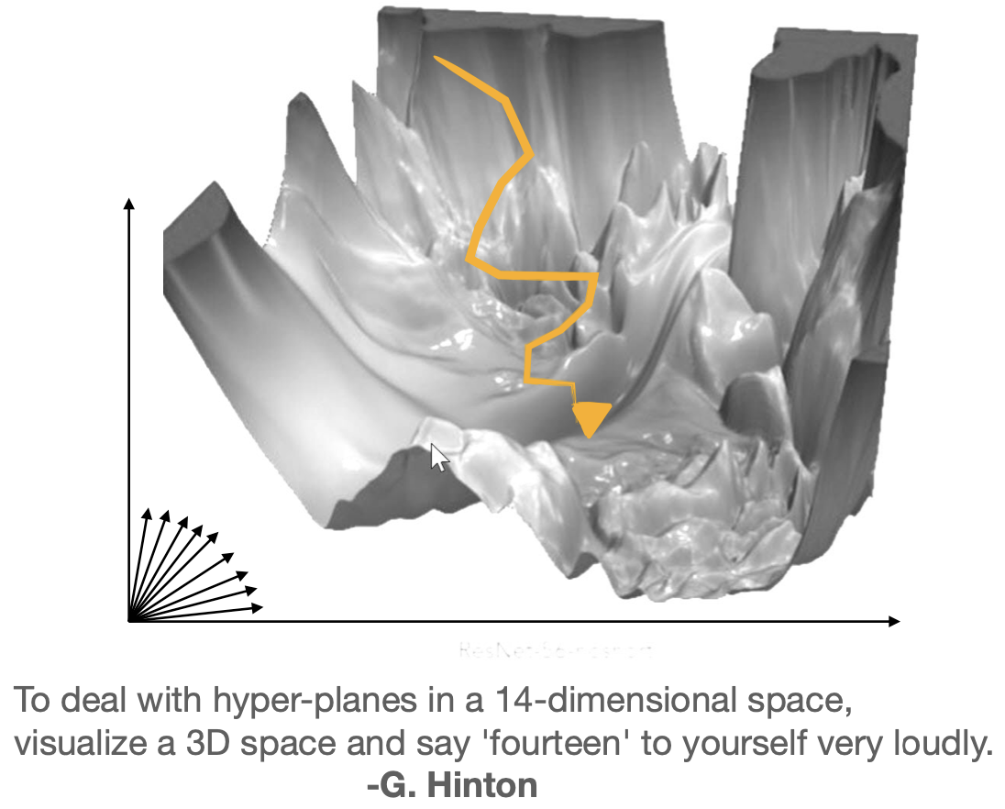
Gradient-based optimization
An efficient and powerful way to optimize high dimensional functions like those used in HEP
Differentiable GEANT simulation would have far-reaching applications in topics like detector design
N parameters

Slide 3
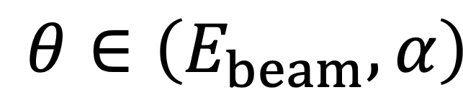
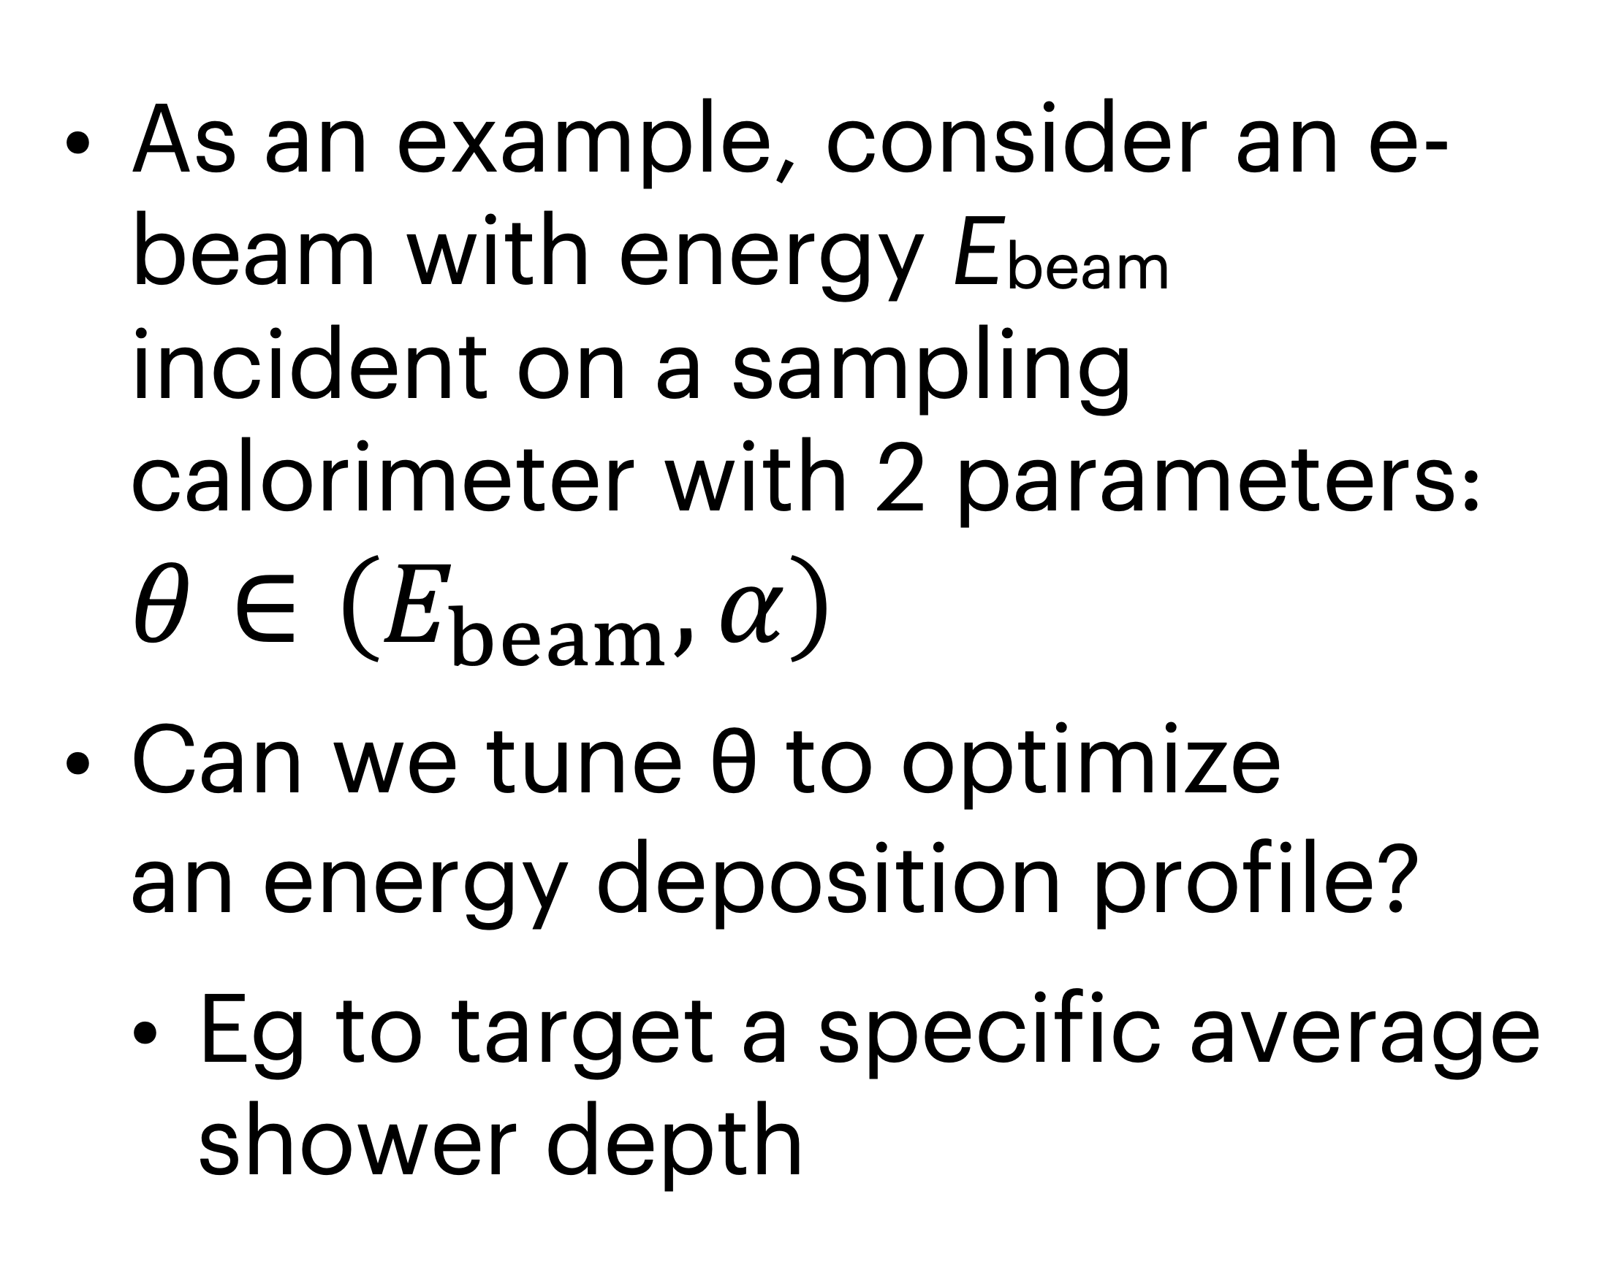
Detector optimization example
$$θ∈\left(E_{beam},α\right)$$
2405.07944
As an example, consider an e- beam with energy Ebeam incident on a sampling calorimeter with 2 parameters: $θ∈\left(E_{beam},α\right)$
Can we tune θ to optimize
an energy deposition profile?
  Eg to target a specific average shower depth
⍺
⍺
⍺
Ebeam
…
e-
Pb
LAr

Slide 4
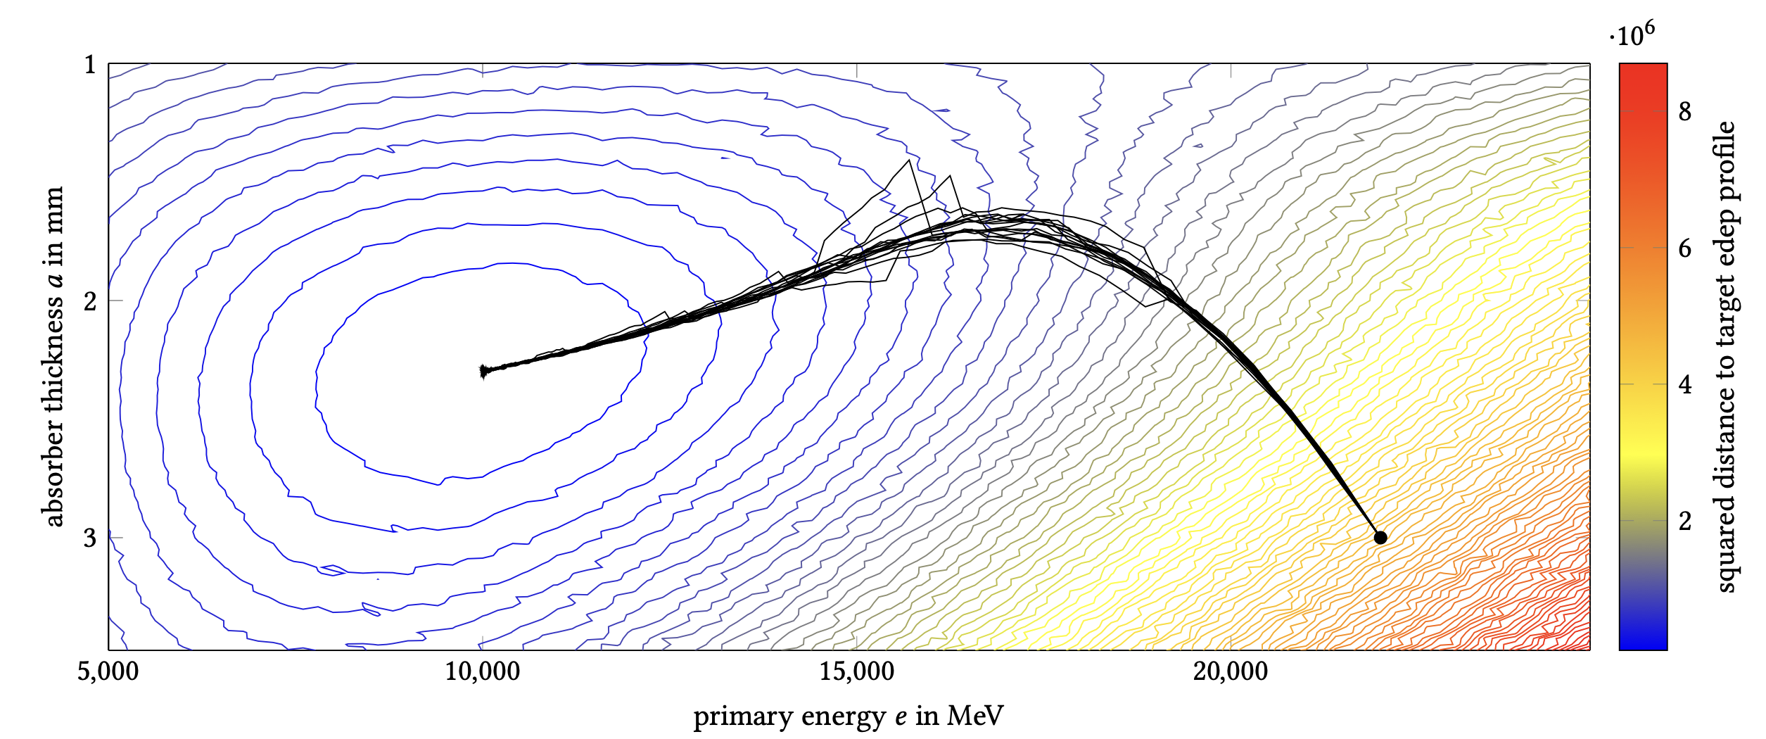
Detector optimization example
2405.07944
⍺
⍺
⍺
2D example of gradient descent in a realistic calorimeter
Ebeam
…
e-
END
Gradients
Loss surface
START
Pb
LAr

Slide 5
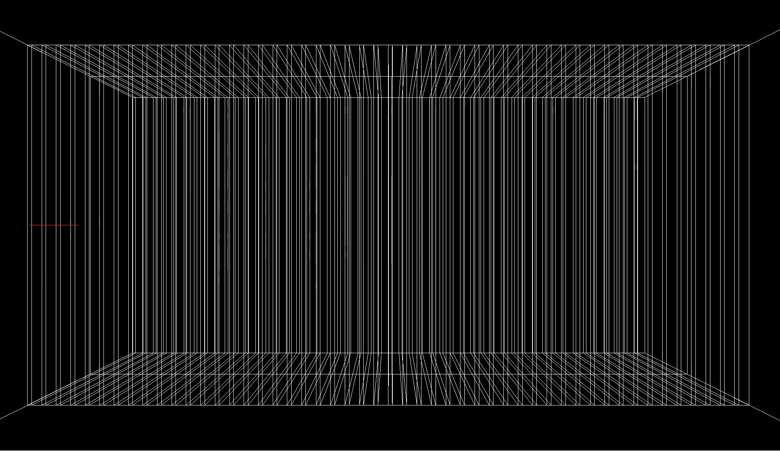
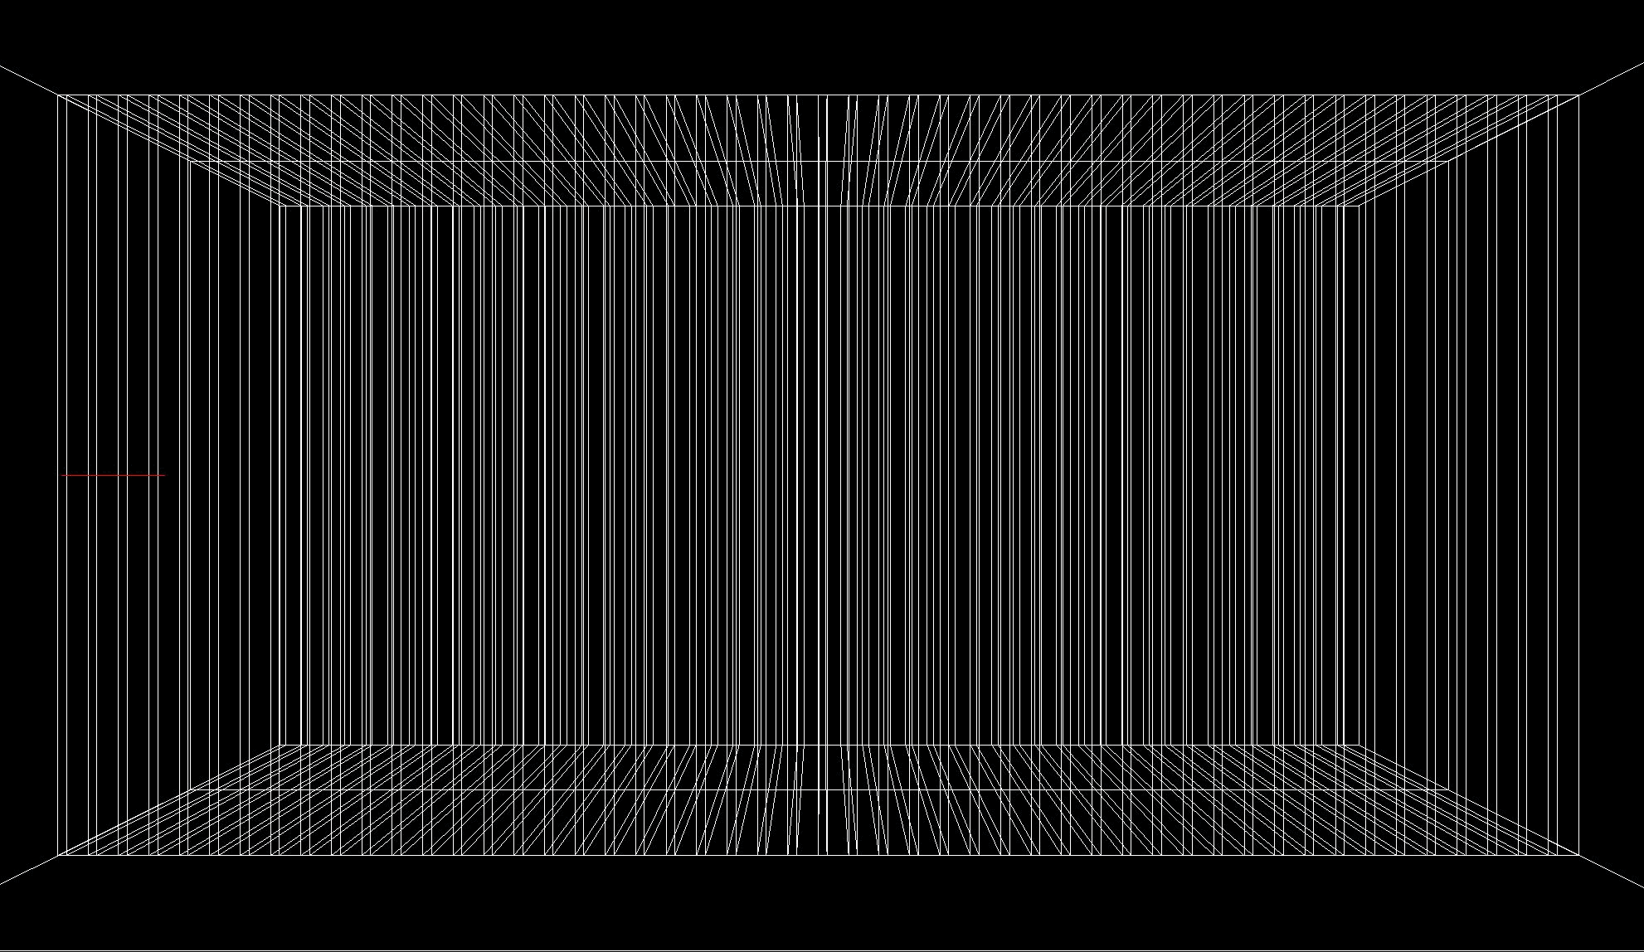
GEANT
High fidelity software for simulating the passage of particles through matter, used in HEP and more!
50 layer sampling calorimeter
⍺
⍺
⍺
Ebeam
…
e-
Pb
LAr
5

Slide 6
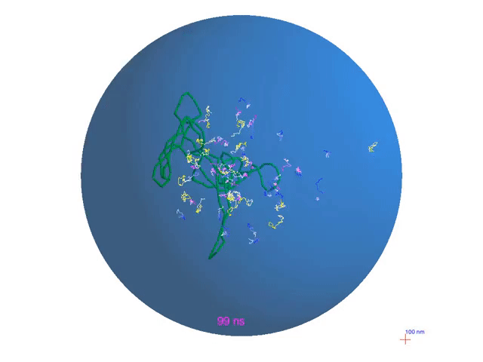
GEANT
High fidelity software for simulating the passage of particles through matter, used in HEP and more!
~100nm
DNA

Slide 7


Making GEANT differentiable
Using AD tools built at Kaiserslautern
CoDiPack AD: operator-overloading tool which defines derivatives of all functions and operations
  G4double type inherits all of these operations
First: integrate the tool
Second: dig deep into the application to understand the implementation
see 2405.07944 2407.02966
Illustrative example
Multiplication operation
Forward operator *(Forward a, Forward b){
return {a.val*b.val, a.dot*b.val+a.val*b.dot};
}
Cosine function
Forward cos(Forward a){
return {cos(a.val), -sin(a.val) * a.dot};
}

Slide 8
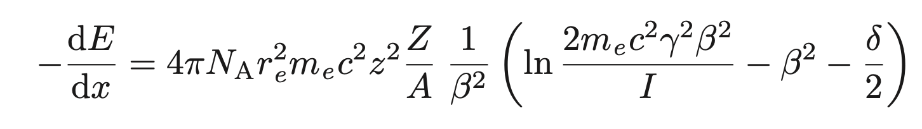
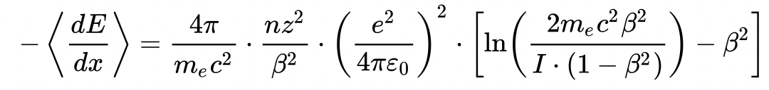
Lightning intro to EM GEANT
Electron propagating through a volume = track
Propagate track through steps with defined length. At each step, perform:
  Discrete loss: sample discrete interaction probabilistically
  Continuous loss: calculate mean energy loss over entire step length
Transport particle to next step
Continue this until energy is exhausted or track leaves volume
Discrete interactions for electrons*
Ionisation loss (Bethe-Bloch)
Bremsstrahlung
+
Check if this includes brem
Multiple coulomb scattering
*positrons can also undergo annihilation
*photons can also undergo photoelectric, Compton, pair production

Slide 9
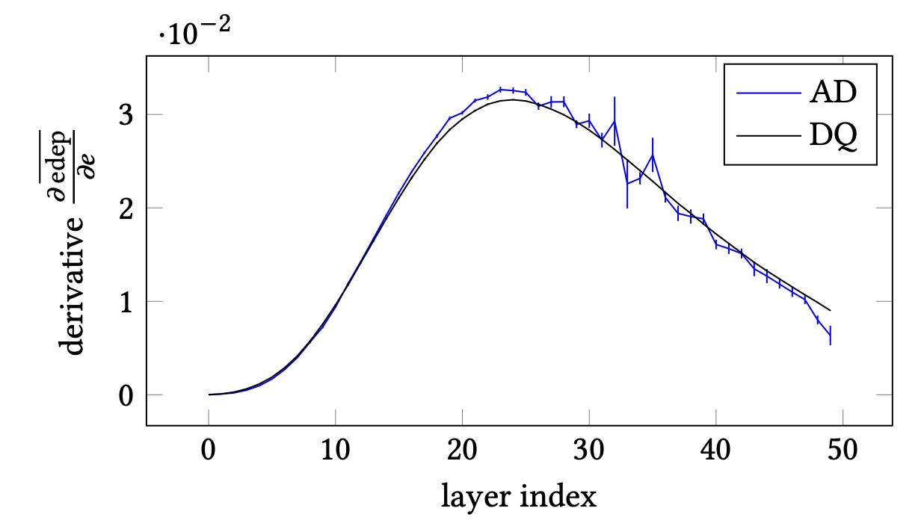
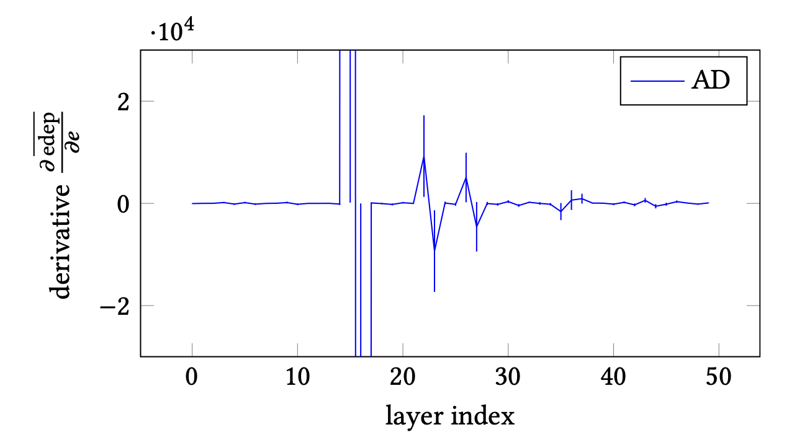
Multiple Coulomb Scattering
Electron traveling through volume undergoes elastic scattering with very short mean free path
  Computationally infeasible to be treated discretely
Instead, an average deflection is estimated at each step
In 2405.07944 we observed large unphysical derivatives with MSC and it was turned off→address this challenge in this talk!
Numerical derivative
Automatic derivative
Automatic derivative
Multiple scattering OFF
Multiple scattering ON
2405.07944

Slide 10
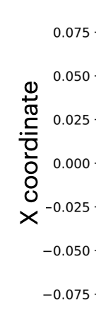
Multiple Coulomb Scattering
Consider a detector with two layers of Pb, boundary at X = 0
  Boundary here carries no physical meaning→but plays a key role in GEANT navigation
Layer 2
Pb
Layer 1
Pb
e-

Slide 11
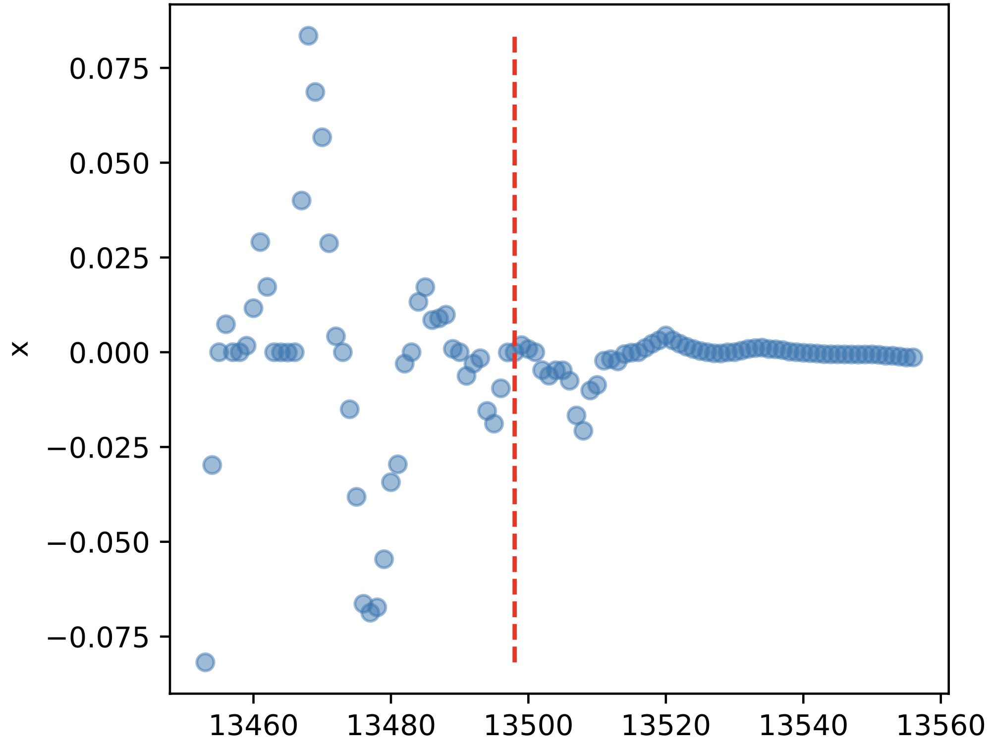
Multiple Coulomb Scattering
Consider a detector with two layers of Pb, boundary at X = 0
  Boundary here carries no physical meaning→but plays a key role in GEANT navigation
Track 7444
Layer 2
Pb
X coordinate
Layer 1
Pb
e-
Step

Slide 12
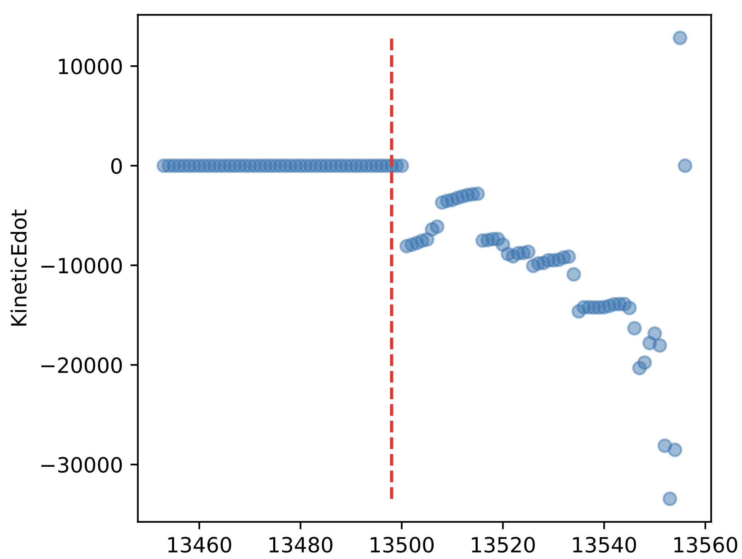
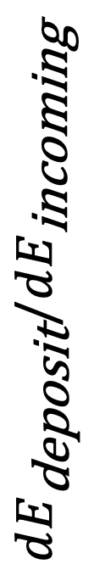
Multiple Coulomb Scattering
Consider a detector with two layers of Pb, boundary at X = 0
  Boundary here carries no physical meaning→but plays a key role in GEANT navigation
Track 7444
Track 7444
Layer 2
Pb
X coordinate
Energy deposit derivative
$$dE_{\text{deposit}}/dE_{\text{incoming}}$$
Layer 1
Pb
e-
Step
Step
Early observation: pathological tracks where derivatives become unstable

Slide 13
Geometry and Stepping in GEANT
Step length cannot exceed the distance to boundary
  This folds navigation into derivative calculation

Slide 14
Geometry and Stepping in GEANT
Step length cannot exceed the distance to boundary
  This folds navigation into derivative calculation
End
Proposed step
real physics
Start
Pb volume 1
Pb volume 2

Slide 15
Geometry and Stepping in GEANT
Step length cannot exceed the distance to boundary
  This folds navigation into derivative calculation
End (post-MSC)
Real step
with MSC
End
Proposed step
real physics
Start
Pb volume 1
Pb volume 2

Slide 16
Geometry and Stepping in GEANT
Step length cannot exceed the distance to boundary
  This folds navigation into derivative calculation
End (post-MSC)
Real step
with MSC
Final step length geometry-limited
End
Proposed step
real physics
Start
Pb volume 1
Pb volume 2

Slide 17

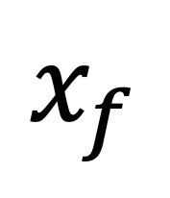
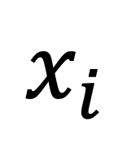
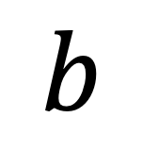
The Boundary in 1D
$$x_{i}$$
$$b$$
$$x_{f}$$
tb
t
Initialize Ekin > 0 and track position/direction.
while (Ekin > 0) do
distToPhysics ← sample physics interaction length
distToBoundary ← distance to volume boundary
if (distToPhysics < distToBoundary) then
stepLength ← distToPhysics
else
stepLength ← distToBoundary
end if
…propagate track by stepLength
…do physics interactions
end while

Slide 18
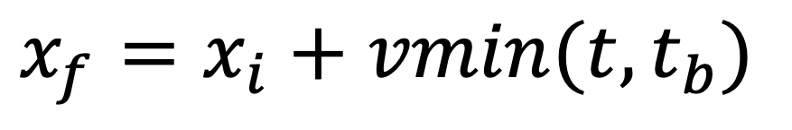
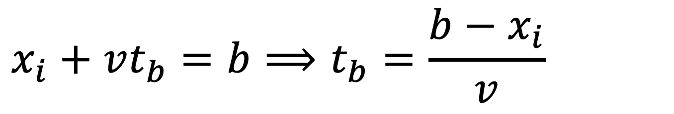
The Boundary in 1D
$$x_{i}$$
$$b$$
$$x_{f}$$
tb
t
Initialize Ekin > 0 and track position/direction.
while (Ekin > 0) do
distToPhysics ← sample physics interaction length
distToBoundary ← distance to volume boundary
if (distToPhysics < distToBoundary) then
stepLength ← distToPhysics
else
stepLength ← distToBoundary
end if
…propagate track by stepLength
…do physics interactions
end while
$$x_{i}+vt_{b}=b⟹t_{b}=\frac{b−x_{i}}{v}$$
$$x_{f}=x_{i}+vmin(t,t_{b})$$

Slide 19
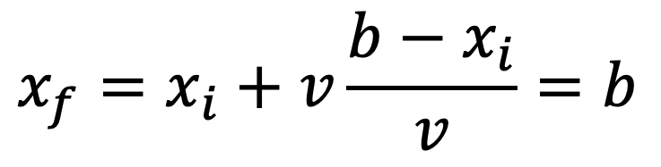
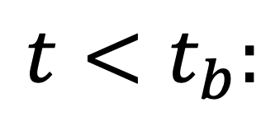
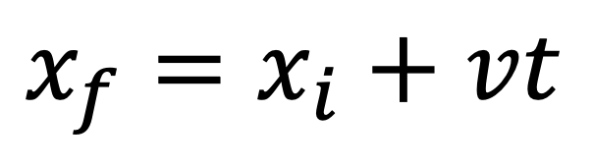
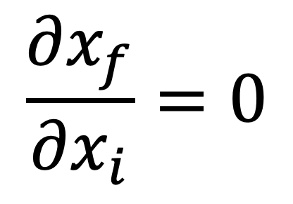
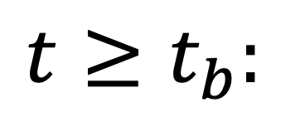
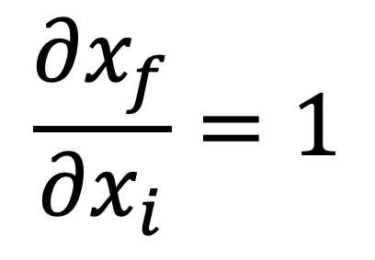
The Boundary in 1D
$$x_{i}$$
$$b$$
$$x_{f}$$
tb
t
Initialize Ekin > 0 and track position/direction.
while (Ekin > 0) do
distToPhysics ← sample physics interaction length
distToBoundary ← distance to volume boundary
if (distToPhysics < distToBoundary) then
stepLength ← distToPhysics
else
stepLength ← distToBoundary
end if
…propagate track by stepLength
…do physics interactions
end while
$$x_{i}+vt_{b}=b⟹t_{b}=\frac{b−x_{i}}{v}$$
→
$$\frac{∂x_{f}}{∂x_{i}}=1$$
$$t<t_{b}:$$
$$x_{f}=x_{i}+vt$$
!!!
$$x_{f}=x_{i}+vmin(t,t_{b})$$
$$t≥t_{b}:$$
$$x_{f}=x_{i}+v\frac{b−x_{i}}{v}=b$$
→
$$\frac{∂x_{f}}{∂x_{i}}=0$$

Slide 20
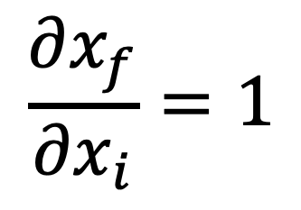
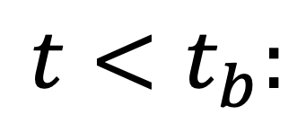
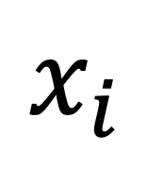
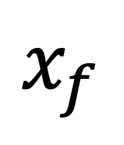
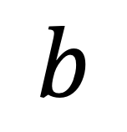
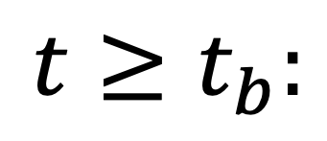
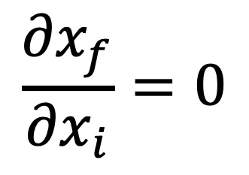
The Boundary in 1D
At a step length that transports to the boundary, there is a discontinuity in the derivative→instability in AD computations
We can remediate this by pausing gradient computation to boundary-limited steps
Initialize Ekin > 0 and track position/direction.
while (Ekin > 0) do
distToPhysics ← sample physics interaction length
distToBoundary ← distance to volume boundary
if (distToPhysics < distToBoundary) then
stepLength ← distToPhysics
else
stepLength ← distToBoundary
end if
…propagate track by stepLength
…do physics interactions
end while
$$x_{i}$$
$$b$$
$$x_{f}$$
length t
tb
t
$$\frac{∂x_{f}}{∂x_{i}}=1$$
$$t<t_{b}:$$
$$\frac{∂x_{f}}{∂x_{i}}=0$$
$$t≥t_{b}:$$

Slide 21
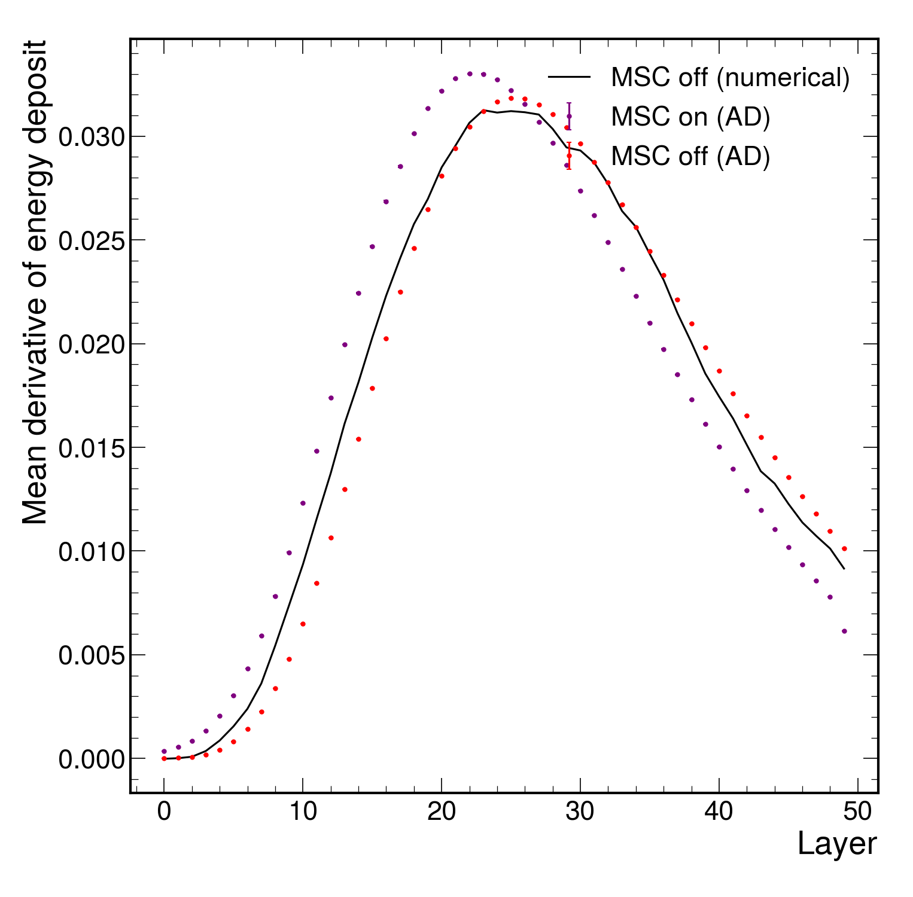
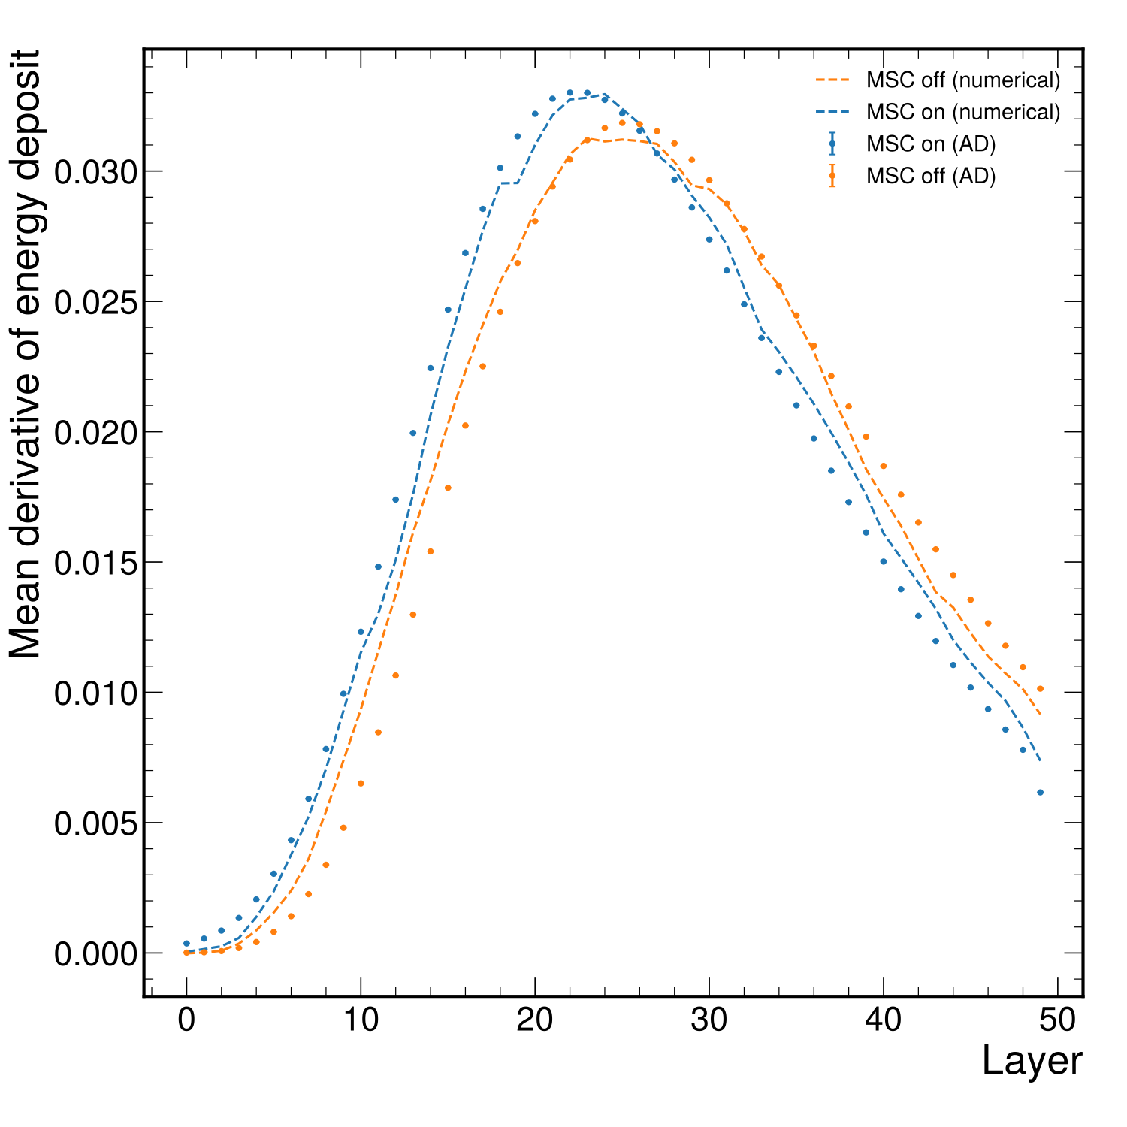
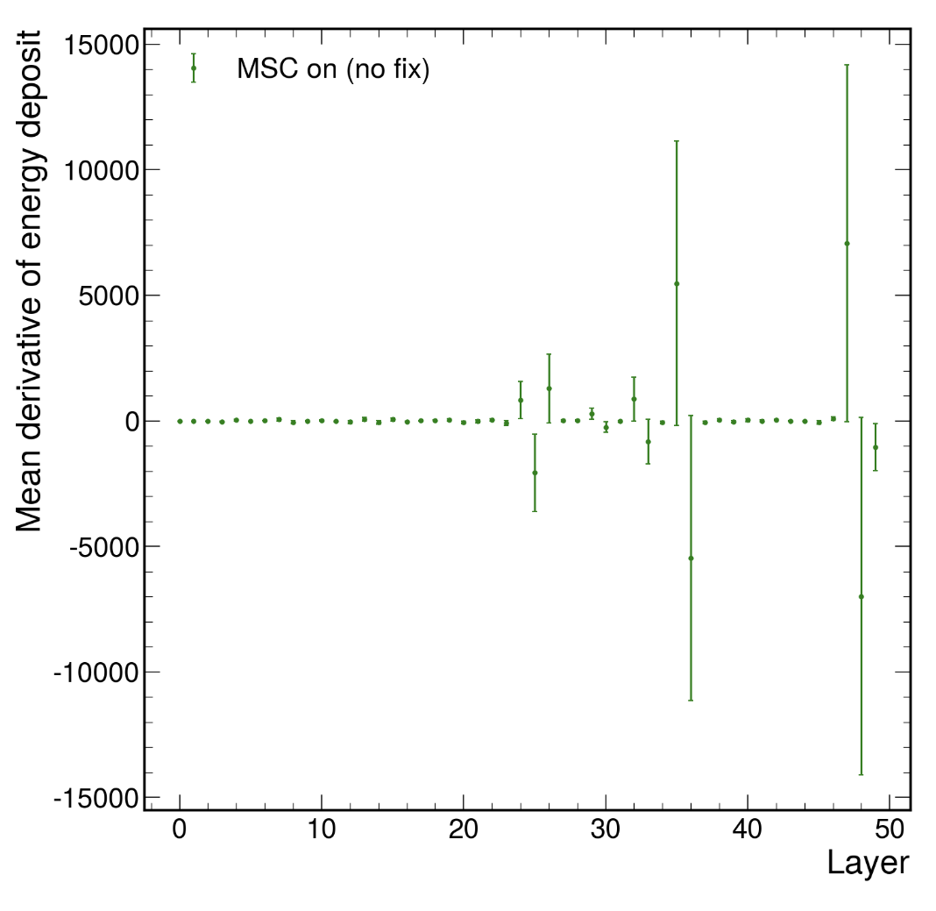
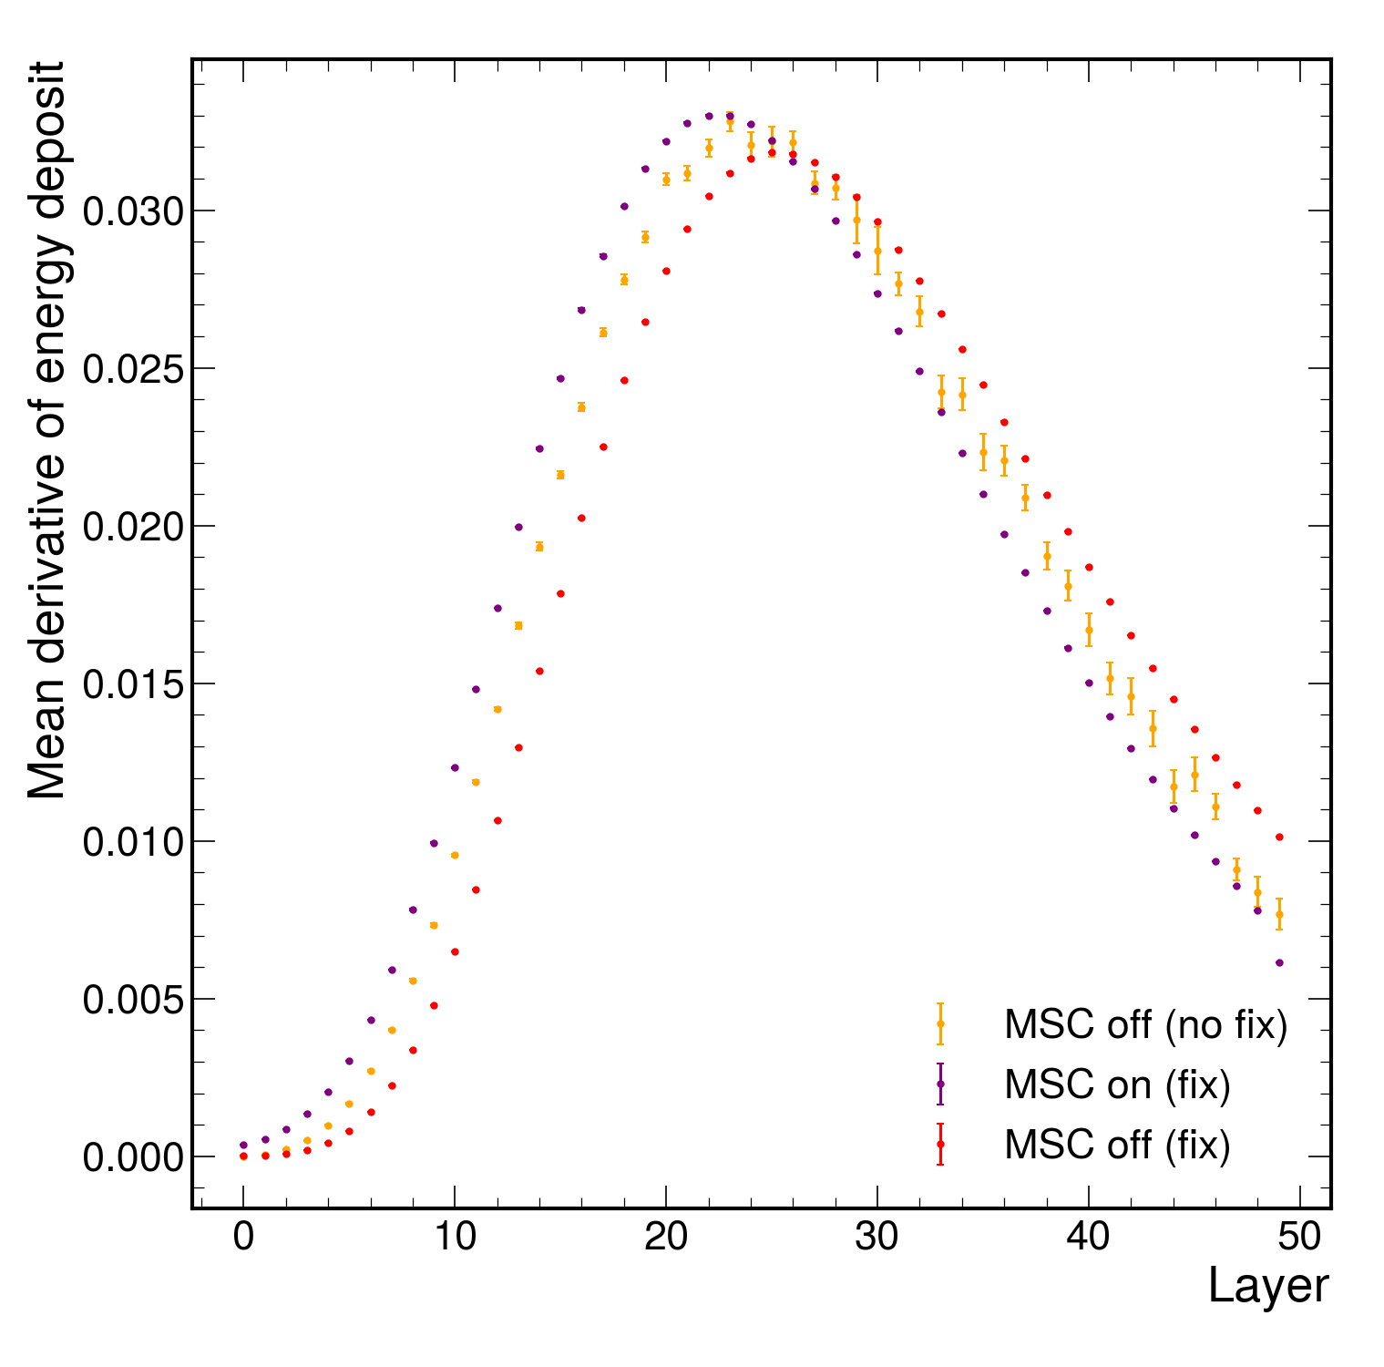
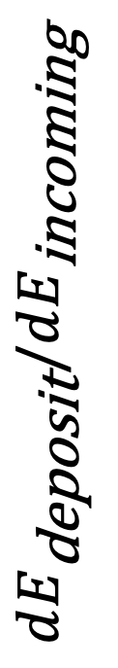
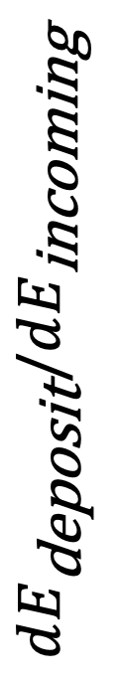
Derivatives
After controlling gradient through navigation computations, noise in derivatives decreases substantially
  No change to primal (physics energy deposits remains unchanged)
$$dE_{\text{deposit}}/dE_{\text{incoming}}$$
$$dE_{\text{deposit}}/dE_{\text{incoming}}$$

Slide 22
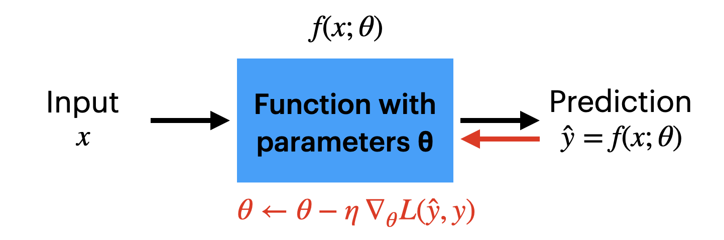
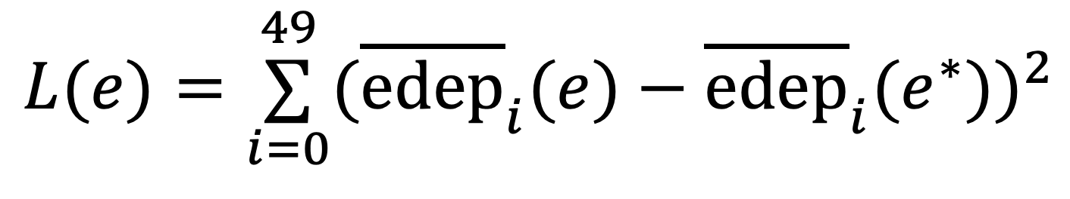
Simple Optimization
Define a target shower shape
Update primary energy to minimize loss
Optimization now using full EM physics processes in GEANT including multiple scattering
⍺
⍺
⍺
Ebeam
$$L(e)=\overset{49}{\underset{i=0}{∑}}({\overline{edep}}_{i}(e)−{\overline{edep}}_{i}(e^{∗}))^{2}$$
…
e-
Pb
LAr

Slide 23
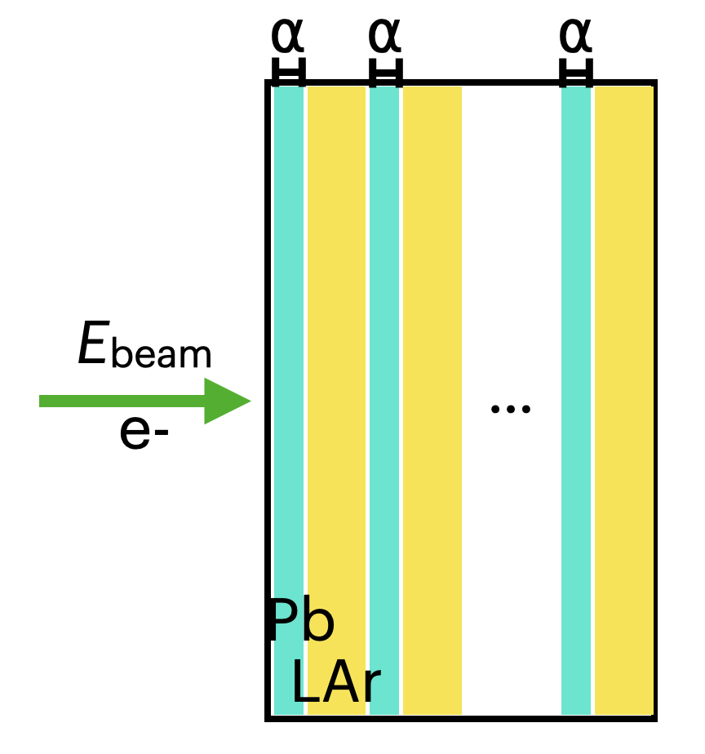
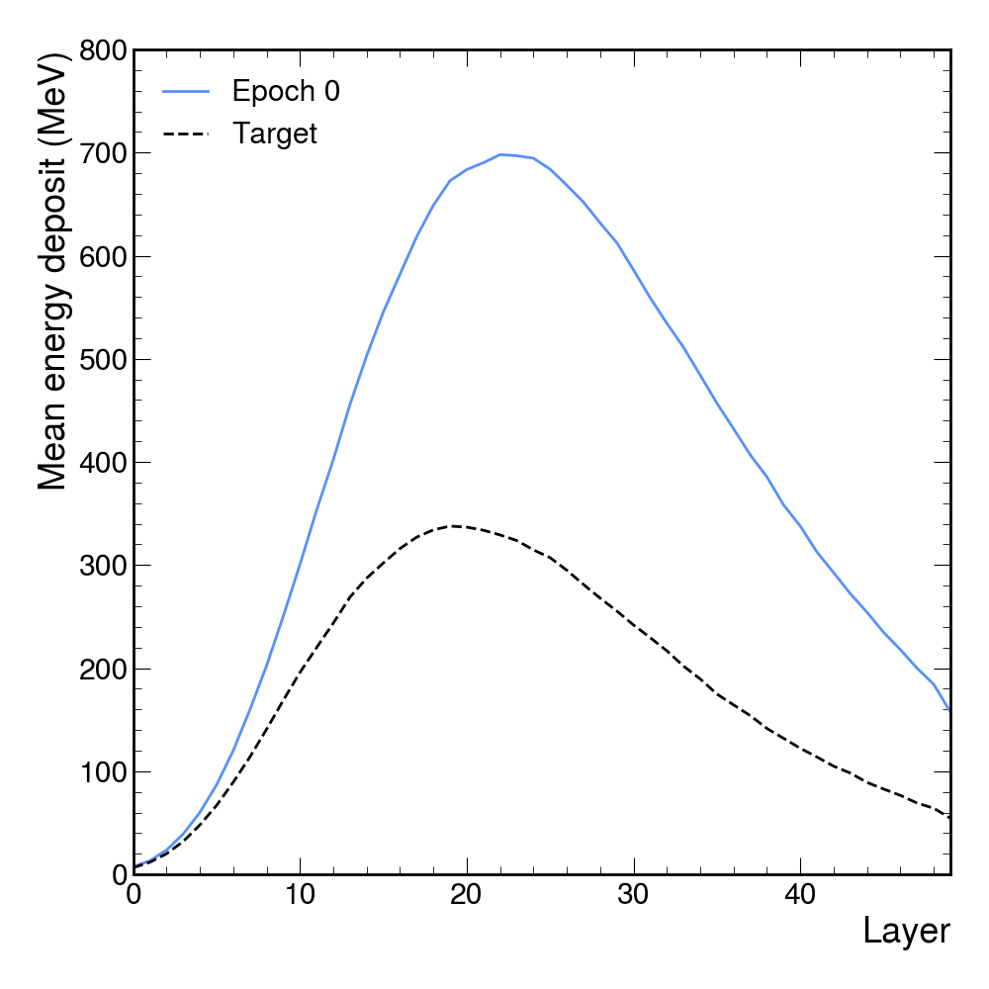
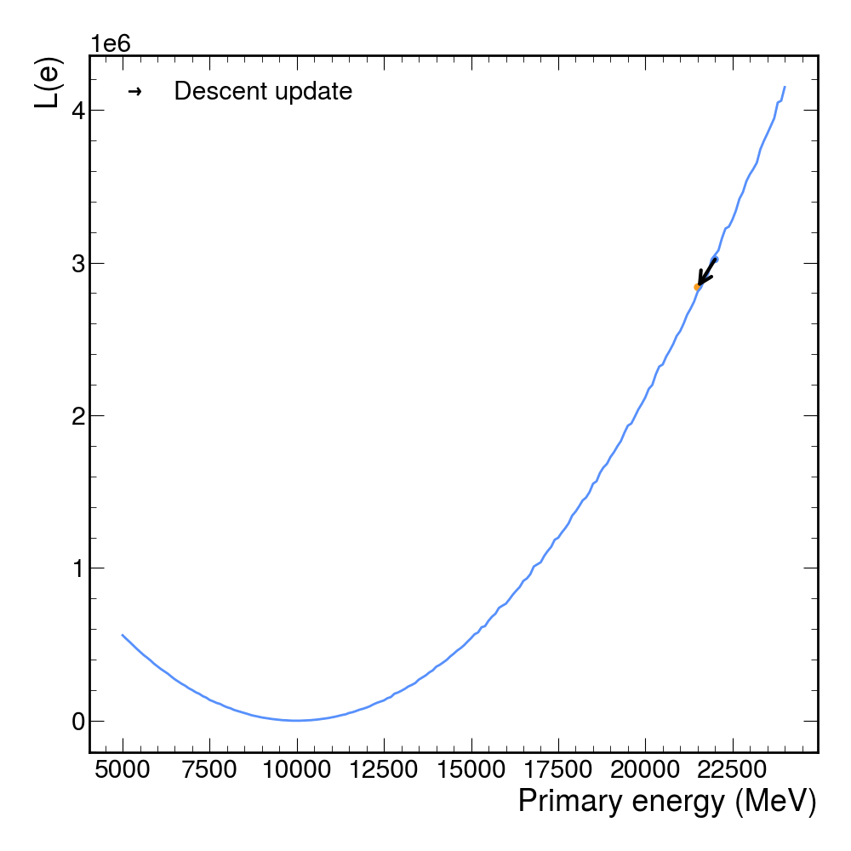
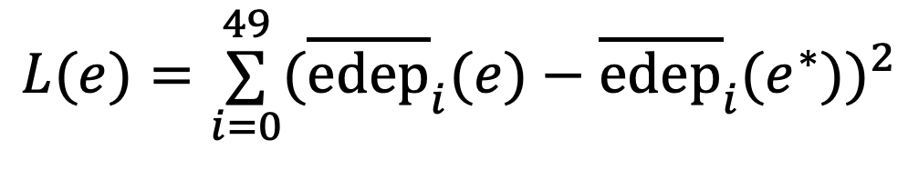
Simple Optimization
$$L(e)=\overset{49}{\underset{i=0}{∑}}({\overline{edep}}_{i}(e)−{\overline{edep}}_{i}(e^{∗}))^{2}$$

Slide 24
Conclusion
Presented latest results on differentiable GEANT with full EM physics
Developed a solution for high-variance derivatives related to multiple scattering
  Understood these results in the context of a detector optimization
  Still studying the effects of derivatives w.r.t. geometry
Paper forthcoming

