Slide 1
Optimization of the Future
P-ONE Neutrino Telescope
Christian Haack, Erlangen Centre for Astroparticle Physics
FAU Erlangen-Nürnberg

Slide 2
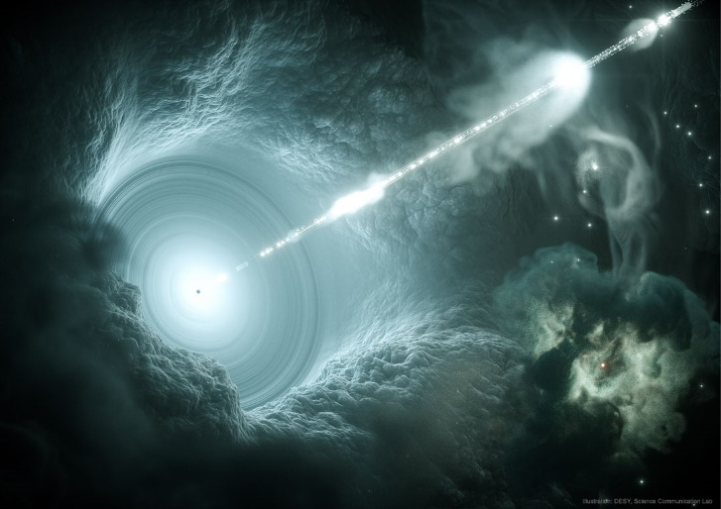
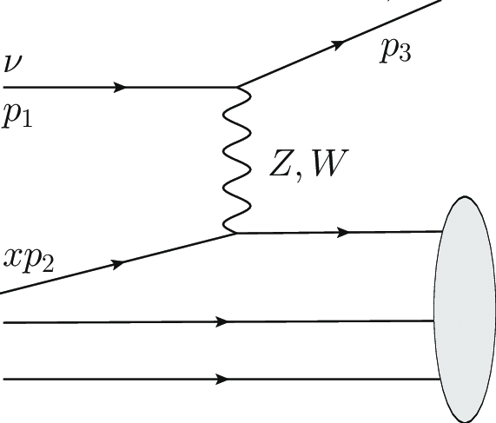
Detection Method
Transparent Natural Medium (Water / Ice)
Astrophysical Accelerator
Secondaries
Photons
(Cherenkov)
Strings with photosensors
Neutrinos
DIS
DESY

Slide 3
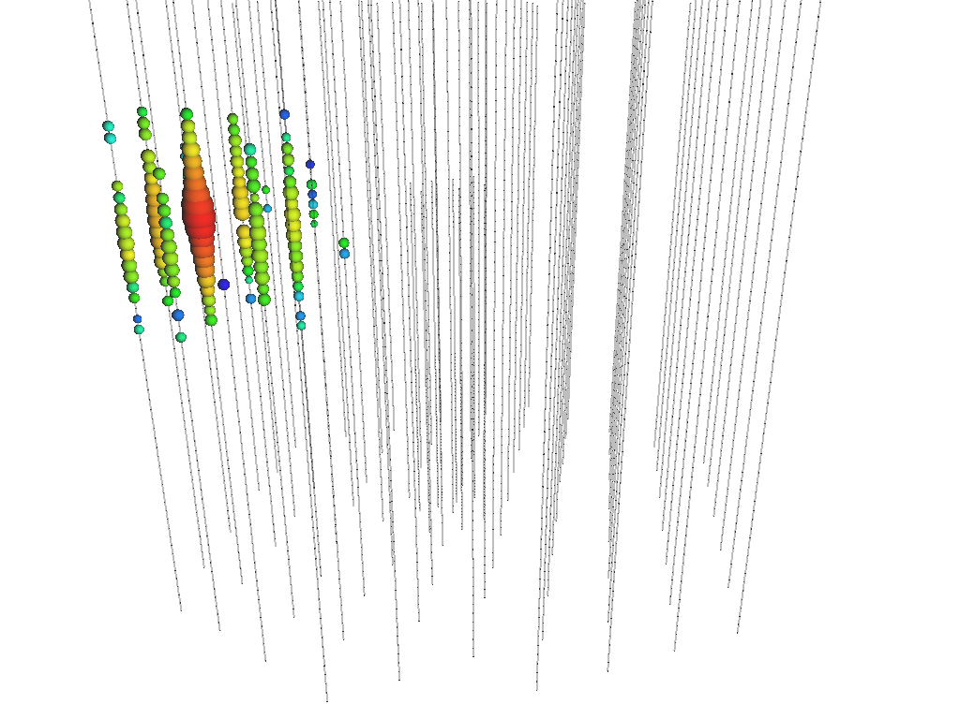
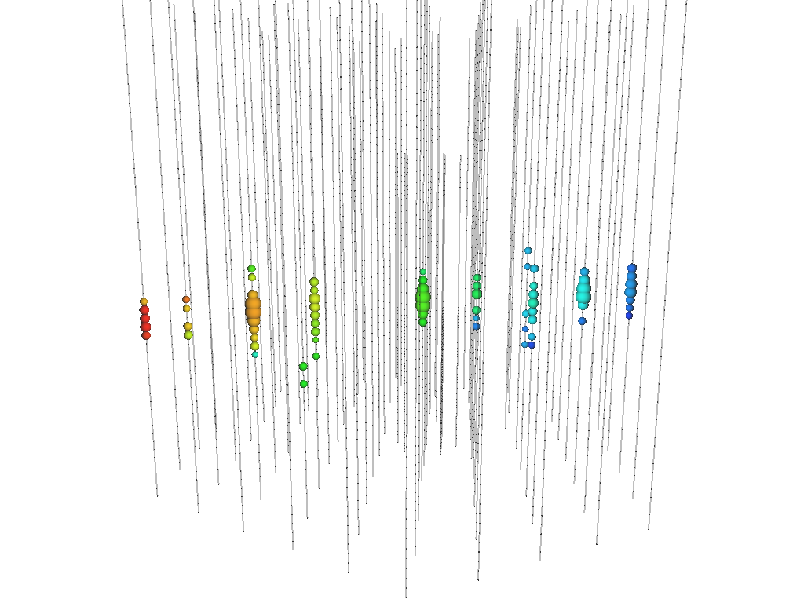



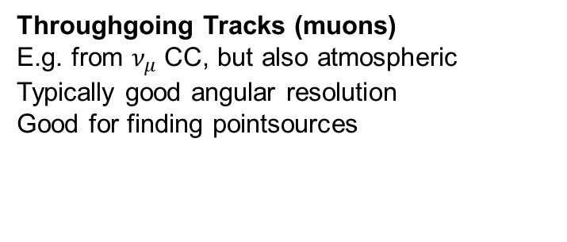
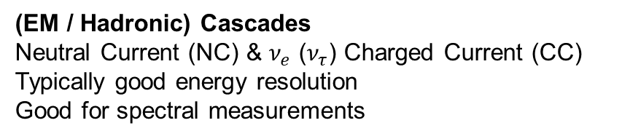
Event Topologies in Nu-Telescopes
IceCube
IceCube
Early Late
$$ν$$
Time
$$μ$$
$$ν_{μ}$$
(EM / Hadronic) Cascades
Neutral Current (NC) & $ν_{e}$ ($ν_{τ}$) Charged Current (CC)
Typically good energy resolution
Good for spectral measurements
Throughgoing Tracks (muons)
E.g. from $ν_{μ}$ CC, but also atmospheric
Typically good angular resolution
Good for finding pointsources

Slide 4
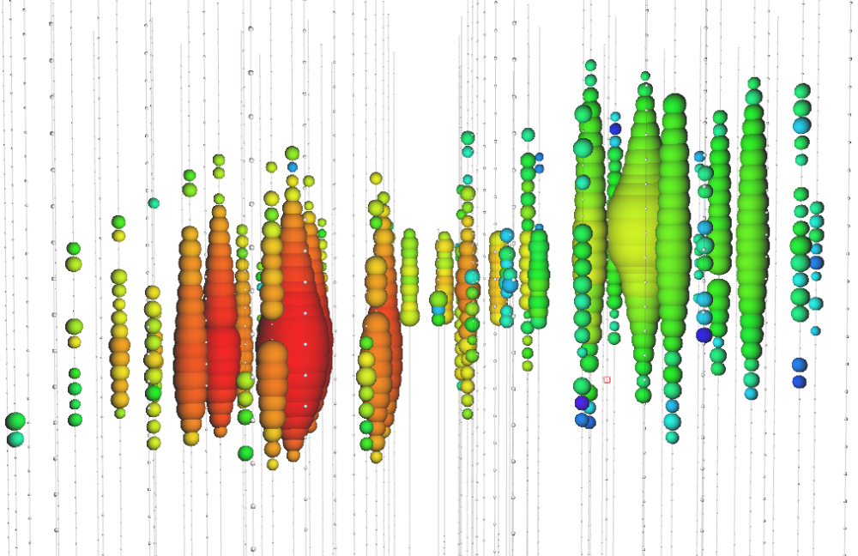
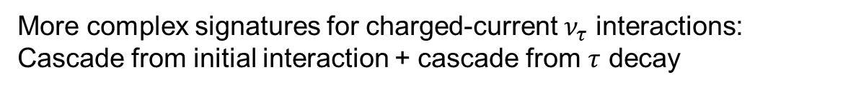



Event Topologies in Nu-Telescopes
IceCube
IceCube
$ν_{τ}$- Interactions
IceCube
Early Late
Time
$$τ_{ }$$
$$ν_{τ}$$
(EM / Hadronic) Cascades
Neutral Current (NC) & $ν_{e}$ ($ν_{τ}$) Charged Current (CC)
Typically good energy resolution
Good for spectral measurements
Throughgoing Tracks (muons)
E.g. from $ν_{μ}$ CC, but also atmospheric
Typically good angular resolution
Good for finding pointsources
More complex signatures for charged-current $ν_{τ}$ interactions: Cascade from initial interaction + cascade from $τ$ decay

Slide 5
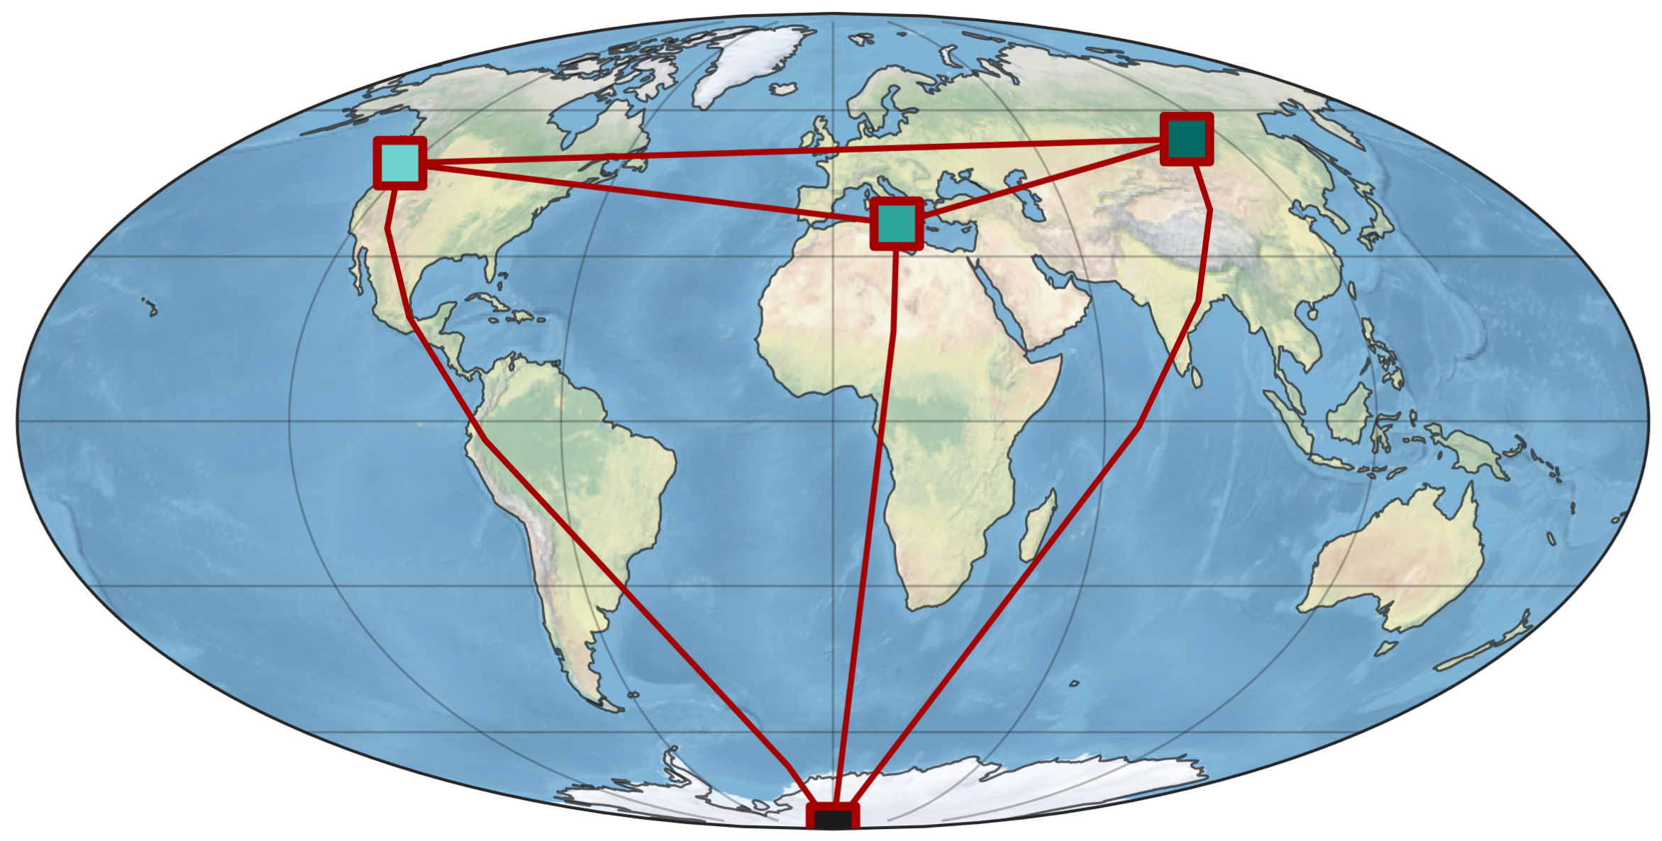




High-Energy Neutrino Telescopes
Planned
Under construction
+ several proposed Chinese
projects (TRIDENT, HUNT, ..)
Taking data for 10+ years

Slide 6
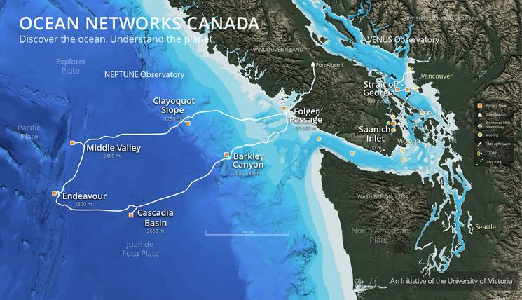

Slide 7
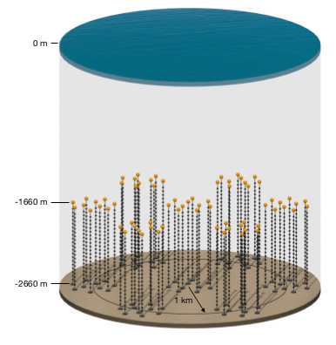
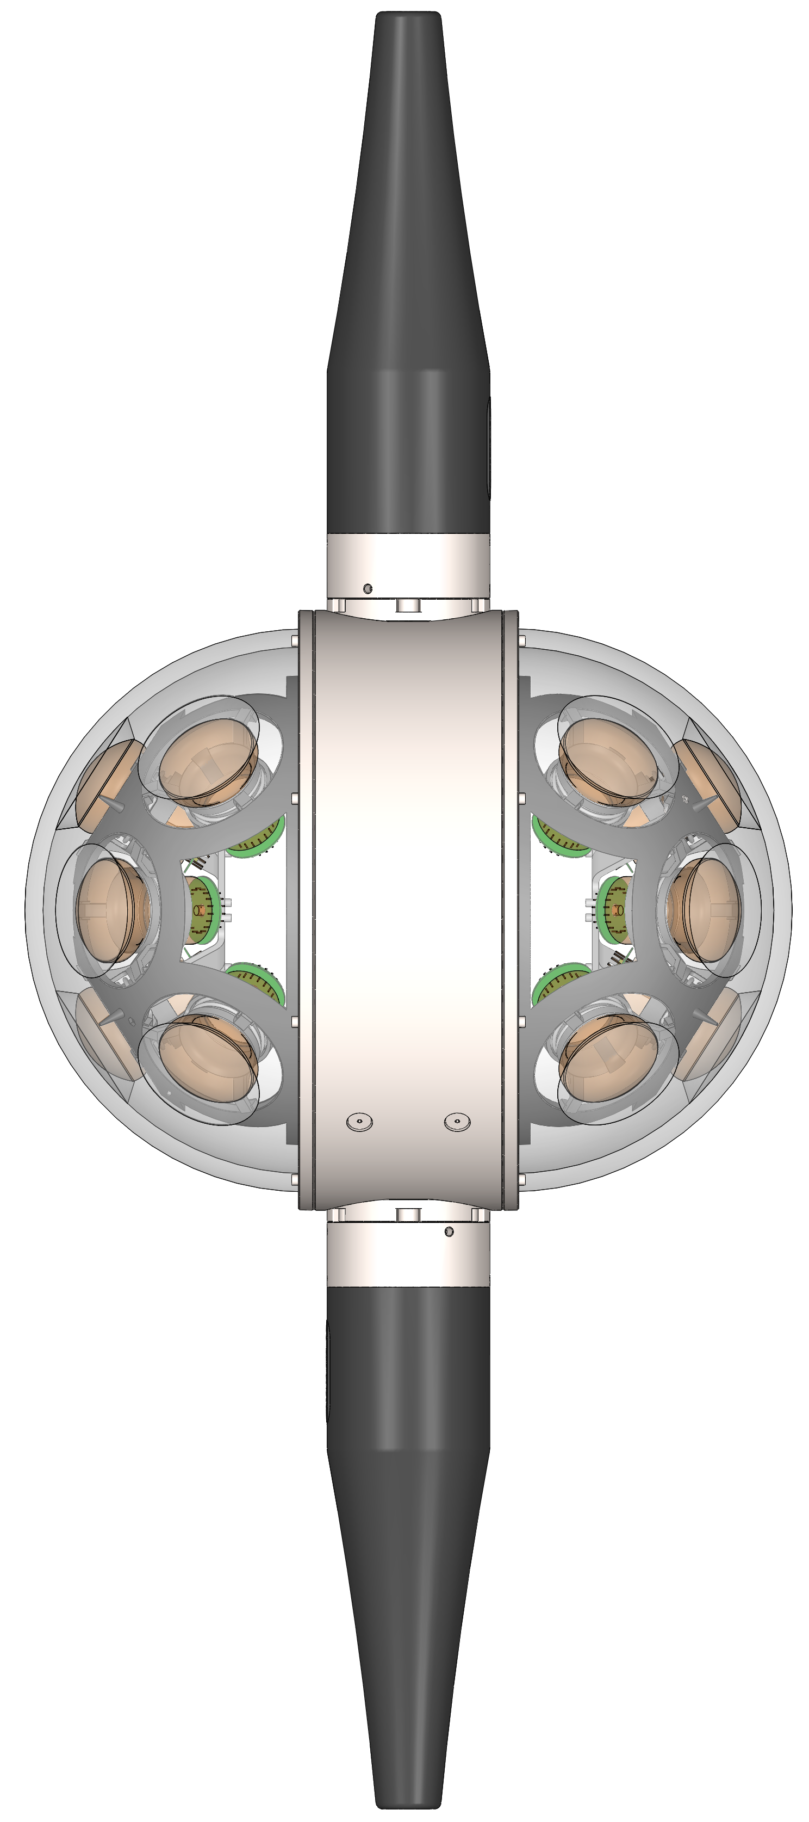
The Pacific Ocean Neutrino Experiment
First Vision
First Neutrino Telescope hosted by an existing large scale oceanographic infrastructure: Ocean Networks Canada
Relatively simple detector: One basic detection unit arranged on ~1km cables
Great case study for optimization of large scale experiment

Slide 8
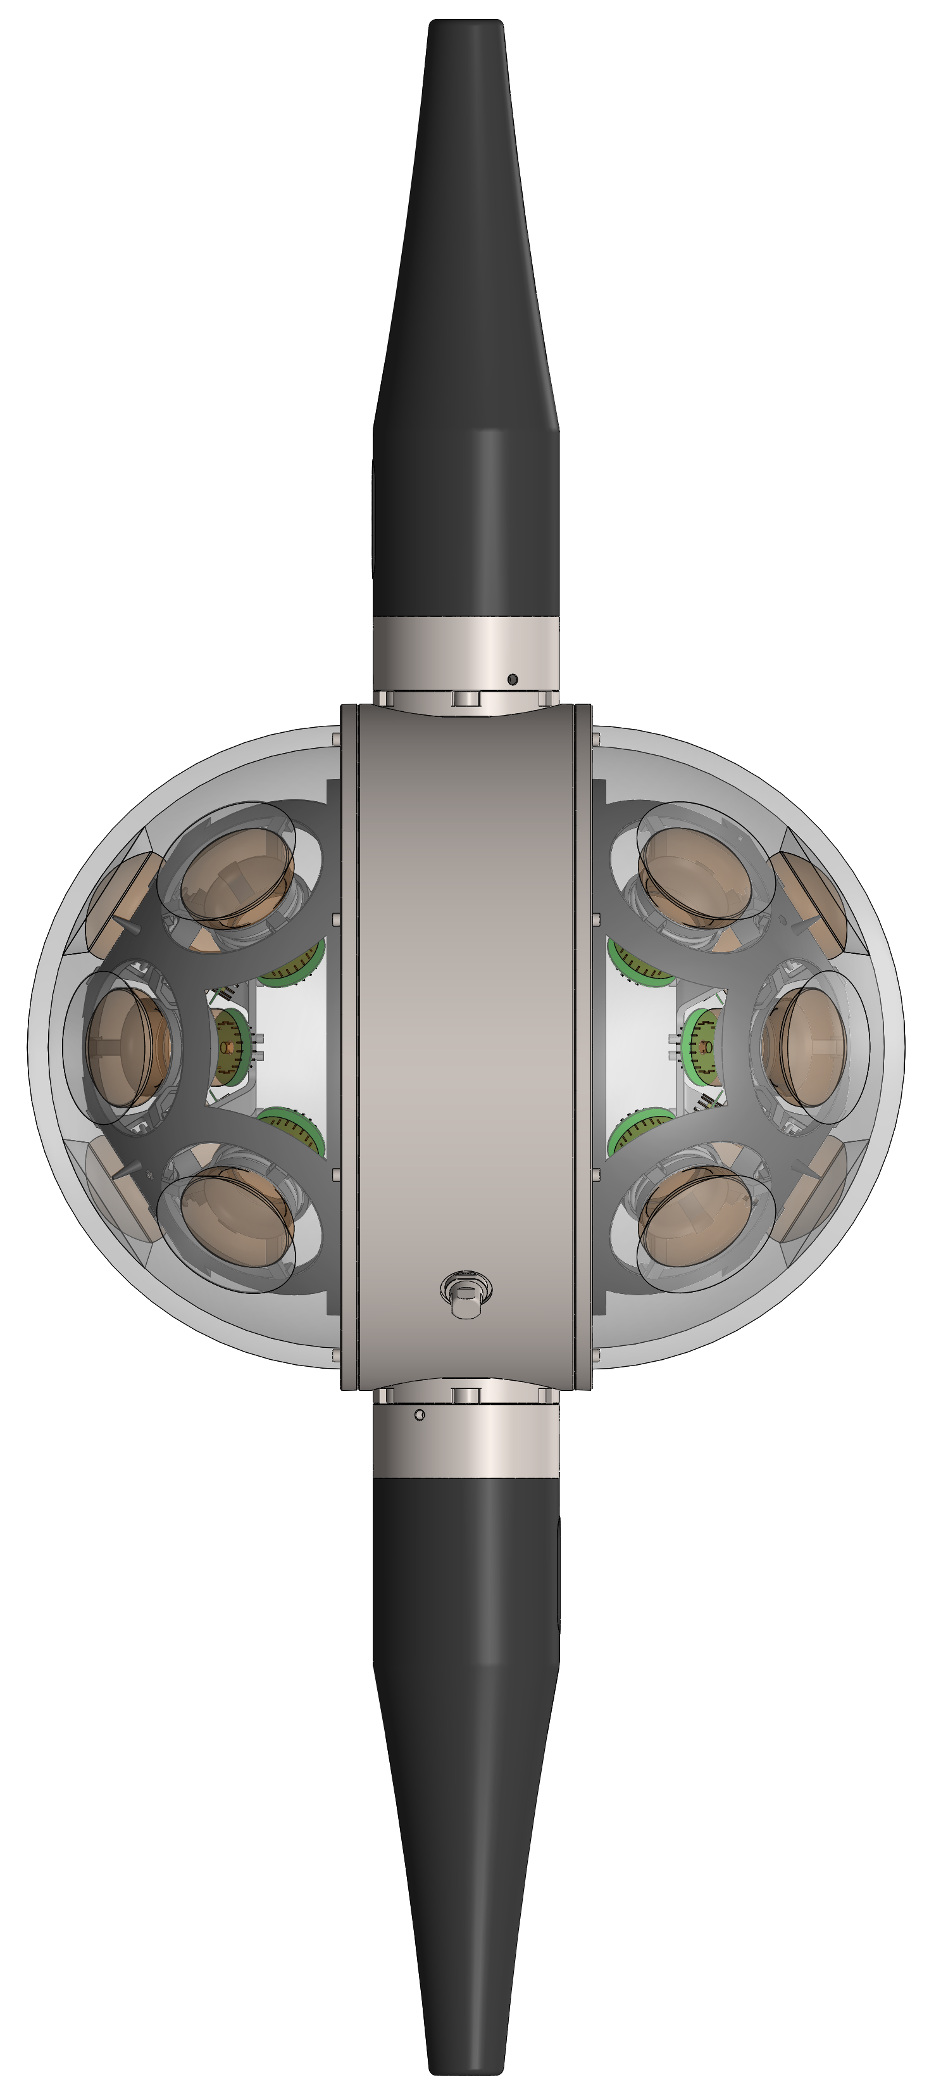
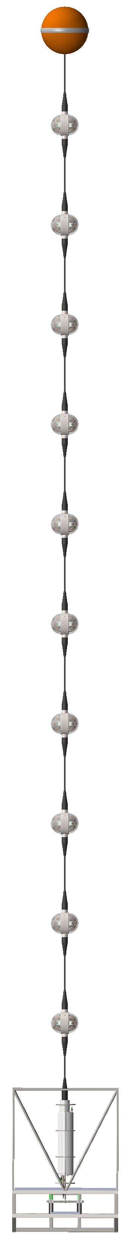
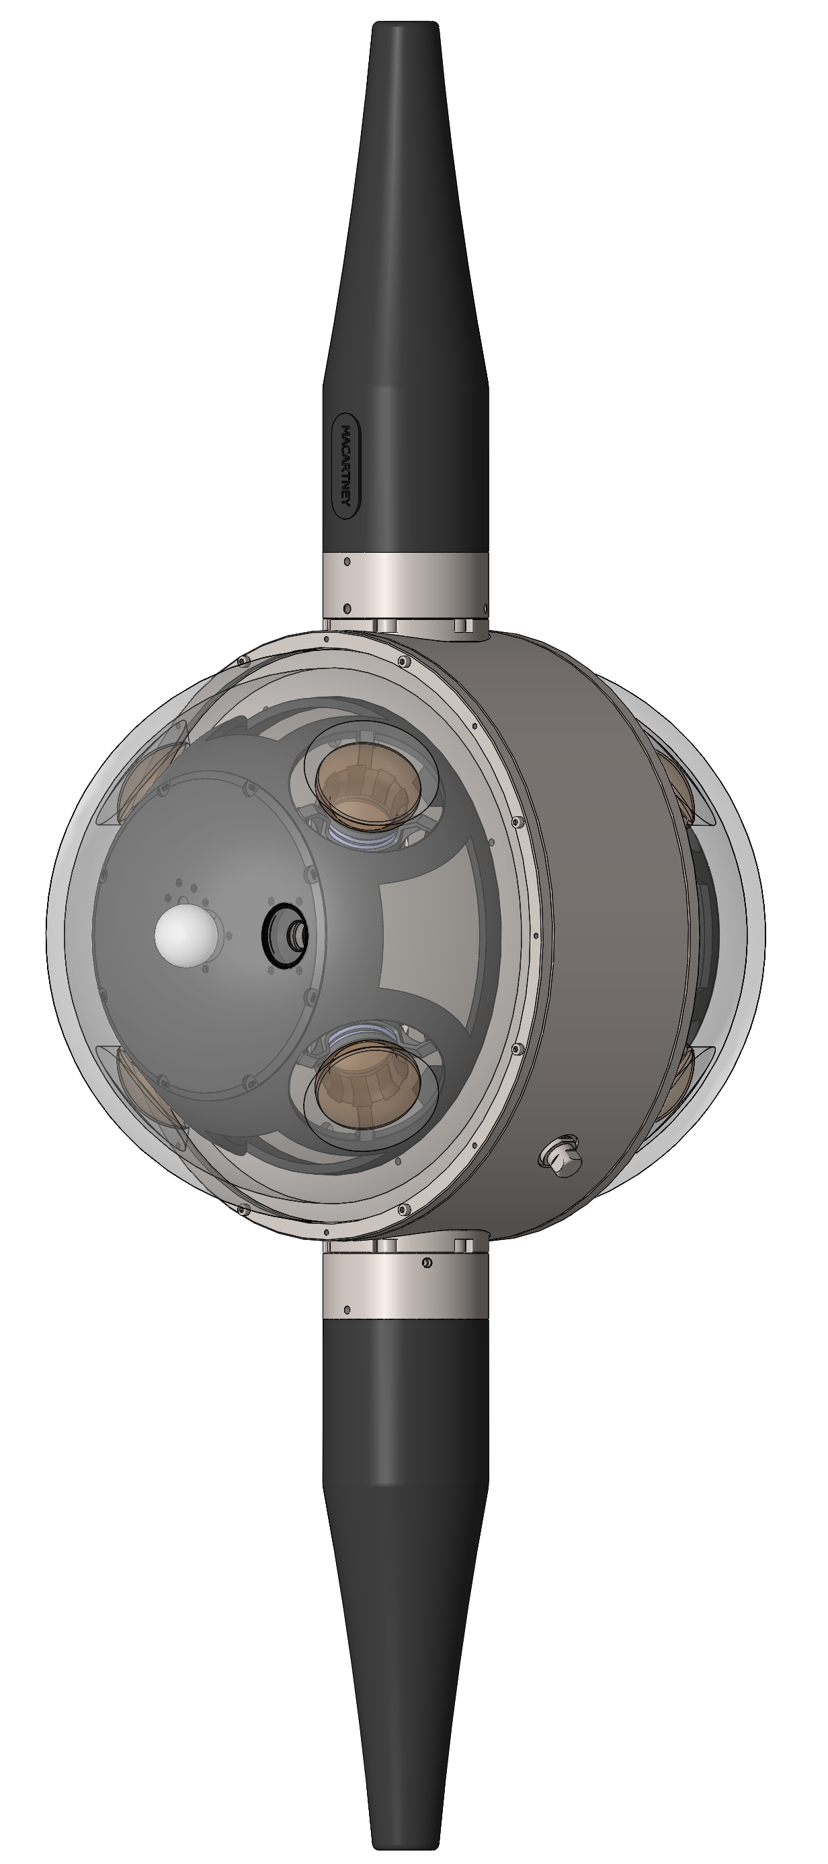
P-ONE 1
Two module types
First line of P-ONE
Proof of Concept:
    Scalability
    Deployment strategy
    Calibration
    Timing
POM
Hybrid fibre & copper communication
Connectorless cable design
50m vertical spacing
20 modules per line
PCAL

Slide 9
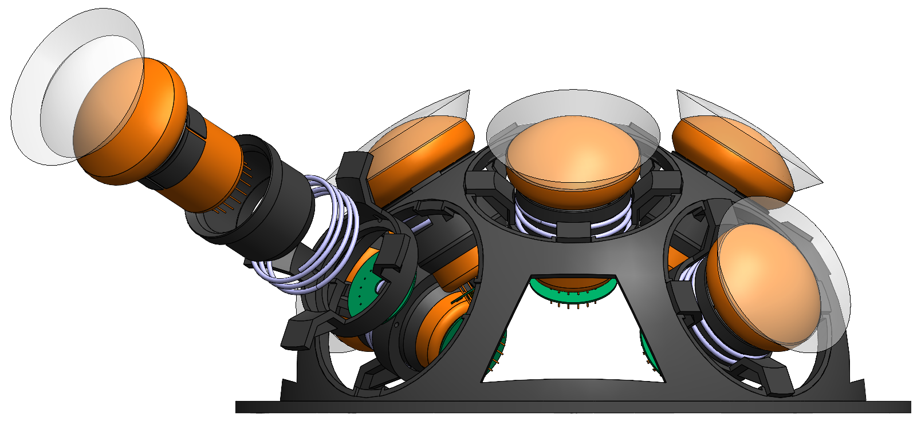
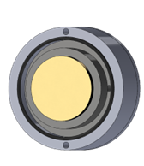
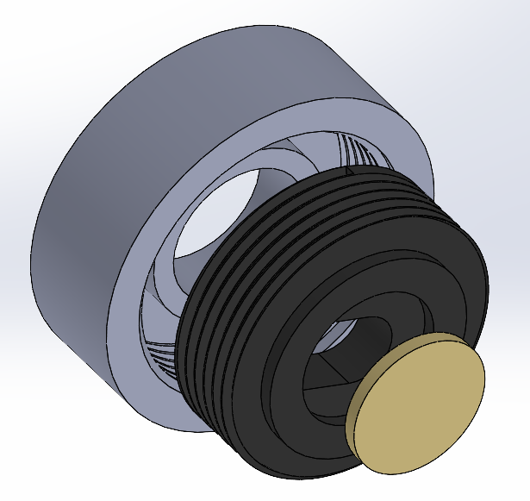
POM
P-ONE baseline optical module with 16 PMTs
PMT: Hamamatsu R14374-10 (3“)
QE at 450 nm: 24.5 %
Transit-time-spread (FWHM): 1.5 n
Optical gel reflector pads
Piezo-based acoustic receiver
Spring loaded mounting structure

Slide 10
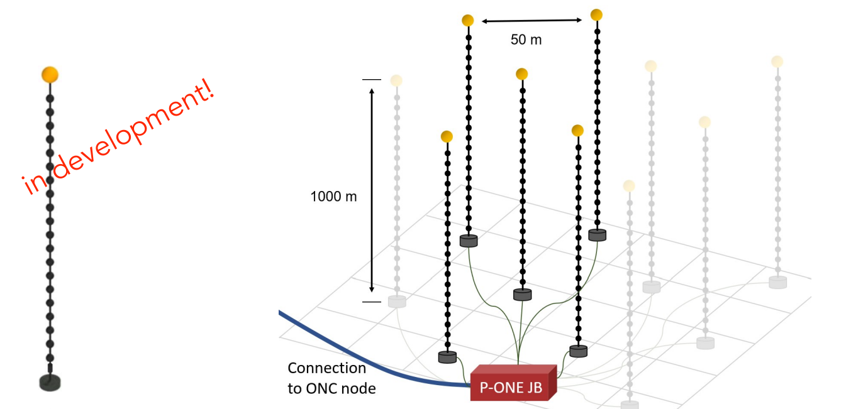
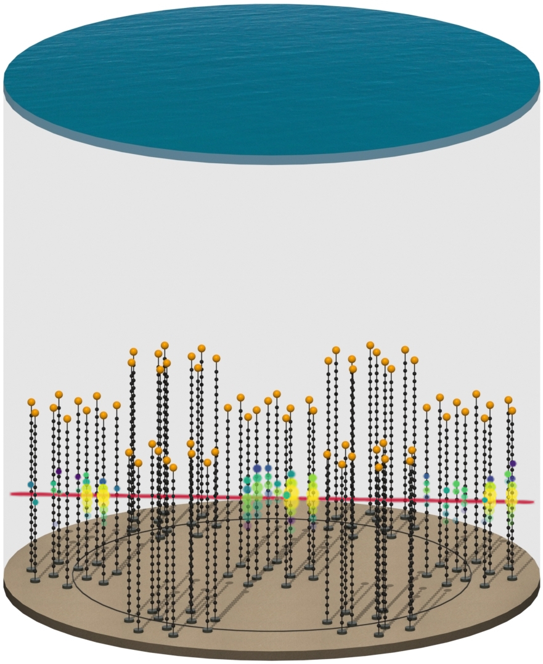
P-ONE Roadmap
Nat Astron 4, 913–915 (2020)
1km
Optimal layout under study
to ONC node
P-ONE-1
2025
P-ONE Demonstrator
2025+

Slide 11
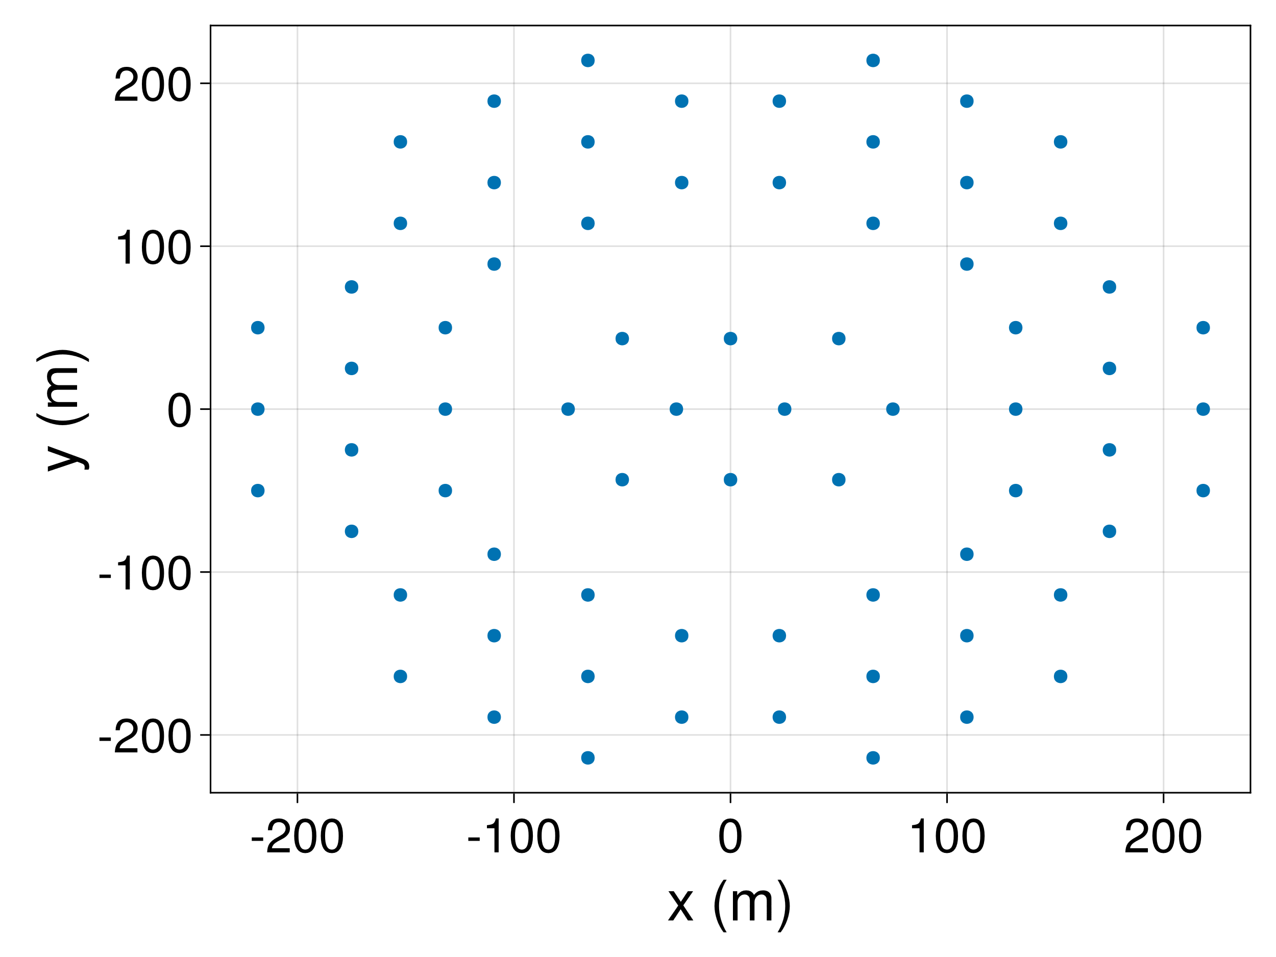
ML-Based Optimization Workflow
Simulate interaction (MC)
Calculate light yield
Photon Surrogate Model
Propagate photons (MC)
Detector Response (MC)
Fisher Information
Reconstruction
Resolution Functions
Resolution Functions

Slide 12
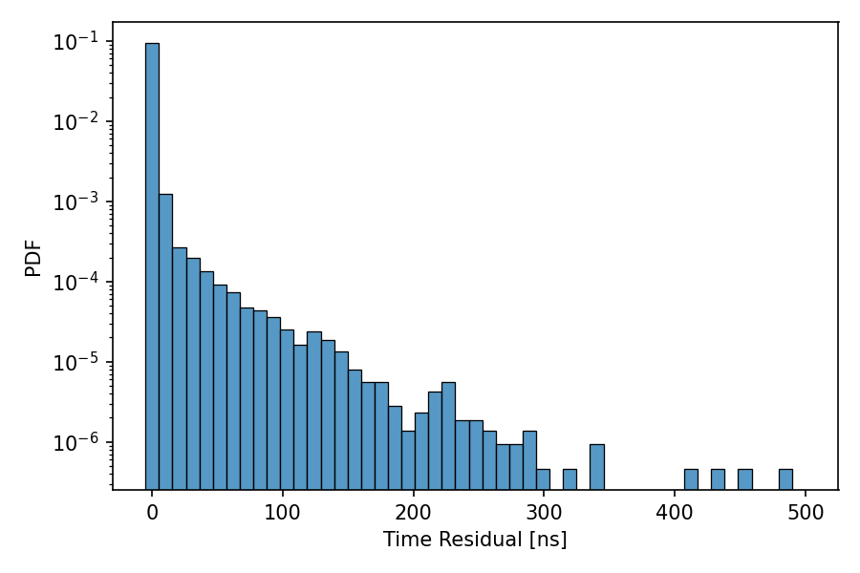


Surrogate for Neutrino Telescopes
CUDA-accelerated photon propagation code
https://github.com/PLEnuM-group/PhotonPropagation.jl
Surrogate model learns detector response for single module as function of input parameters (neutrino energy, direction ….)
Particle Shower
$$ν$$
Our PMTs see this:
$$E, \vec{Ω},t_{0},…$$
Computationally Expensive!
Relative photon arrival time

Slide 13
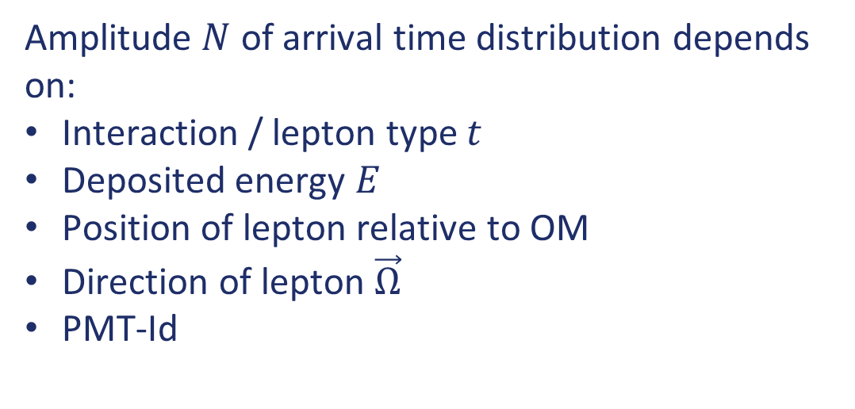
Surrogate for Neutrino Telescopes
Amplitude $N$ of arrival time distribution depends on:
Interaction / lepton type $t$
Deposited energy $E$
Position of lepton relative to OM
Direction of lepton $\vec{Ω}$
PMT-Id
Relative photon arrival time
Shape of distribution is strongly correlated with amplitude in low-scattering environments
-> Modeling only amplitude is good approximation

Slide 14
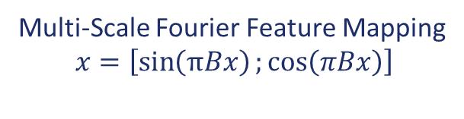





Amplitude Surrogate Model
$$B_{ij}∼𝒩\left(0,s_{1}\right)$$
Embedding
MLP
Concat
+
Linear
$$B_{ij}∼𝒩\left(0,s_{2}\right)$$
Embedding
16D Output $λ_{i}$
$$E, \vec{Ω},\vec{x}$$
Surrogate model predicts
# detected photons
per PMT
$$B_{ij}∼𝒩\left(0,s_{3}\right)$$
Embedding
Multi-Scale Fourier Feature Mapping
$$x=\left[\sin\left(πBx\right);\cos\left(πBx\right)\right]$$
https://doi.org/10.1016/j.cma.2021.113938

Slide 15

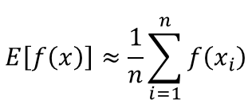
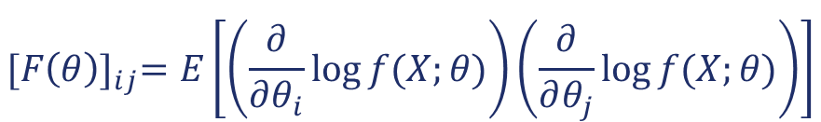


Fisher Information
Given a PDF $f(X;θ)$of an observable $X$ conditioned on a parameter vector $θ$, the Fisher Information Matrix is:
$${[F\left(θ\right)]}_{ij}=E\left[\left(\frac{∂}{∂θ_{i}}\log{f(X;θ)}\right)\left(\frac{∂}{∂θ_{j}}\log{f(X;θ)}\right)\right]$$
$$E\left[f\left(x\right)\right]≈\frac{1}{n}\sum_{i=1}^{n}{f\left(x_{i}\right)}$$
$$θ=(Energy, Direction, Position, …)$$
$f(X;θ)$: Photon Surrogate Model
Cramer Rao Bound: $cov_{θ}\left(\hat{θ}\right)≥ℐ{\left(θ\right)}^{−1}$
$$\hat{θ}=Any estimator of (Energy, Direction, Position, …)$$

Slide 16
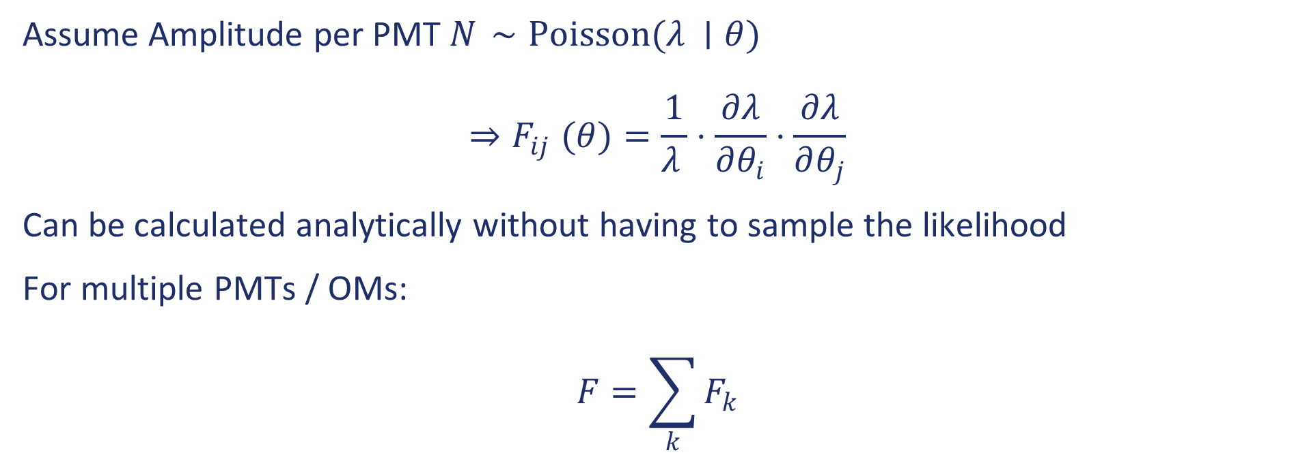
Fisher Information for Poisson Likelihood
Assume Amplitude per PMT $N_{ }∼Poisson(λ_{ }∣θ)$
$${⇒F}_{ij}(θ)=\frac{1}{λ_{ }}⋅\frac{∂λ}{∂θ_{i}}⋅\frac{∂λ}{∂θ_{j}}$$
Can be calculated analytically without having to sample the likelihood
For multiple PMTs / OMs:
$$F=\sum_{k}{F_{k}}$$

Slide 17
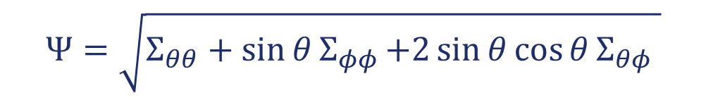
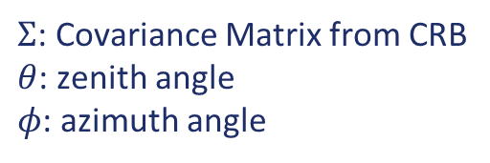
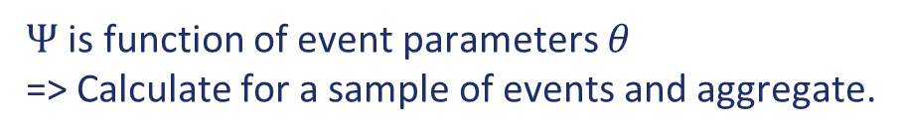
Optimization Metric
Goal: Metric summarizes the detector performance at the analysis level (ie analysis sensitivities)
Depends strongly on choice of analysis
Requires surrogate or differentiable analysis
For now: Focus on a metric that genereally benefits every analysis – angular resolution
$$Ψ=\sqrt{Σ_{θθ}+\sin{θ}Σ_{φφ}{+2\sin{θ\cos{θ}Σ_{θφ}} }}$$
$Σ$: Covariance Matrix from CRB
$θ$: zenith angle
$φ$: azimuth angle
$Ψ$ is function of event parameters $θ$
=> Calculate for a sample of events and aggregate.

Slide 18
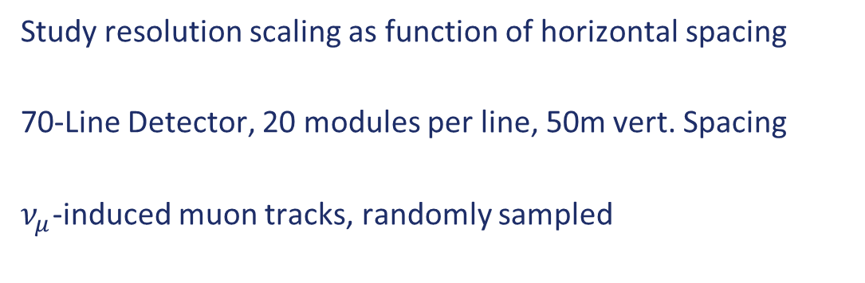
P-ONE Geometry Optimization
Proof of Concept
Study resolution scaling as function of horizontal spacing
70-Line Detector, 20 modules per line, 50m vert. Spacing
$ν_{μ}$-induced muon tracks, randomly sampled

Slide 19
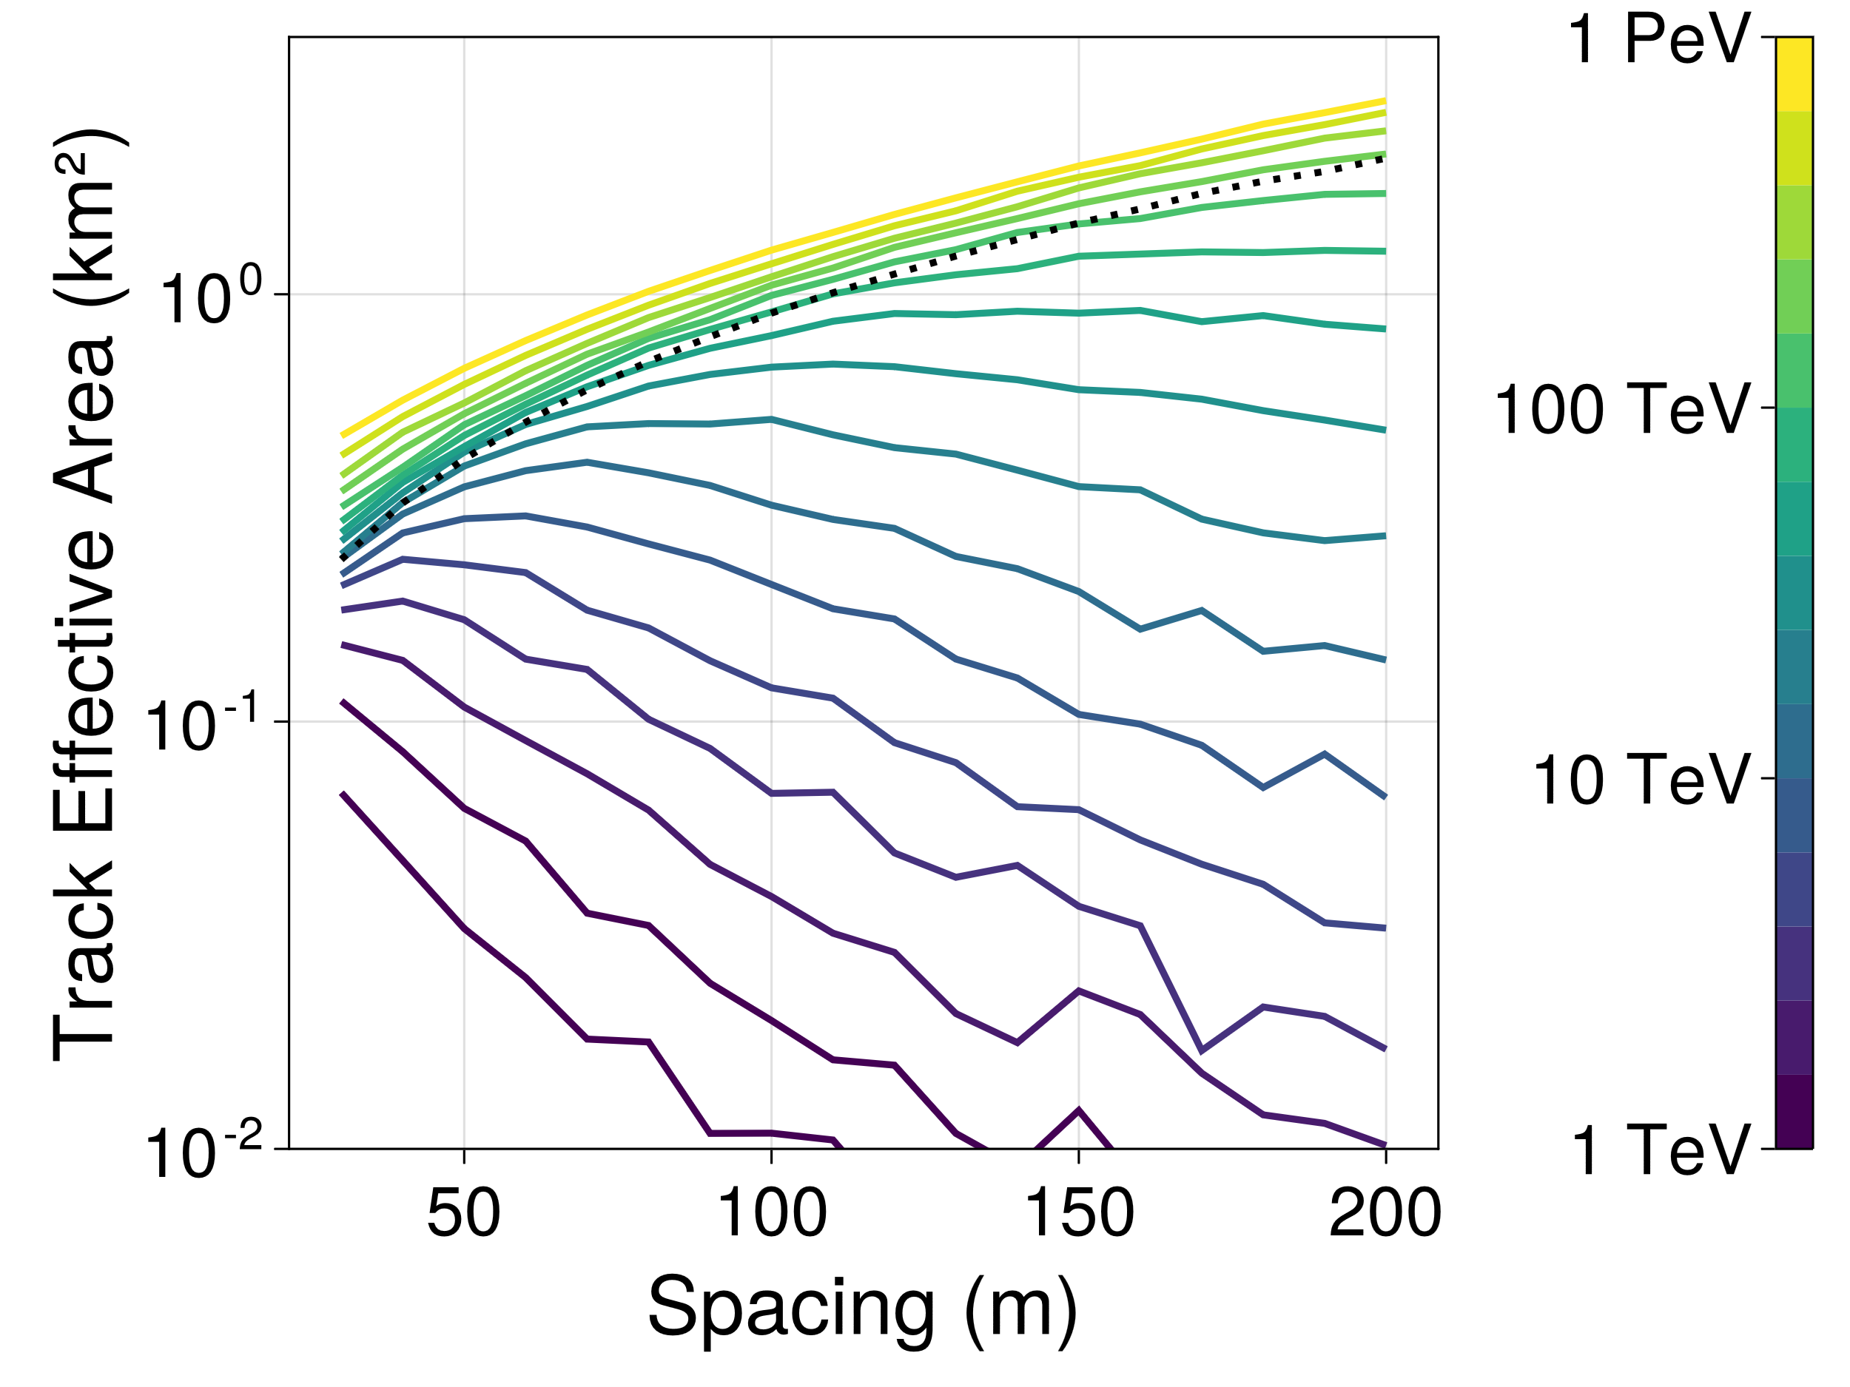
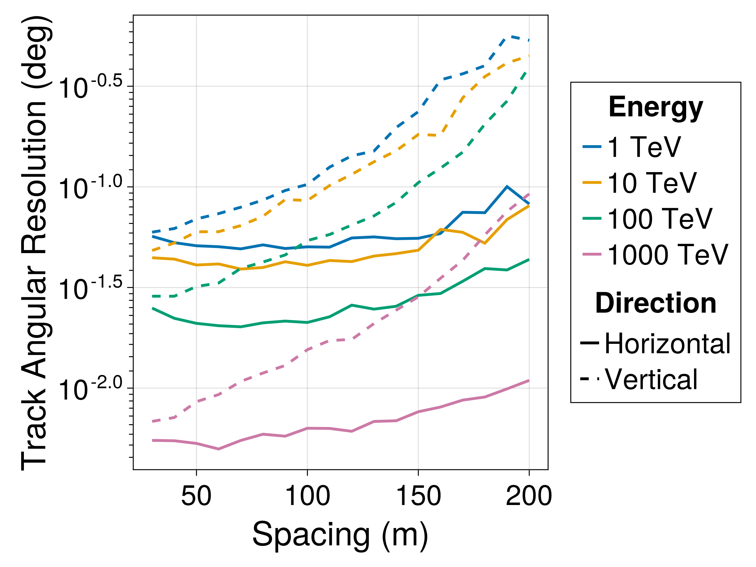
Resolution Scaling
Christian Haack et al., PoS(ICRC2023)1059

Slide 20
Analytic Surrogate
Simultaneous optimization of all detector lines with NN-based surrogate model is rather slow (need to calculate two gradients for each event)
Idea: Use Symbolic Regression to find an analytic expression for the number of detected photons at each PMT

Slide 21

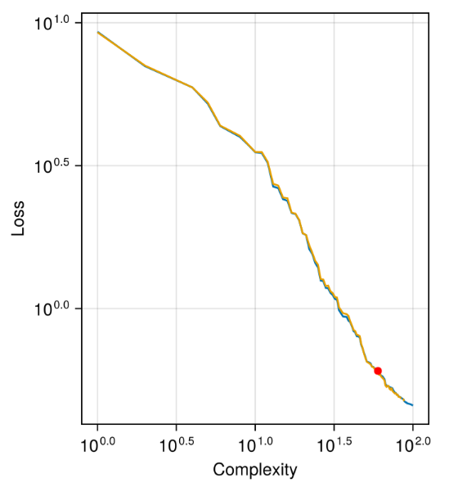
Symbolic Regression
https://github.com/MilesCranmer/PySR
Pareto-Front

Slide 22
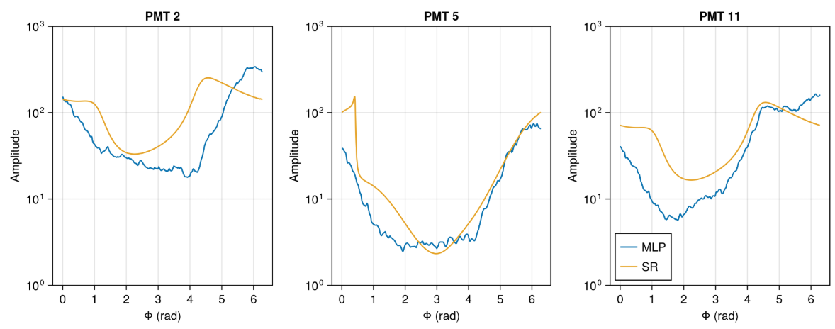
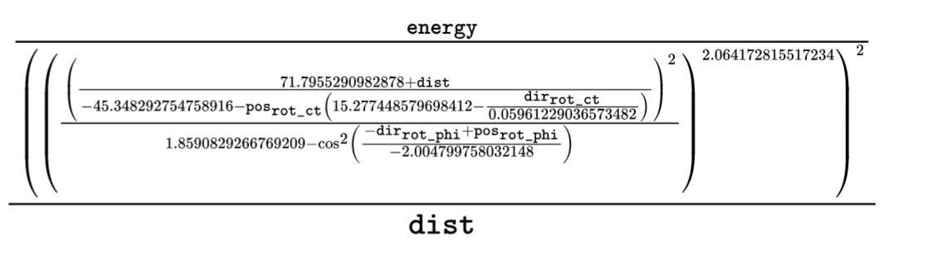
SR Model
The equation at complexity 32:

Slide 23
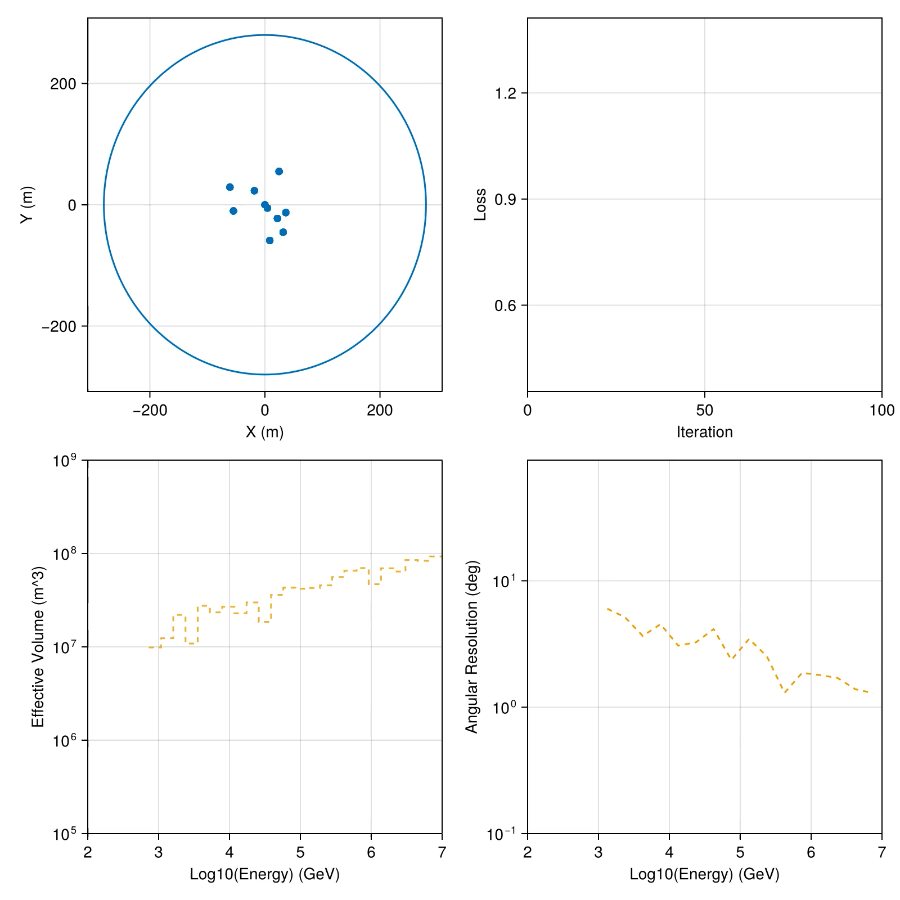
Optimization Example
All lines are optimized simultaneously using stochastic gradient descent over batches of randomly generated events
Constraints can easily be incorporated as additional terms in the loss function
Need to check how well the metric correlates with actual analysis performance

Slide 24

Weighted Optimization Scheme
Inspired by the Interferometer optimization by the MLP Group:
Start with an overparameterized Scenario (ie. 625 detector lines) at fixed positions
Assign each line a weight that scales the Fisher-Information contribution of that line:
Allows us to precalculate the FI for our event sample -> don’t have to differentiate through the surrogate
$$F=\sum_{k}{w_{i} }⋅F_{k}$$

Slide 25
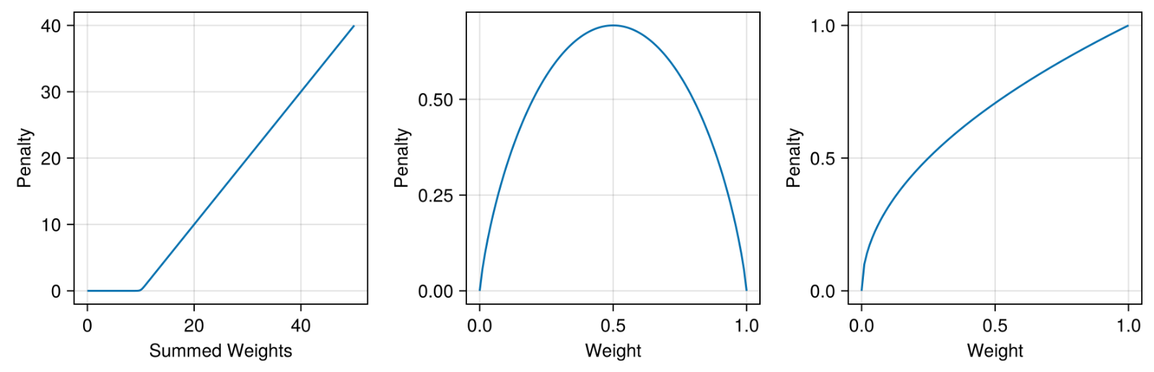

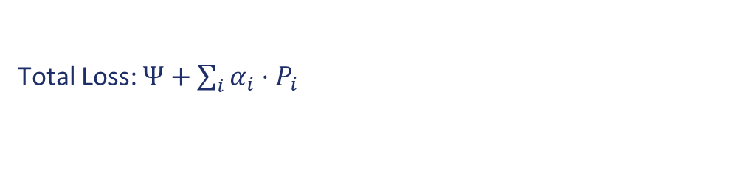
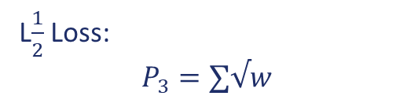
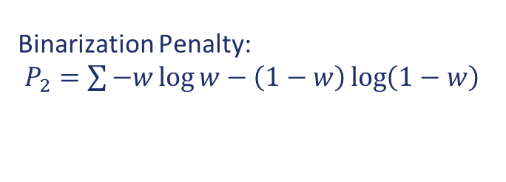
Constraints / Penalties
Line Number Constraint:
$$P_{1}=softplus(∑w−N)$$
Binarization Penalty:
$P_{2}=\sum{−w\log{w}−\left(1−w\right)\log\left(1−w\right)}$
L$\frac{1}{2}$ Loss:
$$P_{3}=∑√w$$
Total Loss: $Ψ+\sum_{i}{α_{i}}⋅P_{i}$

Slide 26
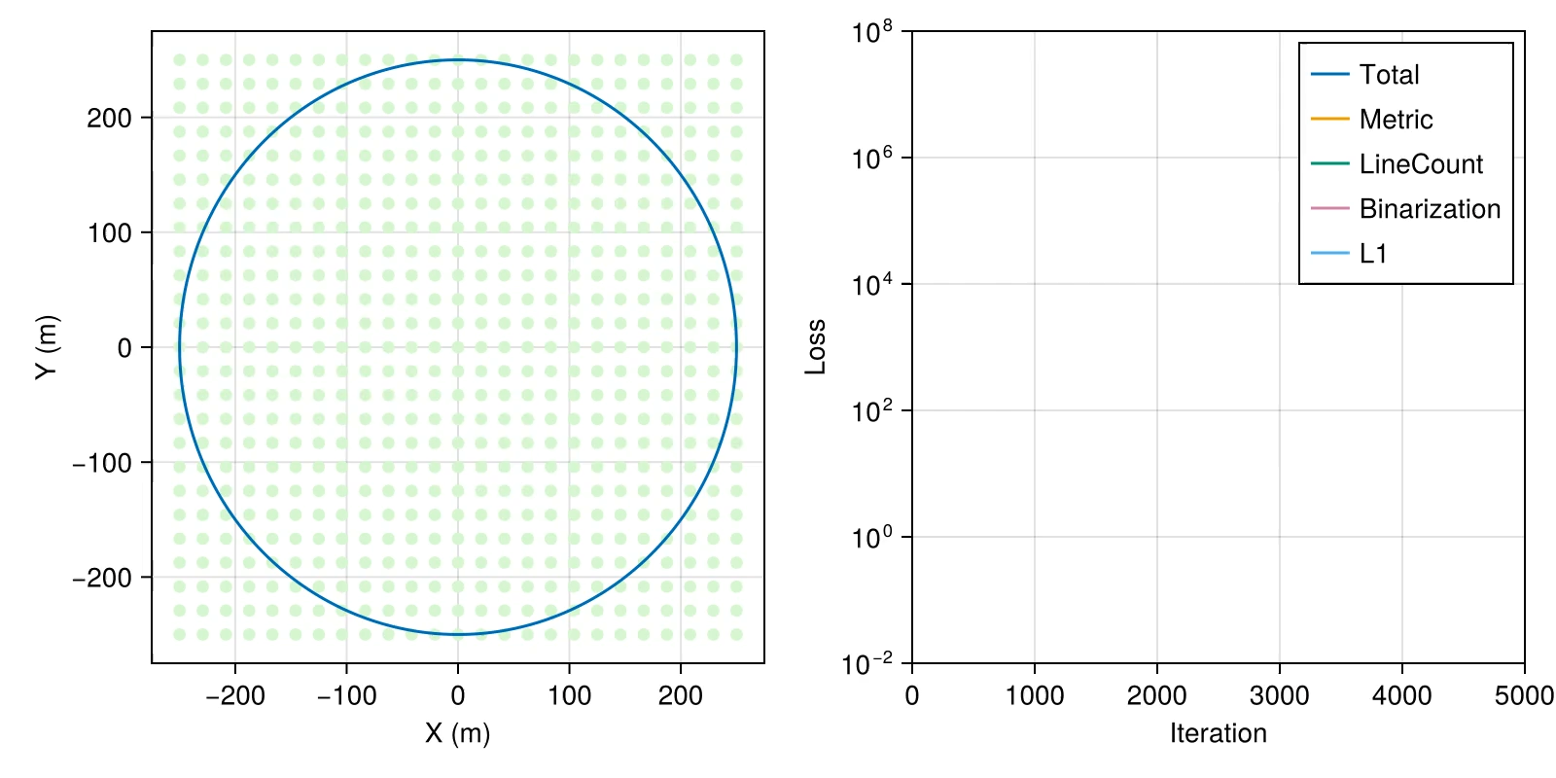
Optimization with Weights

Slide 27
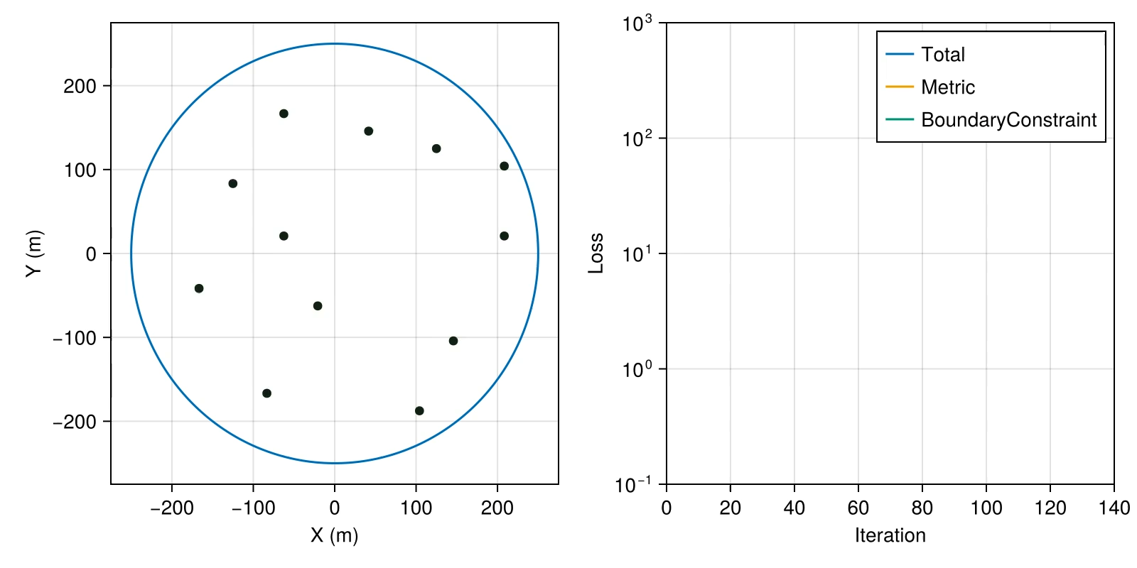
Positional Optimization

Slide 28
Summary / Outlook
P-ONE is a planned Neutrino Telescope in the Pacific Ocean. First detector line constructed.
Pipeline for calculating resolutions using Fisher-Information is in place
Optimization pipeline is progressing: Direct optimization of detector line positions + optimization via weights
Todo: Improved optimization metrics (analysis surroates?), engineering constraints

Slide 29
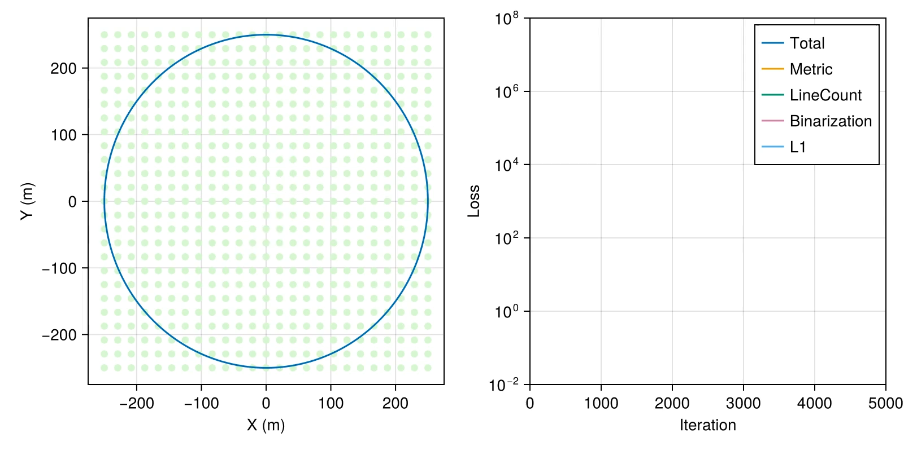
Weighted Optimization / Different Seed

Slide 30
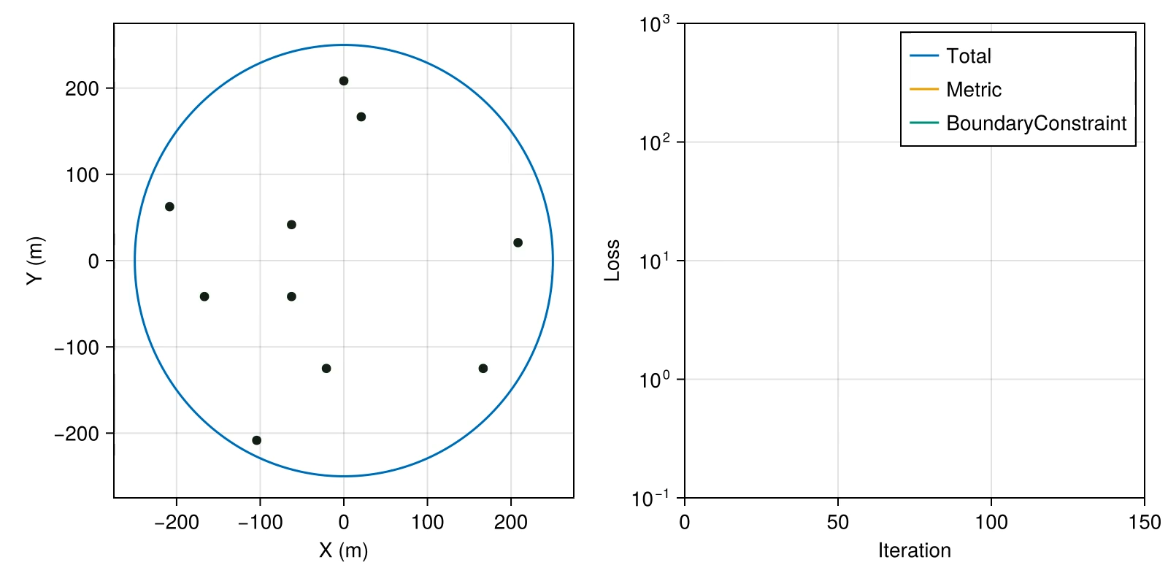
Positional Optimization / Different Seed

Slide 31
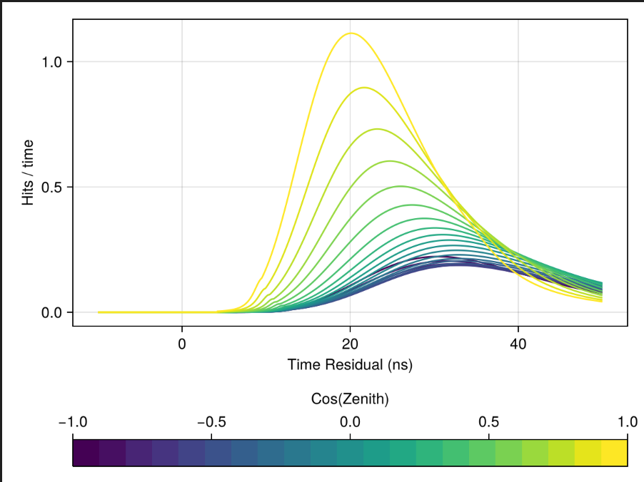
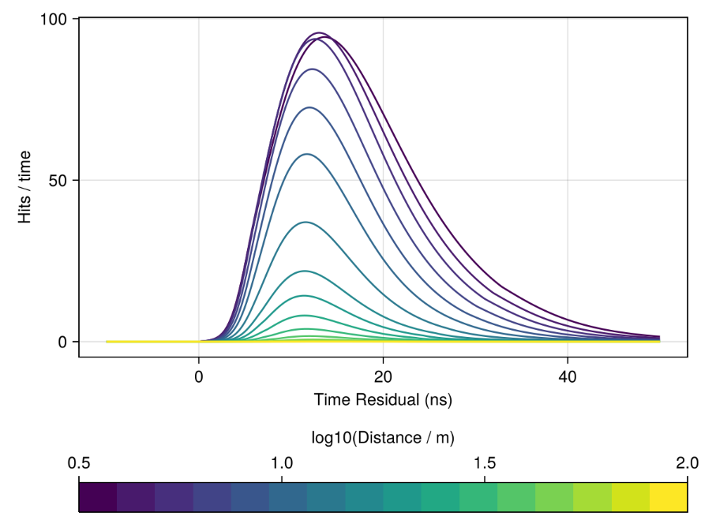
Normalizing Flow Model
Zenith Variation
Distance Variation

Slide 32
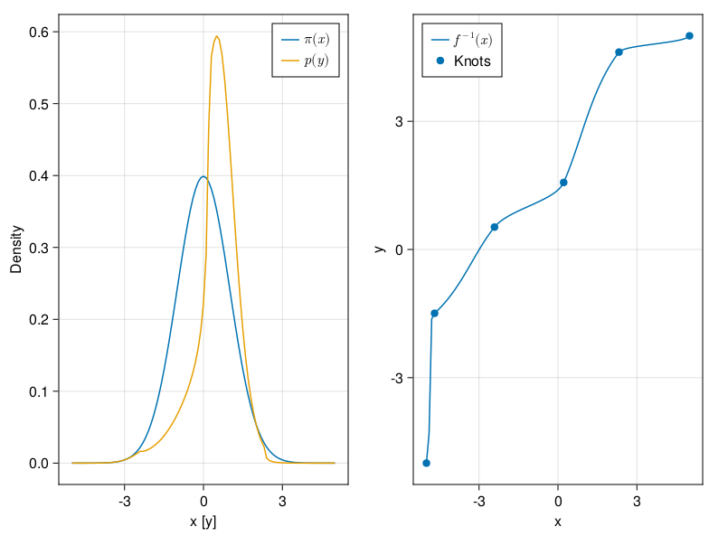


Normalizing Flow Surrogate
E, dist, dir,… pmt_id
Encoding
MLP
Flow Parameters
Normalizing Flow
Base Distribution
(Gaussian)
Normalizing Flow
Optimize
Defines
Base Distribution
Target Distribution
($t_{res}$)
Likelihood $ℒ$

Slide 33

Fisher Resolution Example
Cherenkov Cone
Single Detector Line at [0, 0, 0]
Cascade at [-10, 10, -400], zenith-angle 90°
Worst resolution at azimuth 135° (cascade pointing away)

