Slide 1
Maritime Scene Understanding with Neural and Differentiable Computing
MODE workshop 2025, Kolymbari, 09.06.2025
Dr Sarah Barnes
Sarah Barnes, DLR Institute for the Protection of Maritime Infrastructures, 09.06.2025

Slide 2
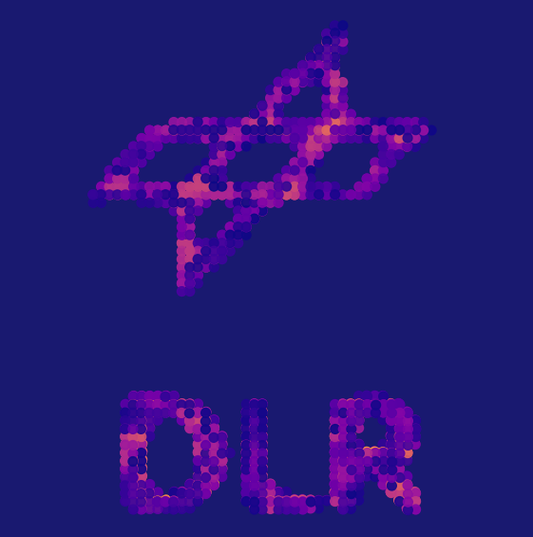
Overview
Who we are and key challenges for the Maritime domain
How „MODE“ topics are currently applicable?
  Cosmic-ray Tomography
  Optical reconstruction
  Further areas of application
Towards generalised reconstruction methodologies
Our broad vision for Maritime Situational Awareness
2
Sarah Barnes, DLR Institute for the Protection of Maritime Infrastructures, 09.06.2025

Slide 3
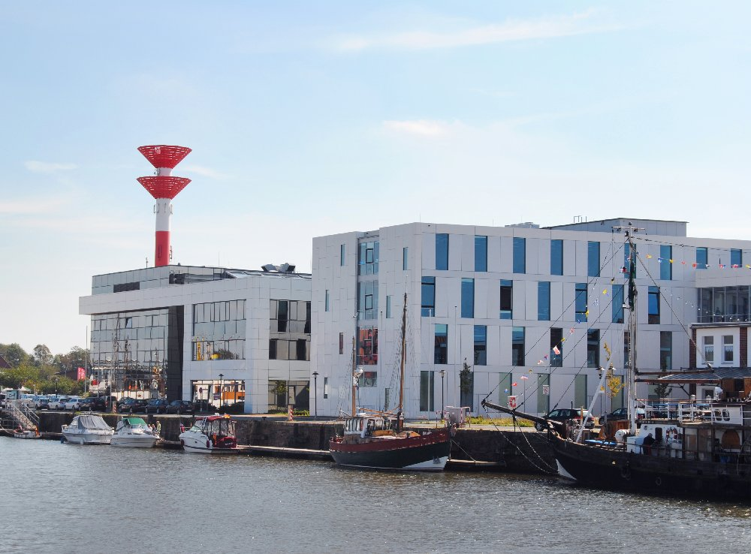
Institute for the Protection of Maritime Infrastructures
Development of methods and technology to improve the resilience, safety and security of maritime infrastructures – Improve Maritime Situational Awareness
Work closely with stakeholders and industrial partners to test and develop usable concepts.
Relatively new institute – founded in 2017
Around 60 scientific employees and students
Situated in Bremerhaven, Germany
3
Sarah Barnes, DLR Institute for the Protection of Maritime Infrastructures, 09.06.2025

Slide 4
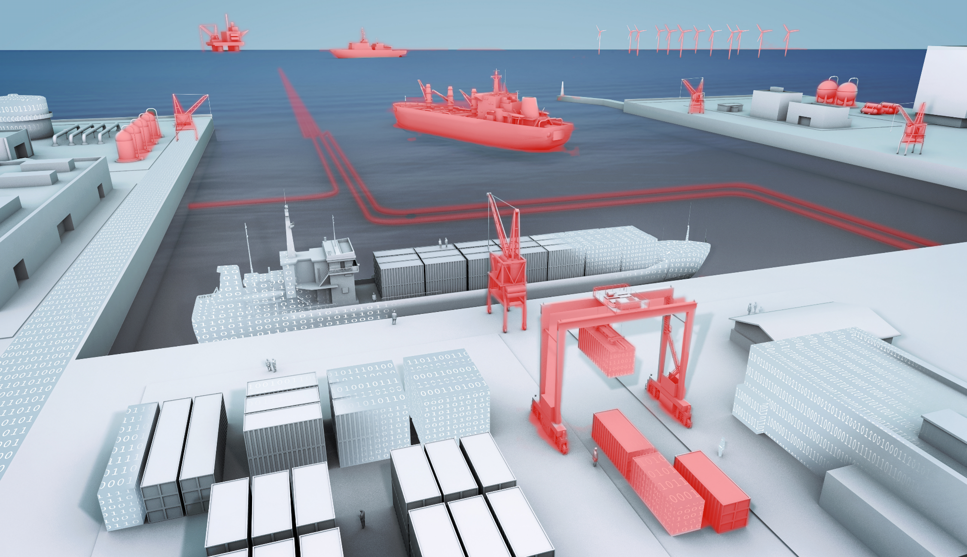
Offshore-Infrastructure
Ships and transport routes
Energy cables
Data cables
Pipelines
Harbours
Transport links
Maritime INFRASTRUCTURES
4

Slide 5
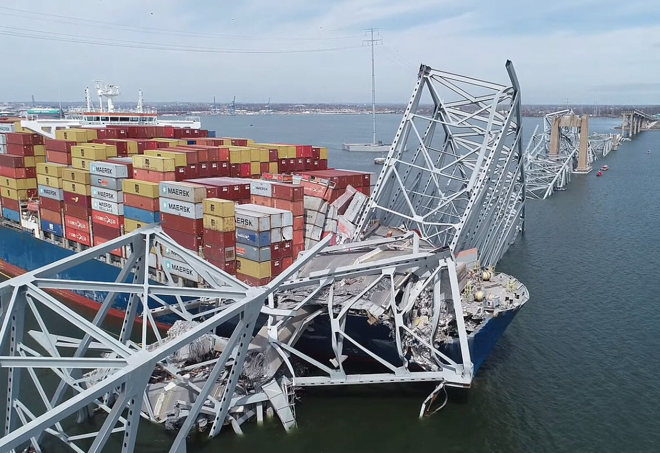
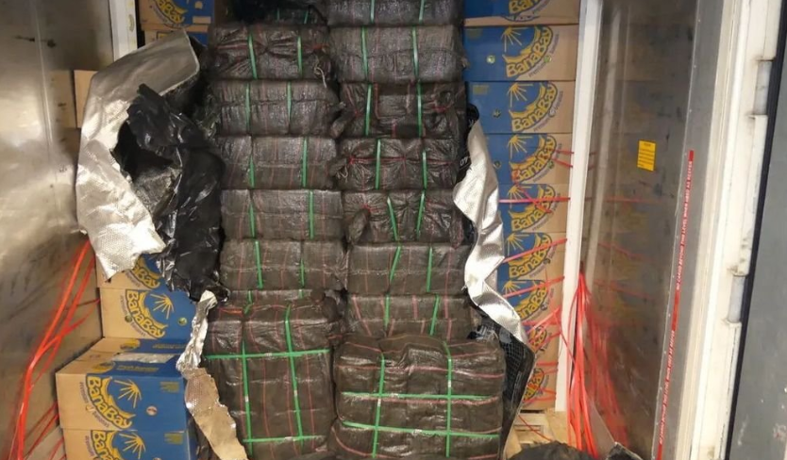
Key Challenges in the Maritime Domain
Smuggling and Trafficking – illegal trade, weapons, human trafficking
Sabotage and attacks – posing threats to economic stability and safety
Environmental Crimes – e.g. waste dumping, oil spills
Structural integrity of infrastructure – Corrosion, wear, and insufficient maintenance can lead do failures
Fire and Hazardous Materials – improperly declared or handled dangerous cargo. Spills or damages to waste containers
https://www.wikipedia.com/
https://www.riskintelligence.eu/
5
Sarah Barnes, DLR Institute for the Protection of Maritime Infrastructures, 09.06.2025

Slide 6
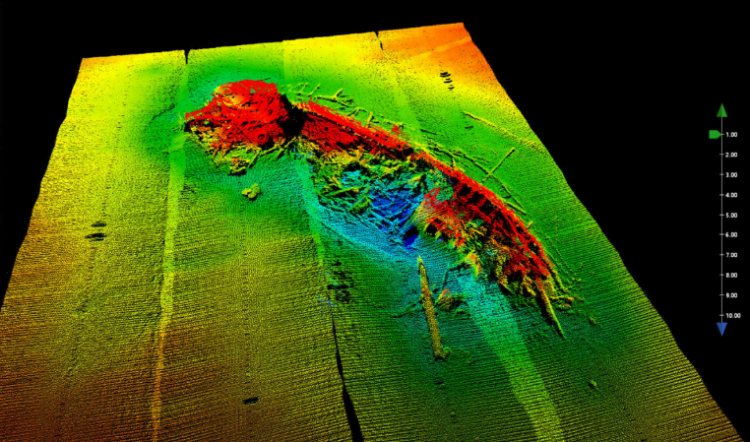
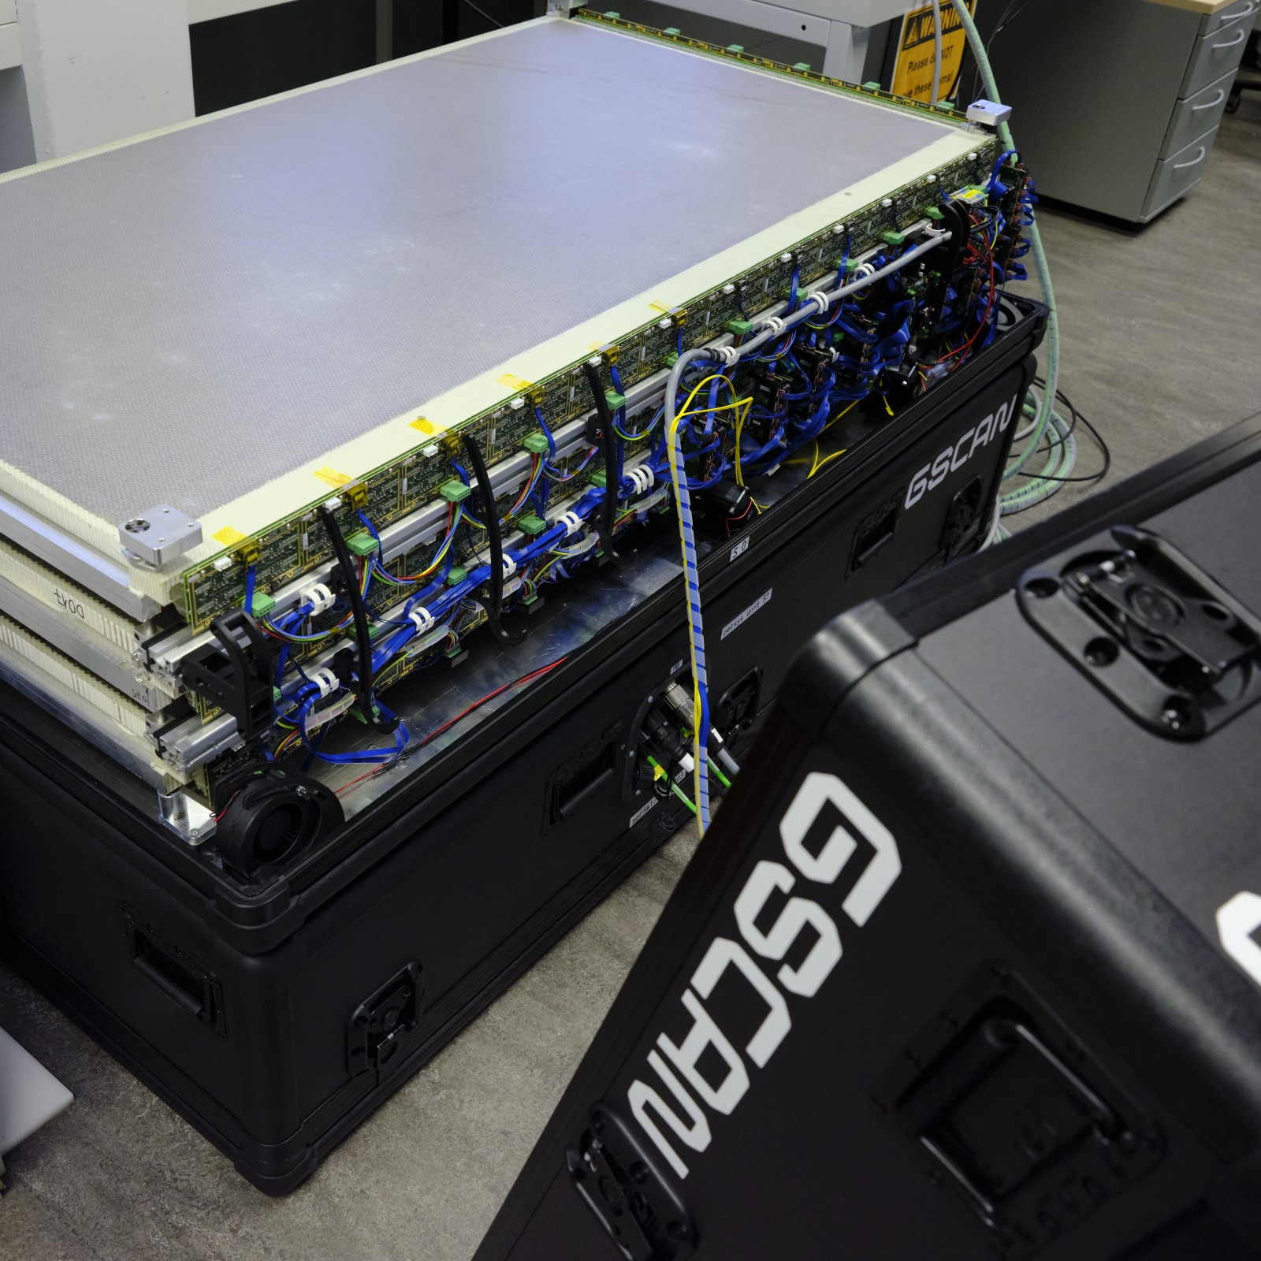
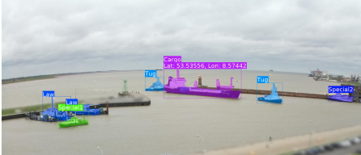
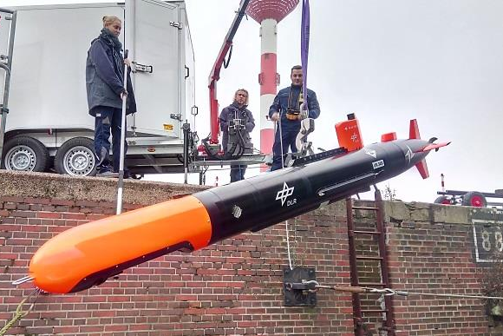
Methods and Processing Group
Muon Tomography
Optical Reconstruction
Acoustic Data Processing and Analysis
Autonomous
Instrument platforms
Machine Learning
6
Sarah Barnes, DLR Institute for the Protection of Maritime Infrastructures, 09.06.2025

Slide 7
Overview
Who we are and key challenges for the Maritime domain
How „MODE“ topics are currently applicable?
Cosmic-ray Tomography
Optical reconstruction
Further areas of application
Towards generalised reconstruction methodologies
Our broad vision for Maritime Situational Awareness
7
Sarah Barnes, DLR Institute for the Protection of Maritime Infrastructures, 09.06.2025

Slide 8
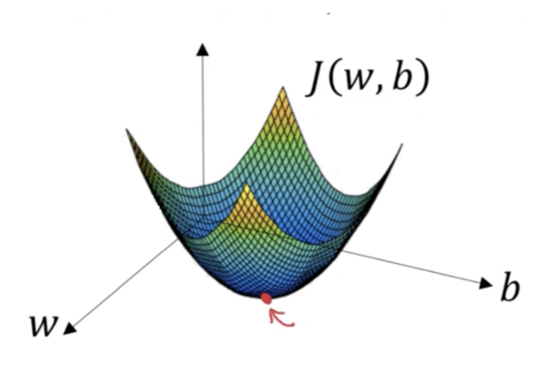
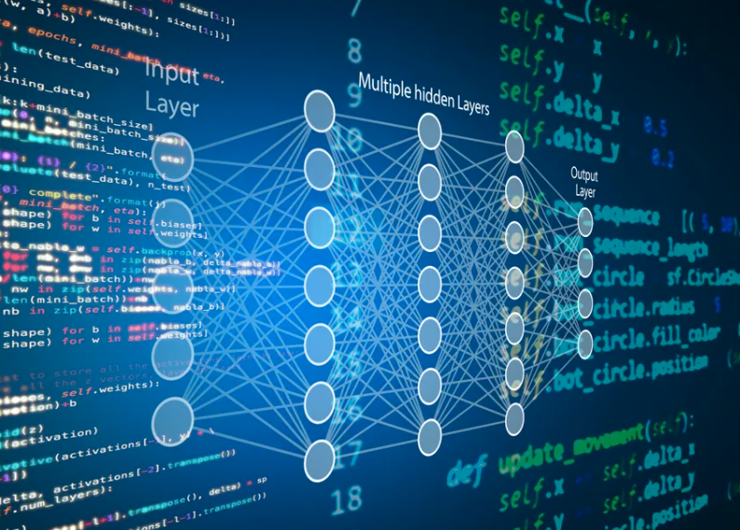

„MODE“ topics we currently apply
Machine learning (deep learning) approaches extensively utilised
  Object recognition and classification
  Anomaly detection
  Neural or volumetric rendering
  Reinforcement learning *NEW*
Extending our workflows to incorporate more elements of differential programming
Machine Learning
Gradient Based Optimisation
Automatic Differentiation
8
Sarah Barnes, DLR Institute for the Protection of Maritime Infrastructures, 09.06.2025

Slide 9
Cosmic-ray Tomography
9
Sarah Barnes, DLR Institute for the Protection of Maritime Infrastructures, 09.06.2025

Slide 10
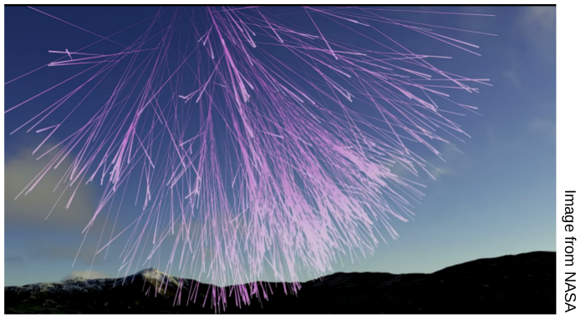
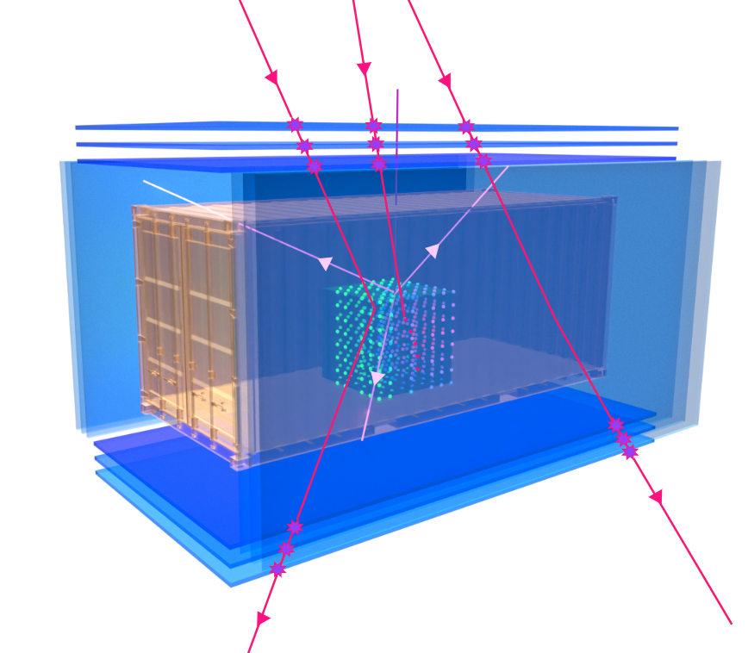
Cosmic-ray tomography
Non-destructive testing method utilising air-showers to probe closed volumes or hard to reach regions
Muon Scattering Tomography (MST) analyses the muon path deflection in a material
Muon transmission radiography measures differences in background muon flux due absorption effects in target material
Term “Cosmic-ray tomography” is used to incorporate all measurement principles and novel methods such as secondary particle analysis.
10
Sarah Barnes, DLR Institute for the Protection of Maritime Infrastructures, 09.06.2025

Slide 11
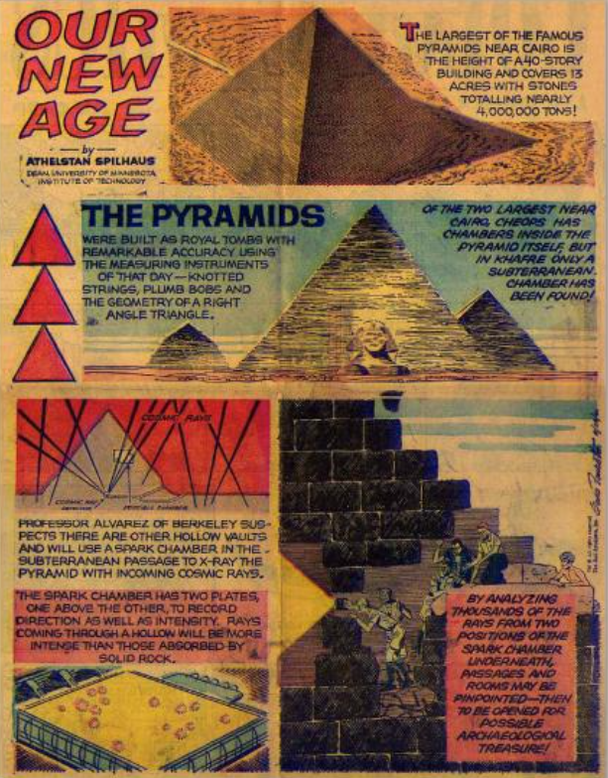
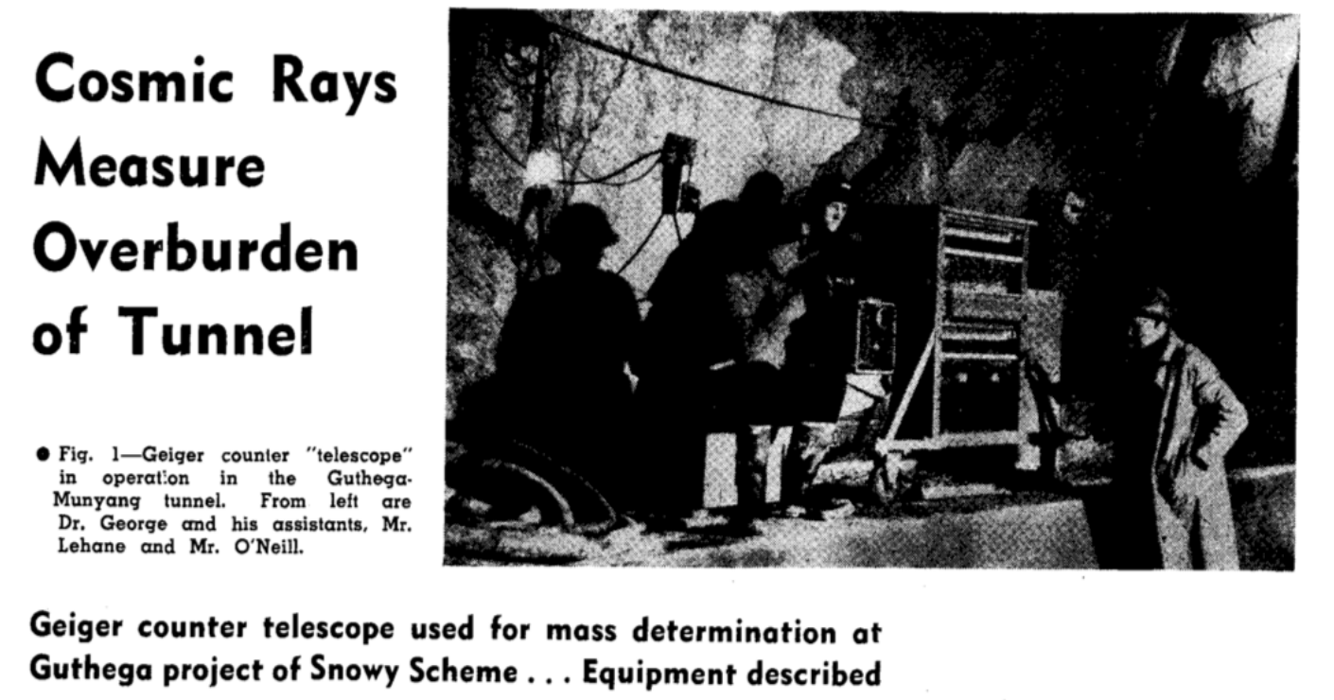
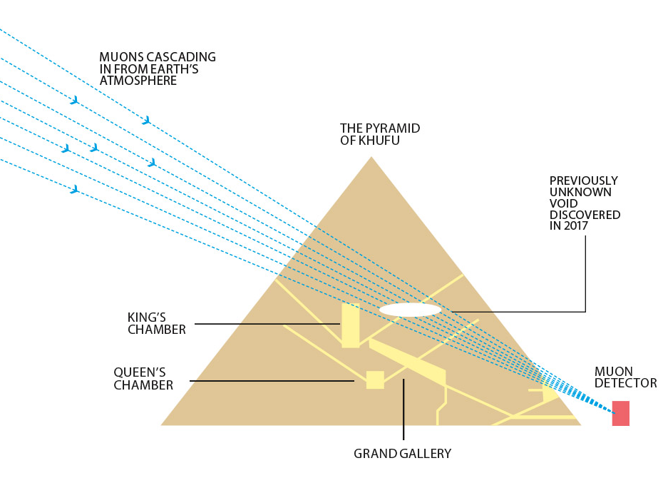
Muon radiography
Technique originated in 1955 to measure tunnel overburden
Other key measurements of pyramids in 60s (recently repeated by ScanPyramids project finding new voids)
Other applications in industrial monitoring, vulcanology etc..
11
Sarah Barnes, DLR Institute for the Protection of Maritime Infrastructures, 09.06.2025

Slide 12
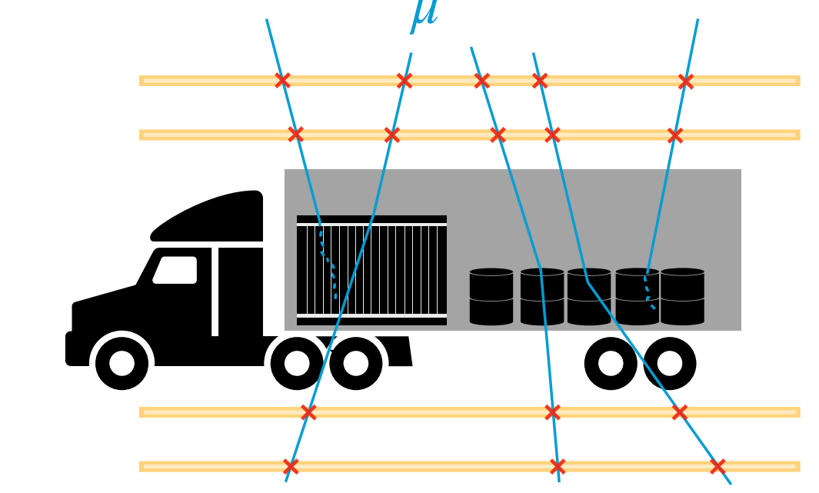
Muon Scattering Tomography
Technique first proposed by Borozdin et. al. In 2003 as an alternative to X-ray radiography.
Key Benefits :
  Passive radiation source – safe to operators and observers
  3D data by default
  Not greatly impacted by shielding
  Low operational cost
Wide range of applications in the maritime domain : security screening, nuclear monitoring, infrastructure monitoring, inspection of large parts, dyke monitoring…
12
Sarah Barnes, DLR Institute for the Protection of Maritime Infrastructures, 09.06.2025

Slide 13

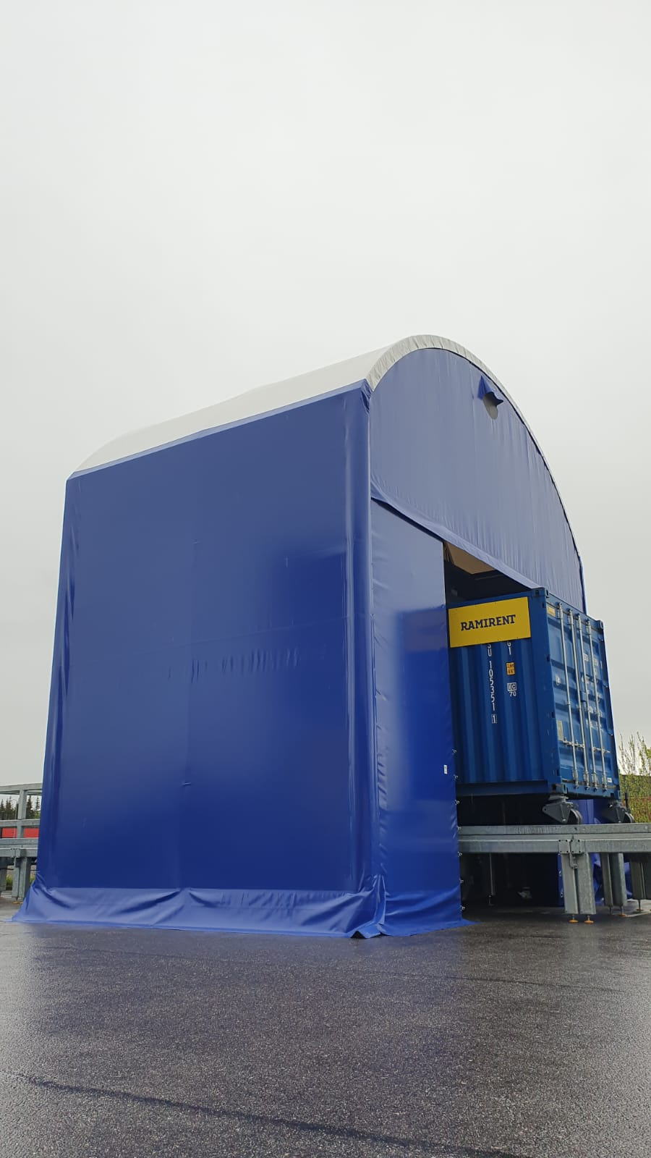
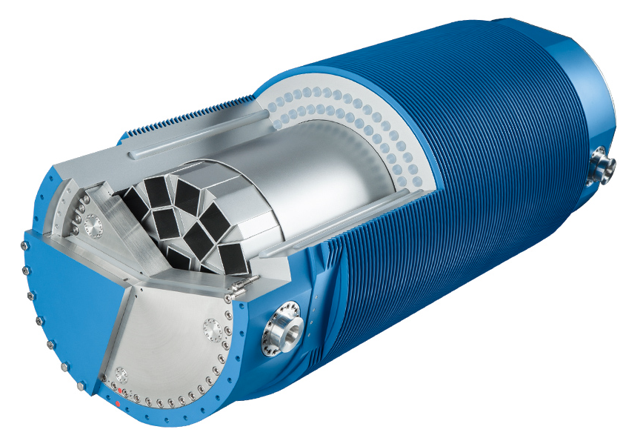
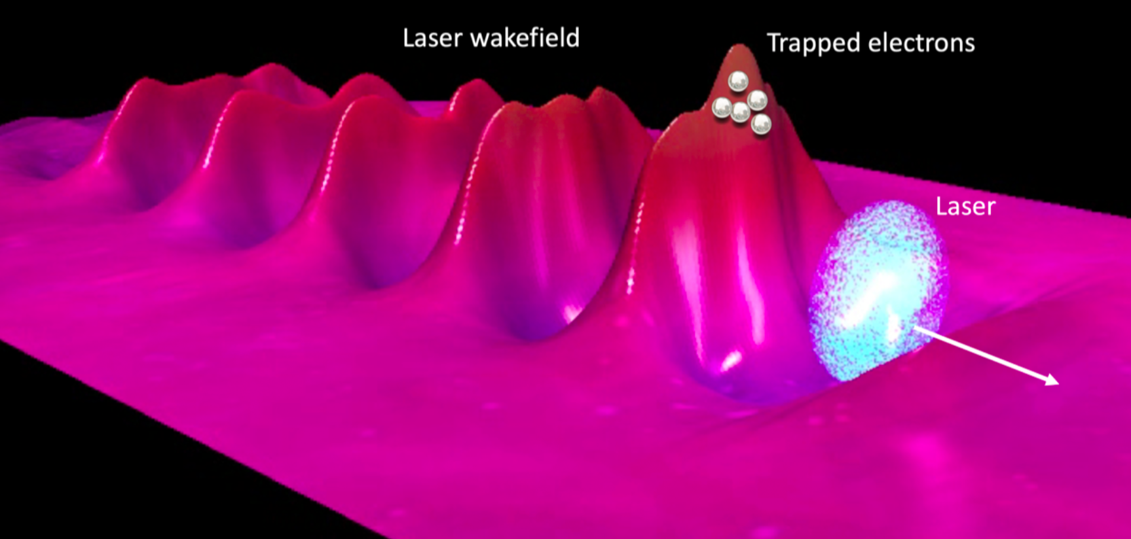
DLR involvement in Muon Tomography
DLR is involved in the H2020 SilentBorder to develop a muon tomography based scanner for ports and borders
  AI Method development and secondary particle analysis
CACTUS Projct alongside BGZ (German Company for Interim Nuclear storage) to obtain single rod resolution in CASTOR containers
  Reconstruction method development and AI based analysis
Analysis utilising artificial muon sources
  Data generation and reconstruction method development
13
Sarah Barnes, DLR Institute for the Protection of Maritime Infrastructures, 09.06.2025

Slide 14

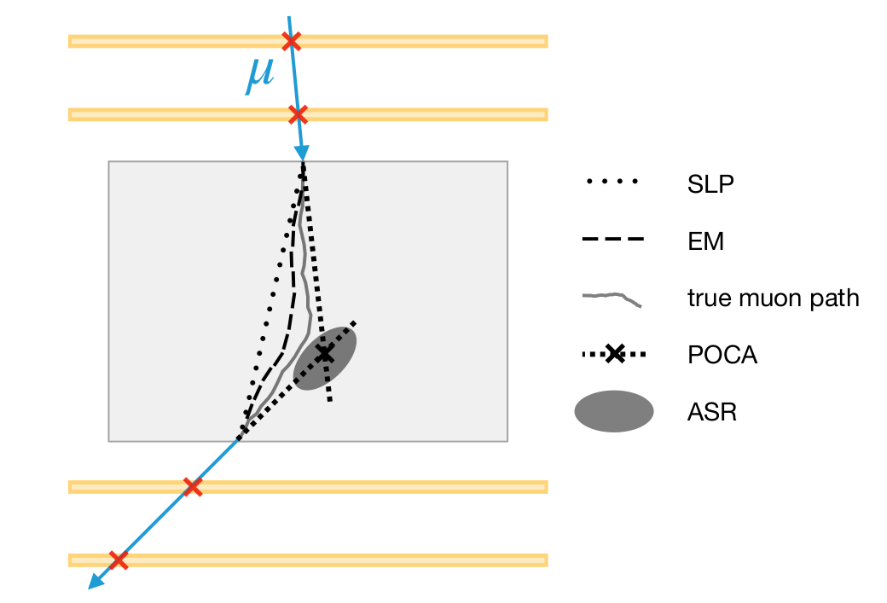
Muon Reconstruction
MST reconstruction uses information from muon track to perform volumetric reconstruction
Output generally a voxelised density map, used for further clustering, filtering, feature extraction or material identification
Statistical methods have proven challenging to implement, memory intensive and sensitive to initialisation – although powerful they are not commonly utilised
14
Sarah Barnes, DLR Institute for the Protection of Maritime Infrastructures, 09.06.2025

Slide 15
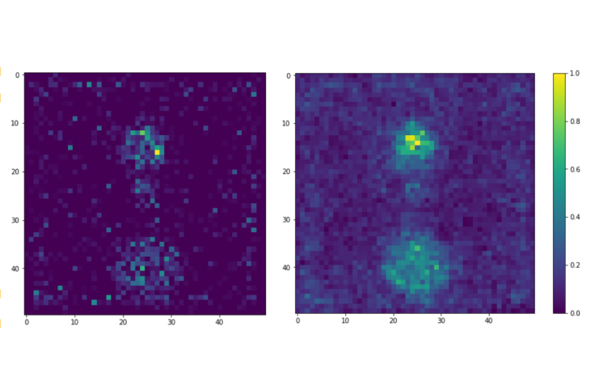
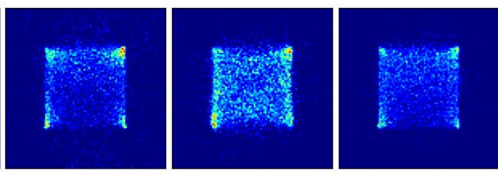
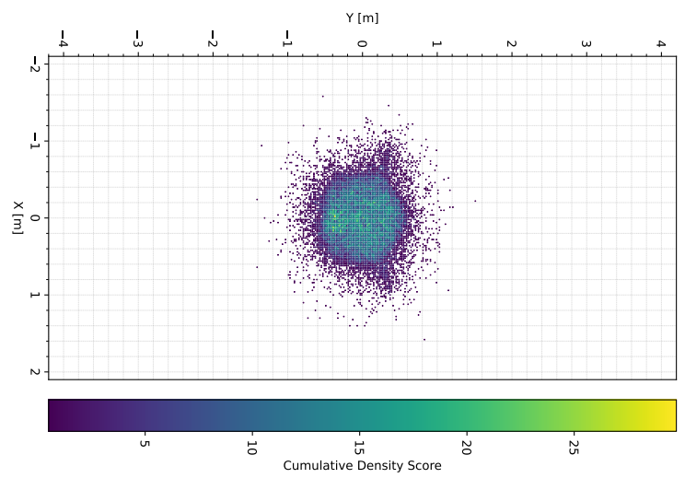
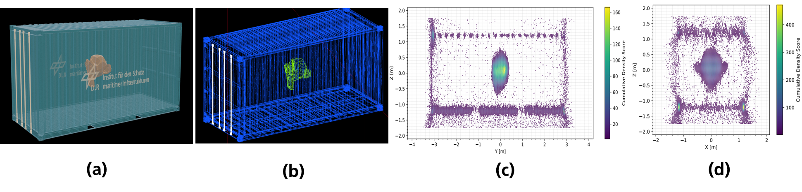
Image (Top Left) : https://doi.org/10.3390/instruments7010013
Reconstruction examples
10 cm lead, 5 cm uranium and 15 cm iron spheres (top to bottom) using PoCA and ASR
Statistics based reconstruction of iridium,sodium and lead cubes (1m³)
15
Sarah Barnes, DLR Institute for the Protection of Maritime Infrastructures, 09.06.2025
Reconstruction concrete monkey “suzanne” using ASR

Slide 16
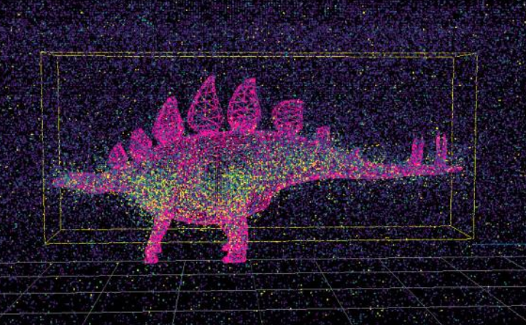
Muon Reconstruction and Machine Learning
Faithful reconstruction is essential to obtain the best output from neural networks
Statistical approaches show promise but a scalable implementation is still required
Enabling end-to-end learning would allow a more optimised and generalisable volumetric predictions
  Integration into standard differntiable frameworks (e.g. Pytorch)
  Reconstruction methodologies that incorporate physical contraints
  Fast and scalable implementations on which run on GPU
16
Sarah Barnes, DLR Institute for the Protection of Maritime Infrastructures, 09.06.2025

Slide 17
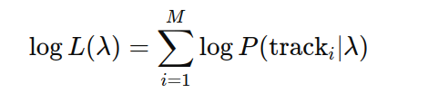
Reconstruction with Expectation Maximisation
Methodology proposed by L.J Schultz et. al in 2007
Approach updated with optimsed hybrid CPU/GPU based inplementation utilising PyTorch
Designed to reduce memory consumption
Optimisation process completly differentiable in PyTorch
Comparitive study performed between new implemntations
Methodology Overview
Define likelihod function (L) – probability of observed tracks (track) given a set of assumed scattering densities per voxel (λ)
Sum over muons (M) and take log to ensure numerical stability
Maximise Log(L) - compare prediction to observed data and updating scattering densities
Iterate till convergence is obtained
17
Sarah Barnes, DLR Institute for the Protection of Maritime Infrastructures, 09.06.2025

Slide 18
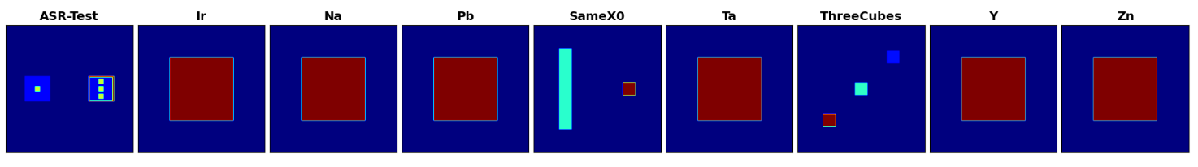
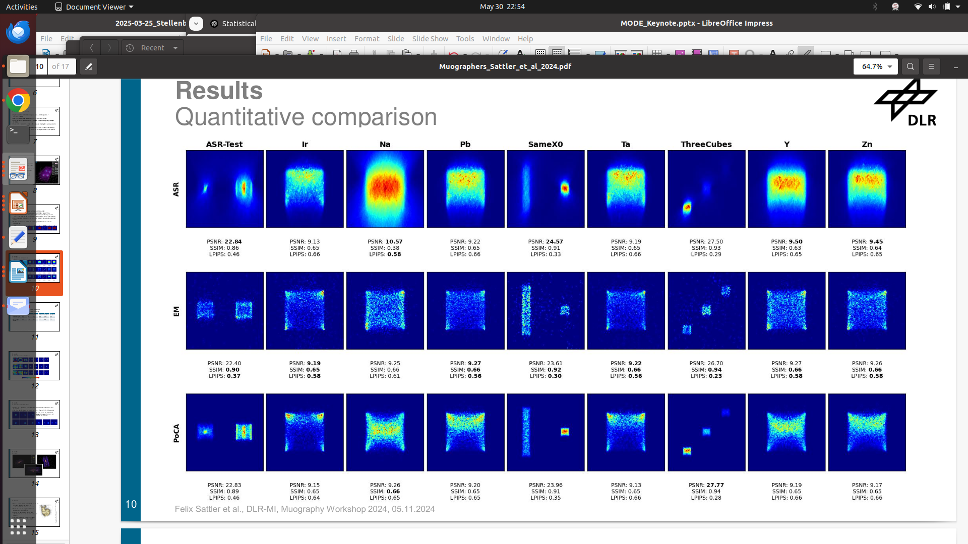
Reconstruction with Expectation Maximisation
Takeaway : EM implemntation is scalable and generally outperforms ASR/PoCA but stability remains a problem
18
Sarah Barnes, DLR Institute for the Protection of Maritime Infrastructures, 09.06.2025

Slide 19
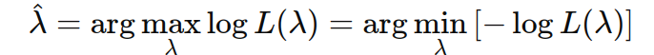
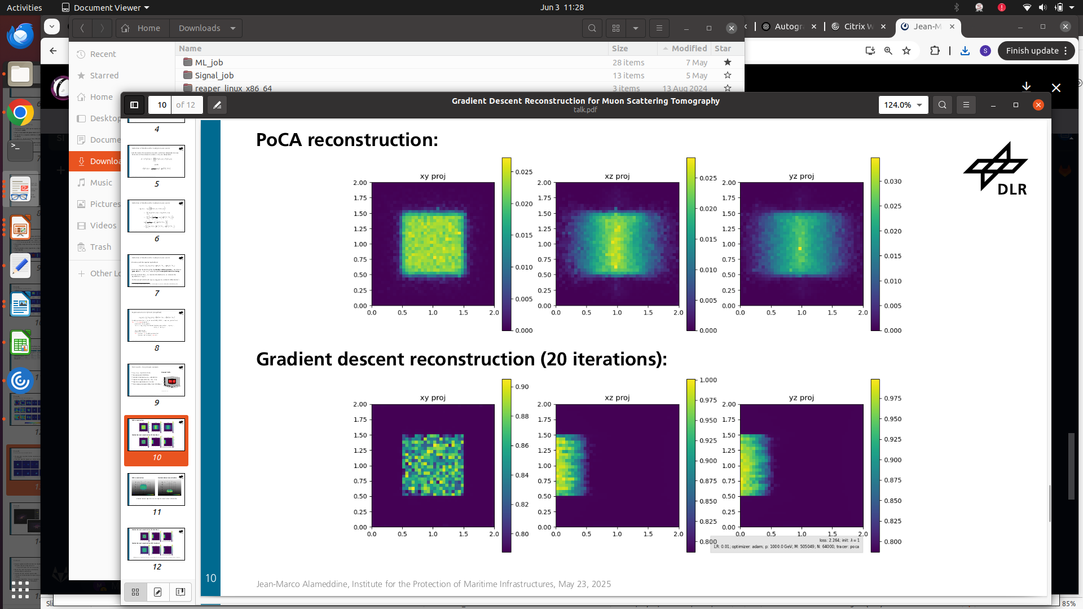
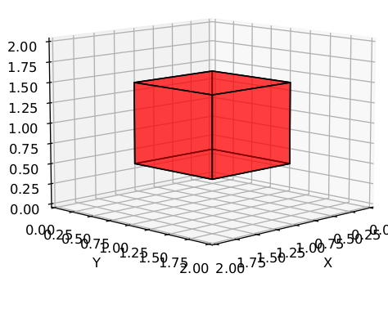
Maximisation or Minimisation?
So far the method has been formulated as a maximisation problem
It is possible to redefine the task instead to a minimusation of the negative log likelihood
Allows the utilisation of AutoGrad functionality in PyTorch
See Talk by Jean-Marco Alameddine
Tool generally used for neural network training
Keeps track of all steps in mathematical operations performed allowing gradients to be calculated during backpropogation
Supports automatic differentiation and GPU based operations
19
Sarah Barnes, DLR Institute for the Protection of Maritime Infrastructures, 09.06.2025

Slide 20
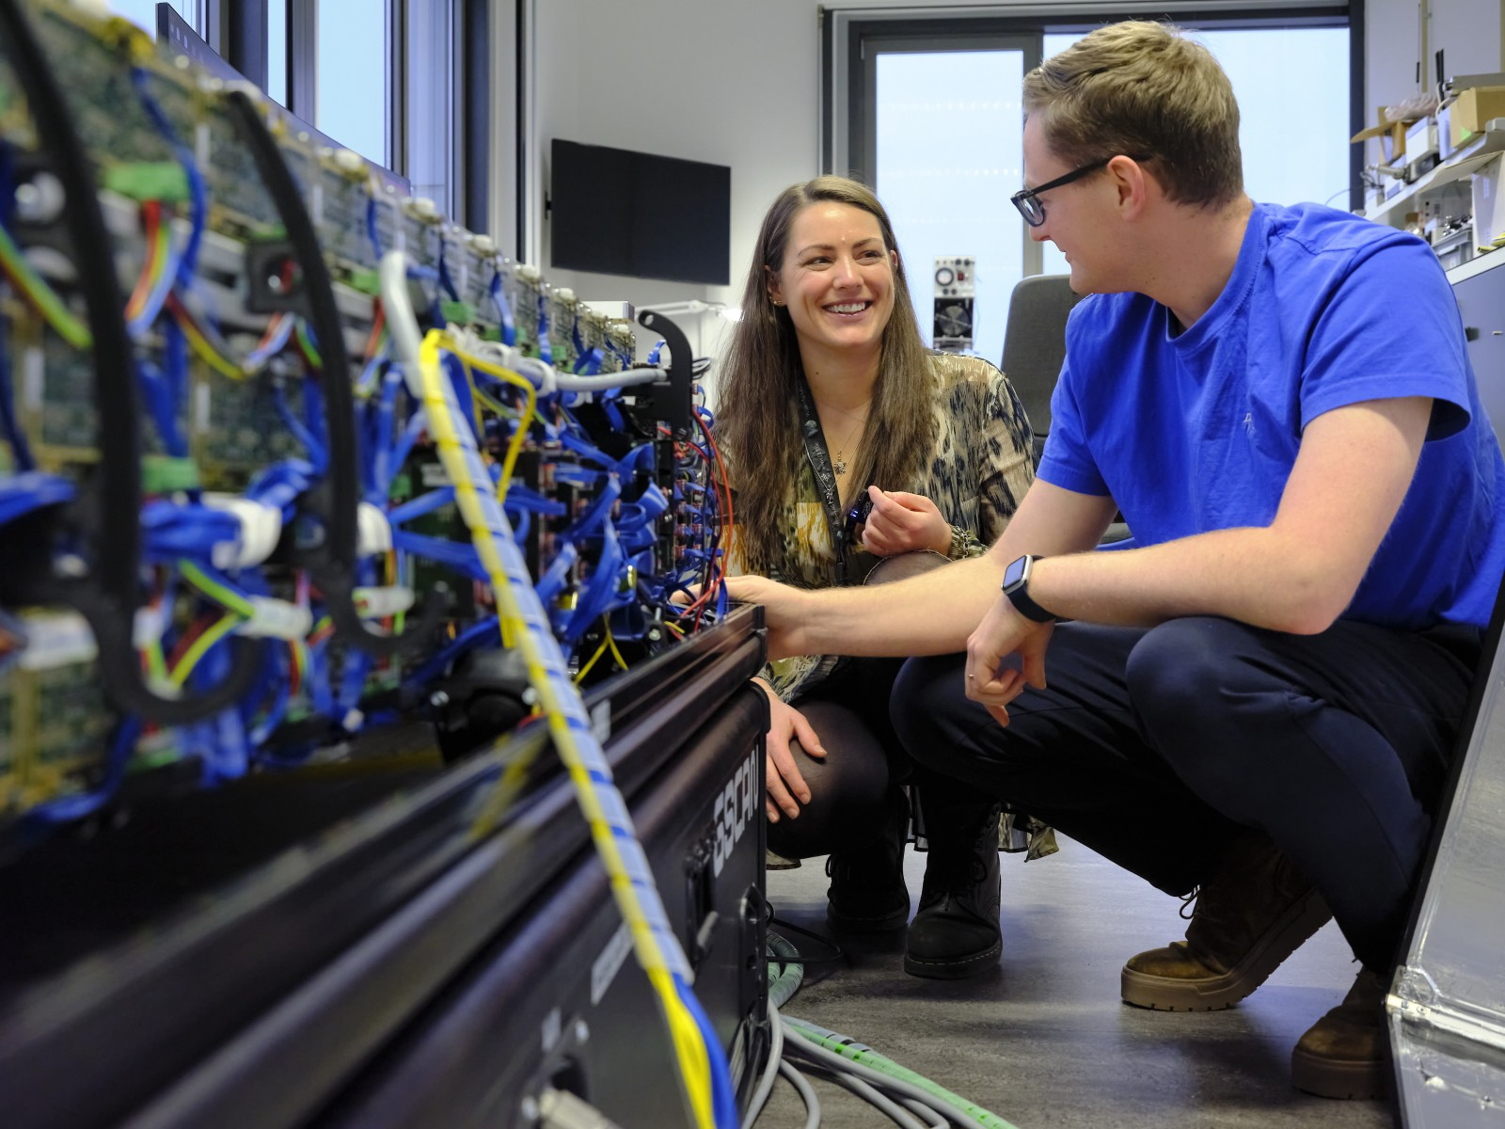
Key application area – CACTUS project
Due to large material budget traditional reconstruction methodologies would not provide suitable imaging resolution
Statstical reconstruction most promising option – approach will be refined to allow the observation of large and dense objects such as nuclear waste casks
Optimisation against shape priors included as a regularisation term is a promising approach
20
Sarah Barnes, DLR Institute for the Protection of Maritime Infrastructures, 09.06.2025

Slide 21
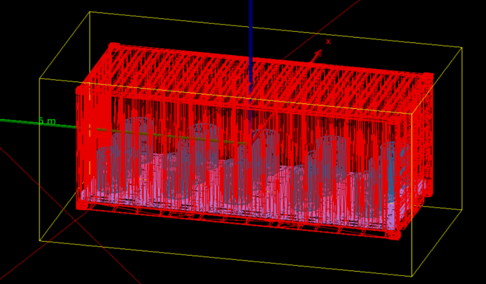
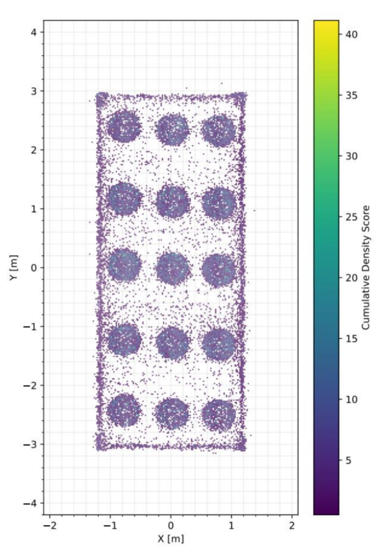
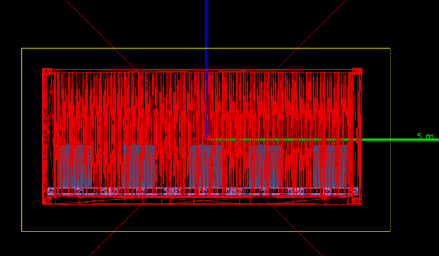
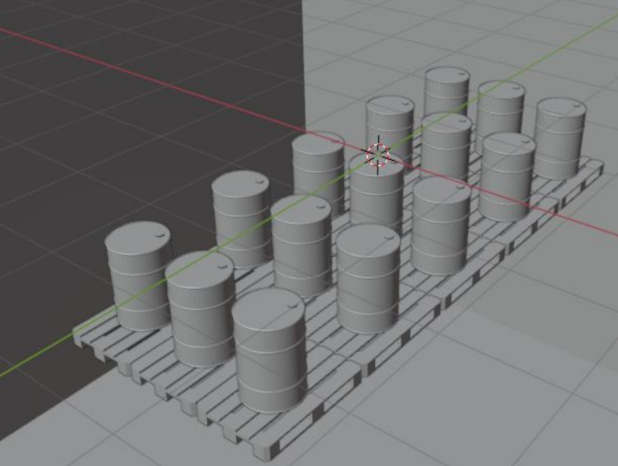
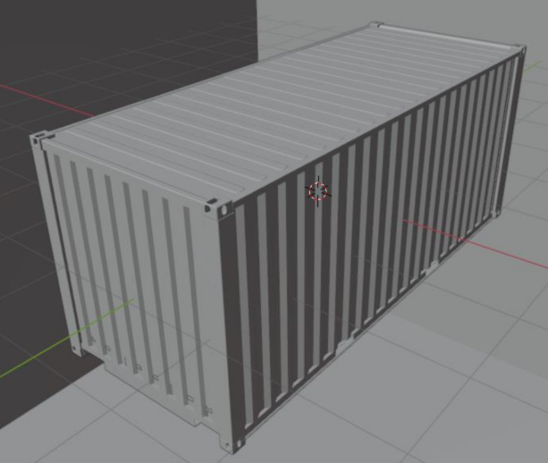
Data Scarcity and B2G4
Challenge for Neural Networks: Significant datasets required for training:
    No large scale public muography datasets available
    Complex simulated data requires accurate 3D models and large scene variance
Wide range of materials and configurations needed for train - difficult to obtain physically
B2G4 is a novel framework which transplants highly detailed 3D scenes from Blender into Geant4
21
Sarah Barnes, DLR Institute for the Protection of Maritime Infrastructures, 09.06.2025

Slide 22
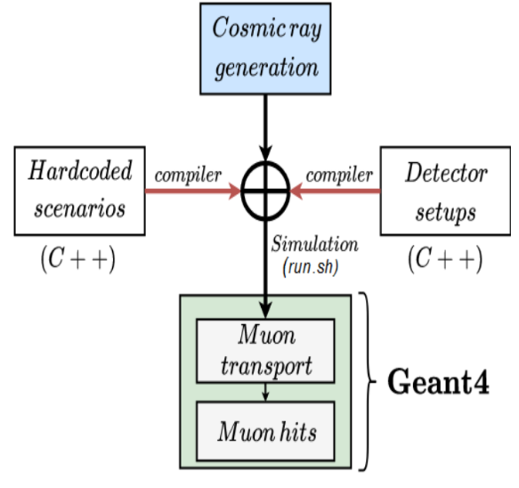
Blender to Geant4 (B2G4)
B2G4 provides Python scripts for Blender export and a C++ library for Geant4 imports:
  3D scenes are created (and randomised) using Blender
  B2G4 translates the scene into a format readable by Geant4 for simulation
  New model imports do not require Geant4 code to be recompiled, allowing for fast and automated dataset creation
Direct integration into optimisation code (e.g. TomoOpt) would allow for end-to-end optimisation of complex muography problems
22
Sarah Barnes, DLR Institute for the Protection of Maritime Infrastructures, 09.06.2025

Slide 23
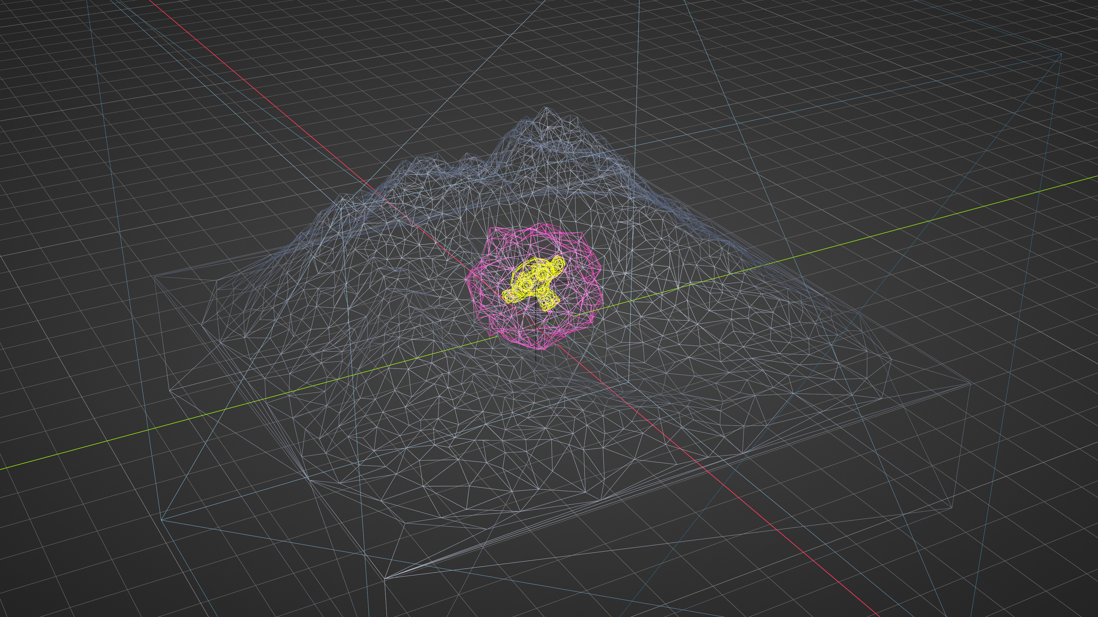
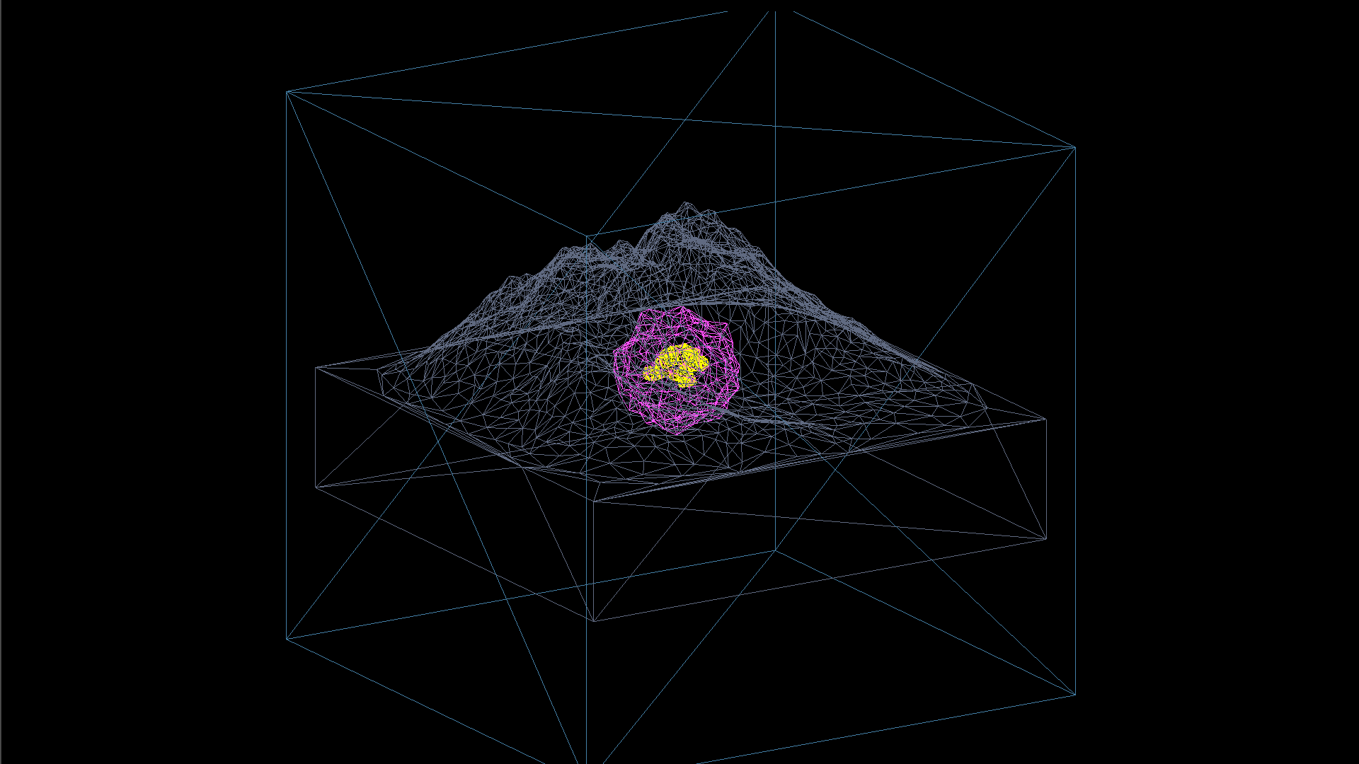
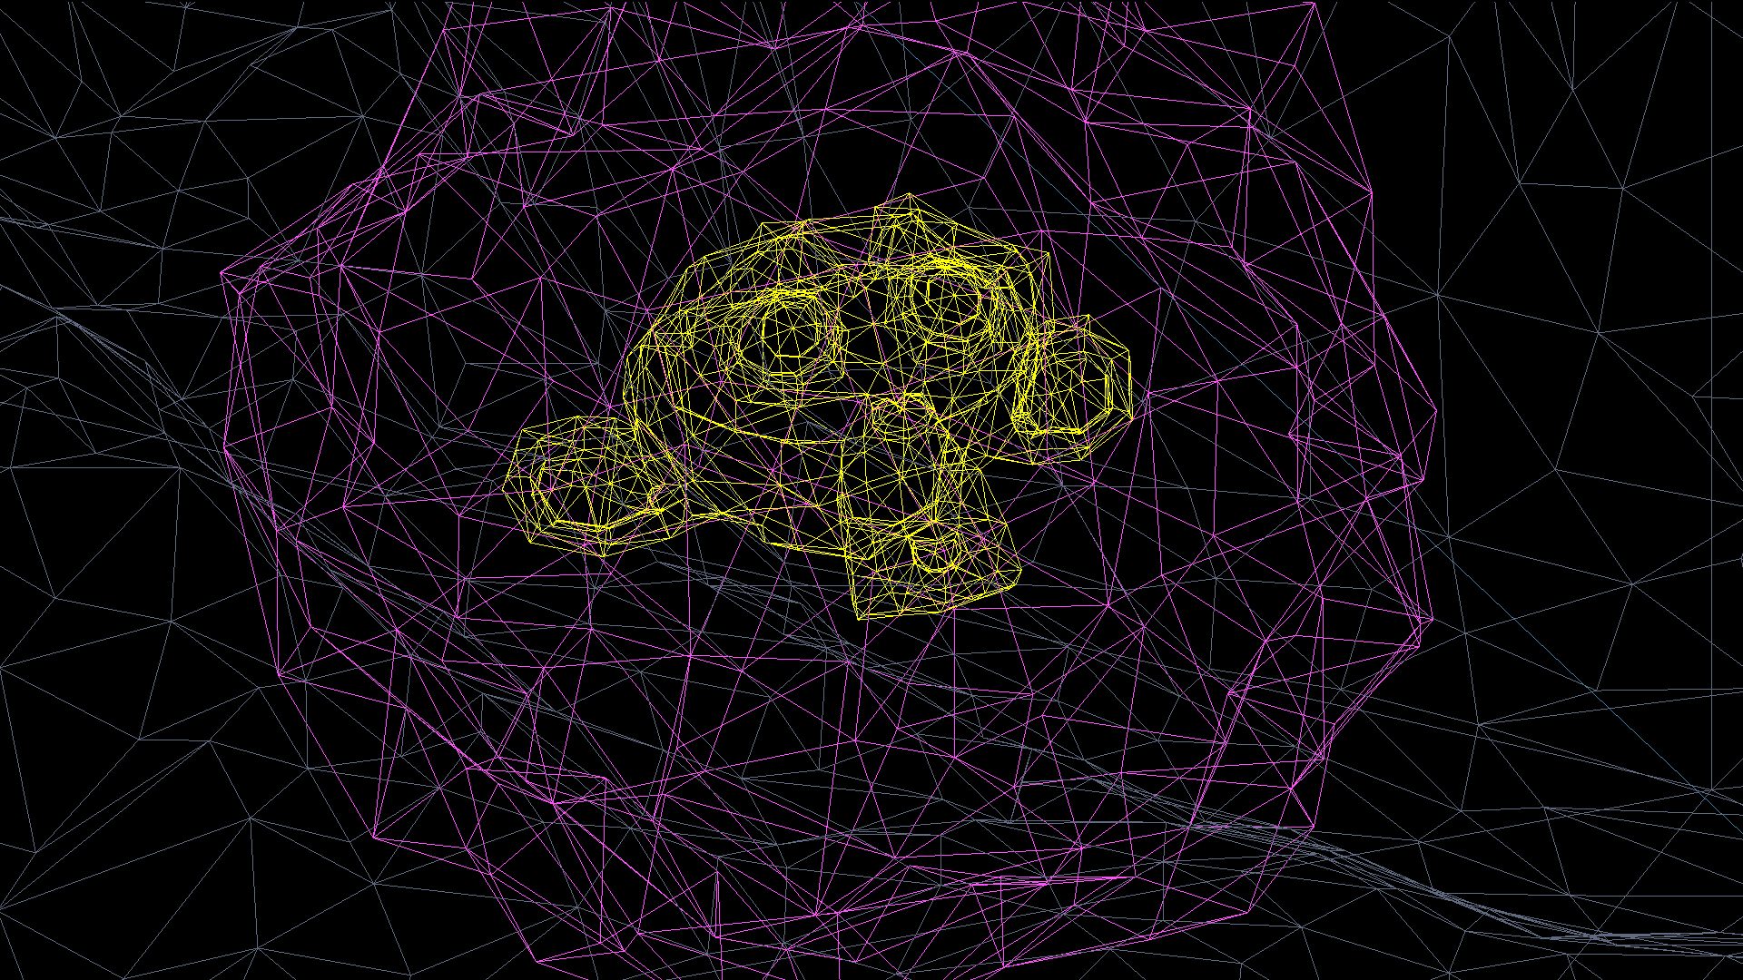
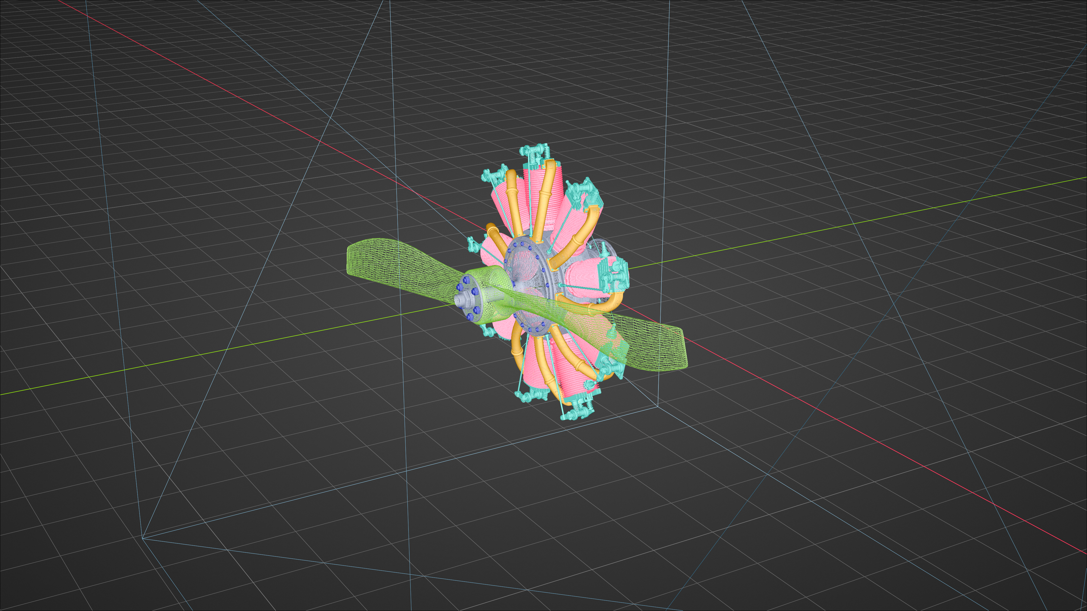
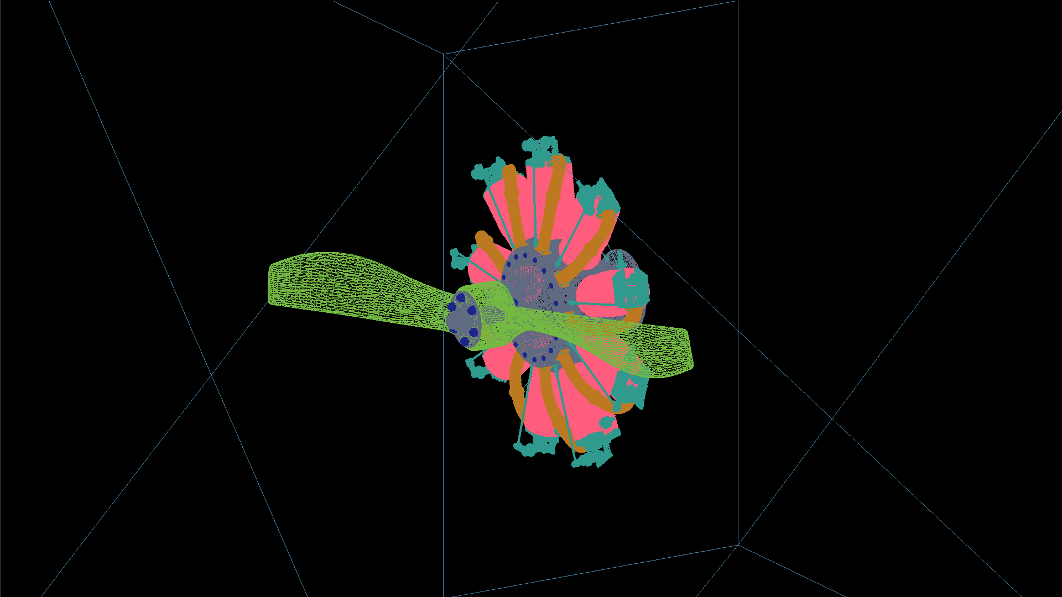
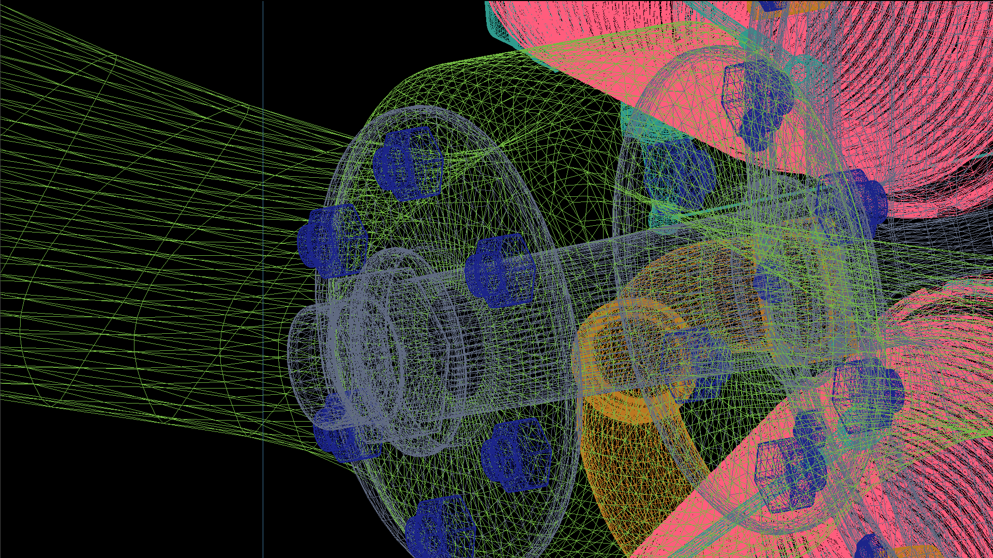
Blender to Geant4
Geant4
Blender
Geant 4
A monkey head made of gold inside a structure buried in a mountain
Blender
Geant 4
Aircraft engine. Metal bolts, propellers and cylinders from Blender are faithfully replicated in Geant4.
23
Sarah Barnes, DLR Institute for the Protection of Maritime Infrastructures, 09.06.2025

Slide 24
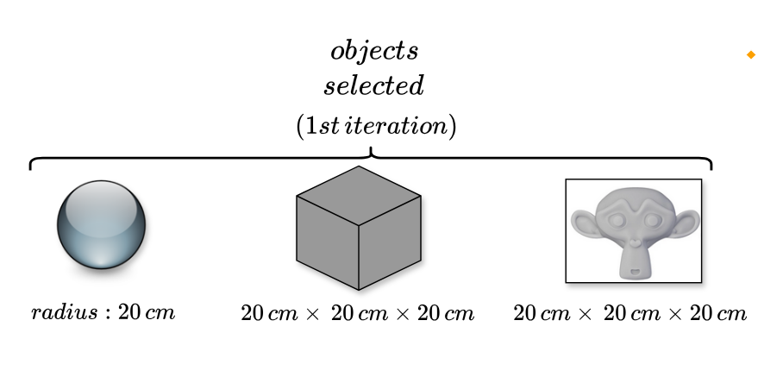
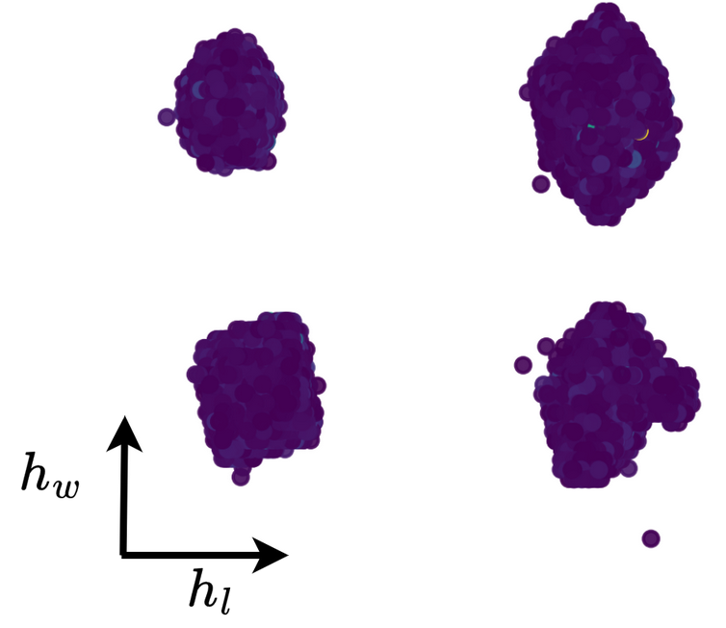
Applications of Machine learning – SilentBorder
Overall aim to detect anomalies corresponding to contraband items – relevant for many applications
Inherently challenging:
  Do not know container contents in advance
  Difficulty learning density due to reconstruction biases
  Detector effects significantly impact results
An approach is required which learns what is „normal“ and how test data compares to underlying distribution
Multi-stage stage process :
  Volumetric reconstruction
  Material segmentation/classification
  Anomaly detection
24
Sarah Barnes, DLR Institute for the Protection of Maritime Infrastructures, 09.06.2025

Slide 25
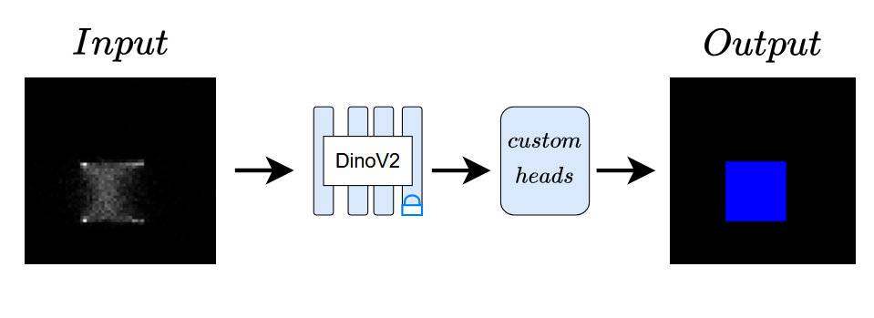
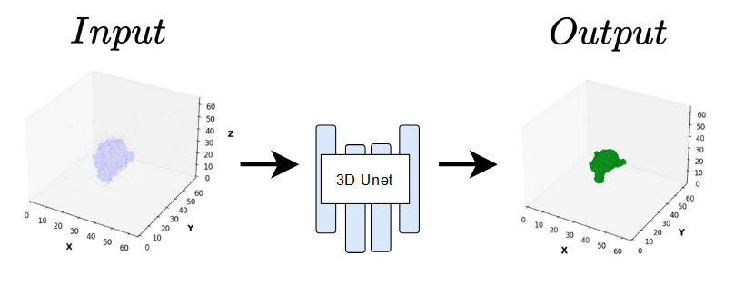
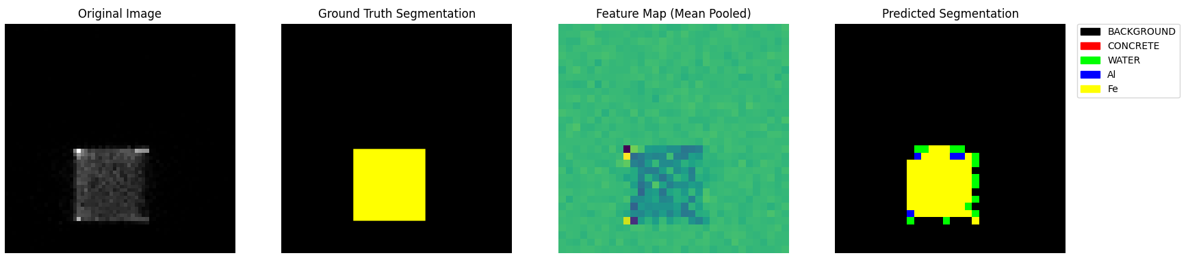

2D Supervised Learning: Material segmentation and classification from 2D slices - transformer-based method for material classification (custom DinoV2)
3D Supervised Learning: Material estimation and volumetric segmentation from 3D volumes (custom U-NET). Uncertainty on prediction can be utilised directly for anomaly detection
Approaches for Material Classification
25
Sarah Barnes, DLR Institute for the Protection of Maritime Infrastructures, 09.06.2025

Slide 26



Significant number of synthetic scenes generated plus limited real data from SilentBorder scanner
3D U-NET adapted to work with 2D data (slices)
Approach learns underlying distributions within the data as well as domain adaption between real and synthetic data
Good performance obtained – even small anomalies detected in initial tests
Approaches for Anomaly detection (data)
26
Sarah Barnes, DLR Institute for the Protection of Maritime Infrastructures, 09.06.2025

Slide 27
Optical Reconstruction
27
Sarah Barnes, DLR Institute for the Protection of Maritime Infrastructures, 09.06.2025

Slide 28


Maritime Situational Awareness (MSA)
Improvement of maritime scene understanding through real-time monitoring and data integration to improve security, safety and reliability.
Focus on recongnition and visualisation of dynamic objects within the scene
Aids end users to understand the maritime situation
Enables geospatial visualization
Provides input for high-level analysis and processing
3D reconstruction for enhanced semantic scene understanding
28
Sarah Barnes, DLR Institute for the Protection of Maritime Infrastructures, 09.06.2025

Slide 29



MareVis3D (→ LoRE)
DLR involvement in Optical Reconstruction
DigitalAtlas2.0 (→ LoRE)
Development of Deep learning methods for vessel recognition
Development of methods for monocular 3D optical reconstruction of vessels
Focus on deployment on embedded systems
Reconstruction of near-real-time 3D reconstruction of dynamic objects
Focus on optical stereoscopic images
Integration of objects within static 3D scene and treatment of semi-static objects
→ LoRE : Integration of remote sensing data
https://www.mdpi.com/1424-8220/22/7/2713
https://link.springer.com/article/10.1007/s00371-023-02802-4
29
Sarah Barnes, DLR Institute for the Protection of Maritime Infrastructures, 09.06.2025

Slide 30

Object Recognition (Vessels)
Vessel recognition using Convolutional Neural Networks (CNNs)
Scattering transforms use wavelets to filter images and highlight features
Attention mechanisms applied to focus on spacial regions of interest
Improve state of the art – measured via standard metrics compared with established methods
Multi-class vessel detection dataset made available to community - ShipSG
https://ieeexplore.ieee.org/document/10279352
30
Sarah Barnes, DLR Institute for the Protection of Maritime Infrastructures, 09.06.2025

Slide 31


Optical 3D Reconstruction
Implemented an end-to-end pipeline for near-real-time 3D reconstruction using stereo-cameras
Complexity of pipeline means results were not perfect
  Vessel reconstruction noisy even with ideal simulated data
  Significant optimisation possible
Treatment of semi-static objects not trivial within fixed static scene – important in security domain.
→ look to other approaches
31
Sarah Barnes, DLR Institute for the Protection of Maritime Infrastructures, 09.06.2025

Slide 32


Deep-learning-based Methodologies
Neural Radiance Fields (NeRF)
Gaussian Splatting
Represents a scene as a continuous volumetric field using a neural network (MLP)
Provides neural volume which can be queried at any point in space
Represents a scene with 3D Gaussians (points with position, scale, opacity).
Provides a discrete 3D point based representation
https://www.matthewtancik.com/nerf
https://rmurai.co.uk/projects/GaussianSplattingSLAM/
32
Sarah Barnes, DLR Institute for the Protection of Maritime Infrastructures, 09.06.2025

Slide 33


Vessel Reconstruction with Gaussian Splatting
*https://arxiv.org/abs/2312.13150
Implemented generative network* to test application in maritime domain
Due to data scarcity train with synthetic data and test model generalisation with real data
Result showed fairly accurate reconstruction given the input data but still low-resolution output
Point-cloud output not optimal:
  Cannot extract 3D polygonal mesh
  Cannot provide volumetric data
  Not able to encode any material specific information
33
Sarah Barnes, DLR Institute for the Protection of Maritime Infrastructures, 09.06.2025

Slide 34

Neural Radiance Fields
See Talk by Felix Sattler
First experiments ongoing with both optical and hyperspectral data
Lab-based test objects utilised mirroring established body of research to allow benchmarking
Custom implentation and methodology utilised based on gradient descent (not MLP as standard)
Approach works well – 3D ojects faithfully reconstructed
34
Sarah Barnes, DLR Institute for the Protection of Maritime Infrastructures, 09.06.2025

Slide 35
Further areas of Application
35
Sarah Barnes, DLR Institute for the Protection of Maritime Infrastructures, 09.06.2025

Slide 36


Underwater Acoustics and Robotics
Underwater acoustics
Sonar systems
Hydrophones (arrays)
Distributed acoustic sensing (DAS)
Unmanned (cooperative) systems
Unmanned Underwater vehicles (UUVs)
Unmanned Surface vehicles (USVs)
Unmanned Areal vehicles (UAVs)
Benefit from automatic processing using deep-learning, where possible on-board the sensors
Unmanned missions require complex path-planning and mission control methods optimized for certain parameters of interest - gradient descent a useful tool
36
Sarah Barnes, DLR Institute for the Protection of Maritime Infrastructures, 09.06.2025

Slide 37


Sonar and Deep Learning
Deep learning scarcely applied in this domain
  Inherantly traditional relying on established classical signal processing methods for analyis
Very limited data availability
  Difficult to collect experimentally requiring extensive measurement campaigns
  Very limited public data – often restricted to the military domain
Focus :
Methods for object recognition and synthetic data generation in the sonar domain (imaging sonars)
Methods for 3D reconstruction and data fustion underwater
37
Sarah Barnes, DLR Institute for the Protection of Maritime Infrastructures, 09.06.2025

Slide 38

Distributed Acoustic Sensing (DAS)
Existing submarine cables for telecommunication and Internet can be repurposed as underwater acoustic sensors
Offers excellent spatial resolution, localisation capabilities and real-time monitoring and response
Open area of research to apply deep learning models for vessel and event recognition
38
Sarah Barnes, DLR Institute for the Protection of Maritime Infrastructures, 09.06.2025

Slide 39
Overview
Who we are and key challenges for the Maritime domain
How „MODE“ topics are currently applicable?
Cosmic-ray Tomography
Optical reconstruction
Further areas of application
Towards generalised reconstruction methodologies
Our broad vision for Maritime Situational Awareness
39
Sarah Barnes, DLR Institute for the Protection of Maritime Infrastructures, 09.06.2025

Slide 40

Towards general reconstruction methodologies
See Talk by Felix Sattler
Many elements of the work presented have strong commonalites despite the wide range of sensor and data types
Final scenes reconstructed volumetrically taking into account various physical processes
Approach is fundamentally the same, differences lie only in the way rays or particles are traced and the loss which is utilised.
Can we develop a unified method for the reconstruction of volumetric sensor data?
40
Sarah Barnes, DLR Institute for the Protection of Maritime Infrastructures, 09.06.2025

Slide 41

Why is this Beneficial?
Going back to the concept of Maritime Situational Awareness :
  A range of data types are used to sense the same region in space and time
  Different domains present within the same scene (e.g. under and above water)
  Maximising information gain and scene understanding is key (e.g. by sensor fusion)
A unified volumetric representation can allow data to be easily fused and visualised over time, increasing scene understanding
41
Sarah Barnes, DLR Institute for the Protection of Maritime Infrastructures, 09.06.2025

Slide 42


Solving Key Challenges in the Maritime Domain
Image from BBC
Smuggling and Trafficking – combine anomalies in optical data with analysis from non destructive testing methodologies
Sabotage and attacks – perform forensic analysis of events by back-tracing scene over time
Environmental Crimes – detect anomalies in optical and remote sensing data combined with vessel data
Structural integrity of infrastructure – monitor infrastructure status over time using multiple input data types
https://www.elektormagazine.com
42
Sarah Barnes, DLR Institute for the Protection of Maritime Infrastructures, 09.06.2025

Slide 43
Overview
Who we are and key challenges for the Maritime domain
How „MODE“ topics are currently applicable?
Cosmic-ray Tomography
Optical reconstruction
Further areas of application
Moving forward – towards generalised reconstruction methodologies
Our broad vision for Maritime Situational Awareness
43
Sarah Barnes, DLR Institute for the Protection of Maritime Infrastructures, 09.06.2025

Slide 44

Utilisation for Situational Awareness
The construction of neural volumes already provides a significant increase in information compared with the input data alone
The question remains – How can we fully utilize these volumes?
One idea is to look to reinforcement learning, allowing us to essentially treat neural volumes or volumetric data as simulation environment
44
Sarah Barnes, DLR Institute for the Protection of Maritime Infrastructures, 09.06.2025

Slide 45

Reinforcement Learning
Reinforcement Learning is a method for training agents to make sequential decisions by interacting with an environment to maximise rewards
Interactions are typically modeled as Markov Decision Processes : state, action, and reward over time
Policies can be optimised using gradient-based methods for end-to-end learning
Can be used to control simulations, explore parameter spaces, or find efficient strategies for solving inverse problems
https://www.rdworldonline.com/
45
Sarah Barnes, DLR Institute for the Protection of Maritime Infrastructures, 09.06.2025

Slide 46

Why is this interesting?
Proposal : Use agents to interact directly with the neural volume
Gain scene understanding or extract information for upstream analysis
Perform predictive analysis for unknown or unforeseen events
Agent-based training for autonomous missions
Risk modeling given initial conditions
Example : drones flying close to water experience significant impact from chaotic weather. Agents can learn how to navigate this therefore allowing autonomous missions
46
Sarah Barnes, DLR Institute for the Protection of Maritime Infrastructures, 09.06.2025

Slide 47
Summary
Wide range of methodologies presented which highlight the applicability of machine learning and differential programming in the maritime domain
Despite the range of topics, clear commonalities exist :
Solving of inverse problems in multiple domains
3D Volumetric reconstruction
High-level deep learning based analysis
Looking to the future presents interesting challenges in terms of method development, data representation and information utilisation
We welcome any suggestions and collaborations!
47
Sarah Barnes, DLR Institute for the Protection of Maritime Infrastructures, 09.06.2025

