Slide 1



AMBER --> Feedback from CEDAR operation
Josef Novy

Slide 2
October 2024 Drell-yan run CEDAR performance
Measurements done
  Alignment runs
  Diaphragm scan
    190 GeV positive, kaon and pion, 2e6, 20e6, 70e6, 160e6, 280e6, diaphragm 0.10, 0.20, 0.30, 0.35, 0.40, 0.45, 0.50, 0.55, 0.6 mm,(0.65,0.7,0.75,0.80,0.85,0.90,0.95,1 low intensity).
    190 GeV negative, both kaon peak, 20e6, 70e6, 160e6, 300e6, diaphragm 0.10, 0.20, 0.30, 0.35, 0.40, 0.45, 0.50, 0.55, 0.6 mm,(0.65,0.7,0.75,0.80,0.85,0.90,0.95,1 low intensity).
    160 GeV positive, kaon and pion, 70e6, 310e6, diaphragm 0.75, 0.65, 0.55, 0.45, 0.4 ,(0.35, 0.3, 0.2, 0.1 high intensity).
    160 GeV negative, both kaon peak, 20e6, 70e6, 160e6, 350e6, diaphragm 0.75, 0.65, 0.55, 0.45, 0.4.
  'Periscope' Test (Misalignment Test) (190 GeV negative, 2.9e8)
    Aligned runs and misaligned runs (diaphragm 0.2mm and 0.4mm)
  Normal Runs with Kaon Settings (190 GeV)
    Smal changes of pressure around peak – problematic control
Highlights & Major issues faced
  Air contamination in CEDAR 2 and later CEDAR 1 – hard to diagnose and recover -> ~3 days lost
  Precise pressure control of CEDARs problematic
  A lot of different beam conditions take time to setup (beam tuning, CEDAR aligments etc.) – more time spend commisioning than measuring

Slide 3
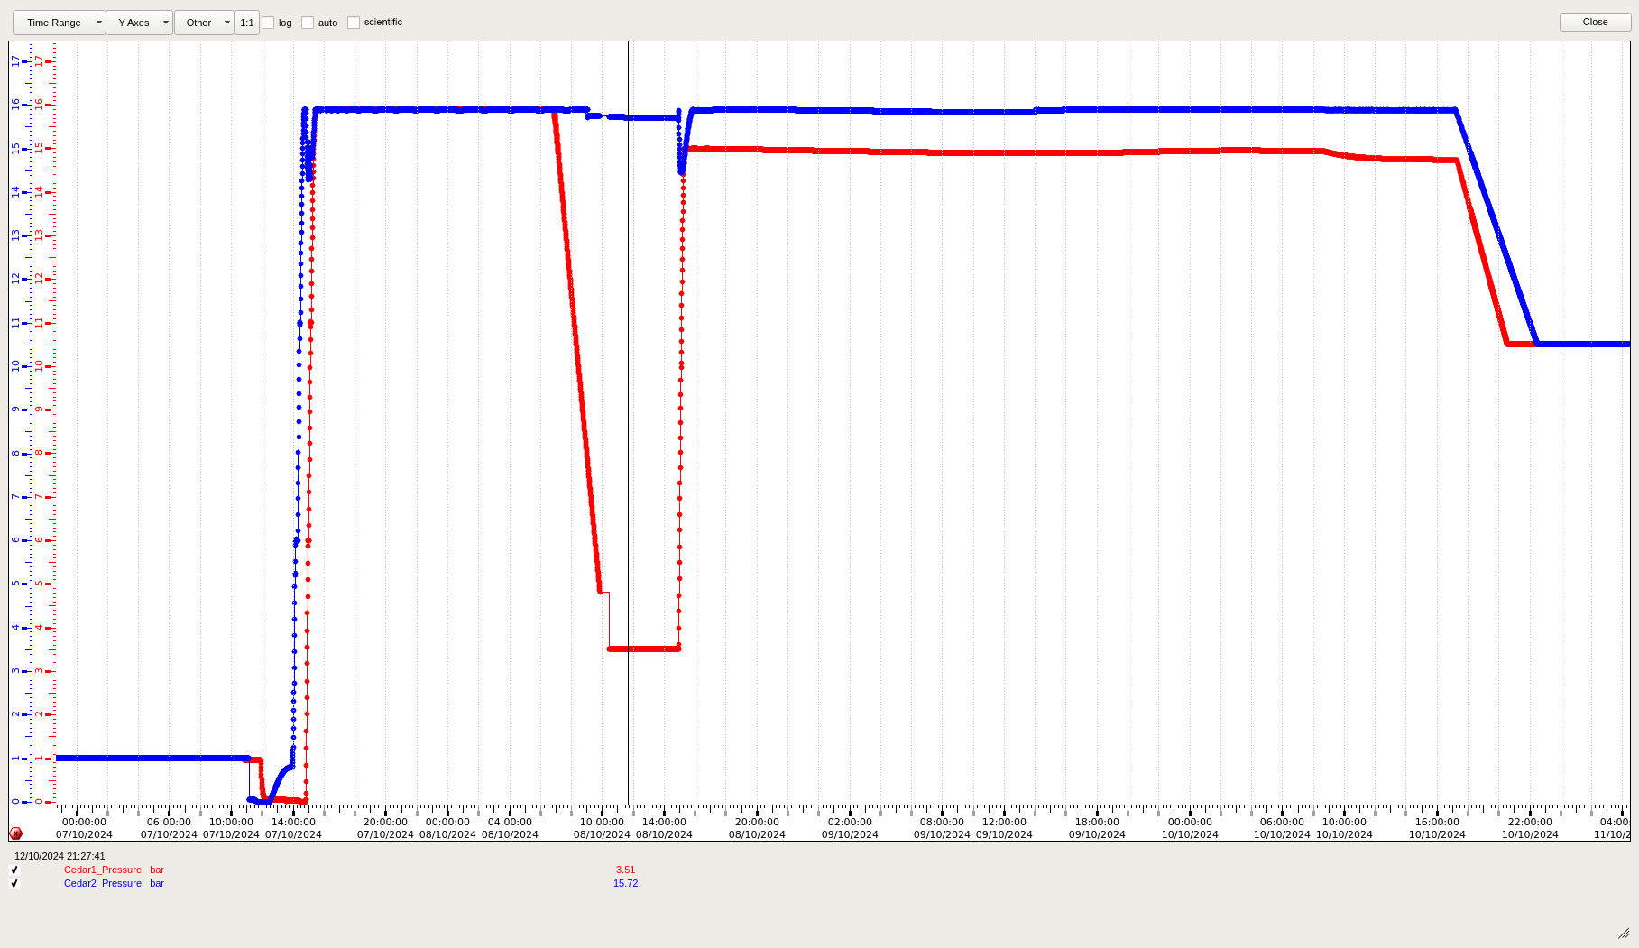
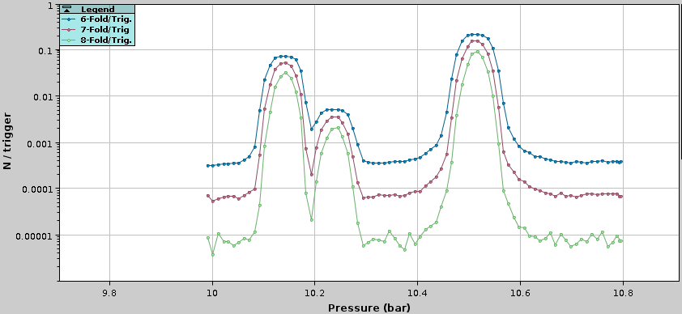
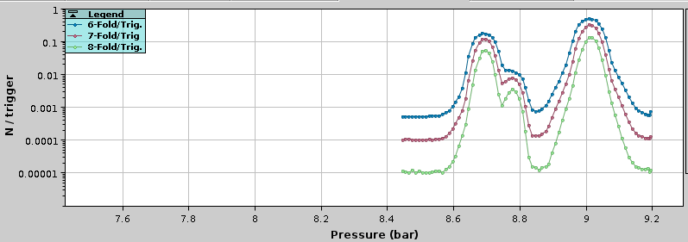
CEDAR operation – air contamination
Initial Issue:
  Peak not found during pressure scan; wider scan revealed it much lower than expected.
Peak Movement:
  Peak position moved towards the expected value with each scan—indicating air contamination.
Verification:
  Issue confirmed by emptying to 3 bar and pressurizing back to 12 bar.
Refilling:
  System pumped to vacuum and refilled on Monday. CEDAR 2 OK, but CEDAR 1 showed similar problems.
Solution:
  Issue resolved by cycling gas volume between 2 and 13 bar for CEDAR 1.
Recommendation:
  Develop a precise preparation procedure for CEDAR.

Slide 4
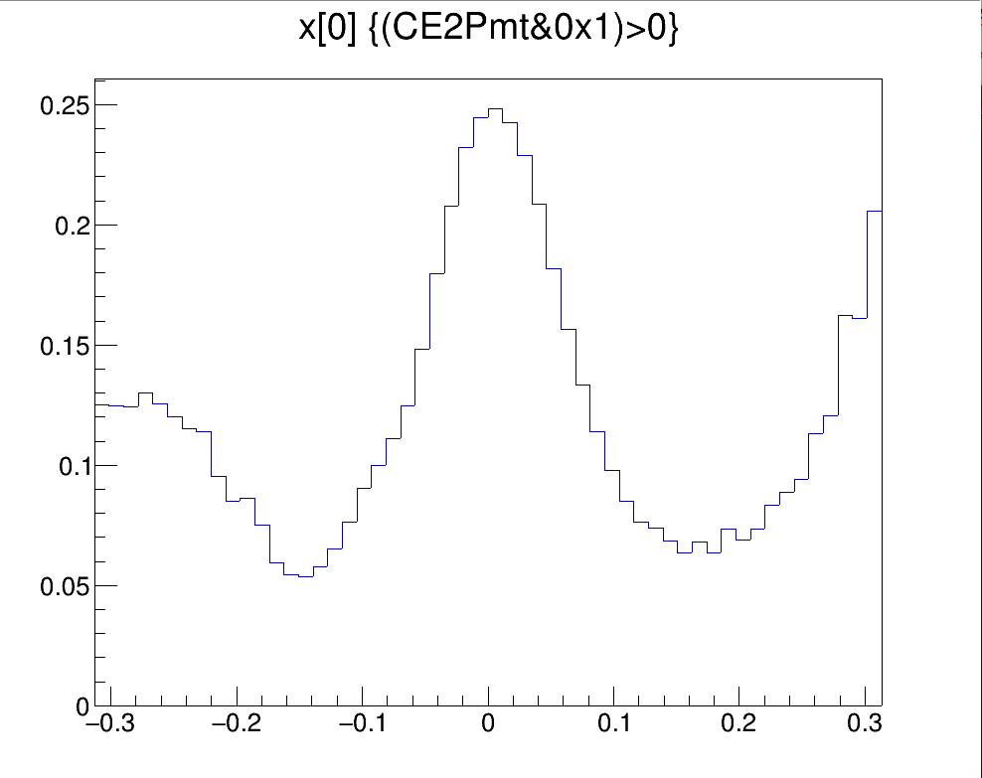
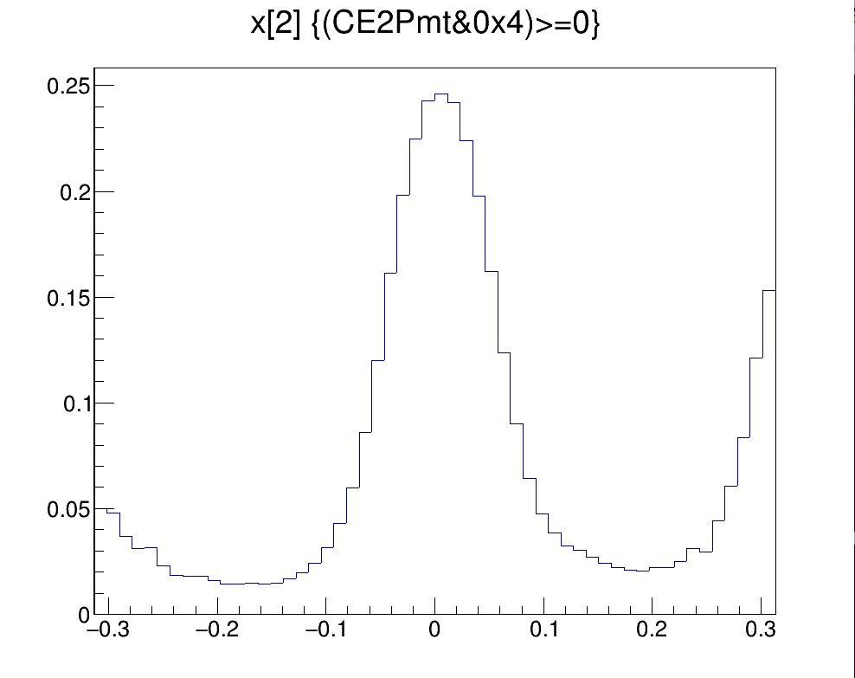
Very good centering of CEDAR w.r.t beam
PMT1
PMT3
mrad
mrad
2024 - all PMTs less than 10urad from the center,
2023 - discrepancies up to 70urad seen….

Slide 5
Highlights & Major issues faced
  Air contamination in CEDAR 2 and later CEDAR 1 – hard to diagnose and recover -> ~3 days lost
  Precise pressure control of CEDARs problematic
  A lot of different beam conditions take time to setup (beam tuning, CEDAR aligments etc.) – more time spend commisioning than measuring

