Slide 1
Cherenkov Threshold Detector Prototype Beam Test in H8 North Area
J. Buesa Orgaz, M. van Dijk
26th November 2024

Slide 2
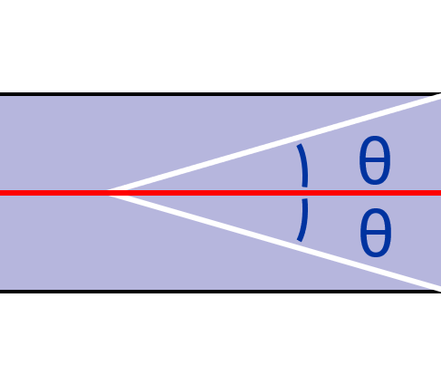
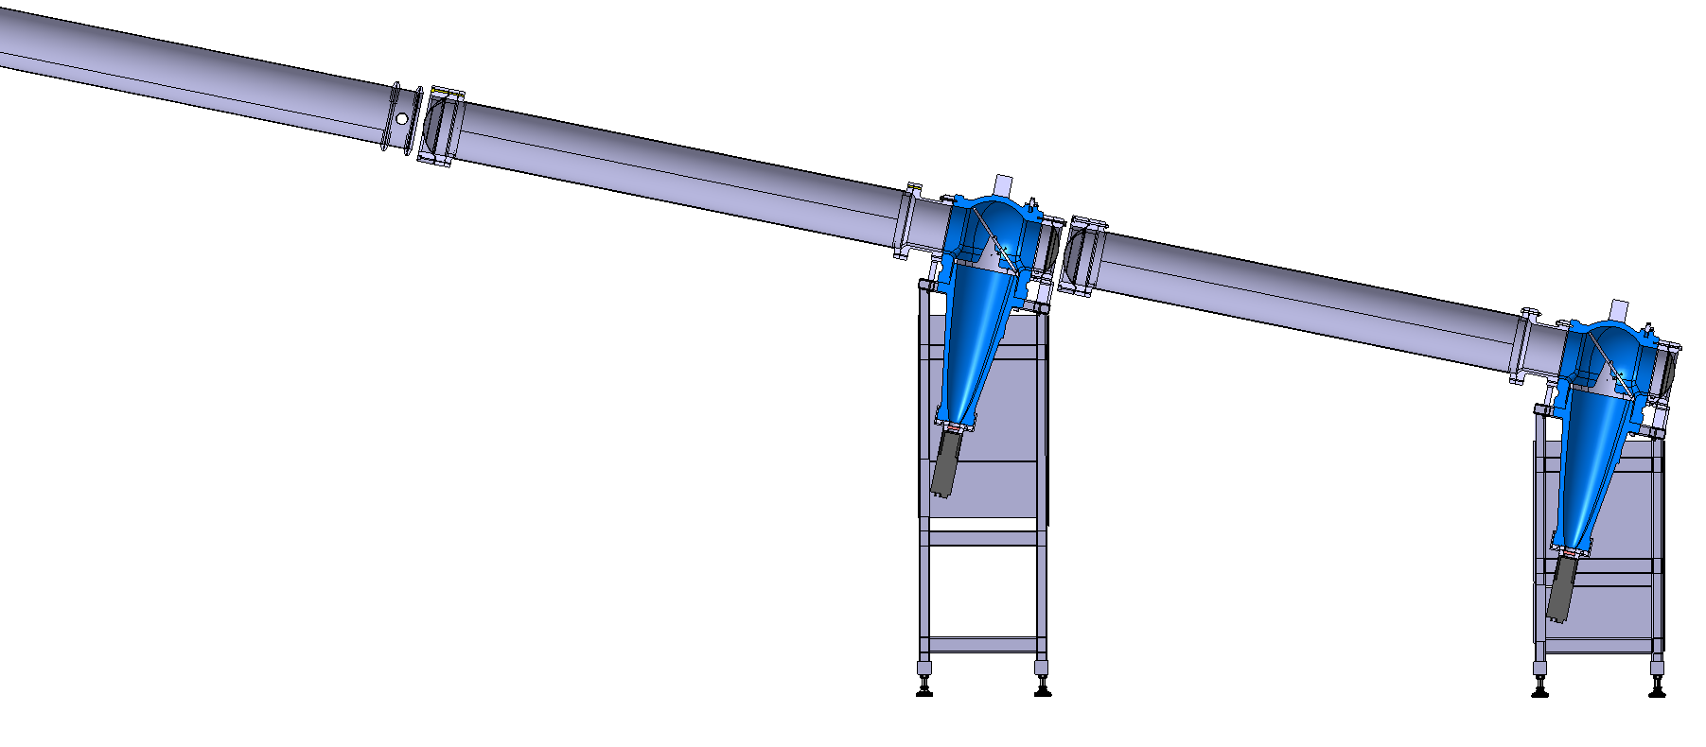
Cherenkov Threshold Detector Layout
Particle beam
Cherenkov light
Mirror 45°
Exit window
Vacuum beam pipe
Vacuum pipe beam window
Air
Cherenkov angle
Entrance window
Pressurized radiator pipe
Parabolic mirror
Particle arrives upstream from vacuum pipe
Particle enters pressure vessel
Cherenkov light is produced with a specific angle (θ), and is reflected in the mirrors
Photons arrive to the photomultiplier (PMT)
Particle is detected
Optical window
Photomultiplier

Slide 3
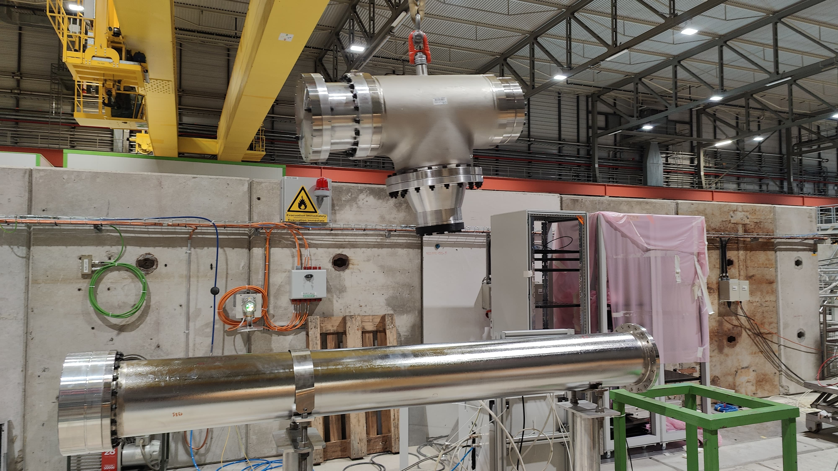
Motivation For New Design
XCET detectors were built in 1970s
Current mechanical design not compliant with unfired pressure vessel safety regulations
  no personnel access when P > 3.5 bar (g), maximum pressure of 15 bar (g)
Mirror optics have degraded over time, decreasing detector’s efficiency.
With a new mechanical design, opportunity to bring an improved design of the optics
Assembly of prototype in PPE158

Slide 4
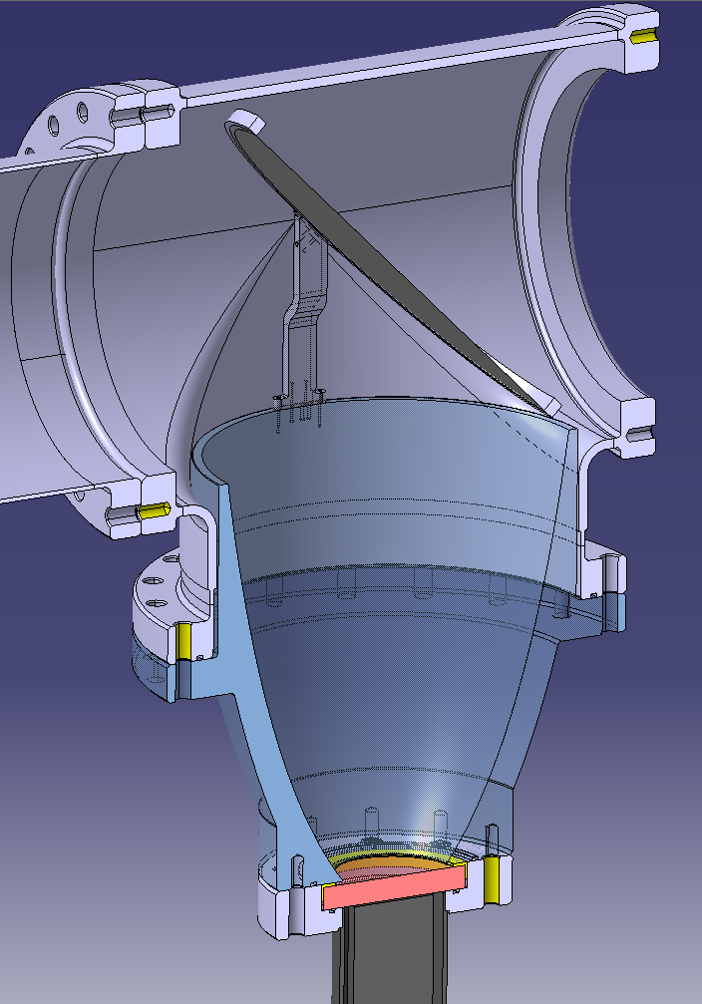
New Mechanical Design
The new XCET detector prototype has been designed, manufactured, inspected and tested according to the European standard EN-13445 (unfired pressure vessels)
HSE has issued an SRF lifting access restrictions with new prototype
Head was manufactured in EN-MME main workshop
Parabolic mirror manufactured by Wielandts UPMT
45-degree mirror manufactured by BE-EA and EP-DT
Other machined components by SY-STI main workshop
3D cross-section of XCET prototype

Slide 5
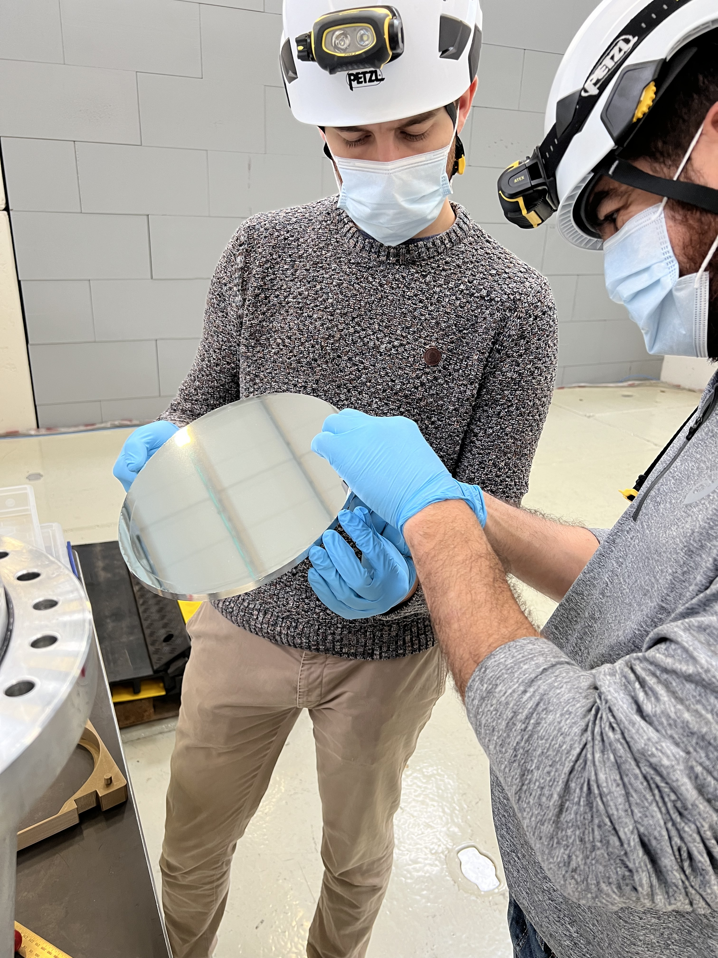
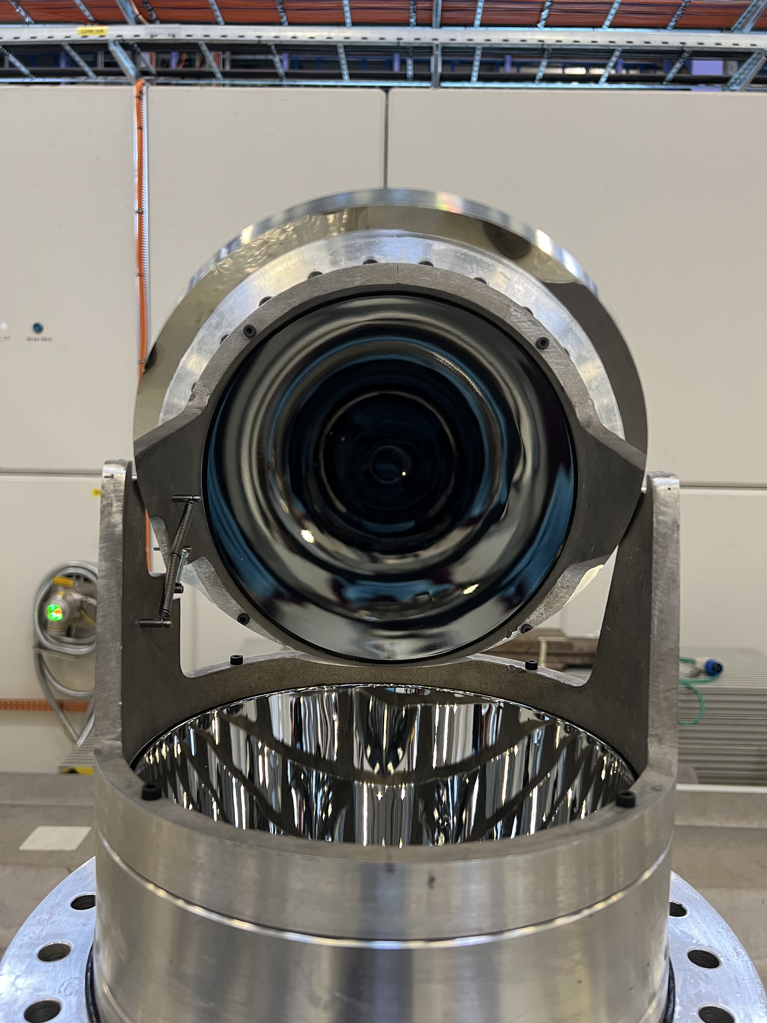
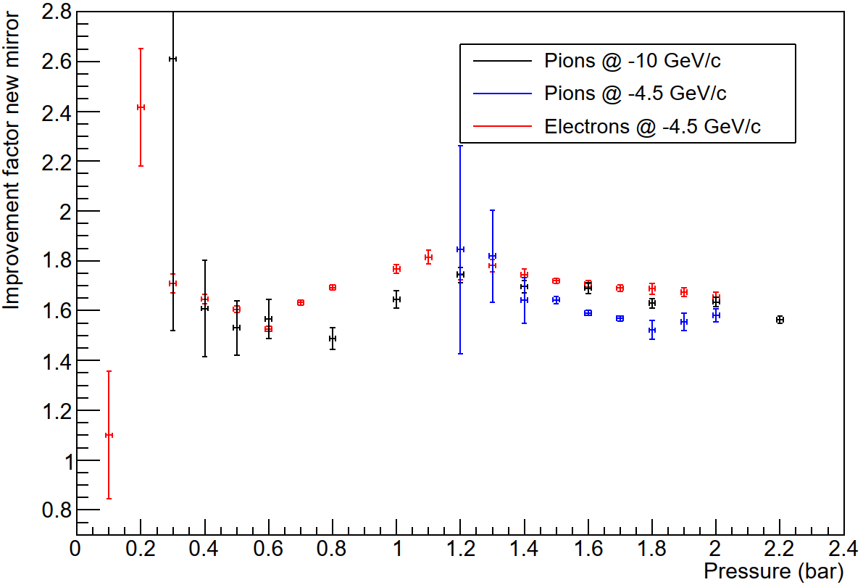
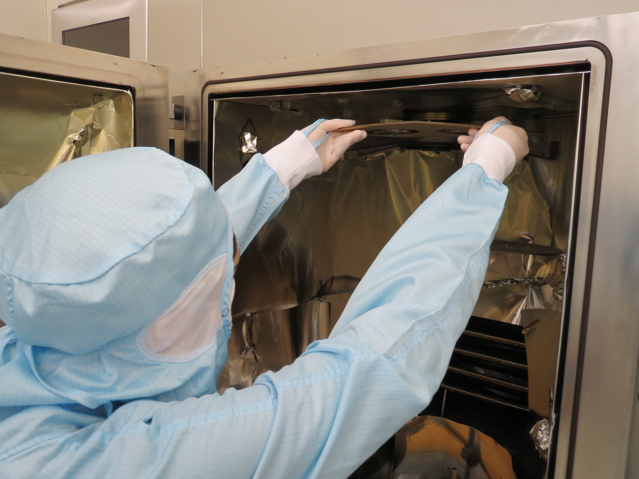
New 45-degree Mirror First Tested in East Area (2023)
New 45-degree mirror tested in T10 beamline low pressure XCET in April 2023
Mirror coated with enhanced UV reflective coating (Al+MgF2)
Compare the new to the old mirror by taking the ratio of the charge observed before and after
  We consistently found 50-80% more light for the new mirror!
Same mirrors were used during the beam test of the October 2024 in H8 North Area

Slide 6
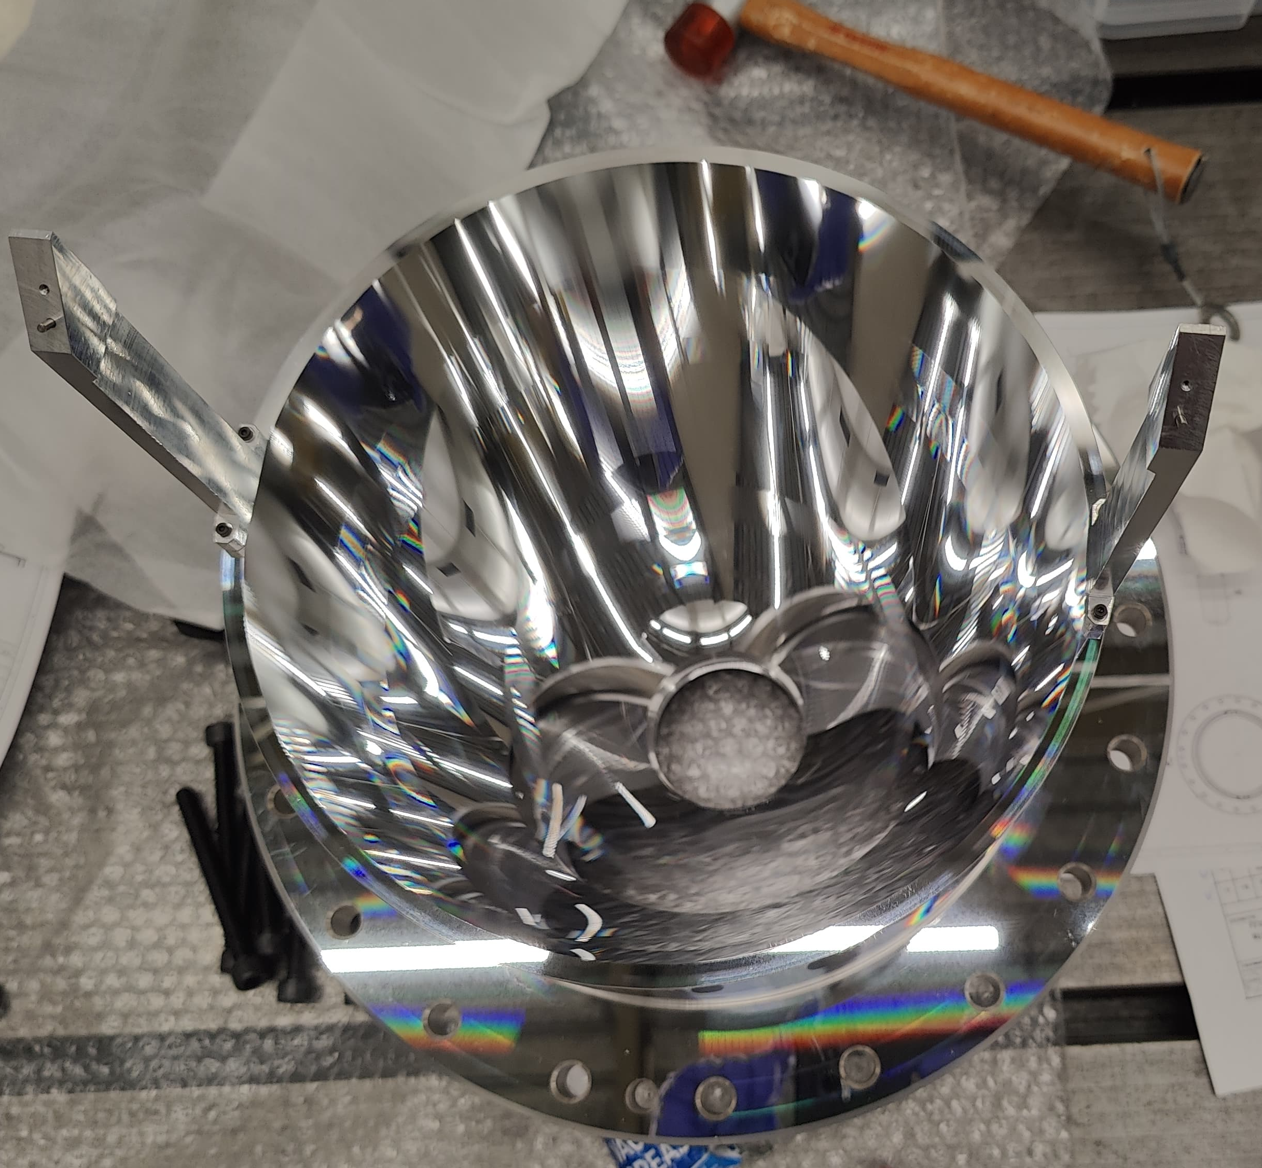
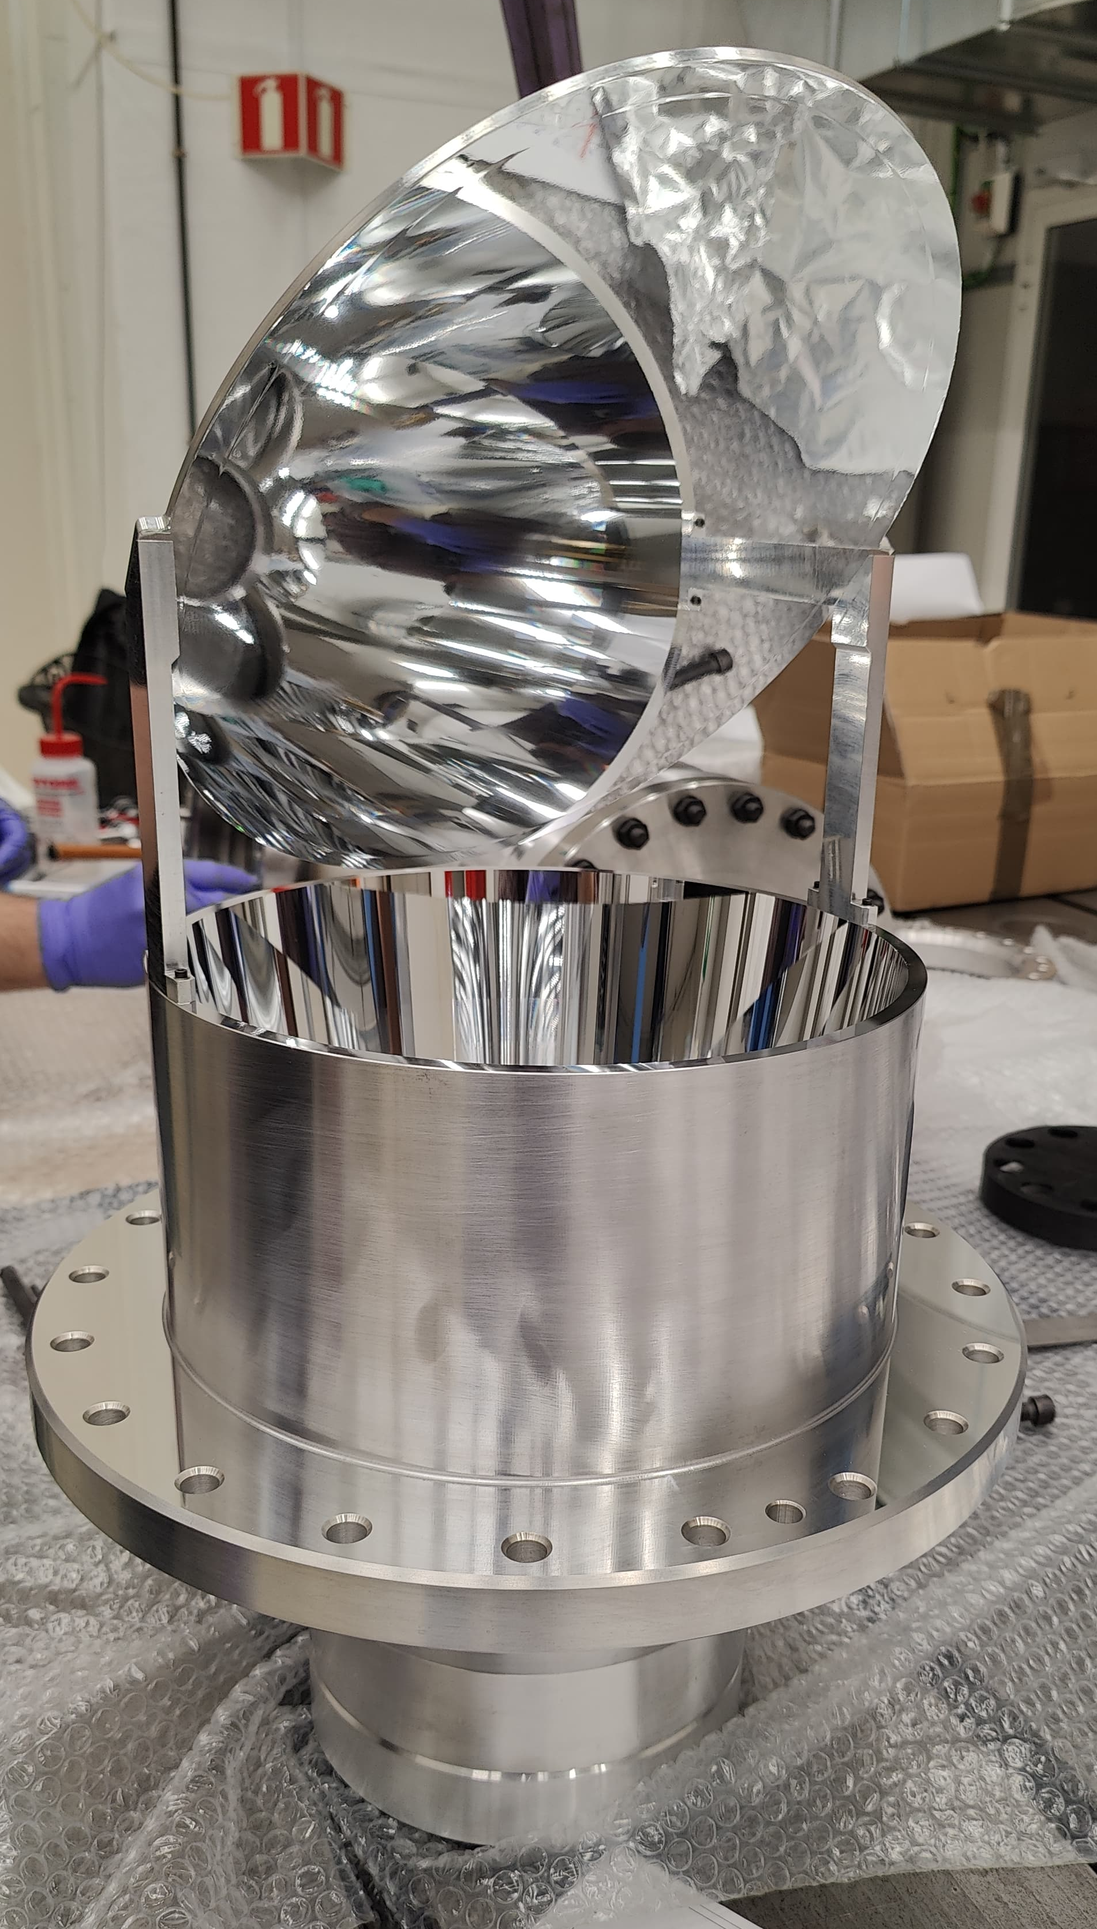
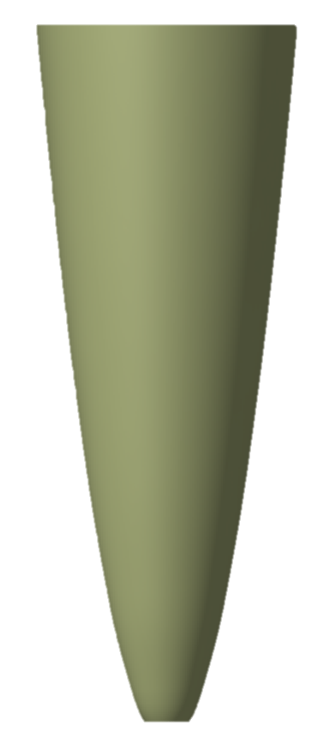
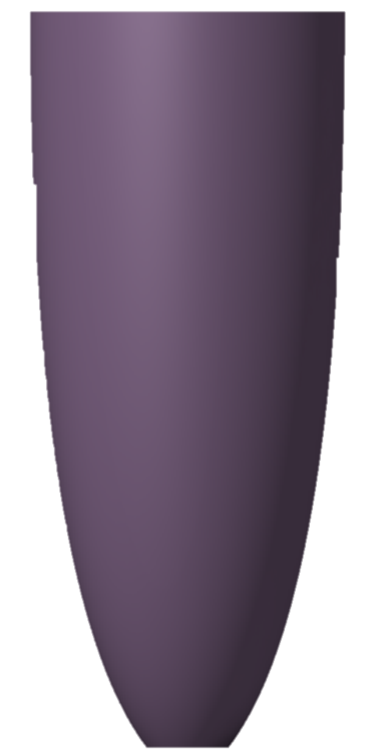
Beam Test to Assess New Parabolic Mirror Design
New optical design to enhance the photon collection performance using a Compound Parabolic Concentrator (CPC) while minimizing dimensions to reduce cost and allow machinability.
Original parabolic mirror
Parabolic mirror prototype
Ø220
Ø245
272
587
Ø75
Ø37.5

Slide 7
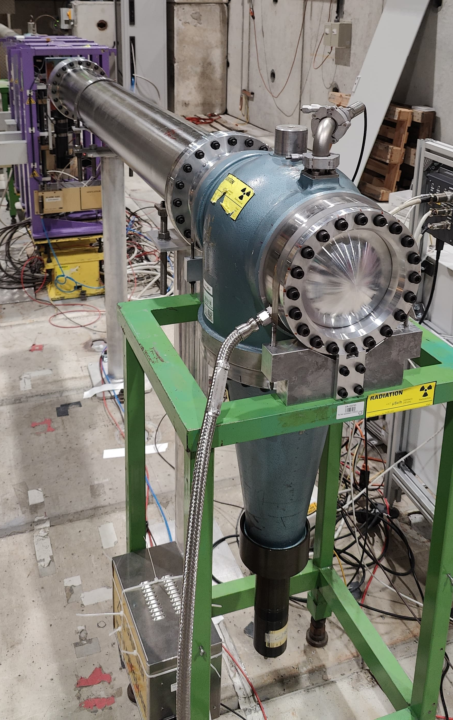
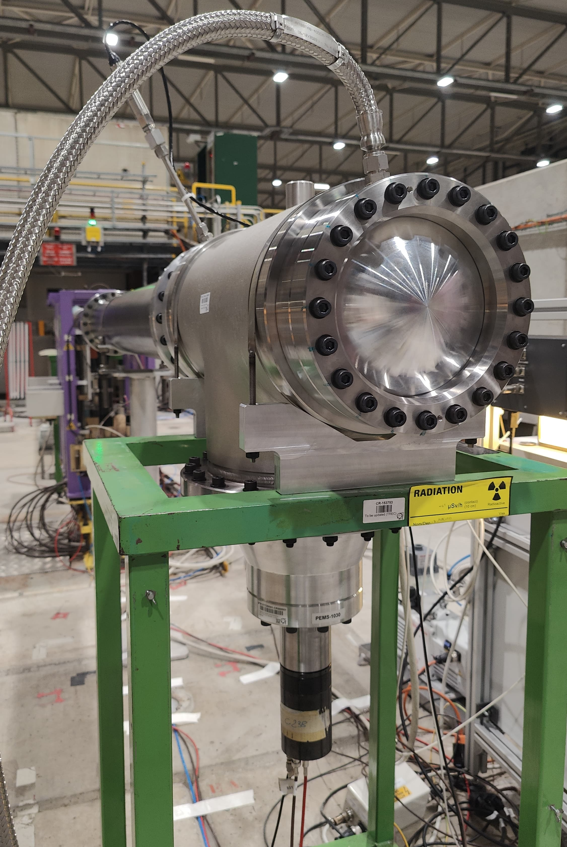
Beam Test Program
Beam momenta: 180 GeV/c
Beam composition: 70% protons – 30% pions
Main users in PPE158 in H8 beamline in North Area during week 41 (October 2024)
Tested with CO2 and Helium from 0.05 bar to 15 bar
Tested as-built XCET version from NP02 with new 45-degree mirror
Tested prototype parabolic mirror and body with new 45-degree mirror
Tested prototype parabolic mirror and body with UV-enhanced 45-degree mirror
As-built XCET detector
Prototype XCET detector

Slide 8
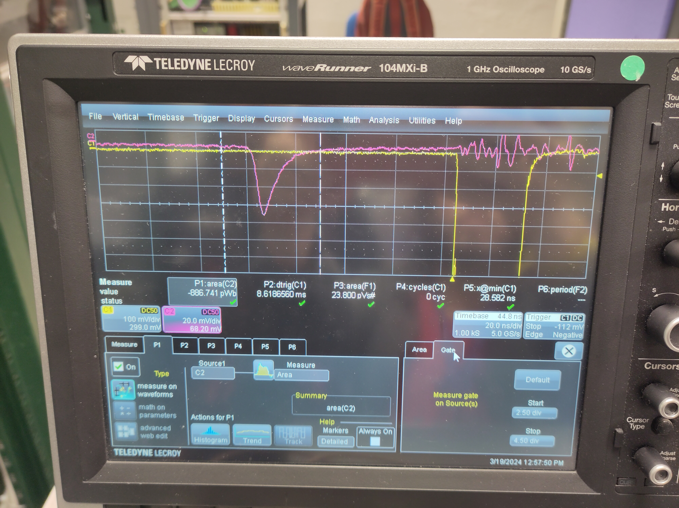
Data Acquisition
Basic plan for testing: take baseline measurement with old parabolic mirror, replace, repeat
  We measure the amount of light collected by the mirrors
  Use for this the amount of charge collected by the PMT
Main tool: Oscilloscope
  Use signal from scintillators as trigger to
  verify particle goes all the way through (yellow)
  Check PMT signal on scope (pink)
  Integrate under the curve using scope (between lines)
  Save resulting histogram, analyze offline
Signal
Trigger

Slide 9
Crosschecks on PMT – Gain and Linearity
PMT gain needed to calculate number of
observed photons from signal
  Measurements done by M. Kirschbaum – THANKS!
  Measure PMT gain in lab using LED with around
  9% single photons (derived from fits)
  Observed signal for single photons at given HV unfolded to gain
  Use as key input for analysis

Slide 10
Crosschecks on PMT – Gain and Linearity
Key requirement for signal: use regime where PMT is linear
  Can cross-check using data from beamtest: compare different HV in same conditions
  So, for example, take for identical pressure the signal at 2100V and 1950V, then make a scatter plot of all these for the high voltage, against the size of the signal
  This number should be independent of the signal size for as long as the PMT is linear
  Where it starts dropping off (approximately, red dotted line) is onset of non-linearity
  Discard in signal analysis the points where the signal is >10nVs (~1.2 10⁹ electrons)

Slide 11
New Parabolic Mirror Improves Detector Efficiency at all Pressures
Parabolic mirror prototype performed better than the original parabolic mirror for all pressure points.
For the same 45-degree mirror, parabolic mirror prototype increased photon collection from 20%- 50% < 2 bar
With UV-enhanced 45-degree mirror (flash mirror) light collection improved by another 10%-15%

Slide 12
New Parabolic Mirror Improves Detector Efficiency at all Pressures
For the same 45-degree mirror, parabolic mirror prototype increased photon collection an extra 50% at 2 bar to 320% at 15 bar
With large Cherenkov angles, light starts touching stainless steel radiator tube, low UV reflectivity, light is absorbed (kink in curve).
Old parabolic mirror has maximum light collection at 2 bar, old design was not intended to capture large Cherenkov angles

Slide 13
Conclusions
Extremely successful beam test program performing all tests desired.
With the new 45-degree mirror, XCET efficiency increases by 50%-80% wrt to as-buil/old mirrors.
Adding the new parabolic mirror, photon collection increases an extra 20-50% below 2 bar and up to 320% at maximum pressure of 15 bar.
Using the UV-enhanced 45-degree mirror (flash coating) adds a 10%-15% photon collection wrt to the EB-PVD mirror below 2 bar.
Significant insights of the XCET operations were discovered leading to potential improvement for a prototype v2 if needed.
Expertise in the design and manufacturing of each component has been successfully developed.
Full debriefing of beam test coming tomorrow. Potential publication to be sent by end of the year.

Slide 14
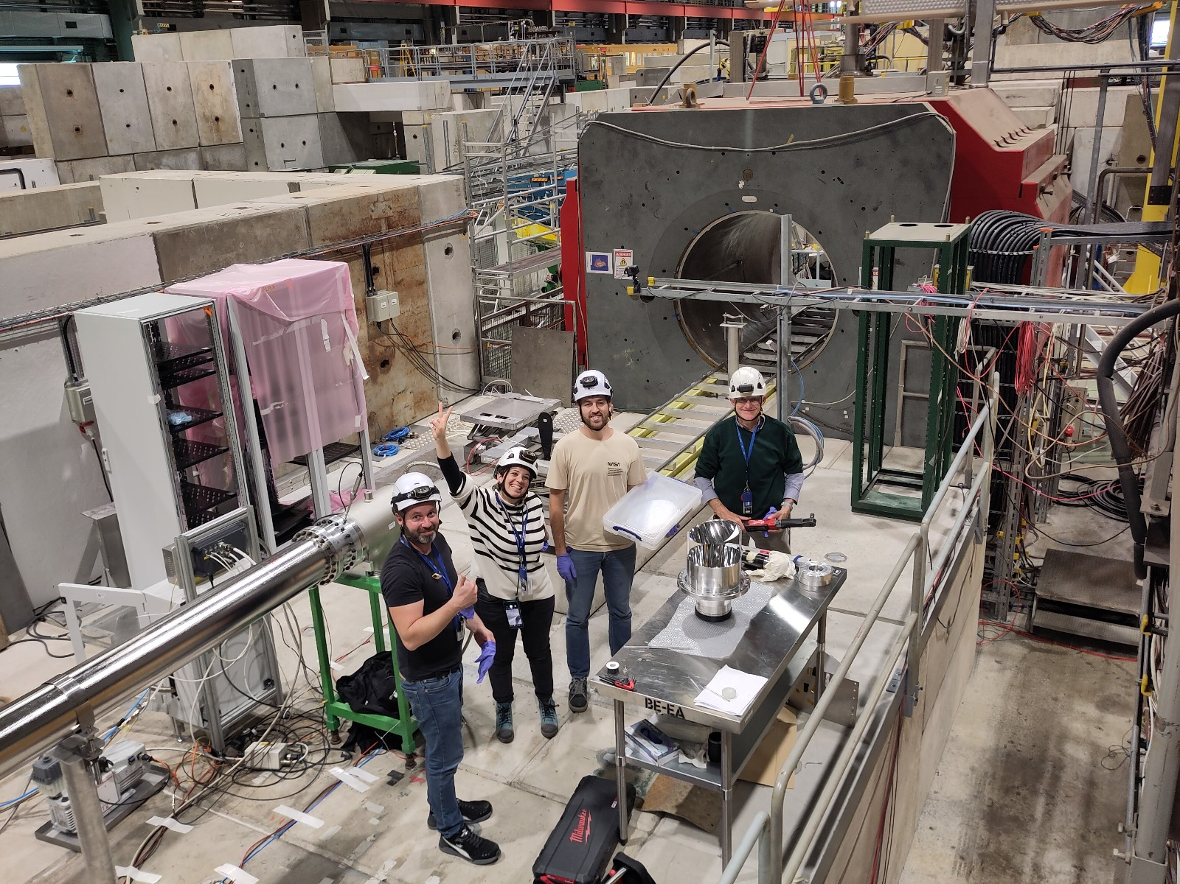
Thank you!
All people attending the talk today!
The teams that have helped us make this happen
  To all BE-EA teams involved! ☺
  SY-BI S. Deschamps, W. Devauchelle,
  I. Ortega Ruiz, J. Tan, M. Kirschbaum
  EP-DT T. Schneider, M. van Stenis
  EN-MME E. Rigutto team
  SY-STI P. Broussart team
THANK YOU!!!

Slide 15
Number of photons collected with original parabolic mirror vs prototype
> 2 bar (higher angles), new mirror performs better
Unexpected drop at 9 bar. New mirror’s maximum collection capacity should be higher than 15 bar.
We were definitely losing light
1st measurement of prototype collected less light at low pressures < 2 bar
Hypothesis: losing light at the PMT connection. Distance from optical window to PMT window not adequate

Slide 16
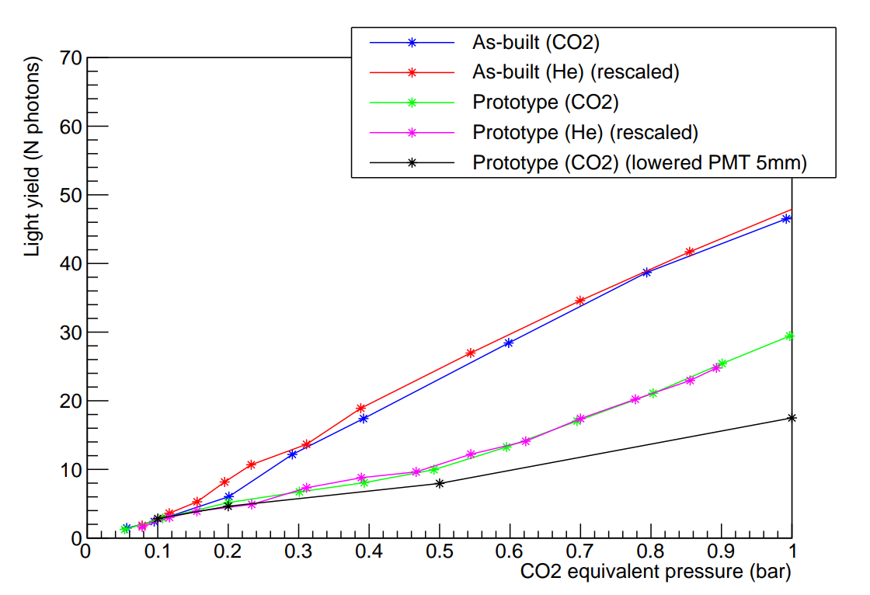
Lowering PMT showed light escaping from optical window-PMT coupling
With available components, we could only lower PMT to partially validate theory.
Lowering 5 mm the PMT → losing even more light at low Cherenkov angles
Next step: decrease distance from optical window to PMT to see if collection improved

Slide 17
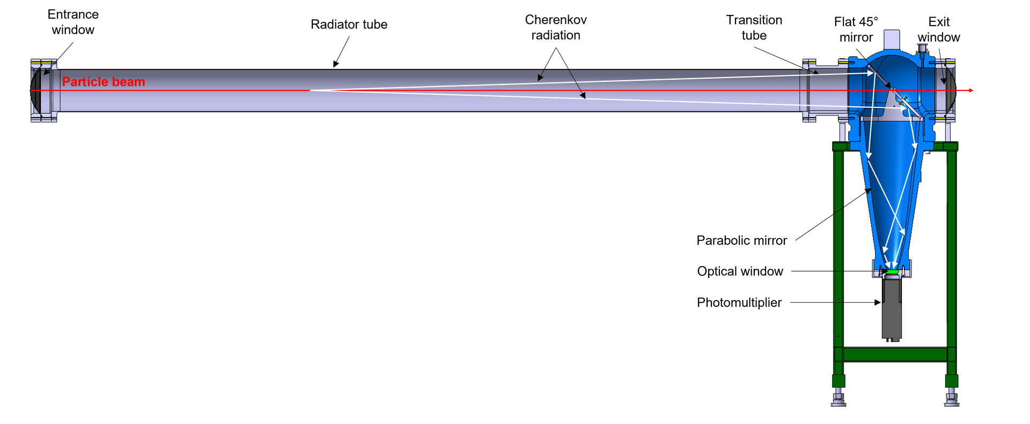
XCET detector
Cherenkov threshold detectors form one of the key pieces of instrumentation of the East and North experimental areas
  Cherenkov light is emitted differently depending on particle mass, pressure, and type of gas (CO₂ and He for this test)
  Each type of particle has a “threshold” for emitting Cherenkov light in gas dependent on the pressure
  Below threshold: no light! Over threshold: Yes light, and quantity is linear with (P-P_{thr})
  Light is emitted under an angle that grows with (P-P_{thr})
  These characteristics dictate the design of the XCET parabolic mirror

Slide 18
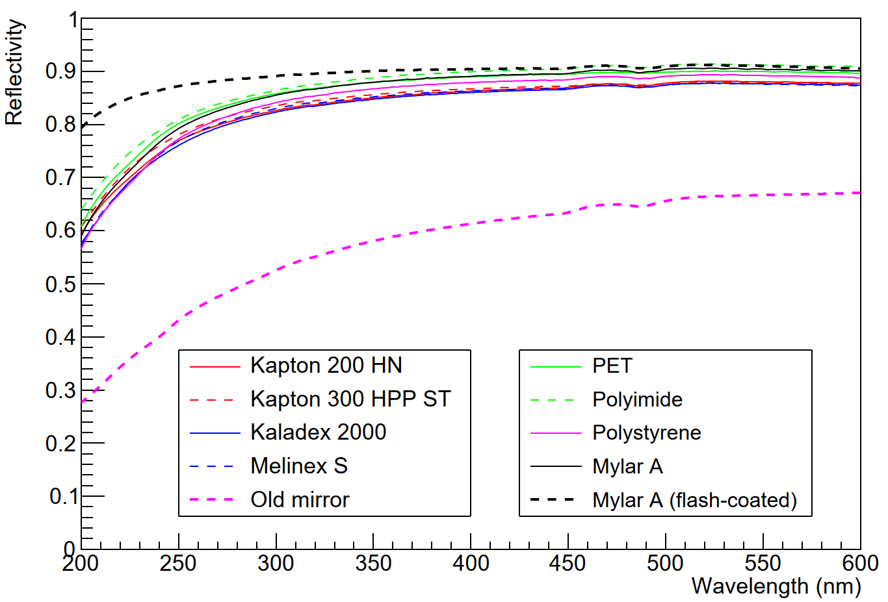
Reflectivity measurements
The choice of coating technique outweighs the impact of the polymer substrate selection
No big difference among polymers was found with EB-PVD
Faster Al+MgF₂ evaporation
reduced oxidation and enhanced
UV reflectivity

Slide 19
Final performance of the new mirror
Compare the new to the old mirror by taking the ratio of the charge observed after and before
  We consistently find 50-80% more light for the new mirror!
Not all points agree within error bars?
  At low charge, fitting of overlapping gaussians can be difficult
  Cherenkov angles at same pressure for different particles not the same
  Optical behaviour of the remaining elements not fixed

Slide 20
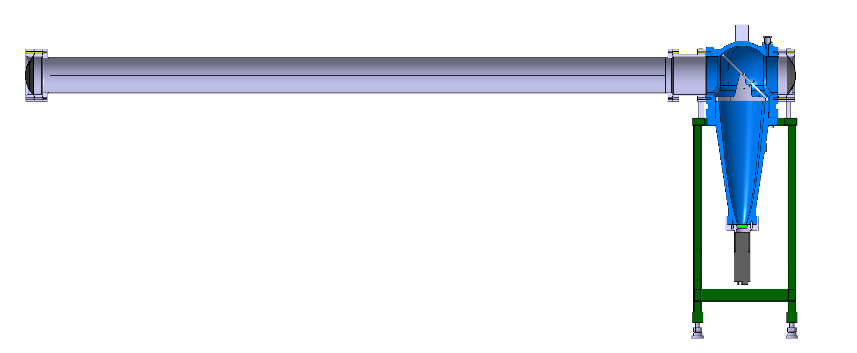
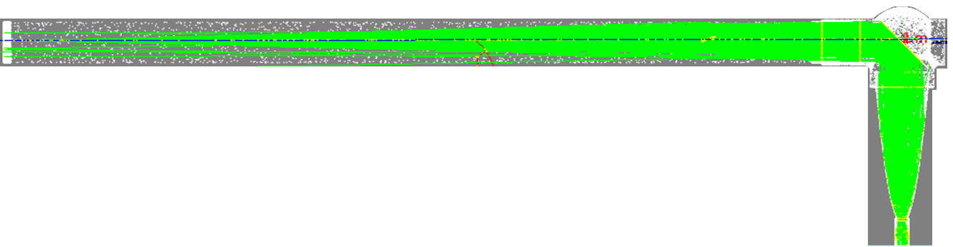


From Mechanical Design to Analysis: an Iterative Monte Carlo-based Optimization Process
Simulation Parameters
Particle type (μ, e, K, 𝝅, p)
Radiator gas (CO2, R-218)
Pressure range [0 - 16 bar]
Momenta range [0.5 - 20 GeV/c]
Mesh
+
Format file
Geometry
Optical Performance
Photons produced
Photons reaching the PMT
Fresnel reflection
Cherenkov angles
Detector Components | Relative Efficiency
Optical window | Transmission
Flat mirror, radiator tube, parabolic mirror | Reflectivity
Photomultiplier | Quantum efficiency
Feedback and guidance for future iterations

Slide 21
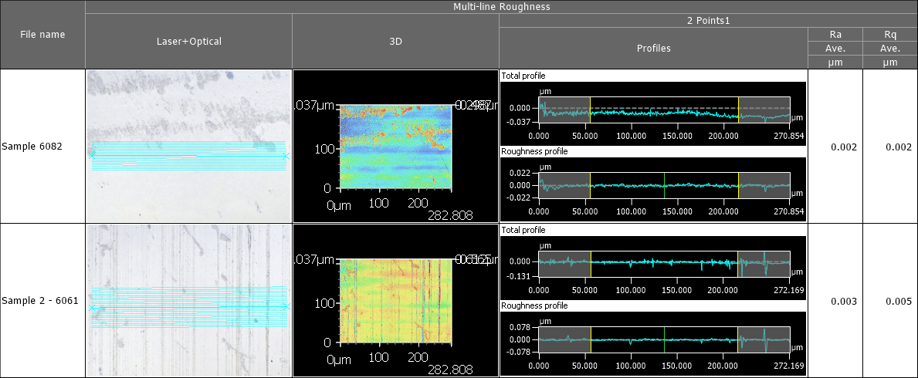
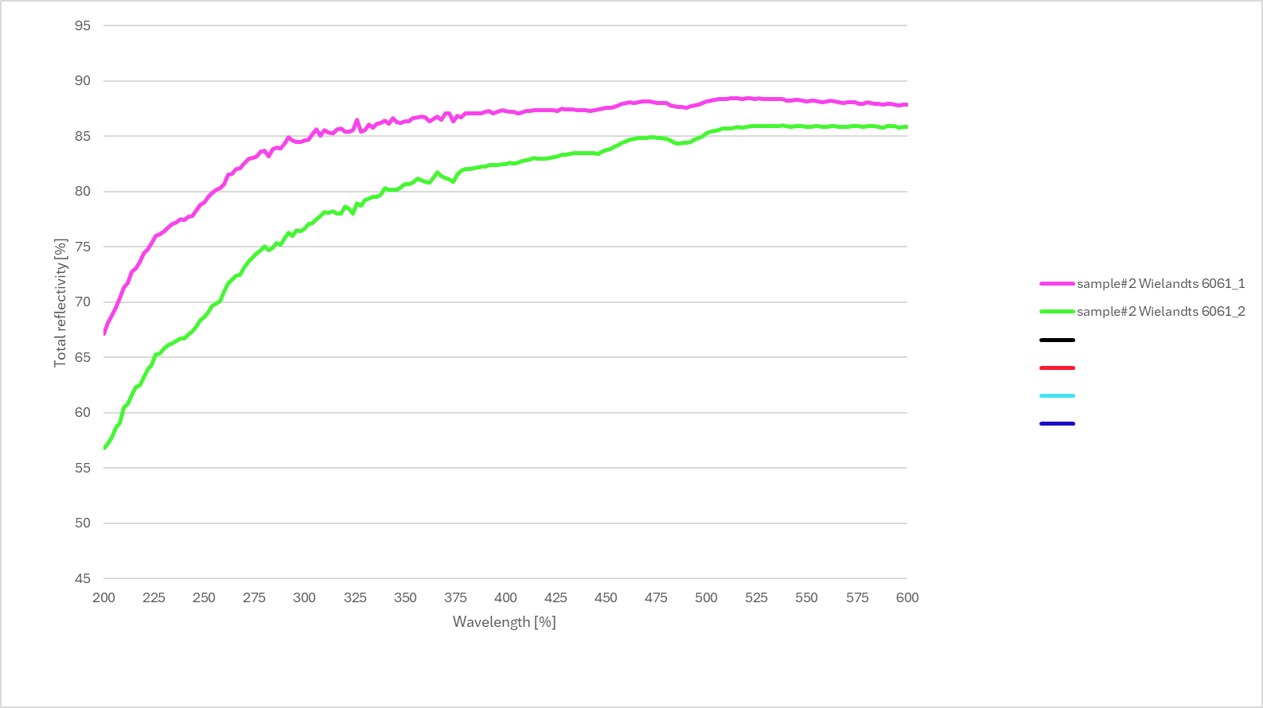
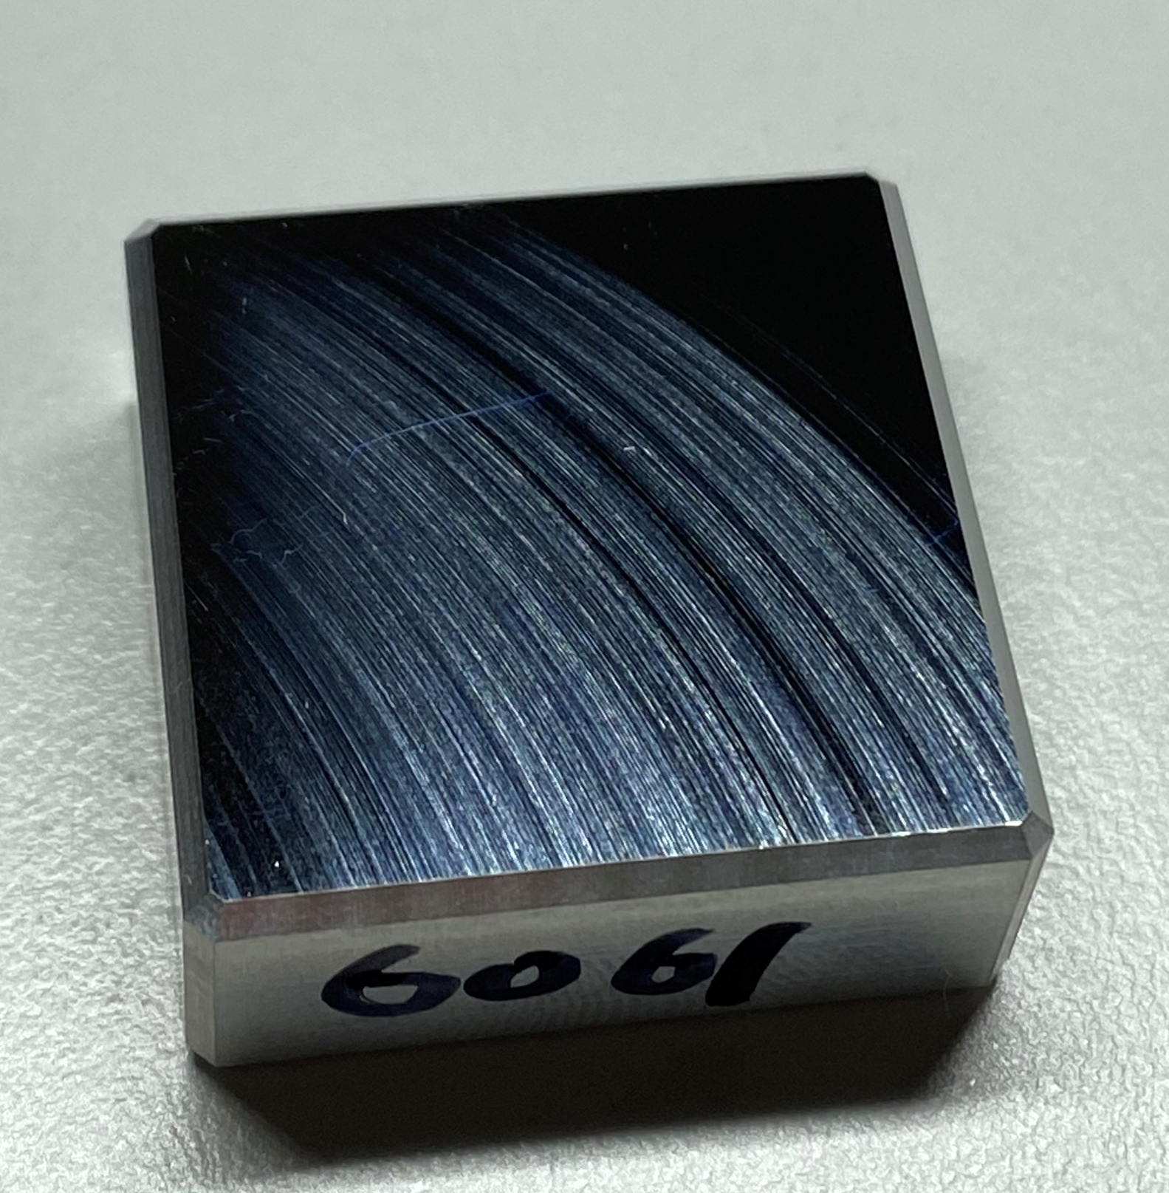
Surface roughness provided by Wielandts (6061 sample #2)
Reflectivity measured from different areas

