Slide 1

ECR/Documents for Information and Approval
Giulia Romagnoli and Natalya Kahn for BE-EA, 2024-11-26
EA Documents - Agile Board - CERN Central Jira

Slide 2
LIST OF DOCUMENTS for Info
FOR INFORMATION EATM
Summary | Reporter | EA Projects | EDMS number | EDMS Status
Pre-DEC from EN-EL following the office identification | Alicja Ostrega | North Area, NACONS | 3165982 - SPSX-E-LST-0032 | Under Approval
Consolidation Program for the XCED Detectors | Miguel Santos | North Area, NACONS | 2742855 - SPSX-B-WD-0002 | Under Approval
NACONS WP 3.4 - Supports Structures | Miguel Santos | North Area, NACONS | 2798515 - SPSX-H-WD-0002 | Under Approval
North Area Secondary Beam Areas (SBAs) Vacuum System Consolidation | Miguel Santos | North Area, NACONS | 2488128 – SPSX-V-WD-0001 | Under Approval
Consolidation of the SPS TT20 TED (Target External Dump) and TBSE (Target Beam Stopper External) | Matthew Fraser | North Area, NACONS, HI-ECN3 | 2780156 – SPSX-T-ES-0004 | Engineering check
P42 Transfer Line Dump for the High Intensity ECN3 Facility | Aleksandr Gorn | North Area, HI-ECN3 | 3049242 – SPS-XT-SPC-0001 | Engineering check
Clean Room Functional Specification | Krystian Sidorowski | North Area | 3189466 – SPSX-J-SPC-0004 | Engineering check
ANSYS Thermal Simulation of XCHV | Maud Wehrle, Naini Mandal | North Area | 3065546 – SPSX-TC-ER-0001 | Under Approval
Assembly Procedure for the Fast FISC | Eva Kamenicka | Experimental Areas | 3178861 | Engineering check
Disassembly Procedure for Fast FISC | Eva Kamenicka | Experimental Areas | 3128634 | Released
Template for Equipment Safety Assessment of BE-EA Group | Naini Mandal | Experimental Areas | 3138858 | Released
TemplateEA_Simulation Note | Naini Mandal | Experimental Areas | 3175025 | Released

Slide 3
LIST OF DOCUMENTS for Info
FOR INFORMATION EATM
Summary | Reporter | EA Projects | EDMS number | EDMS Status
East Area Plan for YETS | Aboubakr Ebn Rahmoun | East Area | 3191727 - PSZ-PM-MS-0001 | Under Approval
Risk assessment for the Individual System Tests of East Area power converters at the end of the YETS | Stephane Reignier | East Area | 3170222 - PSZ-RP-SYP-0001 | Under Approval

Slide 4
LIST OF DOC for FUTURE APPROVAL
ECR INFO/FUTURE APPROVAL EATM
Summary | Reporter | EA Projects | EDMS number | EDMS Status
Low-energy Beams in the T10 Beamline of the East Area | Maarten Van Dijk | East Area | 3174332 - PSZ-L-EC-0003 | In Work
Installation 5 additional units of BLMs on P42 | Christos Zamantzas | North Area – NACONS | 3167561 – SPSX-B-EC-0011 | In Work
Creation of New Lorry and Personnel Doors in Building 911 | Jean-Louis Grenard | North Area, HI-ECN3 | 3173295 – SPSX-J-EC-0008 | In Work
GIF++ extension/ gas balcony | Sylvain Girod | North Area |  | In Work
AUG installation EHN2+ AUL removal EHN1, GIF++/H8 and EHN2/M2/BA82 | Marcin Szewczyk | North Area | 3178530 - SPSX-SF-EC-0016 | Engineering check
PPE144 patch panel installation with passarelle modification | Sylvain Girod | North Area – NACONS | 3121860 – SPSX-J-EC-0006 | Under Approval
Installation of a New Hydrogen Buffer outside EHN1 for the NA61/SHINE Experiment | Bartosz Maksiak | North Area | 3197663 – SPSX-J-EC-0009 | Engineering check

Slide 5
LIST OF DOCs for APPROVAL
ECR APPROVAL EATM
Summary | Reporter | EA Projects | EDMS number | EDMS Status
New Motorized Support for XEMC in PPE128 on H8 Beamline | Eva Kamenicka | North Area | 3171836 - SPSX-H-EC-0001 | Under Approval
New Buffer Zone in BA81 | Iliasse Derrag | North Area | 3151414 – SPSX-J-EC-0007 | Under Approval
Asset Replacement Request - BSPI.045769 | Aurelie Goldblatt | North Area | 3189528 – SPSX-B-ARR-0002 | Under Approval
User Requirements for the Vacuum System of the M2 Beamline in the North Area | Silvia Schuh-Erhard | North Area | 3129053 – SPSX-V-ES-0002 | Under Approval

Slide 6
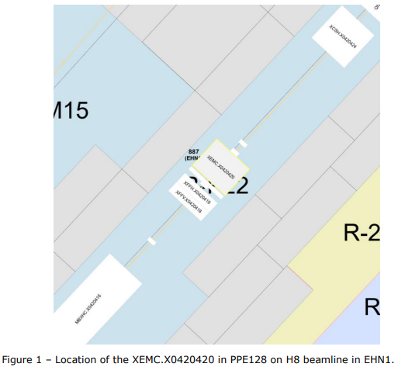
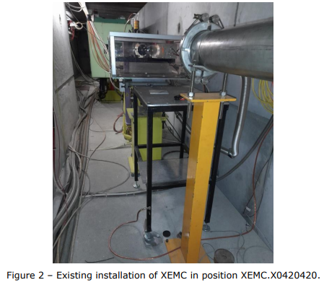
ECR for Approval
SPSX-H-EC-0001
Version 0.2
New Motorized Support for XEMC in PPE128 on H8 Beamline
By Eva Kamenicka
This document describes the new motorized support designed for the electromagnetic calorimeter installed in H8 beamline in position XEMC.X0420420. It will replace the standard yellow support which is currently being used.
Currently, the XEMC and frame must be dismounted from the support and manually carried out of the beamline area to install a vacuum pipe.

Slide 7
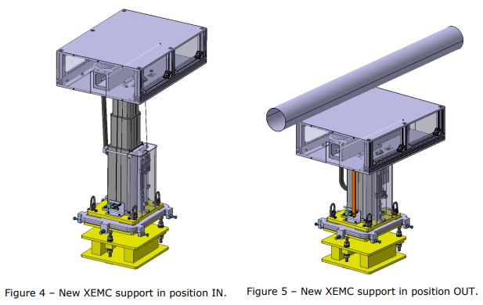
ECR for Approval
SPSX-H-EC-0001
Version 0.2
New Motorized Support for XEMC in PPE128 on H8 Beamline
By Eva Kamenicka
The new support will allow for remote vertical movement IN and OUT of the beamline.
Actions described in this ECR:
Assembly of the HXEMC
Removal of the currently used XEMC.X0420420 support from the H8 beamline, PPE128.
Installation of the new HXEMC support for the XEMC.X0420420
Alignment of the XEMC equipment and ISTs

Slide 8
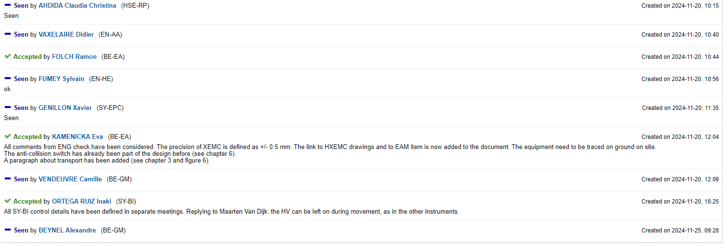
ECR for Approval
SPSX-H-EC-0001
Version 0.2
New Motorized Support for XEMC in PPE128 on H8 Beamline
By Eva Kamenicka
Seeking approval from EATM

Slide 9
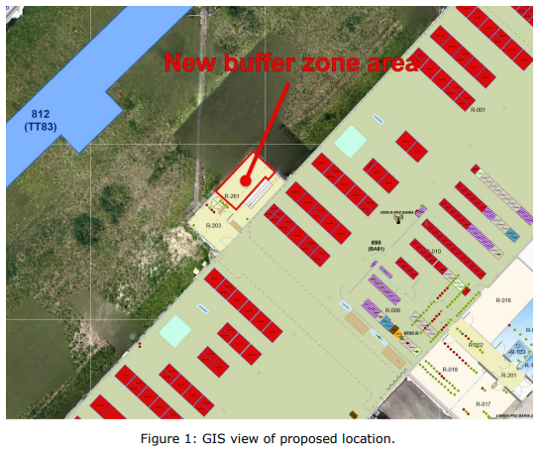
ECR for Approval
SPSX-J-EC-0007
Version 0.2
New Buffer Zone in BA81
By Iliasse Derrag
This document describes the addition of a buffer zone in BA81.
There is currently no buffer zone in BA81, but radioactive objects pass through it on their way to and from the transfer tunnels.
The new buffer zone will be:
Fenced
Access controlled (using a Dosimeter Key Access)

Slide 10
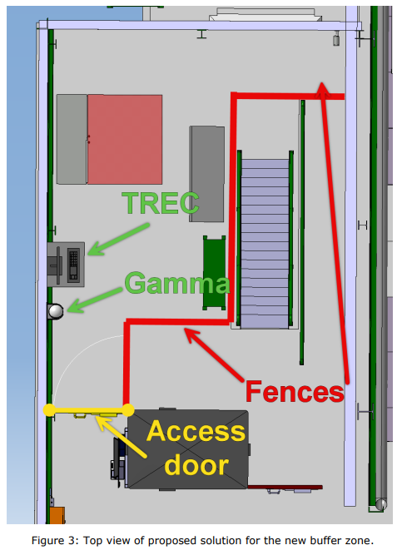
ECR for Approval
SPSX-J-EC-0007
Version 0.2
New Buffer Zone in BA81
By Iliasse Derrag
Some modifications will be necessary:
Pivoting of dosimeter/display panel to be flush with the PAD/MAD.
Addition of a Dosimeter Access controlled door at the edge of the PAD/MAD.
Installation of new fences to delimitate the area while leaving enough space at the PAD/MAD’s exit.
Installation of a TREC PC connected to the network.
Installation of a Gamma probe used for actively detecting radiation in the area.
Placement of racks to be used as temporary storage within the buffer zone.
The work will involve the following groups:
EN-EL for electrical cable pulling to power the TREC PC, as well as extension of cables for the pivoted dosimeter panel.
IT-CS for the ethernet-wired connection of the TREC PC, as well as the extension of ethernet cables for the pivoted dosimeter panel.
EN-ACE for the creation and installation of the new fences and door.
EN-AA for the installation of the Dosimeter Key Access and related cable pulling.

Slide 11
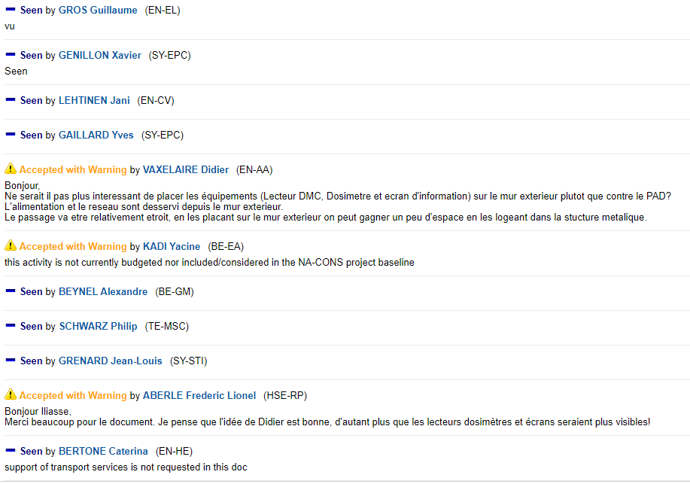
ECR for Approval
SPSX-J-EC-0007
Version 0.2
New Buffer Zone in BA81
By Iliasse Derrag
Seeking approval from EATM

Slide 12
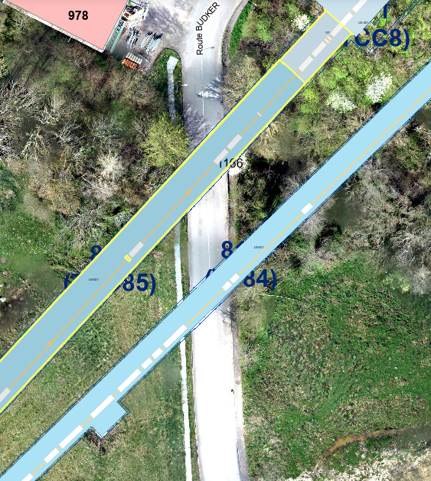
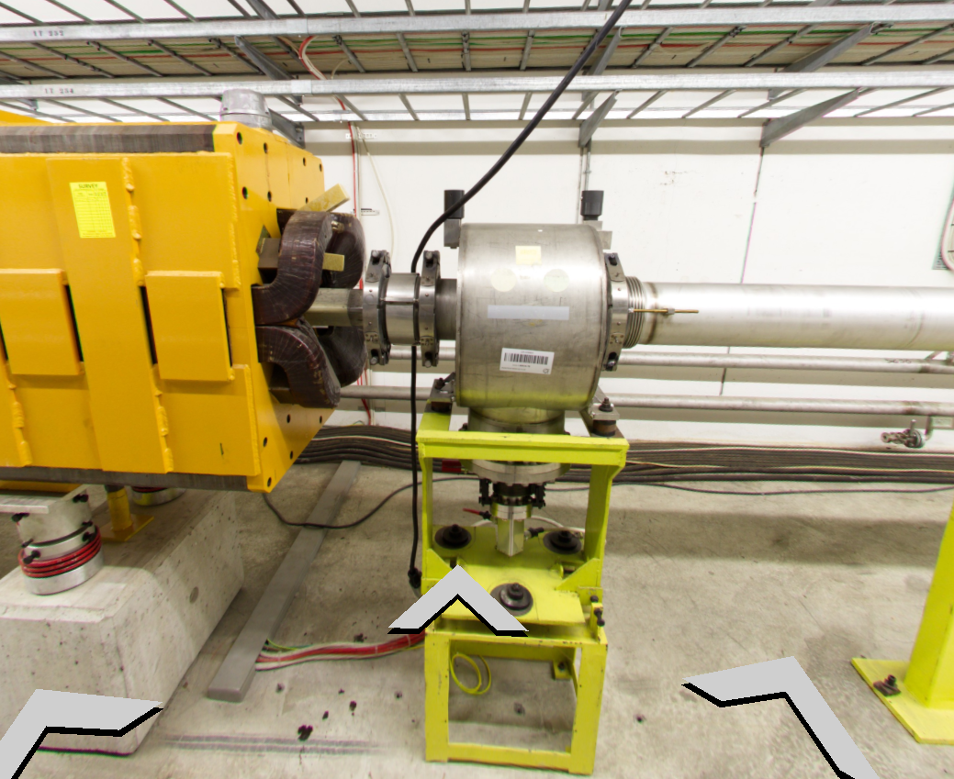
ARR for Approval
SPSX-B-ARR-0002
Version 0.2
Asset Replacement Request - BSPI.045769
By Aurelie Goldblatt
BSP.X0450769 is damaged and there is no signal. It will be replaced by a spare (SPBSAPA003-CR000063).
Modus operandi once vacuum is opened:
Cables disconnection
Removal from the beam line of the full tank with its support
Installation of the spare (full tank + support)
Cables reconnection
IST

Slide 13
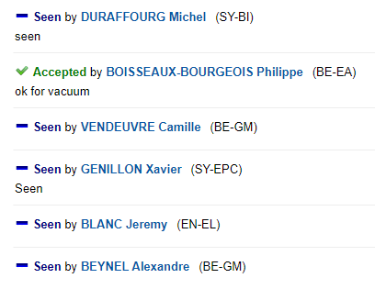
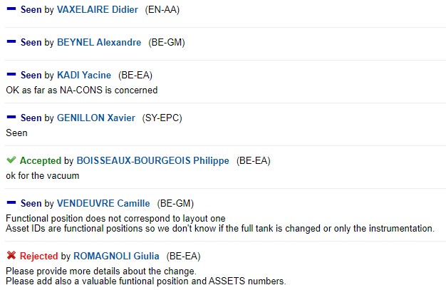
ARR for Approval
SPSX-B-ARR-0002
Version 0.2
Asset Replacement Request - BSPI.045769
By Aurelie Goldblatt
Comments from previous version
Seeking approval from EATM

Slide 14
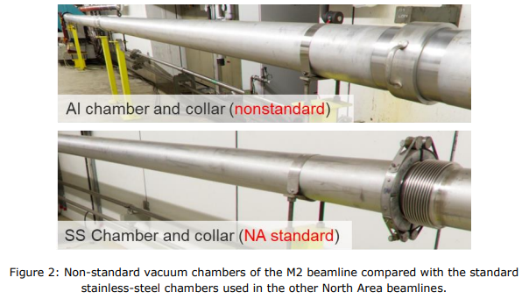
UR for Approval
SPSX-V-ES-0002
Version 0.2
User Requirements for the Vacuum System of the M2 Beamline in the North Area
By Silvia Schuh-Erhard
This document outlines the user requirements for the consolidation and upgrade of the vacuum system in the M2 beamline to facilitate a hadron beam of higher intensity to be delivered to the EHN2 experimental hall.
The current M2 beamline design includes a number of beam sections in air in which the beam scatters off the air molecules leading to an incoherent increase of the beam emittance. This cannot be improved with optics. Overall, there is a reduced number of accumulated kaons.
Currently there are 44 vacuum windows installed in the line, of which:
20 – AL 0.1mm
5 – AL 0.2mm
19 – Mylar 0.175 mm
The M2 beamline is almost completely built with non-standard chambers, flanges and collars, which increases maintenance time.

Slide 15
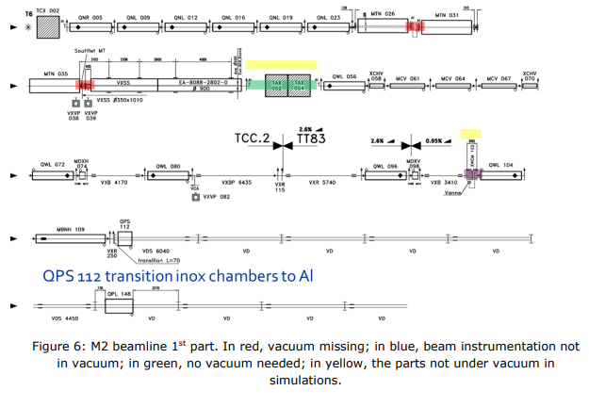
UR for Approval
SPSX-V-ES-0002
Version 0.2
User Requirements for the Vacuum System of the M2 Beamline in the North Area
By Silvia Schuh-Erhard
User Requirements
A gas pressure at the level of 1x10-3 mbar would be adequate to transport the highest number of kaons at a good purity level to the AMBER experiment.
The vacuum upgrade needs to be completed by the end of LS3
Vacuum level: 9x10-3 – 1x10-3 mbar or better; as low as can be reasonably optimised using primary pumping technology.
Leak rate: 10-7 mbar/l/s for the individual vacuum hardware components.
Sectorisation should allow for a vacuum recovery within 4 hours after an intervention that breaks the vacuum. In explicit terms, pumping down from atmospheric to 0.1 mbar should not take more than 3–4 hours, at which time beam operation can already be resumed while further pumping down to the nominal vacuum pressure could take up to 12 hours.
Any use of vacuum windows shall be minimised and the strategy discussed before implementation. The simulation assumed 24 vacuum windows of 200 µm Mylar each which correspond to an overall divergence increase along the beamline of 1.4 µrad.
No particular material constraints have been identified for the vacuum chambers, except for the normal material constraints for a beamline. Simulations were performed to compare aluminium and stainless steel and no beam performance difference was found.
Should the current aluminium vacuum chambers (185 mm internal/198 mm external diameter) need to be replaced, the upper standard DN219 rather than DN159 shall be used.
Addition of one collimator at 300 m downstream the T6 target, integrated in vacuum.

Slide 16
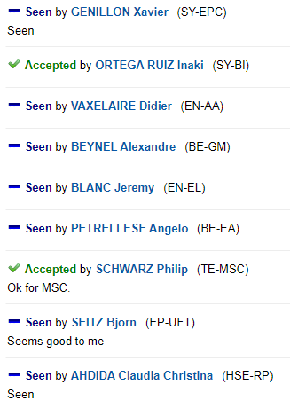
UR for Approval
SPSX-V-ES-0002
Version 0.2
User Requirements for the Vacuum System of the M2 Beamline in the North Area
By Silvia Schuh-Erhard
Seeking approval from EATM

Slide 17
Thank you!

