Slide 1
MTN.211128 incident and mitigation
TE-MSC
Philip Schwarz
26.11.2024

Slide 2
Incident and mitigation timeline
20.08.2024:
  CCC informed that circuit corresponding to 3 MTNs in 241 tripped due to excessive current-to-ground
  Fuse on converter was exchanged and operation restarted
  Magnet tripped again multiple times during the night, with accelerating frequency
  No increased water consumption of abnormal conductivity for the water was observed
28.08.2024:
  Access was possible and the circuit split between cables and magnet chain, confirming that the problem lies with the magnets
  Increase of tripping threshold from 100 mA to 160 mA

Slide 3
Incident and mitigation timeline (continued)
09.09.2024:
  The circuit did not trip since the incident and occasional measurements of the current-to-ground reveal current-to-ground well below the threshold of even 100 mA
  Installation of datalogger to monitor and record the development of current-to-ground
  Data logs shows hiking current (only sometimes above 100 mA), followed by a drop to lower levels
  Suggests a worsening problem
  Due to radiation environment, a closer investigation during the YETS was planned

Slide 4
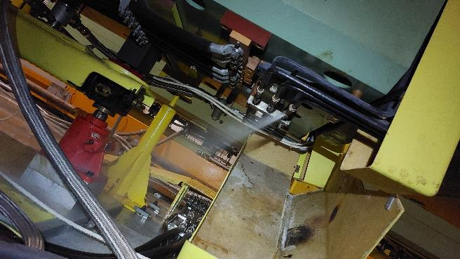
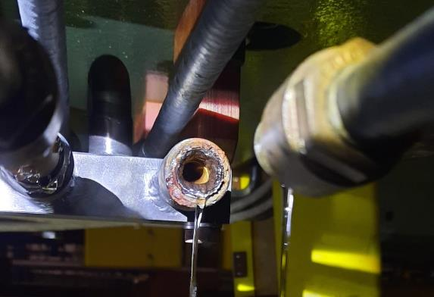
Incident and mitigation timeline (continued)
21.10.2024:
  CCC informed that a leak in the water circuit had caused a trip of the pumps
  Leak was significant enough as to not allow the continuation of the operation
22.10.2024:
  Access was granted and MTN.241128 found with a leak on a broken insulator
  Replacement of the insulator was not possible within exposure time limits, as part of the broken insulator remains gripped within the fixation nut
  In agreement with the beamline physicists, it was decided to remove the faulty magnet (MTN.241128) from the circuit, as the remaining two magnets were sufficient to enable ion operation

Slide 5
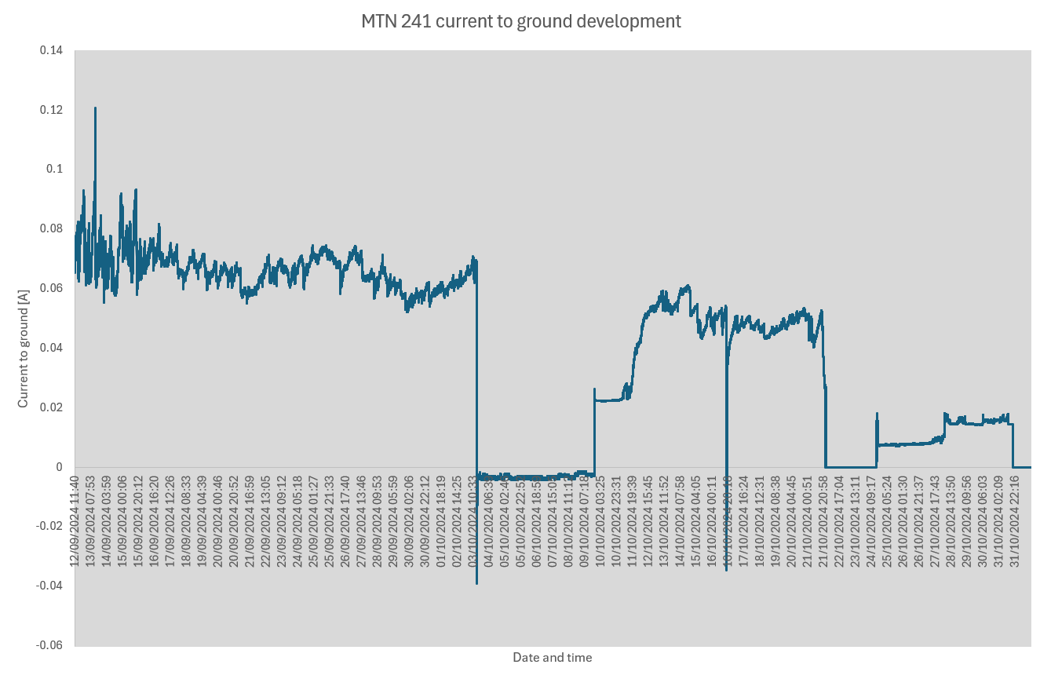
Situation now and future actions
Operation was continued with the magnet removed
  A significant improvement can be observed in the current-to-ground development after the intervention
  The current-to-ground levels seem much more in line with typically observed levels
MTN.241128 will be exchanged during the YETS
Broken insulator and neighbouring insulators will be analysed for cause of (apparent) corrosion

Slide 6
Questions?
Thanks to all involved groups for their support,
enabling a quick mitigation of the problem!

