Slide 1
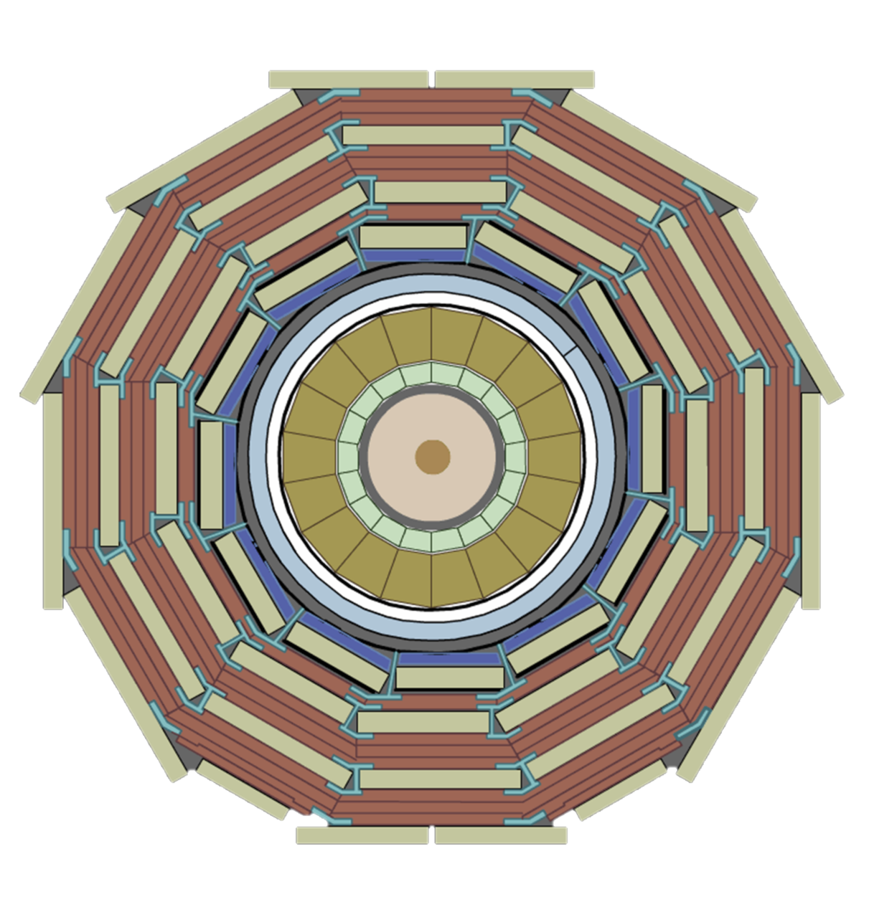


LVPS – Low Voltage Power Supply for the CMS detector
Use of magnet for environmental qalification test.
+
-
Krzysztof Stachon
26/11/2024

Slide 2
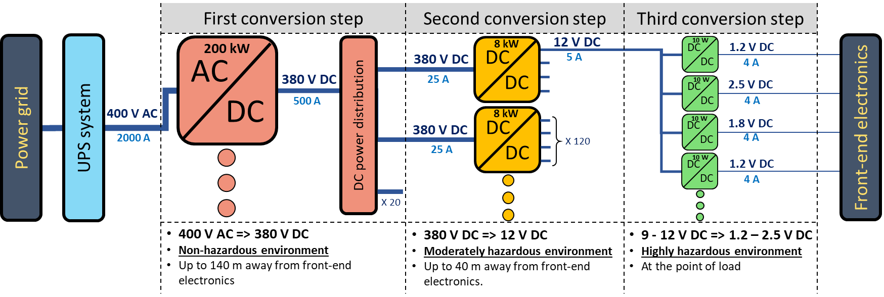
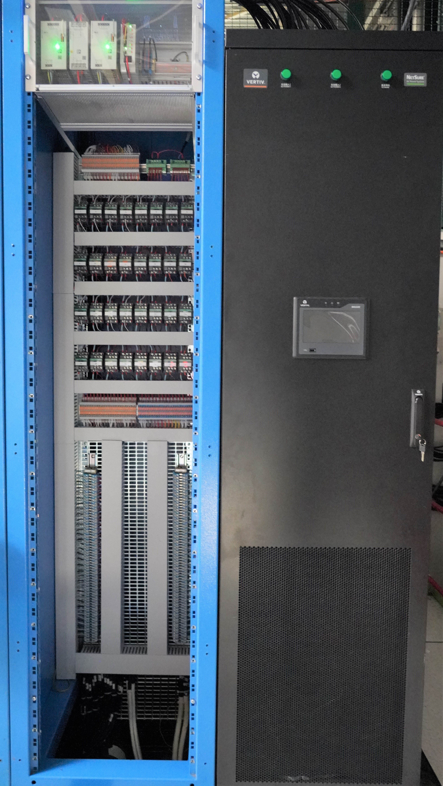
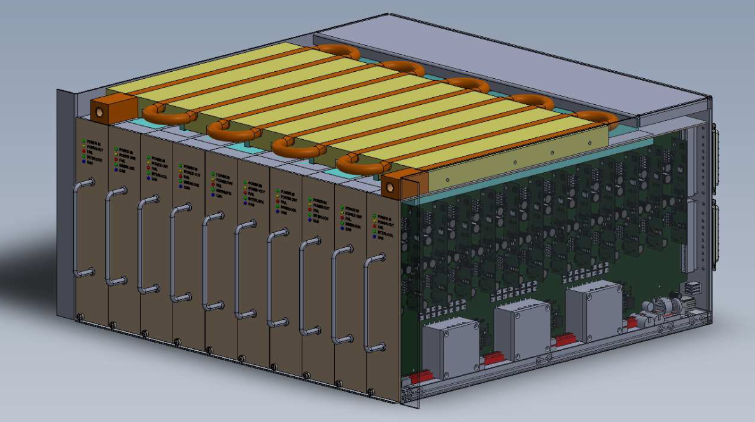
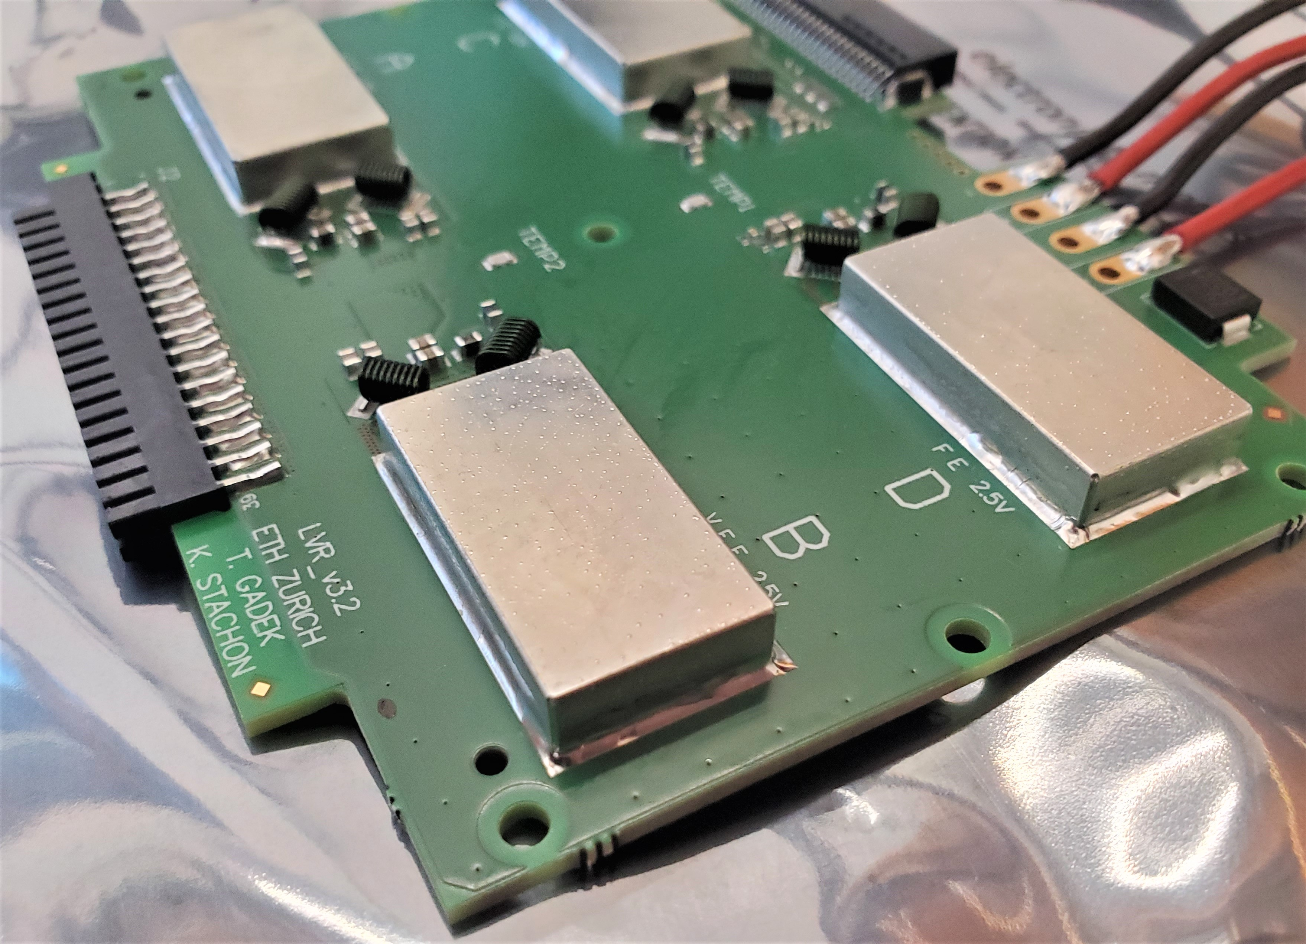


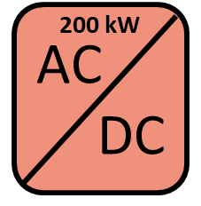
CMS power conversion chain
CMS SERVICE CAVERN
100 m
20-40 m
A small scale prototype of the first conversion step. It is composed of: a a power cabinet (right) and a distribution cabinet (left).
Visualization of radiation-tolerant implementation of the second conversion step. This device will be located in experimental cavern, where radiation is present. .
A photo of the PCB acting as the third conversions step in EB subdetector. It hosts four radiation-hard DC-DC converters called bPOL12V.

Slide 3
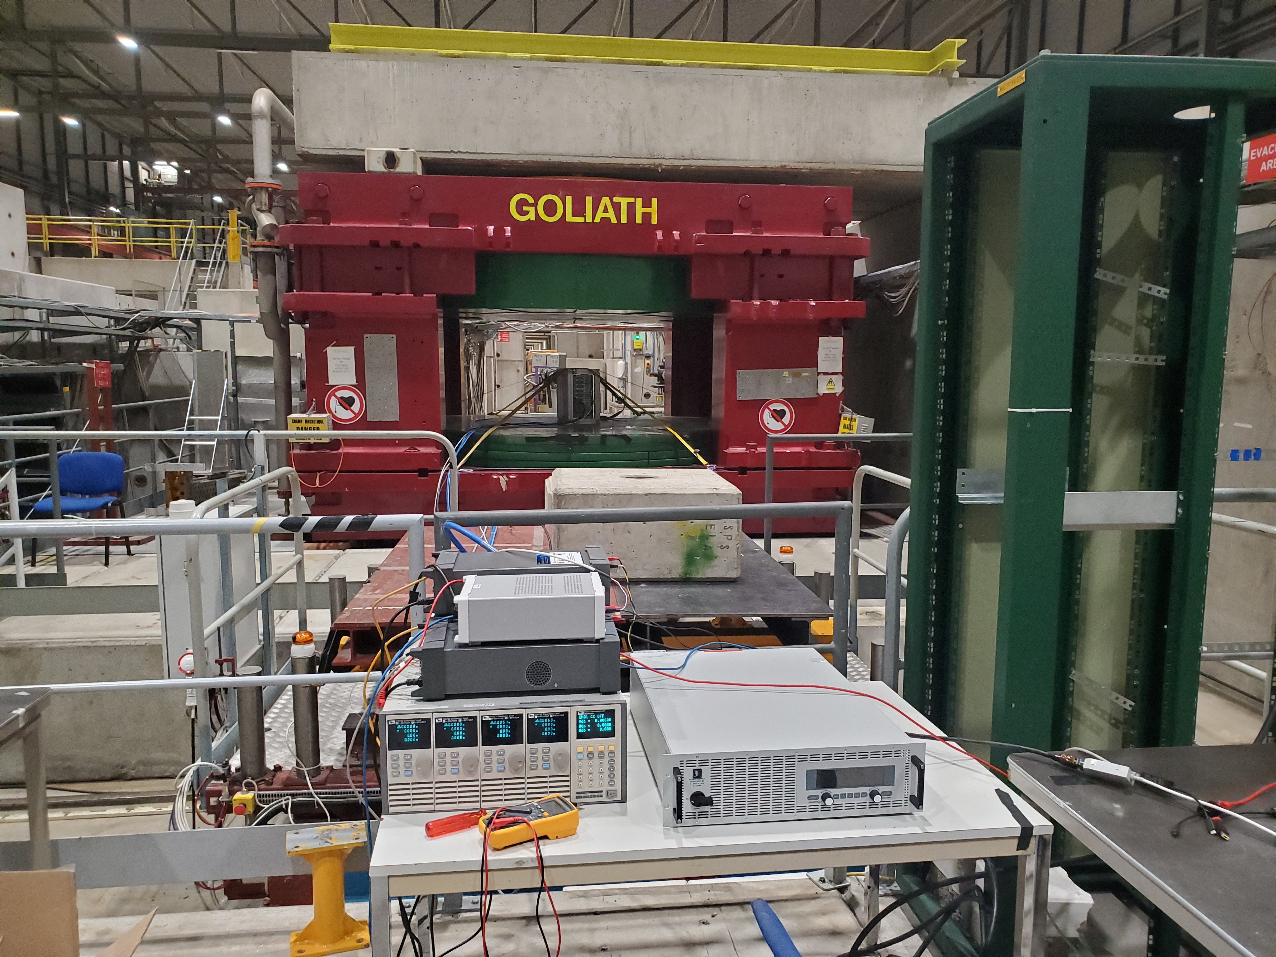
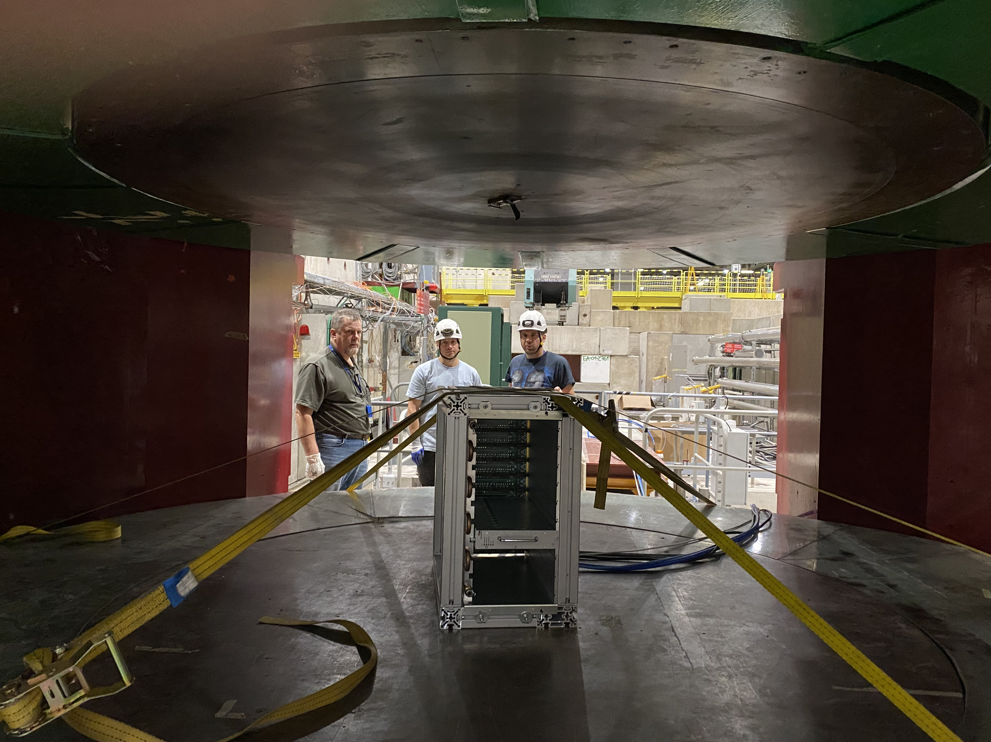
LVPS: Magnetic field tollerance testing
2-3 November 2023 – full system-level magnetic field test at Goliath magnet.
  Results: did not pass. More info: next slides.
Repetition of the test desired: preferably: 5 days within 20 January – 7 Febuary 2024 due to manpower availability these dates.
Requirements:
  Up to 160 mT in 20 mT increments
  Minimum aperture size to test in 3 orientations: 650 mm
  Electrical needs:
    1 x 3-phase 16 A (32 A socket would also be good) with max consumption of 1 kW
    1 x 230V standard socket, 10A
    One table for laboratory equipment
  Full access to the magnet (no beampipe in the aperture)
  Optionally: magnetic field probe to cross-check magnetic field value.
B-field direction

Slide 4
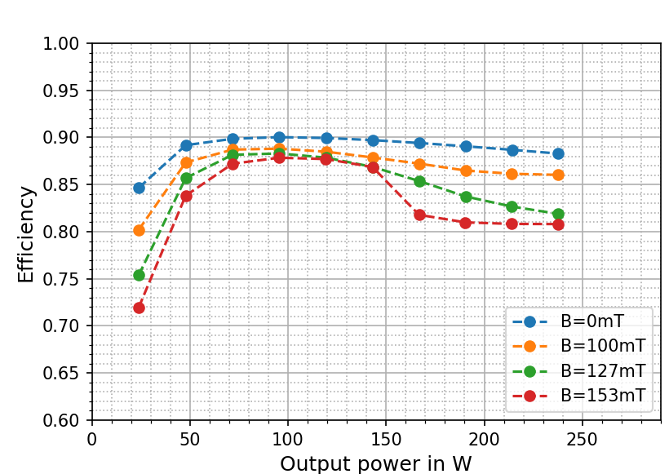
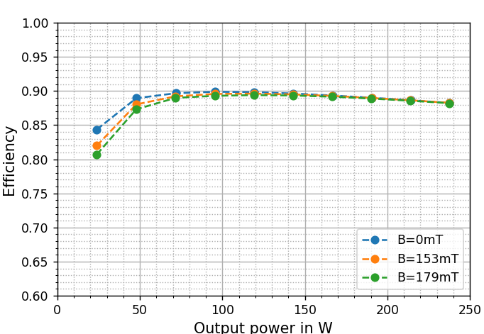
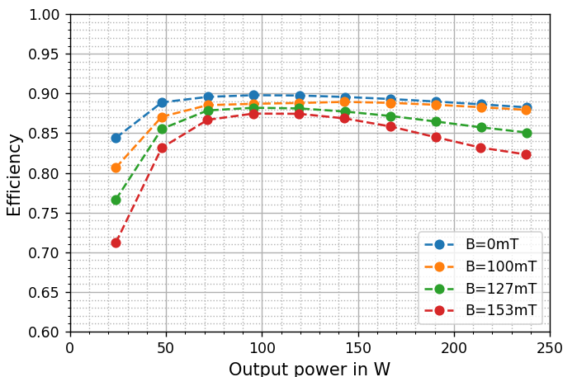
Results
z - orientation
Efficiency
Output power / Input power
Calculated from measured input and output voltages
V_{in} = 380V
Correct for idle current: 0.078A
Requirement
>88% at > 40% of full load = 96 W
> 40% full load
B-field
Module
M6 120W
2-channels aggregate = 1 LLC
Output power = 240W
y
z
x
x - orientation
> 40% full load
y - orientation
> 40% full load
Results
x: ok
y: not ok (B >~ 90mT)
z: not ok (B >~ 90mT)

Slide 5

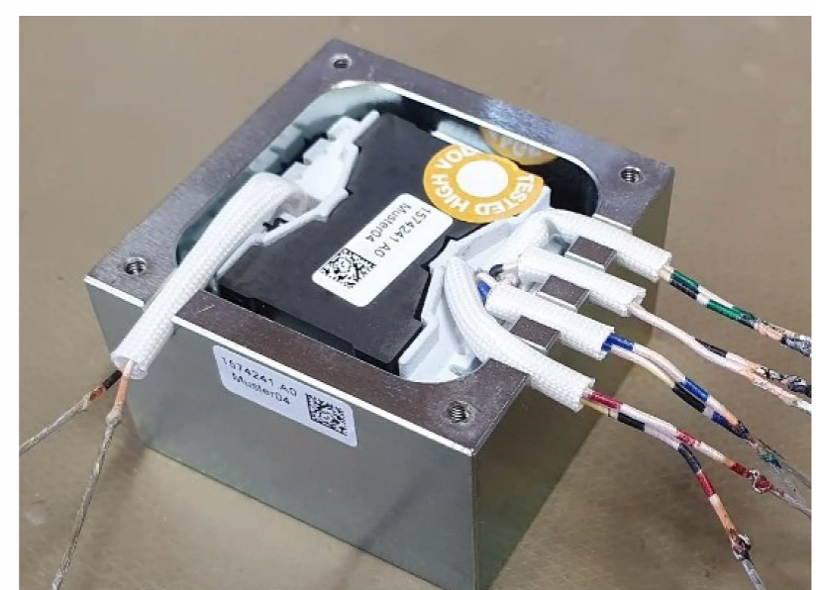
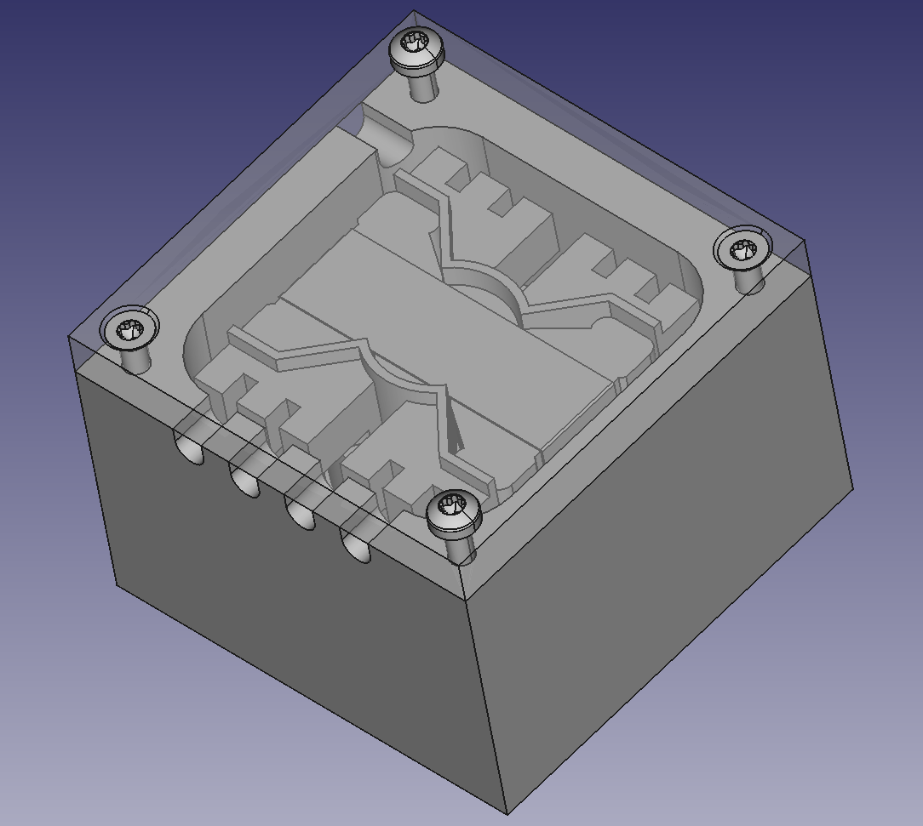
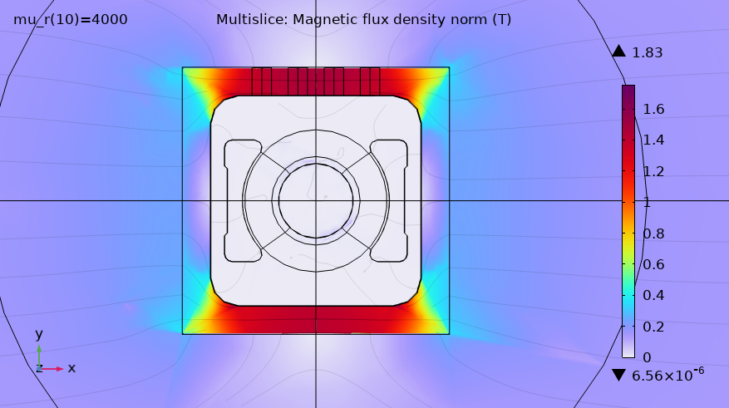
Study supported with computer simulations.
COMSOL Multiphysics used for simulation
Shield – saturation? ➔ NO
5mm thick high purity iron
Peak flux density ~1.8T at ~120mT external field
Flux penetration into inductor core? ➔ YES
Core relative permeability: µ_{r} ~ 3000
Shield no annealing: µ_{r} < 2500
Mitigation
Thermal annealing of the shield
Extended duty-cycle range of the PWM circuitry preventing oscillations.

Slide 6
Thank you for your attention
Contact
Krzysztof Stachon
krzysztof.stachon@cern.ch

