Slide 1
DRD8 Collaboration Meeting
Concluding Remarks
June 20, 2025
Burkhard Schmidt

Slide 2
General remarks
DRD8 has at present 40 participating Institutes and about 100 collaborators.
New Institutes are welcome, provided they indicate to which Work Package they wish to contribute and what are the resources they will provide.
  Small resources are appreciated as well!
  DRD8 has no entrance fees nor Common Fund contributions.
We are open minded to add further Work Packages related to Mechanics and Cooling for Vertex and Tracking Systems, e.g. on Gas based tracking detectors.
We are aware that R&D on large area gas detectors has been revived for future e⁺e⁻ colliders (FCC-ee and CepC).
  Projects related to such R&D should be clearly defined, together with Milestones and Deliverables. We will get a presentation later on this morning.
For a WP related to mechanics for Calorimeters it seems to be still too early

Slide 3
Memorandum of Understanding (MoU) for the DRD collaborations
MoU Core Part → Common to all DRDs
  This part has recently been finalized by Helge Meinhard from CERN. It takes into account most of the feedback received from the large national Funding Agencies. However, some FAs indicated that they will not sign it…
MoU Annexes → Specific of each DRD
  This part is under preparation following largely the example of DRD1. We should try to make it as easy as possible to sign for the FAs. Hopefully, the approval process can be launched in the coming months.
It has been a painful process to reach the present version of the MoU…
The MoU for DRD1 has been finalized and is about to be send to the FAs

Slide 4
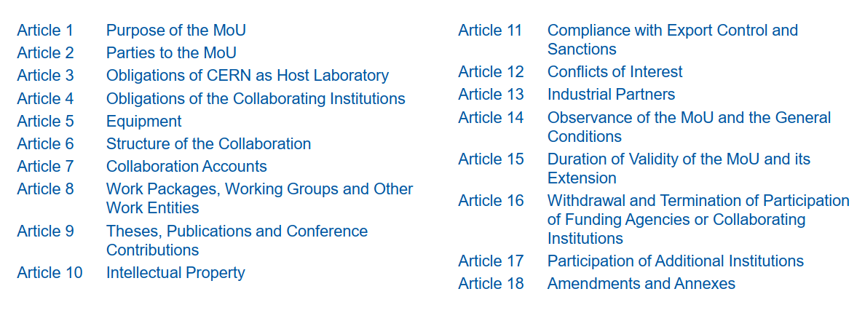
List of Articles (Core part)

Slide 5
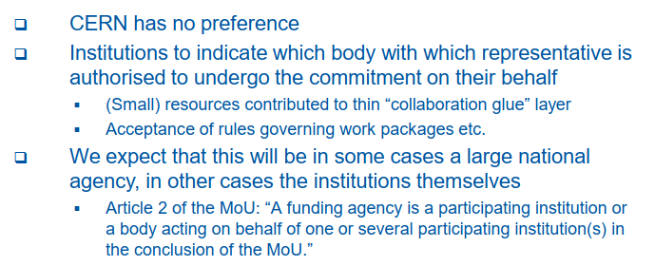
Who Signs the MoU?

Slide 6
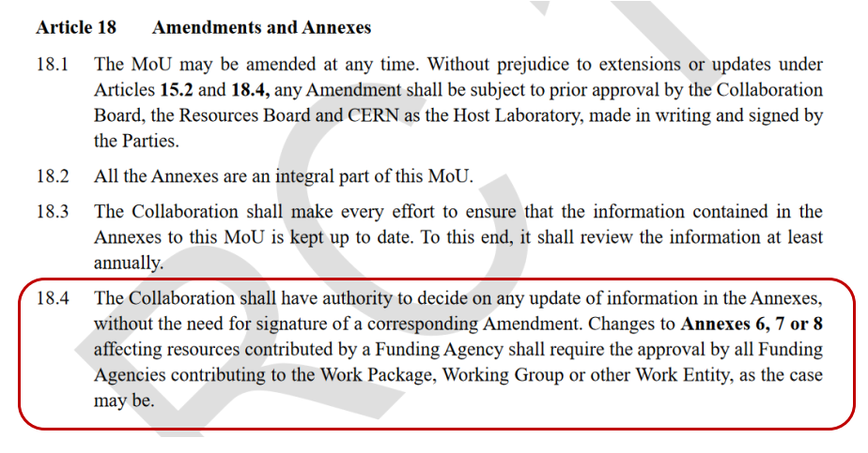
Amendments and Annexes

Slide 7
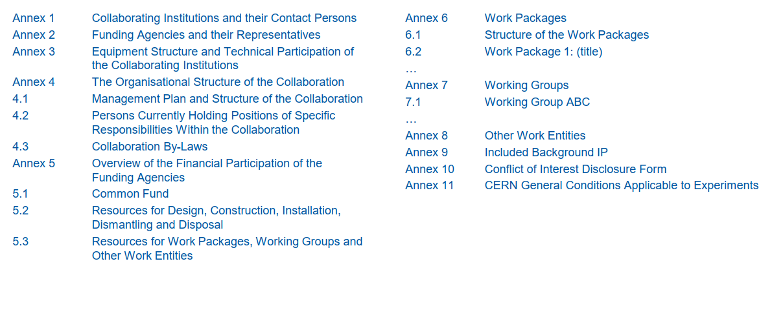
List of Annexes

Slide 8
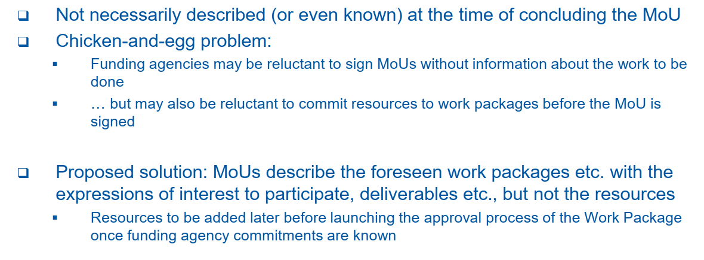
Resources for the Work Packages

Slide 9
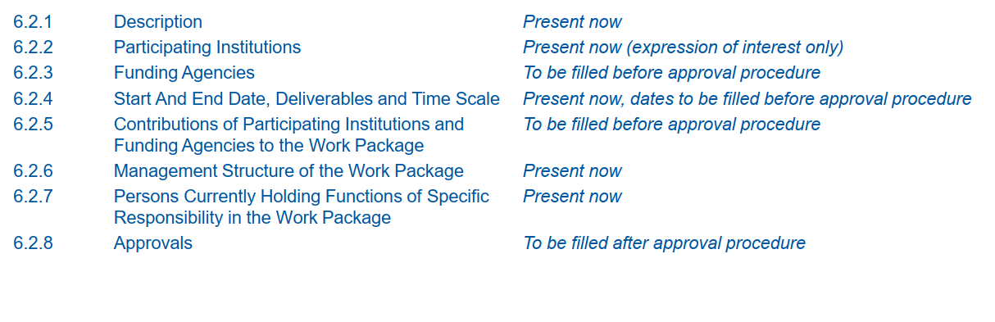
Work Packages in the MoU
of the WP!
of the WP!

Slide 10
Report from the Technical Committee
To advance with the various sections of Annex 6 of the MoU, we need to get confirmation from the institutes who indicated interest to contribute to a WP that they maintain their interest to contribute.
  In the coming weeks the WP conveners will contact the institute leaders who expressed interest to contribute to a WP to confirm their interest.
  At this stage we only need the expression of interest, not indication of resources is needed
  The institutes should follow-up with their FA about the intended resources
Adjustments might be needed regarding Milestones and Deliverables.
  We should not change the goals of the intended R&D but rather delay the achievement of a Milestone resp. a Deliverable where needed.
  As T₀ for a Milestone resp. a Deliverable we might take the time when the MoU is signed, i.e. this autumn, e.g. September.

Slide 11
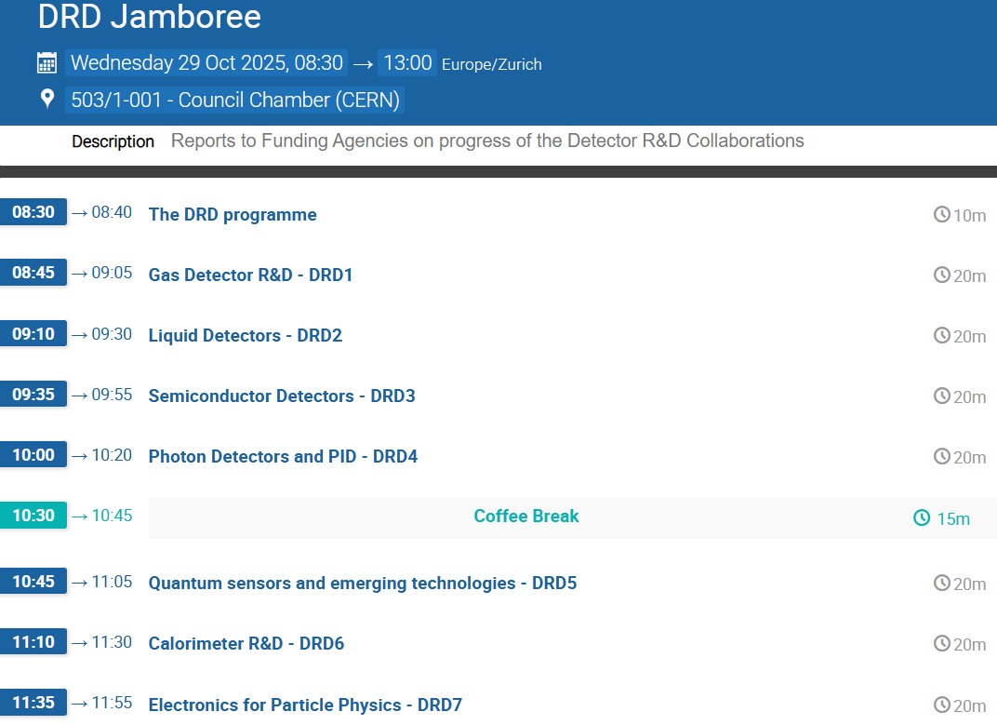
Next Collaboration Meeting
The Technical Committee suggest to
have the next Collaboration Meeting
around October 15, about two weeks
before the DRD Jamboree.
By that time the MoU should be already
in the hands of the Funding Agencies and
Hopefully signed by some.

