Slide 1

Conceptual Considerations for the Installation and Key Technical Challenges of the CEPC Detector
Quan JI, Haoyu SHI(IHEP, CAS)
DRD8 Collaboration Meeting, 2025
June 20th, 2025, The University of Bristol, Bristol, UK

Slide 2
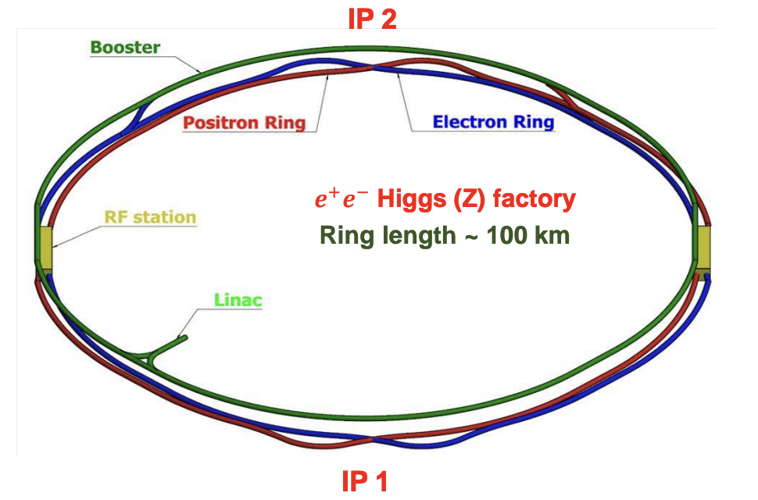
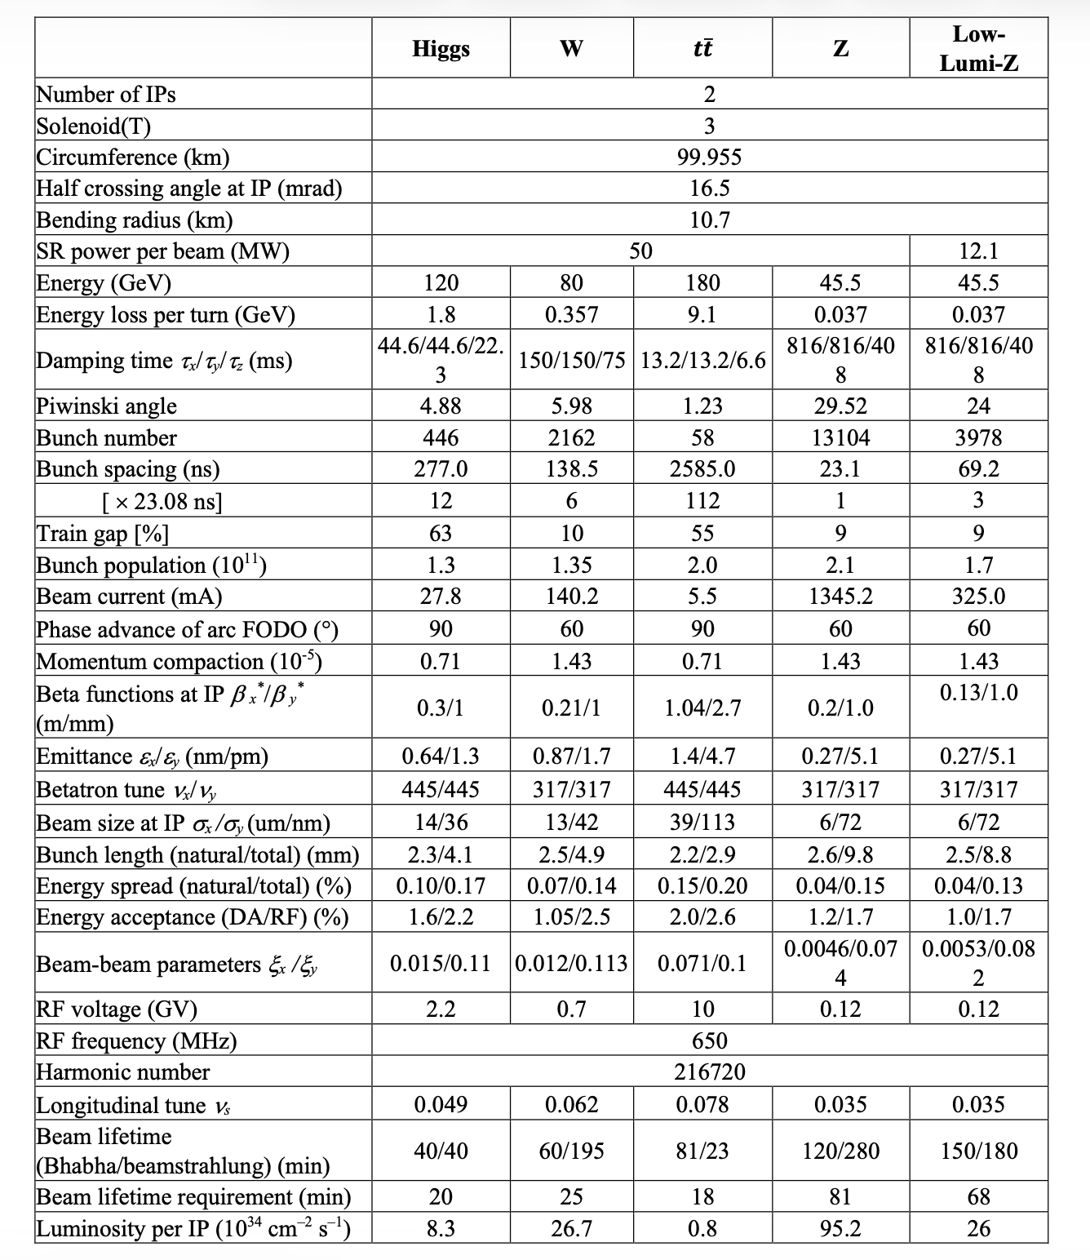
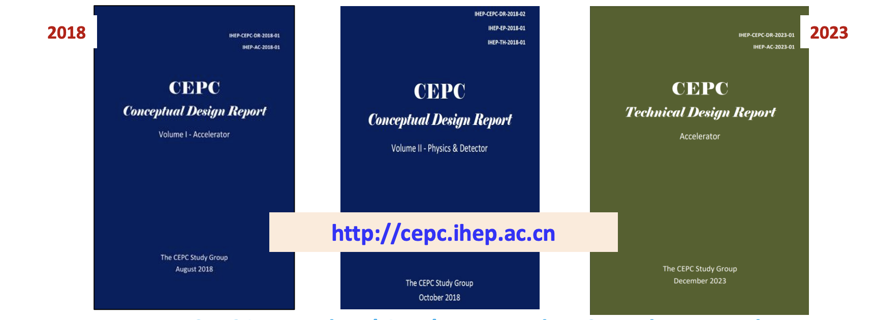
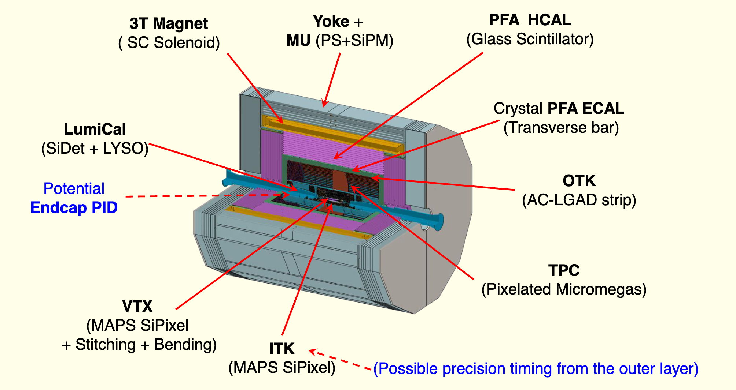
Circular Electron-Positron Collider(CEPC)
CEPC Ref. Detector
CEPC Acc. Parameters @ 2025

Slide 3
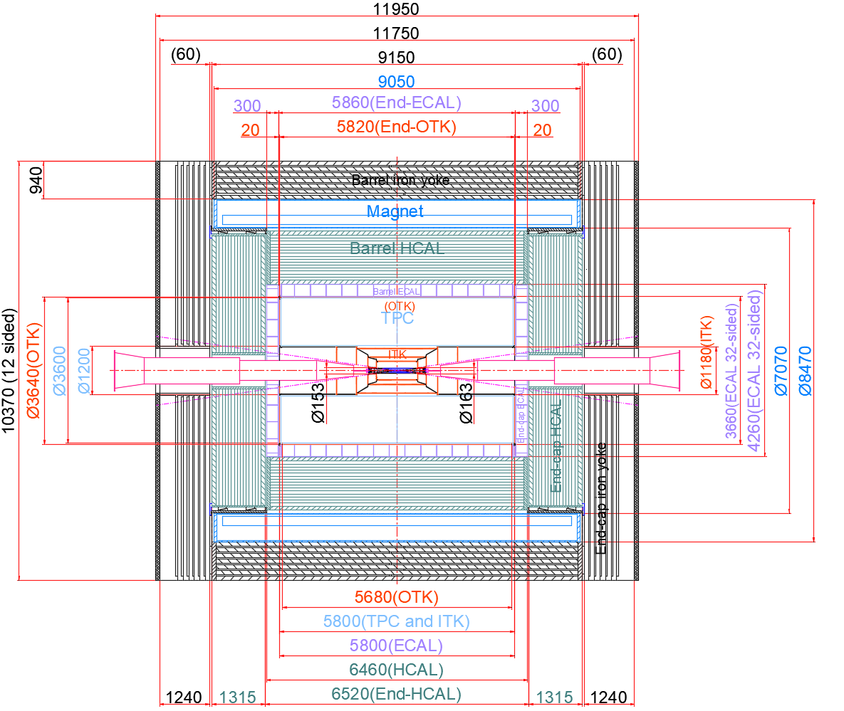
Geometry and Mechanical Support
Sub-System | Supported by
Barrel Yoke | Base
Magnet | Barrel Yoke
Barrel HCal | Barrel Yoke
Barrel ECal | Barrel HCal
TPC + Barrel OTK | Barrel ECal
ITK | TPC
Beampipe + VTX + LumiCal | ITK
Endcap Yoke | Base
Endcap HCal | Barrel HCal
Endcap ECal + OTK | Barrel ECal
Detector Overall
Length: 11,950 mm
Height: 10,370 mm
Weight: 5,290 t

Slide 4
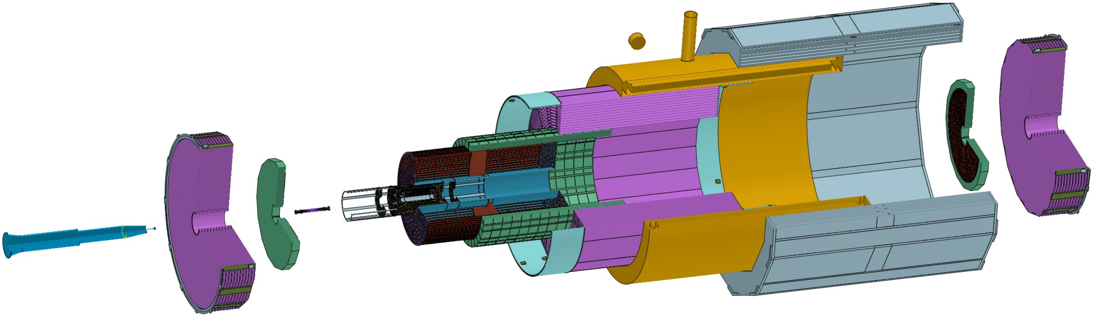
Sub-detector Installation Sequence
1) Install the barrel sub-detector in the following order :
Yoke, Magnet, HCAL, ECAL, TPC(OTK), ITK, Beampipe(Vertex)
2) Install the endcaps in the following order :
End ECAL(OTK), End HCAL, End Yoke
Easy to install, Easy to repair, Easy to replace
ACC Component
Beampipe
(Vertex)
End HCAL
End ECAL(OTK)
ITK
TPC(OTK)
ECAL
HCAL
Magnet
Yoke

Slide 5
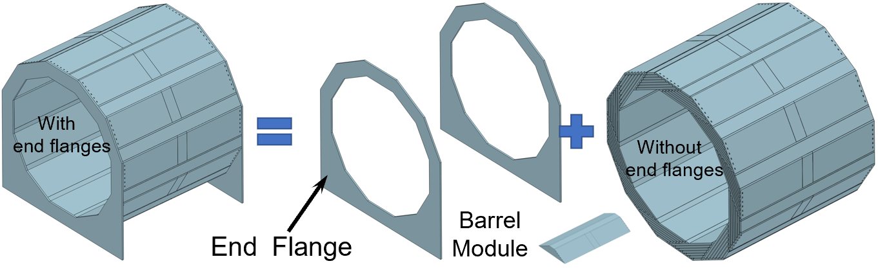
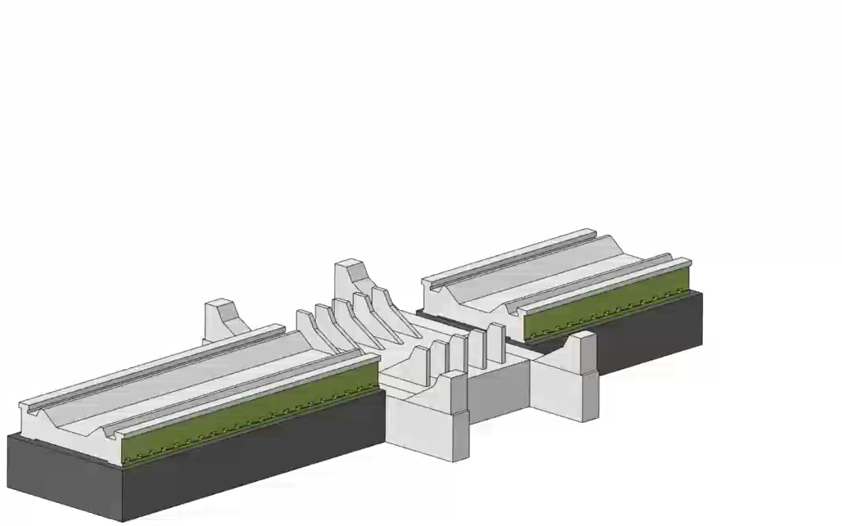
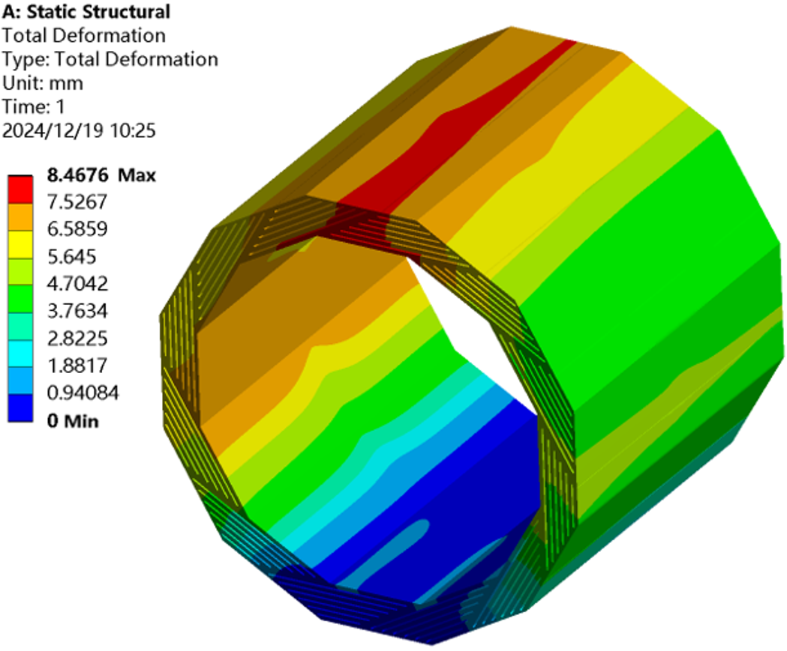
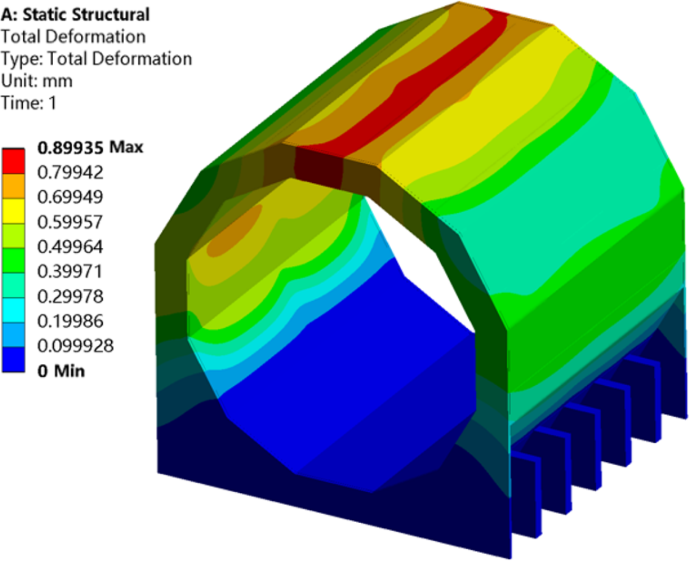
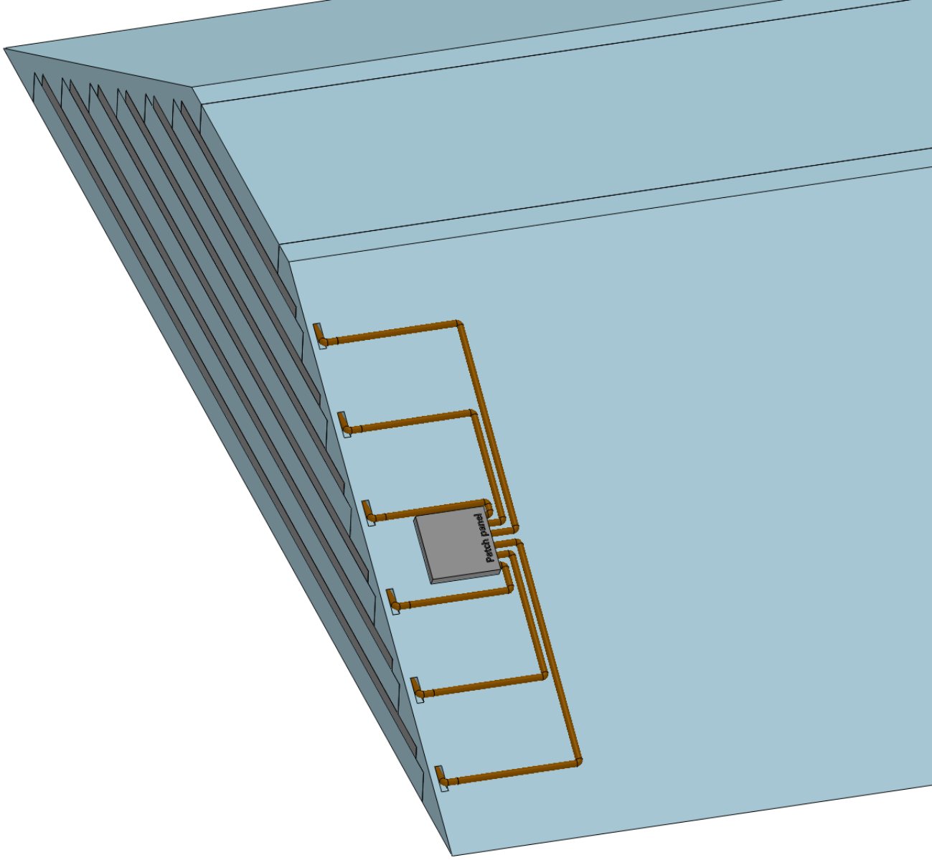
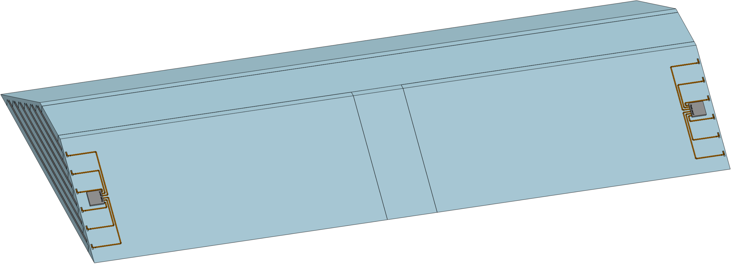
Inter supporting between the barrel modules
Inter-supporting connection structure design
makes zero auxiliary tooling assembly possible
Installation design of "zero auxiliary tooling"
CITIC Heavy Industries
Deformation
8.5 mm--> 0.9mm
Requires such design:
Each layer of muon detectors
converges into a single HDMI c able
Barrel Yoke Module

Slide 6
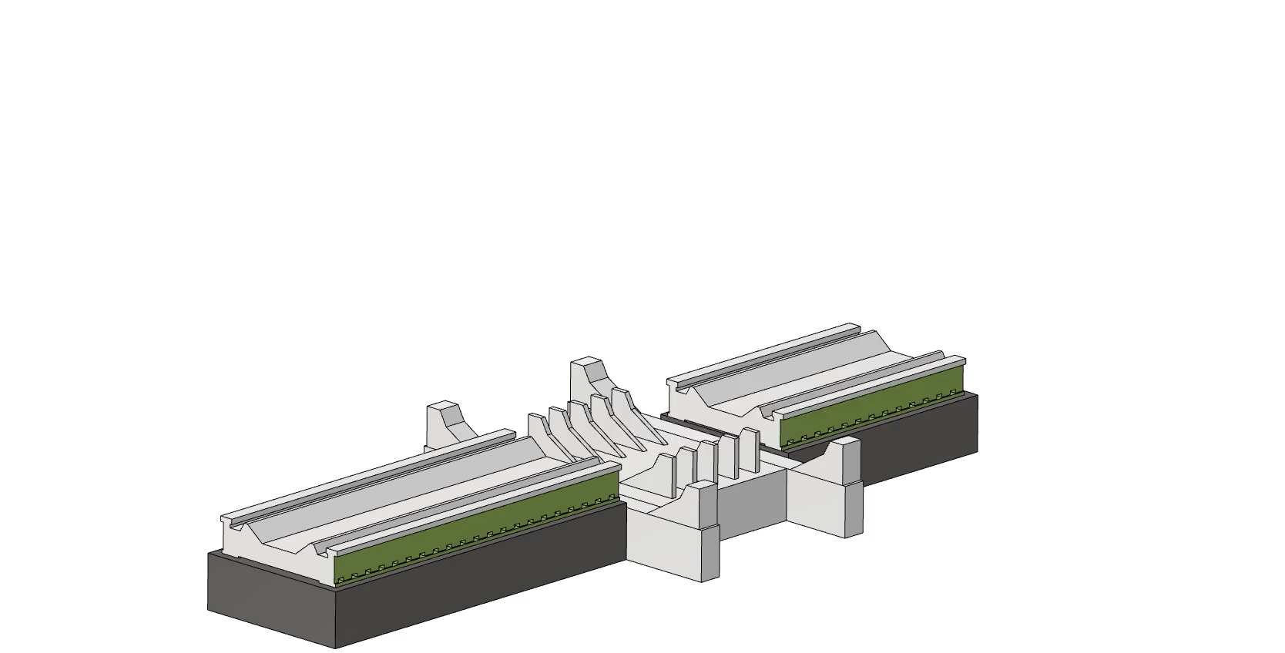
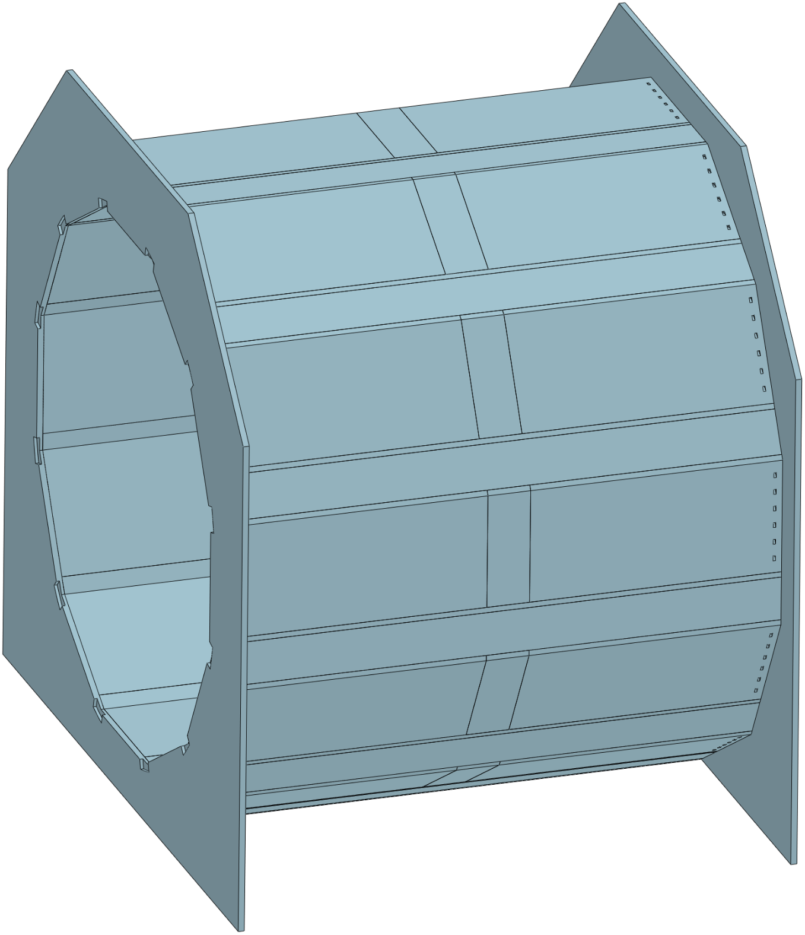
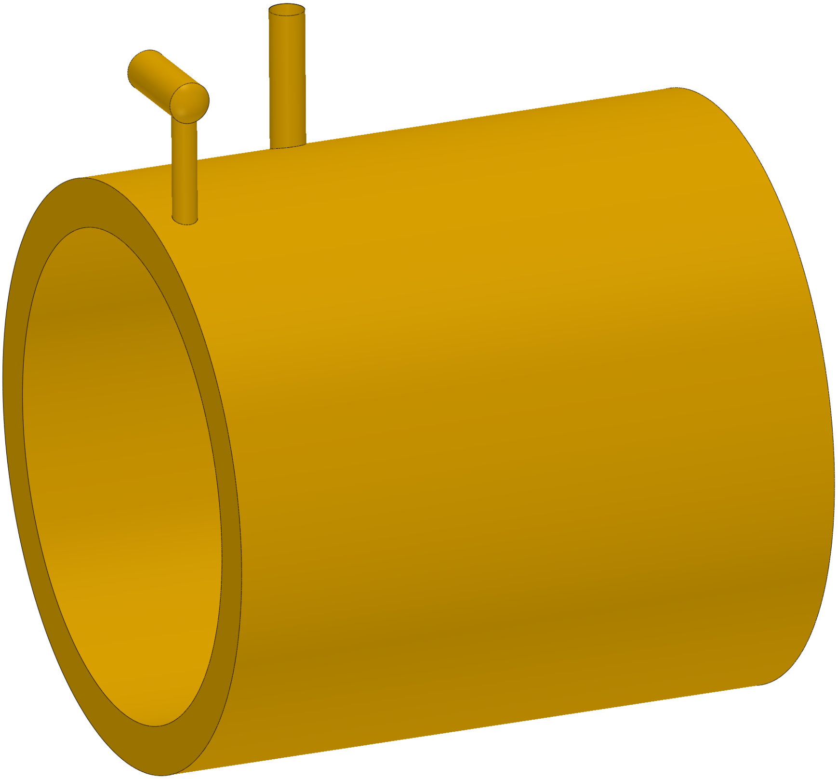
Installation of Barrel Yoke and Magnet
Inter-supporting connection structure design
makes zero auxiliary tooling assembly possible
Installation design of "zero auxiliary tooling"
CITIC Heavy Industries
Barrel Yoke
Requires such design:
Barrel Yoke Module
Each layer of muon detectors
converges into a single HDMI c able
Magnet

Slide 7
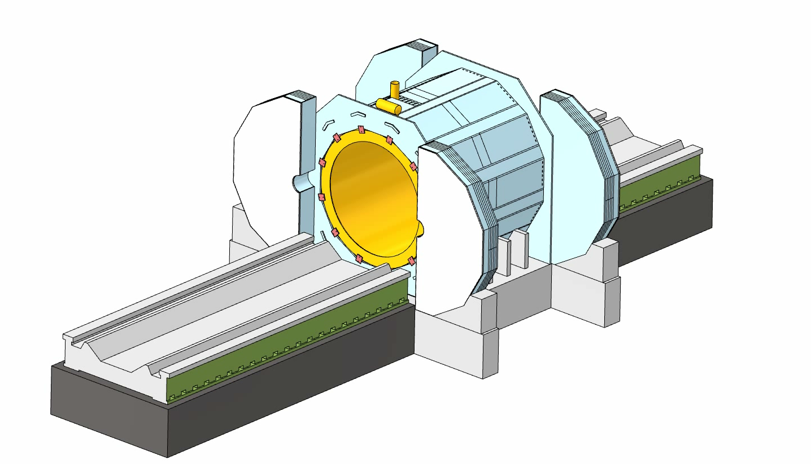
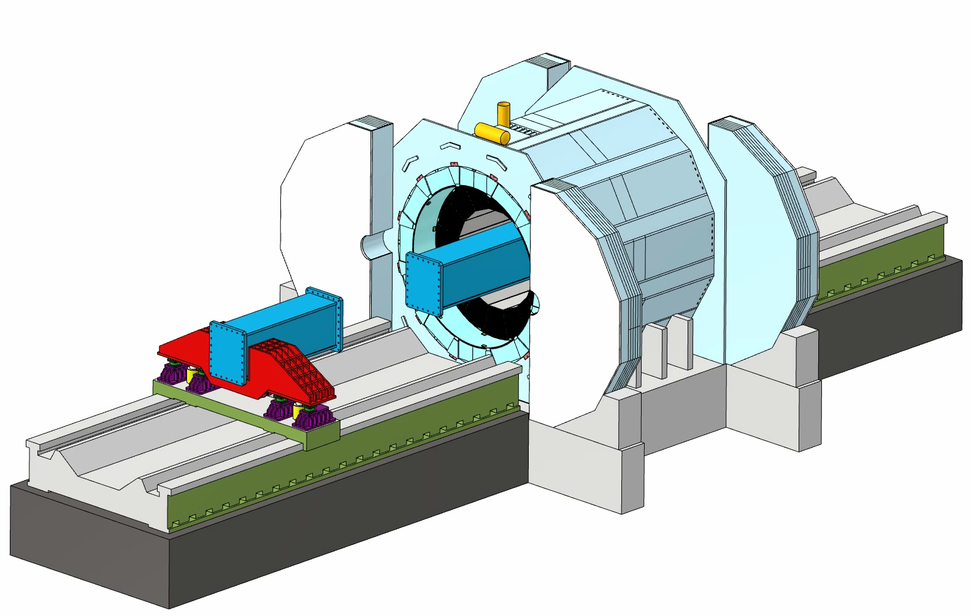
Installation of the Barrel HCal and ECal
Core shaft installation
CITIC Heavy Industries
Install the Barrel HCAL
Install the Barrel ECAL

Slide 8
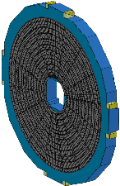
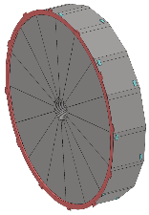
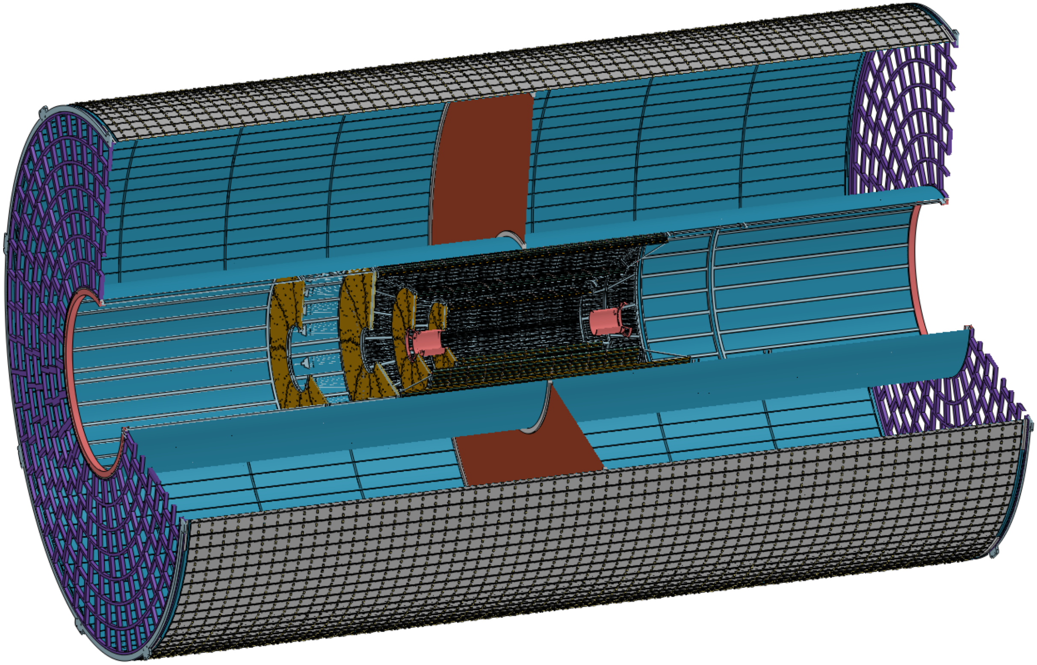
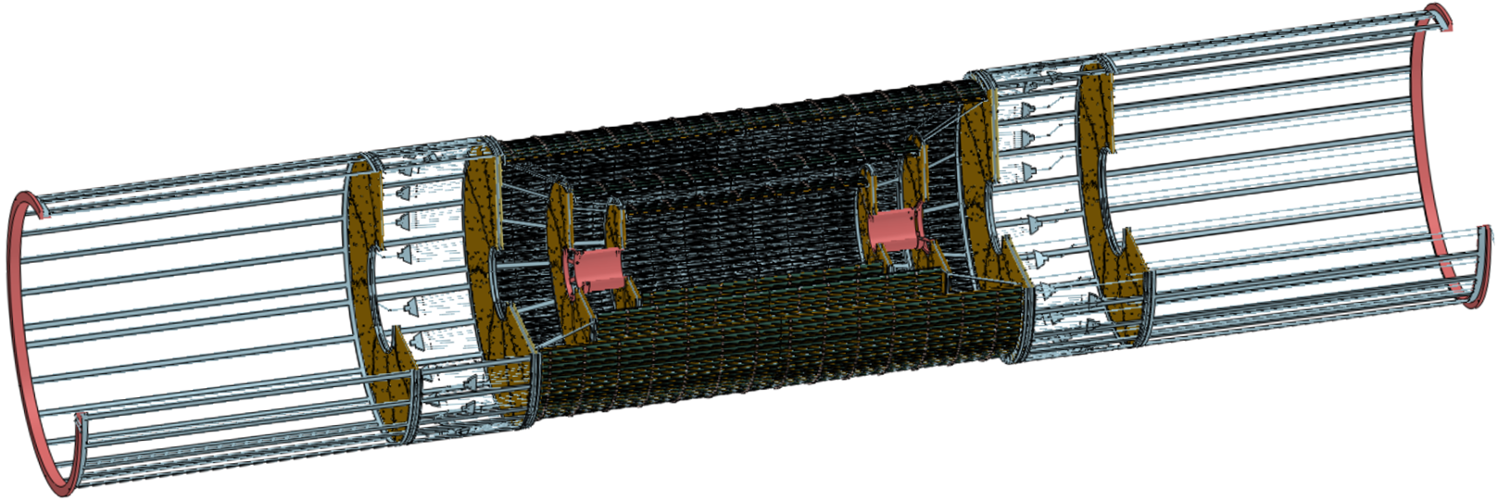
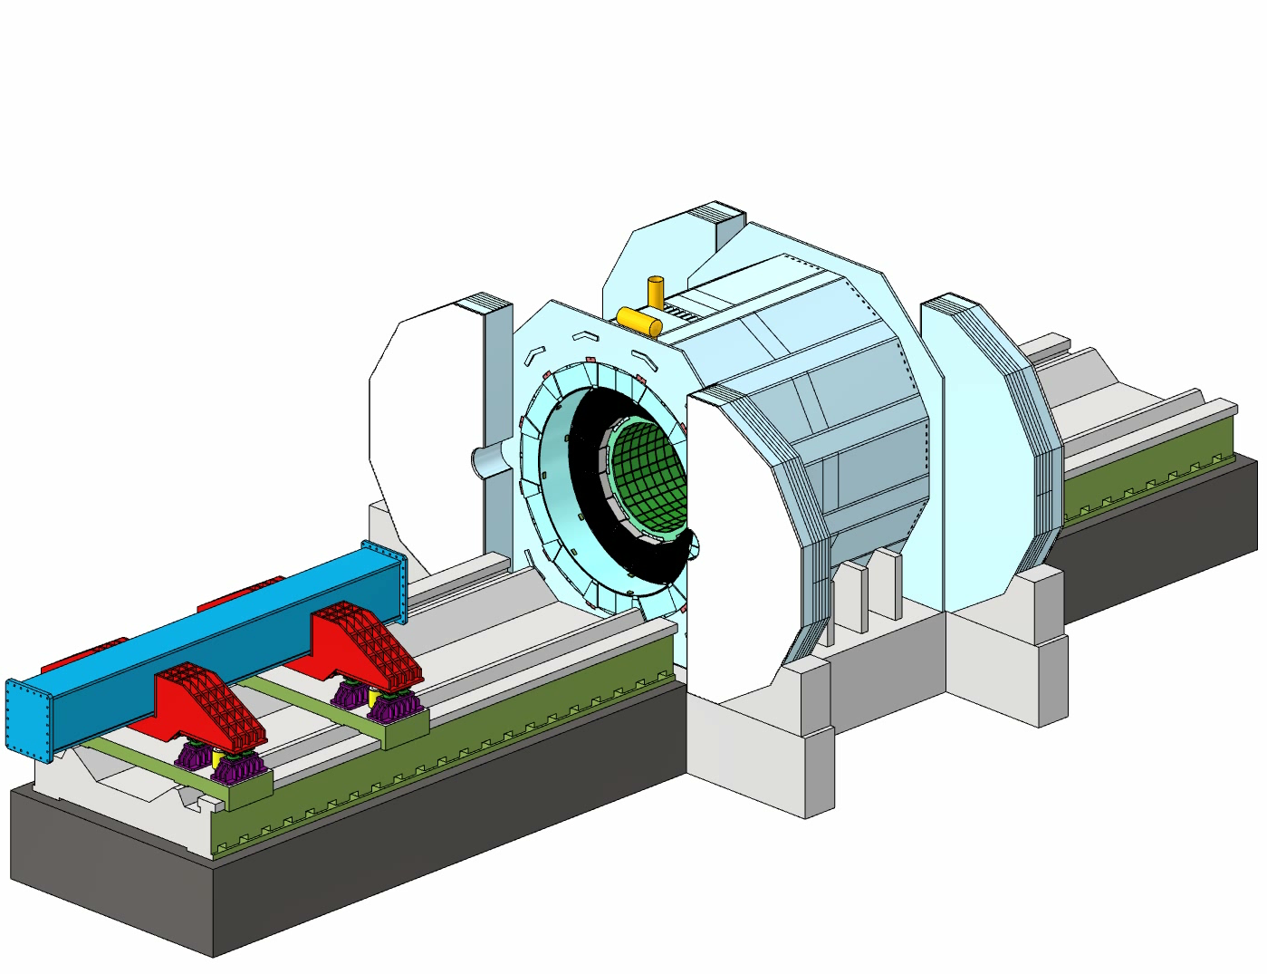
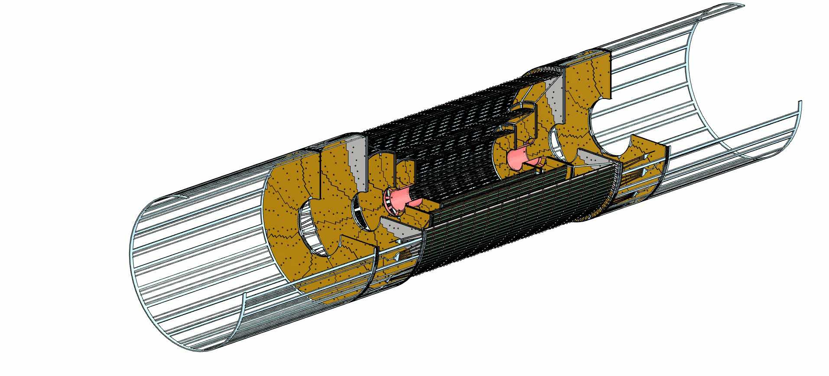
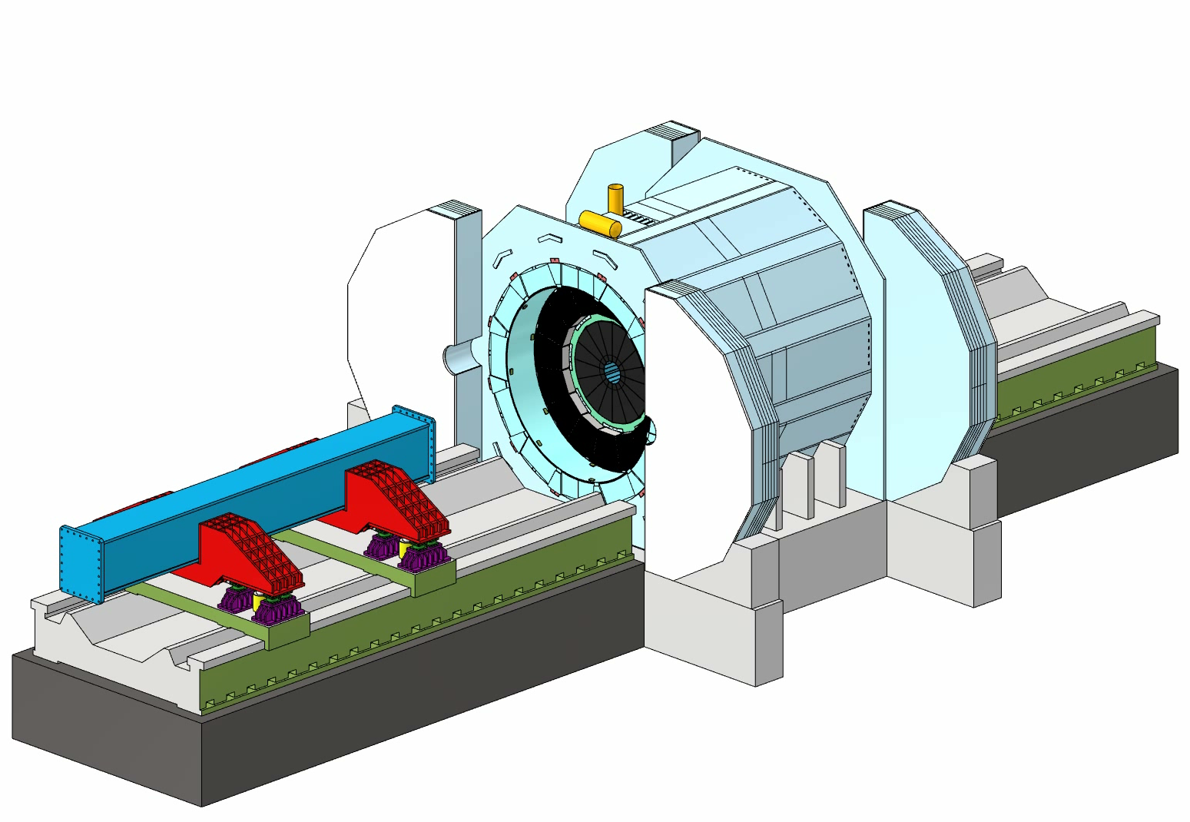
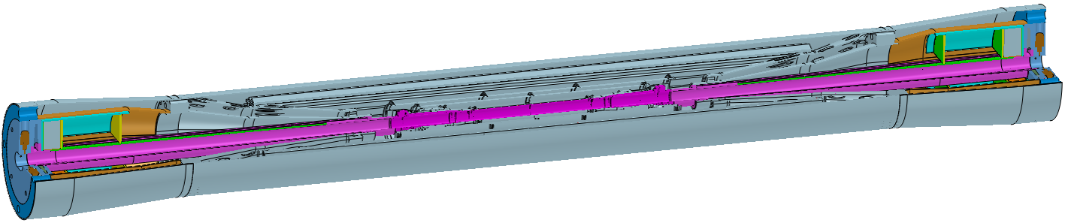
Installation of other detectors
CITIC Heavy Industries
Pre-assemble the near-end ring
Minimal installation steps
Pre-assembly
of Beampipe and ITK
Install the TPC(+OTK) and ITK(+Beampipe)
Install the End ECAL and End HCAL
Reduce the installation difficulty
of the Beampipe

Slide 9
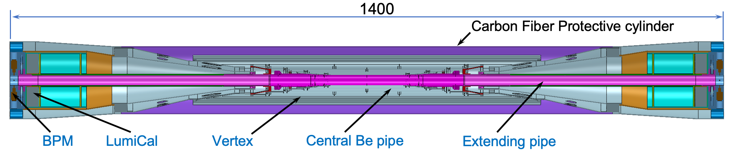
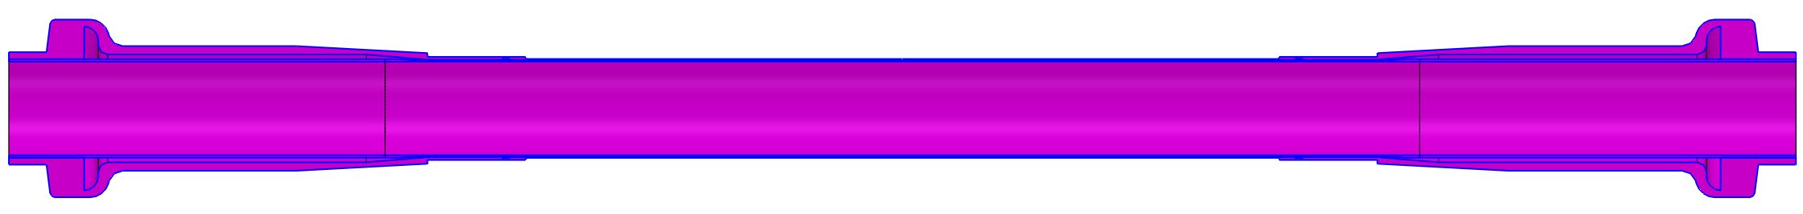
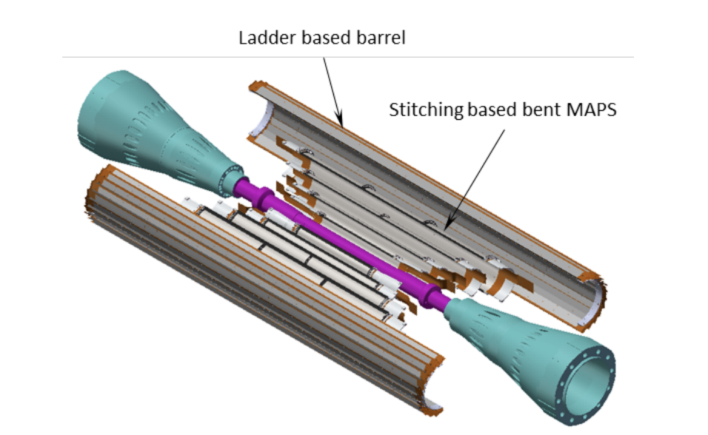
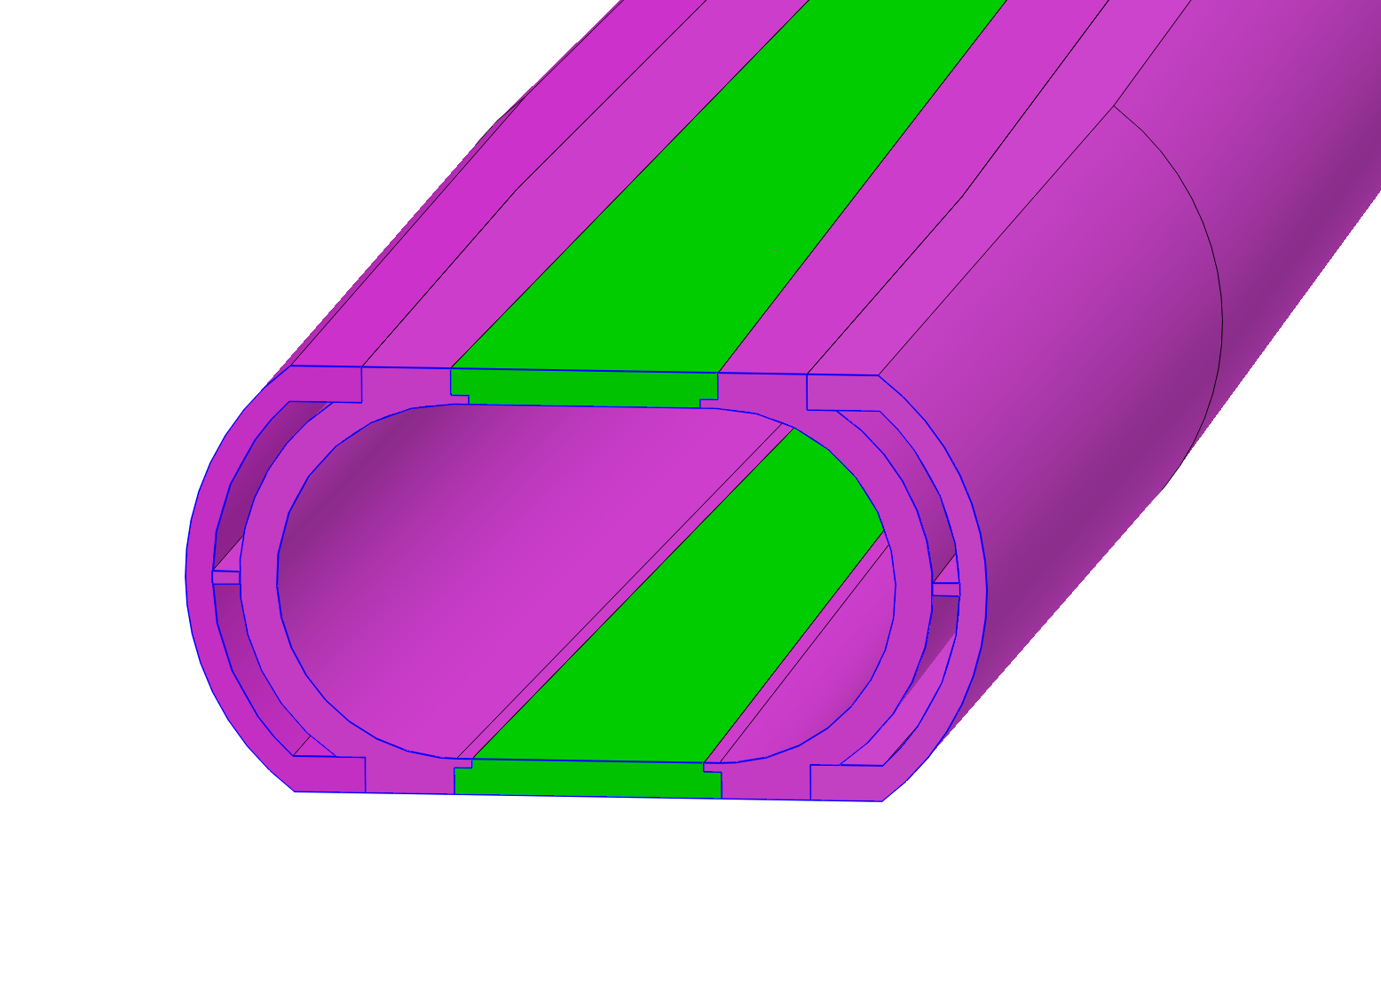
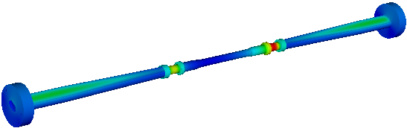

Design of the Beampipe and VTX
Central Beam pipe at the CEPC
  Single Beam pipe has a total length of 1.4 m
  Racetrack design @ Extending pipe implemented
Central Be pipe
  20 mm inner diameter
  The inner layer has a thickness of 0.20 mm
  The outer layer has a thickness of 0.15 mm
  The gap for coolant has a thickness of 0.2 mm with water or 0.3 mm with paraffin
  Material Budget: ~0.15% X/X₀
  For shielding the SR, a gold coating with thickness of ~5 µm is used(~0.30% X/X₀ in total)
Extending Al pipe
  Be window implemented for LumiCal
  Active water cooling
Vertex
  Stitching based bent MAPS + Ladder based barrel
Highest @ Z:
1200 W in total

Slide 10
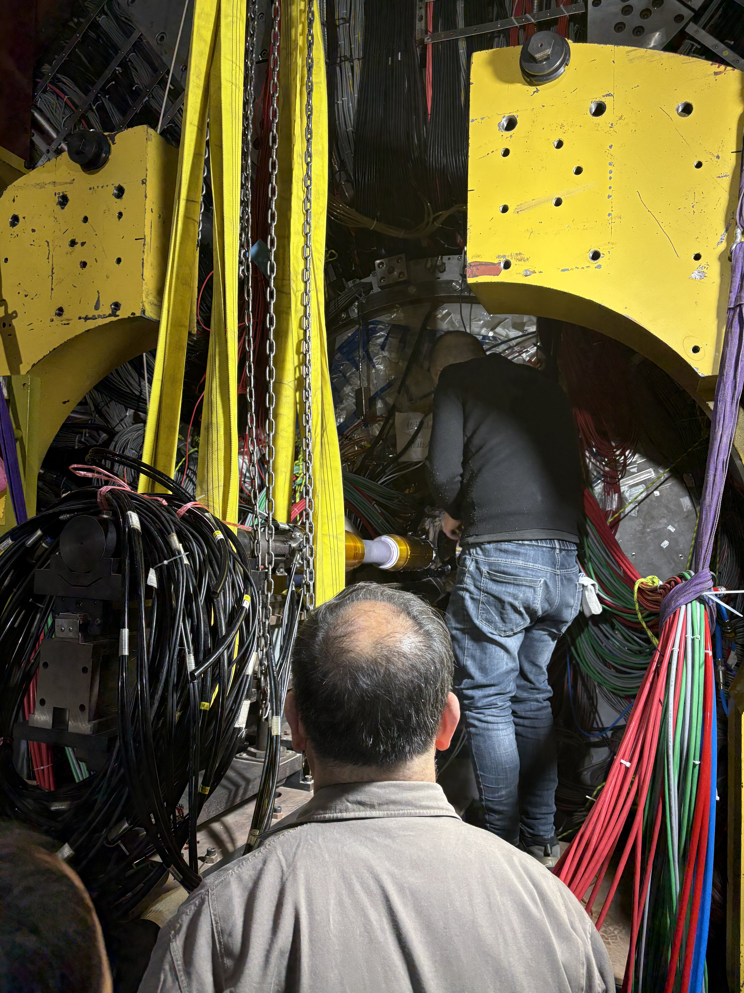
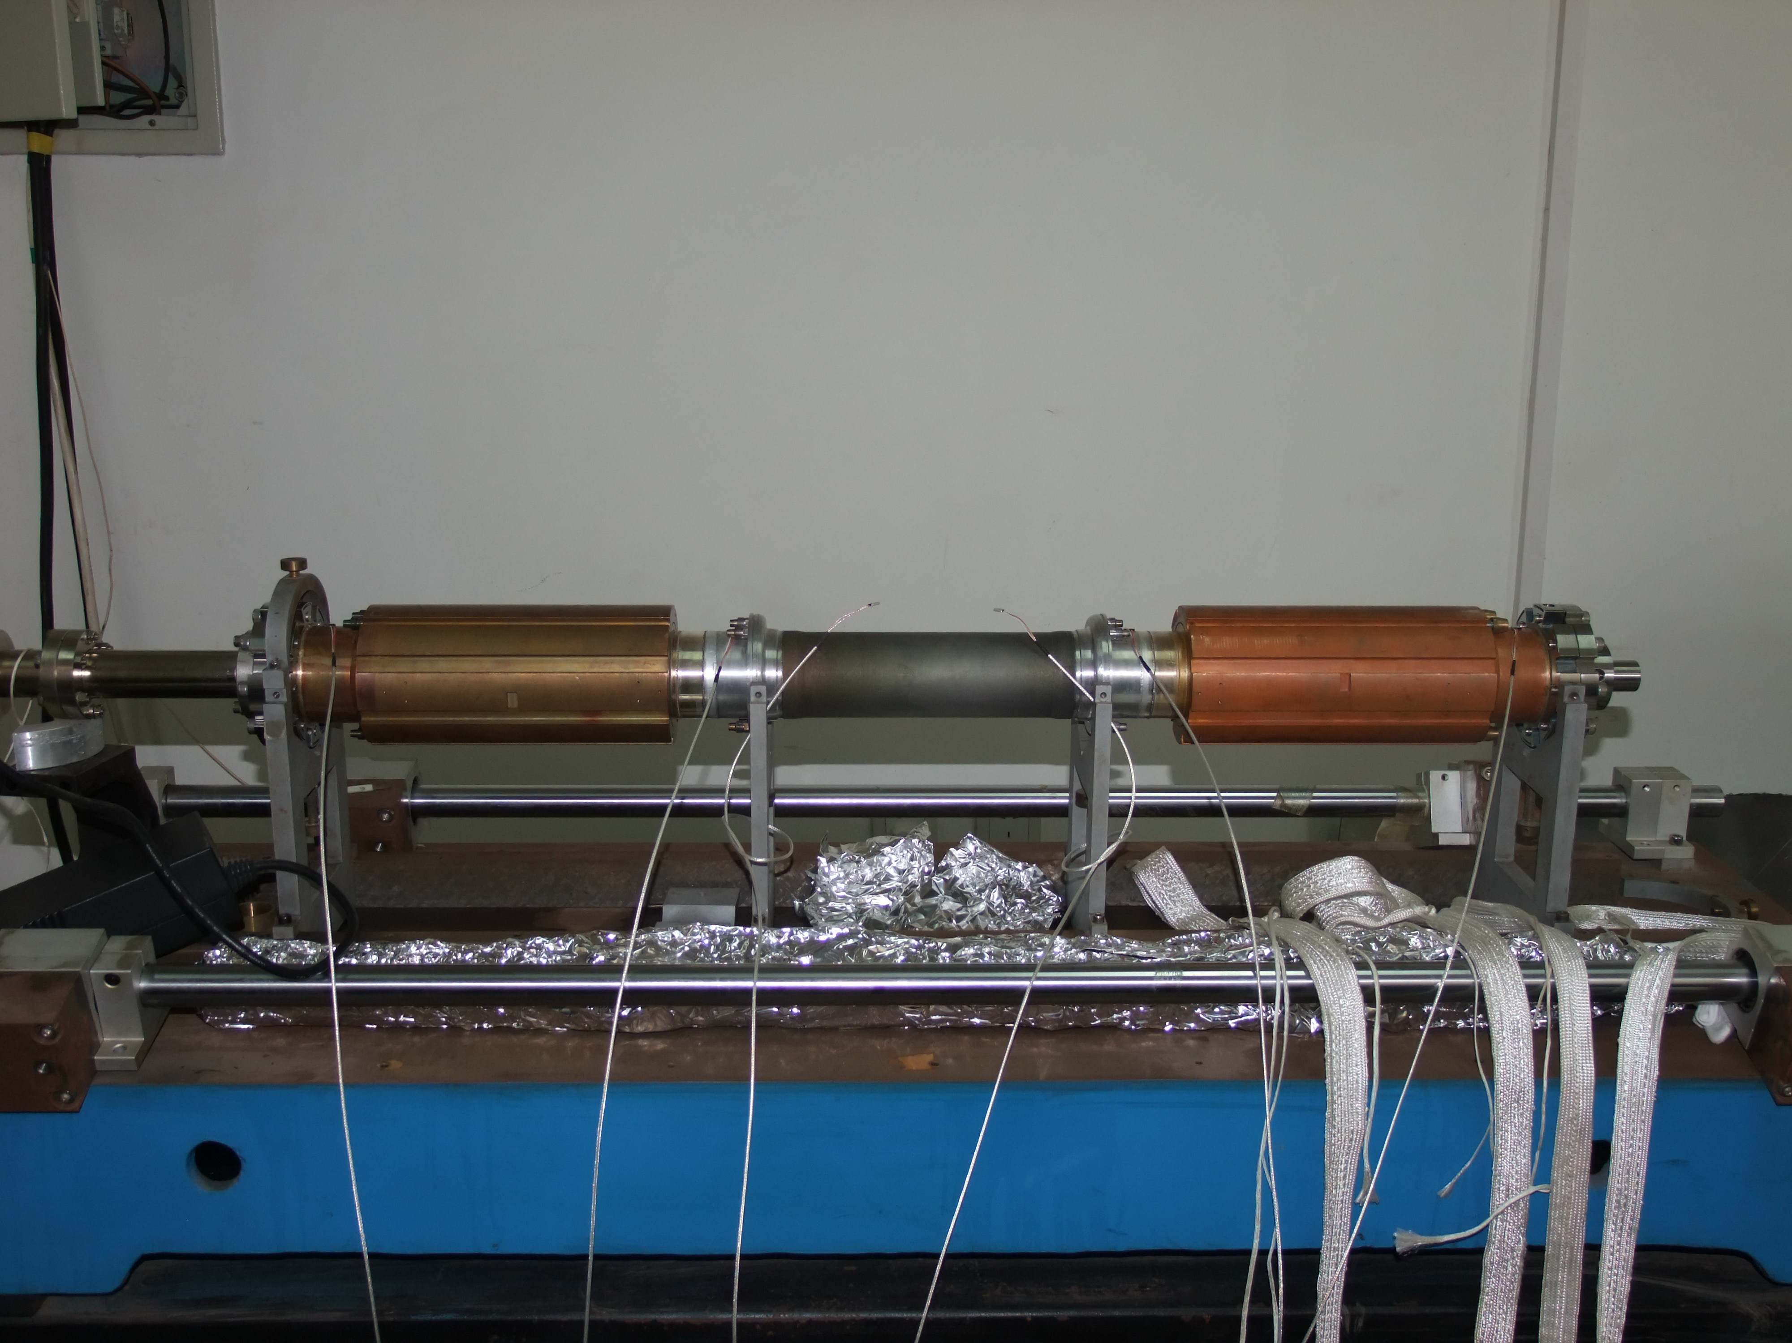
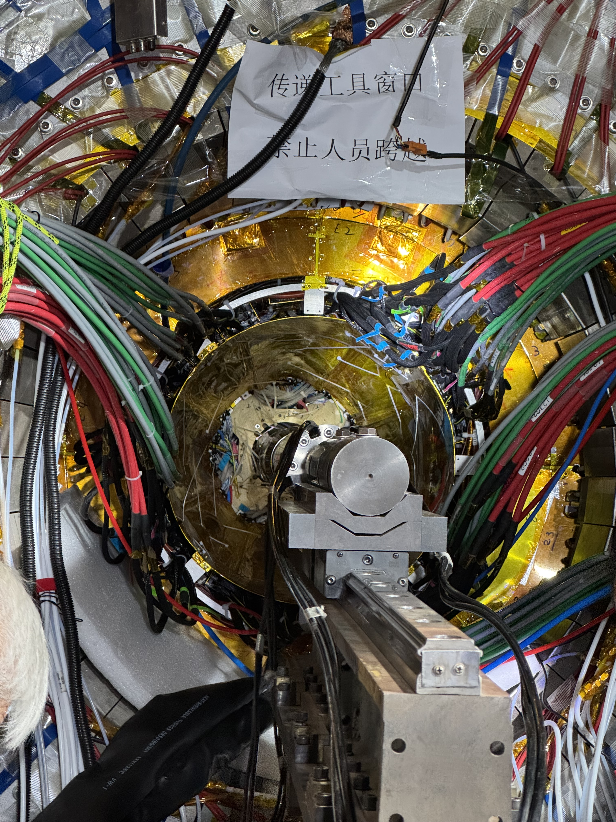
Thin pipes at BESIII
The BESIII central Be pipe
  The inner layer has a thickness of 0.8 mm
  The outer layer has a thickness of 0.6 mm
  The gap for the coolant has a thickness of 0.8 mm
    Paraffin was used as coolant
    An anti-corrosion coating is applied in the gap.
  For shielding the SR, a gold coating with a thickness of 15 µm is used.
The extending pipe made by Cu, using active water cooling
Running successfully nearly two decades with no issues. No Leakage
Dec 27th, 2024

Slide 11
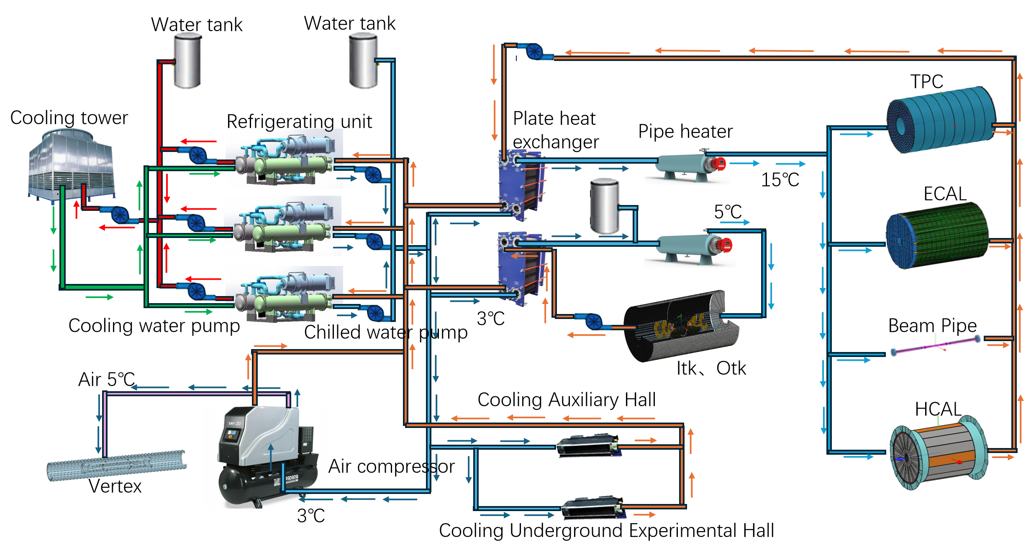
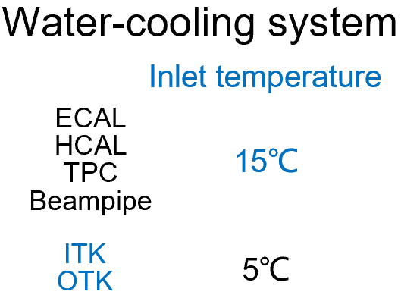
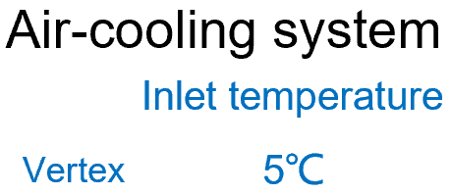
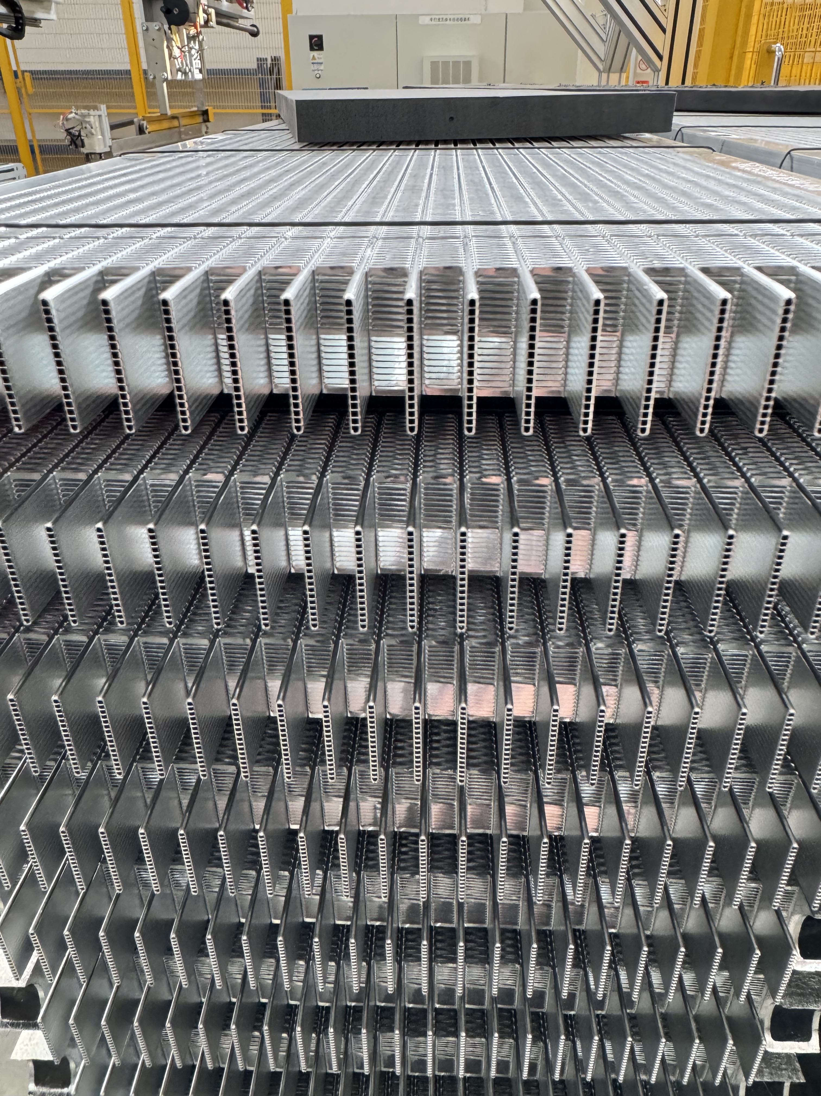
Cooling Design of CEPC Detector
We are also investigating on Microchannels and Supercritical CO₂

Slide 12
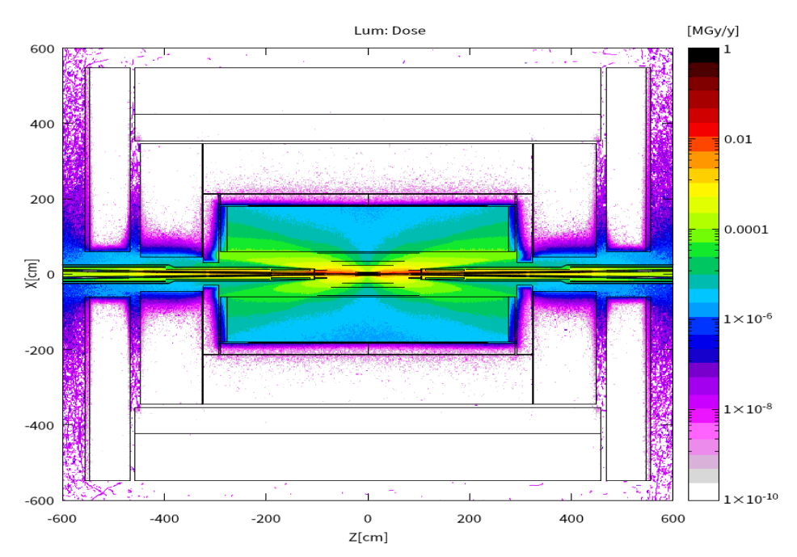
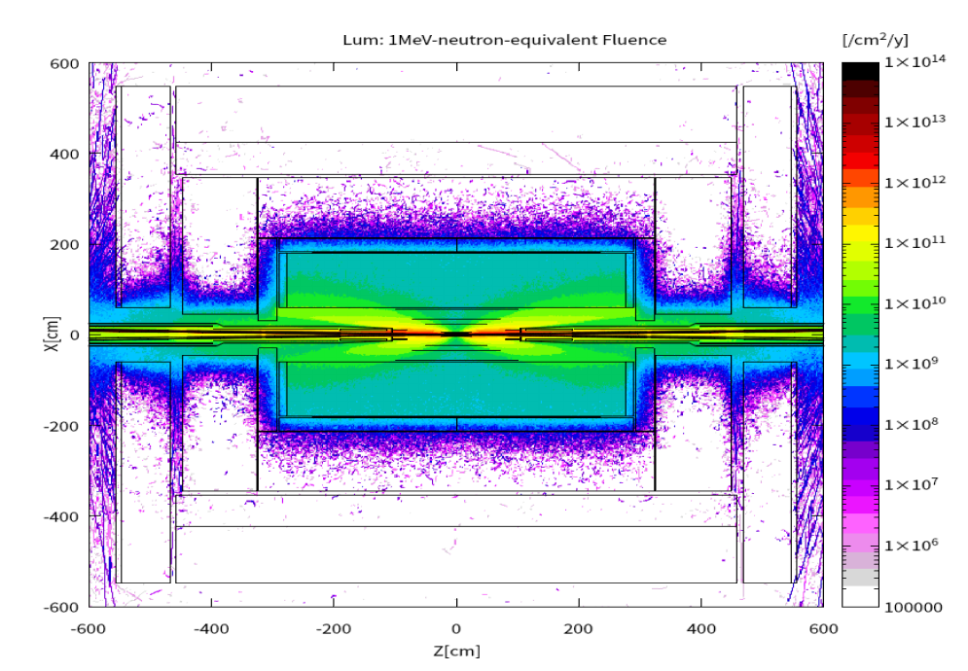
Concerning the Radiation Env.
The radiation level at CEPC Det. is more friendly comparing with LHC.
Highest: ~0.2MGy/yr
Highest: at the level of 10¹³/yr

Slide 13
DRD8 Related Items @ CEPC Detector
Working Packages | CEPC Interests / Doing
WP 8.1 | Curved Det/MDI/Alignment… + Robotic Arms
WP 8.2 | Material
WP 8.3 | Cooling system design, CO₂ cooling + Micro Channels…
WP 8.4 | 3D Simulation (in) xR + Converting tools
Thank You

Slide 14
Backup

Slide 15
Steps of the installation
Overall Installation Sequence :
1) Pre-assembly of sub-detectors in the Ground Hall
2) Transport through the shaft
3) Install each sub-detector in the underground experimental hall

Slide 16
Sub-detector Installation Design
Installation Steps for the Sub-detectors :
Minimal installation steps
1) Alternating installation : Yoke and Magnet (3) --- Barrel and End Yoke
2) Core shaft installation : Barrel HCAL and Barrel ECAL (2) --- Barrel Detectors
3) Cantilever installation : TPC(OTK) ITK + Beampipe(Vertex + LumiCal) (3) --- Barrel Detectors
End HCAL and End ECAL (2) --- End Detectors
4) Detector movement, positioning and alignment
Move the detectors from the Pre-assembly point to the Collision point
Connect the beampipe and Acc component

Slide 17
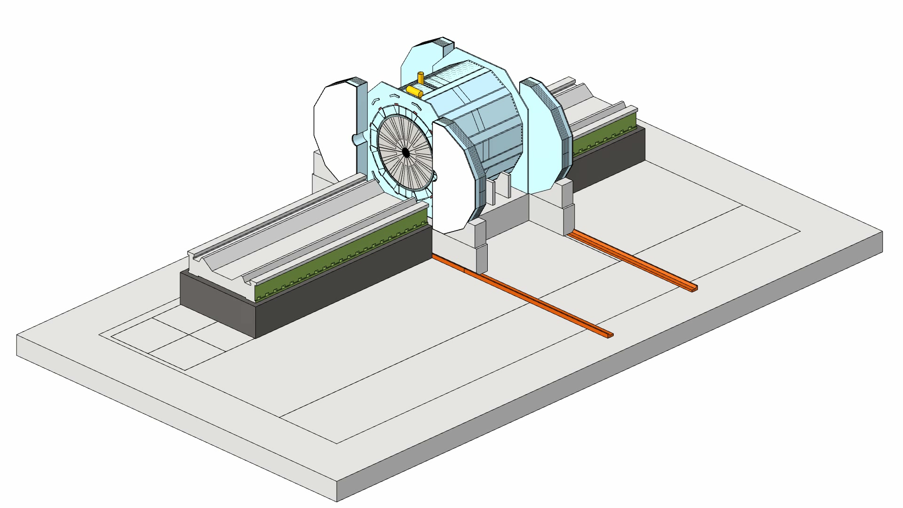
Sub-detector Installation Design
1. Move the detectors and two guide rails of the two sides
2. Connect the beampipe and Acc component
The alignment is very challenging
Purpose of moving the guide rails to the collision point :
To facilitate the maintenance and replacement of the detectors in the future

Slide 18
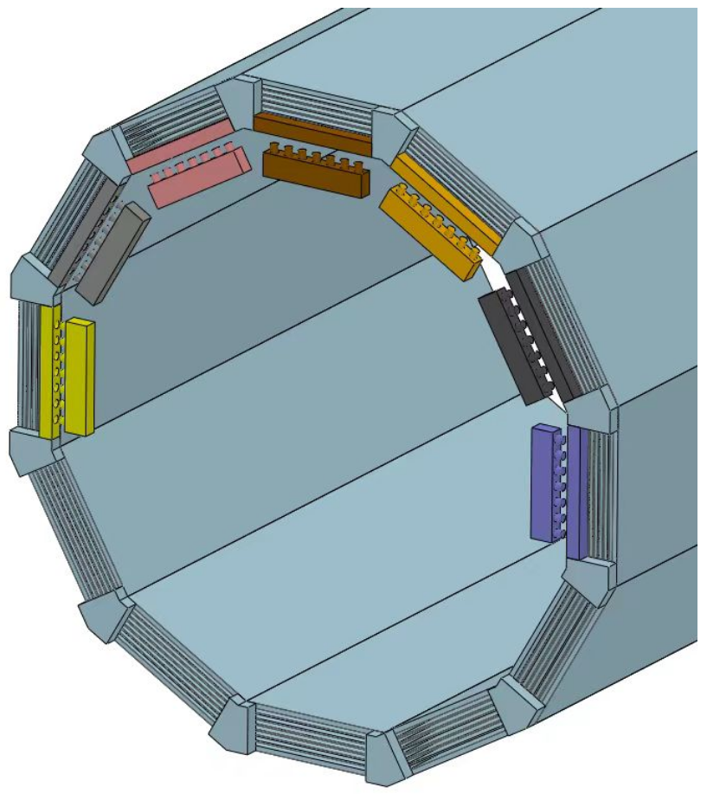
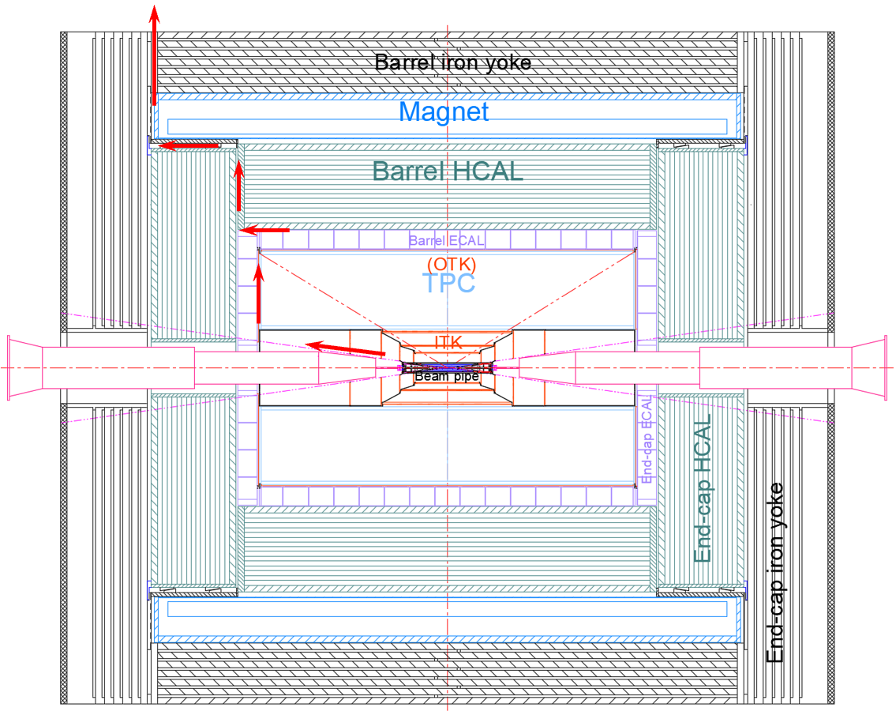
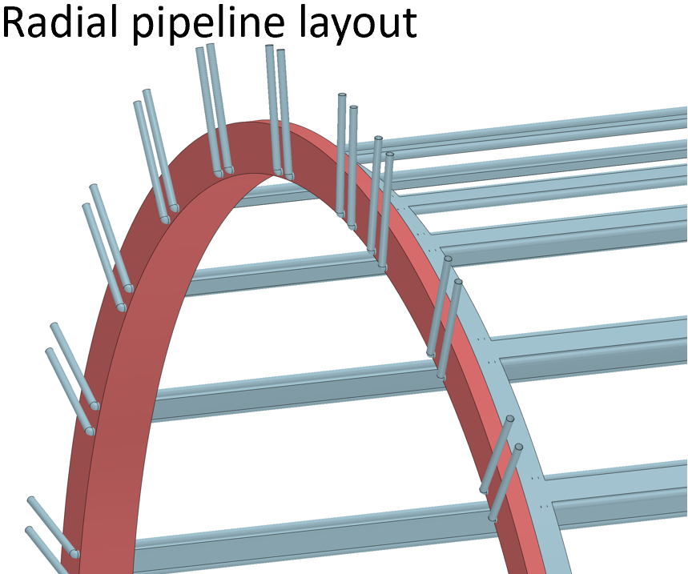
Requirements and Space for cabel
Pipeline Layout Optimization
Achieve : more time is required for the optimization design
What to do after the pipeline is led out?
OTK
HCAL
ITK
ECAL
TPC
Quadrant angle arrangement
ITK
Quick connect
The red arrow indicates the pipeline route
For the convenience of maintenance and installation :
Arranging the pipelines according to quadrant angles is the most reasonable design

