Slide 1




Ole Thomsen, Co-Director
A leading composites research and skills development ecosystem

Slide 2

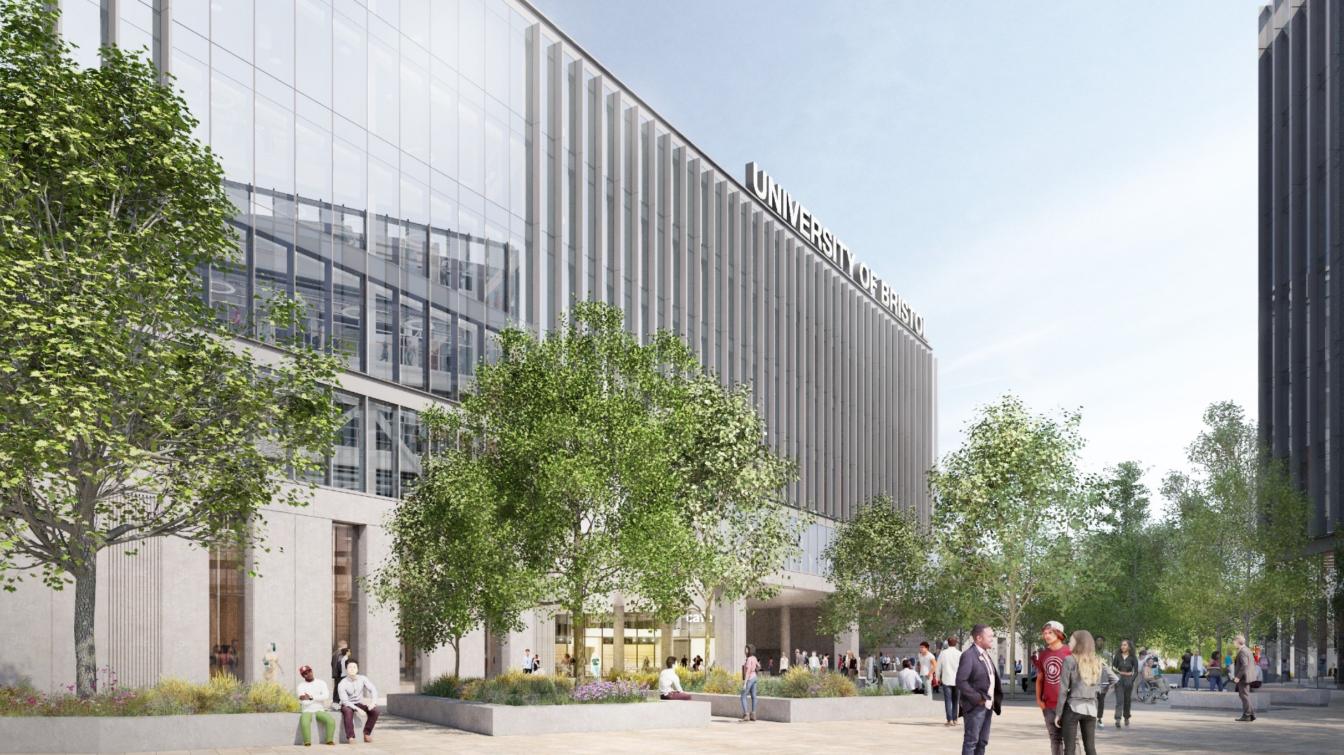

Top 10 UK university and 54th in the world (QS Rankings 2025)
3rd most targeted university by top UK employers
Top 5 UK university for research
RESEARCH
Est. in 2007 as Advanced Composite Centre for Innovation and Science (ACCIS) and rebranded Bristol Composites Institute in 2017.
Fundamental and applied composites research and education, with strong industrial links for exploitation.
EDUCATION
ENTERPRISE
INNOVATION

Slide 3







13 ACADEMICS FEATURED IN STANFORD / ELSEVIER’S TOP 2% SCIENTISTS LIST 2024
>200 CORE STAFF & STUDENTS
£25M R&D INVESTMENT
>800 ACADEMIC PAPERS SINCE 2017
>40 ENGAGED COMPANIES
4 POSTGRADUATE PROGRAMMES
55 LIVE PROJECTS

Slide 4



INDUSTRY & ACADEMIC PARTNERSHIPS
Partner in £42M Dstl funded Defence Materials Centre of Excellence (DMEx).
Programme Grants with Cambridge, Imperial College London, Bath, Exeter and Southampton.
Dual PhD with TU Dresden and cotutelle agreements with RMIT and TU Delft, collaboration with Texas A&M.
MOUs with DTU Copenhagen, UBC and others.
Strategic University
Partnership
Composites University
Technology Centre
supported by
Rolls-Royce

Slide 5
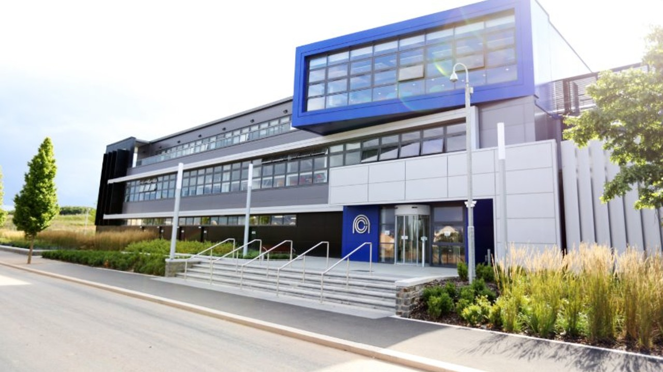

NATIONAL COMPOSITES CENTRE
A University of Bristol owned facility, operated independently, on behalf of its industrial members.​
Mid-TRL research - Translating novel concepts from academia, and de-risking industrial solutions​.
Strong cross-sectoral industrial membership​.

Slide 6

Research capability
Sustainable composites engineering
Responding to societal challenges
Digital innovations

Slide 7





















Funders & partners
>40 ENGAGED COMPANIES

Slide 8
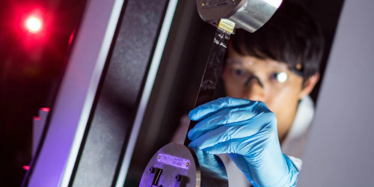
World-class
Facilities & labs
MECHANICAL
TESTING
MICROSCOPY & FULL FIELD IMAGING
MANUFACTURING
TECHNCIAL SUPPORT TEAM
5 to 500kN
Thermal and Chemical Analysis
Nanomaterials lab
Optical microscopy
SEM
DIC
TSA
Training
Support
Machine set-up
Health & safety
Clean room
Autoclave
Microbraider
Automated fibre placement

Slide 9


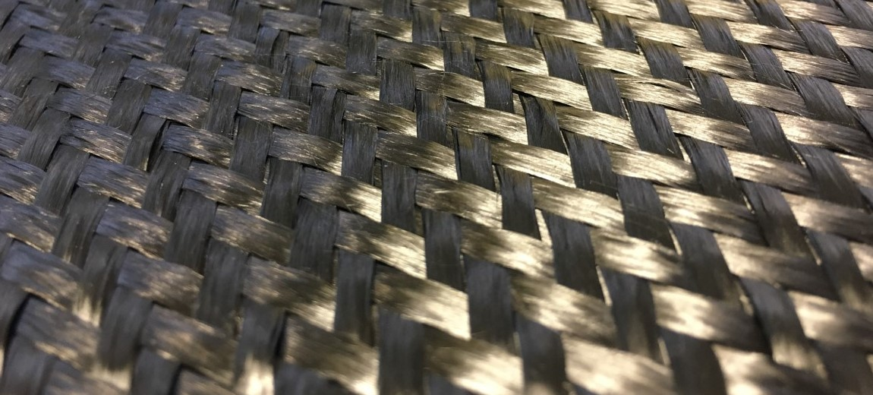


Aligned short fibre composites using HiPerDiF technology​.
Enterprise
Spin-outs
To rid industries of outdated hardware using origami methodology.​
Novel rapid, defect free tow shearing technology.​
Spin-out in progress – textile simulation software.​

Slide 10
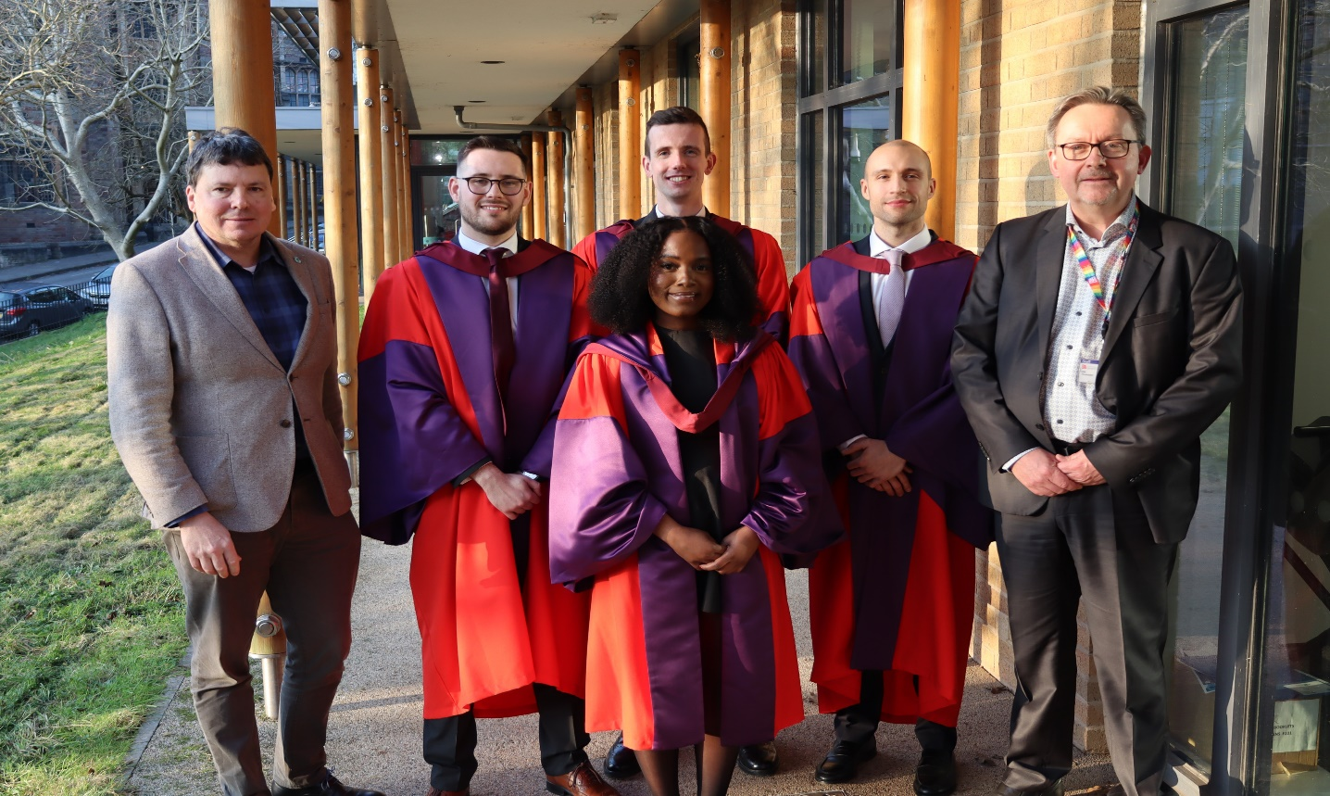
01
MSC ADVANCED COMPOSITES
POSTGRADUATE pROGRAMMES
02
PHD IN AEROSPACE ENGINEERING
Centre for doctoral training
INNOVATION FOR SUSTAINABLE COMPOSITES ENGINEERING
03
Centre for doctoral training
Composites science, engineering & manufacturing
04

Slide 11
Work with us
composites-institute@bristol.ac.uk
UNIVERSITY FUNDING
UKRI FUNDING
HORIZON EUROPE

Slide 12

UNIVERSITY FUNDING
University of Bristol has £4.3M of IAA funding from UKRI for…critical, early-stage translation and impact of UK research
Types of award
  Early Career Researcher Kickstarter awards (£3k): to develop impact, partnerships etc.
  Exploratory Impact awards (£15k): to build early stages of impact
  People Exchange awards (£50k): exchanges to/from University for researchers or external collaborator
  Commercialisation awards (£50k): projects with a clear commercial opportunity and route to market

Slide 13

UK RESEARCH & INNOVATION
UK Research and Innovation (UKRI) directs research funding within the UK.
Types of award
Programme grants (Multi £M funding (typically £6 - £7M for up to 6 years))
Challenge based directed calls, discipline, activity and/or UK region specific
Collaboration with international partners
Responsive mode (high-risk/high return from short-term grants to multi £M research projects)

Slide 14

HORIZON EUROPE
EU’s key funding programme for research and innovation, with budget of €95Bn from 2021-27.
Focus on excellent science, global challenges and EU competitiveness and innovation.
Primarily for larger, multi-partner R&D efforts, where existing connections and networks are useful in building consortia for HE calls.

Slide 15


WELCOME TO BRISTOL

