Slide 1


Design and Testing of the Outer Barrel Stave for the ePIC Silicon Vertex Tracker (SVT)
Adam Huddart - Rutherford Appleton Laboratory
Georg Viehhauser, James Julian Glover, Laura Gonella, Marcello Borri, Qing Yang

Slide 2
Agenda
Overview
SVT/Outer Barrel Layout
Outer Barrel (OB) Stave Performance Targets
Background on Sensor/Stave Layout
Stave Prototyping
Stave Structure & Build Process
Test Setup
Analysis/Testing
Pressure Loss
Vibration
Thermal

Slide 3
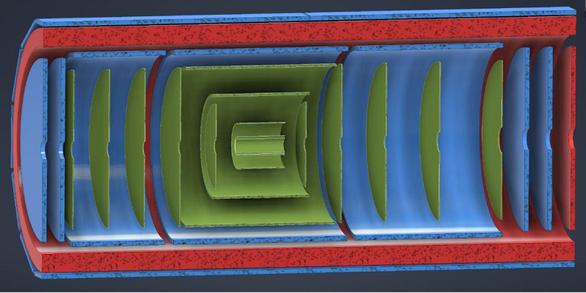
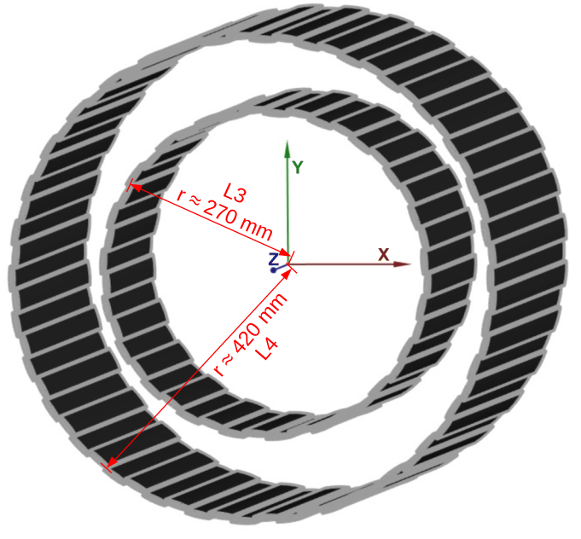
ePIC Silicon Vertex Tracker (SVT)
Inner Barrel (IB)
3 curved layers
Same curved, wafer-scale
stitched MAPS used within ITS3
Outer Barrel (OB)
2 stave-based layers
optimised sensor for EIC.
Focus of EIC-UK WP1
Barrel comprised of castellated staves
  L4 (8 x 5 RSU long EIC-LAS)
    approx. 440 mm radius
  L3 (4 x 6 RSU long EIC-LAS)
    approx. 270 mm radius
SVT
MPGDs
ToF (fiducial volume)
Electron/Hadron Endcaps (EE, HE)
5 discs on either side of the IP

Slide 4
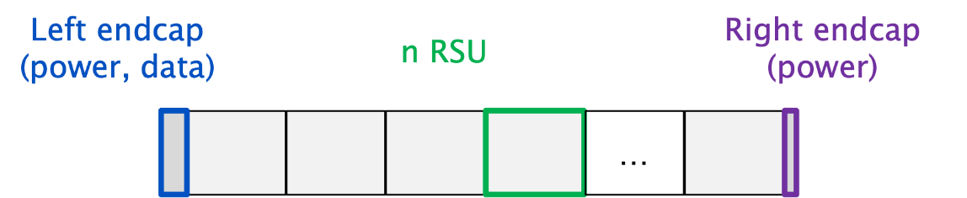
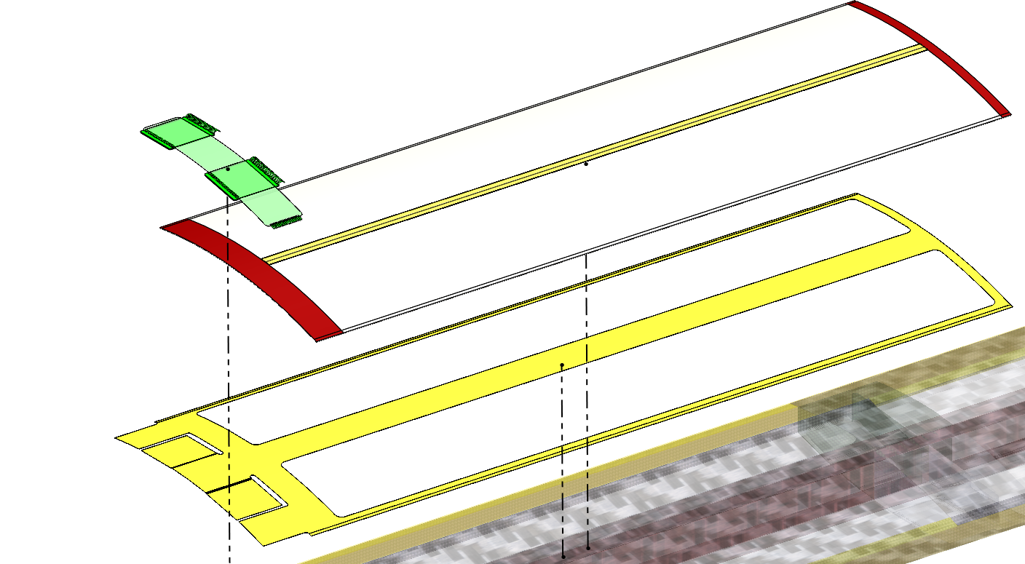
Stave Sensor
LEC:
EIC-LAS
REC:
(stitching plan termination)
~ 20 mm
Length 5 RSU (L4) ~ 114 mm
Length 6 RSU (L3) ~ 136 mm
EIC-LAS is a version of the ALICE MAPS with 5 or 6 repeat sensor units (RSU)
Built into a module for testing and wire bonding
  Modules are comprised of:
    2 EIC-LAS mounted side by side (2x6 or 2x5 RSU)
    Kapton carrier – serves as an electrical insulation layer & bonding surface
    Ancillary ASIC (one ASIC per EIC LAS)
    Bridge FPC (Flexible Printed Circuit)
Modules mounted onto stave structure in an alternating top/bottom arrangement
REC
Ancillary ASIC
Bridge FPC
LEC
EIC LAS
Kapton Carrier
OB L3 (6 RSU segments)

Slide 5
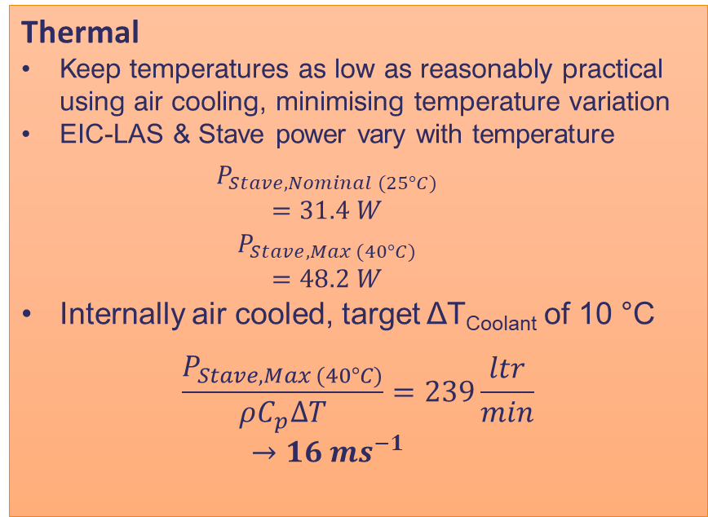
OB Performance Targets
Thermal
Keep temperatures as low as reasonably practical using air cooling, minimising temperature variation
EIC-LAS & Stave power vary with temperature
  $$P_{Stave, Nominal (25°C)}$$
  $$=31.4 W$$
  $$P_{Stave, Max (40°C)}$$
  $$=48.2 W$$
Internally air cooled, target ΔT_{Coolant} of 10 °C
$$\frac{P_{Stave, Max (40°C)}}{ρC_{p}∆T}=239\frac{ltr}{min}$$
  $$→16 ms^{−1}$$
Structure/Stiffness
All vibration modes above 100 Hz
Minimise deformation under static & dynamic airflow induced loading
  Exact requirements to be determined
Material
Radiation length Targets of 0.25% for L3 and 0.55% for L4
Note: All calculation are for L4 staves, L3 will have lower power consumption/flow rate requirements

Slide 6
Agenda
Overview
SVT/Outer Barrel Layout
OB Stave Performance Targets
Background on Sensor/Stave Layout
Stave Prototyping
Stave Structure & Build Process
Test Setup
Analysis/Testing
Pressure Loss
Vibration
Thermal

Slide 7
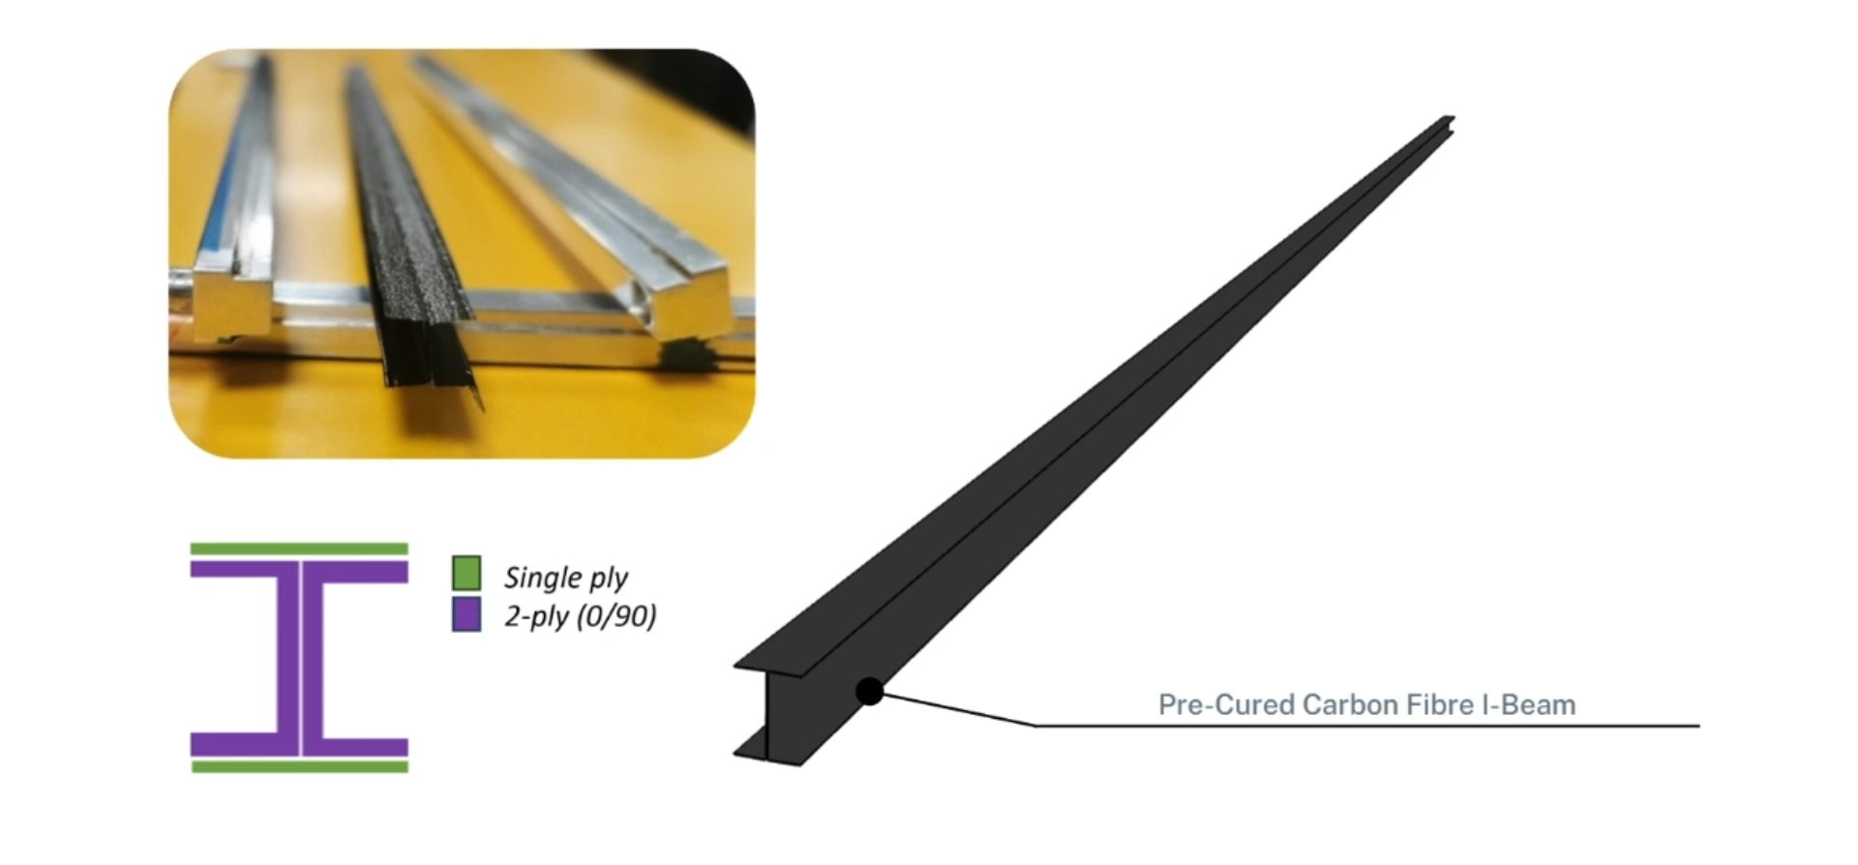
Stave Construction Overview

Slide 8
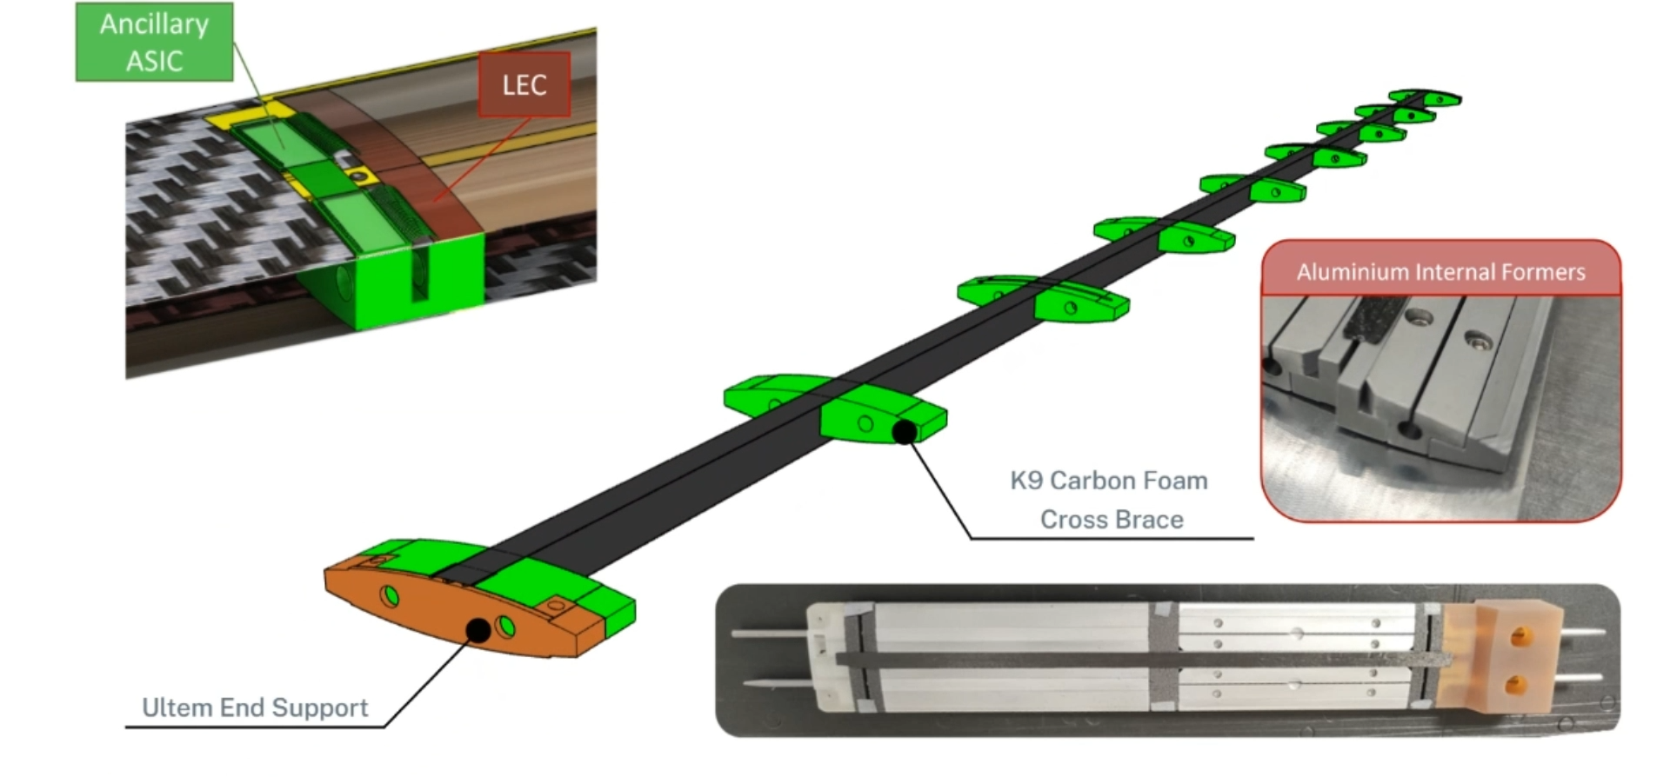
Stave Construction Overview

Slide 9
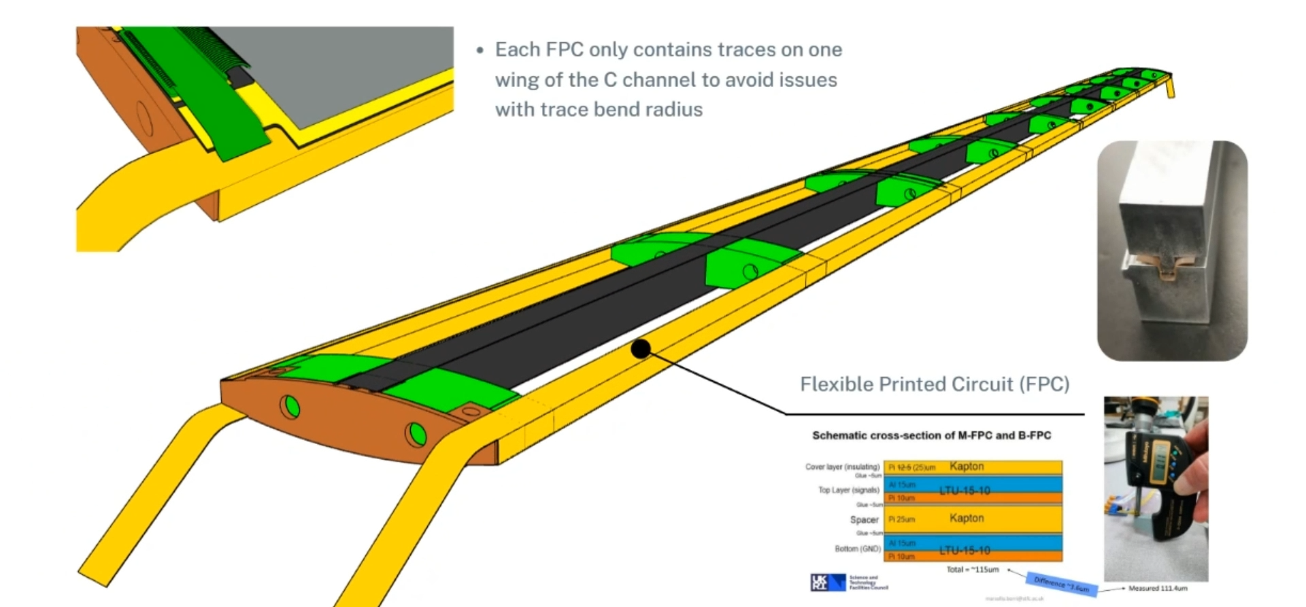
Stave Construction Overview

Slide 10
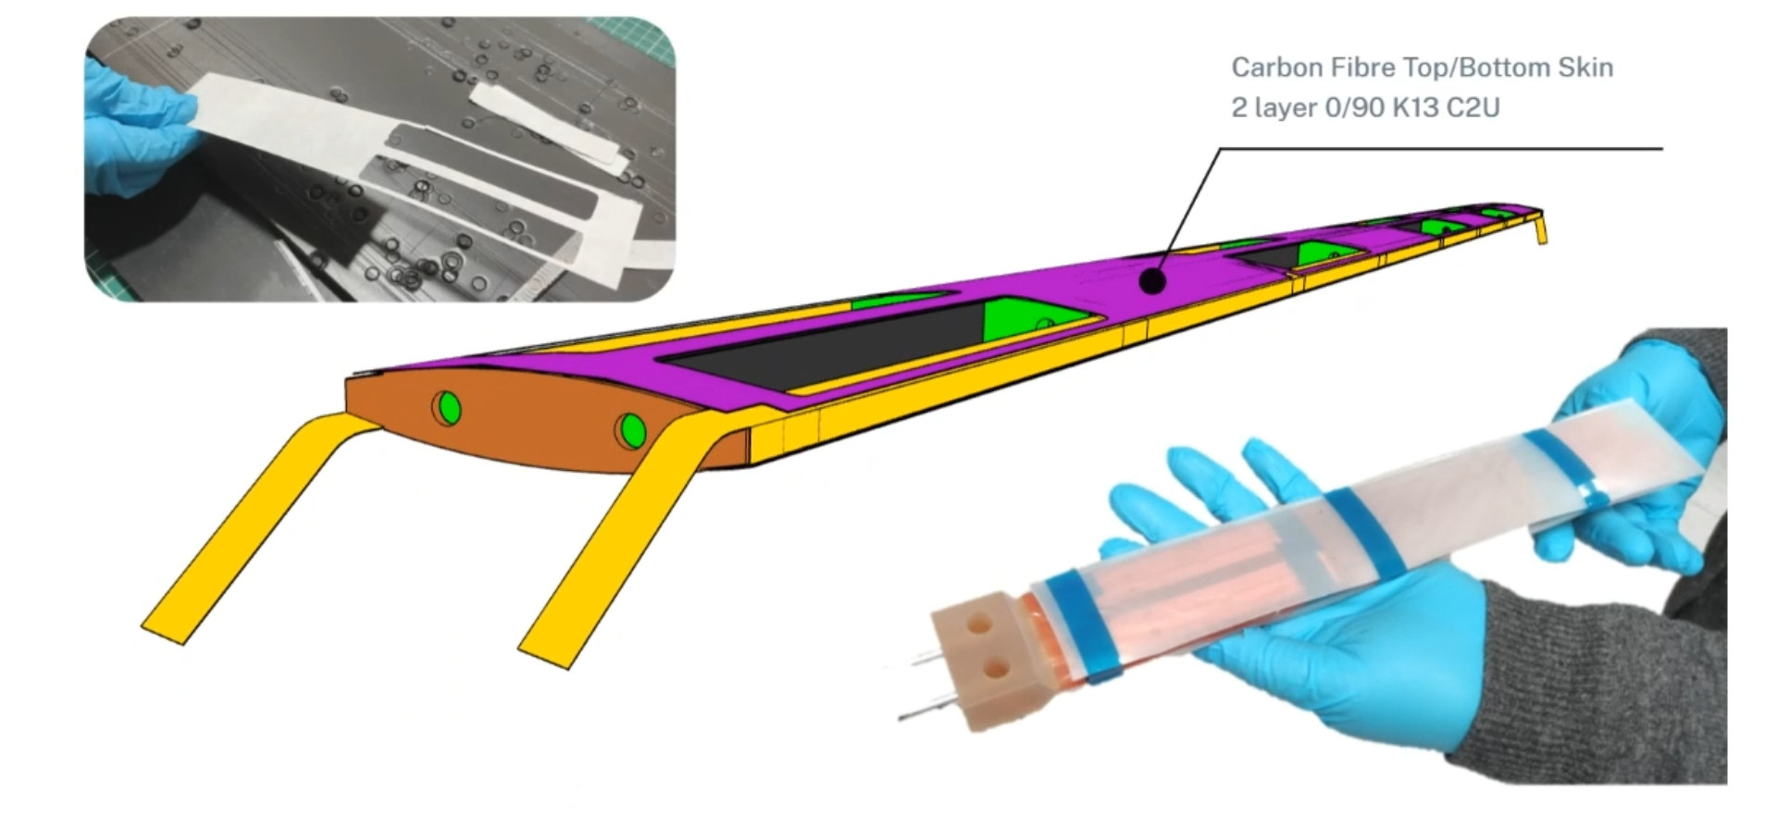
Stave Construction Overview
Autoclave Cycle Parameters
Temperature : 121°C (3 °C/ minute ramp)
Pressure: 90 psi (builds over 30 minutes)
Cycle Time: temperature held for 3 hours

Slide 11
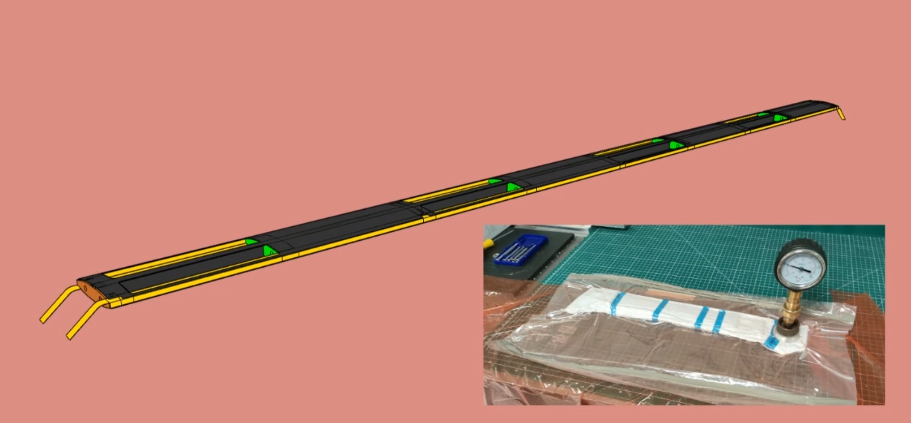
Stave Construction Overview
Autoclave Cycle Parameters
Temperature : 121°C (3 °C/ minute ramp)
Pressure: 90 psi (builds over 30 minutes)
Cycle Time: temperature held for 3 hours

Slide 12
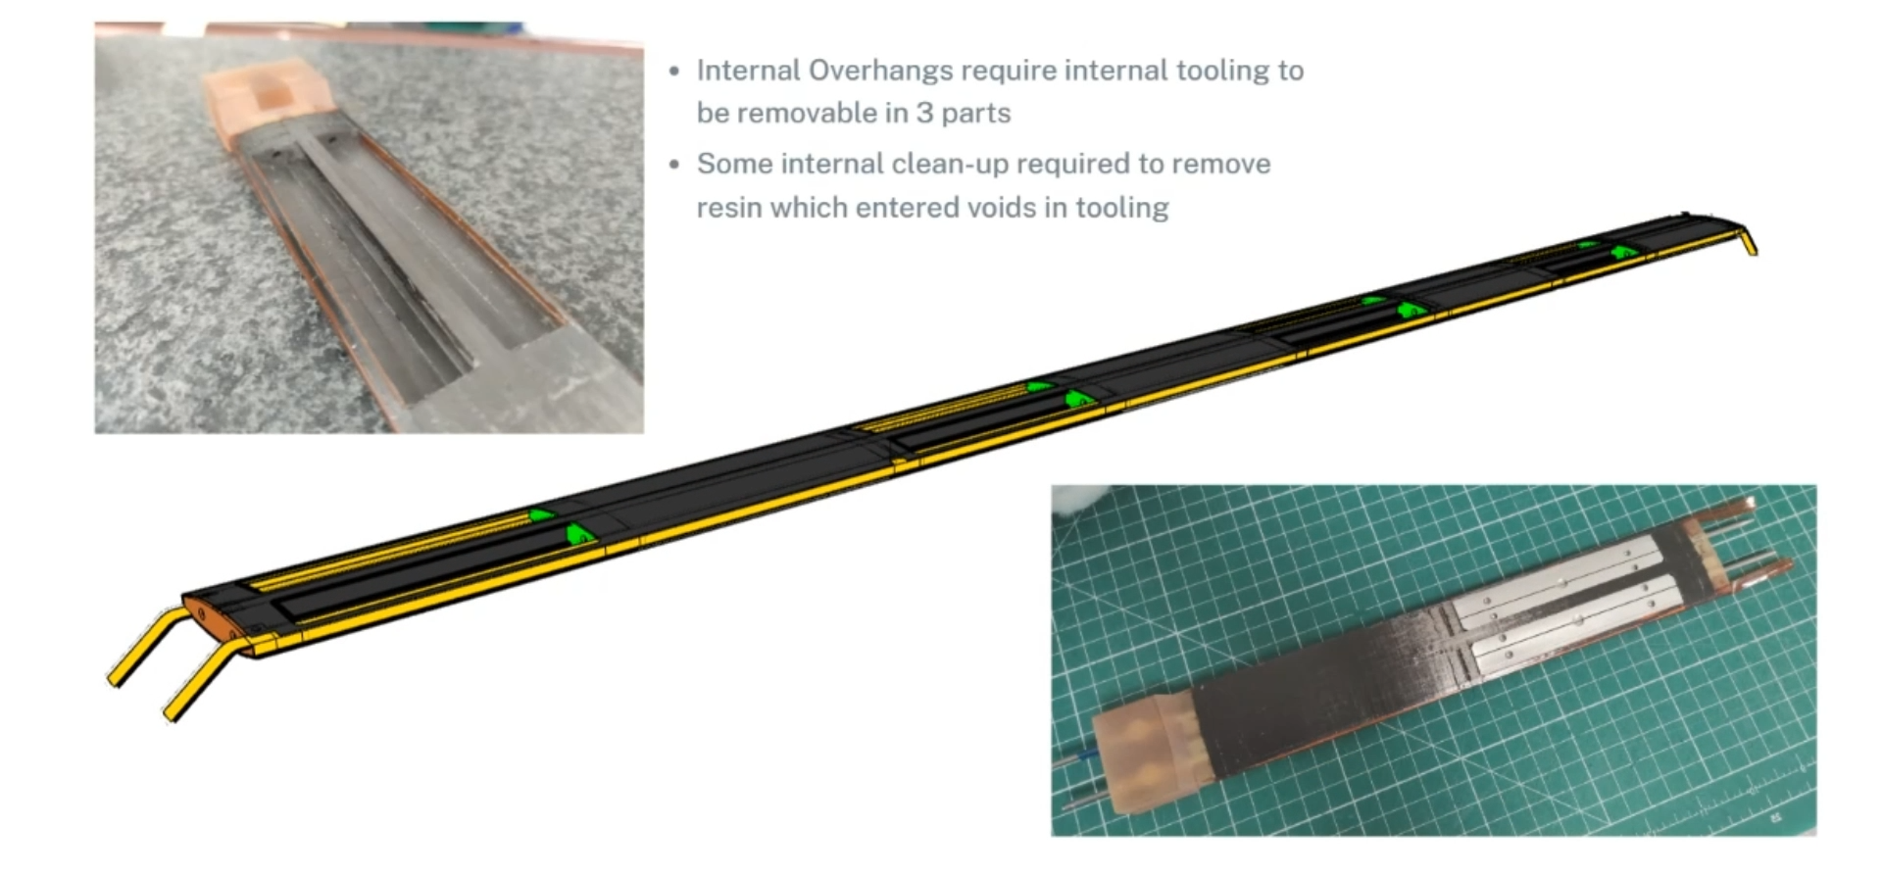
Stave Construction Overview

Slide 13
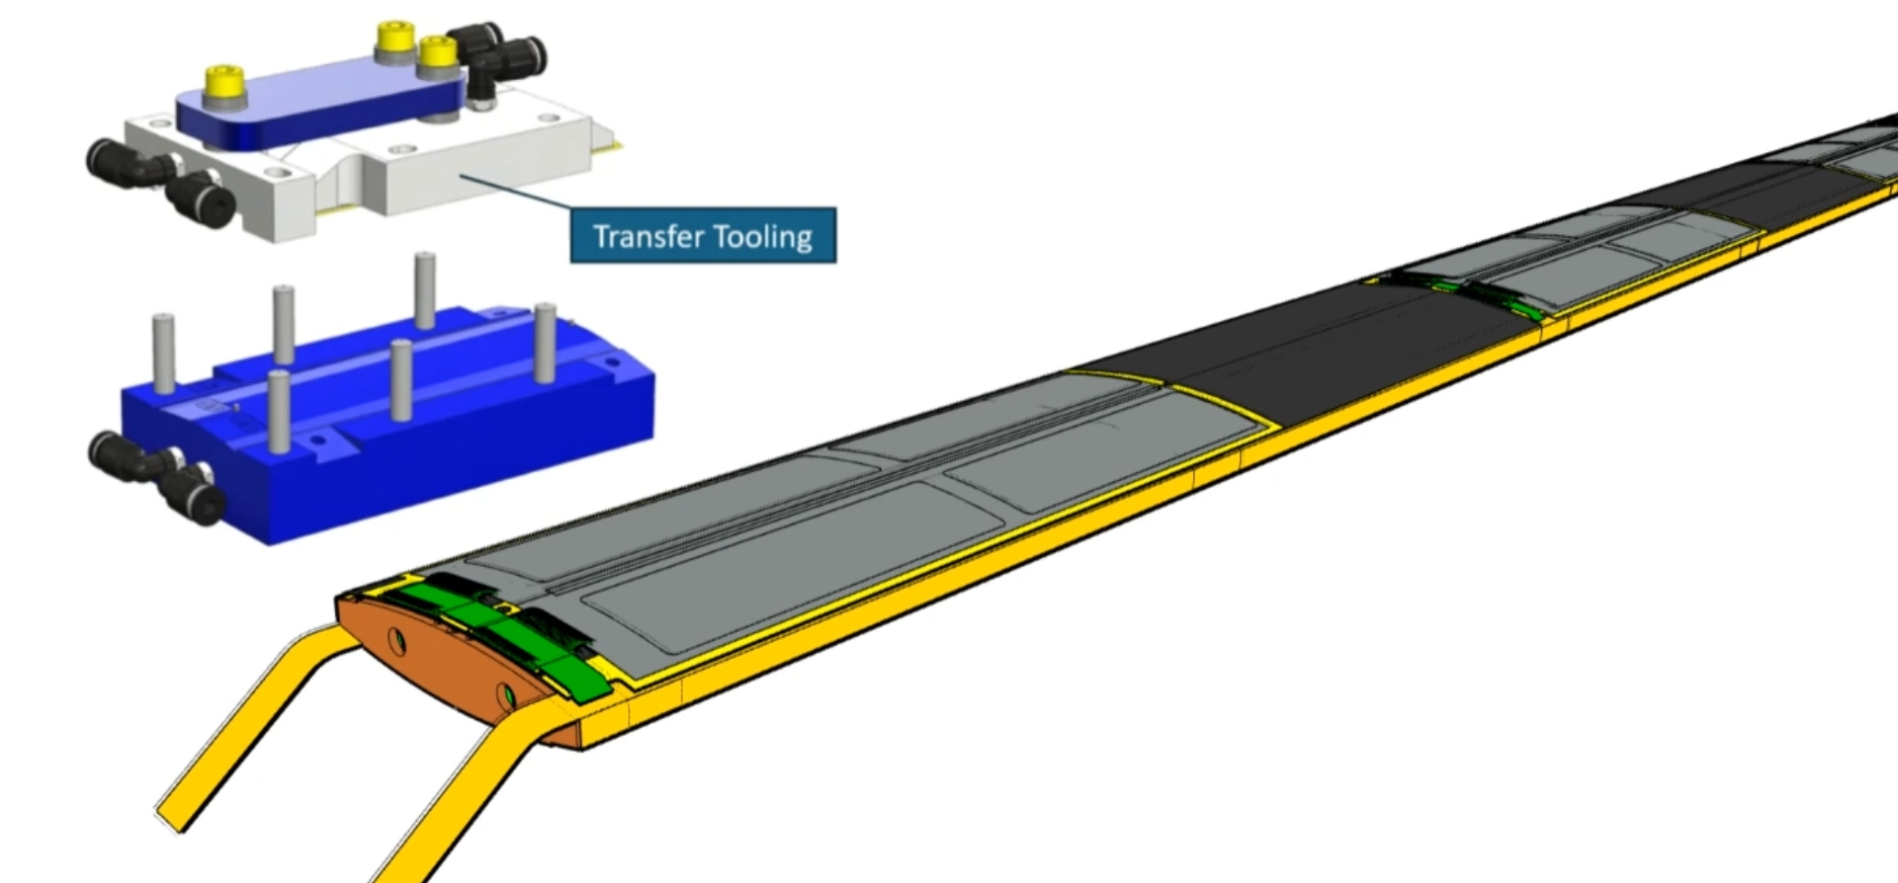
Stave Construction Overview

Slide 14
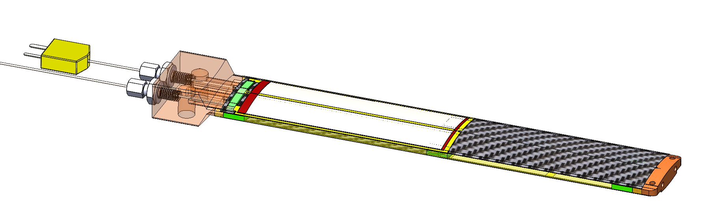
Quarter Stave Prototypes (QSP)
Manufactured 3 Quarter Stave Prototypes (QSP)
¼ of a full L4 stave (2 modules, 5 RSU Variant 1 top side, 1 bottom side)
Construction is identical other than modified inlet block

Slide 15
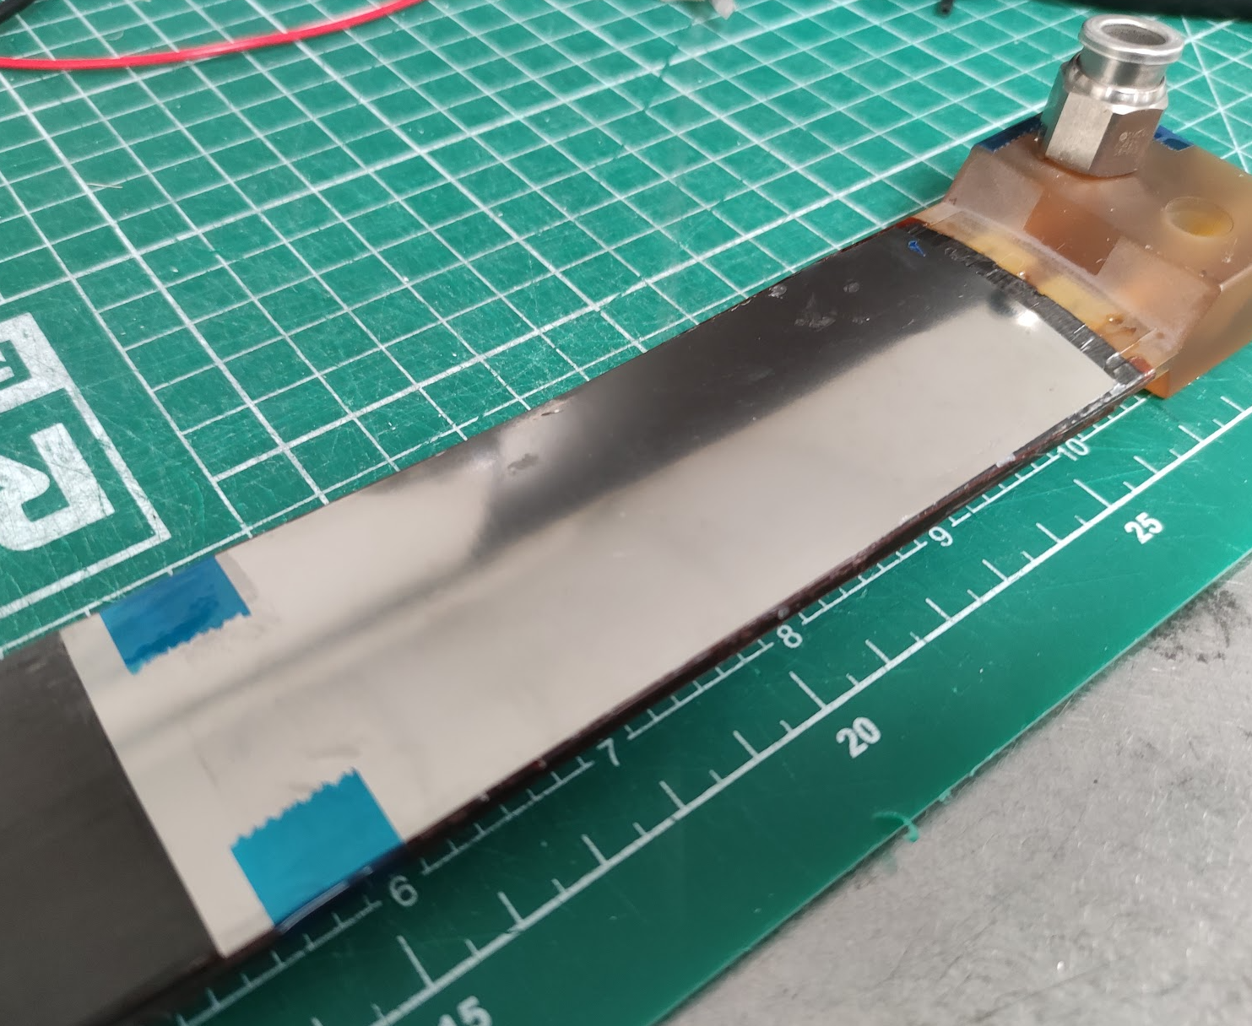
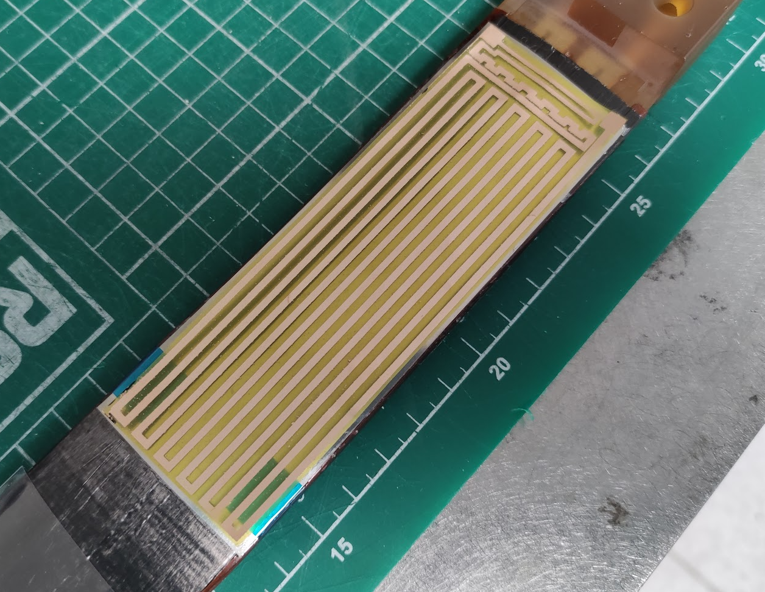
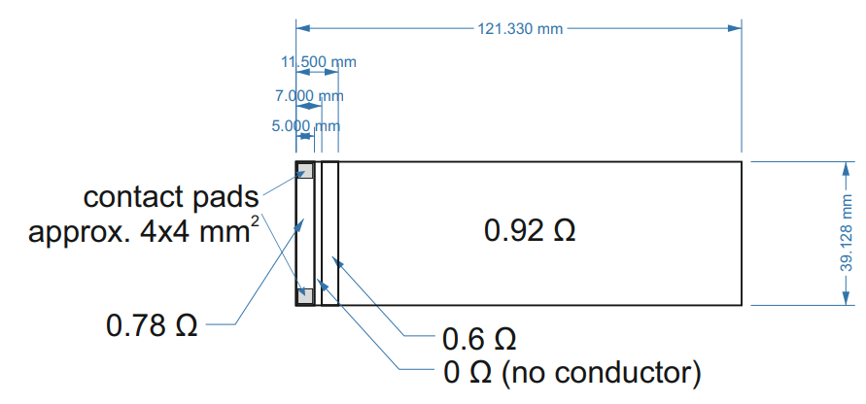
Module Mock-ups
Structure openings closed with 50-micron steel shim,
A Kapton heater equivalent to the 2 sensors + Ancillary ASIC is bonded to the shim with Araldite
Module power distribution:
 | Power (W) | Expected Power Fraction | Measured Power Fraction
Repeat Sensor Units (QTY 10) | 1.33 | 40% | 89.6%
Left End Cap (QTY 2) | 0.87 | 26% | 6.3%
Ancillary ASIC (QTY 2) | 1.13 | 34% | 4.2%
Module Power | 3.32 W
Powers are total for all components in 1 module (2 sensors)
As Designed Trace Resistances

Slide 16
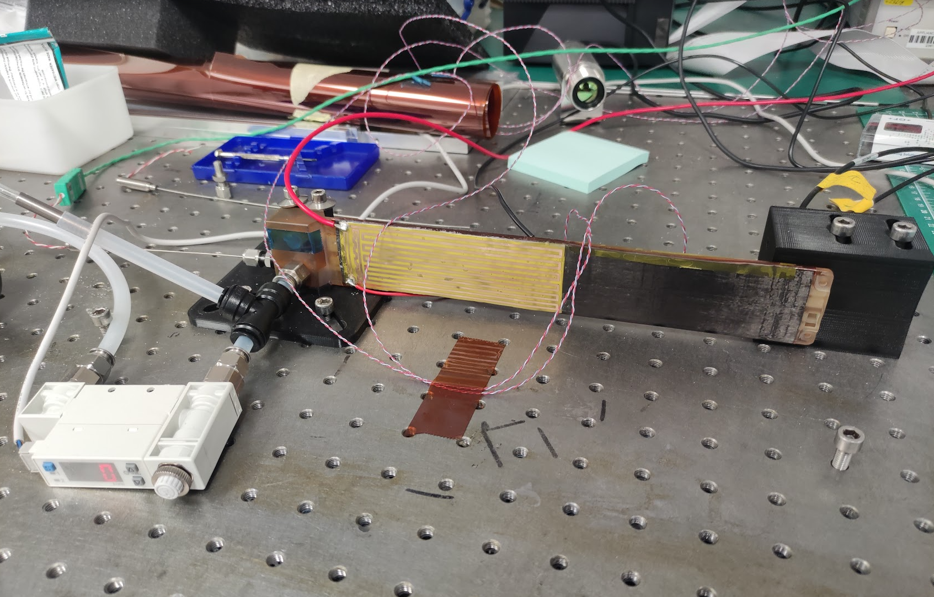
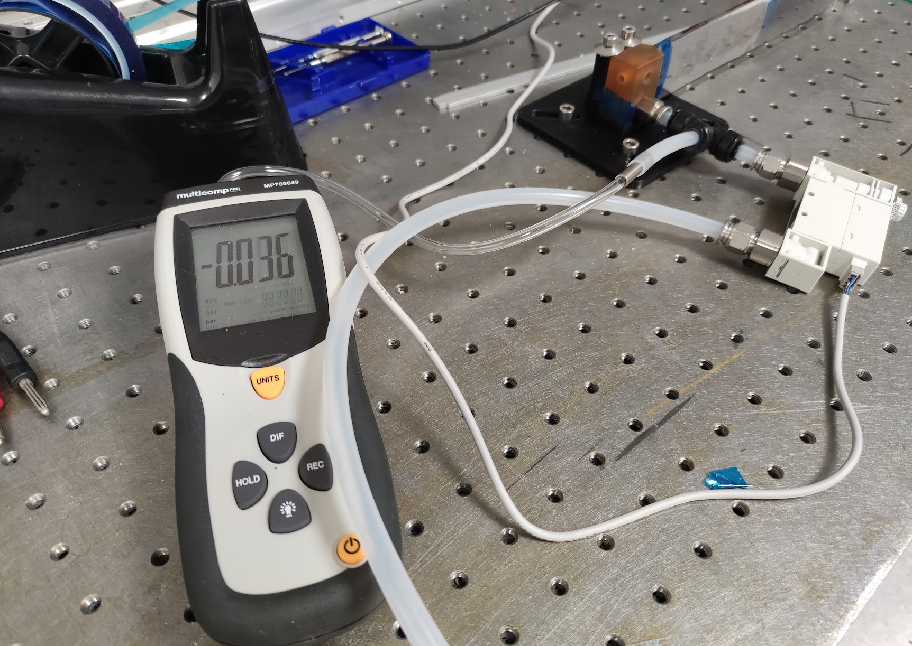
Test Setup
Differential Pressure Sensor
Monitor pressure, temperature & displacement
Staves are cantilever mounted
Airflow within 1 channel (half) of the quarter stave
Sensors & Readout
  Flow meter (up to 100 l/min) + needle valve to adjust flow, flow measurement in DAQ
  2 capacitive displacement sensors, in DAQ
  Pressure sensor (up to 0.350 bar_{d}) – standalone, no connection to DAQ
  In-flow thermocouple for coolant temperature monitoring
  Surface mount thermocouple for thermal imaging camera validation
Thermal Imaging Camera
Displacement Sensors
Flow Meter
Fixed edge
Heater 1
Heater 2
Airflow
Displacement sensors

Slide 17
Agenda
Overview
SVT/Outer Barrel Layout
OB Stave Performance Targets
Background on Sensor/Stave Layout
Stave Prototyping and Testing
Stave Structure & Build Process
Test Setup
Analysis/Testing
Pressure Loss
Vibration
Thermal

Slide 18
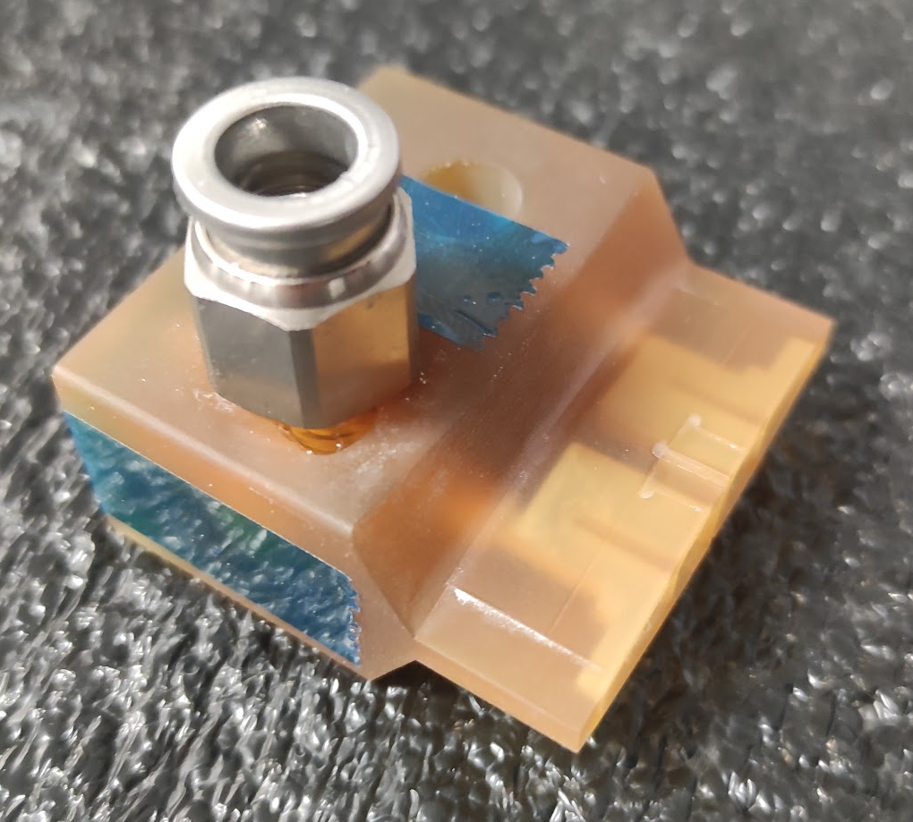
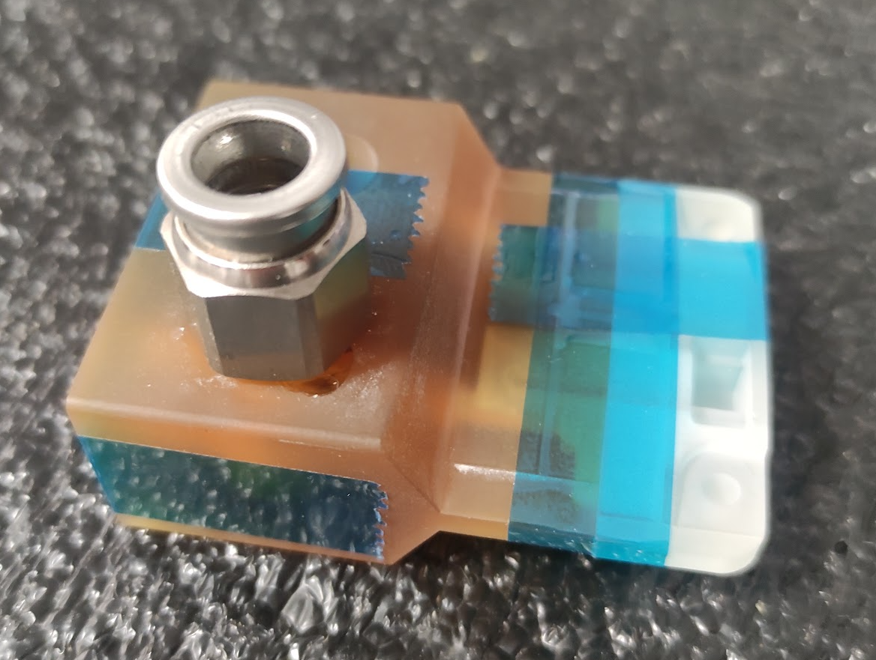
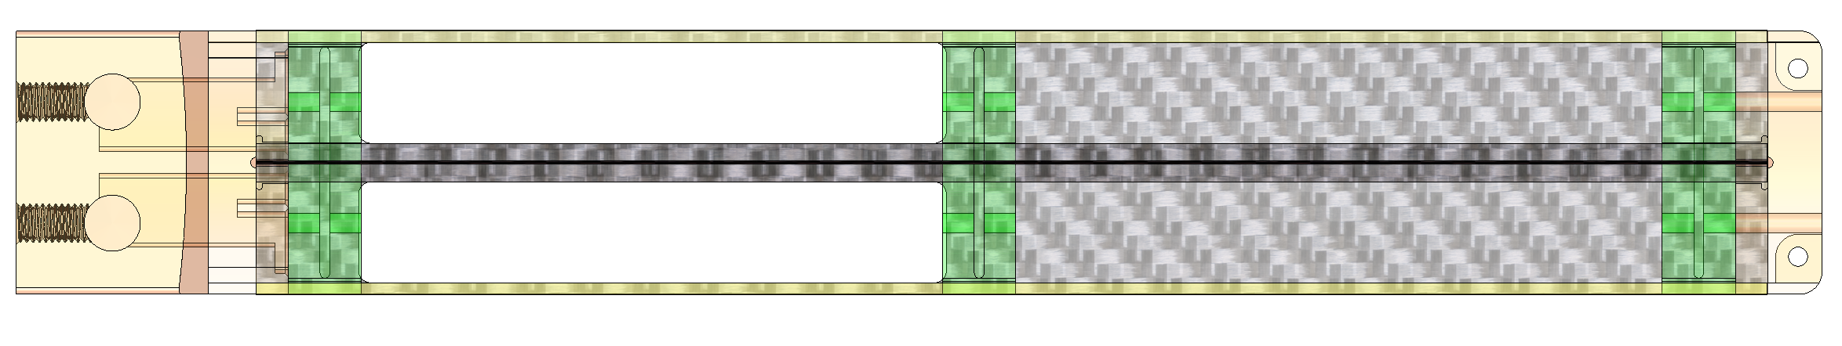
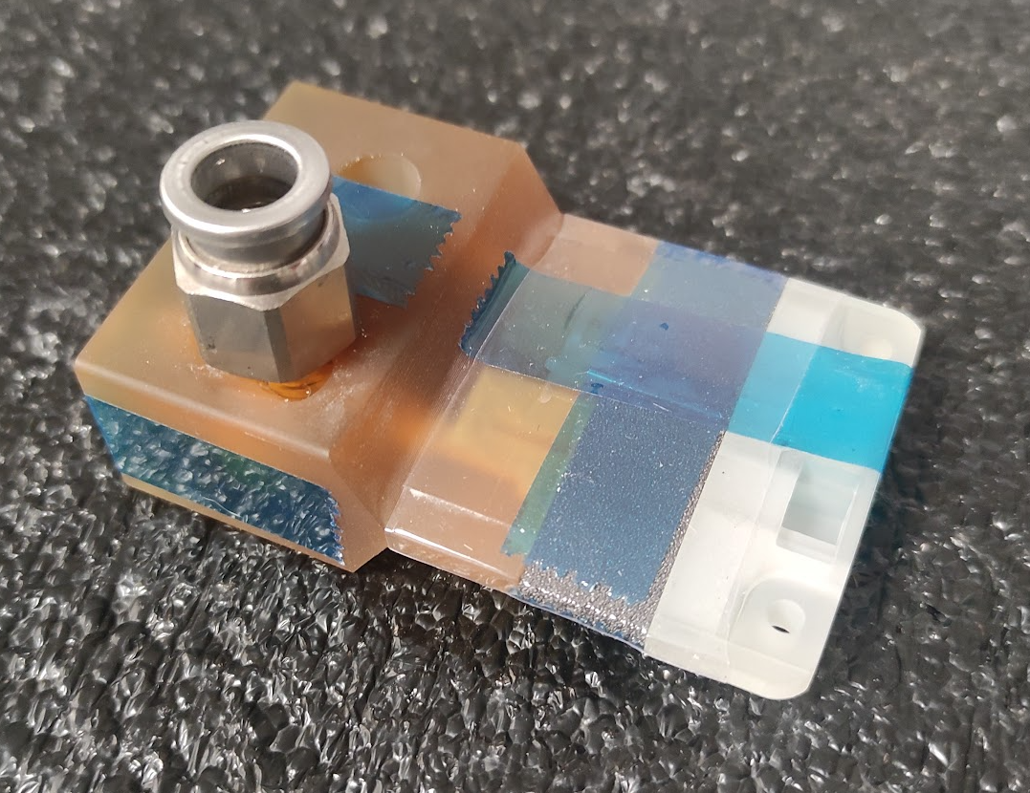
Pressure Loss Contributions
Subassemblies used to isolate contribution
59 ltr/minute pressure drop contributions
  Inlet - 0.124 bar
  K9 Foam – 400 Pa
  Outlet – 400 Pa
Scaled for full L4 stave
  Pressure at first K9 foam block
    59 lpm → 0.062 Bar
    Scaled to 110 lpm → 0.207 bar
Inlet Block
0.0216 Bar
Inlet & Outlet Blocks
Inlet, Outlet & K9

Slide 19
Vibration Analysis/Simulation

Slide 20
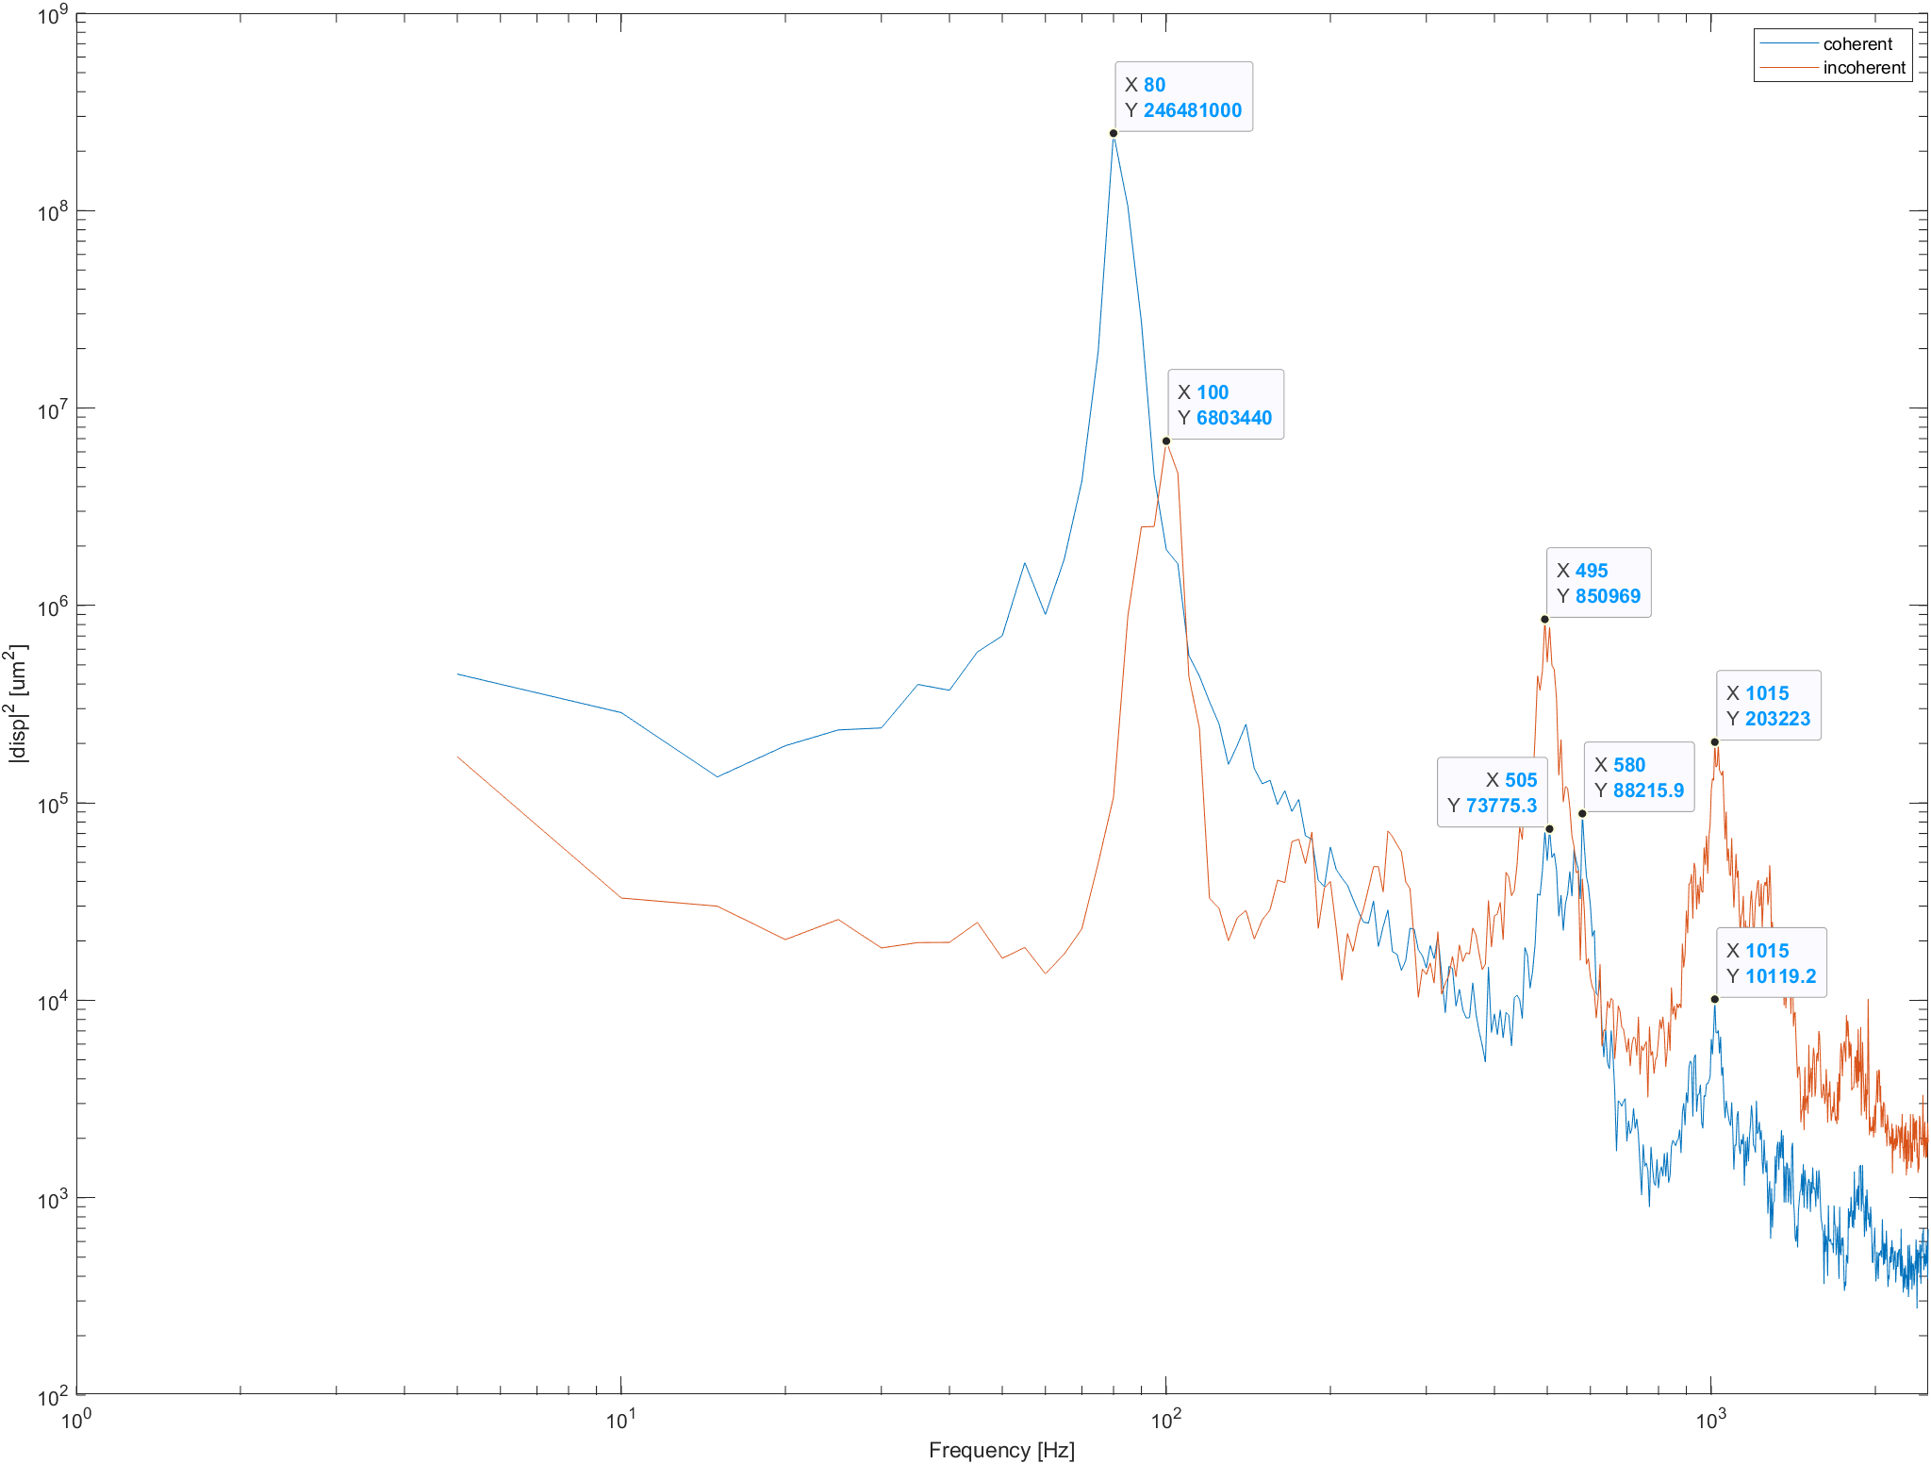
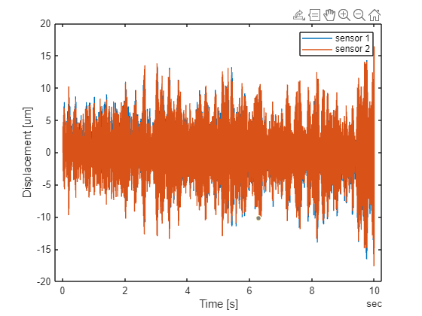
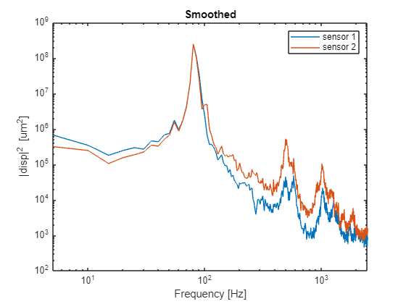
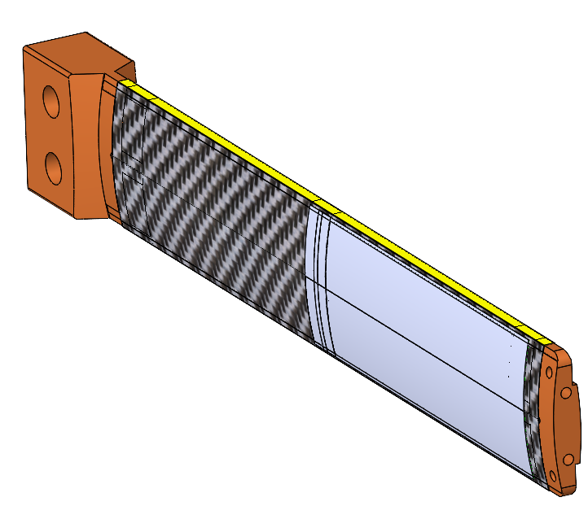

Vibration Testing
f_{s} = 5 kHz, fl = 68.1 l/min, T = 10 s
d_{RMS}¹ = 4.2 µm, d_{RMS}¹ = 4.2 µm
$d_{coh}=\frac{d_{1}+d_{2}}{2}$, for longitudinal (beam) modes
$d_{incoh}=d_{1}−d_{2}$, for transverse (torsional) modes

Slide 21
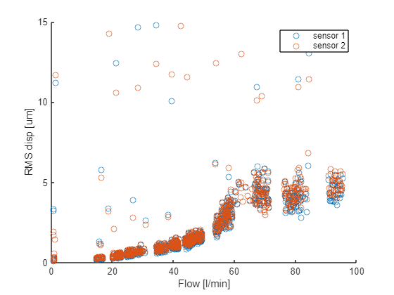
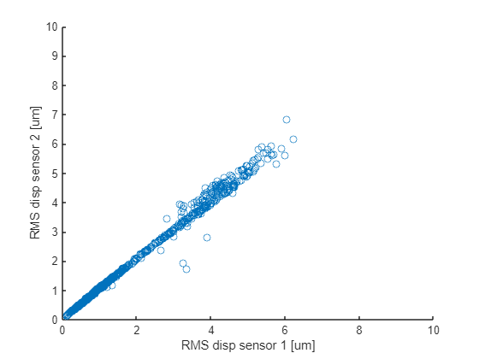
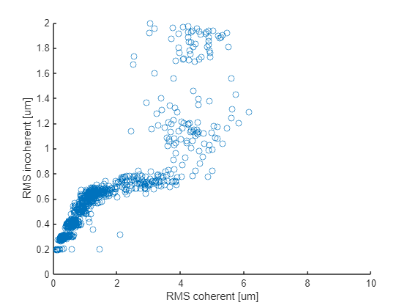
Impact of Varying Flow Rate
f_{s} = 5 kHz, T = 10 s, 2000 points

Slide 22
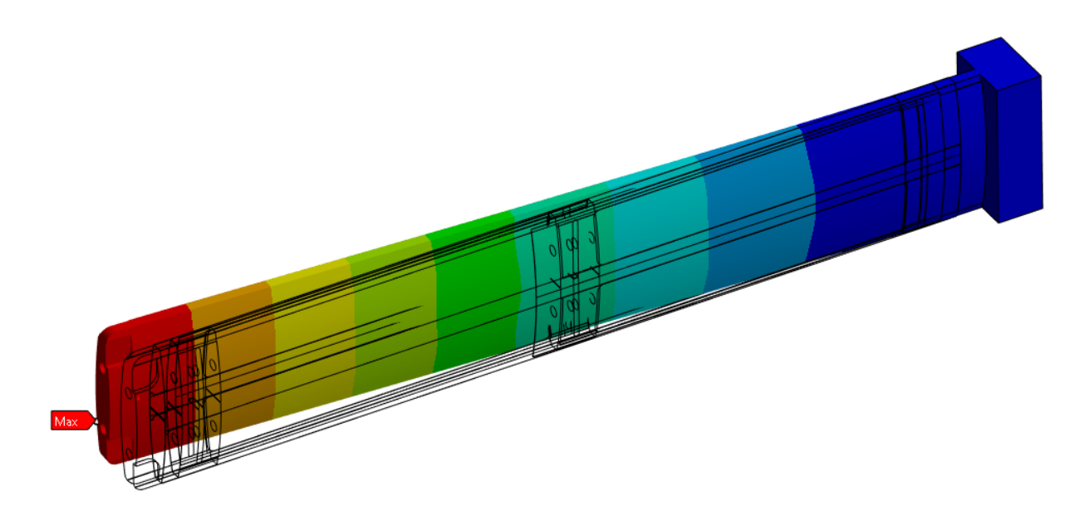
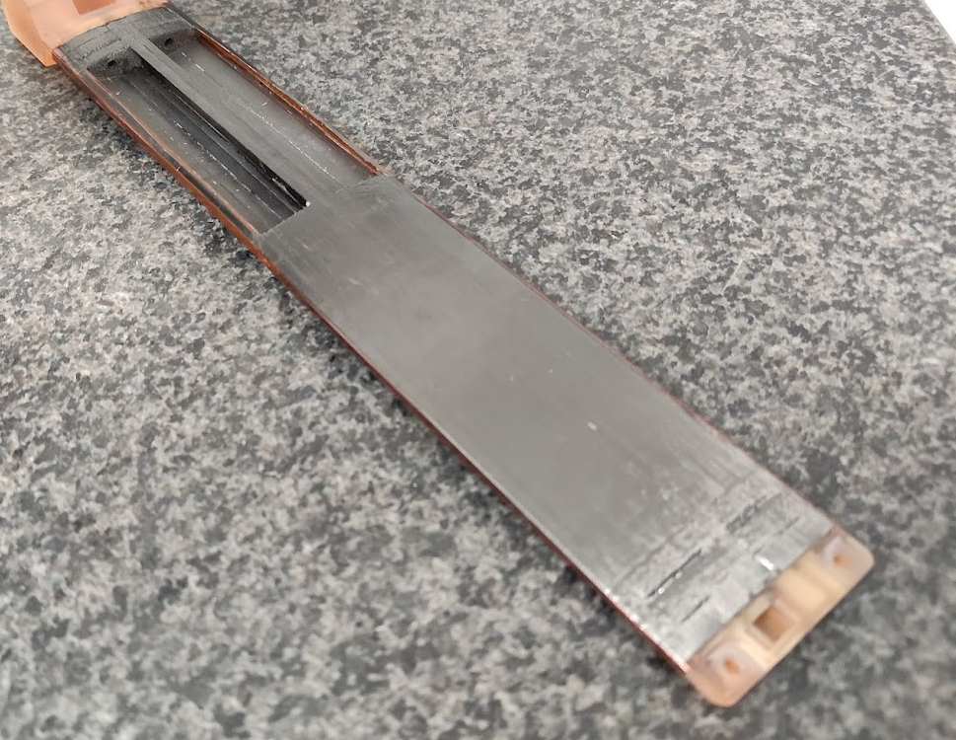
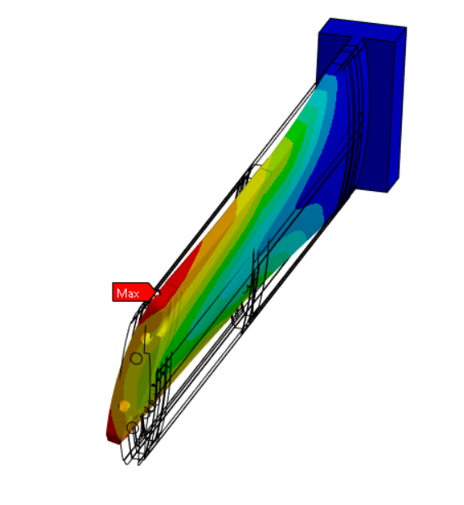
Modal Analysis
Experimental results can be compared to finite element modal analysis
  First beam mode about 30% higher
  First torsional mode frequency 3 times greater
Defect in prototype stave skin
  Split in the carbon fibre skin, patched with Kapton & glue
  Affects integrity of torsion box structure
Vibration modes and magnitudes from a ¼ Stave can’t be applied to a full stave, we are just testing the method of data collection and accuracy of simulations
First Beam Mode - 106.96 Hz
Crack in carbon fibre skin
First Torsional Mode - 364.65Hz

Slide 23
Thermal Analysis/Testing

Slide 24
Thermal Modelling Approach
1D analysis to determine to determine boundary conditions (e.g. coolant temperature along stave)
2D Steady state thermal Finite Element Analysis (FEA) with semi-empirically derived heat transfer coefficients
3D CFD Simulations for complex regions e.g. porous K9 blocks
Too early to judge effectiveness/viability of air cooling
  Power distribution is not representative of module
  Focus for now is on building the analysis methods

Slide 25
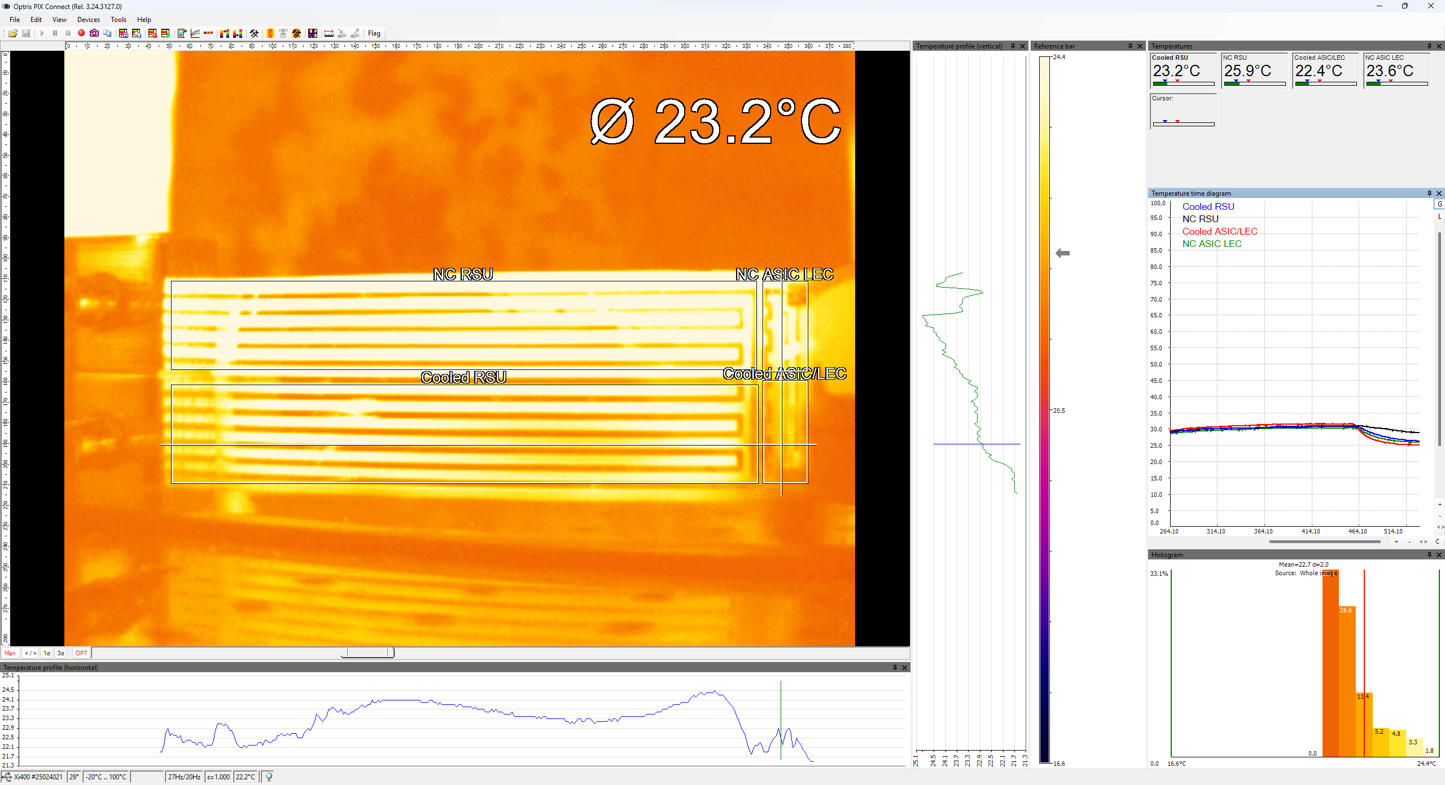
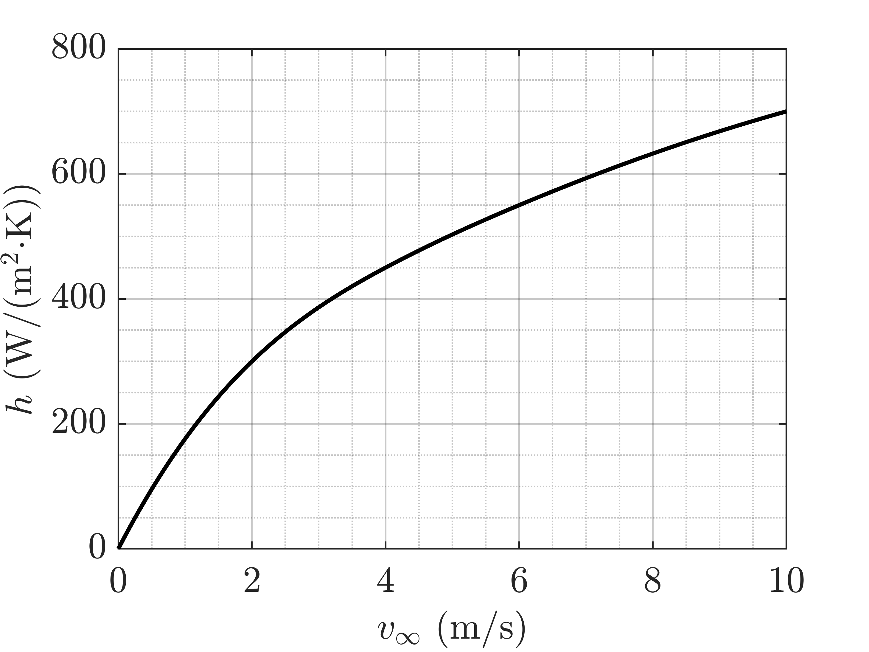
2D FEA Model vs. Thermal Imaging
Internal heat generation in Kapton layer – 50 microns thick
Convection Coefficients
  Natural convection - 7 W/m² K from external surfaces
  Forced convection - 48.44 W/m² K from internal surfaces
  Forced convection - 650 W/m² K from K9 adjacent surfaces
Forced convection temperature from 1D model
X₀
X_{end}

Slide 26
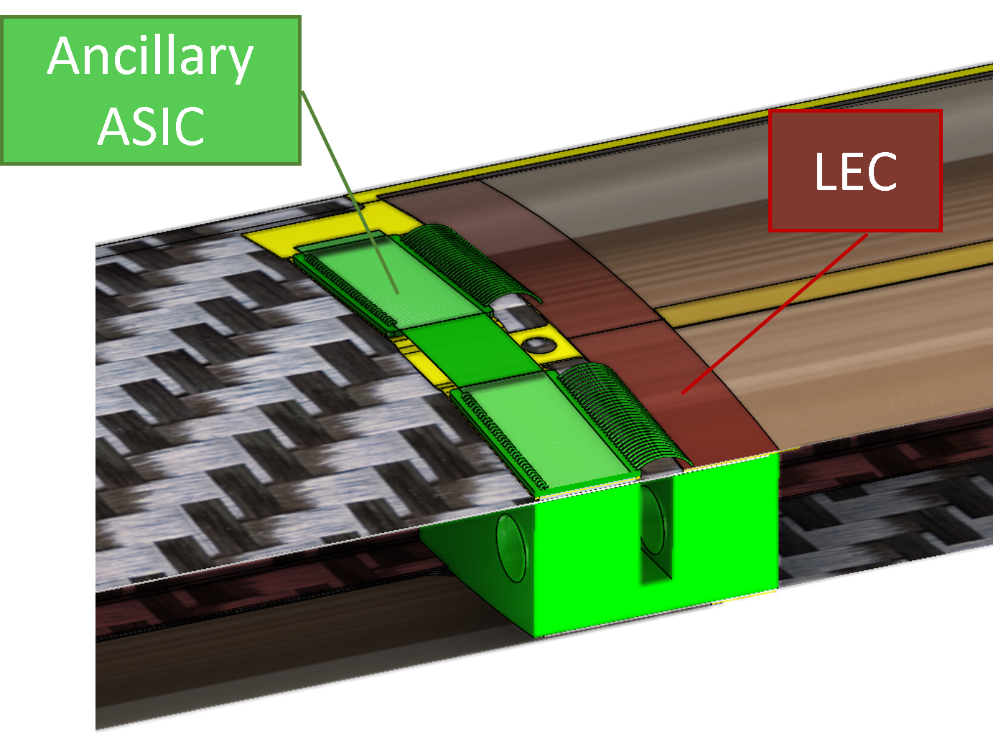
K9 Foam Performance
Kapton heater issue means LEC & ASIC power are lower than what they will be, making it difficult to evaluate performance
To compensate for this:
  Flow velocity reduced to 30 ltr/min
  Total Module power increased
    LEC Power – 0.28 W
    ASIC Power – 0.19 W
Trace line shown in dotted blue plotted
Uncooled
Cooled

Slide 27
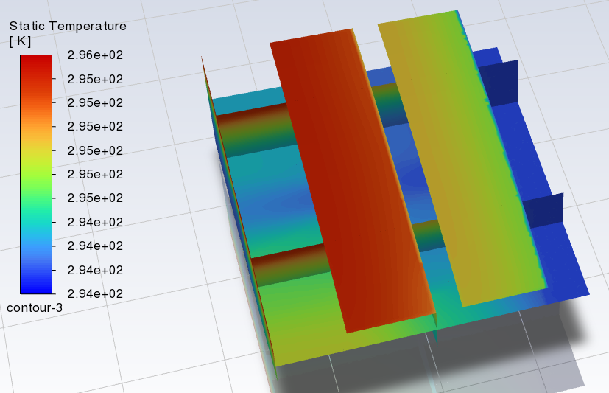
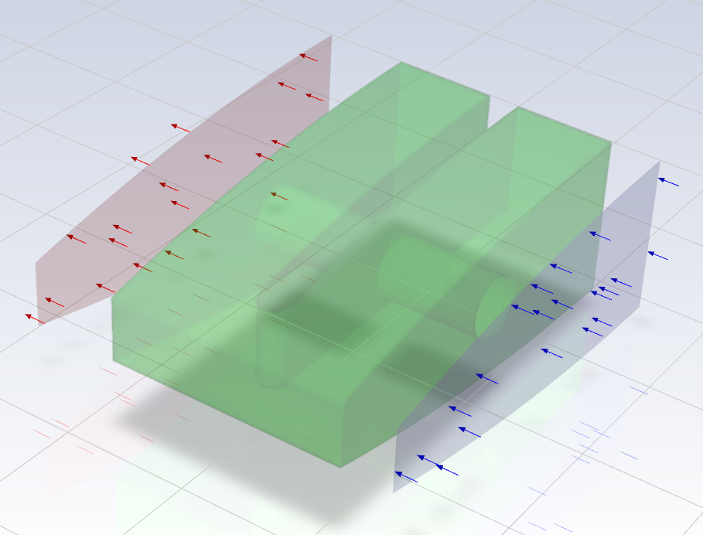
CFD Flow Models
CFD will be beneficial for K9 block geometry optimisation
Match experimental inputs
  Inlet Velocity of 4.03 m/s (30 lpm equivalent)
  LEC Power – 0.28 W
  ASIC Power – 0.19 W
Porous laminar flow zone
  Porosity 0.89
  Viscous and Inertial Resistance from ALICE Studies
  Thermal Conductivity 25 W/m²K
Outputs
  Mean Velocity Porous Zone – 3.3 m s⁻¹
  Average Surface Heat Transfer Coefficient – 285 W/m²K
LEC
ASIC

Slide 28
Summary & Outlook
Key Achievements
  Refined build process through co-curing of multiple Quarter Stave Prototypes
  Thermal, pressure & vibration testing performed on prototypes
  Simulation approach for thermal and structural analysis
Current Challenges
  Non-representative power distribution in Kapton heaters affecting thermal realism
  Vibration measurement of ¼ Stave can’t be applied to a full-length stave
Next Steps
  Scale up to full-length stave prototypes – Tooling in production (build within a month)
  Improve power mock-up design for more representative thermal testing
  Include more representative FPC, check durability to autoclave cycle

Slide 29
Questions

Slide 30
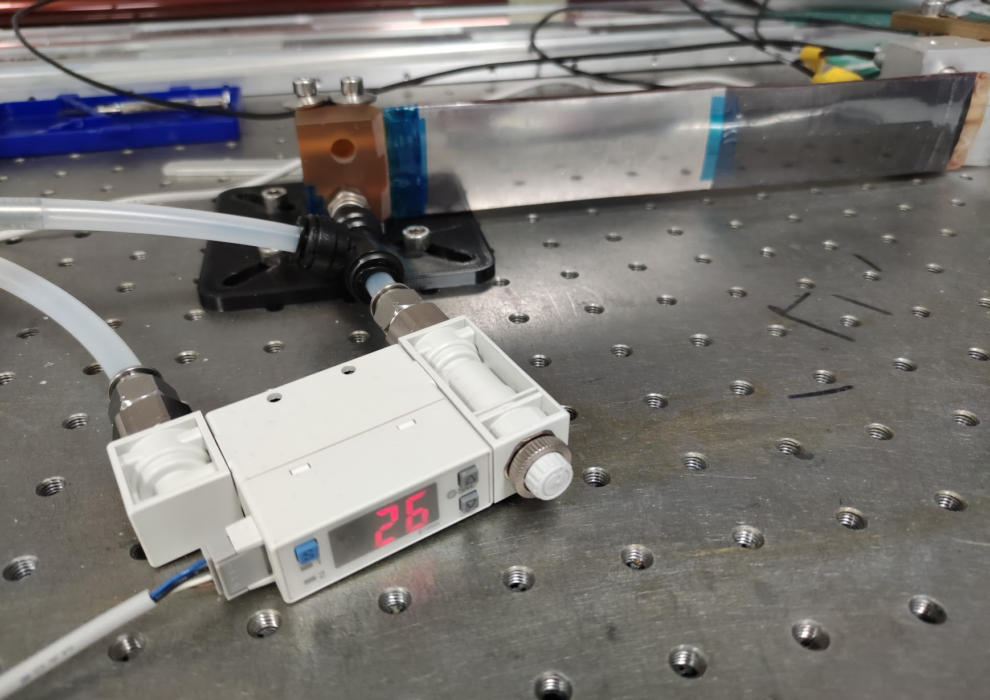
Pressure Loss
Internal pressure results in stave deformation
Target ΔT coolant of 10°C
  25°C Power Case → Flow Rate = 70 lpm
  40°C Power Case → Max Flow Rate = 100 lpm
Nominal
Max

Slide 31
1D Flow Models
Module 1
  Inlet – 20°C
  Post ASIC – 20.3 °C
  Post LEC – 20.4 °C
Module 2
  Inlet – 20.7°C
  Post ASIC – 21°C
  Post LEC – 21.1°C

Slide 32
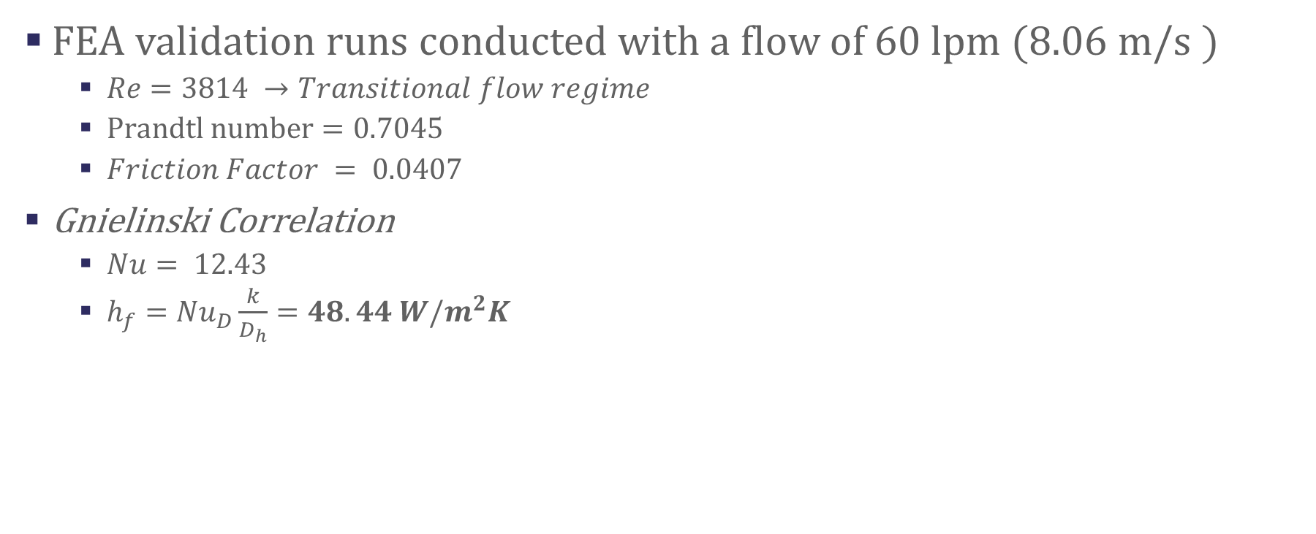
2D FEA - Fluid Properties
FEA validation runs conducted with a flow of 60 lpm (8.06 m/s )
  $Re=3814 →Transitional flow regime$
  $Prandtl number=0.7045$
  $Friction Factor = 0.0407$
Gnielinski Correlation
  $Nu= 12.43$
  $h_{f}={Nu}_{D}\frac{k}{D_{h}}=48.44 W/m^{2}K$

Slide 33
Mass & Radiation Length
ITEM NO. | PART NUMBER | Material | DENSITY(kg/m^3) | MASS(g) | QTY. | TOTAL VOLUME | TOTAL MASS (g) | X0(cm) | X/X0
1 | Cross Brace | K9 Carbon Foam | 200 | 0.41 | 9 | 1.85E-05 | 3.69 | 260.82 | 0.02%
2 | Longerons | 8% Rel Vol Aluminium Foam | 216 | 1.66 | 1 | 7.69E-06 | 1.66 | 296.5666667 | 0.01%
5 | Mid Brace | 3% PRV Foam | 45 | 0.10 | 8 | 1.78E-05 | 0.8 | 644 | 0.01%
6 | Carbon Top Plate | Carbon Fibre | 2000 | 4.14 | 2 | 4.14E-06 | 8.28 | 19.32 | 0.07%
7 | ALICE SENSOR ASSEMBLY | Silicon | 2330 | 0.50 | 8 | 1.70E-06 | 3.961072 | 9.37 | 0.06%
9 | Kapton FPC - 2-4 | Kapton | 1420 | 0.85 | 2 | 1.19E-06 | 1.693468 | 28.57 | 0.01%
10 | MirrorLongerons |  | 216 | 1.66 | 1 | 7.69E-06 | 1.66 | 296.5666667 | 0.01%
11 | Kapton FPC - 1-3 | Kapton | 1420 | 0.70 | 2 | 9.86E-07 | 1.4 | 28.57 | 0.01%
12 | Stave End Gas Feed | Ultem | 1280 | 0.84 | 1 | 6.56E-07 | 0.84 | 28.57 | 0.01%
13 | Stave End Gas Feed | Ultem | 1280 | 0.92 | 1 | 7.19E-07 | 0.919726 | 28.57 | 0.01%
 |  |  |  |  |  | Total Mass | 24.90 | Total Radiation Length | 0.21%
EXCLUDES CONTRIBUTIONS FROM FPC,BRIDGE FPC OR ASIC

Slide 34
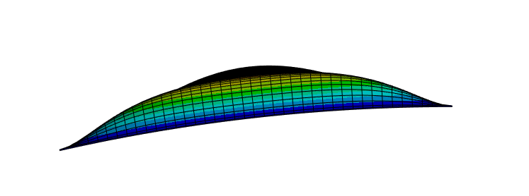
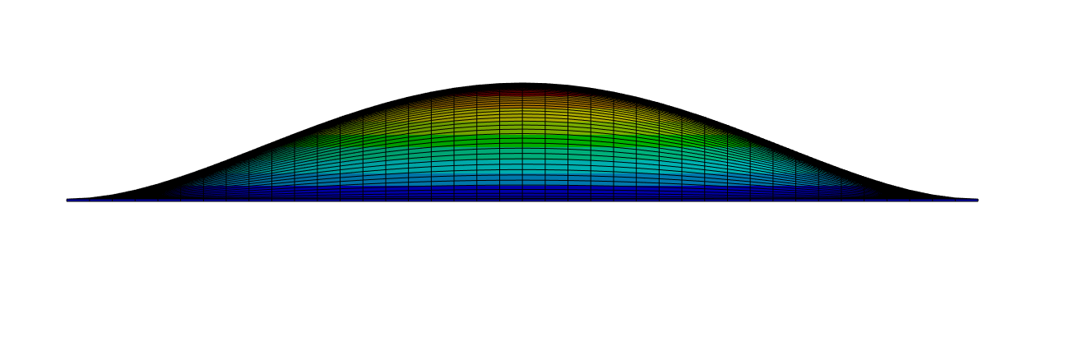
Sensor Deformation Due to Internal Pressure
Air velocities in flow channel will be high
  High pressure drop/high inlet pressure
Curvature reduces deformation due to internal pressure
Sensor/module curvature of Ø180 mm results in micron level deformation due to 1000 Pa internal pressure
Notes:
Sensor modules will form an integral part of the pressurised wall of the stave. We expect that we’ll need quite high flow velocities to cool the sensors which will result in high inlet pressures acting on the stave internal surfaces
Having a small curvature to the sensor dramatically reduces deformation due to internal pressure. The plot shows the sensor surface deformation for a range of curve diameters, our current design has a diameter of 0.18m

Slide 35
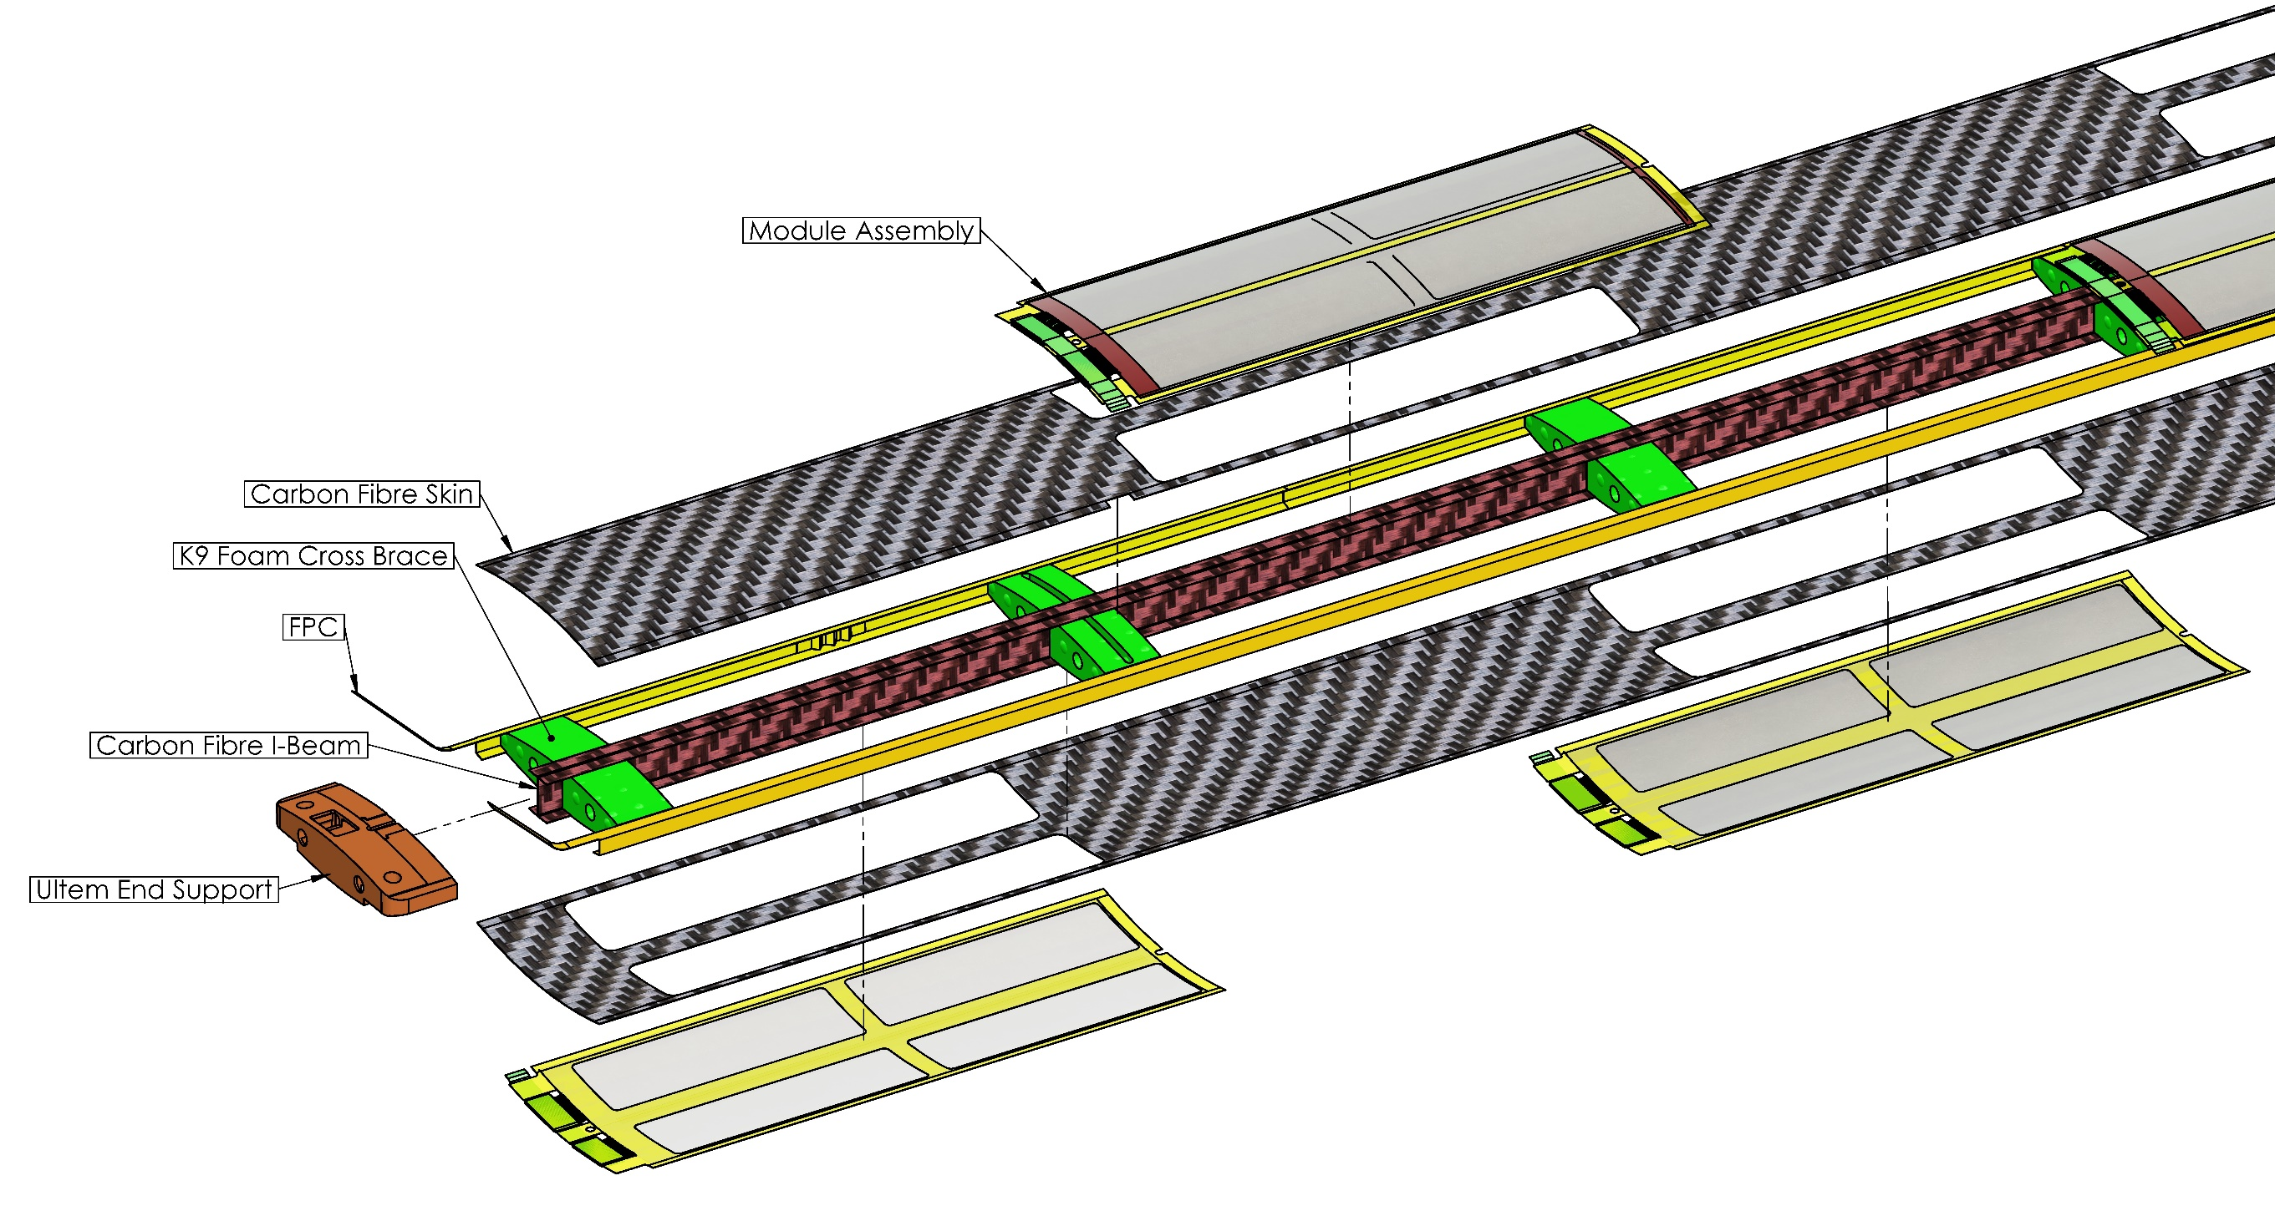
OB Stave Construction
¼ Length Stave End
QSP
L4 X 8 Modules
L3 X 4 Modules
Notes:
We form a skeleton structure with a central carbon fibre I-beam and K9 foam cross braces
K9 foam blocks are located to align with the Ancillary ASIC and LEC of the modules for enhanced heat transfer.
Serial power chain
Flexible Printed Circuit (FPC) is structurally integral to the stave, is part of the gas containment boundary and supplied power and data transfer.

Slide 36
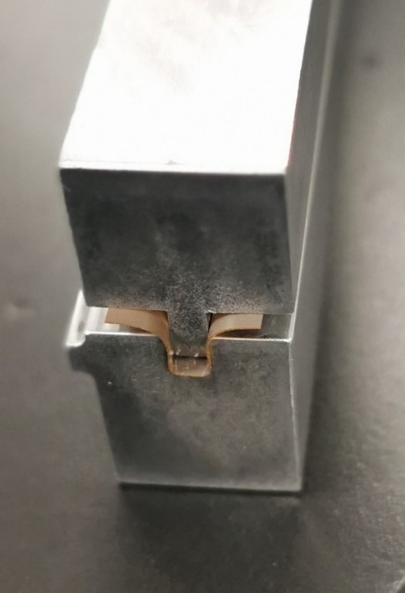
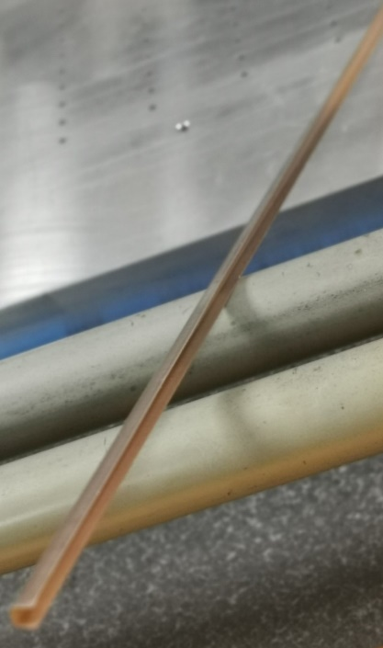
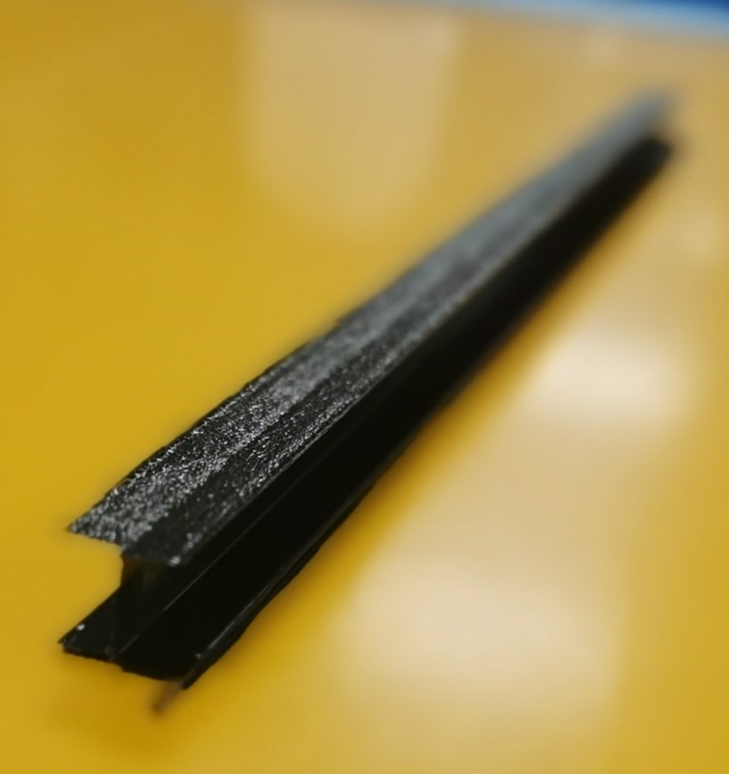
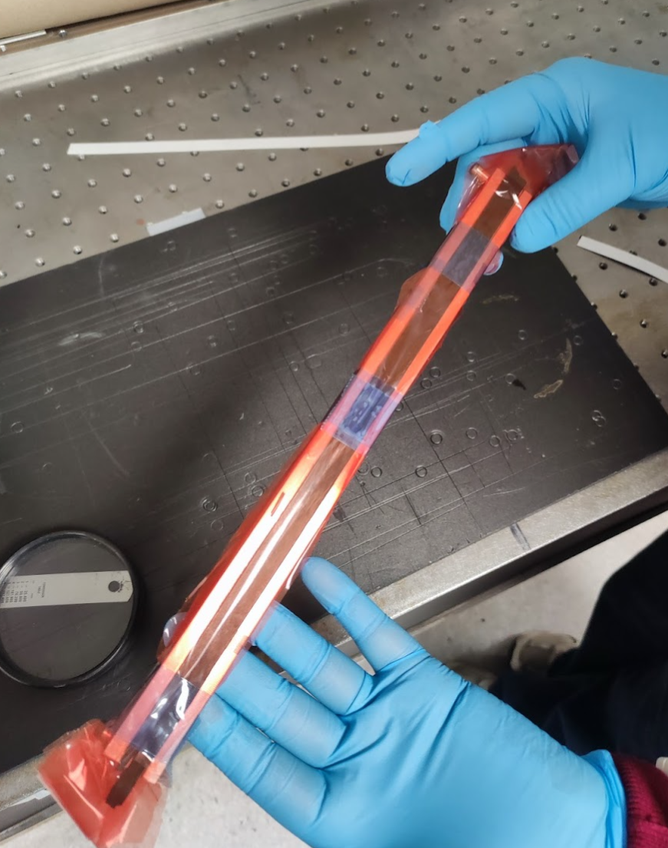
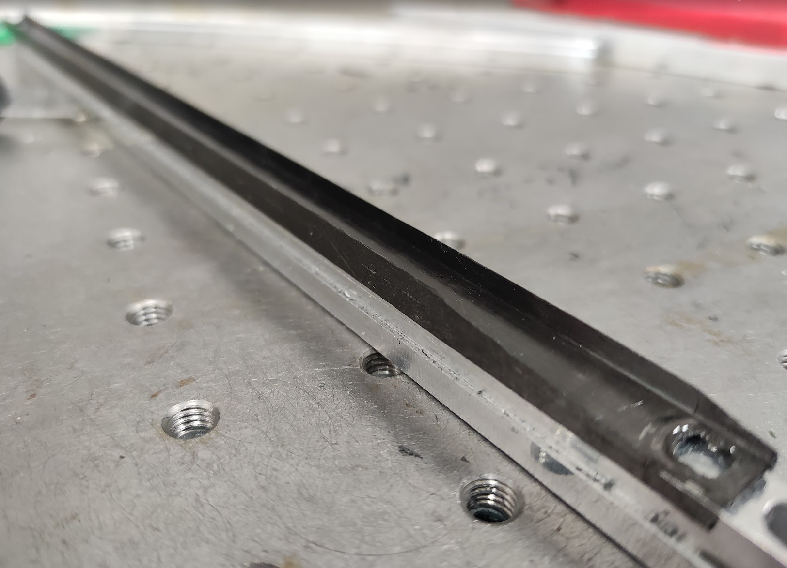
¼ Length Stave Prototypes
Preformed components
  Carbon Fibre I-beam pre-cured in a 2-part mould
  Flexible Printed Circuits (FPC) preformed (with heat and pressure) into C channel

Slide 37
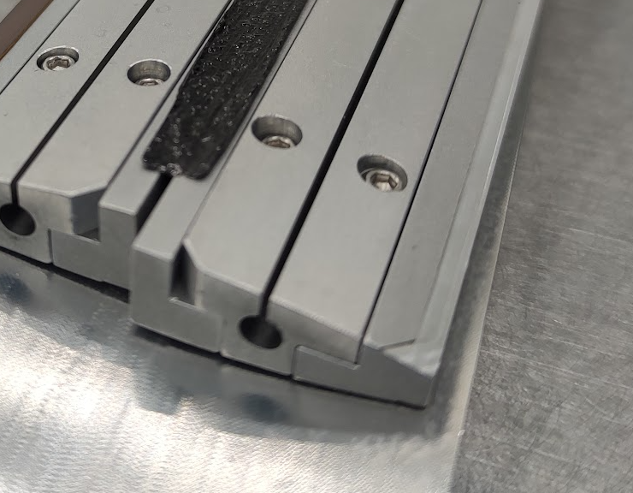
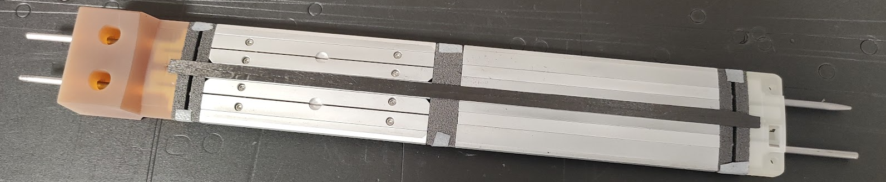

Stave Inner Structure
Aluminium Internal Formers
K9 Foam Heatsink
⌀ 3 mm Silver Steel rods

Slide 38



Outer Skin
Airtight boundary formed by FPC, Carbon Fibre face sheet and modules
FPCs Mounted along outer edge, joined to K9 Foam with Prepreg Adhesive Film
Carbon fibre face sheets aligned on inner structure
Silicone rubber sheet added on top and bottom surfaces as an intensifier

Slide 39



Post-Cured Stave Assembly

