Slide 1
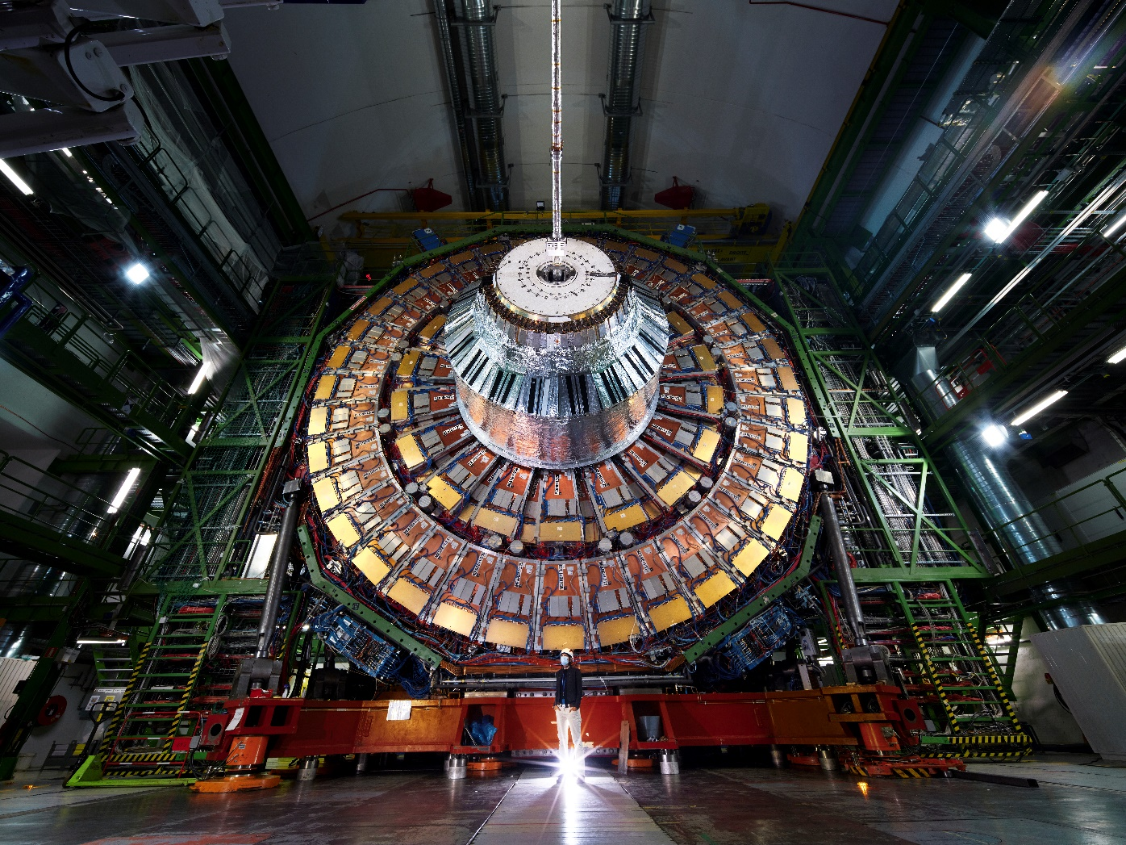
Forum on Tracking Detector Mechanics 2025 Bristol, UK
Experimental tests on TBPX cooling loops at different CO2 vapour qualities
Lorenzo Bistoni, EP-CMX-ID
With major contributions from: D. Abbaneo, G. Baldinelli, P. F. Cianchetta. On behalf of the CMS Tracker Group

Slide 2
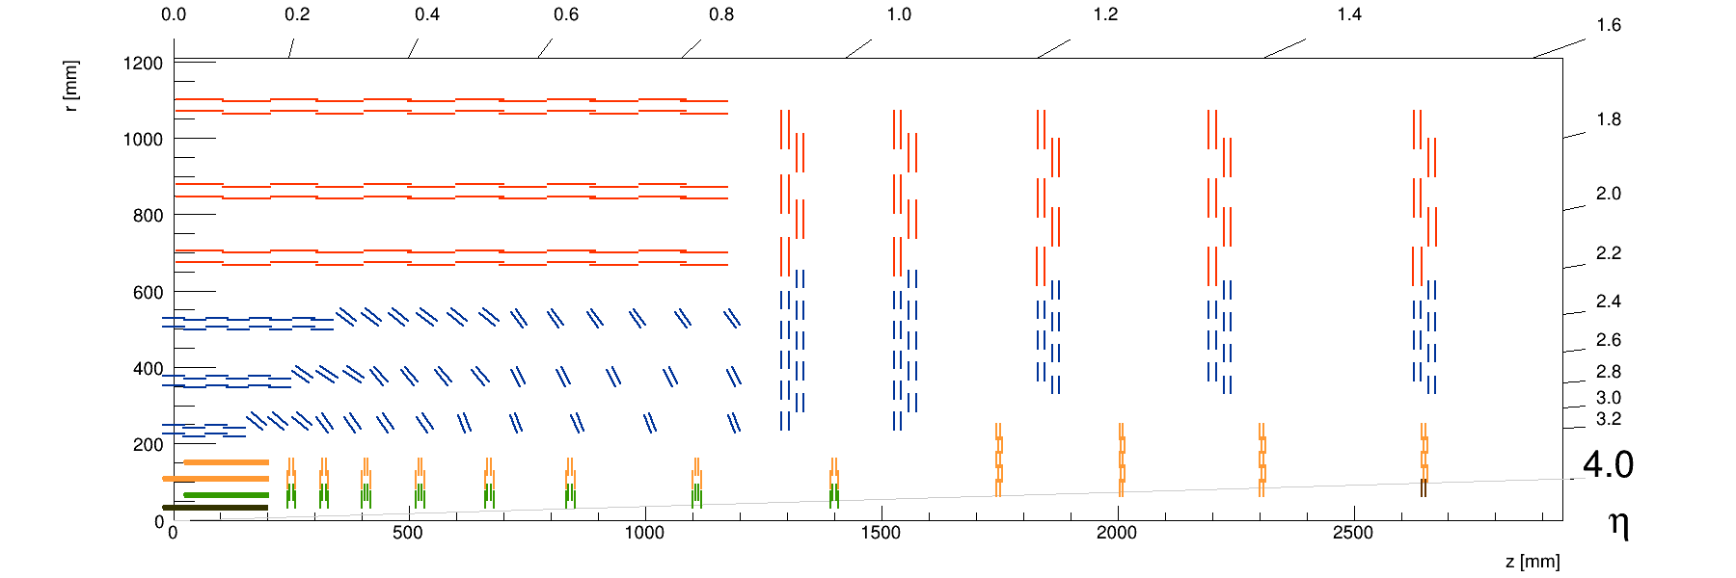
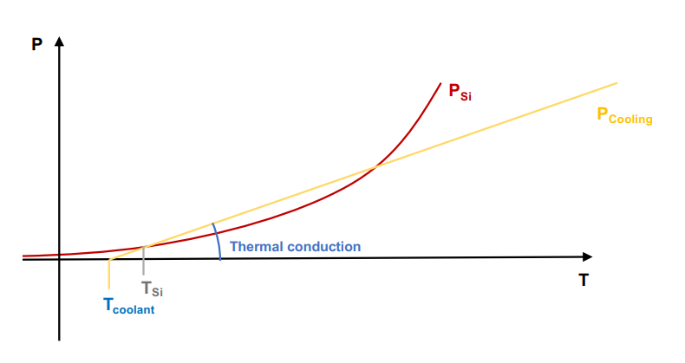
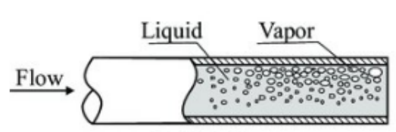



Introduction
Longitudinal layout of the upgraded CMS Tracker
Detector | Inner Diameter [mm] | Max Heat Flux [kW/m^2]
TBPX | 1.6 | 50
TFPX | 2.5 | 18
TEPX | 2.1 | 19
TBPS tilted | 2.2 | 8
TBPS Flat | 2.0 | 16
TB2S | 2.0 | 5
TEDD | 2.2 | 5
TB2S
TEDD
TBPS
TBPX
TFPX
TEPX
Vapour Quality (VQ):
Thermal runaway (Tα):
$$x= \frac{m_{vap}}{m_{vap}+m_{liq}}$$
α
VQ Target = 42%
Heat flux [kW/m^2]
Tα
Validated with extensive tests on Outer Tracker Structures
$$HF= \frac{Power applied [kW]}{Internal pipe surface[m^{2}]}$$
$$Cooling power<Heat generation$$

Slide 3
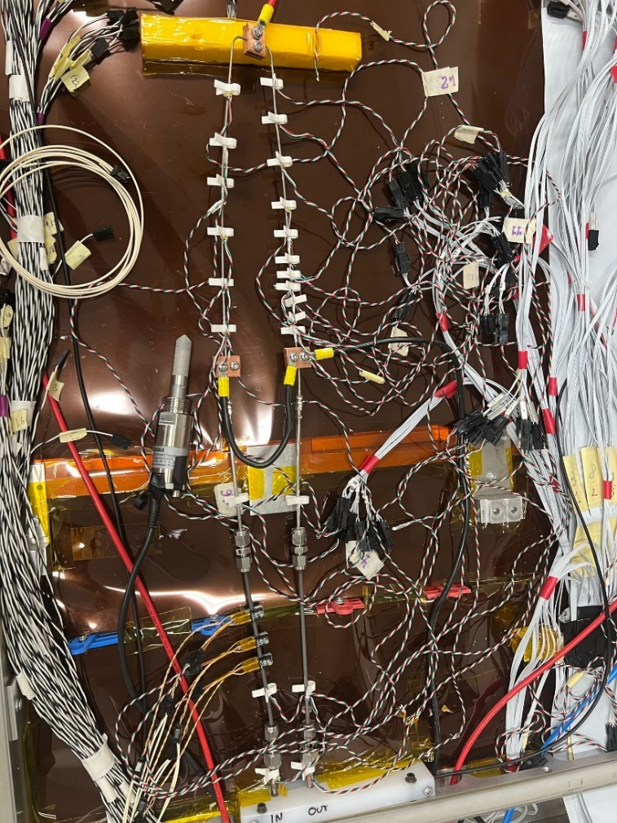

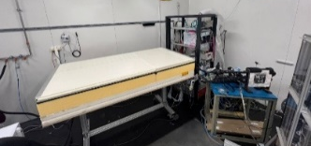
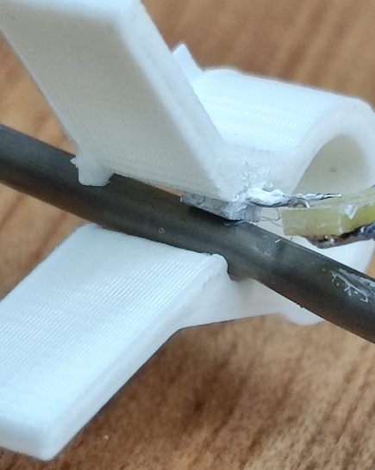
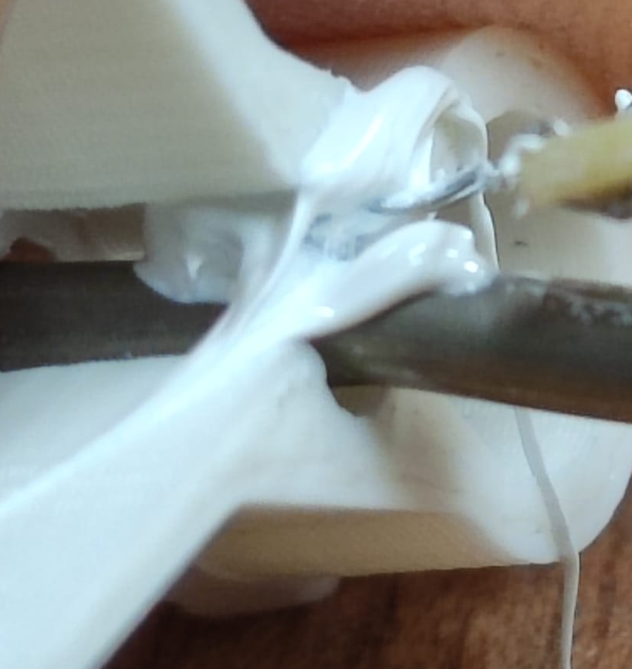
Test setup
Lyon Cold Room – CERN B.186
TRACI: CO2 bi-phase cooling plant.
REF | OBJECT | Material | Inner Diameter [mm] | Outer Diameter [mm]
A,E | Transfer line | Titanium | 2.8 | 3.2
B,D | Transfer line | Stainless Steel | 2.5 | 3
C | Evaporator | Stainless Steel | 1.6 | 1.8
C
B
D
A
E
PT1000: Temperature reading
Thermal paste

Slide 4


Test plan
Cooling loops: current design TBPX PH2
Cooling loop | HF [kW/m2] | VQ multiline | Power [W] | Flow test [g/s]
Z+ L3-1 | 50 | 38% | 126 | 1.2
Z+L3-9/ Z+ L3-10/ Z- L4-1/ Z- L4-2 | 50 | 40% | 126 | 1.2
Z+ L3-2 | 39 | 39% | 94 | 0.9
Z- L2-8 | 30 | 37% | 73 | 0.8
4 different cooling loops, restrictions due to pipe lengths
Nominal conditions
Max heat fluxes of TBPX
Further evaluations
50 [kW/m^2]: Different Vapour Quality tested, from 20% to 50%.
Reducing flow with fixed power
40%, 33%, 25% : Different Heat Fluxes tested, from 5 to 60 kW/m^2
Changing both flow & power
1 Hz sampling frequency
~10 minutes per case

Slide 5



Results: temperature over time. 50 kW/m^2, different VQ
In designed operating conditions, TBPX loops shows consistent temperature instabilities
Instabilities since DAY 1 of tracker!
9
10
12
14
7
8
11
13
Why..?
6
5
4
3
2
1

Slide 6
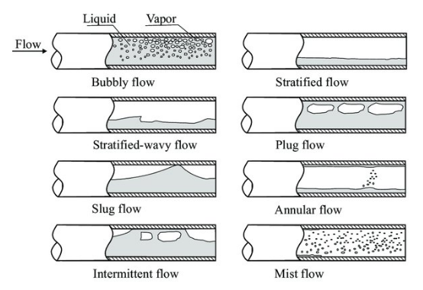
Hypothesis
Probably because:
When the size of the bubbles reaches dimensions comparable to the pipe ID, they cannot evolve freely, and the possible boiling patterns are different: “confined flow”
(courtesy P. Petagna)

Slide 7


Results
Test campaign: different VQ (40 %, 33%, 25%) and HF (5 to 60 kW/m^2)
Complete thermal test results: https://indico.cern.ch/e/1528650
Main points:
25% of VQ as a new operation parameter for TBPX
VQ at 40%: First spikes at 40 kW/m^2
VQ at 33%: First spikes at 50 kW/m^2
More mass flow needed!
VQ at 25%: Stable temperature for all Heat fluxes!
Pressure drop constraint
New evaluation of both flow rate and capillaries (diameter and lengths): Multiline simulations
Can we push more flow?
Thermal runaway constraint
17/06/2025

Slide 8
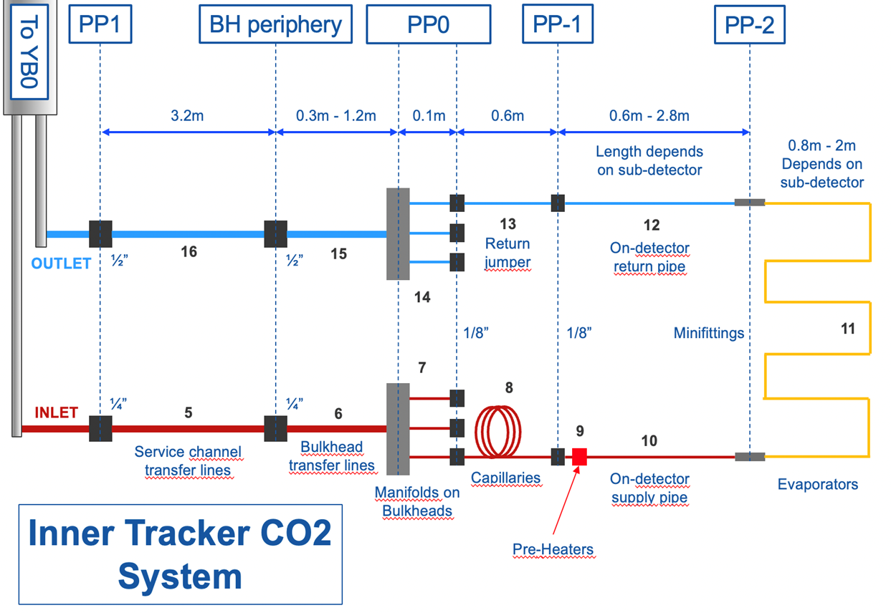
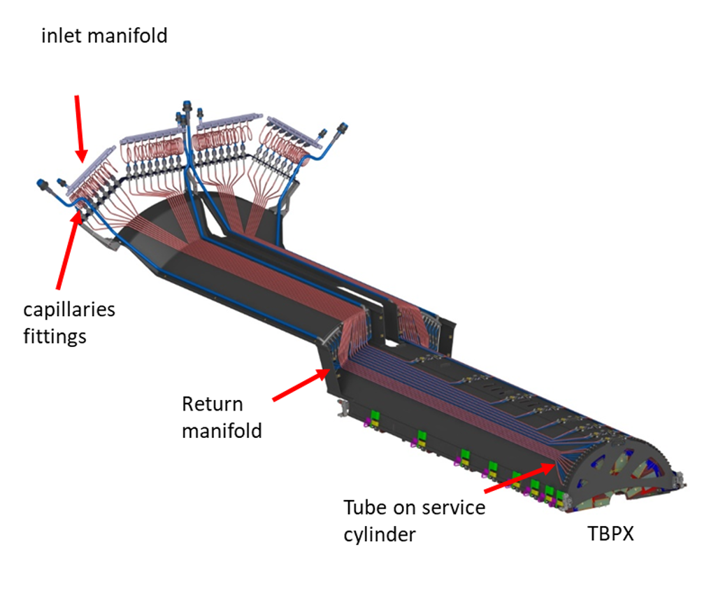
Boundary condition for new calculations
Fixed parameters:
T_{point16} = -35deg [B]
dP_{points5-16} = 10 bar [AB]
B
0.8m-2m
Depends on sub-detector
Lengths depends on sub detector
Return jumper
On-detector return pipe
Minifittings
A
Service channel transfer lines
Bulkhead transfer lines
Capillaries
On-detector supply pipe
Evaporators
Manifold on bulkheads
Pre-heaters
17/06/2025

Slide 9

Pressure drop:
Reducing VQ = increasing the flow
Is the flow still balanced?
ΔP evap
ΔP tot
ΔP capillaries 8 bars guaranteed in mostly all the loops, even at VQ 25%
17/06/2025
Notes:
Se mettiamo più flusso nell’evaporatore, la sua Perdita di pressione sarà più alta e, quindi quella del capillare più bassa. Teniamo dappertutto 8 bar?

Slide 10
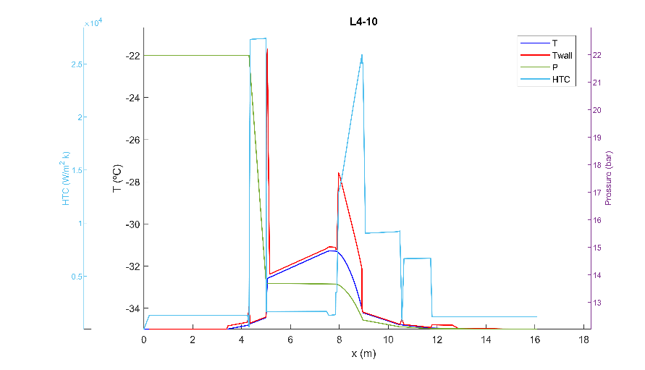
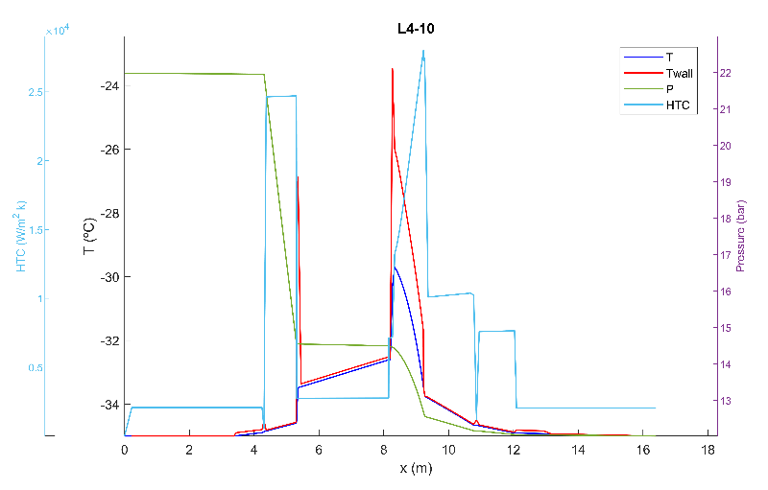
ΔP effect on CO2 temperatures [°C] in the evaporator:
VQ 40% Z- L4-10
VQ 25% Z- L4-10
More ΔP in the evaporator = higher inlet temperature
Constraints on thermal runaway...
17/06/2025

Slide 11
Tmax CO2 evaporators, TBPX Z+, Z-
Less VQ = More ΔP = Higher Tin [°C]
VQ [%]
Tmax[°C]
17/06/2025

Slide 12
Thermal runaway margins (Tα – Tmax)
Reduction in vapour quality
More ΔP in the evaporator
Higher inlet temperature
Smaller thermal runaway margin
NB: T.R. margin are evaluated for different integrated luminosity:
The minimum margin is 1.86°C in Z- L3-6 with 25% VQ. (1.3°C lower than VQ 42%)
2000 fb-1 for L1
4000 fb-1 for L2,L3,L4
17/06/2025

Slide 13
Conclusions
Original design: ID = 1.6 mm, max HF = 50kW/m^2, VQ = 42%
High temperature instabilities: behaviour close to dryout or prolongated contact pipe-bubbles
No way of accepting this instabilities: they will occour from day 1 of future tracker!
Worst Therm. Runaway margin is 2.98 [°C]
All cooling loops guarantee ΔPcapillaries > 8 bar
TBPX current design: ID = 1.6 mm, max HF = 50kW/m^2, VQ = 25%
No instabilities detected during our tests
Worst Therm. Runaway margin is [1.86°C]
Mostly all cooling loops guarantee ΔP capillaries > 8 bar
17/06/2025

Slide 14
Forum on Tracking Detector Mechanics 2025 Bristol, UK
Thanks for your attention
Questions?
- Lorenzo Bistoni, EP-CMX-ID
With major contributions from: Duccio Abbaneo, Giorgio Baldinelli, Pier Filippo Cianchetta. On behalf of the CMS Tracker Group
17/06/2025
lorenzo.bistoni@cern.ch

Slide 15
Backup: full test plan
Cooling loops: current design TBPX ph2
Test | Length [m] | Surface [m2] | Power [W] | HF [kW/m2] | Flow [g/s] | VQ multiline | P_PH [W] | HP th [W] | P_PH + HP th[W] | HP Test [W] | Flow test [g/s]
Z+ L3-1 | 0.50 | 0.00251 | 126.10 | 50.30 | 1.20 | 0.38 | 8.00 | 6.46 | 14.46 | 20 | 1.21
Z+L3-9/ Z+ L3-10/ Z- L4-1/ Z- L4-2 | 0.50 | 0.00251 | 126.10 | 50.30 | 1.14 | 0.40 | 8.00 | 6.46 | 14.46 | 20 | 1.15
Z+ L3-2 | 0.50 | 0.00250 | 94.58 | 37.88 | 0.92 | 0.39 | 8.00 | 6.50 | 14.46 | 20 | 0.93
Z- L2-8 | 0.48 | 0.00242 | 72.90 | 30.17 | 0.75 | 0.37 | 8.00 | 6.52 | 14.46 | 20 | 0.79
50 kW/m^2, different VQ[%]:
40 % VQ, different HF:
33 % VQ, different HF:
25 % VQ, different HF:
VQ[%] | Power [W] | Ftest [g/s]
0.50 | 126.4 | 0.92
0.45 | 126.4 | 1.02
0.42 | 126.4 | 1.10
0.40 | 126.4 | 1.15
0.38 | 126.4 | 1.21
0.35 | 126.4 | 1.32
0.33 | 126.4 | 1.40
0.30 | 126.4 | 1.54
0.28 | 126.4 | 1.65
0.25 | 126.4 | 1.84
0.20 | 126.4 | 2.29
HF [kW/m2] | Power [W] | Ftest [g/s]
60 | 150.42 | 1.37
55 | 137.88 | 1.25
50 | 126.10 | 1.17
45 | 112.81 | 1.07
40 | 100.28 | 0.95
35 | 87.74 | 0.88
30 | 75.21 | 0.79
25 | 62.67 | 0.67
20 | 50.14 | 0.57
15 | 37.60 | 0.46
10 | 25.07 | 0.37
5 | 12.53 | 0.26
HF [kW/m2] | Power [W] | Ftest [g/s]
60 | 150.42 | 1.66
55 | 137.88 | 1.51
50 | 125.35 | 1.42
45 | 112.81 | 1.30
40 | 100.28 | 1.15
35 | 87.74 | 1.06
30 | 75.21 | 0.95
25 | 62.67 | 0.81
20 | 50.14 | 0.69
15 | 37.60 | 0.79
10 | 25.07 | 0.68
5 | 12.53 | 0.55
HF [kW/m2] | Power [W] | Ftest [g/s]
60 | 150.42 | 2.19
55 | 137.88 | 2.00
50 | 125.35 | 1.88
45 | 112.81 | 1.71
40 | 100.28 | 1.52
35 | 87.74 | 1.40
30 | 75.21 | 1.26
25 | 62.67 | 1.06
20 | 50.14 | 0.91
15 | 37.60 | 1.04
10 | 25.07 | 0.89
5 | 12.53 | 0.73
17/06/2025

Slide 16
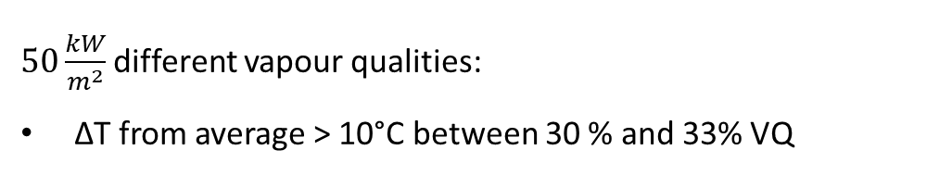
Backup: Results: temperature over time, cooling loops and 50 kW/m^2
Cooling loops:
50 kW/m^2 different vapour qualities:
6
7
8
5
9
4
10
3
11
2
12
13
1
14
Cooling loops:
ΔT from average ≃ 60°C for higher H.F.
Instabilities also at lower ones
$50\frac{kW}{m^{2}}$different vapour qualities:
ΔT from average > 10°C between 30 % and 33% VQ
17/06/2025

Slide 17
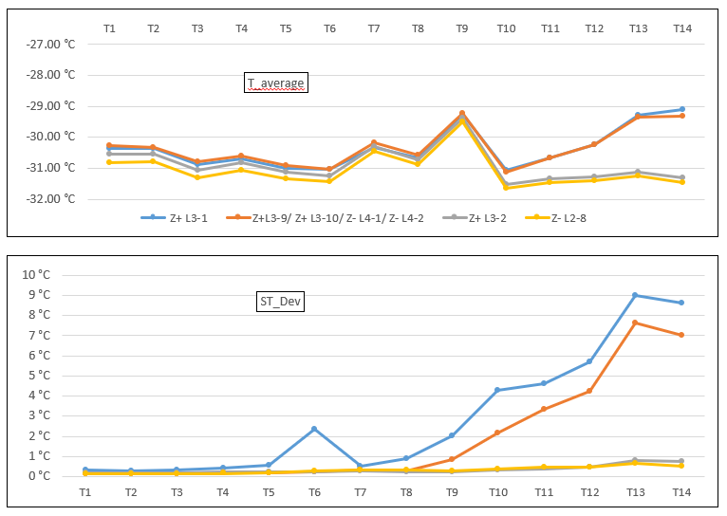
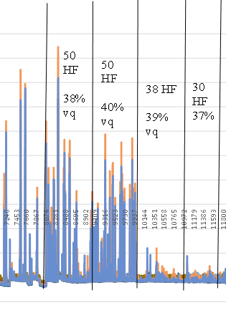

Backup: Results: AVG & STD loops
Test | HF [kW/m2]
Z+ L3-1 | 50.30
Z+L3-9 | 50.30
Z+ L3-2 | 37.88
Z- L2-8 | 30.17
Test | VQ
Z+ L3-1 | 0.38
Z+L3-9 | 0.40
Z+ L3-2 | 0.39
Z- L2-8 | 0.37
17/06/2025

Slide 18
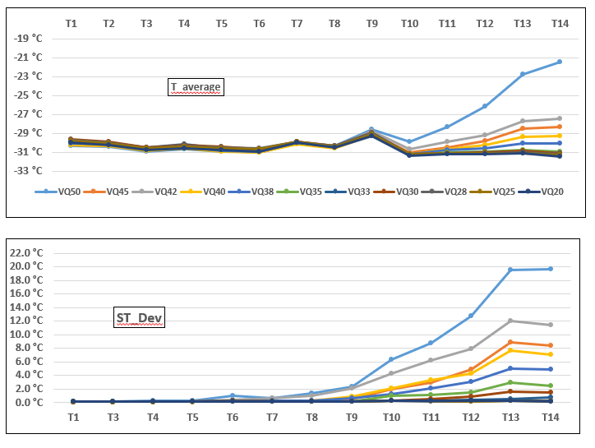
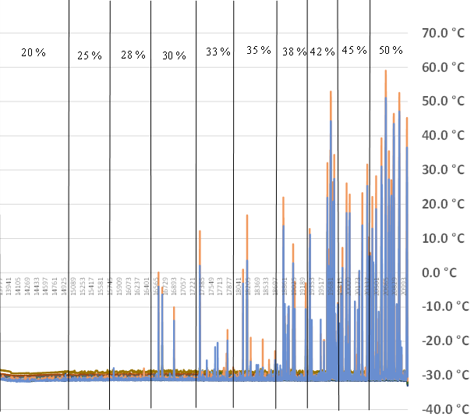
Backup: Results: AVG & STD 50 kW/m^2
17/06/2025

Slide 19
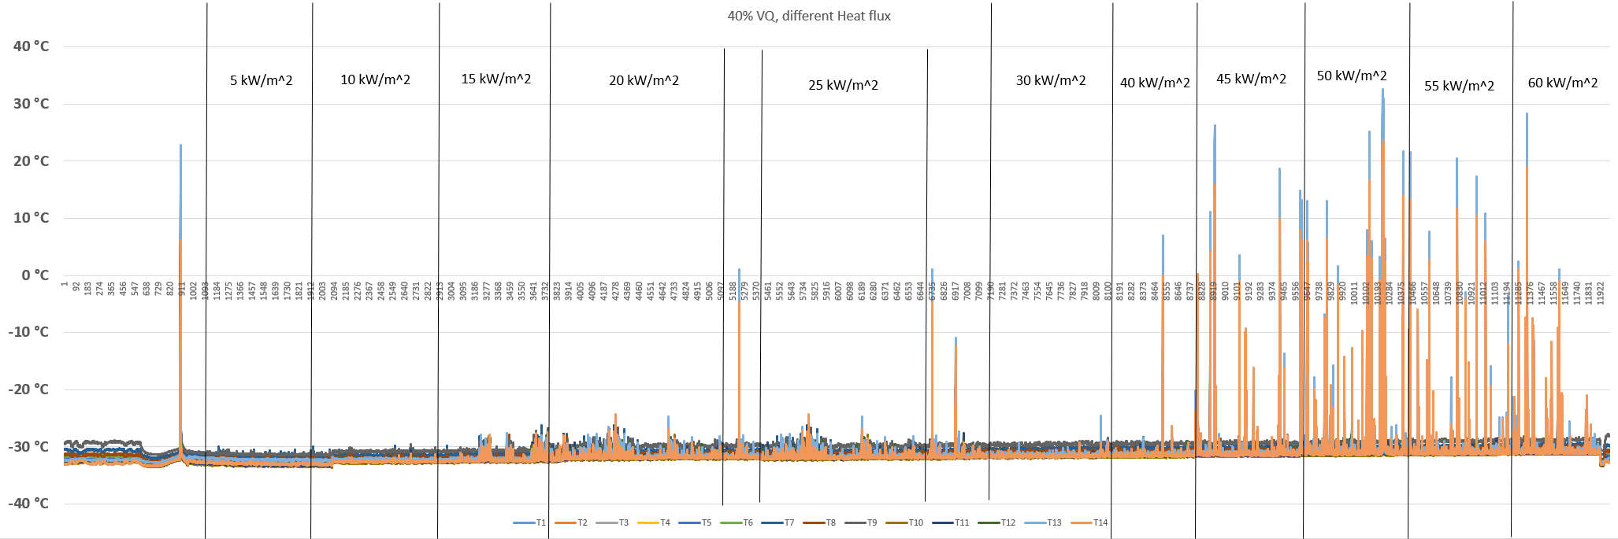
Backup: Results: temperature over time 40%VQ
40% VQ:
Significant instabilities for HF ≥ 40kW/m^2
17/06/2025

Slide 20
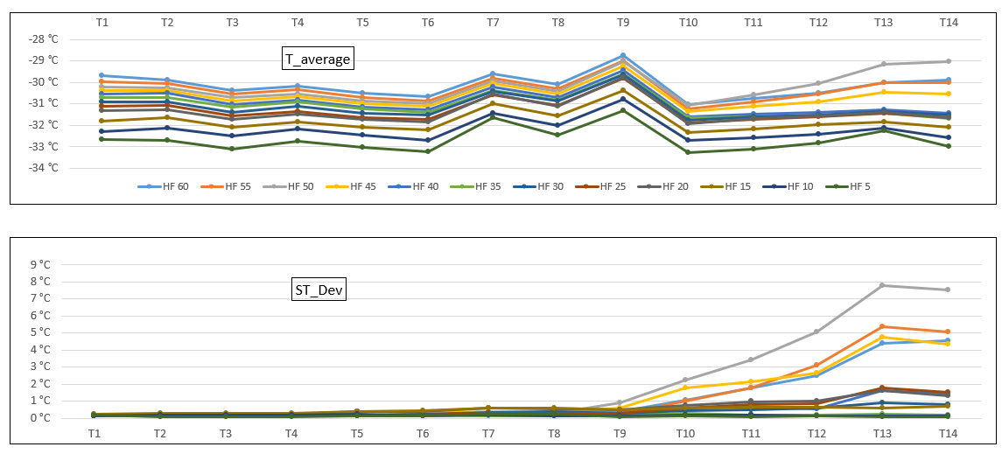
Backup: Results: AVG & STD 40%VQ
17/06/2025

Slide 21

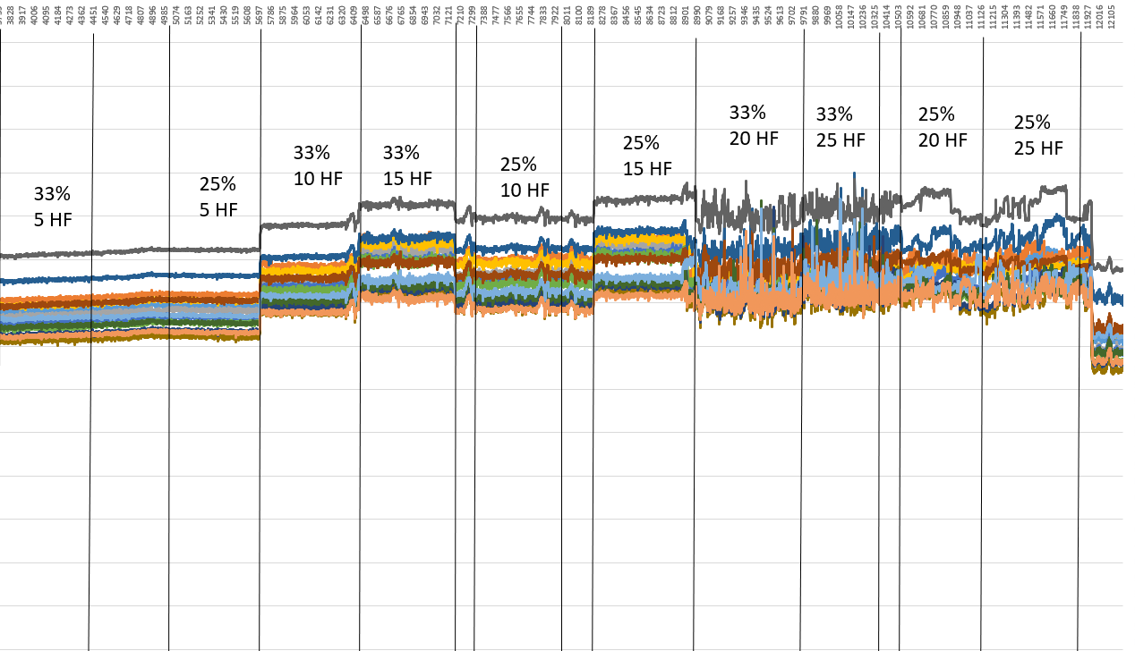
Backup: temperature over time 33% & 25% VQ
6
7
8
5
9
4
10
3
11
2
12
13
1
14
25% & 33% VQ, small heat fluxes:
Small spikes detected at 33%, 20 and 25 kW/m^2
17/06/2025

Slide 22

Backup: temperature over time 33% & 25% VQ
6
7
8
5
9
4
10
3
11
2
12
13
1
14
25% & 33% VQ, high heat fluxes:
Spikes detected at high HF for 33% of VQ, no spikes at 25% VQ
17/06/2025

Slide 23
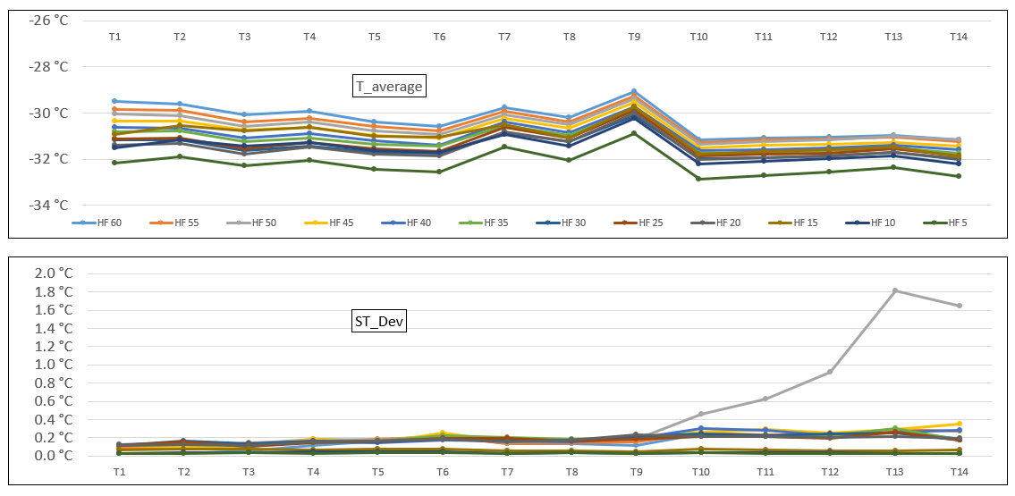
Backup: AVG & STD 33%
17/06/2025

Slide 24
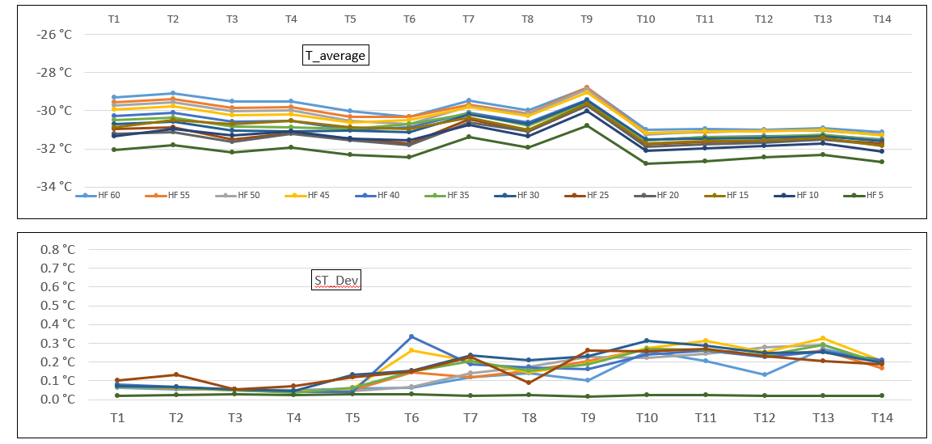
Backup: AVG & STD 25% VQ
17/06/2025

Slide 25
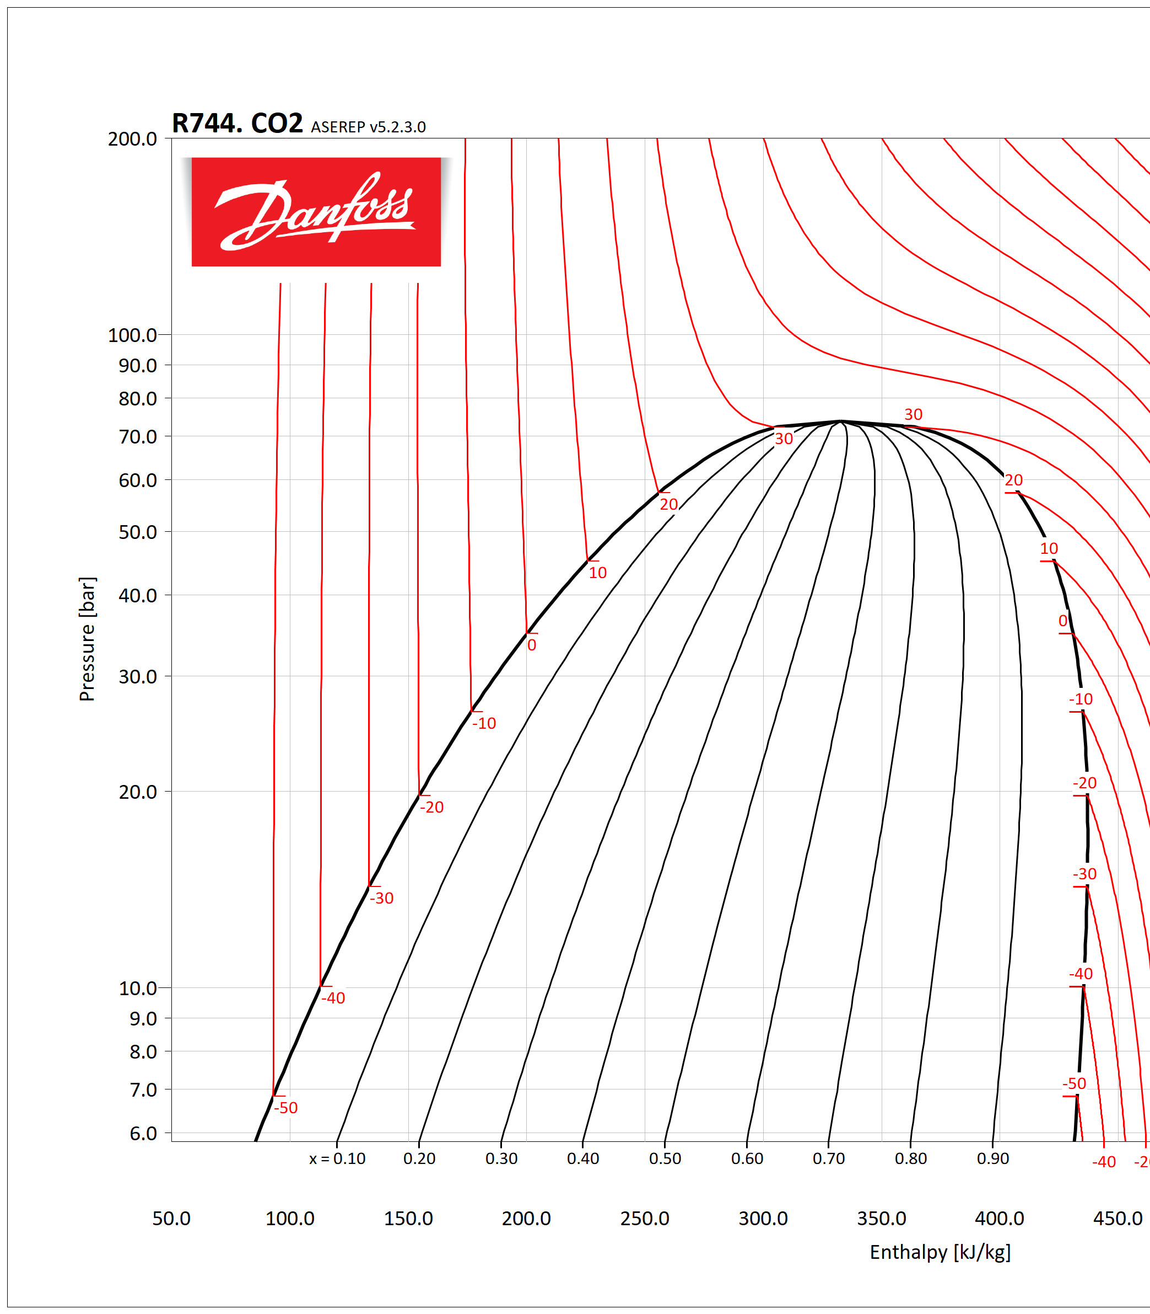
Backup: heat pickup
1: Reliably in subcooling
1’: Saturation at T1 temperature
0 : Starting point
A : Saturation point at T0 Temp.
0: P_in is measured, surely saturated.
0 – 1 : We create a striction with an outlet valve. In 1 we were in saturated condition. Hypotesys that 1-1’ is isothermic
1’: x = 0, T = -31.2°C
h = 130.77 J/g
0:
p = 12.3 bar
h = 130.77 J/g
x = 2.212 %
12.3
A: p = 12.3 bar, h = 124 j/g
F: 1.083 g/s
x =0.022
Dh at 12.3 bar = 311.9 J/g
W = F*x*Dh
W =7 watt
17/06/2025

Slide 26
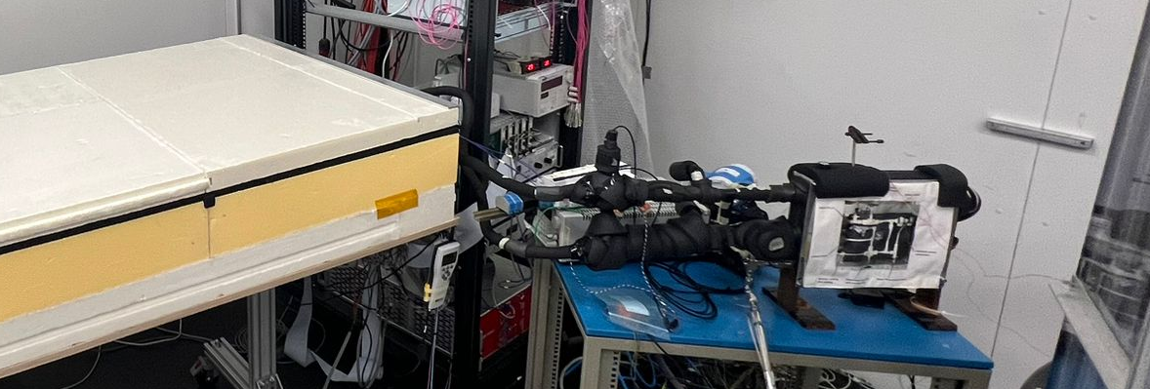
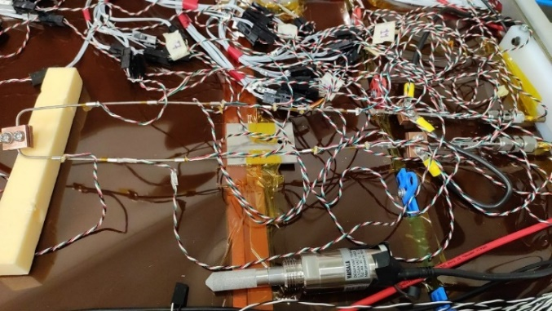




Backup: heat pickup
Pt1000 -Embedded sensors
Tout_box
Tair
Tin_bph
Preheater
PT1000
Tair_box
Tin_box
$$W_{local_box_sc}=m[\frac{g}{s}]∗C_{p}[\frac{J}{g∗k}]∗({T_{in_box} −T}_{inbph})[k]$$
$W_{real local_box}$ =$\frac{W_{local_box_sc}}{T_{air} −T_{in_box}}∗(T_{air} −T_{intest})$
$$W_{test_box_s.c.}=m[\frac{g}{s}]∗C_{p}[\frac{J}{g∗k}]∗(T_{out_{box}}−T_{in_box})[k]$$
$W_{real test_box}$ =$\frac{W_{test_box_sc}}{T_{air_box} −T_{in_box}}∗(T_{box} −T_{intest})$
$W_{real local_box}$ = 9W
$W_{real test_box}$ = 4 W
17/06/2025

