Slide 1
DRD 8 WP1 kick-off meeting
C. Gargiulo (CERN)
F. Palla (INFN Pisa)
CERN, 27 March2025

Slide 2
DRD8 – WP1 projects
The Vertex Region of Future Particle Physics Experiments
  Development of the next generation mechanics for advanced vertex layouts, including
    Curved and tilted silicon sensors
    Low radii vertex and retractable detectors
    Ultra-light, high-vacuum leak tight beam pipes and vessels
    Low mass hardware alignment systems for future vertex detectors
    Machine Detector Interface and impact on Detector
Robots in the HEP Experimental Caverns
  Development of robotic systems for future high energy physics experiments for inspection monitoring and first intervention for particle detectors even during the operation of beams
    Legged ground robotic platform in experimental cavern
    Aerial robotic platform in experimental cavern
    Mini-robots swarm and mobile mesh network

Slide 3
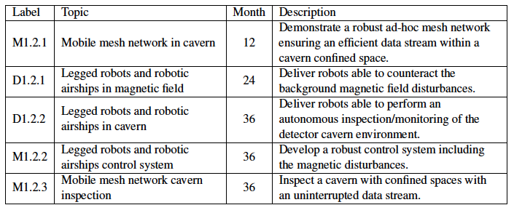
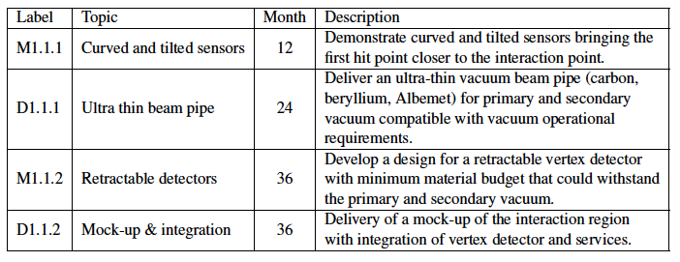
DRD8 – WP1 Deliverables and milestones

Slide 4
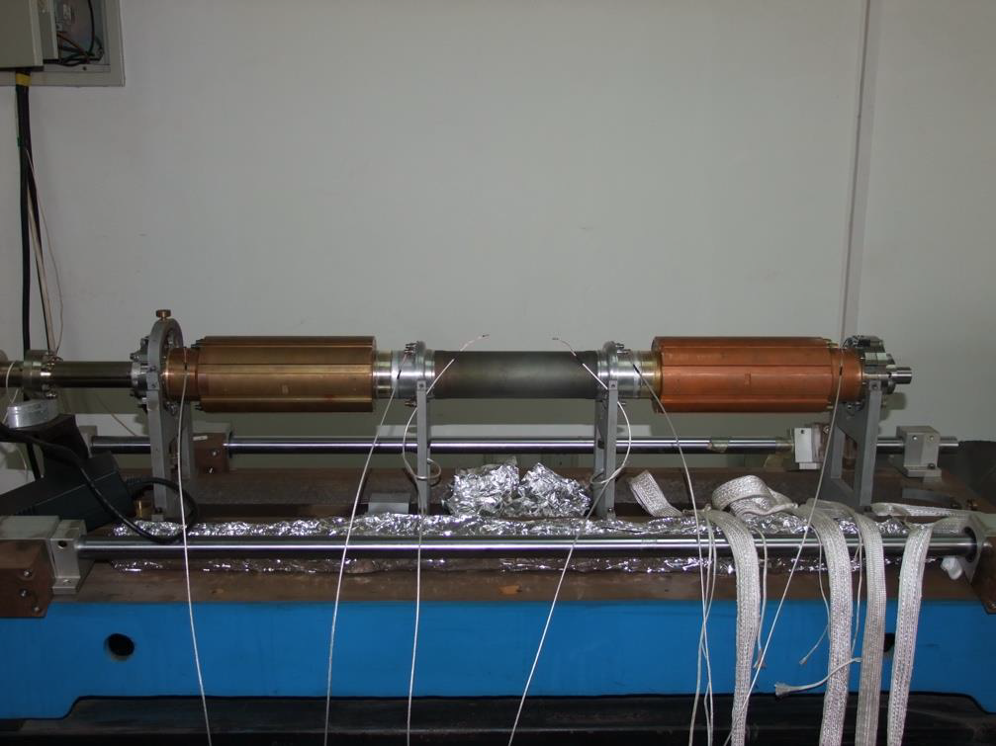
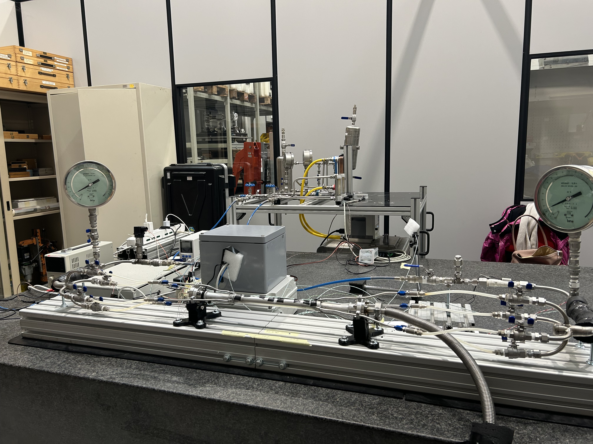
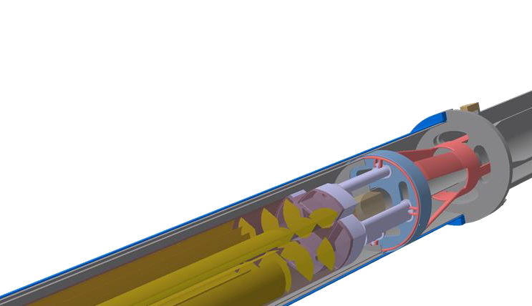
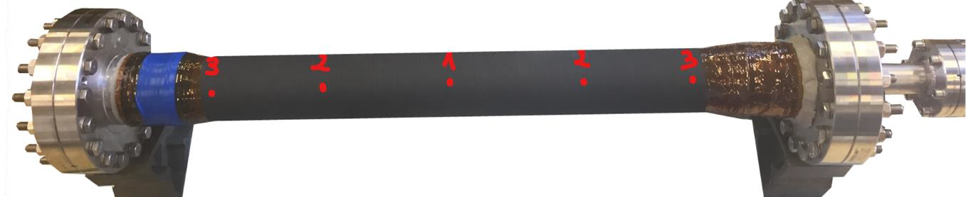
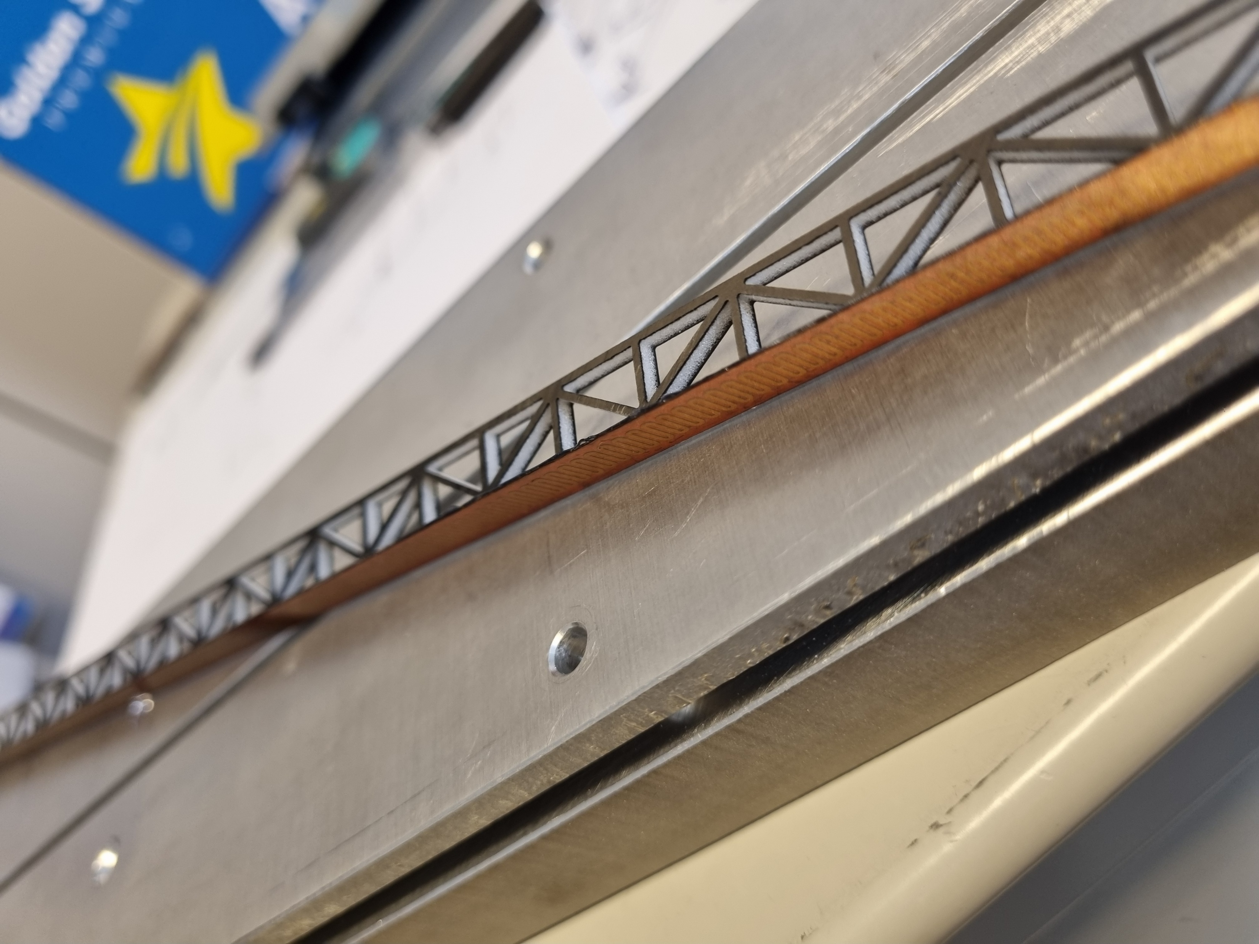
DRD8 – WP1.1
D1.1.1 Thin beam pipes
  IHEP: BESIII and CepC
  LNF: FCC-ee
  CERN: Carbon fibre based
M1.1.1 & M1.1.2 Vertex detectors (curved and tilted det)
  CERN: Retractable and curved detectors
  Pisa: air cooled reinforced stave
LNF
IHEP

Slide 5
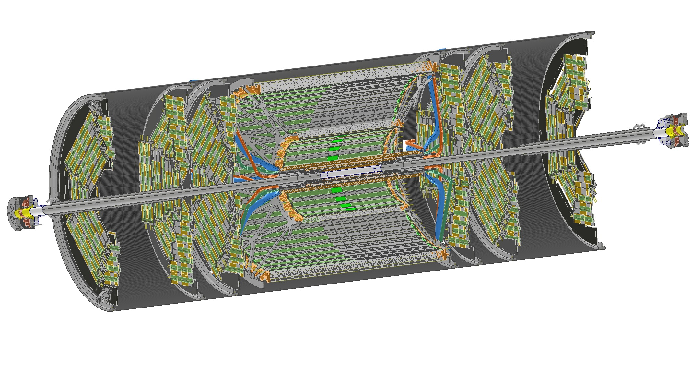
DRD8 – WP1.1
D1.1.2 Mock up and integration
  IHEP: CepC
  LNF- Pisa & CERN: FCC-ee
LNF
IHEP

Slide 6






DRD8 – WP1.2
Deliverables and milestones for WP 1.2 are being carried out by:
With (at the moment) Chinese and US robotic companies

Slide 7
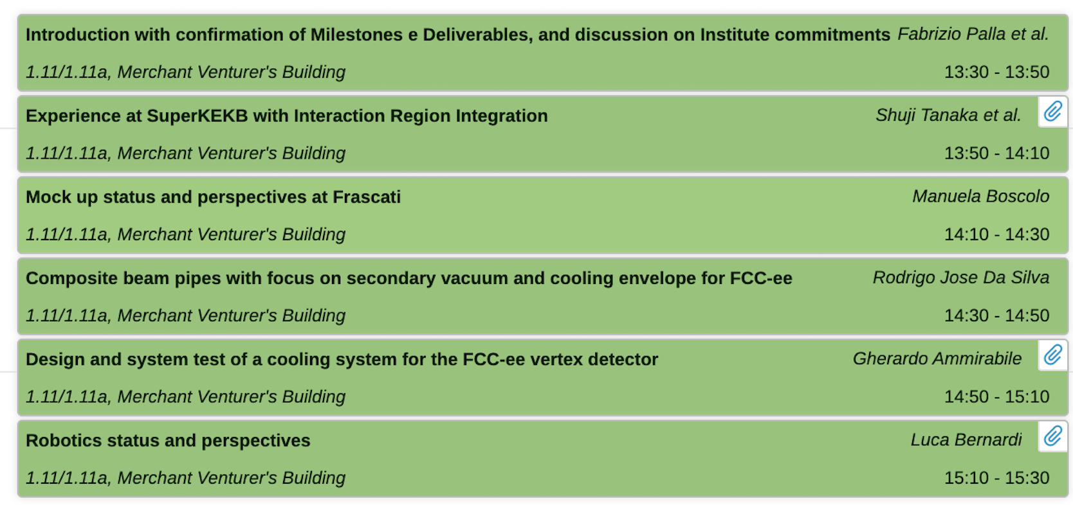
DRD8 – today’s agenda

