Slide 1





Composite beam pipes for the FCC
Rodrigo José da Silva (RJS), PhD
ORCiD 0000-0001-8016-3165
R&D Engineer at CERN EP-DT
DRD8 collaboration meeting
Supported by
16-20 June 2025
Bristol – UK

Slide 2
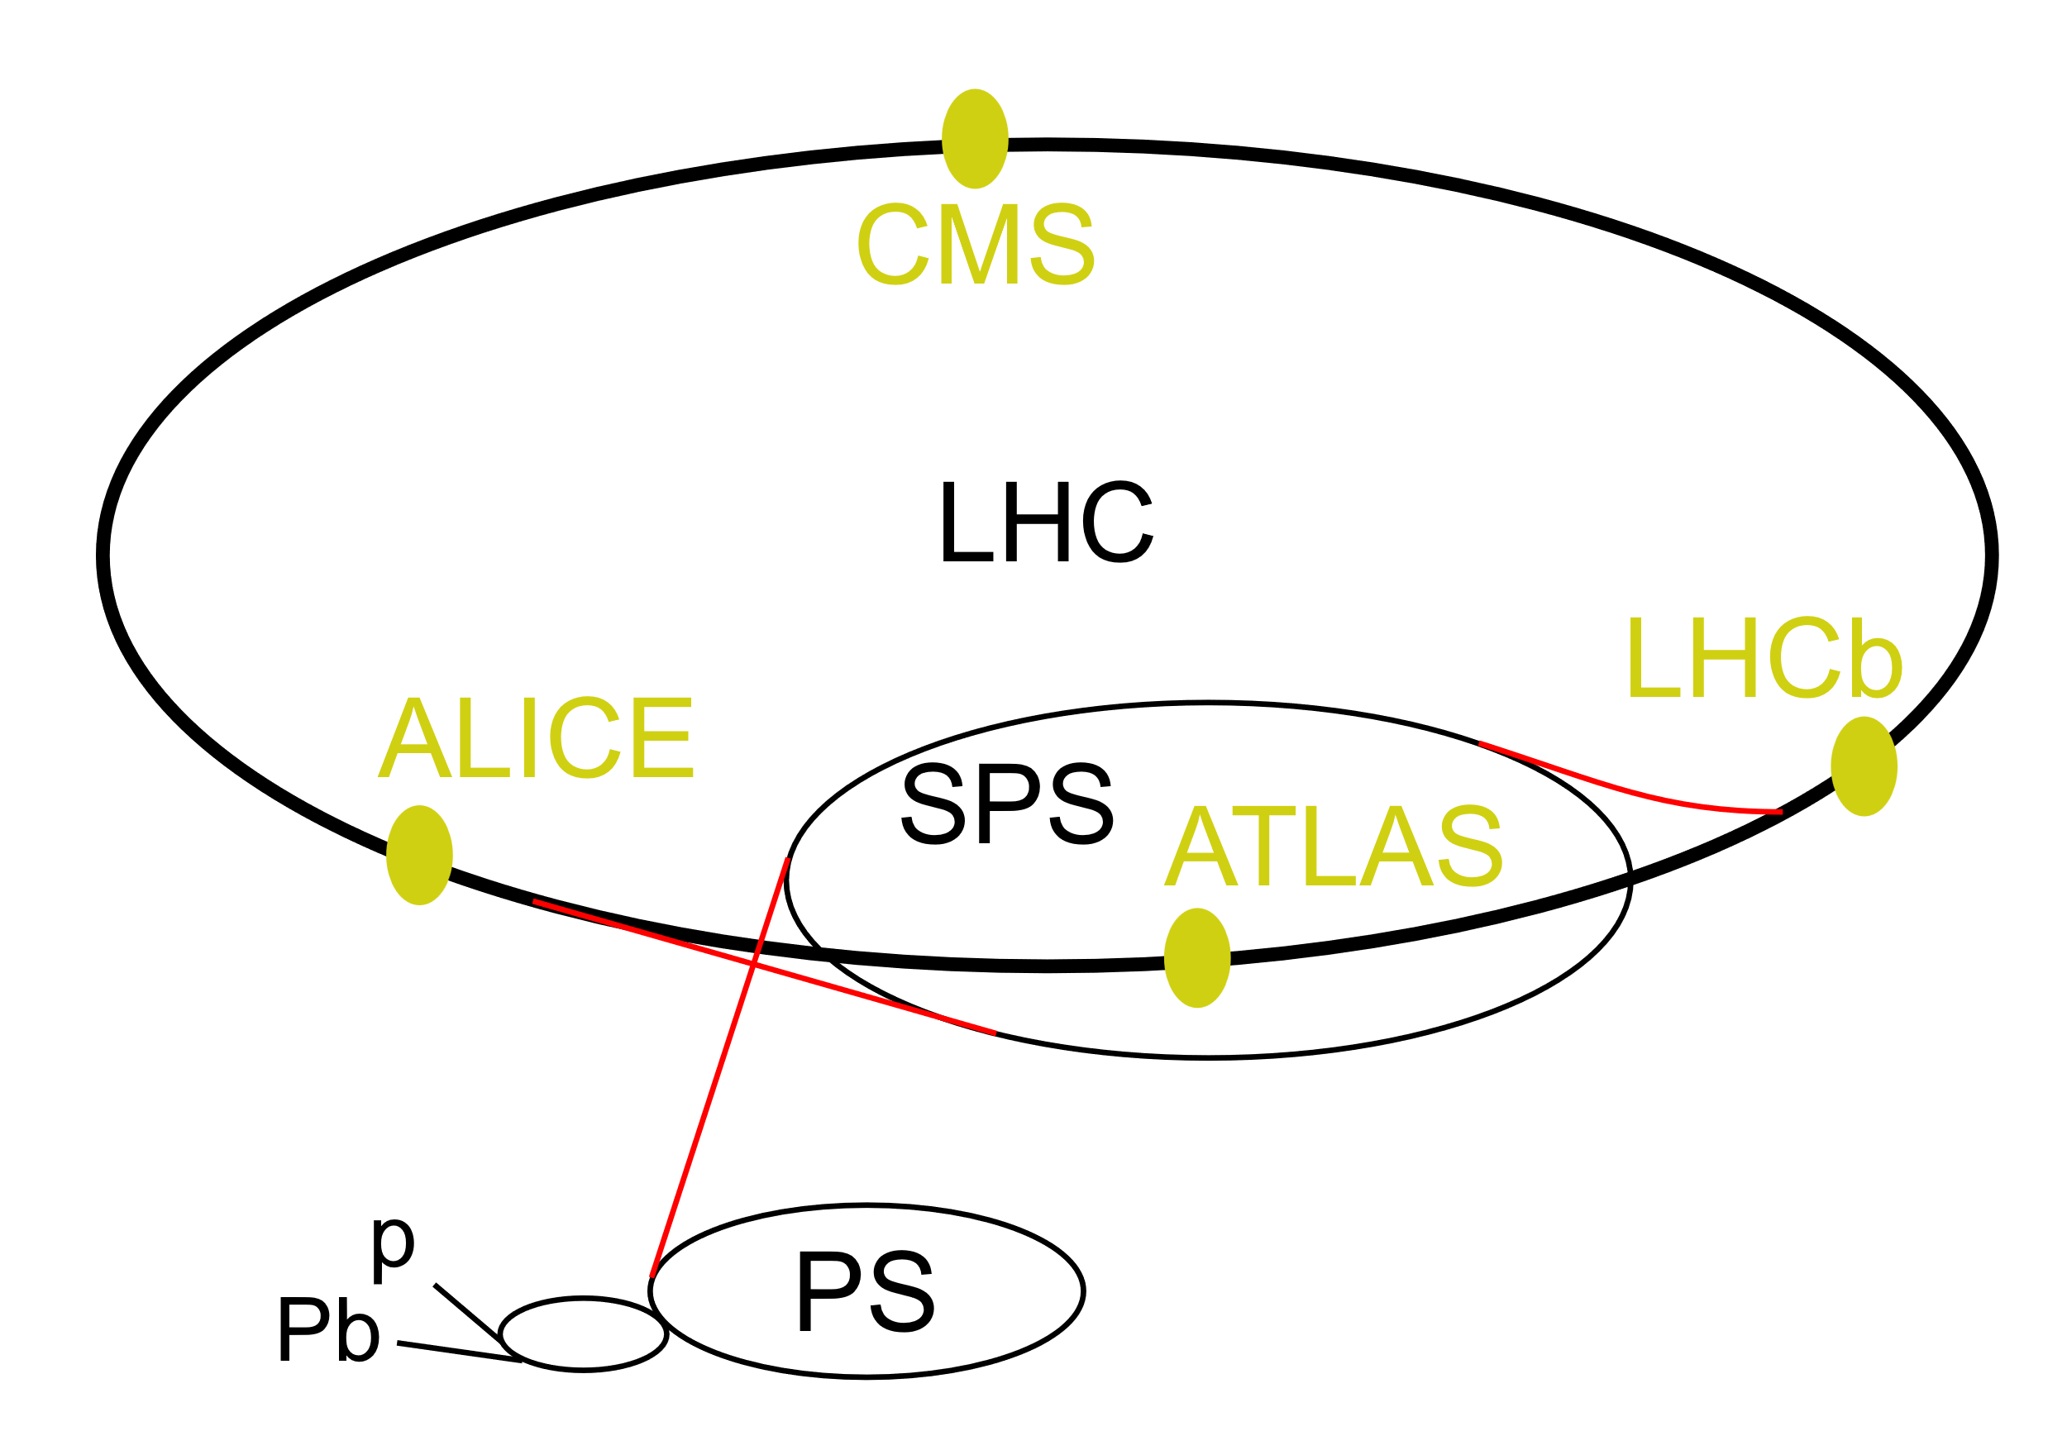
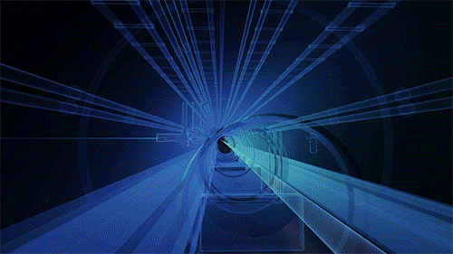


Beam pipe definition
Beam pipe
End flanges
Supports
Joints
Interaction point
RJS | Composite beam pipes for the FCC
DRD8 collaboration meeting
Notes:
Let’s start with some outline on why we want to implement CFRP for cryostat.
The main drive is the overall reduction in material budget compared to current aluminium designs, thanks to CFRP higher radiation length (higher particles transparency). From preliminary studies, the reduction can reach up to 60% comparing CFRP against Aluminium sandwich structure cylinders
Not copy of industry
RnD follow existing development and tune/develop adaptable

Slide 3
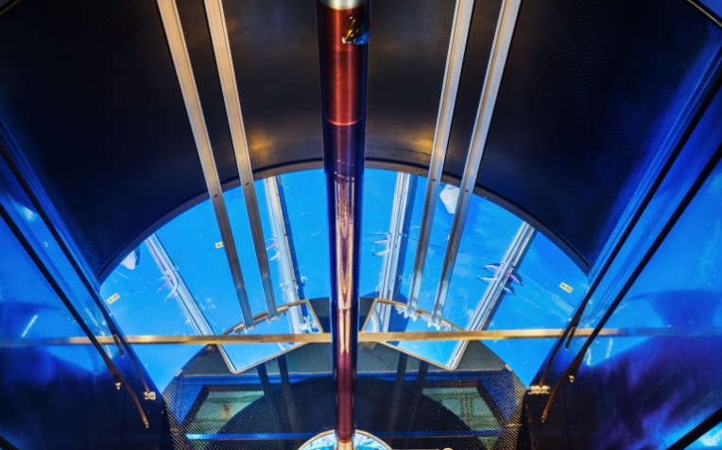
General requirements and challenges
Energy preserved
Transparency
Radiation length
ALICE – LS2 Central beam pipe
⌀ 60 mm, Wall thickness 0.8 mm
Beryllium ( ̴ 35 cm radiation length)
Thickness
Secondary or primary vacuum
Buckling resistance
Stiffness
Keep mechanical integrity
Radiation environment
Can we consider
CFRP pipes?
Secondary or primary vacuum
Leak tightness
Permeability
Thickness
RJS | Composite beam pipes for the FCC
DRD8 collaboration meeting
Notes:
Let’s start with some outline on why we want to implement CFRP for cryostat.
The main drive is the overall reduction in material budget compared to current aluminium designs, thanks to CFRP higher radiation length (higher particles transparency). From preliminary studies, the reduction can reach up to 60% comparing CFRP against Aluminium sandwich structure cylinders
Not copy of industry
RnD follow existing development and tune/develop adaptable

Slide 4
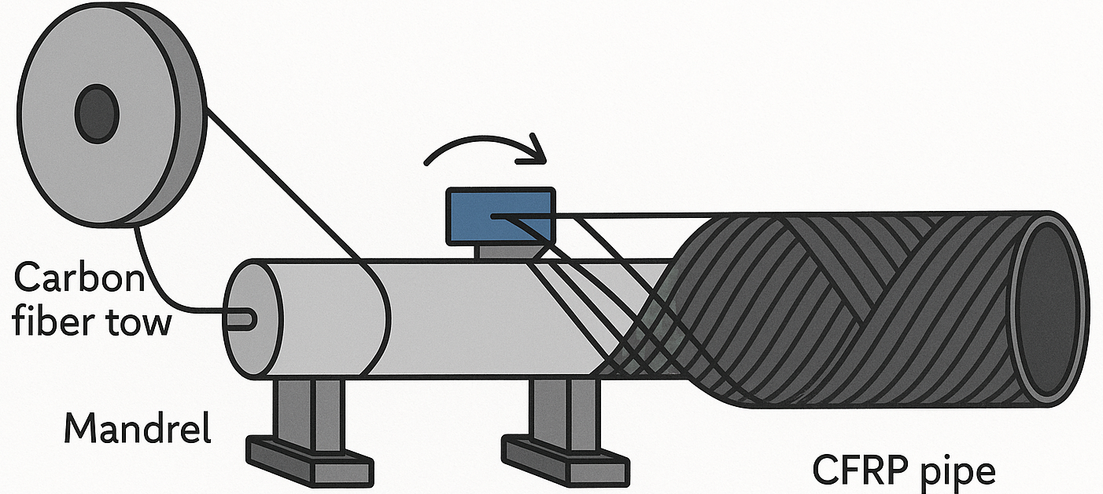
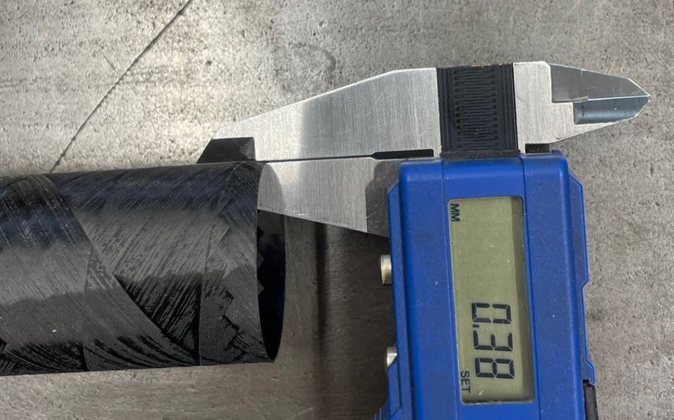
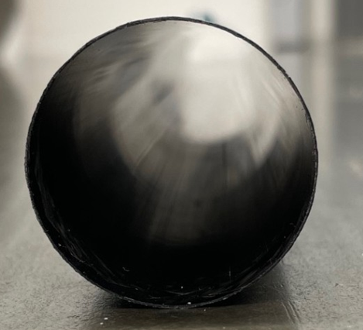
Non-Evaporable Getter (NEG) and manufacturing viability
Be
CFRP
Transparency: 0.4 mm CFRP (+ 5 µm coating) ≈ 0.8 mm Be
NEG
Cu/Ni
CFRP
RJS | Composite beam pipes for the FCC
DRD8 collaboration meeting
Notes:
Let’s start with some outline on why we want to implement CFRP for cryostat.
The main drive is the overall reduction in material budget compared to current aluminium designs, thanks to CFRP higher radiation length (higher particles transparency). From preliminary studies, the reduction can reach up to 60% comparing CFRP against Aluminium sandwich structure cylinders
Not copy of industry
RnD follow existing development and tune/develop adaptable

Slide 5
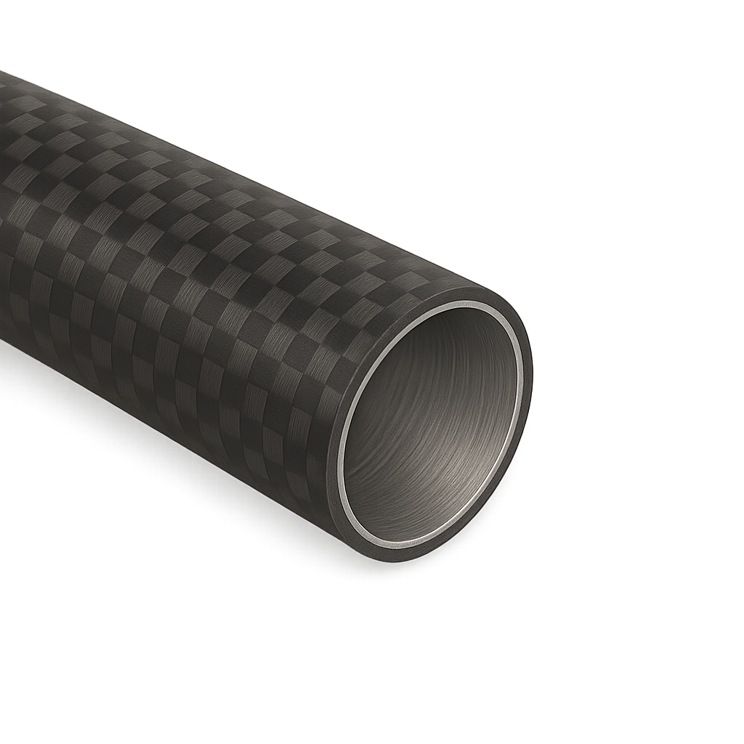
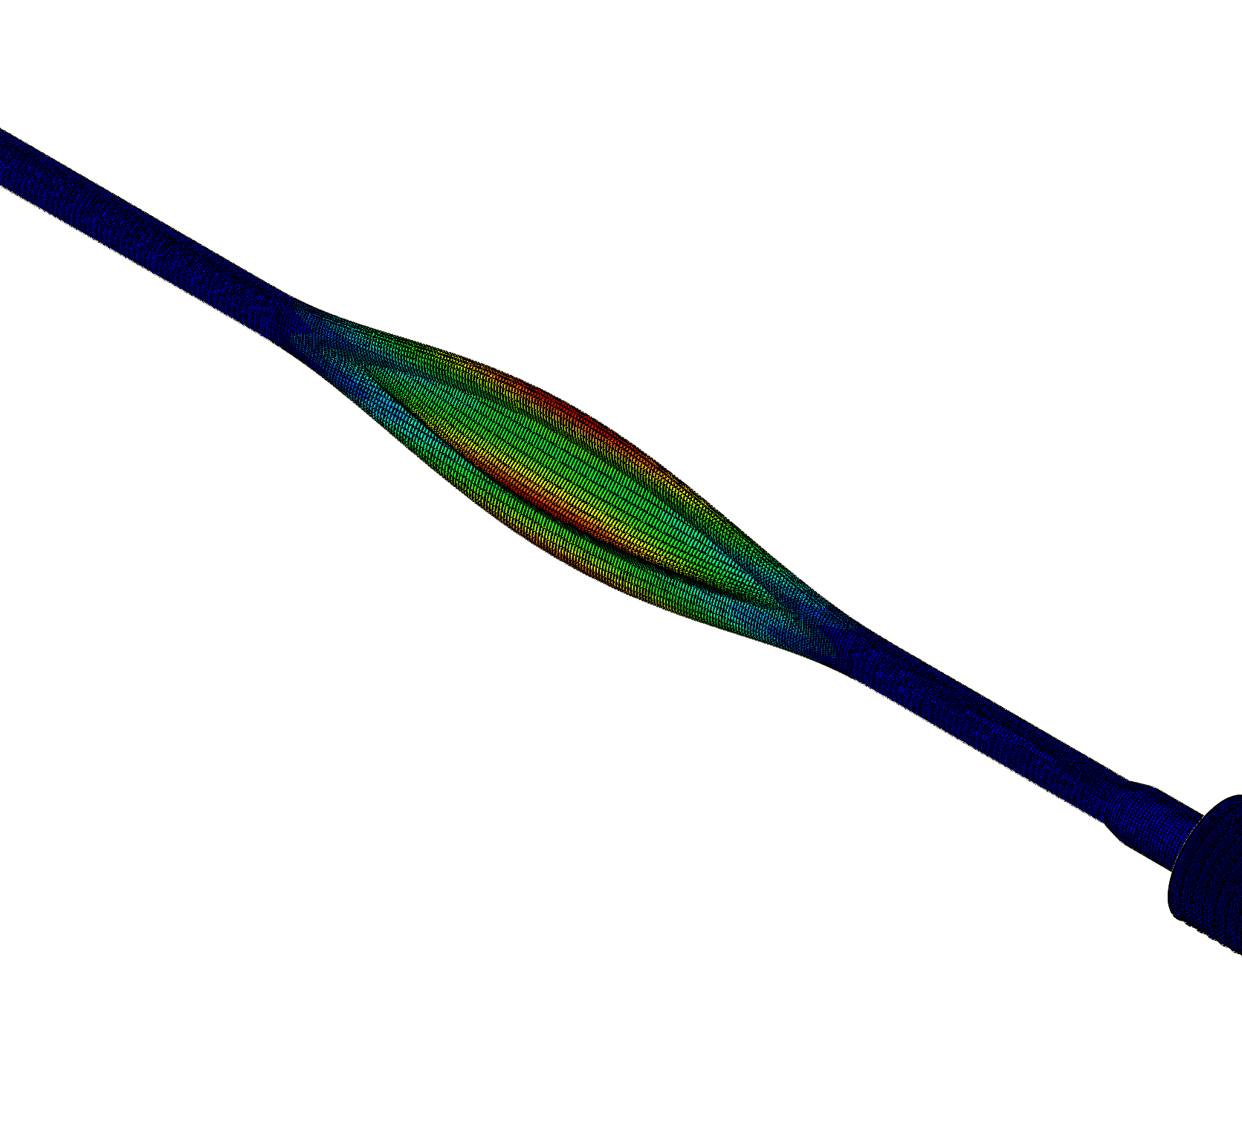
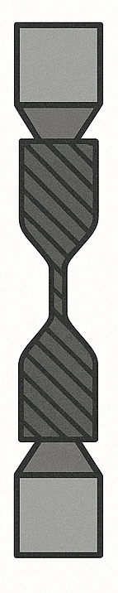
Work in progress
Assessing CFRP properties pre and post radiation exposition
Cu/Ni coating deposition on the CFRP pipes (assessing quality)
NEG deposition on the CFRP pipes (assessing quality)
Vacuum testing (leak tightness)
Additional investigation on manufacturing (can we go with even thinner pipes?)
0.4 mm thickness
[90/+30/-30/90]
Buckling SF ≈ 17
RJS | Composite beam pipes for the FCC
DRD8 collaboration meeting
Notes:
Let’s start with some outline on why we want to implement CFRP for cryostat.
The main drive is the overall reduction in material budget compared to current aluminium designs, thanks to CFRP higher radiation length (higher particles transparency). From preliminary studies, the reduction can reach up to 60% comparing CFRP against Aluminium sandwich structure cylinders
Not copy of industry
RnD follow existing development and tune/develop adaptable

Slide 6
To the most critical case: primary vacuum
Other sections
(thicker wall)
Interaction point
(thinner wall)
1st case: CFRP at the interaction point
2nd case: full CFRP (including flanges)
3rd: full CFRP (except at the collision point)
RJS | Composite beam pipes for the FCC
DRD8 collaboration meeting
Notes:
Let’s start with some outline on why we want to implement CFRP for cryostat.
The main drive is the overall reduction in material budget compared to current aluminium designs, thanks to CFRP higher radiation length (higher particles transparency). From preliminary studies, the reduction can reach up to 60% comparing CFRP against Aluminium sandwich structure cylinders
Not copy of industry
RnD follow existing development and tune/develop adaptable

Slide 7
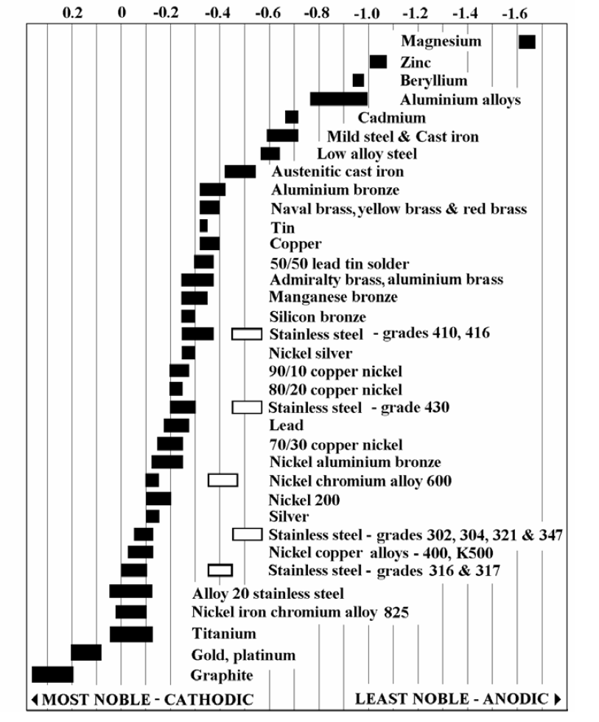
Joints: CFRP - metal
RJS | Composite beam pipes for the FCC
DRD8 collaboration meeting
Notes:
Let’s start with some outline on why we want to implement CFRP for cryostat.
The main drive is the overall reduction in material budget compared to current aluminium designs, thanks to CFRP higher radiation length (higher particles transparency). From preliminary studies, the reduction can reach up to 60% comparing CFRP against Aluminium sandwich structure cylinders
Not copy of industry
RnD follow existing development and tune/develop adaptable

Slide 8
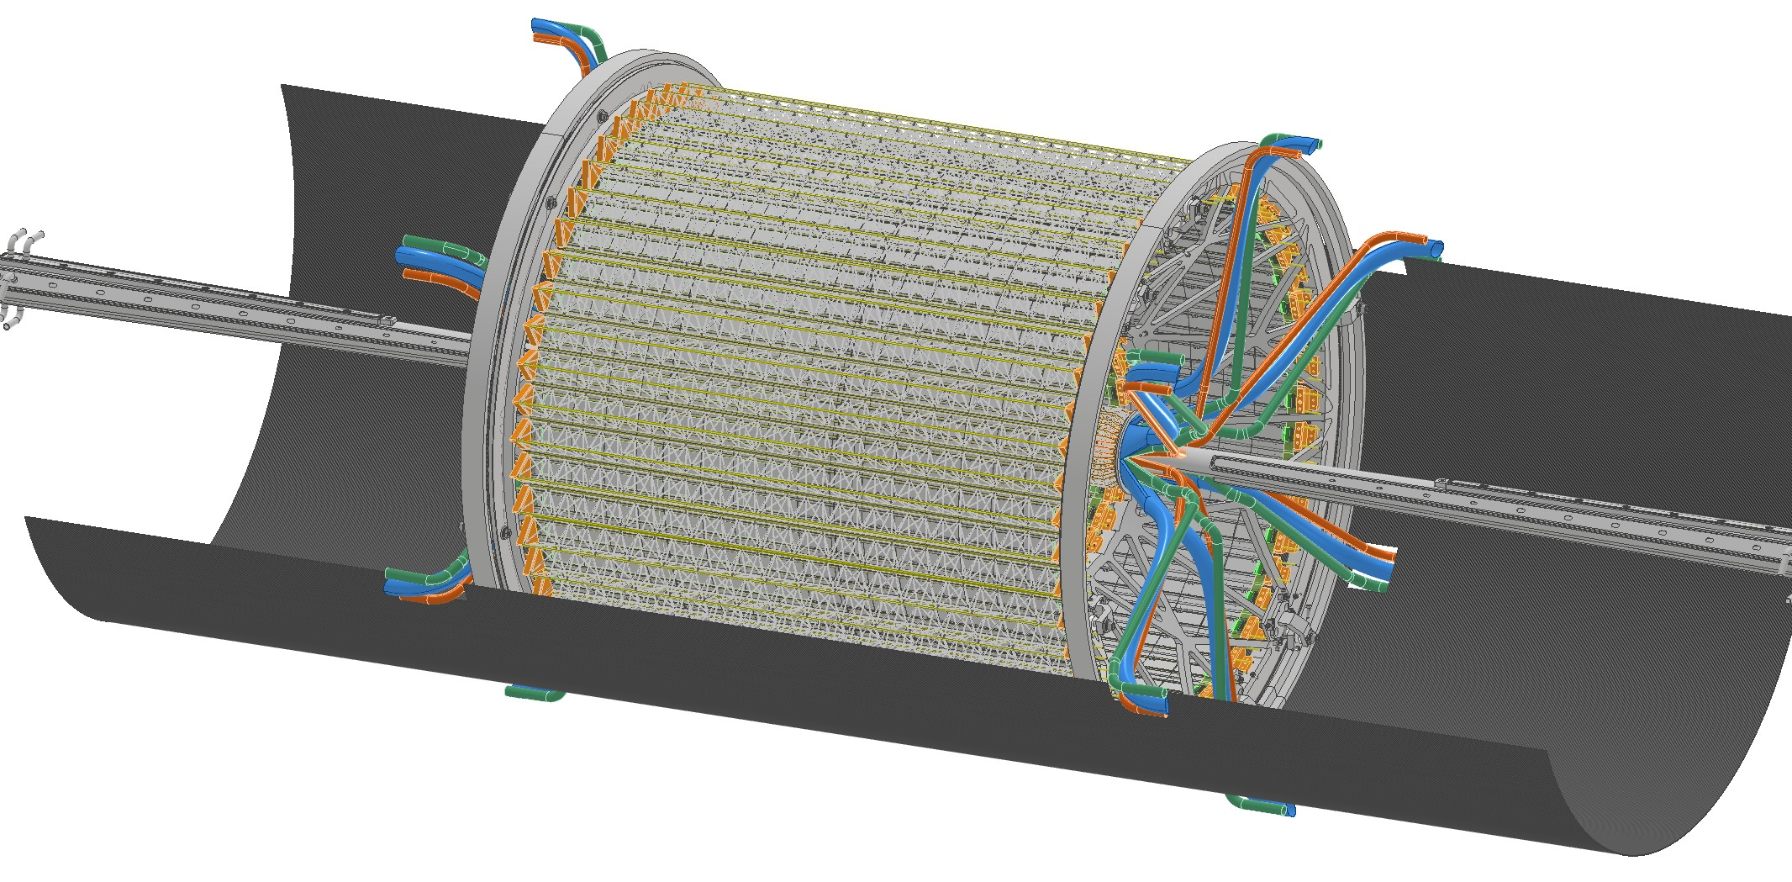
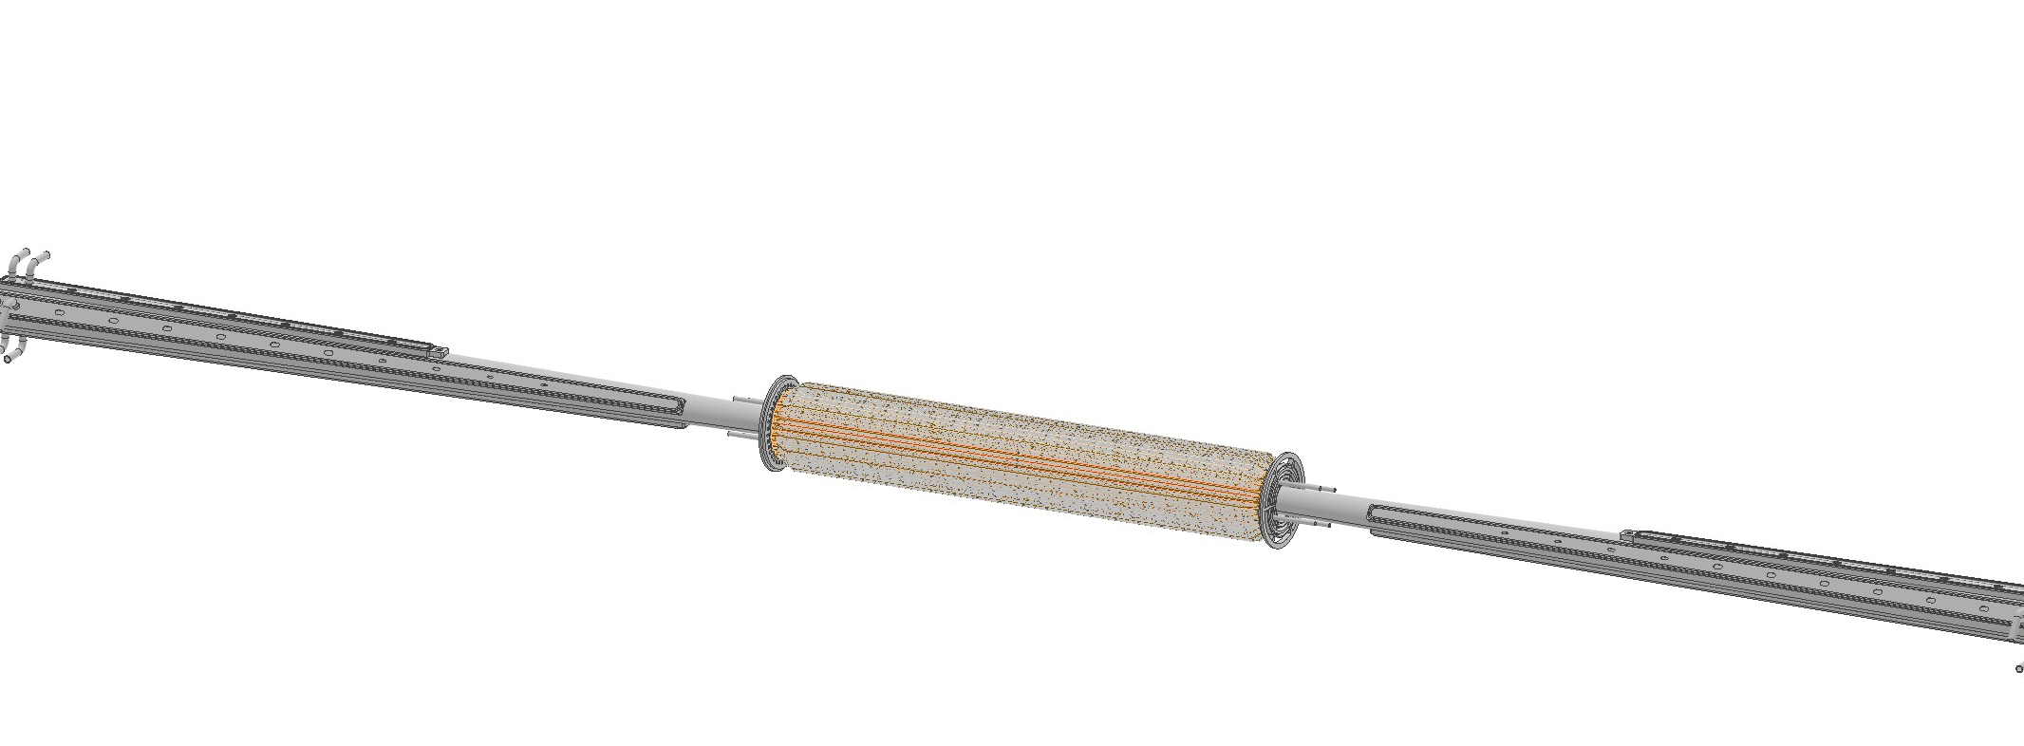
Secondary vacuum: double-wall central chamber (FCC ee)
Vertex detector
Beam pipe
RJS | Composite beam pipes for the FCC
DRD8 collaboration meeting
Notes:
Let’s start with some outline on why we want to implement CFRP for cryostat.
The main drive is the overall reduction in material budget compared to current aluminium designs, thanks to CFRP higher radiation length (higher particles transparency). From preliminary studies, the reduction can reach up to 60% comparing CFRP against Aluminium sandwich structure cylinders
Not copy of industry
RnD follow existing development and tune/develop adaptable

Slide 9
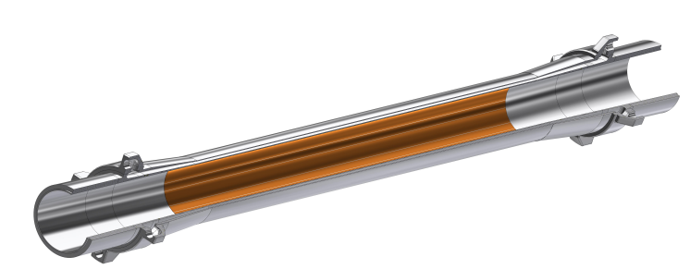
Secondary vacuum: double-wall central chamber (FCC ee)
PARAFFIN
OUTLET
Heat load on central vacuum chamber ̴ 58 W
PARAFFIN
INLET
Double-wall AlBeMet
RJS | Composite beam pipes for the FCC
DRD8 collaboration meeting
Notes:
Let’s start with some outline on why we want to implement CFRP for cryostat.
The main drive is the overall reduction in material budget compared to current aluminium designs, thanks to CFRP higher radiation length (higher particles transparency). From preliminary studies, the reduction can reach up to 60% comparing CFRP against Aluminium sandwich structure cylinders
Not copy of industry
RnD follow existing development and tune/develop adaptable

Slide 10
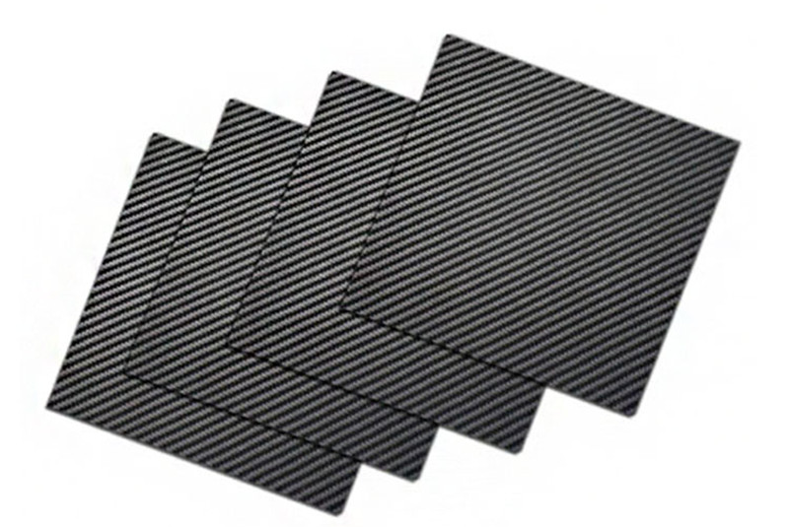
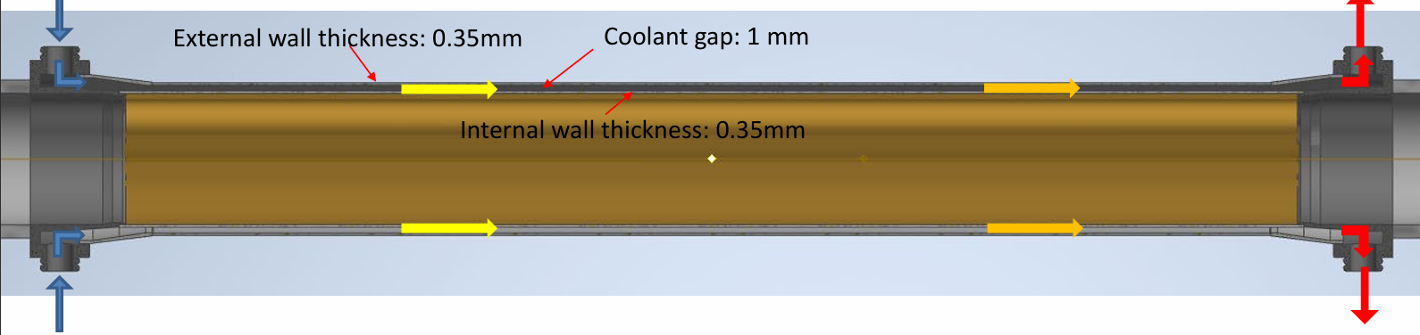
Secondary vacuum: double-wall central chamber (FCC ee)
External wall:
CFRP candidate
Heat load on central vacuum chamber ̴ 58 W
RJS | Composite beam pipes for the FCC
DRD8 collaboration meeting
Notes:
Let’s start with some outline on why we want to implement CFRP for cryostat.
The main drive is the overall reduction in material budget compared to current aluminium designs, thanks to CFRP higher radiation length (higher particles transparency). From preliminary studies, the reduction can reach up to 60% comparing CFRP against Aluminium sandwich structure cylinders
Not copy of industry
RnD follow existing development and tune/develop adaptable

Slide 11
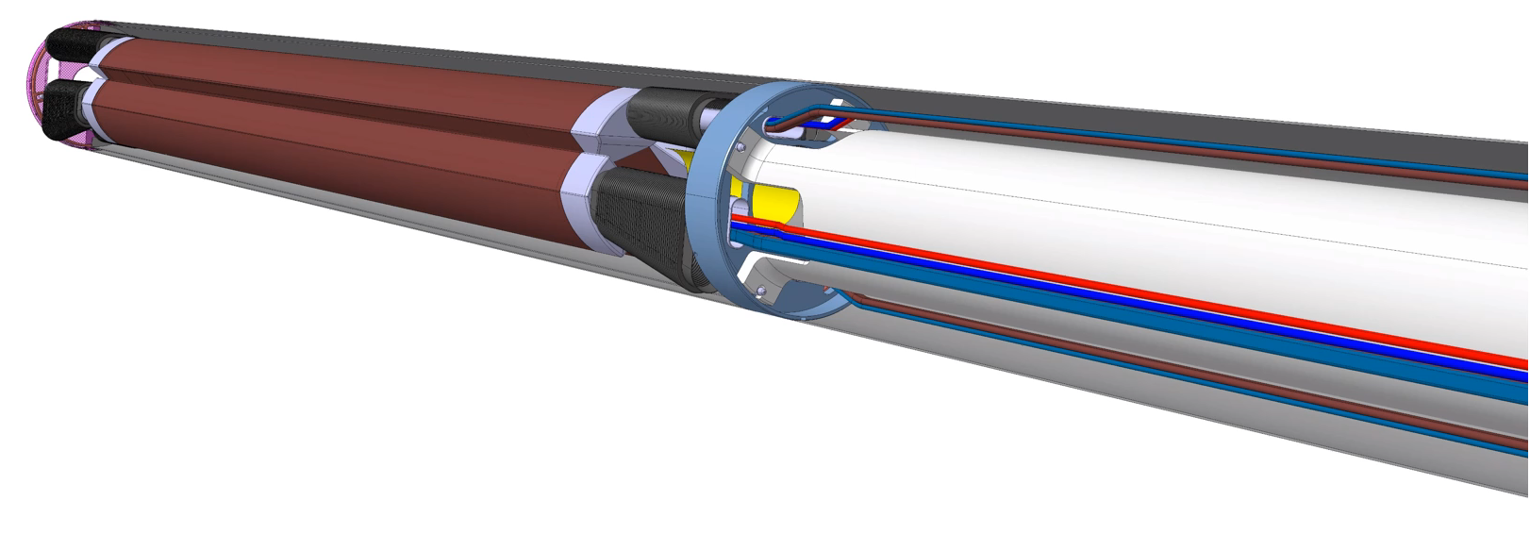
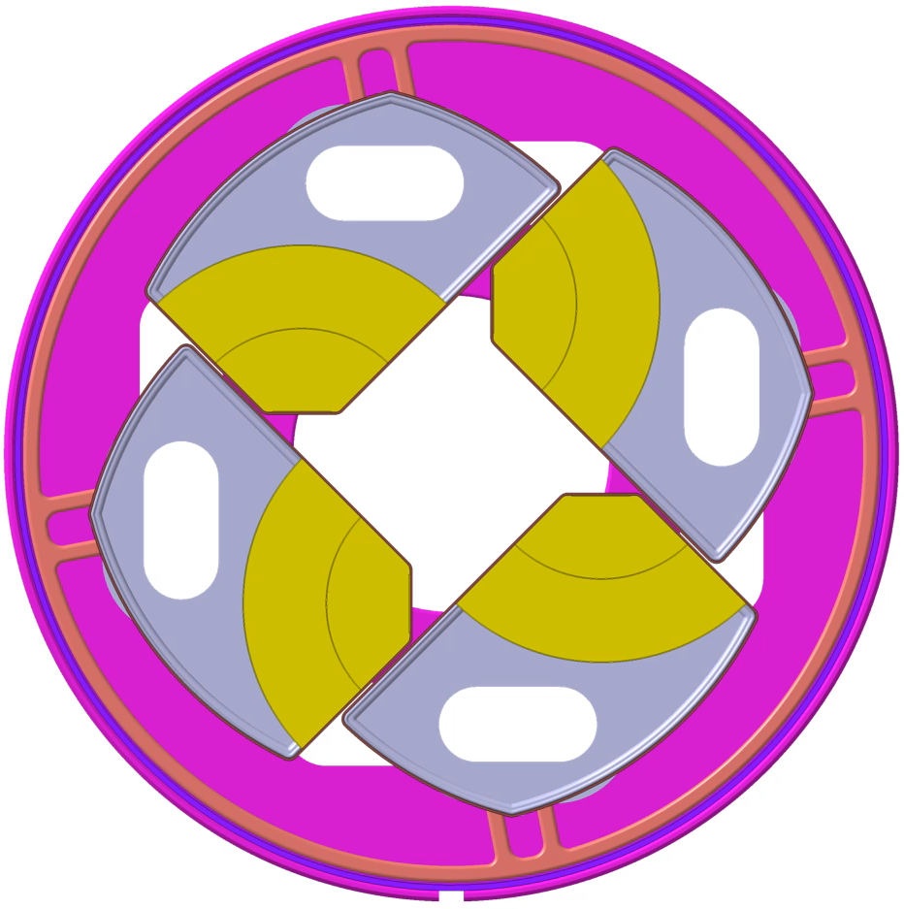
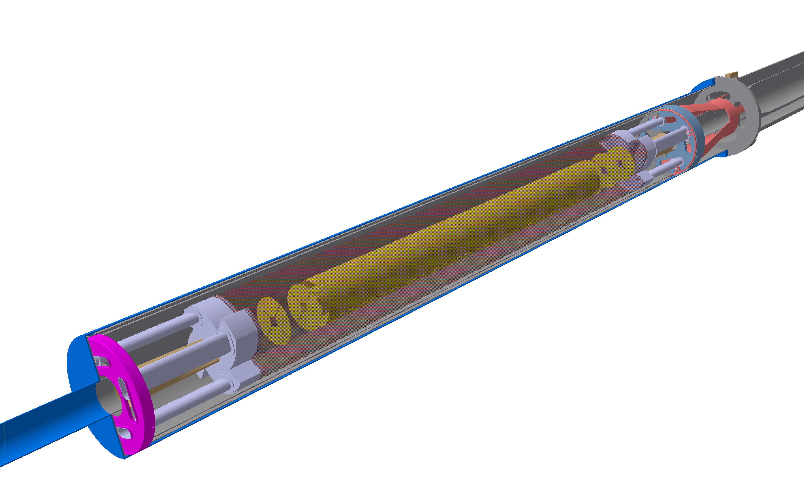
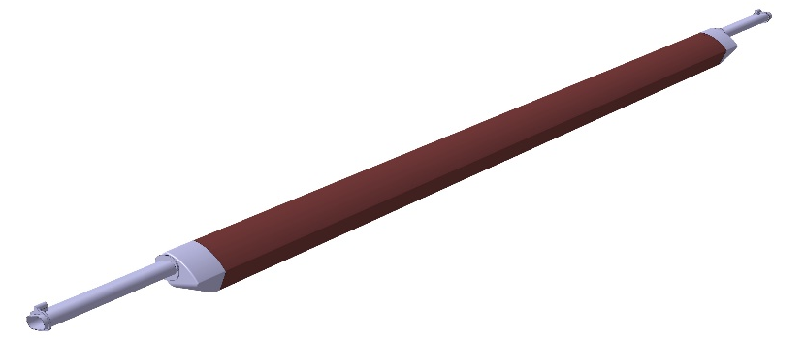
Secondary vacuum: IRIS
Retractable Tracker Petals
TRANSLATIONAL MOTION
ROTARY MOTION
Vertex detector
CFRP candidate
RJS | Composite beam pipes for the FCC
DRD8 collaboration meeting
Notes:
Let’s start with some outline on why we want to implement CFRP for cryostat.
The main drive is the overall reduction in material budget compared to current aluminium designs, thanks to CFRP higher radiation length (higher particles transparency). From preliminary studies, the reduction can reach up to 60% comparing CFRP against Aluminium sandwich structure cylinders
Not copy of industry
RnD follow existing development and tune/develop adaptable

Slide 12
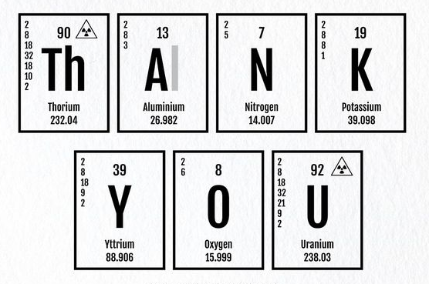

Questions?
rjs.phd@cern.ch
RJS | Composite beam pipes for the FCC
DRD8 collaboration meeting
Notes:
Let’s start with some outline on why we want to implement CFRP for cryostat.
The main drive is the overall reduction in material budget compared to current aluminium designs, thanks to CFRP higher radiation length (higher particles transparency). From preliminary studies, the reduction can reach up to 60% comparing CFRP against Aluminium sandwich structure cylinders
Not copy of industry
RnD follow existing development and tune/develop adaptable

