Slide 1


DRD8.3: introduction
Oscar Augusto* and Bart Veerlat
(oscar.augusto@manchester.ac.uk and Bart.Verlaat@cern.ch)

Slide 2
DRD8 Technical Committee
DRD8: General Mailing list
Endorsed Work Package Conveners:
WP1: Global system design and integration
  Corrado Gargiulo (CERN)
  Fabrizio Palla (Universita & INFN Pisa (IT))
WP2: Low-mass mechanics and thermal management
  Adam Dominic Lowe (University of Oxford (GB))
  Sushrut Karmarkar (Purdue University (US))
WP3: Detector cooling
  Bart Verlaat (CERN)
  Oscar Augusto De Aguiar Francisco (Manchester (GB))
WP4: Design and qualification tools
  Diego Alvarez Feito (CERN)
  Joao Batista Lopes (CERN)
Burkhard slides
WG 8.3: Detector Cooling:
Evaporative and liquid cooling for both low and warm temperatures, based on natural or eco-friendly refrigerants and new cycles;
Gas cooling solutions for detectors, including flow design and heat transfer through porous media;
Connection technologies for cooling circuits, including leak repair methods;
Instrumentation, including flow measurements for gases and liquids.
Letter of Intent
Please subscribe to the mailing lists of interest using the links above!

Slide 3
DRD8 letter of intent
link
Because of the dependence on design choices for sensors, front-end electronics, and electrical and readout services, the work on mechanics and cooling is highly reliant on the system specifications. To enable targeted and collaborative R&D work in our field, we propose to focus on solutions within two application frameworks.
Low intensity (LI): In this framework the mechanics and cooling will support sensors and electronics that have been designed for low power densities, possibly involving pulsed powering. The number and cross-section of electrical services will be small. Radiation damage levels will be low, and thus there will be no need to operate these systems cold (> 15 °C). Where possible, gas cooling will be an appealing solution. Radiation hardness levels of materials will be moderate. This will be the framework that will target, although not exclusively, experiments at future lepton colliders.
High intensity (HI): Detector systems within this framework will have to cope with high particle densities of signal and background particles. The high channel density and complexity of the front-end electronics will result in high power densities, which will need to be supplied (likely by advanced powering systems like serial powering or DC-DC conversion), and removed by potent evaporative cooling systems. Significant radiation damage will require cold (< -35 °C) operation to keep leakage currents under control. Materials will need to be qualified for the high radiation environment. This will be the framework that will aim for experiments at future hadron machines.
Material minimisation and a good thermal connection between local heat sources and sinks will be major goals in both cases, but the optimisation will be different. Nevertheless, we do expect that some of the solutions we will develop will be of benefit for both frameworks.
To verify and benchmark the performance of the solutions developed in this R&D effort, and as physical deliverables, we propose the construction of demonstrators which take into account the specifications defined in the context of other DRD efforts like DRD3 or DRD7. These demonstrators should be exercised in realistic environments, in a test-beam and/or real physics experiments, where possible.

Slide 4
DRD8 letter of intent
link
Mechanics is highly reliant on the system specifications
Two potential optimization paths:
Within the DRD8 framework, the proposal is to construct demonstrators defined in the context of DRD efforts like DRD3 and DRD7 to be tested in realistic environments (Test beam or physics experiments)
Low intensity
Low power ($<300mW/cm^{2}$)
Low power (<300mW/cm^2)
Low radiation
Temperature $>15℃$
Temperature >15℃
Targeting future lepton colliders
High intensity
High power (>=300mW/cm2)
High radiation
Temperature $<−35℃$
Temperature <−35℃
Evaporative systems preferred
Targeting future hadron colliders
Liquid and evaporative cooling can be considered
Gas cooling has an appealing low material budget
Typically, $<50mW/cm^{2}$
Typically, <50mW/cm^2

Slide 5
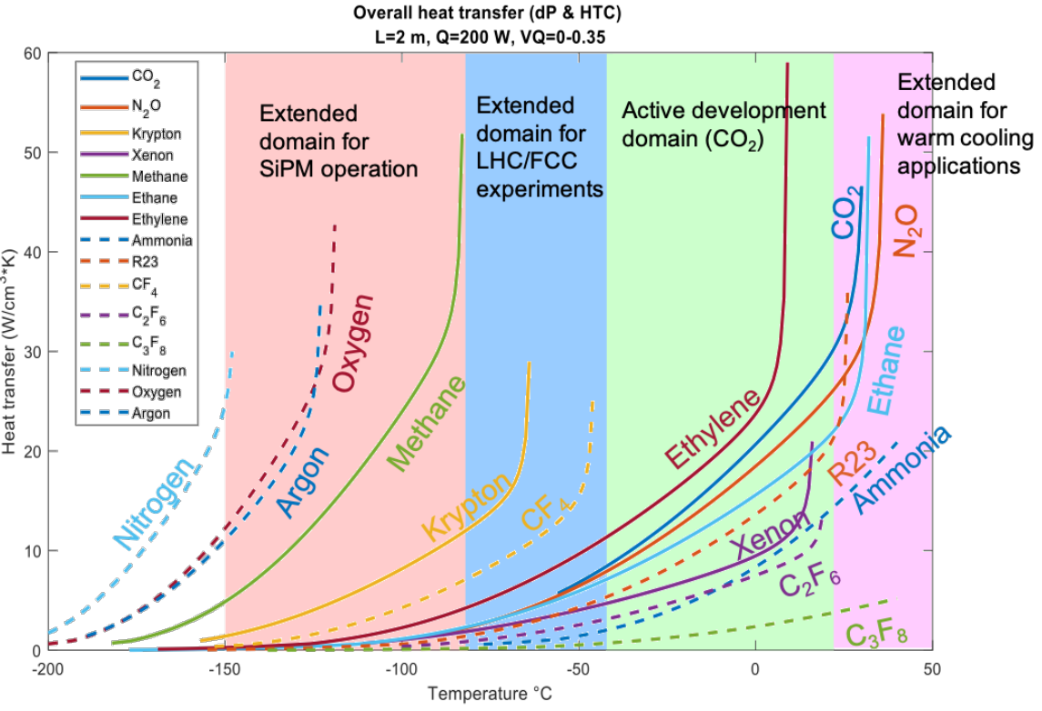
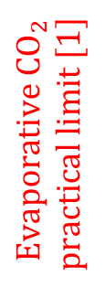
Evaporative coolants
$$Evaporative CO_{2}$$
$$practical limit [1]$$
No R&D is advised for any fluorocarbon or other greenhouse cooling liquid [2].

Slide 6
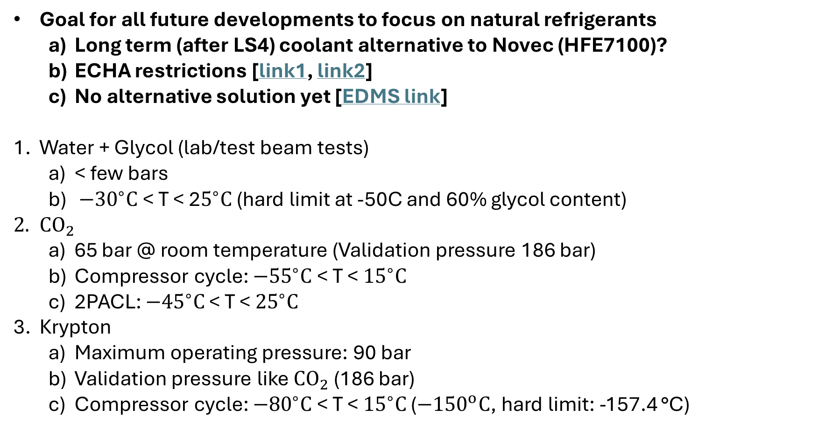
Liquid/evaporative Cooling Parameters
Goal for all future developments to focus on natural refrigerants
  Long term (after LS4) coolant alternative to Novec (HFE7100)?
  ECHA restrictions [link1, link2]
  No alternative solution yet [EDMS link]
Water + Glycol (lab/test beam tests)
  < few bars
  $−{30}^{∘}C$ < T < 2$5^{∘}C$ (hard limit at -50C and 60% glycol content)
$CO_{2}$
  65 bar @ room temperature (Validation pressure 186 bar)
  Compressor cycle: $−{55}^{∘}C$ < T < ${15}^{∘}C$
  2PACL: $−{45}^{∘}C$ < T < ${25}^{∘}C$
Krypton
  Maximum operating pressure: 90 bar
  Validation pressure like $CO_{2}$ (186 bar)
  Compressor cycle: $−{80}^{∘}C$ < T < ${15}^{∘}C$ ($−{150}^{o}C$, hard limit: -157.4 °C)

Slide 7
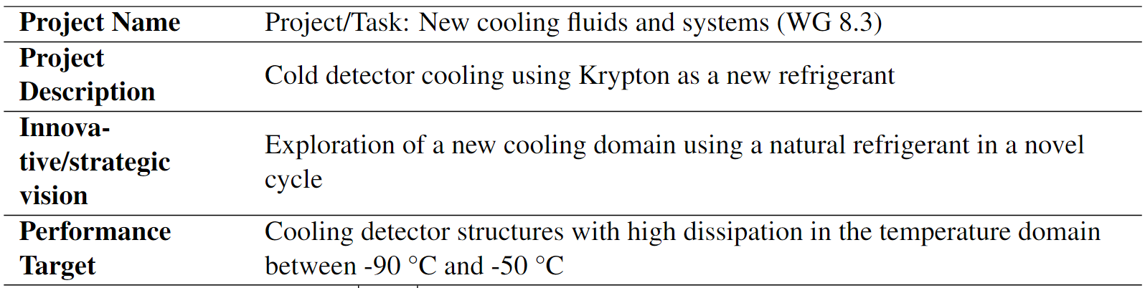
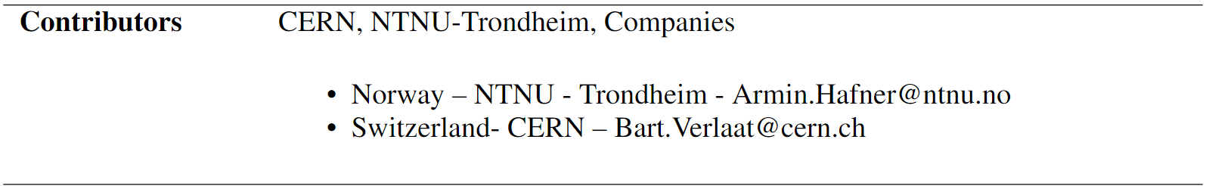
DRD8.3: Coolants and cooling cycles
Luca/Paolo’s talk

Slide 8
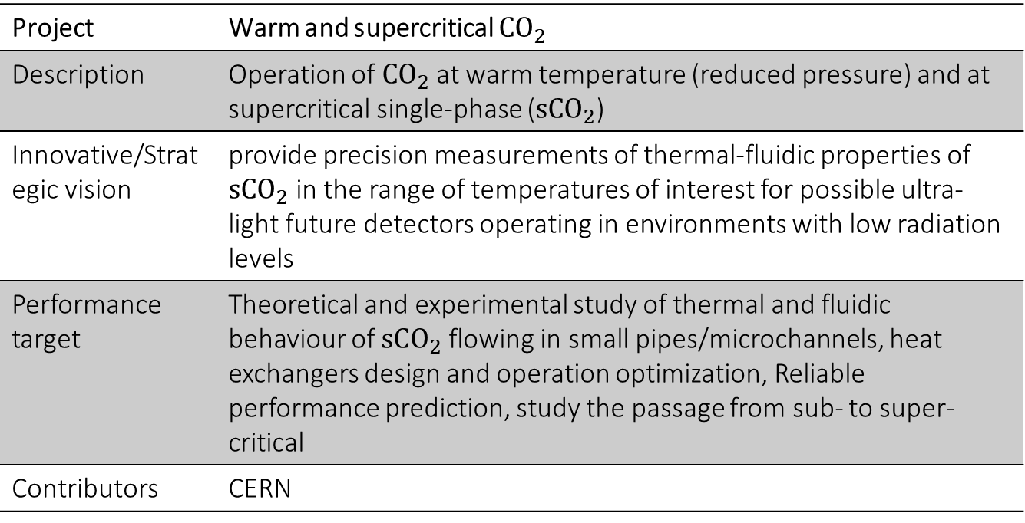

DRD8.3: Warm and Supercritical $CO_{2}$
Project | Warm and supercritical $CO_{2}$
Description | Operation of $CO_{2}$ at warm temperature (reduced pressure) and at supercritical single-phase ($sCO_{2}$)
Innovative/Strategic vision | provide precision measurements of thermal-fluidic properties of $sCO_{2}$ in the range of temperatures of interest for possible ultra-light future detectors operating in environments with low radiation levels
Performance target | Theoretical and experimental study of thermal and fluidic behaviour of $sCO_{2}$ flowing in small pipes/microchannels, heat exchangers design and operation optimization, Reliable performance prediction, study the passage from sub- to super-critical
Contributors | CERN
Camila’s talk

Slide 9
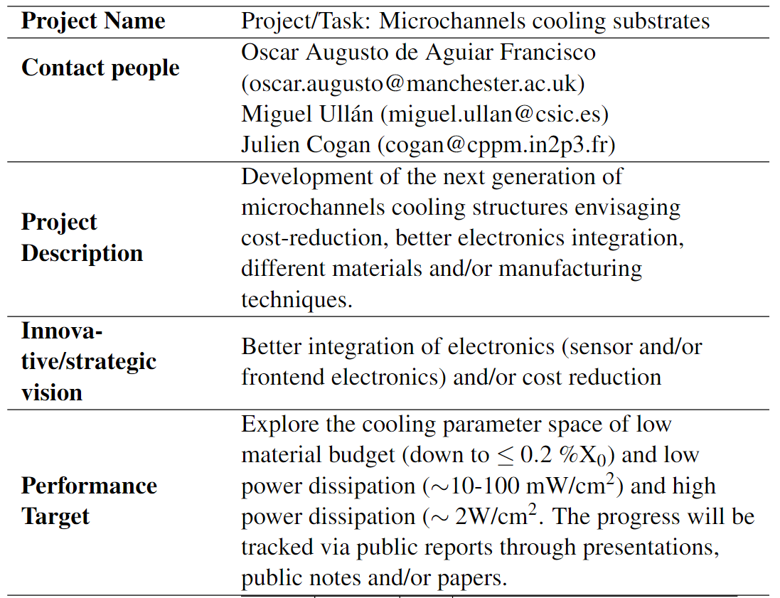
DRD8.3: Microchannels
Silicon microchannels
CMOS compatible process (CNM)
Ceramics
LTCC/HTCC (UoM/CERN)
Thermocompression (“Hyperbar”, CPPM)
3D printing
Metal (UoM)
Javier’s talk

Slide 10
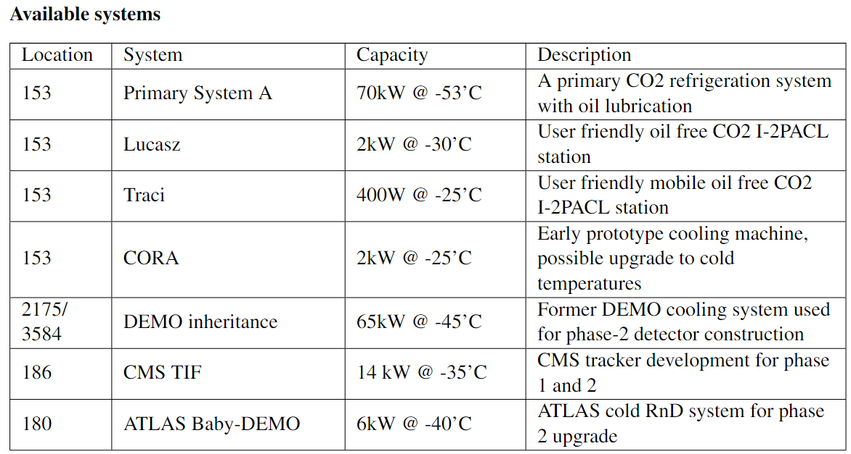
DRD8.3: Cooling Facilities
Infrastructure sharing via DRD8 is possible. Please don’t hesitate to contact us if you like to contribute!

Slide 11
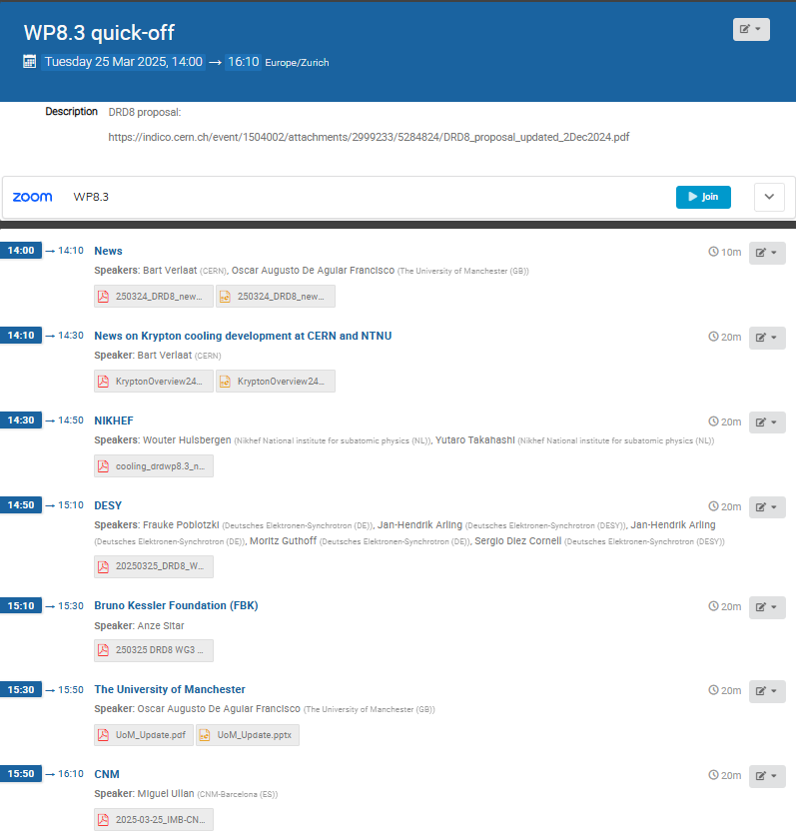
Highlights from different institutes/groups
Flash slides based on
Slides received
Kick-off meeting (subscription to the DRD8 WP3 needed for access)
DRD8 WP3 meetings
Kick-off meeting (link, 25/03/25)
AIDA projects proposals discussion (link, 03/06/25)
23-29 people connected

Slide 12
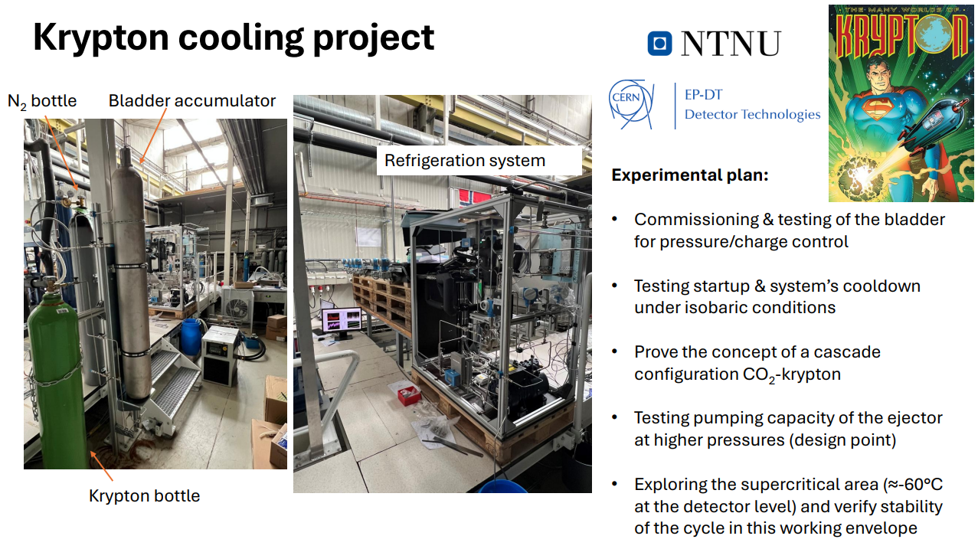
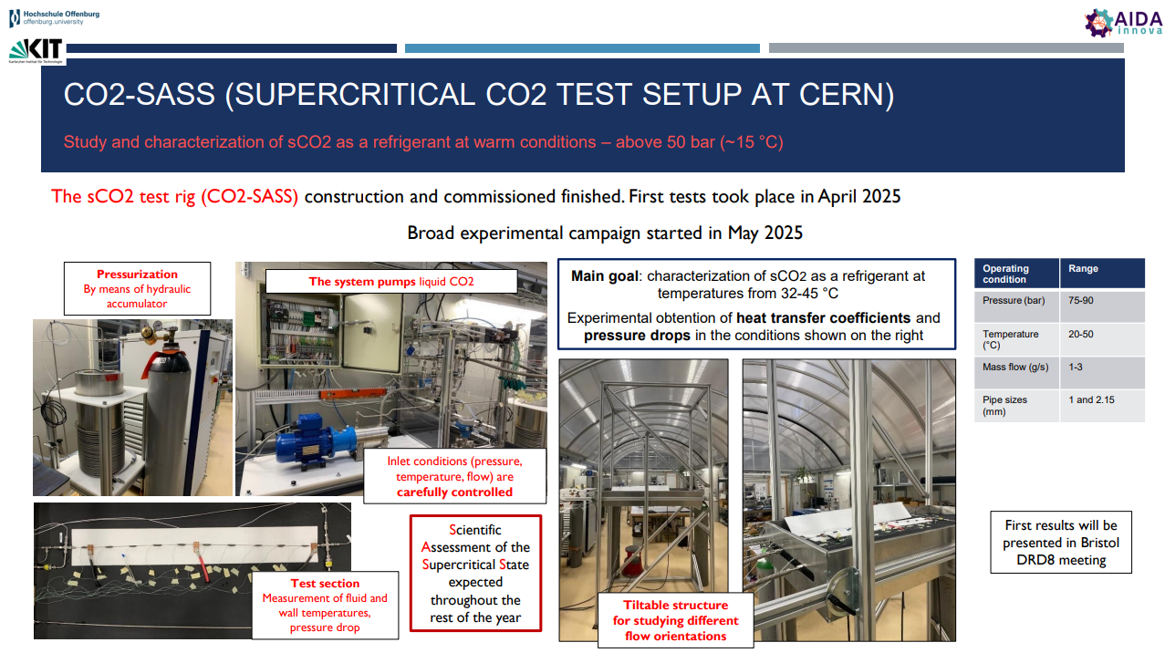
Highlights from different institutes/groups
Luca/Paolo’s talk
Camila’s talk

Slide 13
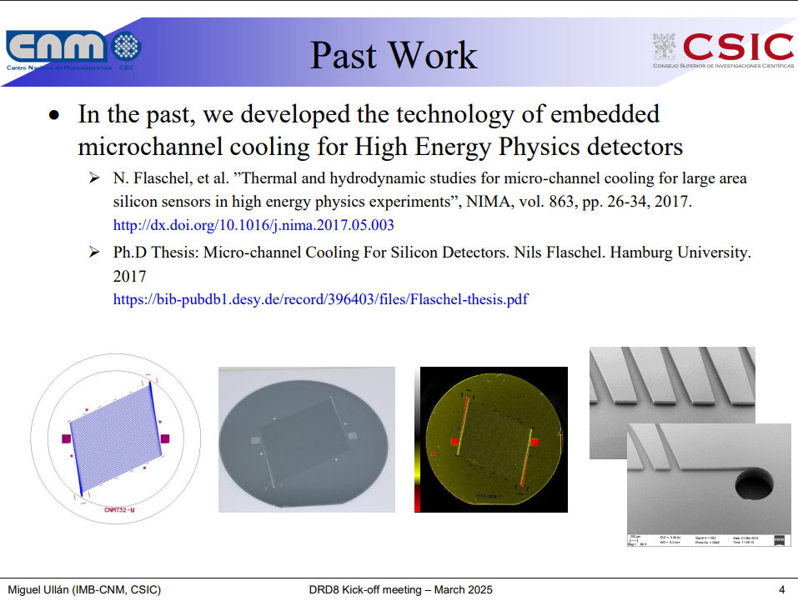
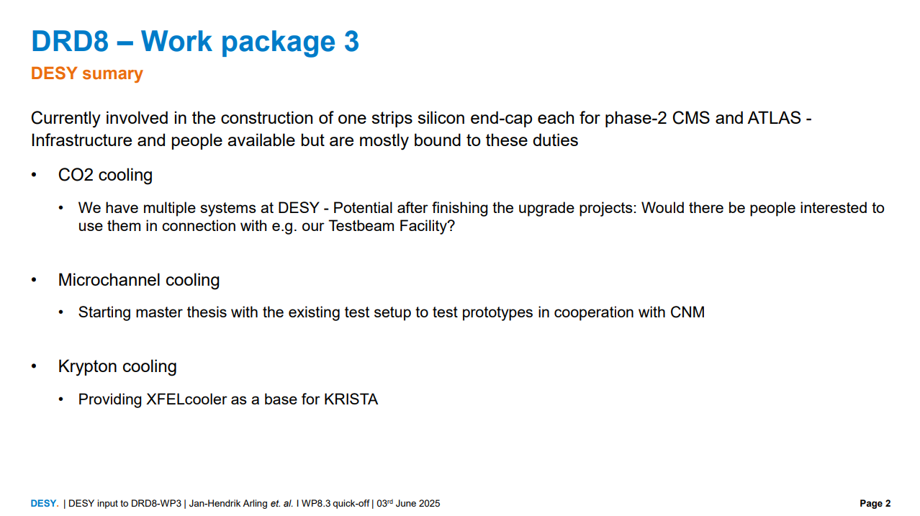
Highlights from different institutes/groups
Javier’s talk

Slide 14
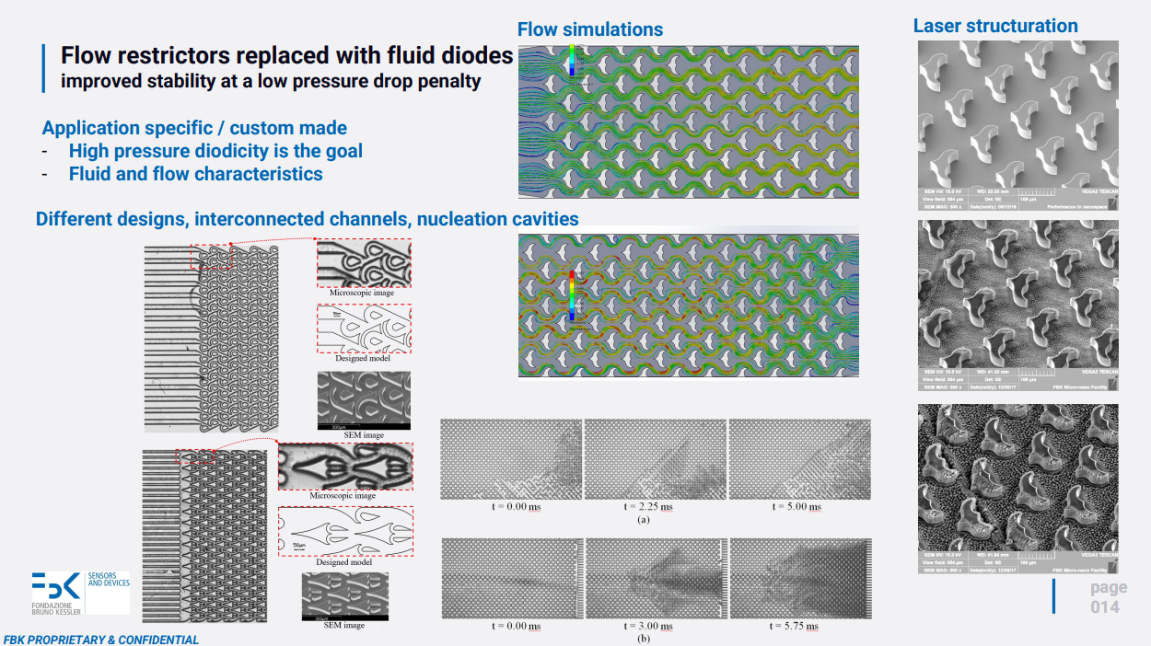
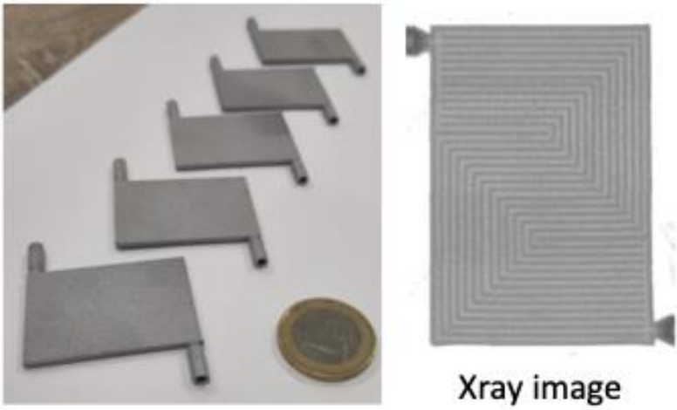
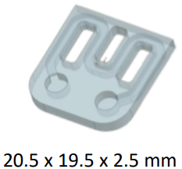
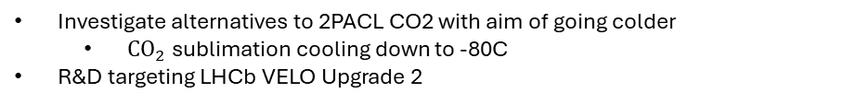
Highlights from different institutes/groups
NIKHEF
Investigate alternatives to Si Microchannels
AlSi10Mg 3D printing
Al2O3 with IKTS Fraunhoffer
Investigate alternatives to 2PACL CO2 with aim of going colder
  $CO_{2}$sublimation cooling down to -80C
R&D targeting LHCb VELO Upgrade 2
FOTM Yutaro’s talk

Slide 15


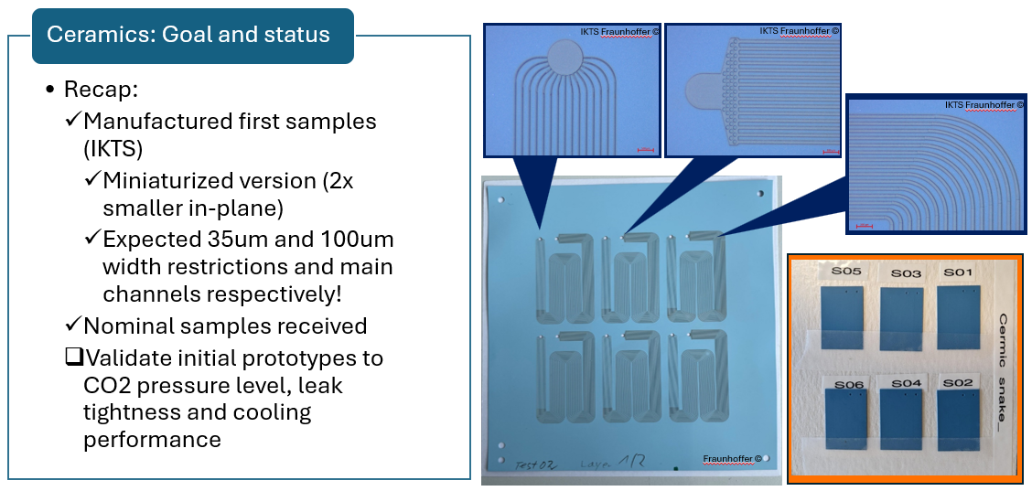
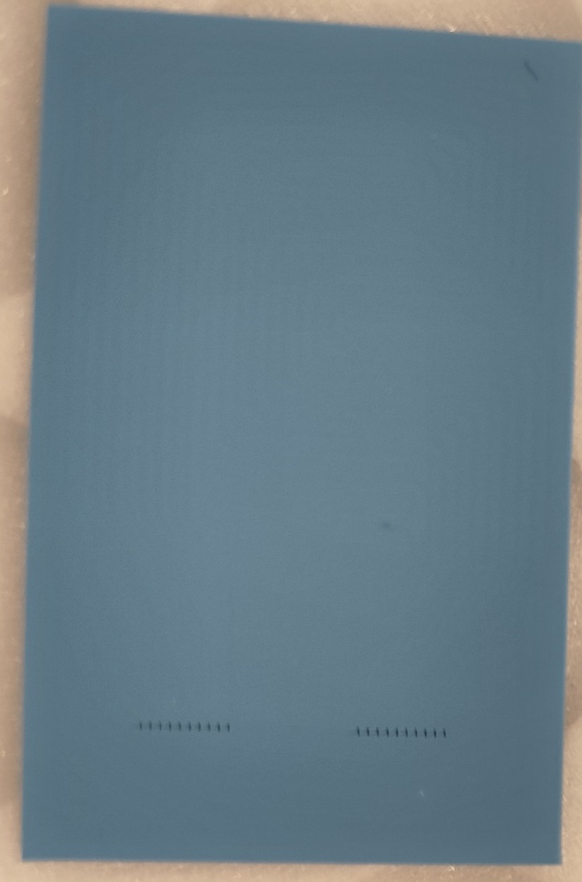
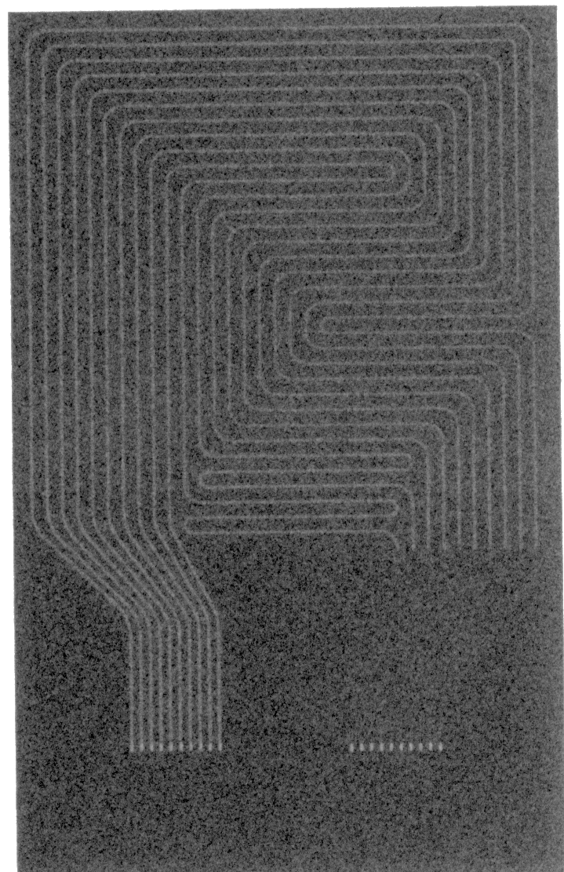
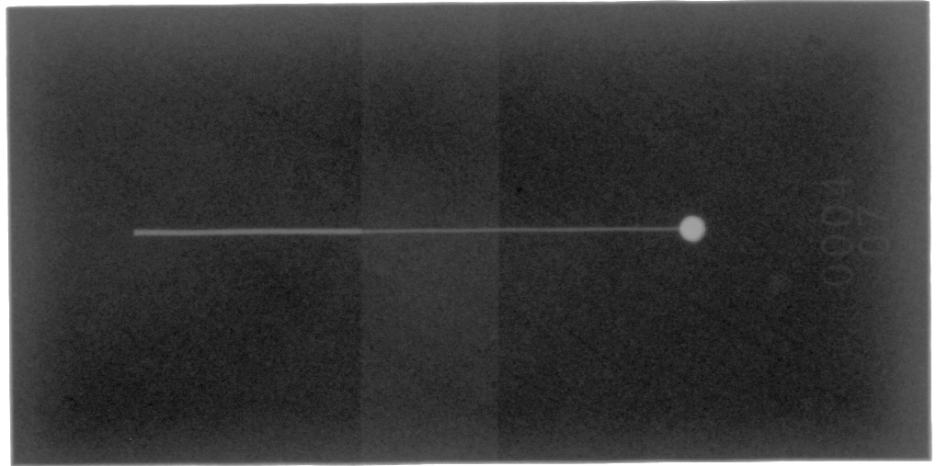
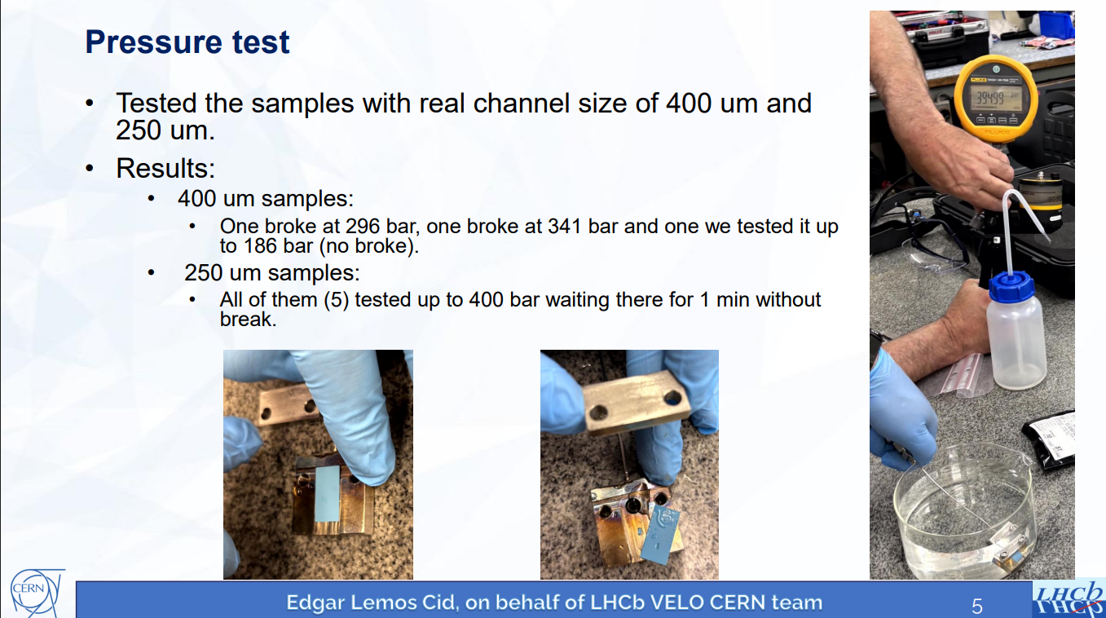
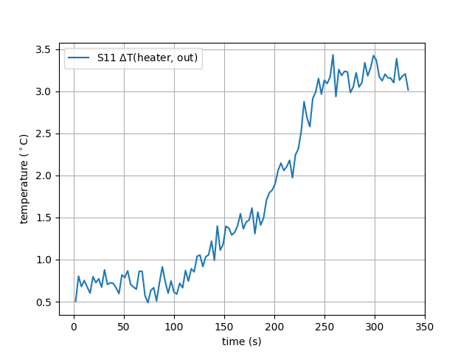
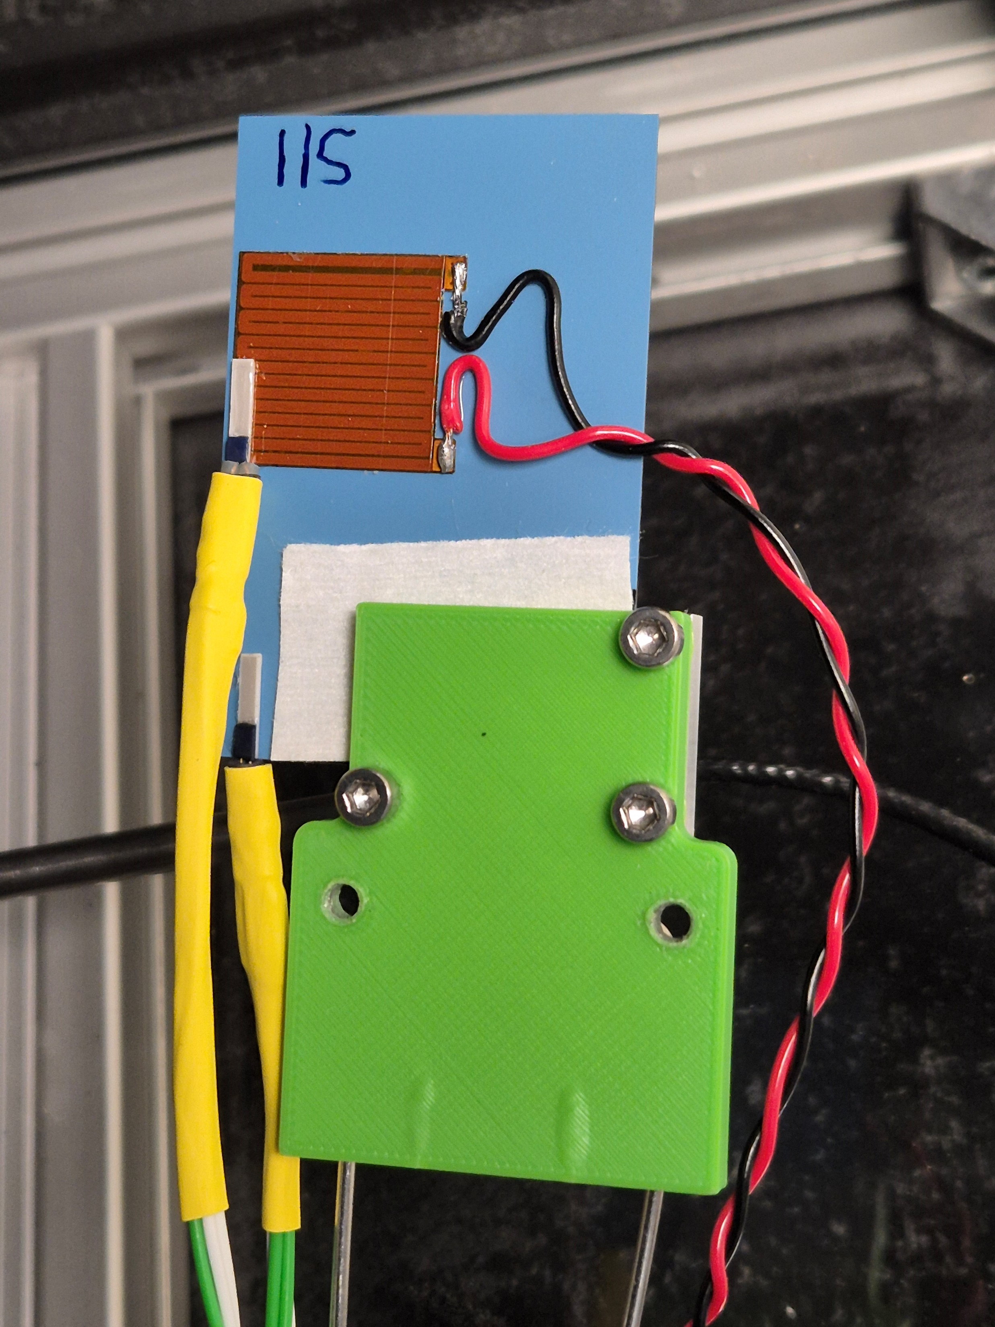
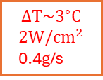
Highlights from different institutes/groups
High pressure sample
based on LTCC/HTCC
$$ΔT\sim 3^{∘}C$$
$$2W/cm^{2}$$
0.4g/s

Slide 16
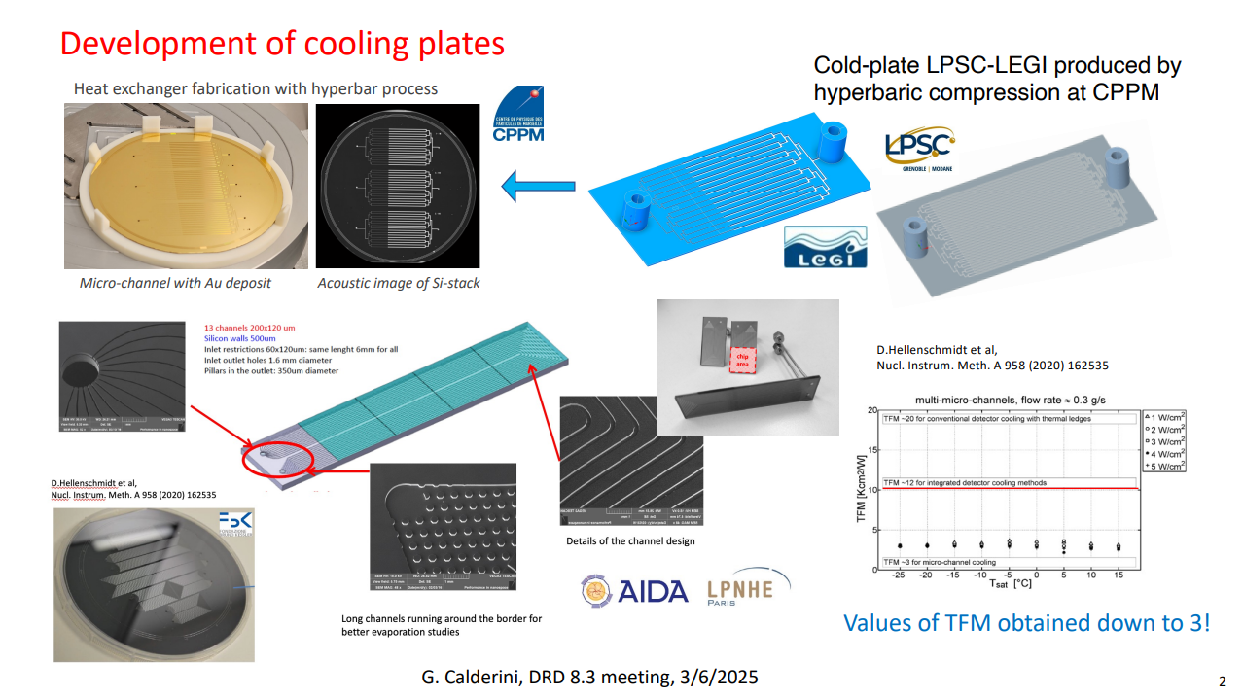
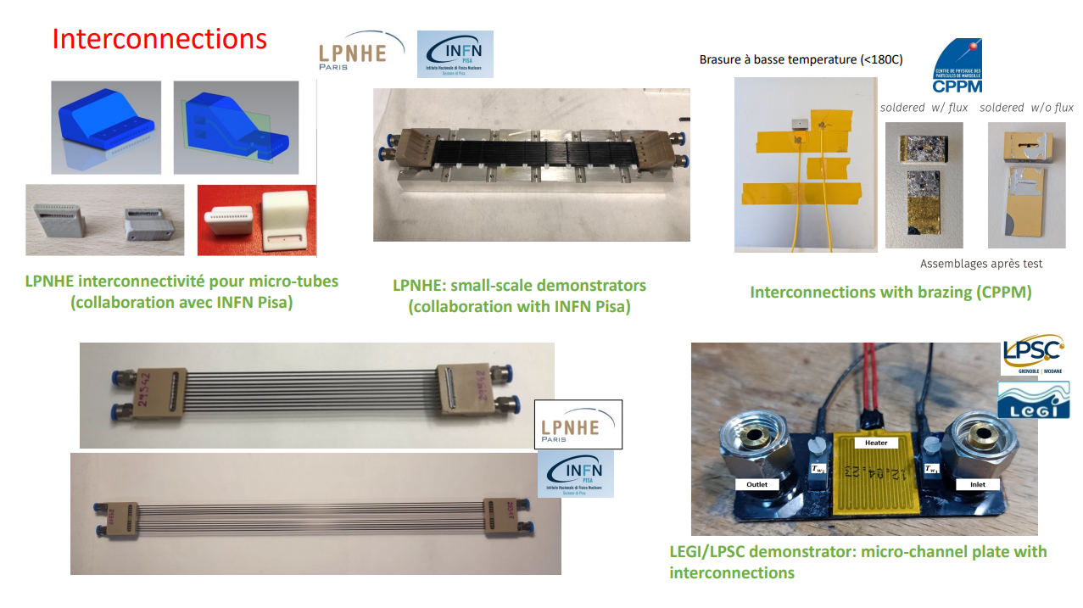
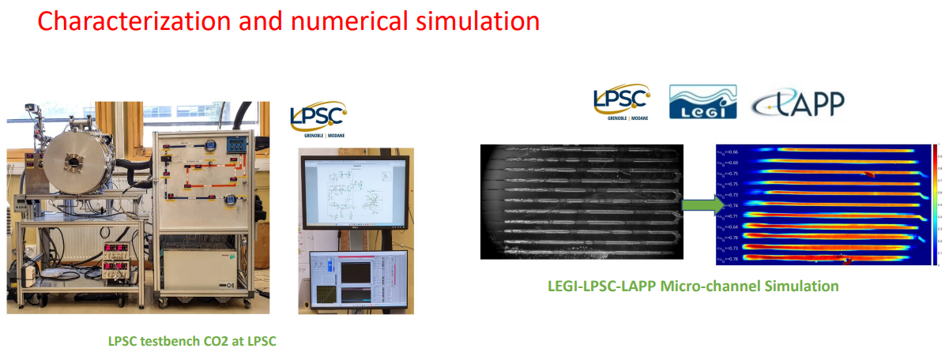
Highlights from different institutes/groups

Slide 17
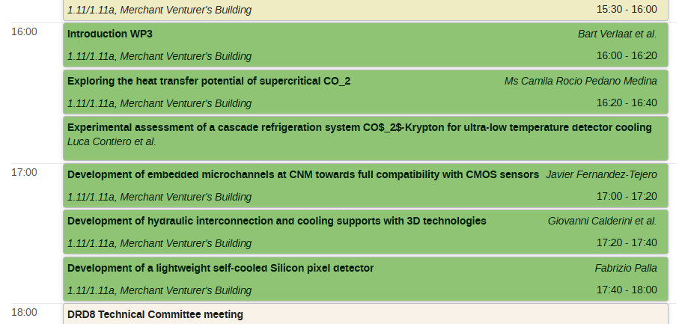
Final remarks
Please subscribe to the mailing list (DRD8-all and WP3)
  Many interesting initiatives being discussed in the dedicated meetings
Don’t hesitate to contact the conveners
  New project proposal contribution
  Share the status of on-going projects or infrastructure
  Next meeting: Early August
Enjoy the session! ☺

Slide 18
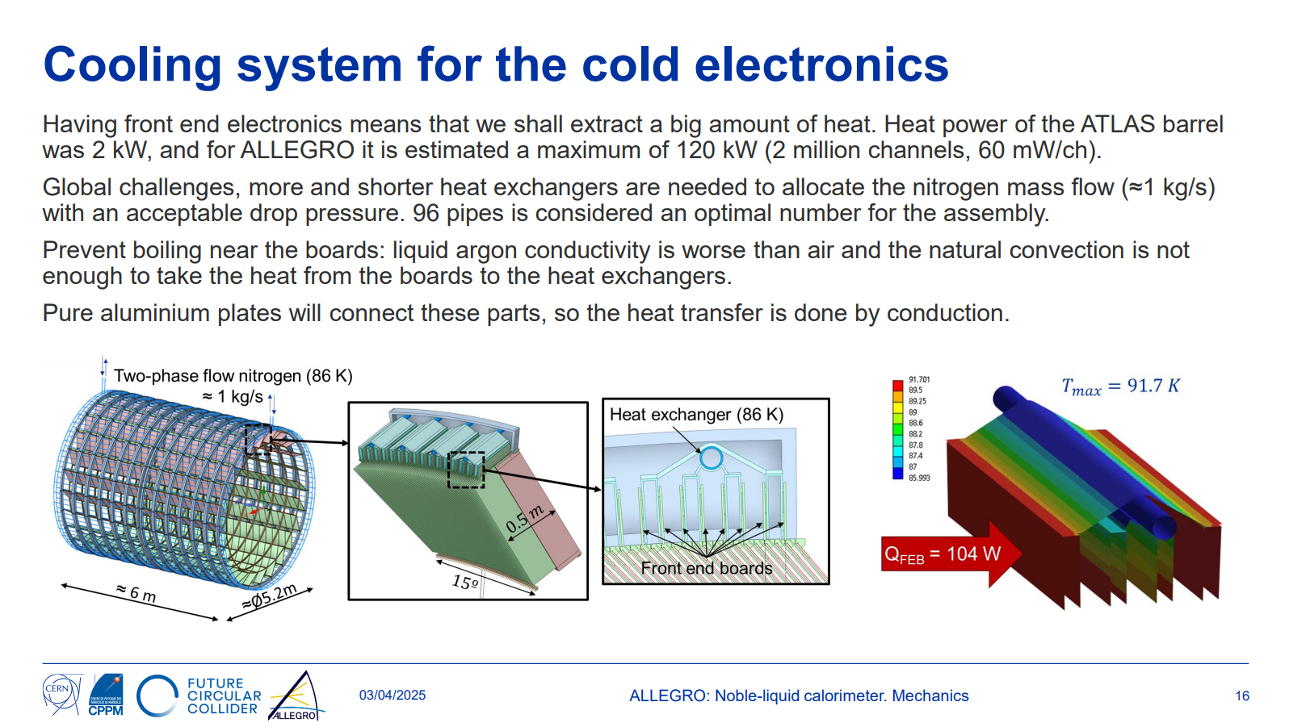
Thermomechanical analysis of the barrel electromagnetic calorimeter of the ALLEGRO full detector concept at the FCC-ee collider (link) – DRD8 WP3 contribution?

