Slide 1
Exploring the heat transfer potential of sCO2
Camila Pedano
Paolo Petagna, Susanne Gleissle
17th of June 2025

Slide 2
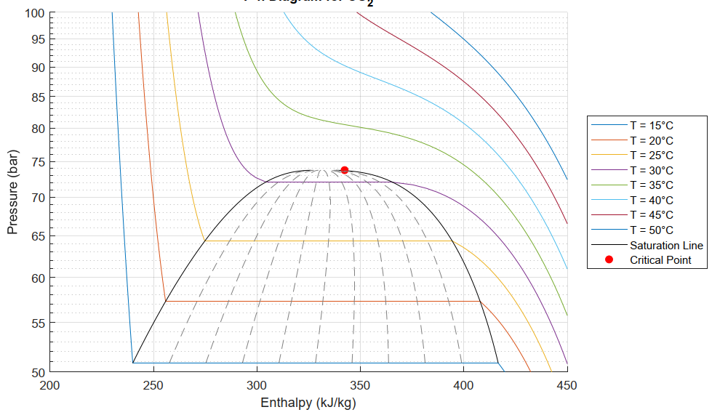
What is sCO2 and why are we looking at it?
  Supercritical carbon dioxide (sCO2):
    Above its critical pressure
    No possibility of phase-change, only a continuous variation from liquid-like to gas-like fluid
Here we continuously transition
31 ºC, 73.8 bar
  Why is it interesting?
    sCO2 has shown to have very high heat transfer coefficients in small pipes due to high heat capacity at the pseudocritical point (Tm)
    Very low pressure drops also characterize these types of flows due to low dynamic viscosities
Here we boil: discontinuous process

Slide 3
What is sCO2 and why are we looking at it?
  It has potential as coolant for warm detector and cable racks
  We already have a 27 km collider pipe underground and we want to build a 90 km one. So why not study sCO2?
  There are operating conditions (around ambient temperature, space constraints) where:
    Boiling CO2 might not be worth using as a coolant
    Water is definitely not worth being used as a coolant
Here we continuously transition
31 ºC, 73.8 bar
Around ambient temperature = above 20 ºC, below 40 ºC
Here we boil: discontinuous process

Slide 4
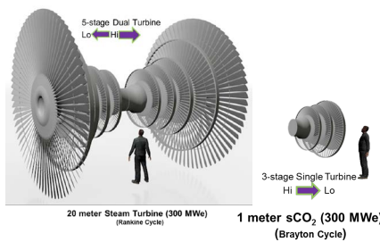
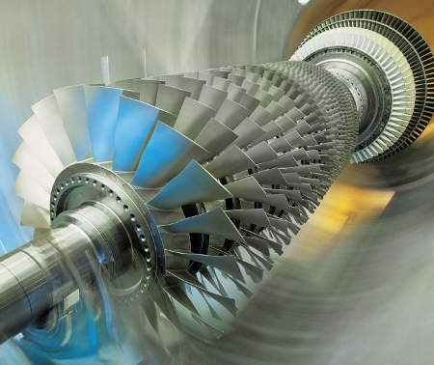

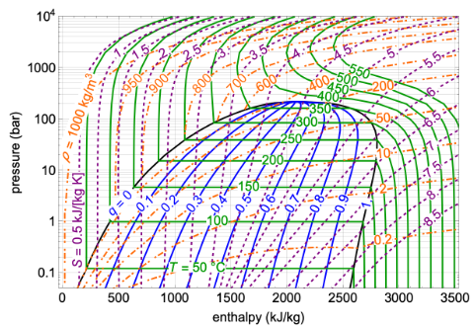
sCO2 uses currently
Turbines, energy production
Nuclear reactor cooling
Modelling fluid to understand others
No direct studies on how to use it as a refrigerant for electronics

Slide 5
The (green) cooling options we have
  …for warm detectors and cable racks
  Water
    Good coolant: cheap, high specific heat
    Used in chillers, racks and general infrastructure
    Works well when you can afford big flowrates and don’t mind big pipes
    Not ideal for electronics (risk of leaks): leak-less system can be designed but imply big design limitations due to pressure drop constraints
  Carbon dioxide (evaporative flows)
    Excellent properties and performance in cold detectors
    Evaporation is inherently almost isothermal
    Difficulties for flow distribution (see talks about capillaries on Tuesday – Arianna and Patryk)
    Dry-out
    Complex control strategy (see Lukasz Zwalinski’s talk on Tuesday)
    Need of very proficient personnel for M&O

Slide 6
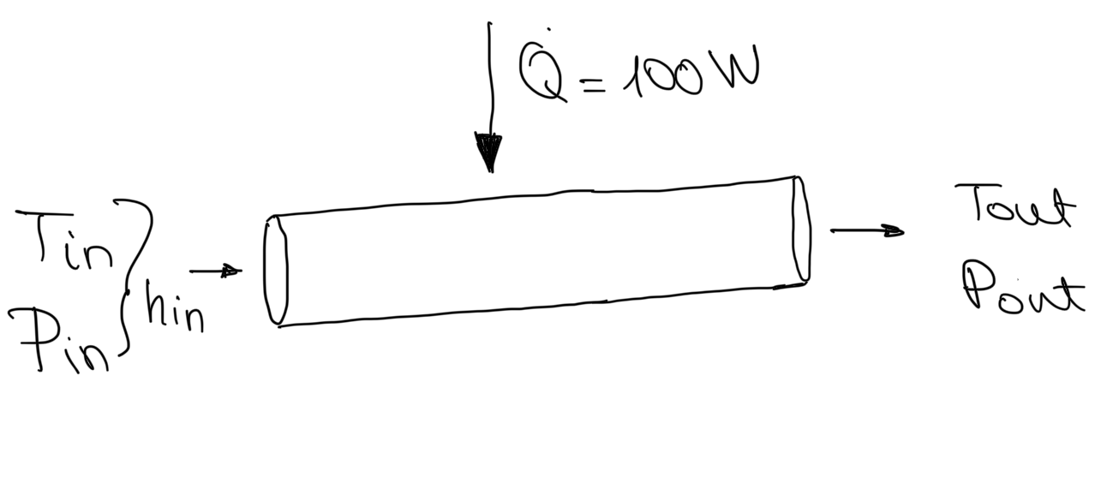


Our options: water above atmospheric
Case study: I want to keep the wall of this pipe at around 25 ºC using water
Specifications:
Power = 100 W
Pipe length = 1 m
Inlet temperature = 25 ºC
Temperature gradient (in-out) allowance = 3 ºC
Our simplification: perfect conduction through pipe
Q (W) | ID (mm) | m (g/s) | v (m/s) | f | dp (bar) | dT (ºC)
100 | 1 | 8.3 | 10.6 | 0.031 | 16 | 3
100 | 2 | 8.3 | 2.6 | 0.036 | 0.7 | 3
$$Q=m∆h$$
$$dp=f\frac{L}{D}\frac{{ρv}^{2}}{2}$$

Slide 7
Our options: water above atmospheric
Case study: I want to keep the wall of this pipe at around 25 ºC using water
Specifications:
Power = 100 W
Pipe length = 1 m
Inlet temperature = 25 ºC
Our simplification: perfect conduction through pipe
Q (W) | ID (mm) | m (g/s) | v (m/s) | f | dp (bar) | dT (ºC)
100 | 1 | 8.3 | 10.6 | 0.031 | 16 | 3
100 | 2 | 8.3 | 2.6 | 0.036 | 0.7 | 3
100 | 3 | 24 | 3.4 | 0.031 | 0.5 | 1
$$Q=m∆h$$
$$dp=f\frac{L}{D}\frac{{ρv}^{2}}{2}$$

Slide 8
Our options: water below atmospheric
Case study: I want to keep the wall of this pipe at around 25 ºC using water
Specifications:
Power = 100 W
Pipe length = 1 m
Inlet temperature = 25 ºC
Strong restrictions on pressure drop
Our simplification: perfect conduction through pipe
Q (W) | ID (mm) | m (g/s) | v (m/s) | f | dp (bar) | dT (ºC)
100 | 3 | 24 | 3.4 | 0.031 | 0.5 | 1
100 | 4 | 24 | 1.9 | 0.032 | 0.3 | 1
$$Q=m∆h$$
$$dp=f\frac{L}{D}\frac{{ρv}^{2}}{2}$$

Slide 9
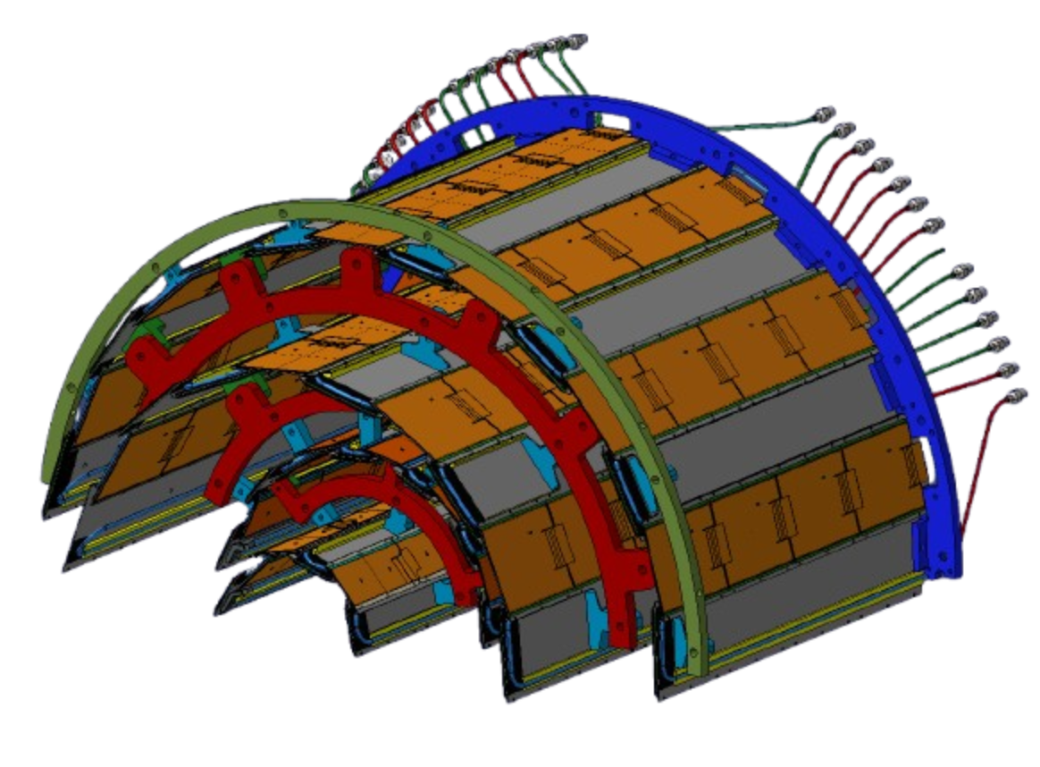
Our options: water below atmospheric
Case study: I want to keep the wall of this pipe at around 25 ºC using water
Specifications:
Power = 100 W
Pipe length = 1 m
Inlet temperature = 25 ºC
Strong restrictions on pressure drop
Our simplification: perfect conduction through pipe
Q (W) | ID (mm) | m (g/s) | v (m/s) | f | dp (bar) | dT (ºC)
100 | 3 | 24 | 3.4 | 0.031 | 0.5 | 1
100 | 4 | 24 | 1.9 | 0.032 | 0.3 | 1
Not on my watch
Water does not work well in small diameter pipes unless we accept large temperature increase or low flow rates

Slide 10
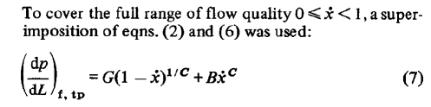




Our options: evaporative CO2
Case study: I want to keep the wall of this pipe at around 25 ºC using boiling CO2
Specifications:
Power = 100 W
Inner diameter = 1 mm
Pipe length = 1 m
Inlet temperature = 25 ºC
Inlet Pressure = Psat(T) bar = 64.5 bar
HTC ≈ 30 kW/m2K
$$Q=mx{∆H}_{vap}$$
$${∆H}_{vap}={∆H}_{vap}\left(Psat\right)=119.6 kJ/kg$$
max. vapor quality to avoid dryout
$$x=0.4$$
Our simplification: perfect conduction through pipe
$m=2.1 g/s$
Using Muller-Steinhager-Heck the total dp is 2.1 bar → temperature gradient of 2.5 ºC due to pressure drop

Slide 11

Our options: evaporative CO2
If we expand to even higher temperatures
Specifications:
Power = 100 W
Inner diameter = 1 mm
Pipe length = 1 m
Inlet Pressure = Psat(T) bar
x = 0.4
Latent heat of evaporation decreases
Ts (ºC) | Mass flow (g/s) | dp (bar) | dT (ºC)
25 | 2.1 | 2 | 2
29 | 3.2 | 3.5 | 3
$$\frac{∆H_{v,−30 ºC}}{{∆H}_{v,30 ºC}}≈5$$

Slide 12
Conclusions on the comparisons
Water
in detector systems we are forced to go to leakless systems
very constrained with allowed pressure drop in the system
too limited
not isothermal itself – going really isothermal needs big flow <> big diameter / short pipe <> tight on bends and restrictions
in general, difficult for design
Boiling CO2
performs well in small diameters
not fully isothermal either
operation is the difficult part

Slide 13
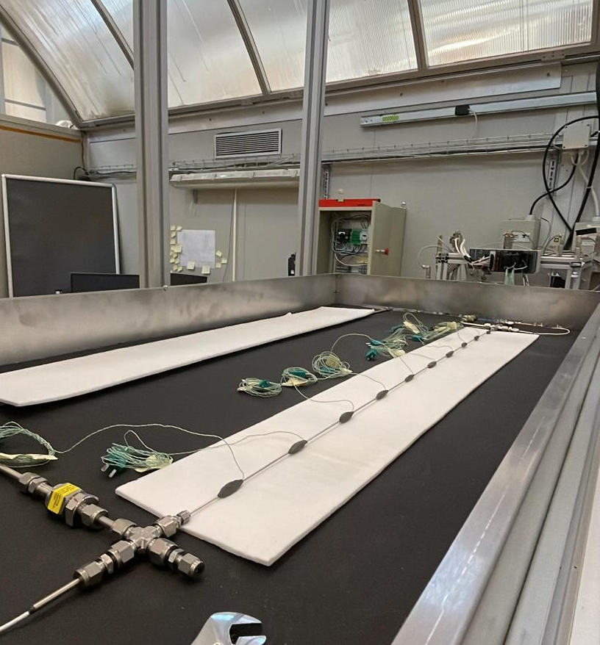
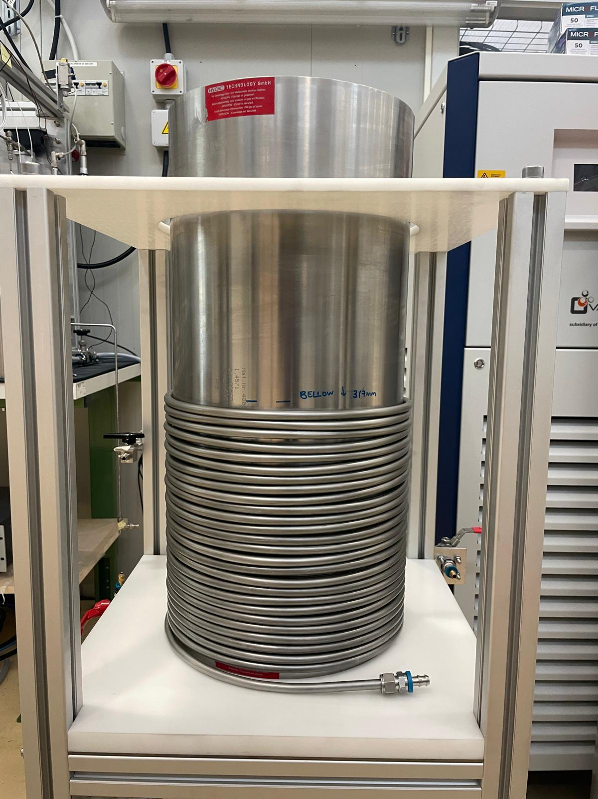
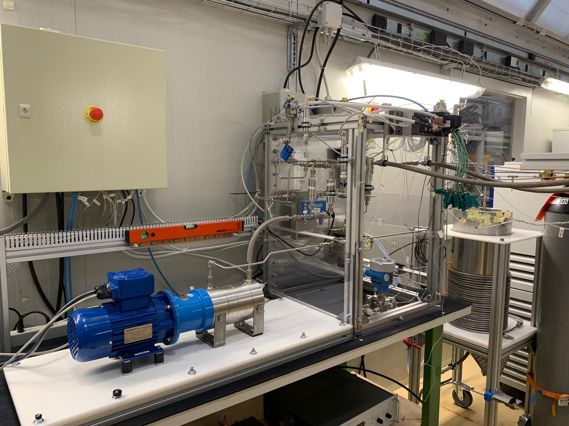

Knowing this, we built a setup
Electrical side with help of Jarl Pettersen and Andrzej Baran (EP-DT)
CO2
SASS
Scientific Assessment of the Supercritical State
We measure
More pictures and a poster describing the process in detail
We pressurize liquid CO2
We pump it and set an inlet temperature
P = 50-120 bar
https://gitlab.cern.ch/co2-cooling/labview-sass
Monitoring, control, DAQ via LabVIEW

Slide 14
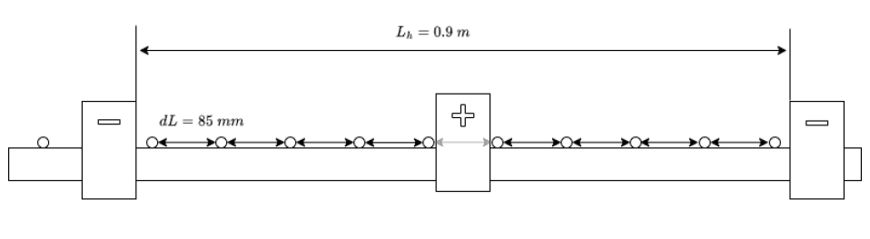


Knowing this, we built a setup
Electrical side with help of Jarl Pettersen and Andrzej Baran (EP-DT)
CO2
SASS
Scientific Assessment of the Supercritical State
Goal: Heat transfer coefficients and pressure drops
Inlet fluid temperature PT100
Outlet fluid temperature PT100
Thermocouples 2:11
evenly spaced
Variable | Uncertainty
Fluid temperature / ºC | 0.07
Wall temperature / ºC | 0.07
Absolute Pressure / bar | 0.18
Pressure drop / mbar | 2.50
Mass flow / kgh-1 | 0.04
Test section:
inside insulated box
on tiltable frame
L/D>50
L = 1 m
Data reduction
$$qdA=m(h_{i+1}−h_{i})$$
$$HTC=\frac{q}{T_{w,i}−T_{b}}$$

Slide 15
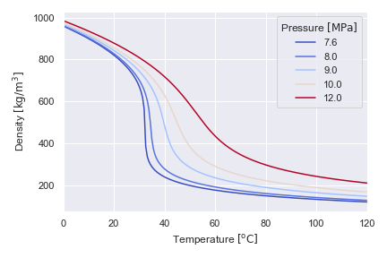
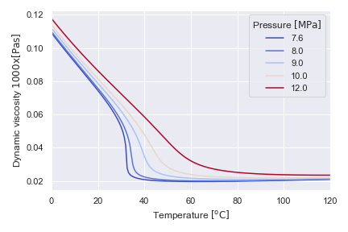
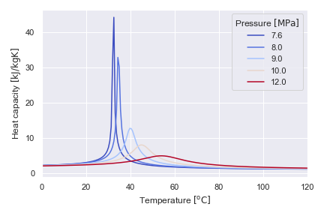
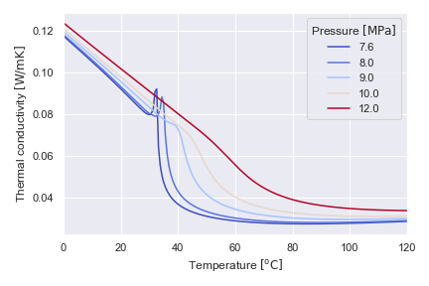
Some parameters of interest
Tm
Tm
Liquid-like to gas-like
Fluid properties of interest:
  High Cp at Tm
  Density shifts at Tm
Tm: Pseudocritical point
Point at which Cp = max at that pressure
First results explore the left region of Tm and the right region of Tm at 85 bar
Tm(85) = 37.4 ºC

Slide 16
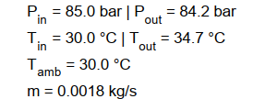
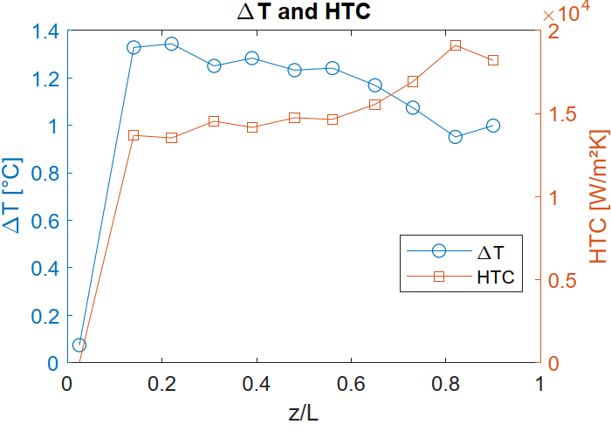
First results of CO2-SASS – Tin<Tm
Tm(85) = 37.4 ºC
Heated zone
Heat transfer coefficient comparable with that of CO2 during evaporation
Much lower pressure drop than cooling with CO2 in such a pipe
dT = 4 ºC but dp = 0.8 bar for 1.8 g/s in 1 mm pipe!
Perhaps mass flow can be increased to reach isothermal operation while maintaining low dp
Corresponding flow needed of boiling CO2 = 2.1 g/s, dp = 1.6 bar, with a dT of 1.5 ºC

Slide 17
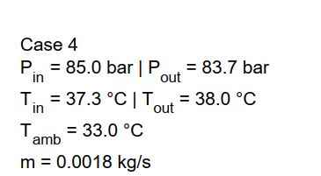
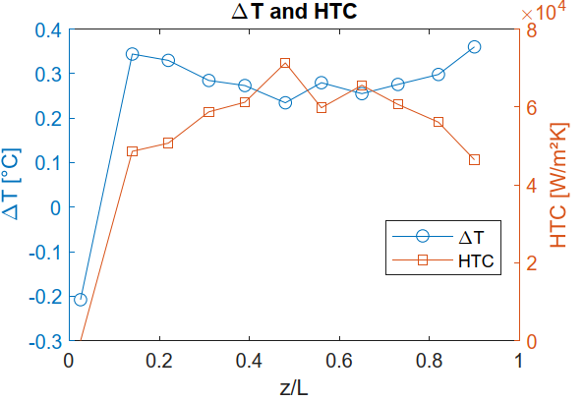
First results of CO2-SASS – Tin>Tm
Tm(85) = 37.4 ºC
Heated zone
Heat transfer coefficient comparable with that of CO2 during evaporation
dT < 1 ºC !!
Higher pressure drop, still low = 1.3 bar
1.8 g/s in 1 mm pipe!
Perhaps mass flow can be increased to reach even more isothermal operation while maintaining similar order of magnitude dp

Slide 18
Conclusions
sCO2 shows high heat transfer coefficients and reasonable pressure drops in the conditions tested
Data campaign to be performed during summer to obtain parametric trends of important system variables
Water is simple but inefficient at small scale. Boiling CO₂ is efficient but complex. Supercritical CO₂ gives us the best of both worlds: good performance, small pipe compatibility, and low system complexity. We can dream of a simpler system.
What does simpler system mean?

Slide 19

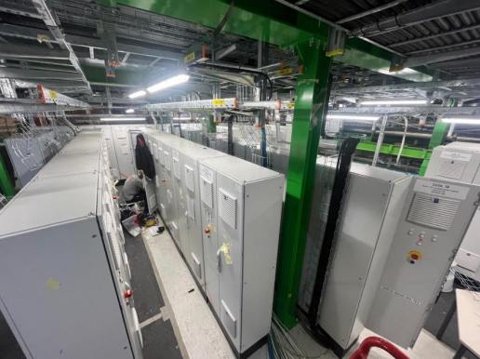
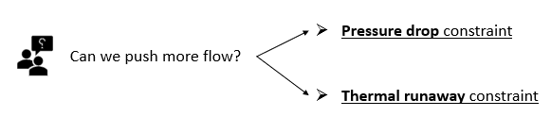

Simpler system means…
Zwalinski, L. et al.
Tuesday talk
Instabilities since DAY 1 of tracker!
Bistoni, L. Cianchetta, P.
Tuesday talk
Less intense control strategy <> less cabinets!
Less phases <> less problems!

Slide 20
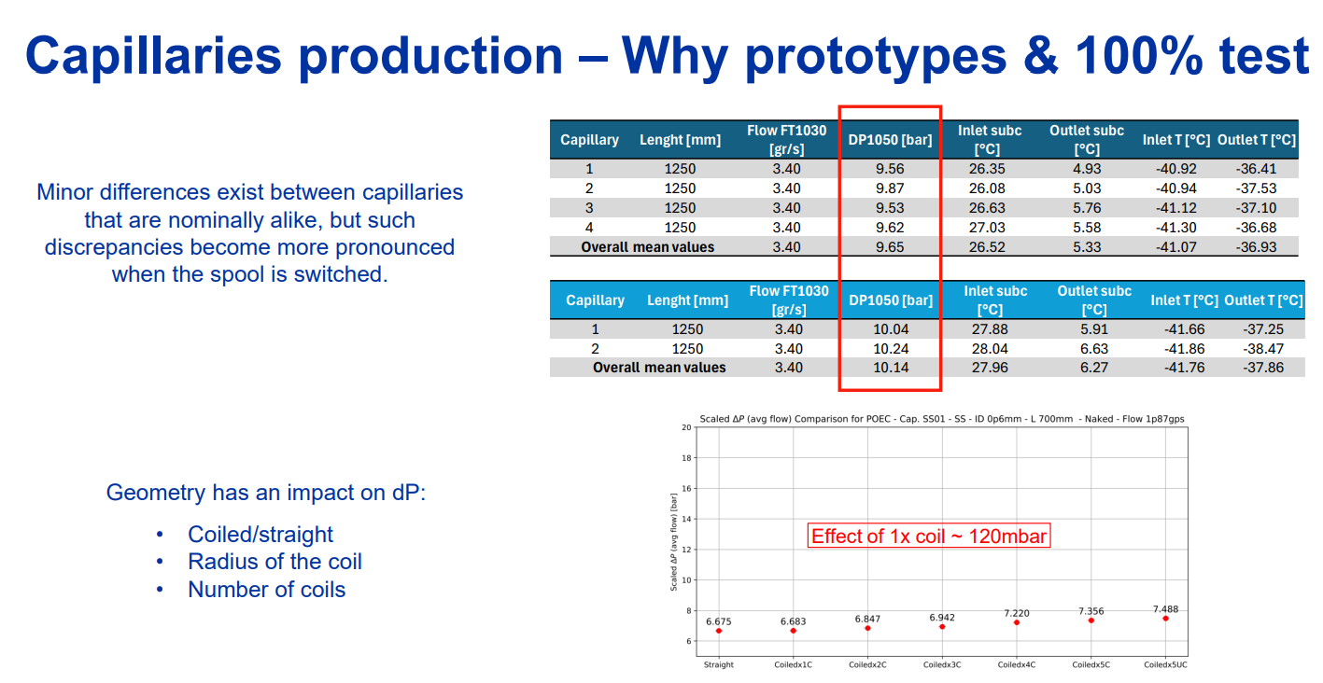
Simpler system means…
Slide of Eugeni, A. and Paterak, P.

Slide 21
The final final conclusions
At lower temperatures:
  we need to boil and be complicated (right now); but at higher temperatures, why would we keep complicated when we can just skip it and go simple?
  there are fluids (Kr, Pc at -63 ºC, 54 bar) one could study at their supercritical state to evaluate thermal performance
Two phase systems need many considerations which depend on other considerations!!!!
If we have a single phase flow, we go a bit more to plug and play: set pressure, set temperature = stay cool
Maybe today
But tomorrow
Make bigger pipes
Go supercritical

Slide 22
Thanks!

Slide 23
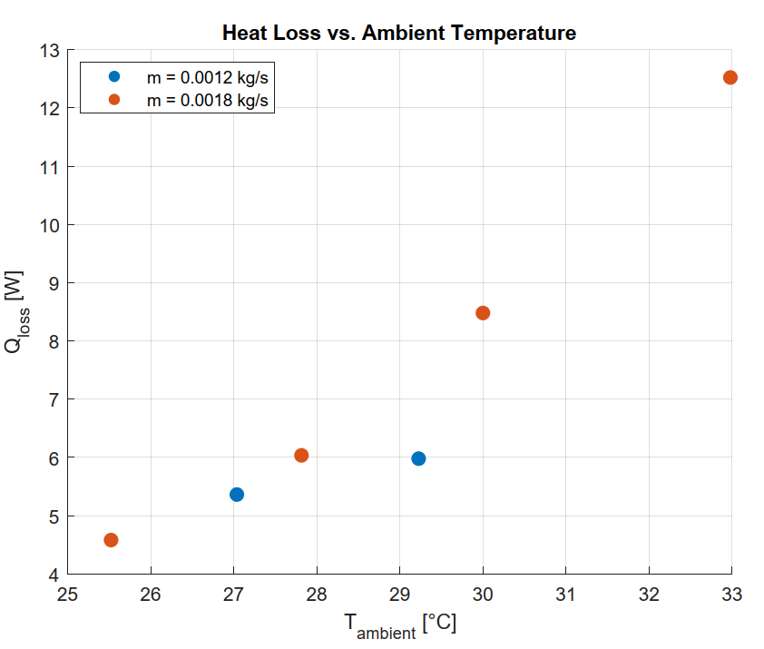
Heat leaks f(T, m, Tamb)

Slide 24
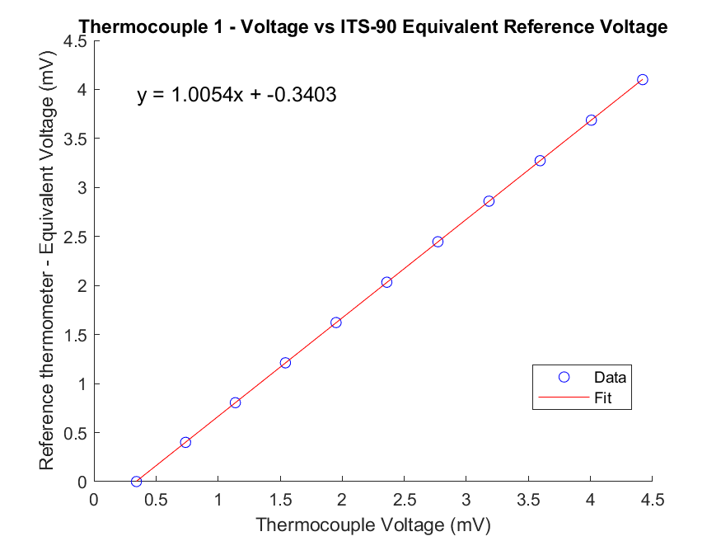
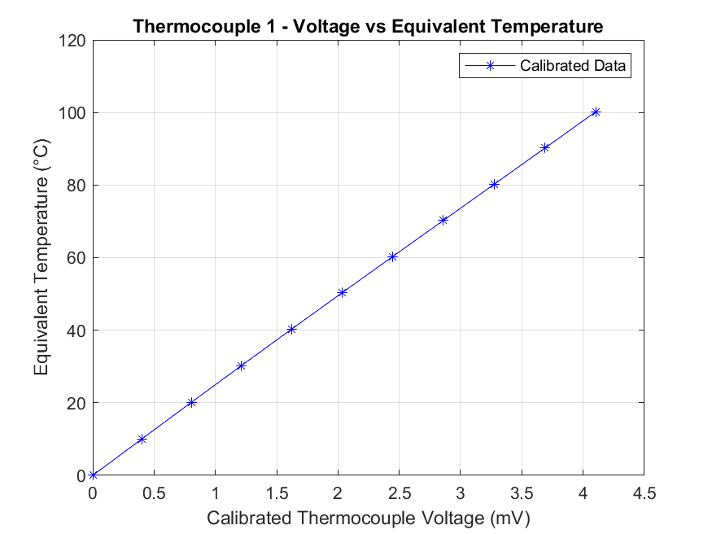
Thermocouple fits

Slide 25
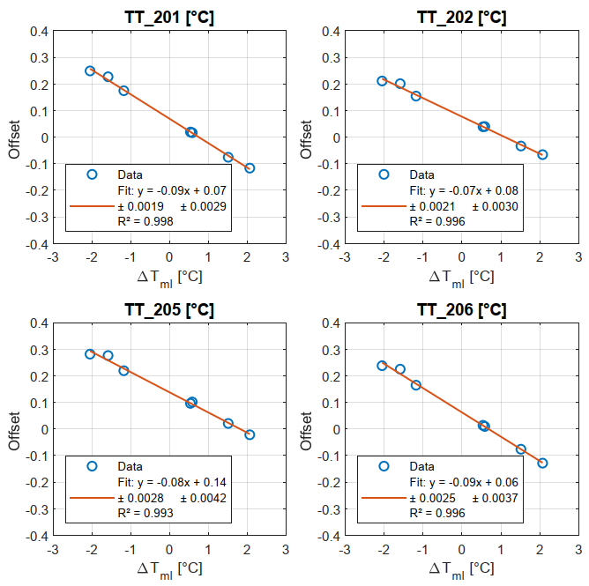
Flow correction

Slide 26
Flow correction

