Slide 1


Overview krypton project
Forum on Tracking Detector Mechanics 2025
University of Bristol, UK.
Luca Contiero
PhD student NTNU-CERN
June 19th, 2025

Slide 2
Content
Introduction
  Why krypton as cooling agent?
New cycle technology
  Principle
  Ejector as passive pumping device
  Experimental assessment
  Installation at CERN
Potential applications
  Low temperature cooling (-40/-80 °C)
  Ultra-low temperature (ULT) cooling (< -80°C)
Future program
  Oil-free machine development
  HTC & Δp performance map
Conclusion

Slide 3

Fluid study analysis: why krypton?
Low-mass detectors demand:
  Integration of small cooling channels (hardware minimization)
  Uniform temperature distribution
The working temperature range allows to select potential candidates → Critical pressure and temperature
{ T = -80°C, Q = 200 W, L = 2 m, VQ = 0-35% }
Old cooling choice at CERN
VHTC = $\frac{Q}{Volume∗ΔT(HTC+DP)}$
Improved performance near critical point
Krypton
Assess the dependence of the change in saturation temperature on pressure drop
Krypton appears to have better thermal performance at small pipe diameters

Slide 4
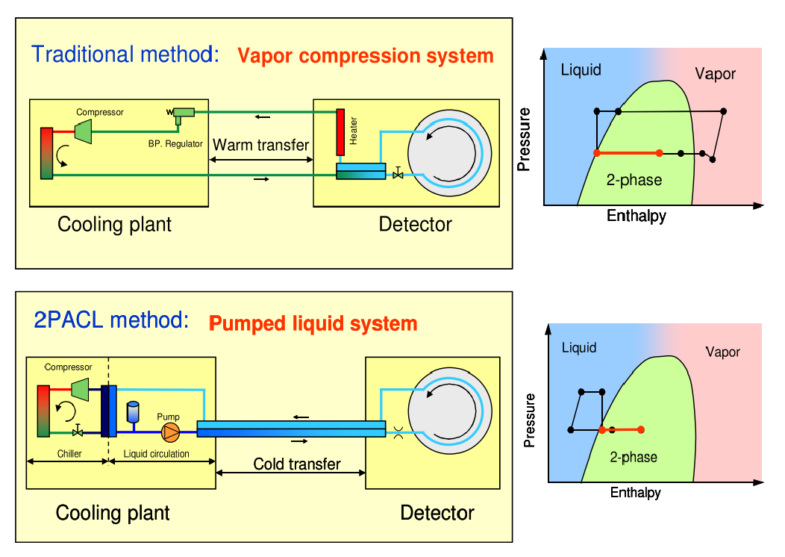

New cycle technology: p-h diagram
Similar pressure levels to CO₂
Starting conditions in gas-phase precludes the use of pumped loop system (2PACL)
Room temperature
CO₂ limit
Starting point
New technology must be developed to avoid thermal shocks on the detector modules → CONTROLLED COOLDOWN
This challenges apply to any potential coolant for ULT, as fluids with low critical temperature are required for boosted performance

Slide 5
New cycle technology: Ejector-driven system
Vapor compression cycle
Pumping loop driven by the ejector
System must be oil-free
Layout of the detector loop partially unaltered with respect to 2PACL
Use of an ejector as pumping device
External high-pressure (accumulator) tank for single-phase operation & transition to two-phase

Slide 6

New cycle technology: Two-phase operation
Rejection to CO₂ primary
Ejector sucks liquid
Expansion primary flow
Free-compression
Gas compression (no risk of sending liquid)
Capillary
Vaporization in the detector
Local depressurization invoke flow to the detector (p < p_{out,det})

Slide 7
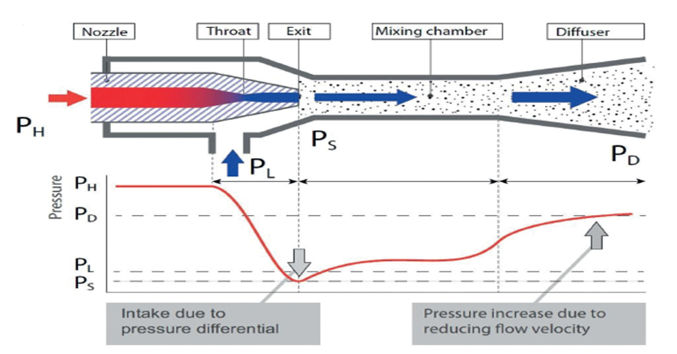
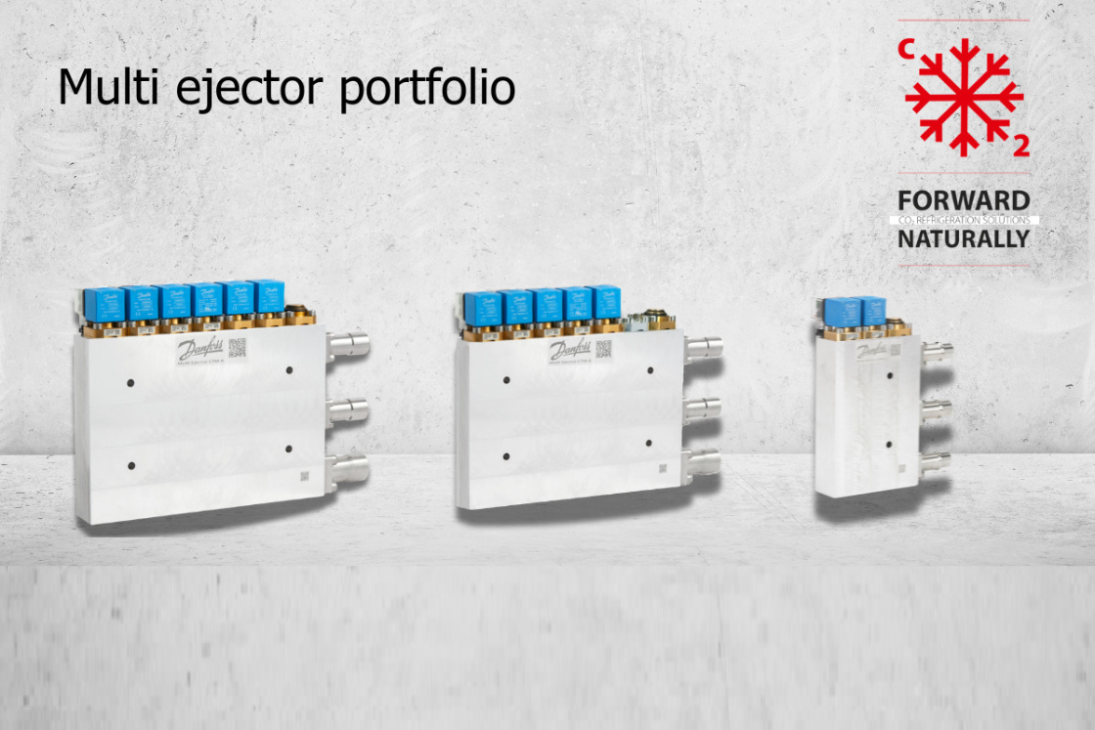
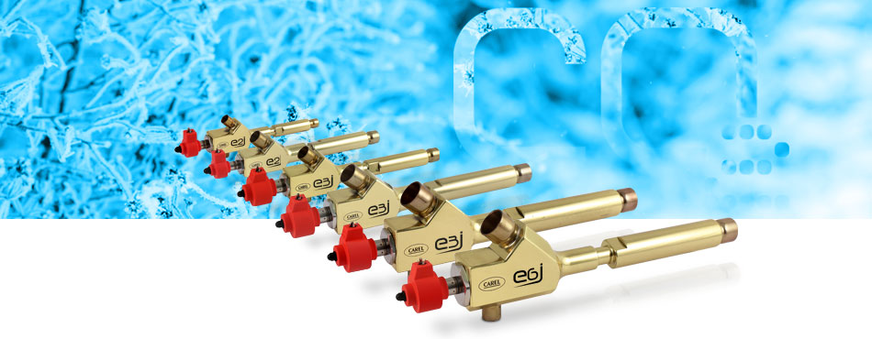
New cycle technology: Ejector
No risk of liquid delivered to the compressor due to flooded operation in the detector
It works as the pump in the 2PACL!
But how to regulate the pumping capacity?
Adjust pressure motive (primary) flow
Have multiple static ejectors in parallel
(see Danfoss https://www.danfoss.com/en/products/dcs/valves/electric-
expansion-valves/multi-ejector-solution/)
Adjust nozzle throat area by inserting a needle (see Carel https://www.carel.com/emj-electronic-modulating-ejector)
Mechanical devices involving no moving parts and widely applied to transcritical CO₂ systems
Devices for high-pressure control
They utilize energy from a high-pressure flow to entrain and compress a low-pressure stream
They can work with gas, liquids, two-phase and solid
Comprise three main parts: motive nozzle, mixing chamber and diffuser

Slide 8
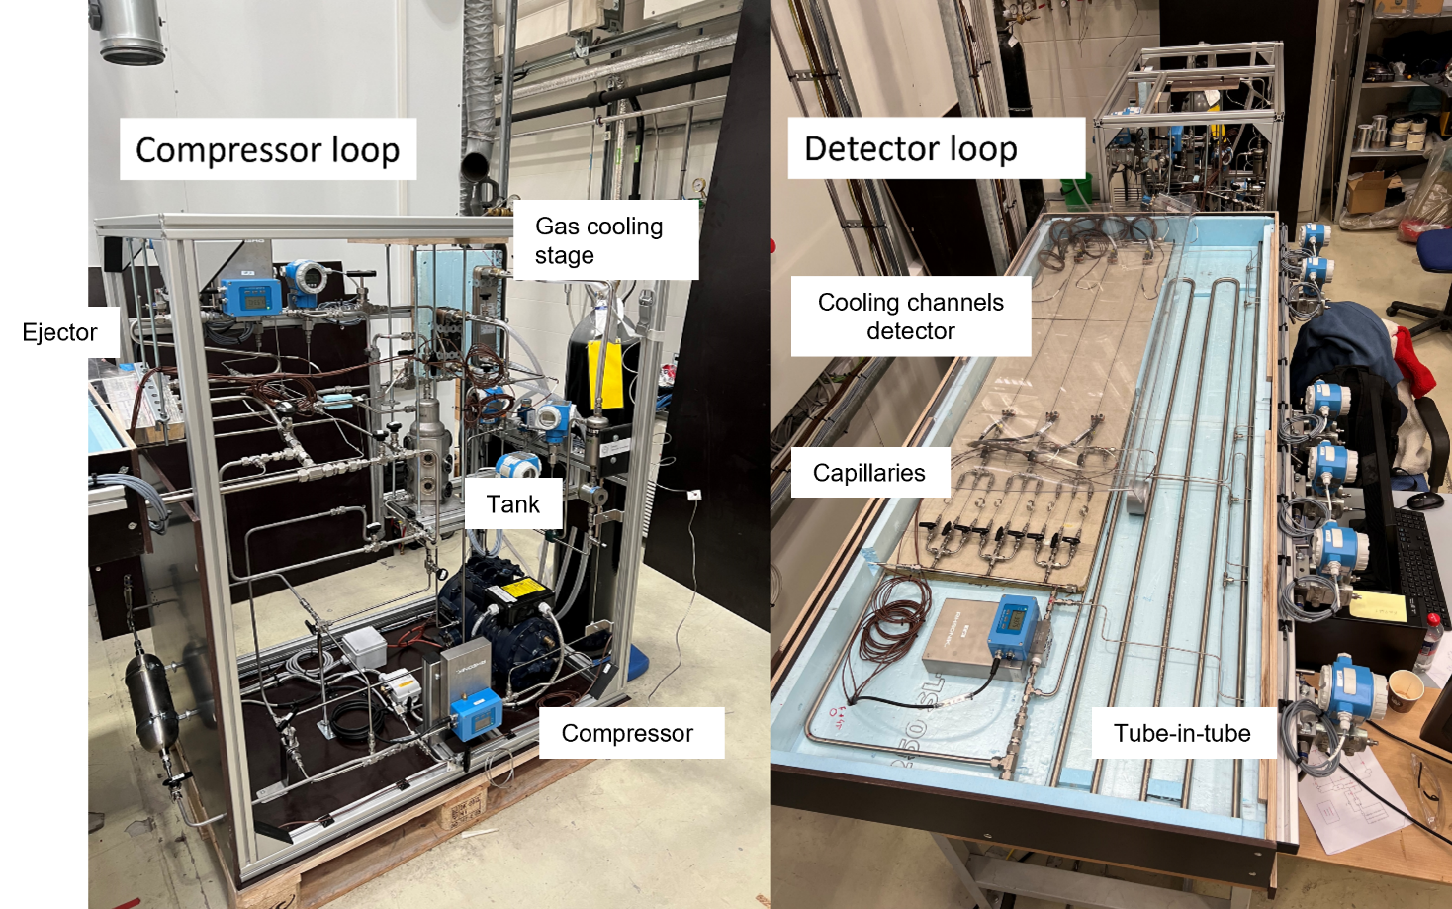
New cycle technology: Experimental prototype
Compressor and detector mockup box built at NTNU (Norway)
Use of an oil-lubricated transcritical CO₂ compressor with standard oil
Initially coupled with Julabo chiller for testing main transients (startup, cooldown, two-phase)
Missing external high-pressure tank and cold primary CO₂ chiller → system is now moved at CERN
Ejector

Slide 9
New cycle technology: startup
Closed
  Ejector loop is decoupled from vapor compression cycle at the start
  High-pressure control and connection to the bladder allows to avoid thermal shocks all time at the start
  Compressor starts and thermally stabilize
  Ejector opens to start circulating gas through the detector
  V.10 is initially used to add additional degree of controllability
accumulator
accumulator

Slide 10
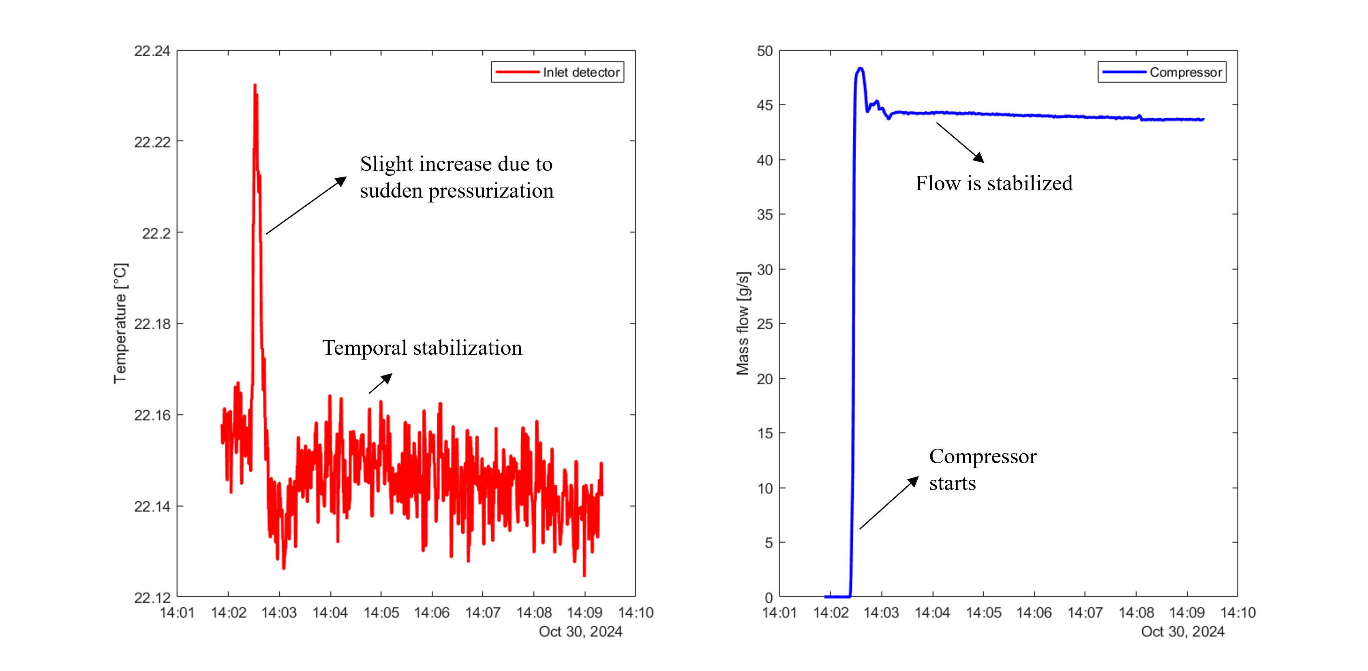
New cycle technology: startup

Slide 11
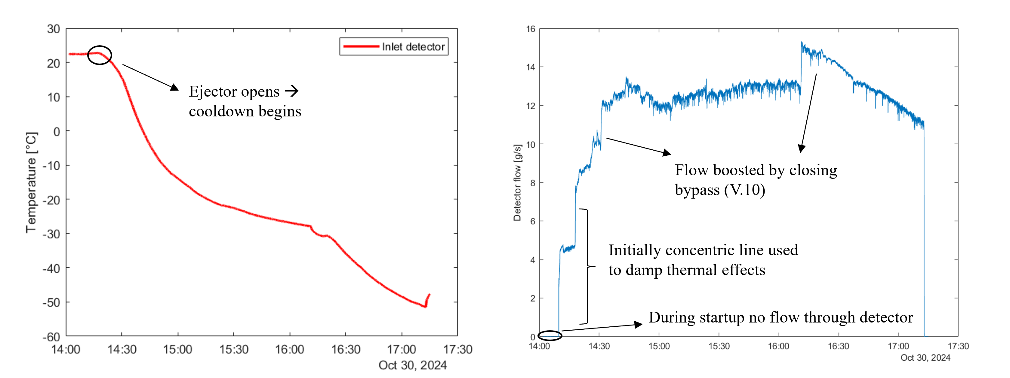
New cycle technology: cooldown
  The cooldown is driven by the external chiller, which provides additional cooling to the high-pressure side of the krypton system
  Ejector and valves in the detector loop are used to adjust the cooldown speed
  Average cooldown speed of ≈ 2 K/min

Slide 12
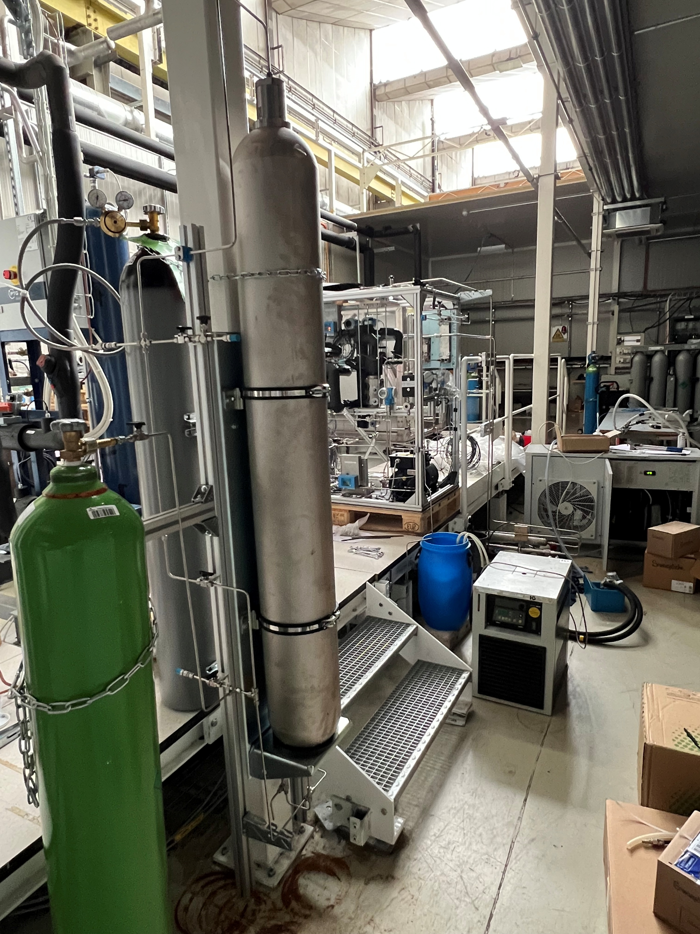
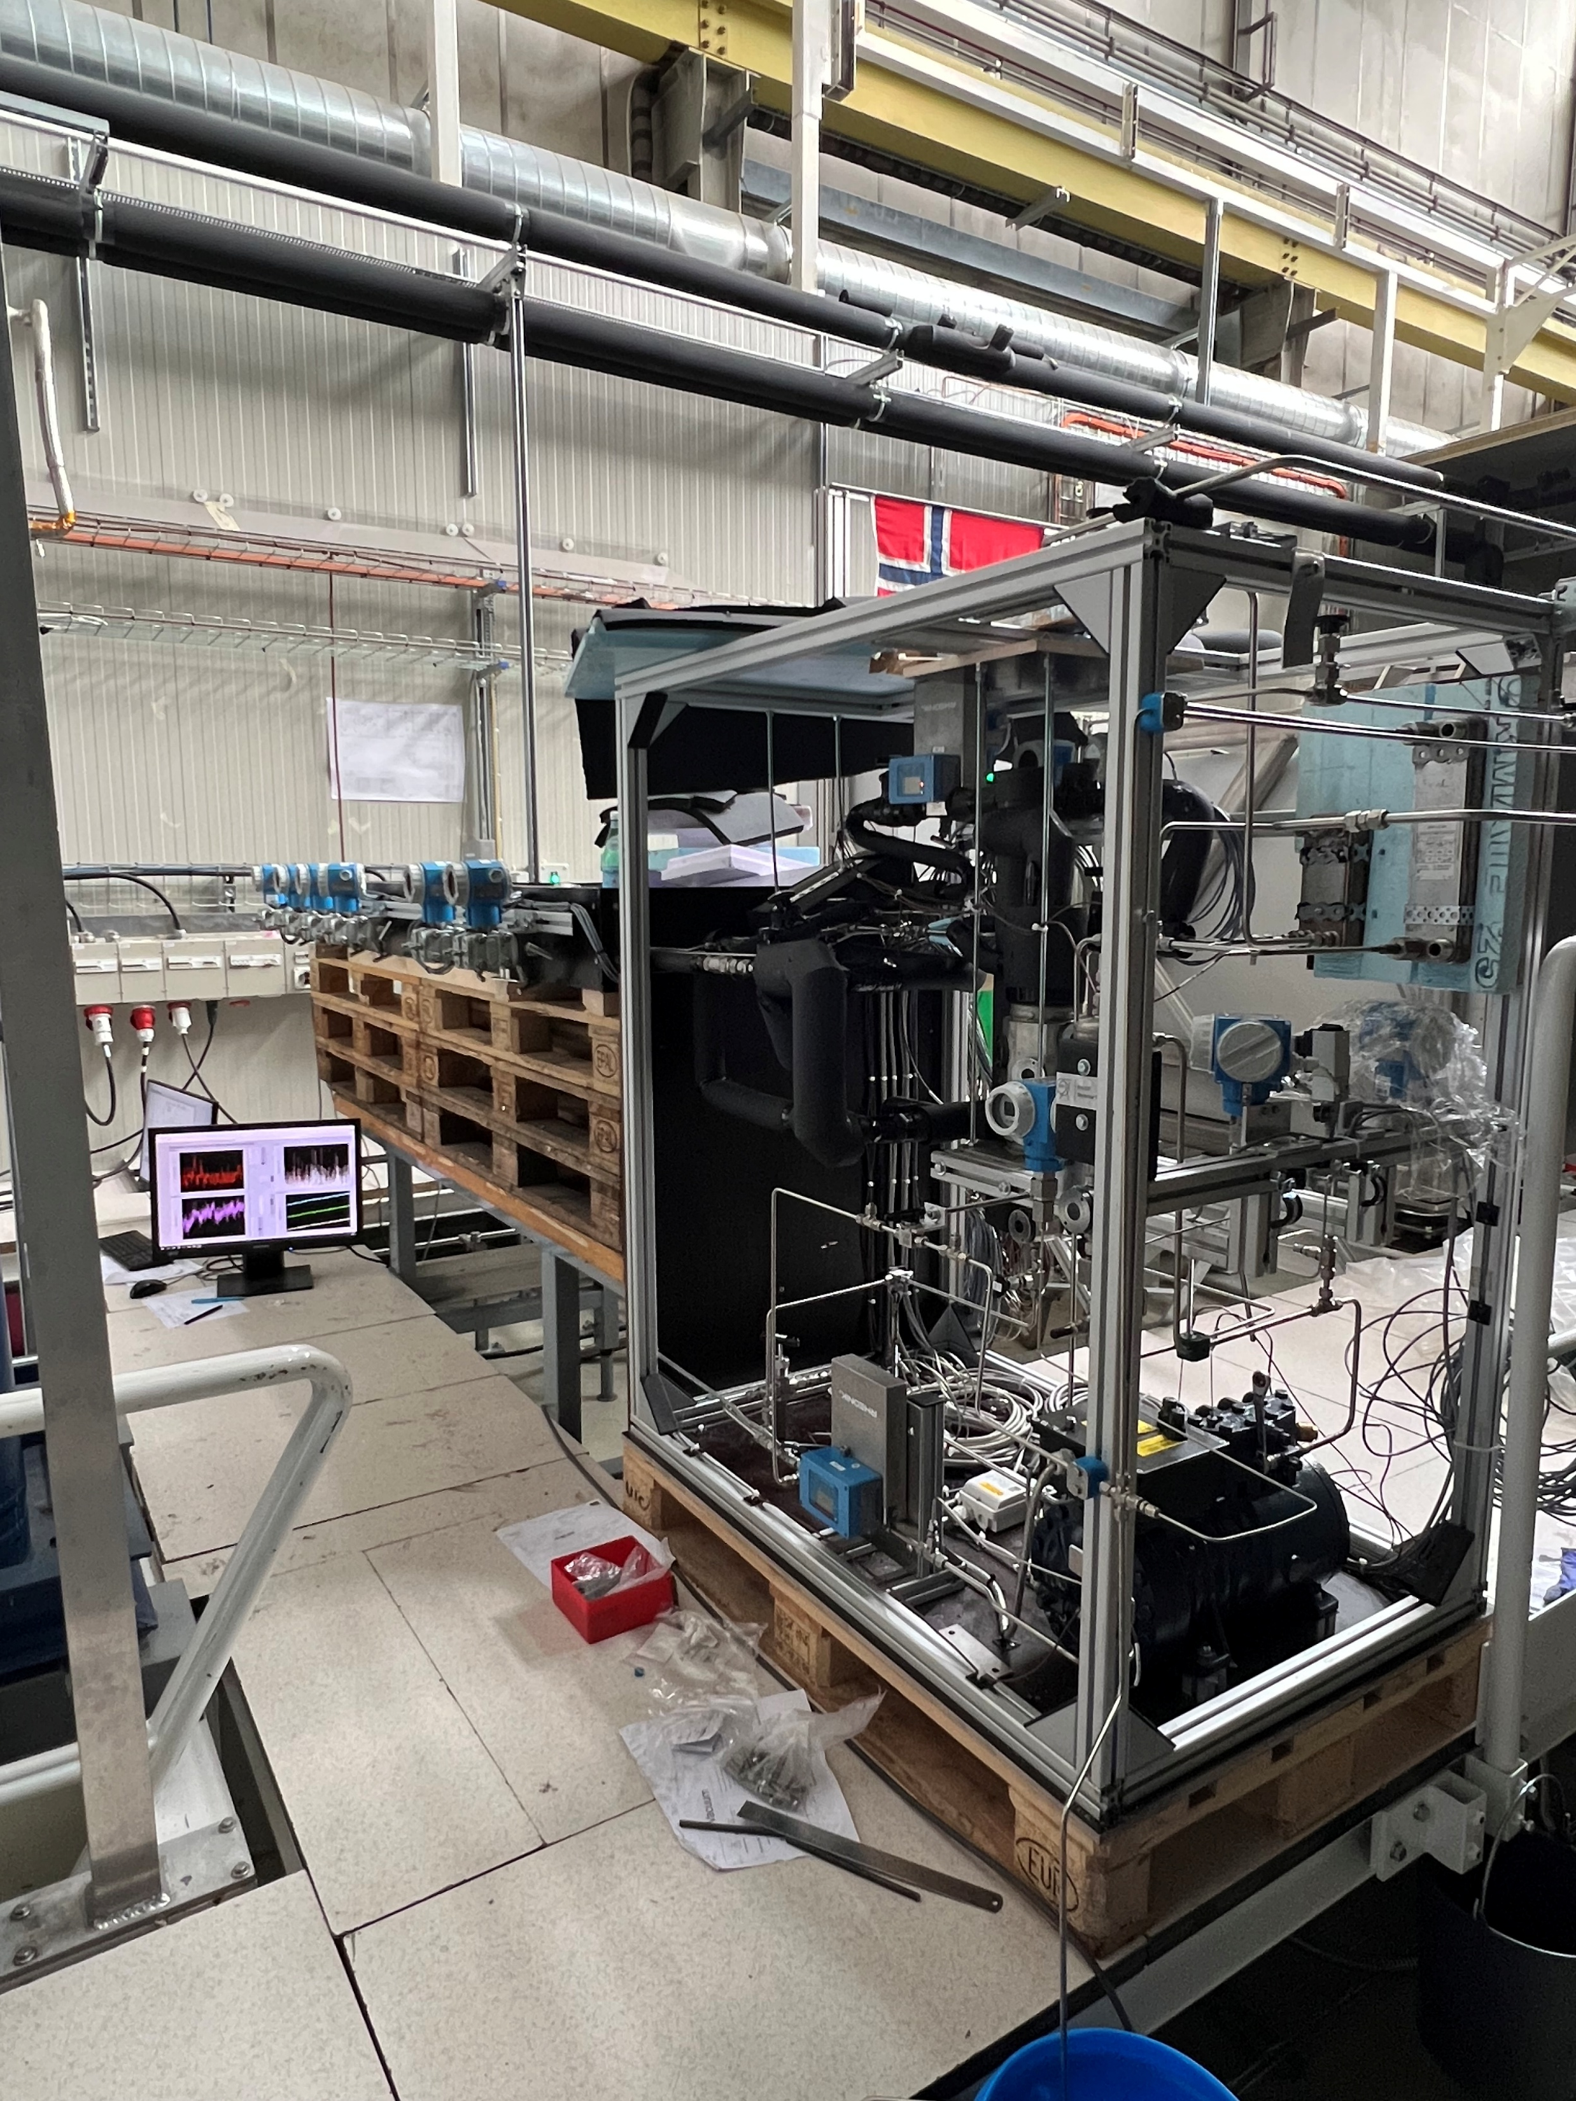
Installation of the prototype at CERN
Connection to a primary CO₂ chiller (system A)
External tank (bladder accumulator) is used to provide an isobaric cooldown when the system is in gas/supercritical phase
It provides additional refrigerant charge as the CO₂ primary circuit progressively cools down the krypton
In the prototype nitrogen is used for the pressurization, however small diffusion towards the krypton side may occur
  In the real system, a pneumatic accumulator with no interface among the two fluids must be used
N₂ bottle
Refrigeration system
Bladder accumulator
Krypton bottle

Slide 13
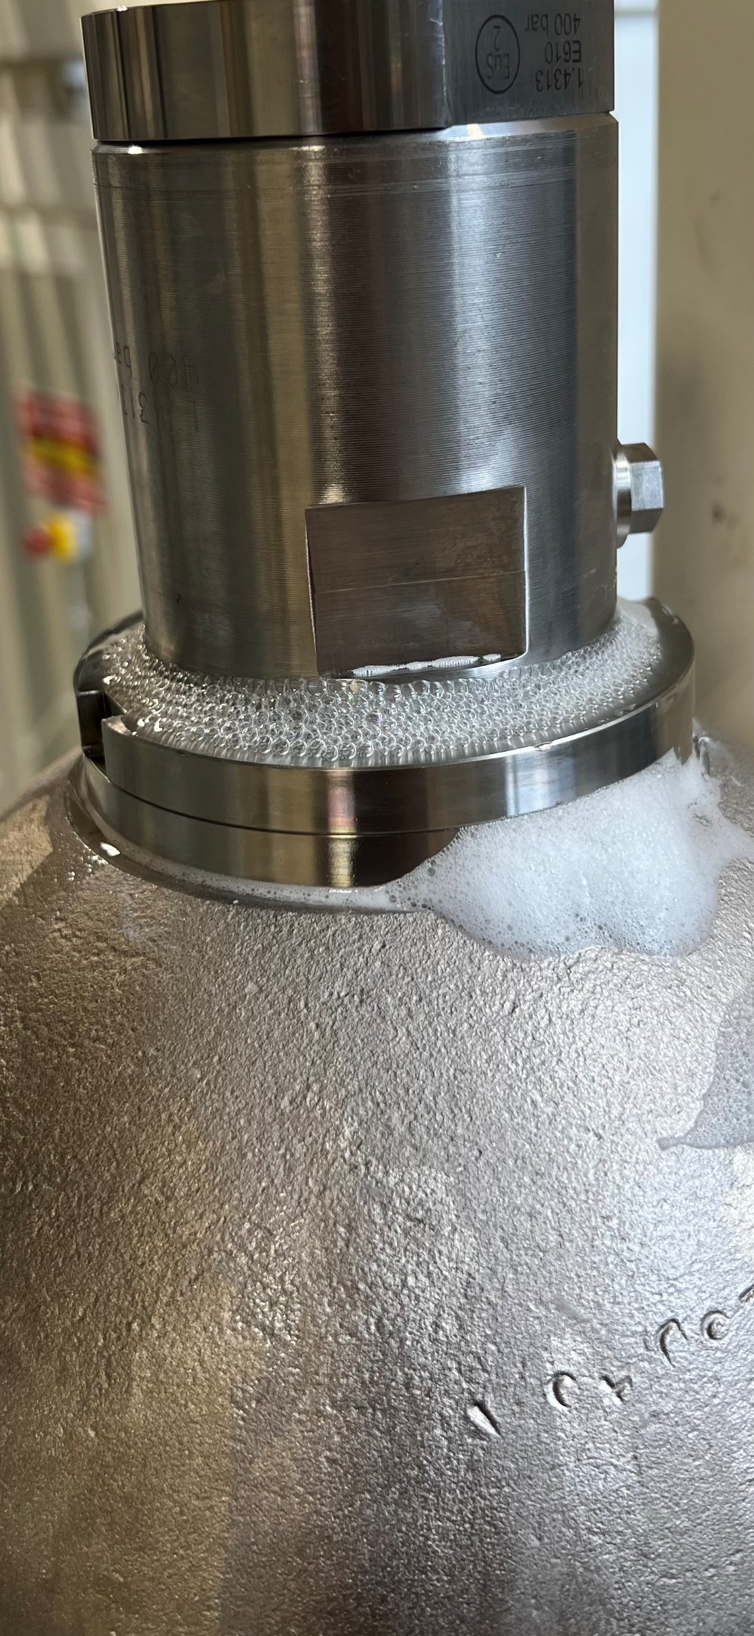
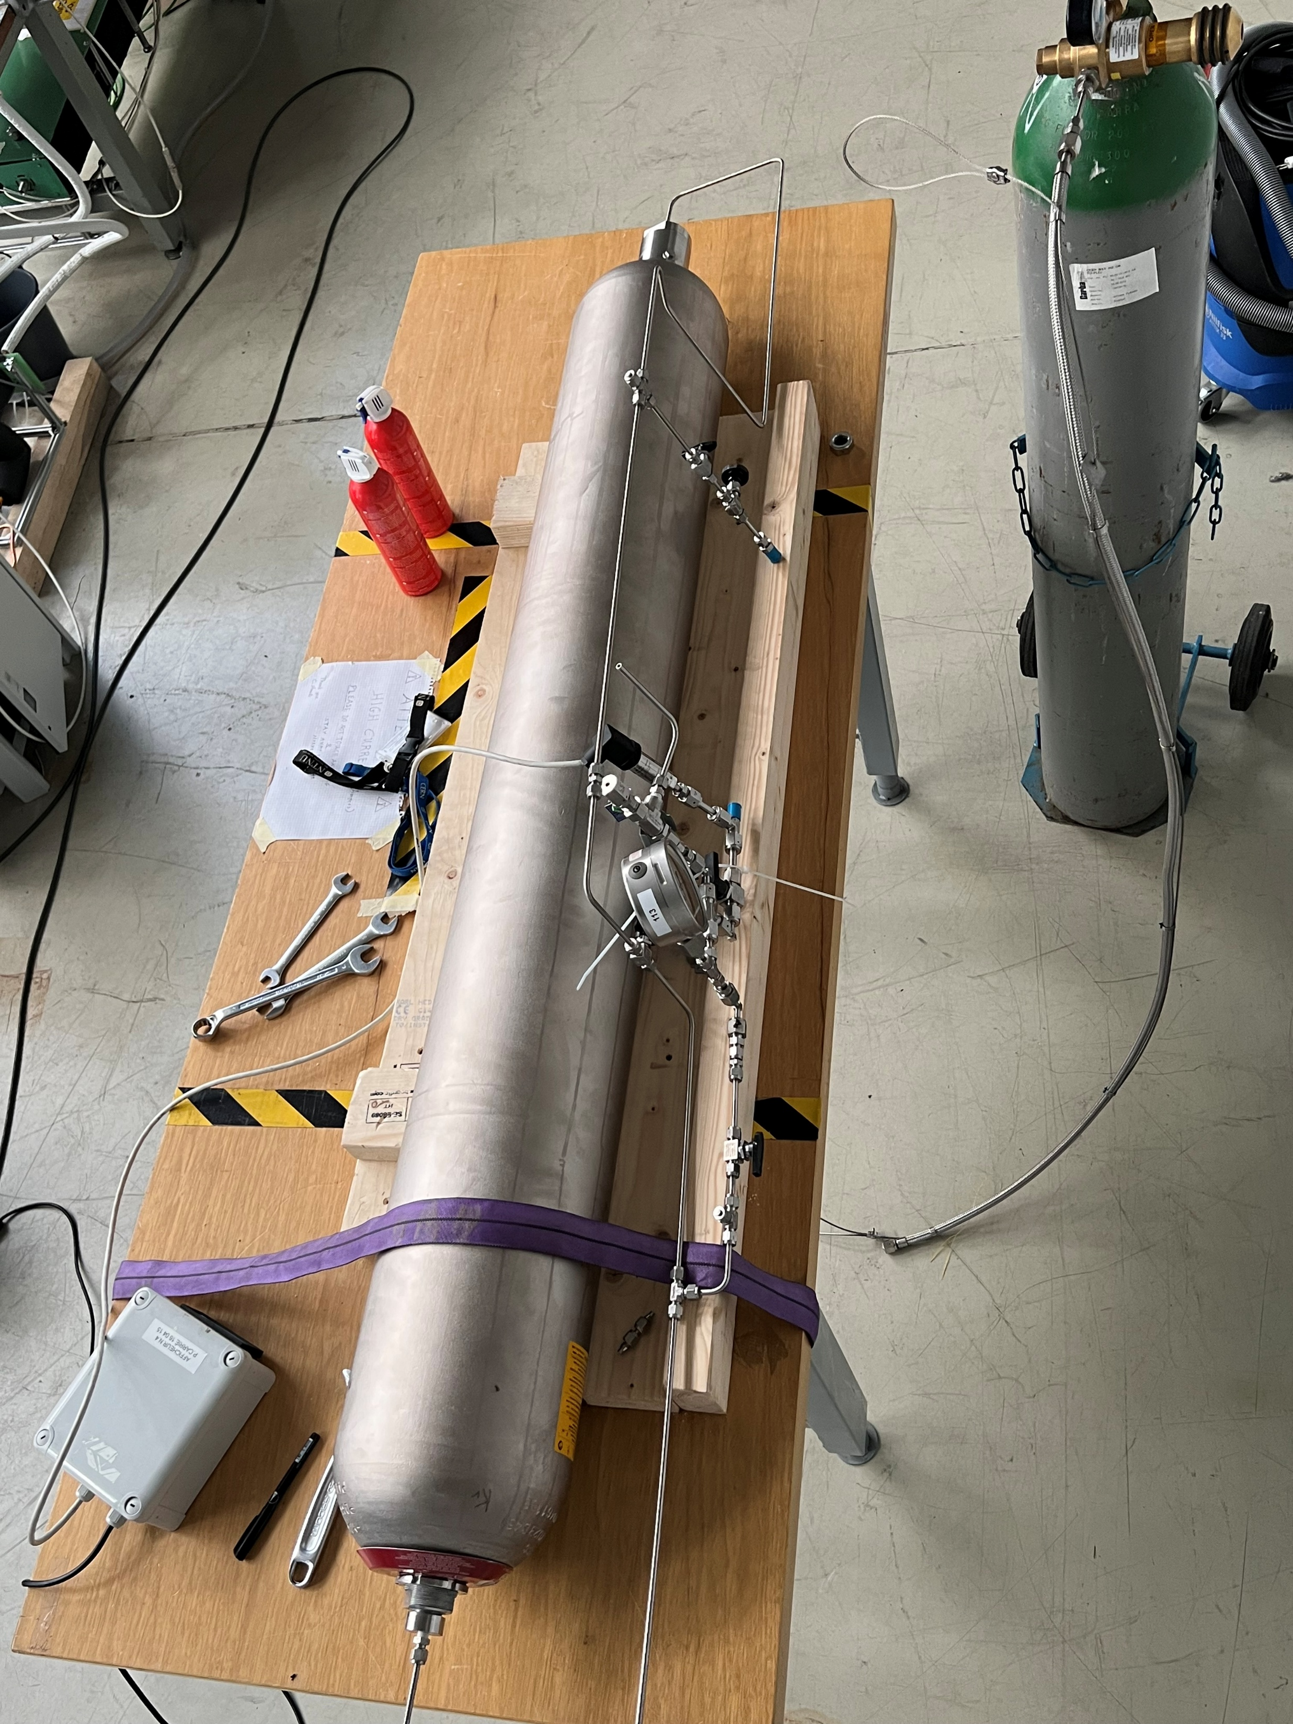
Installation of the prototype at CERN
The system is currently not in operation due to some hardware issues:
Delay from the company
Defected connector of the bladder
Bladder has been dismounted and soon a technician from the company will reseal the bladder
Leak during
pressure test

Slide 14
Potential application for krypton cooling
For the low-temperature cooling, different approaches are under investigation depending on what is required by the detectors:
Use of supecritical krypton to provide cooling below the CO₂ triple point
  In this respect studies conducted by PhD Camila Pedano will serve as fluid-to-fluid scaling (ScCO₂ to ScKr)
  Operation with fluid in single-state
  Optimal temperature range (with respect to possible isothermal operation) is within -50 to -62°C
Nearly isothermal cooling can be achieved by proper designing the cooling lines

Slide 15
Potential application for krypton cooling
For the low temperature cooling (-30 < T < -55°C):
As the ejector system works with both CO₂ and krypton, another option is to run the cycle with CO₂ to reach temperatures unattainable by the 2PACL
  A primary chiller is no longer needed as a multi-stage CO₂ system can reject heat directly to the air
  CO₂ system can now potentially reach temperatures down to -53°C
  A configuration with two interchangeable parallel systems provides the flexibility to switch to krypton as working fluid if colder temperatures will be required (in opposition to use directly supercritical krypton)
Rejection to H₂O - air
CO₂
Second stage compression
Only illustrative example!
Intercooling
Liquid circulation driven by ejector
Capillary
First stage compression
Detector
Current 2PACL limit (-40°C)

Slide 16
Potential application for krypton cooling
For the ultra-low cooling, ≈ -100°C and below, krypton can be an alternative coolant for future detectors at HL-LHC using Silicon Photomultipliers (SiPM) with single photon detection capabolity:
This detector technology has almost no power to be dissipated, future upgrade will required extremely cold cooling down to -140°C
Currently a cryogenic system is under investigation but the same krypton system, although with few different requirements (almost no thermal load, i.e. recirculation of mainly liquid via the ejector), can potentially be used:
  It allows integration of small cooling pipes
  With one single system the thermal loads coming from the surrounding structure and cables can easily be evacuated

Slide 17
Future work
The cycle technology developed gave promising results, now the focus is on:
Demonstration of the real detector cooling system coupled with a CO₂ primary chiller and the external high-pressure tank
Extensive test on supercritical and two-phase operation
A new PhD (Lukas Köster) has started in Norway aiming to:
  Study heat transfer and pressure drop performance of krypton in minichannels
  Development of an oil-free compressor, in this respect:
    It is of primary importance for the success of the development to involve an industrial partner
    Few industrial partners have shown their interest in taking part of the project
    While the development of the system is covered by CERN & NTNU funding, the compressor development is lacking an economic support

Slide 18
Thank you for your attention!
Contributors of the project:
Luca CONTIERO^{(a,b)}, Bart VERLAAT^{(a)}, Paolo PETAGNA^{(a)}, Armin HAFNER^{(b)}, Krzysztof BANASIAK^{(b)}, Yosr ALLOUCHE^{(b)},
CERN, Geneva, 1211, Switzerland, luca.contiero@cern.ch
NTNU, Trondheim, 7491, Norway

