Slide 1
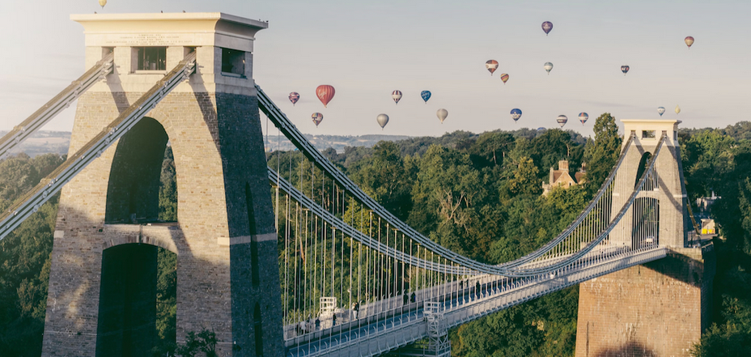

DRD8 Collaboration Meeting: WP4 Introduction
J. Batista Lopes; D. Alvarez
Bristol, 19th June 2025

Slide 2

Introduction
WP4 aims to develop new tools and approaches to improve how we design and build detectors
Enhance the entire design cycle for detectors, from the early conceptual phase to the final installation, maintenance and decommissioning
The DRD8-WP4 activities will focus on two projects:
  Extended Reality (XR) Development for Detector Design
  Connection of Engineering Design & Physics Simulation Tools

Slide 3
4.1: Extended Reality Development Programme
Objective: Investigate the adoption of Extended Reality (XR) technologies for the design, construction and interaction with detectors
Detector design, and particularly activities in experimental areas (e.g. installation, maintenance, decommissioning) could benefit greatly of Augmented Reality (AR), Virtual reality (VR) and Mixed Reality (MR) technologies (potential synergies with Project 1.2)
  Phase 1: Research and evaluation of current XR technologies
    Evaluation of off-the-shelf XR solutions/platforms
    Procurement of initial software & hardware and training
  Phase 2: Implementation of XR technologies for in detector application
    Initial evaluation in lab environment
    Application of XR technologies in an ongoing project at one of CERN’s experimental areas, including the necessary digital content to build a demonstrator

Slide 4
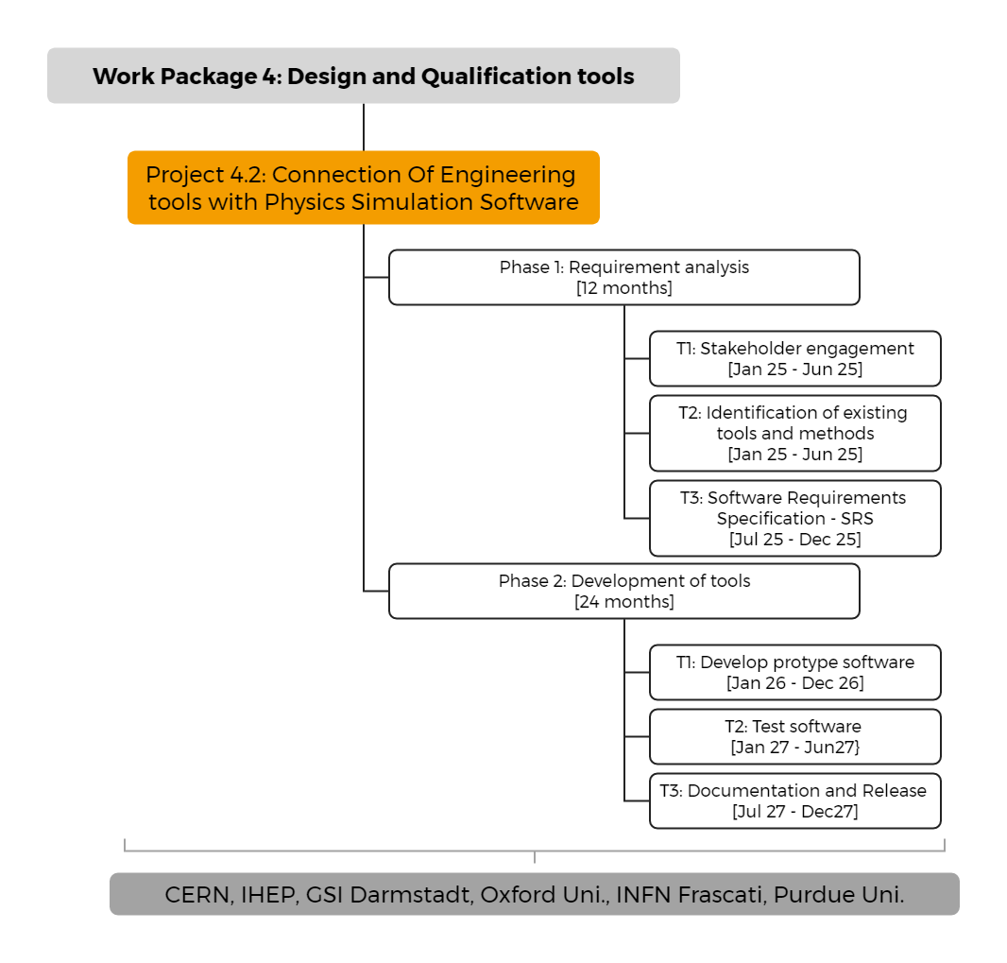
4.2: Connecting Engineering & Physics Simulation Tools
Objective: Enhance connection between Engineering Design Tools (i.e. CAD, FEA) and Physics Simulation Software (e.g. GEANT4, FLUKA)
Automatise geometry and material data transfer to shorten design times, minimise errors and allow for more realistic detector descriptions
Bringing the Engineering and Simulation communities together will be essential to maximise the potential of this activity

Slide 5
Where We Stand Today
Unlike other DRD8-WPs, research areas covered in Projects 4.1 and 4.2 currently have limited or no activity within our community (smaller number of interested in WP4 during DR8 proposal preparation)
  We need to find financial resources and person power to advance the projects
  We need to tap into wider HEP community to find partners & maximise synergies
Ongoing discussions with members of the CERN community, particularly TC teams of major experiments and colleagues from accelerator sector, to collect inputs, gather support and potentially some funding
Ongoing work to put forward an XR/AR-based project in the next AIDA call (possible joint effort with CTAO)

Slide 6
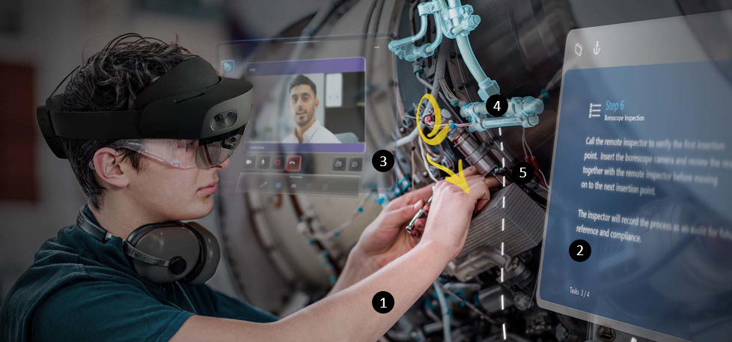
Project 4.1: Initial Feedback
Very positive feedback from LHC TC teams, with high interest in different applications areas for XR/AR/VR-based solutions
  Remote communication & bi-directional information flow during interventions
  Planning and training for cavern activities
  Safety related applications: hazard identification, evacuation procedures
  Radiation and magnetic fields overlayed with real environment
  Outreach opportunities
Operator (1) accessing digital instructions (2) calls remote help (3) discussing assembly by overlaying digital data (4) with physical elements (5)
[source]

Slide 7
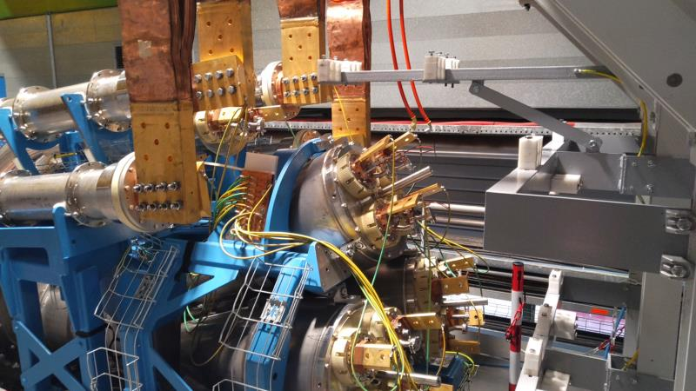
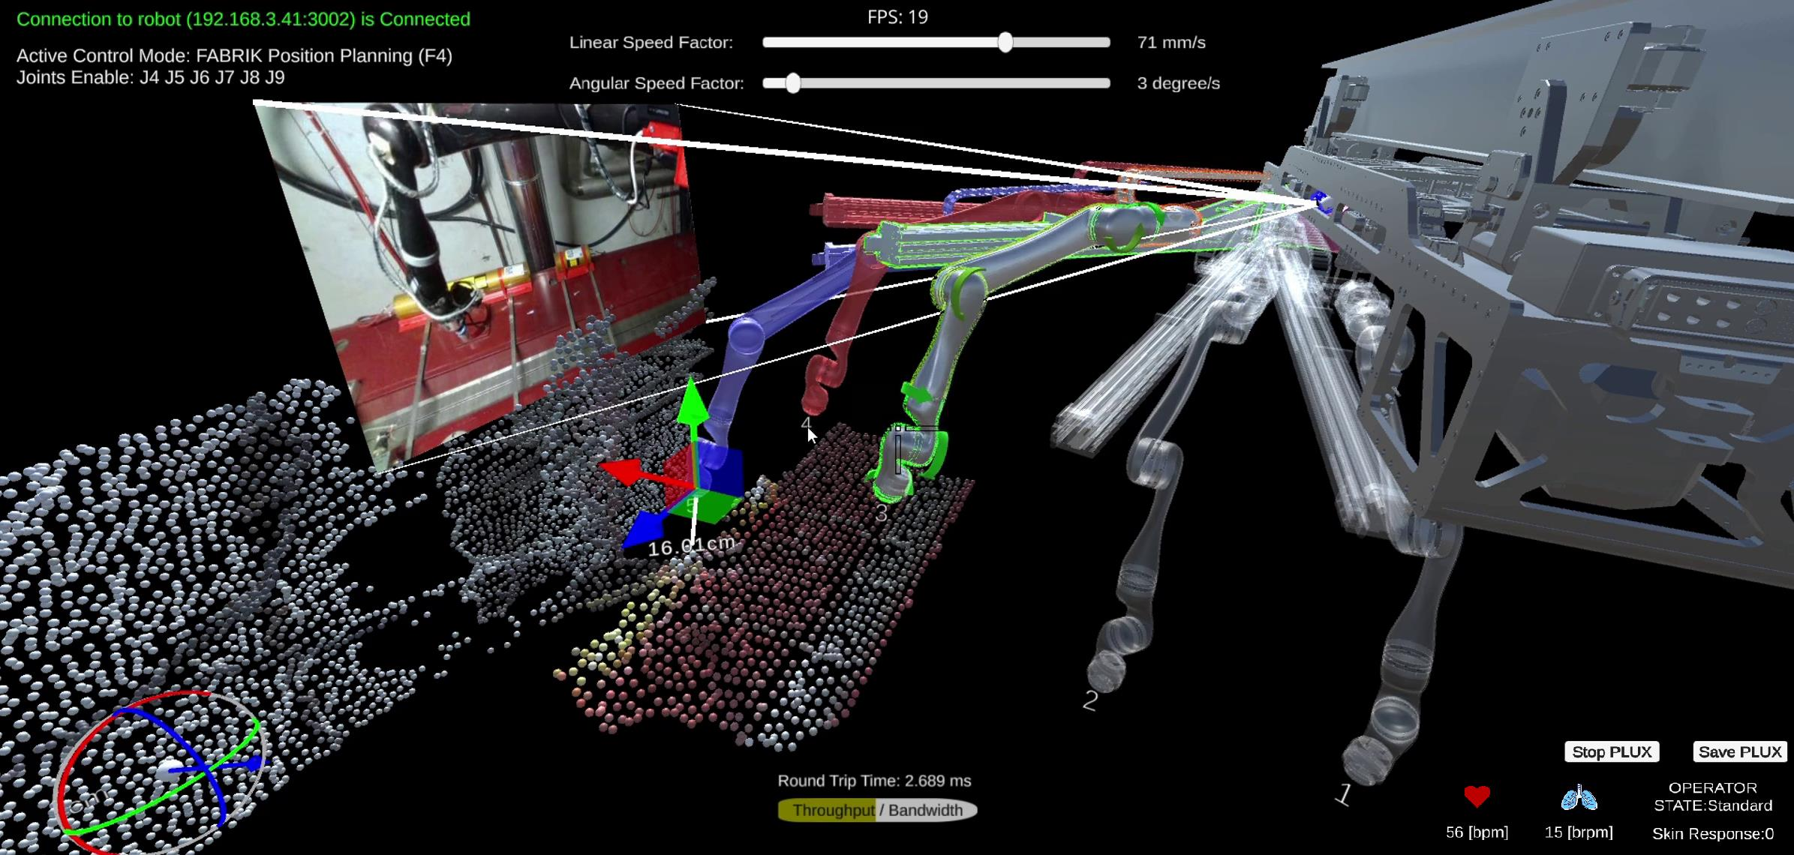
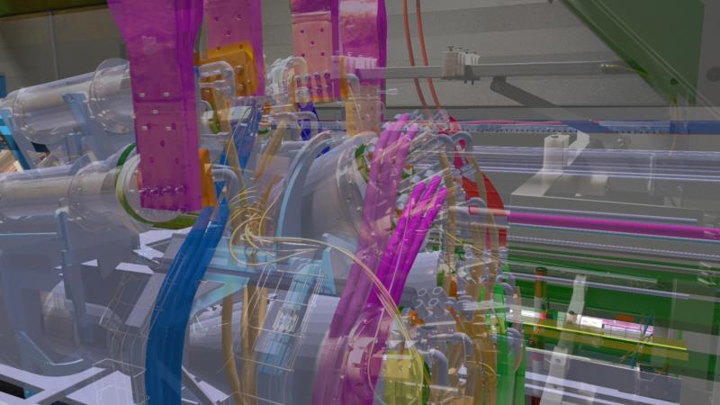
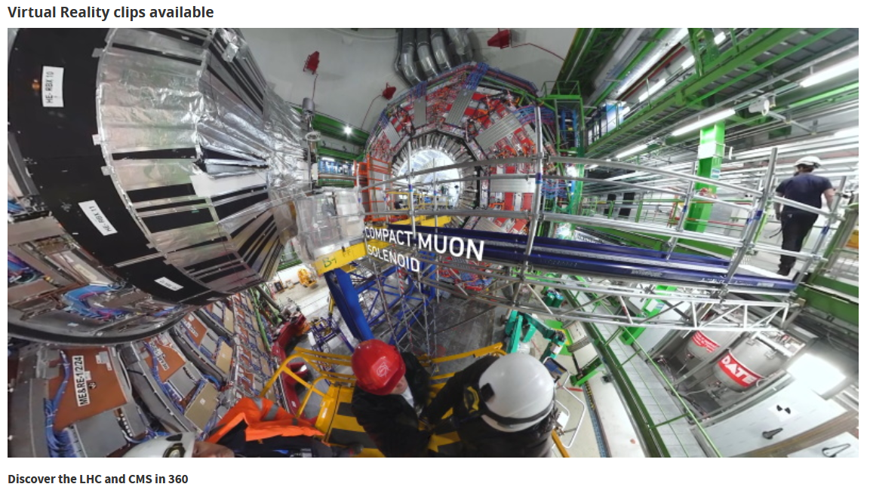
Project 4.1: XR/VR/MR @ CERN
Multiple CERN groups/teams actively investigating/using/interested in XR solutions:
MR Human-Robot Interface (M. Di Castro et al.)
MR 3D Integration Studies for CERN Accelerators (J. Coupard et al.)
CERN internal workshop in preparation to discuss potential synergies (XR-CERN dedicated e-group for CERN staff involved in XR activities)
https://visit.cern/vr

Slide 8
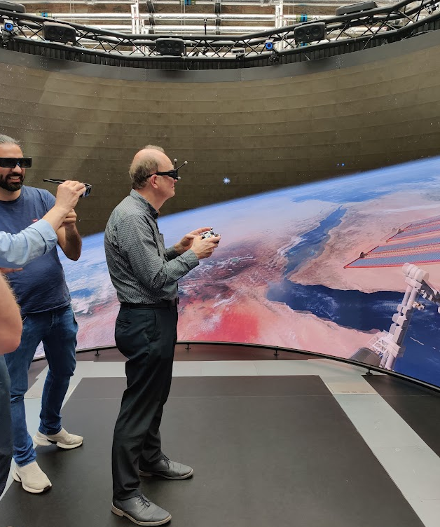
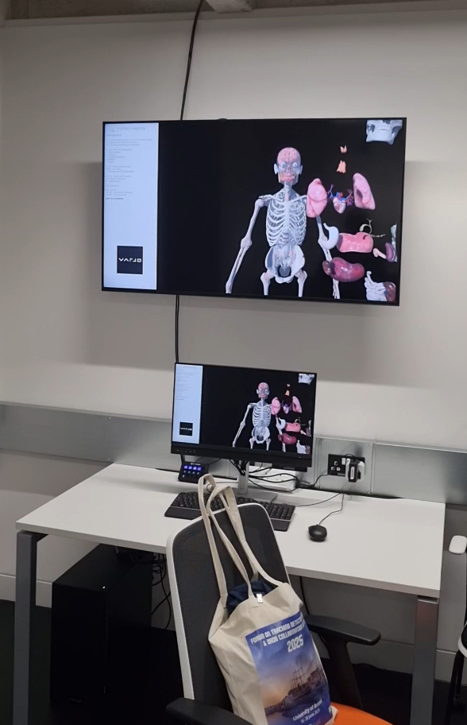
Project 4.1: Visit to BDFI
Thank you to Joel & Laura for organising a visit to Bristol Digital Futures Institute
Very productive discussion with the BDFI team (technology demonstrations, potential applications in our field, advice on how to get started, training opportunities)
We plan to organise further interaction with experts and research labs outside CERN as well as vendor demonstrations
BDFI Reality Emulator
Joao’s Surgical Hands

Slide 9
Project 4.2: Next Step
Workshop with colleagues from the Simulation and Engineering communities
  Understand how both communities work at present
    Formulate “Baseline Detector Design Workflow” (based on recent experience from Phase-II upgrades and state-of-the-art tools)
  Understand the different tools and the relevant input /outputs
    Identify areas in “Baseline Workflow” that could benefit most from new development (e.g. automatise geometry transfer, bi-directional information flow, new functionalities)

Slide 10
Simplified CAD models
The need for automatic simplification of CAD models is a common thread for both WP4 projects
Different requirements in each case:
  Project 4.1 requires selective detailed levels (e.g. coarse envelopes for large scale environment vs some detais for specific work)
  Project 4.2: Simplified geometry and material data matching the format of simulation software
Automatization needs to be software independent: collaborating institutes use different software packages

Slide 11
Questions?

Slide 12
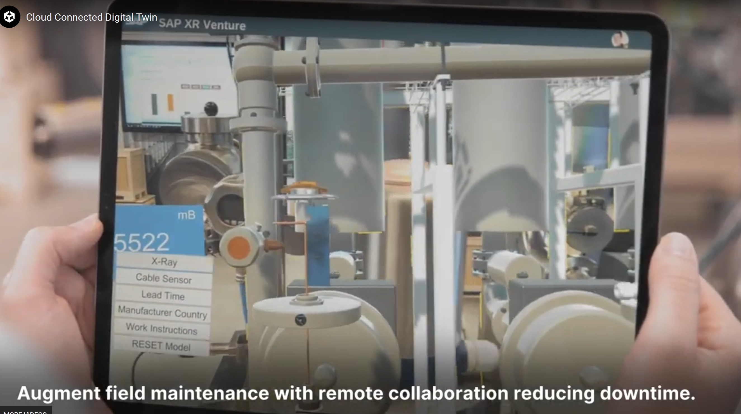

Slide 13
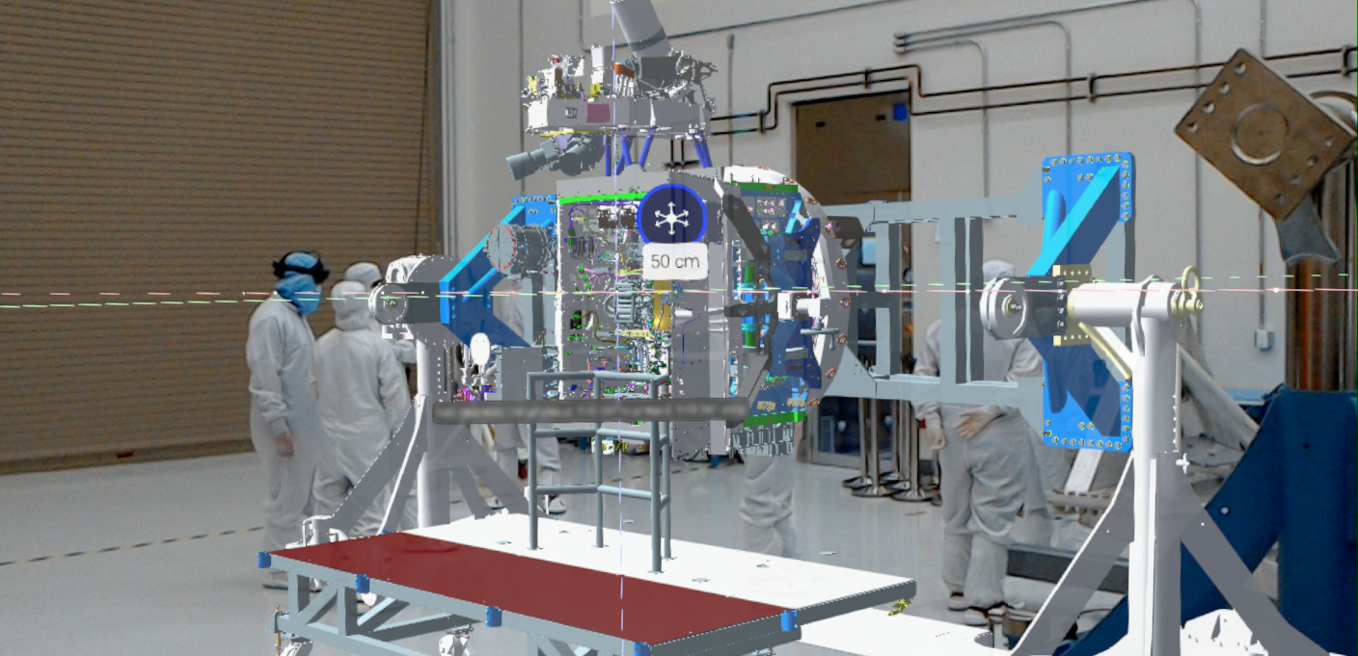
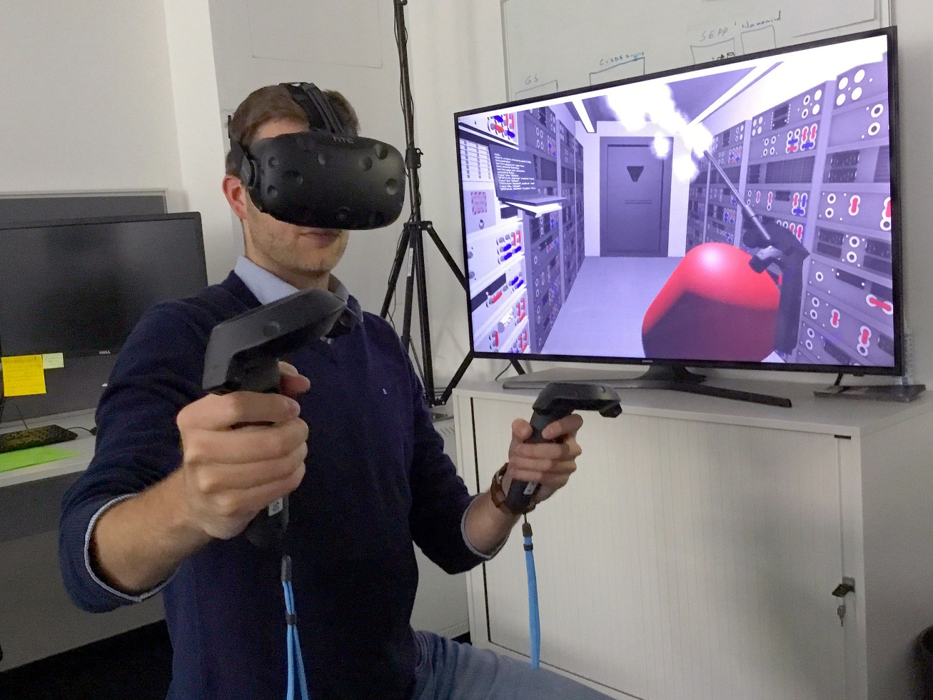
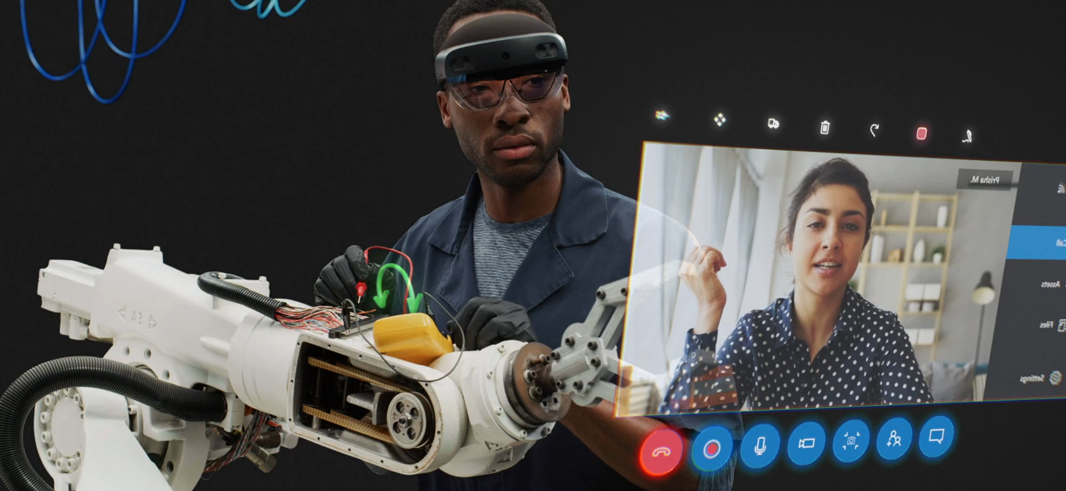
Europa Clipper engineers using mixed reality headsets to examine Europa Clipper’s avionics module assembly. Source: NASA/JPL-Caltech
Researchers at ESA, Darmstadt, using a VR headset & motion controllers to train to extinguish a fire inside a lunar habitat. Source: ESA
Collaboration from anywhere - Microsoft HoloLens 2. Source: Microsoft

Slide 14
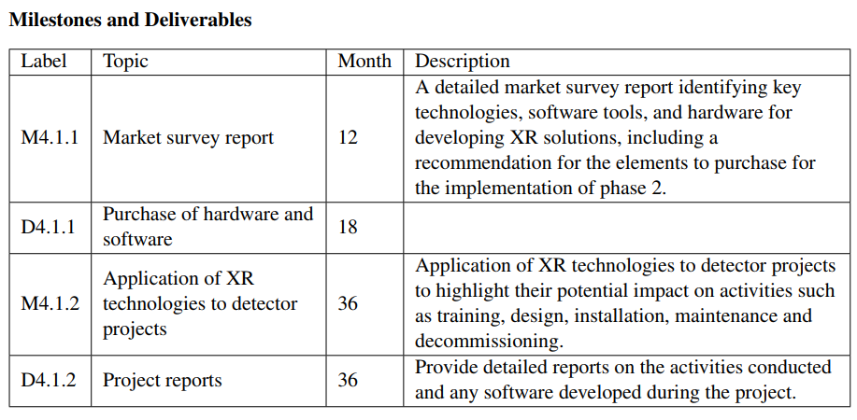
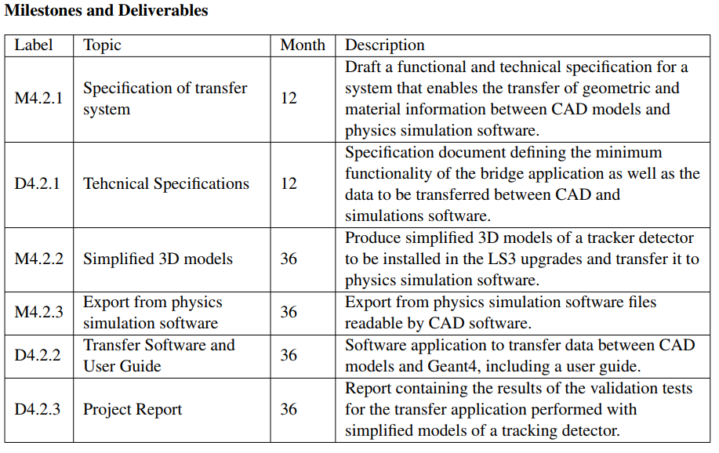
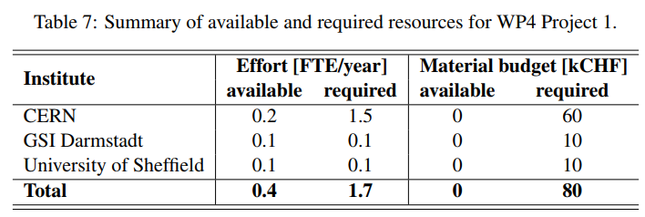
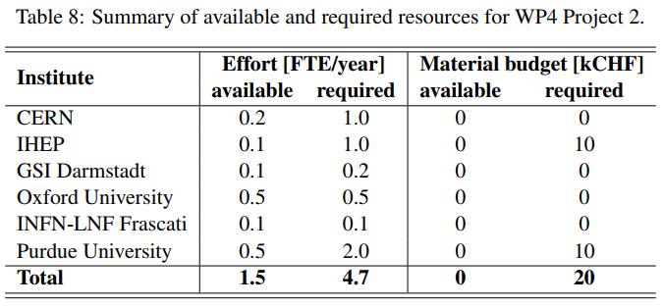
DRD8 WP4: Deliverables & Milestones

