Slide 1
DRD8 Collaboration Meeting
Bristol, June 19 – 20, 2025
Welcome!
Burkhard Schmidt

Slide 2
DRD8 Work Packages
Work Packages:
WP1: Global system design and integration
  Project 1.1: The Vertex Region of Future Particle Physics Experiments
  Project 1.2: Robots in the HEP Experimental Caverns
WP2: Low-mass mechanics and thermal management
  Project 2.1: Advanced Mechanical Tracker Structures
  Project 2.2: Characterisation of Material Properties and Database Development
WP3: Detector cooling
  Project 3.1: New Evaporative Cooling Fluids and Systems
  Project 3.2: Microchannel Cooling Substrates
WP4: Design and qualification tools
  Project 4.1: Extended Reality (XR) Development
  Project 4.2: Connection of Engineering Design Tools with Physics Simulation Software

Slide 3
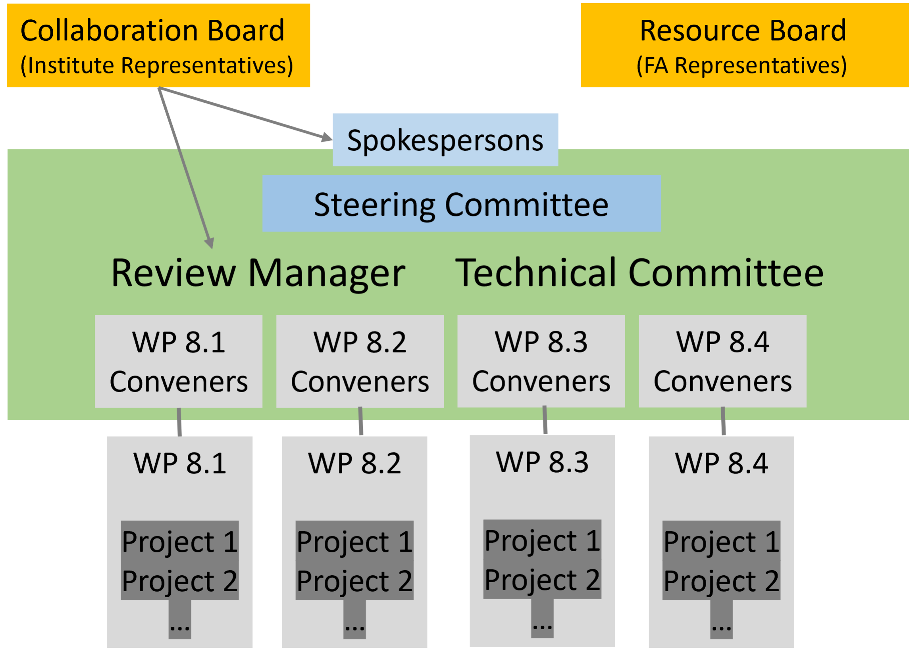
DRD8 Technical Committee
Endorsed Work Package Conveners:
WP1: Global system design and integration
  Corrado Gargiulo (CERN)
  Fabrizio Palla (Universita & INFN Pisa (IT))
WP2: Low-mass mechanics and thermal management
  Adam Dominic Lowe (University of Oxford (GB))
  Sushrut Karmarkar (Purdue University (US))
WP3: Detector cooling
  Bart Verlaat (CERN)
  Oscar Augusto De Aguiar Francisco (Manchester (GB))
WP4: Design and qualification tools
  Diego Alvarez Feito (CERN)
  Joao Batista Lopes (CERN)
The Technical Committee and the Collaboration Board are in place and will meet today/tomorrow

Slide 4
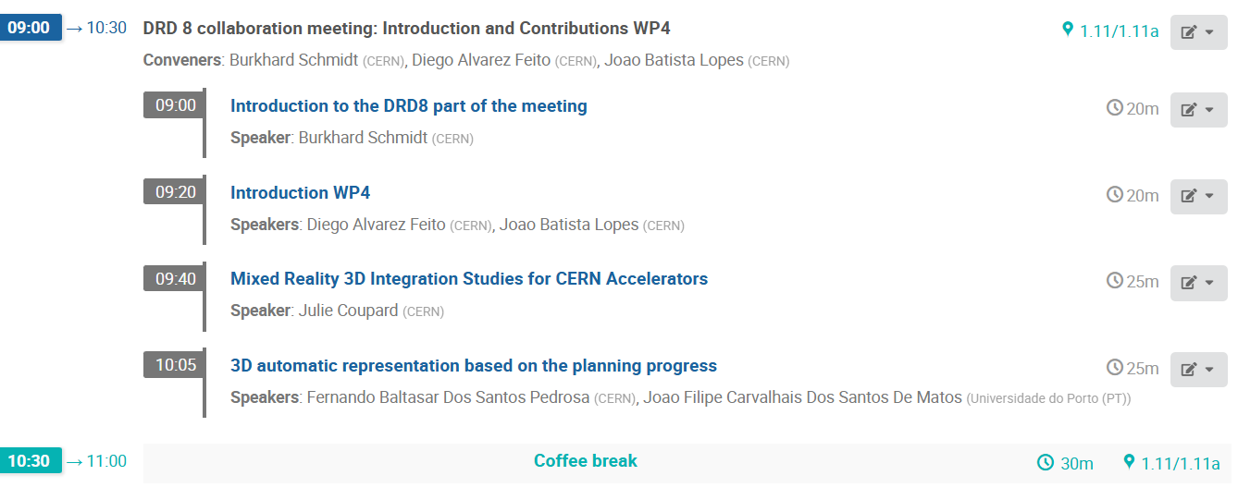
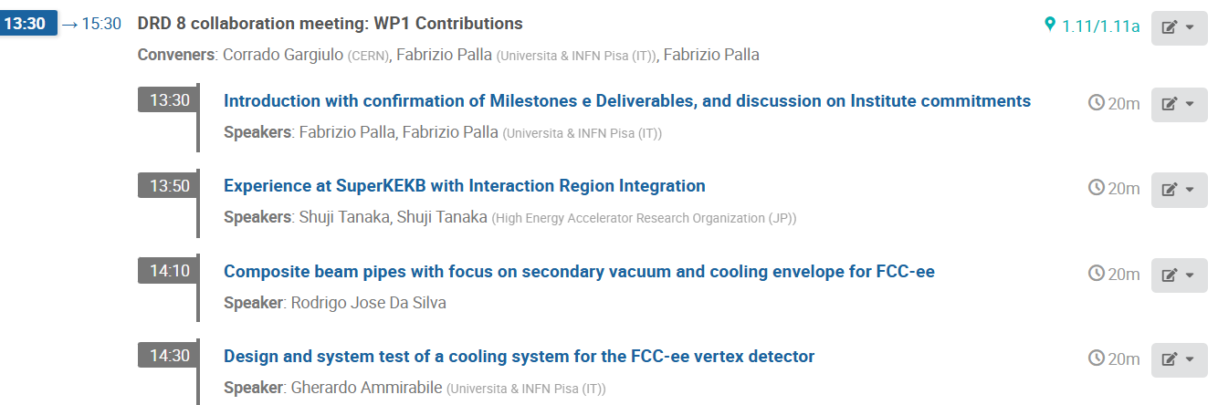
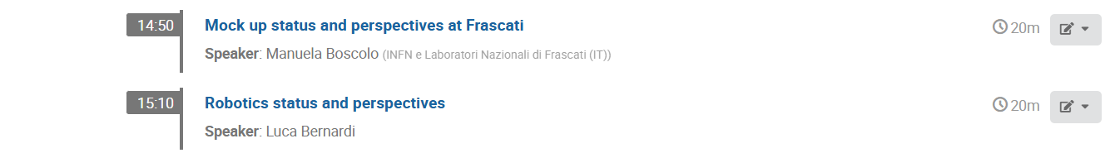
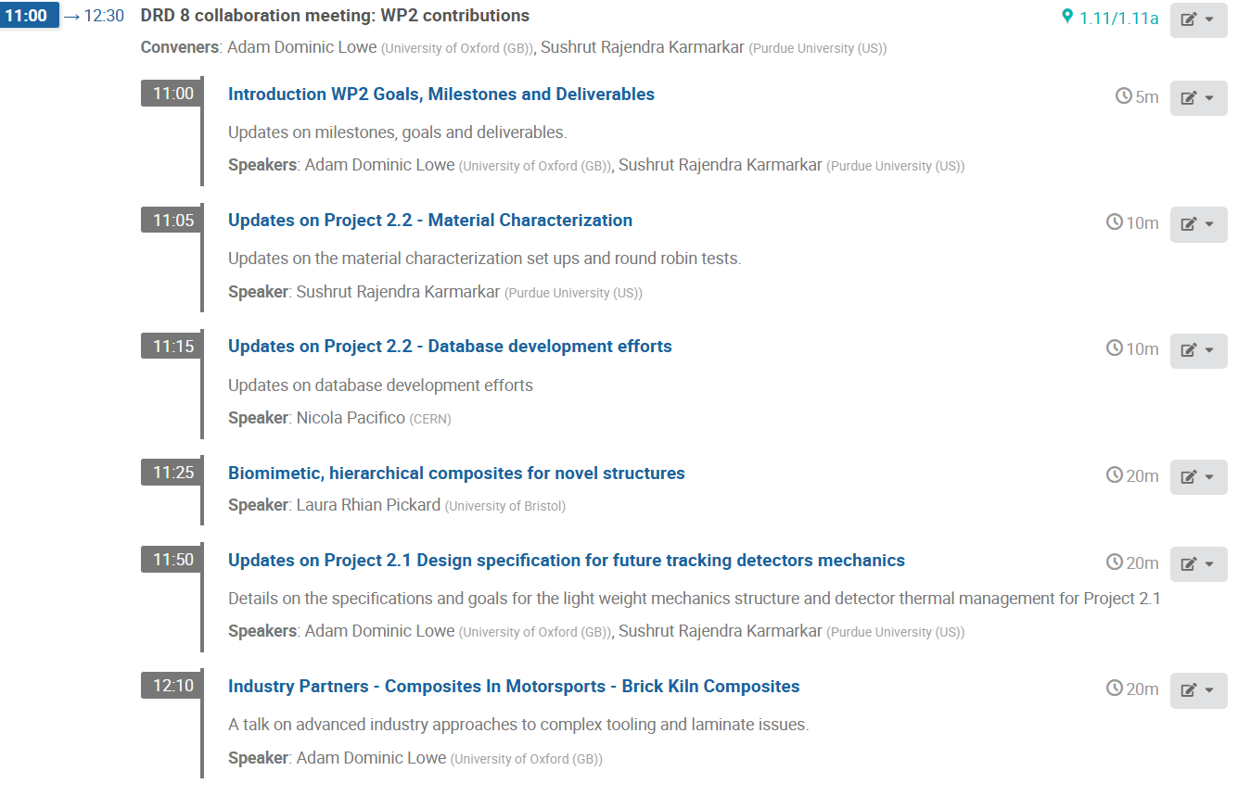
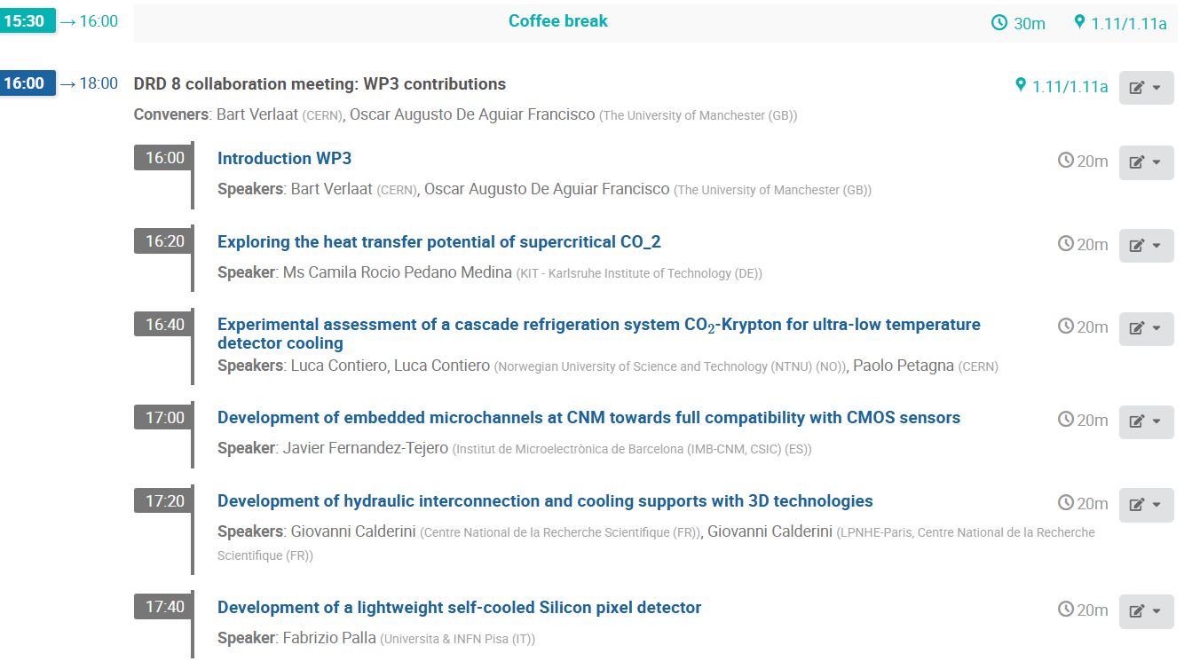
Agenda for the Collaboration Meeting
The agenda is very tight!
Please, leave some minutes for discussion
after your presentation

Slide 5
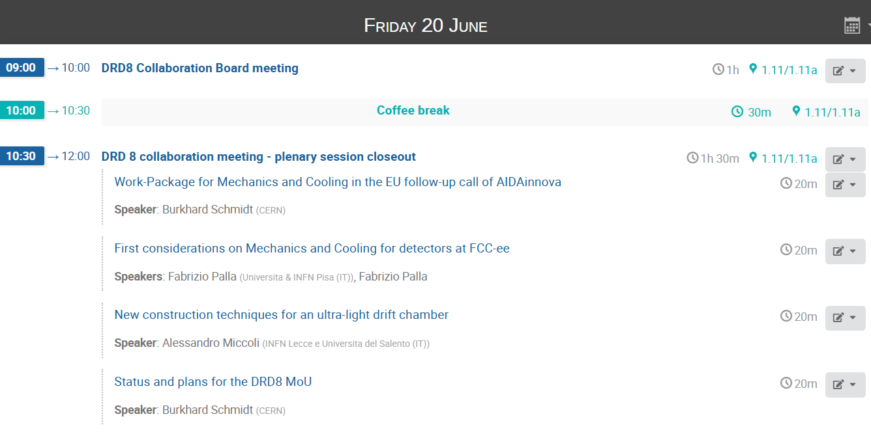
Agenda for the Collaboration Meeting

Slide 6
General remarks
DRD8 has at present 40 participating Institutes and about 100 collaborators.
New Institutes are welcome, provided they indicate to which Work Package they wish to contribute and what are the resources they will provide.
  Small resources are appreciated as well!
  DRD8 has no entrance fees nor Common Fund contributions.
We are open minded to add further Work Packages related to Mechanics and Cooling for Vertex and Tracking Systems, e.g. on Gas based tracking detectors.
We are aware that R&D on large area gas detectors has been revived for future e⁺e⁻ colliders (FCC-ee and CepC).
  Projects related to such R&D should be clearly defined, together with Milestones and Deliverables
For a WP related to mechanics for Calorimeters it seems to be still too early

Slide 7
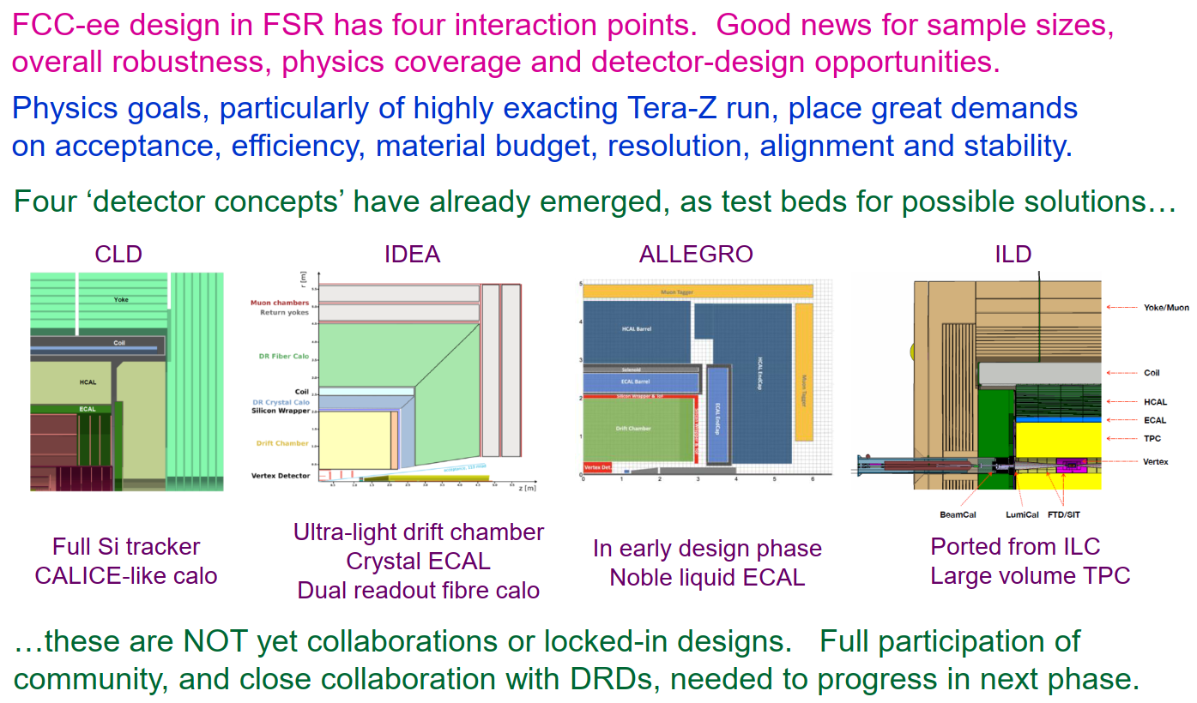
Detector Opportunities at the FCC-ee

Slide 8
DRD8 and the new EU-call for R&D funding
The ECFA DRD collaborations form the technology roadmap for R&D (very broad…)
A first meeting of the DRD Managers Forum with the AIDAinnova management took place on April 29, 2024, to discuss the steps needed to prepare a new proposal.
We discussed the fact that DRD activities can be co-financed by EU projects
  This has to be mentioned in the DRD MoU and Annexes and will be mentioned explicitly in the new proposal.
  The Proposal Preparation Team (PPT) of the new EU-call (AIDAxxx) will "cherry pick“ from the proposed tasks of the different WPs and put them in the new proposal.
  The PPT will follow the European Update of the Strategy for Particle Physics process

Slide 9
DRD8 and the new EU-call for R&D funding
We will have the same amount of funding as for AIDAinnova, e.g. 10 M€ for a 4-year duration project.
Reducing the overhead of 20%, this leads to a budget of about 750 k€ per WP
In order to have a minimum funding for each task, the PPT suggest to limit the proposal to ~3 tasks of about 250 k€ EU funding per WP and to have not more than 2 beneficiaries per task
  The proposal should focus on detector technologies that have not reached the TDR level
  We should give priority to tasks in which an industrial partner (as beneficiary) is involved
The new European project and the DRDs are two separate entities
  Management and funding of the EU project will be separate from the DRDs

Slide 10
Further Considerations of the new EU-call
In AIDAxxx (as for AIDAinnova), matching funds are used from the beneficiaries
  These are mostly provided in terms of time spent on the project by the beneficiaries' employees
  Expect of the order of 2:1 for academic beneficiaries
  Expect of the order of 1:1 for industrial beneficiaries
In AIDAxxx it is good to have some continuation w.r.t. AIDAinnova
  However, a good fraction of Innovation (35-40%) is needed
  Avoid very generic tasks
The proposal will be judged on its Excellence, Impact and Implementation
  Small contributions to tasks already well carried over in other projects should be avoided
  Focus on specific items where we can really make an impact

Slide 11
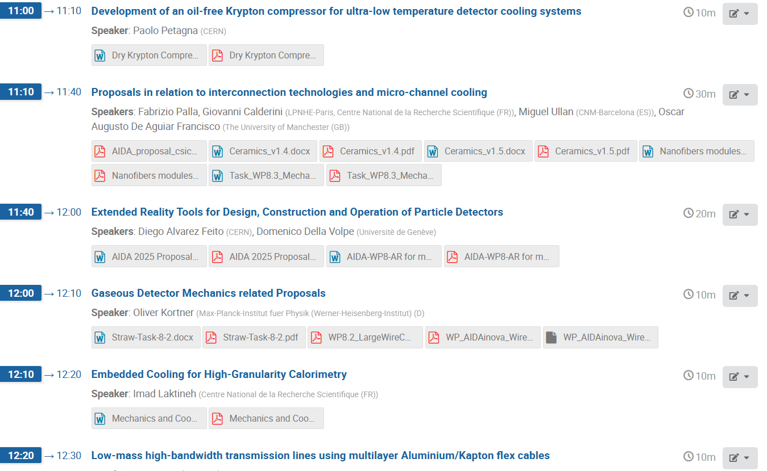
Mechanics and Cooling related Proposals (WP8)

Slide 12
Final Remarks
Many more tasks have been proposed for the new EU-call than those which can be funded by it.
  One should keep in mind that the EU funding is not enormous, about 250 k€/task for 4 years, thus about 60 k€/year in total per task (typically ~2 beneficiaries). You don’t get very far with this funding.
For us as DRD8 it is important that we use the available resources in our institutes in the best possible way to carry out the proposed R&D.
  Keep in mind that according to the proposal more than 50% of the human resources are available and about 30% of the budget.
Let us see in the following presentations where we stand with our proposed R&D.

