Slide 1

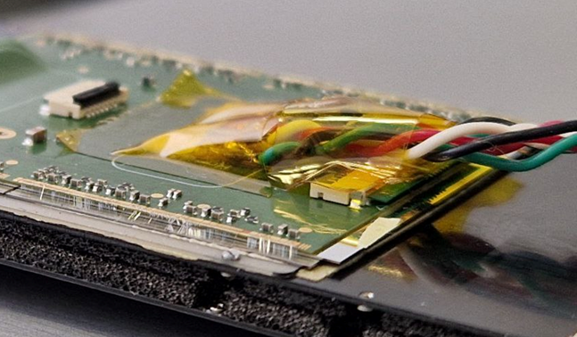
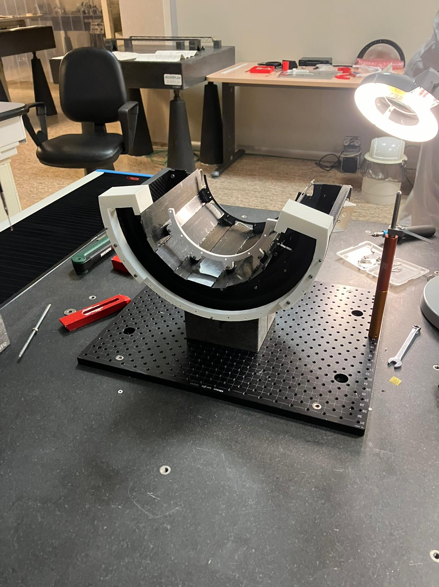

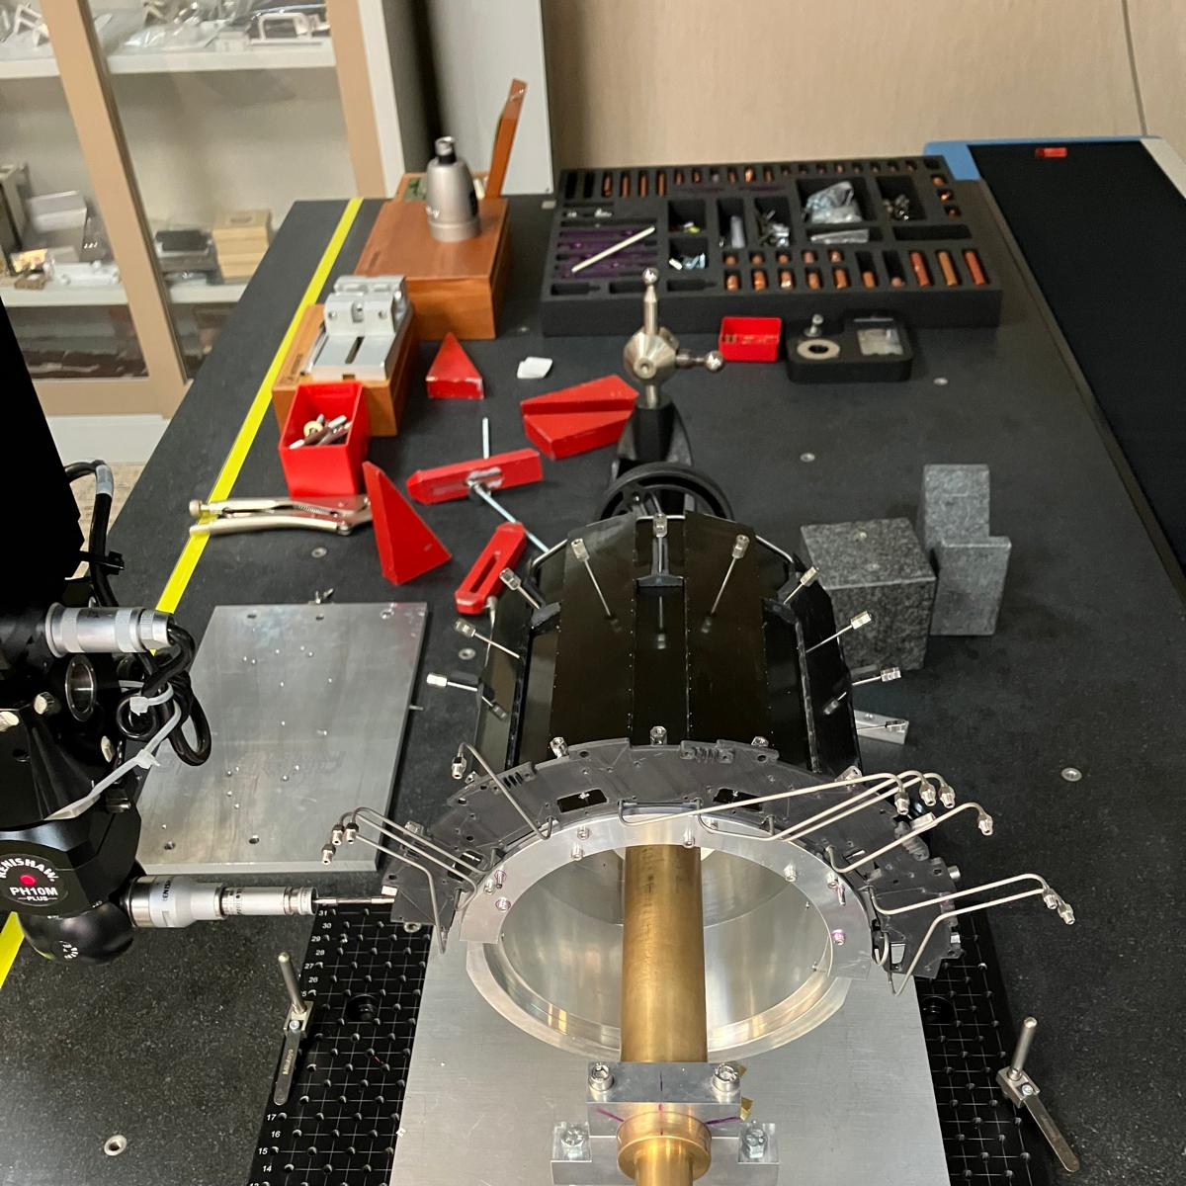
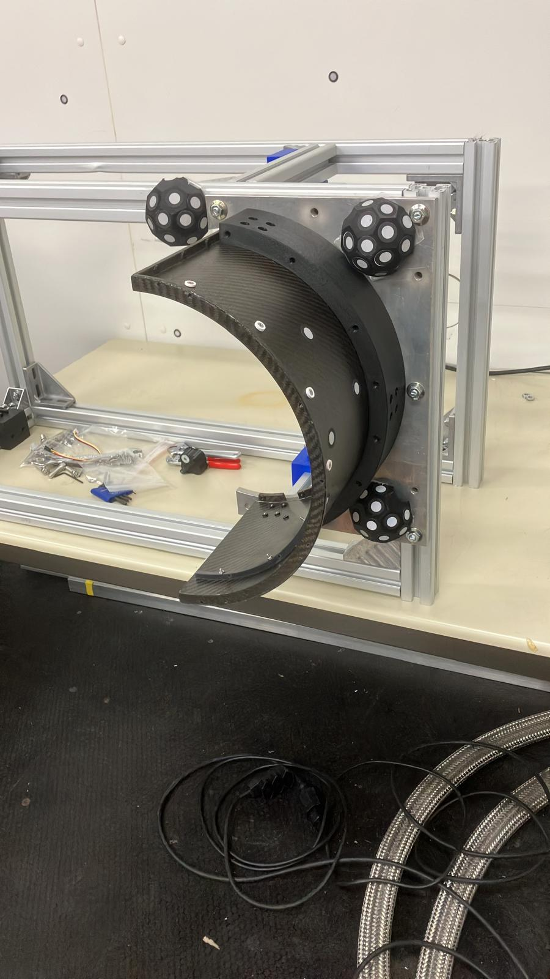
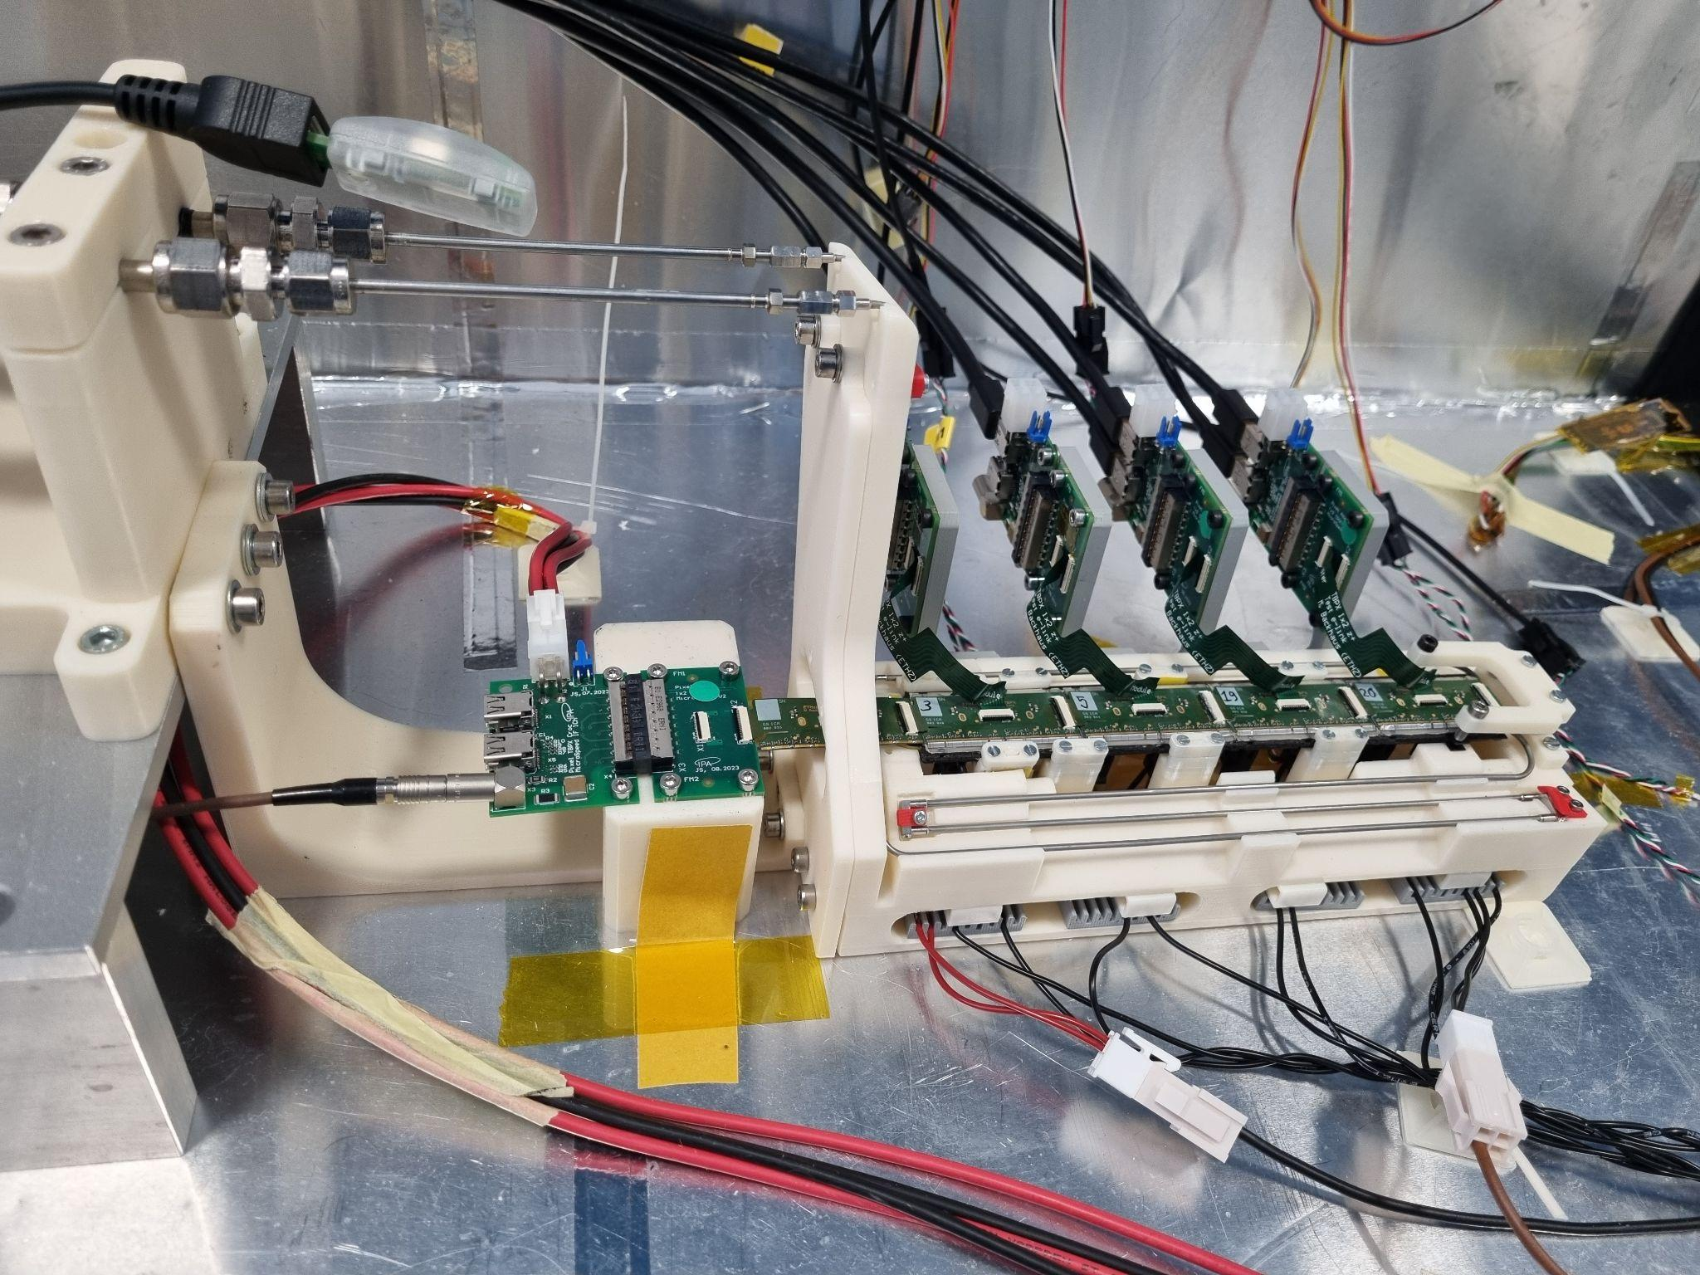
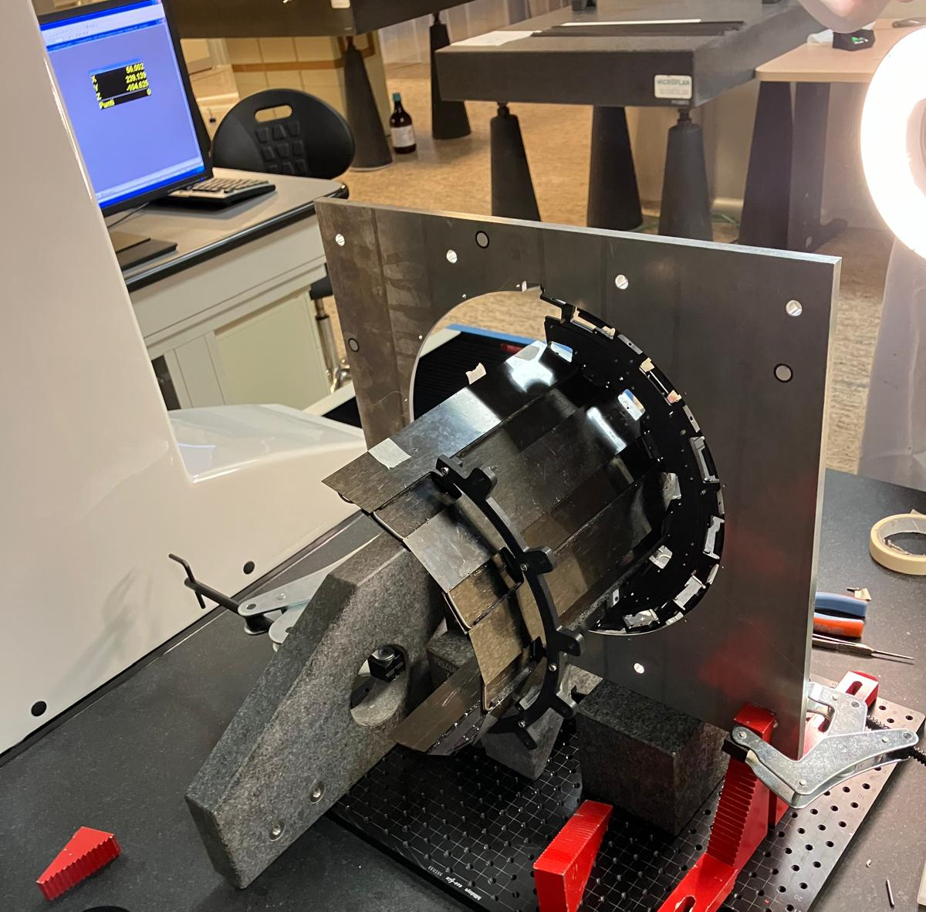
Status of CMS phase2 TBPX detector mechanics:
Layer 3 prototype and final External Cylinder construction and testing, thermal tests on the mechanical structure
Forum on Tracking Detector Mechanics
16-20/06/2025
D.Benvenuti, S.Garrafa, A.Basti, S.Coli, R. Dell’Orso, L. Demaria
On behalf of CMS Tracker group

Slide 2


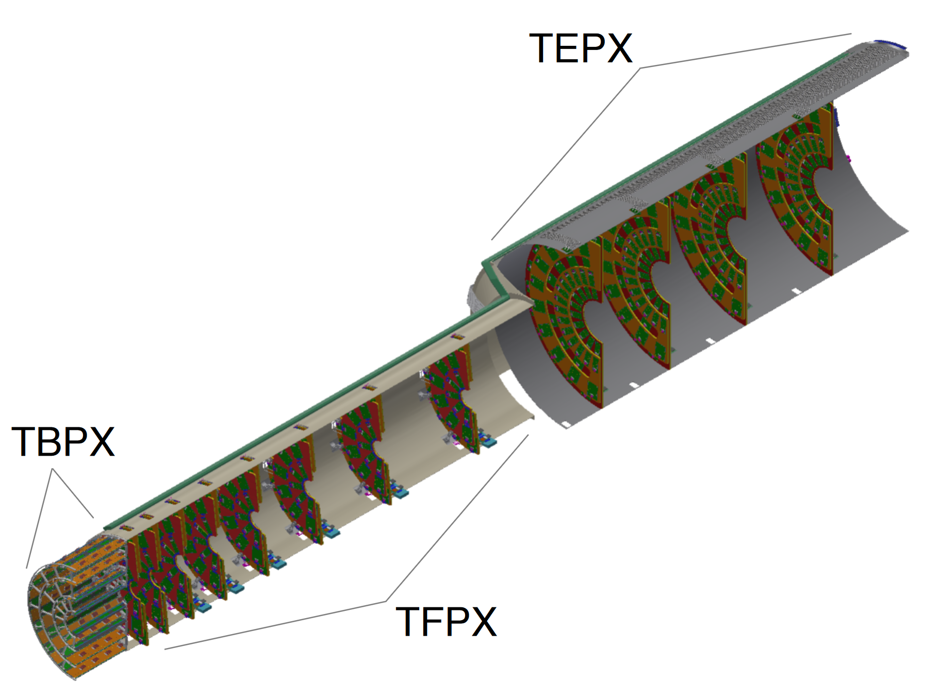
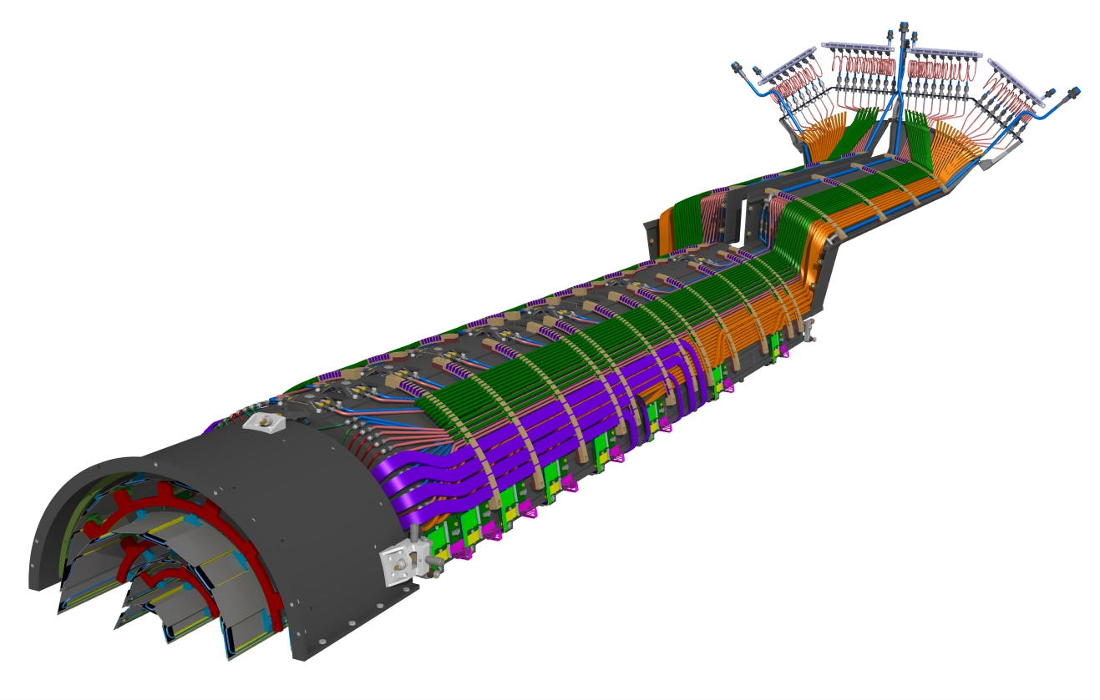
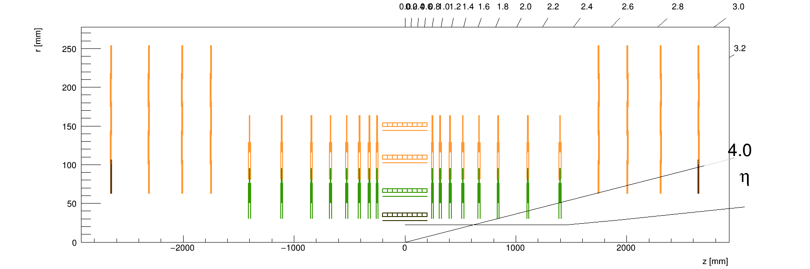
The Phase-2 Inner Tracker
During LHC Phase II, the CMS Inner tracker will be updated. The goal of this upgrade is to maintain or even improve the tracking performance compared to the Phase I detector. The main improvements are the increase of the tracker coverage and the increase of detector resolution
Made of barrel part with four layers (Tracker Barrel Pixel Detector, TBPX), eight small double-discs per side (Tracker Forward Pixel Detector, TFPX) and four large double-disks per side (Tracker Endcap Pixel Detector, TEPX). The whole Inner tracker slides inside ITST rails (Inner Tracker Support Tube)
Placed all around the beam pipe, it is installed inside the Outer Tracker
→ possibility to replace innermost degraded parts over an Extended Technical Stop
TBPX
TFPX
TFPX
TFPX
TBPX
TEPX
TEPX
17.06.25 - Tracker Mechanics Forum Bristol
D.Benvenuti
2

Slide 3
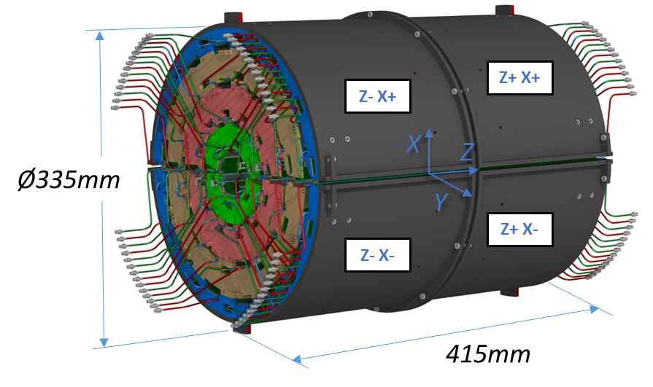
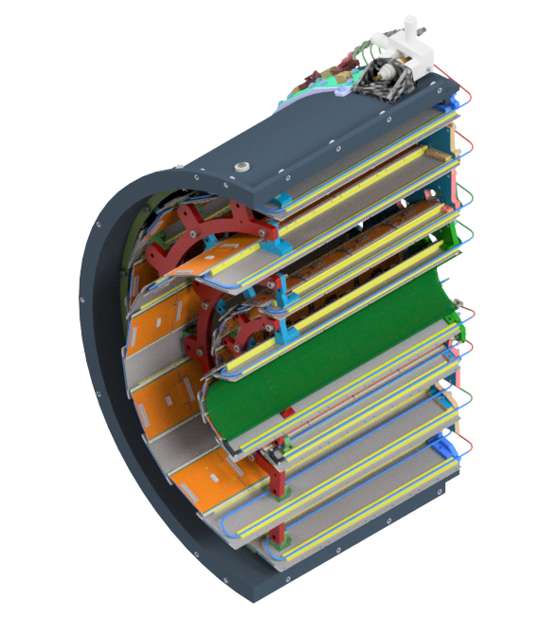
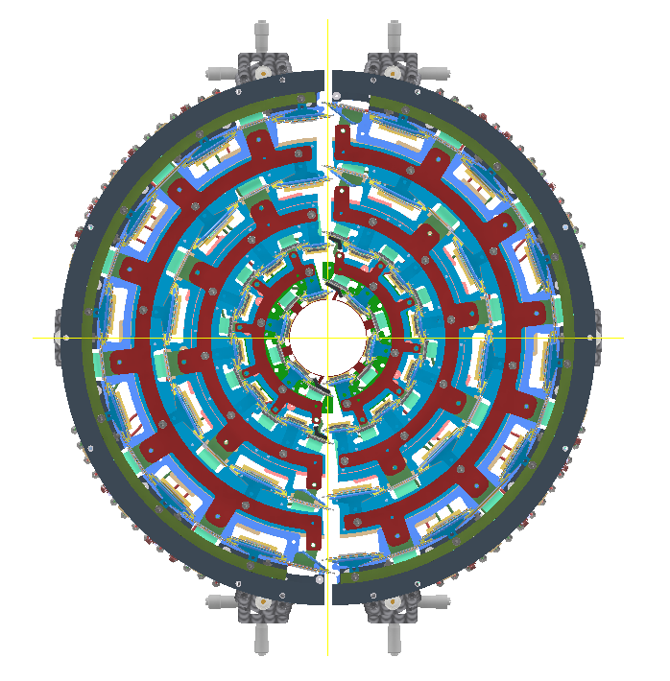
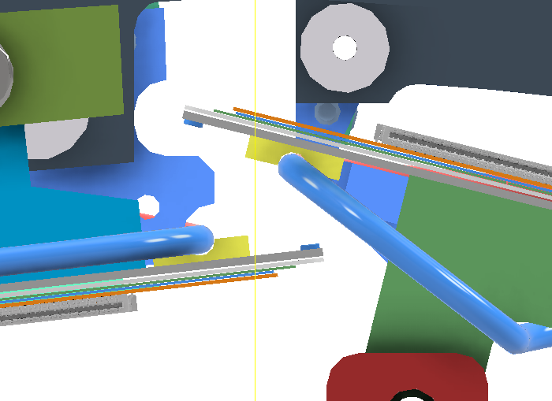
TBPX design
Cooling loops
The TBPX detector is made of four quarters, each quarter is made of four Layers. To increase the Tracker coverage the ladders of each layer of the two halves are staggered around the interaction point. In the intersection of the quarters the ladders are skewed to increase the gap
TBPX is composed by an external carbon fiber shell, the External cylinder, which holds all the TBPX load and allows the connection with TFPX. Inside ladder are connected one by one to the External cylinder by some mechanical flanges, which connect one layer to the other.
Since the parts are connected one by one from the External cylinder up to the innermost layer, this propagate their positioning error, that might cause collision between the two halves during the installation.
External cylinder
Flanges
External rings
Pillars
Ladders
17.06.25 - Tracker Mechanics Forum Bristol
D.Benvenuti
3

Slide 4
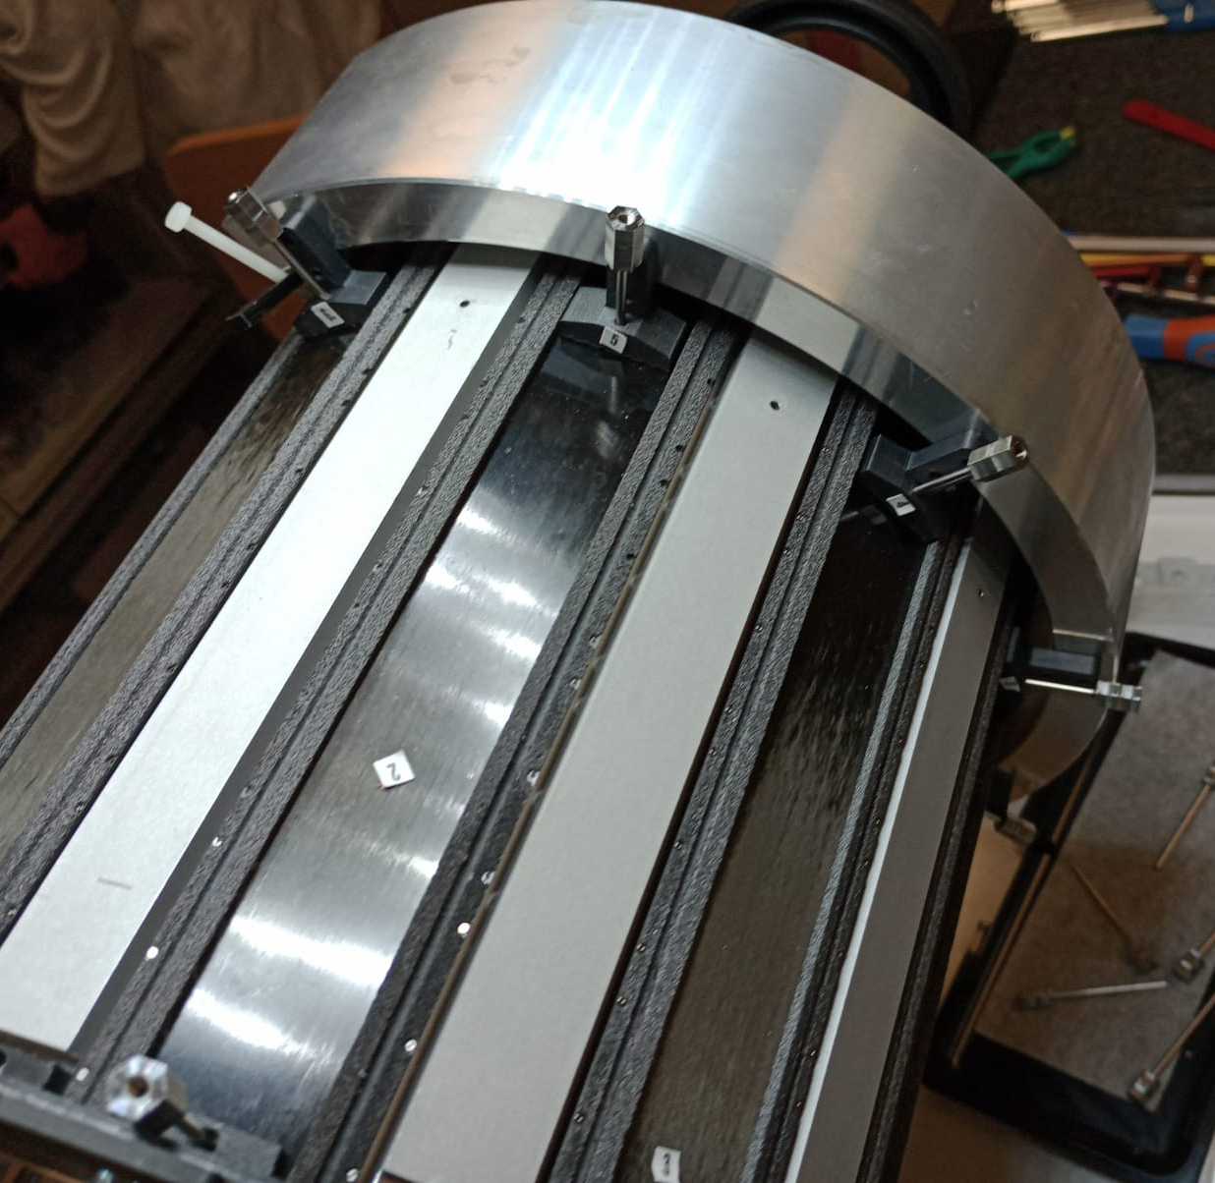
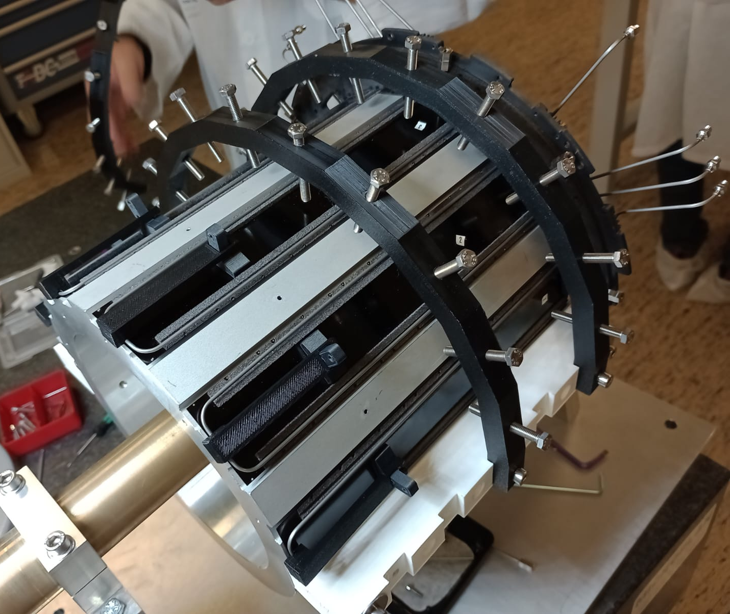
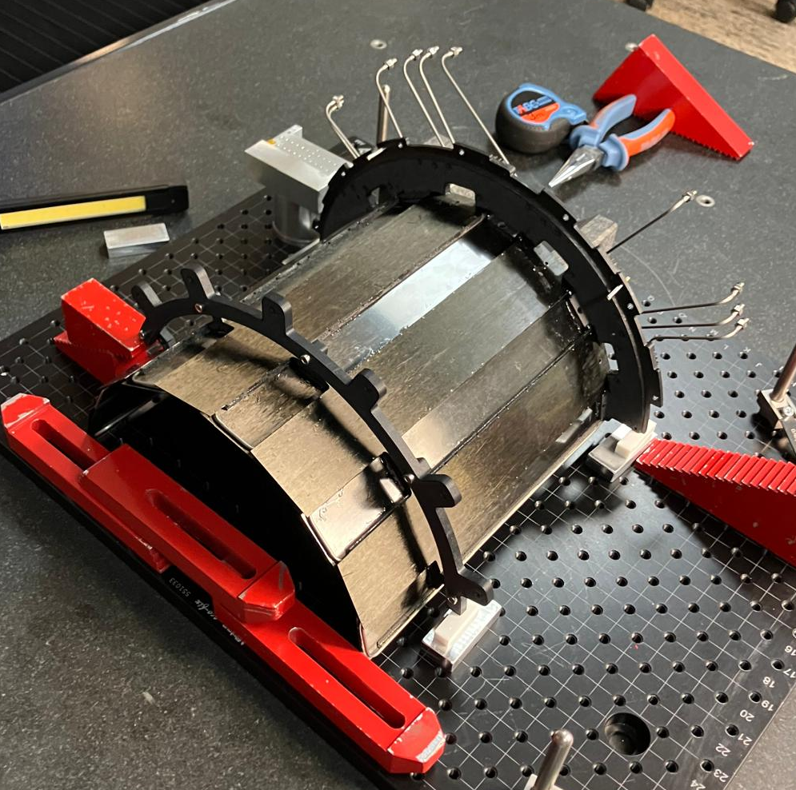
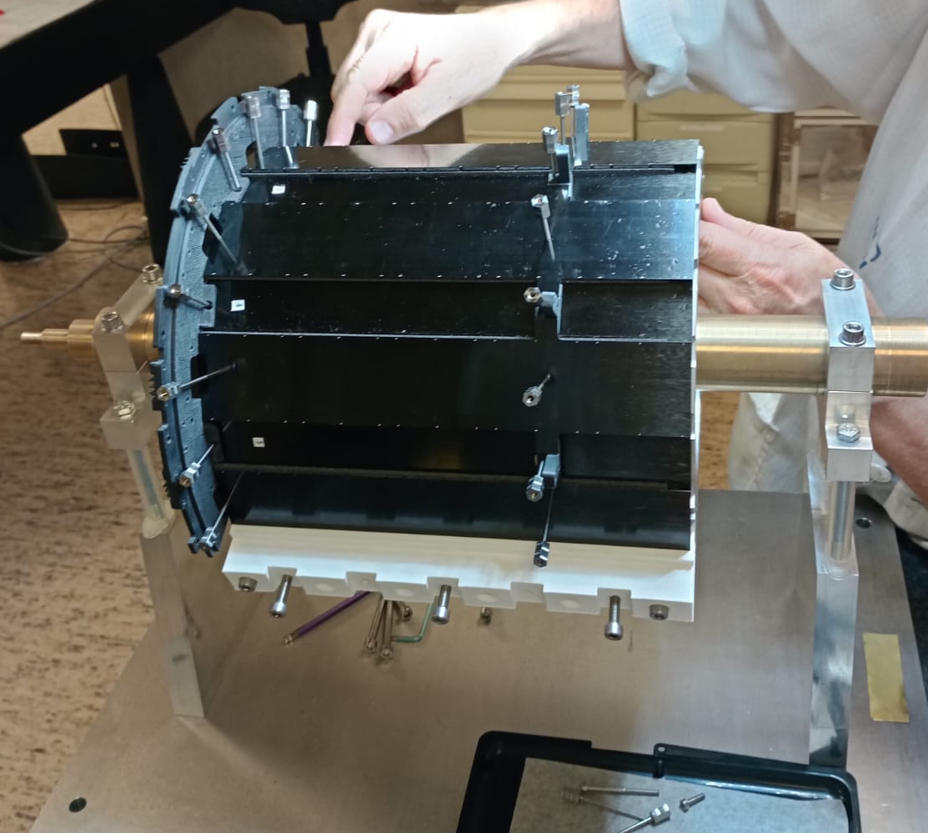
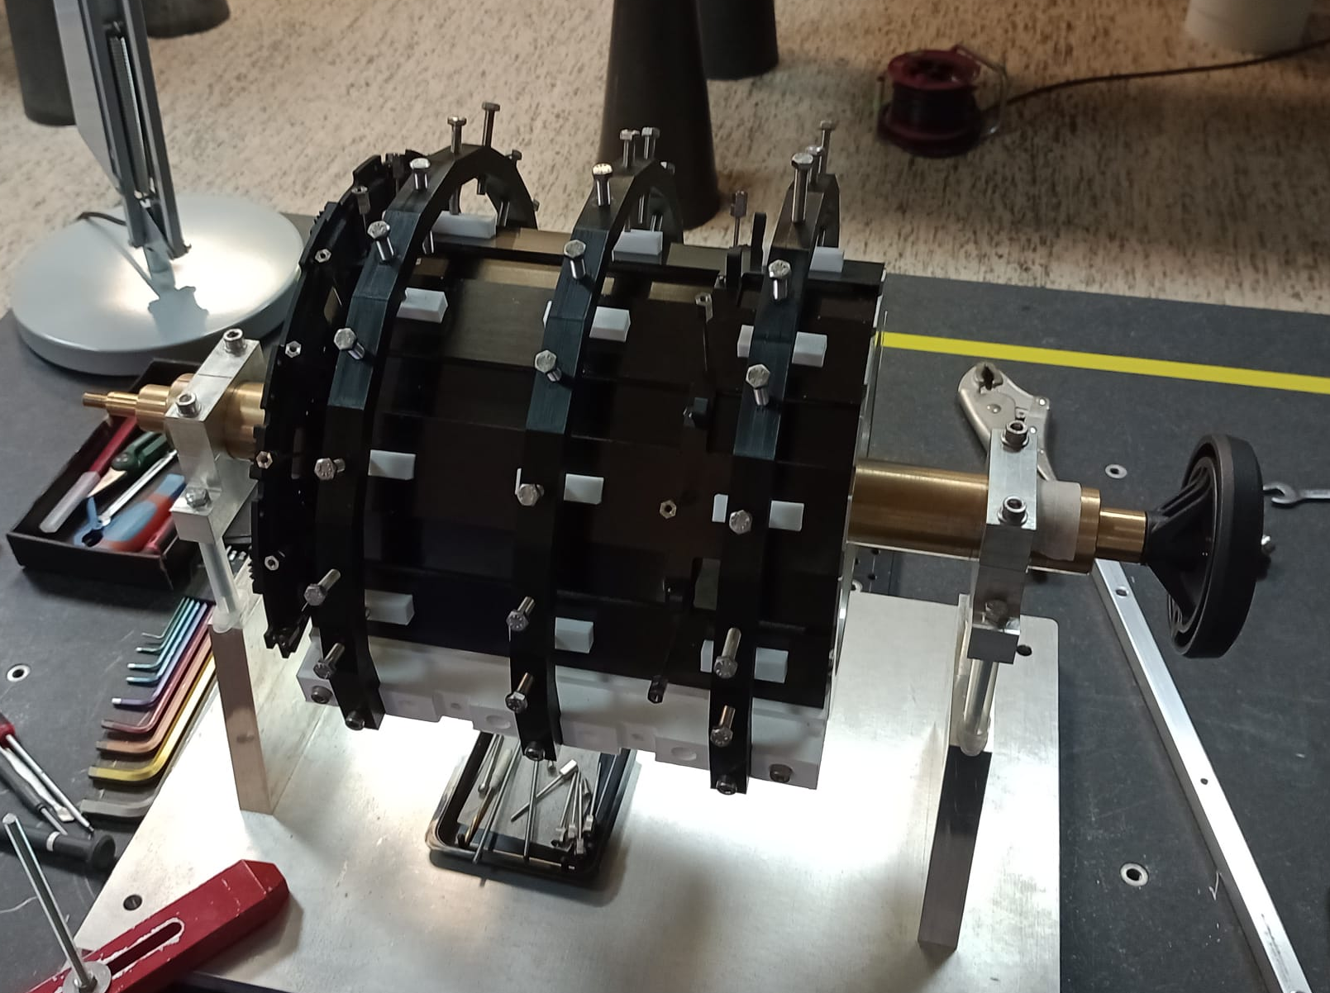
Layer 3 prototype gluing
1/4 Pillar on internal ladders gluing
2/4 Flange on internal ladders gluing
4 steps of gluing ET 1 day per step
Araldite flows inside the carbon foam. Gravity must be used to avoid it to flow away
Grease is applied to the internal ladders one by one, and the tubes are place into position.
Glue is applied between the flange planes and the ladders edge
3/4 External ladders on flange and pillars gluing
4/4 Reapplying glue
Grease is applied to the external ladders one by one before putting them into position.
Glue is applied on the edges between internal and external ladders
Glue is re-applied on the carbon foam and flange edges to ensure the best contact
17.06.25 - Tracker Mechanics Forum Bristol
D.Benvenuti
4

Slide 5
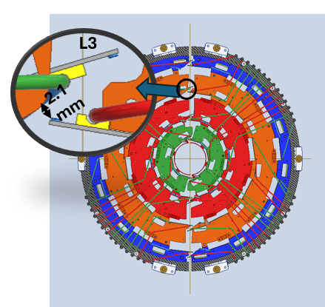
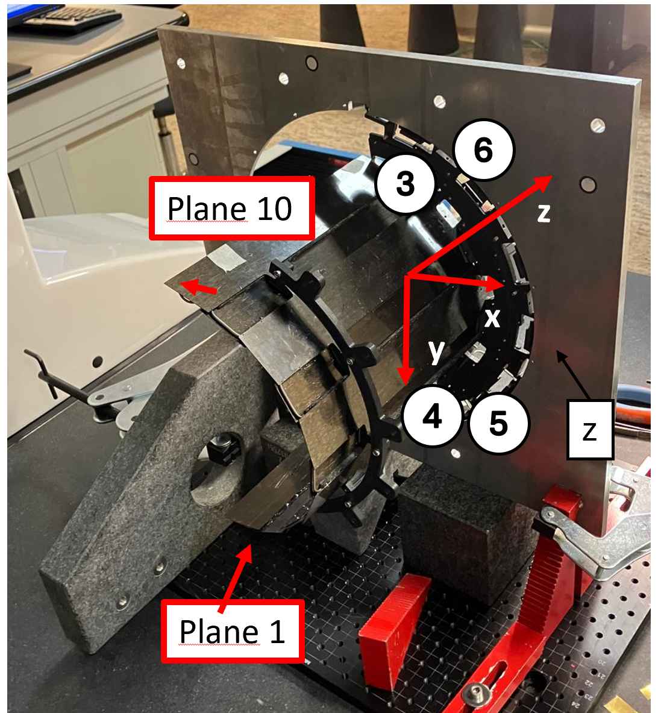
TBPX Layer 3 metrology
Metrology goals:
Layer overall precision
Measure ladder precision and orientation, reference pins on flange precision
Sensor overlap
Check that the sensor overlap is respected for all the layer
Installation feasibility
Avoid the eventual collision points between x+ and x-, z+ and z- halves are below the gap
Metrology results:
The flange side is precise, with an average precision of 100 microns
The prototype is tilted when in cantilever, on the edge side it deflects up to 1 mm. Once it will be connected to the upper layer this tilt can be corrected
The precision at the prototype edge is dependent on the constraints and boundary conditions. Its deflection is probably due to the flatness of the flange place, which change while locking the screws
The overlap is respected for all the ladders
17.06.25 - Tracker Mechanics Forum Bristol
D.Benvenuti
5

Slide 6
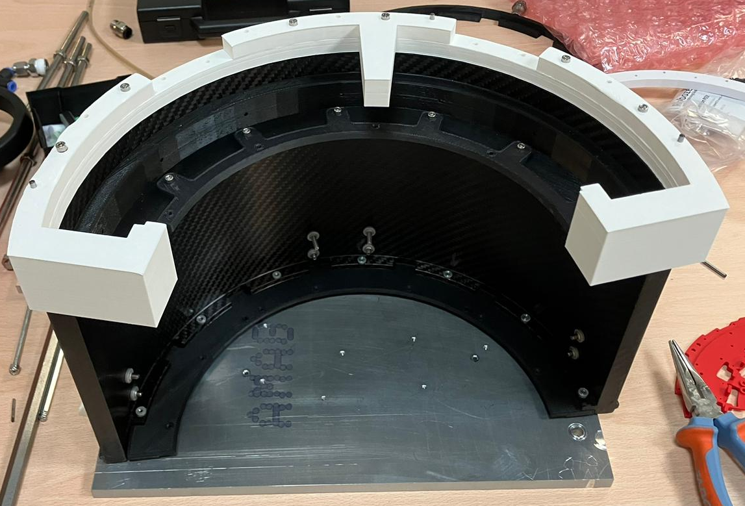
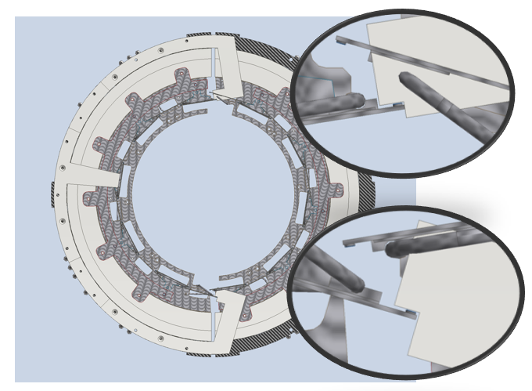
Layer alignment
Edges regulation by internal rings and positioning mask
We regulate the Layer edges by adjusting the screws between the internal ring and the pillars. The reference is given by a 3D printed mask connected to the external cylinder back flange pins. This prevent the waterfall effect of the precision of all the layers. Indeed, all the special ladders, layer by layer, are referred to the external cylinder pins, granting the same positioning tolerance between L4 and L1.
Before the positioning
Planes | Nominal | Measured
 | R [mm] | R [mm] | ΔR [mm]
Internal special | 102.630 | 102.630 | 0.000
External special | 107.810 | 109.225 | 1.415
Connected to the L3 internal ring and locked into position
Planes | Nominal | Measured
 | R [mm] | R [mm] | ΔR [mm]
Internal special | 102.630 | 102.901 | 0.271
External special | 107.810 | 107.698 | -0.112
The special ladder positioning given by the 3d printed mask is cautious. The mask is preventing the special ladder to go to the area covered by the other half quarter, keeping the gaps at least at the nominal value. This will reduce the error on the edge side to the same amount of the flange side
17.06.25 - Tracker Mechanics Forum Bristol
D.Benvenuti
6

Slide 7
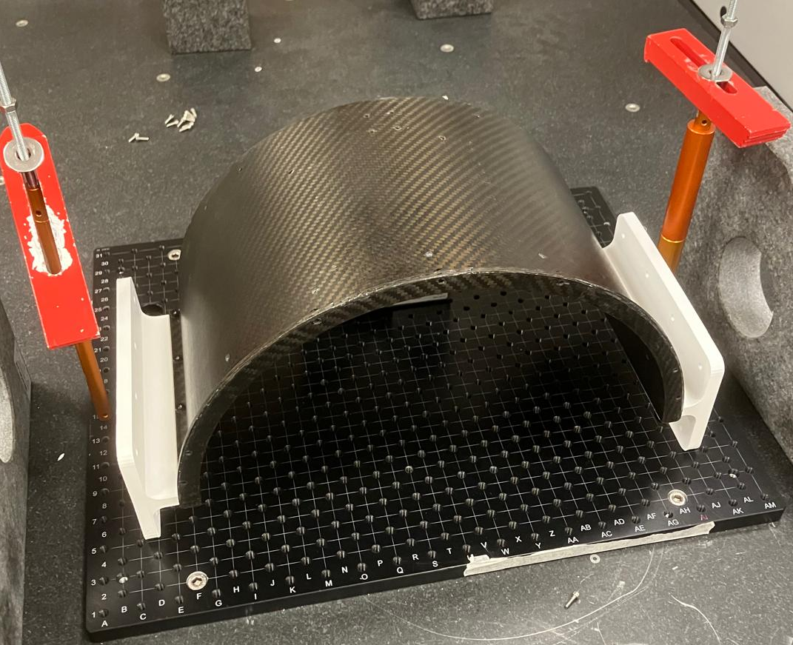
External cylinder construction
Internal skin lamination
Cold gluing
Holes machining and inserts gluing
Pin holes precision below 50 µm
External skin lamination
Gluing between:
External skin
Airex R82.80
Internal skin
Result
The advantage of cold gluing is to create two precise skins and to avoid thermal deflection given by the lamination.
It also prevents the Airex to be absorbed by the resin during the lamination
17.06.25 - Tracker Mechanics Forum Bristol
D.Benvenuti
7

Slide 8
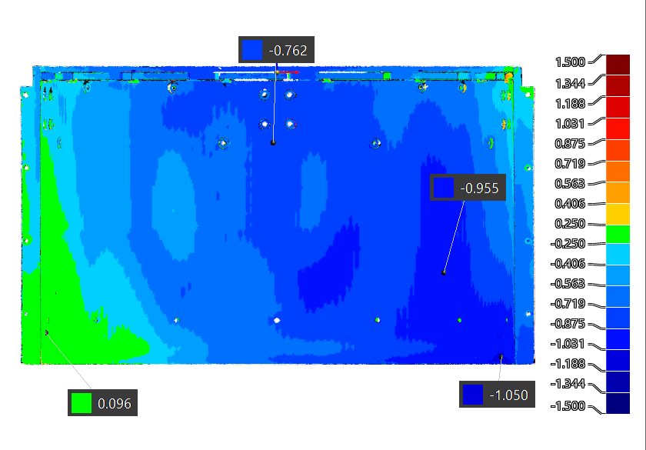
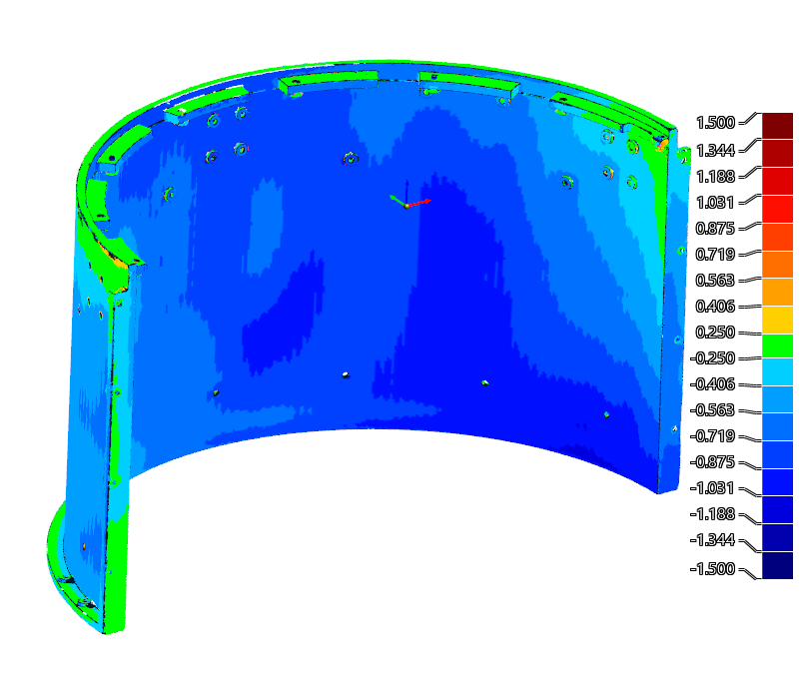
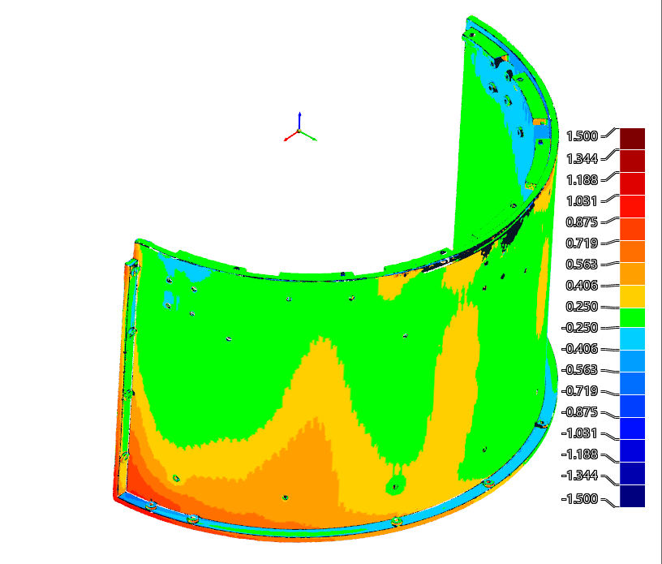
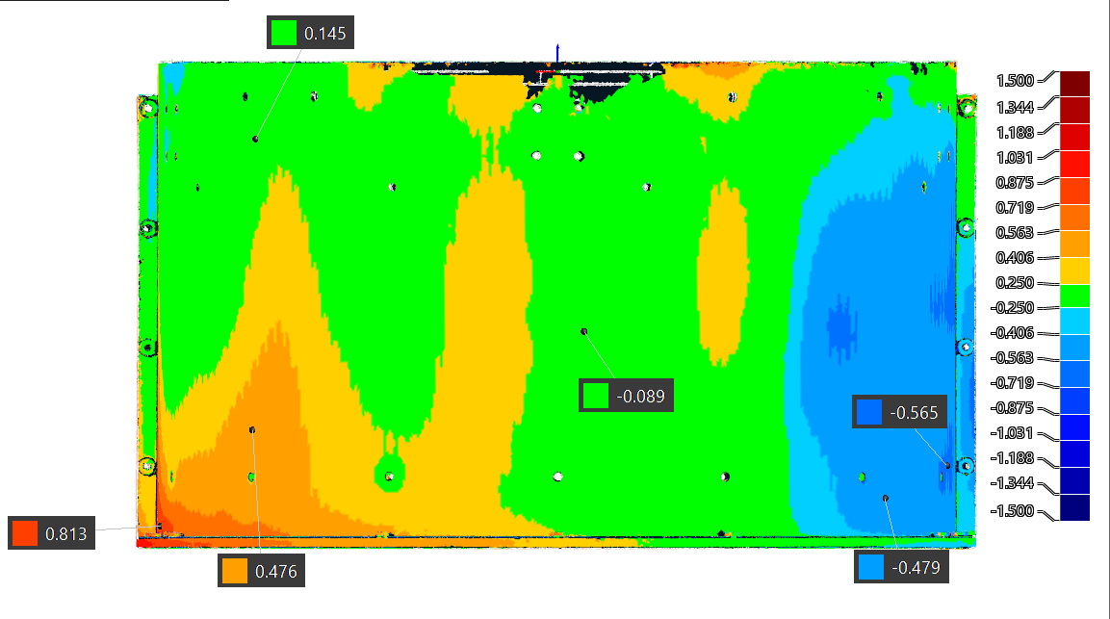
External cylinder metrology
Main dimensions | Nominal [mm] | Measured [mm] | Δ [mm]
Inner radius | 162.000 | 162.370 | 0.370
External radius | 167.500 | 167.430 | -0.070
After the gluing, the cylinder slightly shrinks.
The reference pins are the one which really matters, and their precision is below 100 microns. The pins from the front side aren’t precise, but what really matters from them is that they are stable from different conditions, so we can compensate
17.06.25 - Tracker Mechanics Forum Bristol
D.Benvenuti
8

Slide 9
Thermal management
INTRODUCTION:
The TBPX sensors after irradiation should be cooled well enough to avoid thermal run-away.
The heat production, caused by the sensor leakage current and by the electronics (CROC), should be transferred to the cooling pipes where CO2 is flowing passing through the module rails and the TBPX mechanics ladders
Above a certain working Temperature the sensor goes into “run-away”, the Tsensor goes to infinite, and It cannot be switch-on anymore
The “thermal runaway margin” tells us how far the temperature reached by the sensor is far away from the runaway.
This margin is estimated by thermal simulation taking into account
  The worst module in within a layer (the CO2 temperature is varying in the cooling tube)
  The total life of the sensor (maximum integrated luminosity 4000 fb-1 except L1 for half life, because it will be replaced)
  Conservatives power conditions of the sensor (i.e. HV)
17.06.25 - Tracker Mechanics Forum Bristol
D.Benvenuti
9

Slide 10
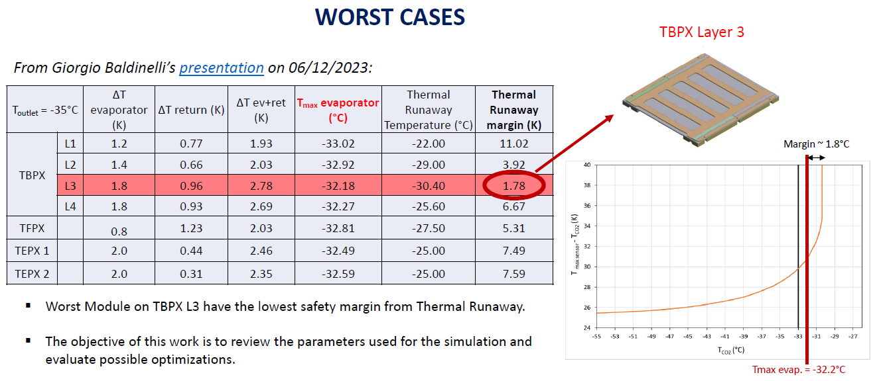
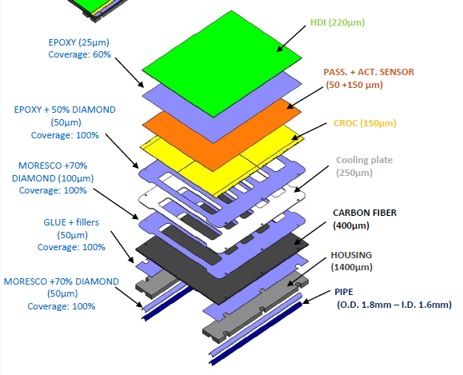
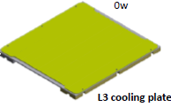
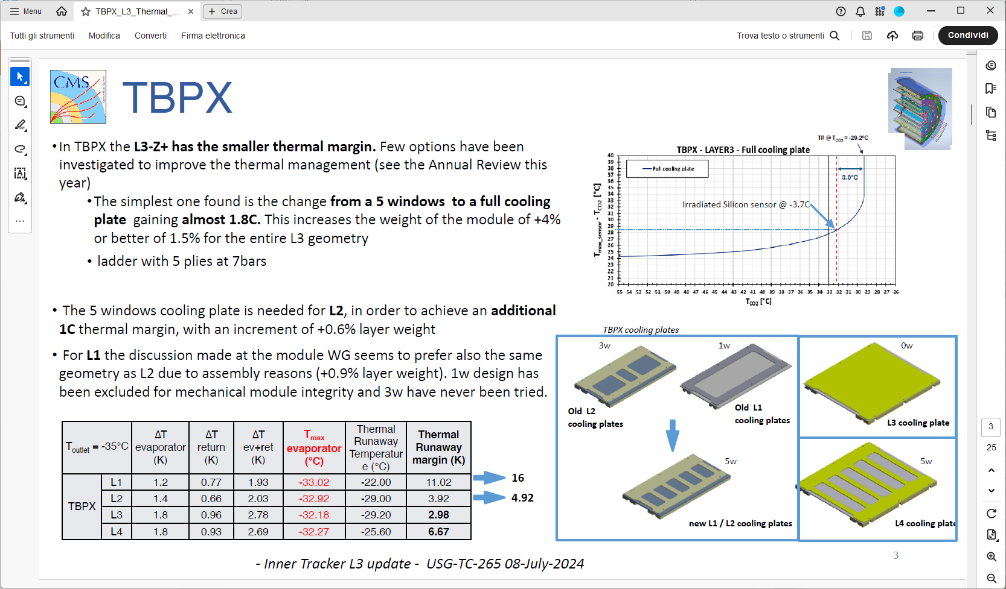
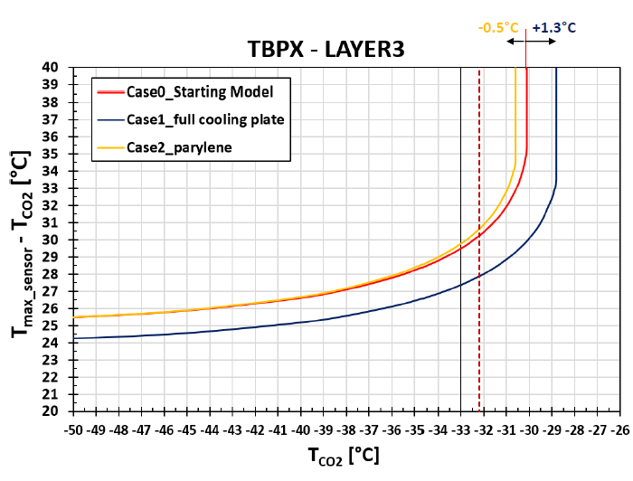
Optimization in simulations (layer 3 ladders)
STARTING POINT
In TBPX the L3-Z+ has the smaller thermal margin. Few options have been investigated to improve the thermal management (by simulations)
- Review of all the parameters and layers
full cooling plate instead 5 window plate.
ladder with 5 plies
OPTIMISED POINT
17.06.25 - Tracker Mechanics Forum Bristol
D.Benvenuti
10

Slide 11
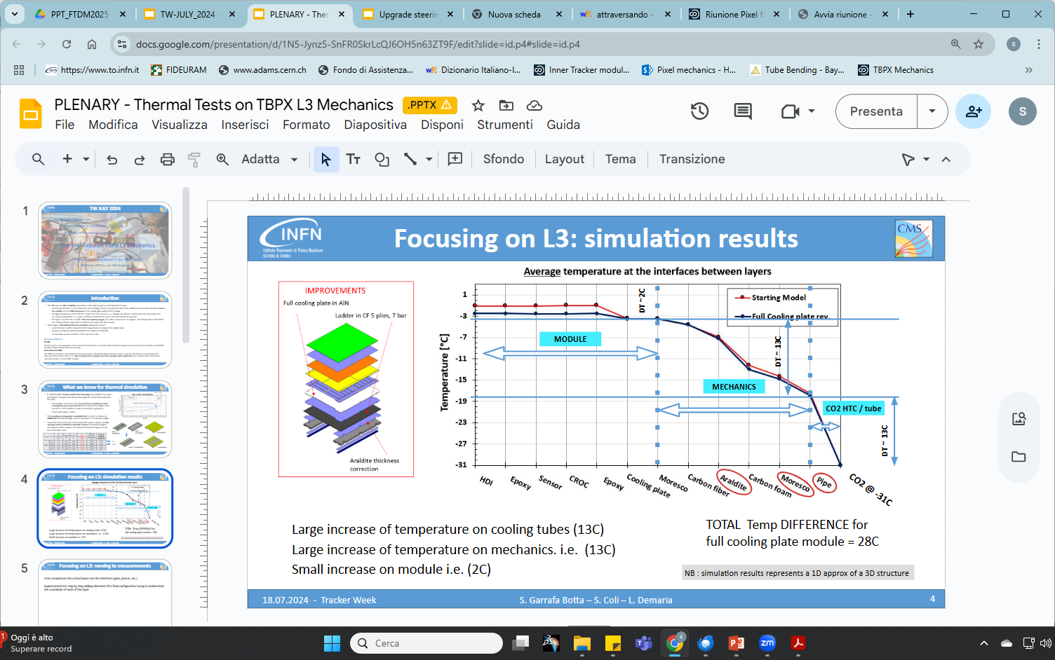
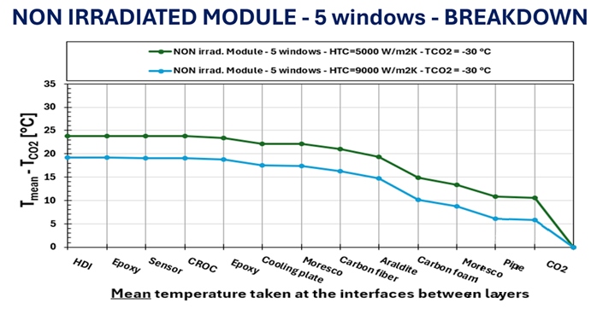
Thermal test approach
From simulations the critical layers are the interfaces (glue, grease, etc.)
Experimental test step by step adding elements till a final configuration trying to understand the contribute of each of this layer
MODULE
MECHANICS
CO2 HTC
1. Glue layer between CFiber and Cfoam
x
x
DT ̴ 11°C
2. Moresco grase+ diamond layer between CFiber and Cfoam
DT ̴ 2°C
x
DT ̴ 11°C
Large increase of temperature on cooling tubes (about 11°C)
Large increase of temperature on mechanics i.e. (about 11°C)
Small increase on module i.e. (about 2°C)
1
2
17.06.25 - Tracker Mechanics Forum Bristol
D.Benvenuti
11

Slide 12
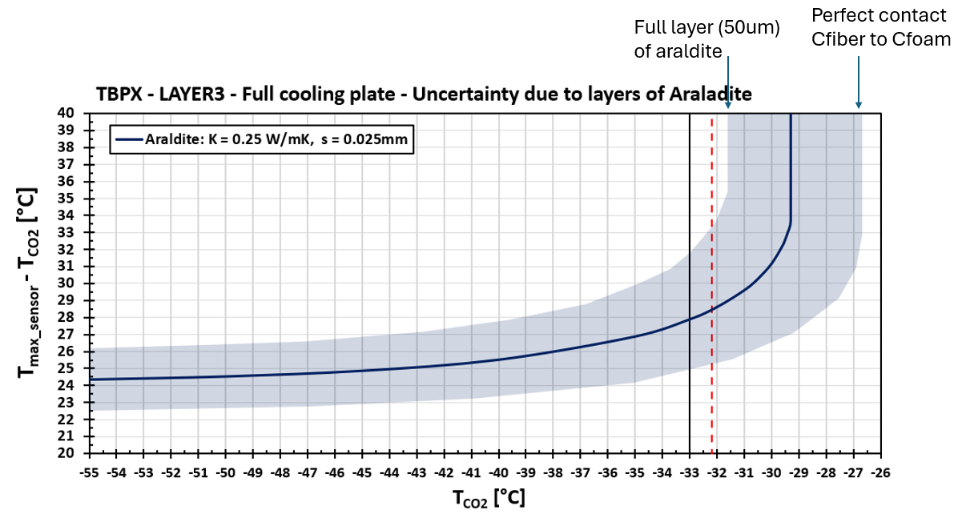
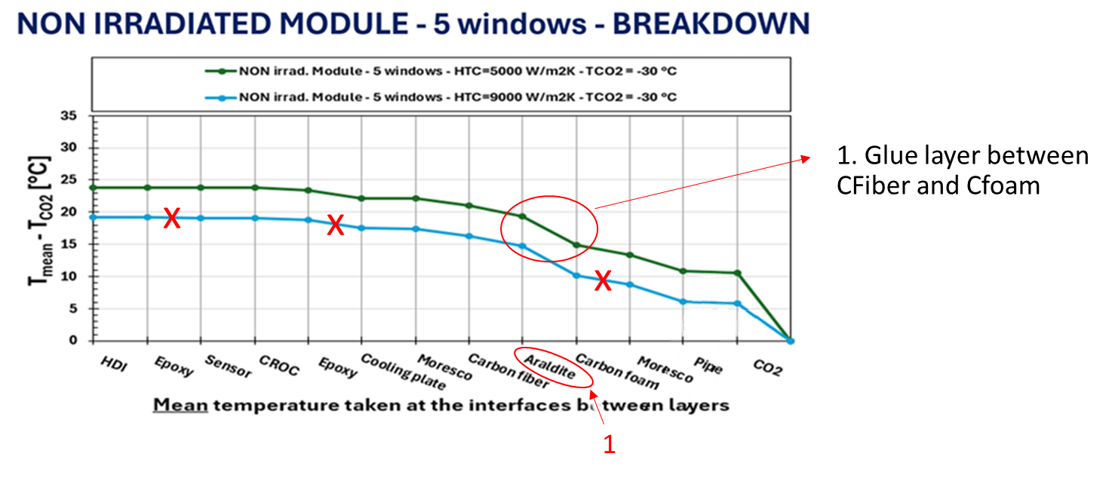
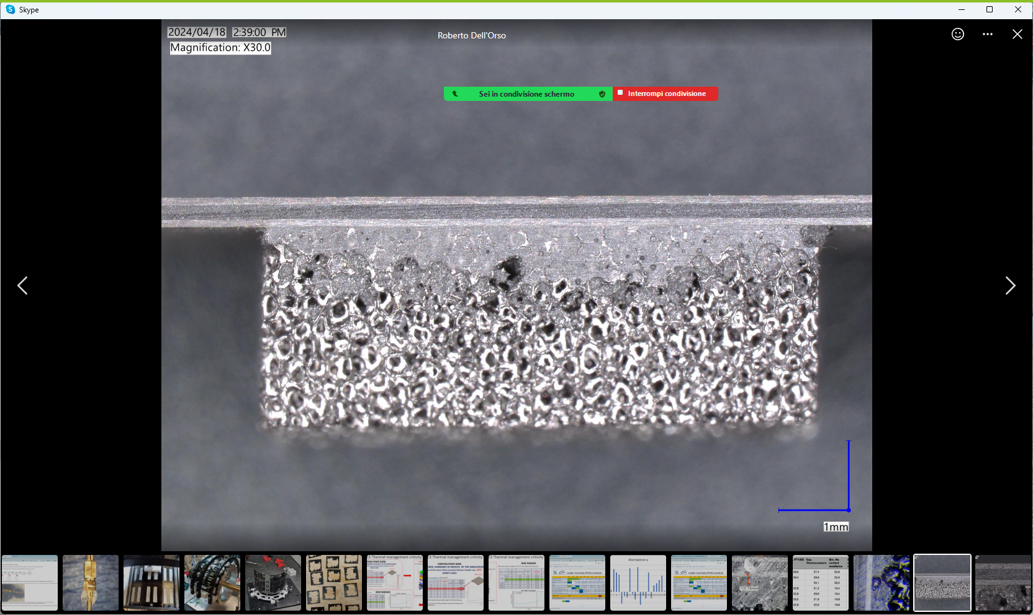
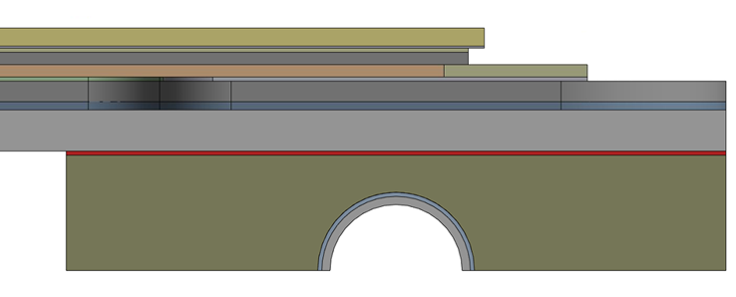
1. Glue layer between CFiber and Cfoam contribution
Glue layer between Carbon foam to the Carbon Fiber: very important thermal contact because of the reduction of surface for heat transfer.
Pure Araldite has thermal conductivity of 0.25 W/mK.
NB: In simulations a full layer of 25 µm of araldite between Cfiber and Cfoam is considered: in reality C-Foam and C-Fiber are directly in contact (with a lower thermal resistance).
ARALDITE LAYER
17.06.25 - Tracker Mechanics Forum Bristol
D.Benvenuti
12

Slide 13
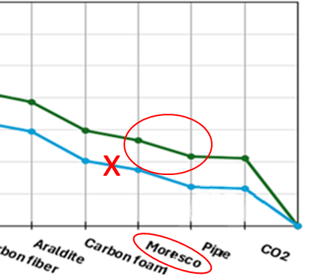
2. Grease layer between CFoam and tube contribution
TIM (Thermal Interface Material) between the housing and the pipe is one of the most critical layers for the modules thermal performance.
Adding a layer of thermal grease + diamond between carbon foam and tube brings the following advantages:
the heat exchange surface is increased
any air gaps are covered
any non-uniformities in the foam cavity or bends in the tube are corrected
with a significant performance benefit in terms of dissipation of the heat produced by the module.
17.06.25 - Tracker Mechanics Forum Bristol
D.Benvenuti
13

Slide 14
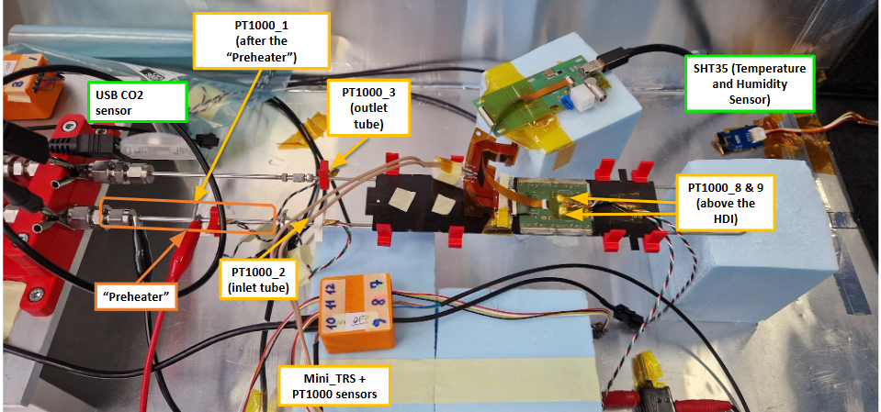
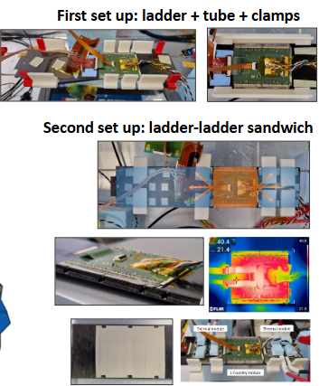
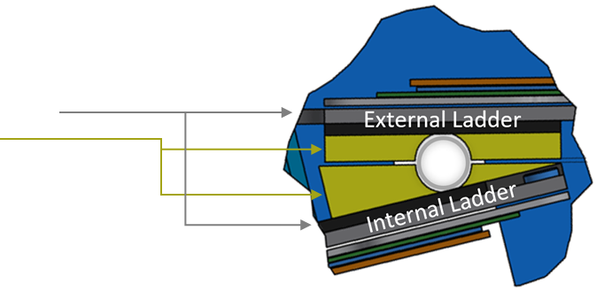
Thermal test setup (Layer 3)
- TBPX 2x2 CROC L-Foundry Module
  Actual ceramic plate (5 openings)
- Ladder (Layer3)
  Carbon fiber plate (K13D2U, 4ply, 4bar)
  Carbon Foam (K9) pipe housing
  SS bushings for M0.5 screws
- TBPX Flexible Printed Circuit (Layer3 prototype)
  LV cables soldered on it (CCA10% AWG16)
- Adapter Board (2x2 CROC Mod) + Flat Cable
- 3D printed clamps (ABS) to hold the tube into the housing
17.06.25 - Tracker Mechanics Forum Bristol
…
14

Slide 15
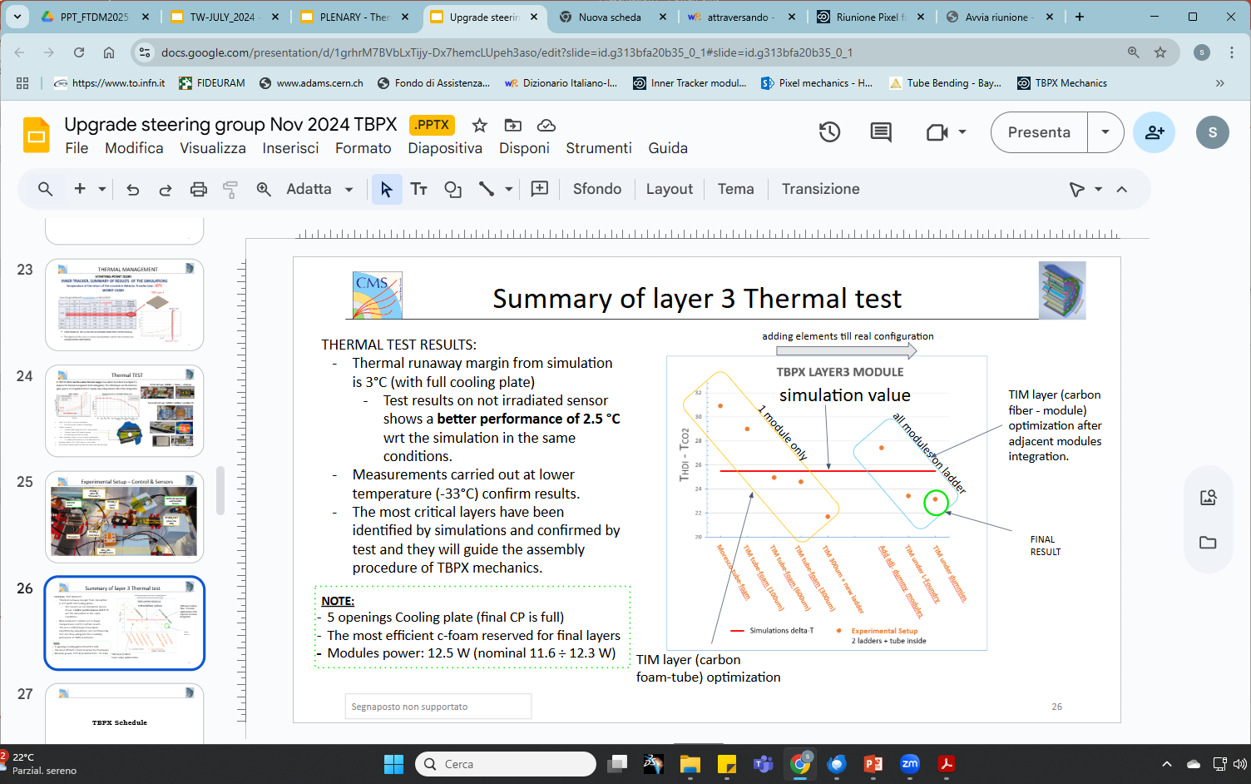
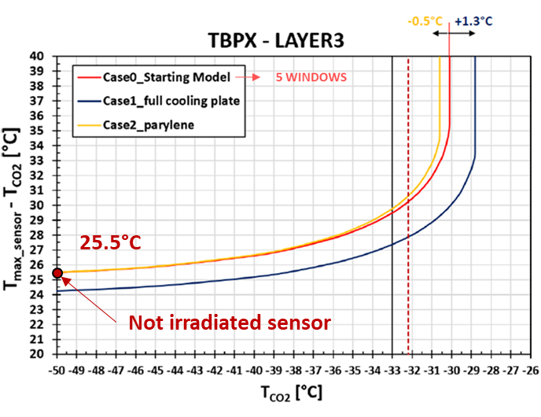
Thermal test vs Thermal simulation results
Results from thermal test projected to this plot
THERMAL TEST VS SIMULATION RESULTS on layer 3:
Thermal simulations on not irradiated sensor of layer 3 modules (with 5 windows cooling plate) predict ΔT of 25.5°C
Thermal Test results of layer 3 modules show a lower Temperature of 2.5 °C wrt the simulation in the same conditions (of CO2 T and flux), therefore a ΔT=23 °C
Measurements carried out at lower temperature (-33°C) confirm results.
17.06.25 - Tracker Mechanics Forum Bristol
D.Benvenuti
15

Slide 16
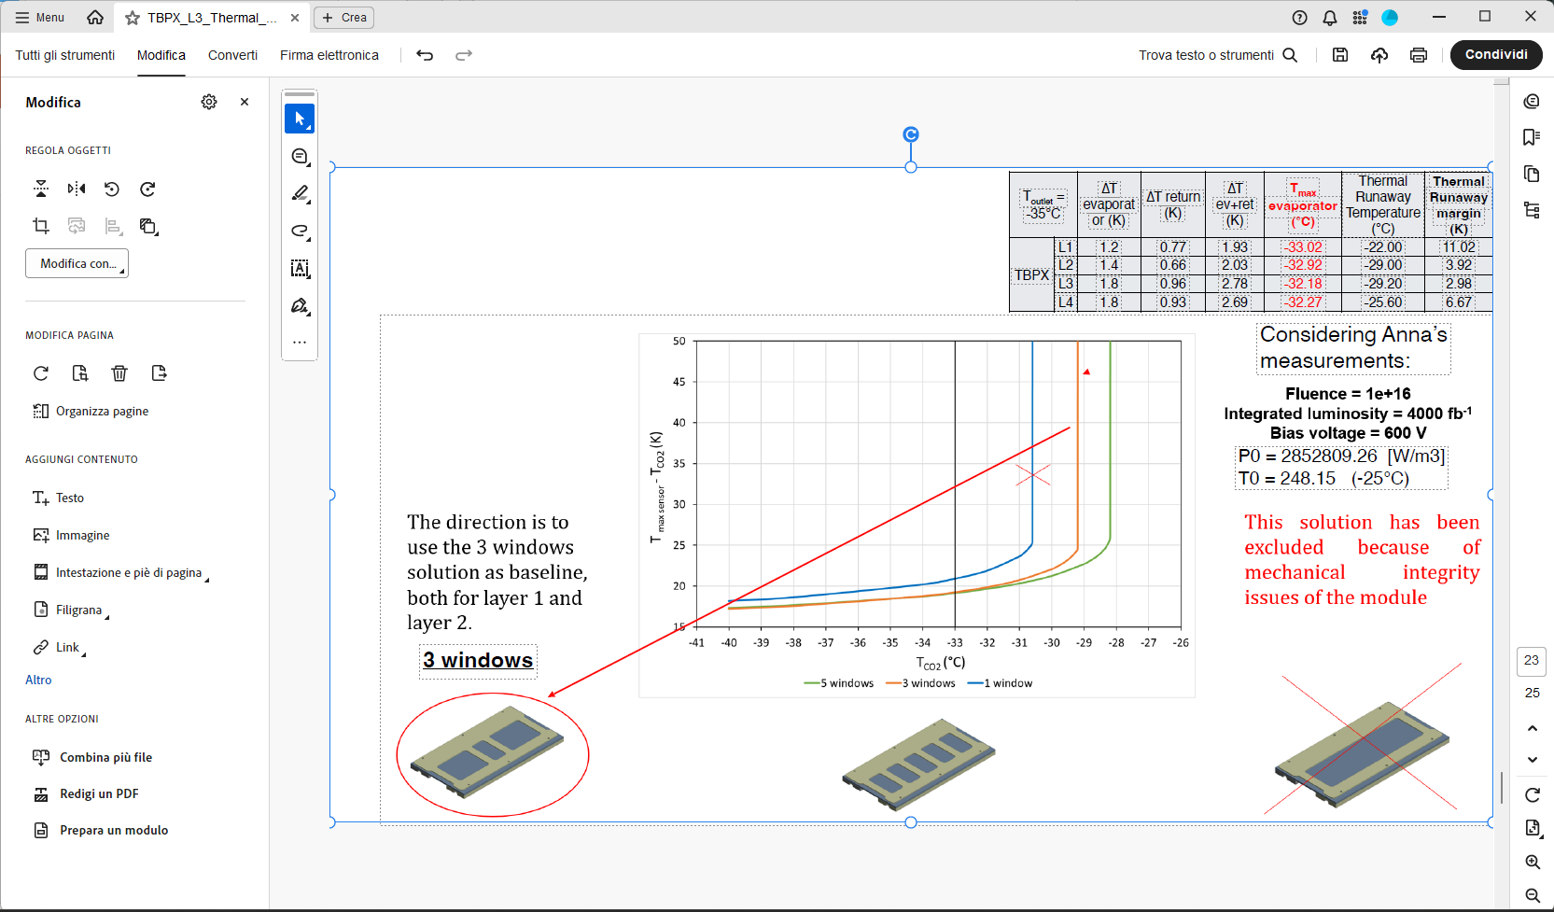
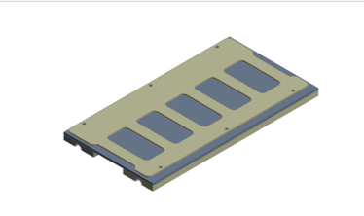
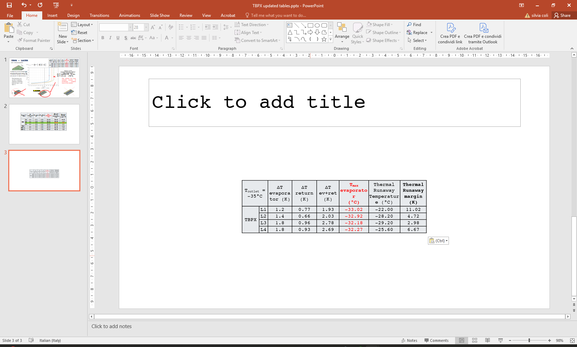
Optimization in simulations (layer 2 ladders)
STARTING POINT
In TBPX the L2-Z+ is the other critic layer with a reduced thermal margin. Few options have been investigated to improve the thermal management (by simulations)
- Review of all the parameters and layers
change the plate drawing
OPTIMISED POINT
17.06.25 - Tracker Mechanics Forum Bristol
D.Benvenuti
16

Slide 17
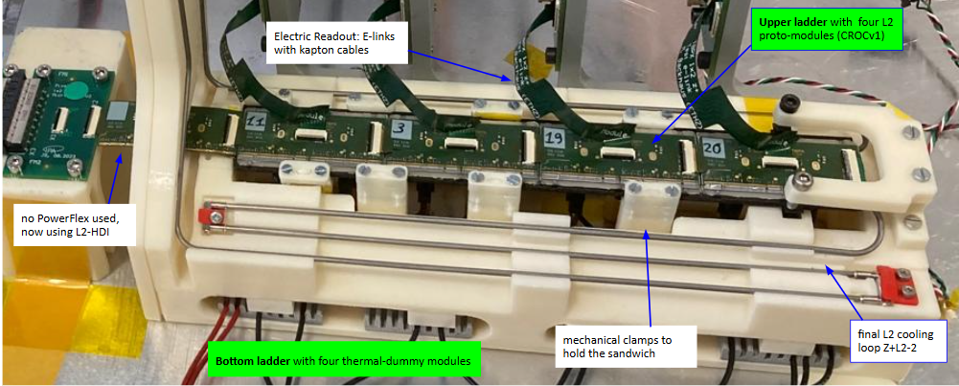
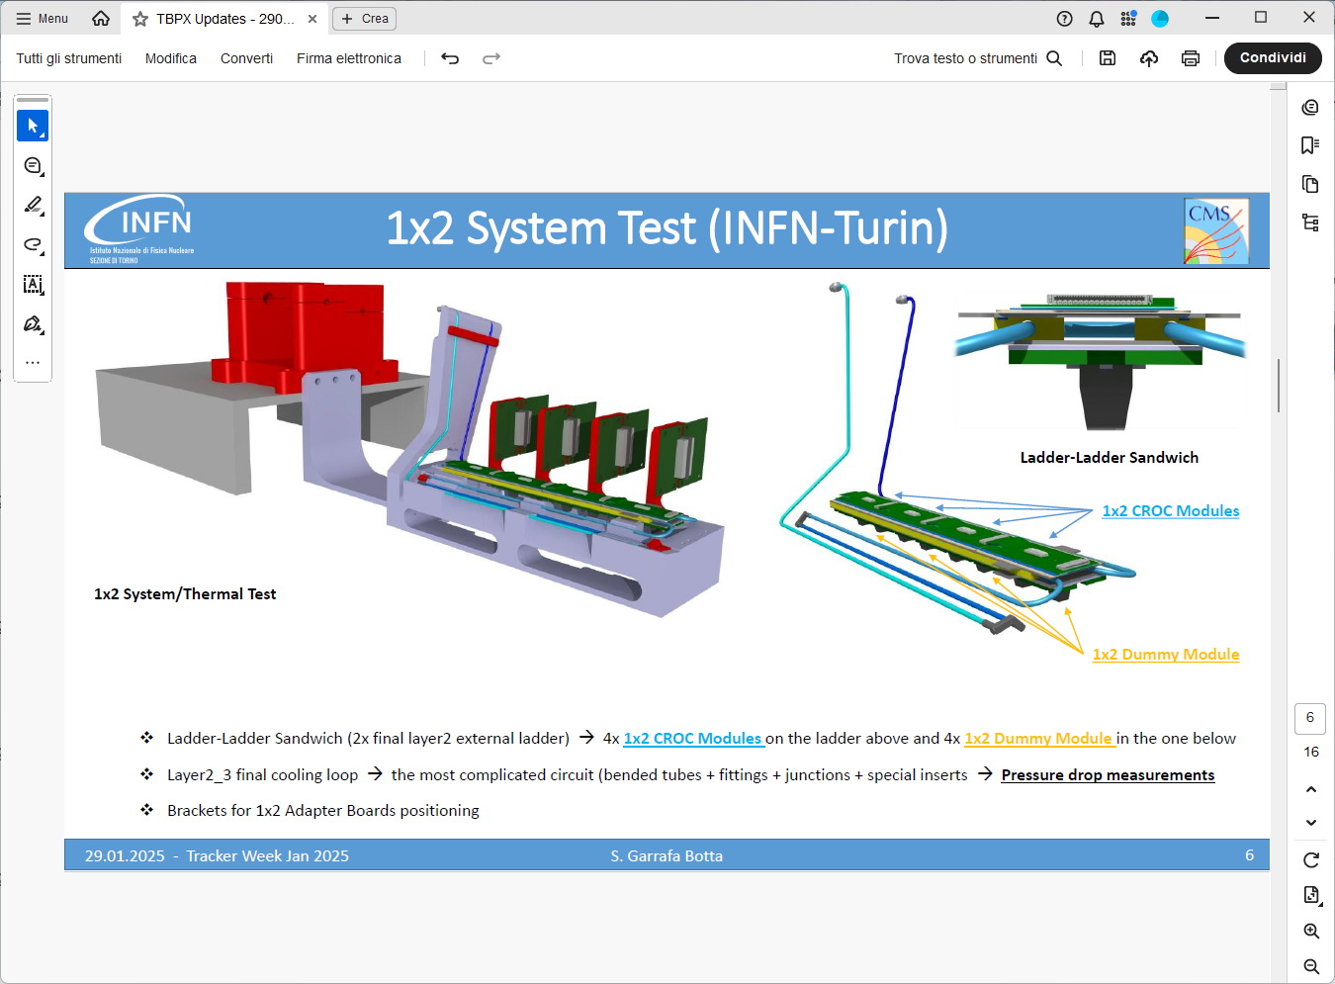
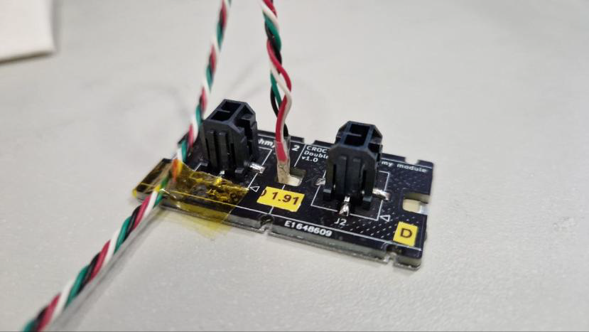
Thermal test setup (Layer 2)
Considering what learnt from Layer 3 thermal test:
- Ladder-Ladder Sandwich (2x final layer2 external ladder) :
  4x 1x2 CROCv1 Modules on the ladder above and
  4x 1x2 thermal Dummy Module in the one below
- Ladder (Layer2)
  Carbon fiber plate (K13C2U, 4ply, 4bar)
  Carbon Foam (K9) pipe housing
  SS bushings for M0.5 screws
- Adapter Board (2x2 CROC Mod) + Flat Cable
- 3D printed clamps (ABS) to hold the tube into the housing
17.06.25 - Tracker Mechanics Forum Bristol
D.Benvenuti
17

Slide 18

Thermal test vs Thermal simulation results
THERMAL TEST VS SIMULATION RESULTS on layer 2:
Thermal simulations on not irradiated sensor of layer 2 modules (with 5 windows cooling plate) predict a ΔT of 17°C
Thermal Test preliminary results of layer 2 modules show a lower Temperature of 3-4 °C wrt the simulation in the same conditions (of CO2 flux), therefore a ΔT=13-15 °C
Results from thermal test projected to this plot
17.06.25 - Tracker Mechanics Forum Bristol
D.Benvenuti
18

Slide 19
Conclusion
The layer prototypes allowed to practice with the mechanics, to do the first exercise for thermal validation, to define the assembly procedure, to finalize the flange design, to test the handling tools and to set up the module integration tool.
We defined a procedure to align layer by layer starting from the external cylinder avoiding a waterfall effect on the misplacements. This improves the precision for the whole quarter
The first final external cylinder is realized. Its precision and stability will drive the realization of the rest of the detector
Test results on not irradiated sensor show a better performance with respect to the simulation in the same condition
The most critical layers have been identified by simulations and confirmed by test, they will guide the assembly procedure of TBPX mechanics.
17.06.25 - Tracker Mechanics Forum Bristol
D.Benvenuti
19

