Slide 1
DRD8 – WP2 – Project 2.2 Mechanical, thermal testing and database development
Sushrut Karmarkar and Adam Lowe on behalf of DRD8 – WP2
19 June 2025

Slide 2

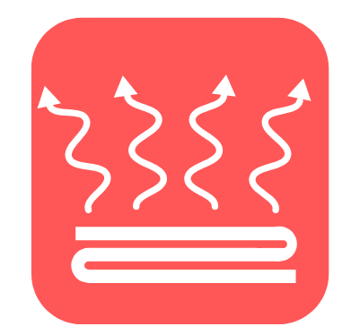
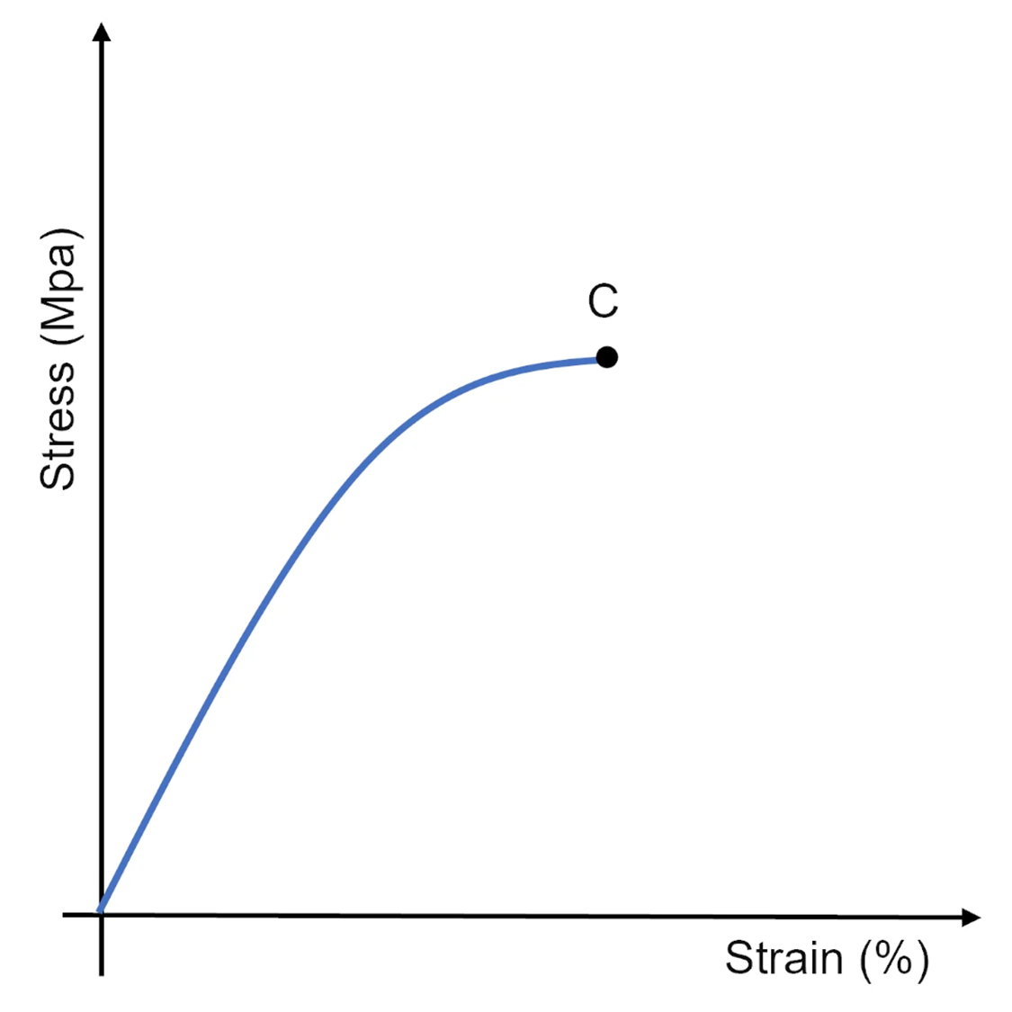
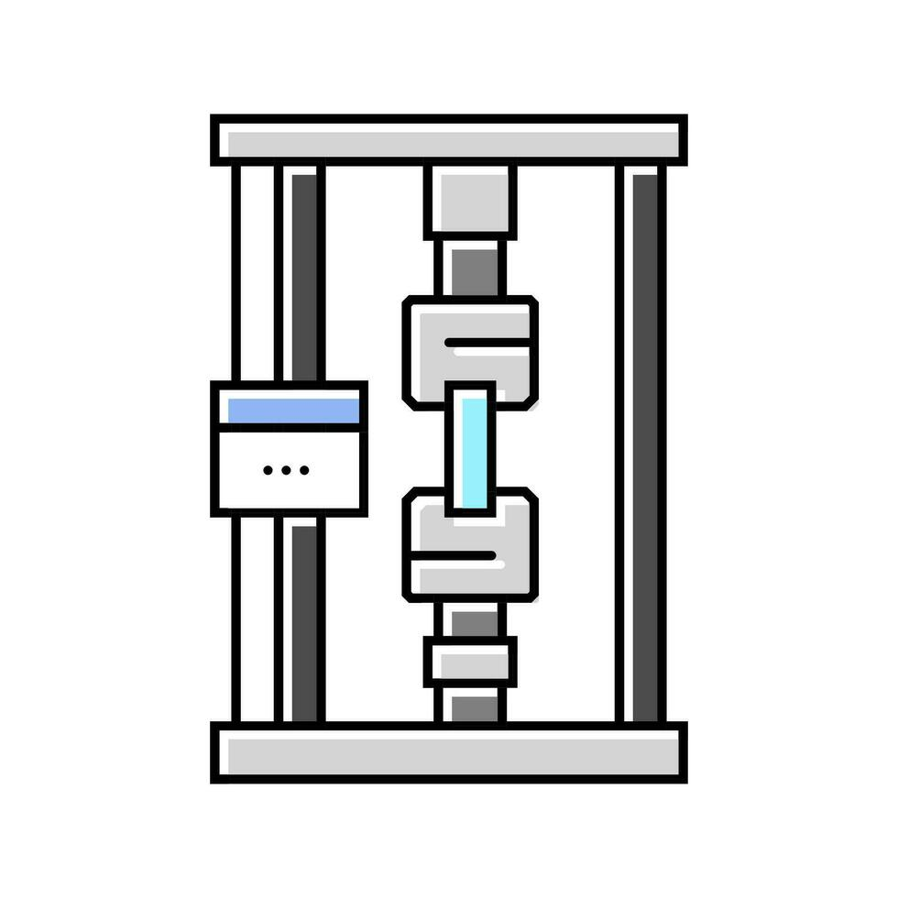
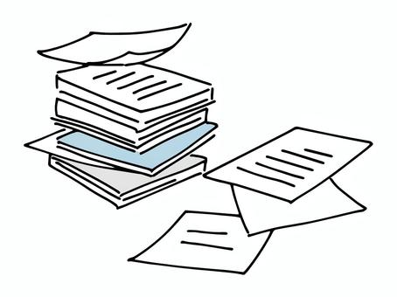


WP2 – Project 2.2 : Approach to the tasks
Year 1 (2025)
Round robin testing of samples to ensure uniformity in results
Documentation guidelines per ISO/ASTM standards for automized input into database
Explore current MaxRAD database revamp options and AI based smart search algorithms*
Identify needs from HEP community
Reach out to institutes for list of equipment and contact person for characterization tests.
Identify lead times, machine availability and needs of each institute
Increase # of participating institutes
Explore opportunities and collaboration with other DRDs for material characterization needs/testing
Tensile tests for carbon fiber composite laminates across institutes
Thermal conductivity tests
Standardized samples from a single institute sent to all testing facilities and cross comparison of results
Reach out to institutes for list of equipment and contact person for characterization tests.
Identify lead times, machine availability and needs of each institute
Increase # of participating institutes
Integration options between IMHOTEP and MaxRAD
Opportunities to explore use and development of AI based search algorithm that can answer to prompts like
“hey MaxRAD what is the best gamma radiation tolerant adhesive to use with Kapton?” *
* Proposal by Nicola Pacifico

Slide 3
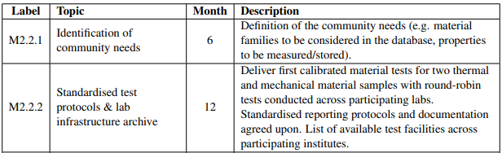
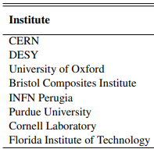
WP2 – Project 2.2 : Material Testing – Round Robin
Deliverables for 2025 (12 months)

Slide 4
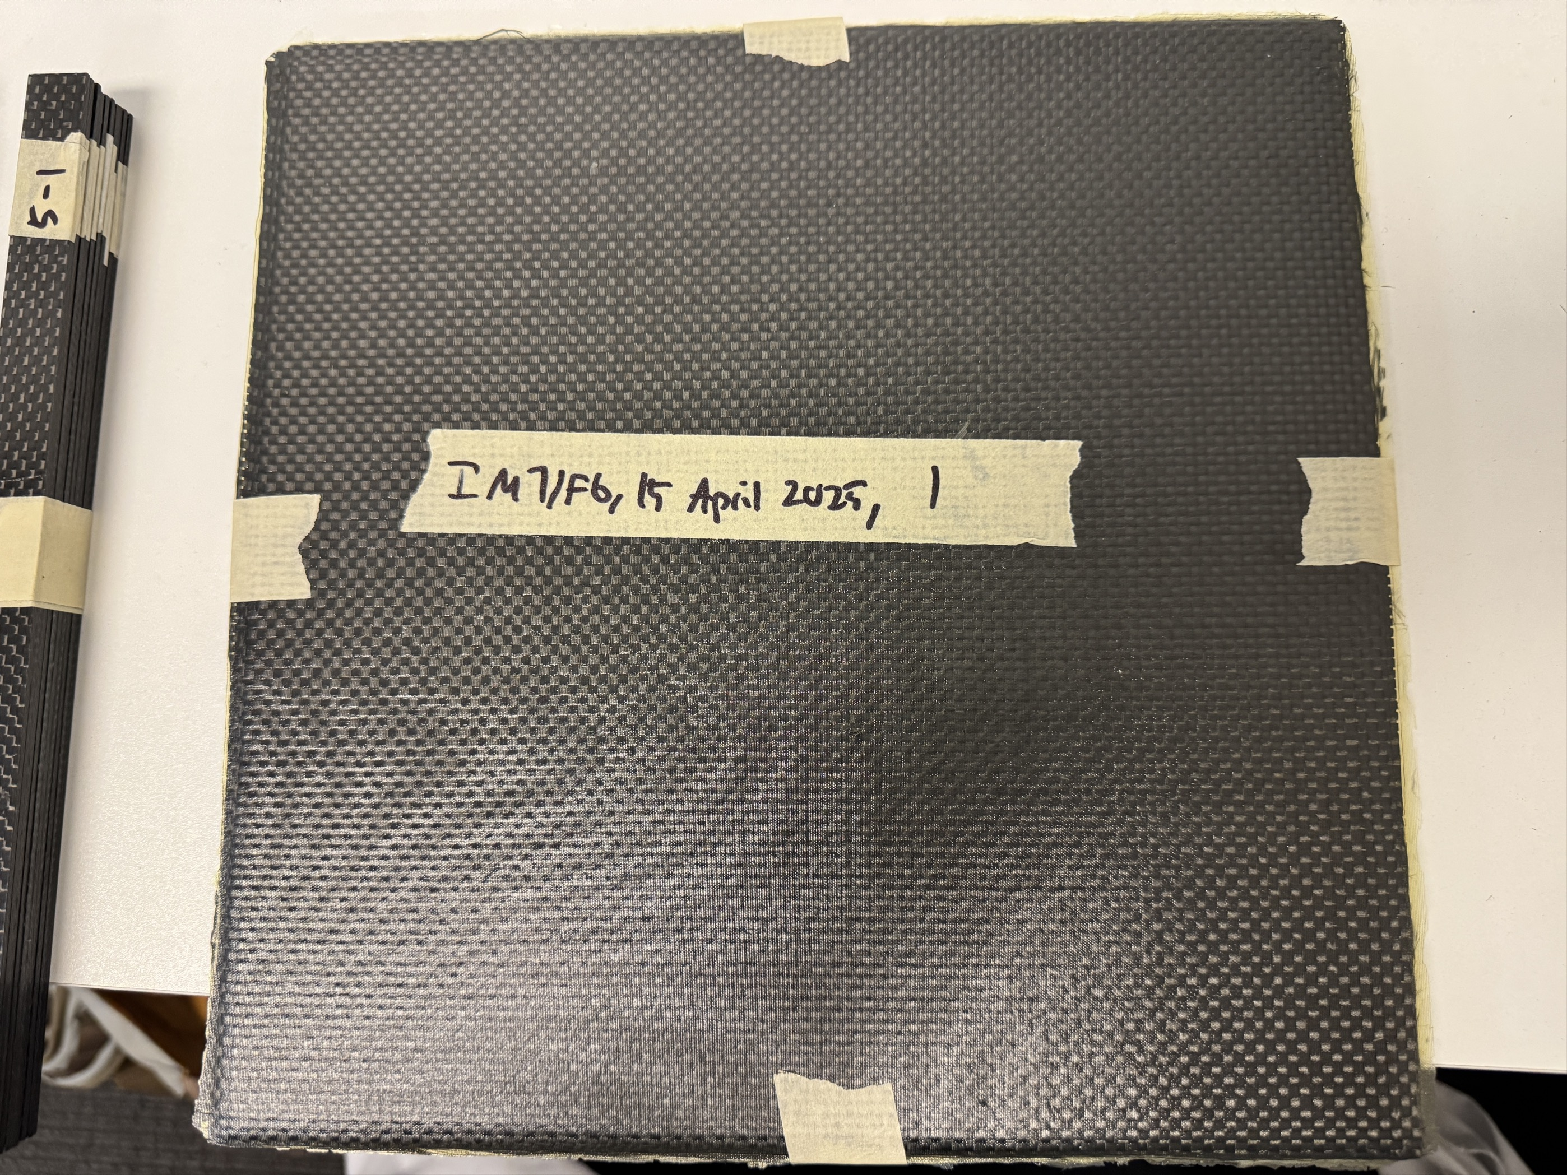
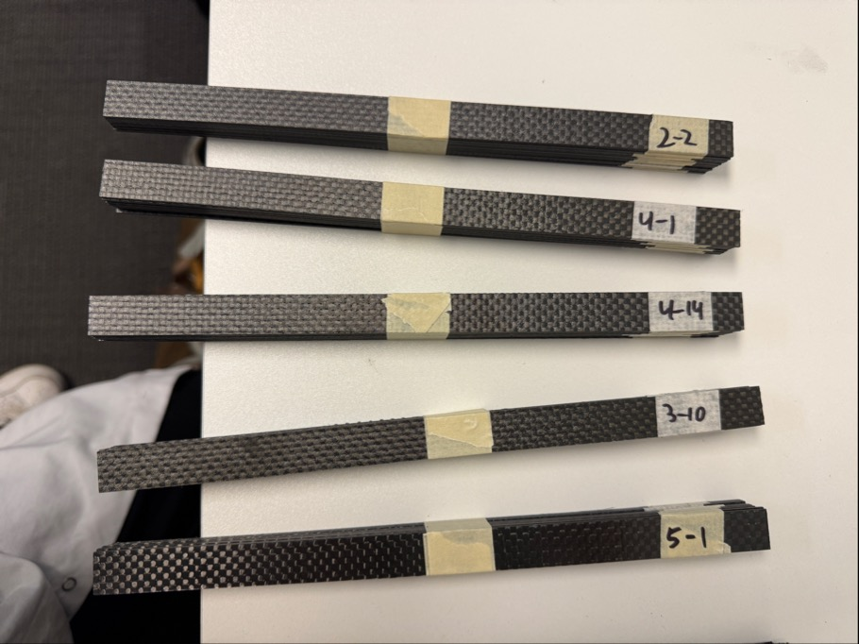
Tensile & thermal samples for CFRP and aluminum for Lab-Lab calibration
Thermal conductivity samples include a sapphire disc calibration sample and an aluminum calibration sample.
Tensile samples are aluminum samples and Patz F6/IM7 plain weave samples
Samples shipped from Purdue Univ. to CERN after a lot of export control paperwork.
You will get samples from CERN – institute contacts will get email to coordinate.
Small success (we have a FedEx tracking number on 13 June 2025!!) https://www.fedex.com/fedextrack/?trknbr=289763275648&trkqual=2460840000~289763275648~FX

Slide 5
Open for more institutes to join in the round robin testing
US institutes (easier* shipping)
EU institutes (not so…easy* shipping)
Institute | Contact
Purdue Univ | Sushrut Karmarkar
Florida Tech | Souvik Das
Univ. of Buffalo (in process of joining collaboration) | Christine Mc Lean
…
…
…
Institute | Contact
CERN | Nicola Pacifico
DESY | Moritz / Jan-Hendrick
INFN Perugia | Cristiano Turrioni
Uni. of Oxford | Adam Lowe
Bristol (BCI - ?) | via Adam Lowe
INFN Pisa | Daniele Benvenuti

Slide 6
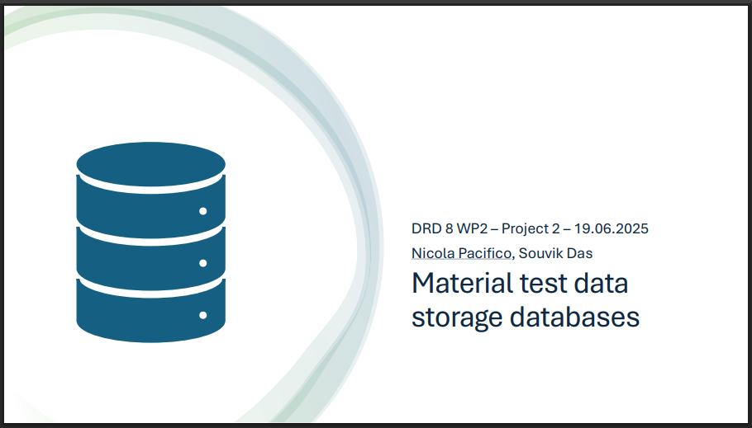
Database development
Nicola Pacifico and Souvik Das have some resources to get started this Summer.
Details in talk by Nicola - https://indico.cern.ch/event/1482847/contributions/6530125/

