Slide 1
3D Automatic Representation Based On The Planning Progress
Forum on Tracking Detector Mechanics 2025 – João Matos
2025-06-19
https://indico.cern.ch/event/1482847/
Notes:
Good morning!
Today I am going to present the work I have developed at CERN regarding an evolutive three-dimensional visualization tool that is able to follow the planning of activities made on CERN machines and equipment.

Slide 2
Agenda
Introduction
Prototype
Validation
Notes:
This is the agenda for this presentation

Slide 3
1. Introduction
Notes:
First let’s understand the context of the project and of the problem I worked on.

Slide 4
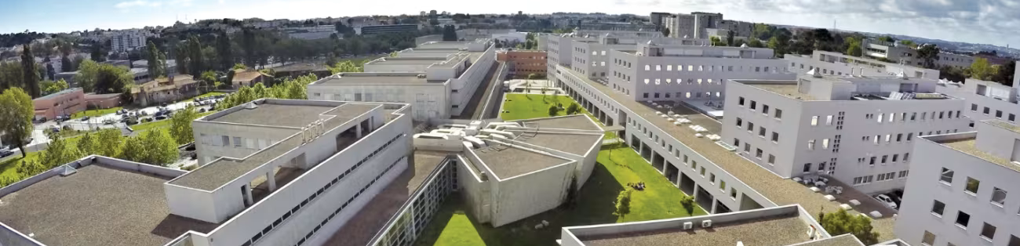
1.1. Personal Context
Trainee at CERN
March - May
MSc Student
FEUP
Notes:
I’m João Matos, a 22-year-old Portuguese student studying Informatics and Computing Engineering.
From March to May, I was a trainee at CERN, where I worked with Fernando Pedrosa.
My work contributes to my Master’s dissertation at the Faculty of Engineering of the University of Porto.

Slide 5
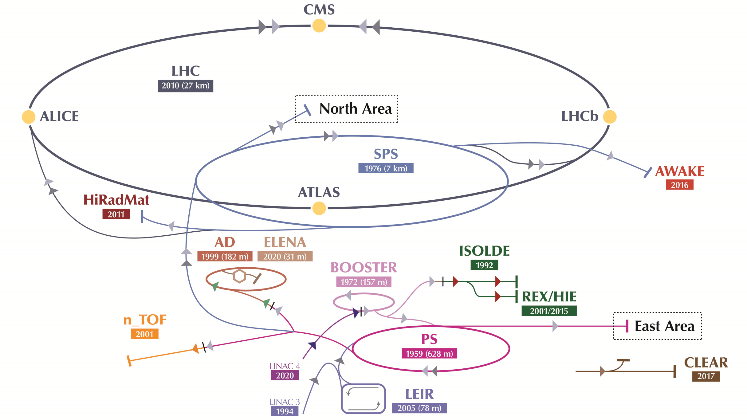
1.2. Project Context
Notes:
Let’s start by understanding the context of the project.
You all know this much better than me, even then:
At CERN, there are many complex machines and facilities, kilometers of them, and so there are frequent maintenance operations.

Slide 6
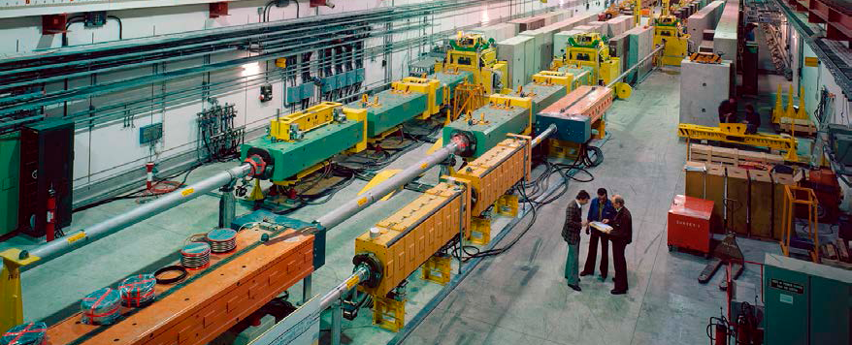
1.2. Project Context
Notes:
About those activities, it is desirable to be able visualize WHAT is happening (whether it’s maintenance, installations, removals), WHERE and WHEN. This is essential to optimize the usage of time and of other resources.
This should be possible without having to burden Coordinators with keeping new systems manually up to date. Everything should be as automatic as possible.

Slide 7
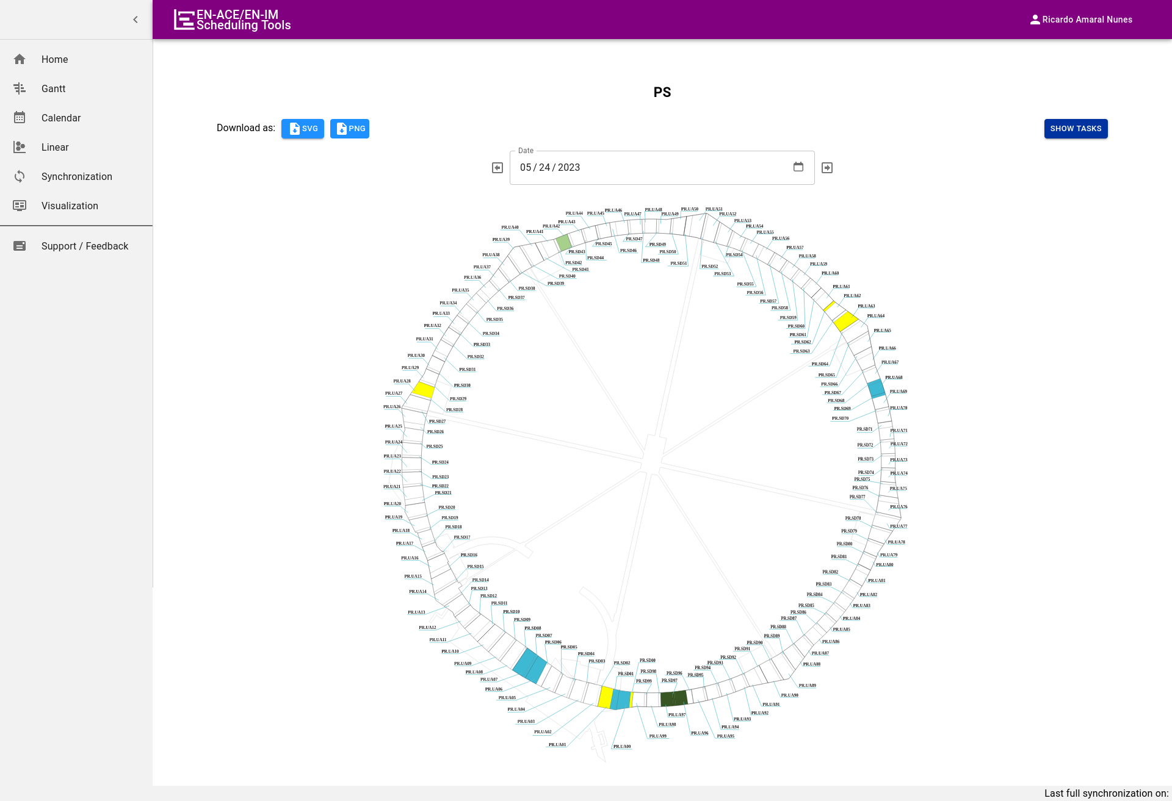
1.2. Project Context
2021 Summer student
Expanded to several facilities
Notes:
To that effect, a 2D view was created in 2021 by a Summer student (supervised by Fernando), to visualize ongoing maintenance tasks on 2D drawings of facilities, for a selected date.
The model is static but the locations are colored with the color of the responsible group whenever an acitivity is ongoing.
I thas been in use and visible to all users since summer 2021 for the PS
It was extended to several other facilities
It includes a power point generation functionality

Slide 8
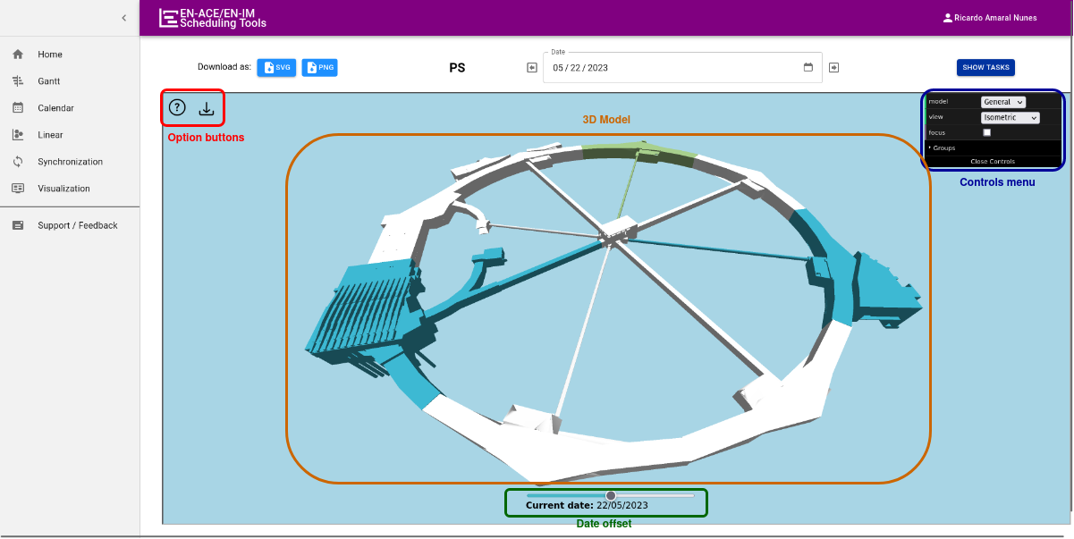
1.2. Project Context
2023 FEUP Master’s student
Expanded to LINAC3 and LINAC4
Location based
Notes:
To improve this, a 3D view was created two years ago by another Portuguese Master Student from FEUP, (also supervised by Fernando).
It is used and visible to all users since end 2023 for the PS and it was expanded to LINAC3 and LINAC4. It is similar to the 2D view and as it is still static but it is interactive and displays the machines as they look like in real life.
This tool however, could only be used for maintenance tasks, it did not support installations or removals.
Here the octants of the PS appear colored in the global view which indicates that, for the selected date, there are tasks ongoing inside of the octants
The 3D model is automatically colored based on the task information.

Slide 9
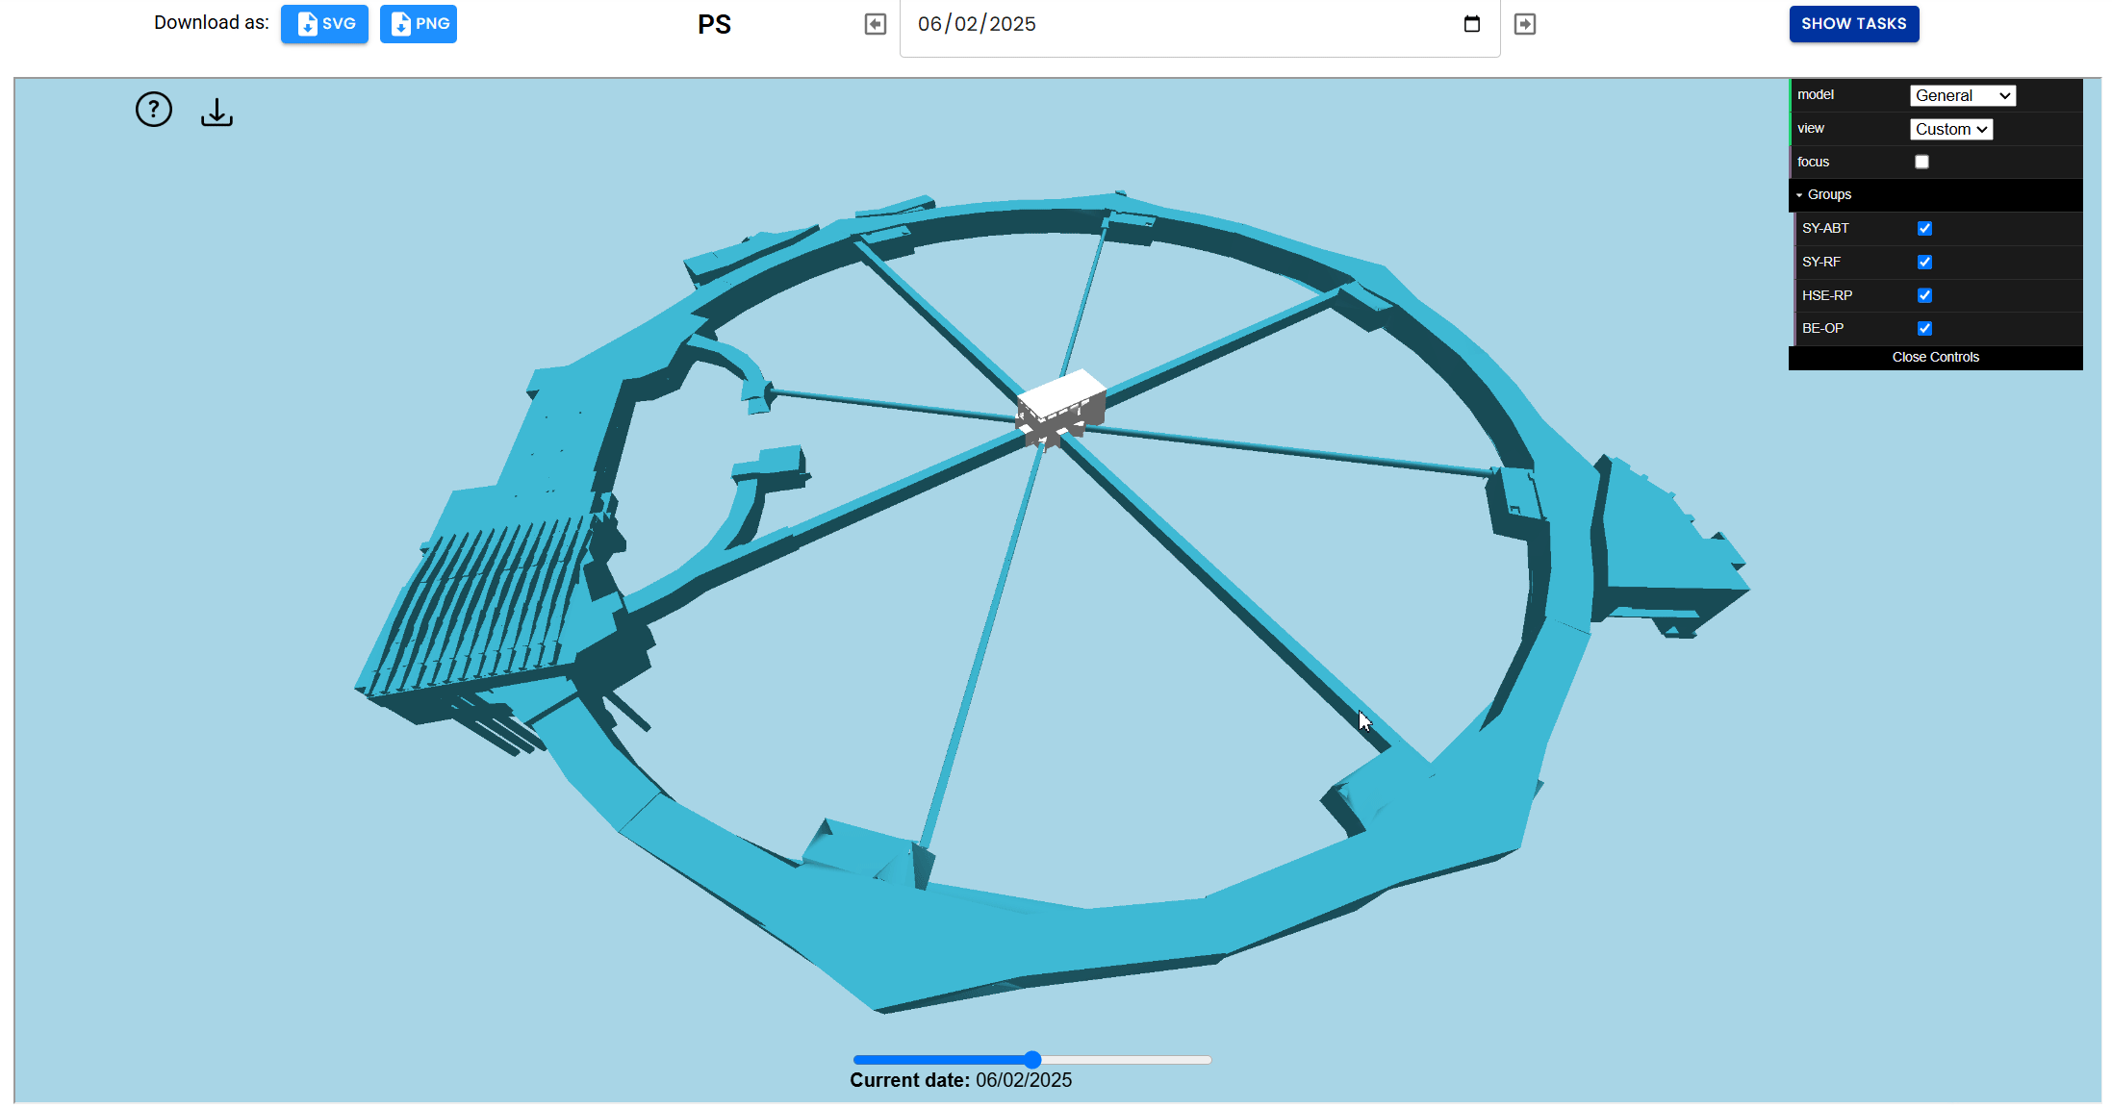
1.3. Problem
Notes:
-> By double clicking an octant, a detailed view is loaded.
But now that CERN is approaching a Long Shutdown and there will be many changes in several facilities, an interesting idea is to be able to make the models evolutive, that is, as components progressively change, and are removed or installed in the real world, the same must happen in the 3D models.
[??“What will TCC2 in the North Area look like in October 2027?” is an example of a question that we want to be able to answer quickly and visually.]
A tool like this can be used to better organize and simulate future activities, which should bring value to Facility Coordinators and for the teams that perform the activities.

Slide 10
1.4. Methodology
State of the Art
Requirements
Approach
Prototype
Testing
Literature Review
Supervision:
FEUP - Prof. Daniel Silva; Prof. Alexandre Valle
CERN - Fernando Pedrosa; Afonso Caiado
Notes:
How can we get a tool like this?
I read Ricardo’s dissertation all the way back in September and, being a Masters student, I followed a thorough methodology:
I reviewed the literature and learned about the techniques used to solve similar problems [in October and November.]
I compiled the state of the art [by the middle of December.]
Then I gathered requirements, devised an approach, and[ by the middle of January I started to create a prototype]. At the end, I validated the prototype by testing with users.

Slide 11
2. Prototype
Notes:
Moving on, how can a new iteration of this tool be then implemented?

Slide 12
2.1. General Objectives
Date 1
Part 1
Date 2
- Part 1
Part 2
Part 3
Part 2
Part 3
+ Part 4
Notes:
The main objectives to achieve are:
Being able to update the model of a facility dinamically according to the planning of activities , so for any selected date, the model is correct
AND
Have a visual mechanism to help perceive changes that occurred in the near past and will occur in the near future

Slide 13
2.2. Technical Objectives
E₁
E₂
E₃
E₄
time
Efficient data structure
Adjustable time window
Notes:
The technical objectives that allow us to reach the main objectives are:
Using or building an adequate data structure suited for managing different versions of the models. It needs to be efficient so it can handle complex models and maintain a good performance.
Implement a “focus + context” visual mechanism, in the form of an adjustable time window, to give more or less visual importance to events depending on temporal proximity, in an intuitive way.

Slide 14
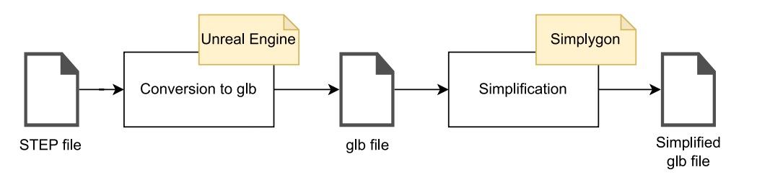
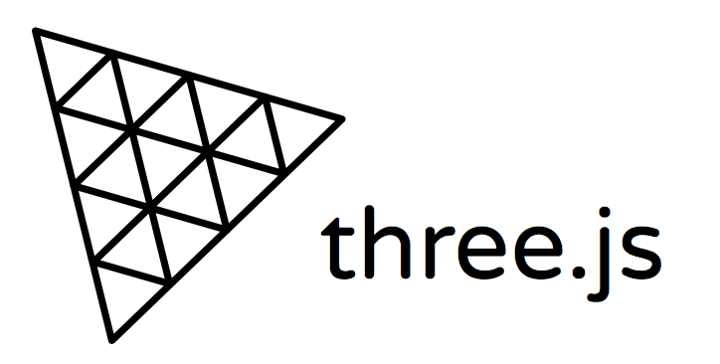
2.3. Starting Point
CAD Assistant
GLTFPack
Notes:
The starting point of the prototype is the code and pipeline left by Ricardo.
3D models of the facilities exported from CATIA are converted using a program like Unreal Engine or CAD Assistant.
They are then simplified by another program given a simplifcation target, e.g. reduce to 20% of the original size.
Ricardo used another program to make the simplification which does not have a free license anymore. In its place I am using an open source program called GLTFPack.
Then the model is simplified. Simplygon used to be a good choice for this, but since it is now paid, GLTFPack is a good open source alternative.
To render the models, the tool used is a popular rendering library used to build 3D interfaces on the web called ThreeJS, which is also open source.
---
To add a new facility, some configuration files have to be created that define the models, cameras and a few other properties, but it is a one and done process. The program can then display the newly added facility.

Slide 15
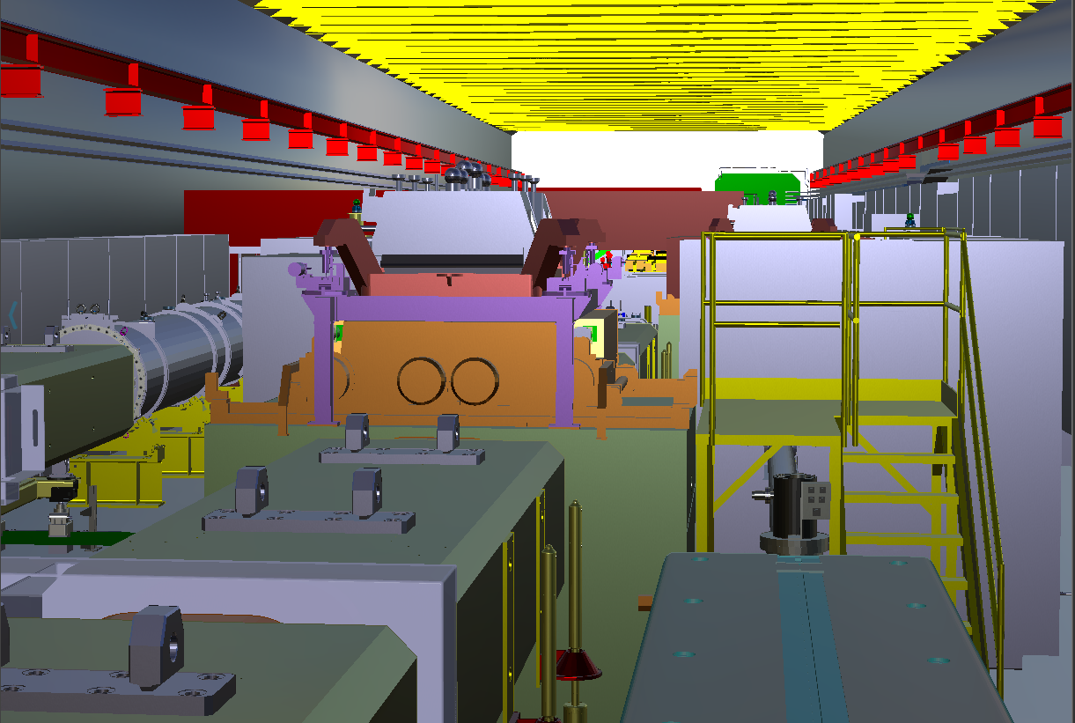
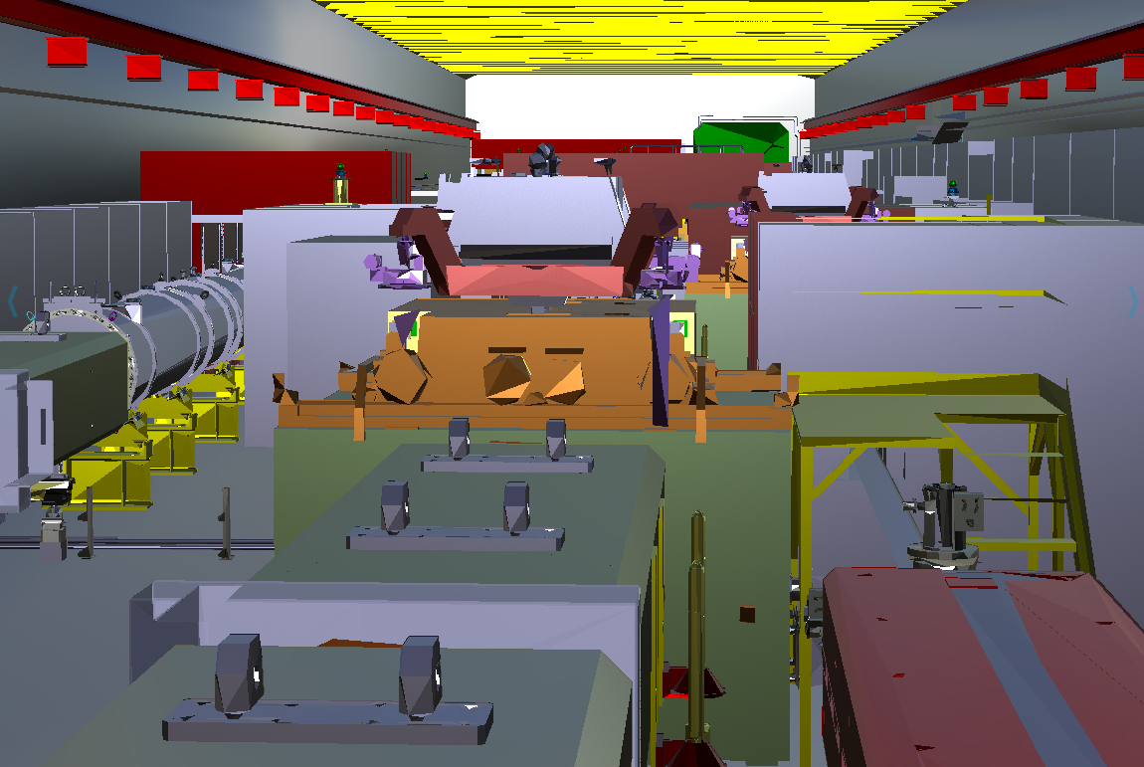
2.3. Starting Point
Original – 178 MB, 6.8m polygons
Simplified – 19 MB, 700k polygons
Notes:
The simplification process does not remove objects, it only simplifies the geometry.
It also only takes from a few seconds to a few minutes depending on the model. The simplification process itself is as simple as running a program inside a terminal with some options like the desired percentage of simplification.
It is a crucial step to be able to load them on a web browser, as the more complex a model is, the worse the performance will be.
(6.8 million polygons vs. 700k)
This can also be important for Virtual or Mixed reality applications. Using simplified models is a tradeoff between visual fidelity and the performance and interactivity of the system. In many cases, the fullest level of detail is not necessary.
In this example, the model is simplified to roughly 10% of its original size and, although some quality loss is clearly visible, the scene still retains enough detail to distinguish components of the machines.
You may notice that the stairs on the right don’t look great, that is because the same level of simplification was applied to the entire model. Setting different targets depending on the objects or sizes, for example, is a possibility, but one that I did not explore much.

Slide 16
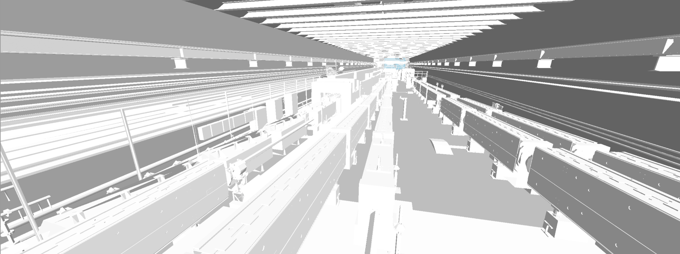
2.3. Starting Point
Notes:
One of the first things I did was follow the previous steps for TCC2 in the North Area of CERN.
I simplified two models: one representing what is installed today and the other was a study model showing what will be installed after LS3.

Slide 17
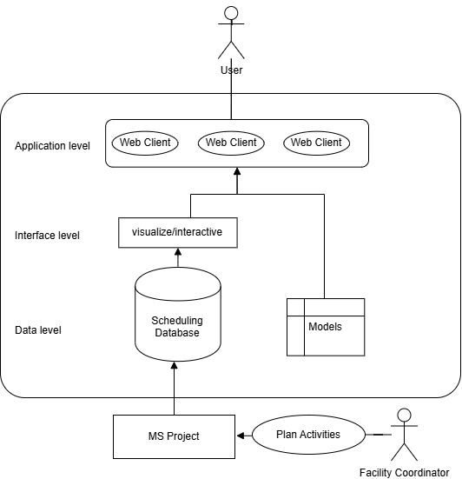
2.4. Task Information
Notes:
This is a representation of the flow of information.
The users of the platform do not have to input anything to visualize the tasks. The tasks are created on MS Project as usual and then they will be available in the visualization platform.
Again, the models are colored automatically. The main information being displayed are the tasks present in MS Project that are synchronized with a database and are then acessed via an API.
Those tasks are associated with componentes of the 3D model.
This is a way of centralizing information regarding the 3D models themselves and their tasks so that people dont have to consult many diferente tools to find the information they need.
However, this is just one exemple of an application that can be done. The information could come from anywhere else, another API, another database, multiple databases, another tool, JIRA, etc.

Slide 18
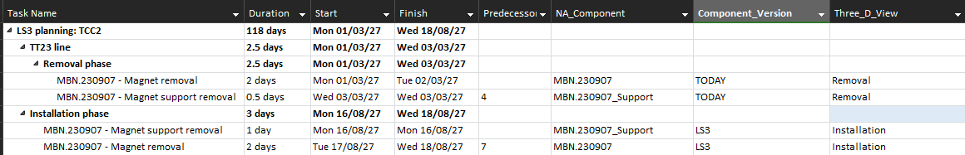
2.4. Task Information
Equipment name
Model version
Task type

Slide 19
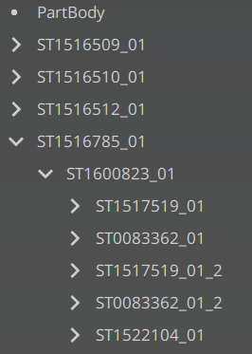
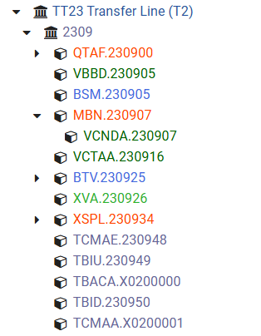
2.5. Challenges
≠
Structure of the TCC2 3D model
Some of the equipment in TCC2, from layout
Notes:
We faced some challenges associating the information received from the database with the componentes of the 3D models, here what is important to note is that if you want to display something about one part of of the model, like one machine inside the previously shown TCC2, it is very importante to have the 3D model structured in a way that allows the lookup of specific parts.
That includes having unique names for the equipments.

Slide 20
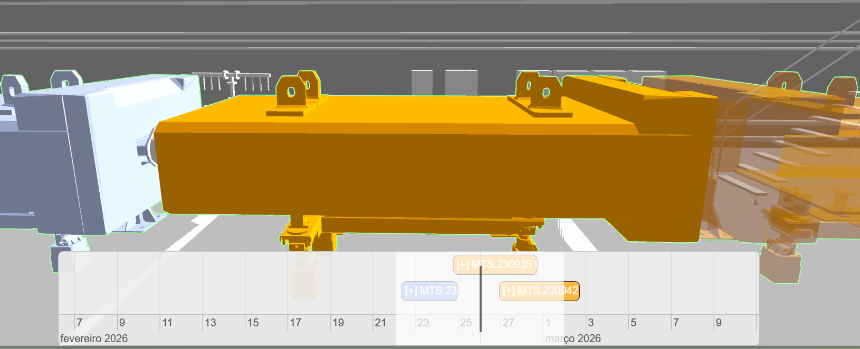
2.6. Technical Remarks
1
2
3
2
1
3
Notes:
The time window mechanism [or Temporal Degree of Interest Mechanism] works like this: - based on the proximity from the task interval to the "central" moment of the window, a value (from 0 to 1) is calculated to adjust the color or transparency of the objects.
These are installation tasks. Task 1 has already finished and has a brighter color indicating recency.
Task 2 is ongoing – the equipment possesses the exact color of the task.
Task 3 is starting soon, as indicated by the transparency effect.

Slide 21
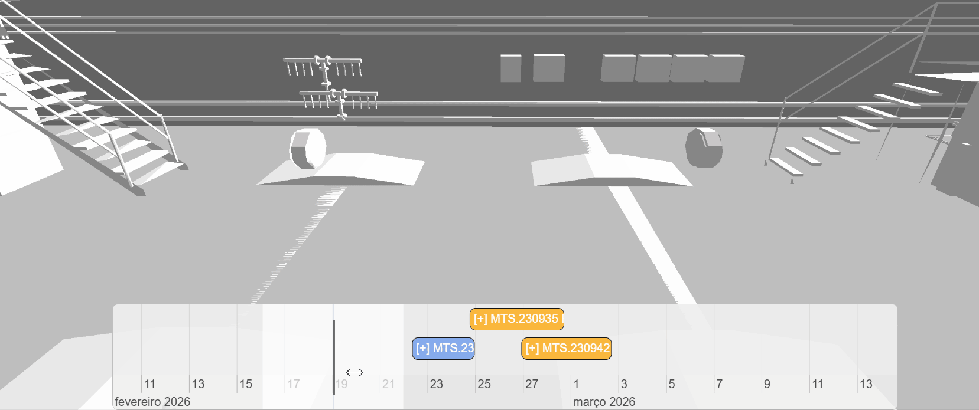
2.6. Technical Remarks
3
Notes:
In this example, only installations are shown. As the window begins to intersect a task, na equipment appears and goes from fully transparente to fully opaque until the middle bar of the window reaches the task interval.
It remains opaque for the duration of the task and as the middle bar starts to leave the task the color gets progressively whiter.
Removals have these effects in reverse
This is tool is also expected to be useful take precaution against unfavorable conditions. For exemple, according to the planning examplified there are tasks occurring simultaneously in adjacente equipment. This may actually be na issue, and it is easier to detect visually than by just looking at rows in a table.

Slide 22
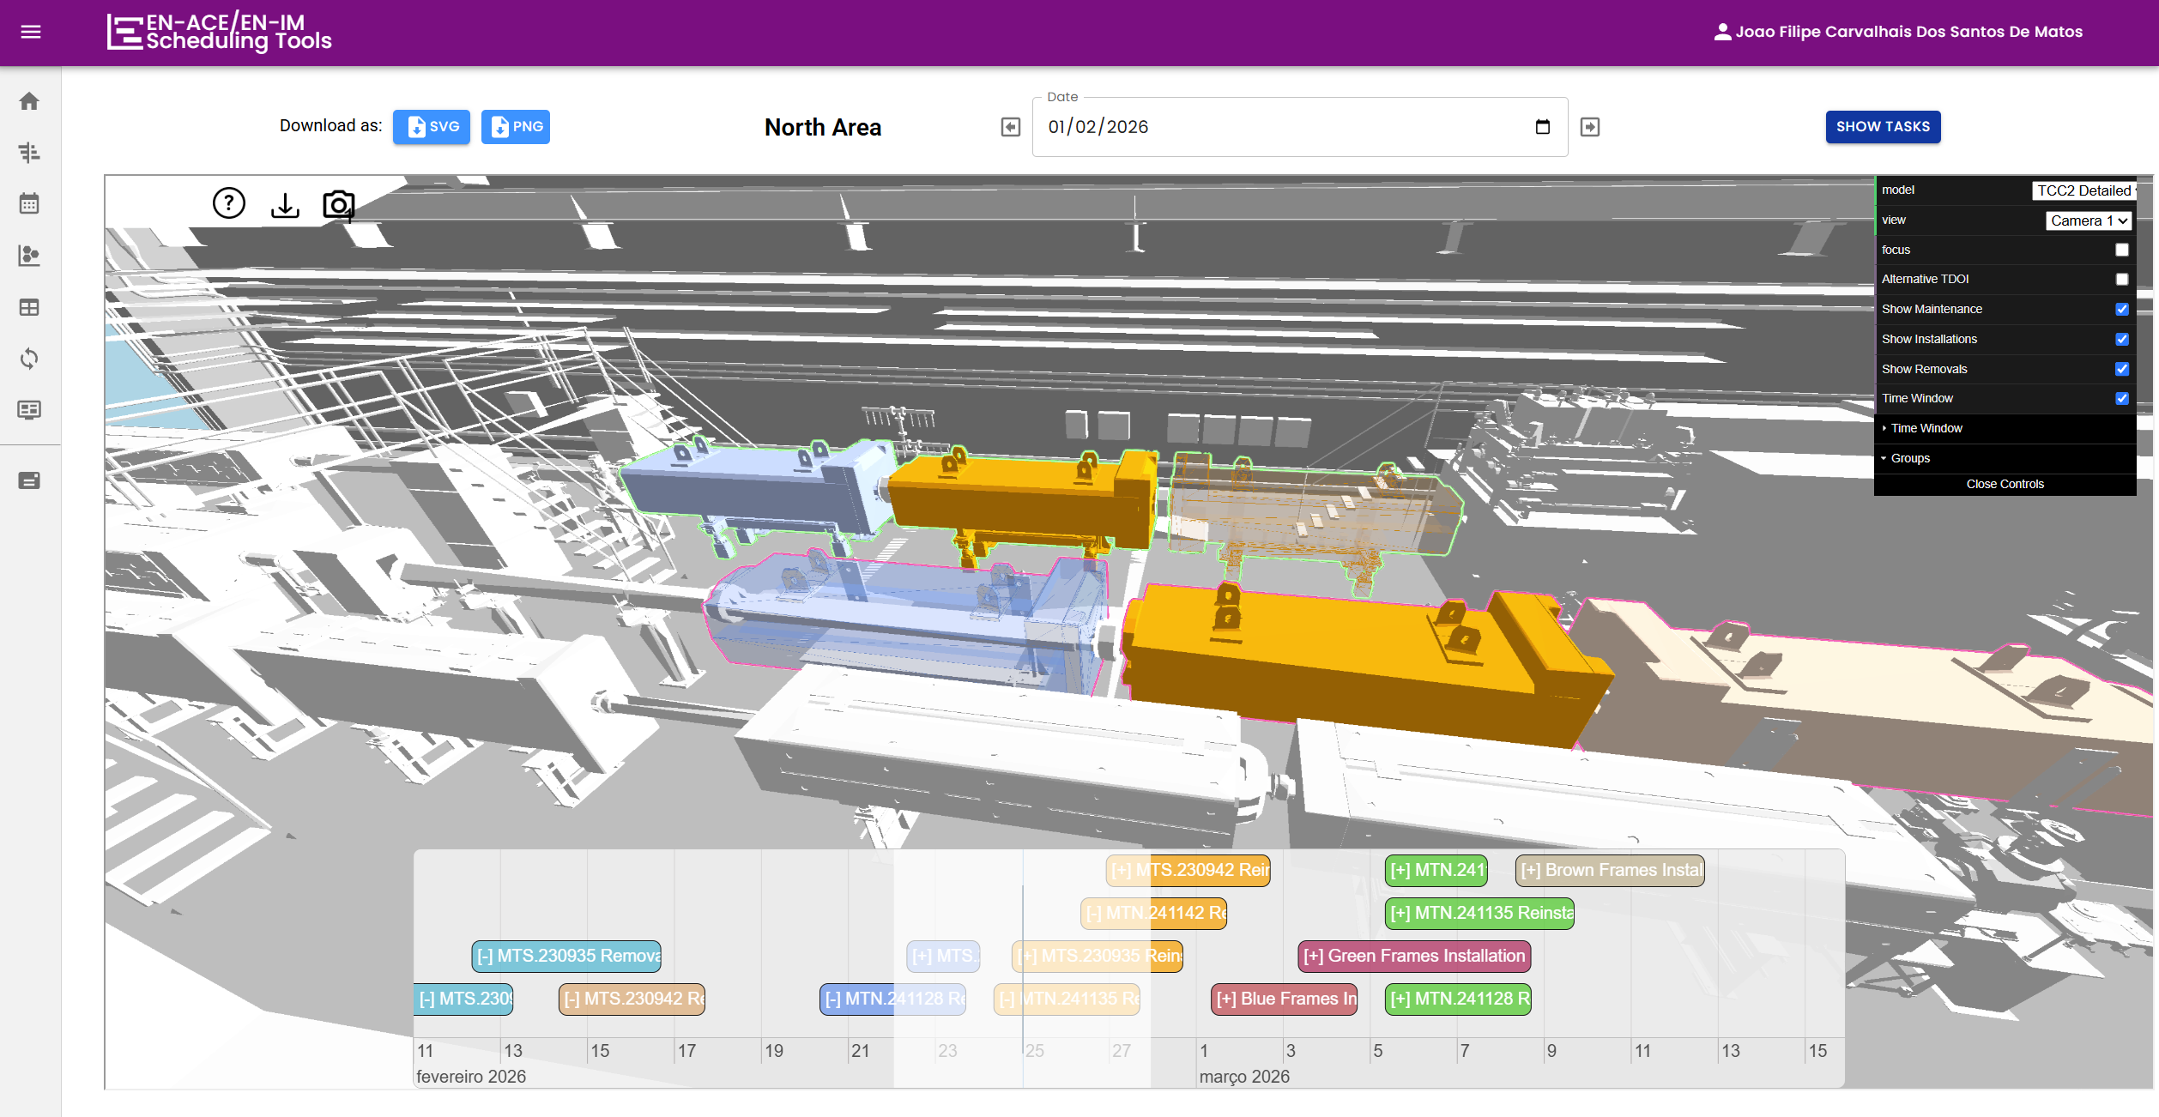
2.7. Current Status
Notes:
In March, when I arrived at CERN, I already had a working prototype where I could make componentes appear and disappear from a model of TCC2.
In the meantime, I adapted the old code from Ricardo to support this new feature and I started working on the time window mechanism.
As of today, the main features are already developed and I am fixing bugs and making adjustments to improve the user interface and usability. Last week, I started perfoming user tests to evaluate the system’s usability and gather feedback.
As of today, the main development is finished.

Slide 23
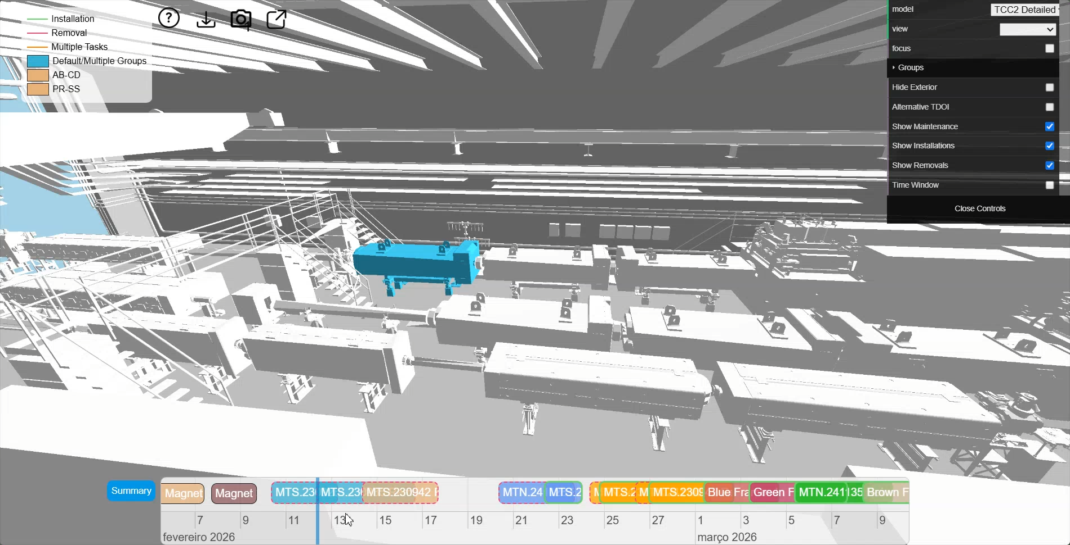
2.7. Current Status
Notes:
…

Slide 24
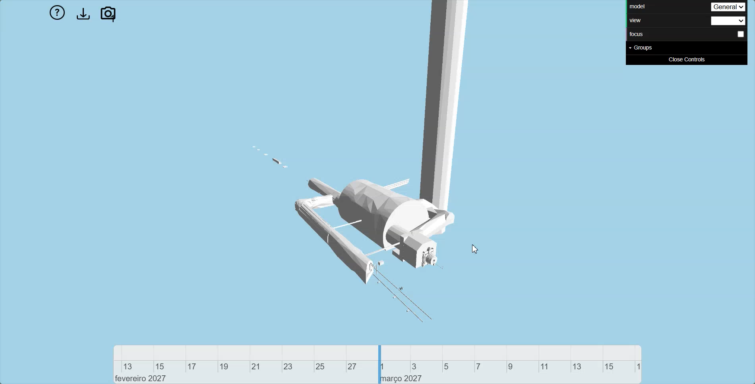
2.8. Using Larger Models
Notes:
To test the scalability of this program for larger facilities, we tried using some models from HighLumi-LHC and the conclusion is actually not new:
To make the application perform acceptably when we need to view models with very large file sizes and number of polygons we can just create a low detail global view that loads the detailed sections when they are selected.
Ricardo did the same thing, he had already separated the octants of the PS into different detailed models.

Slide 25
3. Validation
Notes:
During the last month of my stay at CERN, I performed usability tests and gathered feedback

Slide 26
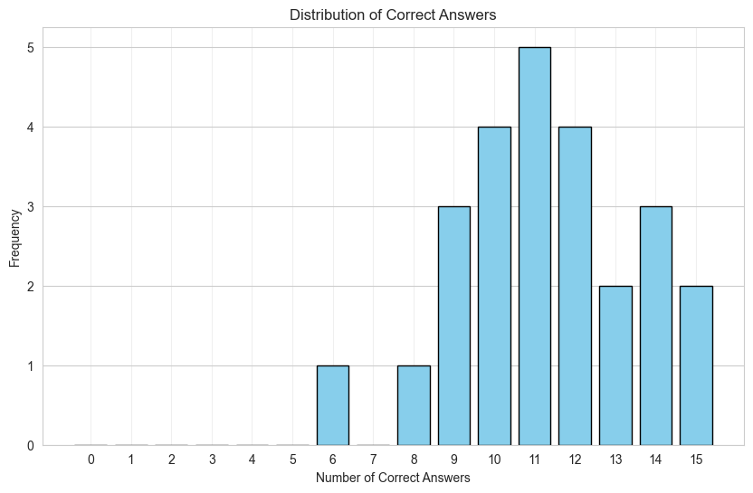
3.1. Testing
25 supervised tests
Mean SUS score: 79.4
Notes:
25 supervised tests were performed .
Each test consisted of a 15 task questionnaire, a System Usability Scale questionnaire and some other questions to understand the preferences of the participants.
The mean System Usability Scale score is 79 . According to one of the common interpretations of this scale, 79 is good even if not excellent., which means there is still room for improvement,
But, it means that it is already usable. From the feedback received, in general, the participants found the tool useful and interesting.

Slide 27
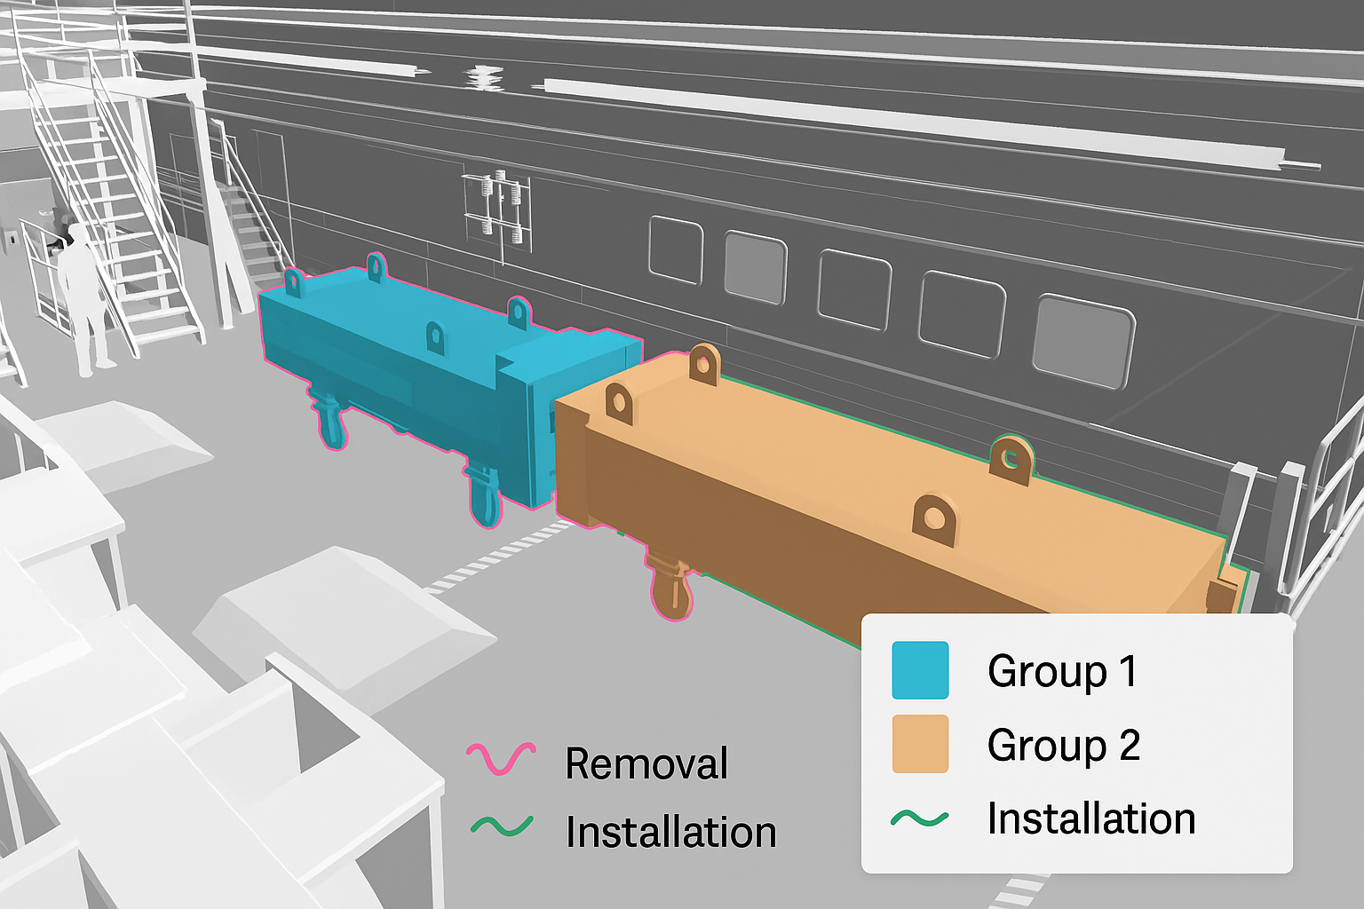
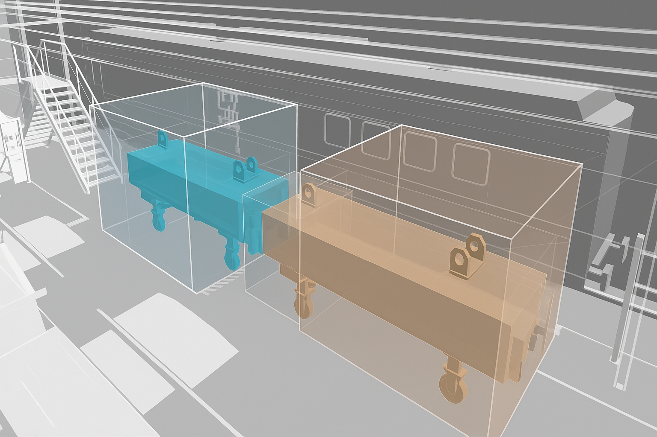
3.2. More Options
Displaying other relevant information
Adding more visual elements
Notes:
I showcased today a specific application of the usage of 3D models in na interactive environment but I want to make it clear that if it is possible to create a tool with evolving models to display ongoing tasks, it is also possible to display whatever information you want. Maybe you are more interested in interacting with the 3D model and selecting equipment and inspecting details like materials, procedures, manuals, that is absolutely possible to create!
And maybe you would like to directly manipulate the objects, add new visual elements, change properties, etc. That is possible aswell and you can combine data sources like databases, APIs, files, …
This type of tool is directed at the laymen who dont need have any background with computer models or other specific tools. The infomration comes to the users in a way that is easy to find, see, and understand.

Slide 28
Notes:
Thank you very much for your attention!
I am open to any questions.

Slide 29
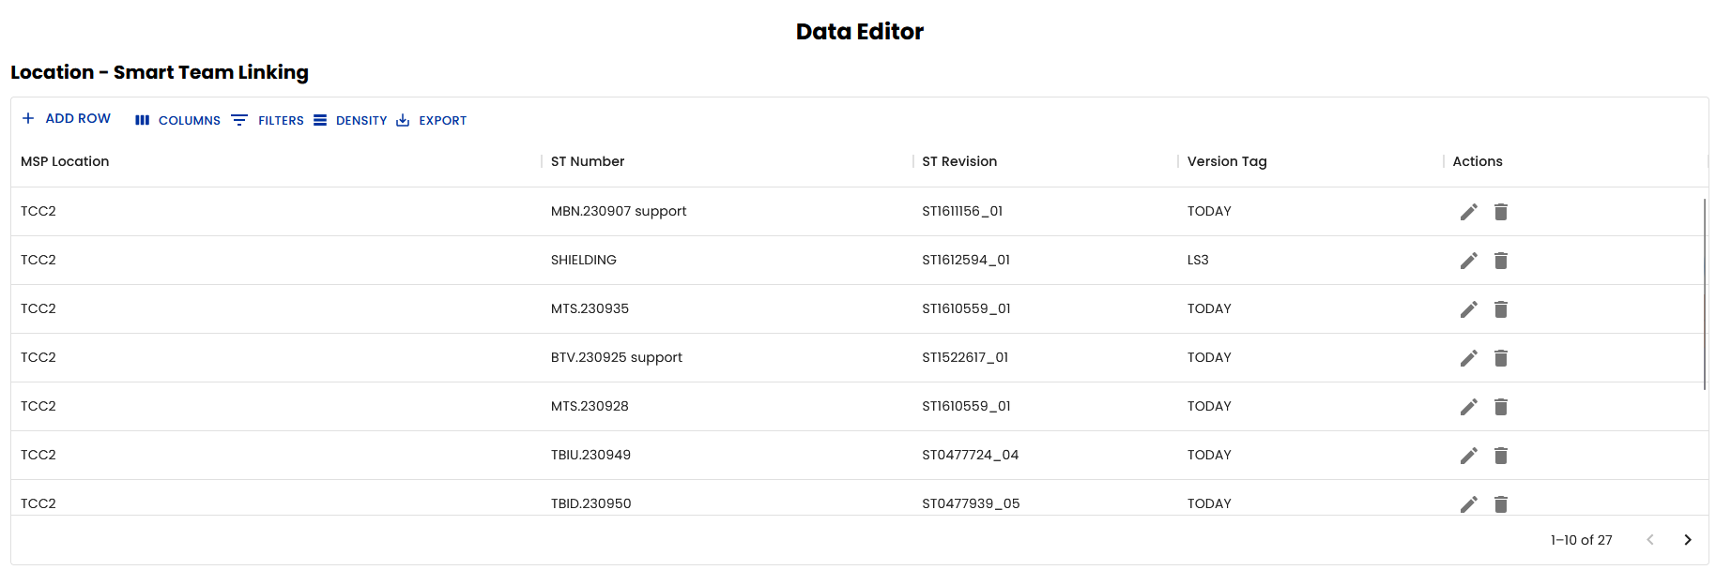
A1 – Link With Layout

