Slide 1
HENAPIX
HEat pipe NAno Fiber PIXel detectors
Fabrizio Palla
INFN Pisa

Slide 2
Abstract
HENAPIX (HEat pipe NAno Fiber PIXel detectors) is a multi-institutional R&D initiative focused on developing a self-cooled, ultra-lightweight mechanical structure for silicon pixel sensors in next-generation high-energy physics (HEP) detectors, such as those foreseen for the Future Circular Collider. The project addresses the growing thermal demands imposed by localized power densities reaching 1 W/cm², particularly for high speed alectronics and timing detectors with high channel count. HENAPIX proposes a novel cooling approach based on an integrated nanofibre-enhanced heat pipe system, constructed from few 100 µm carbon fibre envelopes embedded with high-capillarity nanowires (~200 nm diameter). The targeted structure aims to remove ≥1 W/cm² across several cm² while preserving a material budget below a fraction of a percent X₀ per layer.
The project is organized into four work packages: WP1 develops high-fidelity CFD/CHT simulations incorporating capillary action and phase-change phenomena to determine optimal design parameters; WP2 fabricates and characterizes nanofibre tissues via electrospinning, evaluating morphology, thermal conductivity, and radiation hardness; WP3 handles mechanical integration, module sealing, and prototype assembly; and WP4 validates system performance through thermal and mechanical stress testing. HENAPIX directly contributes to low-mass, high-performance vertex detector technologies for future collider experiments.

Slide 3
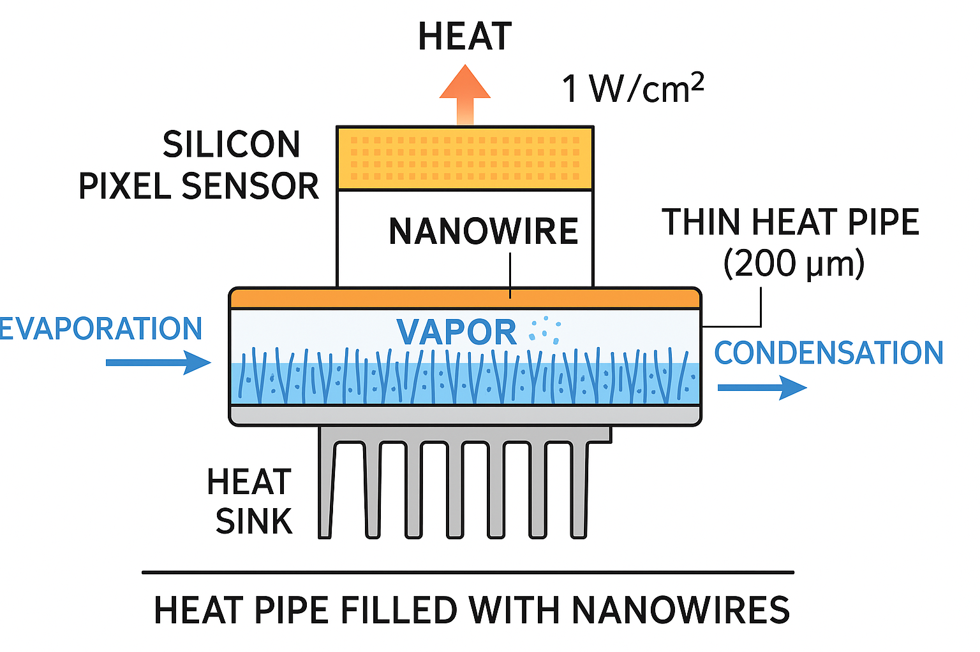
Heat pipe as “supeconductor” of heat
A heat pipe is a device with very high thermal conductivity
Up to now two-phase heat-transfer devices such as cylindrical heat pipes (HPs), planar (i.e., flattened heat pipes (FHPs) and vapor chambers (VCs) have been widely used for the thermal management of high-power density electronic devices such as desktop computers, laptops, spacecraft components, and LED modules and provide temperature uniformity and eliminate local hotspots generated in such devices.
The reason is the heat transfer capabilities of such passive cooling devices with heat pipes exhibiting thermal conductivities up to 100.000 W/m K in theory, whereas for solid copper thermal conductivity is approximately 390 W/m K.
The need for thin (<1mm) or ultrathin (<500 µm) and flexible vapour chambers (UTHPs) has seen developments using micro- and nano-fabrication devices

Slide 4
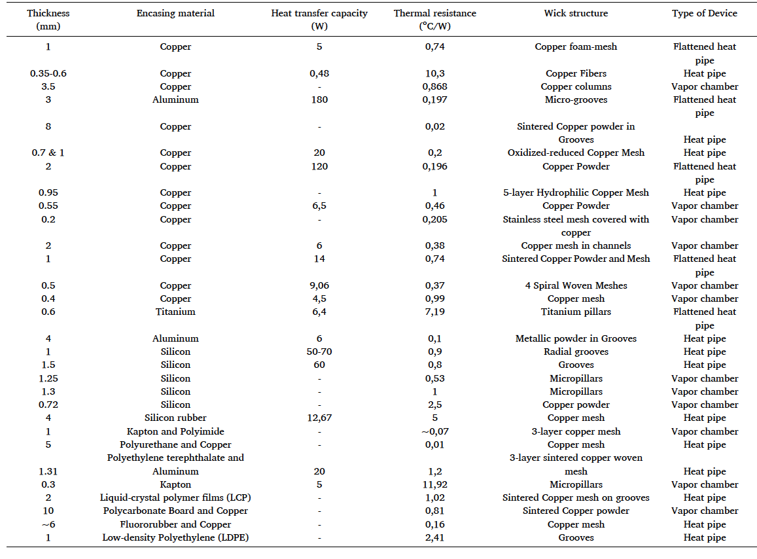
Review of methods used

Slide 5
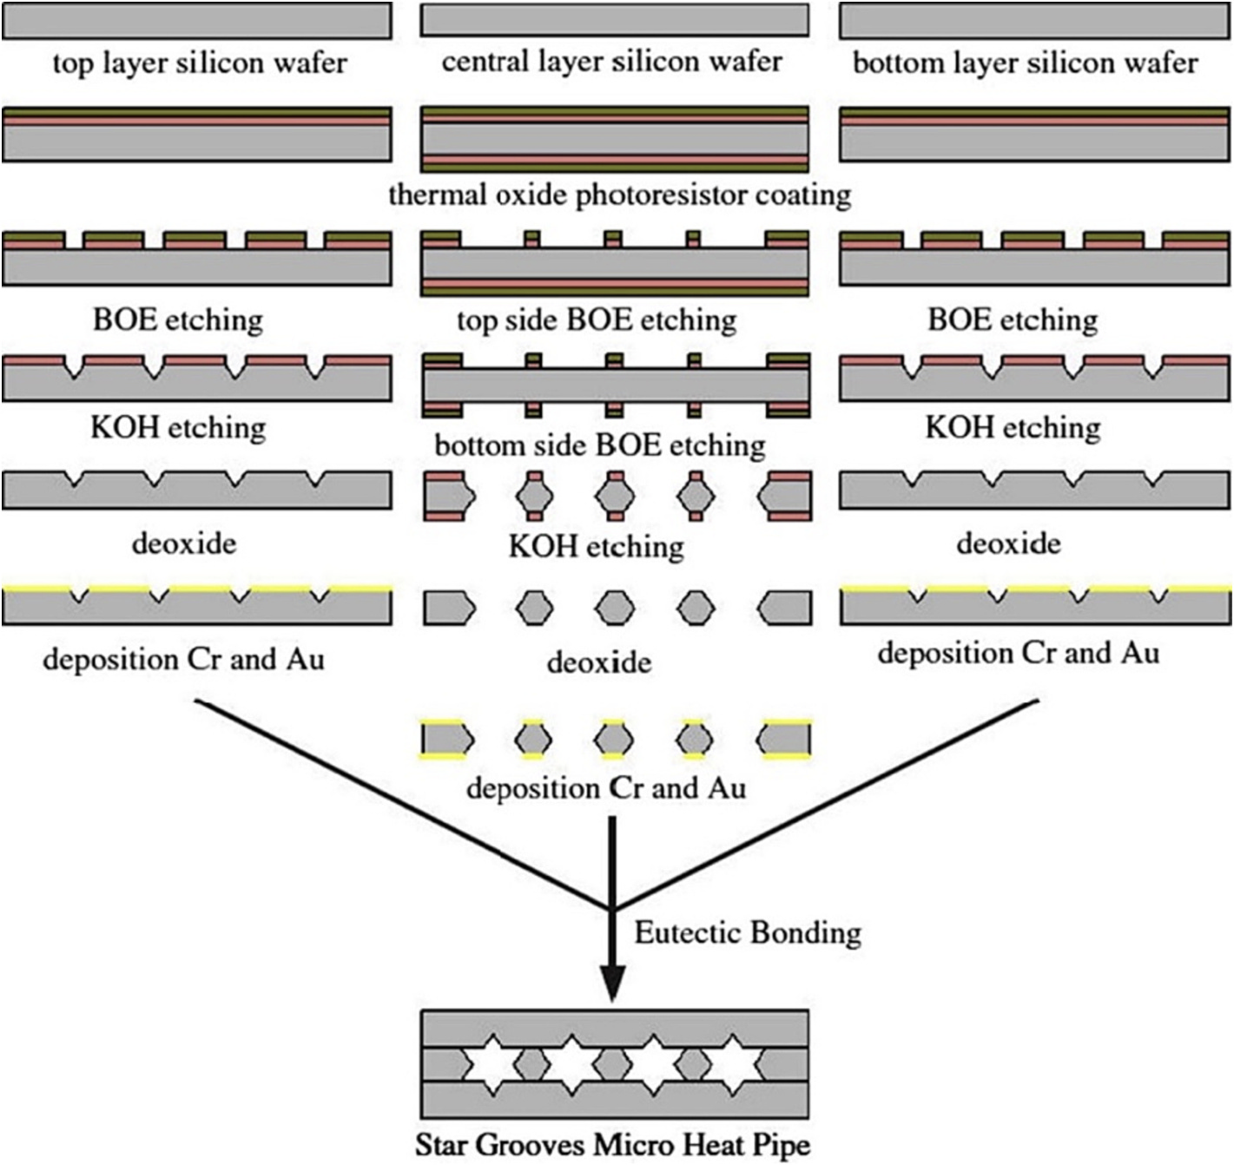
Silicon as an advantage (compared to metallic VC/HP)
Plus
  The compatibility of silicon micro heat pipes with the coefficient of thermal expansion (CTE) of numerous electrical components, as well as their mechanical properties and the availability of various working liquids, renders them a promising option for heat dissipation.
  Can use DRIE process
Minus (from the past experience)
  Channel clogging
  Corrosion
  Leakage

Slide 6
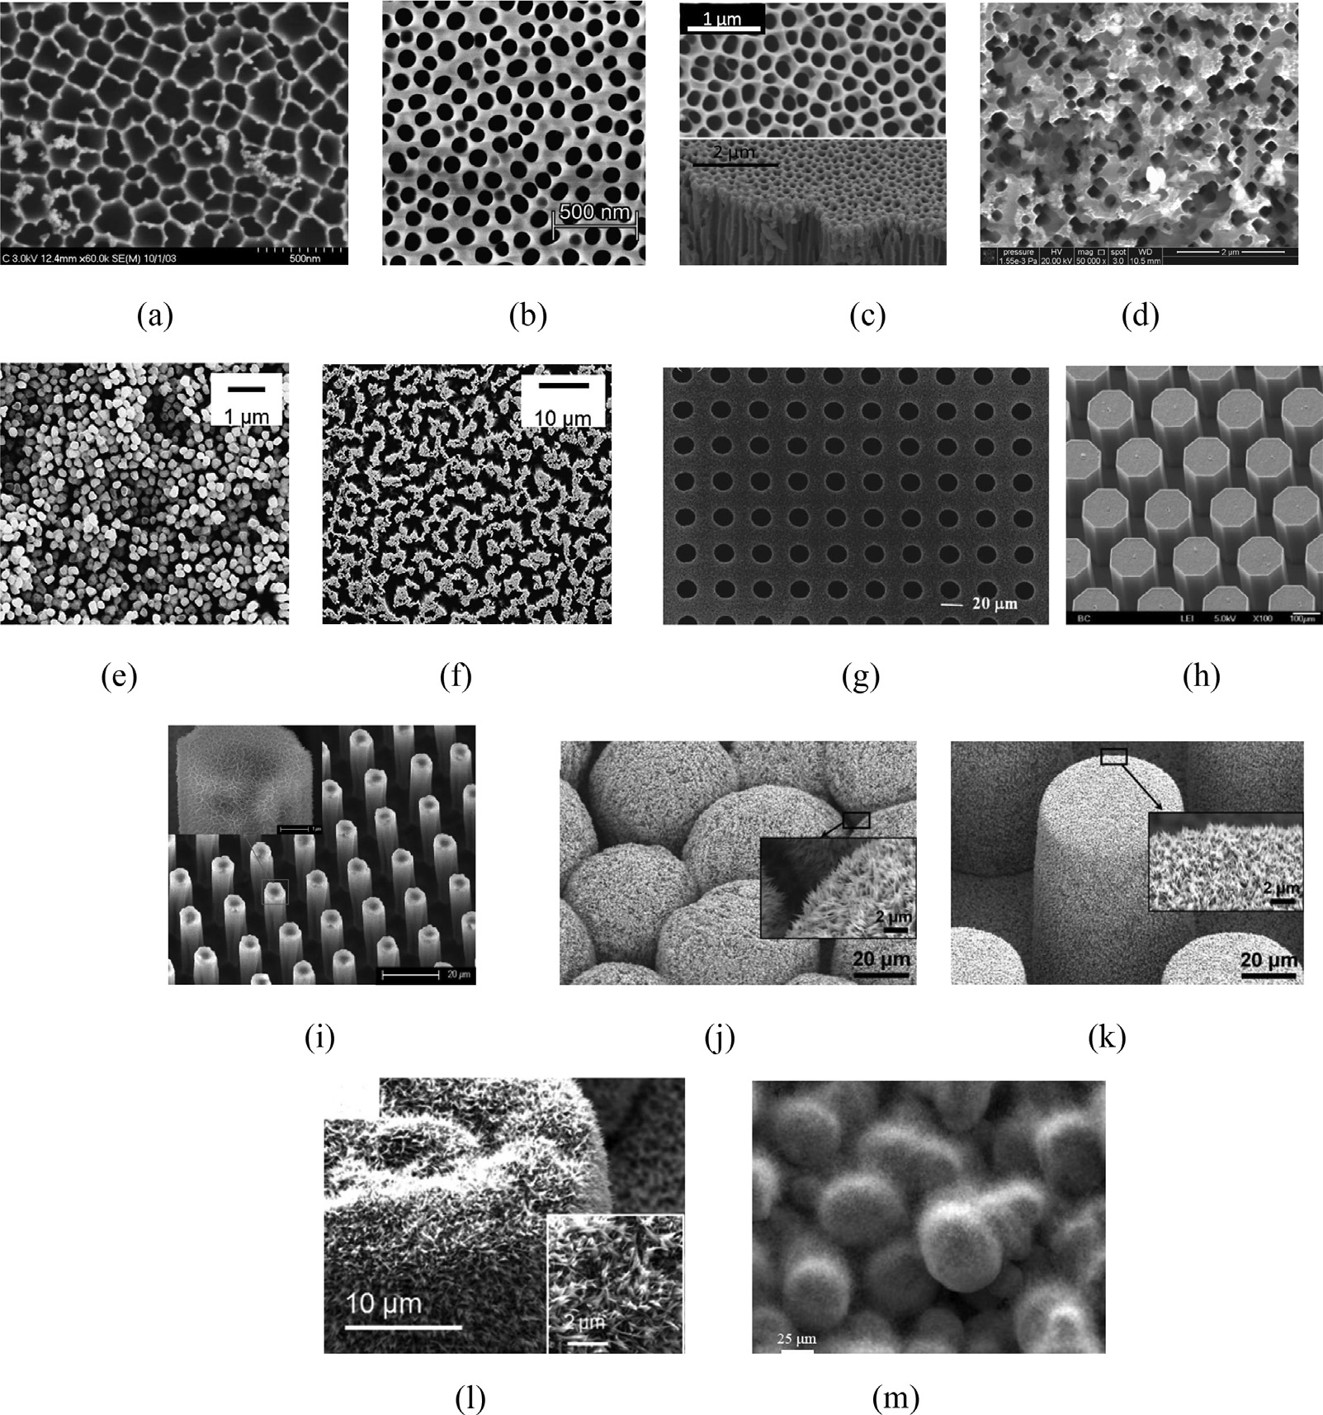
Nano structures
Fabrication of MEMS VC with CNT or nanowires has been already demonstrated in several research with different results
  Important issues were linked to the permeability of the nano-arrays
  Bio-inspired wick structures can solve the problem

Slide 7
Advantages
Compared to microchannel
  No need of connections for fluid nor piping
  More efficient thermal conductivity
  Less material budget
Compared to “traditional” CO2 bi-phase
  No need to go to -30 ºC
  No need of connections

Slide 8
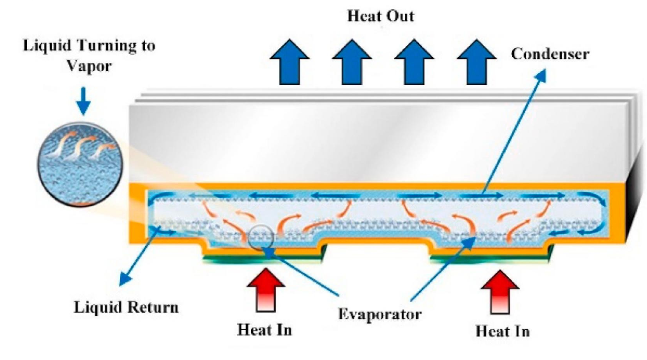
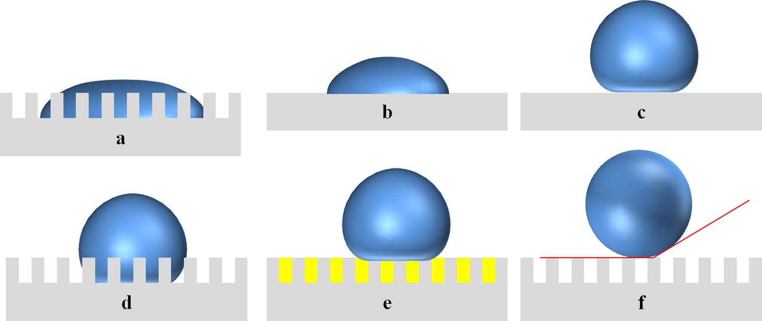
Project rationale
Flattened heat pipes (vapour chambers) with fibres
  Sintered wick structure made of nanofibres
    Hydrophilic to absorb water
    Hydrophobic to repel water
  Liquid water stays in the hydrophilic section, while it is repelled from the section with hydrophobic fibers
  Water vapour is then transferred to the hydophobic section where it condensate.
Fibres will have a diameter of ~200 nm
In a ~100 µm thickness we could have hundreds of fibres with high capillarity
  Porosity of nanofibres increases capillary pumping pressure
Target power density is >1 Watt/cm²
The clear advantage of such a system is the removal of any piping in the detector area

Slide 9
System aspects
Vacuum chambers efficiently works with minimal power density. Given that the trend in sensors and electronics developments is given emphasis on reducing the power density, it is important that the simulation should determine the minimal power density of the electronics
To allow efficient condensation, one needs to study the positioning of an external plate with a fin that acts as a radiator thanks to an air flow, and to calculate the minimum surface area needed.

Slide 10
How electrospinning works
Nanofibers create a tissue
Polimeric solution feeding system
~100 mm
Liquid
+
+
+
+
+
+
+
+
+
+
+
+
Metallic needle
D~1mm
Solid nanofiber
D~200 nm
+
Up to 60kV
+ -

Slide 11
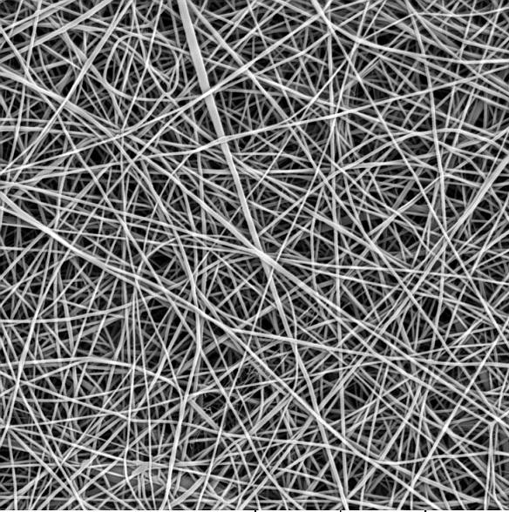
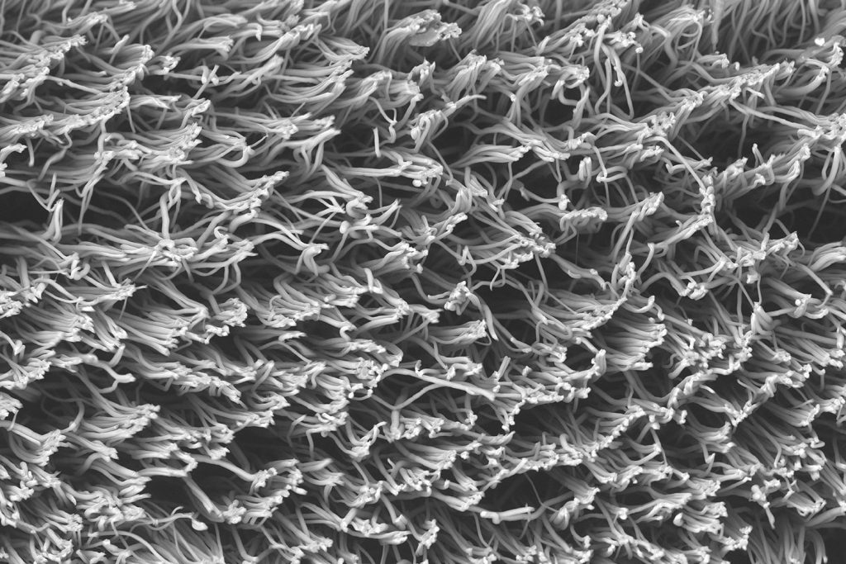
Nano composites at tissue scale: stacked materials
Top View
Double layer nanofibers in a sealed cooling channel
Cross section View

Slide 12
References
https://www.linarinanotech.com/
https://doi.org/10.1016/j.mne.2023.100235 (and references therein)
https://doi.org/10.1016/j.ijheatmasstransfer.2017.03.034.

