Slide 1
Present and future of
IR4 Optics
R. De Maria
Thanks to F. Roncarolo

Slide 2
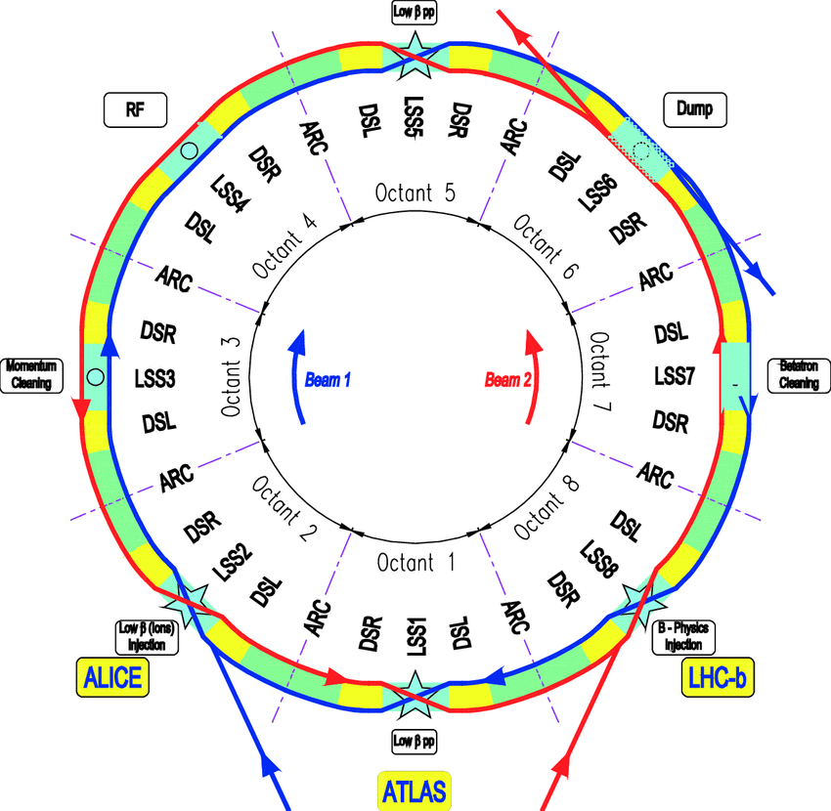
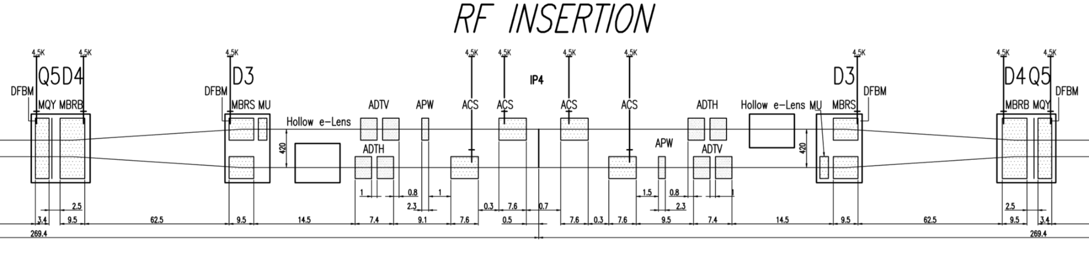
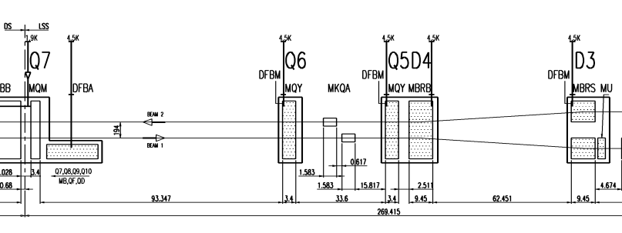
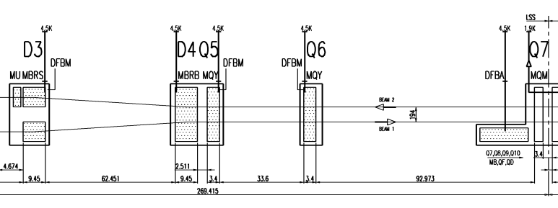
Point 4 Region
LSS4 contains the main RF and most of the special instruments. In addition, ADT BPMs are hosted in the DS.
E-lens is not expected in Run 4.
Existing
New for HL
B2
BSTMB.B2
BPLV
WS.B2
BSRTM.B2
BGC B2
BGI.B2
BQSH
BSTMB.B1
BGI.B1
BGC B1
B1
BSRTM.B1
WS.B1
BQSV
EO/BPM?
B2
BPLH
BQSH
BQSV
BPLs
BQSH
BPLs
B1
BQSV
EO/BPM?

Slide 3
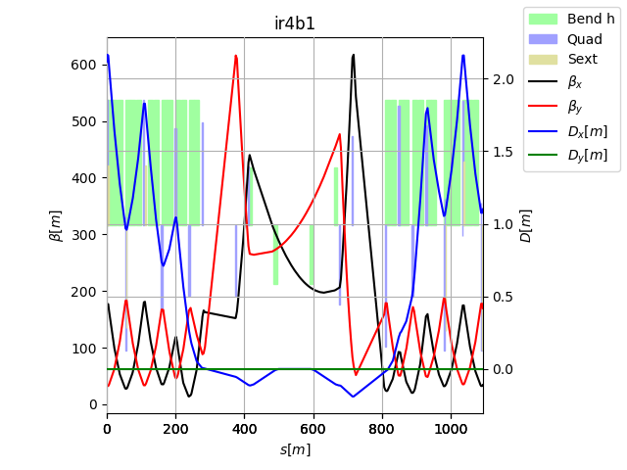
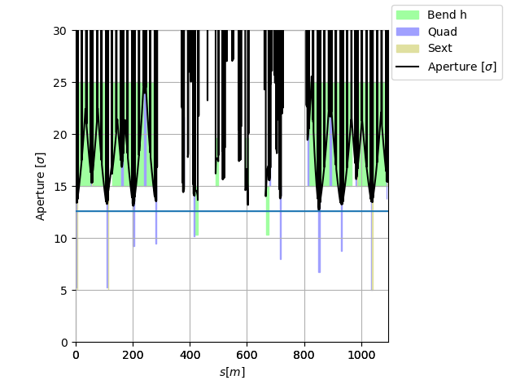
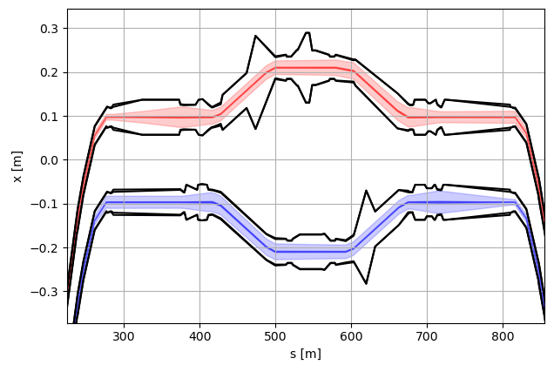
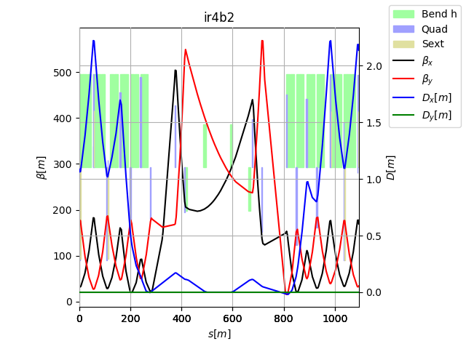
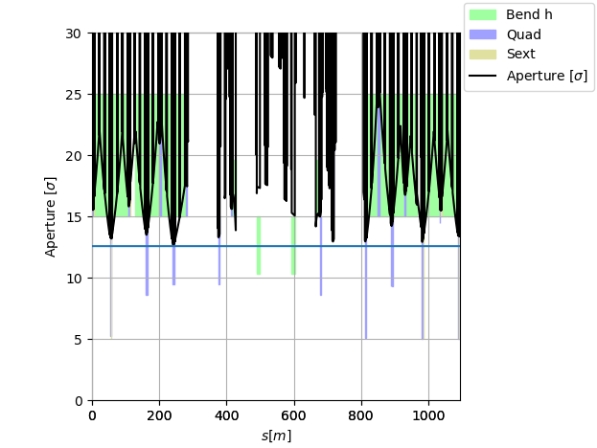
IR4 Optics: injection
The optics unit IR4 goes from Q13L and Q13R and contains 36 individually powered quadrupoles.
At injection energy, IR4 optics is severely constrained (as any other LHC insertions) by aperture constraints.
e-lens

Slide 4
IR4 Optics: Run 3 to Run 4
Still, some flexibility exists, and it was used in 2018 to build the HL-LHC version optimized for e-lens.
Elements | Pos. | LHC Run III β_{xB1} β_{yB1} β_{xB2} β_{yB2}[m] | HL-LHC V1.6/MD β_{xB1} β_{yB1} β_{xB2} β_{yB2}[m]
e-lens | D3 | 287 220 280 271 | 280 280 280 280
BSRT/I | D3 | 205 287 197 358 | 206 351 206 384
BGI | D3-4 | 324 214 314 258 | 314 270 311 263
BWS | D3-4 | 193 340 185 418 | 197 402 197 453
Type | Elem Beam 1 | Elem Beam 2 | Type | Elem Beam 1 | Elem Beam 2
BSRT | MU.A5R4.B1 | MU.A5L4.B2 | BPLH1 | BPLH.A6R4.B1 | BPLH.6R4.B2
BGI | BGIH.5L4.B1 | BGIH.5R4.B2 | BPLH2 | BPLH.7R4.B1 | BPLH.A7L4.B2
WS | BWS.5R4.B1 | BWS.5L4.B2 | BPLV1 | BPLV.B6R4.B1 | BPLV.B5L4.B2
BQSH | BQSH.7R4.B1 | BQSH.5R4.B2 | BPLV2 | None | BPLV.7R4.B2
BQSV | BQSV.5R4.B1 | BQSV.7R4.B2 | BPLX | BPLX.H6R4.B1 | BPLX.D6R4.B2

Slide 5
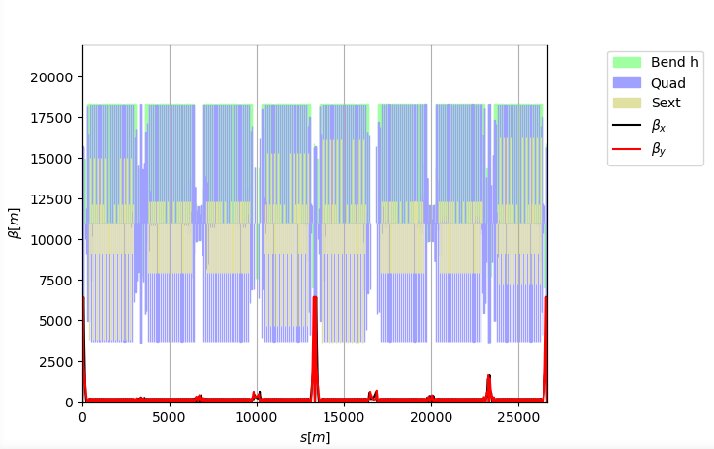
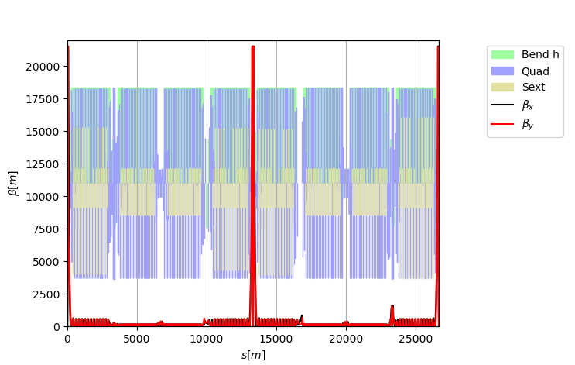
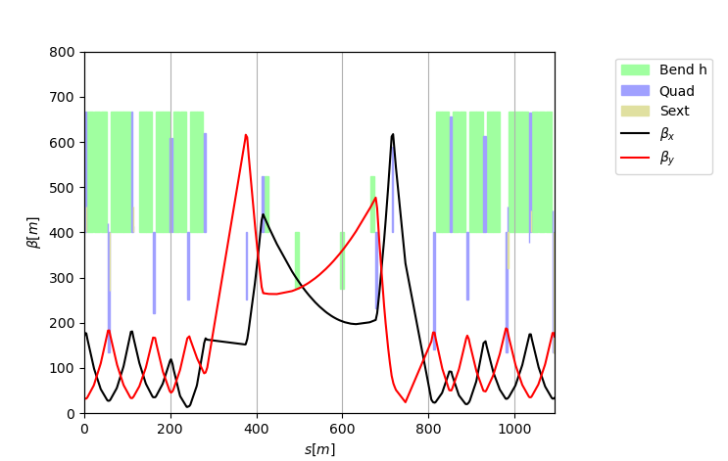
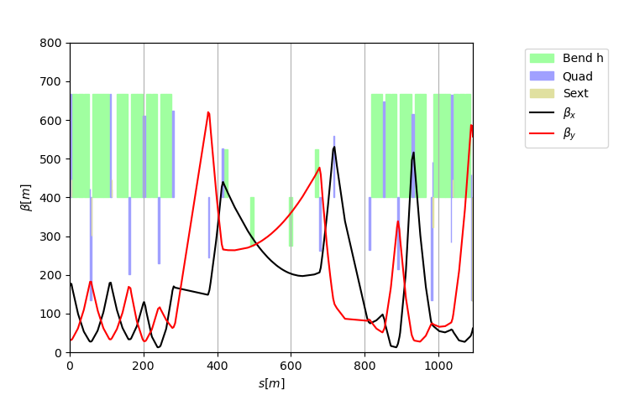
IR4 Optics: flat top constraints
β*=50cm
β*=15 cm
Going to flat top the injection constraints disappear and the optics flexibility is used
to build the ATS scheme
keep optics conditions at IP unchanged from injection to end of levelling
There is still additional optics flexibility.
Currently, is used to control the long-range phase advance constraints, in combinations with the MQTs in the arcs.
However, could also be used to further optimize the optics, in particular, if we allow changes of optics conditions at the IP.

Slide 6
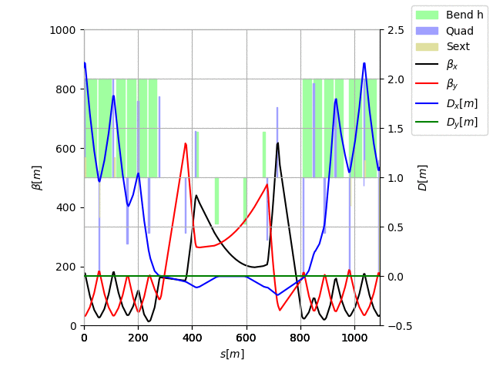
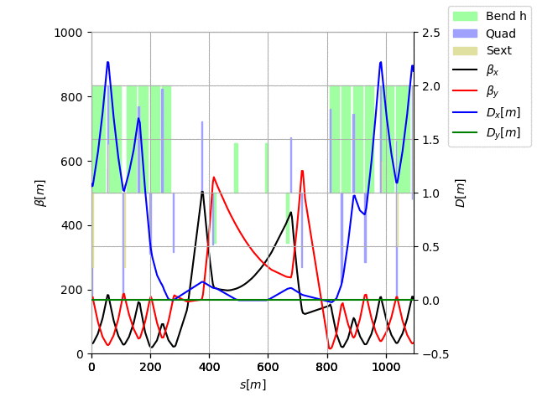


IR4 Optics: future directions
Example 1: Round large beam at elens
Few example of transitions were studied in 2018 to evaluate potential gains.
Here, a transition in LSS4 is also combined with an ATS squeeze, but one has to apply them separately.
Example 2: Round large beam at elens and BGI

Slide 7
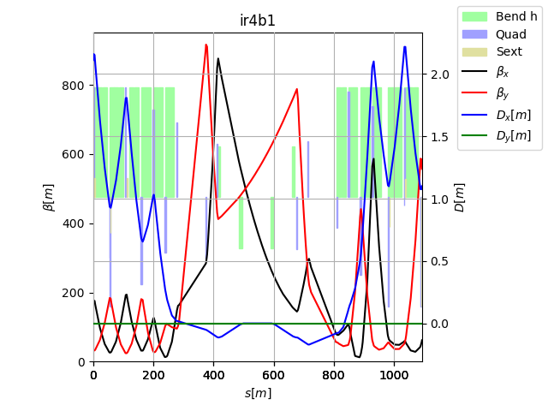
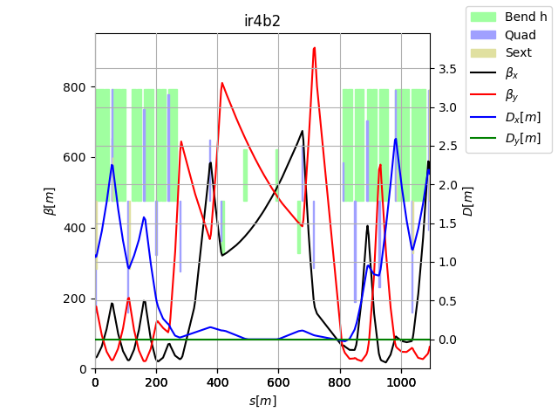
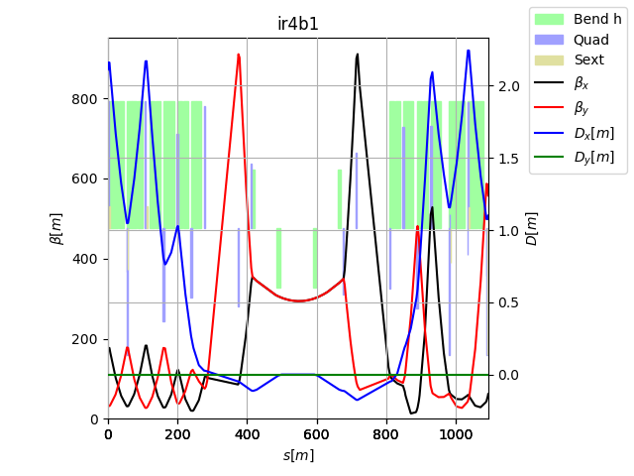
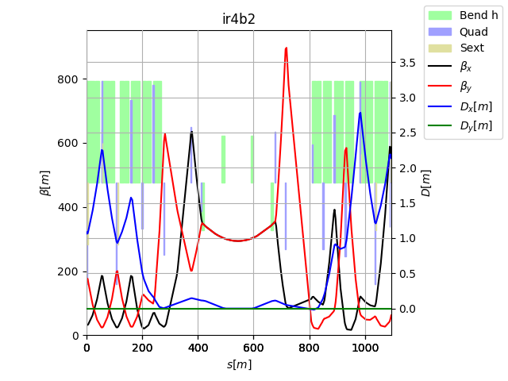
IR4 Optics: future directions
Example 1: Round large beam at elens
Few example of transitions were studied in 2018 to evaluate potential gains.
Here, a transition in LSS4 is also combined with an ATS squeeze, but one has to apply them separately.
The two examples show that it is easier to optimize one side of two planes rather than the two sides of two planes.
Example 2: Round large beam at elens and BGI

Slide 8
IR4 Optics: future directions
These examples show potential improvements.
However, the optics solutions are just a proof of concept and needs to be incorporated in a new operational cycle, which may degrade some figures.
β_{xB1}/β_{yB1} β_{xB2}/β_{yB2}[m] | Pos. | HLLHC No ramp | HLLHC Ramp elens max | LHC Ramp all round
e-lens | D3 | 280/280/280/280 | 500/500/500/500 | 300/300/300/300
BSRT/I | D3 | 206/351/206/384 | 265/624/386/634 | 300/300/300/300
BGI | D3-4 | 314/270/314/262 | 587/472/541/470 | 309/309/309/309
WS | D3-4 | 197/402/197/453 | 195/695/350/710 | 317/317/317/317
BQSH | Q5-7 | 577/ 58/405/240 | 284/211/638/417 | 864/ 76/341/341
BQSV | Q5-7 | 201/451/124/506 | 157/757/161/831 | 337/337/ 86/811
BPLH1 | Q5-7 | 543/117/396/270 | 270/303/602/453 | 809/116/316/409
BPLH2 | Q5-7 | 543/ 51/479/168 | 272/201/554/374 | 826/ 72/601/209
BPLV | Q5-7 | 260/389/201/517 | 164/678/328/777 | 425/295/338/338
BQLV2 | Q5-7 | -/-/124/483 | -/-/156/801 | -/-/ 84/780
BPLX | Q5-7 | 375/246/280/371 | 208/489/418/609 | 584/203/217/572
The cost of going in this direction is
Build a new optics cycles for round and flat optics. Study in detail implications of changing optics in LSS4: needs of recalibration, optics measurements, ADT kickers in principle ok.
An MD with pilots has been carried out already!

Slide 9
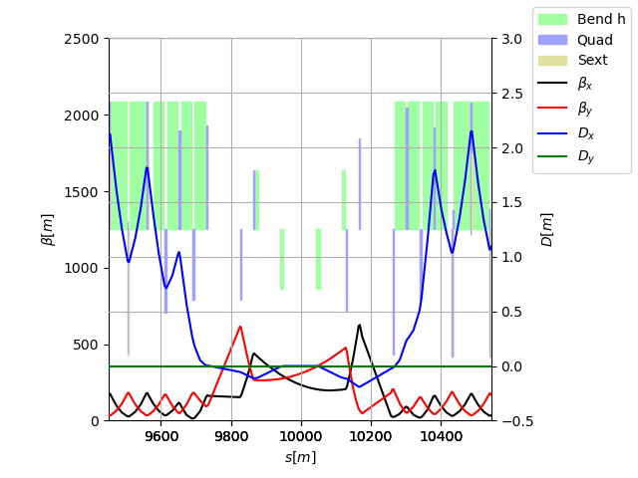
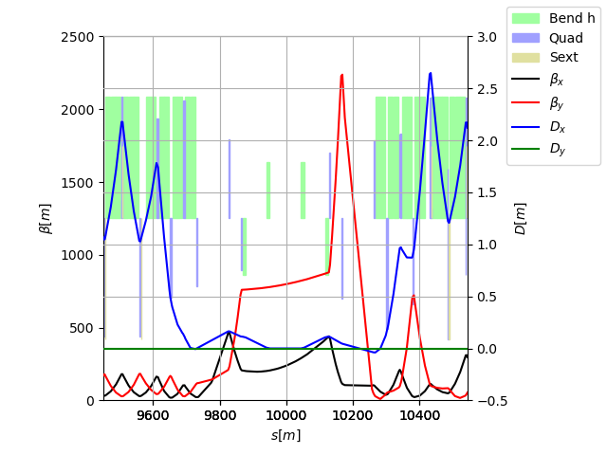
IR4 Optics MD
Inj. nominal
IR4 optics for HL was studied and optimized for BI around 2019.
At that time, it was decided not to use the aperture flexibility at high energy to increase beta* for the baseline.
Still, the option is not excluded in general and the interest for BGI, coronograph, etc.. is very high.
For the MD studies, we proposed to try to increase the beta function during a segment in the squeeze.
Proof of principle optics for machine studies

Slide 10
Conclusion
HL-LHC IR4 optics was optimized in Run 4 based on:
Largest round beam at e-lens
No optics change from injection to end of levelling as a conservative approach.
E-lens will not be likely present in Run 4, we can then displace optics flexibility towards instruments.
LHC operations is getting more and more experienced with optics transitions, we can re-evaluate the options of also changing optics IR4 optics during the ramp.
This opens a new window of optimization opportunities that could be exploited at the cost of optics development time: studies and MD time to certain extent.

Slide 11
Back-up

Slide 12
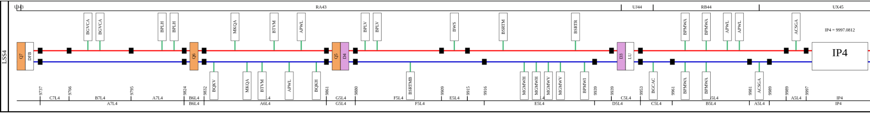
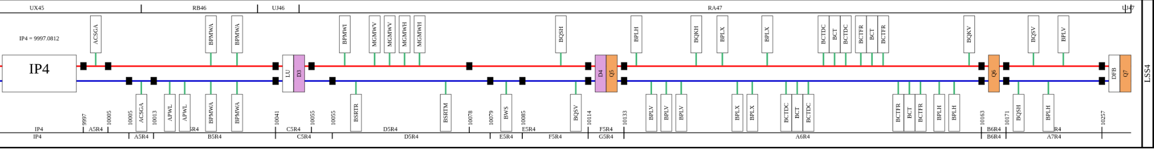
Synoptic
https://accelerator-synoptics.web.cern.ch/?machine=LHC&version=EYETS%202024-2025&region=LSS4

Slide 13
Requirements on optics
Device/ instrument | Position (from IP4) and constraints | Phase advance | Beta/beam size | Injection/flattop optics
BGI | ~ -63m (B1) | N/A | as large as possible | *
BGI for HL | one on each side – opposite beam from BSRT. (BGI B1 on L, BGI B2 on R) | N/A | as large as possible | *
BGV now | ~ -220m (B2) | N/A | as large as possible | *
BGV for HL | 1 on B2. Baseline location for HL between Q6 and Q7. Could also consider Q5 to Q6 but more crowded. | N/A | as large as possible circular beam | constant beam size throughout the cycle would be an advantage
BSRT – BSRI | ~ ±59m | 90° from crabs and -180°from IP in IP1/5 | as large as possible | *
E/O BPM | Where phase advance (Q5-Q6 easier to integrate) | 90° from crabs and -180°from IP in IP1/5 |  | -
HEL | ~ +40m (B1), -40m (B2) | N/A | as large as possible circular beam | constant beam size throughout the cycle would be an advantage
Schottky BPM BQSV & BQSH | ~ 115.3, 174.1m (B1) ~ 114, 176m (B2) | N/A | as large as possible | Orbit must be in the centre throughout the cycle*
Tune BPM BPL | ~ 138, 149, 172.7m (B1) ~ -175, -116.8m (B2) | N/A | as large as possible | *
WS | ~ ±85m | N/A | as large as possible | *
* change in beta between injection and flattop (if not too large) should be ok, to be evaluated depending on proposed optics. Beta must then be measured throughout the full cycle.

Slide 14
IR4 Beams sizes
*squeezed optics not optimized in IR4
β_{xB1}/β_{yB1} β_{xB2}/β_{yB2}[m] | Pos. | LHC Run I | LHC 2015-16 | LHC 2017 | HLLHC <=V1.3 (inj*)
e-lens | D3 | 271/ 94/224/228 | 280/250/283/206 | 287/220/278/272 | 232/212/281/263
BSRT/I | D3 | 178/191/128/332 | 204/317/201/327 | 205/287/190/356 | 136/270/191/365
BGI | D3-4 | 314/ 96/273/213 | 316/242/321/188 | 324/214/318/259 | 279/208/321/245
WS | D3-4 | 165/288/124/405 | 195/368/189/411 | 193/340/178/414 | 130/320/178/435
BQSH | Q5-7 | 469/129/406/198 | 483/126/419/171 | 459/129/421/247 | 426/ 92/425/226
BQSV | Q5-7 | 169/388/138/459 | 198/418/151/372 | 194/393/130/543 | 142/371/130/491
BPLH1 | Q5-7 | 434/175/416/229 | 455/173/415/195 | 443/169/416/283 | 400/135/420/256
BPLH2 | Q5-7 | 448/126/399/166 | 460/123/460/182 | 431/128/433/152 | 403/ 89/431/165
BPLV | Q5-7 | 216/386/139/474 | 245/384/191/493 | 239/365/180/470 | 193/337/180/500
BQLV2 | Q5-7 | -/-/138/440 | -/-/151/358 | -/-/130/519 | -/-/129/470
BPLX | Q5-7 | 304/279/297/323 | 331/278/302/268 | 323/266/294/394 | 277/234/296/356
Type | Elem Beam 1 | Elem Beam 2 | Type | Elem Beam 1 | Elem Beam 2
BSRT | MU.A5R4.B1 | MU.A5L4.B2 | BPLH1 | BPLH.A6R4.B1 | BPLH.6R4.B2
BGI | BGIH.5L4.B1 | BGIH.5R4.B2 | BPLH2 | BPLH.7R4.B1 | BPLH.A7L4.B2
WS | BWS.5R4.B1 | BWS.5L4.B2 | BPLV1 | BPLV.B6R4.B1 | BPLV.B5L4.B2
BQSH | BQSH.7R4.B1 | BQSH.5R4.B2 | BPLV2 | None | BPLV.7R4.B2
BQSV | BQSV.5R4.B1 | BQSV.7R4.B2 | BPLX | BPLX.H6R4.B1 | BPLX.D6R4.B2

Slide 15
Small aperture structure
W. Hofle asked for an aperture restriction to fit a small aperture structure (High-BW pickup).
Best location for round structure as close as possible to the e-lens:
β_{x} and β_{y} ~280 m at injection
Beam size (12.6 σ + tol. ) ~20 mm (radius) instead of 26 mm (e.g. in ADT)

