Slide 1
Beam Halo Measurements in Run2 and Run3 - Status and Prospects
C.E. Montanari, M. Giovannozzi, P. Hermes, M. Rakic, S. Redaelli
HL-LHC Beam Halo Monitor Review - 18 December 2024

Slide 2
Outline
Introduction: LHC collimation and the halo problem
Beam Halo - Measurement methodology
  Collimator scraping and calibrated BLM signal
  Bunch-by-bunch visualization via fastBCT
Beam Halo - Recent observations
  Recall of Run2 and Run3
  Correlation with e-cloud
  Slow repopulation
  Influence from BB effects and observed differences with BBCW
Ongoing modelling efforts
  Global diffusive models
  Chaos indicators for single-particle tracking
  Investigations at injection

Slide 3
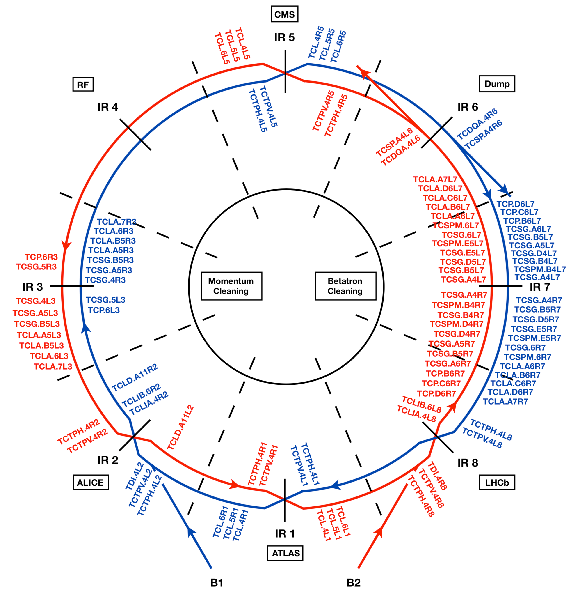
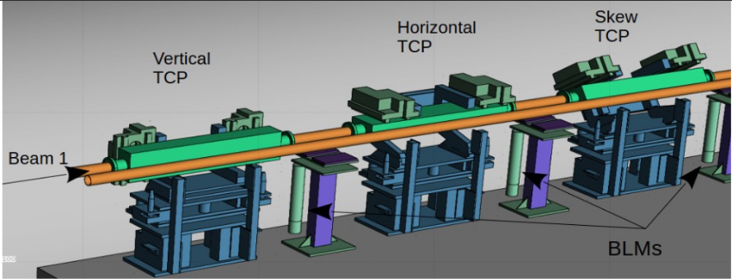
The LHC collimator system
  Multi-stage system
    Betatron cleaning in IR7
    Momentum cleaning in IR3
    Local protection of triplets and experiments
  Critical for machine protection and background mitigation
  Multiple challenges for HL-LHC intensities
    Doubling of the bunch population
    Total stored energy of 678MJ per beam
    Higher impedance expected
    No hollow electron lenses to mitigate the halo
Overview of the LHC collimation system

Slide 4
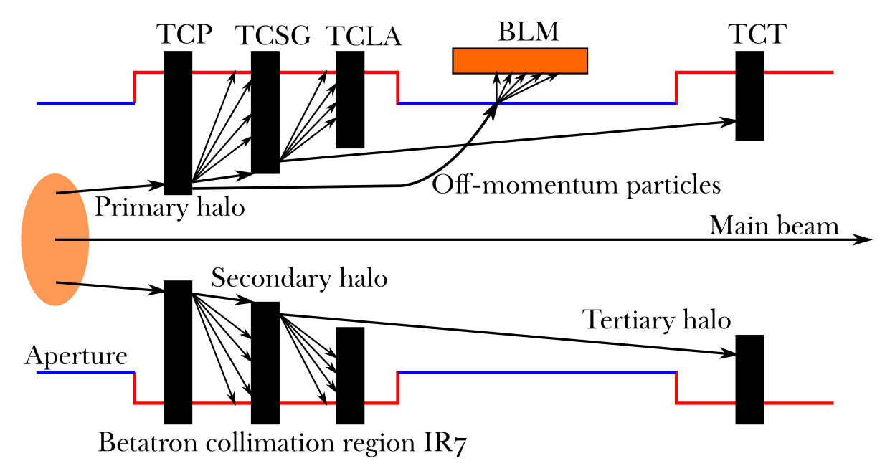
The LHC collimator system
  Different collimation types for different purposes
    Primary collimators (TCP) – closest to main beam
    Secondary and Tertiary collimators – remove particle showers, protect IPs, reduce background
  Hierarchy designed around optics, aligned to beam centers, validated with dedicated runs

Slide 5
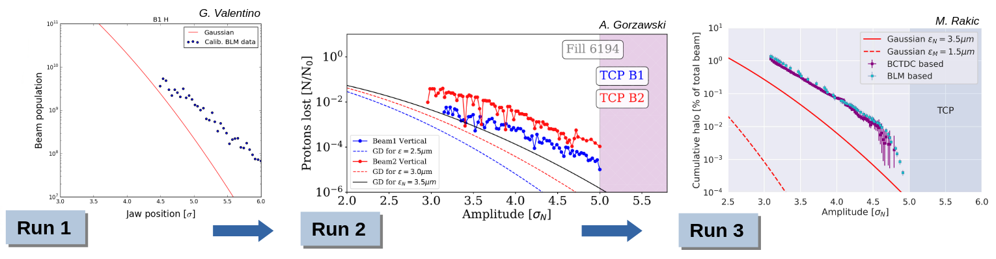
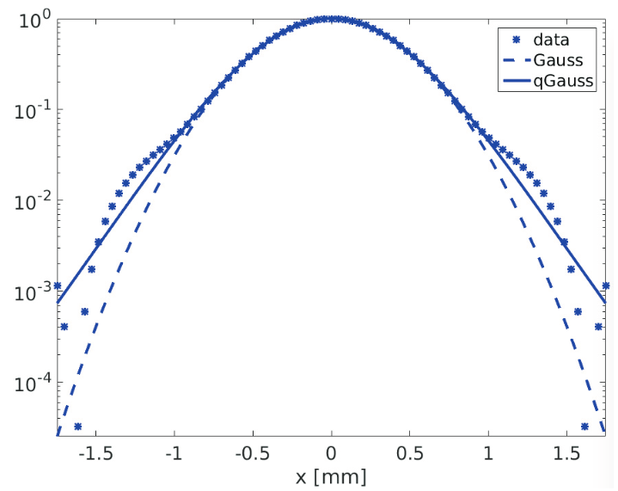
The Beam Halo Problem
Assuming nominal σ
with ε_{N}=3.5μm rad
Transverse beam halo: particle population above 3 σ_{N}
Measured since LHC start: heavily populated halo, up to 5% total intensity [ref.]
  Risk for loss spikes, dumps, damage with orbit jitters
  Threatening fast failure scenarios for HL if scales
  Mitigation HW unavailable
Normalized distribution
Halo
Core
Halo

Slide 6
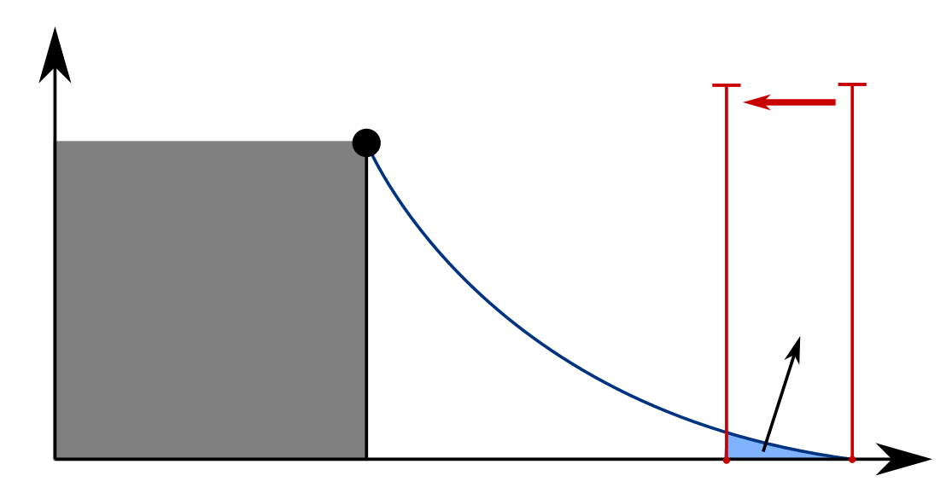
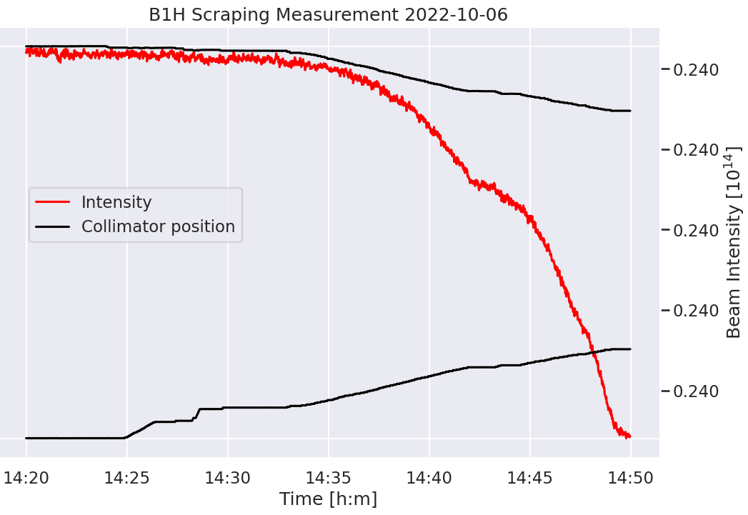
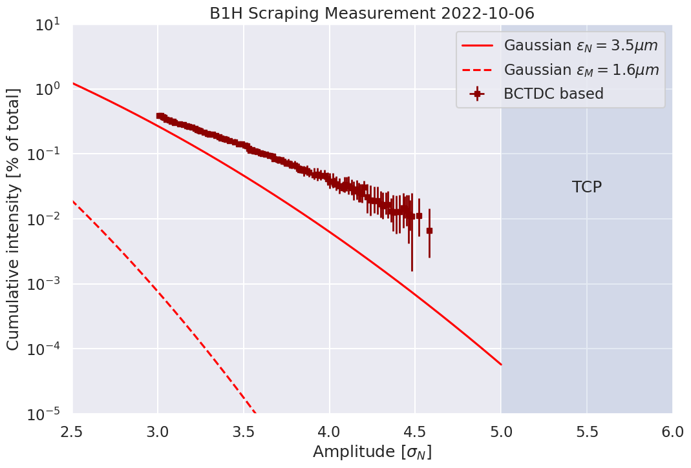
Halo measurement via collimator scraping
Precise indirect destructive measurement via BLM/fBCT losses:
  Perform BBA
  Move TCP inwards
  Measure induced losses
  Integrate measured losses to reconstruct the scraped beam halo
Inward movement
TCP
Beam distribution
Core
Halo
Scraped
beam halo
3.0
σ_{N}
BCT signal. Intensity drops as
TCPs are moved inwards
Delta in signal used to
reconstruct halo intensity
fBCT signal delta not
clear enough above 4.5 σ_{N}
Courtesy of M. Rakic

Slide 7
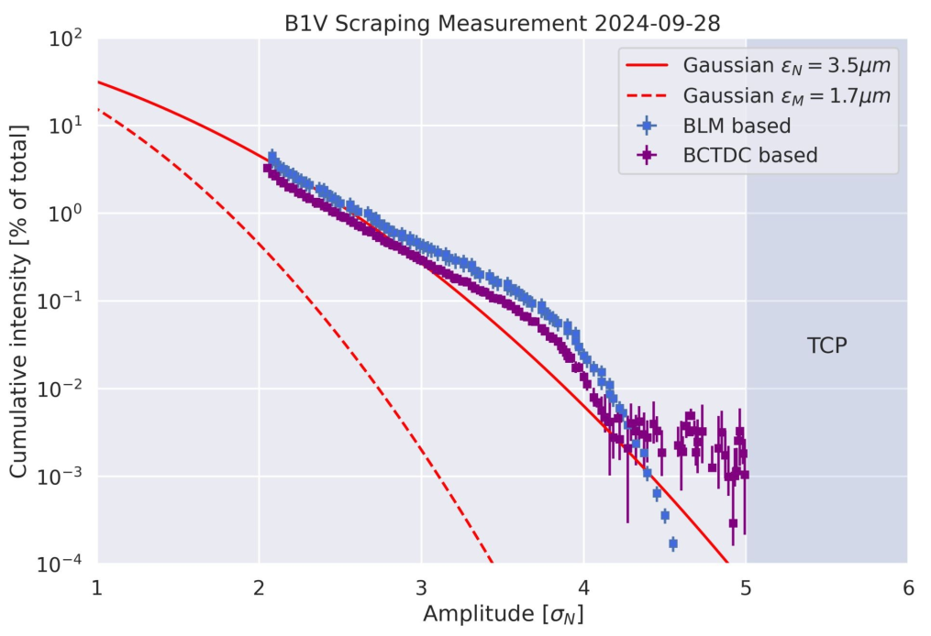
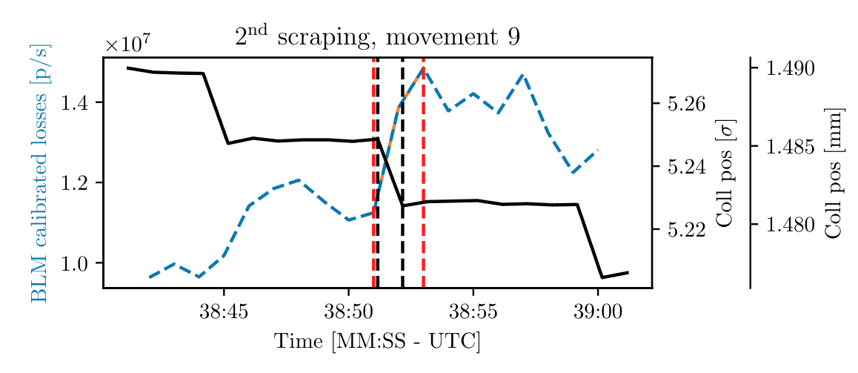
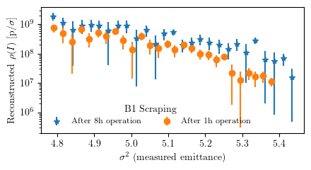
BLM calibrated signal for halo reconstruction
Courtesy of M. Rakic
Leverage on BLMs large dynamic range
Calibration of Gy/s signal on dedicated runs:
  Induce high scraping losses, compare BCT intensity drop with BLM response
  Construct Response Matrix
  Apply inverse Response Matrix in nominal fills
Further details here
B1H scraping measurement
Spike in calibrated BLM signal during collimator movement considered

Slide 8
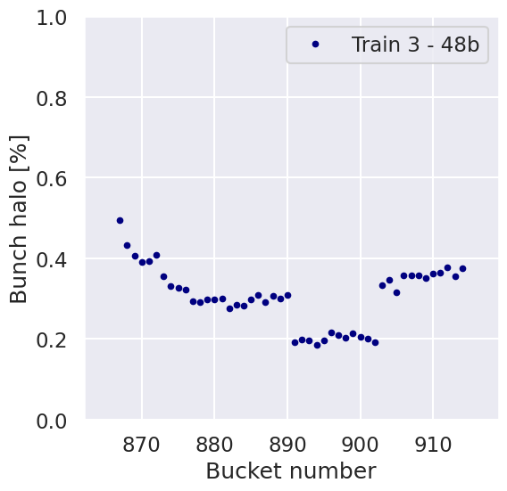
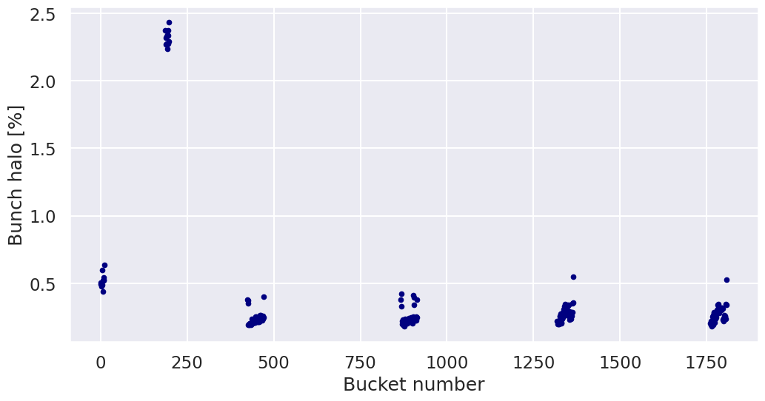
Visualizing the beam halo bunch-by-bunch
Collisions in
IP1/5/8
Fast BCT data enables bunch-by-bunch halo measurement
HALO MEASUREMENTS IN FILL 9808 - B2H
Also collisions in IP2
Larger halo for the non-colliding bunches
Decrease of halo for bunches which spent hours in collisions
Clear view of the impact of beam-beam effects from different collision patterns!
Courtesy of M. Rakic

Slide 9
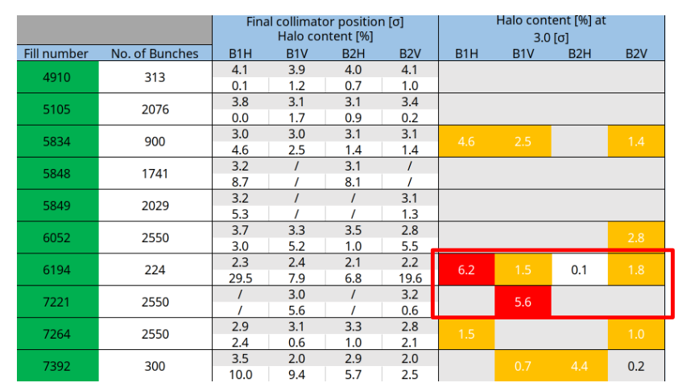
Recall of Run2 Halo measurements
10/05/2016
19/07/2016
15/06/2017
19/06/2017
20/06/2017
06/08/2017
13/09/2017
25/09/2018
06/10/2018
30/10/2018

Slide 10
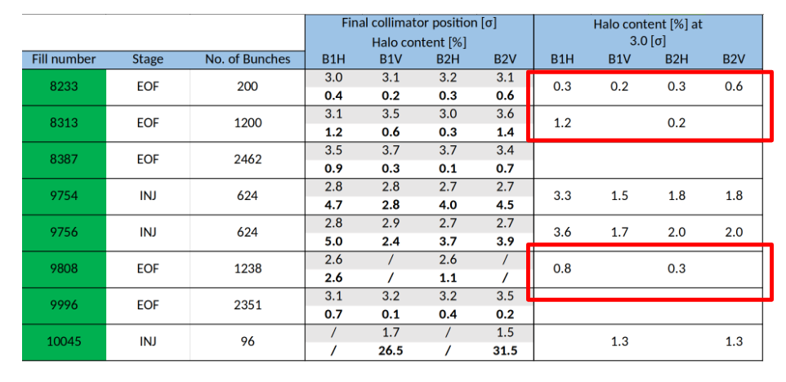
Recall of Run3 Halo measurements
06/10/2022
25/10/2022
12/11/2022
09/06/2024
09/06/2024
29/06/2024
12/08/2024
22/08/2024

Slide 11
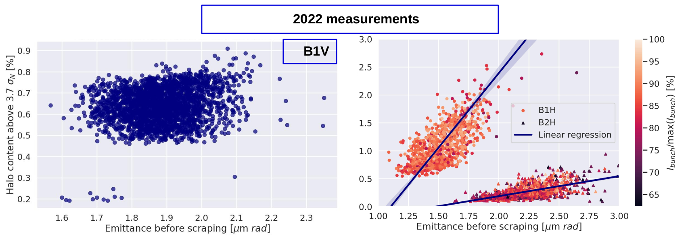
Correlation with initial emittance
Can beam halo population be related to initial beam emittance?
Spurious correlations have been observed, but no systematic relations so far
More details available here
Courtesy of M. Rakic

Slide 12
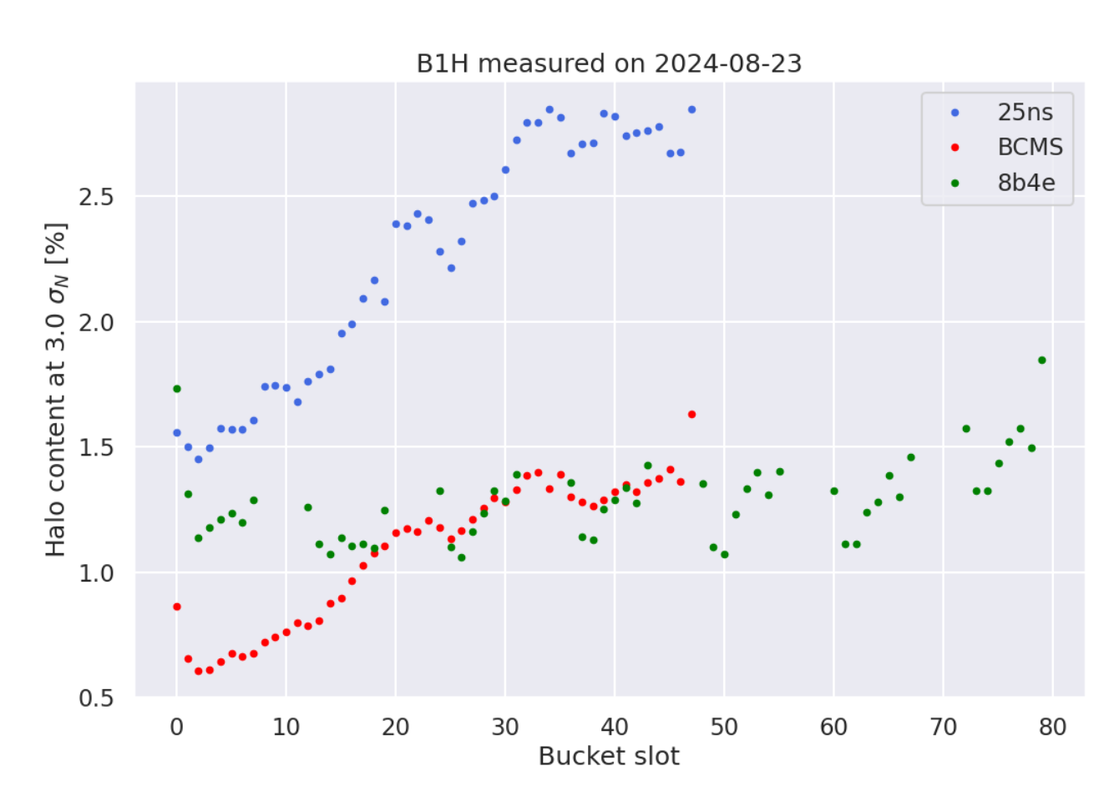
Electron cloud and beam halo
Collimator scraping @ Flat Top
Recent halo measurements performed at Flat Top (@MD9325)
Comparison of halo population intra-train between different train typologies
  25ns: standard train
  BCMS: 25ns batch compression, merging, and splitting train
  8b4e: train designed to minimize electron cloud presence
Strong correlation between halo population and electron cloud intensity
Courtesy of M. Rakic

Slide 13
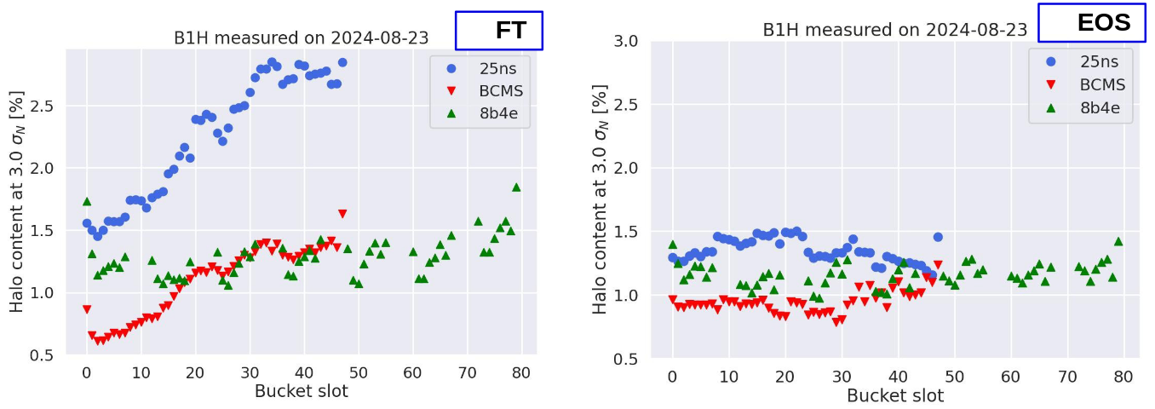
A slow repopulation
A collimator scraping removes the beam halo
Repeated measurements in same fill suggest long repopulation times (order of hours)
Huge challenge for making comparable measurements!
Measurement performed after FT scraping -> squeeze to β*30cm -> only 1h collisions
Courtesy of M. Rakic

Slide 14
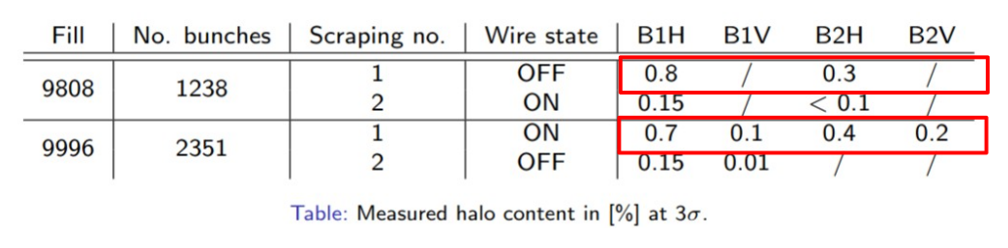
Halo distribution and wire compensator impact
Two EOF scrapings:
  Fill 9808: wire kept OFF 1h before scraping, 10 min between OFF/ON,
  Fill 9996: wire kept ON 5.5h before scraping, 10 min between ON/OFF
On nominal settings, no visible impact of wires on halo population between
          Need for a comparative study with wires kept ON/OFF equal amount of time
          BB-dominated configurations show more visible effects (in later slides)

Slide 15
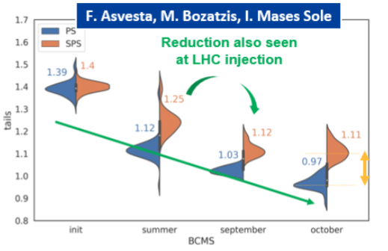
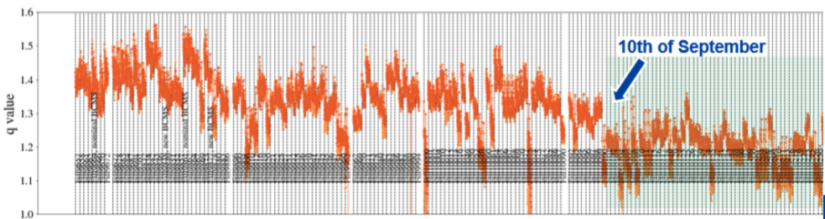
Open investigation - halo induced at injection
Slow repopulation times suggest main halo source may come from injection
This checks out with observed improvements after LIU
Overview on the topic presented by S. Kostoglou at recent JAPW
Modeling of beam tails/halo by means of q-gaussian distributions
Degradations in beam-halo populations can be traced back up to the PS!
Main improvements achieved with last iteration of BCMS
Still an open chalenge relating beam profiles to beam halo scraping measurements!

Slide 16
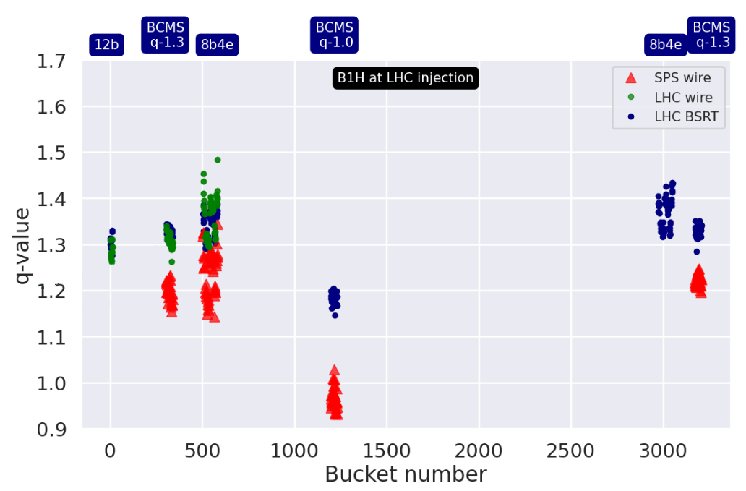
Comparison with SPS halo population
Comparison of q-value evolution from SPS measurement to LHC at flat bottom
Clear increase in q-value along the SPS-LHC transfer line
Biggest relative increase for the case BCMS q-1.0 (most scraped at SPS level)
Courtesy of M. Rakic

Slide 17
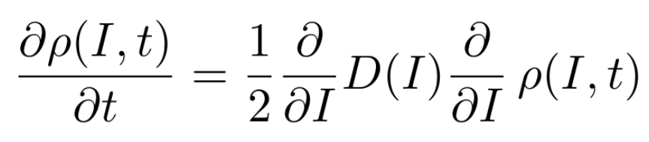
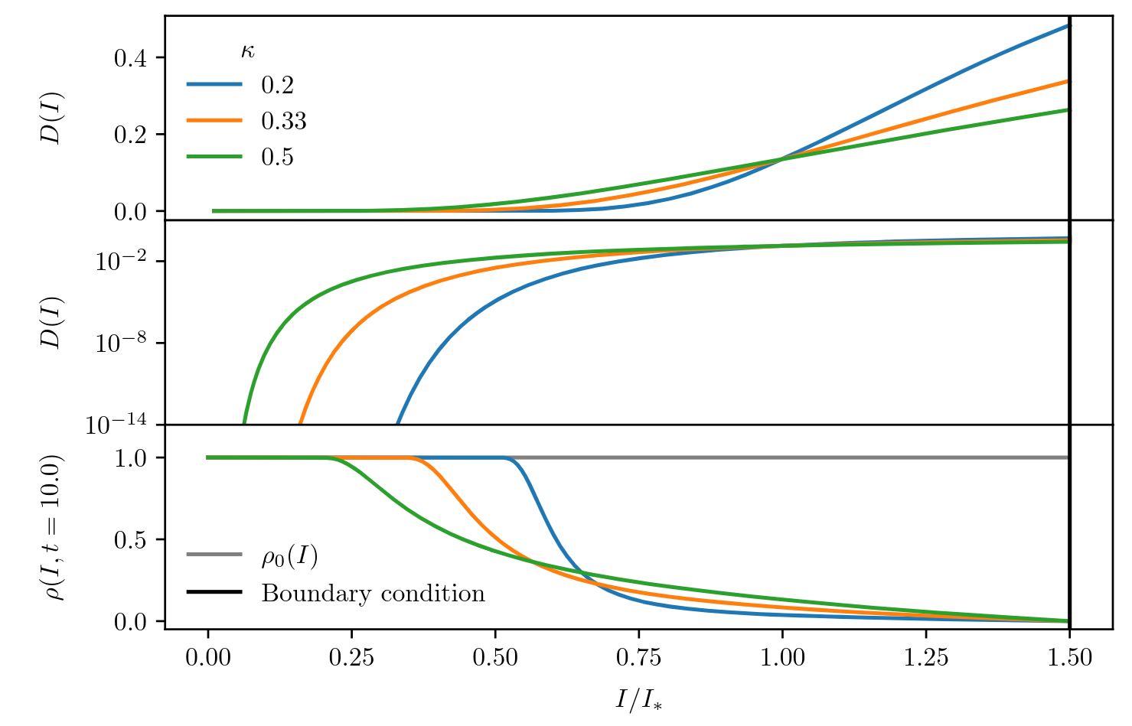
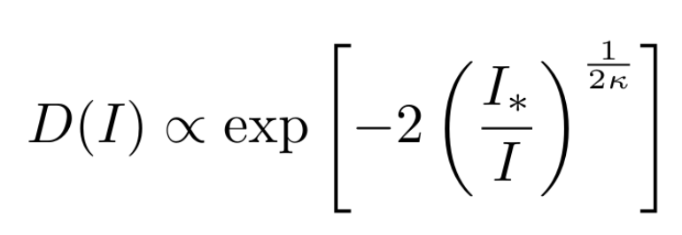

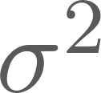
Investigating scale-laws: diffusion models
Natural extension of established Dynamic Aperture scale-laws [A. Bazzani et al.] and local diffusion measurements performed in the LHC [A. Gorzawski et al.]
Description of beam distribution as solution of a Fokker-Plank equation
where perturbations are summarized by the
diffusion coefficient with functional form:
is the action variable
  evaluated with measured beam emittance
Equation valid only for the beam-halo!
Beam core expected to follow a separate regime (mostly due to Beam-beam head-on effects)

Slide 18
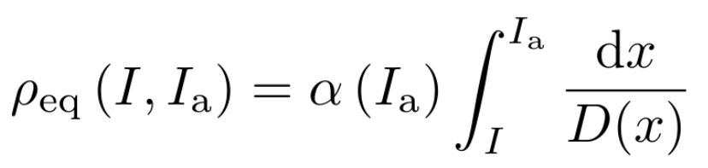
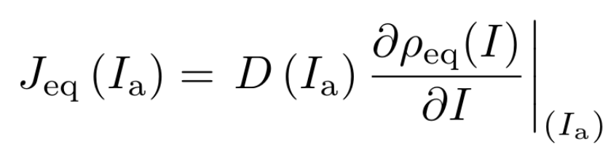
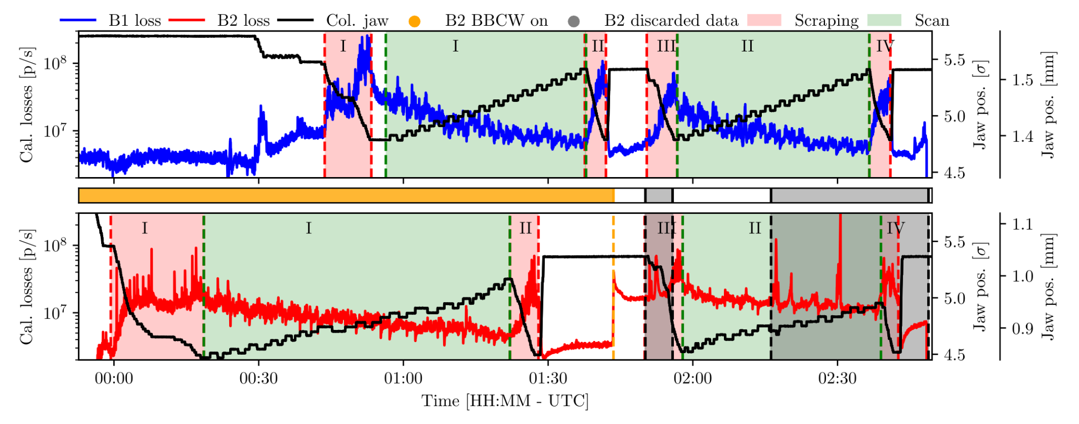
Observable from our diffusive model
BEAM-HALO POPULATION
Measured by means of Collimator Scrapings
BEAM-LOSS SIGNAL AT DIFFERENT AMPLITUDES
Measured while retracting the collimator
Outward movements or alternation of outward and inward movements with pauses in between;
J_{eq}; is the stabilized BLM beam-loss signal
Measurement performed at the end of
Beam-Beam wire compensation MD in 2022
  Special configuration dominated by BB effects
  Wire compensation available in B2

Slide 19
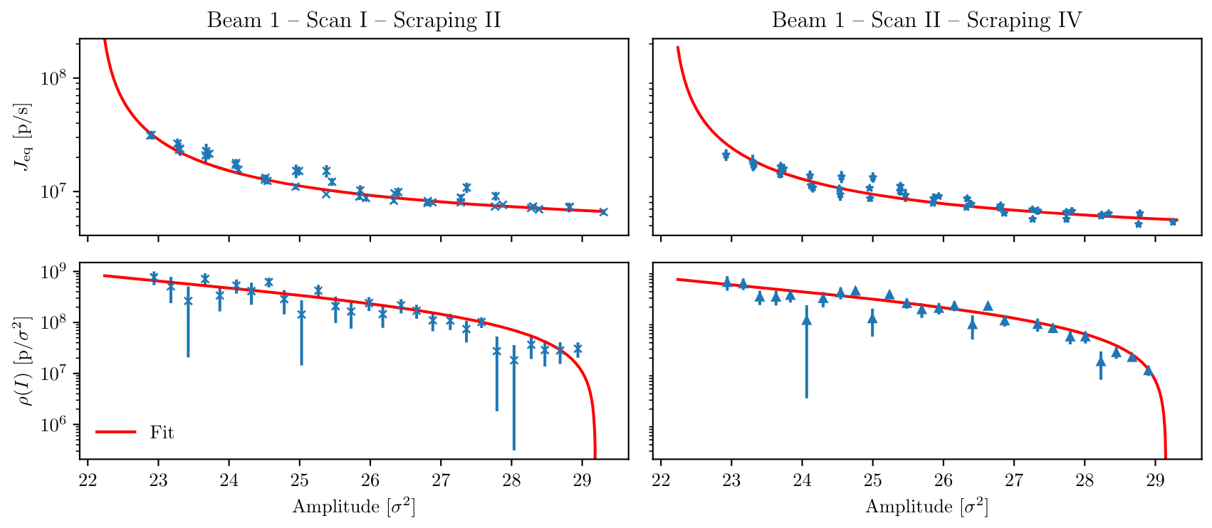
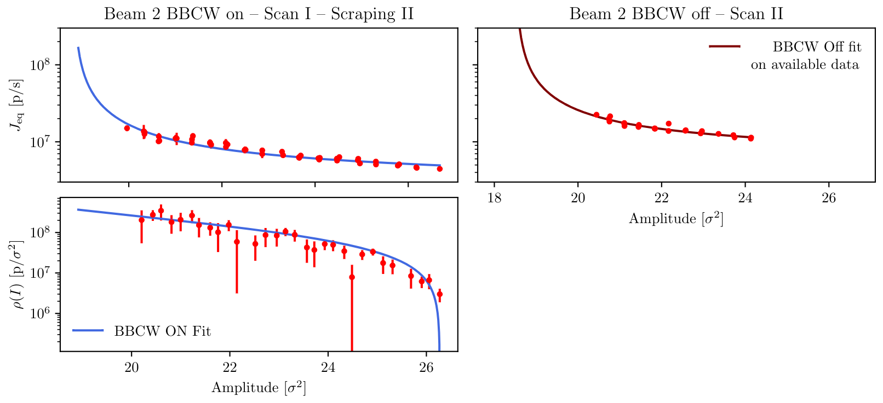
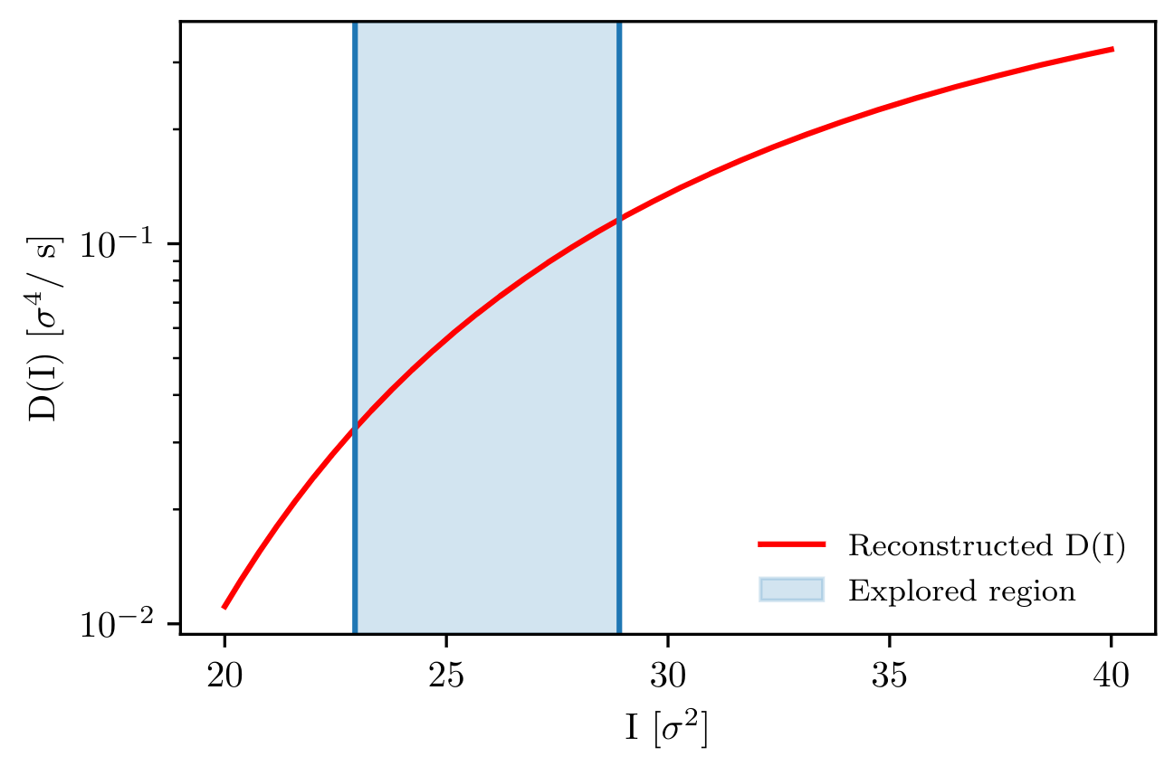
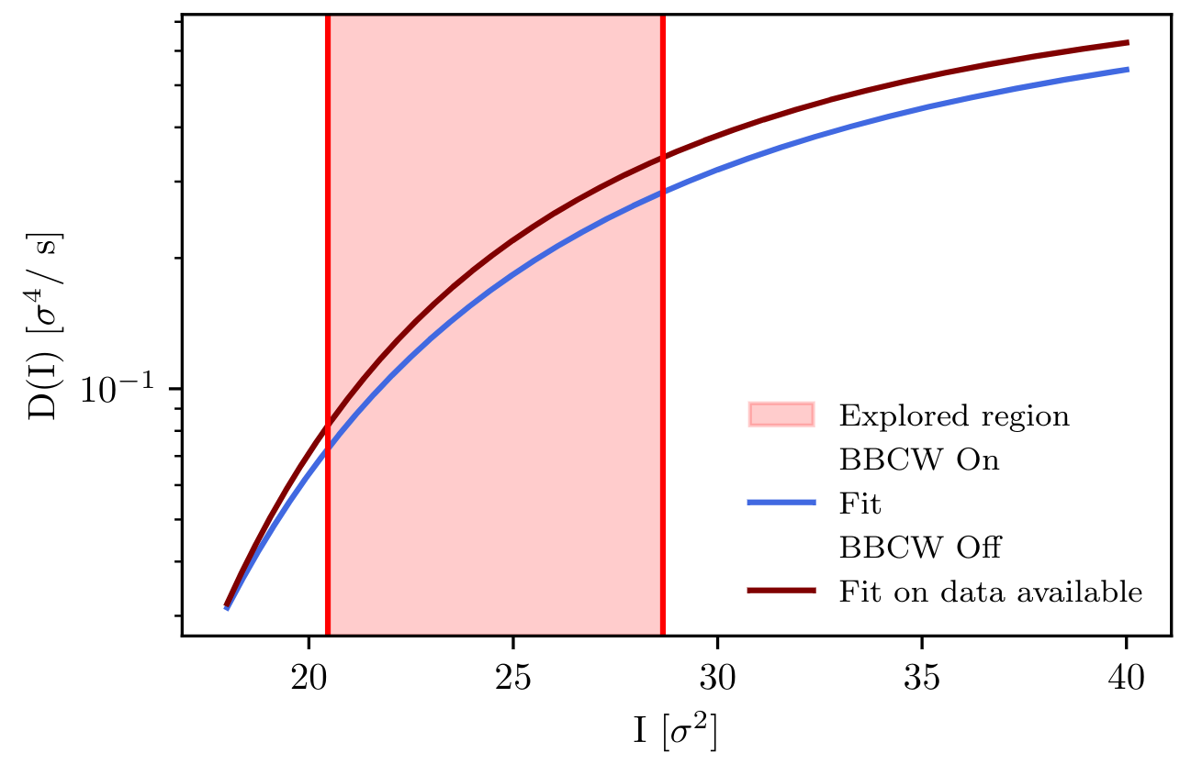
An example of diffusion reconstruction
Calibrated BLM beam loss signal
(B2 scraping data w/o BBCW polluted by bunch instabilities)
Beam halo population
Reconstructed Diffusion coefficient B1
Reconstructed Diffusion coefficient B2
Overall great fit reconstruction
Able to relate both beam-halo and equilibrium beam loss signal
Lower diffusion reconstructed with Beam-Beam wire compensators on
  Initial analysis of B1 presented at IPAC’23
  Complete work to be published on EPJ Plus @ C.E. Montanari et al. “Measurement of the nonlinear diffusion of the proton beam halo at the CERN LHC”

Slide 20
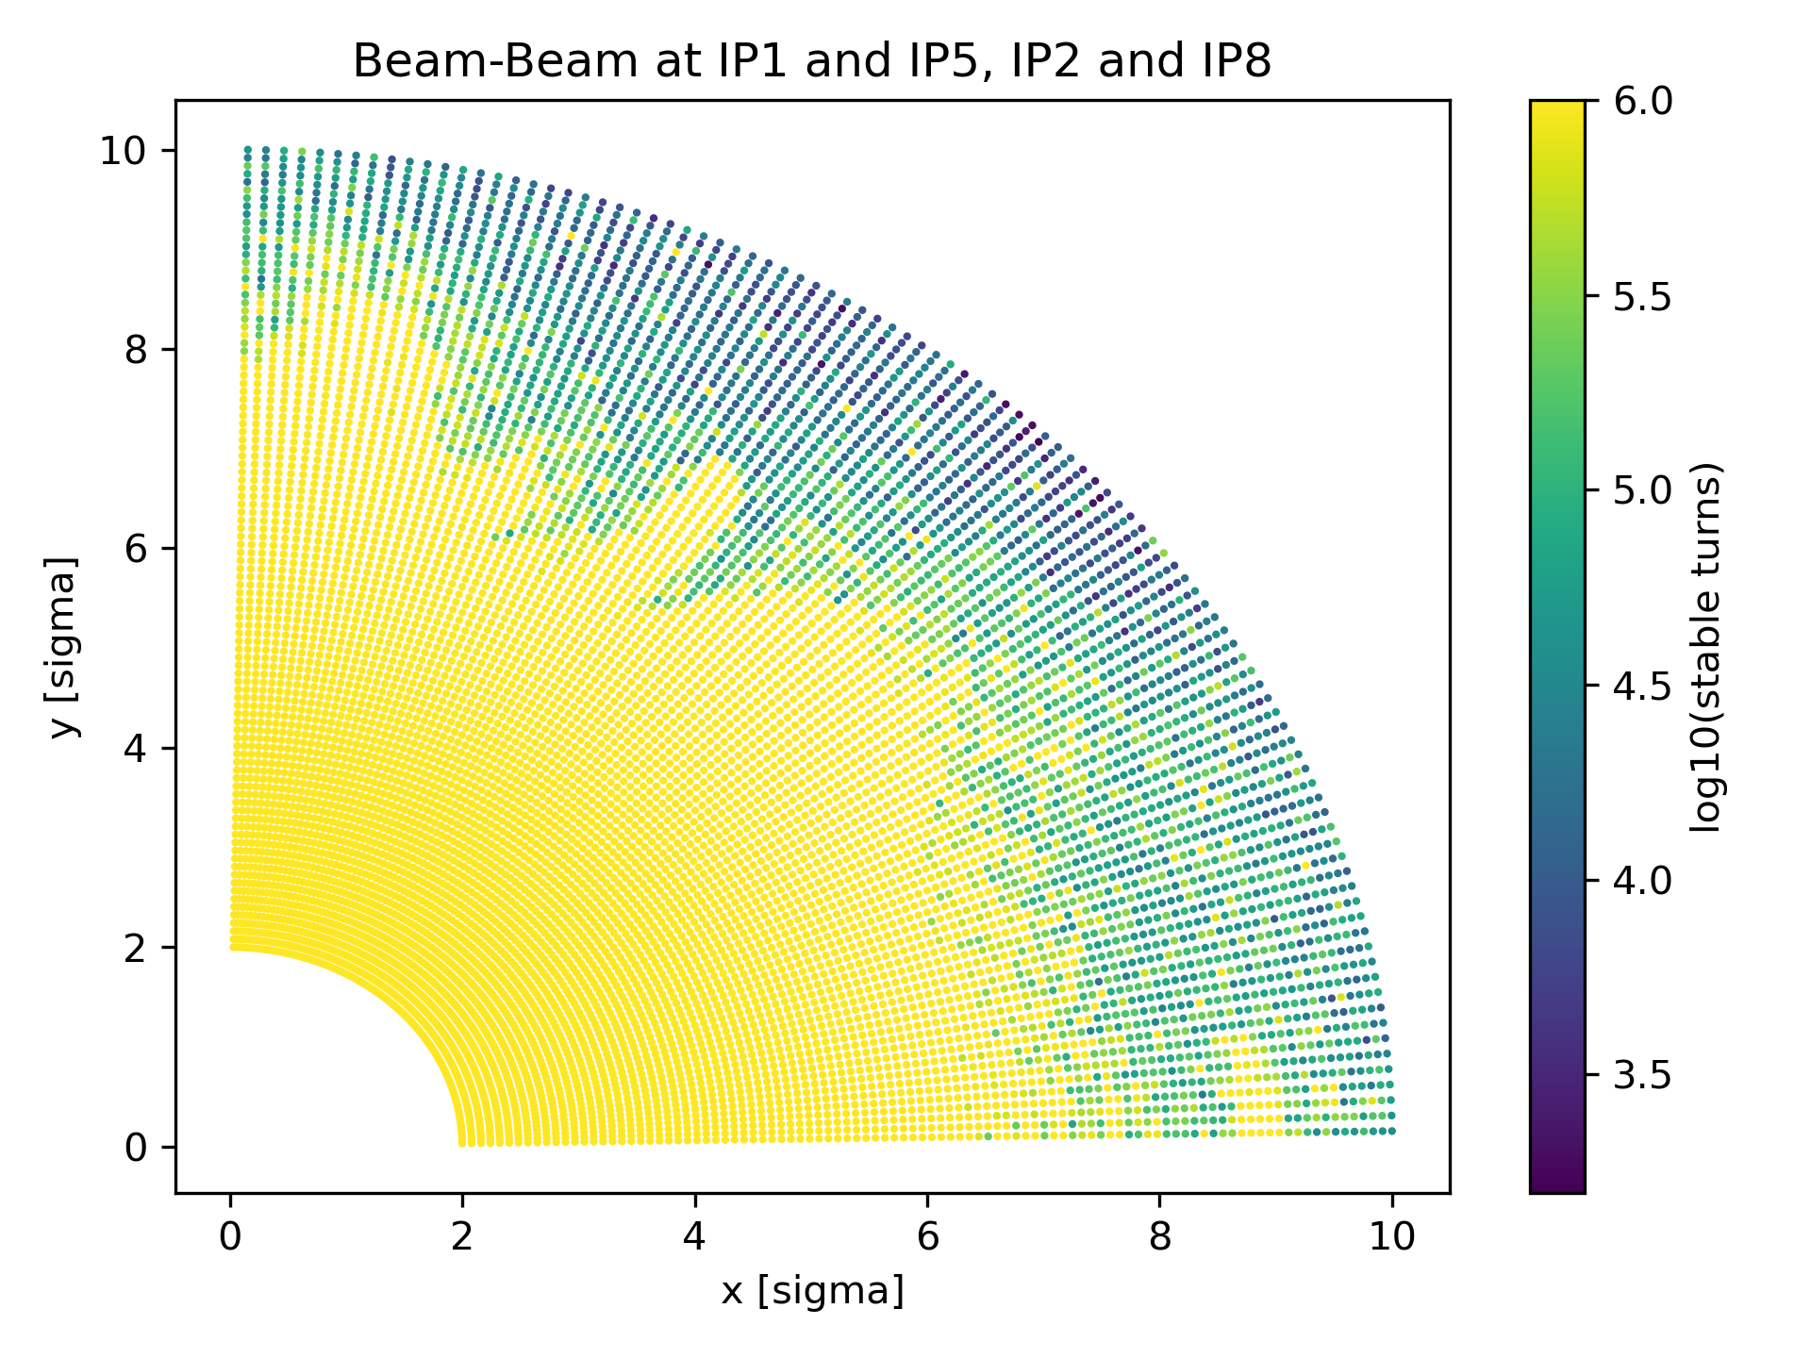
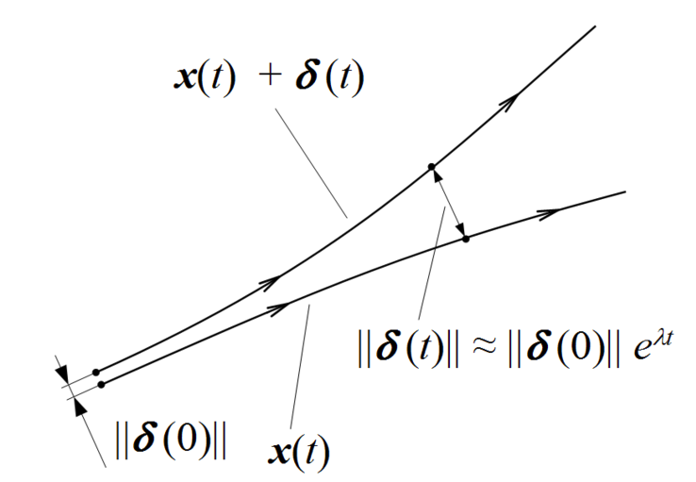
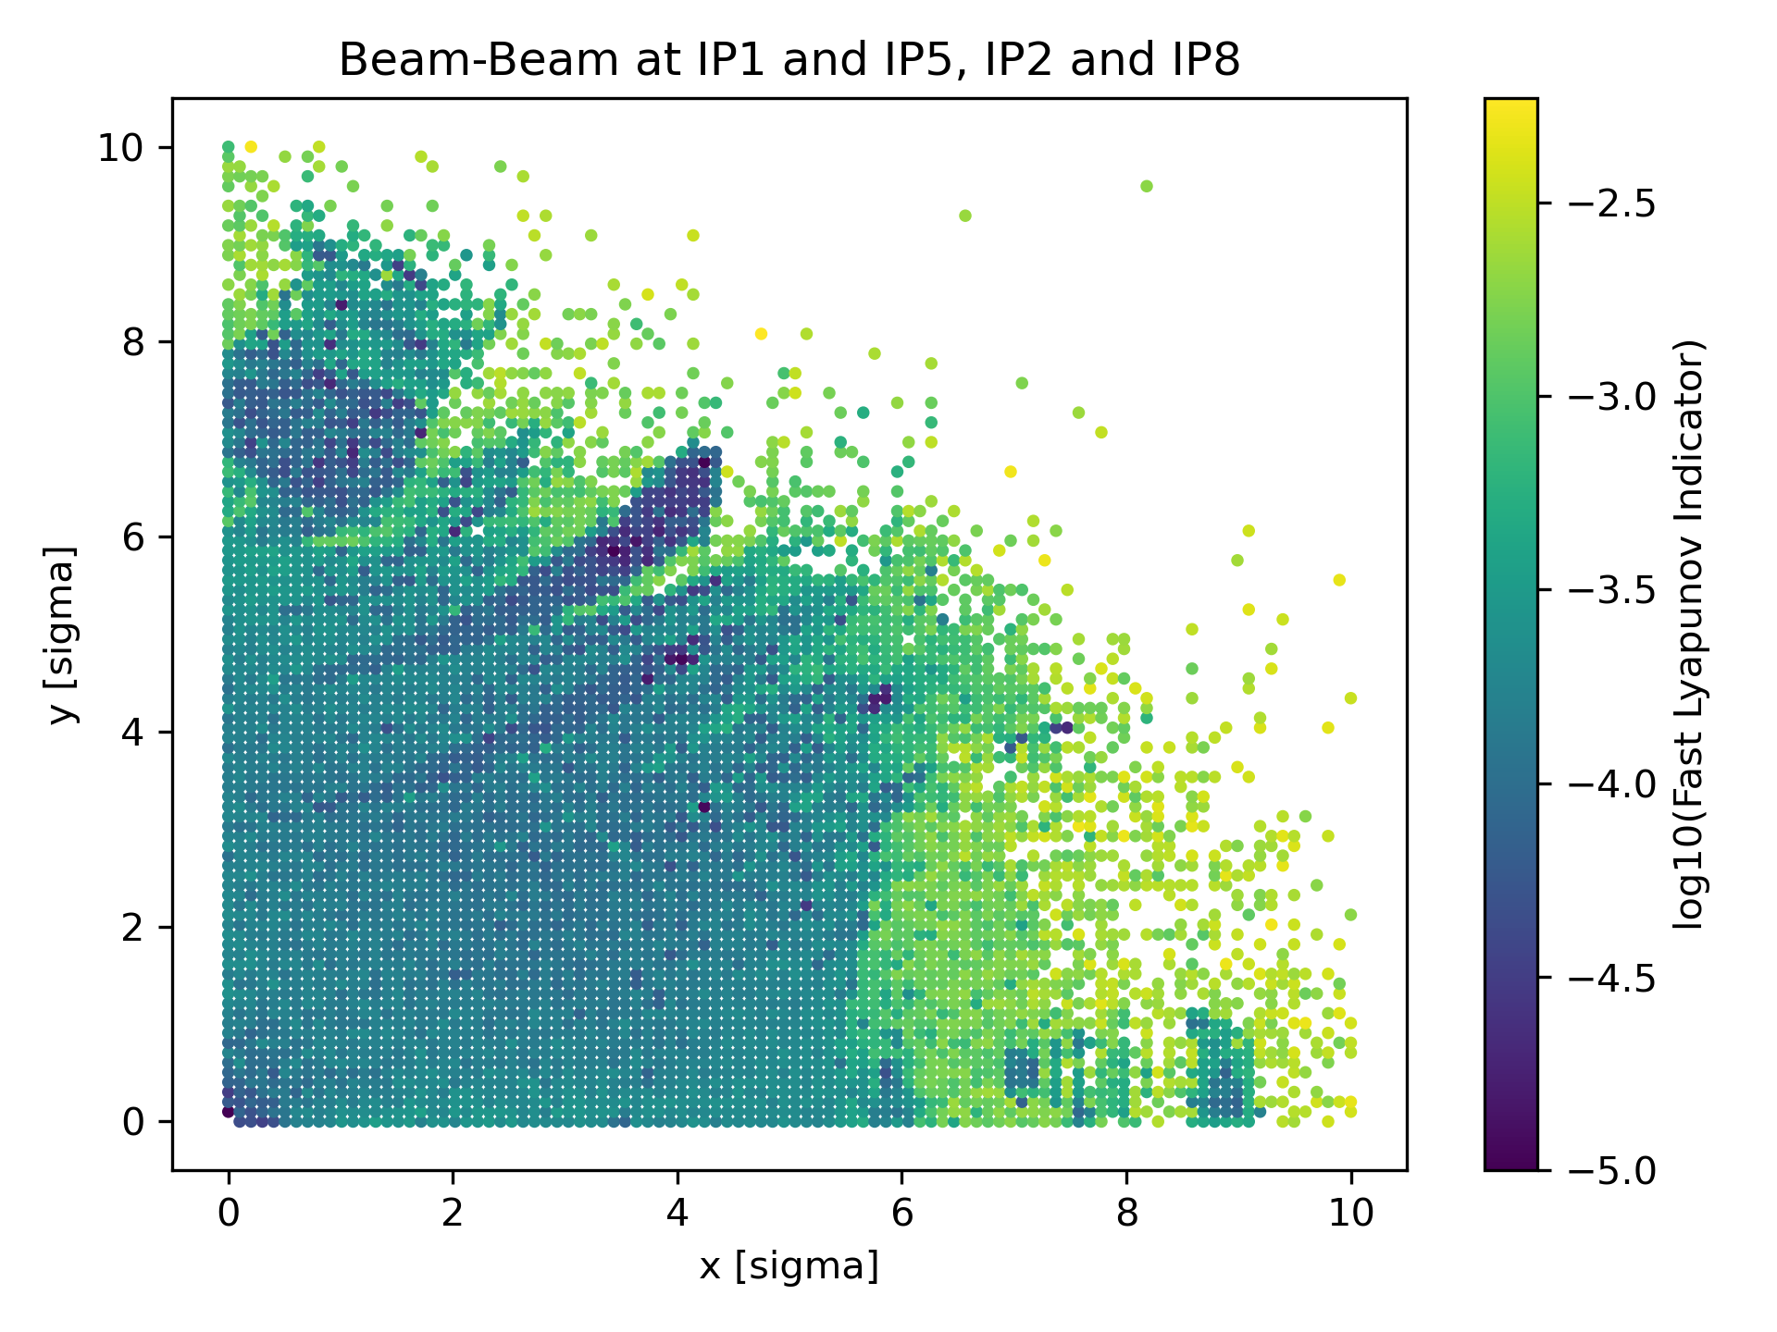
Enhancing single-particle tracking: Chaos Indicators
Dynamic Aperture Tracking
@10⁶ turns
Chaos: sensitivity of a particle orbit to initial perturbations
Performance studies based on chaos have been performed in the past with, e.g., the Fast Lyapunov Indicator (FLI)
We are studying applications of more advanced chaos indicators
Implementation (CPU/GPU) on Xsuite under the package Xnlbd
Lyapunov Exponent λ
λ = 0 - Non-chaotic
λ > 0 - Chaotic
FLI Tracking
@10⁵ turns

Slide 21
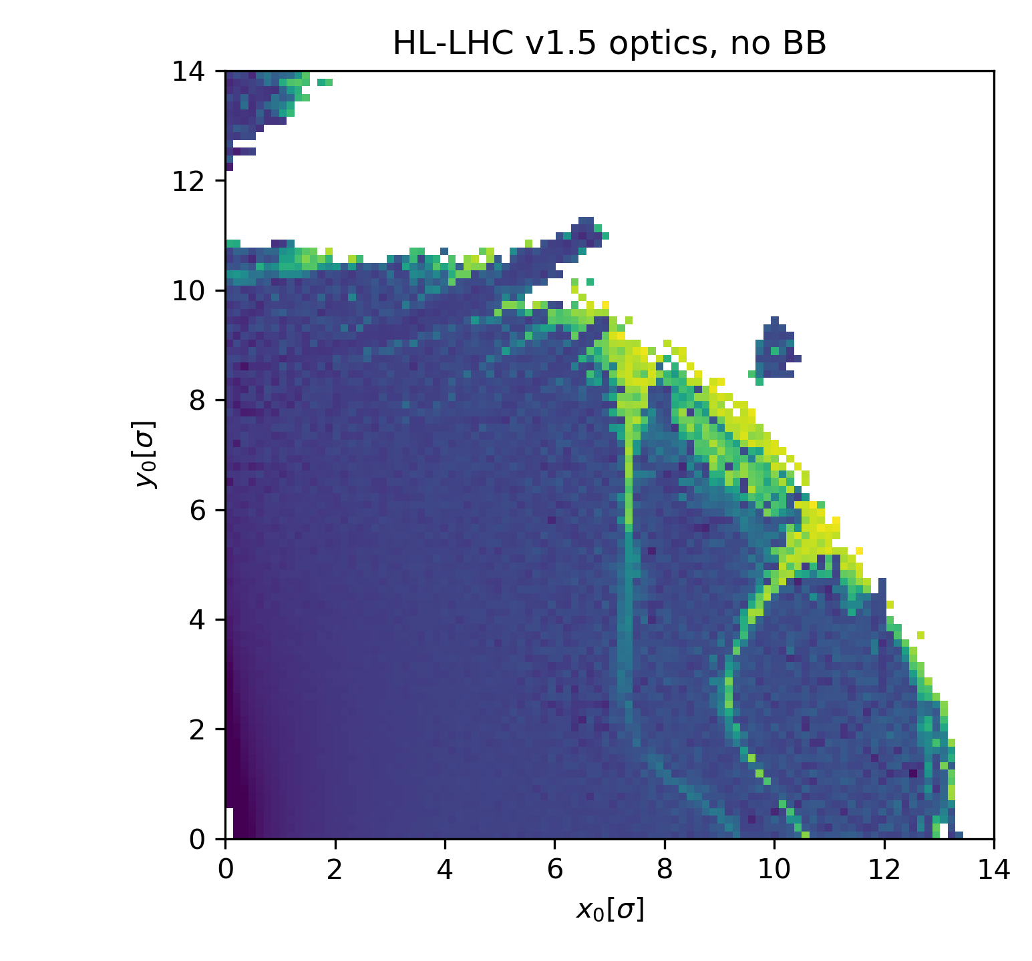
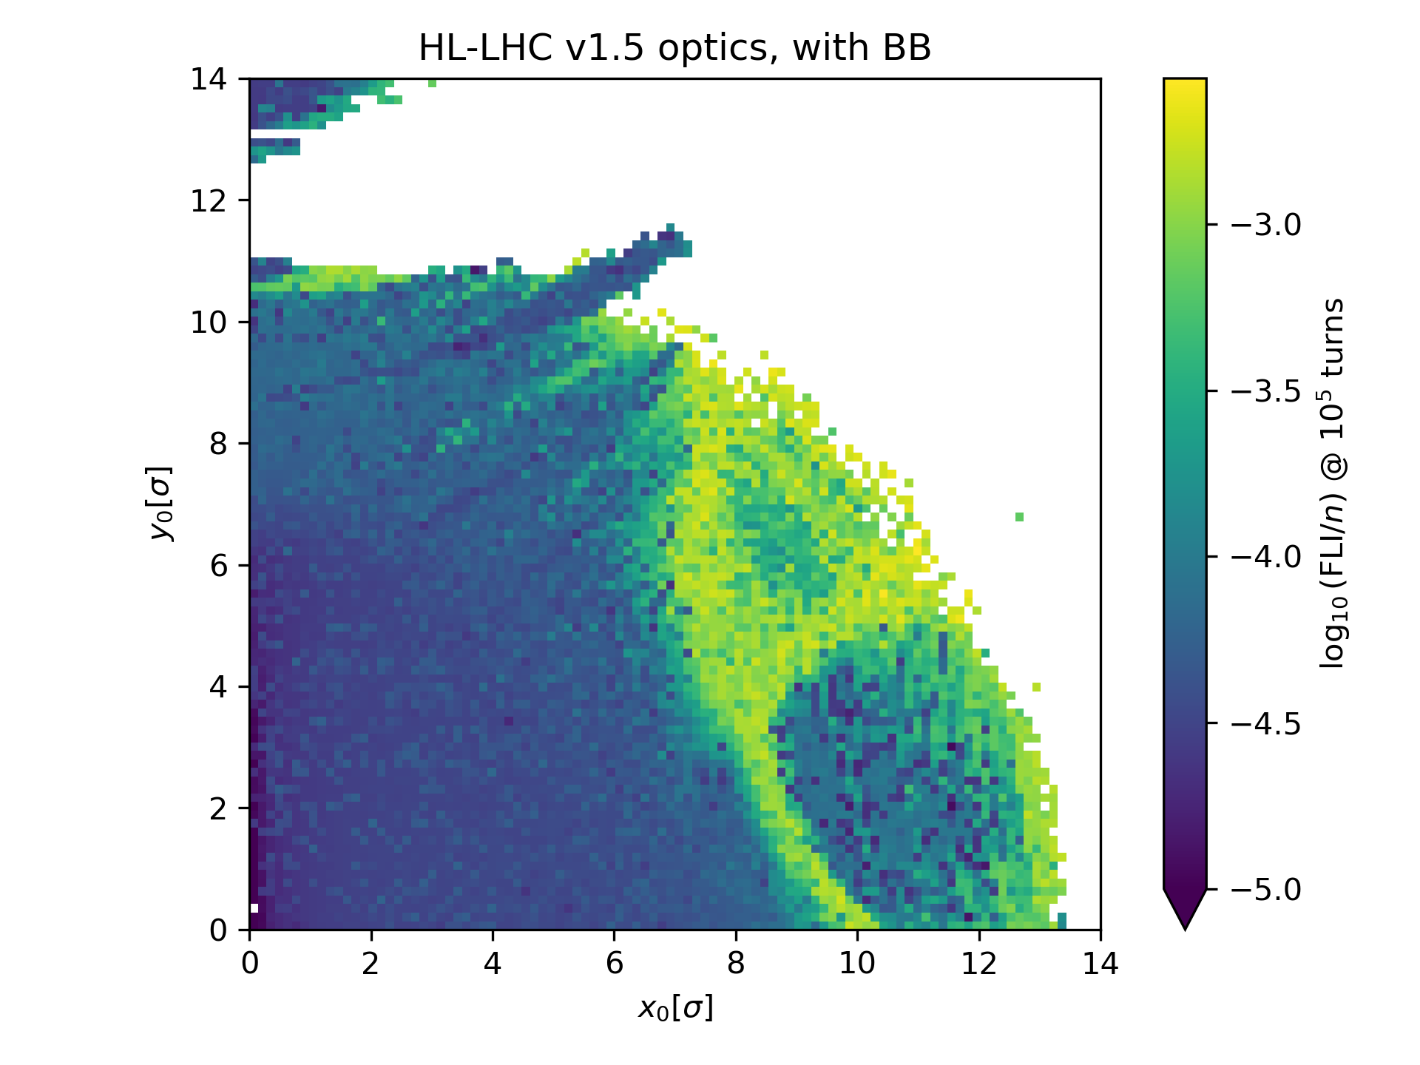
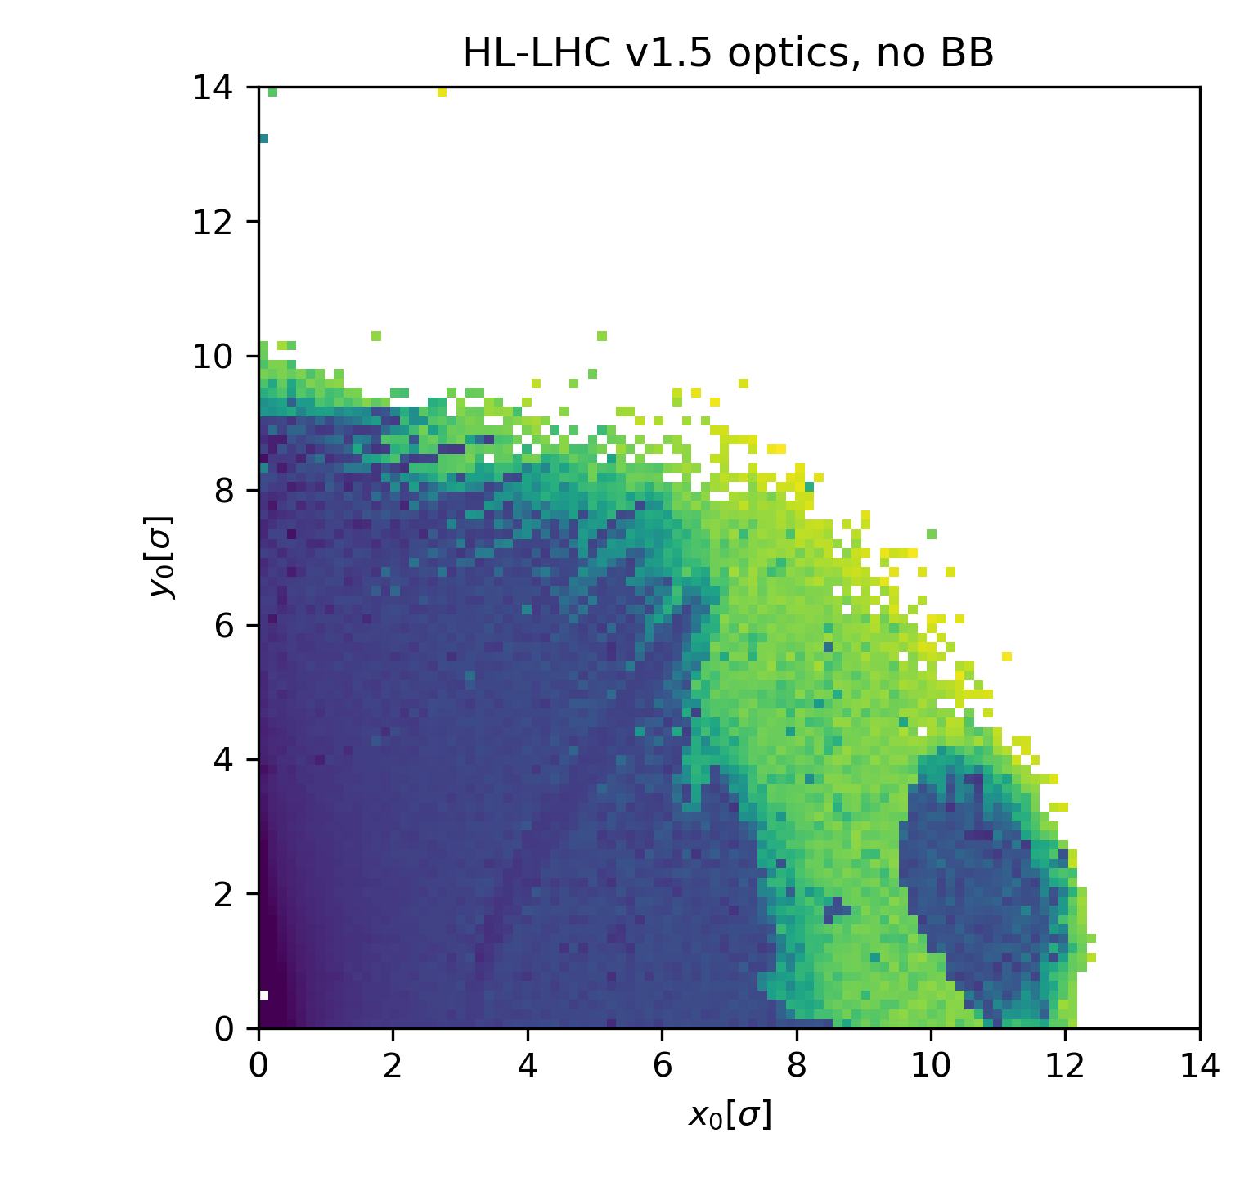
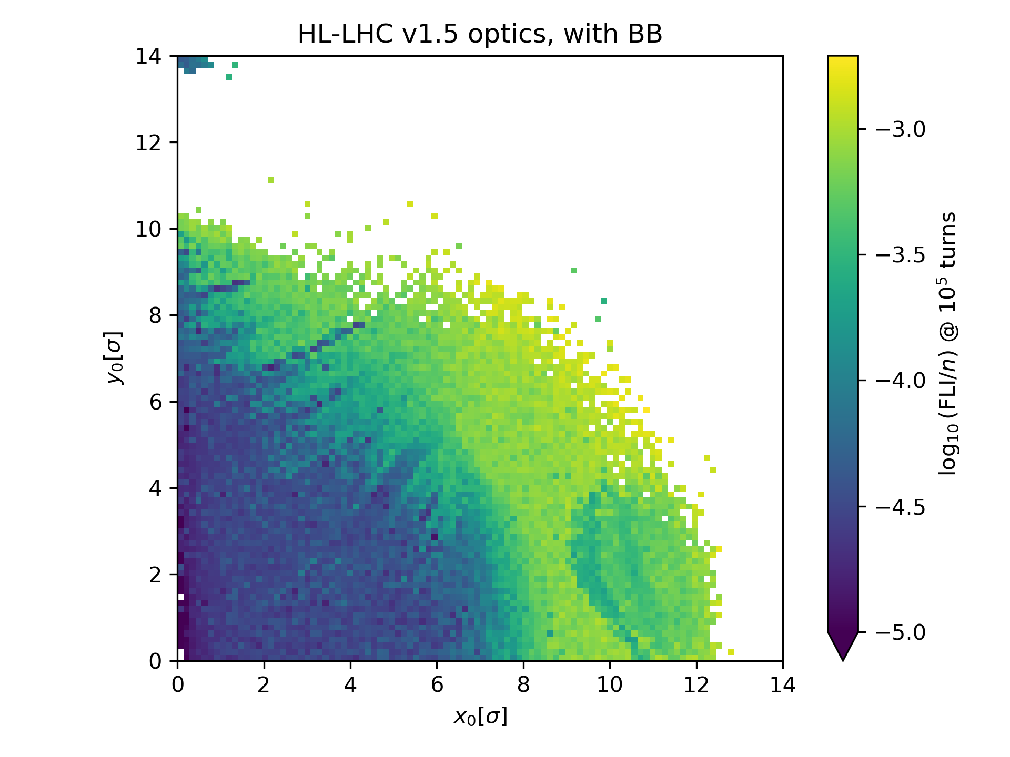
Example of FLI evaluation on HL-LHC lattice
No Beam-Beam
With Beam-Beam
Lattice considered with and without Beam-Beam effects
Different chaos topology with BB weak-strong
  Thin chaotic border and resonance-like lines without BB
  Large regions of chaos appearing with BB long-range;
Light chaos can be observed up to the core region of the beam due to head-on BB;
Chaos topology reflects interplay of nonlinear contributions (beam-beam, longitudinal motion, etc.)
Ongoing work: connect observed chaos timescales to diffusion presence/halo population
(zeta=0)
(zeta=0.0761m)

Slide 22
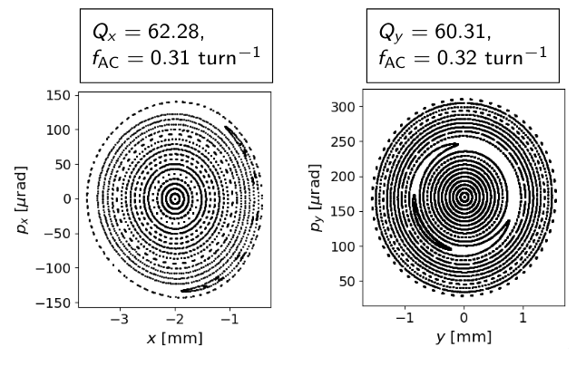
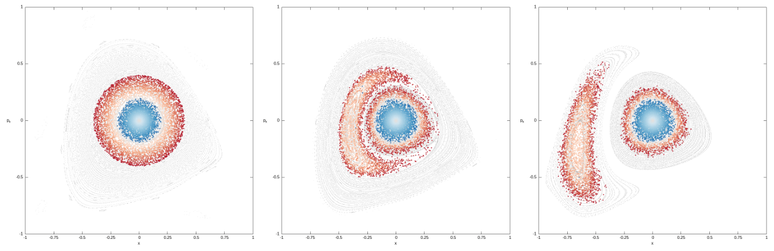
Novel halo depletion approach under study: halo cleaning via AC magnets
Island trapping & transport could be a solution to halo cleaning
Adiabatic changes ideally via AC multipoles
Theoretical approach by F. Capoani et al.
Initial simulation attempts with LHC AC dipoles under study by D. Veres
For more information!
Courtesy of D. Veres
Courtesy of F. Capoani

Slide 23
Conclusions and outlook
Influencing factors on halo population
  E-cloud effects
    Observed clear correlation between e-cloud and halo population
  Long-Range Beam-Beam (LRBB) wire compensators
    Impact on halo population is unclear
    Requires studies with extended configuration times for halo relaxation and re-population
    Better observations achieved on BB-dominated settings
Halo evolution across LHC stages
  Halo increases from SPS to LHC
  Energy ramp in the LHC does not appear to be the main driver of halo re-population
Ongoing and future efforts
  Relating beam profile measurements to observed beam halo measurements
  Developing diffusive models to predict and extrapolate long-term halo behavior
  Enhancing insights from single-particle tracking simulations using chaos indicators
  Exploration of alternative depletion methods based on AC magnets ongoing!

Slide 24

Thank you!

