Slide 1
BSRH: Establishing performance at the LHC
Jan Pucek on behalf of BI-PM
HL-LHC collaboration week in Genoa, October 2024

Slide 2
Important parameters (prepare, carry out, analyze MD)
Wire scanners BWS:
  ß_{y} = 418.23m
  ß_{x} = 185.15m
Coronagraph BSRH:
  ß_{y} = 366.63m
  ß_{x} = 193.8m
Primary collimators TCP (V):
  ß_{y} = 71.49m
  ß_{x} = 148.43m
For ε_{N} = 2.5um rad
σ_{y} = 386 um
σ_{x} = 257 um
σ_{y} = 362 um
σ_{x} = 263 um
σ_{y} = 160 um
σ_{x} = 230 um

Slide 3
Outline
Coronagraph – principle
Calibration measurements
Data analysis
Performance overview
System status
Summary table

Slide 4
Coronagraph – principle

Slide 5
Coronagraph – principle
1. Telescope – two lenses
2. Telescope with occulter
Occulter to block the ”core”
Aperture – creates diffraction
Aperture
3. Coronagraph
Telescope provides an image of an object
In case of measuring low intensity tails, the occulter is not sufficient – diffraction created at the aperture will disturb the image
Coronagraph is an “enhanced” telescope that uses “field” lens to image the aperture on the Lyot’s stop – blocking the diffraction of the aperture
Lyot’s stop
Field lens to image the aperture onto the “eyepiece” lens

Slide 6
Introduction – the source
*not to scale
Distance between D3 and BSRTM (extraction mirror) ≈ 21m
Synchrotron radiation emitted in a narrow cone (due to Lorenz transformation) ≈ 140 µrad
Extraction mirror
RF cavities
SR radiation
D3
D3
Beam 2
D4
D4
Beam 1
D3
D3

Slide 7
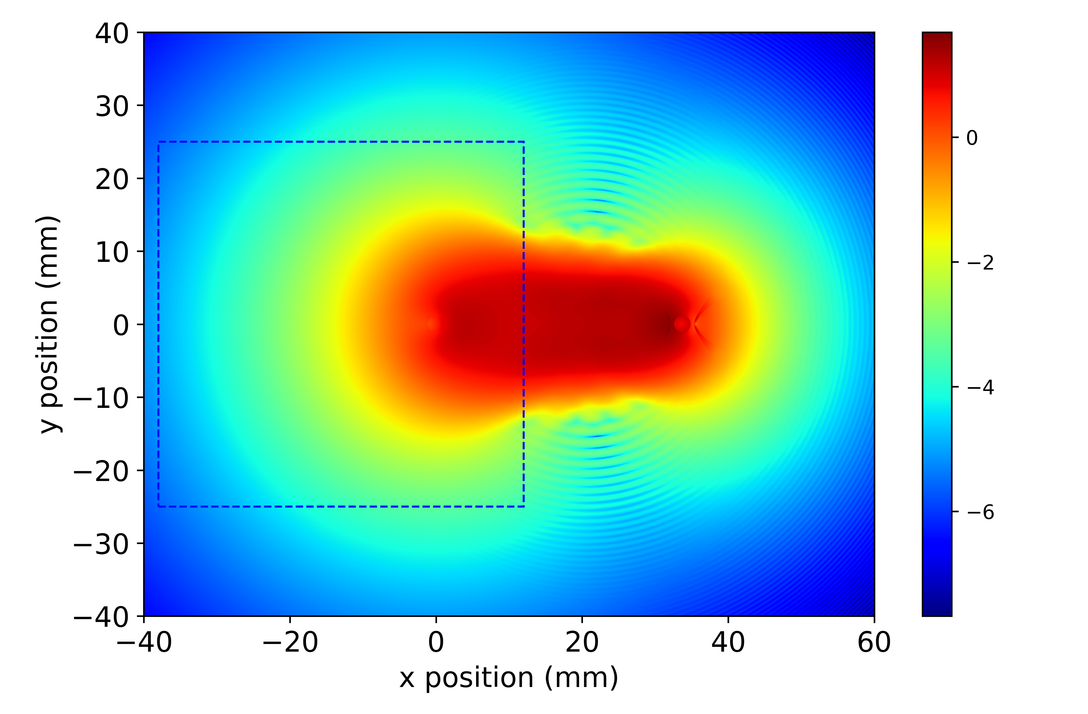
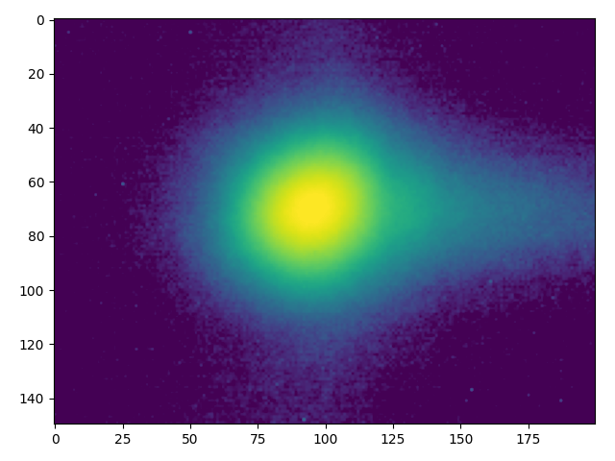
Introduction – the source
Sharp edge of the extraction mirror within the light spot -> source of diffraction in horizontal plane
Diffraction tail
When imaged
Simulation and figure produced by D. Butti

Slide 8
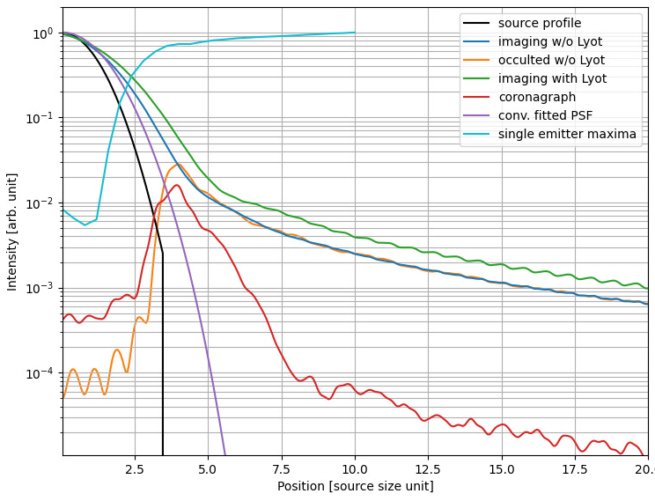
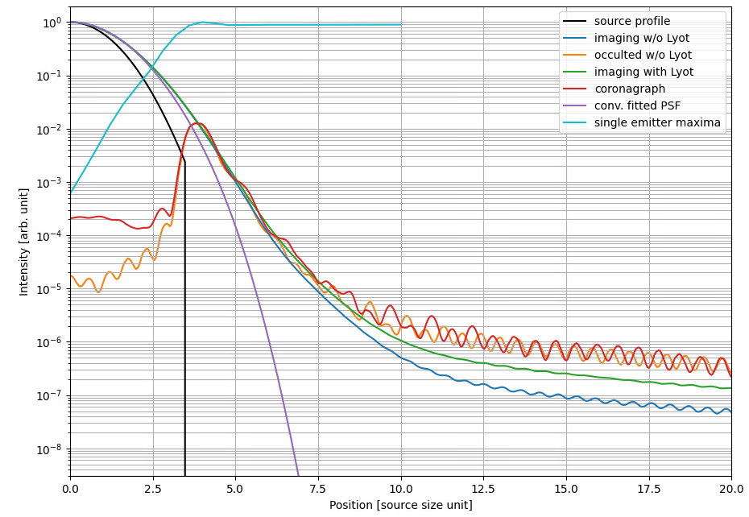
Concept of diffraction
Horizontal plane
Vertical plane
Measured profile ≠ True beam profile
Coronagraph can lower the diffraction contribution of the sharp mirror cut

Slide 9

Calibration measurements - imaging
Pixel size calibration:
  Bunches with 3 different emittances
  Comparing the BWS and the BSRH profiles in both planes independently
Charge scaling calibration:
  Requires the full measured profile from the BSRH and the corresponding FBCT measurement
$$FBCT\left(q\right)=A ∗BSRH(c)$$
Calibrating this factor

Slide 10
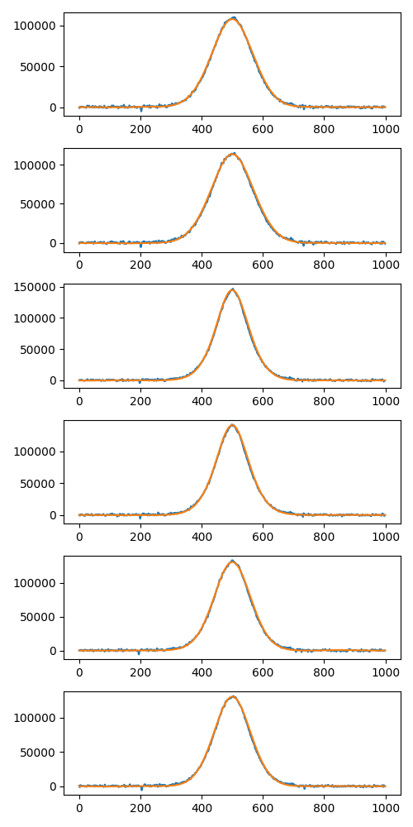
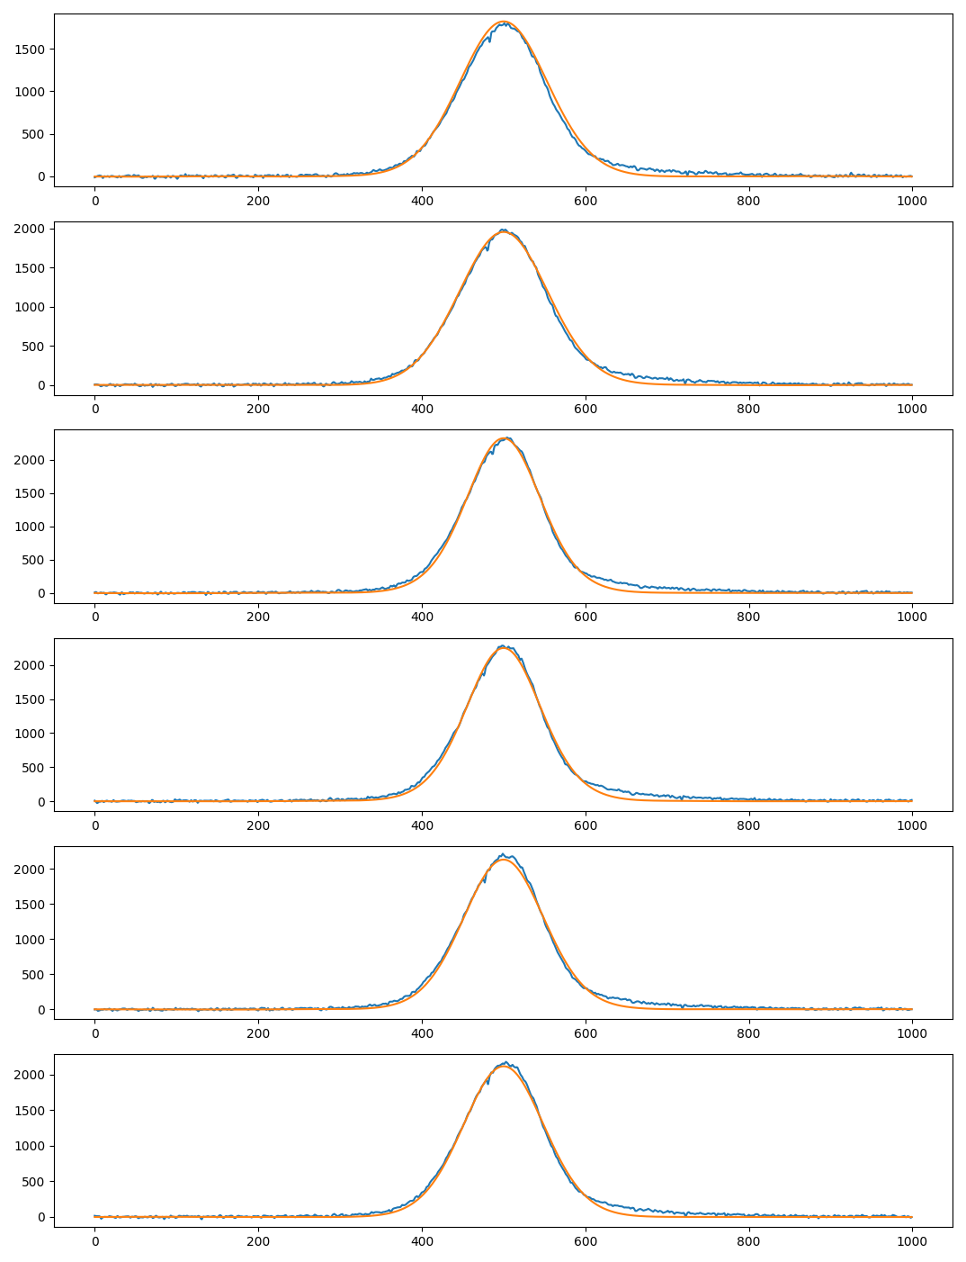
Calibration measurements
Results: σ = (277 ± 8)μm
m = (0.64 ± 0.006)
pixel size = (18.3 ± 0.2) μm/px
BWS ⮾ PSF
BSRH
σ_{y} = 362 um
σ_{x} = 263 um
Results (L-BFGS-B):σ = (320 ± 30)μm
m = (0.68 ± 0.03)
pixel size = (17.0 ± 0.8) μm/px

Slide 11
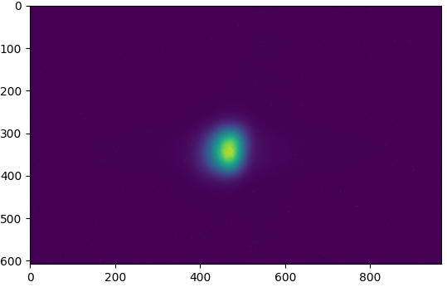
Calibration measurements
The charge scaling factor = (42.7±1.7)p⁺/count

Slide 12
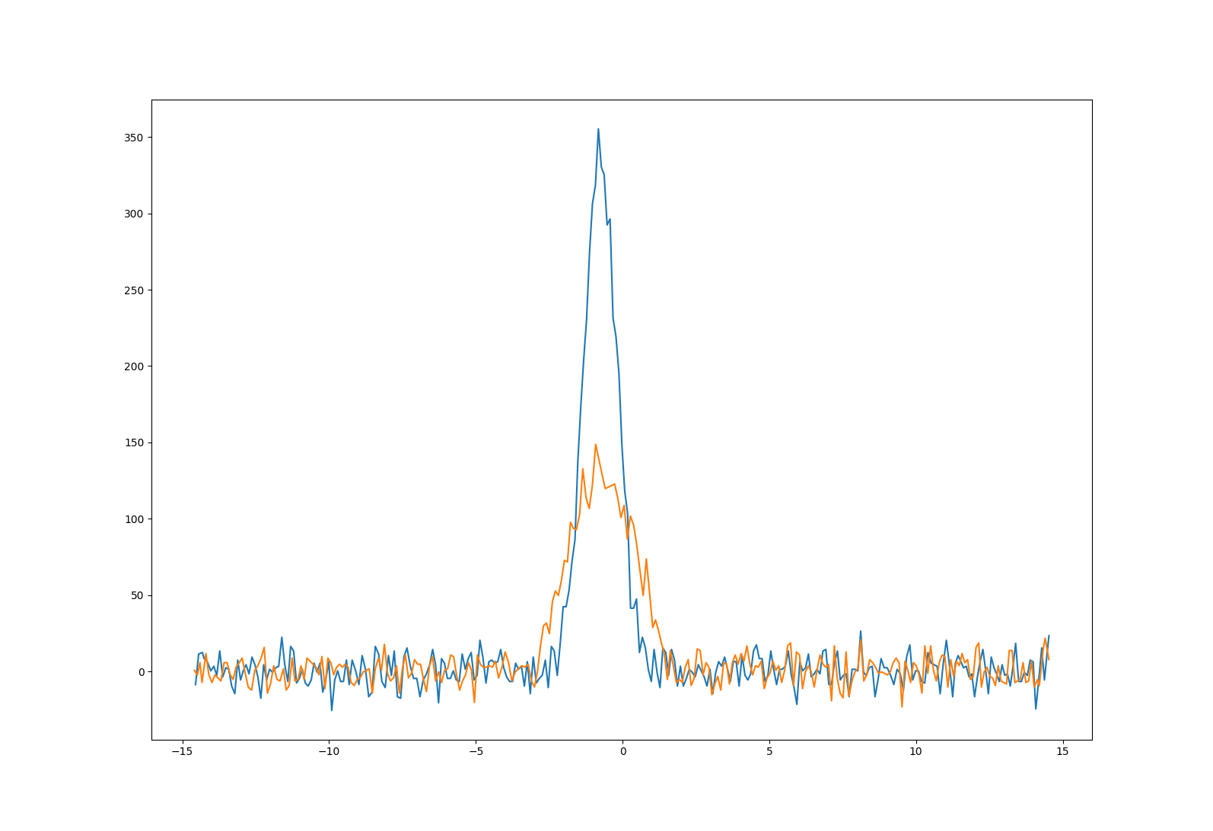
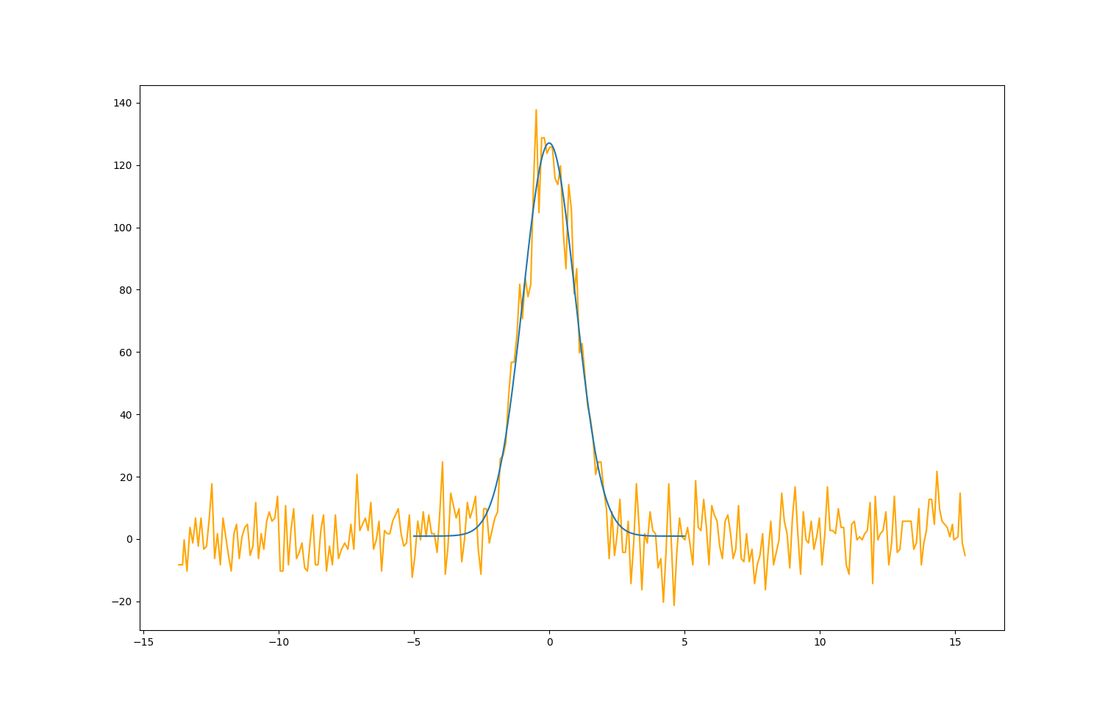
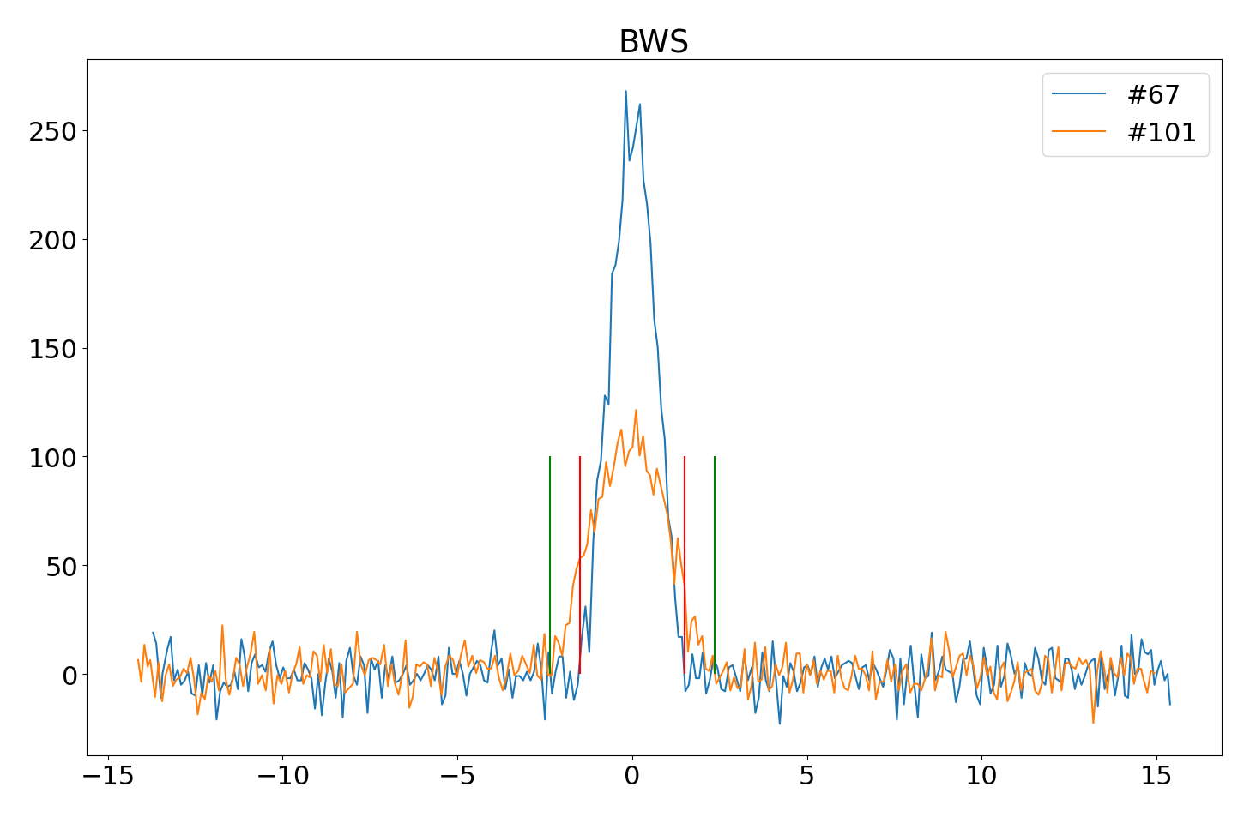
Illustration of the analysis procedure
BWS
Integration region
Raw data
Gaussian Fit
BSRH
Raw data
Projection + Fit
Scaling factor
Integration region → Charge in halo

Slide 13
Machine development session(s) - overview
How to asses the performance of the instrument?
Scrape the beam to known size → beam halo = 0
Blow up a bunch (ADT) to populate the halo region
Measure charge in halo by two instruments (BWS, BSRH)
MD1:
Nominals and pilots (- charge resolution of the BWS)
Tried to measure changes in the profile
MD4:
Pilots only (+ charge resolution of the BWS)
Online analysis ready
Lessons learnt

Slide 14
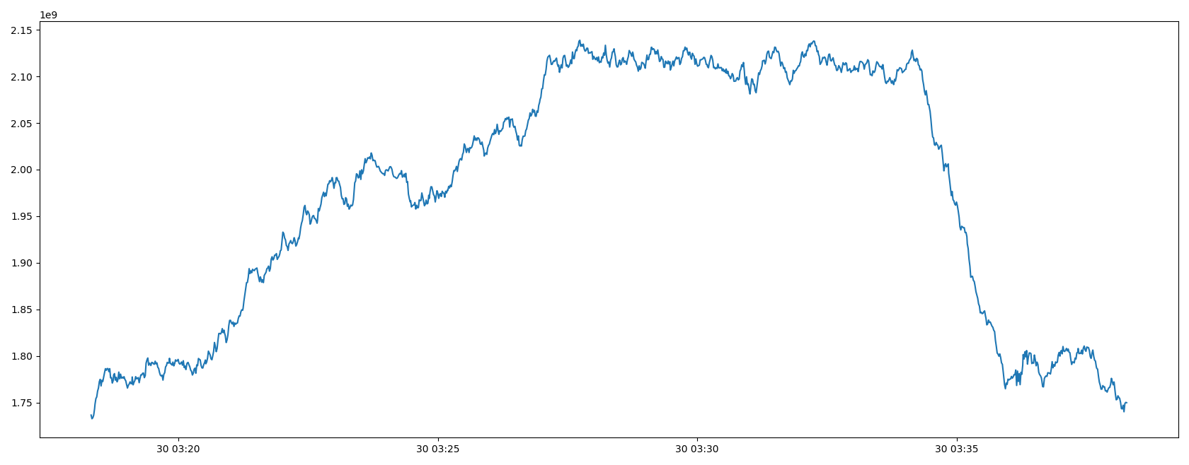
Data handling
1.6x10⁹
Subtract background (known from collimator position)
makes the measurement only relative

Slide 15
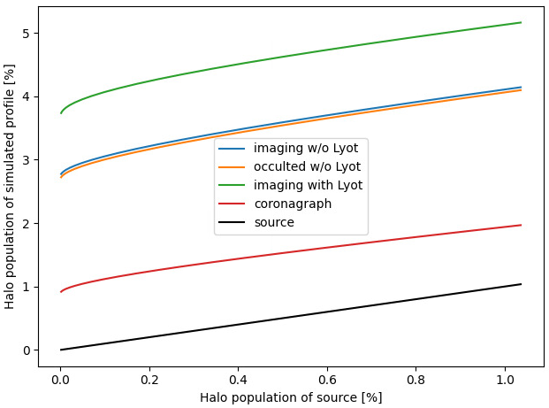
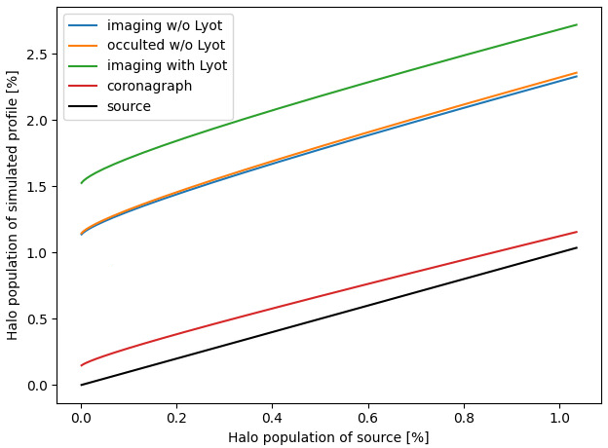


Simulation proof of linearity
Diffraction creates offset, yet linearity unchanged (for the “Gaussian” blow up)
Constant offset
$$σ_{}=σ_{nominal}$$
$$σ_{} ={2σ}_{nominal}$$
Courtesy of D. Butti

Slide 16
Performance overview

Slide 17
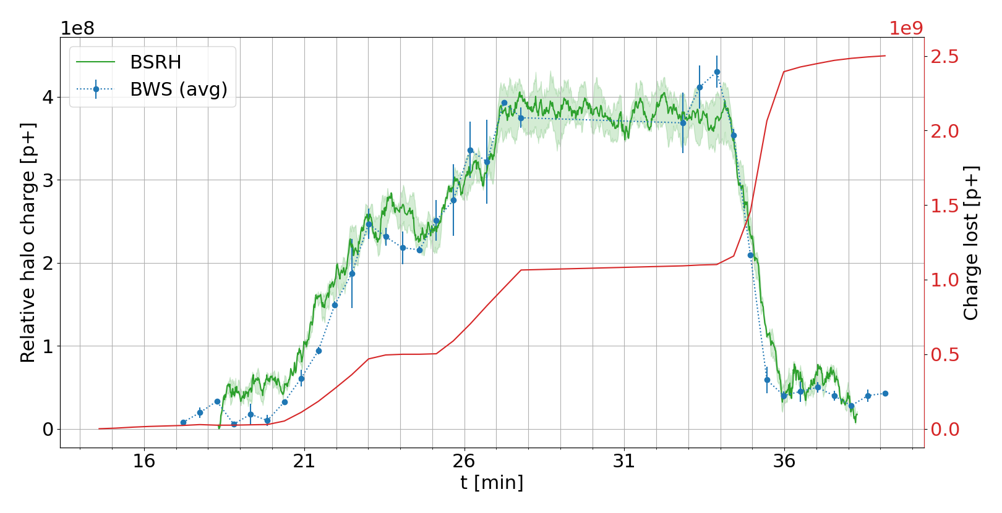
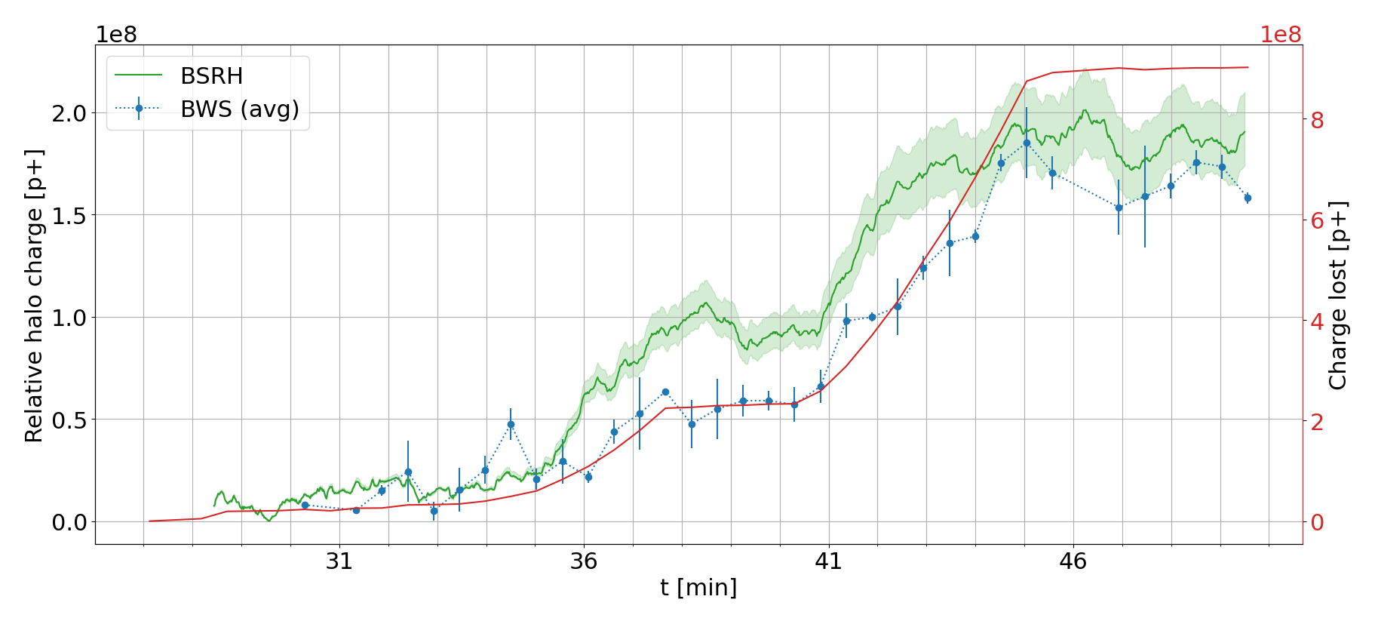
Vertical plane
Total population = 9x10¹⁰
Green curve = 15s moving average of the BSRH data, gated on 10 pilot bunches
Blue curve = BWS (average of IN/OUT) of the single pilot
Red curve = FBCT reading of the single pilot
Blow up
Steady state
Scraping
Blow up
Steady state
Halo above 3.5σ
Total population = 10¹¹
Halo above 4.7σ

Slide 18
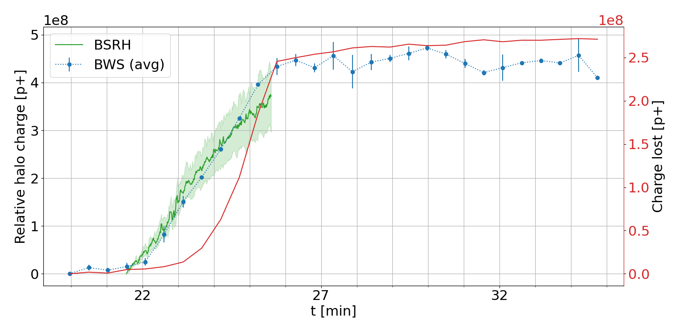
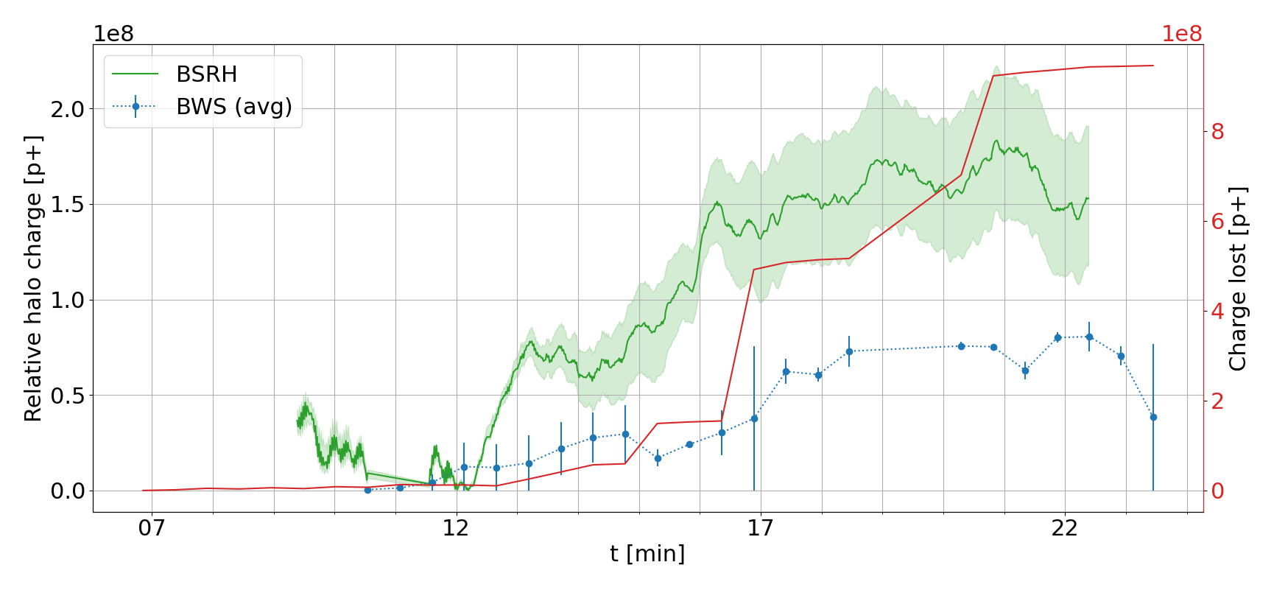
Horizontal plane
1
Single bunch measurement, 2s moving average, limit of “static” core
Reason behind the difference is unclear
Factor 2…
Halo above 3.5σ
Measurement of 10 pilots, one blown up, 15s moving average
Halo above 4.7σ

Slide 19
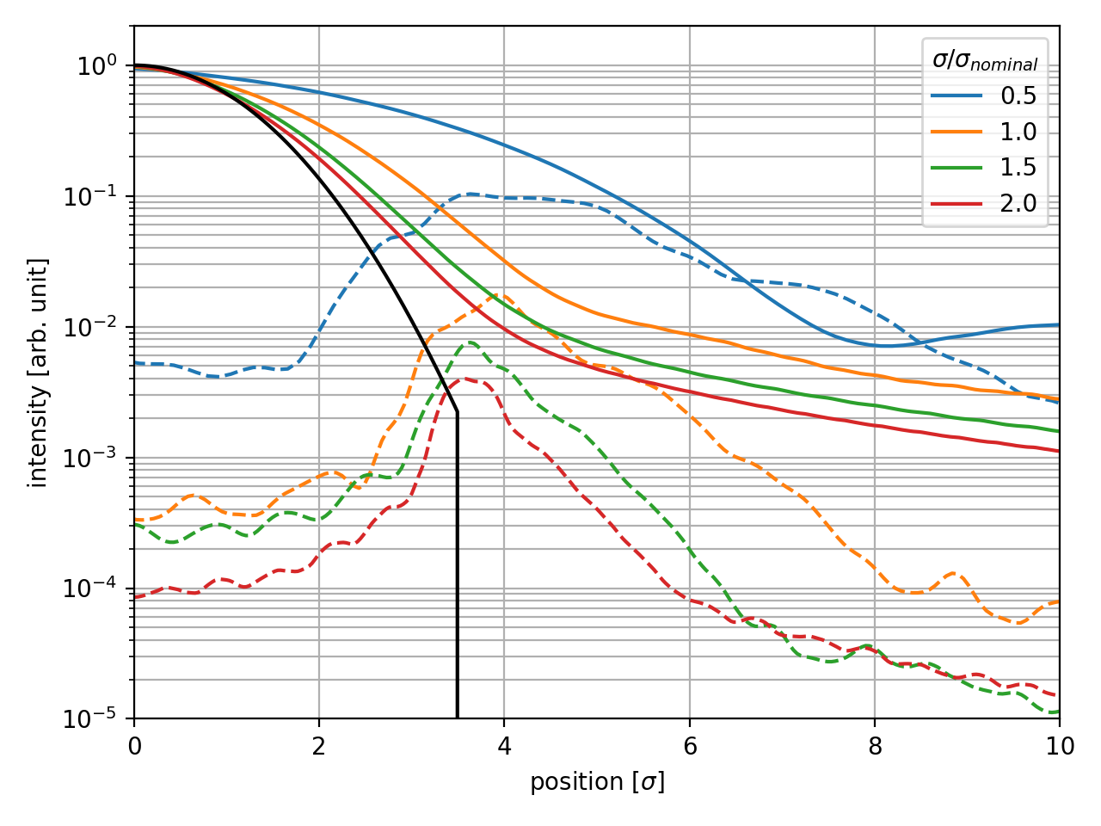
System status
Imaging
YETS underway
  Solving the image intensifier ripples
  Splitting the optical line BSRT to BSRH to make the systems work simultaneously
  Apodizer to be tested
Demonstrate potential profile/image deconvolution
Prepare procedures for automatized data taking during physics fills
Only way to increase the resolution is to increase the beam size
Coronagraph

Slide 20
Summary Table
Performance Metric | Required Range | Use Case(s) | BSRH
Contrast | 10^-4 to 10^-6 | Collimation: 10^-4 at upper bound MP: 10^-6 at 6.7σ | Currently unknown
Relative Integral | 0.2% to 5% | Collimation: 5% to 0.5% MP: 1.4% to 0.2% | <0.1% (relative)
Absolute Integral | 10^10 to 10^12 | Collimation: 1.5×10^12 MP: (1-4)×10^10 | Currently unknown (~1.5% during MD)
1D Profile Capability | Yes/No | Required for Beam-Beam | Yes
2D Image Capability | Yes/No | Required for Beam-Beam | Yes
Max. Acquisition Rate | 10-60 seconds | MP: ~10s Others: ~60s | ~20Hz (time for full beam depends on the gated sample - >100s for full machine bunch per bunch, around 3s for 48b., limited by data processing)
Bunch-by-Bunch Gating | Yes/No | Required for Beam-Beam | Possible
Number of Turns Needed | - | All cases accept multi-turn | Order of 100 turns (depends on gated sample)
Interlock Capability | Yes/No | Required for MP | Warning possible, Software interlock?

Slide 21
Final words
Important measurements during 2 MDs
A lot of SW work in the future
Hopefully in 2025 first halo data of physics run
  Currently only relative
  Through additional MDs we might lower the uncertainty and prove possible deconvolution of the measured profile/image and the PSF

Slide 22
Thank you for your attention

Slide 23
Backup

Slide 24
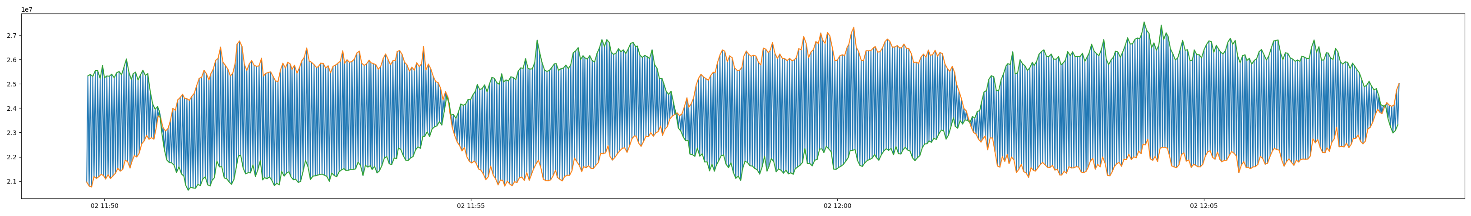
BSRH intensity problem
±10% intensity oscillation due to finite capacitance of the intensifier – change of intensifier model

Slide 25
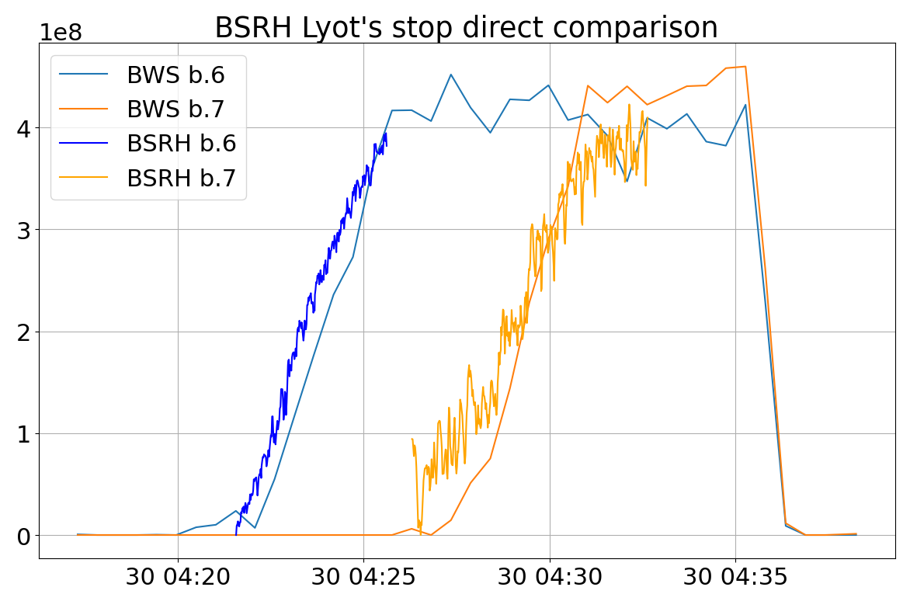
Lyot’s stop - data
Lyot’s stop closed
Lyot’s stop opened

