Slide 1
Beam Synchrotron Radiation Halo (BSRH) monitor: Implementation during LS3
F. Roncarolo
With precious input from:
W. Andreazza, E. Bravin, S. Burger, D. Butti, T. Lefevre, S. Mazzoni, C. Pasquino, J. Pucek, G. Trad, R. Veness et al.
HL-LHC Beam Halo Monitor Review, 18-Dec-2024

Slide 2
Contents
Recall of present BSRs implementation
BSR for beam halo (BSRH)
  Pre-LS3 studies, achievements, plans
  Possible LS3 implementations and dependencies
Conclusions / Outlook / General Considerations

Slide 3
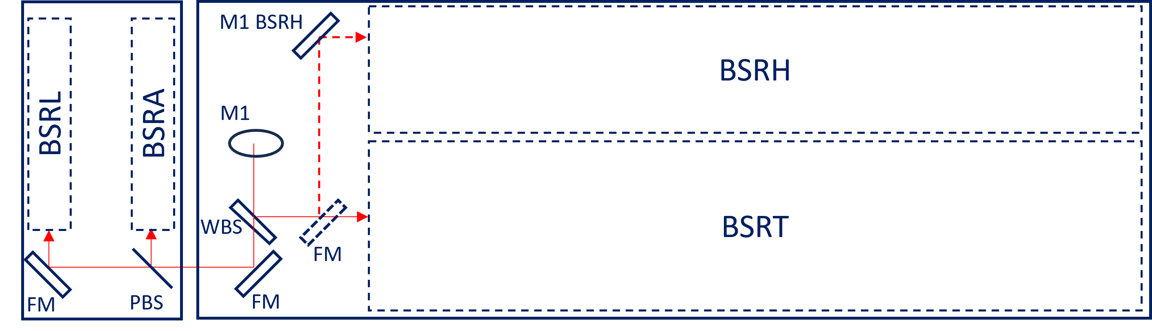
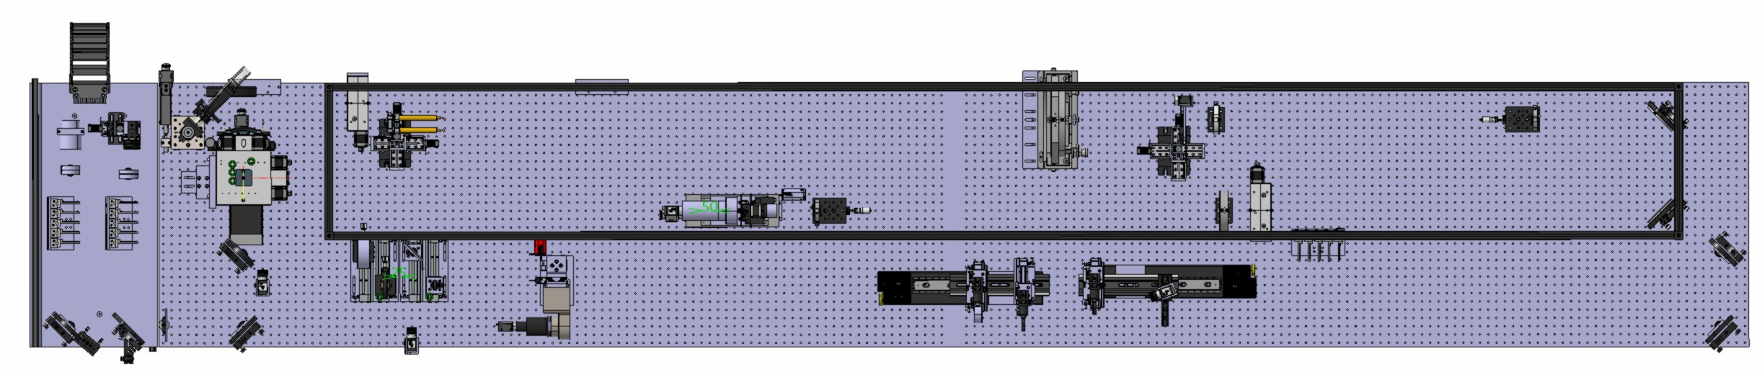
Present BSRs implementation
Optical Table Below Beam Pipe
1 Beam Synchrotron Radiation Halo (BSRH) monitor (coronograph layout) system @ BSRTM 5L4 (Beam 2) , all details in previous talk by J.P.
Schematic Layout
BSRH
BSRA
BSRL
SR from BSRTM
BSRT
Cad Drawing
Readout camera
Occulter (masks)
Lyot’s stop
Light in
BSRH
BSRT

Slide 4
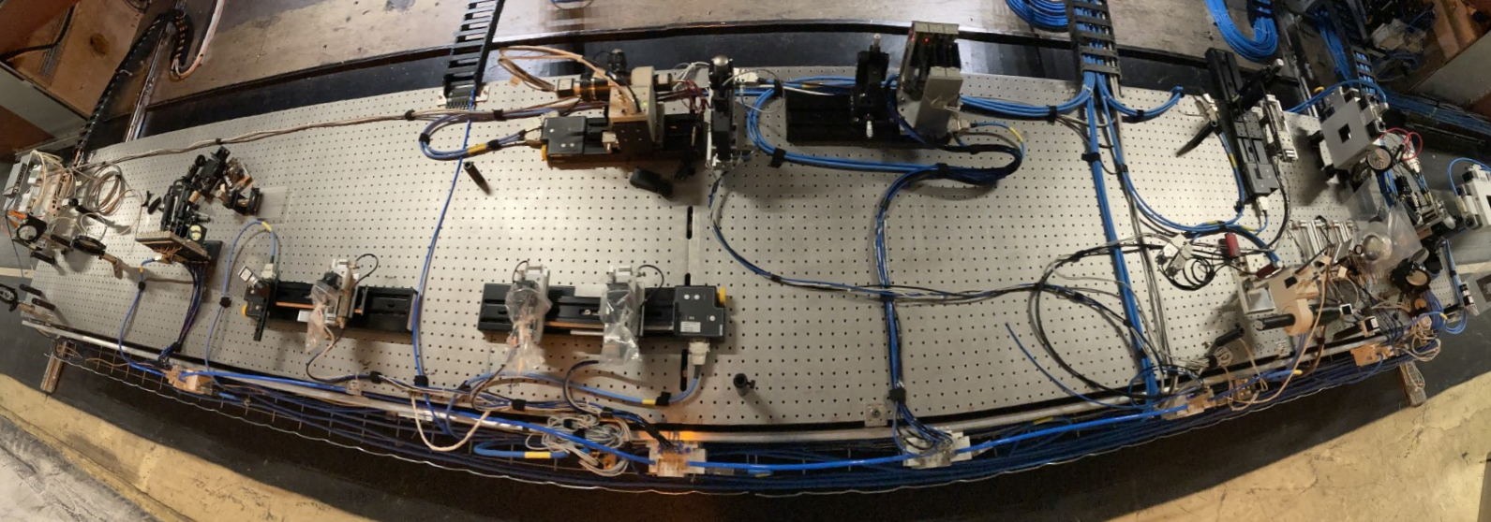
Present BSRs implementation
Almost for every intervention the table below beam pipe must be ‘extracted’ via rails on passage area

Slide 5
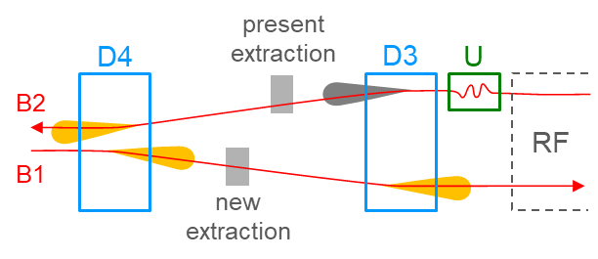
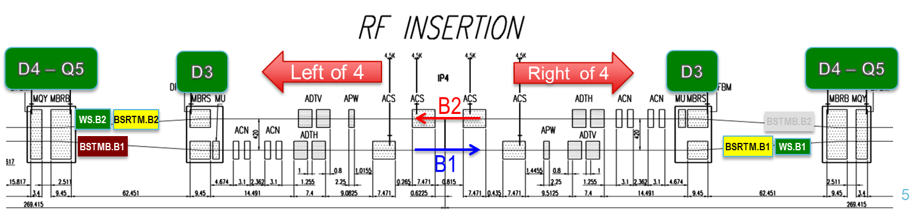
Present BSRs implementation
BSRTM
2 (B1, B2) x BSRTM extraction systems
  SR from Undulators and D3 dipoles. Layout and sha
  Operational, evolved since LHC startup. Today serving transverse beam size (BSRT) and longitudinal (Abort Gap - BSRA, Longitudinal Density - BSRL) monitors
1 (B1) x BSRTMB extraction system
  SR from D4
  New extraction mirror design, movable with beam energy, see next slide
BSRTMB

Slide 6
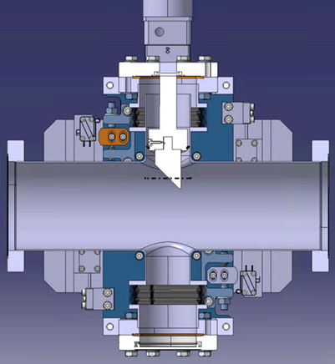
Pre-LS3 Development Phase
What is already designed (completed), installed, validated
BSRH prototype Beam2 @ BSRTM. Two MDs 2024, all details in previous talk
BSRTMB (Second SR Source) - HL-LHC baseline:
  Completed design, RF studies, and lab measurements
  Installed B1 system with movable mirror for aperture/impedance tests
    Successfully integrated with LHC operations and interlocks
    Confirmed no RF heating issues via temperature monitoring
  Coated mirror installed B1, for 2025 beam tests
  Infrastructure/integration:
    Cables and fibers ordered for both beams
    Space reserved for B1 and B2
    Vacuum integration design ~complete
    Schottky monitors (BQS) B1 and B2 swap to optimize future BSRTMB B2 upstream pipe aperture
    D4-BSRTMB enlarged chambers in procurement
Movable mirror to optimize light collection at flat top and reduce effect of diffraction from edge

Slide 7
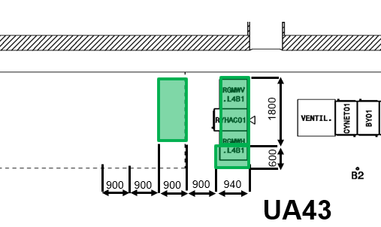
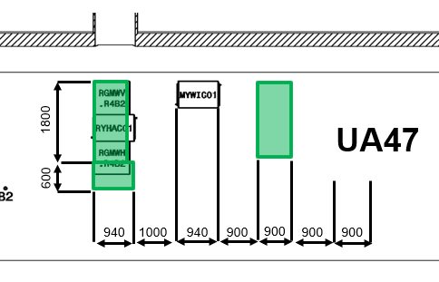
Pre-LS3 Development Phase
What is planned and expected to be implemented before LS3
BSRH prototype Beam2 studies:
  systematic studies (2025: possible in parallel to BSRT), in MDs and normal operation.
  propose / test simplified version (e.g. apodized occulter)
2025 BSRTMB B1 Testing Plan:
  Light collection efficiency validation (Q1-Q2)
  Parasitic SR impact assessment from upstream magnets (Q2)
BSRTMB-UA optical line
  ZEMAX simulations (by Q2 2025)
  complete (ongoing) integration (by 2026), e.g. to allocate space for BSR optics as close as possible to UA wall
Spaces for HL-LHC BGI magnets PS
SR from RA → UA via existing core
Courtesy of Miguel Navarro Baeza ATS-DO

Slide 8
LS3 Implementation Phase
Context Recap
2024 SR sharing setup
Instrument | B1 Splitting Ratio | B2 Splitting Ratio
BSRT (Synchrotron radiation telescope) | 0.35 (or 0.70 if BSRI splitter removed) | 0.70
BSRA and BSRAN (Abort gap monitor) | 0.15 | 0.15
BSRL (Longitudinal density monitor) | 0.15 | 0.15
BSRI (Synchrotron radiation interferometer) | 0.35 | N/A (R&D on B1 only)
BSRH (Halo monitor) | N/A | 0.7 (redirects BSRT light)
BSRS (Slit scanner) | 0.35 (redirects BSRI light) | N/A (R&D on B1 only)
Current Setup:
Located below beam pipe at BSRTM locations
Used for multiple measurements:
  Transverse (BSRT)
  Longitudinal (BSRA - abort gap monitor, BSRL - density monitor)
  R&D and prototype testing (BSRA, BSRI, BSRS)
Key Challenges:
Tables are ‘overcrowded’, with SR shared among detectors via splitters/mirrors
Access difficulties - maintenance
Radiation concerns for detectors and electronics in Run3, expected to worsen in Run4

Slide 9
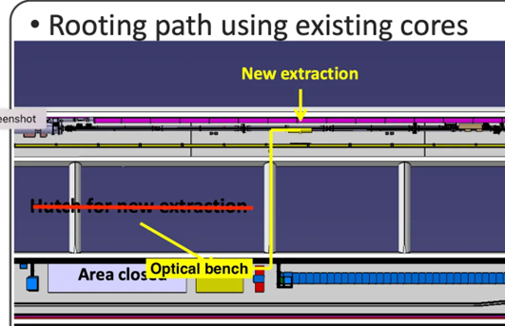
LS3 Implementation Phase
Option 1
Option | Advantages | Disadvantages | Dependencies
1-BSRTMB with RA→UA Optical Lines | Higher light collection Less system interdependency Redundant diagnostics Immunity to radiation Future-proof for LS4 (e.g. Undulator option) | More systems to maintain, including +2 viewports Longer outside vacuum (at optical line (see note** on the side) SR only above xx TeV (no injection) | • Optics validation (Zemax simulations) (Q1-2 2025) • UA integration
2-BSRTMB without Optical Line | Shorter outside vacuum optical line | • Difficult access • More shielding needed • Higher total cost | Budget for shielding tbc
3-Upgrade Existing BSRT | maintenance of 2 systems only | Crowded tables, difficult access BSRA-BSRT-BSRL systems intercedences Radiation exposure | RF impedance of present BSRTM with HL-LHC beam parameters to be re-checked
RA 43(47)
(BSRTMB)
8m
UA 43(47)
** at least 8m to go to UA , detailed optics tbc
All options compatible coronagraph or other (simpler) SR based beam halo monitor. This can include
More standard ‘occulting’ imaging telescope. No need for Lyot stops and related re-imaging present in coronagraph
HDR camera: can re-iterate on ultimate performances reach (update survey made many years ago)
Slit Scanner

Slide 10
LS3 Implementation Phase
About non confirmed plan and open items requiring resolution/decision (picking from previous slide and previous presentation), focusing on Option1:
Technical challenges:
Ultimate reach of SR based BH monitor
Bringing system to be operational
Resource gaps
HL-LHC GRAD : needed at least till end of commissioning Run4
Approval/coordination needs,
Big efforts in 2024 to include all possible options in the planning. See also next slide. All should be ~clear including support from integration, cabling, vacuum and other groups/teams/units.

Slide 11
From PLAN Tool
Activity 12854 | BSRT Upgrade activities for HL LHC | SY-BI | FEDERICO RONCAROLO (SY-BI-PM) | 3. HL-LHC project | HL-13
DOCUMENTS
Type | Description | Status | Information
ServiceNow | Cable installation, number of cables: 34, lenght: 3400, LHC, LS3 | In progress | Open
ServiceNow | [HL-LHC] Fiber Optics installation: LHC - LS3 | In progress | Open
EDMS | Installation of a Compact Imaging System on BSRTMB.5L4.B1 Device | Approval Accepted | Open
EDMS | HL-SRR - Beam Synchrotron Radiation Telescope (BSRT) | Approved | Open

Slide 12
Post-LS3 Phase
Here: best estimate of the scenario, always focusing on Option 1 (but most of this applies to any BSRH option). Based on pre-LS3 plan execution.
Features/capabilities that
  Will be available after LS3: Enhanced BSR-based halo monitor system with continuous relative halo integral monitoring. Aim at basic OP GUI.
  Will need to be developed/implemented after LS3: Detailed performance characterization with HL-LHC beams and comprehensive reliability validation
Expected timeline for transition from expert to operational mode
  1 year after LS3
Known risks related to schedule and performance
  risks: ultimate reach in terms of sensitivity and relative/absolute accuracy dependency on technical choices, implementation, learning curves
  About schedule: what proposed = compatible with HL-LHC master schedule, tbc 2025

Slide 13
Budget (and Other General) Considerations
Budget status:
  Cost estimates for development and implementation phase vs available budget
    Present budget ok. If Option 2: possible risk is additional radiation shielding
  Funding gaps to be addressed ?
    For ensuring GRAD till after LS3 ?
Long-term budget considerations. Maintenance and operational costs, including manpower:
  General (also for beam profile monitoring via BSR):
    Need dedicated staff member for BSRs (currently vacant; Internal Mobility or LD position planned for 2026) + graduate student
    Maintain adequate technical support from SY-PM team for ongoing maintenance and operations
    Require expert SY-BI-SW staff support due to complex BSRs control architecture
  If Option1: +2 systems to maintain, may need to re-allocate or add manpower
Identify and anticipate potential future upgrade requirements:
  Radiation potentially an issue for electronics and detectors left in the RAs (tbc)
  New undulator ? (considered as option years ago, not in any plan now)

Slide 14
Outlook / Conclusions
Present BSRH B2 prototype installed on optical table below BSRTM, with all others BSRs
Present reach (e.g. absolute and relative resolution in measuring beam halo) discussed in previous talk
3 options presented for a BSR@HL-LHC with pro/cons/open questions
2025 fundamental to test present BSRH during physics + MDs and confirm optical line is a viable solution (optics simulations, lab tests)
Second SR extraction systems: completing integration studies + keeping enlarged vacuum chambers in VSC procurement looks to be best (only?) option for not loosing LS3 implementation opportunity

