Slide 1
Low Density Wires: Development for beam halo monitoring - status and plans
G. Aliana Cervera, C. Pasquino, R. Veness (CERN)
A. Lunt, D. Mattia (University of Bath)
HL-LHC Beam Halo Review

Slide 2
Summary
Presentations focus: Evaluate results and benefits of carbon nanotube (CNT) wires for beam halo monitoring
Key properties of Carbon Nanotubes
Practical considerations
Potential operational impact
Thermal studies
Quenching studies
LSS4 – B1
LSS4 – B2

Slide 3
Intercepted material for gaseous and solid devices
Molecular mass of interceptor
Quench, material strength and handling limits
Matter particles intercepted by the beam (mol.m⁻²)
(1) Slide provided by R. Veness

Slide 4
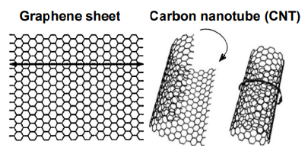
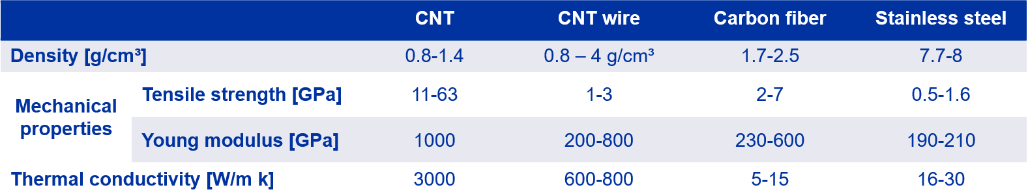
Key properties of Carbon Nanotubes
Allotropic form of carbon.
Graphene sheet coiled in a specific direction.
One or several walls (SWCNT – MWCNT)
Long and hollow nanometric structure
Figure 1. Carbon nanotube structure
Figure 2. SEM image of our Dexmat CNT structure
Exceptional properties
TEST RIG
(2)
Gerard Aliana Cervera | Low Density Wires: Development for beam halo monitoring - status and plans

Slide 5
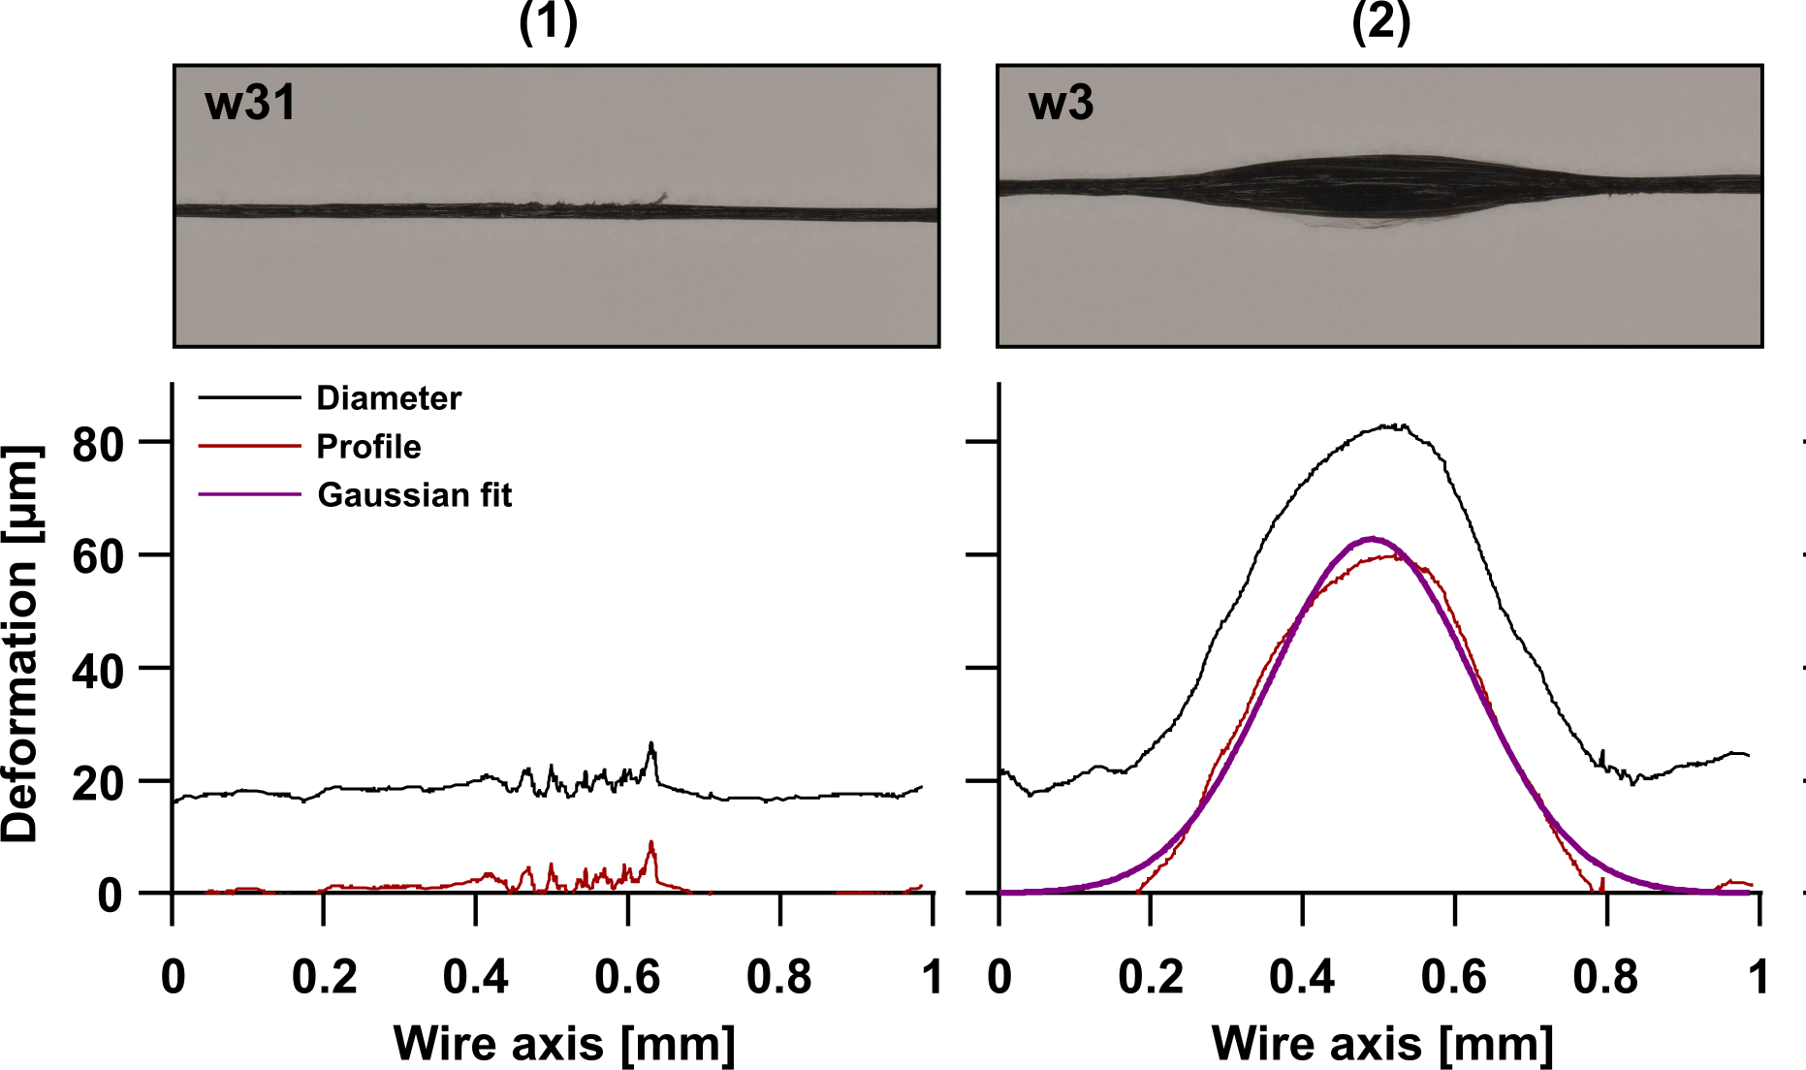
Practical considerations
High variability of performance.
  Each batch of wires needs to be tested on its own to ensure its characteristics.
Few available suppliers.
Required postprocessing.
Expected characteristics after treatment
Diameter(⌀) – 8 µm
Density (ρ)– 1 g/cm3
Figure 3. Optical microscopic images of CNT wire samples after irradiation. Profile of the deformation after image treatment with Gaussian fit (3)
No direct relation with the dose deposited
Obvious change of shape Residual iron particles melted

Slide 6
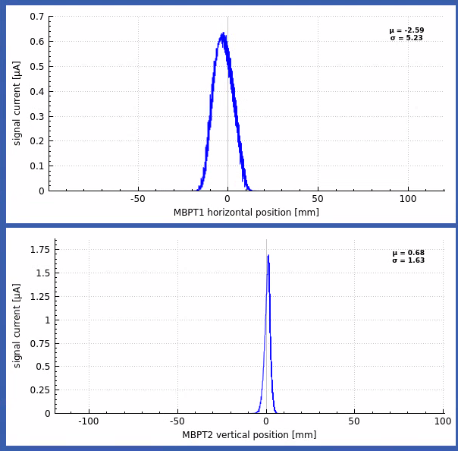
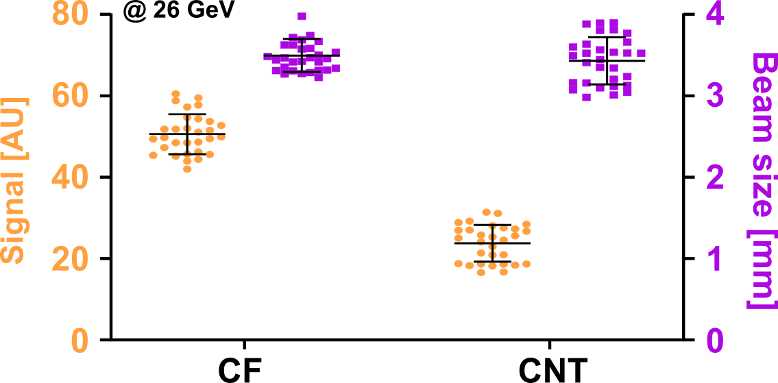
Potential operational impact
Capable of reading full intensity and energy of SPS beam.
Signal decrease compared to other wires.
Noise increase compared to other materials
PS conditions
CNT wire 30 µm
CF wire 34 µm
Energy 26 GeV
PSI conditions
CNT wire 20 µm
Molybdenum wire 25 µm
Energy 2.5 GeV
Molybdenum Dexmat CNT
Wire
Figure 4. Summary of integral signals and beam sizes for scans with CF and CNT wires at 26 GeV (3)
Figure 5. Example of a signal acquired using CNT wire at PSI compared to molybdenum wire. Provided by M. Sapinski (PSI)

Slide 7
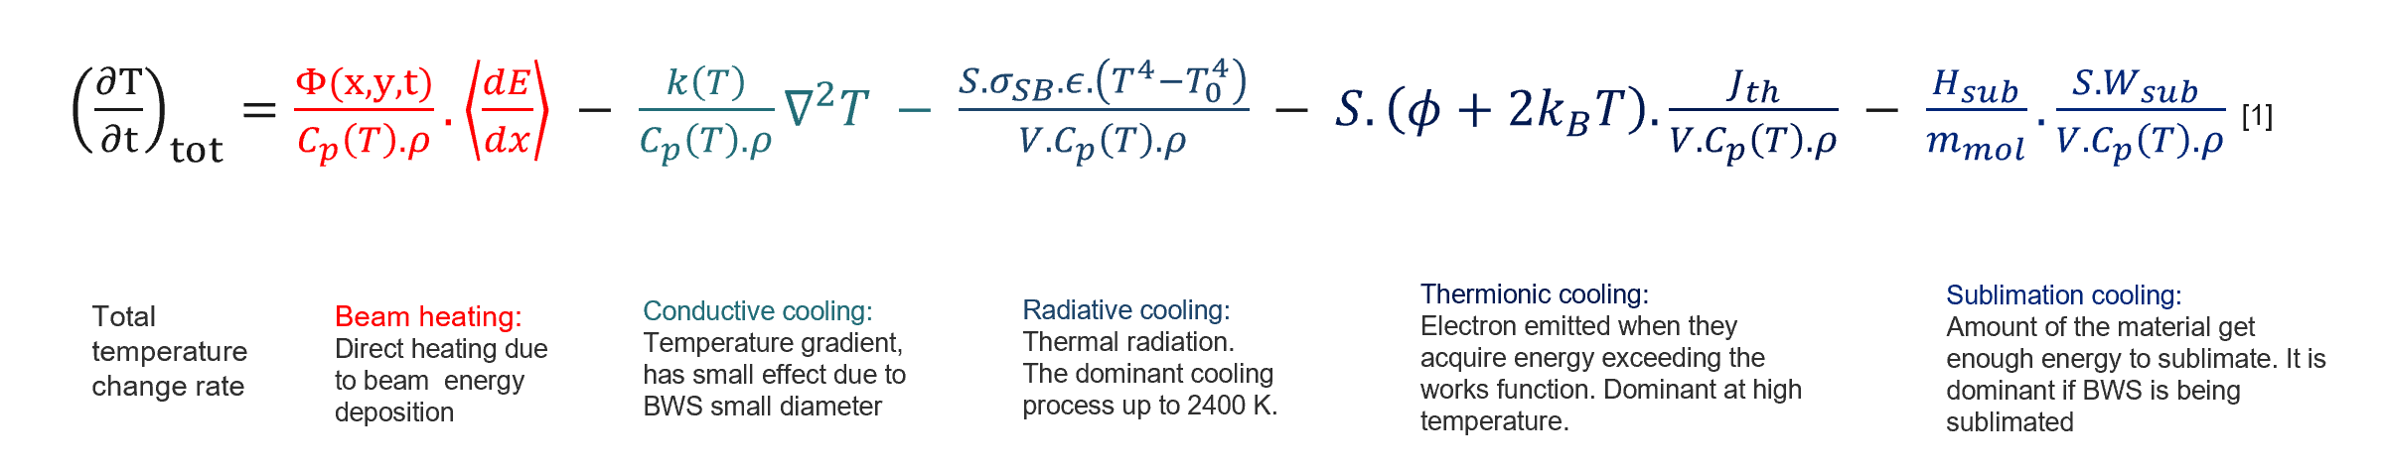
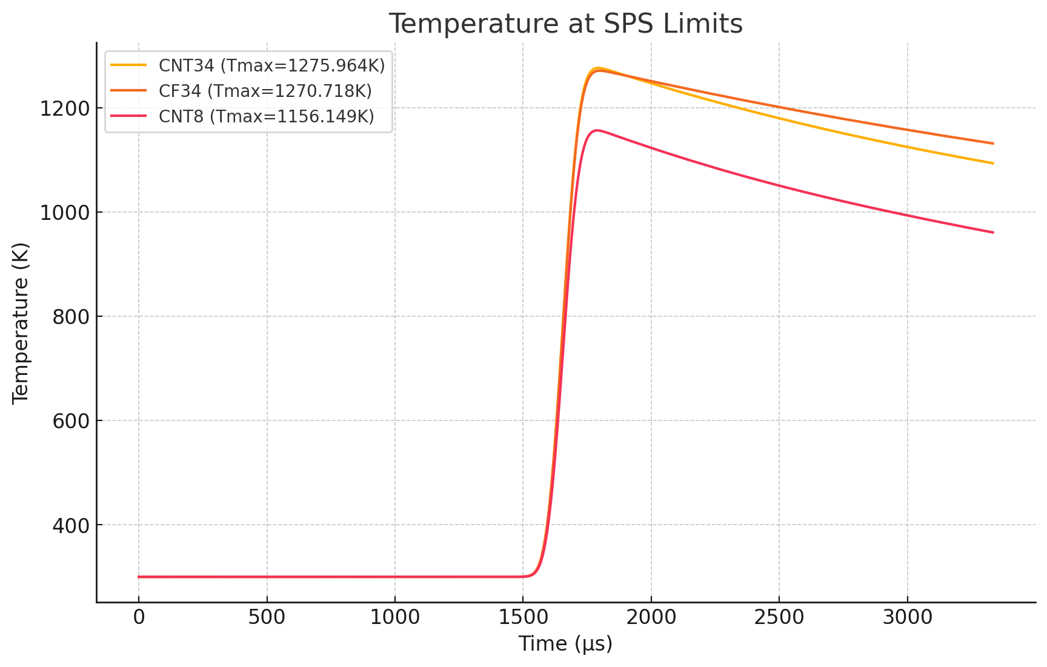
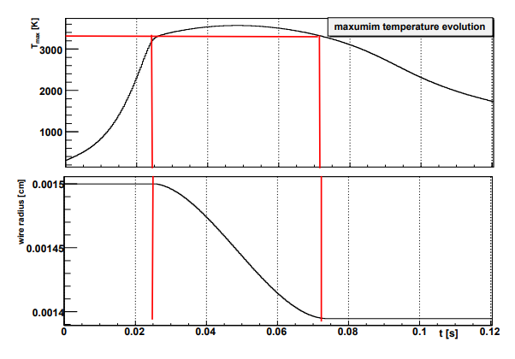
Thermal studies – Comparison with CF
Thin target detectors temperature equation
Figure 7. Temperature evolution of 34 µm CF and CNT wire at CF experimental beam limits in the SPS. Current expected 8 µm CNT wire temperature evolution under the same conditions.
Figure 6. Sublimation conditions in a WS (4)
(4)

Slide 8
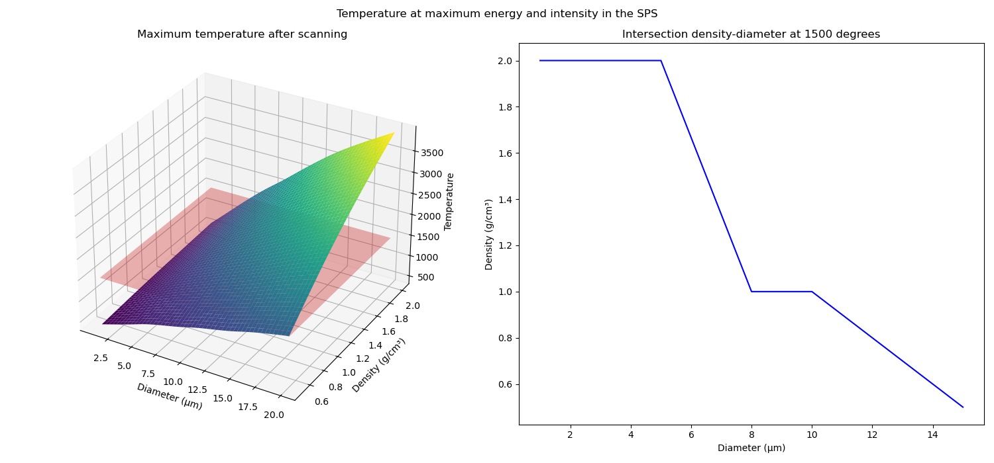
Thermal studies - Wire heating in SPS
Simulation conditions
Gaussian beam
Energy – 450 GeV
Intensity – 5,7e13
Scanning speed – 15 m/s
Temperature limits – 1500 degrees
Beam size of 1 mm
Sublimation cooling area
Current expected wire
Safe area

Slide 9
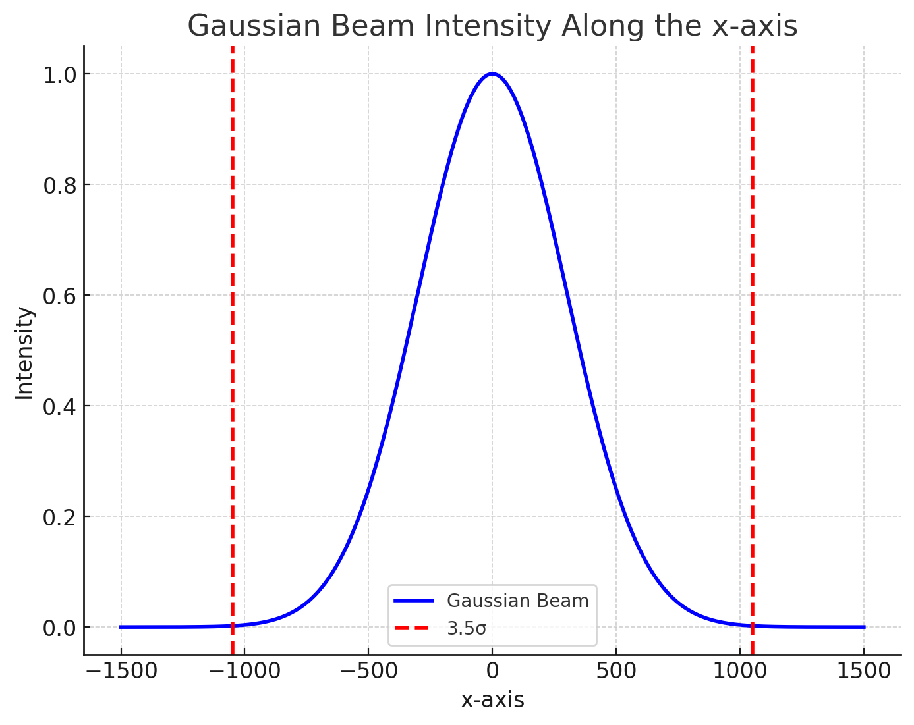
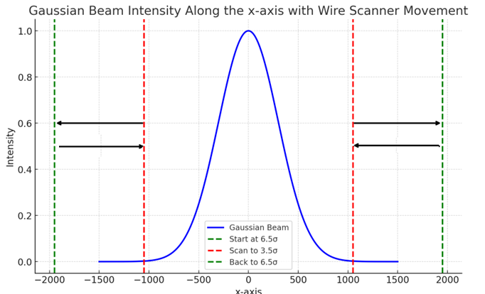
Beam Halo Monitoring approach to 3.5σ
Stationary wire
Scanning wire

Slide 10
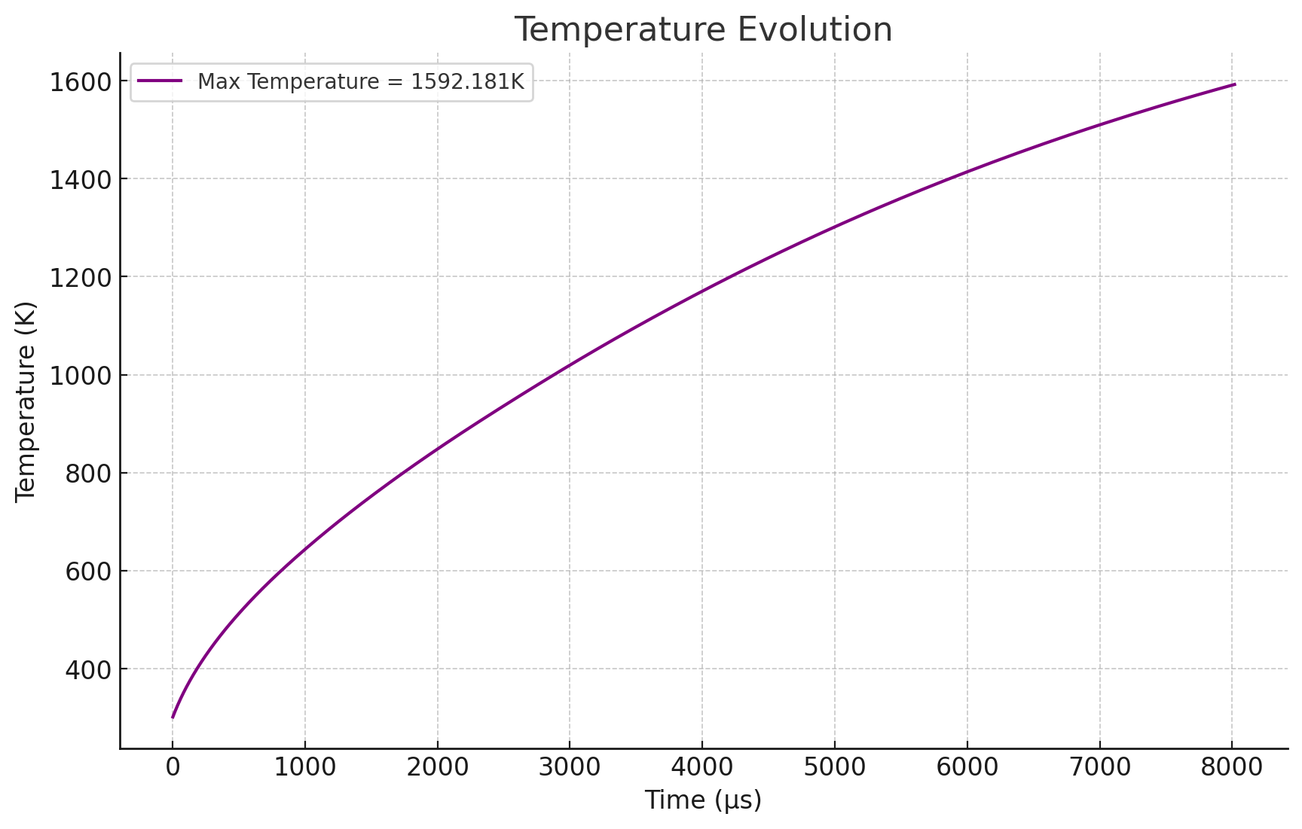
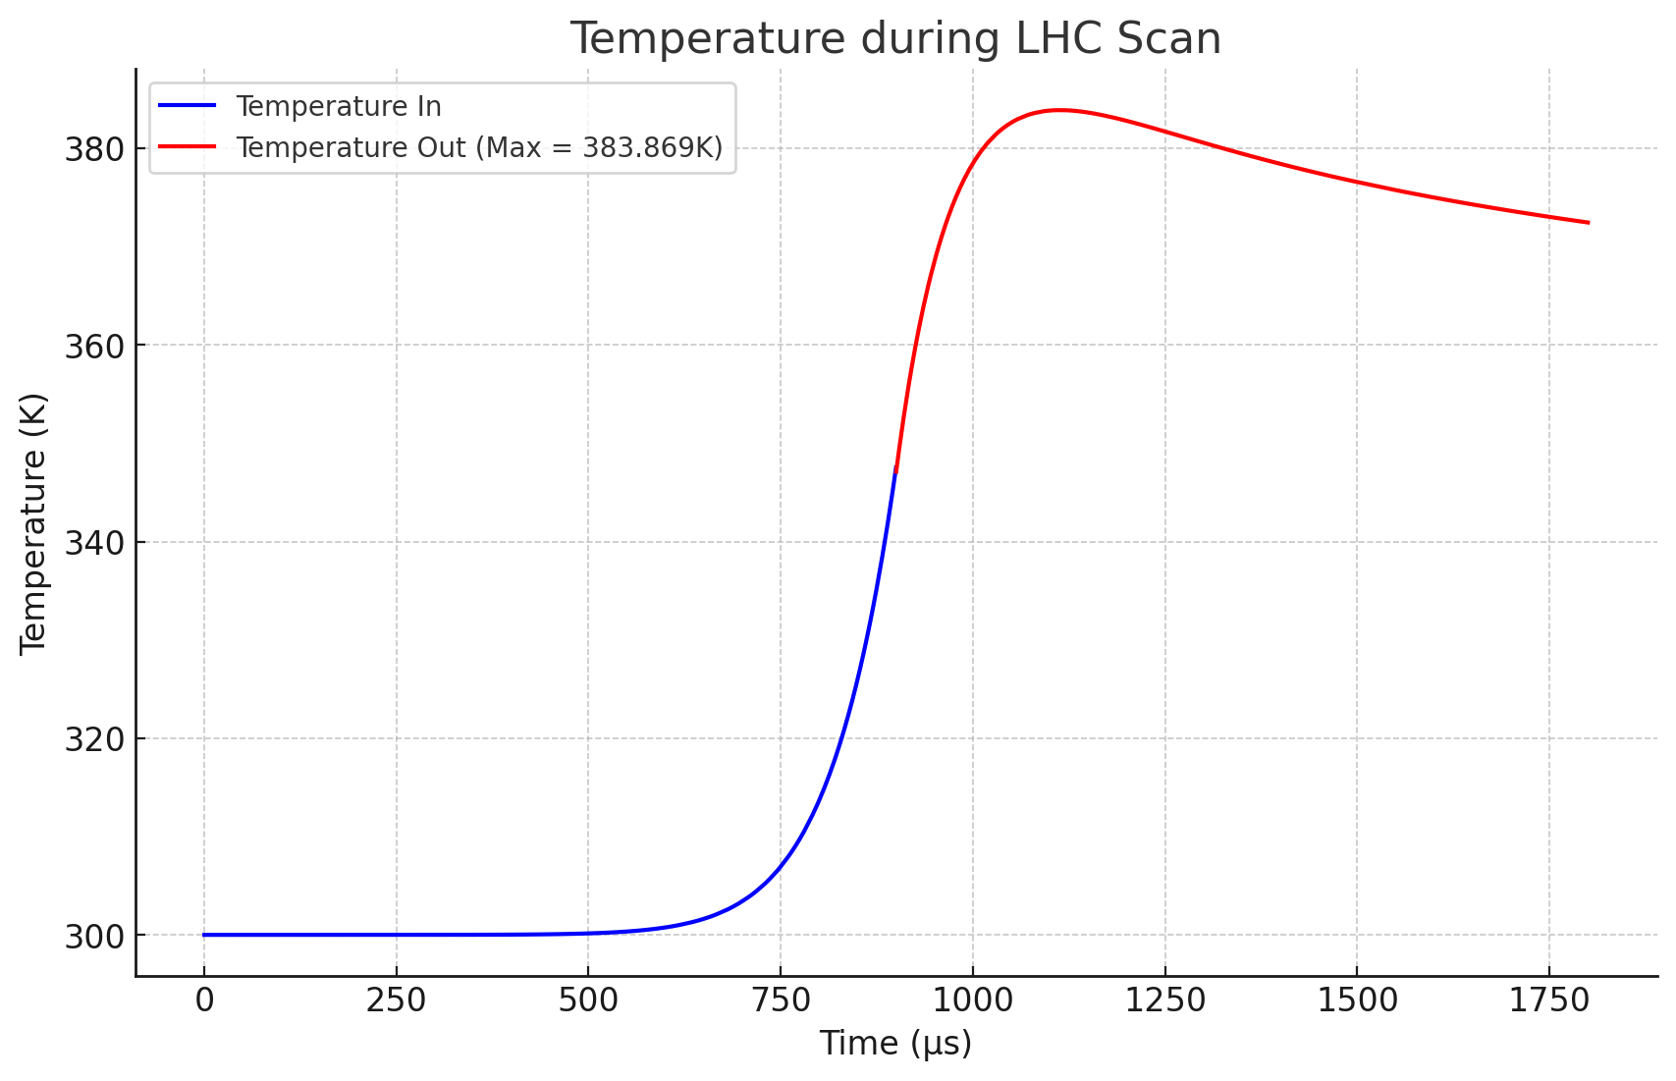
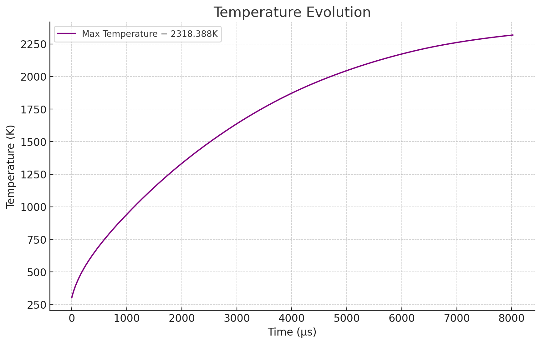
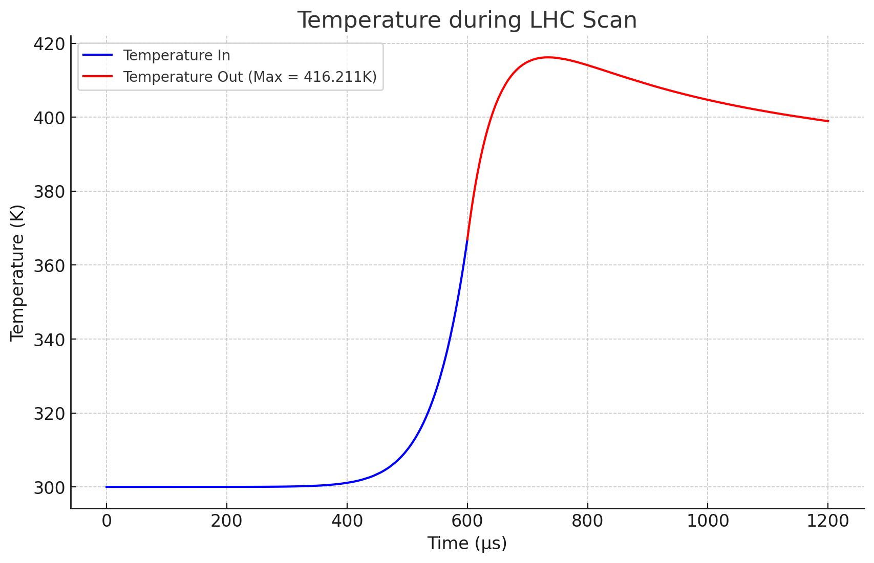
Thermal studies – Current wire in the BHM (3.5σ)
Beam size
Stationary wire
Scanning wire
300 µm
200 µm
w/ Collaboration of A. Abouelenain

Slide 11
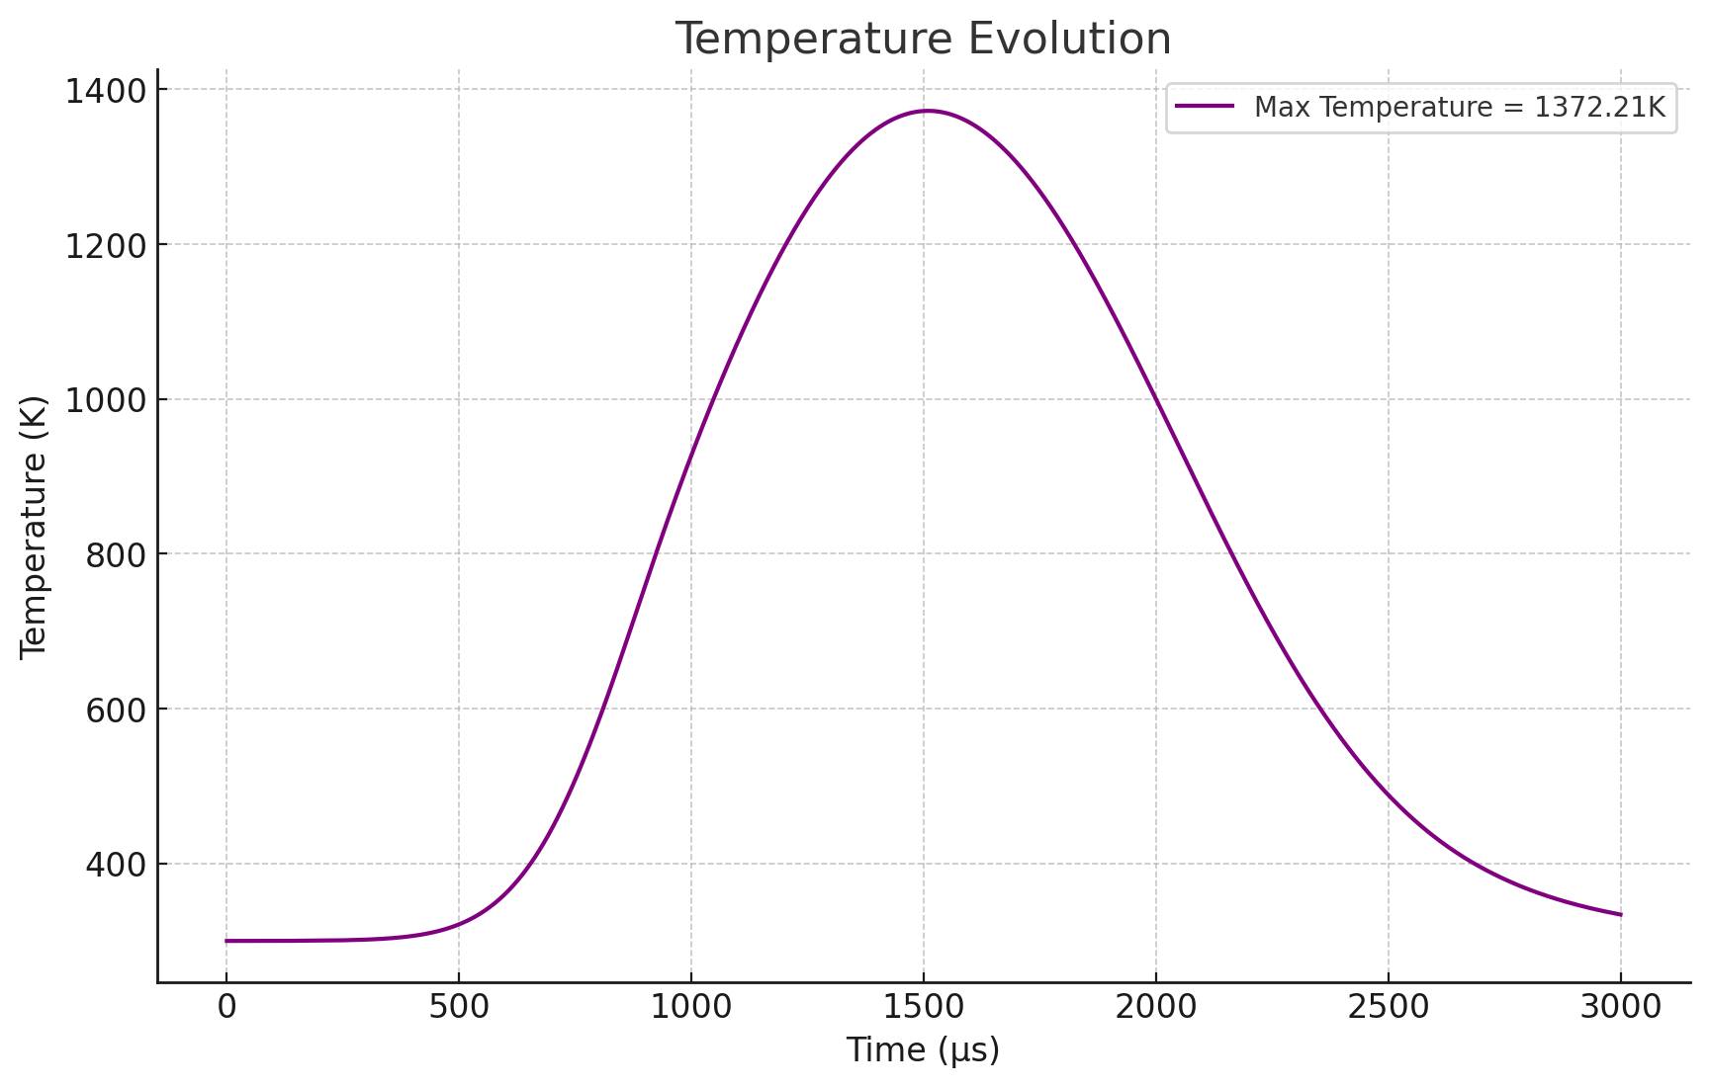
Thermal studies – Physical limits
Simulation Characteristics
Energy of 7 TeV – Intensity of 5.7e14
Limitations
Carbon atoms being knocked out have been neglected.
Wire defects have not been considered
Wire characteristics
0.01 µm of diameter .
Density of 0,8 g/cm3

Slide 12
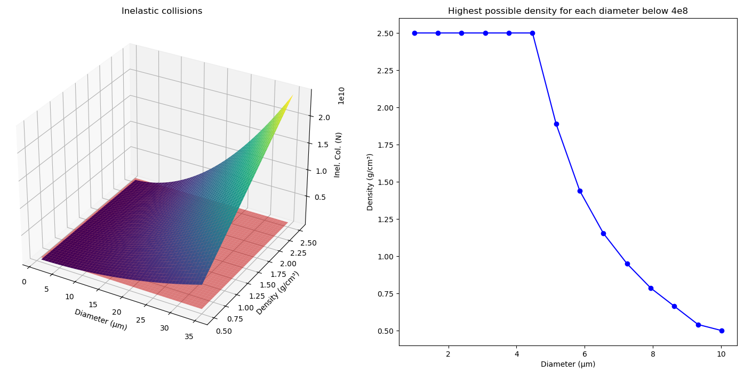
Inelastic collisions studies
Simulation conditions
Energy – 6,5 TeV
Intensity – 5,7e14
Scanning speed – 1 m/s
Quench limit – 4e8
Quenching area
Safe area
(5)

Slide 13
Conclusions
CNT-based Beam Wire Scanners (BWS) could enable precise and reliable monitoring of the beam halo, even at high intensities and energies.
  The low-density nature and small diameters of CNT wires reduce beam interaction, preserving beam quality.
  CNT wires exhibit improved properties over the current Carbon Fiber wire.
Streamlined integration with the next generation of linear beam wire scanner.
State-of-the-art advancements driven by active R&D, with key contributions from our collaborations with leading partners
  20-21 June 2023 Workshop - Low density materials for Beam Instrumentation
Further testing and characterization is required to ensure an adequate performance.
Concerning expected accuracy, contrast, signal levels, a BH monitor via wires needs more studies and simulations. Basic information can be inferred from standard BWS are:
  Present BWS flying at 1m/s -> achievable contrast in the range 1e-3 to 1e-2
  1D profile only (unless tomoscopy via multiple BWS can be implemented)
  Bunch per bunch possibility (may need to be integrated over many turns)

Slide 14
Thank you for your attention
Any questions?

Slide 16
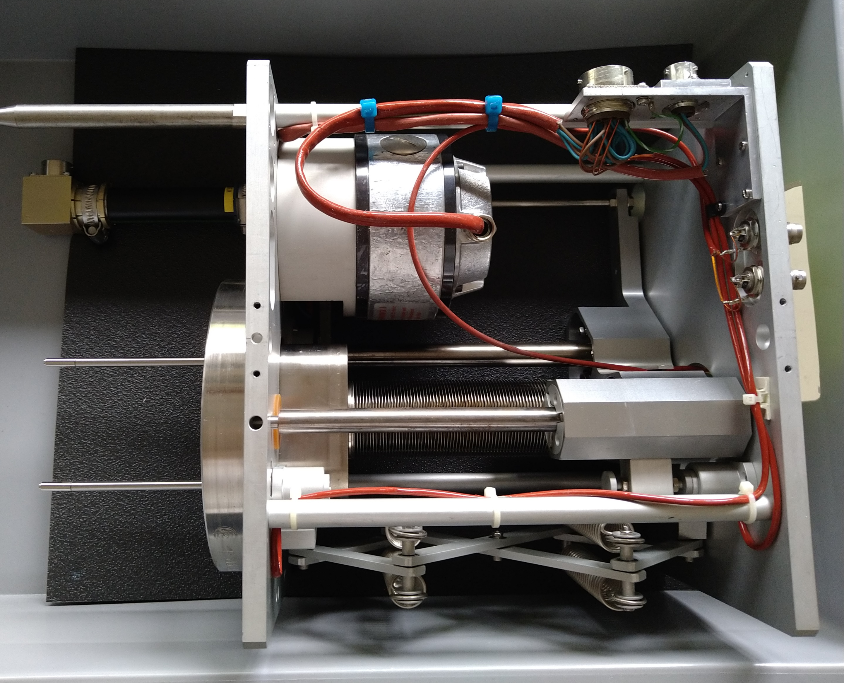
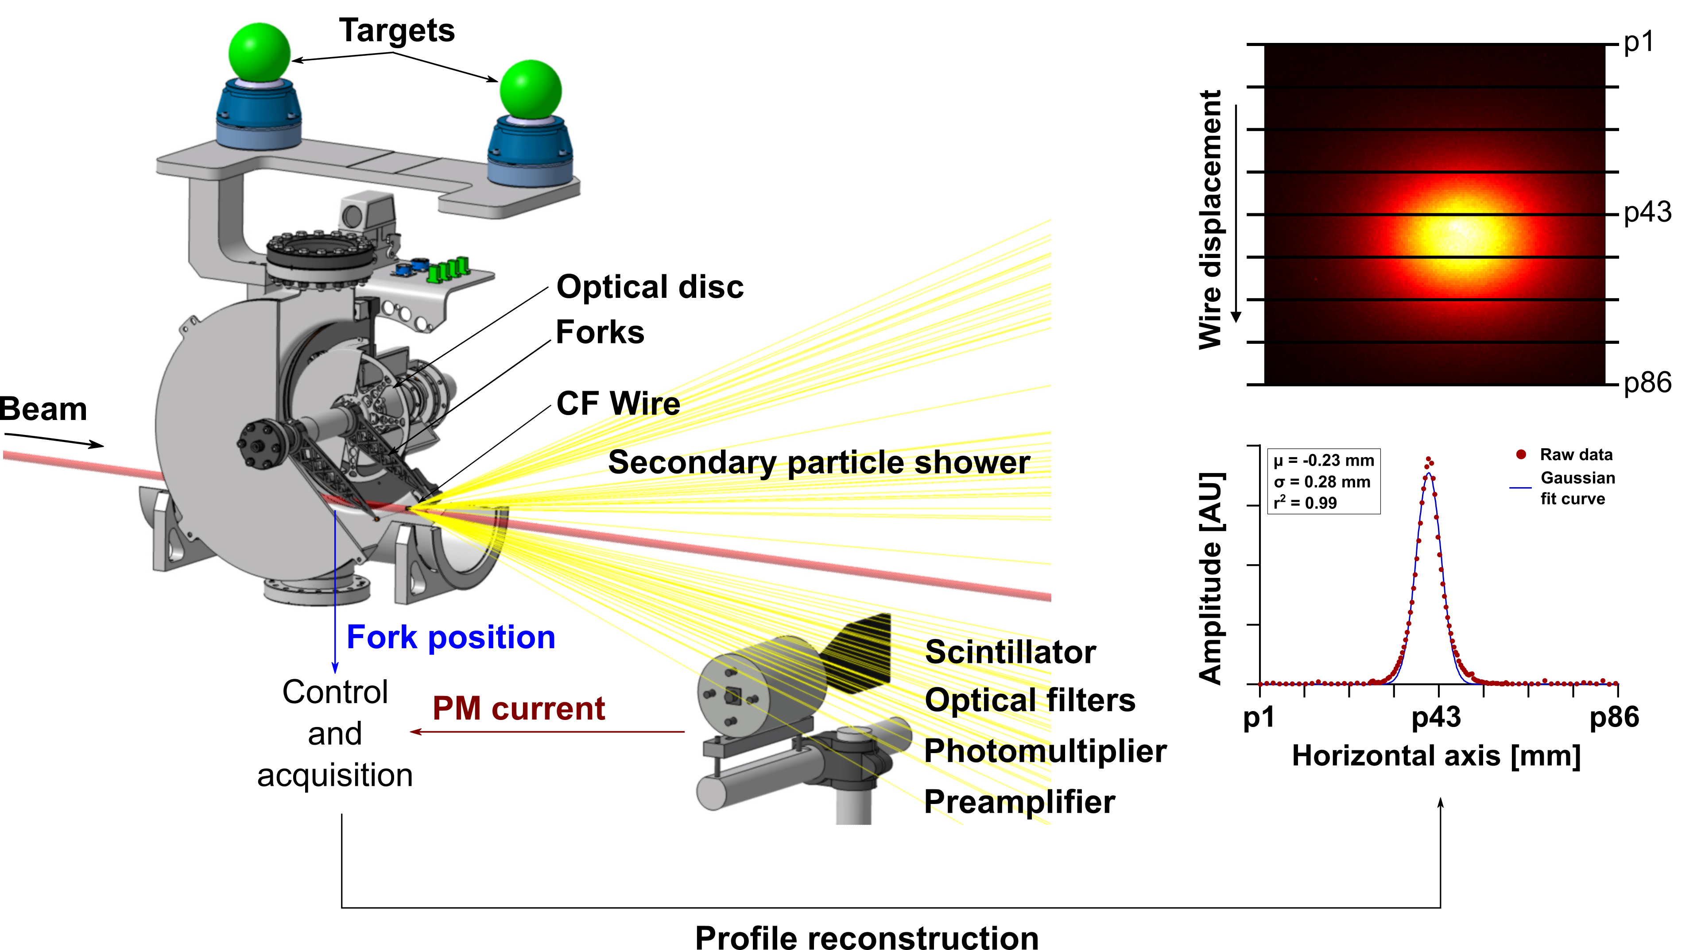
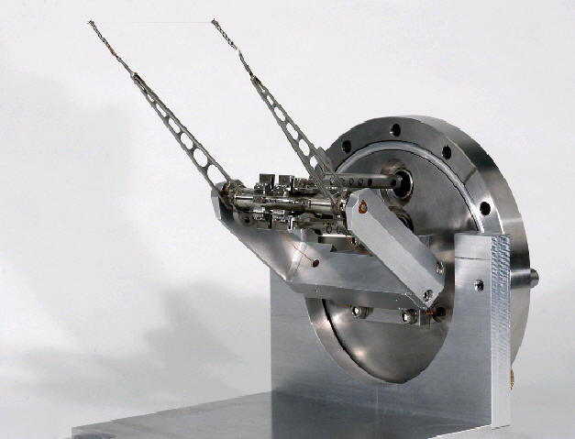
Wire-scanners (WS)
Figure 6. Linear and rotary Wire Scanners
A. Mariet (2023) [3]

Slide 17
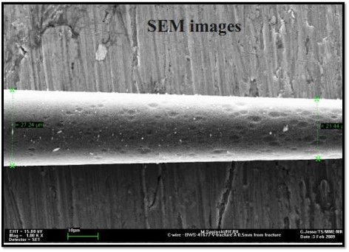
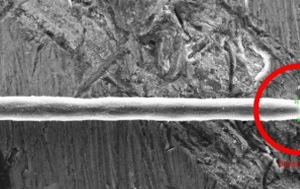
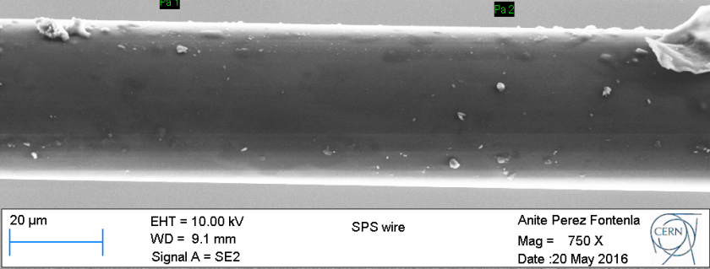
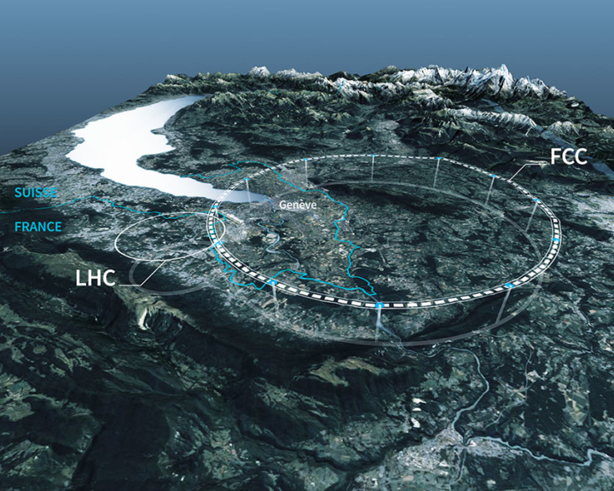
Wire scanners challenges
Wire degradation
Today, the ageing of Carbon Fiber wires is a limitation
d = 21 µm
d = 7 µm
d = 34 µm
0.5 mm away from the beam impact location
In the center of the wire
Figure 7. Pristine 34 µm Carbon Fiber (CF) before irradiation [3]
Figure 8. Aging Carbon Fiber (CF) after irradiation [3]
Future challenges of intercepting devices [4]
Machines
SPS
450 GeV
2 mm
LHC
7 TeV
200 µm
FCC
50 TeV
20 µm
Beam energy
Beam size
Max intensity (N_{p})
~ 5.10¹³
~ 3.10¹⁴
~ 1.10¹⁵
Figure 9. Future Circular Collider project representation

Slide 18
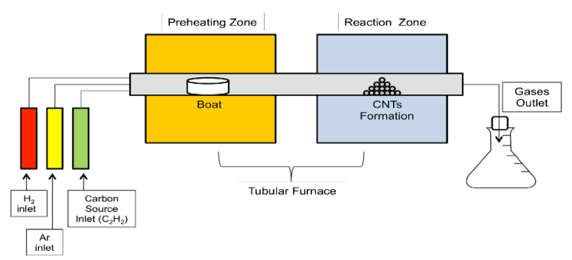
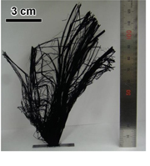
CNT manufacturing
CNT manufacturing methodologies [6]
Types of chemical vapor deposition for our purpose:
Thermal CVD (TCVD)
Plasma-enhanced CVD (PECVD)
Floating Catalyst CVD (FCCVD)
Catalyst-Supported CVD (Cat-CVD)
  Davide Mattia – University of Bath
Photo-Thermal CVD
Electric-arc discharge
Laser ablation
Chemical Vapor Deposition (CVD)
Figure 10. Chemical Vapor Deposition (CVD) schematic
Figure 11. Ultra-long CNT forest created by CVD [7]

Slide 19
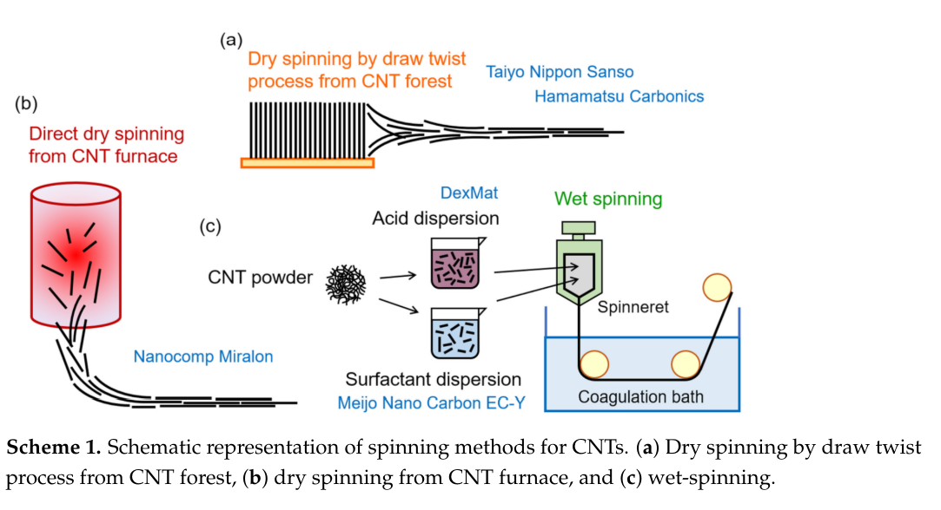
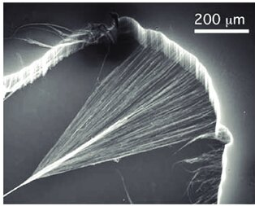
CNT wire manufacturing
CNT rope manufacturing methodologies [7]
Wet spinning
Dry spinning (solid-state)
Figure 12. Wet spinning procedure schematics
Figure 13. Dry spinning SS procedure schematics
Dry spinning from a CNT forest
Figure 15. Dry spinning from a CNT forest
Figure 14. Dry spinning from a forest procedure schematics

Slide 20
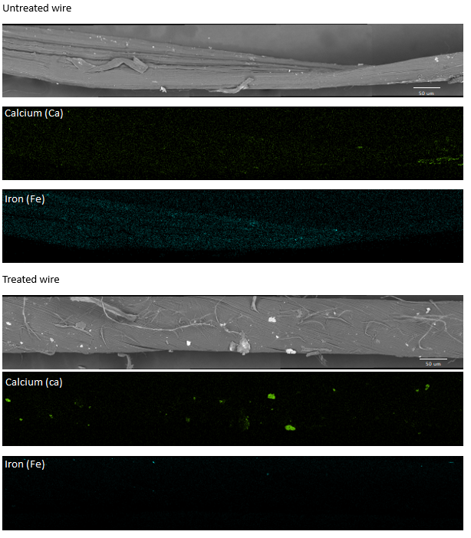
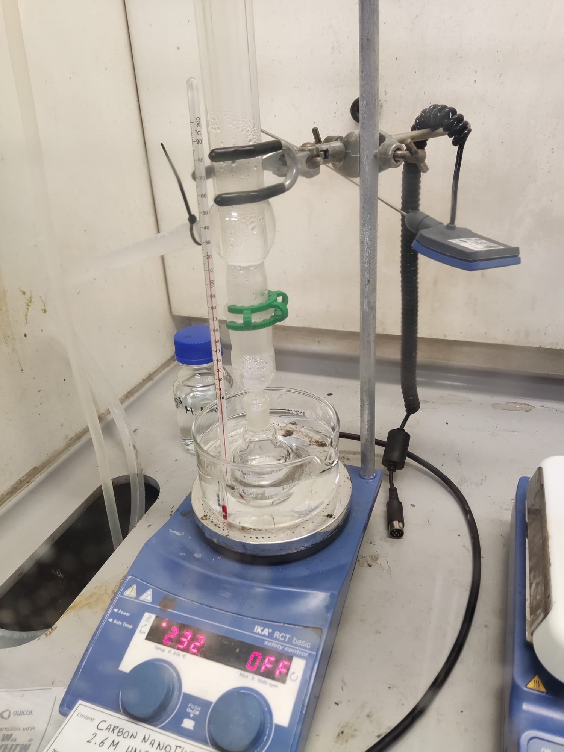
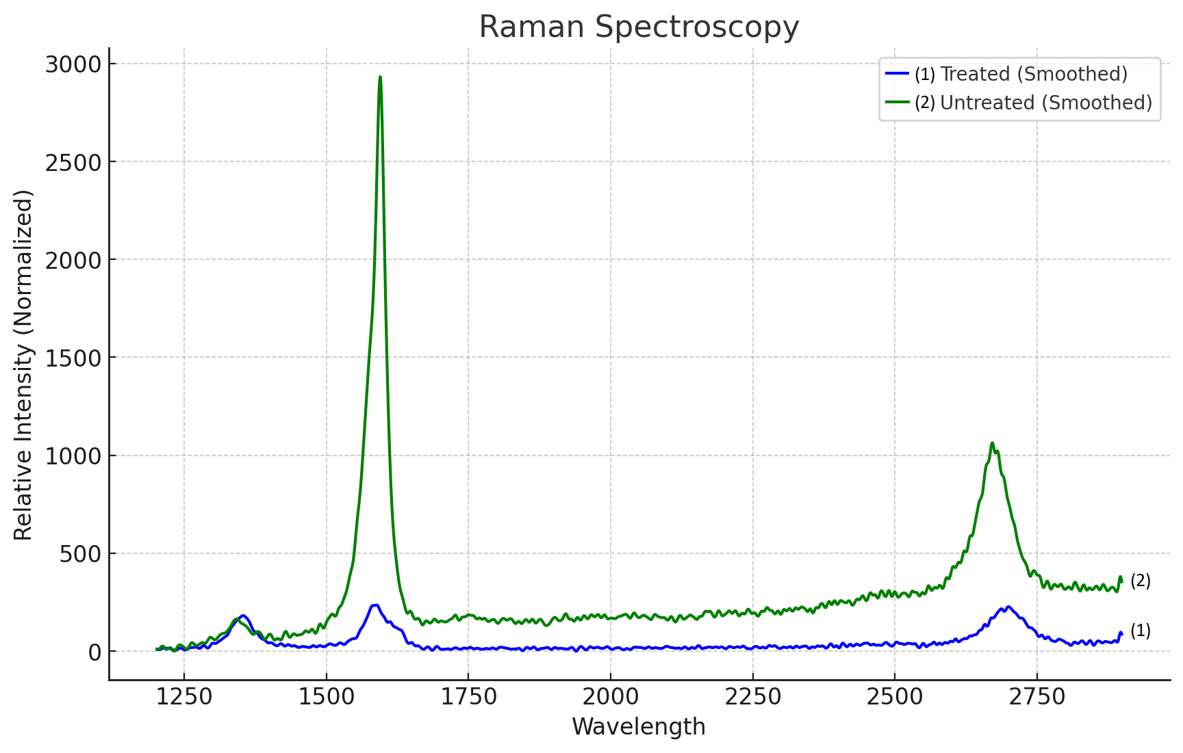
Proof of concept
Treatment applied
12 h nitric bath (2.8 M concentration) at 125 degrees.
Neutralisation of the acid and dry overnight
Figure 17. Raman spectroscopy result from both wires
Figure 16. Treatment done at University of Bath
Figure 18. EdX and SEM images of both wires, treated and untreated

