Slide 1
Low Density Wires: implementation during LS3 (and beyond)
C. Pasquino, R. Veness, W. Andreazza, H. Sullivan, G. Aliana, J. Emery, F. Roncarolo
HL-LHC Beam Halo Review

Slide 2
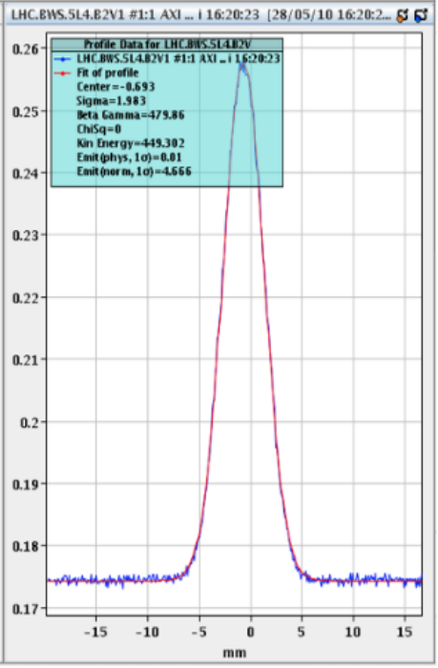
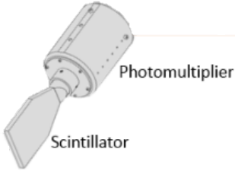
Beam Wire Scanners in the LHC
Intensity
CONTROL AND ACQUISITION
Particle Beam
Beam Losses
Position
Beam Transversal Profile
Carbon wire 34 micron;
Scanning speed 1 m/s;
10 micron of the beam size accuracy;
Use case: LHC injection energy, few bunches only; used to calibrate the BSRT.

Slide 3
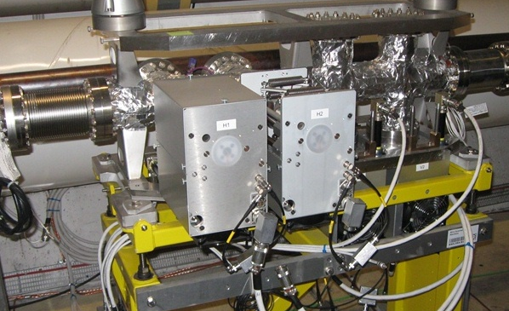
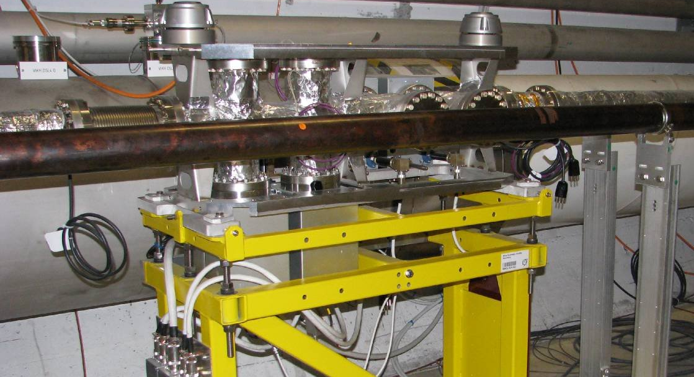
Beam Wire Scanners in the LHC
LSS4 – B1
LSS4 – B2
8 BWS: 2 per plane per beam;
4 Legacy systems inherited from LEP;
4 Hybrid+, featuring new electronics and new feedthrough: intermediate implementation to bridge to the new generation of WS.

Slide 4
Beam Wire Scanners in the LHC - CONS
Approved CONS program: EDMS 2282009 - Consolidation of LHC Beam Wire Scanner Electro – Mechanics;
Improve performance
  Reduce vibrations;
  Reduce position uncertainty;
  Improve positional resolution;
Improve reliability
  Reduce intervention frequency;
Broaden the use case
  Potential for use as halo monitor;
  Higher intensity measurement – can be designed to support CNT implementation;

Slide 5
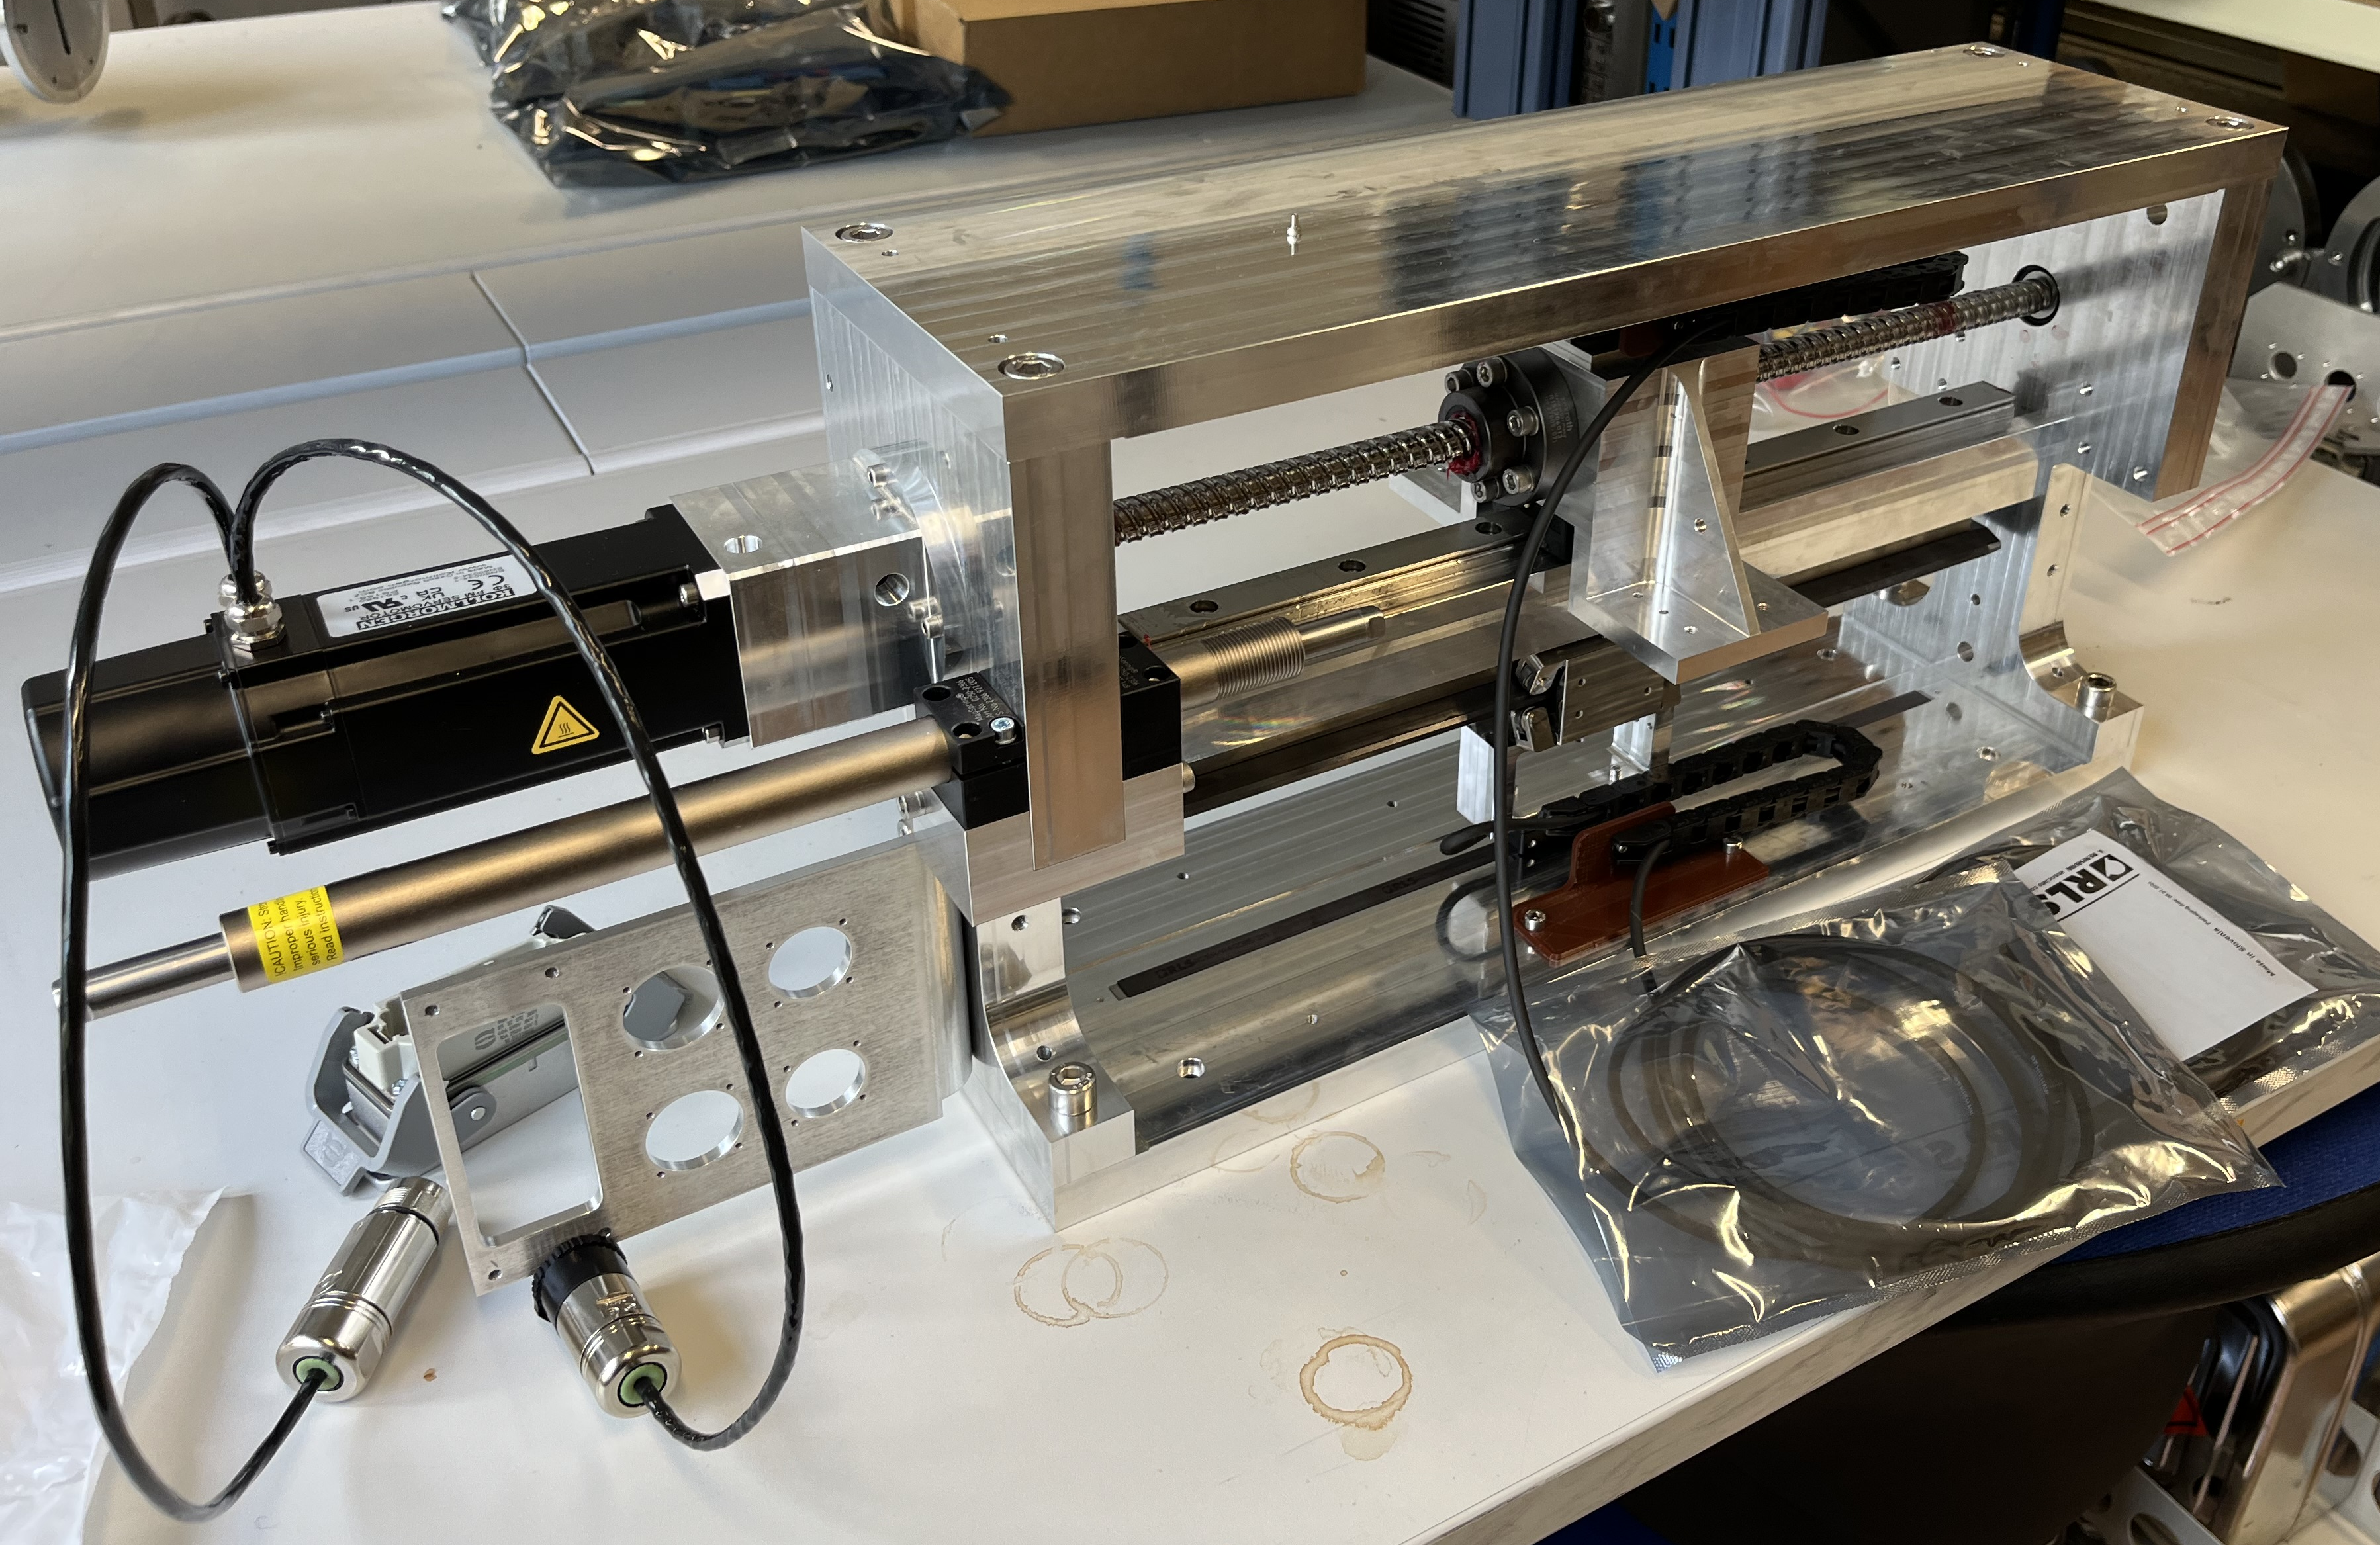
Beam Wire Scanners LHC CONS - STATUS
Linear encoder portholes
In vacuum linear guide assembly
TEST RIG
In vacuum side coupling
Optical linear encoder ruler
Ceramic instrument card

Slide 6
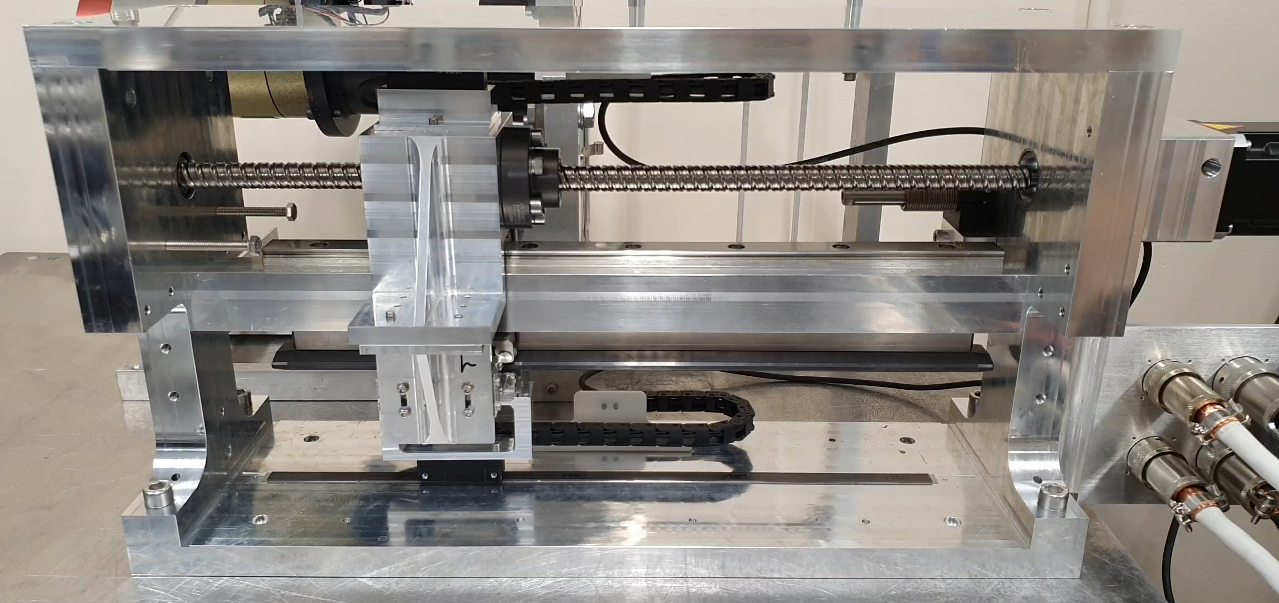
Pre-LS3 Development Phase
What is already designed (completed), installed, validated
Magnetic coupling validated with the test rig;
Adaptation of the control system to the new mechanism;
Mechanical design well advanced – detailed design with MME to start in January;
Impedance design well advanced – longitudinal impedance studies completed, transverse to be computed together with a power loss map;

Slide 7
Pre-LS3 Development Phase
What is planned and expected to be implemented before LS3
Roadmap up to LS3:
Instrument design and development:
  Impedance prototype to be installed in YETS 2025-2026 for beam validation;
  Detailed mechanical design, with feedback from beam validation;
  Test rig testing campaign for carriage lifetime and controls validation;
CNT R&D:
  HRMT tests foreseen in 2025 in the shadow of the 4 experimental weeks;
  Dedicated HRMT week in 2026;
  Installation of a CNT in the SPS linear wire scanner during YETS24-25;
  Feasibility study for CNT gold ball bonding technique;
  Assessment of the carbon (or CNT) wire position determination of the future scanner using laser system in the lab

Slide 8
LS3 Implementation Phase
Confirmed installation plans:
  4 BWS to be installed (2H+2V);
  Vacuum layout discussed with VSC;
  Cabling request filed, PLAN 12763 .
Non confirmed plan and open items requiring resolution/decision: → see next slides
  Technical challenges
  Resource gaps
  Approval/coordination needs, including support from integration, cabling, vacuum and other groups/teams/units

Slide 9
Technical challenges
Use Case 1 :
Scanning the full beam
Use Case 2 :
Scanning the Halo only
Measurement that comes for ‘’free’’ by replacing the standard C wire with a CNT.
R&D activities:
    CNT tension tests;
    CNT assembly on the card by gold ball bonding;
    Vibrations studies;
    Braided wires – possible solution?
Scan from 8.5 to 3.5 σ only, assuming beam fully symmetric.
R&D activities & open points:
    How to know where the 3.5sigma is systematically? Coupling with another technique needed.
    Only half halo distribution;
    Improved moving mechanism? Or preloaded?
    Speed?
    Wire exposure to beam?
    Possible test on Hybrid+ calibration tests bench
    Challenges in the controls – absolute position measurement needed.
    Signal to background/noise ratio & related quenches?
Suitable for SPS full scans at flat top
Suitable for LHC partial scans at flat top

Slide 10
Resource gaps
R&D on CNTs:
  PhD position for CNT simulations;
  PhD/GRAD for mechanical design implementation;
  GRAD for CNT position measurement, motion control and electronics design;
Material budget:
  Prototype WS for CNT;
  Equipment for nanomaterial handling;

Slide 11
Approval/coordination needs, including support from integration, cabling, vacuum and other groups/teams/units
Depending on the strategy:
  SPS installation, full beam scans at extraction:
    All supports needed from SPS teams (integration, cabling, vacuum, survey) → feasible within LS3
  LHC installation, halo beam scans at flat top:
    All supports needed from LHC teams (integration, cabling, vacuum, survey) → longer timescale

Slide 12
Post-LS3 Phase
Features/capabilities that
  will be available after LS3 → none in the LHC
  will need to be developed after LS3 → a proto WS for LHC
Expected timeline for transition from expert to operational mode→ NaN ☺
Known risks related to schedule and (also picking from ‘technical’ presentation before) performance → it is an R&D program, fully based on the material quality and characteristics!

Slide 13
Budget (and Other General) Considerations
Budget status:
  Cost estimates for development and implementation phase vs available budget → see slides above
  Funding gaps to be addressed ? → yep!
Long-term budget considerations:
  Maintenance and operational costs, including manpower → depends on the scenario, could be in the shadow or not
  Possible need for upgrade, anything can be already anticipated → see slides before.

Slide 14
Key Milestones
Phase | Timeline | Deliverables | Dependencies | Budget Status
Pre-LS3 | By 2026 | HRMT test Material sim Material chemistry optimization Ball bonding | No dependencies | Covered
During LS3 | By 2028? | Proto for SPS | R&D dependecies | Not Covered
Post-LS3 | ? | Proto for LHC | R&D dependencies | Not Covered

Slide 15
Conclusions
Implementing a CNT wire within the new design of the linear wire scanner is feasible but entails R&D;
In the SPS: the scanner could work in the full scan modes, LIU intensity and flat top energy;
In the LHC: the scanner could work potentially from 8.5 to 3.5 σ, but with much more R&D required (timeline beyond LS3).

Slide 16
