Slide 1




BGC: development in LHC and implementation study for LS3
D. Butti on behalf of the BGC collaboration

Slide 2
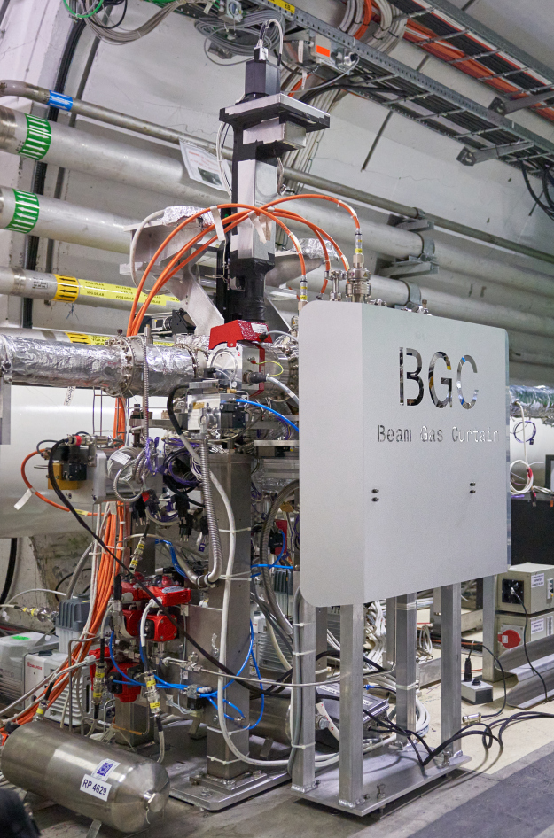
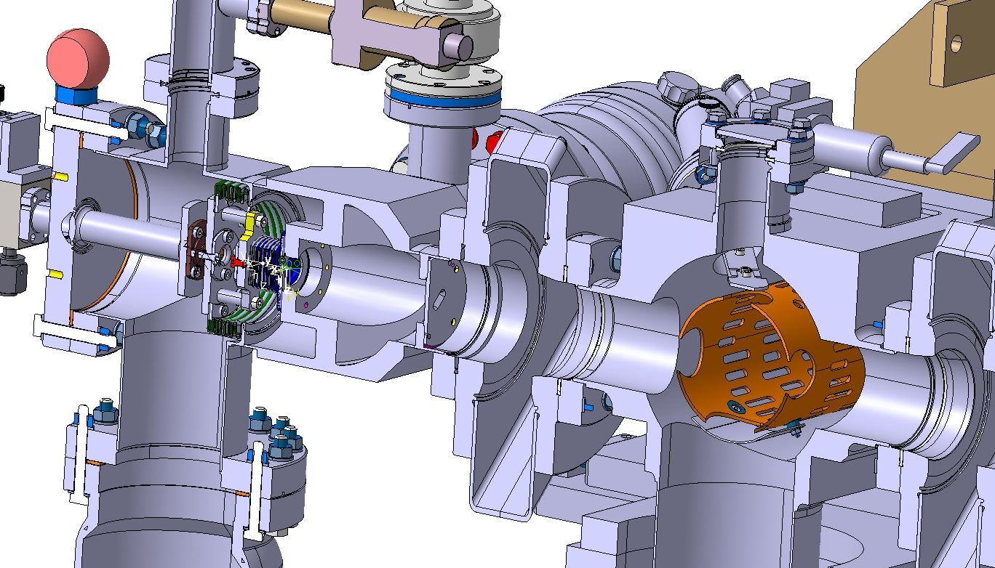
Beam Gas Curtain principle
D3
UND
Point 4
UND
D3
B2
RF section
B1
beam
gas jet

Slide 3
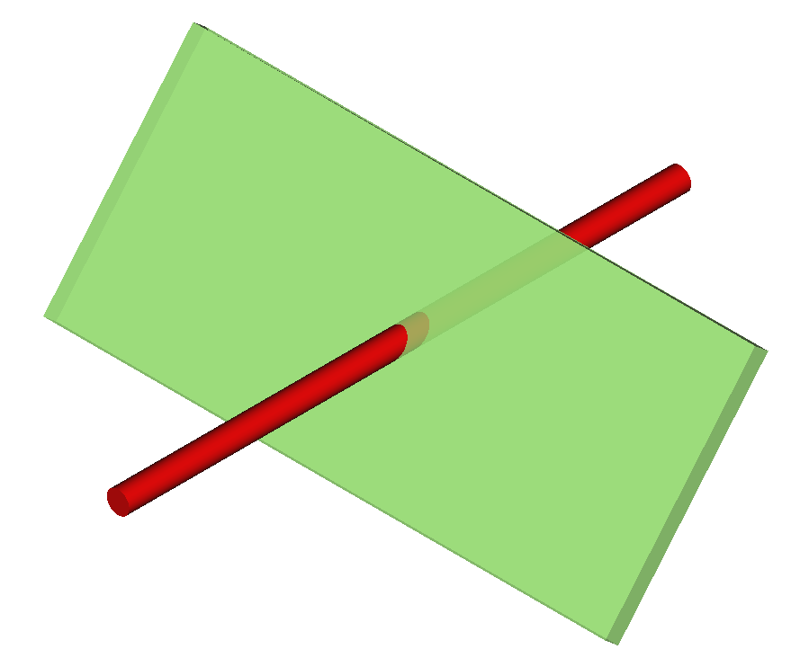
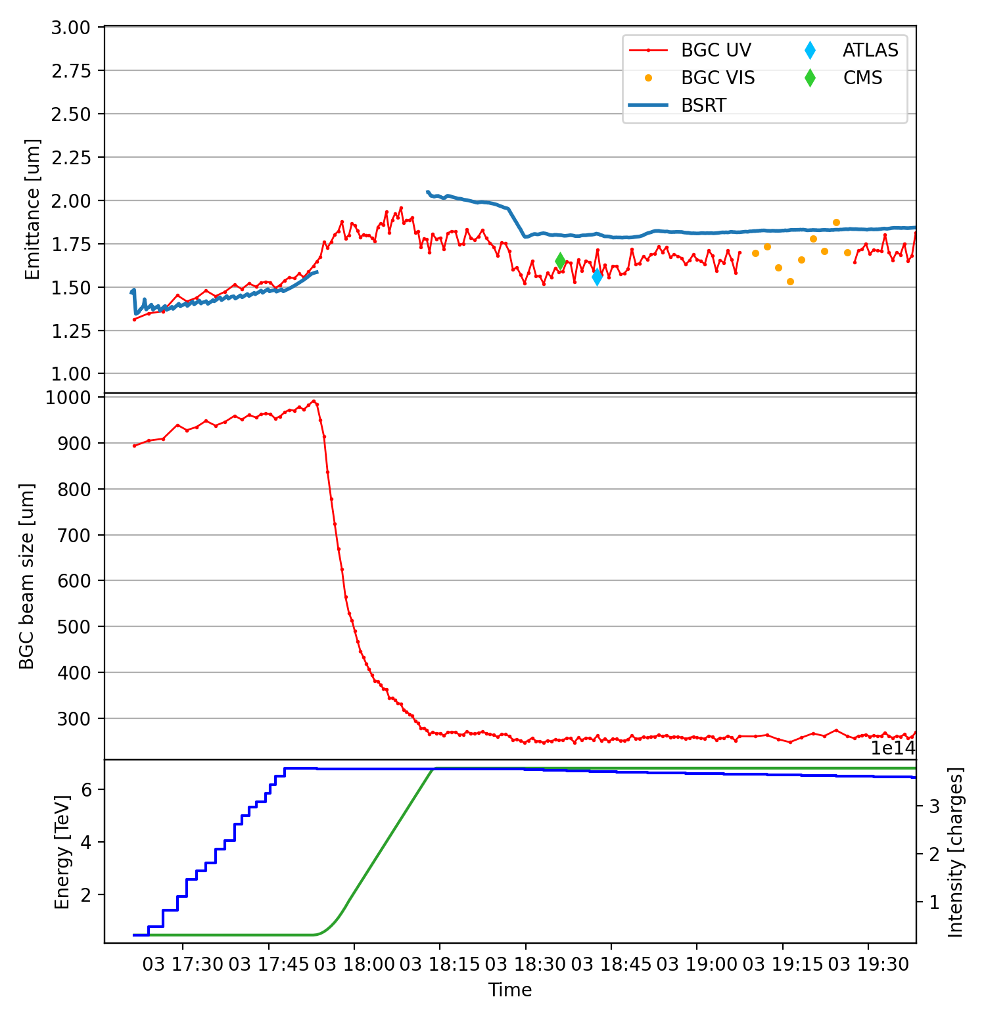
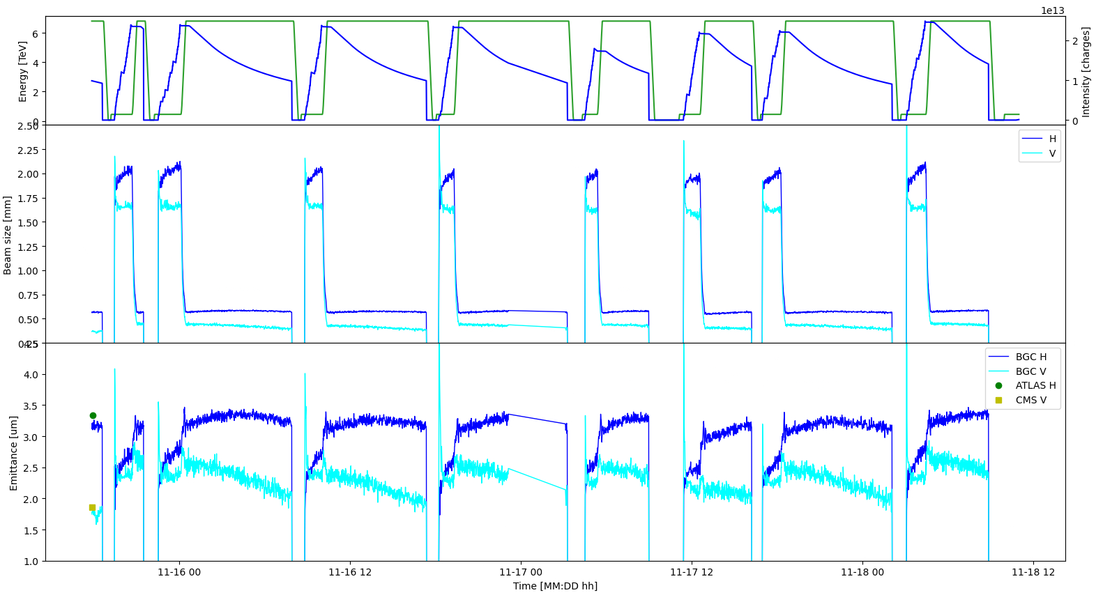
Beam Gas Curtain as beam imaging system
Conceived as overlap monitor for the Hollow Electron Lens, reproposed as beam size monitor:
detector
minimally-invasive
simple beam imaging
weak fluorescence signal, only suitable for avg measurements
fluorescence photons
Interesting emittance measurements in run 2024…
Full cycle with protons (H only)
Online measurements with ions (both H/V)
proton beam
gas jet
…can it be useful for halo measurements?
BGC animation on YouTube

Slide 4
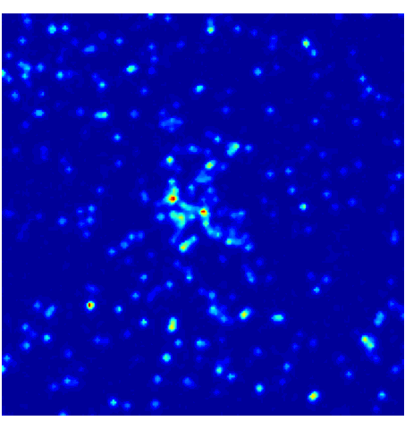
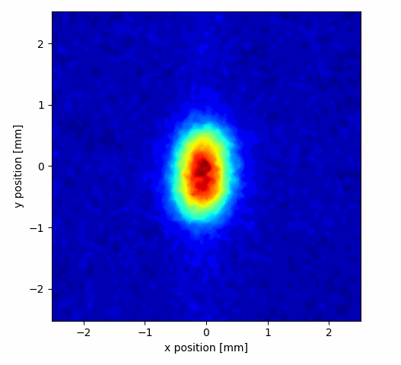
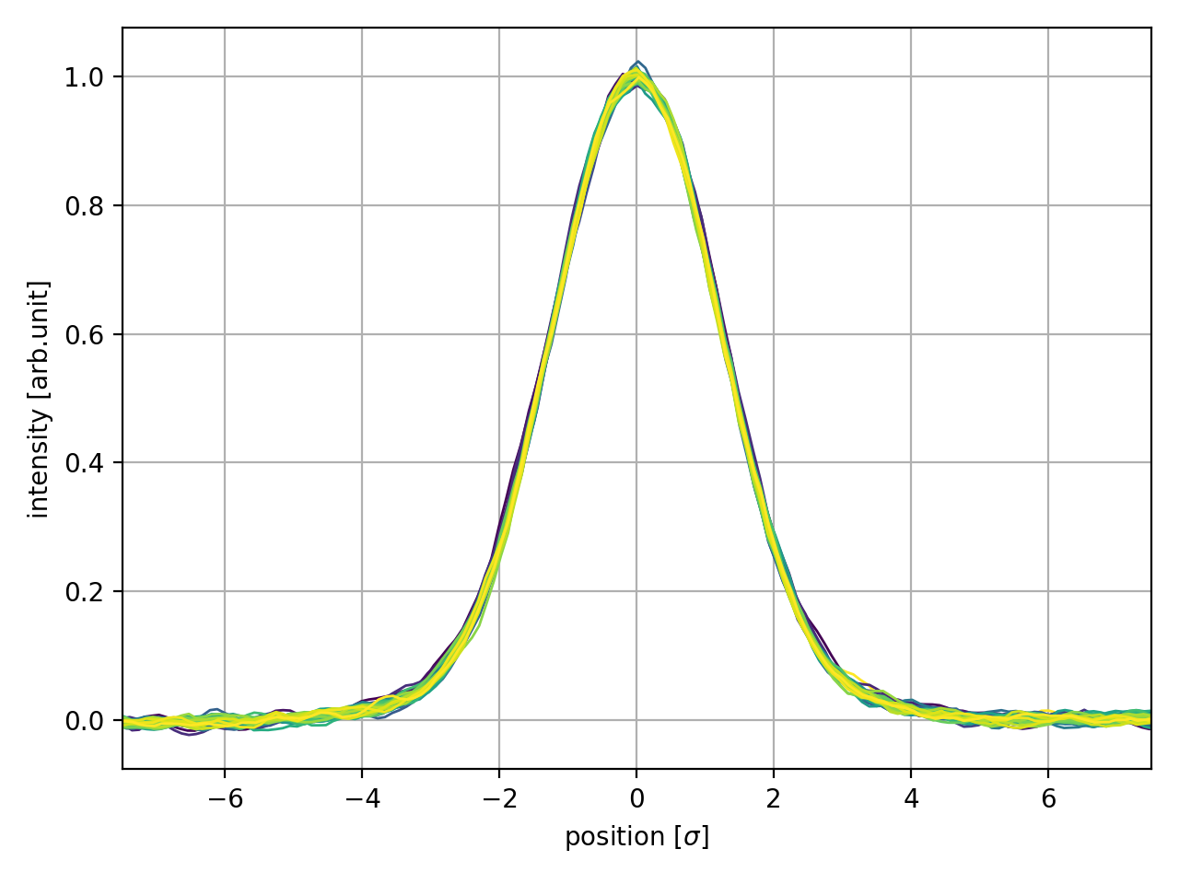
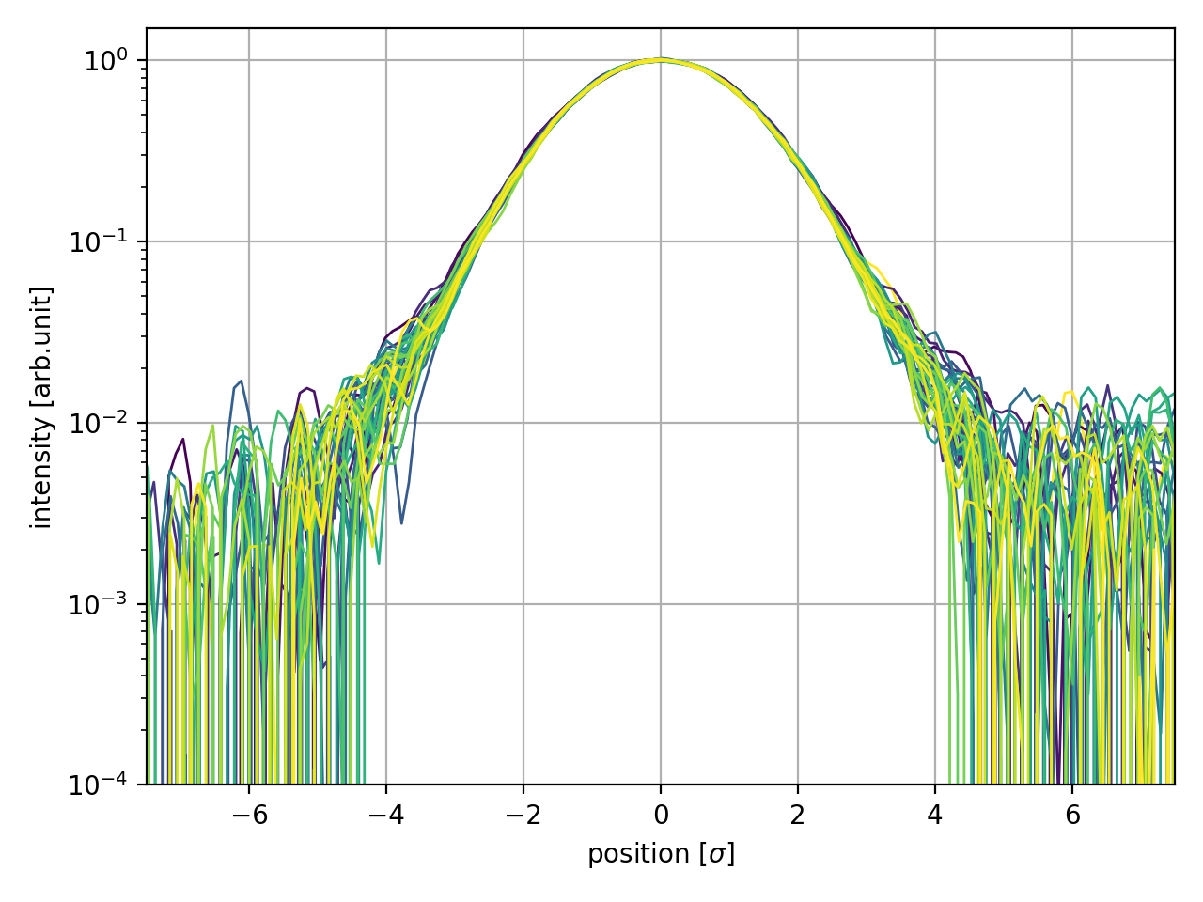
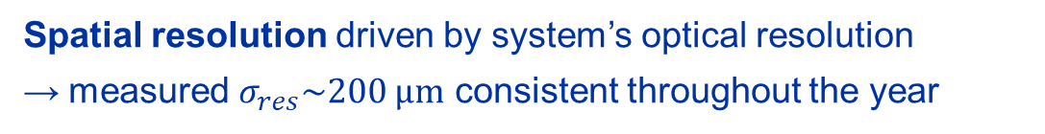
Tail information in BGC images
single frame - 50 ms
Spatial resolution driven by system’s optical resolution
measured $σ_{res}\sim 200 μm$ consistent throughout the year
Dynamic range not an issue
image build as (slow) sum of single photon frames
Contrast driven by signal-to-noise ratio
values ~2% peak-to-tail in present BGC configuration
integrated frame - 30 s
lin scale
log scale
~2% peak-to-tail
HALO

Slide 5
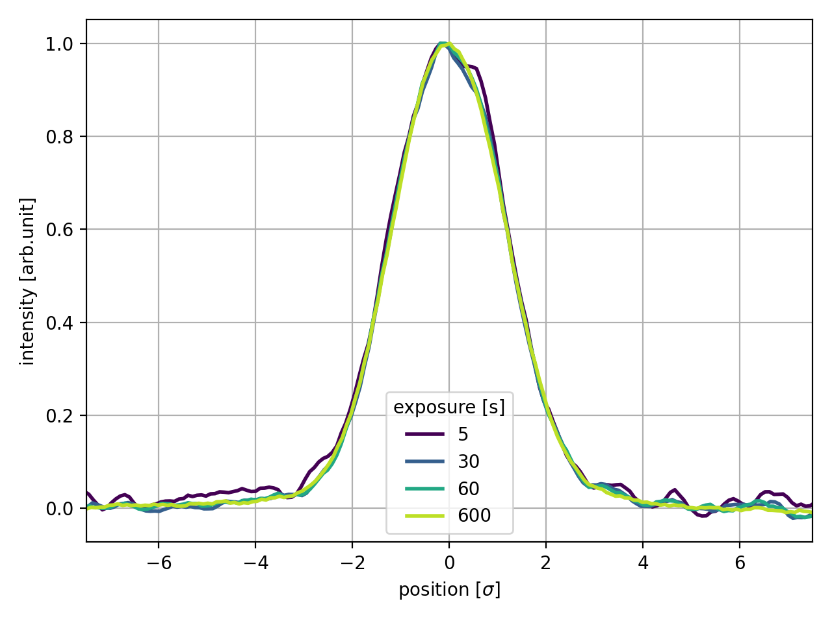
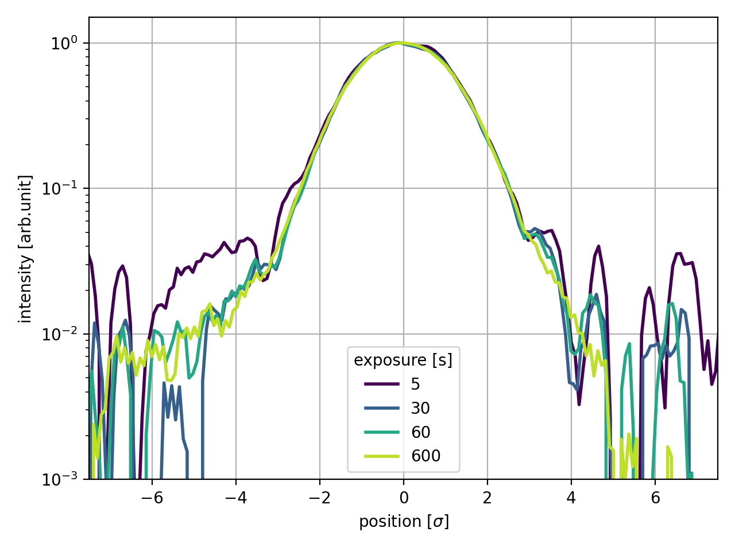
Improving image contrast
lin scale
Longer exposure times increase beam and background signals
less noisy profiles but no exceptional contrast gain
Some options available to improve contrast
increase light collection efficiency → under study, may gain factor 4
increase jet density/active volume → under study
reduce dark counts and light background → already pushed, little margin
reduce losses background → requires dedicated shielding
advanced denoising techniques → to be studied
use alternative gas species (e.g. N₂) → gain/feasibility to be tested
log scale
~1%
Margin to reach stable ~1% contrast with exposure ~1 min, feasibility of exceeding this requires further investigation and testing

Slide 6
Summary of BGC imaging
Contrast: ~1% likely feasible in halo, margin for improvement but feasibility to be studied
Halo integral: requires experiments to assess sensitivity to actual halo population change (e.g. EoF scraping)
1D/2D information: likely 1D (jet much thinner than beam size needed for 2D beam image)
Acquisition rate: slow ~1 min, average measurements only
Interlock: only software (image processing required)
Full cycle: mildly affected by beam energy
Ad-hoc optics: larger size improves spatial resolution, not too much (i.e. < 2σ) to avoid signal dilution
Take-home message for BGC imaging:
limited performance in acquisition rate and contrast
robust and reproducible thanks to its simplicity
→ insufficient as single halo monitor, might provide a solid cross-reference for other monitors

Slide 7
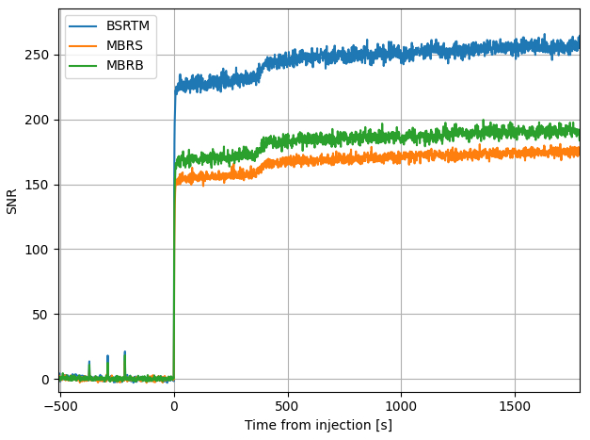
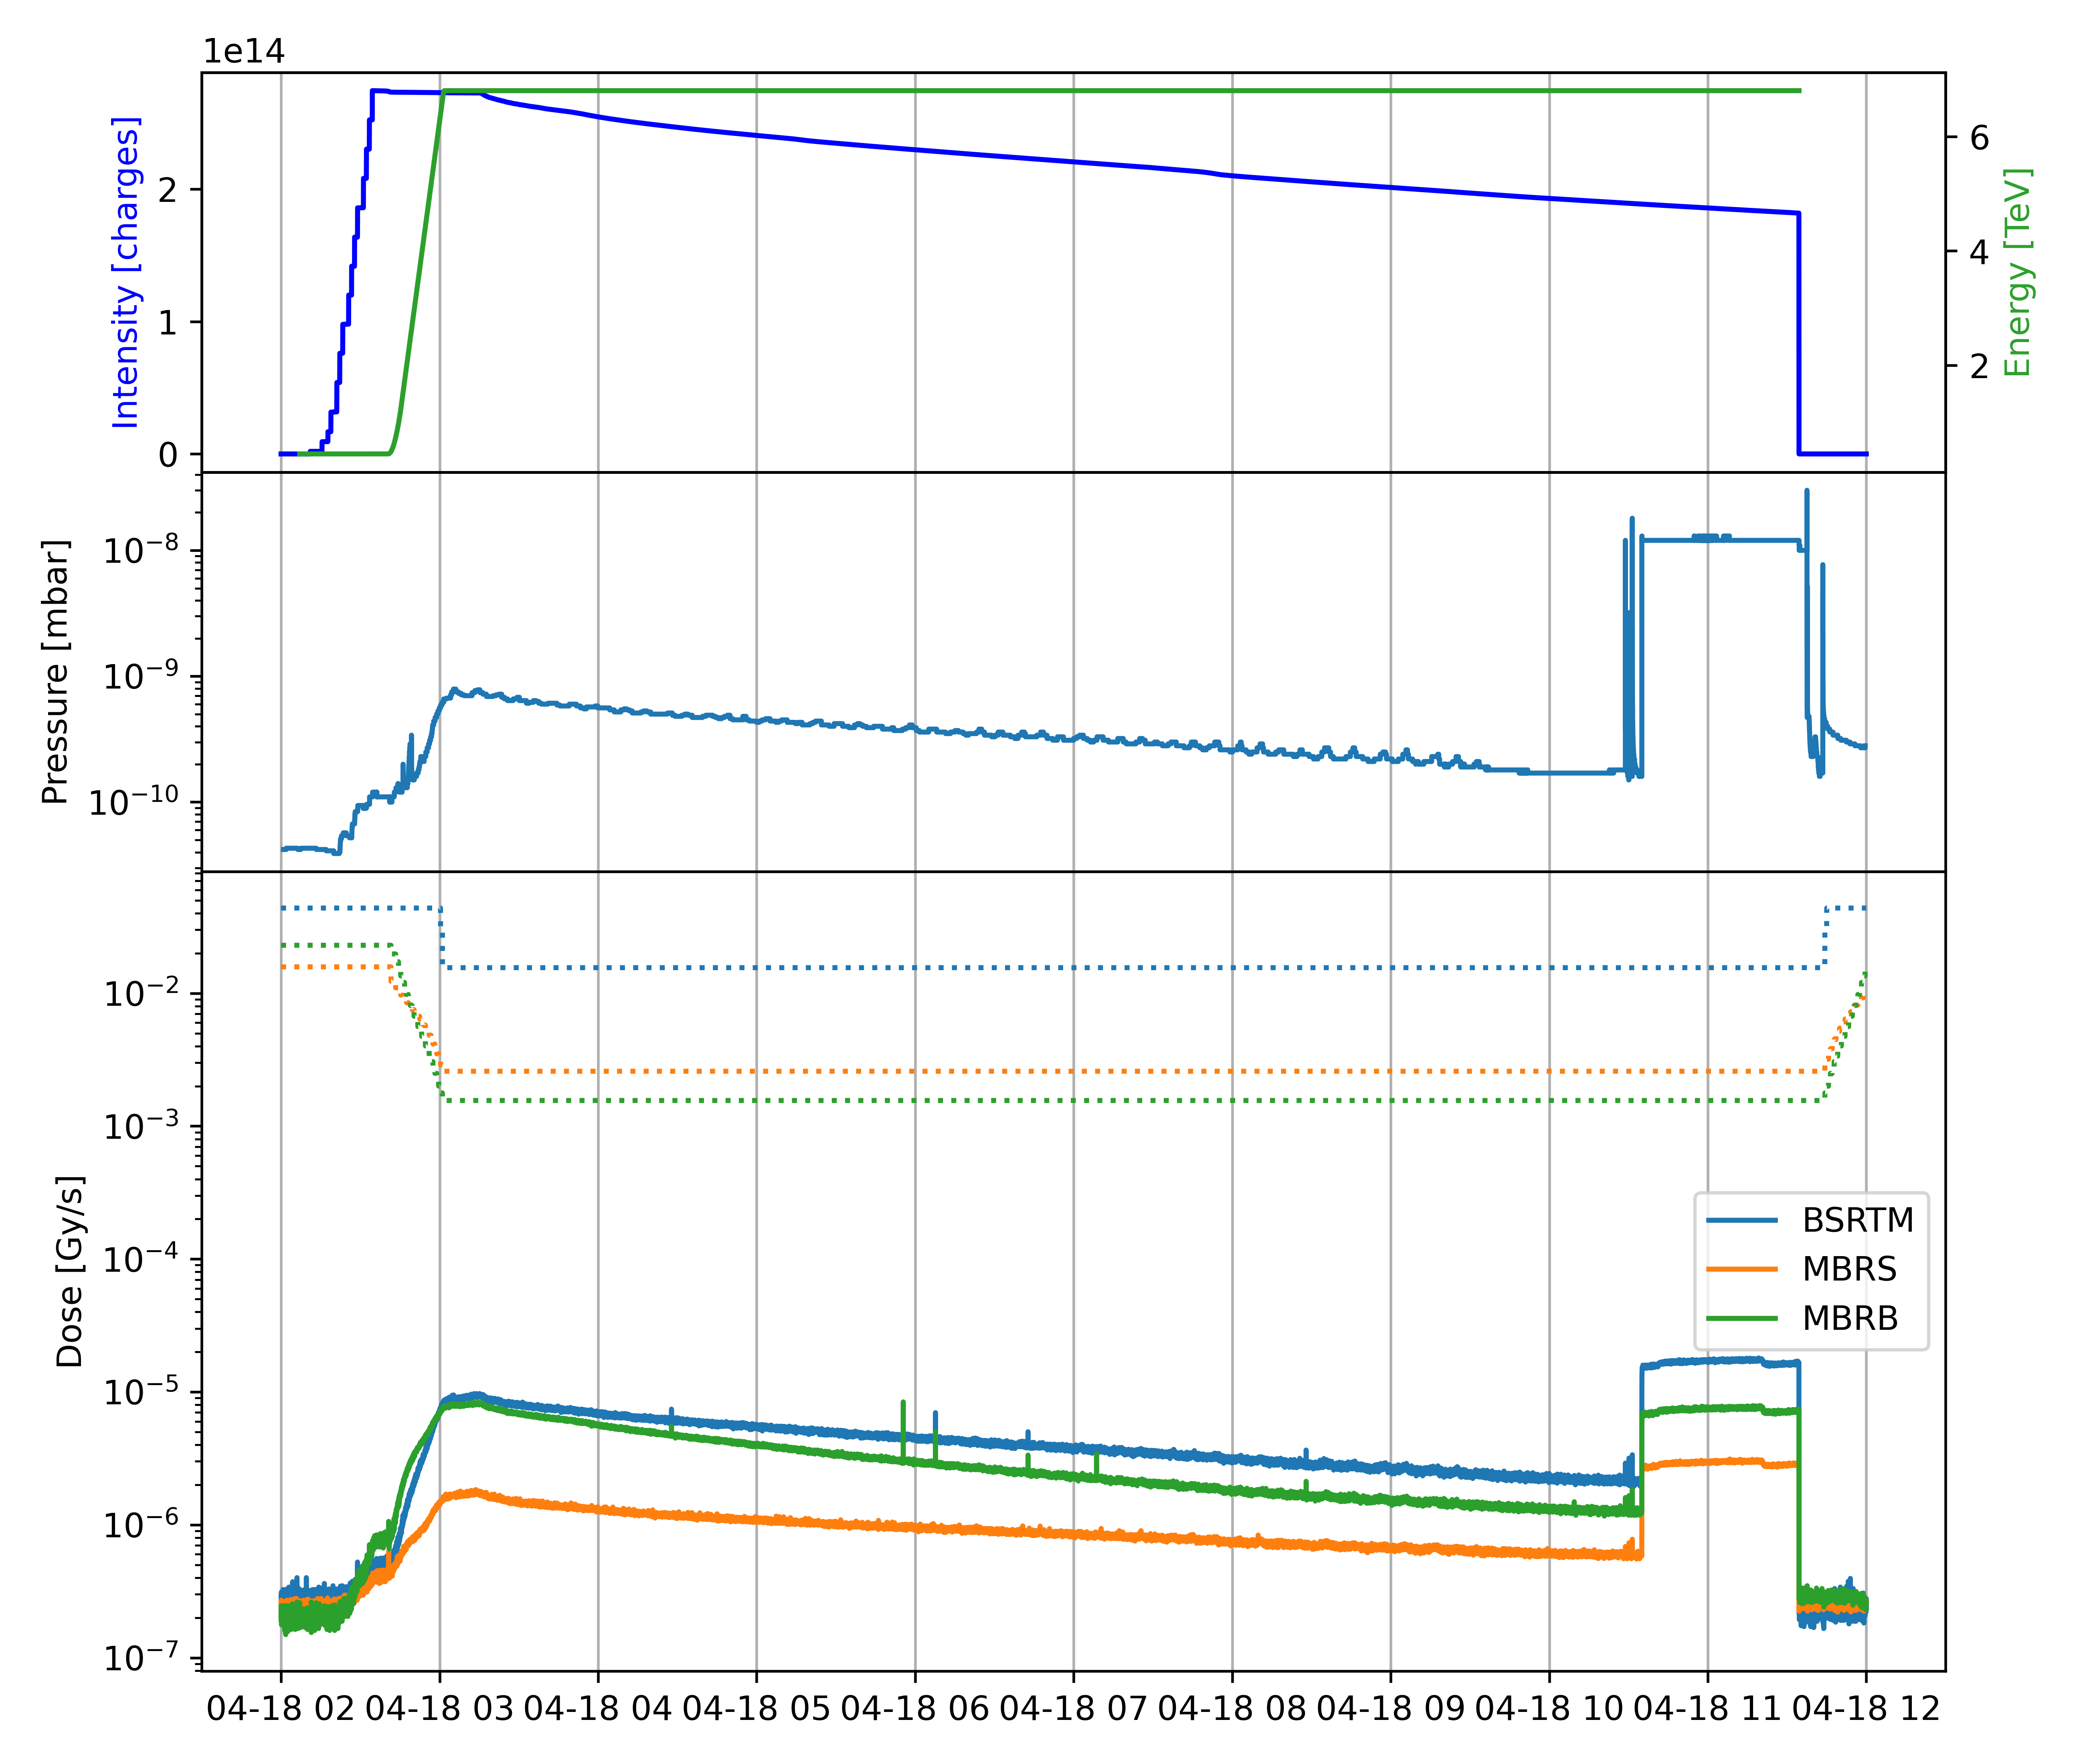
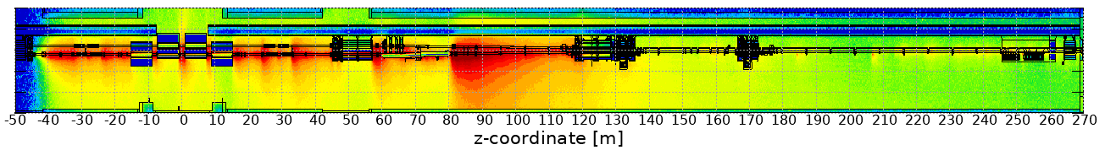
Beyond fluorescence: losses-based diagnostics
Fluorescence is not the only signal produced by the BGC, jet-induced losses clearly detectable downstream
jet activated
Losses baseline subtracted and normalized by standard deviation
FLUKA simulation of BGC induced dose by D. Prelipcean
BGC
MBRS
BSRTM
MBRB

Slide 8
Concept of BGC as beam profiler
camera
Present BGC configuration as beam imaging system
jet is “gas screen” and detect fluorescence photons
photons
info about 2D beam distribution
low fluorescence cross-section, limited halo performance
beam
jet
System can be converted into a beam profiler
use jet as “gas collimator” and detect losses
jet
losses
BLM
intrinsically a 1D instrument
measures integrated population within jet,
profile obtained by scanning jet position
beam

Slide 9
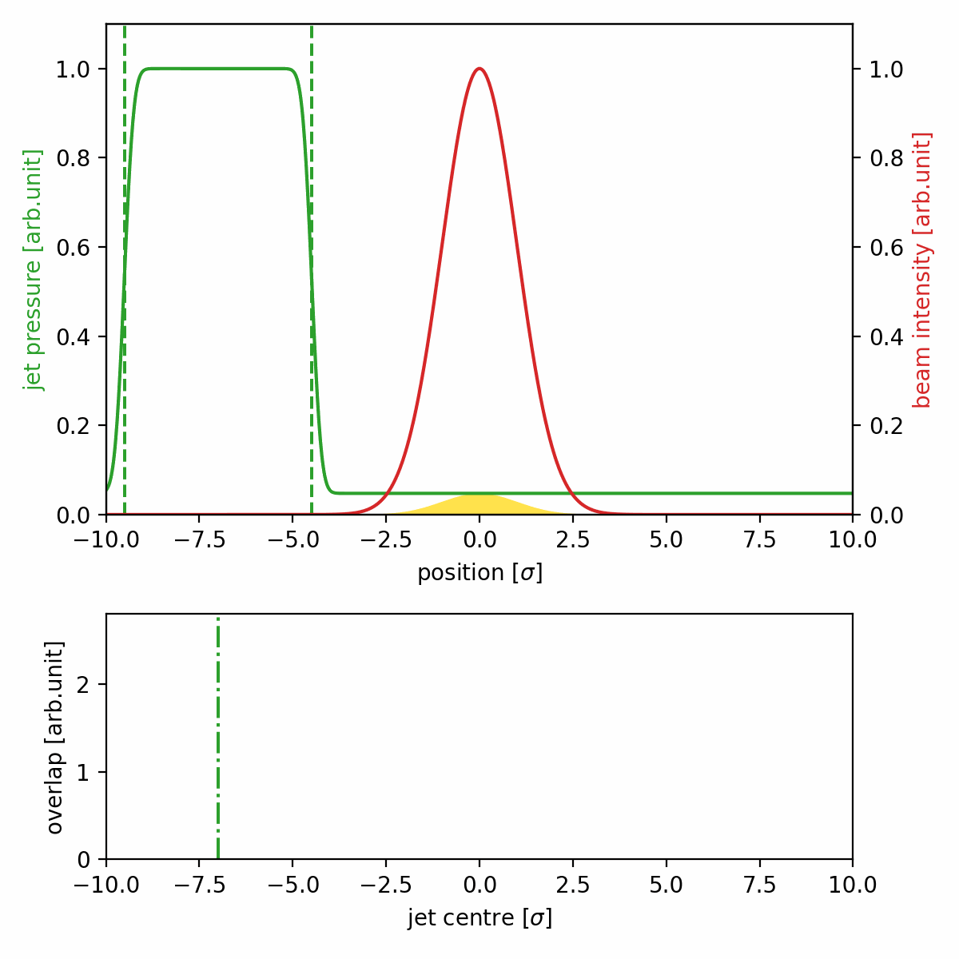
Concept of BGC as beam profiler
Jet used as a probe to scan the beam
Measurement principle
full transverse scan of the beam. Beam distribution obtained by deconvolution of losses signal and jet profile
take background reference with jet away from beam
approach jet to beam to monitor evolution of tail population
Scan repeated whenever full-profile is requested and to adjust jet position
Background subtraction can be regularly adjusted by displacing jet but very high sensitivity required to resolve halo signal

Slide 10
Gas curtain as “interceptive” device
Molecular mass of interceptor
Quench, material strength and handling limits
Matter particles intercepted by the beam (mol.m⁻²)
Stolen from R. Veness through G. Aliana Cervera

Slide 11
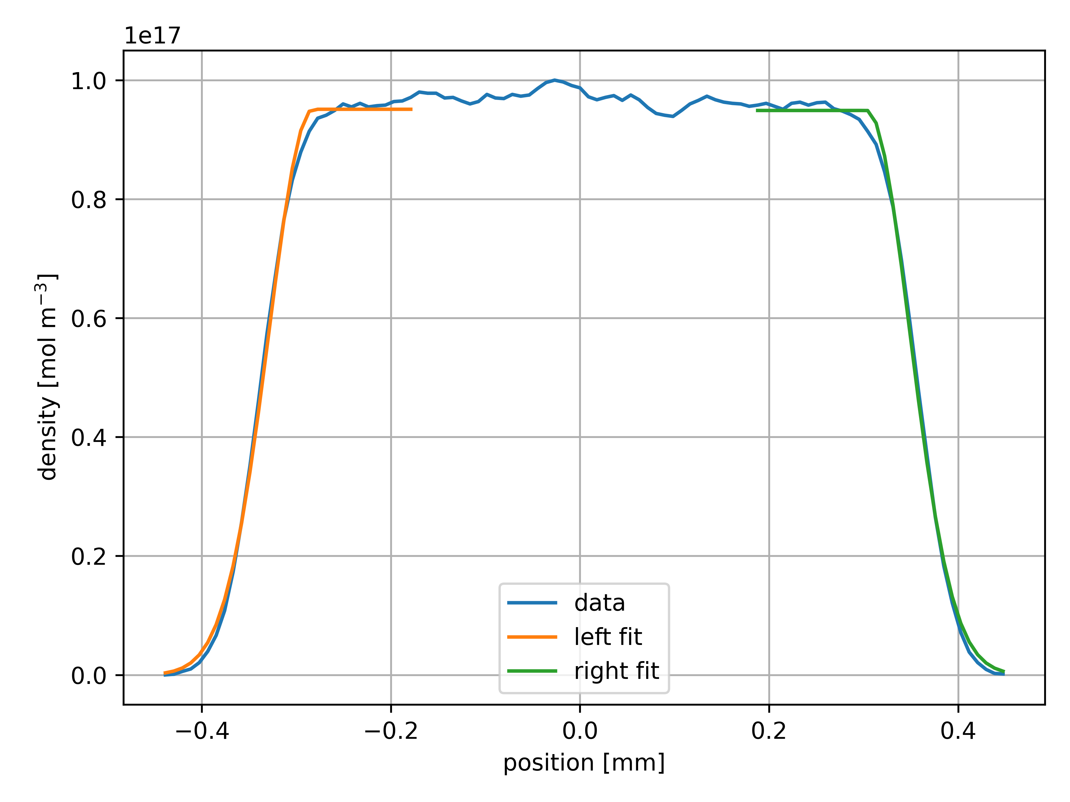
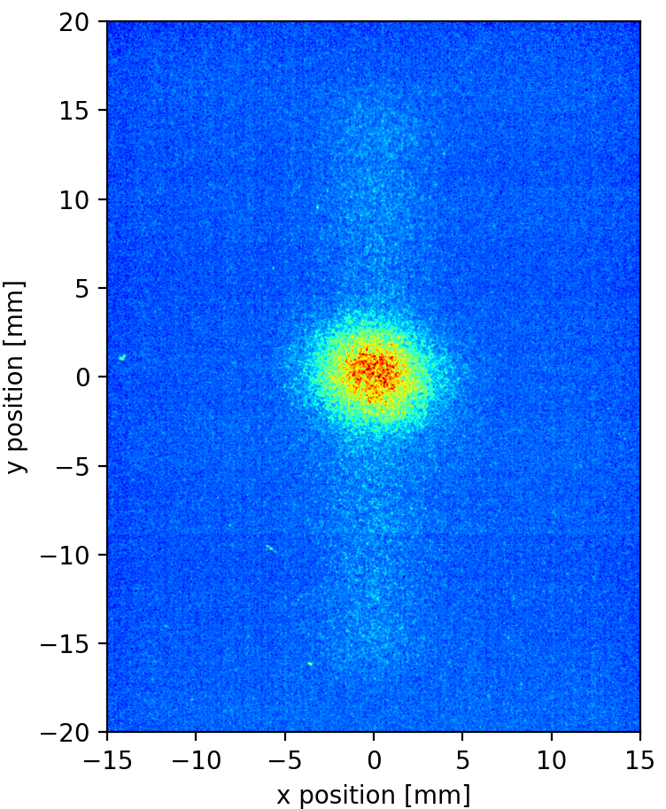
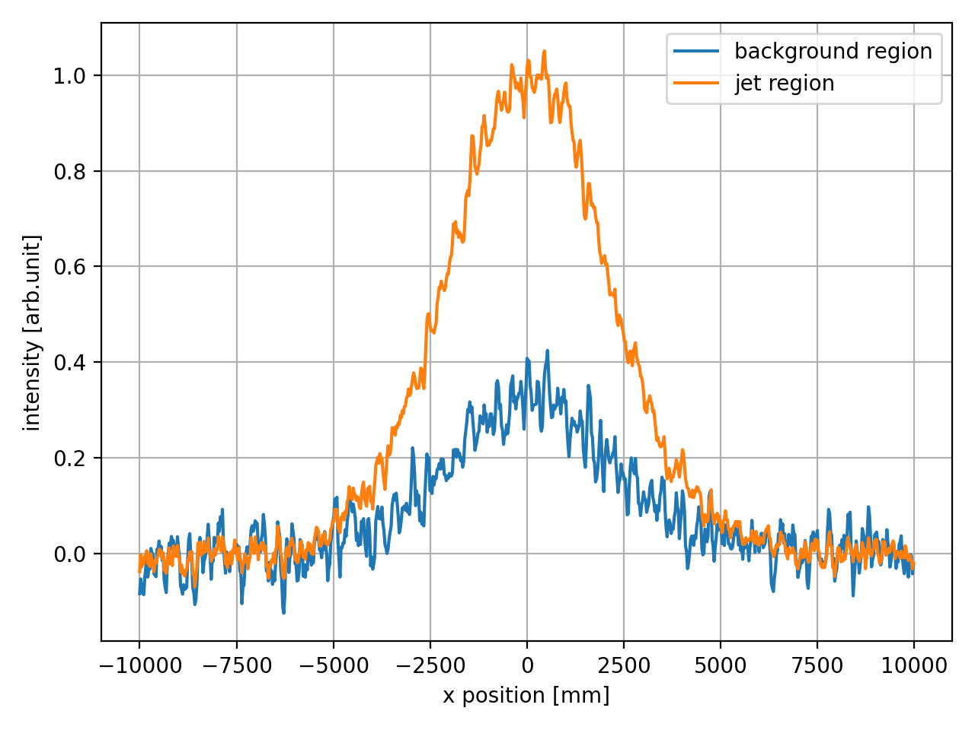






Gas distribution: jet
Real jet profile not an ideal rectangle but has finite edge sharpness and pressure gap
Edge sharpness measured by movable gauge
$$\frac{p_{jet}}{p_{0}}$$
$$σ_{edge}≃100 μm$$
$$σ_{edge}$$
Finite edge sharpness → ultimate limit for spatial resolution
Pressure gap can be estimated from fluorescence emission
$$a_{jet}$$
$$\frac{p_{jet}}{p_{0}}\sim \frac{a_{jet}}{a_{0}}+[geom. factors]≃50$$
$$a_{0}$$
Finite background pressure → parasitic losses from core
Pb @ INJ

Slide 12
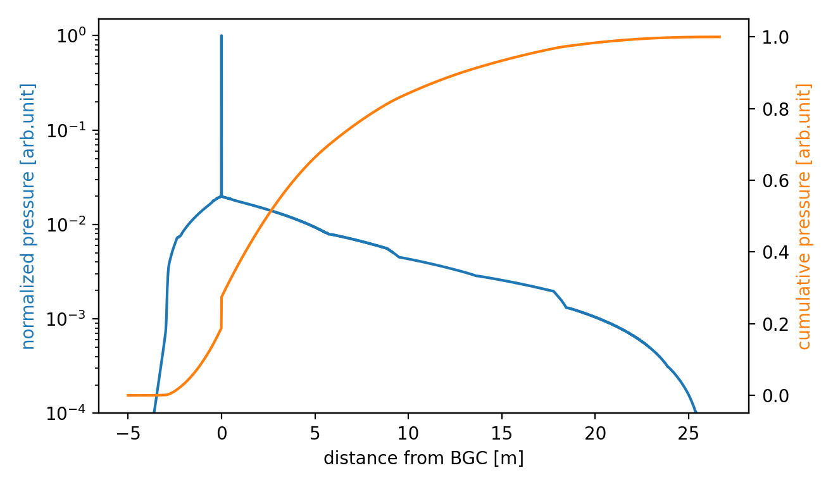
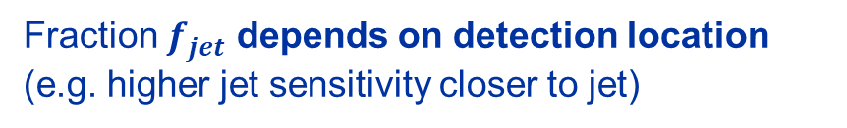
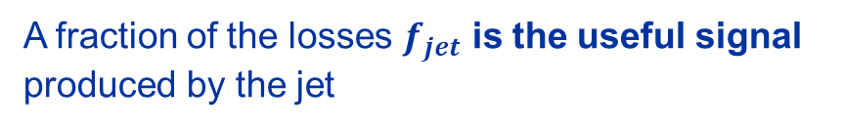

Gas distribution: background
Gas injected by BGC not fully confined within to jet but spans over several meters
At present, a fraction of the gas load belongs to the jet while the majority remains as background
$$\frac{p_{jet}}{p_{0}}$$
A fraction of the losses $f_{jet}$ is the useful signal produced by the jet
Fraction $f_{jet}$ depends on detection location
(e.g. higher jet sensitivity closer to jet)
$$\sim 5÷10\%$$
beam

Slide 13

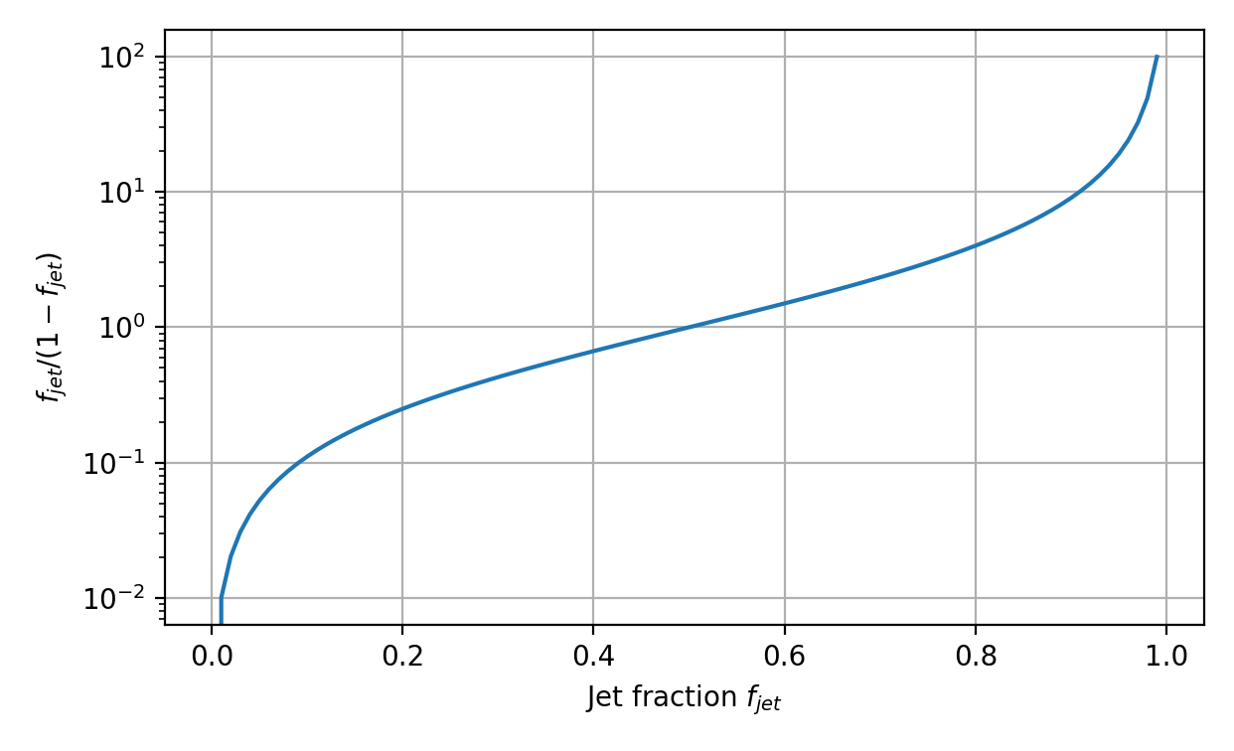









Contrast of BGC as beam profiler
How to quantify the contrast of the BGC profiler?
$$f_{jet}$$
losses
$$losses$$
$$D_{signal}$$
$$D_{bkg}$$
$$f_{halo}$$
$$D_{bkg}$$
$$\frac{D_{signal}−D_{bkg}}{D_{bkg}}≃\frac{f_{jet}}{1−f_{jet}}f_{halo}$$
$$D_{signal}$$
$$jet$$
$$position$$
Basic model where signal depends only on geometric overlap between jet and halo
Proportionality between contrast to integrated population and sensitivity to losses, with jet fraction as modulating function
no jet = no signal
only jet = no bkg
region of interest

Slide 14
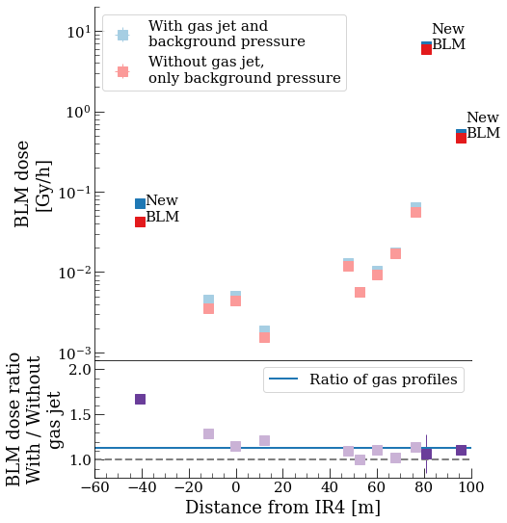
Improving contrast
Optimizing contrast requires maximizing production and detection of losses created by the jet
Options available to improve jet losses (vs background)
optimize jet aspect ratio for maximum jet-beam overlap → under study
increase gas pressure in jet → to be studied, limited margin
increase pumping to reduce background → under study (helpful also to reduce gas load)
Options available to improve losses detection (vs background)
optimize detection location → dedicated IC BLMs installed in YETS2425
maximize detection sensitivity → best detector technology to be studied
BLM
BLM
BWS
BGC
BLM
BLM
BLM
Credit: D. Prelipcean

Slide 15
Summary of BGC profiler
Contrast (integral): to be quantified depending on achievable sensitivity to jet losses
1D/2D information: intrinsically 1D
Acquisition rate: potentially bunch-by-bunch, integration time depends on achieved sensitivity to jet losses
Interlock: potentially HW, if interlock on simple loss threshold is reliable
Full cycle: not affected by beam energy
Ad-hoc optics: larger size improves spatial resolution, not too much (i.e. < 2σ) to avoid signal dilution
Take-home message for BGC profiler:
using BGC as beam profiler is a very recent concept
BGC profiler configuration very similar to existing one, already validated in the machine
→ instrument has potential, but further investigations needed (before LS3) to quantify performance

Slide 16
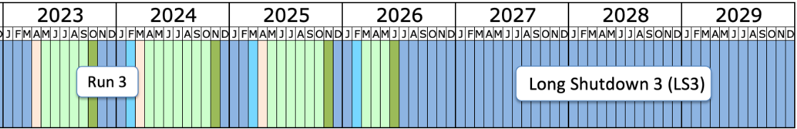


Timeline for BGC development
done
planned
tentative / optional
reduce jet thickness to increase resolution
change gas species
B1 prototype commissioned and preliminary measurements
BGC imaging
study of emittance monitoring performance
regular operation and study of final HL design
move towards operational instrument
upgrade of B1 prototype
installation of B2 instrument
(details in Gerhard’s talk)
today
installation of required 1 instrument / plane
(details in Gerhard’s talk)
studies on losses and HL design
proof of principle in dedicated MD
BGC profiler
dedicated BLMs installation
concept proposed and preliminary investigations
rotate jet to profiler configuration

Slide 17
Conclusion
Beam Gas Curtain is an R&D instrument with demonstrated potential as average emittance monitor
Two candidate configurations for halo monitoring
Beam imaging based on fluorescence
principle and implementation validated
requires optimisation for halo measurements
→ known limitations but little uncertainty on
implementation by HL-era
Beam profiler based on losses
new concept, proof of principle possible before LS3
performance and limitation still to be assessed
→ principle more suitable for halo measurement but
exploitation is more challenging
Primarily work as emittance monitors, halo measurements would come as additional feature
Tests and studies planned for next year will provide estimate of ultimate performance of both configurations

Slide 18

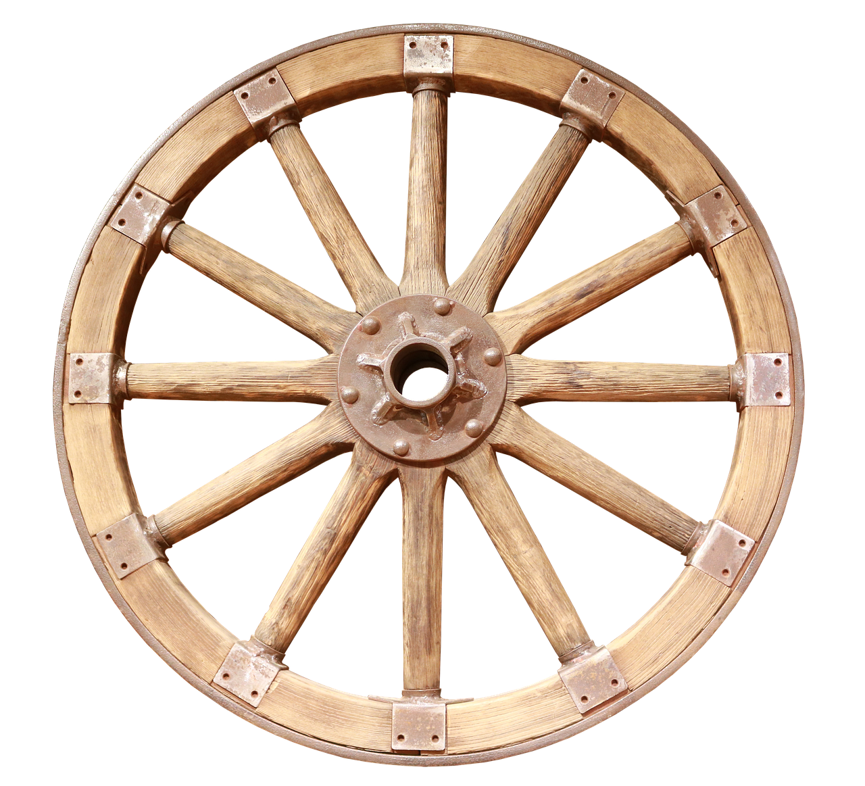
Asked AI for ideas about this review…
Looks like there are simpler solutions…

Slide 19
Thank you for your attention!

