Slide 1
Beam Gas Ionisation (BGI) Profile Monitor: Development
J. Storey, W. Andreazza, D. Bodart, J. Braach, H. Bursali, G. Cabrera, W. Devauchelle, G. Le Godec, L. Golino, S. Jensen, J. Joul, G. Khatri, M. Mclean, C. Pasquino, M. Teresa Ramos Garcia
Thanks to: M. Navarro Baeza, C. Fleisig, S. Gibson, M. Gonzalez Berges, S. Jackson, S. Levasseur, T. Lefevre, H. Sandberg, G. Schneider, R. Veness, C. Vollinger
HL-LHC Beam Halo Review on 18th December 2024

Slide 2
Outline
Technique
Installations & Status
Beam-Halo Signal Rates
Technical Limits & Backgrounds
Systematic Effects
Template Questions & Summary Table

Slide 3
Beam Gas Ionisation (BGI) Profile Monitor
Beam ionises residual gas;
Ionisation electron accelerated & transported by electromagnetic fields onto detector;
Electron detector = Timepix3(/4) Hybrid Pixel Detector.

Slide 4
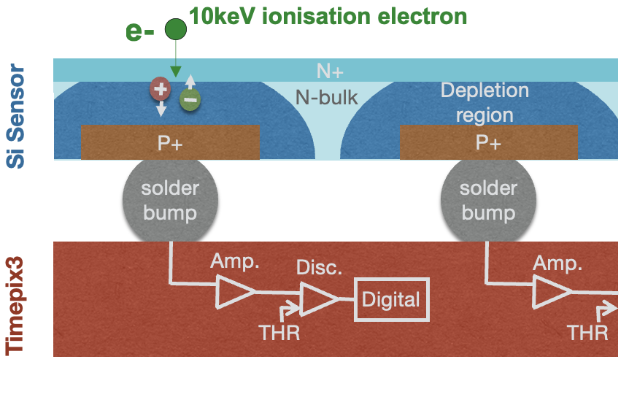
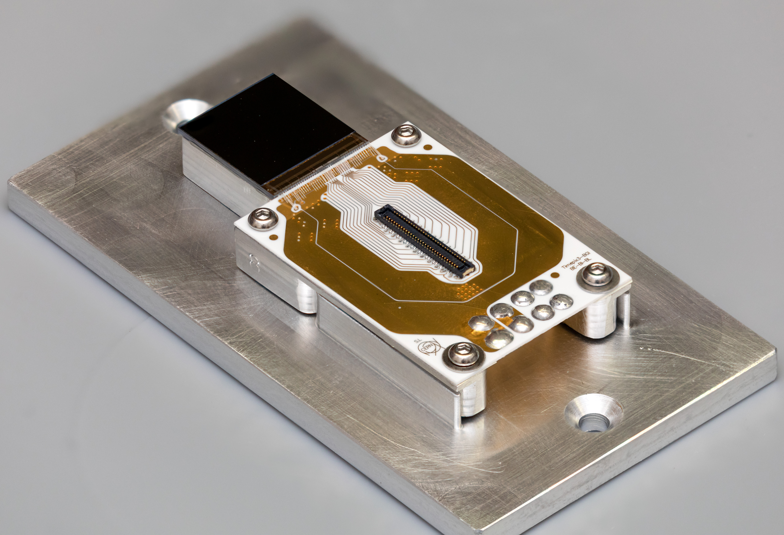
Ionisation Electron Detection
Timepix3(/4) Hybrid Pixel Detector optimized for 10 keV electron detection inside the beam pipe
Charge > Threshold → Event, consisting of:
Pixel position → Where (σ_{position}< 16 um)
Time of Arrival (ToA) → When (σ_{time}=1.6 ns / 200 ps for TPX4)
Time-Over-Threshold (ToT) → ~Energy
Single electron detection & digitisation directly inside the beam pipe.

Slide 5
Beam Profile Measurement
Measure beam profile by counting the number of ionisation electrons detected in each column.
Refs. IBIC 2017, IBIC 2019, IBIC 2021

Slide 6
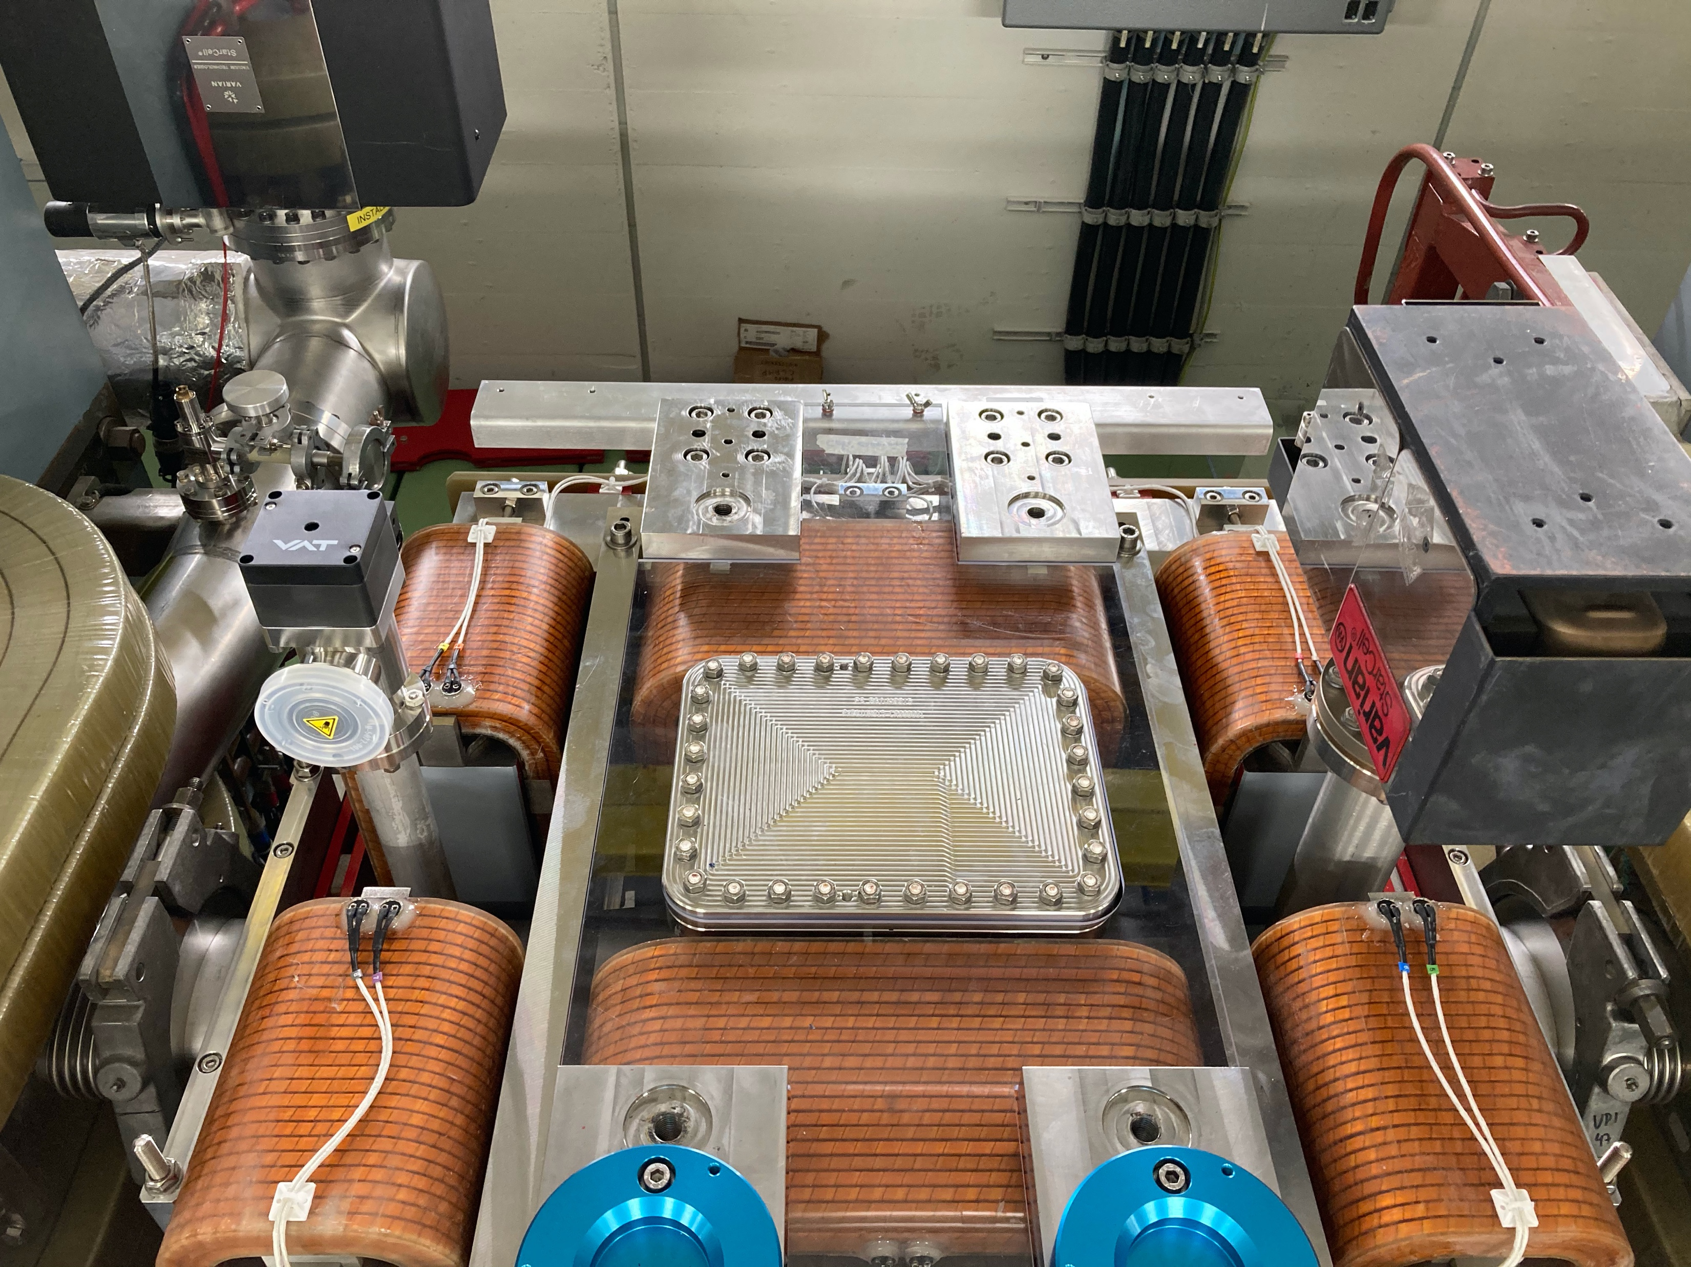
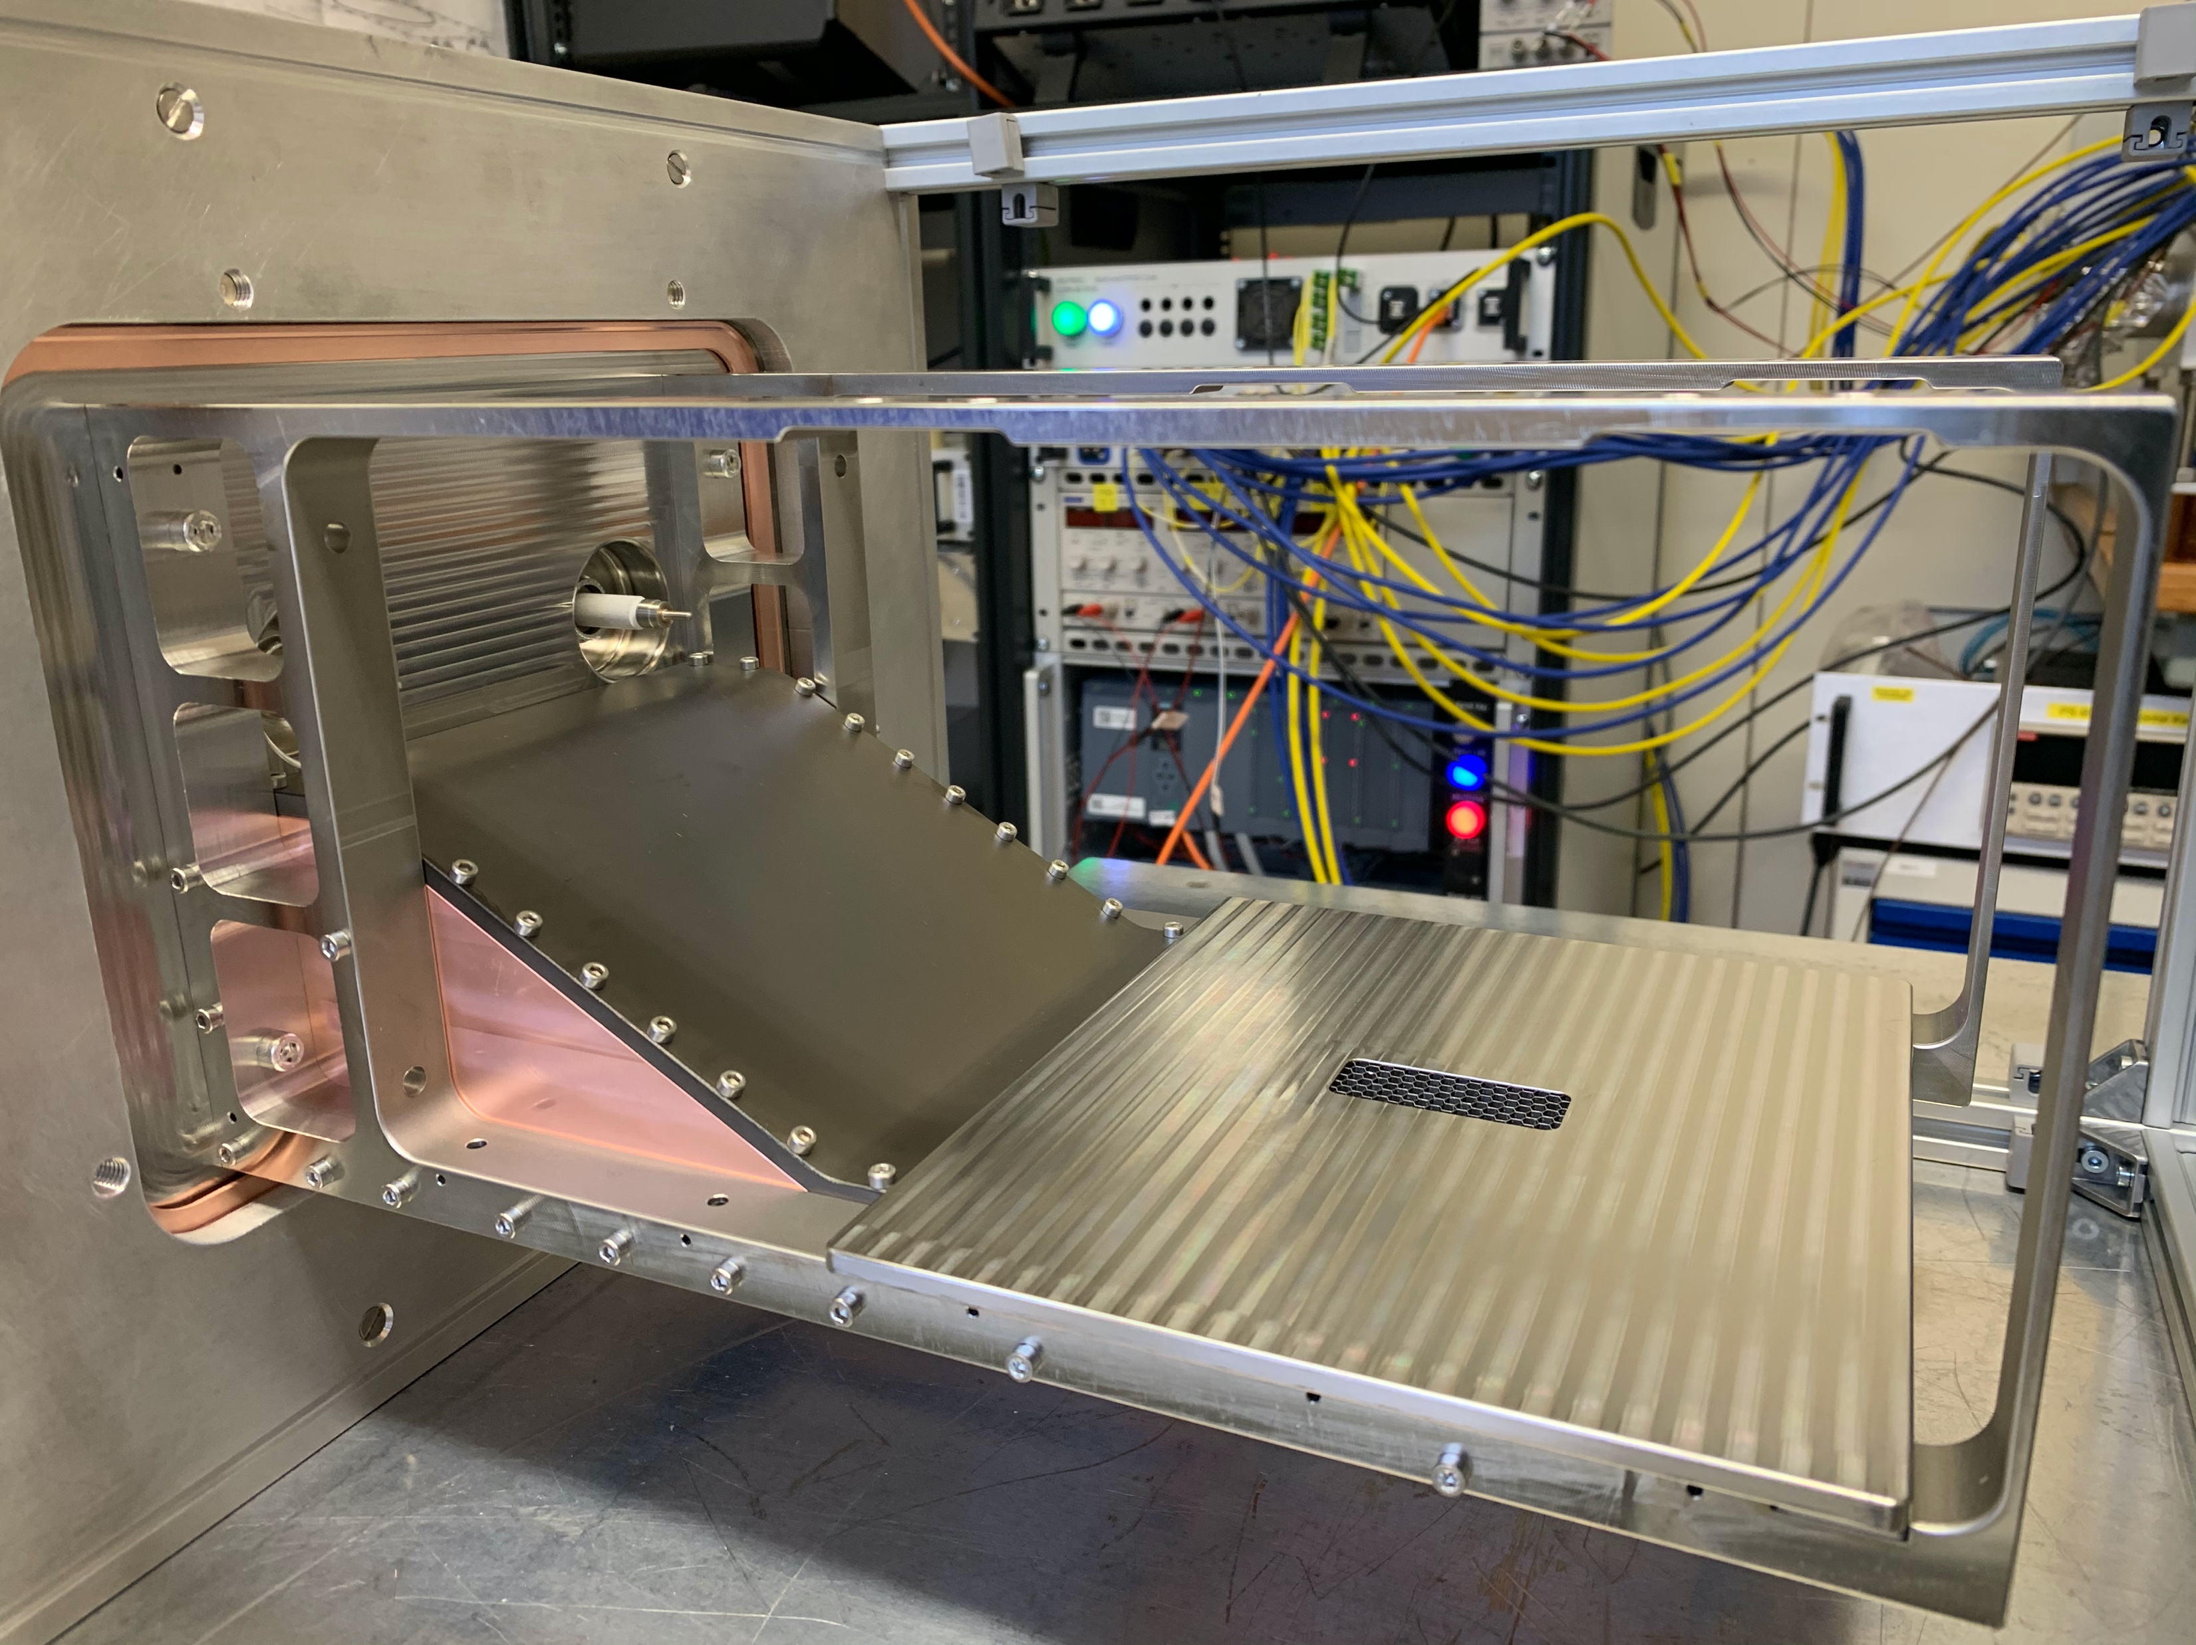
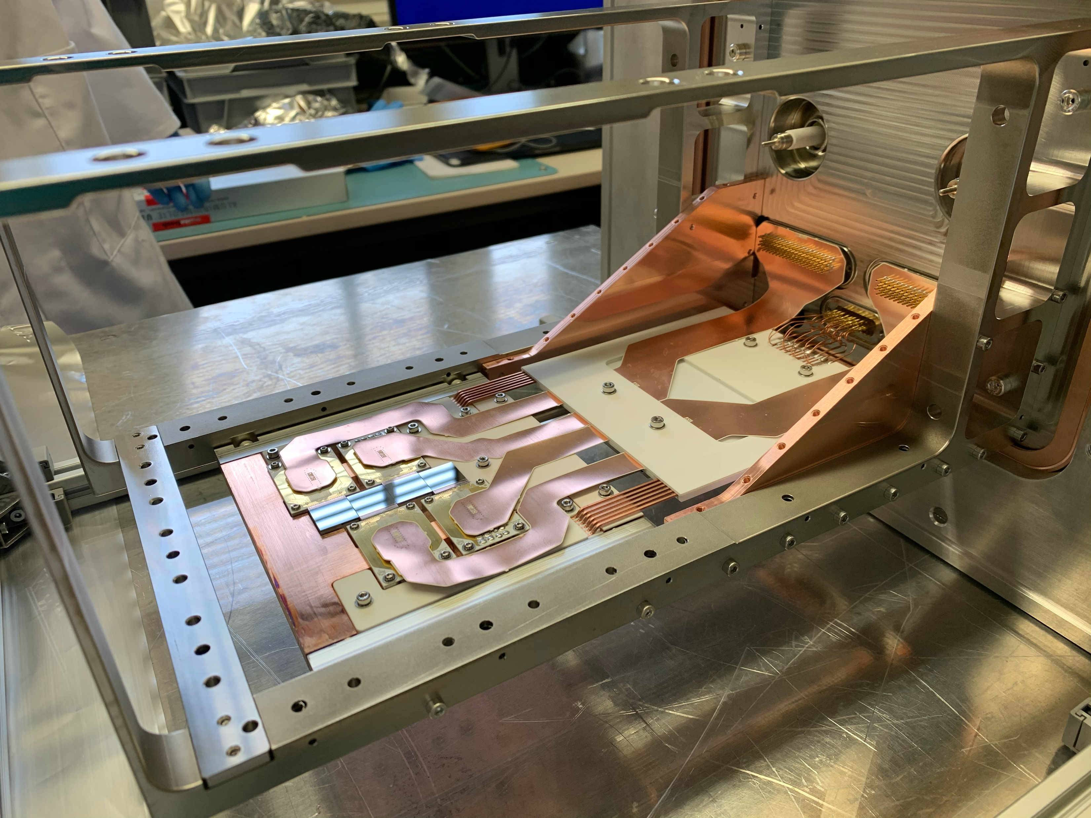
Existing BGI’s based on Timepix3
PS BGI-Horizontal & BGI-Vertical profile monitors installed in LS2
SPS BGI-Horizontal installed during YETS 23/24, SPS BGI-Vertical to be installed YETS 24/25
PS BGI-Vertical
Field cage + Faraday cage
UHV compatible Timepix3 electronics

Slide 7
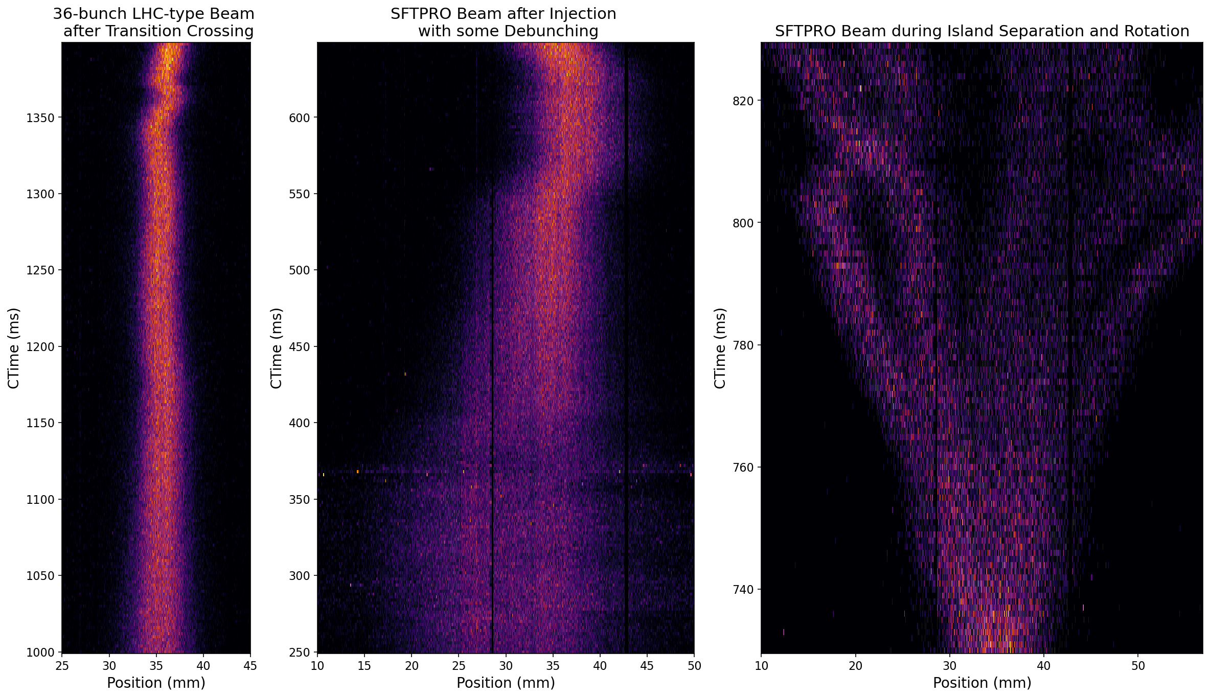
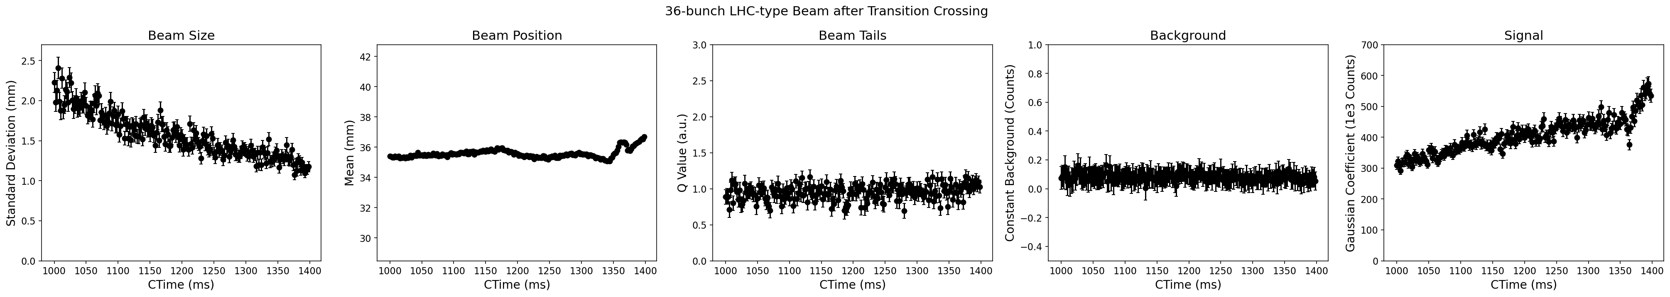
Example: Beam Evolution Measurments
Measuring many profiles over the course of one cycle, provides information on the evolution of:
Profile distribution
Transverse emittance
Beam position
Relative intensity

Slide 8
Status of PS & SPS BGI’s
Current Status
Despite promising results (*), PS & SPS BGI’s are not yet fully operational.
Review held 3rd September 2024 → outcome EDMS 3161142
Follow-up at BI-Technical Board on 28th November
Main Outcomes
Move immediately to FESA-on-SoC platform.
  In progress.
Highest priority is to solve SPS BGI communication problem with Timepix3 during AWAKE & LHC25 cycles:
  Investigations made at ATS EMC lab in November 2024, symptoms reproduced, issues identified & potential solutions to be implemented during EYETS 24/25 & validated during 2025 run.
  Important to solve this with a view to the LHC BGI & to validate the operation of Timepix4 in the LHC in 2026.
(*) Refs.: https://bgi.web.cern.ch/papers/

Slide 9
LHC BGI (2007-2018): MCP/Optical Based
BGI’s were originally installed in the LHC, but removed in 2017/18 due to damage to the instruments caused by beam induced heating.
Original design based on detection of ionisation electrons with a Microchannel Plate (MCP) + Phosphor Screen + Optics + Intensified Camera.
Technical Limitations:
Impedance no problem for beam, but 260W power into instrument;
Inhomogeuous ageing of MCP / Phosphor / Intensitifed camera.
Performance Limitations:
Distortion to measured profile at E>4 TeV;
Not an independent measurement, due to need to cross-calibrate with BWS to remove optical aberations (PSF of optics).

Slide 10
HL-LHC BGI: Timepix4 Based
Compact design based on direct detection of ionisation electrons inside the beam pipe with a Timepix4 HPD. Electrons guided to detector with 0.6T magnetic field.
Technical Limitations (HL BGI solution):
Impedance no problem for beam, but 260W power into instrument; → Compact low impedance design with active cooling.
Inhomogeuous ageing of MCP / Phosphor / Intensitifed camera. → Replaced with Timepix3/4 HPD.
Performance Limitations (HL BGI solution):
Distortion to measured profile at E>4 TeV; → Higher strength guiding magnetic field.
Not an independent measurement, due to need to cross-calibrate with BWS to remove optical aberations (PSF of optics).→ Direct detection inside beam beam pipe (no optics.)
Baseline HL-LHC WP13 instrument to provide independent bunch-by-bunch beam profile measurment throughout the acceleration cycle.

Slide 11
Beam Halo Measurement with HL-LHC BGI?

Slide 12
Expected Ionisation Electron Yields
 | Injection | Collision
E_{k} [GeV] | 450 | 7000
N_{b} [10¹⁰ p/b] | 22 | 22
n_{b} | 2748 | 2748
Residual gas (H₂, 1x10⁻¹⁰ mbar)
𝜎_{ion,H2} [Mb] | 0.300 | 0.371
n_{electrons} [/turn] | 630 | 770
n_{electrons} [/s] | 7.0x10⁶ | 8.7x10⁶
Gas injection (Ar, 1x10⁻⁸ mbar)
𝜎_{ion,Ar} [Mb] | 1.61 | 2.04
n_{electrons} [/turn] | 3.4x10⁵ | 4.2x10⁵
n_{electrons} [/s] | 3.8x10⁹ | 4.8x10⁹
Refs.: CERN-Thesis-2020-236, Beam-Gas Ionsiation Cross Sections at 7TeV

Slide 13
Expected Ionisation Electron Yields
 | Injection | Collision
Residual gas (H₂, 1x10⁻¹⁰ mbar)
n_{electrons} [/s] | 7.0x10⁶ | 8.7x10⁶
n_{electrons} [/s] * RI(3σ→∞) | 2.2x10⁵ | 2.8x10⁵
n_{electrons} [/s] * RI(3.5σ→∞) | 9700 | 12000
n_{electrons} [/s] * RI(5σ→∞) | 20 | 25
Gas injection (Ar, 1x10-8 mbar)
n_{electrons} [/s] | 3.8x10⁹ | 4.8x10⁹
n_{electrons} [/s] * RI(3σ→∞) | 1.2x10⁸ | 1.5x10⁸
n_{electrons} [/s] * RI(3.5σ→∞) | 5.3x10⁶ | 6.7x10⁶
n_{electrons} [/s] * RI(5σ→∞) | 1.1x10⁴ | 1.4x10⁴
Assuming Gaussian beam profile

Slide 14
Readout Limitations
1 x ionisation electron creates ~1 x Timepix4 event
Limitations of Timepix4
Technical limit of 2.5 GEvents/s ( 16 links @ 10.24 Gbps. )
Demonstrated links @640 Mbps through vacuum feedthrough → 155 MEvents/s.
Maximum pixel event rate = 10.8 kHz / pixel ( 512 x 448 pixel array = ¼ M pixels. )
Limitations of Timepix4 Readout System (BIPXL)
Current FPGA limited to event processing at maximum rate of 125 MEvents/s.
Key Limits
Maximum event rate per Timepix4 = 125 MEvents/s
Maximum event rate per pixel = 10.8 kHz / pixel

Slide 15
Expected Ionisation Electron Yields
 | Injection | Collision
Residual gas (H₂, 1x10⁻¹⁰ mbar)
n_{electrons} [/s] | 7.0x10⁶ | 8.7x10⁶
n_{electrons} [/s] * RI(3σ→∞) | 2.2x10⁵ | 2.8x10⁵
n_{electrons} [/s] * RI(3.5σ→∞) | 9700 | 12000
n_{electrons} [/s] * RI(5σ→∞) | 20 | 25
Gas injection (Ar, 1x10-8 mbar)
n_{electrons} [/s] | 3.8x10⁹ | 4.8x10⁹
n_{electrons} [/s] * RI(3σ→∞) | 1.2x10⁸ | 1.5x10⁸
n_{electrons} [/s] * RI(3.5σ→∞) | 5.3x10⁶ | 6.7x10⁶
n_{electrons} [/s] * RI(5σ→∞) | 1.1x10⁴ | 1.4x10⁴
Maximum event rate per Timepix4 = 1.25x10⁸ events / s

Slide 16
Maximum Rates Per Pixel
 | Injection | Collision
Residual gas (H₂, 1x10⁻¹⁰ mbar)
Max n_{electrons} [/pixel/s] | 5.2x10² | 2.3x10³
Gas injection (Ar, 1x10-8 mbar)
n_{electrons} [/pixel/s] | 2.8x10⁵ | 1.3x10⁶
n_{electrons} [/pixel/s] * RI(3σ→∞) | 2.5x10⁴ | 1.1x10⁵
n_{electrons} [/pixel/s] * RI(3.5σ→∞) | 1.1x10³ | 5.2x10³
Maximum event rate per pixel = 10.8x10³ events / pixel / s

Slide 17
Beam Halo “Signal”
Assuming Gaussian distrubtion.
With only residual gas ionisation (H₂, 1x10⁻¹⁰ mbar):
~10,000 samples / second in the range [ 3.5σ → inf. ]
No readout limitations.
Measure core & halo simulataneuously.
With gas injection (Ar, 1x10⁻⁸ mbar):
~5M samples / second in the range [ 3.5σ → inf. ]
Signal rate in the core is too high → Mask out (almost) all pixels (next slide).
Bunch-by-bunch halo measurments possible at rate of 1800 samples / bunch / second.

Slide 18
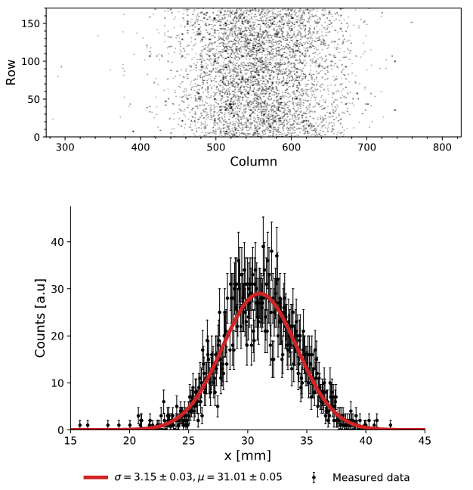
Avoiding Saturation with Gas Injection
Timepix4 allows the masking of individual pixels, whereby enabling to mask the “core” (i.e., functioning as a ~“digital coronagraph.”)
Example: Mask pixels in range -3.5σ < x < 3.5σ reduces the date from 5x10⁹ to 7x10⁶ events / s.
Could still leave unmasked some pixels under the “core” distribution to allow for a concurrent complete profile measurement.

Slide 19
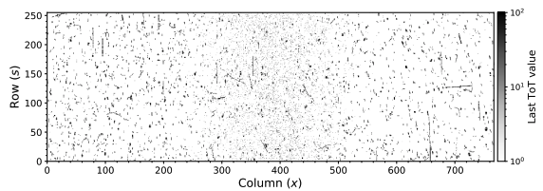
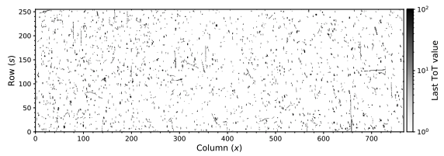
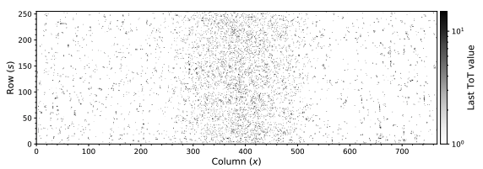
Backgrounds
Raw data = Signal + Background
Background(s)
Timepix4 Hybrid Pixel Detector is sensitive to any charged particle crossing the sensor.
Possible sources of charged particle backgrounds include:
  Secondary particles from inelastic beam gas interactions;
  Particles from the decay of surrounding activated material;
Other possible backgrounds = synchrotron light, florescence of injected gases, etc.
Mitigation
Use cluster finding methods (e.g. DBSCAN) to transform Timepix4 events into particle events and then apply selection criteria (e.g. cluster size, cluster energy) to select only ionisation electrons.
Method already demonstrated with the PS BGI.
Clusters passing Background selection
Clusters passing Signal selection

Slide 20
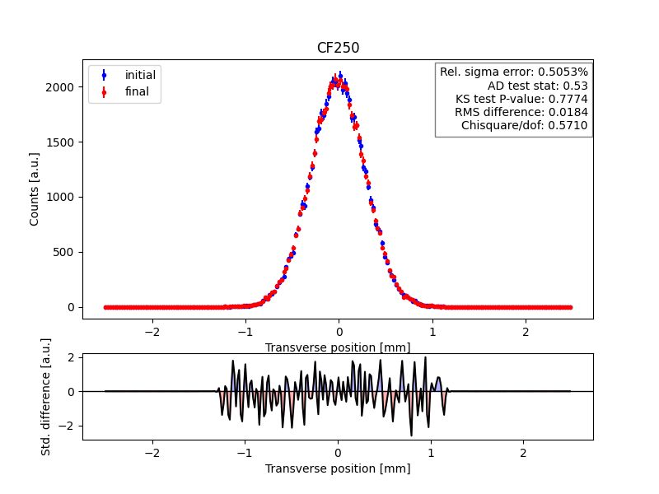
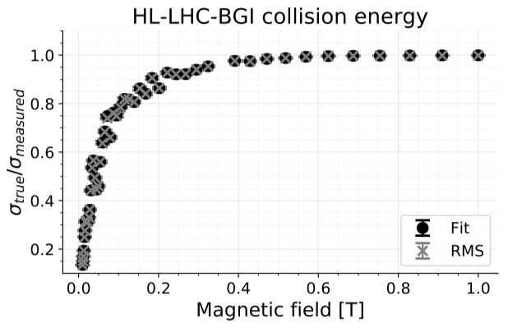
Systematics (I)
Ideal instrument preserves the ionisation electron transverse position during transport from creation to the detection (Timepix4) plane.
Transport of ionisation electron from formation to the electron detector studied with CST-Studio (Static EM-fields) & IPMSim (tracking of ionisation electron in dynamic and static EM-fields.)
Magnetic strength specified to ensure beam size measured with a systematic error < 2%.

Slide 21
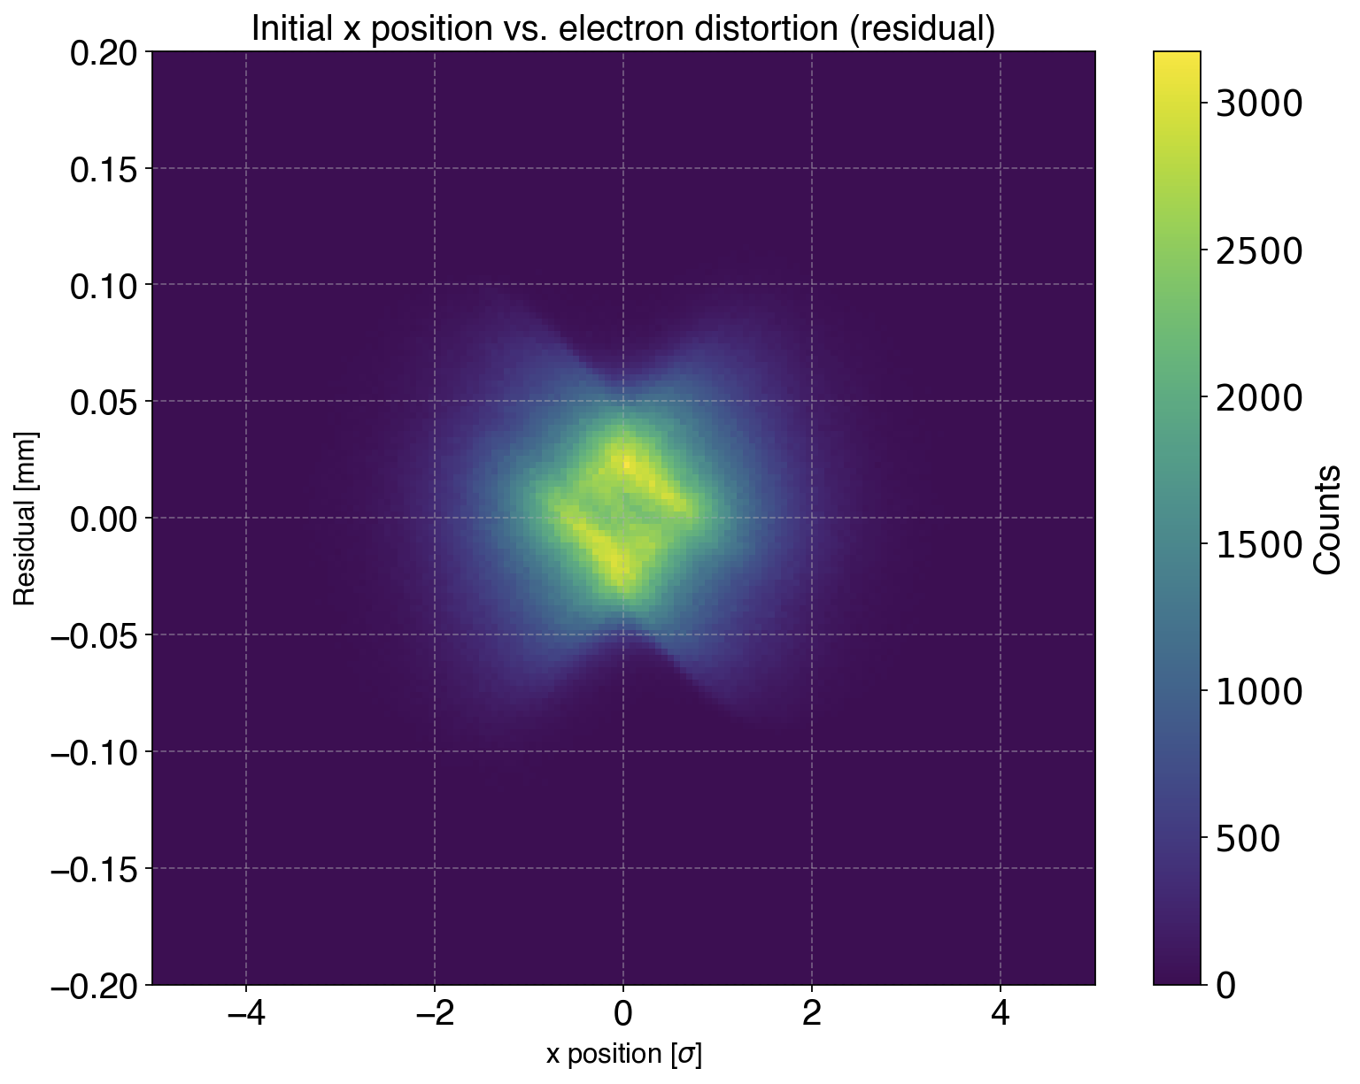
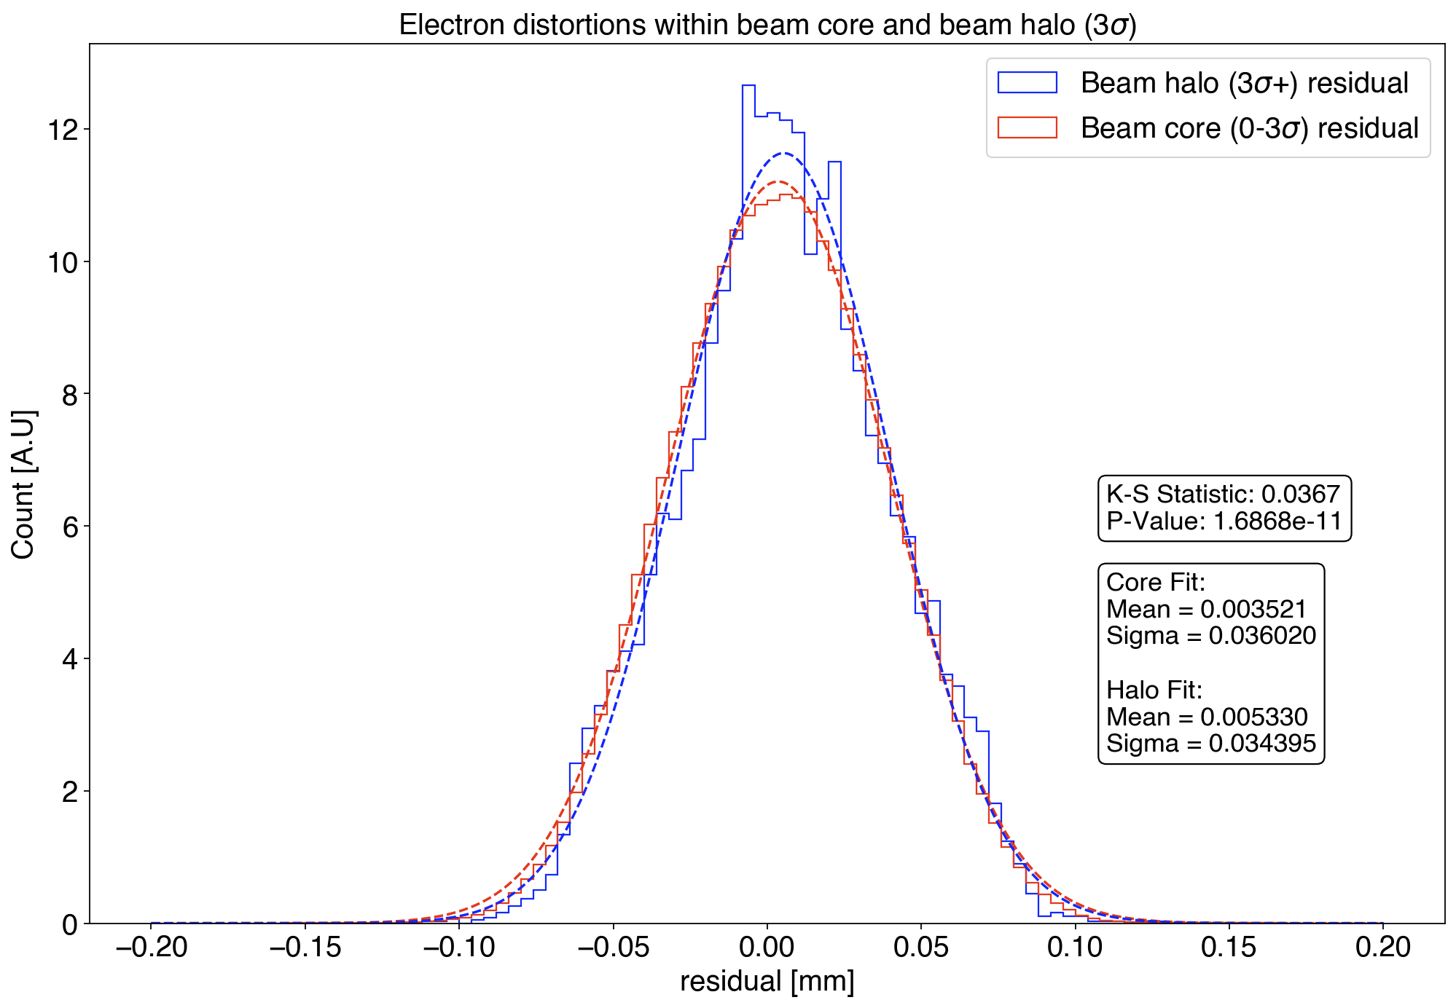
Systematics (II)
What happens to ionisation electrons in the beam halo during transport from creation to the detection plane? Simulation of 3.5M ionisation electrons with IPMSim.
Point spread for ionisation electrons created in the beam halo is approximately the same as for those created in the beam core.

Slide 22
‘Template questions’
What is the maximum contrast your technique can achieve? At which sigma value?
  Signal [3.5σ→inf.] = 10 kHz (residual gas) or 5 MHz (injected gas)
  Particle backgrounds = ~0 (with cluster finding + selection)
  Electrical backgrounds = 0
What fraction of the total beam can you measure in the ROI (relative integral)?
  With residual gas → no limit in the ROI
  With gas injection → x > 3.5σ
What is the absolute number of particles you can detect in the ROI?
  Signal [3.5σ→inf.] = 10 kHz (residual gas) or 5 MHz (injected gas)
Can your technique provide:
  1D beam profiles? Yes
  2D beam images? No
What is the fastest acquisition rate you can achieve for a full machine measurement?
  5 MHz (with injected gas)

Slide 23
‘Template questions’
Does your technique support bunch-by-bunch measurements? Yes
  How many turns are needed for a measurement?
    1800 samples / bunch / second
  What is the minimum number of particles needed per bunch?
    Linear scaling between number electrons (samples) and particles per bunch
Can your technique be connected to an interlock system? Possibly, but requires further study
  What would be the response time?
    Need to study number of electrons needed for an interlock.
  What reliability level can be achieved?
    Needs further study.
Is your technique expected to perform all along the LHC cycle? Yes
Assuming it will be possible to increase beam size at the location of your detectors, would your technique gain or lose performance reach? Gain - since larger beam reduces the effects of space charge on the distortion to the transverse position of the ionisation electrons. Aperture of new dipole magnetic fixed, so would be difficult to increase instrument aperture beyond 50mm.

Slide 24
Summary Table
Performance Metric | Required Range | Use Case(s) | Your Technique
Contrast | 10^-4 to 10^-6 | Collimation: 10^-4 at upper bound | Signal = 10 kHz (residual gas) or 5 MHz (injected gas) Background = tbd. (~0)
 |  | MP: 10^-6 at 6.7σ
Relative Integral | 0.2% to 5% | Collimation: 5% to 0.5% | See table on slide #14.
 |  | MP: 1.4% to 0.2%
Absolute Integral | 10^10 to few 10^12 | Collimation: 1.5×10^12 | See table on slide #14.
 |  | MP: (1-4)×10^10
1D Profile Capability | Yes/No | Required for Beam-Beam | Yes.
2D Image Capability | Yes/No | Required for Beam-Beam | No.
Max. Acquisition Rate | 10-60 seconds | MP: ~10s | 5 MHz with injected gas → 1800 electron / bunch / s.
 |  | Others: ~60s
Bunch-by-Bunch Gating | Yes/No | Required for Beam-Beam | No gating required for Bunch-by-Bunch (use timestamp of electrons), but gating is possible.
Number of Turns Needed | - | All cases accept multi-turn | With gas injection 5 MHz → 440 samples / turn.
Interlock Capability | Yes/No | Required for MP | Needs further study.

Slide 25
Conclusion
New generation of Beam Gas Ionisation (BGI) profile monitors have been developed for the PS & SPS, based on direct detection of individual ionisation electron inside the beam pipe.
Long development, which is still to be completed, but offers the potential for independent continuous non-invasive bunch-by-bunch beam profile measurements throughout the acceleration cycle.
Common technique for PS, SPS & LHC.
Beam halo measurement with residual gas ionisation at 10 kHz (core + halo) and gas injection at 5 MHz ( halo only. )
Additional costs (w.r.t.. current EVM) - possible consolidation of gas injection system(s).
Main risk - electromagnetic interference between beam & Timepix4 - not specific to beam halo measurement. Solutions to be validated in 2025.

