Slide 1
A straw tracker for FCC-ee
Oliver Kortner, Junjie Zhu
Dec 2, 2024

Slide 2
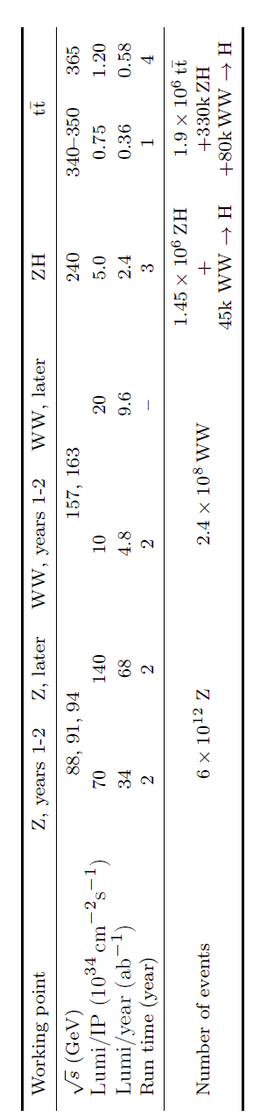
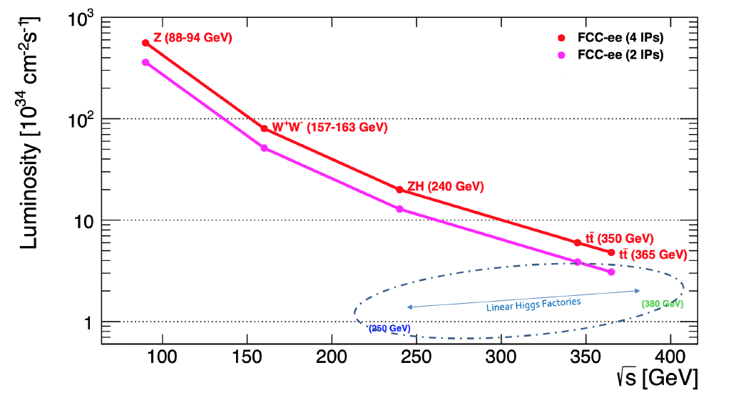
FCC-ee physics program
2
FCC-ee:
  ~100,000 Z / second (~1 Z / second at LEP)
  ~10,000 WW / hour (20,000 WW in 5 years at LEP)
  ~1,500 Higgs / day (O(10) times more than ILC)
  ~1,500 top quarks / day
  Physics potential:
      ×10-50 improvements on all EW observables
      Up to × 10 improvement on Higgs coupling (model-indep.) measurements over HL-LHC
      ×10 Belle II statistics for b, c, τ
      Indirect discovery potential up to ~ 70 TeV
      Direct discovery potential for feebly-interacting particles over 5-100 GeV mass range
Detector specifications are often determined by the Z run

Slide 3
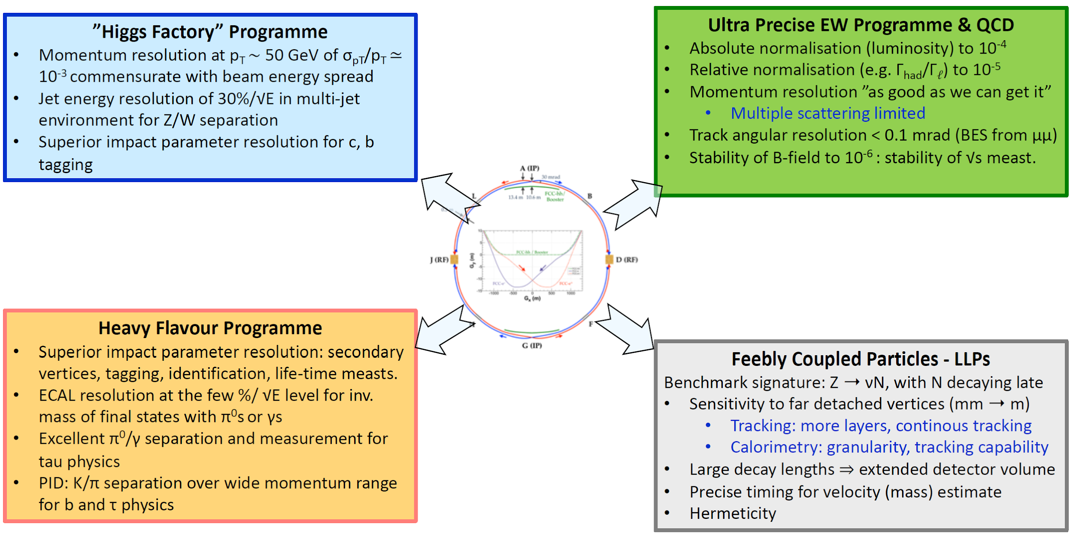
General detector requirements
3
From Mogens Dam

Slide 4
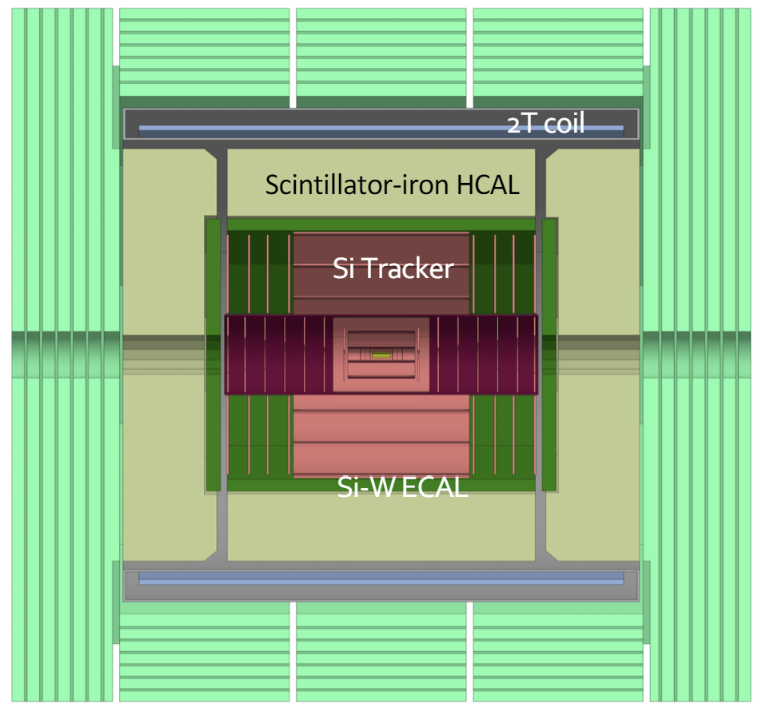
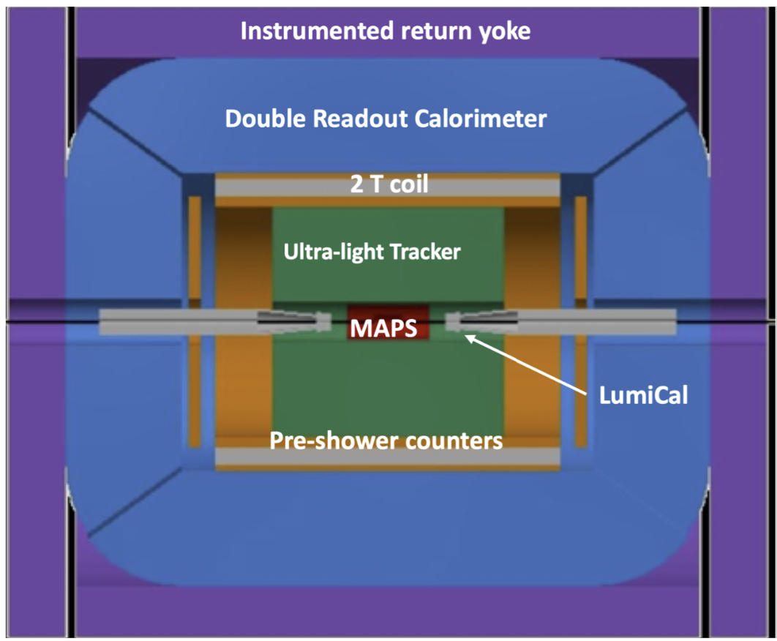
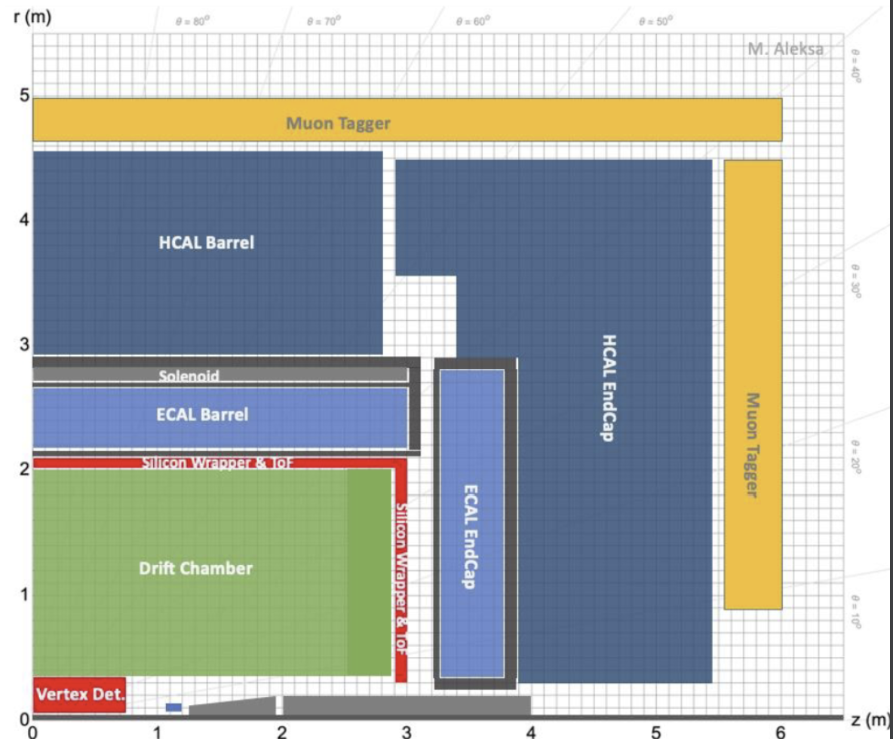
Detector benchmarks
Four detectors considered for FCC-ee
4
CLD
IDEA
ALLEGRO
Full silicon vertex + strip tracker (TPC under consideration)
CALICE-like 3D-imaging high-granular calorimetry with Si-W for ECAL and Sci-iron for HCAL
Muon system with RPCs
Coil outside of calorimeters
Silicon vertex + ultra-light tracker
Monolithic dual readout calorimeter with Cu-fibers (possibly augmented by dual-readout crystal ECAL)
Muon system with µ-RWELL
Coil inside calorimeters
Silicon vertex + ultra-light tracker
High granularity noble liquid ECAL (LAr or LKr with Pb or W absorbers)
CALICE-like or TileCal-like HCAL
Muon system
Coil outside of ECAL
The maximum magnetic field will be 2 T for the Z run, but could be 3-4 T for other runs
ALLEGRO assumes an inner tracker with a length of 5 meters, 4 meters for the CLD and IDEA detectors

Slide 5
Straw tracker
5
We propose to have an ultra-light weight straw tracker (combined with pixel and silicon wrapper) for an FCC-ee inner tracker:
  Reasonable single hit resolution: 100~130 µm
  Low material and less multiple scattering with thin-wall straws
  Pattern recognition
  Particle identification (π-K, K-p identifications)
  Long-lived particle searches
  Capable of triggering
Straw trackers are robust and could provide high performance for tracking and particle identification:
        Each straw is a single unit, if a sense wire is broken, the channel can be easily removed
        Charges produced in one single straw will remain in that unit
The electric field is radial symmetric; the resolution is independent of a particle's incident angle, no need to incorporate angular correction factors → better single hit resolution
Straws with different radii can be used in different regions to optimize hit occupancy and channel counting
Relatively low wire density: <1 wire/cm² (40~60k straws)
Simpler endplate structure
Optimize the gas mixture to improve the PID capability
Flexible layouts for central and endcap regions
Different gas mixtures may be used at the same time

Slide 6
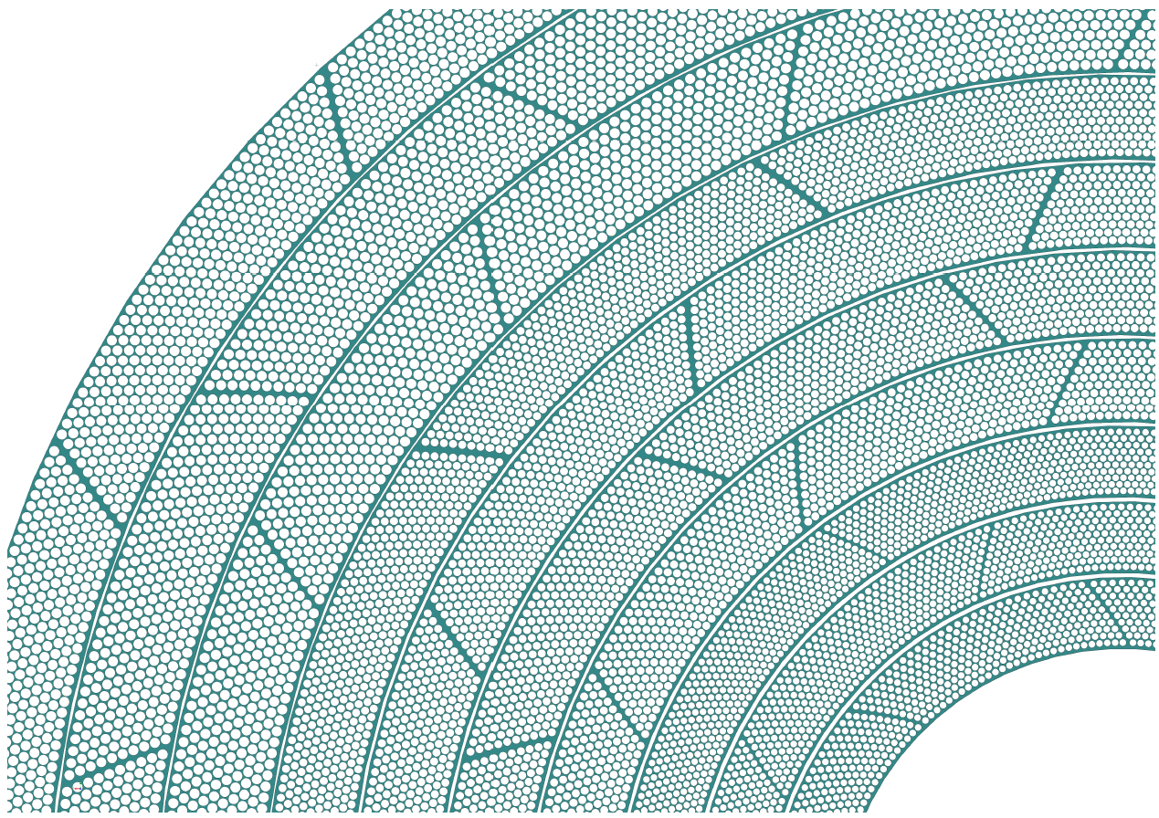
One example layout
6
Coverage: r between 0.3-1.8 m and a length of 4-5 m
10 superlayers (each 10 layers)
Diameters 1.0 - 1.5 cm
Single hit resolution: ~120 µm
O(50k) straws
Stereo angle: 2-5 degrees (Can achieve a resolution of ~3 mm along the z direction with γ=2⁰)

Slide 7
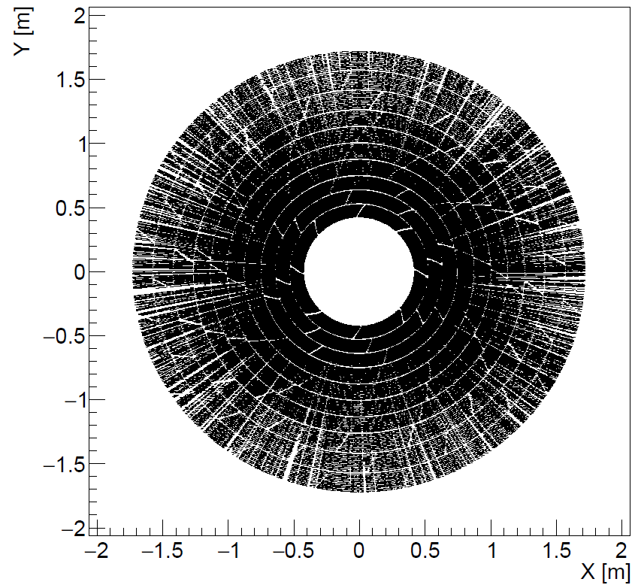
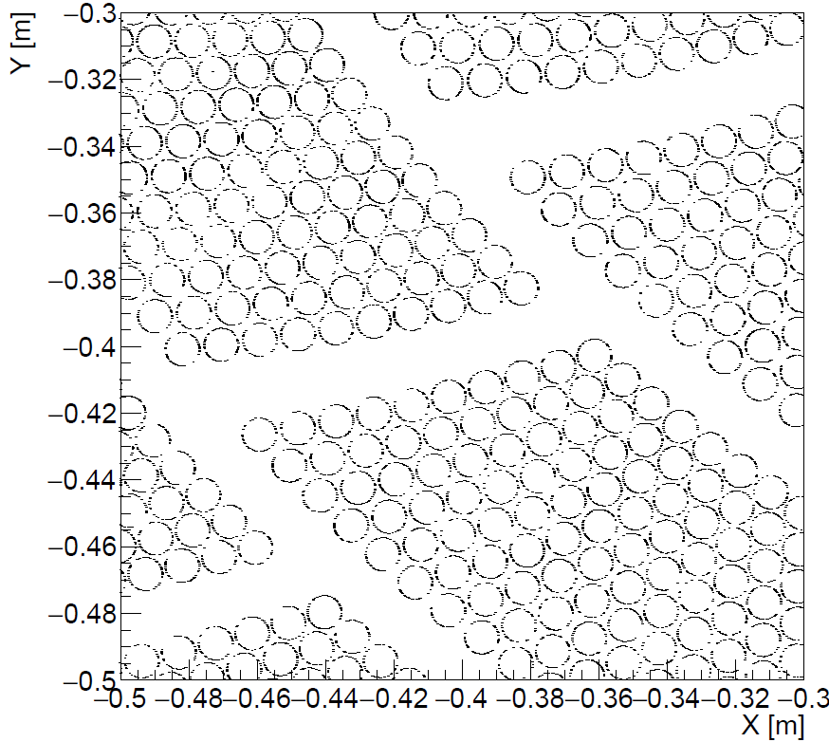
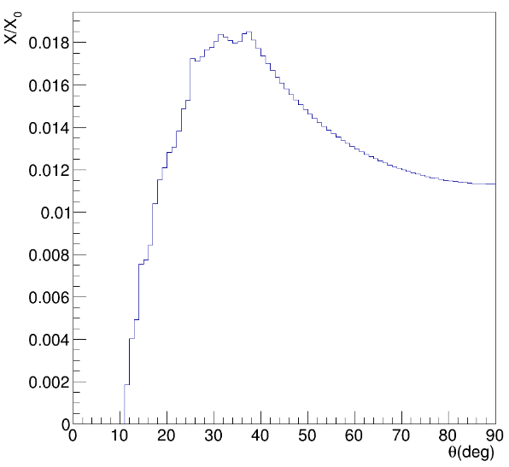
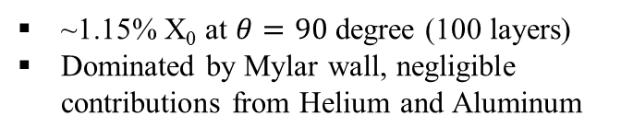
Material budget for a straw tracker
7
For straws with a Mylar wall thickness of 12 µm, 100 layers means ~3.7 mm Mylar in total 🡪 ~1.2% X₀
0.05 µm Aluminum coating on the inner wall
Wire: 20 µm-diameter Tungsten
We have implemented the simulation of a 100-layer straw tracker in GEANT4
No endplate supporting structure added yet
No endplate simulation
Hits for 5000 muons with p_{T}=20 GeV

Slide 8
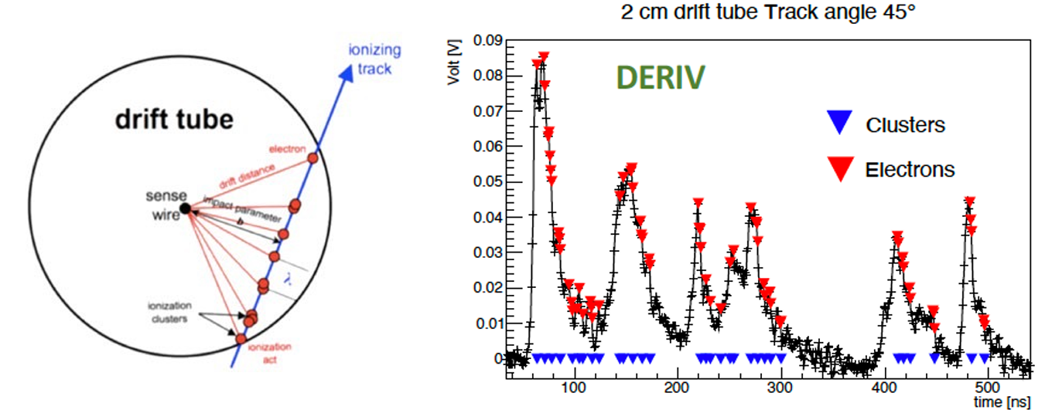
dE/dX and dN/dX
8
  dE/dX:
    remove 20-60% of events with large momentum transfer to obtain a Gaussian distribution
  The accuracy often depends on: sample length t, gas pressure p, number of samples n, and the gas mixture
  Empirical parameterization of resolution: σ = 0.41× n^{-0.46} × (tp)^{-0.32} for Argon (tp in unit of cm bar)
                σ=4.5% assuming n=120 and tp=1 cm bar (σ=3.2% if tp=3 cm bar)
                Denser gases have a smaller plateau: E_{max}/E_{min} ~ 1.6×p^{-0.09} (decreases by 10% if p increases by ×3)
                dN/dX:
  Count number of clusters produced along the track path
  Estimate the resolution to be σ = N_{clusters}^{-0.5}
  With n=120 and 15 clusters per sample, N_{clusters}=1800 and σ = 2.3%. Will be 2.6% if a cluster-finding efficiency of 80%
  Roughly ×2 better than the truncated mean method
  Lots of studies performed by the MEG-II experiment and the IDEA community
  Not a single experiment has implemented this method and used it online yet
Finding electron peaks
Clustering electrons to clusters
N. De Filippis

Slide 9
R&D studies
9
Overall detector design: detector geometry (length, tube radius, layers), axial-stereo layout and stereo angle, module design, momentum and angular resolution, occupancy etc
Single tube production and assembly: wall thickness, aluminum coating, wire, wire tension, end plug, wire centering, gas leakage, assembly procedure, tube support, etc
Gas studies: gas mixture (He-based or Argon-based), Garfield simulation, pressure, flow rate, HV, etc
Mechanics: endplate, spacer, electronics boards, cooling etc
dN/dX and electronics: amplification, waveform digitization, fast algorithms for peak and cluster findings, etc
Prototype chamber assembly
Cosmic ray studies in the lab
Test beam studies with different types of particles at different energies at CERN and Fermilab (unfortunately no test beams will be available for FY25 at Fermilab)

Slide 10
Conclusions
10
A straw tracker could be a good option for FCC-ee experiments
    Reasonable material budget (~1.2% X₀ for ~100 layers assuming a wall-thickness of 12 µm)
    straws with 15-19 µm-thick wall (ultrasonic welding) and 3.5 (×2) µm-thick wall (winding) are available
    will have another 10+ years for industry to improve the yield for straws with wall thinner than 15 µm and develop even thinner straws
    could use >4 m straws to extend the tracker volume
        Robust technology and used in many experiments, could achieve high performance for both tracking and particle identification
        Lots of challenges still remain and need to be investigated and solved
Synergies with DCH for many studies such as wire, gas mixture, frontend electronics, dE/dx(dN/dx) etc
Groups interested so far: Michigan, MPI, Duke, UT Austin, Tufts, SLAC, MSU, UMass, Harvard, UCI
Other groups interested in the project are always welcome to join, plenty of studies to perform
Important to have close collaborations with people working on the DCH, straw production companies, and other experiments using straws
Plan to organize a monthly working group meeting (first Monday of each month) to discuss progress
Mailing list?

