Slide 1
Status of the straw prototype
G.Proto on behalf of the MPI group

Slide 2


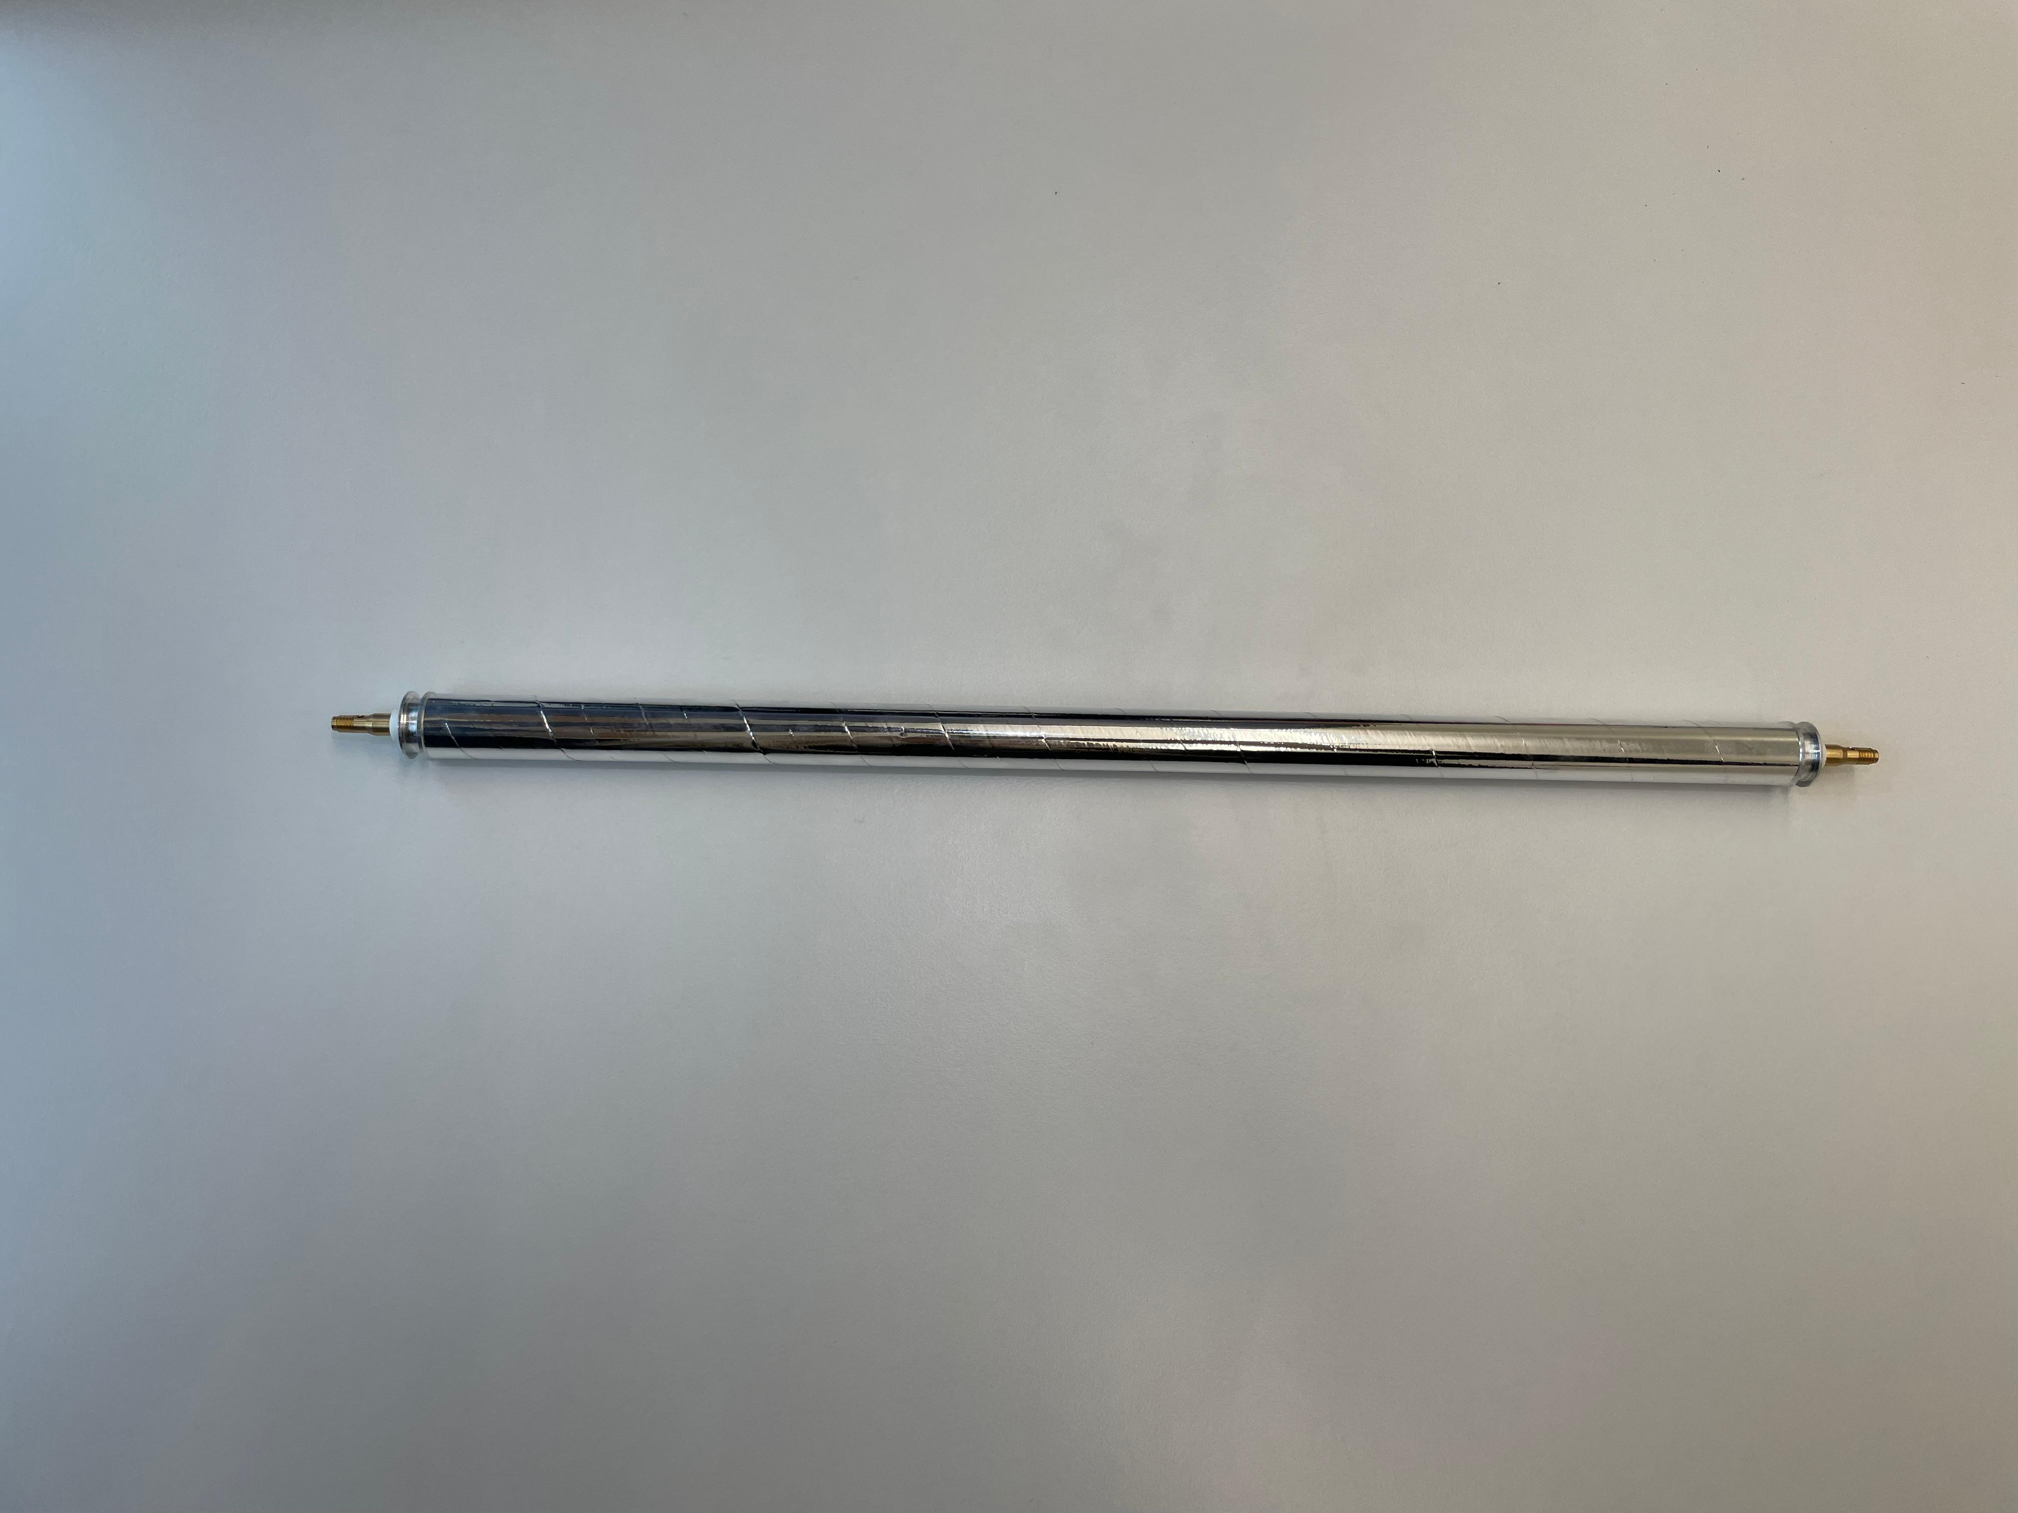
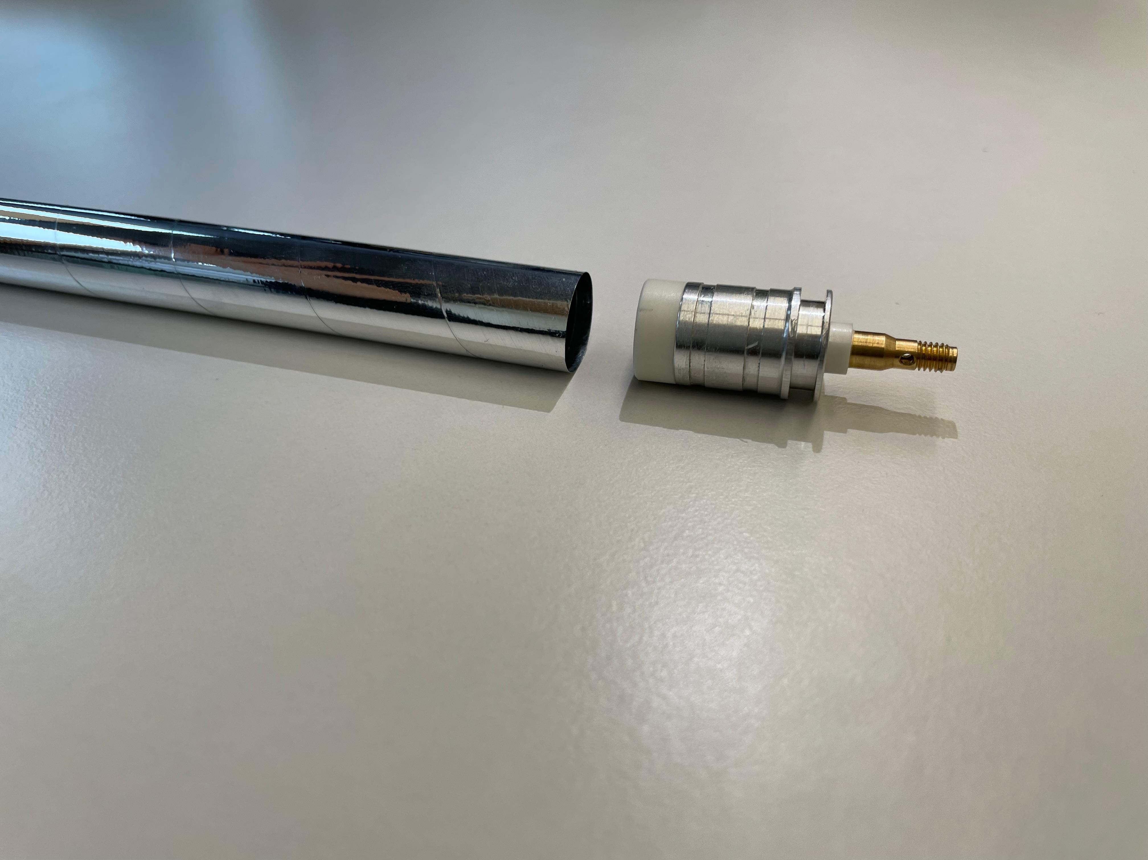
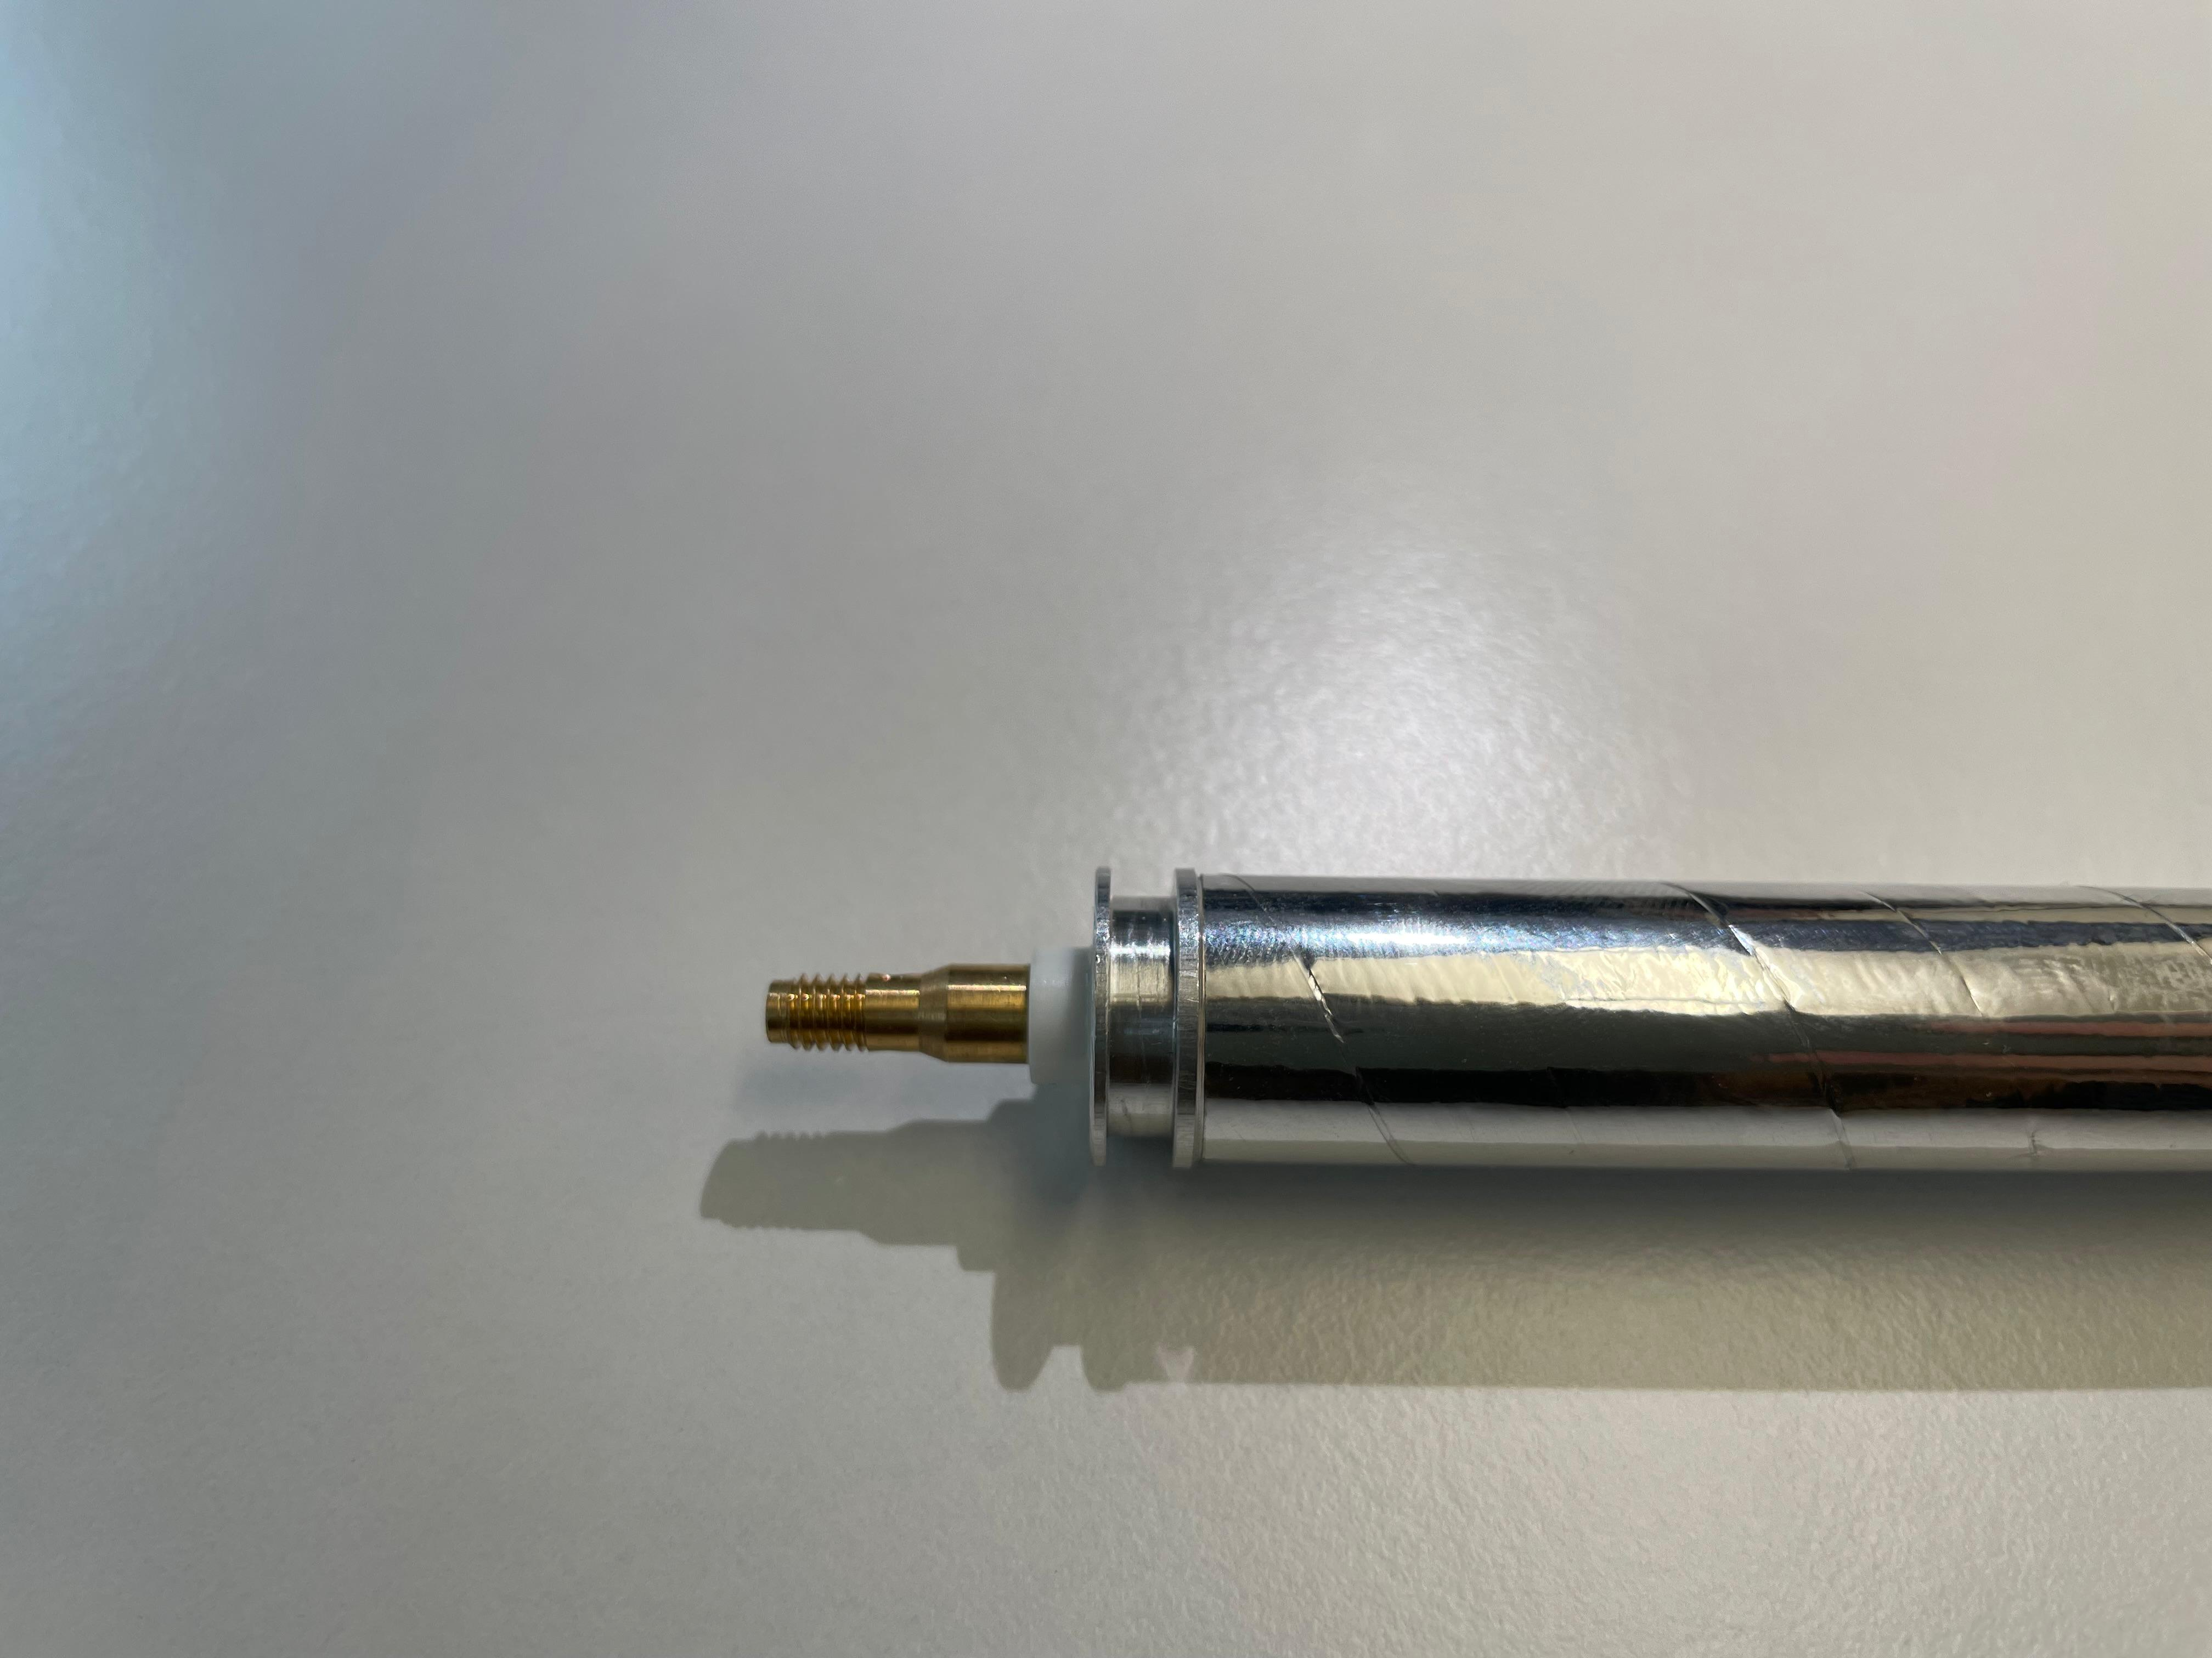
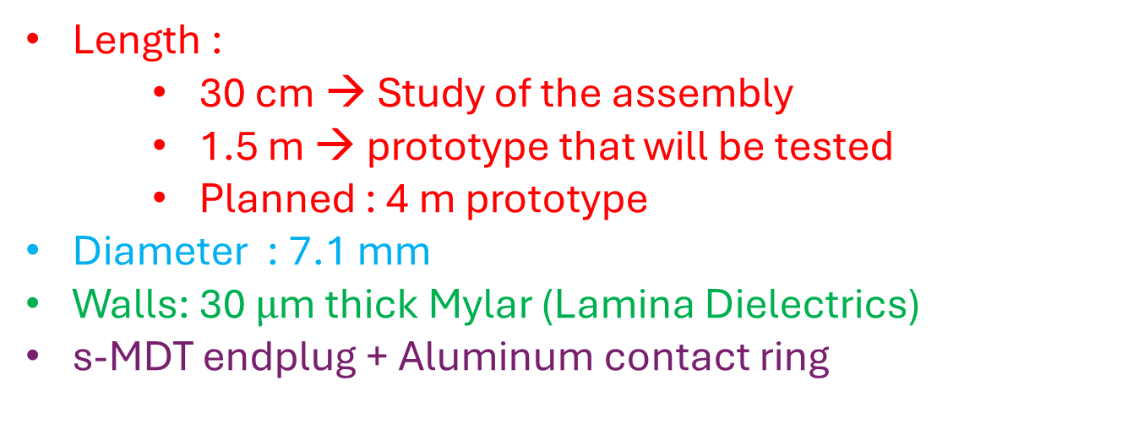
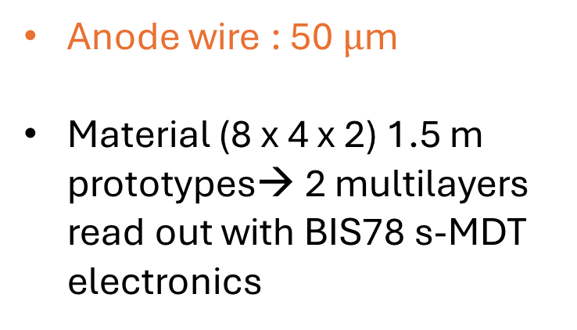
Description of the prototype
Length :
    30 cm → Study of the assembly
    1.5 m → prototype that will be tested
    Planned : 4 m prototype
Diameter : 7.1 mm
Walls: 30 $μ$m thick Mylar (Lamina Dielectrics)
s-MDT endplug + Aluminum contact ring
Straw prototype
Anode wire : 50 $μ$m
Material (8 x 4 x 2) 1.5 m prototypes→ 2 multilayers read out with BIS78 s-MDT electronics
End-plug

Slide 3
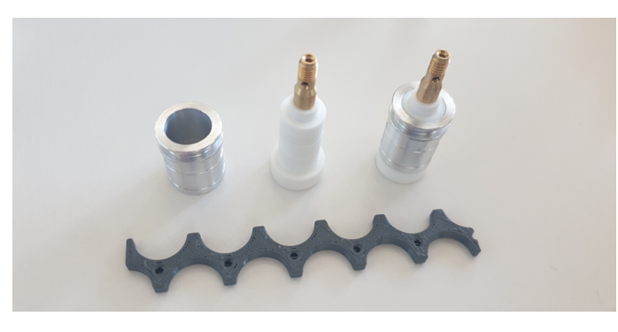
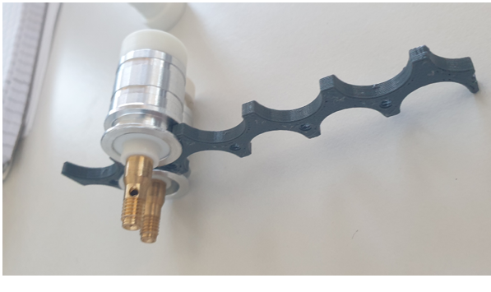
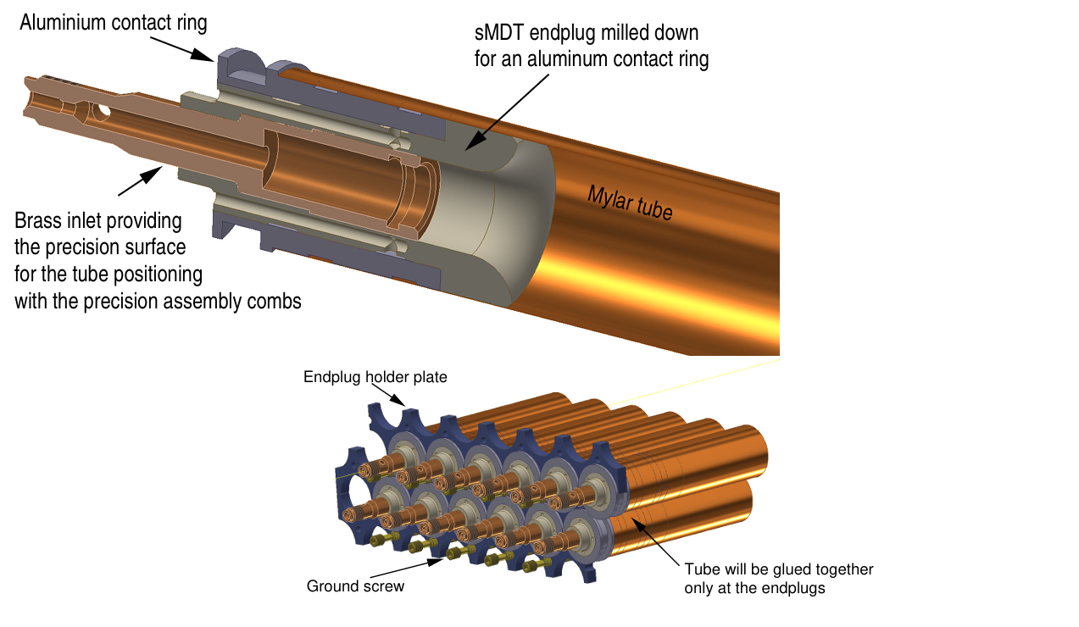
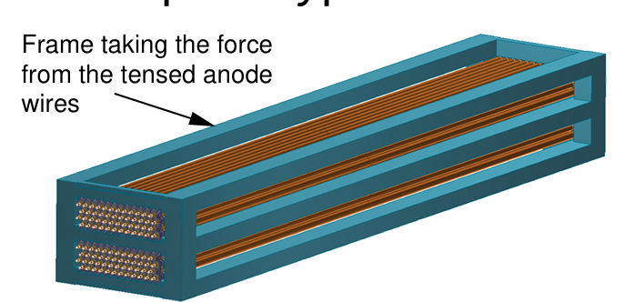
End-plugs + support structure in details

Slide 4
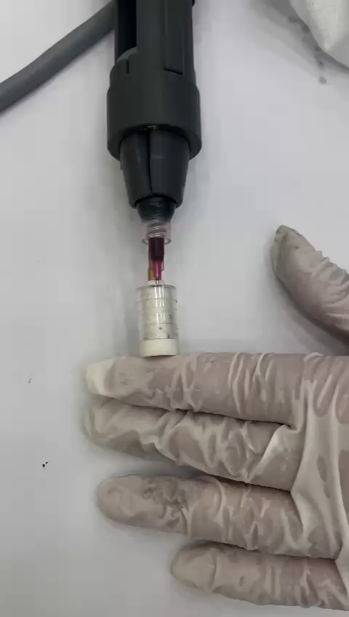
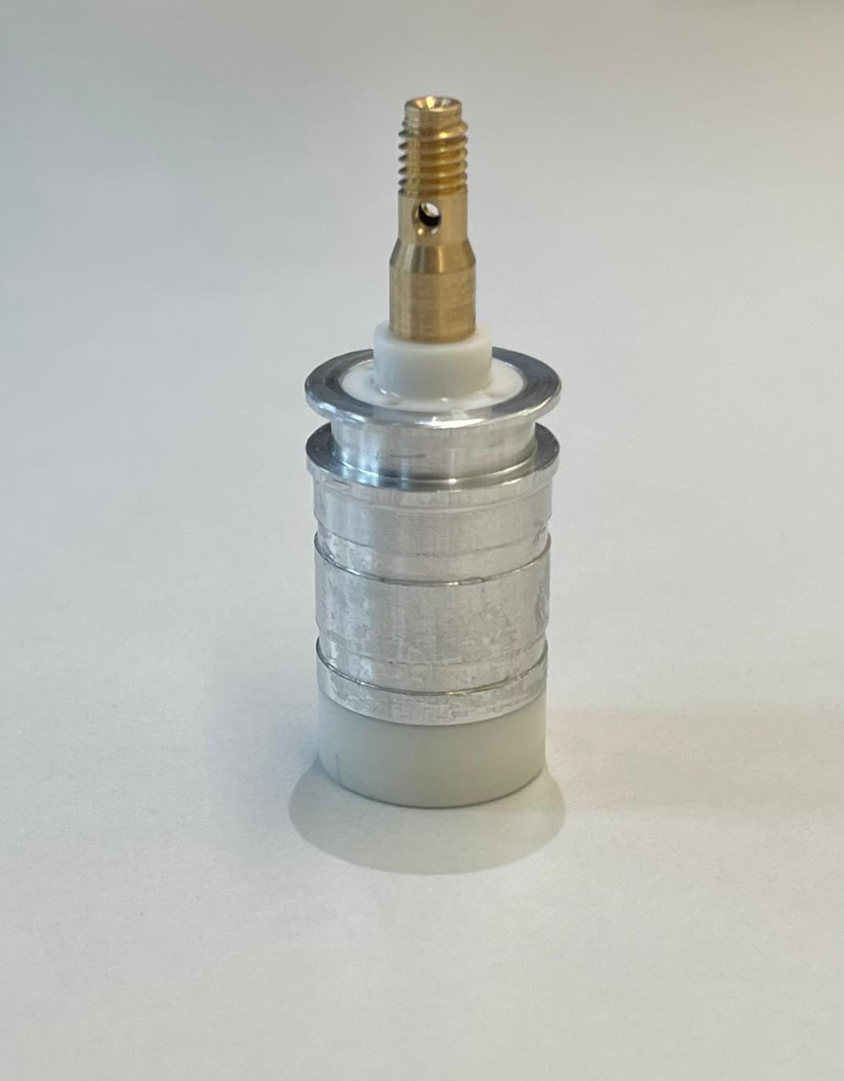
End-plug assembly : gluing process
Development of a special ‘pistol’ device for the gluing of the Aluminum contact ring
Calibration of the device in order to put the proper amount of glue and be sure that it does not escape on the other side (→ clean surface for the electronics installation)
Glued all the end-plugs with the Aluminum ring using mechanical glue (DP 460) → ready for the assembly

Slide 5
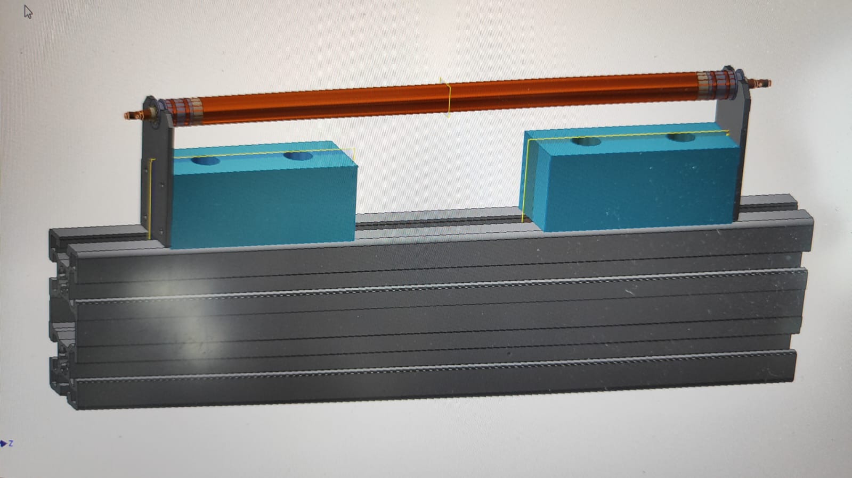
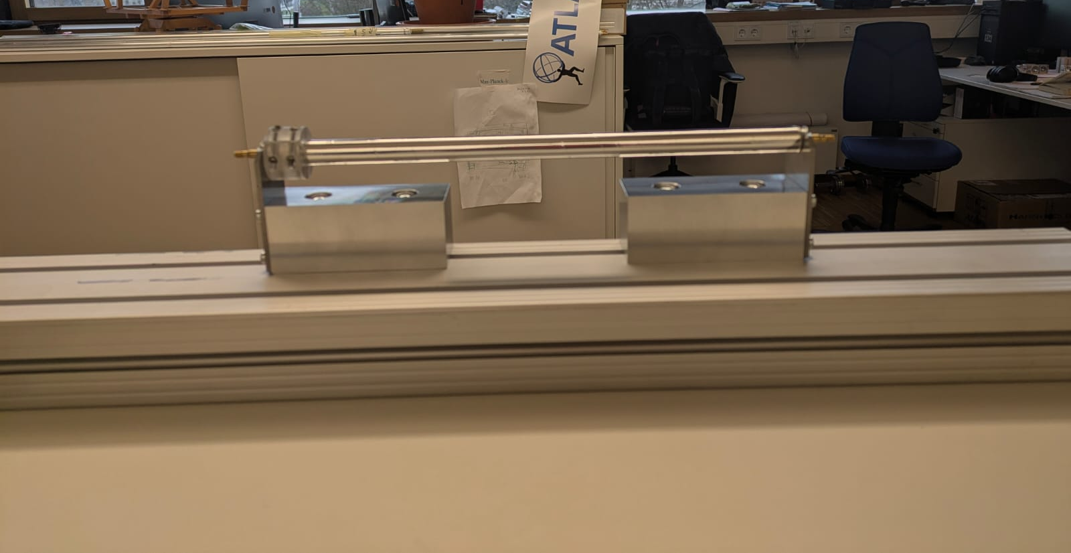
Assembly station
Simple concept for the tube assembly that can be adjusted for several lenght (up to 4 m lenght tube)
Waiting for the conductive glue in order to start the assembly (expected this week)
Wire installation by means of calibrated weights →study the possibility to crimp or solder the wire
Geometry of the prototype measured using a Coordinate Measurement Machine (CMM)

Slide 6
General strategy
The prototype layout has been studied in order to be fully compatible with s-MDT services :
    Endplugs
    Gas system
    HV distribution
    Read-out boards
Test on the prototypes as a proof of concept and as baseline to :
      gain experience for the construction of the straw detector
      Optimize the composition of the gas mixture
      Optimize the electronics (shaping of the amplifier)

Slide 7
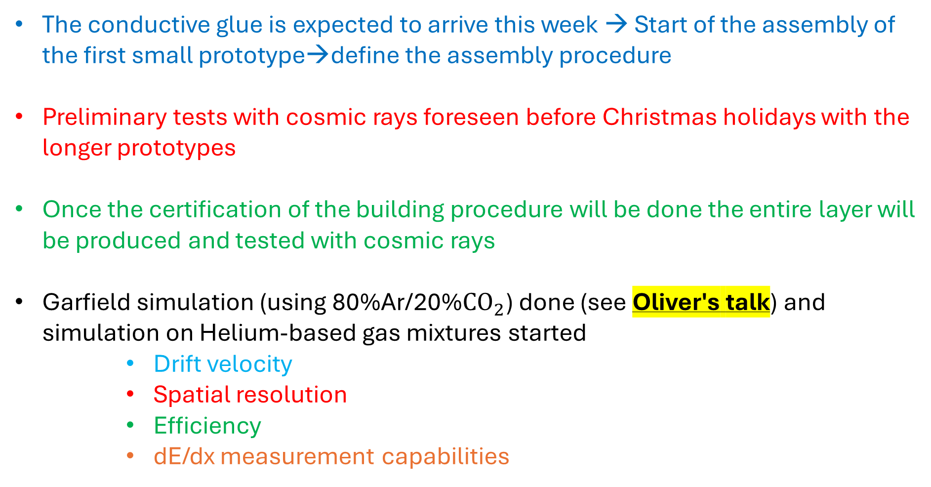
Next steps
The conductive glue is expected to arrive this week → Start of the assembly of the first small prototype→define the assembly procedure
Preliminary tests with cosmic rays foreseen before Christmas holidays with the longer prototypes
Once the certification of the building procedure will be done the entire layer will be produced and tested with cosmic rays
Garfield simulation (using 80%Ar/20%${CO}_{2}$) done (see Oliver's talk) and simulation on Helium-based gas mixtures started
      Drift velocity
      Spatial resolution
      Efficiency
      dE/dx measurement capabilities

Slide 8
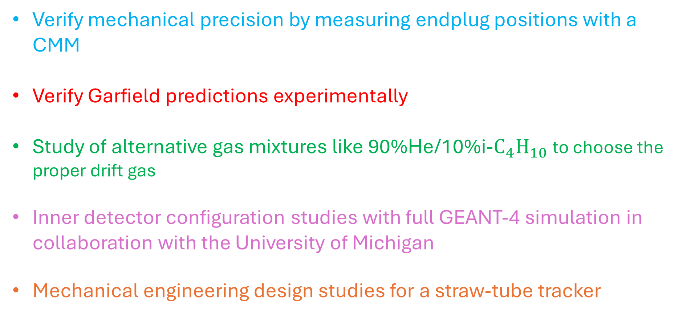
Test programme
Verify mechanical precision by measuring endplug positions with a CMM
Verify Garfield predictions experimentally
Study of alternative gas mixtures like 90%He/10%i-$C_{4}H_{10}$ to choose the proper drift gas
Inner detector configuration studies with full GEANT-4 simulation in collaboration with the University of Michigan
Mechanical engineering design studies for a straw-tube tracker

Slide 9
Thank you

