Slide 1
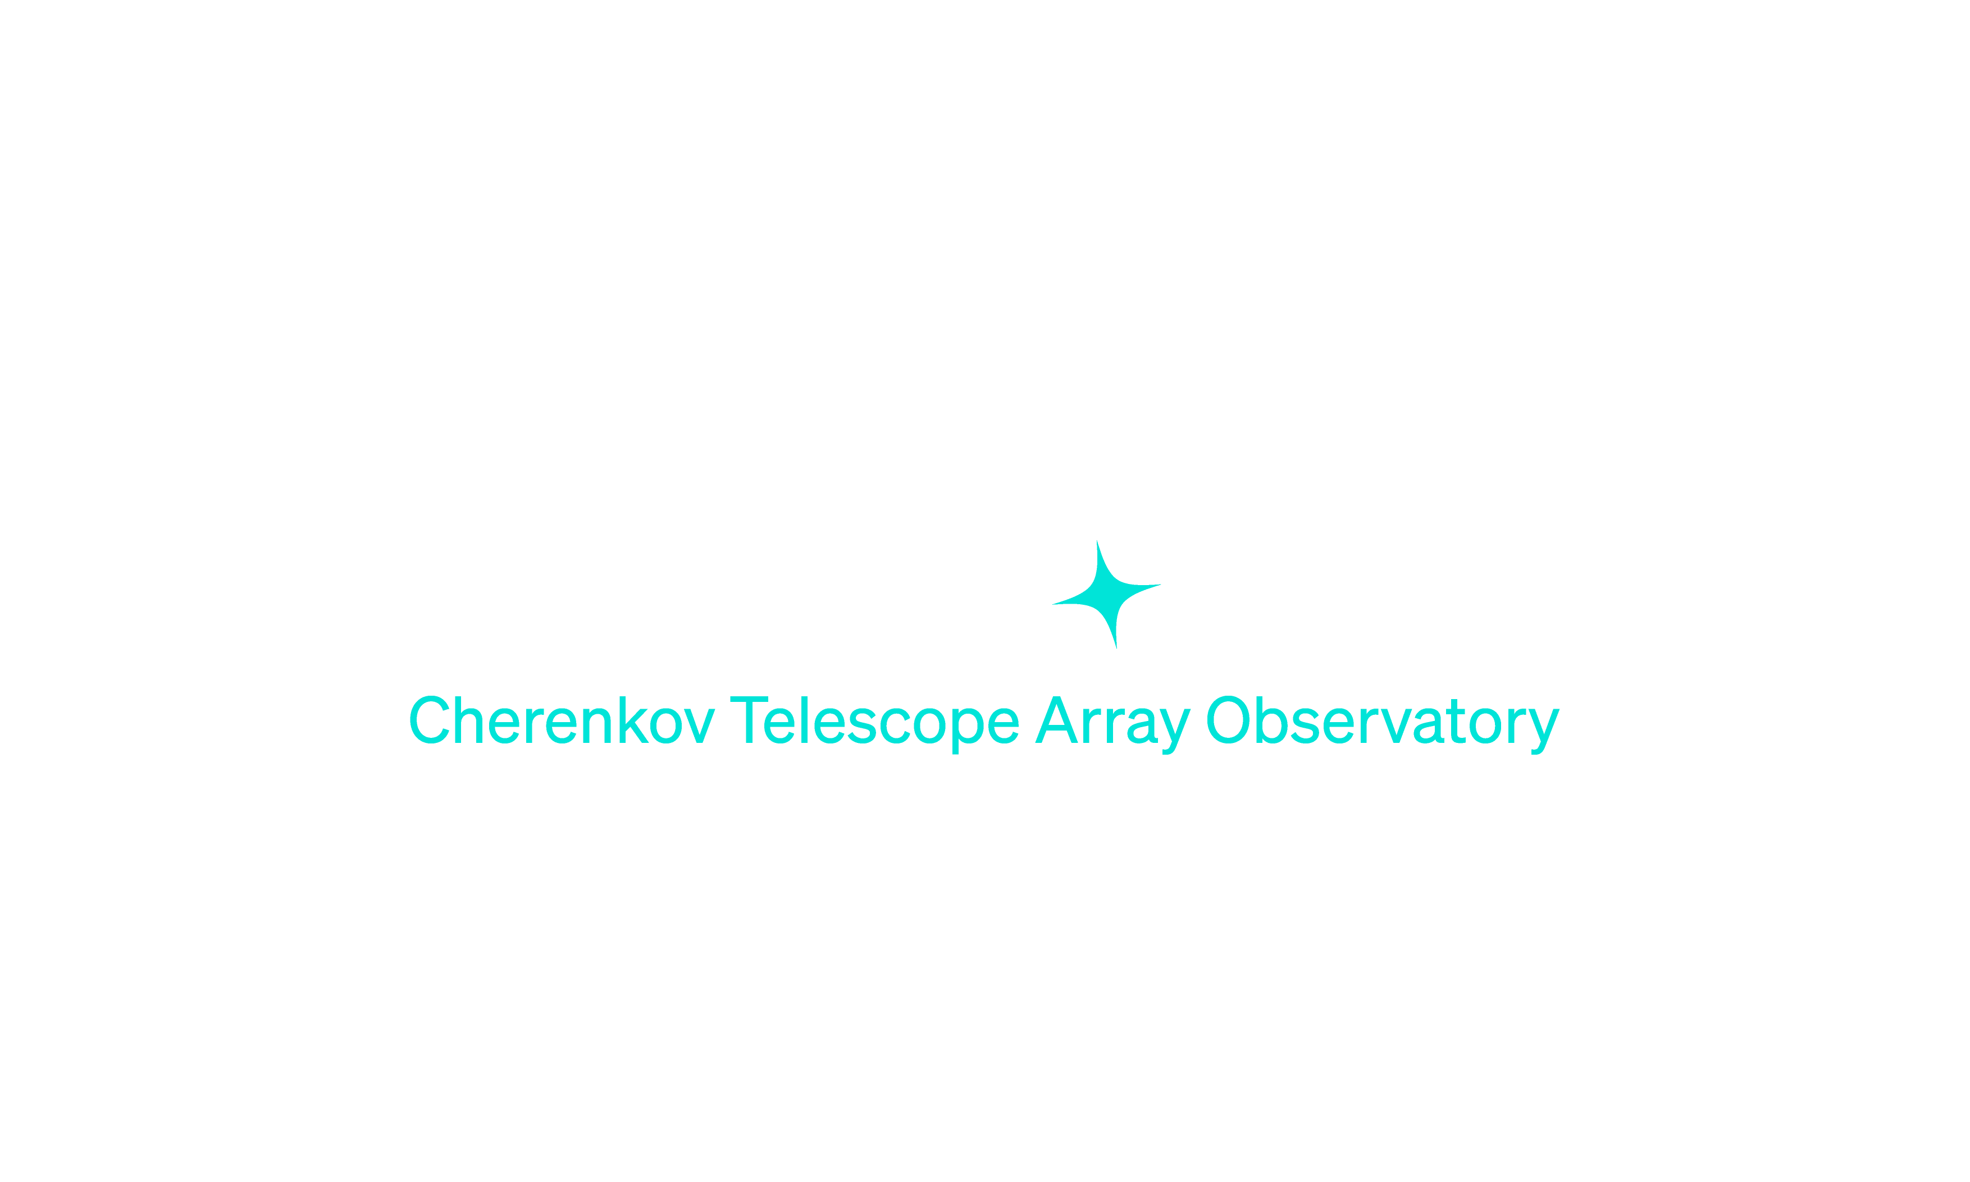
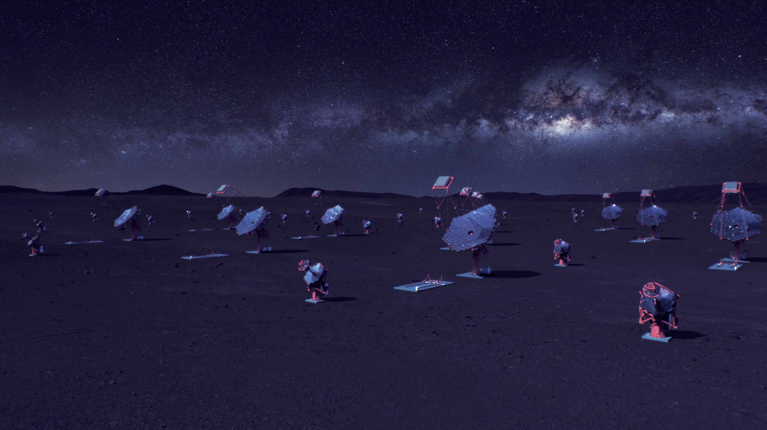
Status report on Swiss Contribution to BDMS
DPPS Workload – BDMS workshop
13-14 January 2025, CERN
Syed Hasan for the Swiss BDMS Team – E. Lyard, H. Li, R. Walter, A. Biland
shasan@phys.ethz.ch

Slide 2
1
2
3
4
5
6
DPPS Overview
DPPS BDMS Bulk Archive and Swiss Contributions
BDMS Ingest and Data Management
BDMS prototyping in Docker and Kubernetes
Recent Activities
Looking Ahead: Towards and Beyond DPPS Release 0.0

Slide 3
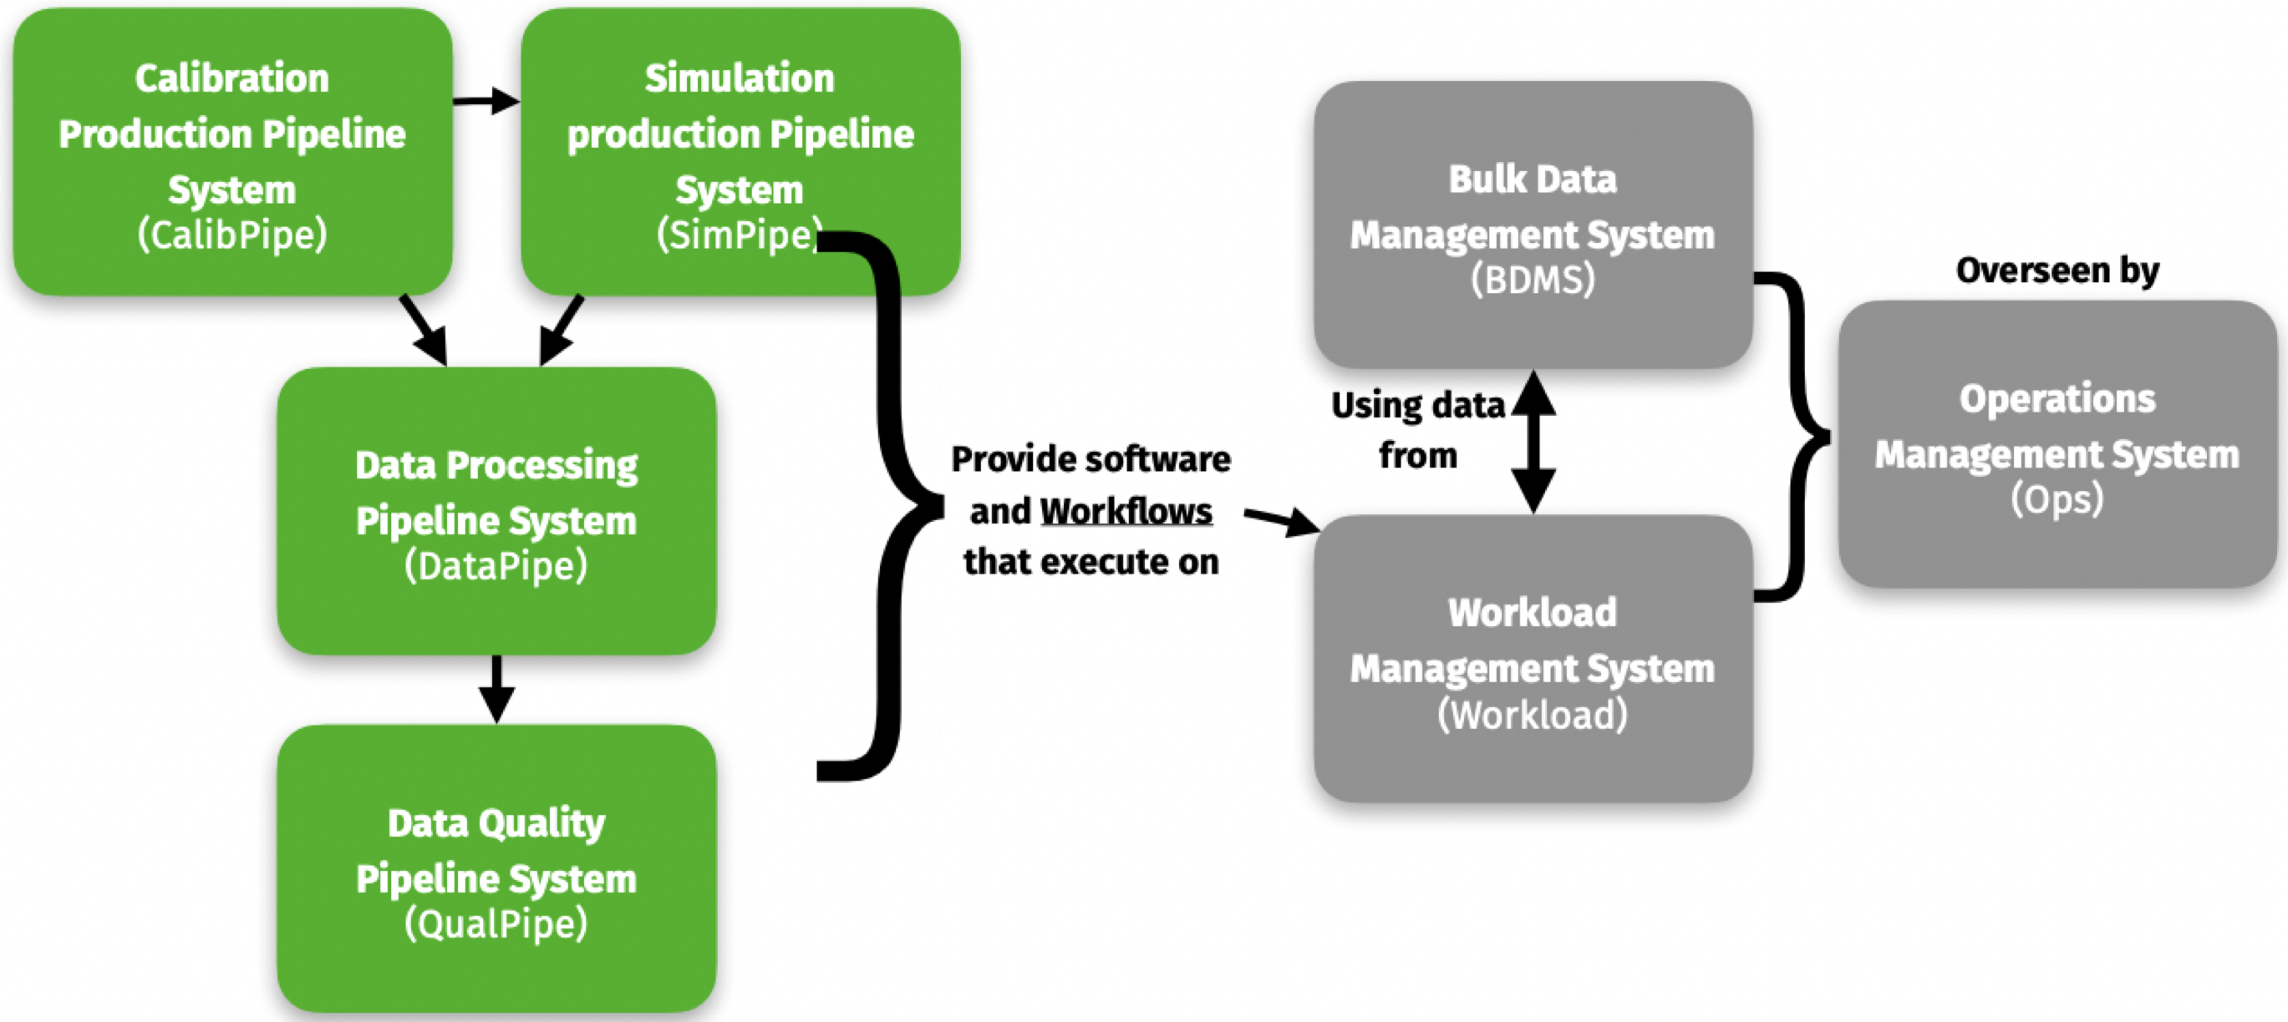
Data Processing and Preservation System (DPPS) in CTAO
DPPS overview
Functional Decomposition to Subsystems
Source: DPPS Introduction, DPPS workshop at DESY (Zeuthen), 10-12th October, 2022

Slide 4
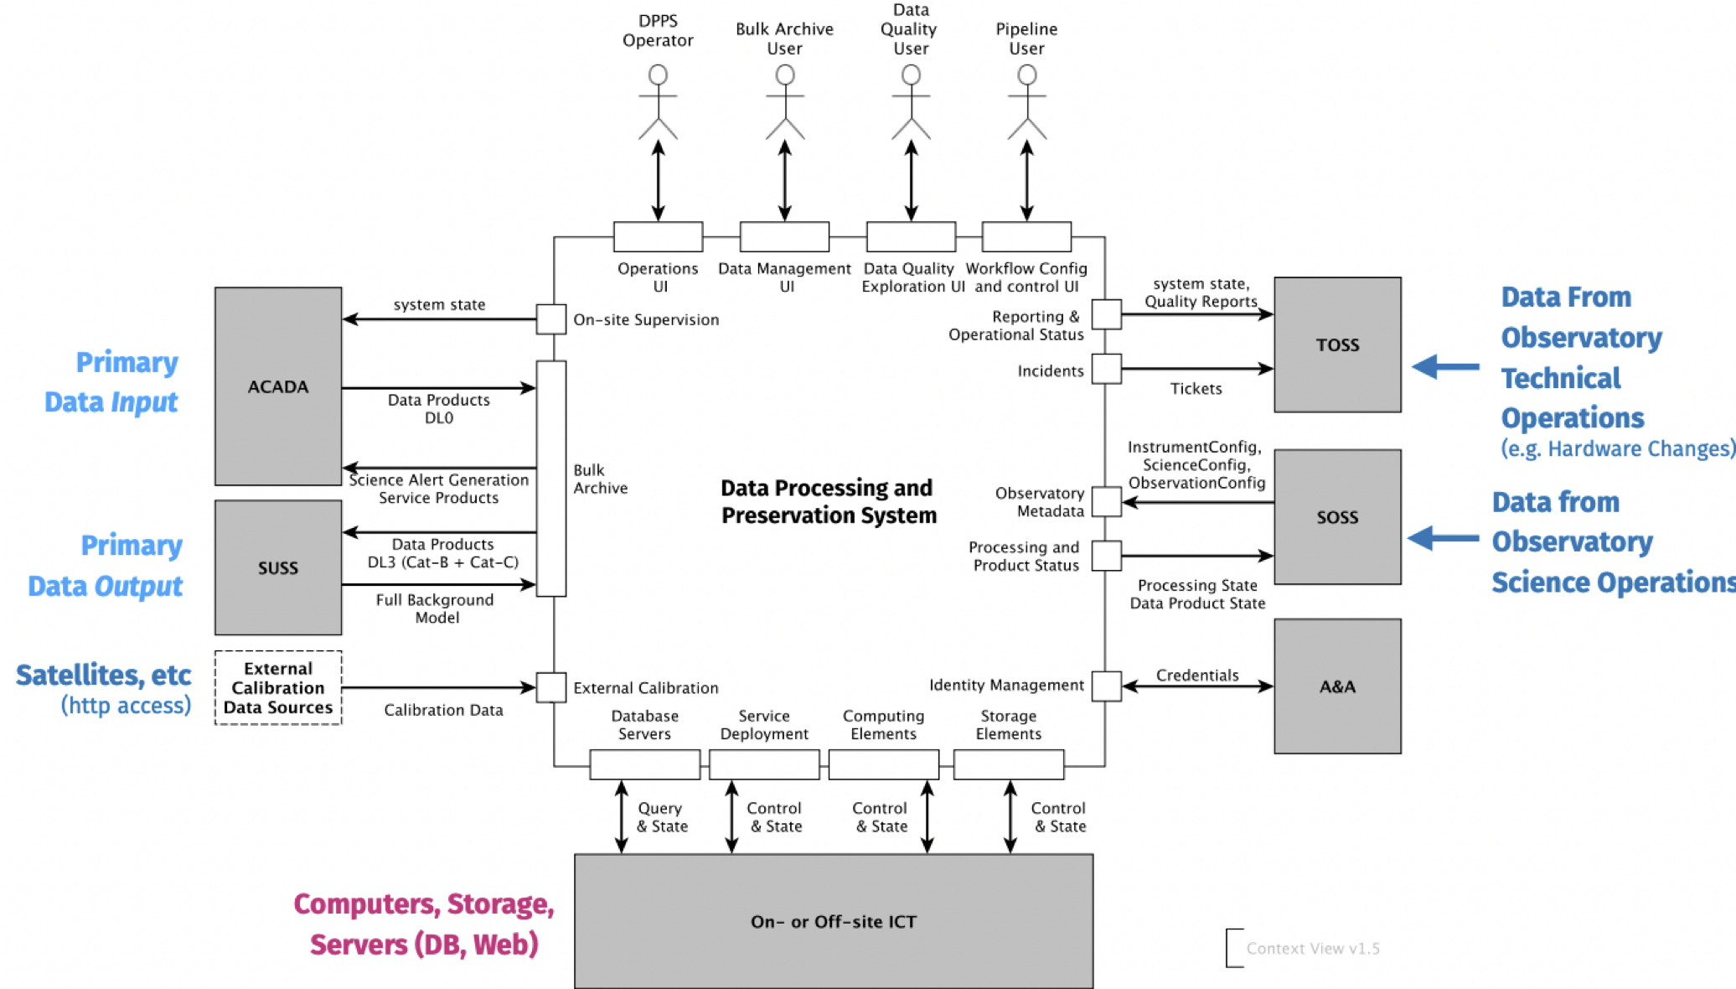
DPPS - Context
DPPS overview
DPPS is a software system responsible for the long-term preservation, (re-) processing, and quality monitoring of low-level data products acquired from real observations or simulated internally
DPPS also ensures that all required data products are preserved (at least two copies must exist at distinct off-site data centers), traceable and reproducible
Source: DPPS Introduction, DPPS workshop at DESY (Zeuthen), 10-12th October, 2022

Slide 5
DPPS – BDMS
DPPS BDMS Bulk Archive and Swiss Contributions
List of Contributors in Switzerland
  Syed Hasan, Adrian Biland (ETH Zürich)
  Etienne Lyard, Hancheng Li, Roland Walter (University of Geneva, Department of Astronomy)
Data centres for DPPS, SUSS, and SOSS
  Off-site data centres: PIC (Spain), Frascati (Italy), CSCS (Switzerland), and DESY (Germany)
  Part of BDMS runs also on on-site ICT
Close collaboration:
  With DPPS Lead Developer and DPPS AIV: Maximilian Linhoff, Volodymyr Savchenko
  with EPFL and CSCS (Off-site ICT Work Package):
  Volodymyr Savchenko, Pablo Fernandez, Victor Holanda Rusu, and Andrii Neronov) - CSCS is one of the teams participating in this WP

Slide 6
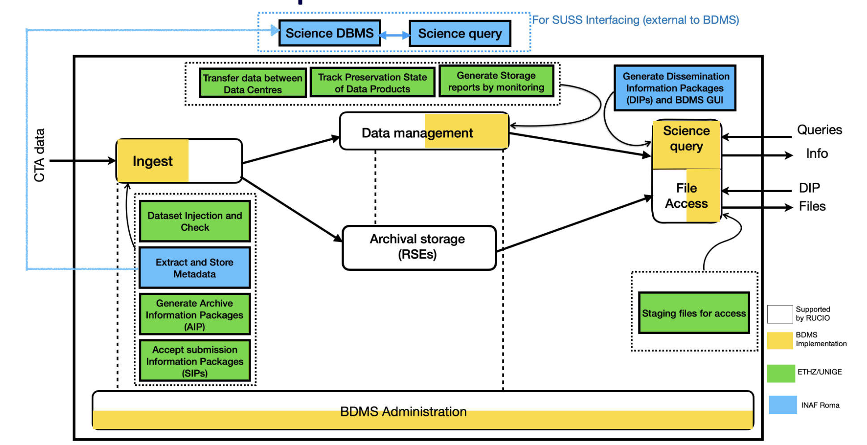
DPPS BDMS Functional Decomposition
DPPS BDMS Bulk Archive and Swiss Contributions
Based on Open Archival Information System (OAIS) ISO standard, many high energy astronomy archives follow OAIS principles, INTEGRAL is one such example
6

Slide 7
Swiss contributions to BDMS
DPPS BDMS Bulk Archive and Swiss Contributions
ETHZ - UNIGE
Bulk data storage
  RUCIO
    Deploy and run RUCIO instances
    Manage certificates and investigate token-based RUCIO
    Manage and monitor datasets replication
    Track datasets preservation status
  Ingest
    Verification of incoming datasets based on checksums
    Extraction of basic metadata, e.g. pointing direction
  AIV (Assembly Integration Verification)
    Deploy BDMS tests on DESY Kubernetes test cluster
  Users access
    Datasets staging based on user requests
    Interface with WMS
  Design and documentation
    Use-cases
    Level-C requirements
    Architecture
7

Slide 8
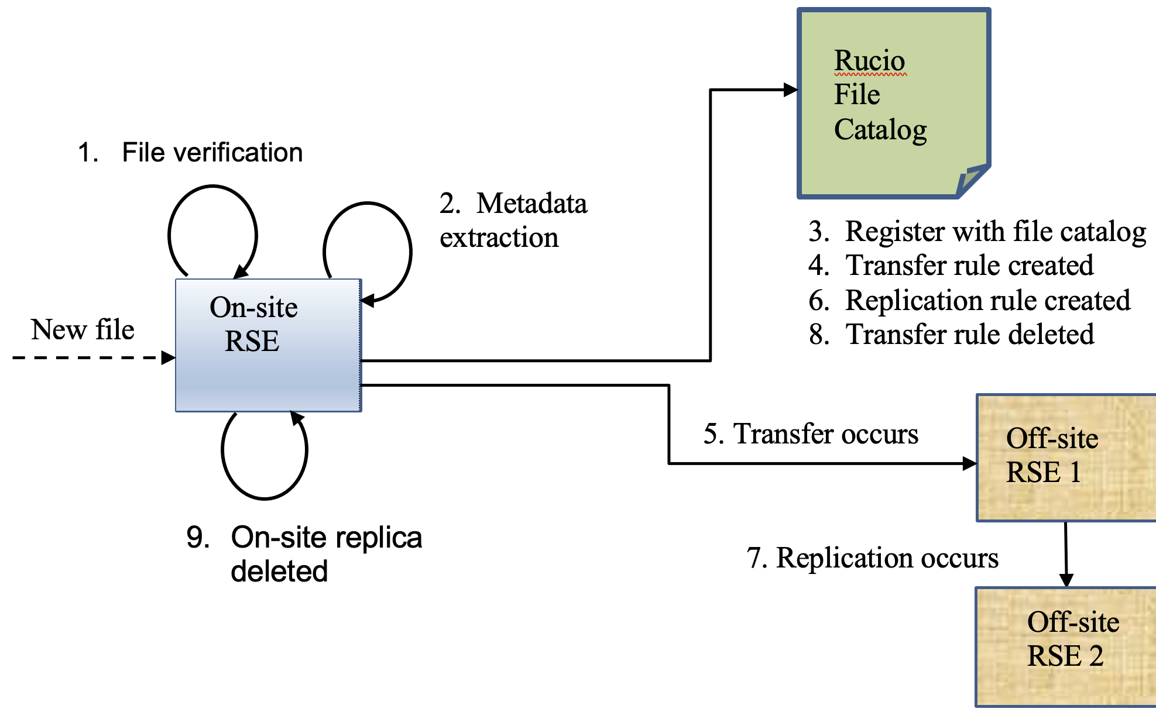
BDMS Ingest and Data Management: ACADA Case
BDMS Ingest and Data Management
Metadata is in separate files at predefined locations. ACADA should make sure that these files are present before submitting the raw data
As the data is already in the RSE before ingestion it is added to RUCIO by directly modifying the file catalog
ACADA plans to deliver DL0 (raw data) to DPPS on-site, via an interface directory and trigger files
BDMS will need to have on-site scripts for verification and metadata extraction
Produces archived products for long-term storage and preservation
We have a preliminary version of this use-case implemented in our BDMS prototype successfully in both Docker and Kubernetes environment
On-site RSE is directly directory where ACADA puts the data

Slide 9
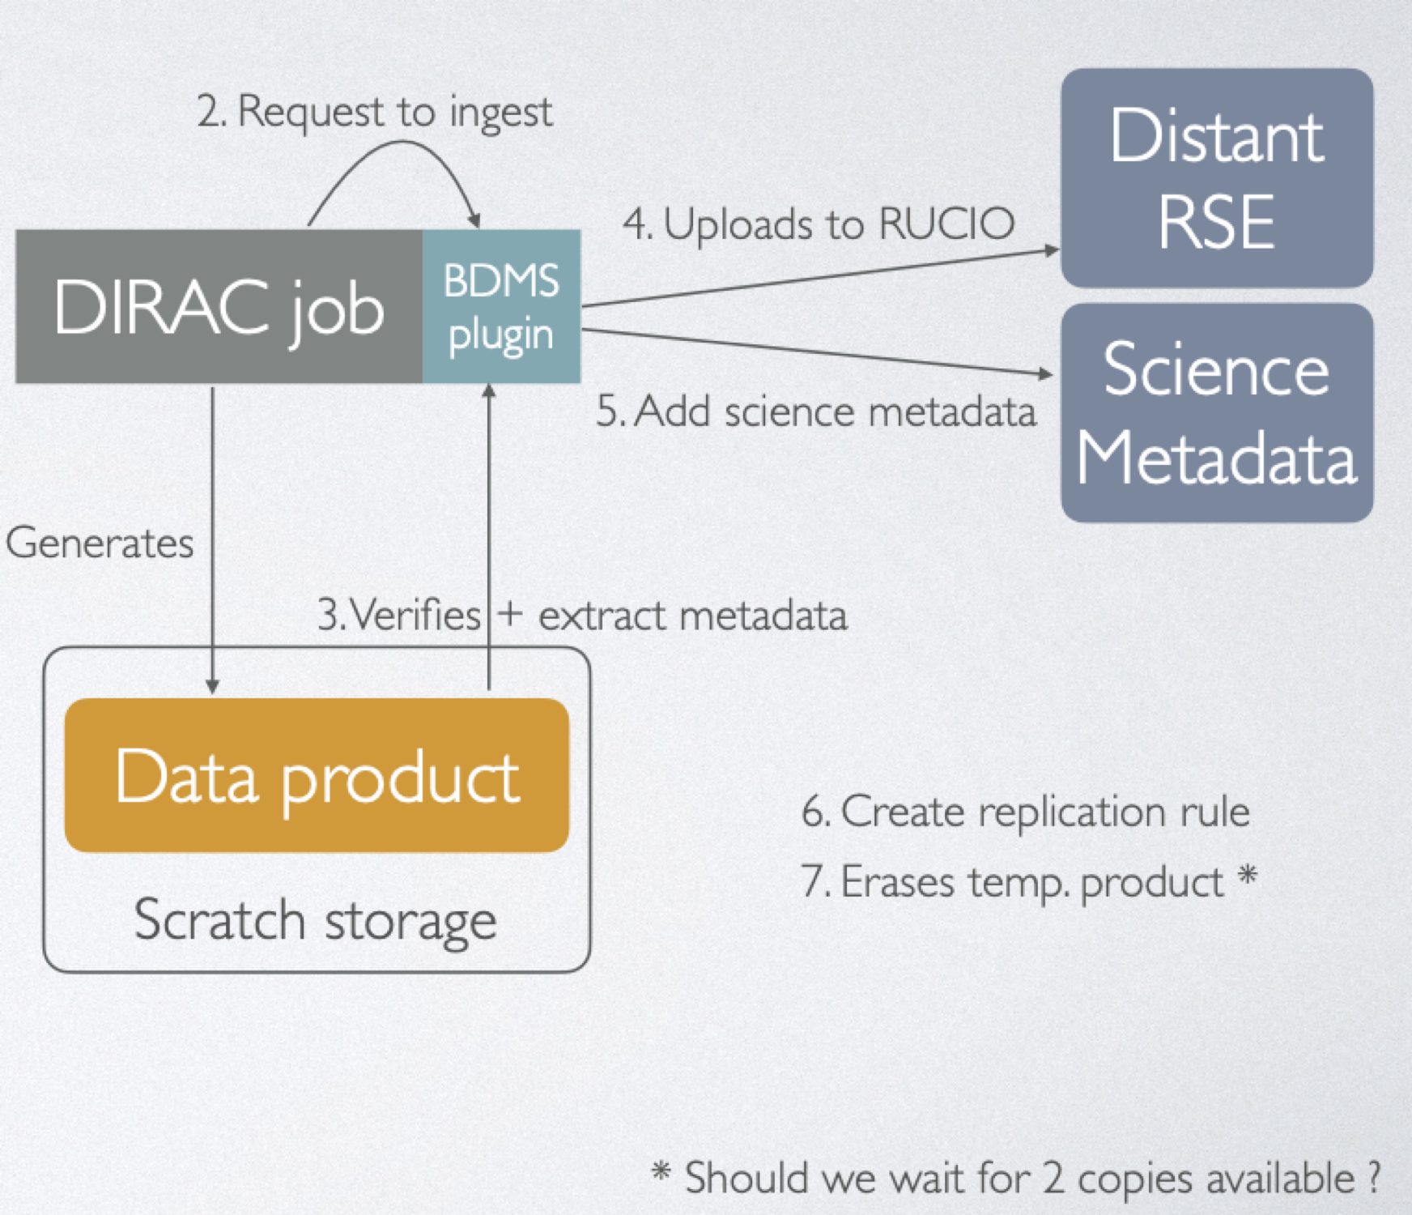
BDMS Ingest and Data Management: WMS Case
BDMS Ingest and Data Management
Not as straightforward due to distributed architecture
Currently, we use RUCIO file catalog plugin (RFC) for DIRAC. BDMS – WMS integration with basic tests performed with Docker and Kubernetes (DPPS AIV)
Proposed a BDMS plugin for DIRAC-RUCIO interfacing
  The BDMS plugin would perform verification and metadata extraction before ingesting files to RUCIO
  For temporary datasets only metadata extraction is performed
  Temporary datasets to be stored in a separate RUCIO scope* from the archive data
AIV: Assembly, Integration, and Verification
* DIRAC would have read/write/erase access to that scope only

Slide 10
BDMS Prototyping in Docker and Kubernetes (K8s)

Slide 11
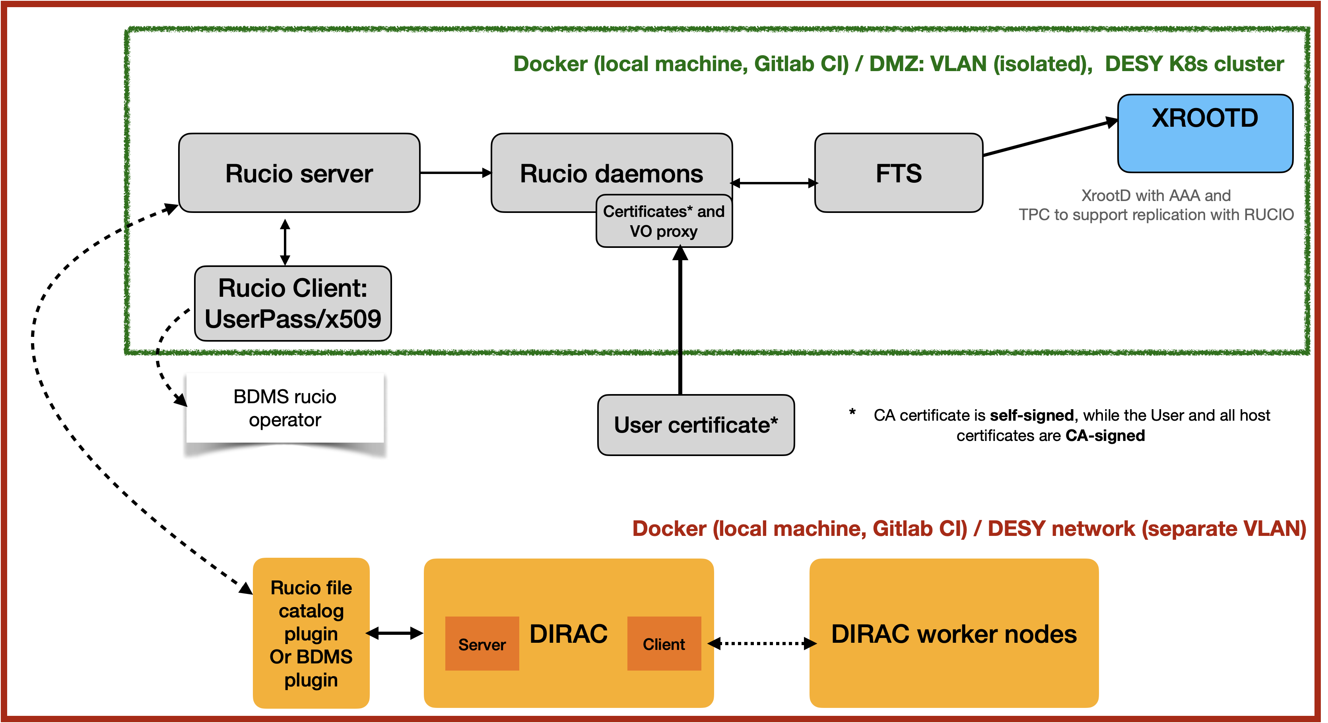
BDMS prototypes: Docker / DESY K8s Test Cluster
BDMS Prototyping
What we have achieved ?
  BDMS ingest and replication for data management both in Docker and Kubernetes
  With K8s staging environment at the Test Cluster: BDMS client (with data included) residing in external network (ETH, Zurich) is able to connect to the RUCIO server and Storage elements at Kubernetes cluster (DESY, Zeuthen) for performing ingest and replication – ACADA case
  CTA gitlab CI using kind K8s setup for pipeline runs for integration & unit tests; kind setup for local development and testing
At the DPPS level
  RUCIO policy package for CTAO got developed by Max for DIRAC – RUCIO integration
  RUCIO
    Deploy and run RUCIO instances
    Manage certificates and investigate token-based RUCIO
    anage and monitor datasets replication
    Track datasets preservation status
  Ingest
    Verification of incoming datasets based on checksums
    Extraction of basic metadata, e.g. pointing direction
  AIV
    Deploy BDMS tests on Desy Kubernetes test cluster
  Users access
    Datasets staging based on user requests
    Interface with WMS
  Design and documentation
    Use-cases
    level-C requirements
    Architecture

Slide 12
BDMS Prototyping experience – Docker vs. Kubernetes
BDMS Prototyping
Attribute | Docker Compose | Kubernetes
Motivation | Local and fast prototyping, ease, testing, Single-node | Ideal for production environments (CTAO off-site data centers have kubernetes infrastructure, e.g., PIC/CSCS), multi-node/distributed
RUCIO | All Rucio components have docker containers | Deployments create pods, services, ingress, replicasets; DB and RSEs pods have storage; RSEs and client have persistence
Management | Gitlab CI | Rancher (Kubernetes management with high-availability)
Container orchestration | Docker Compose YAML file | YAML files, Helm Charts
Deployment tools | Docker Compose CLI | Helm, kubectl (local client to K8s cluster), vault, shuttle
Networking and Storage | Built-in networking; Docker volumes (local storage) | Ingress controller (nginx), K8s service (cluster type IP vs. LoadBalancer IP), Firewall configuration; Persistent Volumes (PVC), StatefulSets
Configuration management | Docker Compose YAML file, mounting certificates | configmaps, values.yaml (helm charts), K8s secrets, cert manager
Monitoring, Failure recovery | Docker logs, manual restarts of containers | kubectl logs, automated pod restarts, self-healing, deployment robust to cluster upgrades
Gitlab CI | VM with gitlab runner (shell), sonarqube to test coverage on Kubernetes runner | VM with gitlab runner (shell) needs kubectl, kubeconfig (to authenticate) and routing set-up (to access) the K8s Test cluster either via kind (self-managed) or staging K8s environment (managed by DESY IT admins)

Slide 13
Recent Activities

Slide 14
DPPS Release 0 (Integration Test)
Recent Activities
Implement use-cases with a BDMS prototype via unit tests with RUCIO API in Kubernetes environment on the DESY Test cluster (kind and staging set-ups)
  BDMS functionality using RUCIO was first evaluated with RUCIO CLI commands, code with RUCIO API calls
  Current work on unit tests with fixtures written by Max for BDMS which are also evaluated at the DPPS level focused on testing RUCIO core functionality for BDMS including metadata and file localization
  CTAO-specific RUCIO policy package enables custom LFN with slashes (matching the directory structure of CTA data storage). This LFN schema with VO name at the start also required for DIRAC and RUCIO integration
Notes:
RUCIO core functionality for BDMS – authentication, ingesting of files and adding datasets, download, replication, file localization for ingested files, and adding metadata and also query with metadata

Slide 15
DPPS Release 0 (Integration Test)
Recent Activities
On the AIV front, Max and Volodymyr contributed greatly to setup CI with kind to deploy K8s resources for BDMS on the Test cluster for local development and CI tests
  Organization of repos in BDMS for different needs: RUCIO policy; Helm charts for RUCIO; AIV toolkit to produce Test reports
  BDMS deployment is done with Helm charts with a global values file for ease in future helm-based upgrades
  We also adapted YAML files based BDMS deployment to Helm charts
  - Different than Kind, works in a staging K8s environment* with ingress & load balancer configured
  - The use of global helm values file allows configurability for re-use at different datacenters. This is planned for beyond DPPS Release 0.1
  * staging K8s environment: enabling clients to connect to BDMS deployment and allow traffic from external networks
Notes:
to deploy K8s resources for BDMS (deployments, pods, bootstrap jobs) on the DESY Test cluster for both local development and CI pipeline runs
All images for BDMS on CTAO Harbor with proxy cache
Complementary to Kind and works in a staging K8s environment managed by DESY admins (Jan Philipp) leveraging ingress and load balancer enabling clients to connect and allow traffic from external networks

Slide 16
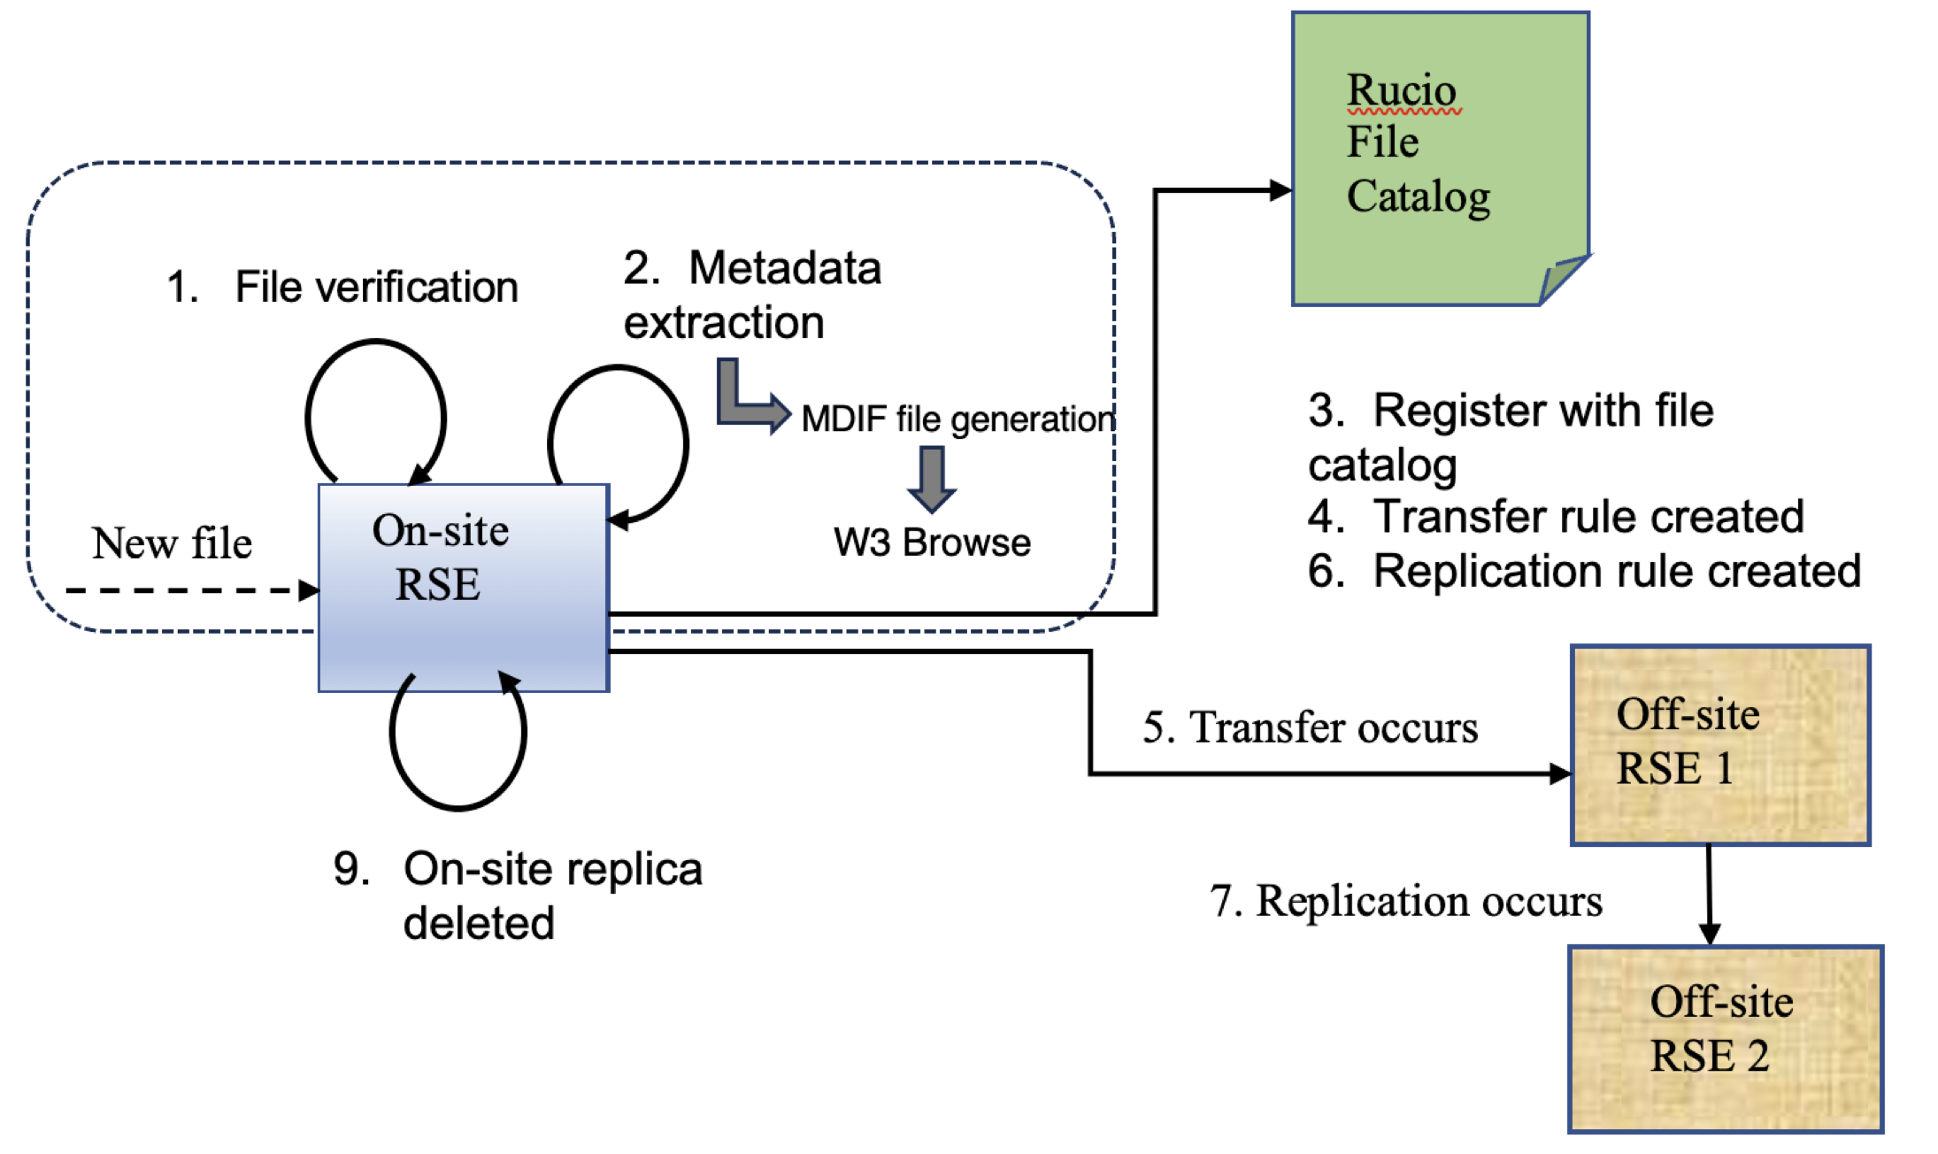
Metadata extraction from CTA files
Recent Activities
This metadata contribution extends our initial work on ACADA DL0 ingestion by DPPS on-site via interface directory and trigger files
We work with both real observation datasets and also simulated ones (eventio)
The ACADA DL0 ingestion and replication will be enhanced following ACADA-DPPS ICD to meet the objectives of DPPS Release 1.0
https://gitlab.cta-observatory.org/cta-computing/dpps/bdms/bdms/-/blob/tobe-sorted/src/bdms/ingest/scripts/fits_eventio_verification_before_ingest/__init__.py

Slide 17
Looking Ahead

Slide 18
On-going work on DPPS Release 0.0
DPPS Release 0.0 (Integration test) is scheduled for release next month (February 2025)
  Documentation: We are working on providing some documentation to be published as gitlab pages for DPPS-BDMS covering the BDMS deployment guide with focus on (i) RUCIO, (ii) Grid-certificates and X509 Proxy, (ii) Storage elements (XrootD); (iv) Updating the RUCIO version; (v) Different repos in BDMS organization and how they are used; (vi) Helm charts: application and configuration
Collaborating with our colleagues: Max, Volodymyr, and Georgios on further AIV efforts towards meeting the next month deadline of DPPS Release 0.0

Slide 19
Beyond DPPS Release 0.0
For DPPS Release 1.0, BDMS milestones have been defined and a gitlab issue has been created: Implement DL0 ingestion by DPPS on-site for products coming from ACADA according to ACADA-DPPS ICD
We will contribute to address the tasks associated with the gitlab issue and implement the desired functionality
  Configuring an ON-SITE storage element
  Function to translate ACADA Path to BDMS LFN
  Function to extract metadata from DL0 files
  Function for DL0 ingestion

Slide 20
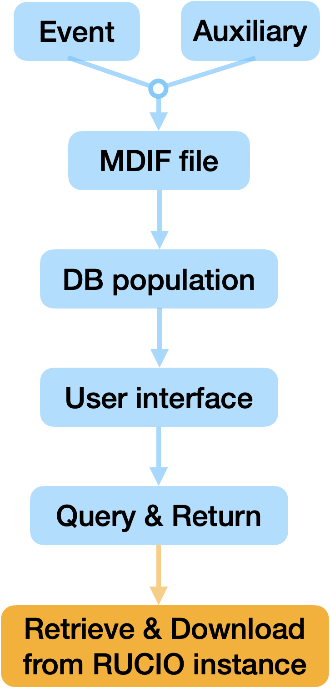
Connecting metadata to database and GUI with W3Browse
More on metadata and its database
We explore the possibility of W3Browse as a science database with metadata storage and GUI for CTAO, given our past experience in using it for INTEGRAL, FACT and LST data archive
Rucio instance could be based on a local Docker compose setup or kind setup
https://gitlab.cta-observatory.org/cta-computing/dpps/bdms/bdms/-/blob/tobe-sorted/src/bdms/ingest/scripts/fits_eventio_verification_before_ingest/__init__.py

Slide 21
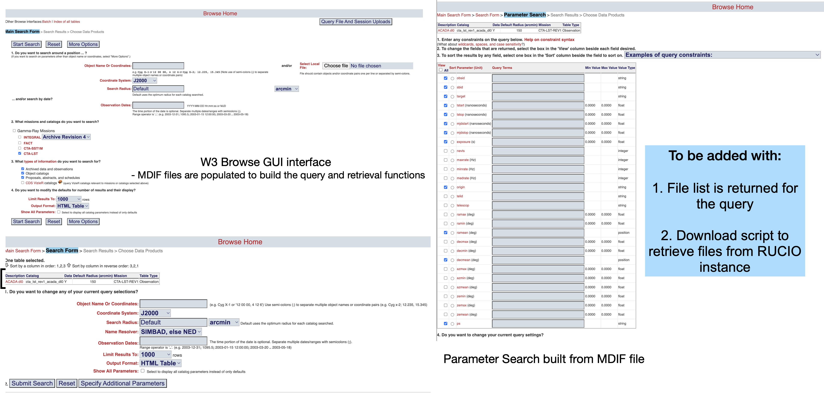
W3Browse GUI (HEASARC NASA)
Adapted from https://heasarc.gsfc.nasa.gov/cgi-bin/W3Browse/w3browse.pl
More on metadata and its database

Slide 22
Thank you for listening
www.ctao.org

