Slide 1

CERNBox @ TechWeekStorage
Giuseppe Lo Presti
March 24, 2025

Slide 2
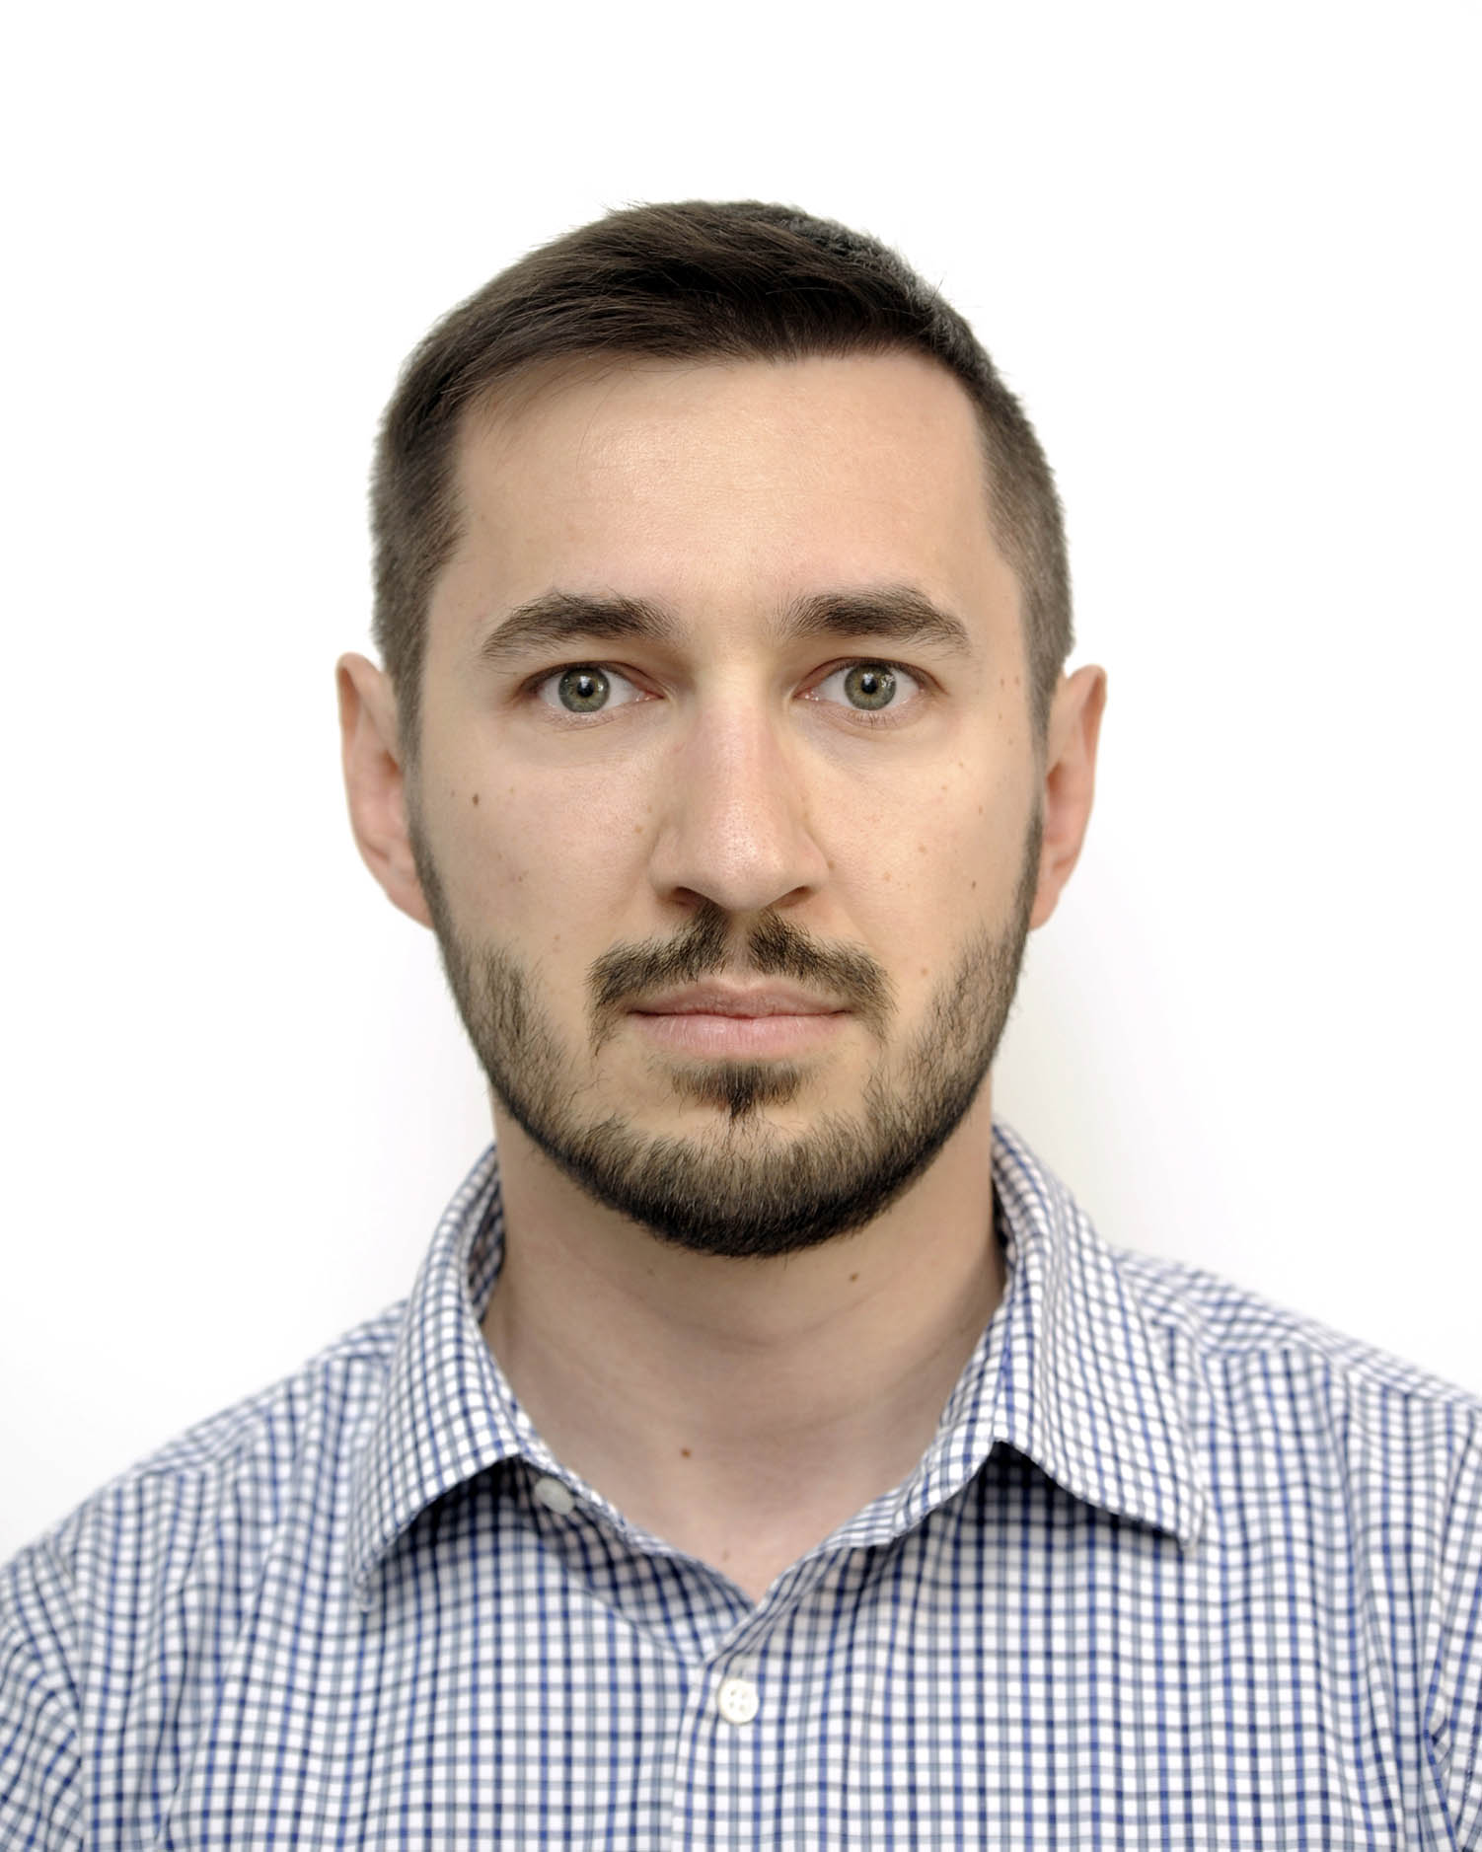
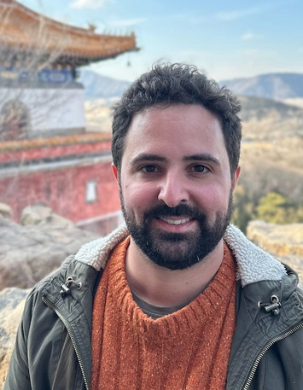
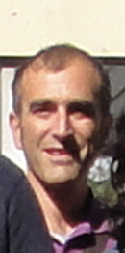
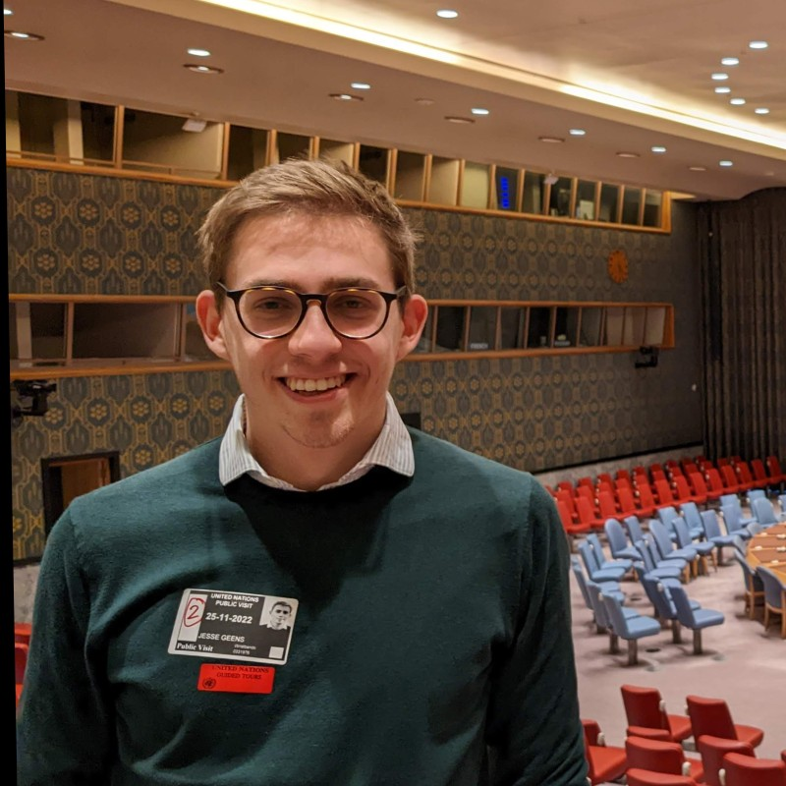

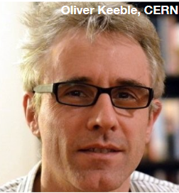
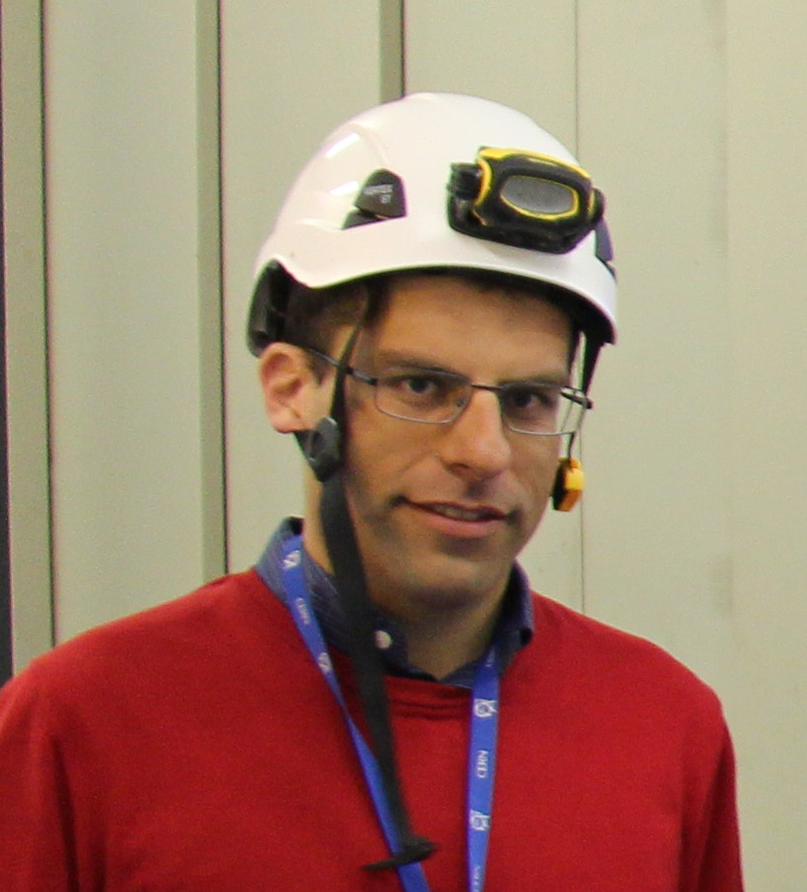

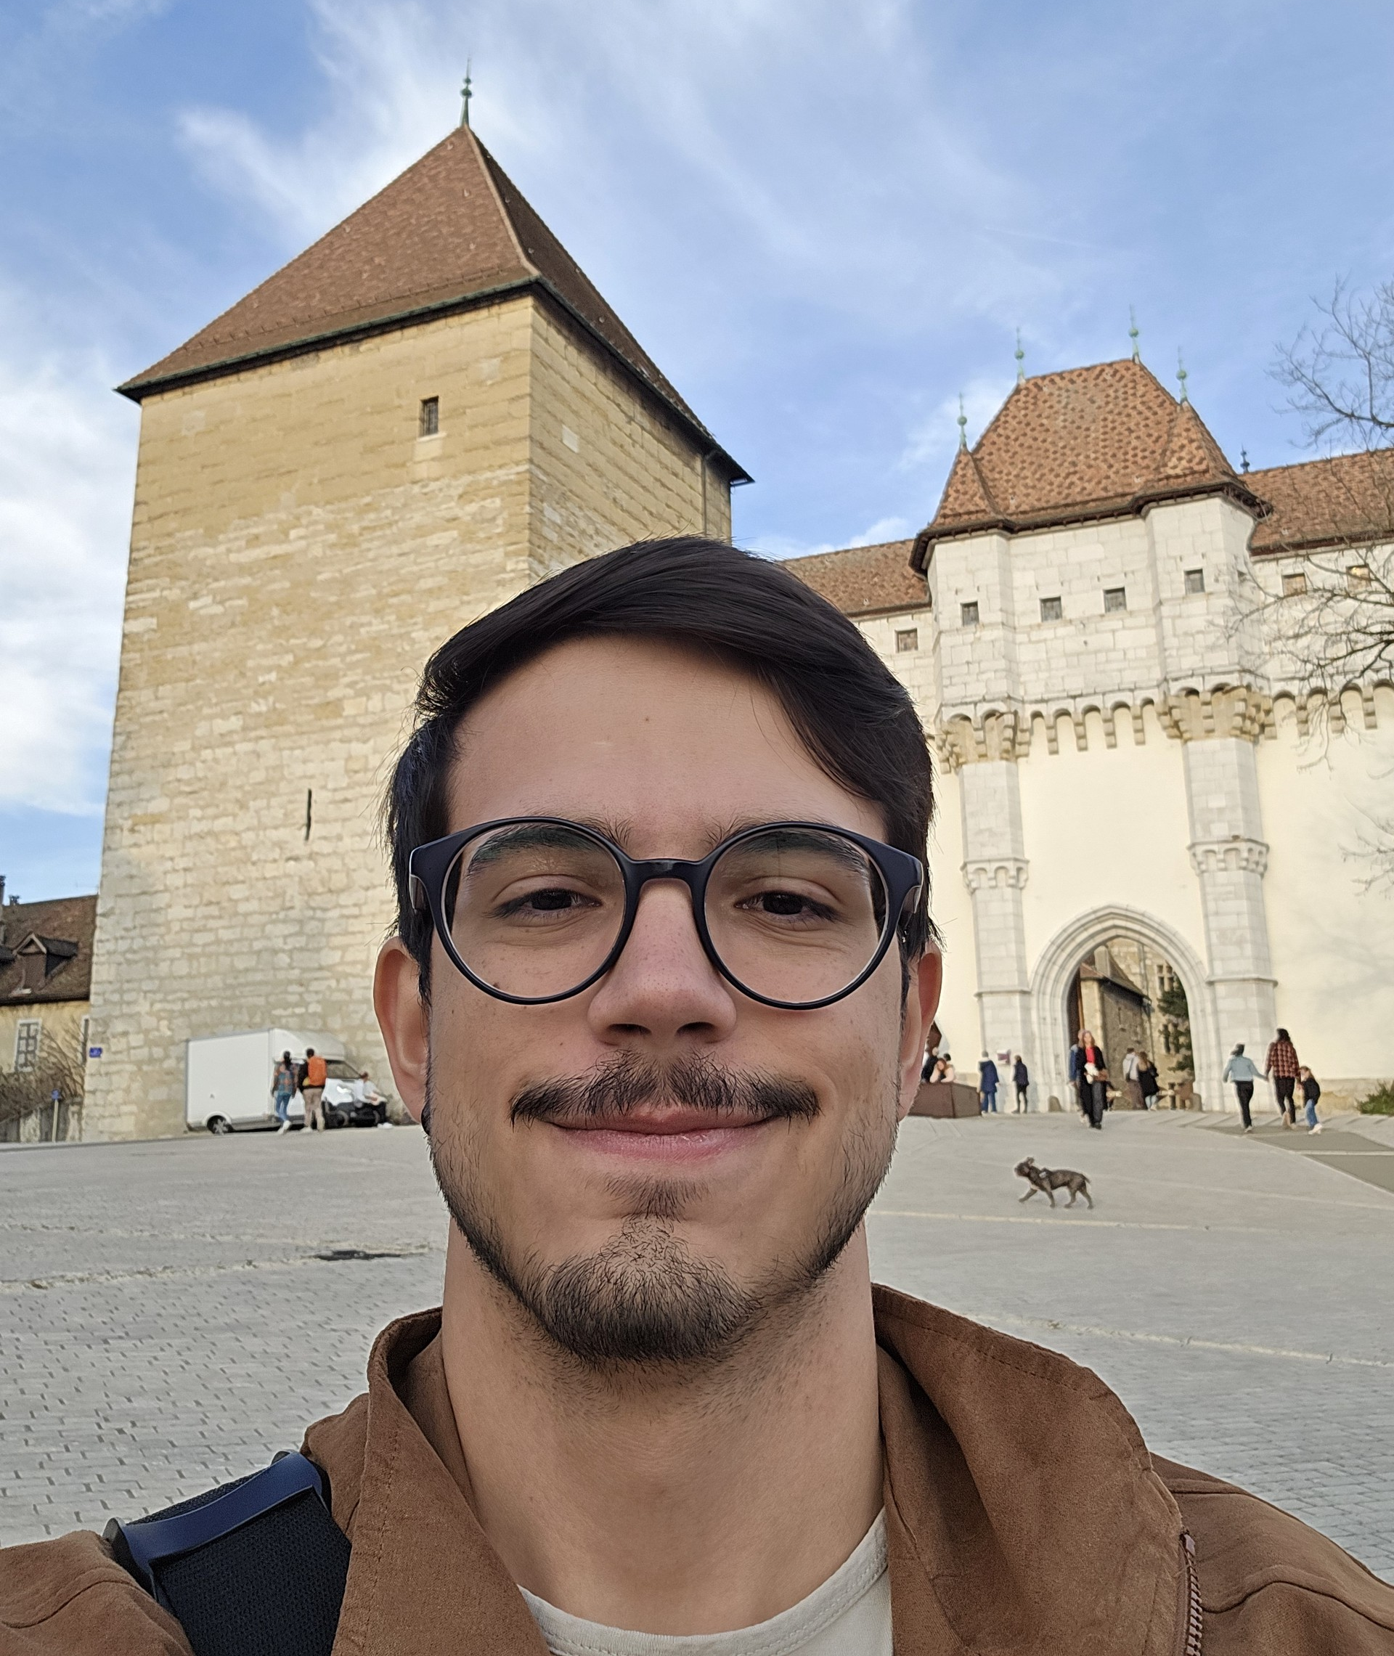
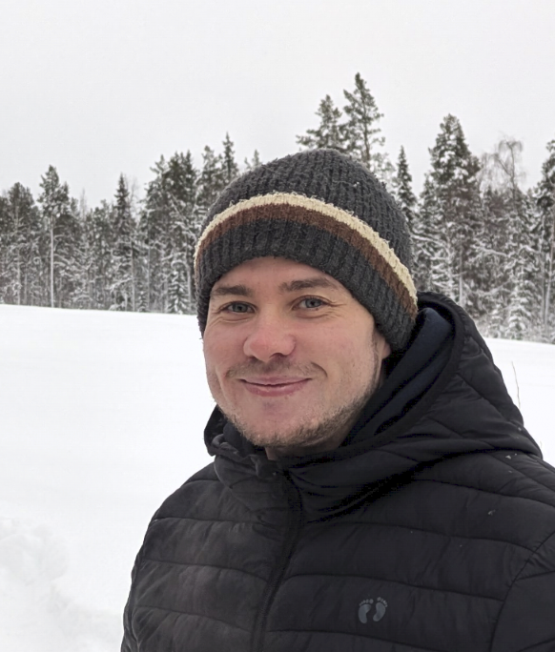
The team
Sebastian Bukowiec
Windows, WinSpaces
Diogo Castro
Service Manager, Front-end
Fabrizio Furano
Sync clients (part time)
Jesse Geens
Reva back-end
Jan Iven
EOS (part time)
Oliver Keeble
Section Leader
Giuseppe Lo Presti
Project Leader, Back-end
Pablo Medina
EOS Operations
Rodrigo Nunes
Front-end
Rasmus Welander
CephFS, EOSC

Slide 3

The CERNBox Service
CERN's cloud collaboration storage platform
1 TB for every user, up to 50 TB on demand
Built purely with open-source components
  ownCloud sync clients for “Dropbox" use-case
  Reva for the back-end
  EOS and CephFS for storage
Data safely stored on CERN premises
Strong integration with scientific platforms
  Jupyter notebooks, computing farms, HPC clusters
16K+ monthly users
12 PB Data
4 Billion Files

Slide 4

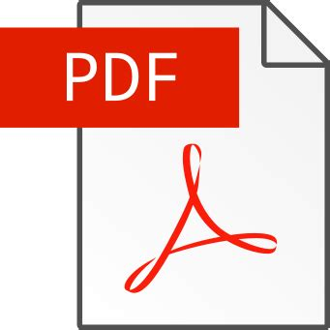










CERNBox Applications
Long track of apps integrated in CERNBox
For Research / Data Science
  SWAN, Apache Spark (via FUSE mount!)
  ROOT viewer
For productivity
  Microsoft Office 365 Online
  Collabora, CodiMD, Onlyoffice
  Draw.io
For Engineering
  CAD viewer

Slide 5











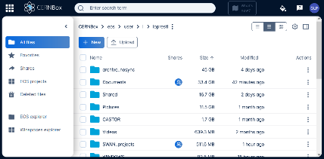



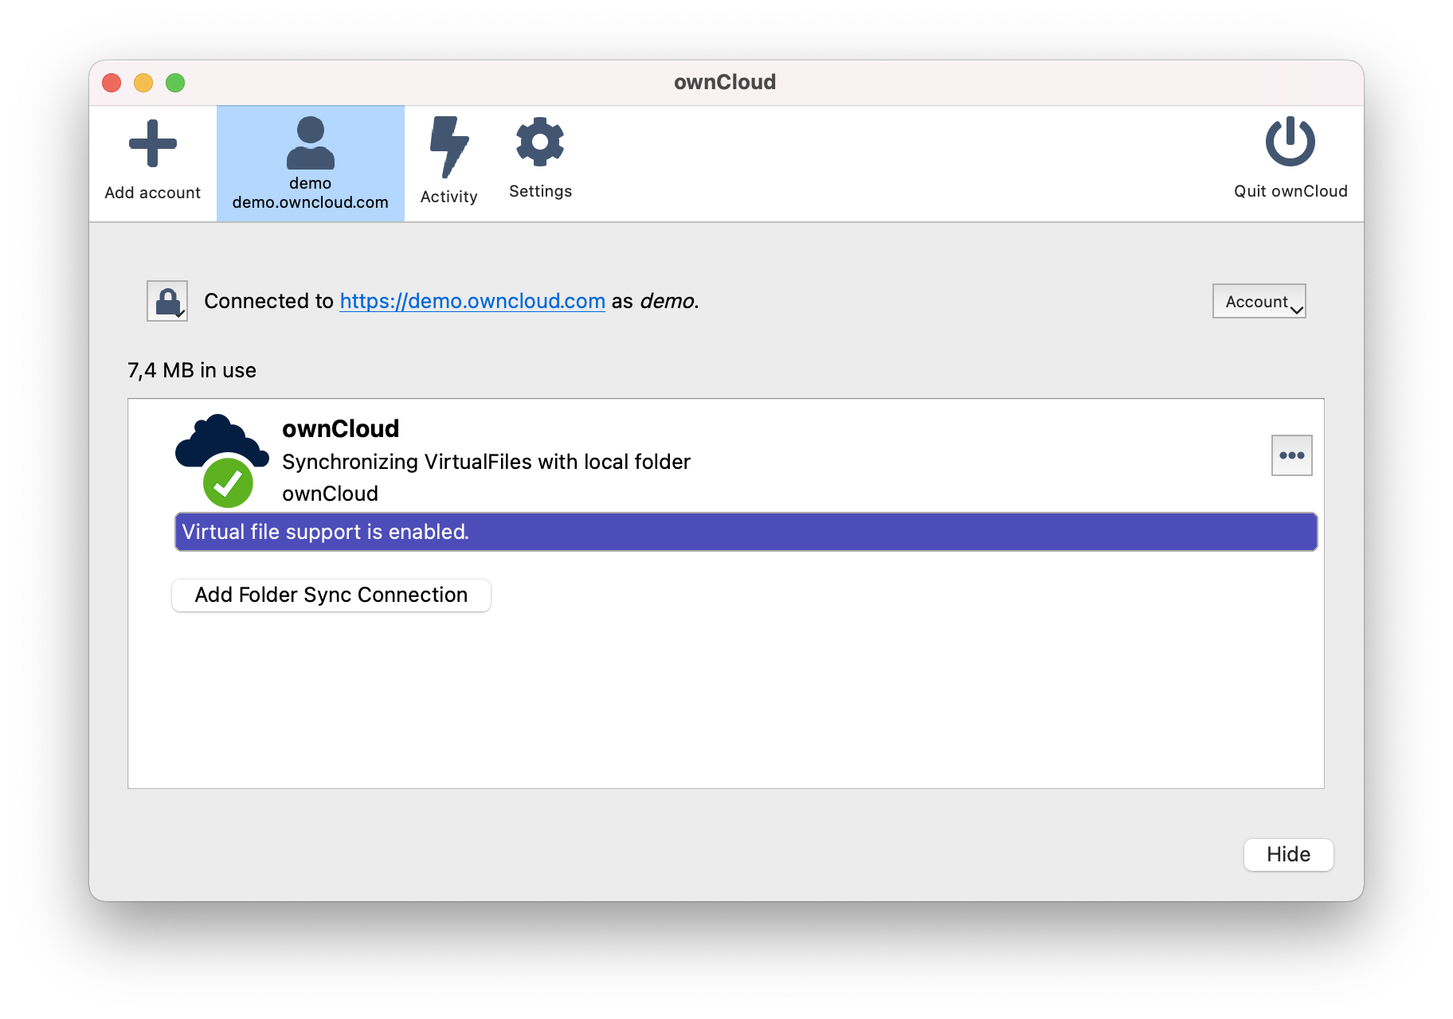
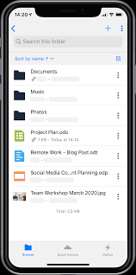


The CERNBox Galaxy
HTTP / REST
gRPC / XRoot
FUSE
Applications
WOPI
HTTP / REST
Kernel
WebUI
(metadata, shares)
libcephfs
WEBDAV
Sync Client / App
Backup:
cback
The Andromeda Galaxy
Source: Wikimedia

Slide 6
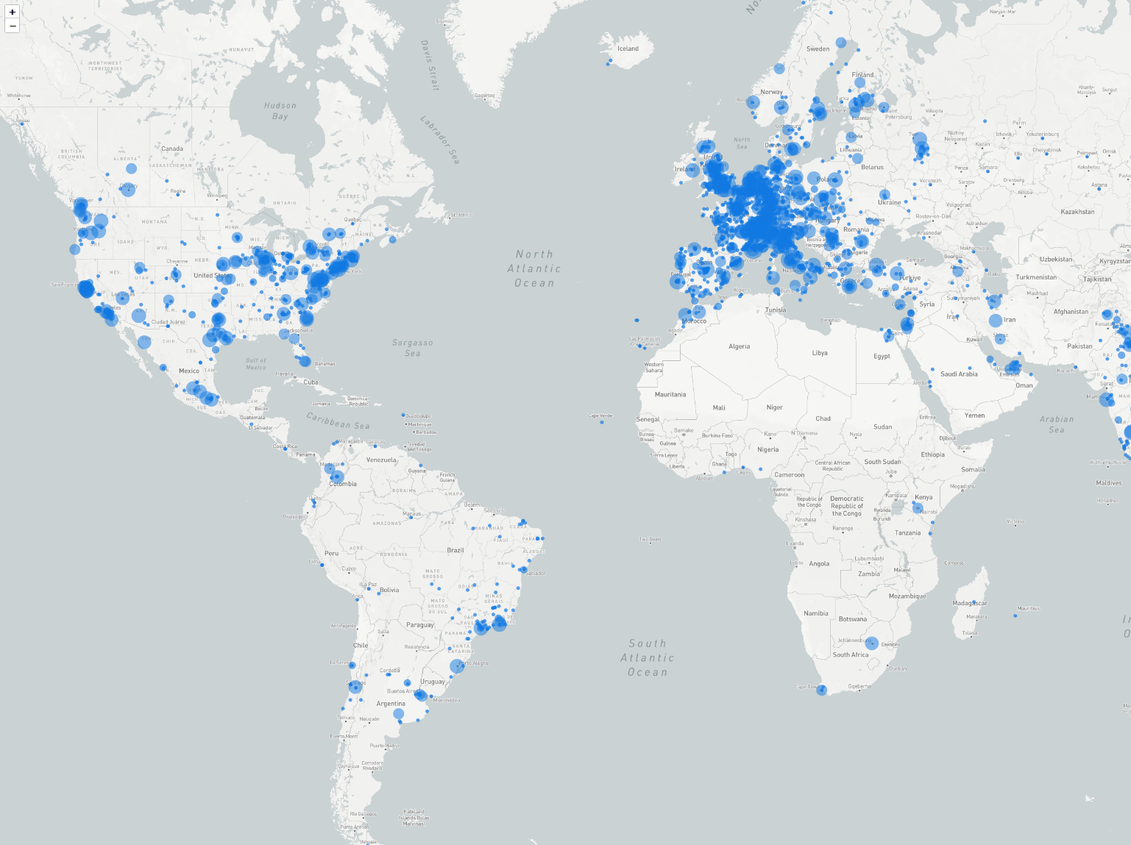
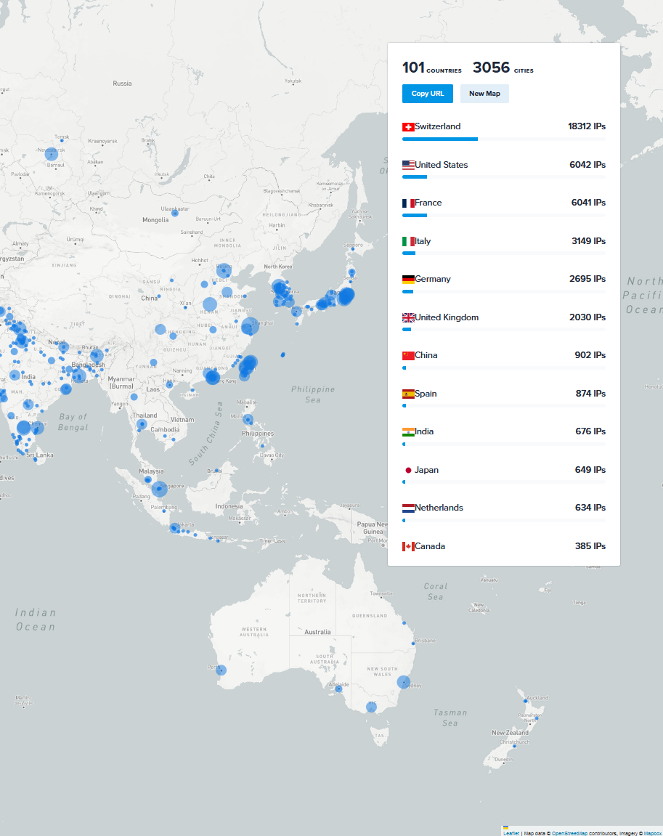
One week of traffic (3-9/03/2025)
50K unique IPs
Generated at https://ipinfo.io

Slide 7
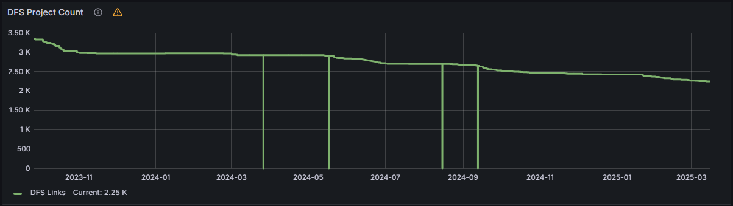
What keeps us busy
16K+ unique users per month with 0.5M shares:
plenty of different workflows and use cases across the Organization
  Physics, Engineering, Administration
  Lots of user support: from configuring embedded devices (oscilloscopes, etc.) for uploading data to CERNBox, to urgently sorting out sharing by administrative staff for a VIP presentation
DFS migration: consolidate all
Windows-based workflows in CERNBox
  Introduction of WinSpaces
Implement most demanded features
Align to upstream, following the EFSS market

Slide 8
Conclusions
New team members, more development effort available
Focus on CephFS and Spaces for this year
Opportunities for synergies with the community
You’re welcome to join the CERNBox workshop
on Wed March 26th pm in room 31/S-28!

