Slide 1
On the importance of
Integration and Homogeneity
(In Control Systems)

Slide 2
Disclaimer
  A personal view…
  Hope I don’t offend anybody
  (Apologies in advance)

Slide 3
Integration and Homogeneity
Of What?

Slide 4
What?
All Areas of Control (& Monitoring)
within an Experiment
Uniformity between Experiments

Slide 5
Integration and Homogeneity
Why?

Slide 6
Why?
Technical Advantages:
  All data made available, archived and presented the same way:
    Any correlations (live or historical) directly available, ex.:
      Trigger rate vs. HV Currents vs. LHC bunch intensity
  Same automation tools:
    Same mechanism to recover errors in all areas
    Direct control of all sub-systems:
      LHC Handshakes/State -> Act on HV -> Start/Stop Run
  Same Alarm Handling Everywhere
    Possibly only one Alarm Screen
  Only one Configuration Mechanism (and one ConfDB)

Slide 7
Why?
Non-Technical Advantages:
  Same look and feel, mechanisms and features of User Interfaces throughout (ex.: partitioning, access control)
    Possibly less people on shift
    Simpler operator training
  Common tools and Standard development environment
    Less resources needed (centrally and in sub-detectors)
    Larger knowledge base:
      Common/Centralized training for developers
      Users can share information
      Central team can help sub-systems
      (Specially later, or not so late, when they start disappearing)
    Easier maintenance

Slide 8
Integration and Homogeneity
So why isn’t it done more often?

Slide 9
Some historical notes
Before LEP and at LEP Startup (end 80s)
  Control Systems were completely and specifically home made
    there was nothing available outside and plenty of person power available
  And they were split in two (or more):
    Slow Control & DAQ/Run Control (& Trigger Control)
During the LEP years (90s)
  Some LEP experiments started seeing the benefits of integrating DCS&DAQ(&Trigger)
  And moved more and more towards that

Slide 10
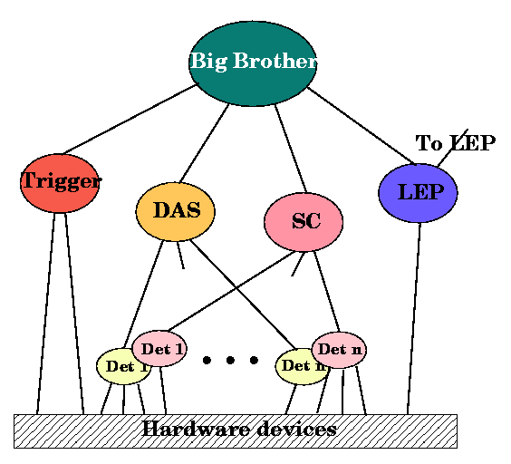
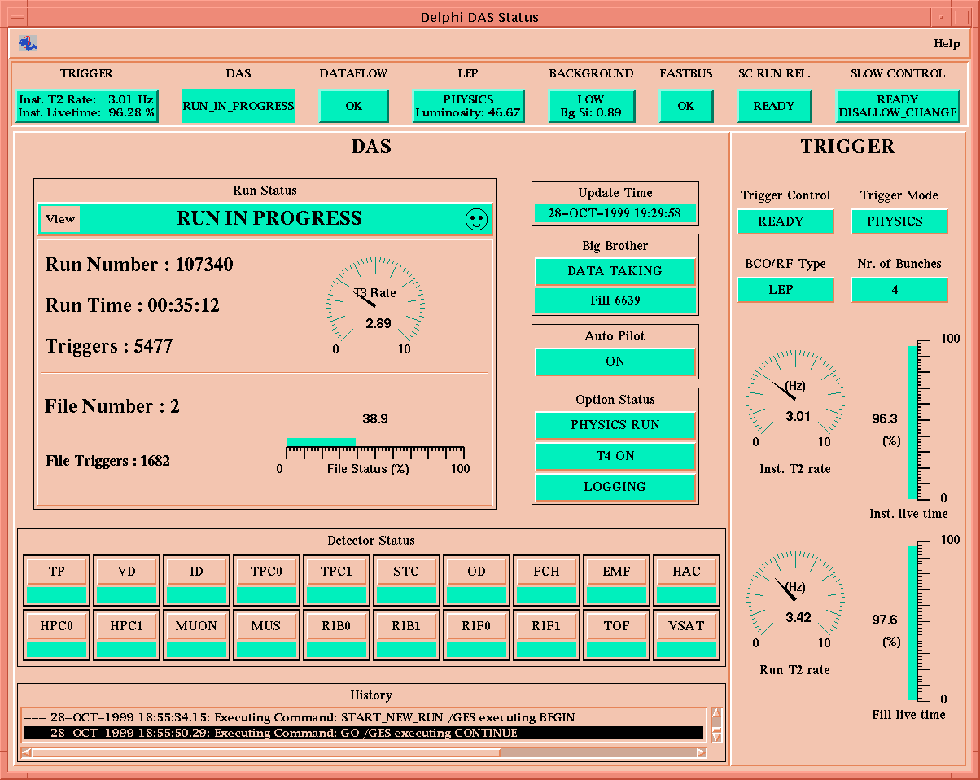
Some historical notes
Ex.:DELPHI Control System in 1995
Integration possible because all areas were (or got to) using the same middleware and FSM/automation toolkit

Slide 11
Some historical notes
At LHC Design Time (end 90s):
  Most experiments kept the DAQ/DCS split
  For several reasons:
    Some people in charge “skipped” the LEP Experiments
      So didn’t see the possibilities/benefits
    Were convinced that the requirements were too different
    “Prejudice”?: DAQ is more important/complex than DCS
    Management: Different people were put in charge of DAQ Control and Detector Control
    (What if there was only one person in charge of the “Control System” per experiment?)

Slide 12
Some historical notes
Also at that time (end 90s)
  CERN Management insisted that experiments try to do things in common, to save resources:
    After several meetings between the Experiments and the management: the only thing that they could agree on was to try to build the Detector Control System in common
    Each experiment proceeded with their DAQ Control independently, in parallel

Slide 13
Some historical notes
Joint COntrols Project (JCOP)
  A common project between the four LHC experiments and a CERN Control Group (ECP/CO -> IT/CO -> EN/ICE -> BE/ICS)
  Mandate (1997/1998):
    “Provide a common DCS for all 4 experiments in a resource effective manner”
    “Define, select and/or implement as appropriate the architecture, framework and components required to build the control system”
  Scope:
    DCS - Detector Control System (at least)
  1st Step: Gather the Requirements from the 4 Exps.

Slide 14
Some historical notes
2nd Step: JCOP Architecture Working Group
(“Status of JCOP Activities”; JCOP Workshop III; W. Salter; 2002)
  Defined design choices for the DCS
    Object names and addressing
    System modelling, control structure and partitioning
    Use of Finite State Machines
    Access Control
    Alarm handling
    Configuration and persistency
    Interfacing to external systems
    Software versioning
    Diagnostics
    Glossary
  Blueprint for the Framework (completely technology agnostic)
  Maybe the biggest challenge… (but great fun)
  Turns out other people have good ideas too (more heads are better than one)

Slide 15
Some historical notes
And a Technology Survey/Evaluation phase
(“Controls for the LHC Experiments”; von Rüden, W.; 2000)
https://cds.cern.ch/record/478249/files/p88.pdf
  The benefits of SCADA are:
    Standard development environment leading to a homogeneous system
    Support for large distributed applications - Buffering against technology changes such as operating systems, platforms, etc.
    Follows market evolution
    Provides maturity and stability
    Saves huge development effort (50-100 personyears)
    Company builds its experience into the product and provides documentation, support, maintenance and training
  The drawbacks of SCADA are:
    Not tailored exactly to the end application
    Risk of company going out of business
    Company may develop unwanted features
    One has to pay

Slide 16
Integration and Homogeneity
Where are we now?

Slide 17
Where are we?
We have 4 completely different Control Systems:
  3 for the DAQ Control of ALICE, ATLAS, CMS
  1 for all DCSs + LHCb ECS
All extremely successful!
So we know that:
  DAQ tailored, experiment specific, Control Systems work (of course)
  But we also know that Integrated Control Systems work
  And that Control Systems done in common also work
Should any of us change our approach now?
  Probably not…
Ref.: Very nice talk by Giovanna on the first instance of this workshop: https://indico.cern.ch/event/217480/contributions/1518521/attachments/349177/486801/DAQLHC_2013.pdf

Slide 18
Integration and Homogeneity
So why this talk now?

Slide 19
Opportunities
There are/will be new Experiments:
  Non-LHC Experiments
  FCC Experiments
Maybe some of you will be in charge at that point!
… Could try having only one person in
charge of the Control System…

Slide 20
Challenges
For the FCC Experiments:
  All the (few) people that have been proposing integrated, coherent systems will have retired (and so will the next generation)
  It will be decades without designing very large new control systems.
  How do we assure the transmission?

Slide 21
Challenges
For our current Experiments
  They still have to run for a long time
  Changes and improvements are unavoidable
  We have new people eager to contribute
    They want to use newer technologies
    (in some cases the only way to obtain financing)
    They should be able to present/publish their work
    And they have to have fun (as I am often told)
  How do we keep the system homogeneous?

Slide 22
And a plea/Some hints…
Please try to keep the system overview
  A new use-case doesn’t necessarily need changing the technology
  Gather/analyse carefully all the requirements (including the original ones) before starting the development
  Check if the new technology can replace the old one everywhere (not just in the corner at hand)
  Balance carefully the trade-off of adding a new technology, is it really worthwhile?
    The expert may leave
    We/You will be left, in any case, with one more thing to monitor, support and maintain

Slide 23
And a plea/Some hints…
Beware of pitfalls
  Evaluate a new technology in detail
    lifetime, maturity, backward compatibility history,…
  Lookout for the “POJO” Effect
    new buzzwords don’t always mean something new
    not all new concepts are appropriate and beneficial
And keep our mission in mind:
  To enable the best Physics
  By making the experiment’s Online System work effectively, efficiently and reliably

Slide 24
Conclusions
Whether for a new system or an existing one:
  (keeping) An integrated and homogeneous system is advantageous:
    Needs less Resources
    Allows for simpler Operations and easier Maintenance
  Discussing the requirements, the architecture, the principles and mechanisms with your peers (inside or outside the experiment) before a new development
  Then, if relevant, R&D-ing for the benefit of the whole system/community
  Can also be a lot of fun!

